Slide 1
Electric Power Analytics Consortium
Department of Electrical and Computer Engineering
Electric Power Analytics Consortium
Meeting with Centerpoint, LLC
Hurricane Planning and Big Data Analysis
July 18th, 2013
EPAC
Industry
University
Industry Driven
University Inspired
Innovative Research

Slide 2
Agenda
Overview on human resources
Catastrophe modeling and asset management
  Hurricane modeling
  Stochastic optimization
  Solution: recourse
  How centerpoint can use the results
Big data analysis
  Approach 1: Compressive sensing/matric completion
  Approach 2: Sublinear algorithm
  How to analyze more practical data provided by centerpoint
Other topics
Next step

Slide 3
Human Resources
Faculty
  Zhu Han, Amin Khodaei, and Suresh Khator
  Recruiting two full time instructors/assistant professors in power
Student
  Ali Arab, hurricane planning, industrial engineering, supported by EPAC
  Lanchao Liu, big data analysis (compress sensing), ECE, Ph.D. candidate
  Jingkai Wu, big data analysis (sublinear algorithm), ECE, coming TA, Ph.D.
  Jorge Sosa, Hispanic, coming TA, Ph.D.
  Fahira Sangare, African America, part time Ph.D.
Coop opportunity
IEEE international conference on communication tutorial
Local workshop and talks (with TAMU, etc.)

Slide 4
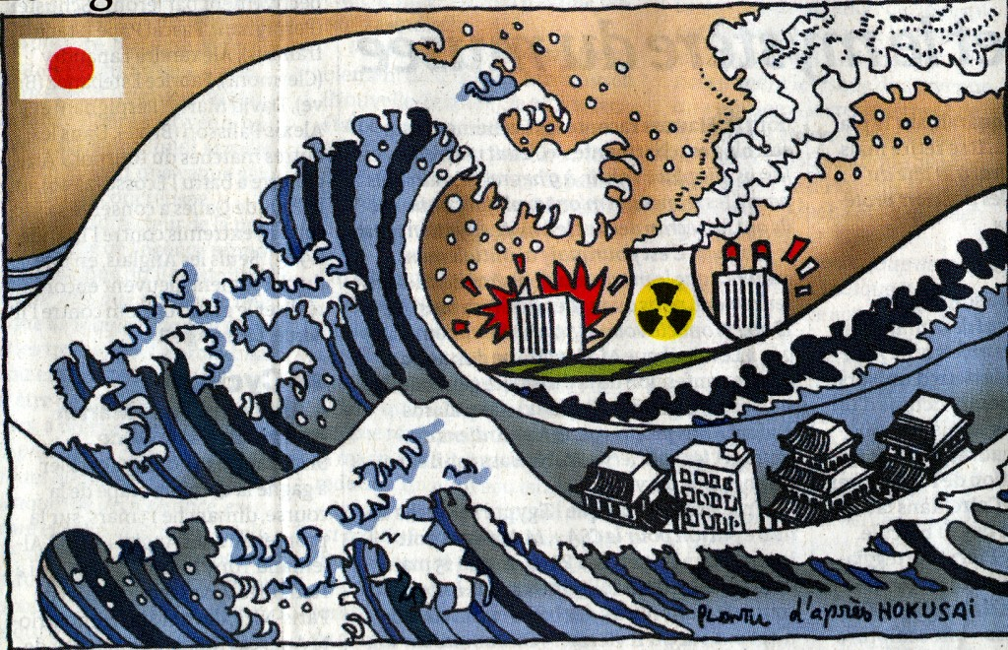
Agenda
Overview on human resources
Catastrophe modeling and asset management
  Hurricane modeling
  Stochastic optimization
  Solution: recourse
  How centerpoint can use the results

Slide 5
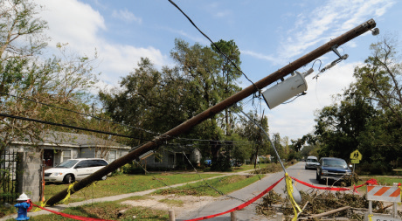
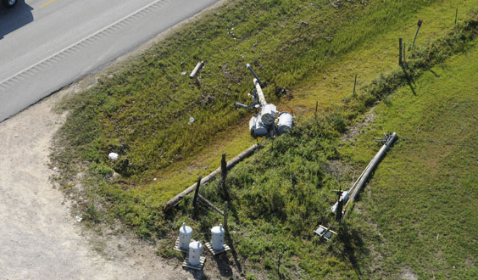
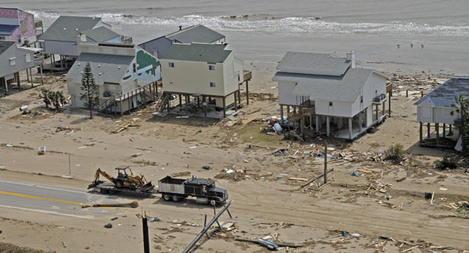
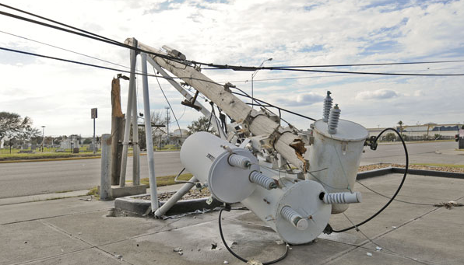
Hurricane Ike
Photo credit: centerpointenergy.com

Slide 6





What to Do?
Power Grids Hardening
Contingency Planning

Slide 7





Proactive Hurricane Planning (PHP)
Predicted Wind Gust Speed
Structural Fragility and Damage Likelihood Analysis
Optimal Post-Hurricane Maintenance
Schedule
Predictive Load Shedding Analysis
Proactive Maintenance
Resource Allocation
Local Terrain
and Characteristics

Slide 8
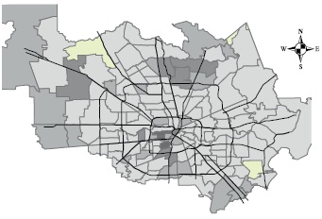
Step 1: Damage Quantification
The damage probability of each component is obtained via a certain random distribution, by considering
  Wind gust speed
  The local terrain and structural characteristics
Critical regions are indicated.

Slide 9
Structural Fragility Analysis
With respect to the probability of damage, the fragility of power system components and structure are analyzed and the related recovery costs are quantified.

Slide 10
Load Shedding Analysis
Considering different scenarios for damage, and the physics of the system, the related load shedding scenarios are predicted.
The Value of Lost Load (VOLL) for each area needs to be carefully analyzed.

Slide 11
Current Outage Estimation
Hurricane | Wind Speed (mph) | Estimated Outage (weeks)
Category 1 | 74-95 | 1-1.5
Category 2 | 96-110 | 2-3
Category 3 | 111-130 | 3-5
Category 4 | 131-155 | 4-6
Category 5 | 156 and up | 6-8

Slide 12
Step 2: Resource Allocation
After quantifying the expected cost and risk of damage, it should be decided to which component of the system, the primary resource to be allocated.
This phase is called the first stage problem. The decision variables are the first stage decision variables.

Slide 13
Optimal Maintenance Schedule
By considering the amount of allocated resources to components, the schedule of allocation of those resources should be derived in a way that minimizes the overall load shedding cost of the system.

Slide 14
Step 3: Two Stage Recourse Program
First period decision is made.
Nature makes a random decision.
A second decision is made to repair the havoc wrought by nature.

Slide 15



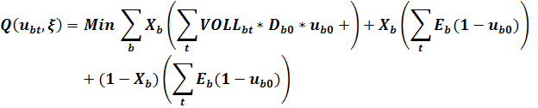
Problem Formulation Example
s.t.
Hurricane stochastic modeling
Stochastic optimization formulation
Recourse solution
- The above complicated computation can be calculated by the centerpoint center.
- The detailed individual plan can be sent to field engineers by smart phone.

Slide 16
Objectives of PHP
Improving the resiliency of the power system for extreme weather events.
Mitigating the aftermath of the event.
Minimizing the load shedding time and cost.
Reduced maintenance operation cost.
Recovering the reliability and security in an efficient way.

Slide 17

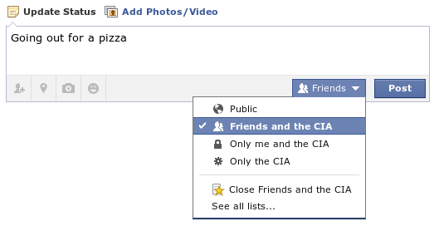
Agenda
Big data analysis
  Approach 1: Compressive sensing/matric completion
  Approach 2: Sublinear algorithm
  How to analyze more practical data provided by centerpoint
Other topics
Next step

Slide 18

Traditional Signal Acquisition Approach
The Typical Signal Acquisition Approach
Sample a signal very densely (at lease twice the highest frequency), and then compress the information for storage or transmission
Image Acquisition
This 18.1 Mega-Pixels digital camera senses 18.1e+6 samples to construct an image.
The image is then compressed using JPEG to an average size smaller than 3MB – a compression ratio of ~12.
Notes:
Before I start to talk about the novel approach of signal acquisition, let’s do a little bit review of how people acquire signal with the traditional approach. Usually, we sample a signal very densely and then compress the information for storage or transmission. Take this 6.1 mega-pixels DC as an example. It senses a large number of samples to construct an image. The image is then compressed using JPEG with an compression ratio of about 20 to an average size of smaller than 1MB.

Slide 19
Compressive Sensing?
A natural question to ask is
?
Could the two processes (sensing & compression) be combined
Move the burden from sampling to reconstruction
The answer is YES!
This is what Compressive Sensing (CS) is about.
Notes:
Facing with the problems mentioned above, a natural question to ask is Could the two processes, say, sensing and compressing be combined? The answer is Yes! And this is CS about.

Slide 20
CS Concept
Sparse X
Random linear projection
Dimension reduction from X to Y
  M>Klog(N/K)
Recovery algorithm for ill-posed problem
Notes:
CS theory claims that, when a signal is sparse, it could be sensed compressively and got fully recovered with over whelming probability. The signal could be sparse either by itself or after some known transformation. X here is an example of sparse signal, with limited number of nonzero entries which are denoted by the colored blocks.
Then by implementing a proper projection, we could realize a compressed sampling, compressed means that we realized a dimension reduction during the process. Besides, the dimension reduction is done with no or litter loss of information of the original signal.
Then you may curious about how this dimension reduction is done, CS theory shows that by simply multiplying the signal with a random matrix, the sparse information will be well preserved in the measurement for signal reconstruction.
And the random matrix could be one of those with IID, since it had been proved that these random matrix satisfies the RIP which has been proved as the necessary conditions for CS.
Then in the signal reconstruction part, as the number of unknowns outweigh the number of measurement, the problem becomes ill posed. However, this problem could be treated as a convex optimization problem, and there are a number of algorithms for solving this kind of problem, including l1 norm minimization, ````
Here is a simple example shows how CS works. Our signal here has 256 entries within which, only 4 are nonzero. We sampled it following CS theory and got 25 samples which is 10% of the signal length, shows in the middle of the figure. Then, using the widely used l1 norm minimization algorithm, we got our signal exactly recovered from the samples.

Slide 21
CS Example
K-Sparse
Signal
Compressed
Samples
Exact
Recovery
Random Linear
Projection (RIP)
K<m<<n
Notes:
CS theory claims that, when a signal is sparse, it could be sensed compressively and got fully recovered with over whelming probability. The signal could be sparse either by itself or after some known transformation. X here is an example of sparse signal, with limited number of nonzero entries which are denoted by the colored blocks.
Then by implementing a proper projection, we could realize a compressed sampling, compressed means that we realized a dimension reduction during the process. Besides, the dimension reduction is done with no or litter loss of information of the original signal.
Then you may curious about how this dimension reduction is done, CS theory shows that by simply multiplying the signal with a random matrix, the sparse information will be well preserved in the measurement for signal reconstruction.
And the random matrix could be one of those with IID, since it had been proved that these random matrix satisfies the RIP which has been proved as the necessary conditions for CS.
Then in the signal reconstruction part, as the number of unknowns outweigh the number of measurement, the problem becomes ill posed. However, this problem could be treated as a convex optimization problem, and there are a number of algorithms for solving this kind of problem, including l1 norm minimization, ````
Here is a simple example shows how CS works. Our signal here has 256 entries within which, only 4 are nonzero. We sampled it following CS theory and got 25 samples which is 10% of the signal length, shows in the middle of the figure. Then, using the widely used l1 norm minimization algorithm, we got our signal exactly recovered from the samples.

Slide 22
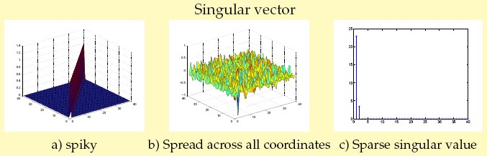
Art of Matrix Completion
Latest development in mathematics claims that if a matrix satisfies the following conditions, we can fulfill it with confidence from a small number of its uniformly random revealed entries.
  Low Rank: Only a small number of none-zero singular values;
  Incoherent Property: Singular vectors well spread across all coordinate.
Notes:
Under our system design, the measurement matrix M at the fusion center satisfies all three conditions

Slide 23

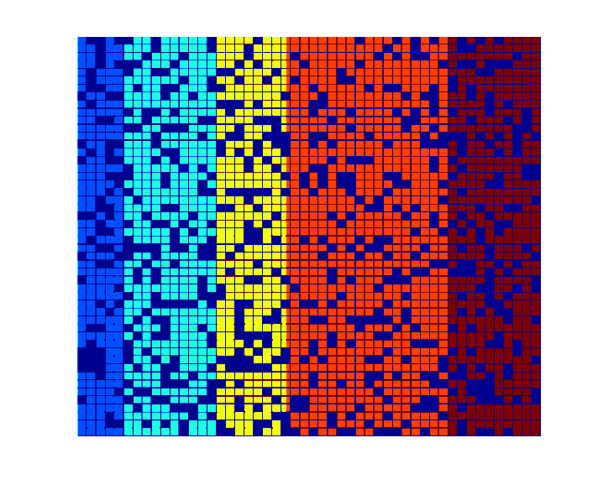
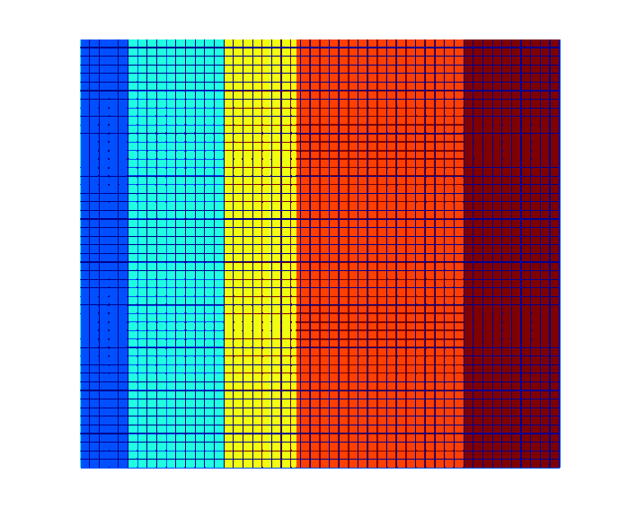
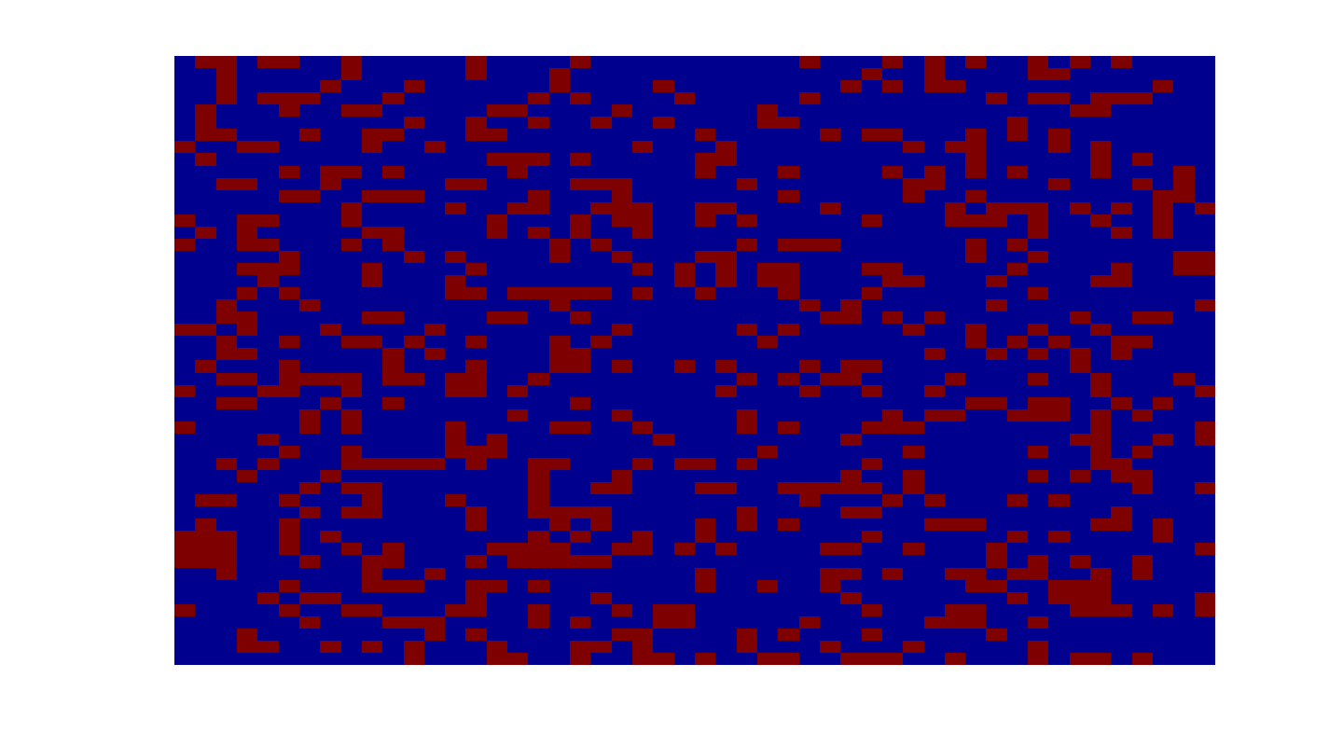


Illustration
$$=$$
$$+$$
Matrix of corrupted observations
Underlying low-rank matrix
Sparse error matrix

Slide 24

Smart Meter Reading
Using represents a collection of smart meter readings
Only limited number of smart meters sample and report their readings
Recover X from Y using IMCOMPLETE MEASUREMENTS!
Hadmard Product
M(i,j) = 1 if node i reports a measurement at time j

Slide 25
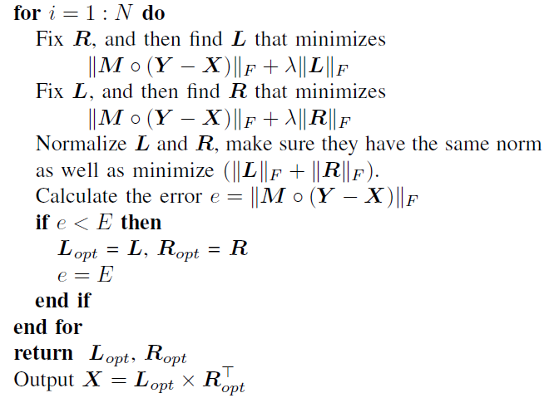
Proposed Algorithm
Fitting the data as well as achieving low rank
Minimizing L and R
alternatively to recover
the spectrum
occupancy data X:

Slide 26
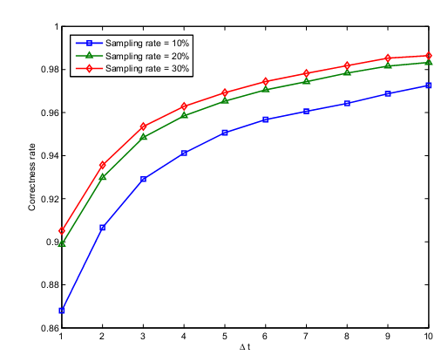
Simulation Results
Performance v.s. Dynamics of smart meter reading
Performance is worse
when the smart meter reading
is changing drastically
To achieve a better performance, more
measurements need to be collected
in a violently changing environment.
Simulated data only. Any real data?

Slide 27
Another Approach
Massive data sets
sales logs
financial transactions
genome project
world-wide web
scientific measurement
Storage problem
Even linear time O(n) is not good enough!!
weather forecast
Not enough data

Slide 28
Sublinear Algorithm
Let’s sample among the whole data set!
Precondition:
An approximation decision is good enough
(efficiency > exactness)
Oracle access to each data entry
otherwise O(n) is the best we can get
Miracle happens if you can accept a certain error

Slide 29
Example
Input: A string s in {0,1}^{n} (represented as array s[])
Output: Fraction of 1’s in s
Previously: Can compute exactly in linear time O(n)
Sublinear: Can approximate whp in sublinear-time by taking sample s[i₁],…,s[i_{k}] of size k
independent of n:
s[1]s[2]…s[i₂]…s[i₁]…s[i₃]…s[n]

Slide 30
Approximation Decision a.k.a. Property Testing
By an additive Chernoff bound:
If exact fraction is μ, and fraction in sample is μ’, then Pr[ | μ’ - μ | ≤ ε ] ≥ 1-δ
with probability at least 1-δ, fraction of 1’s in sample is within ε of true fraction of 1’s in n
We only need k = Θ(log(1/δ)/ε²) samples
Not a function of n.

Slide 31
Summary
CS/MC reconstruct the original vector/matrix
What sublinear algorithm can do
  x% (mean, 0<x<100, cannot be equality);
  Longest increasing/decreasing sub-sequence
  Period
  Compare to common subsequences.
  Testing whether two distributions are similar
  Finding most frequent elements
  Estimating the number of distinct elements
  Estimating frequent moments
Sublinear algorithms are much more efficient than linear algorithms for massive data sets
For both compressive sensing/matrix completion and sublinear algorithms, any relatively real data?

Slide 32
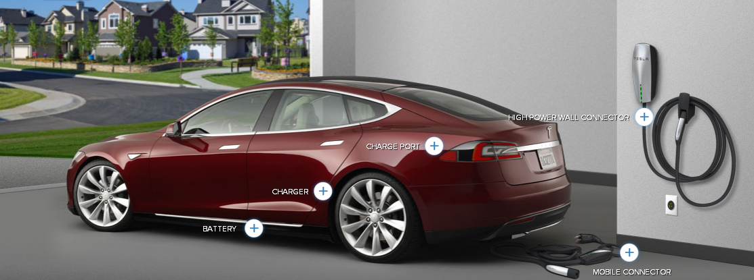

Other Topics
  Impact of PHEVs on the existing power network
  More and more PHEV
  It will cost burden to centerpoint
  Can conduct optimization and schedule schemes
  Smart homes and smart buildings
  Enhanced conservation levels, lowered greenhouse gas emissions, lowered stress level on congested transmission lines.
  We can program smart phone to remote control smart home.

Slide 33
Next Step
Tailor the direction according to Centerpoint needs
Practical data testing
Internship for students
New member of consortium such as ABB
Proposals?
Workshop?
Related courses?

Slide 34


Other Ideas and Suggestions
Thank you
Department of Electrical and Computer Engineering

