Slide 1


Smart Grid
Communications and Networking
Lingyang Song⁺ and Zhu Han*
⁺School of Electronics Engineering and Computer Science,
Peking University, Beijing, China
* Department of Electrical and Computer Engineering
University of Houston, Houston, TX, USA
Tutorial Presentation at IEEE ICC 2013, Budapest, Hungary

Slide 2
Outline
Introduction of Smart Grid
Major topics in Smart Grid (SG)
  Smart Infrastructure system
    Smart energy subsystem
    Smart information subsystem
    Smart communication subsystem
  Smart Management system
  Smart protection system
Research topic examples
  Bad Data Injection Attack and Defense
  Demand Side Management
  PHEV, renewable energy, microgrid, big data, assess management, communication effects, etc.
Conclusion

Slide 3
Existing vs. Smart Grid
Existing Grid | Smart Grid
One-way communication | Two-way communication
Centralized generation | Distributed generation
Few sensors | Sensors throughout
Manual monitoring | Self-monitoring
Manual restoration | Self-healing
Limited control | Pervasive control
Few customer choices | Many customer choices
Table 1 Comparison on properties of the grids

Slide 4
Benefit and Requirement of SG(NIST)
  Improving power reliability and quality;
  Optimizing facility utilization and averting construction of back-up (peak load) power plants;
  Enhancing capacity and efficiency of existing electric power networks;
  Improving resilience to disruption;
  Enabling predictive maintenance and self-healing responses to system disturbances;
  Facilitating expanded deployment of renewable energy sources;
  Accommodating distributed power sources;
  Automating maintenance and operation;
  Reducing greenhouse gas emissions by enabling electric vehicles and new power sources;
  Reducing oil consumption by reducing the need for inefficient generation during peak usage periods;
  Presenting opportunities to improve grid security;
  Enabling transition to plug-in electric vehicles and new energy storage options;
  Increasing consumer choice;
  Enabling new products, services, and markets.

Slide 5
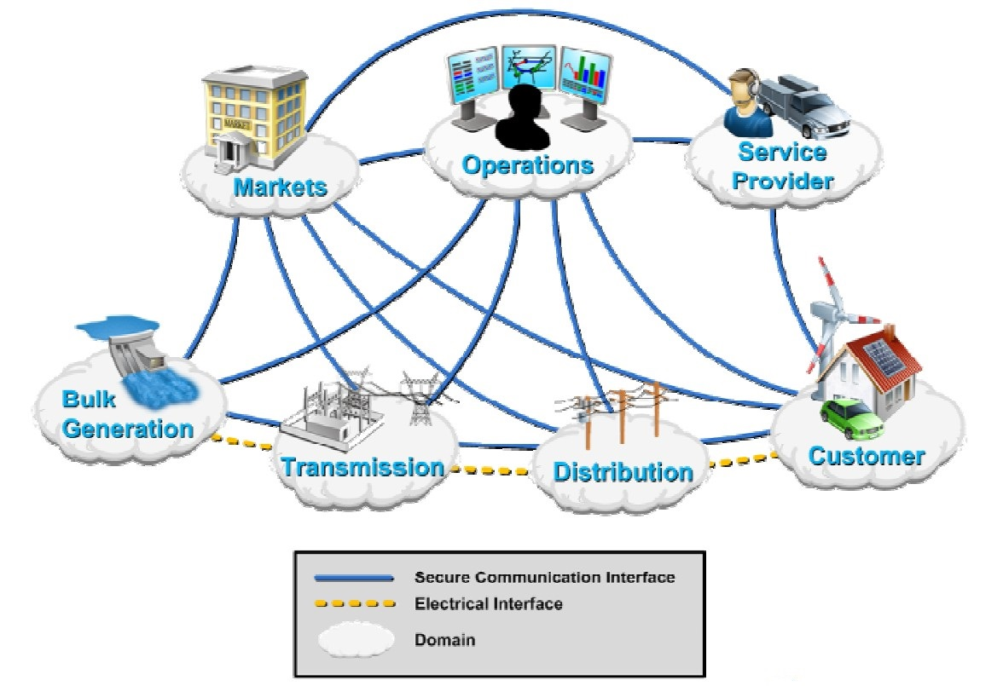
Smart Grid Domains
Fig. 1 Smart Grid domains by the U.S. DOE

Slide 6
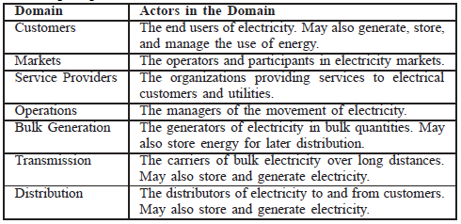
Smart Grid Domains
Table 2 Smart Grid domains by the U.S. DOE

Slide 7
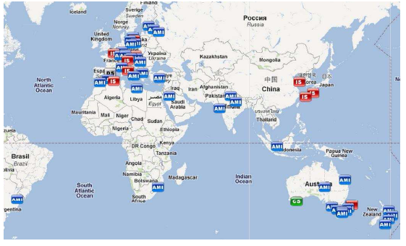
SG Projects in the Worldwide
Fig. 2 SG projects in the worldwide

Slide 8
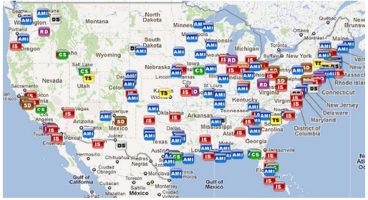
SG Projects in U.S.
Fig. 3 SG projects in U.S.

Slide 9
Smart Grid in U.S.
In 2001, U.S. Dept. of Energy began a series of communications and controls workshops focused on the integration of distribution energy resources.
In 2007, U.S. gov. established “Energy Independence and Security Act”
  Studies state & security of SG, forms agency task force, frames techology R&D, encourage investment.
In 2009, “American Recovery and Reinvestment Act”
  $3.4 billion for SG investment grant program
  $615 million for SG demonstration program
  It leads to a combined investment of $8 billion in SG capabilities.

Slide 10
Smart Grid in China
The Medium-long Term Plan of the Development^{[1]}
‘A strong and robust electric power system’
backboned with Ultra High Voltage (UHV) networks
based on the coordinated development of power grids a different voltage levels
supported by information and communication infrastructure
characterized as an informalised, automated, and interoperable power system
the integration of electricity, information, and business flows
[1] Released by the State Grid Corporation of China (SGCC).

Slide 11
Energy Resources Distribution
Major energy resources | Main region
Coal | Western and northern part (Shanxi, Shanbei, Liaodong, Inner Mongolia)
Natural gas | Beijing, Shanghai, Guangzhou
Hydro | South-west (Jinsha Jiang river lower stream, Szechuan )
Wind | Shinjang, Kansu, West Mongolia, East Mongolia, Jilin
Solar | western and northern
Table 3 Major energy resources distribution^{[1]}
[1] Henry Chung. An Overview of Smart Grid. CityU.

Slide 12
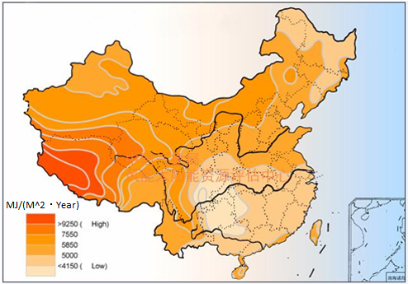
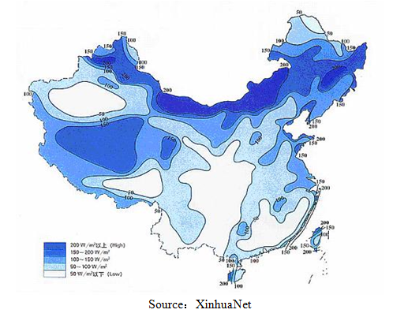
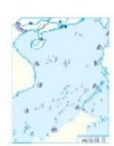
Energy Resources Distribution
a. Solar power resources distribution
b. Wind power resources distribution
Fig. 4 Energy resources distribution in China

Slide 13
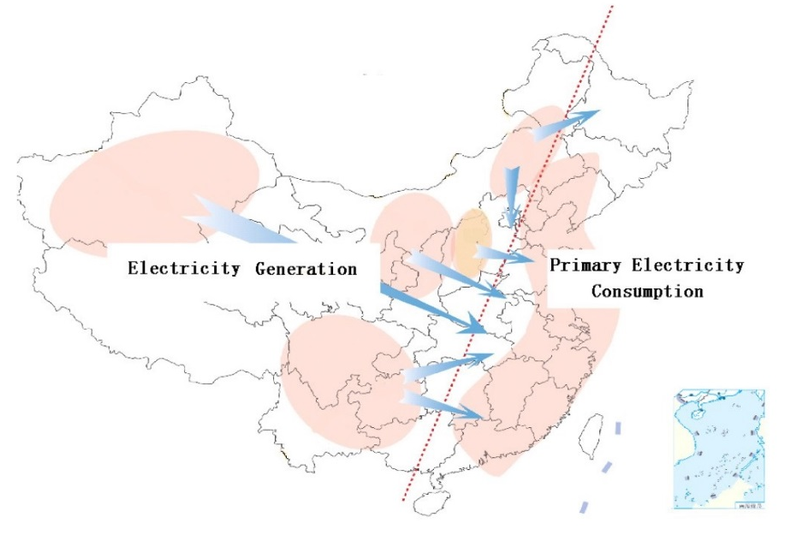
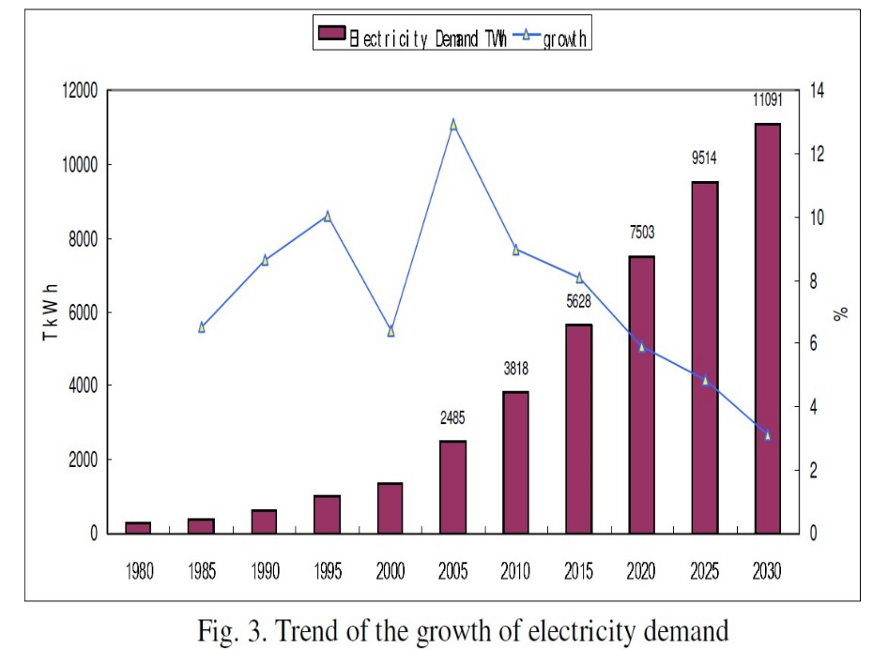
Smart Grid in China
Fig. 5 Geographical distribution of generation and consumption in China
Fig. 6 Trend of the growth of electricity demand

Slide 14
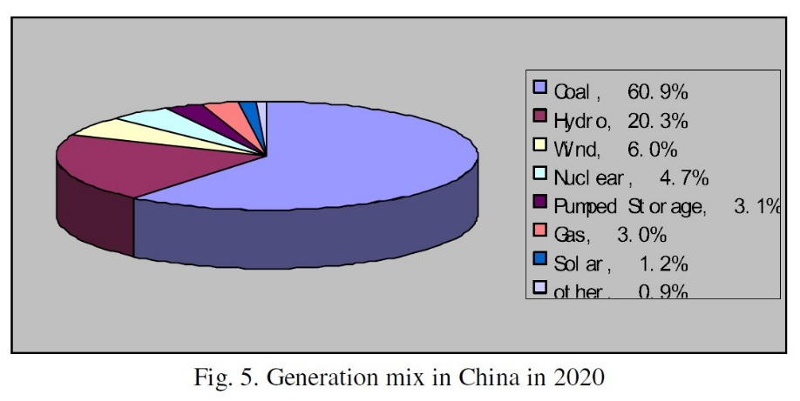
Smart Grid in China
Projected Generation capacity in China, 2020
Energy resources | Generation capacity (kW)
Coal | 1,030,000,000
Natural gas | 58,900,000
Nuclear | 80,300,000
Hydro | 340,000,000
Wind | 150,000,000
Solar | 24,000,000
Bio-fuel | 15,000,000
Others | 50,000,000
Total | 1,750,000,000
Table. 4 Projected energy resources generation capacity in China, 2020
Fig. 7 Generation mix in China in 2020

Slide 15
Outline
Introduction of Smart Grid
Major topics in Smart Grid (SG)
  Smart Infrastructure system
    Smart energy subsystem
    Smart information subsystem
    Smart communication subsystem
  Smart Management system
  Smart protection system
Research topic examples
  Bad Data Injection Attack and Defense
  Demand Side Management
  PHEV, renewable energy, microgrid, big data, assess management, communication effects, etc.
Conclusion

Slide 16
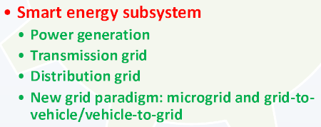
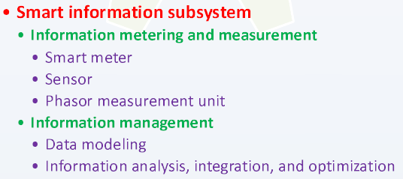
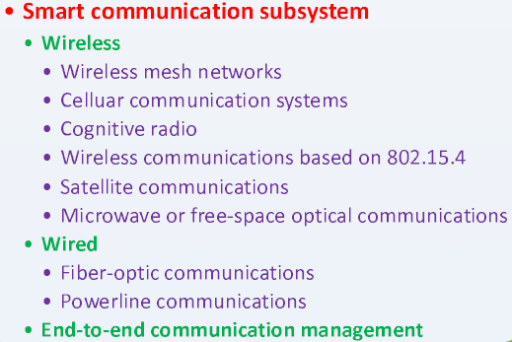
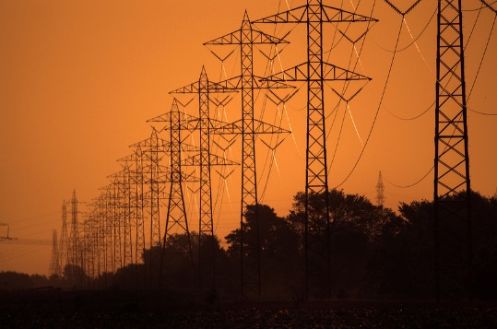
Smart Infrastructure System
Two-way flows of electricity and information lay the infrastructure foundation for SG.

Slide 17
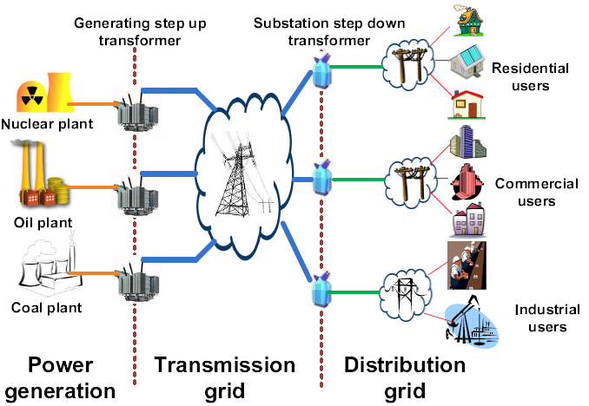
Smart Energy Subsystem
Fig. 8 Energy subsystem in power grid

Slide 18
Power Generation of Smart Energy Subsystem
The distribution generation (DG) is a key power generation paradigm enabled by SG.
It improves power quality and reliability via distributed energy resource (DER)
  DER refers to small-scale power gen. such solar panels, small wind turbines (3kW~10MW)
  large deployment and operation cost
Users in a microgrid can unitize DG if need.
  Disturbance of microgrid can be isolated, so local power supply quality is improved.
  Multiple DGs has the same reliability, and lower capacity margin than a system of equally reliable generators.
A localized grouping of power generators and loads

Slide 19
Virtual Power Plant (VPP)
VPP is a concept of future develop. and deploy. of DG.
VPP manages a large group of DGs with total capacity comparable to that of a conventional power plant.
Higher efficiency , more flexibility
  React better to fluctuations (e.g. deliver peak load electricity or load-aware power generation at short notice.)
Some recent works on VPP
  Optimization of VPP structure via EMS - minimize the electricity production cost and avoid loss of renewable energy.
  Market based VPP – using bidding and price signal as two optional operations and provide indv. Distributed energy resource units with access to current electricity market.

Slide 20
Transmission (TX) Grid of Smart Energy Subsystem
2 factors affect the development smart TX grid:
  Infrastructure challenges
    increasing load demands, quickly aging components, ….
  Innovative technologies
    new materials, adv. power electronics, comm. Technologies, ….
3 interactive components:
  Smart control centers
    Analytical capabilities for analysis, monitoring, visualization
  Smart power TX networks (built-on current grids)
    Innovative technologies help to improve power utilization, quality, system security, reliability
  Smart substations (built-on current automated substations)
    digitalization, atomization, coordination, self-healing
    Enabling the rapid response and efficient operation
Notes:
In brief, with a common digitalized platform, in the smart
transmission grid it is possible to enable more flexibility in
control and operation, allow for embedded intelligence, and
foster the resilience and sustainability of the grid.

Slide 21
Distribution Grid of Smart Energy Subsystem
Goal: deliver power to serve the end users better.
Power flow control becomes complicated, when more DGs are integrated into the grid.
An interested research work:
Two in-home distribution systems:
  The electricity is distributed according to the given information.
  AC power circuit switching system and DC power dispatching system via power packets.
  Packetization of energy requires high power switching devices.
An intelligent power router has the potential .
  The electricity from the source is divided into several units of payload (e.g. a header and footer are attached to the unit to form an electric energy packet)
  Using energy packet, more efficient and easier to control energy control
Notes:
More specifically,
supplied electricity from energy sources is divided into several
units of payload. A header and a footer are attached to the unit
to form an electric energy packet. When the router receives
packets, they are sorted according to the addresses in the
headers and then sent to the corresponding loads. Using energy
packet, providing power is easily regulated by controlling the
number of sent packets. In addition, many in-home electric
devices are driven by DC power and have built-in power
conversion circuits to commutate AC input voltage. Thus, DCbased
power distribution is feasible. These systems will make
in-home power distribution systems more efficient and easier
to control energy flow.

Slide 22
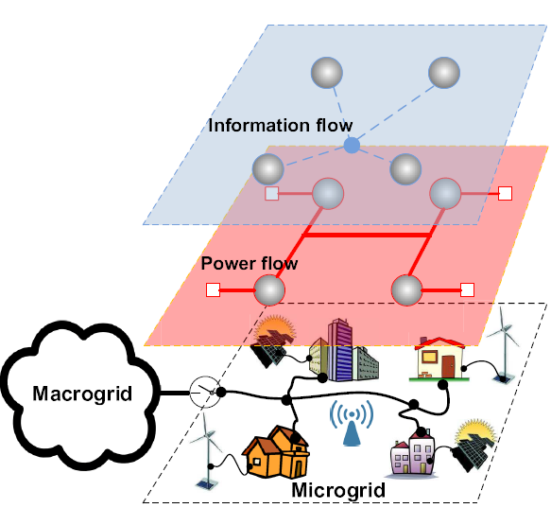
Microgrid
Fig. 9 Microgird
Improves the grid efficiencies, reliability, high penetration of renewable sources, self-healing, active load control.
  Plug and play integration
  Microgrid switches to the isolated mode, if outages at macrogrid
Notes:
In this subsection, we describe two of the most important
new grid paradigms, which benefit from smart energy subsystem
technologies and also further promote the development of
SG. These two paradigms are widely regarded as important
components of the future SG. Note that these two paradigms
also take advantage of other SG technologies as we will
explain in the corresponding sections.

Slide 23
G2V & V2G
Grid-to-Vehicle and Vehicle-to-Grid; EV represents both gully and plug-in hybrid electric vehicle.
G2V
  Charging EV leads a significant new load on existing grid (may cause power degradation, overloading,..)
  Solutions: coordinated charging of EVs can improve power losses and voltage deviations by flattening out peak power.
V2G
  A car is driven only 1 hour per day in average.
  At parking, EVs communicate w/ grid to deliver electricity into grid for helping balance loads by “peak shaving” or “valley filling”
  e.g. V2G-Prius at Google campus, CA; Xcel inc. performs V2G in Boulder, CO.
KEY: how to determine the appr. Charge & discharge time?
  A binary particle swarm optimization algorithm – optimal solution, maximize profits of EV owners, fit both constraint of EV and Grid.
High demands
low demands
Notes:
Note that particle swarm optimization is an iterative
stochastic optimization algorithm. The solution search
is performed in a stochastic nature allowing the algorithm
to overcome nonlinear, non-differentiable, and discontinuous
problems.

Slide 24
Summary & Challenges
The section reviews smart energy subsystem – power gen., transmission, distribution, and mircogrid, G2V.
Challenge_1. Effective utilization of intermittent and fluctuant renewables:
  In practice, the renewable power pattern is hard to predicate.
  online learning technique - to learn evolution of power pattern
  HMM model.
Challenge_2. Utilization of G2V/V2G:
  An analysis of large scale EV stochastic behavior (e.g. the availability of Evs in V2G, the new large load in G2V)
  central limit theorem (EV power profile distribution), queuing theory (EV charging station in G2V)
Challenge_3. large-scale deployment:
  Top-down (distributed) or bottom-up (centralized) approach?
  A open, scalable, instructive SG standard for such hugh network
Notes:
Considering that in practice the power
pattern of renewable resources may not follow any simple
distribution or Markov process, Fang et al. [69] further used
non-stochastic multi-armed bandit online learning technique
to learn the evolution of power pattern of renewable energy
source. Note that online learning is a model of induction
that learns the label of one instance at a time. The goal in
online learning is to predict labels for instances. A typical
application could be that the instances are able to describe
the current conditions of the renewable sources, and an online
algorithm predicts tomorrow’s value of a particular source. In
summary, in order to effectively utilize the renewable energy,
more thorough mathematical analysis on modeling renewable
energy is desirable.
Another possible research topic is the optimal deployment
of the additional ancillary services (e.g. energy reserves) to
maintain reliability and meet operational requirements, taking
into account the uncertainty and variability of renewable
energy resources.
we can use probability theory or
experiments to model the power request profile for a large
number of EVs charging operations, and the total available
power profile provided by a large number of EVs. Although
we cannot accurately predict the behavior of each EV, it is
very likely that over a large dataset, the overall profile must
follow some distribution. Let us recall the normal distribution,
one of the most famous distributions. According to the central
limit theorem [63], the mean of a sufficiently large number
of independent random variables, each with finite mean and
variance, follows the normal distribution. This analysis can
help the operator pre-design the system capacity margins.

Slide 25
Smart Infrastructure System
Two-way flows of electricity and information lay the infrastructure foundation for SG.

Slide 26
Phasor measurement units is to measure the electrical waves on an electrical grid to determine the health of system.
PMU reading are obtained from widely dispersed locations in a power system network and sync. w/ GPS radio clock
ISO can use the reading for SG state estimation in a rapid and dynamic way
PMU leads system state estimation procedures, system protection functionalities, with goal of making system immune to catastrophic failures. (recently , Brazil, China, France, Japan, US….. Installed PMUs for R&W)
WSN, cost-effective sensing and comm. Platform for remote sys monitoring and diagnosis.
Access the realtime mechanical and electrical conditions of transmission line,
Diagnose imminent or permanent faults
Obtain physical and electrical picture of power system realtime
Determine appropriate control measures for autom action or sys operators
Requirements: Quality-of-Service, Resource constraints, Remote maintenance and configuration, high security requirement, Harsh environmental condition
Information Metering of Smart Information Subsystem
1. Obtaining information from endusers’ devices.
2. Automatic metering infrastructure (AMI) is to two-way comm. with meter in realtime on demand
Improve system operations and customer power demand management
Smart information subsystem is used to support information generation modeling, integration, analysis and optimization in the context of SG.
Information Metering, Monitoring, and measurement
Smart Monitoring & Measurement
Sensor
PMU
Smart Metering
Notes:
From a consumer’s perspective, smart metering offers a
number of potential benefits. For example, end users are able
to estimate bills and thus manage their energy consumptions
to reduce bills. From a utility’s perspective, they can use smart
meters to realize real-time pricing, which tries to encourage
users to reduce their demands in peak load periods, or to
optimize power flows according to the information sent from
demand sides

Slide 27
Information Management of Smart Information Subsystem
A large amount data need an advance Information management
Data Modeling
  The structure and meaning of the exchanged information must be understood by both application elements
  The system forward and backward compatibility. A well-defined data model should make legacy program adjustments easier
Information analysis is to support the processing, interpretation, and correlation of the flood of new grid observations.
Information integration
  Data generated by new components enabled in SG may be integrated into the existing applications.
  Metadata stored in legacy systems may share by new application in SG to provide new interpretation.
Information optimization is to improve information effectiveness. To reduce comm. burden and sore only useful information.
Notes:
Why is data modeling important? Let us look at the following
two reasons. First, the information exchange between two
application elements is meaningful only when both of them
can use the information exchanged to perform their respective
tasks. Therefore, the structure and meaning of the exchanged
information must be understood by both application elements.
Although within the context of a single application, developers
can strive to make the meaning clear in various user interfaces,
when data is transferred to another context (another system),
the meaning could be lost due to incompatible data representation.
Considering that the SG is a complicated system of
systems, design of a generally effective data representation is
very important.
important.
Second, the data modeling is also related to the system
forward compatibility and backward compatibility. On one
hand, a well-defined data model should make legacy program
adjustments easier. We hope that the data representation designed
for SG can also be (or at least partially) understood
by the current power system, in order to take advantage
of the existing infrastructure as much as possible. On the
other hand, thus far SG is more like a vision. Its definition
and functionality keep evolving. Suppose that in the current
implementation, all the data is particularly designed to be
stored in an optimized way that can be understood by a
current application X. After some time, a new application Y is
integrated into SG. Data modeling is the key to whether this
new application can understand the historical data and obtain
enough information from the historical data.

Slide 28
Summary
We review the smart information subsystem, including information metering, measurement and management in SG
Challenge_1: Effective information store
  What information should be stored so that meaningful system or user history can be constructed for this data. (e.g. System history for analyzing system operations; User history for analyzing user behaviors and bill.)
  Data mining, machine learning , and information retrieval techniques to analyze the information and thus obtain the representative data
Challenge_2: utilization of cloud computing
  Cloud providers have massive computation and storage capacities
  Improve the information integration level in SG
  Cloud computing security and privacy
  From the cloud provider’s perspective, which information management services should be provided to maximize its own profit?
  From the electric utility’ perspective, which information management functions should be outsourced and which should be operated by itself to maximize its own profit?

Slide 29
Smart Infrastructure System
Two-way flows of electricity and information lay the infrastructure foundation for SG.

Slide 30
Smart Communication Subsystem
Smart communication subsystem is responsible for communication connectivity and information transmission among system, devices and applications in the context of SG.
  What networking and communication technology should be used?
Many different types of networks exist, but they must:
  Support the quality of service of data (critical data must delivered promptly)
  Guaranteeing the reliability of such a large and heterogeneous network
  Be pervasively available and have a high coverage for any event in the grid in time.
  Guarantee security and privacy

Slide 31
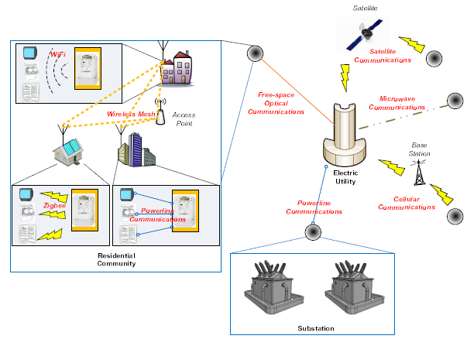
An example of network in SG
Fig. 10 Example of network in SG
Notes:
An example of a communication network in SG:
User devices and smart meters use ZigBee, WiFi, and powerline
communications. Wireless mesh networks are used for
information exchanges between users. Communities are connected
to their electric utility via free-space optical, satellite,
microwave, or cellular systems. A substation communicates
with an electric utility over the powerline

Slide 32
Communication Technology
Wireless
  Wireless Mesh Network
  Cellular Communication Systems
  Cognitive Radio
  Wireless Communications based on 802.15.4
  Satellite Communication
  Microwave or Free Space Optical Communications
Wired technology
  Fiber-optic Communications
  Powerline Communications
End-to-end Communication Management using TCP/IP

Slide 33
Challenges
Interoperability of communication technologies
  Materializing interoperability is not easy, since each communication technique has its own protocols and algorithms
  Suggest studying adv. and disadv. Of cross-layer design in SG comm. subsystem, i.e. the tradeoff between crosslayer optimization and the need for interoperability
Dynamic of the communication subsystem
  This subsystem underlying an SG may be dynamic with topology chane being unpredictable (e.g. EVs plug-in-play)
  Suggest studying systematic protocol design and Dynamic resource allocation algorithms for supporting topology dynamics.
Smoothly updating existing protocols

Slide 34
Outline
Introduction of Smart Grid
Major topics in Smart Grid (SG)
  Smart Infrastructure system
    Smart energy subsystem
    Smart information subsystem
    Smart communication subsystem
  Smart Management system
  Smart protection system
Research topic examples
  Bad Data Injection Attack and Defense
  Demand Side Management
  PHEV, renewable energy, microgrid, big data, assess management, communication effects, etc.
Conclusion

Slide 35
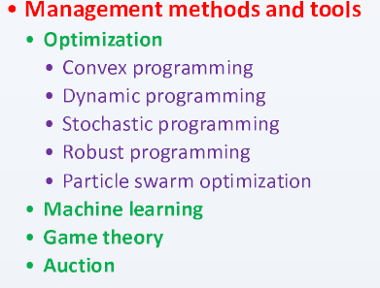
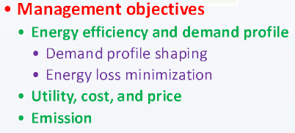
Smart Management System
SG two-way flow of power and data are lay the foundation for realizing various function and management objectives
  Energy efficiency improvement, operation cost reduction, demand and supply balance, emission control, and utility maximization

Slide 36
Energy efficiency & Demand Profile improvement of Management Objectives
Demand profile shaping:
  help match demand to available supply in order to reshape a demand profile to smoothed one, or reduce the peak-to-average ratio or peak demand of the total energy demand.
    shifting (network congestion game), scheduling (dynamic programming), or reducing demand (dynamic pricing scheme)
Energy loss minimization:
  DGs now are integrated in SG, it is more complicated.
  Decentralized optimization algorithm, the optimal mix of statistically-modeled renewable sources
Reduce overall plant and capital cost , increase the system reliability (reduce probability for brownouts and blackouts)

Slide 37
Utility & Cost Optimization and Price Stabilization of Management Objectives
Improving utility, increasing profit, and reducing cost are also important.
  User cost/bill or profit, cost or utility of electricity industry and system.
Stabilization of price in a close-looped feedback system btw. realtime wholesale market prices and end users
  Modeling for the dynamic evolution of supply, demand, and market clearing (locational marginal price LMP) price
Emission control is another important management objective
  Min. generation cost or max. utility/profit ≠ min. emission by using green energy as much as possible
  Cost of renewable energy gen. is not always lowest, related with demand scheduling
Notes:
We have reviewed the work on energy efficiency and
demand profile improvement in the above. Improving utility,
increasing profit, and reducing cost are also important management
objectives. Researchers realize these objectives in various
levels and from various perspectives, such as individual user
cost/bill or profit [32, 40, 53, 69, 95, 120, 170, 171, 188],
single energy bill or aggregate utility of a group of users
[98, 220], cost or utility of electricity industry and system
[37, 74, 83, 89, 120, 150, 171, 178, 206, 218]. Stabilization
of prices is also a research topic in SG, since relaying the realtime
wholesale market prices to the end consumers creates a
closed loop feedback system which could be unstable or lack
robustness, leading to price volatility. Roozbehani et al. [213]
therefore developed a mathematical model for characterization
of the dynamic evolution of supply, demand, and market
clearing (locational marginal) prices under real-time pricing,
and presented a stabilizing pricing algorithm

Slide 38
Smart Management System
In order to solve the management objective, we need management methods and tools:

Slide 39
Management Methods and Tools
Optimization
  Convex & dynamic programming
  For green energy supply (time-varying process), we need stochastic programming, robust programming
  Particle swarm optimization can quickly solve complex constrained optimization problems w/ low computation and high accuracy.
Machine learning
  Allow control systems to evolve behaviors based on empirical data
  It plays a major role in analysis and processing of user data and grid states for a large number deployment of smart meters, sensors, PMUs.
Game theory
  Not all users to be cooperative, so we need guarantee solution
  Emerging SG leads to the emergence of a large number of markets (i.e. it is akin to multi-player games, e.g. energy trading)
Auction
  Bidding & auction can be used for energy sale w/in microgrid market (e.g. demand reduction bid for reducing peak load)

Slide 40
Future Research and Challenges
Future Research
  Integration of pervasive computing and smart grid
  Smart grid store
Challenge
  1. Regulating emerging markets
  Microgrid leads to emergence of new market of trading energy
  e.g. How to guarantee truthful auction, Vickrey-Clarke-Groves scheme (a type of sealed-bid auction)
  2. Effectiveness of the distributed management system
  DGs and plug-in-play components are widely used and formed a autonomous distributed microgrid.
  Hard to compute globally optimal decision (i.e. limited time & information)
  3. Impact of utilization of fluctuant & intermittent renewables.
  System should maintain reliability and satisfy operational requirements, and taking into account the uncertainty and variability of energy source
  Stochastic programming or robust programming for green energy source

Slide 41
Outline
Introduction of Smart Grid
Major topics in Smart Grid (SG)
  Smart Infrastructure system
    Smart energy subsystem
    Smart information subsystem
    Smart communication subsystem
  Smart Management system
  Smart protection system
Research topic examples
  Bad Data Injection Attack and Defense
  Demand Side Management
  PHEV, renewable energy, microgrid, big data, assess management, communication effects, etc.
Conclusion

Slide 42
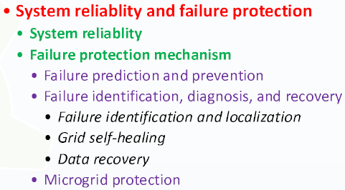

Smart Protection System
Inadvertent compromises of the grid infrastructure due user error, component failure, and natural disasters
Deliberate cyber attacks such as from disgruntled employees, industrial spies, and terrorist

Slide 43
System Reliability
In US, average annual cost of outages is $79B (32% of total electricity revenue)
In 2003 East Coast blackout, 50 million people were w/out power for several days
Some fluctuant and intermittent of green energy source (DGs) may compromise SG’s stability
  DGs serve locally, microgrid is isolated from macrogrid for better stability and reliability
Wide-area measurement system (WAMS) based on PMUs becomes an essential component for monitoring, control, and protection.

Slide 44
Failure Protection Mechanism
Failure Prediction and Prevention:
  Identify the most probable failure modes in static load distribution (i.e. the failures are caused by load fluctuations at only a few buses)
  Utilize PMU data to compute the region of stability existence and operational margins
Failure Identification, Diagnosis, and Recovery:
  Once failure occurs, 1st step is to locate, identify the problem to avoid cascading events
  Utilize PMU for line outage detection and network parameter error identification
  Use known system topology data with PMU phasor angle measurement for system line outage or pre-outage flow on the outage line

Slide 45
Self-Healing & Microgrid Protection
Self-Healing is an important characteristic of SG.
  an effective approach is to divide the macrogrid into small, autonomous microgrid
  Cascading events and further system failure can be avoided, because any failure, outage, or disturbance can be isolated inside the individual microgird.
Protecting microgrid during isolated or normal operations is also important.
  How to determine when an isolated microgrid should be formed in the face of abnormal condition ?
  How to provide segments of the microgrid with sufficient coordinated fault protection while acts independently?

Slide 46
Smart Protection System
Security is a never-ending game of wits, pitting attackers versus asset owners.
Attacker can penetrate a system, obtain user privacy, gain access to control software, and alter load conditions to stabilize the grid in unpredictable way.

Slide 47
Security in Smart Metering
Tens of millions of smart meters controlled by a few central controllers.
Easily to be monetized
  The compromised smart meter can be immediately used for manipulating the energy cost or fabricate meter reading to make money
Injecting false data misleads the utility into making incorrect decisions about usage and capacity.
  Outage, region blackout, generator failure, ….
A secure method for power suppliers to echo the energy reading from meters back to users so that users can verify the integrity of smart meters.

Slide 48
Privacy in Smart Metering
The energy use information stored at the meter acts as an information-rich side channel
  Personal habits, behaviors, activities, preferences, and even b beliefs.
A distributed incremental data aggregation approach
  Data aggregation is performed on all meters, data encryption is used.
A Scheme to compress meter readings and use random sequences in the compressed sensing to enhance the privacy and integrity of meter reading
A load signature moderation system, a privacy-preserving protocol for billing, an anonymizing method for dissociating information and identified person.

Slide 49
Security in Monitoring and Measurement
Monitoring and measurement devices (e.g. sensors, PMUs) can also lead to system vulnerabilities.
Stealth attack or false-data injection attack is to manipulate the state estimate w/out triggering bad-data alarms in control center
  Profitable financial misconduct, purpose blackout
The encryption on a sufficient number of measurement devices
  Place encrypted devices in the system to max. utility in term of increased system security

Slide 50
Security in Information Transmission
It is well-known that communication technologies we are using are often not secure enough
Malicious attacks on information transmission in SG can be followed 2 major type based on their goals:
  Network availability: attempt to delay, block, or corrupt information transmission in order to make network resource unavailable (DoS attack)
  Data Integrity: attempt to deliberately modify or corrupt information
  Information privacy: attempt to eacesdrop on communication to acquire deired information.

Slide 51
Challenges
Interoperability btw. Cryptographic systems
  Many different communication protocol and technologies are in SG, each has its own cryptography requirements, security needs,
  A method of securely issuing and exchanging cryptographic keys (a public key infrastructure approach)
Conflict btw. privacy preservation and information accessibility
  Balance btw. Privacy preservation and information accessibility
  More information, smarter the decision but less privacy
Impact of increased system complexity and expanded communication paths
  Advance infrastructure is a double-edge sword; increasing system complexity and communication paths provides better service for endusers, but may leads to an increase on vulnerability to cyber attack and system failure
  A method of dividing whole system into autonomous sub-grid (mircogrid)
Impact of increasing energy consumption and asset utilization
  Balance btw. Utilization maximization and the risk increase.
Complicated decision making process
  Solving complex decision problems w/in limited time
  A distributed decision making systems, but considering balance btw. Response time and effectiveness of local decision

Slide 52
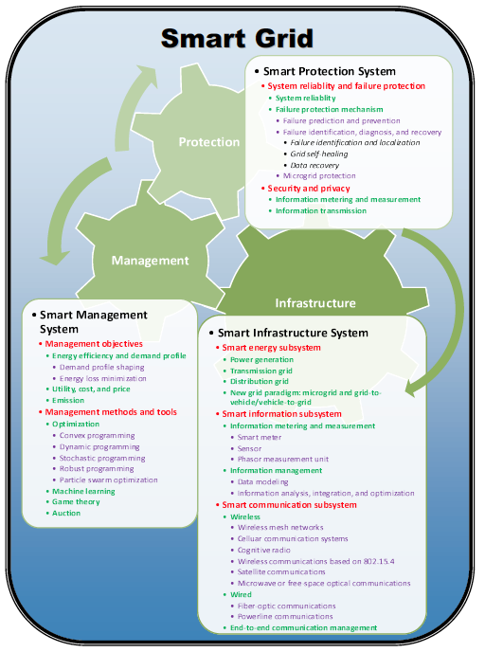
Quick Recap…
Fig. 11 Smart Grid System Review

Slide 53
Useful Lessons
The practical deployment and projects of SG should be well-analyzed before the initiative begins
Electric utilities may not have enough experience on design and deployment of complicated communication and information systems.
Leak of consumer-oriented functionality; need to motive users to buy into SG ideas
  (i.e. Reducing CO2 emission is one of main objective, but not all users like to upgrade their devices and paying more for new feature )
Electric utilities desire to provide services to min. cost or max. profits
  (user privacy and network security may not be their main priority)

Slide 54
Outline
Introduction of Smart Grid
Major topics in Smart Grid (SG)
  Smart Infrastructure system
    Smart energy subsystem
    Smart information subsystem
    Smart communication subsystem
  Smart Management system
  Smart protection system
Research topic examples
  Bad Data Injection Attack and Defense
  Demand Side Management
  PHEV, renewable energy, microgrid, big data, assess management, communication effects, etc.
Conclusion

Slide 55
Overview
Power System State Estimation Model
  Bad Data Injection
Defender Mechanism
  Quickest Detection
Attacker Learning Scheme
  Independent Component Analysis
Electrical Market
Game Theory Approach

Slide 56
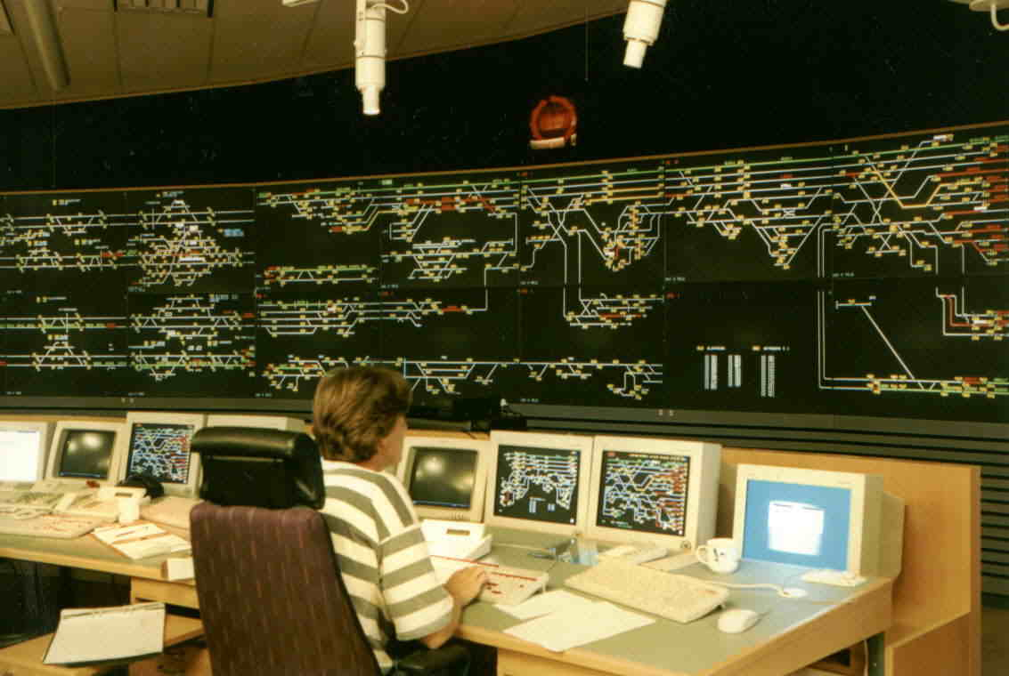
Supervisory Control and Data Acquisition Center
Real-time data acquisition
  Noisy analog measurements
    Voltage, current, power flow
  Digital measurements
State estimation
  Maintain system in normal
  state
  Fault detection
  Power flow optimization
  Supply vs. demand
SCADA TX data from/to Remote Terminal Units (RTUs), the substations in the grid
Notes:
In the power grid network, (pic) the apprearance of the control center. It also know as SCDA center. the supervisory control and data acquisition center, Two of major funcationalityies is Readtime data acquisition and State estimation. In readtime data accquisition, the voltage, current, power flow btw. Each bus have been colleced , For state estimation, it is the place where the control center determine the status of power grid network. Which include the fault detection, power flow optimization, …..
…
[click] In the graphic-theoretic view of SCDA center and power network, it can be represented as…….Green box rep. as SCDA center, RTU is substation of SCDA center. As you can see in the figure, point A1,2,3 , are the some of weak links in SG communication, that allow the hacker to gain the access. The smart grid integration helps the power grid networks to be smarter, but it also increases the risk of adversaries because of the currently obsoleted cyberinfrastructure.
Adversaries can possiblibly paralyzes the power facility by misleading the energy management system with injecting false data. For example of point A! A2(in pic), the attack can hack from either the RTU or just simple tranmission line to gain the information.

Slide 57

Privacy & Security Concern
More connections, technology to the obsolete infrastructure.
  Add-on network technology: sensors and controls estimation
  More substations are automated/unmanned
Vulnerable to manipulate by third party
  Purposely blackout
  Movie Matrix
  Financial gain
  Story of Enron
Notes:
However, Many people concern about cyberterrorism and attacks on the energy infras- tructure since more connection are linked to the power management facility and more technology are implemented into the grid, especially on signal processing and communication.
For example, The smart grid incorporates some new networking technol- ogy, including sensors and controls mechina that make it possible to monitor electricity use in realtime and make automatic changes that reduce energy waste. Furthermore, more and more substation of the power management system has be replaced automated or unmanned which allows hacker t oeasily access the data.
and, indeed, it is vulnerable to manip- ulation by the third party in SG communication.
attackers can manipulate power-grid data by breaking into sub- stations and intercepting communications between substations, grid operators, and electricity suppliers. If someone wanted to cause a blackout, the load data about how much power is flowing could be used to fool grid operators into overloading parts of the grid, tripping generators and leading to cascading failures. Again, A blackout could then occur before grid operators have the chance to correct for the problem.
With similar hacking technique, this data is also used by grid operators to set prices for electricity and to balance supply and demand. Grid hackers could make millions of dollars at the expense of electricity consumers by influencing electricity markets.
From the article in 2009

Slide 58

Power System State Estimation Model
Transmitted active power from bus i to bus j
  High reactance over resistance ratio
  Linear approximation for small variance
  State vector , measure noise e with covariance Ʃe
  Actual power flow measurement for m active power-flow branches
  Define the Jacobian matrix
  The linear approximation
  H is known to the power system but might not known to the attackers.
(1)
(2)

Slide 59
Bad Data Injection and Detection
State estimation from z
Bad data detection
  Residual vector
  Without attacker
  where
  Bad data detection (with threshold γ):
  without attacker:
  with attacker: otherwise
Stealthy (unobservable) attack: c=Hδx
  Hypothesis test would fail in detecting the attacker, since the control center believes that the true state is x + δx.
z=Hx+c+e,

Slide 60
Jamming Attack
Assume that a jammer sends jamming signals to affect the reception of the signal from the remote sensor.
Once jammed, the data in the channel will be lost transmitted.
Once the signal is lost, the control center will use the default value of this dimension.

Slide 61
Overview
Power System State Estimation Model
  Bad Data Injection
Defender Mechanism
  Quickest Detection
Attacker Learning Scheme
  Independent Component Analysis
Electrical Market
Game Theory Approach

Slide 62
Basics of Quickest Detection (QD)
  Detect distribution changes of a sequence of observations
    as quick as possible
    with the constraint of false alarm or detection probability.
  min [processing time]
s.t. Prob(true ≠ estimated) < ŋ
  Classification
    Bayesian framework:
      known prior information on probability
      SPRT (e.g. quality control, drug test, )
    Non-Bayesian framework:
      unknown distribution and no prior
      CUSUM (e.g. spectrum sensing, abnormal detection )
Notes:
Therefore, a advance digital signal processing technique is need to battle for this security issue in SG communiction. One popular approach is QD by H. Vince Poor. , it is a implementalbe realtion …….., and the information……
The concept of QD is to be able to deconde online….. It can be discribed as minimize the processing time whith the error probability is less then a certain threhold \ in the other words, this techqnies is to …..less or equal to the pre-defined threshold

Slide 63



QD System Model
Assuming Non-Bayesian framework with non-stealthy attack
  the state variables are random with
The binary hypothesis test:
The distribution of measurement z under binary hypotheses: (differ only in mean)
We want a detector
  False alarm and detection probabilities
Notes:
We will first formulate a detection problem, which we assume the bayesian framework under the multivariant normal distribution with \um_z as mean vector and crosscorrelation matrix \exlo _z.
From this assumption , we can form a binary hypothesis test H0 as normal state, mean of H1 follows the condition of [Lin2009 paper] of k-sarpse attack.
Therefore, we can catalogize the oberservation Z under two possible hypotheses H0 and H1. and We wish to design a detector; when \delta_z=1 is indicating a detection of attack H1 is true, otherwise is null hyp. In addition, P_F is the false rate wherer given H0 is true but the decision is made for 1, P_Detection is H1 is true

Slide 64

Detection Model - NonBayesian
Non-Bayesian approach
  unknown prior probability, attacker statistic model
The unknown parameter exists
  You do not know when the attacker attacks
  You do not know how the attacker attacks.
Minimizing the worst-case effect via detection delay:
We want to detect the intruder as soon as possible while maintaining P_{D.}
Detection delay
Detection time
Actual time of active attack
Notes:
However, in the detection mode, the non-Bayesian approach is applied because of the unknown prior probability of the adversary and unknown statistical model for the adversary vector.
To notes that , the unknown parameter exists in the post-change distribution and may change over the detection process.
For the detection problem, one of popular apporach is to minimizing the worst case effect by maximizing the detection delay. T_d is average detection delay, and given that the real detection time or stopping time, T_h,\ subtracts \tau, the acutal time of active attack.
We will like to detect the active malicious data attack as quickly as possible while maintaining a certain level of Detection probabilty.

Slide 65

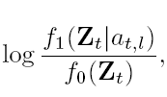
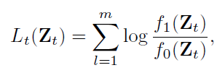



Multi-thread CUSUM Algorithm
CUSUM Statistic:
  where Likelihood ratio term of m measurements:
By recursion, CUSUM Statistic S_{t} at time t:
Average run length (ARL) for declaring attack with threshold h
How about the unknown?
Declare the attacker is existing!
Otherwise, continuous to the process.
Notes:
We first consider the Page’s CUSUM test, because it is non-bayesian framework , which don’t require complete knowledge about the distributions so that The decision can be made directly by analysizing the observation data. Therefore, we further modify the Page’s CUSUM test, to the multi-thread CUSUM since we have multi measurement in a single observation at the time t. Lets start deriving the multithread cusum test:
T_h is average run length or stopping time for declaring the existance of introdor given St>h, in which the detection threshold h is a function of FAR, MDR, and the process variance, St. is cumulative sum statistic which considers and cooperates the likelihood ratio term of m measurements at time t
S_t is the cumulate the likelihood ratio from each time, Lt- the log likelihood ratio for m measurements at time t,
Lt is the sum of …., in which f1 is PDF of H1 given the active intruder
.
And, we can describe CUM statistic by recursion at time t, given that current St is the sum of previous CUSUM statistic + the current culative sum of log likelihood ratio of m measurements. In order to have accurate result, zero is our base line.
St will keep cumulating time by time until it excess the predefined value “h”[click] as shown here…..
However, there is the unknown in the prob density function H1, so, can we deal with it?

Slide 66


Linear Solver for the Unknown
Rao test:
The linear unknown solver for m measurements:
Recursive CUSUM Statistic w/ linear unknown parameter solve:
  Modified CUSUM statistics
  Asymptotically equivalent model of GLRT
The unknown is no long involved
Notes:
we consider the Rao test [18], which is the asymptotically equivalent test model of GLRT. GLRT is to min the worst case effect by maximizing the unknown using ML estimation. But giving us high Complexity, near impossible to implement in the reality.
The derivation of Rao test is similar to the locally most powerful (LMP) test but only much simpler; Rao test has the straight-forward calculation by taking derivative with respect to the unknown parameter evaluated at the unknown parameter equal to zero. Thus, for at near ^ a0 t , we can achieve approximate maximum outcome with a certain level of FAR by maximizing @fe(Ztjat) @at
By inspected the EQ, we can omitting the ne…… it is damend for multi parameter envirement. , then we can simplify the quadratic form because the unknown is always greater the zero. So, the our part of proposed scheme : linear unknown solver will be just a partial dervative of PDF over unknown while repecting the unknown to close zero.
By the recursion and partial dervative of likelihood function repect to zero, the unknwon will be no longer existed in the system.

Slide 67
Simulation: Adaptive CUSUM algorithm
2 different detection tests: FAR: 1% and 0.1%
Active attack starts at time 5
Detection of attack at time 7 and 8, for different FARs
Notes:
The 1st simulation of the proposed scheme is shown with 2 case : case 1 has FAR of 1% and case 2 as the 0.1%. The attacker becomes active at time 6, where the a change distribution from H0 to H1, The proposed algorithm singal the alarm and terminates the pdetection process at time 7, for case 2 is time 8, each has its own threshold h1 h2 repectively, in term of different FAR . As you can see the missing detection occurs , for case is T_d =1 and case 2 is T_d=2. We also can conclude that the higher constraint will need more time to make decision, therefore, the slower detection,. That why we have longer detection delay in case 2.
(FAR is 1% as same as MDR).
The adversary becomes
active and injects the malicious data at time t = 6. In other
words, a change distribution is at τ = 6 from N(0,z)
to N(a,z), where a is unknown. The curve of adaptive
CUSUM statistic (St) shows the sudden increase right after
a change of distributions. The proposed algorithm quickly
responses the abnormal event by signaling an alarm of out-of control.
As a result, ARL (Th) of adaptive CUSUM algorithm
is 7 at St = 13.2351, and ARL (Td) of detection delay is 1
in this simulation.
The proposed algorithm signals the alarm
and terminates the process at time 7 ; the detection delay
occurs because of the missing detection at time 6 as shown in
Figure 3. The system continuos the detection process until the
CUSUM statistic St, which excesses the threshold. However,
the detection accuracy of the proposed scheme is comparable
high while maintaining a certain level of detection error rate.

Slide 68
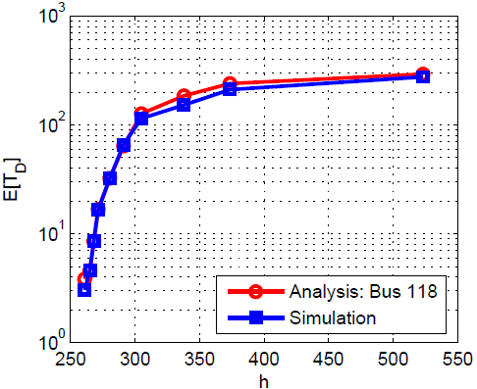
Markov Chain based Analytical Model
Divide statistic space into discrete states between 0 and threshold
  Obtain the transition probabilities
  Obtain expectation of detection delay, false alarm rate and missing probability
How about topology error
Any other applications
Using QD?
Notes:
we consider the Rao test [18], which is the asymptotically equivalent test model of GLRT. GLRT is to min the worst case effect by maximizing the unknown using ML estimation. But giving us high Complexity, near impossible to implement in the reality.
The derivation of Rao test is similar to the locally most powerful (LMP) test but only much simpler; Rao test has the straight-forward calculation by taking derivative with respect to the unknown parameter evaluated at the unknown parameter equal to zero. Thus, for at near ^ a0 t , we can achieve approximate maximum outcome with a certain level of FAR by maximizing @fe(Ztjat) @at
By inspected the EQ, we can omitting the ne…… it is damend for multi parameter envirement. , then we can simplify the quadratic form because the unknown is always greater the zero. So, the our part of proposed scheme : linear unknown solver will be just a partial dervative of PDF over unknown while repecting the unknown to close zero.
By the recursion and partial dervative of likelihood function repect to zero, the unknwon will be no longer existed in the system.

Slide 69
Overview
Power System State Estimation Model
  Bad Data Injection
Defender Mechanism
  Quickest Detection
Attacker Learning Scheme
  Independent Component Analysis
Electrical Market
Game Theory Approach

Slide 70
Independent Component Analysis (ICA)
Question for bad data injection:
  Without knowing H, the attacker can be caught.
  Could attacker launch stealthy attack to the system even without knowledge about H?
  Using ICA, attacker could estimate H and consequently, lunch an undetectable attack.
Linear Independent Component Analysis
  Find a linear representation of the data so that components are as statistically independent as possible.
  i.e., among the data, find how many independent sources.

Slide 71
ICA Basics
A special case of blind source separation
u = G v
u = [u_{i}, i = 1, 2, … m]: observable vector
G = [g_{ij}, i = 1, 2, … m, j = 1, 2, … n]: mixing matrix
(unknown)
v = [v_{i}, i = 1, 2, … n]: source vector (unknown)
Linear ICA implementation: FastICA from [Hyvärinen]

Slide 72
Stealth False Data Injection with ICA
Supposing small noise, we what to do the mapping:
u = G v z = H x
Problem: state vector x is highly correlated
Consider: x = A y, where
  A: constant matrix that can be estimated
  y: independent random vectors
Then we can apply Linear ICA on z = HA y
  We cannot know H, but we can know HA
  Stealthy attack: Z=Hx+HAδy+e

Slide 73
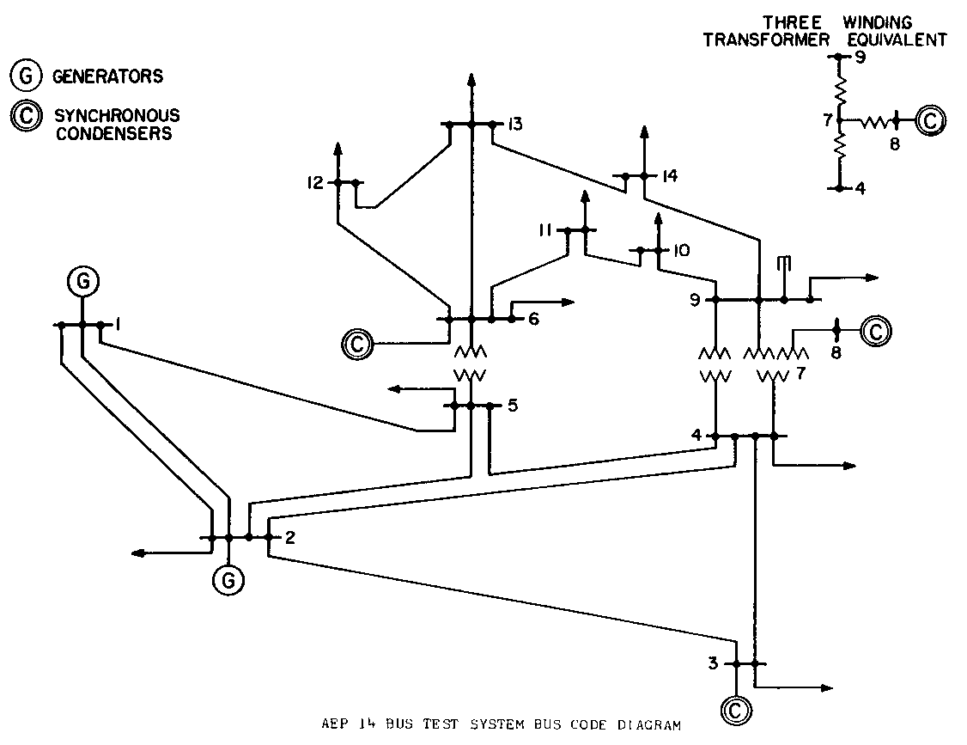
Numerical Simulation Setting
Simulation setup
  4-Bus test system, IEEE 14-Bus and 30-bus
  Matpower

Slide 74
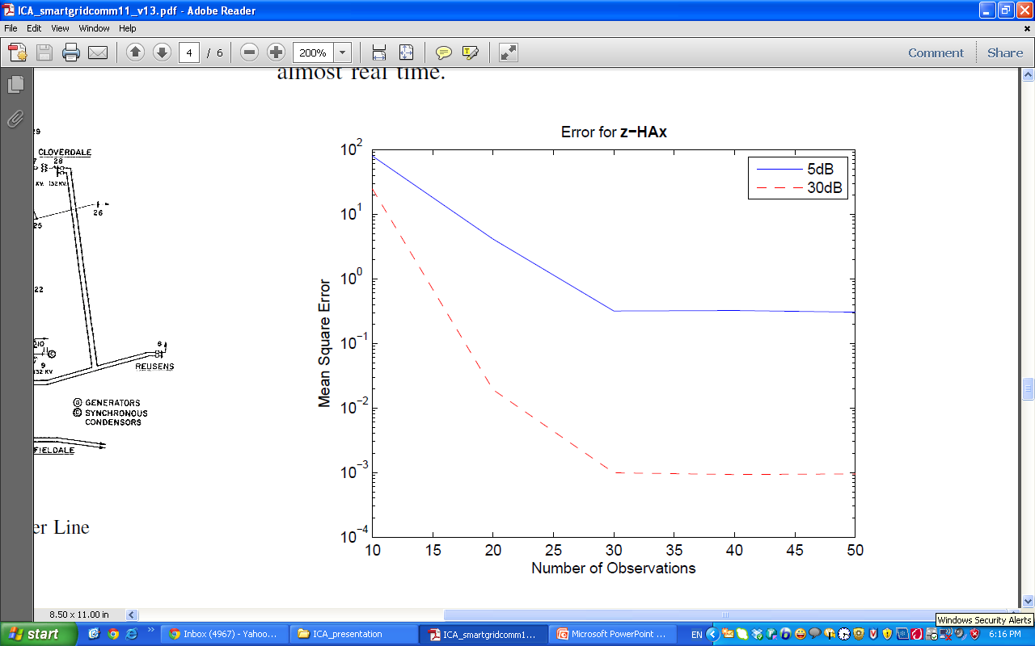
Numerical Results
MSE of ICA inference (z-Gy) vs. the number of observations (14-bus case).

Slide 75
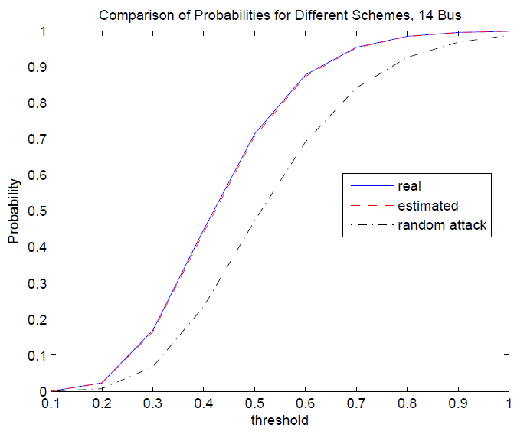
Performance of the Attack
The CDF is the same w or w/o attacking.
So log likelihood is equal to 1– unable to detect

Slide 76
Overview
Power System State Estimation Model
  Bad Data Injection
Defender Mechanism
  Quickest Detection
Attacker Learning Scheme
  Independent Component Analysis
Electrical Market
Game Theory Approach

Slide 77
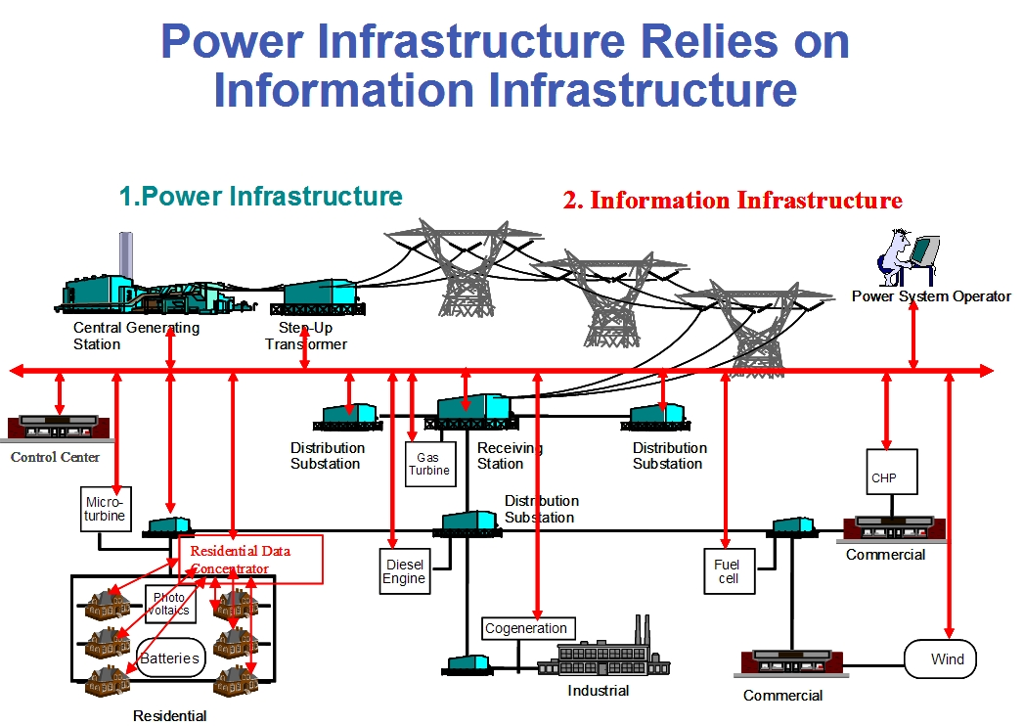
Electrical Market
Directly
Power flow (PF)
Estimation
Optimal Power Flow (opf)
Control Center
Power system Management
Notes:
Due to increase in electricity demand and limited energy resources, power systems become more and more complex in
structure and should operate in a secure and optimal conditions. After deregulation, the physical and financial operations
of electric power systems become significantly different and challenging. State estimation (SE), introduced to improve the
operating point of the power system from both technical and economical viewpoints, helped engineers in energy control
centers (ECC) to monitor all states of the power system, which was previously not practical (or economical) to monitor.
Currently, SE plays an important rule in secure and optimal operation of power systems. Accuracy of state estimation
can be affected by bad data in measurements. These bad data could be caused by unintended measurement abnormalities
or topology errors, or even by injection of malicious attacks. Cyber-attacks can be increased by integrating more advanced
cyber technologies into the energy management system (EMS) and can cause major technical problems such as blackouts
in a power system. These attacks also can be designed for illicit financial benefit by changing the optimal operation of
the system, thereby increasing the net cost of electricity for consumers.

Slide 78

Electricity Market Overview
Electricity Market
(OPF)
Bid’s from Gen and loads, Structure of network, etc
Electricity Prices, Schedule for gen, etc
Day-Ahead
Market:
Predicted values for power network
DCOPF for EX-Ante Electricity Market
Real-time Market:
Direct Measurements
in power network
State
Estimation
DCOPF for EX-Post Electricity Market
Attacker

Slide 79
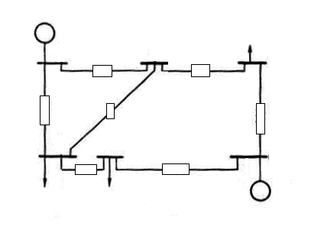

Bad Data Injection
Control Center
G
M
ZL
M
ZL
ZL
ZL
ZL
Fig. 12 Attacker
behavior
ZL
M
ZL
M
G
M
Conventional measurement
ZL
Transmission Line
Cyber links from meas.
to control center
G
Active power generator
Attacker
Active Load

Slide 80
State Estimation Model
Transmitted active power from bus i to bus j
Measurements
Structure of PS

Slide 81

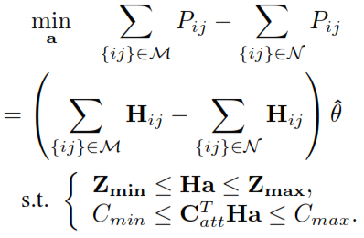
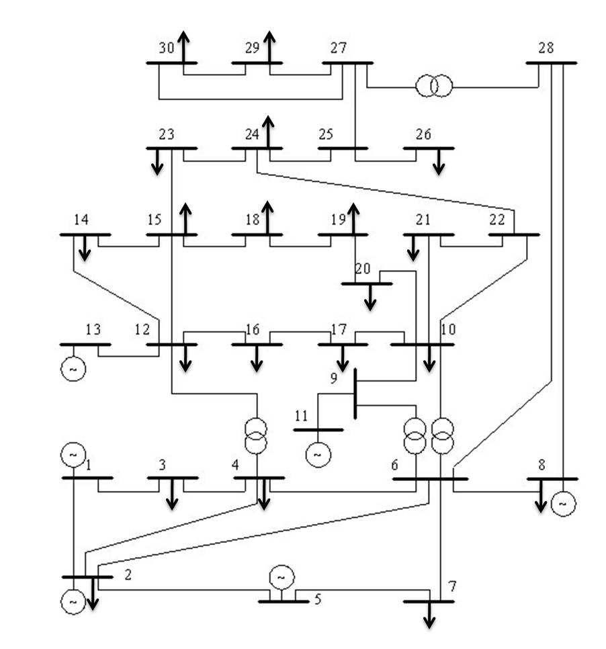
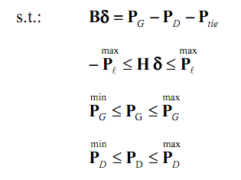
Problem Formulation
DC Optimal Power Flow:
Simulation set up:
IEEE 30-bus Test System
Objective Function:
Gen & Consumption
Cost
Estimated transmitted Power in group “M”
Power Balance
Estimated transmitted Power in group “N”
Line limits
Injected Bad
Data limit
Total Cost of att
Gen limits
Load limits
Notes:
DC Optimal Power Flow
In the Ex-Ante model, the generation dispatches and LMPs are obtained from the same optimization model. In the Ex-Post model, the dispatch is performed at Ex-Ante, while the LMP is calculated after the cycle of the spot market, i.e., at Ex-Post such as after the 5-minute or hourly real-time market, using an incremental dispatch model. The problem formulation is given as above.
where CG is bid vector for supplying active power, CD is bid vector for consumption of active power, PG is the active power generation vector in Mega-Watt (MW), PD is the active power consumption vector in Mega-Watt (MW), PL = Hθ is the vector of transmitted active power, and B is defined as Bij = − 1/Xij
and Bii = Σj Xij.
First constraint of this optimization shows the balance between generation and consumption of active power in each bus. Second, third and fourth constraints consider the thermal limitation in transmission lines, active power generation limits, and active power consumption limits, respectively.
Objective Function
The attacker can compromise the measurement vector and change the state of the system. Changing in transmitted power can modify congestion levels, which is also closely related to the price of trading electricity in most of electricity markets. We formulate the problem to increase or decrease transmitted active power
in the desired transmission lines by injecting bad data.
The objective of the above optimization is to decrease and increase transmitted power, respectively, in group M and N of transmission lines represented by {ij}.

Slide 82
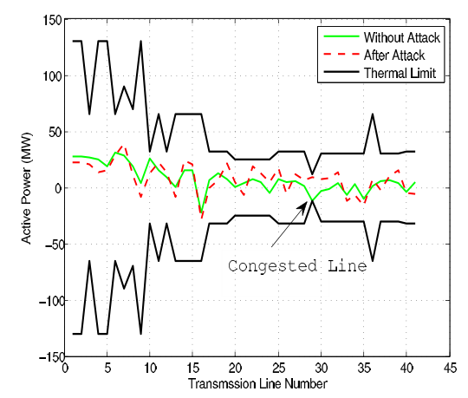
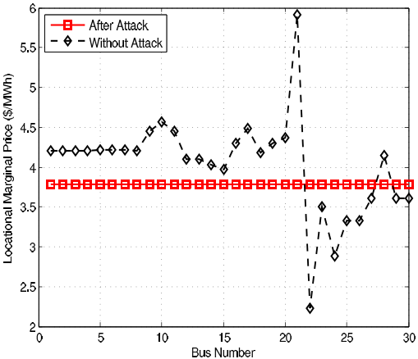
Simulation Results
Illustration of Attack
LMP Price Changes
Line 29 is congested so it is a good candidate for decreasing or increasing congestion level.
Decreasing congestion in this case, releases all congestion, so the price will be the same in network.
Notes:
Consequently, simulation results show that line 29 (from bus 21 to bus 22) is congested. For comparison, we also show in this figure the case without attack and the thermal limits.

Slide 83
Overview
Power System State Estimation Model
  Bad Data Injection
Defender Mechanism
  Quickest Detection
Attacker Learning Scheme
  Independent Component Analysis
Electrical Market
Game Theory Approach

Slide 84
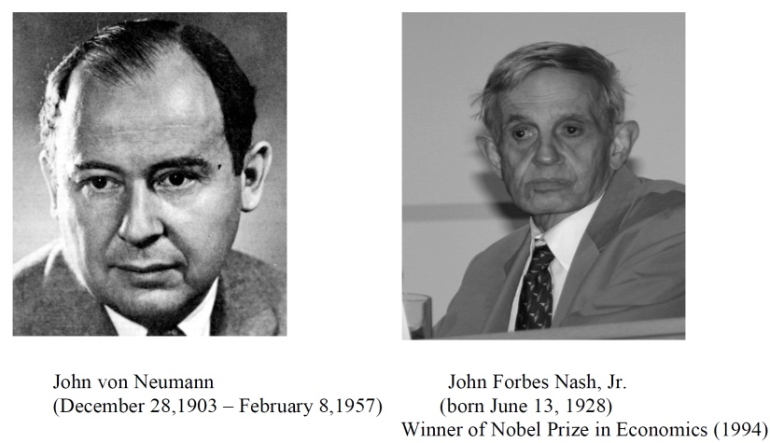

History of Game Theory
John von Neuman (1903-1957) co-authored, Theory of Games and Economic Behavior, with Oskar Morgenstern in 1940s, establishing game theory as a field.
John Nash (1928 - ) developed a key concept of game theory (Nash equilibrium) which initiated many subsequent results and studies.
Since 1970s, game-theoretic methods have come to dominate microeconomic theory and other fields.
Nobel Prizes
  Nobel prize in Economic Sciences 1994 awarded to Nash, Harsanyi (Bayesian games) and Selten (subgame perfect equilibrium).
  2005, Auman and Schelling got the Nobel prize for having enhanced our understanding of cooperation and conflict through game theory.
  2007 Leonid Hurwicz, Eric Maskin and Roger Myerson won Nobel Prize for having laid the foundations of mechanism design theory.

Slide 85
Introduction
Game theory - mathematical models and techniques developed in economics to analyze interactive decision processes, predict the outcomes of interactions, identify optimal strategies
Game theory techniques were adopted to solve many protocol design issues (e.g., resource allocation, power control, cooperation enforcement) in wireless networks.
Fundamental component of game theory is the notion of a game.
  A game is described by a set of rational players, the strategies associated with the players, and the payoffs for the players. A rational player has his own interest, and therefore, will act by choosing an available strategy to achieve his interest.
  A player is assumed to be able to evaluate exactly or probabilistically the outcome or payoff (usually measured by the utility) of the game which depends not only on his action but also on other players’ actions.

Slide 86
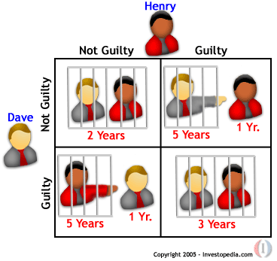
Examples: Rich Game Theoretical Approaches
Non-cooperative Static Game: play once
  Mandayam and Goodman (2001)
  Virginia tech
Repeated Game: play multiple times
  Threat of punishment by repeated game. MAD: Nobel prize 2005.
  Tit-for-Tat (infocom 2003):
Dynamic game: (Basar’s book)
  ODE for state
  Optimization utility over time
  HJB and dynamic programming
  Evolutional game (Hossain and Dusit’s work)
Stochastic game (Altman’s work)
Cooperative Games
  Nash Bargaining Solution
  Coalitional Game
Prisoner Dilemma
Payoff: (user1, user2)
Notes:
John Edwards

Slide 87
Games in Strategic (Normal) Form
A game in strategic (normal) form is represented by three elements:
  A set of players N
  Set of strategies of player Si
  Set of payoffs (or payoff functions) Ui
Notation s_{i} strategy of a player i while s_{-i} is the strategy profile of all other players.
Notice that one user’s utility is a function of both this user’s and others’ strategies.
A game is said to be one with complete information if all elements of the game are common knowledge. Otherwise, the game is said to be one with incomplete information, or an incomplete information game.

Slide 88
Example: Prisoner’s dilemma
Two suspects in a major crime held for interrogation in separate cells
  If they both stay quiet, each will be convicted with a minor offence and will spend 1 year in prison
  If one and only one of them finks, he will be freed and used as a witness against the other who will spend 4 years in prison
  If both of them fink, each will spend 3 years in prison
Components of the Prisoner’s dilemma
  Rational Players: the prisoners
  Strategies: Stay quiet (Q) or Fink (F)
  Solution: What is the Nash equilibrium of the game?
Representation in Strategic Form

Slide 89
Example: Prisoner’s dilemma
Matrix Form
 | P2 Quiet | P2 Fink
P1 Quiet | 1,1 | 4,0
P1 Fink | 0,4 | 3,3

Slide 90
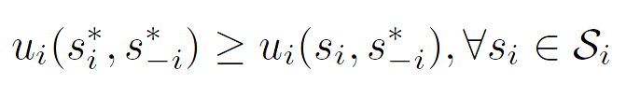
Nash equilibrium (1)
Dominant strategy is a player's best strategy, i.e., a strategy that yields the highest utility for the player regardless of what strategies the other players choose.
A Nash equilibrium is a strategy profile s* with the property that no player i can do better by choosing a strategy different from s*, given that every other player j ≠ i .
In other words, for each player i with payoff function u_{i} ,
No user can change its payoff by Unilaterally changing its strategy, i.e., changing its strategy while s_{-i} is fixed

Slide 91
The price of Anarchy
Centralized system: In a centralized system, one seeks to find the social optimum (i.e., the best operating point of the system), given a global knowledge of the parameters. This point is in many respect efficient but often unfair.
Decentralized: When the players act noncooperatively and are in competition, one operating point of interest is the Nash equilibrium. This point is often inefficient but stable from the players’ perspective.
The Price of Anarchy (PoA), defined as the ratio of the cost (or utility) function at equilibrium with respect to the social optimum case, measures the price of not having a central coordination in the system
PoA is, loosely, a measure of the loss incurred by having a distributed system!

Slide 92
Example: Prisoner’s dilemma
Price of Anarchy 3
 | P2 Quiet | P2 Fink
P1 Quiet | 1,1 | 4,0
P1 Fink | 0,4 | 3,3
Pareto optimal
(recall we’re minimizing)
Nash Equilibrium

Slide 93
Example: Battle of Sexes
Multiple Nash Equilibriums
 | Opera | Football
Opera | 2,3 | 0,0
Football | 0,0 | 3,2
Nash Equilibrium
Nash Equilibrium

Slide 94
Pure vs. Mixed Strategies
So far we assumed that the players make deterministic choices from their strategy spaces
Strategies are pure if a player i selects, in a deterministic manner (probability 1), one strategy out of its strategy set S_{i}
Players can also select a probability distribution over their set of strategies, in which cases the strategies are called mixed
Nash 1950
  Every finite strategic form N-player game has a mixed strategy Nash equilibrium

Slide 95
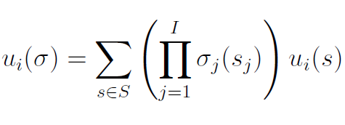

Mixed Nash Equilibrium
Define σ_{i} as a probability mass function over S_{i}, the set of actions of player i
When working with mixed strategies, each player i aim to maximize their expected payoff
Mixed strategies Nash equilibrium

Slide 96
Example: Battle of Sexes
 | Opera | Football
Opera | 2,3 | 0,0
Football | 0,0 | 3,2
Husband picks Opera with probability p , wife picks Opera with probability q
Expected payoff for husband picking Opera: 2q
Expected payoff for husband picking Football: 3(1-q)
At mixed NE, the expected payoff at a strategy is equal to that at another strategy (otherwise, one would use a pure NE)
Mixed NE -> Husband: (2/5,3/5) Wife: (3/5,2/5)
Expected payoffs (6/5,6/5)

Slide 97
Algorithms for Finding the NE
For a general N-player game, finding the set of NEs is not possible in polynomial time!
    Unless the game has a certain structure
Some existing algorithms
  Fictitious play (based on empirical probabilities)
  Iterative algorithms (can converge for certain classes of games)
  Best response algorithms
    Popular in some games (continuous kernel games for example)
  Useful Reference
    D. Fundenberg and D. Levine, The theory of learning in games, the MIT press, 1998.

Slide 98
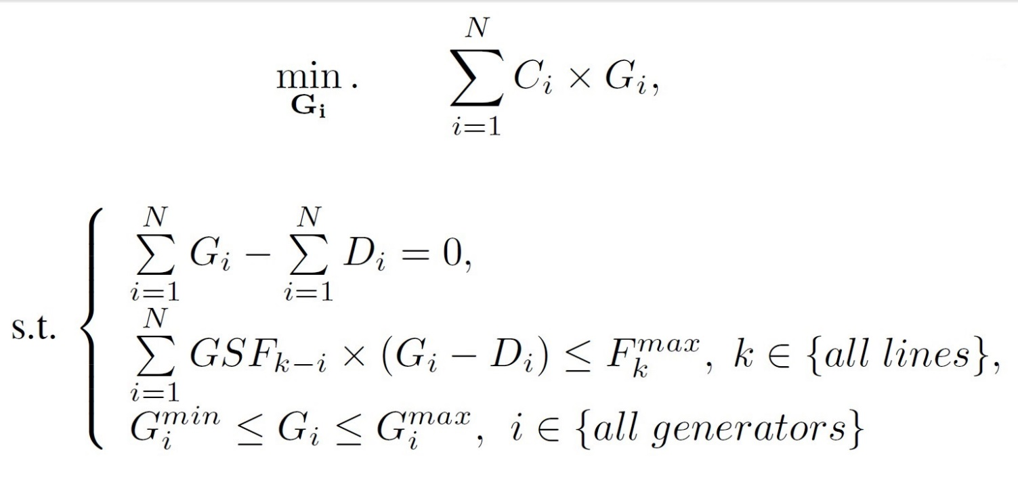
General Dispatch Model
(3)
: the number of buses
: the generation cost at bus i in ($=/MWh)
: the generation dispatch at bus i in (MWh)
: the demand at bus i in (MWh)
: the generation shift factor from bus i to line k
: the transmission limit for line k
Notes:
where Ci ($)is the generation cost function and H is a matrix that relates power flow on transmission lines to nodal power inputs. The first constraint ensures power balance; the second ensures that flows on all the transmission lines lie within their limit, given by the vector Fr max ; and the third one defines generation
capacity limits.

Slide 99
General Dispatch Model
(3)
The control center observes a vector z for m active power measurements. These measurements can be either transmitted active power P_{ij} from bus i to j, or injected active power P_{i} to bus i and we have ( )

Slide 100
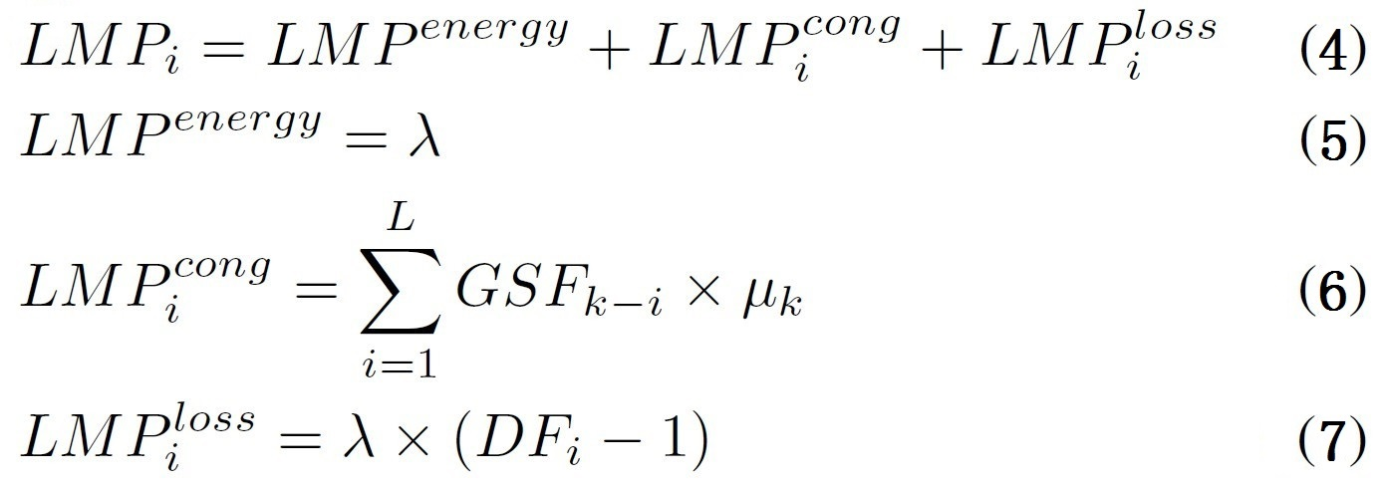
General LMP^{[1]} Formulation
: the number of lines
: the lagrangian multiplier of the equality constraint
: the lagrangian multiplier of the kth transmission constraint
: the delivery factor at bus i
If the optimization model in (3) ignores losses, we will have and in (7). In this work, the loss price is ignored.
[1] Locational Marginal Price.
Notes:
The LMP represents the marginal cost of providing one additional
unit of power at that bus under the optimal generation dispatch.

Slide 101
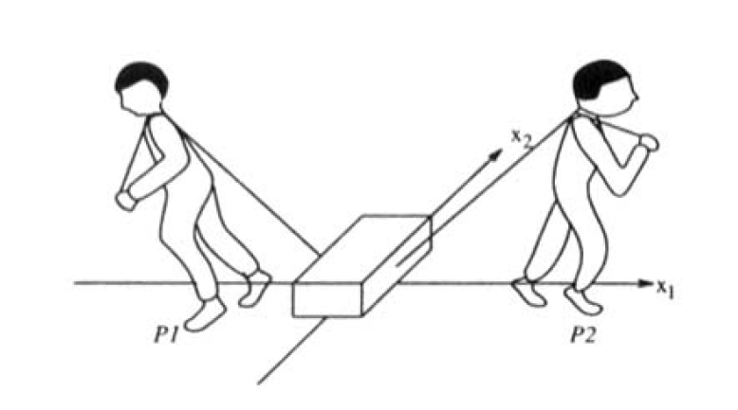
Two-Person Zero-Sum Game
In a zero-sum game, the sum of the cost functions of the players is identically zero.
A salient feature of two-person zero-sum games that distinguishes them from other types of games is that they do not allow for any cooperation between the players, since, in a two-person zero-sum game, what one player gains incurs a loss to the other player.
Fig. 13 Two-person Zero-Sum

Slide 102


Bad Data Injection
Control Center
G
(3)
M
ZL
M
ZL
ZL
ZL
Manipulate the congestion
level in a specific line
ZL
ZL
M
ZL
M
Fig. 12 Attacker
behavior
G
M
Conventional measurement
ZL
Transmission Line
Cyber links from meas.
to control center
G
Active power generator
Attacker
Active Load
Notes:
In order to protect line L, the defender needs to protect groupMand group N. Because the inserted attack will pass the Bad Data Detector in state estimation , the control center should use some other detection methods. For example defender can put some secure measurements into random locations in the network. The main problem in this procedure is that defending all measurements is not possible. On the other hand, it is impossible for the attacker to attack all measurements. Instead it tries to attack measurements that have the most effect on the state estimator without being detected by the control center. This behavior can be modeled with a zero–sum strategic game between the attacker and the defender.

Slide 103
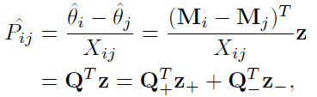
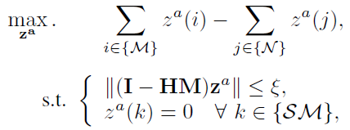

Cyber Attack Against Electricity Prices
Positive and negative arrays
Attacker optimization
  Objective: to increase and decrease measurements value in group M and N
As a result, the demand at the bus will be changed, and then, revise the LMP, where D_i = G_i + P_i
Notes:
In order to manipulate the congestion level in a specific line, the attacker needs to define the group of measurements that can increase or decrease the
congestion, then the attacker can insert false data into the measurements. any change in voltage angle can change the transmitted power through the line.
For example, any increase/decrease in Δθ= （θi-θj）will increase/decrease the transmitted power.
These coefficient vectors divide the measurements into two groups z+ and z-, in which adding za > 0 to any array of z+ and z- will increase and decrease the estimated transmitted power flow, respectively.
where za(i) is the ith element of attack vector za. Group M and N consist of measurements that increasing and decreasing their value will increase the congestion. Objective of the above optimization is to increase and decrease measurements value in group M and N, respectively. First constraint is for avoiding detection of the attack by bad data detector in state estimator. Group SM shows the safe measurements that can not be compromised (such as those protected by Phasor Measurement Units). With inserting the resulted attack vector za to the actual values of measurements (z = z0 + za), the attacker will change the estimated transmitted power in the attacked line. While the attacker tries to increase this change, the defender tries to decrease it by defending the measurements that have high risk of being attacked. Changing the estimated power flow in a specific line will increase the chance of changing prices in both sides of the attacked line.

Slide 104


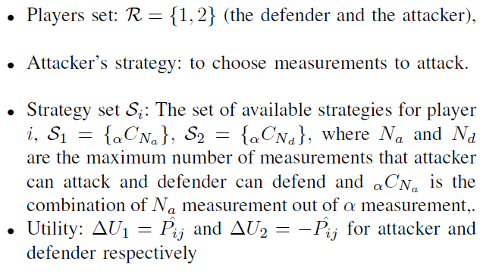
Two-Person Zero-Sum Game
Define as a game, in which the defender and the attacker compete to increase and decrease the change of the estimated transmitted power , respectively.
In this game, R is the set of players (the defender and the attacker), and the game can be defined as:

Slide 105
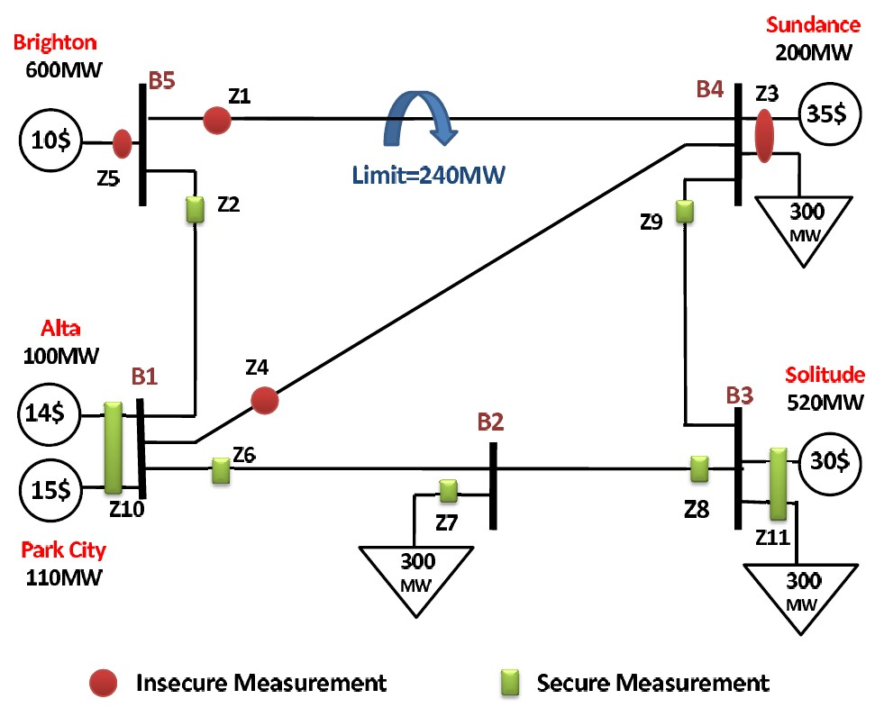
Zero-Sum Game in Stealthy Attack
Suppose there are 4 insecure measurements {z1, z3, z4, z5} and the attacker can compromise 2 of them, also the defender can defend 2 measurements simultaneously.
Fig. 10 Measurement configuration in PJM 5-bus test system

Slide 106
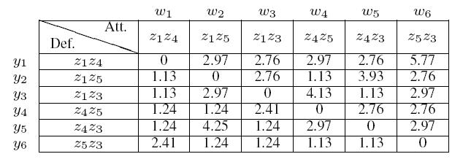
Zero-Sum Game in Stealthy Attack
In this example, the attacker can choose from strategy set S1 =
{z1z4; z1z5; z1z3; z4z5; z4z3; z5z3}, and the defender can
choose from strategy set S2 = {z1z4; z1z5; z1z3; z4z5; z4z3; z5z3}.
Table 5 Zero-sum game between the attacker and the defender,
and the value is the change of power, \delta P_i

Slide 107
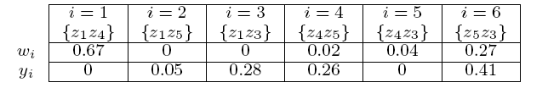
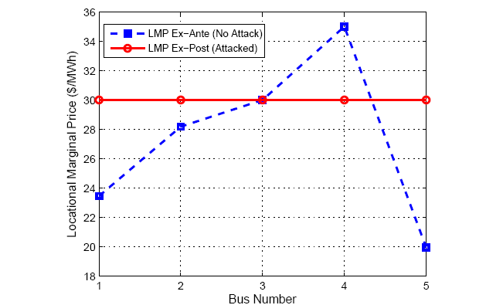

Zero-Sum Game in Stealthy Attack
Table 6 Proportion of times that the attacker and the defender play their strategies
Fig. 11 Locational marginal prices for PJM 5-Bus test system for both with attack and without attack

Slide 108
Jamming Attack in Electricity Market
The defender will transmit two measurement {z1,z4} first. For the jamming attack is detectable, the defender is aware of which one of the first two transmitted measurements is attacked.
Fig. 10 Measurement configuration in PJM 5-bus test system

Slide 109
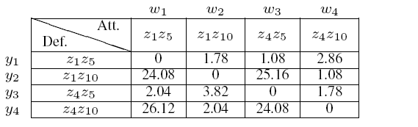
Jamming Attack in Electricity Market
The normal form of this situation is described in Table 7
Table 7 ZERO–SUM GAME BETWEEN THE ATTACKER AND THE DEFENDER
In a finite dynamic game, one player is allowed to act more than once and with possibly different information sets at each level of play.

Slide 110
Games in Extensive Form
In dynamic games, the notion of time and information is important
  The strategic form cannot capture this notion
  We need a new game form to visualize a game
In extensive form, a game is represented with a game tree.
Extensive form games have the following four elements in common:
  Nodes: This is a position in the game where one of the players must make a decision. The first position, called the initial node, is an open dot, all the rest are filled in. Each node is labeled so as to identify who is making the decision.
  Branches: These represent the alternative choices that the player faces, and so correspond to available actions.

Slide 111
Games in Extensive Form
3. Payoffs: These represent the pay-offs for each player, with the pay-offs listed in the order of players.
  When these payoff vectors are common knowledge the game is said to be one of complete information.
  If, however, players are unsure of the pay-offs other players can receive, then it is an incomplete information game.
4. Information sets: When two or more nodes are joined together by a dashed line this means that the player whose decision it is does not know which node he or she is at. When this occurs the game is characterized as one of imperfect information.
  When each decision node is its own information set the game is said to be one of perfect information, as all players know the outcome of previous decisions.

Slide 112
Example: The Prisoner’s Dilemma
(-5,-5)
1
2
Confess
Confess
Quiet
(0,-10)
Confess
(-10,0)
Quiet
Quiet
(-2,-2)

Slide 113
Game Tree in Jamming Attack
Defender
Z1
Z4
Attacker
Z1
Z4
Z1
Defender
Z4
Z5
Z10
Z5
Z10
Z5
Z10
Attacker
Z5
Z10
Z5
Z10
Z5
Z10
Z5
Z10
Z5
Z10
Z5
Z10
Z5
Z10
Z5
0
1.78
24.08
0
1.08
2.86
25.16
1.08
2.04
3.82
26.12
2.04
0
1.78
24.08
0
Z10
Z5
Z10
Fig. 12 Game tree of the jamming attacker and defender
We can get the average value of the outcome of the game J=1.53.

Slide 114

Repeated Game Basics
Repeated game: average utility (power in our case) over time.
Discounting factor β
Folk theorem
  Ensure cooperation by threat of future punishment.
  Any feasible solution can be enforced by repeated game
Enforcing Cooperation by Punishment
  Each user tries to maximize the benefit over time.
  Short term greedy benefit will be weighted out by the future punishment from others. By maintaining this threat of punishment, cooperation is enforced among greedy users.
Repeated Game Approach
  Initialization: Cooperation
  Detect the outcome of the game:
  If better than a threshold, play cooperation in the next time;
  Else, play non-cooperation for T period, and then cooperate.

Slide 115
Outline
Introduction of Smart Grid
Major topics in Smart Grid (SG)
  Smart Infrastructure system
    Smart energy subsystem
    Smart information subsystem
    Smart communication subsystem
  Smart Management system
  Smart protection system
Research topic examples
  Bad Data Injection Attack and Defense
  Demand Side Management
  PHEV, renewable energy, microgrid, big data, assess management, communication effects, etc.
Conclusion

Slide 116
Overview
Demand Side Management
  Management objectives and basic concept
  Main techniques and mathematical key words
  Models and algorithms
  Our site: Auction game approach for DSM
    Auction game: Mechanism design and the AGV mechanism
    Problem formulation and algorithm
    Propositions and Proofs
    Simulation results
  Conclusions

Slide 117



Management Objectives: Load Shaping
User1
Total load shape
On-peak hours
Mid-peak hours
User2
Off-peak hours
User3
Power resources allocations
Auction game capable
Fig. 13 Load shaping objectives in DSM
Notes:
Peak clipping is generally considered as the reduction of peak load by using direct load control. Direct load control
is most commonly practiced by direct utility control of customer‘s appliances.
Valley filling encompasses building off-peak loads. This may be particularly desirable for those times of the year where the long-run incremental cost is less than the average price of electricity. Adding properly priced off-peak load under those circumstances decreases the average cost to customers.
Load Shifting is the last classic form of load management. This involves shifting load from on-peak to off-peak periods.
Strategic Conservation is the load-shape change that results from utility-stimulated programs directed at end-use
consumption. The change reflects a modification of the load shape involving a reduction in sales often as well as a
change in the pattern of use.
Strategic Load Growth is the load-shape change that refers to a general increase in sales, stimulated by the utility, beyond the valley filling described previously. Load growth may involve increased market share of loads that are, or can be, served by competing fuels, as well as economic development in the service area.
Flexible Load Shape is a concept related to reliability, a planning constraint. Once the anticipated load shape, including demand-side activities, is forecast over the planning horizon, the power supply planner studies the final optimum supply-side options.
We can see that the DSM mainly deal with power resources allocation problems, in which we consider it possible to apply auction games. We can let the consumers be the bidders and the energy provider the auctioneer.

Slide 118

Basic Concept
Demand-side management (DSM)
is the planning and implementation of those electric utility activities designed to influence customer uses of electricity in ways that will produce desired changes in the utility’s load shape.
to reach a balance of utilities’ supply and customer needs.
to enable more efficient and reliable grid operation.
to get higher utilization in power grids rather than extensive constructions.

Slide 119

Main Techniques
One of the most serious contenders and a popular research topic in the DSM research arena is RTP.
Instead of shielding the customer completely from the real fluctuations of energy costs in the spot, in RTP, price signals delivered to the customers will act as an economic incentive to modify their demand and alleviate the pressure on the grid, with the reward of lowering their bill.
The key difference in the RTP model, as the name suggests, is that the price is updated and provided only hours/minutes before consumption, so that the signal can reflect actual grid congestion.
Direct Load Control(DLC)
Based on an agreement between the utility company and the customers, the utility or an aggregator, which is managed by the utility, can remotely control the operations and energy consumption of certain appliances in a household.
Smart Pricing
Encourages users to individually and voluntarily manage their loads, e.g., by reducing their consumption at peak hours.
  Real-time pricing (RTP)
  Time-of-use pricing(ToUP)
  Critical-peak pricing(CPP)
Notes:
One of the most serious contenders and a popular research topic in the DSM research arena is RTP. Instead of shielding the customer completely from the real fluctuations of energy costs in the spot market (as it is done when using flat rates and TOU tariffs), in RTP, price signals delivered to the customers will act as an economic incentive to modify their demand and alleviate the pressure on the grid, with the
reward of lowering their bill. The key difference in the RTP model, as the name suggests, is that the price is updated and
provided only hours/minutes before consumption, so that the signal can reflect actual grid congestion.
In TOU pricing strategies, the price is usually decided months or years before the actual TOU. Due to their slow update rate, TOU rates do
not require substantial communication with customers. One of the problems with TOU rates is that they are not dynamic,
so they only enable a response to the gross diurnal differences in peak load and not to specific circumstances occurring in
real time.
Recently, more complex nonflat billing rates have been made possible through the deployment of the so-called advanced metering infrastructure (AMI), with smart meters in the homes. An example of this includes CPP programs, which use TOU rates except for
the duration of a number of emergency and peak events.

Slide 120

Smart Pricing
In most of the DSM programs that have been deployed over the past three decades the key focus has been on individual interactions between the utility and each user
However, such an approach to the residential load control may not always achieve the best solution to the energy consumption problem

Slide 121


Mathematical Key Words
Mathematical Programming
  In the models, specific objectives are generally formulated in the form of optimization problems.
Nonlinear optimizations
  Based on the features of the components in the scenarios, i.e., the energy cost.
  Convex optimization
  Variational inequality
Game theory
  Auction game
  Stochastic game
Notes:
Mathematical tools for smart pricing optimization problems.

Slide 122
Overview
Demand Side Management
  Management objectives and basic concept
  Main techniques and mathematical key words
  Models and algorithms
    Electricity market model
    Basic definitions
    Utility function
    Centralized problem designs
    Distributed problem designs
    Algorithms
  Our site: Auction game approach for DSM
  Conclusions

Slide 123
Electricity Market Model
The power generators and the energy providers are linked to the wholesale market.
Each energy provider serves several load subscribers or users.
For each user, the smart meter contains a communication terminal and can collect user’s consumption information.
Fig. 14 Electricity market in DSM

Slide 124
Basic Definitions
Time slot
  The intended time of operation is divided into K equal-length time slots. K is the set of all time slots.
Power Consumption of Users
Energy Cost Model
  Represents the cost of providing L_{k} units of energy in time slot k by the energy provider.
  written as
C_{k}(L_{k}) = h_{k1}L_{k}² + h_{k2}L_{k} + h_{k3}
  where h_{k1} ≥ 0, h_{k2} ≥ 0, and h_{k3} ≥ 0 are the fixed parameters.
  : the set of users, where N represents the number of users.
  : user n.
  : the power consumption of user n in time slot k.
Notes:
The cost function should obey the following assumptions [3], which are based on power grid’s operation.
Assumption 1: The cost functions are monotonously increasing to the aggregate offered energy capacity, since it will cost
more fuel and sources.
Assumption 2: The cost functions are strictly convex.
Assumption 3: The cost function is differentiable.

Slide 125



Renewable Source Models
Smart buildings
residential wind turbine
roof-top solar panel
Generated output to charge the battery.
The output power of the renewable generator can be modeled as
W + e.
Fig. 16 System with renewable sources
Fig. 17 Predicted Output of Wind Turbine
W: the renewable output prediction
e: the prediction error

Slide 126


Utility Function
Adopt the concept of utility function from microeconomics.
To model
  different objectives that each user may consider for its different appliances.
  the general behavior of each user.
  the level of satisfaction of each user is model as a function of its total power consumption in each time slot.
The quadratic utility functions corresponding to linearly decreasing marginal benefit
ω representing the value of power consumption for the user, and x is power consumption.
(2)
Fig. 18 Utility functions and marginal benefit

Slide 127


Centralized Problem Designs
Peak-to-Average Ratio(PAR) Minimization
is an optimal energy consumption schedule aiming to minimize the PAR.
Characterized as:
This can be resolved by introducing a new auxiliary variable and rewriting in equivalent form as
Linear program and can be solved in a centralized fashion by using either the simplex method or the interior point method (IPM).
May have more than one optimal solution.
The maximum one-slot loads
(3-1)
(3-2)

Slide 128


Centralized Problem Designs
Energy Cost Minimization
aims to minimize the energy costs to all users.
Expressed as:
Convex and can be solved in a centralized fashion using convex programming techniques such as IPM.
Has a unique optimal solution.
SED Minimization
aims to minimizes the square Euclidean distance between the target load profile and the average value. To reduce the peak load and load variability of the system.
Convex and can be solved in a centralized fashion using convex programming techniques such as IPM.
Has a unique optimal solution.
(4)
(5)

Slide 129

Centralized Problem Designs
Social Welfare Maximization
aims to maximize the sum of the utility functions of all users and minimize the cost imposed on the energy provider.
Utility functions and centralized control.
Expressed as:
Concave maximization and can be solved in a centralized fashion using convex programming techniques such as the IPM.
May not have sufficient information and need additional scheme.
Utility Function
Energy Cost
(6)

Slide 130


Distributed Problem Designs: Toy Example
Energy Consumption Game
m in N_{-n} are given

Slide 131





Energy Consumption Game: Algorithms
Distributed Algorithms: Non-Cooperative Game
Given and assuming that all other users fix their energy consumption schedule given .
user ’s best response: solving the local optimization problem
The maximization can be replaced by
We rewrite the problem as:
(11)
(12)
(20)

Slide 132

Overview
Demand Side Management
  Management objectives and basic concept
  Main techniques and mathematical key words
  Models and algorithms
  Our site: Auction game approach for DSM
    Motivation and Contribution & System Model
    Auction game: Mechanism design and the AGV mechanism
    Problem formulation and algorithm
    Simulation results
  Conclusions

Slide 133
Motivation
When applying mechanism design in DSM, it is important to confirm that the players reveal true information, i.e., in the power market, the users have to reveal their true energy demands and consume as what the both sides have agreed upon.
However, the electricity prices have to be fixed before real consumption. So a user can claim lower false demands to get lower prices. Since there is no punishment for over-use, it can consume more energy than planned in the new operation circle. This causes the energy provider suffering losses.
If we relate user’s consumption history to his payment, we are able to punish user to pay more when there is cheat record in his consumption history. The Arrow-d’Aspremont-Gerard-Varet (AGV) mechanism can solve the truth-telling problem, and it is possible to relate player’s history to his new payment using AGV, since AGV contains expectation in its transfer payment.

Slide 134
Contribution
We propose a RTP method that enforces users to reveal true information in declaring energy demands and consume honestly, and meanwhile, encourages the consumption to achieve social objectives.
We apply the AGV mechanism in DSM and enhanced the transfer payment to make to relate player’s history to his new payment. This incentive mechanism can also maximize the expected total payoff of all users.
The enhanced AGV mechanism can achieve the basic qualifications: incentive compatibility, individual rationality and budget balance.

Slide 135
Electricity Market Model
The power generators and the energy providers are linked to the wholesale market.
Each energy provider serves several load subscribers or users.
For each user, the smart meter contains a communication terminal and can collect user’s consumption information.
Fig. 19 Electricity market in DSM

Slide 136



System Model
Basic definitions
User: Let denote the set of all users, and we have .
Time Slot: Let denote the set of all time slots. We have .
Consumption Boundary: Let M_{n}^{k} and m_{n}^{k} denote the maximum and minimum power consumptions for each user, respectively.
Consumption: Let x_{n}^{k} denote the power consumption of user n in time slot k.
Energy Cost Model
C_{k}(L_{k}) = h_{k1}L_{k}² + h_{k2}L_{k} + h_{k3}
  where h_{k1} ≥ 0, h_{k2} ≥ 0, and h_{k3} ≥ 0 are the fixed parameters.

Slide 137
System Model
Utility function
We choose the quadratic utility functions corresponding to linearly decreasing marginal benefit as
α is a predetermined parameter.

Slide 138
  Auction Theory Preliminaries
Recently, auction theory (pioneered by Vickrey, etc) has been widely employed in wireless networks to solve the resource allocation issues.
In an auction, each bidder bids for an item, or items, according to a specific mechanism, and the allocation(s) and price(s) for the item, or items, are determined by specific rules.
Auctioneers: The players own resources (spectrum, power, etc) and expect to earn rewards by offering the resources.
Bidders: The players hope to obtain the resources from the auctioneers to improve their performance but in return need to provide some rewards.

Slide 139
  Auction Theory Preliminaries
Various Types:
  Vickrey Auction [Vickrey’1961]
  Ascending Auction [Ausubel’1997, Cramton’1998]
  First Price Auction, Second Price Auction
  Single Object Auction, Multiple Object Auction
  Double Auction (multiple auctioneers and multiple bidders)
  Hot Application Scenarios:
  Cognitive Radio Networks (PU as auctioneer and SUs as bidders)
  WLAN (users compete for the transmission resources)
  Cellular Networks (D2D, Femtocell)

Slide 140
Properties of Auctions
Allocative efficiency means that in all these auctions the highest bidder always wins (i.e., there are no reserve prices).
It is desirable for an auction to be computationally efficient.
Revenue Equivalence Theorem: Any two auctions such that:
  The bidder with the highest value wins
  The bidder with the lowest value expects zero profit
  Bidders are risk-neutral 1
  Value distributions are strictly increasing and atomless
have the same revenue and also the same expected profit for each bidder. The theorem can help find some equilibrium strategy.

Slide 141

Mechanism Design
Definition of Mechanism

Slide 142

Design goal and properties
The objective of a mechanism M = (S, g) is to achieve the desired game outcome
Desired properties
  Efficiency: select the outcome that maximizes total utility.
  Fairness: select the outcome that achieves a certain fairness criterion in utility.
  Revenue maximization: select the outcome that maximizes revenue to a seller (or more generally, utility to one of the players).
  Budget-balanced: implement outcomes that have balanced transfers across players.
  Pareto optimality

Slide 143

VCG Auction
Vickrey auction is a type of sealed-bid auction, in which bidders (players) submit written bids without knowing the bid of the other people in the auction. The highest bidder wins, but the price paid is the second-highest bid.
In other words, the payment equals to the performance loss of all other users because of including user i .
Truthful relevance, ex post efficient, and strategy proof

Slide 144
Shortcoming of VCG
It does not allow for price discovery - that is, discovery of the market price if the buyers are unsure of their own valuations - without sequential auctions.
Sellers may use shill bids to increase profit.
In iterated Vickrey auctions, the strategy of revealing true valuations is no longer dominant.
It is vulnerable to collusion by losing bidders.
It is vulnerable to shill bidding with respect to the buyers.
It does not necessarily maximize seller revenues; seller revenues may even be zero in VCG auctions. If the purpose of holding the auction is to maximize profit for the seller rather than just allocate resources among buyers, then VCG may be a poor choice.
The seller's revenues are non-monotonic with regard to the sets of bidders and offers.

Slide 145
AGV Auction
AGV(Arrow-d’Aspremont-Gerard-Varet) mechanism is an extension of the Groves mechanism,
  Incentive Compatibility, Individual Rationality and Budget Balance
  “Expected form” of the Groves mechanisms
  The allocation rule is the same as VCG.

Slide 146


The AGV Mechanism
Basic function
Groves introduced a group of mechanisms that satisfy IC and IR. The Groves mechanisms are characterized by the following transfer payment function:
(28)
Utility Function
VCG and AGV Mechanism
The VCG (Vickrey-Clarke-Groves) mechanism is an special case of the Groves mechanisms for which
where is the outcome of the mechanism when agent i withdraws from the mechanism .
Notes:
The VCG and AGV mechanisms are mechanisms in special conditions to achieve specific properties. Both conditions are given in the form of transfer payment.
The VCG mechanism does not in general satisfy both ex-ante budget balance and interim individual
rationality.

Slide 147



The AGV Mechanism
VCG and AGV Mechanism
The AGV (Arrow-d’Aspremont-Gerard-Varet) mechanism is an extension of the Groves mechanism that is possible to achieve IC, IR and BB.
Its transfer payment function is defined as
In the AGV mechanism it is possible to design the transfer payment τ_{i}() to satisfy BB. Let
where
Expectation
Notes:
The first term of t_{i} is the expected total utility of agents j≠i when agent i reports its information θ_{i} (bar) , with the assumption that all other agents report true information.
The function only includes agent i’s report information and is exclusive of the actual strategies of agents j ≠ i, which makes the AGV mechanism differ from the VCG mechanism.
Compared with VCG, the AGV mechanism can also solve the truth-telling problem [14], [15], and it can
relate player’s history to his new payment since it use expectation. It can achieve the budget balance under a weaker participation requirement.

Slide 148


Problem Formulation
Energy Consumption Schedule
An efficient energy consumption schedule can be characterized as the solution of the following problem:
The payoff of each user n is obtained as:
Utility Function
Energy Cost
(29)
Per-unit Energy Cost
(30)
is given for user n.

Slide 149

Problem Formulation
Energy Consumption Game
It is proved that a Nash equilibrium exists for this game.

Slide 150


Problem Formulation
Optimal Energy Consumption Vector:
We suppose that the energy provider does not change the declared amount of every user’s daily power consumption. The problem can be reduced to:
The optimized consumption allocations
are used in setting the payment.

Slide 151






Problem Formulation
Payment:
Transfer Payment:
transfer payment
(31)
Basic part: the expectation of
a kind of average payoff.
Enhanced part: the expectation of the
excessive power consumption, used as the
cheating cost.
User n’s true demand parameters.
User n’s declared demand parameters.
Notes:
Those formulations are all based on the mechanism definition in the former pages.
Since the AGV mechanism is budget balanced, we have to design the transfer payment, and the total transfer
payment of all users equals zero.

Slide 152

DSM Algorithm

Slide 153

Simulation Results
In the utility function, α is set as 0.5. In the cost function for each time slot, we choose h_{k1} > 0, h_{k2} = 0 and h_{k3} = 0.
The hourly power consumption allocations of the VCG and AGV mechanisms are of the same type.
From the perspectives of social objective and the energy provider, the two methods are equivalent in gaining profits.
Completely replaced the VCG mechanism.

Slide 154

Simulation Results
Discussion on Parameter ω
When a user declares a smaller ω than the true one, its calculated payoff may decrease, but it actually gains more, as it consumes the same amount of energy while paying less.
All users except user 25 are honest and they will consumption the energy up to what they have declared.
Cheater’s real ω is 22, in simulation its declared ω ranges from 17.1 to 27.
Gaining in cheating.
Suffering losses in cheating.
Honest user suffering losses.
Payment smaller than usual case.
All are honest.

Slide 155


Simulation Results
Enhanced Transfer Payment
We use the method in which parameter ω is calculated. All users except user 25 are honest and they will consume the energy up to what they have declared.
The enhanced AGV method can ensure that the honest users will not have to pay more or even pay less when some users has cheated.
Enhanced: payment increases almost quadratically
Honest users’
payments decrease.
Original: payment increases but still lower than standard one
Standard payment

Slide 156
Outline
Introduction of Smart Grid
Major topics in Smart Grid (SG)
  Smart Infrastructure system
    Smart energy subsystem
    Smart information subsystem
    Smart communication subsystem
  Smart Management system
  Smart protection system
Research topic examples
  Bad Data Injection Attack and Defense
  Demand Side Management
  PHEV, renewable energy, microgrid, big data, assess management, communication effects, etc.
Conclusion

Slide 157
A Few Other Topics in Smart Grid Communications
Renewable energy
  The renewable energy is unreliable.
  Have to use diesel generators during shortage
  Not cheap and not green
PHEV
  Routing, charging scheduling and resource allocation
  Microgrid,
  Big data: smart metering
  Assess management,
Communication link effect on the smart grid
Privacy and Security

Slide 158

Challenge of Renewable Energy
Unreliable renewable energy

Slide 159


Limitation of Renewable Energy
Ramping constraint for the existing power plants
Gap due to the unpredicatable renewable energy is filled by diesel generator

Slide 160
Problem Statement
Power engineering’s perspective:
  Design efficient scheduling algorithms in support of large-scale distributed, intermittent resource integration; both system-and resource-level multiple objectives must be taken into account
System-theoretic perspective:
  Pose a centralized resource optimization problem with two qualitatively different types of decision variables
    conventional power generation s.t. time-invariant constraints and specified inter-temporal constraints
    intermittent power generation s.t. time-varying constraints and specified inter-temporal constraints
  Design a computationally efficient algorithm to solve this optimization problem by enabling interactions of distributed decision making and system coordination.

Slide 161
Power Statement
Power engineering’s perspective:
  Small-signal stability assessment for the power systems with new, non-uniform resources and sensor-based load dynamics
System-theoretic perspective:
  Introduce module-based dynamical model that supports frequent topological changes and includes non-uniform resource dynamics
  Derive sufficient conditions at component-and interconnection-levels to ensure system-wide linearized stability

Slide 162

Problem and Challenge:
Management of Smart Meter Big Data
Data Analysis
Exploiting optimization techniques for big data management and improve the solution of existing methods
Parallel/decentralized computing, application of computing clusters and cloud computing
Improving system controllability
Enhanced reliability

Slide 163
Problem and Challenge: Transmission and Distribution Expansion Planning
Data analysis
Determining the optimal size, time and location of the investments required to meet the forecasted load
Prevent overinvestment/underinvestment
Consider the role of distributed energy resources, responsive demands, and new types of loads such as plug-in vehicles
Objective: Develop efficient analytical models to optimally expand the transmission and distribution networks while taking the smart grid developments into account

Slide 164

Problem and Challenge: Customer Participation in Grid Operation, Control and Reliability
Data analysis
Electricity customers have the opportunity to understand and reduce their energy use.
If properly utilized, significant benefits will be achievable in power system operation, control and reliability.
  Peak shaving, load shaping, reduction in capital-intensive peak unit installation, reduction in transmission congestion, increased system reliability

Slide 165


Problem and Challenge:
Customer Satisfaction
Data analysis
Customer satisfaction is in the heart of power system developments
Power system reliability is met to guarantee generation adequacy and supply the customers with no interruption in the electricity supply
The current digital age calls for enhanced power quality

Slide 166

Problem and Challenge:
Asset Management
Data analysis
Timely maintenance of the aging power system infrastructure
Prevent unintended equipment outages and keep the system running with no interruption
Prevailing operation and economical constraints
  Budget limitation, labor restrictions and customer interruption costs.

Slide 167

Problem and Challenge:
Smart Homes and Smart Buildings
Data analysis
Residential consumers use more than one third of the total energy consumed in the United States
Smart homes and buildings:
  Enhanced conservation levels, lowered greenhouse gas emissions, lowered stress level on congested transmission lines.
The financial incentives offered to consumers, who would consider load scheduling strategies according to real-time electricity prices, is the most momentous driver for adjusting consumption habits.

Slide 168

Problem and Challenge:
Impact of PHEVs on the Existing Power Network
Data analysis
PHEVs will replace the traditional fuel powered vehicles in the foreseeable future
The PHEV charging will cause significant load in the power network
PHEVs contain a lot of energy which will only be used during the traffic hour. The energy can be used to reduce the power hour demand as well by serving as the battery reserves.
Optimal PHEV charging, so that the power system will not be overloaded

Slide 169

Problem and Challenge:
Catastrophe Modeling
Data analysis
If we model the catastrophe and provide detailed plans for the workforces and resources before the catastrophe, the power system can be recovered much quicker.
This requires two types of analytic researches.
  First, how to model and predict the catastrophe based on the weather information. Some fast learning algorithms are needed from past experiences.
  Second, with different catastrophe level, how to design the corresponding plans. This can be modeled mathematically as Recourse, which optimizes different plans with different level of natural disasters, respectively

Slide 170


Electric Power Analytics Consortium
Goal:
Increase the university-industry collaborations in solving the existing and future power and energy problems, via development of viable computational techniques and mathematical models and benefiting from the available smart grid big data.
EPAC
Industry
University
Industry Driven
University Inspired
Innovative Research

Slide 171
Conclusion
The emergence of SG lead a more environmentally-sound future, better power supply services, and eventually revolutionize human’s daily lives
We need to explore not only how to improve the power hammer (SG), but also the nails (various functionalities) it can be used on.
Bad data injection and many variations
Demand side management and mechanism design
So many topics to be formulated
Bridge between power community and signal processing/communication society

Slide 172

Questions and Answers
Thank you very much!

Slide 173
References
Xi Fang, Satyajayant Misra, Guoliang Xue, and Dejun Yang;
"Smart Grid -- The New And Improved Power Grid: A Survey";
IEEE Communications Surveys and Tutorials (COMST);
Mohammad Esmalifalak, Ge Shi, Zhu Han, and Lingyang Song, “Attack Against Electricity Market-Attacker and Defender Gaming," IEEE Globe Communication Conference, Anaheim, CA, December 2012.
Mohammad Esmalifalak, Zhu Han, and Lingyang Song, ``Effect Of Stealthy Bad Data Injection On Network Congestion In Market Based Power System," IEEE Wireless Communications and Networking Conference, 2012, (best paper award).
Mohammad Esmalifalak, Huy Nguyen, Rong Zheng, and Zhu Han, “Stealth False Data Injection using Independent Component Analysis in Smart Grid," IEEE International Conference on Smart Grid Communications, Smartgridcomm, 2011.
Yi Huang, Husheng Li, Kristy A. Campbell, and Zhu Han, ``Defending False Data Injection Attack On Smart Grid Network Using Adaptive CUSUM Test", the 45th Annual Conference on Information Sciences and Systems (CISS), 2011.

Slide 174
References
C. Gellings, “The concept of demand-side management for electric utilities,” Proc. IEEE, vol. 73, no. 10, pp. 1468–1470, Oct. 1985.
W. Saad, Z. Han, H. V. Poor, and T. Basar, “Game-Theoretic Methods for the Smart Grid: An Overview of Microgrid Systems, Demand-Side Management, and Smart Grid Communications,” IEEE Signal Processing Magazine, special issue on Signal Processing Techniques for Smart Grid, vol. 29, no. 5, p.p. 86-105, September 2012.
P. Samadi, H. Mohsenian-Rad, R. Schober, and V. Wong, “Advanced demand side management for the future smart grid using mechanism design,” IEEE Transactions on Smart Grid, vol. 3, no. 3, pp. 1170–1180, Sep. 2012.
E. Hossian, Z. Han, and H. V. Poor, Smart Grid Communications and Networking, edited Cambridge University Press, 2012.
M. Alizadeh, X. Li, Z. Wang, A. Scaglione, and R. Melton, “Demand-Side Management in the Smart Grid: Information Processing for the Power Switch,” IEEE Signal Processing Magazine, special issue on Signal Processing Techniques for Smart Grid, vol. 29, no. 5, p.p. 55-67, September 2012.
H. Nguyen, J. Song, and Z. Han, “Demand side management to reduce peak-to-average ratio using game theory in smart grid,” in Green Networking and Smart Grid Workshops (INFOCOM WKSHPS), 2012 IEEE Conference on, March 2012.

