Slide 1


Aerial Access Networks for 6G: From UAV, HAP, to Satellite Communication Networks
Lingyang Song*, Zhu Han⁺, and Boya Di
* School of Electronics Engineering and Computer Science,
Peking University, Beijing, China
⁺ Department of Electrical and Computer Engineering
University of Houston, Houston, TX, USA
Department of Computing,
Imperial College London, London, UK
Tutorial Presentation at ICC’2020
http://wireless.egr.uh.edu/research.htm
ACK: Hongliang Zhang, Ruoqi Deng, and Shuhang Zhang

Slide 2
Objectives
To introduce AAN basics and integrations into terrestrial networks
    Infrastructure/Aerial User
To learn related mathematical tools to integrate AAN into terrestrial networks
    Optimization and game theory
To understand how to optimize integrated AAN
  Communication: A2A and A2G Communications
  Control: Trajectory design and 3D deployment

Slide 3
Table of Contents
Background
  6G Communications and Requirements
  AAN Architecture and Physical-layer Characteristics
Mathematical Tools
  Optimization Theory
  Game Theory
Cellular Internet of UAVs and Applications
  UAV serving as Infrastructure
  UAV serving as Aerial User
HAPS for Wireless Communications
  Cooperative HAPS and Terrestrial Networks
Satellite Networks
  Integration of Ultra-dense LEO and Terrestrial Base Station
Integrating Aerial Access Networks with Terrestrial Networks

Slide 4
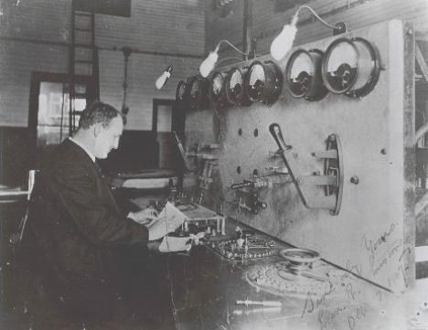

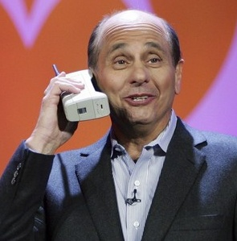

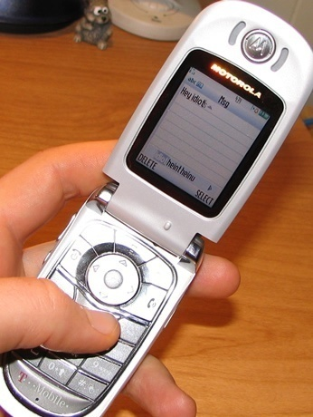
Mobile Communication Development
A market needs both technology and application
From texts …
to voice …
to data and everything

Slide 5
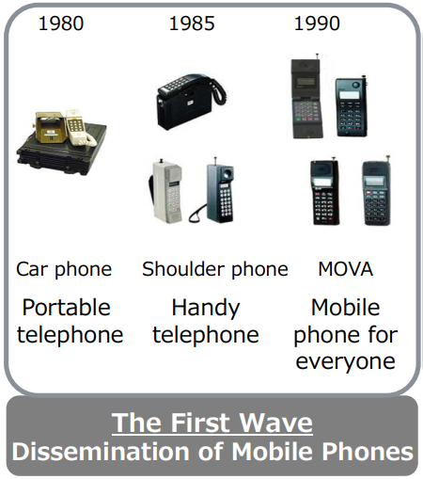
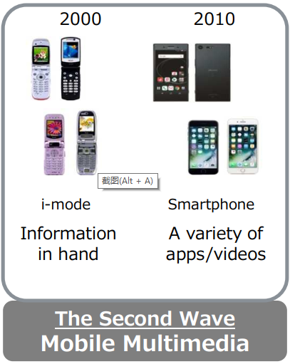

Standardization Facilitates Technology Evolution
Each new evolution builds on the established market of the previous
1G
2G
3G
4G
5G
6G

Slide 6
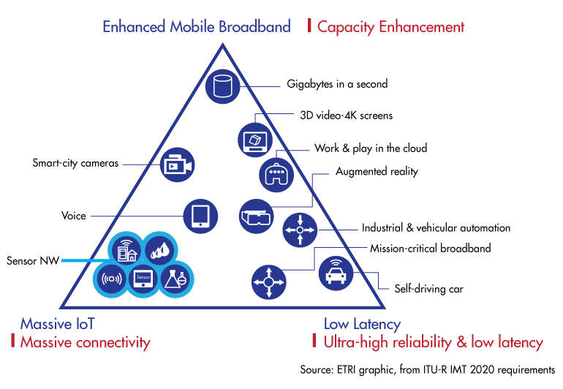
Three Use Cases and KPI in 5G
Capacity Enhancement
eMBB
Capacity Enhancement
eMBB (Gbps)
mMTC
Massive Connectivity
mMTC
Massive Connectivity
(1M/km²)
uRLLC
Ultra-high Reliability & Low Latency
uRLLC
Ultra-high Reliability & Low Latency (1ms)

Slide 7

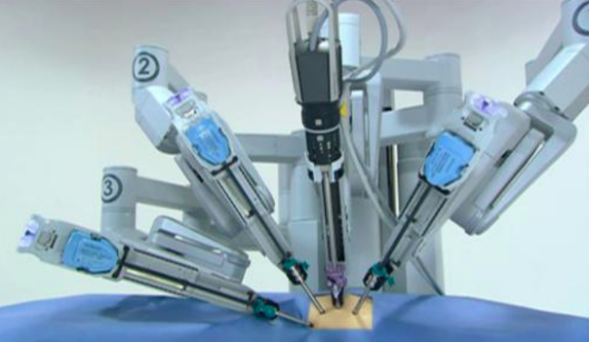


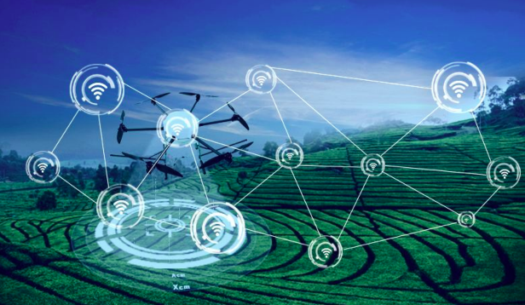
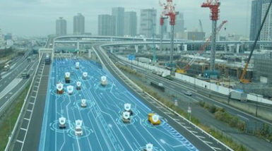
Typical Applications in 5G
Autonomous Driving
VR/AR
Industry IoT
AR for surgery
Auto-manufactoring
Assisted driving
VR for education
UAV transmissions
Smart coordination

Slide 8


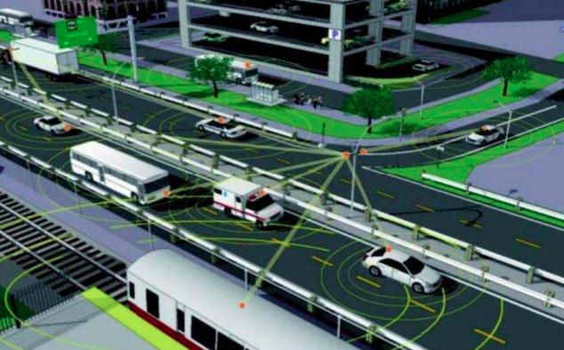

Vision in 6G Era: Enabling Ubiquitous Intelligent Information Network
Higher data rates
Larger coverage
Lower access latency
Smarter devices
Notes:
除了线上模式，在物理世界，主要通过物联网的方式
物联网：通过传感器的感知，将物理世界信息上网，形成物联网
跨学科的研究！！！

Slide 9

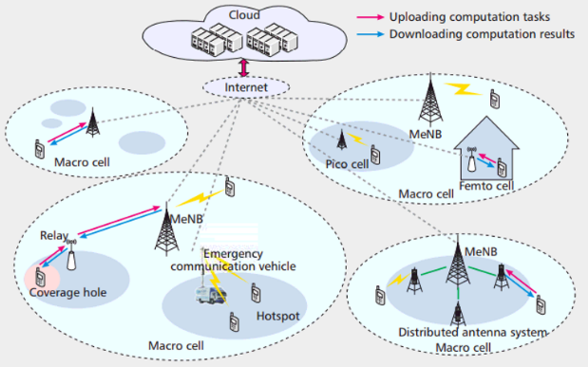
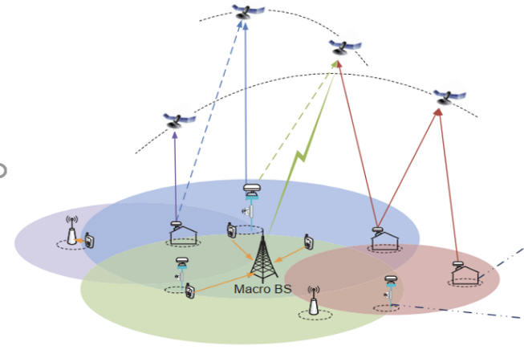

Vision in 6G Era: Enabling Ubiquitous Intelligent Information Network
New Multimedia: holographic display
New Interface: heterogeneous radio access
New Architecture: integrated terrestrial and aerial networks
New Fusion: communication, computing, control, sensing
Notes:
除了线上模式，在物理世界，主要通过物联网的方式
物联网：通过传感器的感知，将物理世界信息上网，形成物联网
跨学科的研究！！！

Slide 10
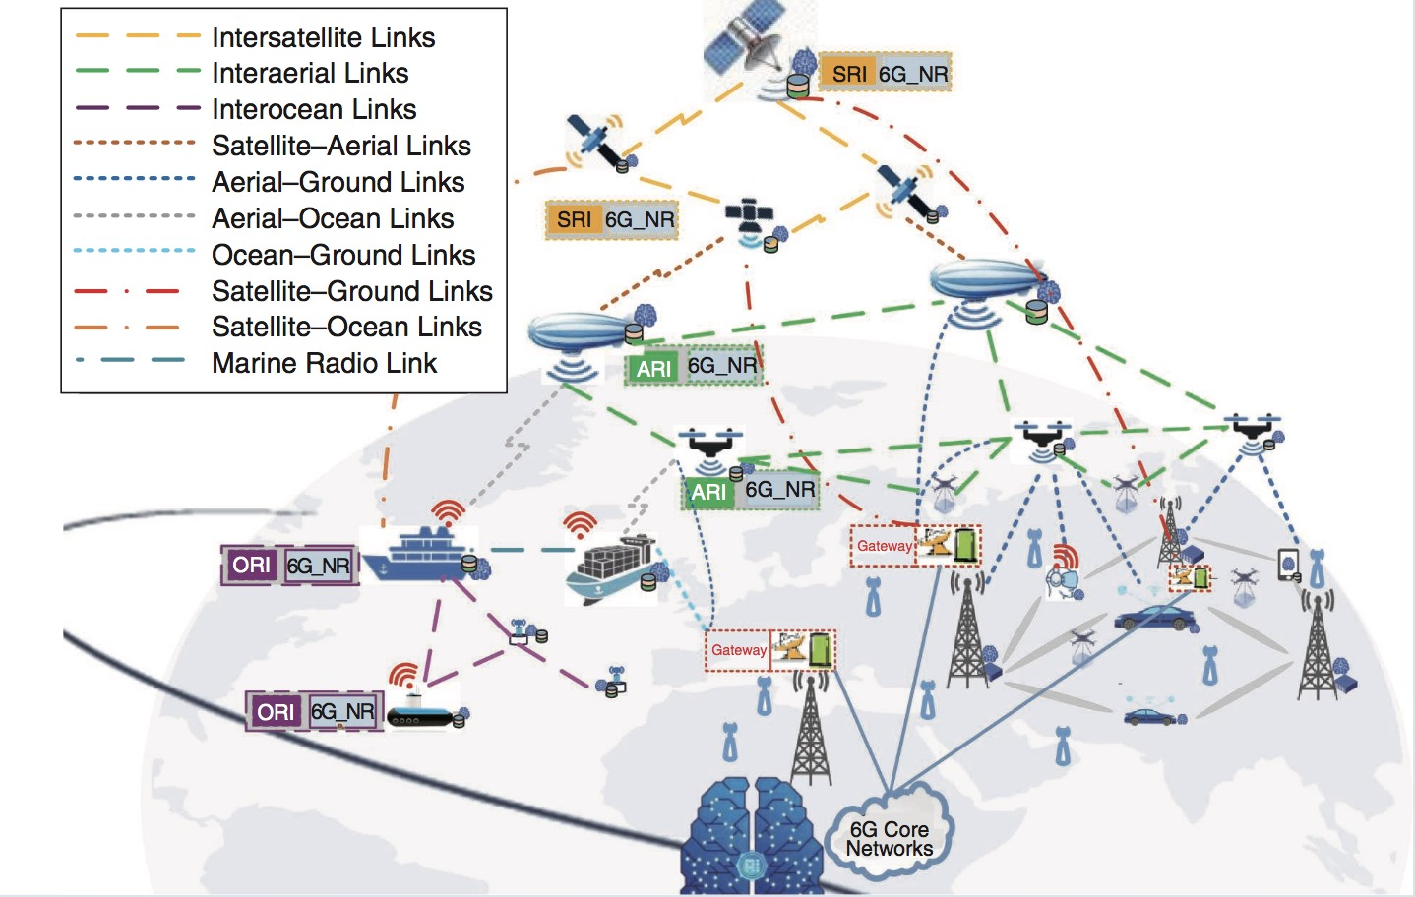
Aerial Access Network is Everywhere
Stretching from the future 6G vision…
Source: Z. Zhang, Y. Xiao, Z. Ma, M. Xiao, Z. Ding, X. Lei, G. K. Karagiannidis, and P. Fan, “6G wireless networks: Vision, requirements, architecture, and key technologies,” IEEE Veh. Technol. Mag., vol. 14, no. 3, pp. 28–41, Sep. 2019.

Slide 11
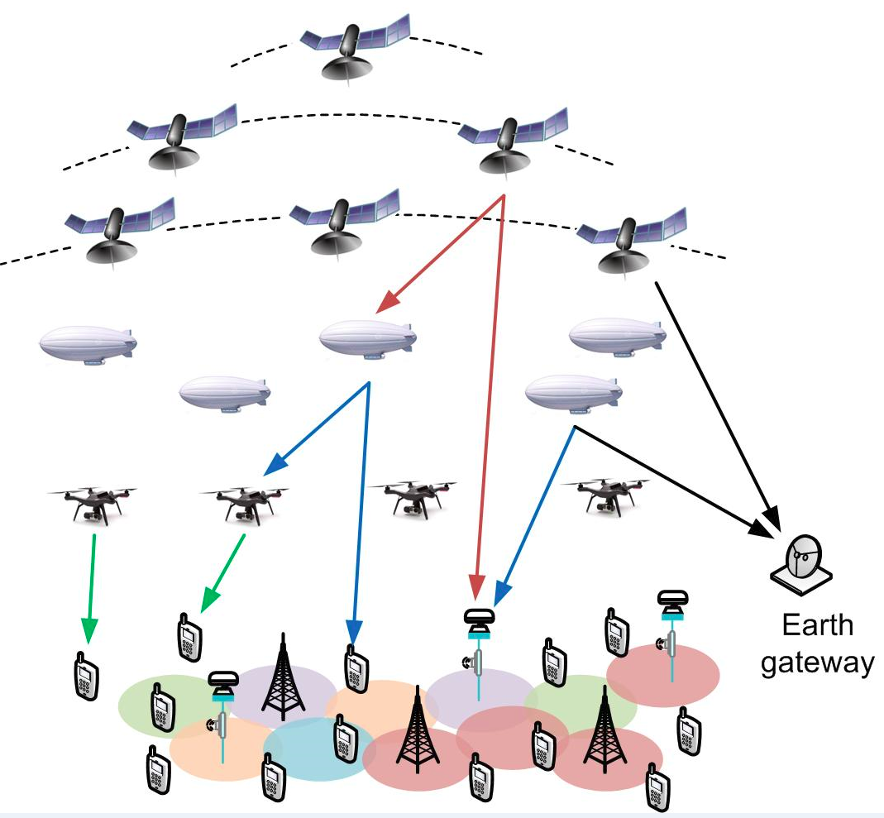
What is Aerial Access Network?
An integrated network consisting of aerial vehicles and satellites
UAV
High-altitude platform
Satellite
(belong to AAN in a
generalized sense)
Terrestrial terminal
(handhold device or
access point)
Gateway (to core network)

Slide 12
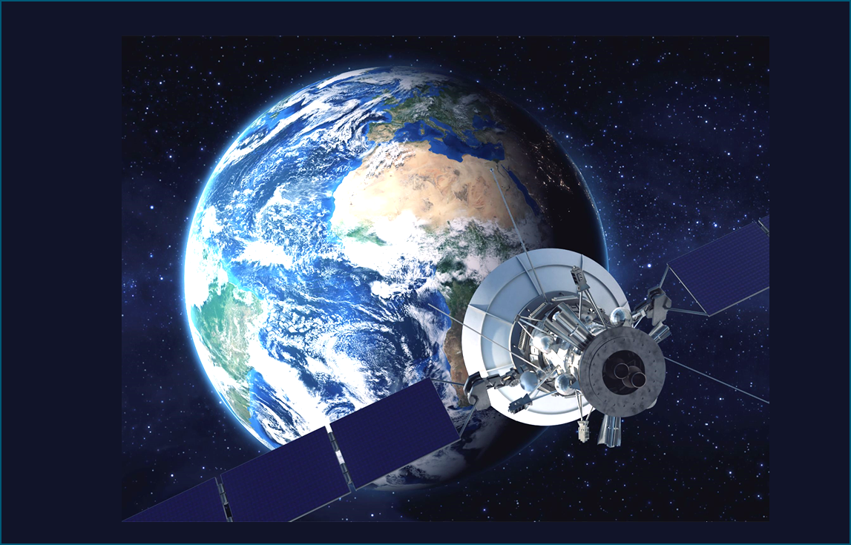
Roles of AAN in 6G
Extended Coverage
1
Provide data services in un-served areas that cannot be covered by terrestrial cellular network and underserved areas
2
Improved User Experience
Reinforce the 6G service reliability by providing service continuity for M2M/IoT devices or on board moving platforms
3
Multicast & Broadcast
Enable 6G network scalability for data delivery towards the network edges or even user terminal
Notes:
在地面5G网络无法覆盖的偏远地区、飞机上或者远洋舰艇上，卫星可以提供经济可靠的网络服务，将网络延伸到地面网络无法到达的地方。
● 卫星可以为物联网设备以及飞机、轮船、火车、汽车等移动载体用户提供连续不间断的网络连接，卫星与5G融合后，可以大幅度增强5G系统在这方面的服务能力。
● 卫星优越的广播/多播能力可以为网络边缘及用户终端提供高效的数据分发服务。

Slide 13
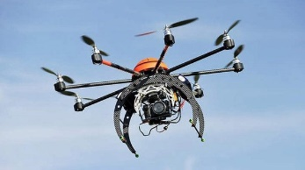
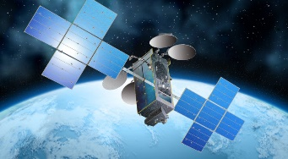

Vehicle Classification
 | UAV | HAPS | Satellite
Height | 600m-18km | 17-22 km | >160km
Time duration | Minutes to hours | hours to months | Years
Coverage | Small and changing | Medium and fixed | Large and periodic
Energy | Lithium battery | Solar panel, battery | Solar panel, battery
Controller | Ground and HAP | Satellite and ground | Ground
Applications | Sensing Communication Surveillance | Real-time monitoring Communication relay Emergency recovery Rocket launch platform | Communication Observation Navigation Weather Astronomy
Notes:
Differences between high-altitude UAV and HAP are insignificant

Slide 14
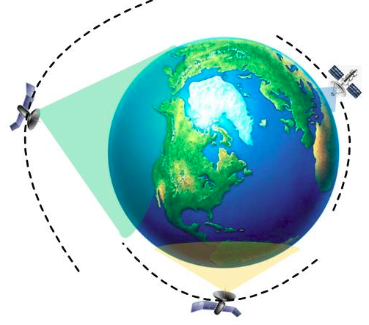
Three Types of Satellites
MEO (medium earth orbit)
Height: 8000km~18000km
Orbital period: 5-10 hours
Propagation delay: 50ms.
Visible time: a few hours.
Mobile data services
LEO (low earth orbit)
Height: 500~1,500km
Orbital period: 1.5~2 hours
Propagation delay: < 10ms
Doppler effect
Visible time: 20 minutes.
Link loss: small
Transmission power: low
Mobile data services and
broadband multimedia
GEO (geostationary earth orbit)
Height: 36,000 km
Orbital period: 24 hours.
Propagation delay: 250ms.
The coverage area is stable.
Fixed satellite services and TV broadcast
(GEO to earth station)
13

Slide 15


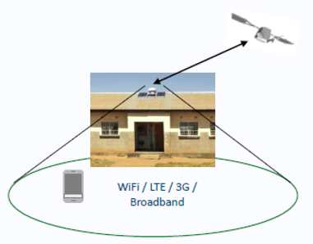
Gateway and Terrestrial Terminals
Earth Gateway Station
  Control and signal processing
  Connect to core network
  Antenna aperture: 5 – 30 m
  Limited number of stations
Very Small Aperture Terminal (VSAT)
  Also known as: satellite/HAP-terrestrial terminal or user terminal
  Support 4G, 3G and WiFi
  Receive from satellites (high-frequency)
  Phase array antennas
14

Slide 16
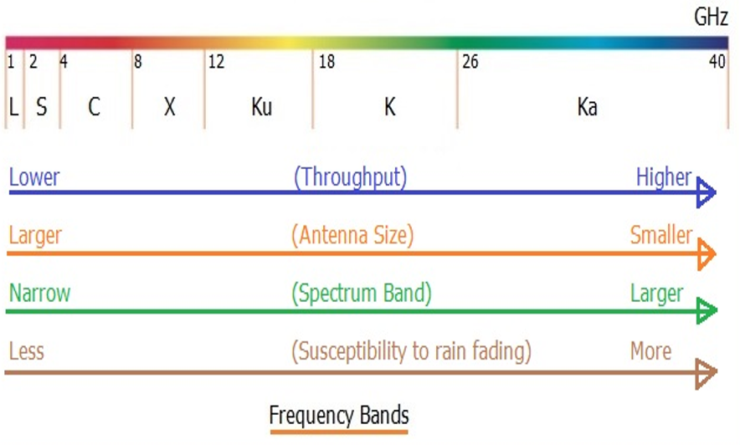
Frequency Band
UAV-to-X
HAP-to-user/ground
Satellite-to-gateway/user
VSAT-to-HAP/satellite
UAV-to-HAP
Satellite-to-gateway
(Downlink: 20GHz
Uplink: 30GHz)
GPS
Satellite TV
Radar
Broadcast satellite
15

Slide 17
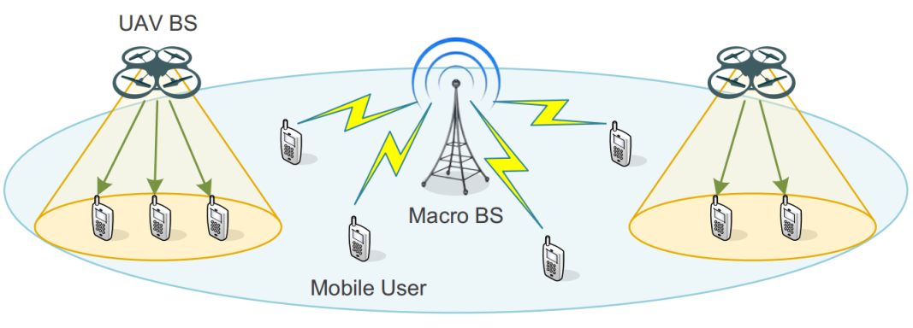
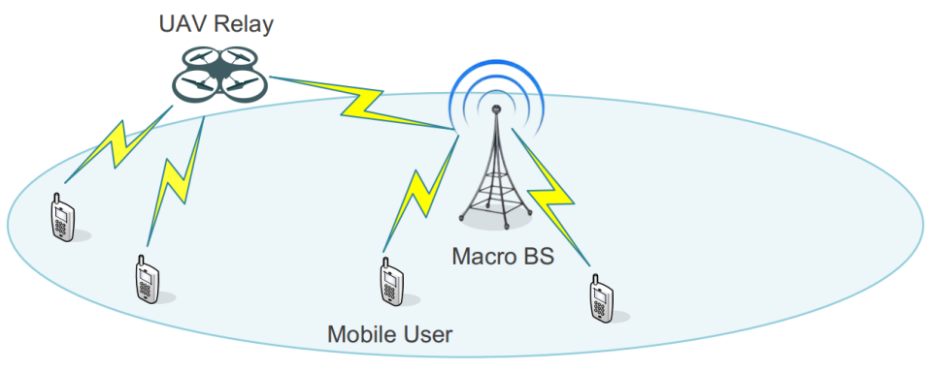
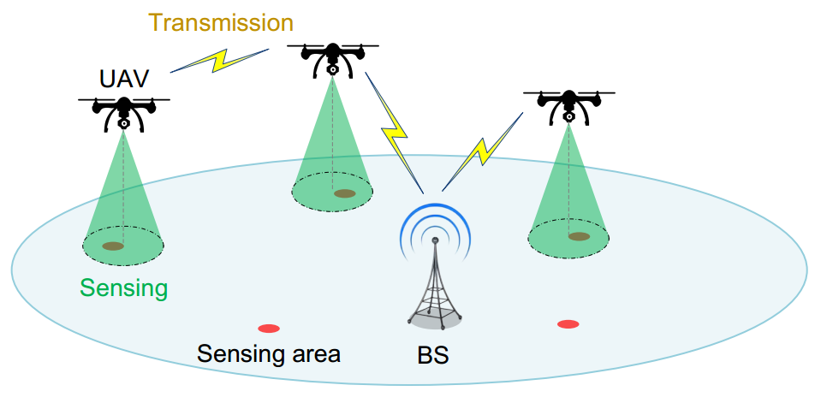
Cellular UAV Applications
UAV working as Flying Infrastructure
UAV base station: data offloading;
emergency communications
UAV relay: coverage extension; QoS improvement
UAV working as Aerial User
  Larger coverage
  More reliable and flexible
Cellular Internet of UAVs: ULLHR

Slide 18
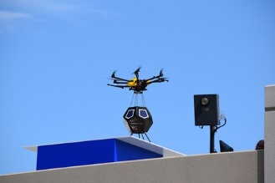

Existing UAV Projects
Nokia’s flying-cell (F-Cell)
  Backhaul via massive MIMO supporting 8 F-cells
Facebook’s Aquila
  UAVs with solar panels sent 18-27km into the stratosphere
  To provide widespread Internet coverage (40-80 square kilometers)
Nokia’s F-Cell
Facebook’s Aquila

Slide 19
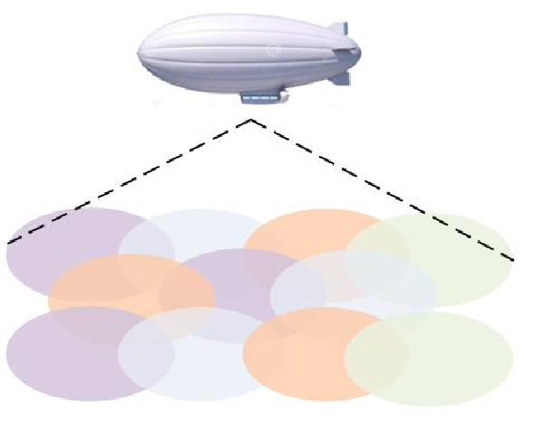
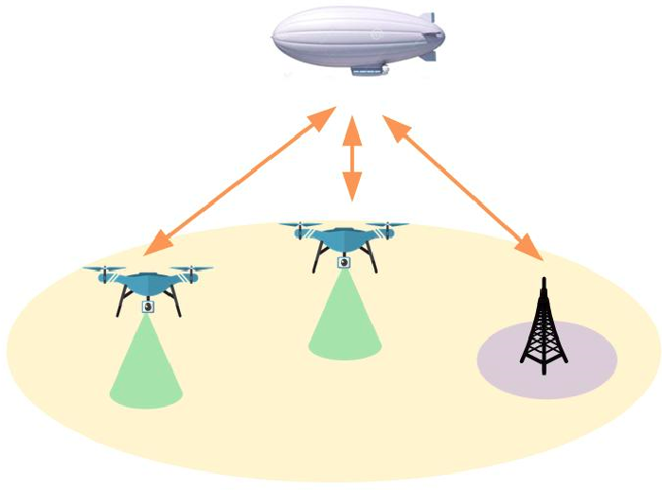
HAP Applications
HAP working as flying infrastructure
Users either offloaded from terrestrial BS or solely served by HAP systems
HAP working as backhaul
Provide backhaul links for UAV/BS and coordinate multiple UAVs

Slide 20
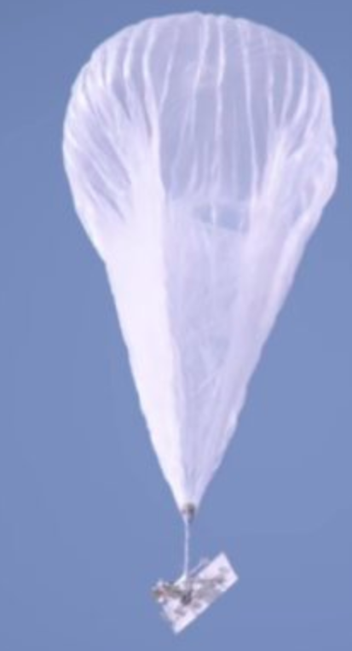
Existing HAP Projects
Airbus’ Zephyr
  Extended from Facebook’s Aquila
  Pseudo satellite (21km) and/or access point
  Replace some spy or Earth-observing satellites
  Working Period: 90 days (solar powered)
Google Balloon: Project Loon
  Floating access point
  Extend connectivity to under developed areas
  Altitude: 18 – 25 km

Slide 21
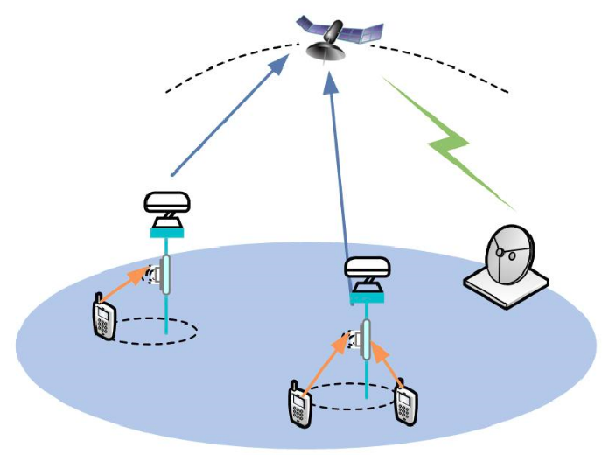
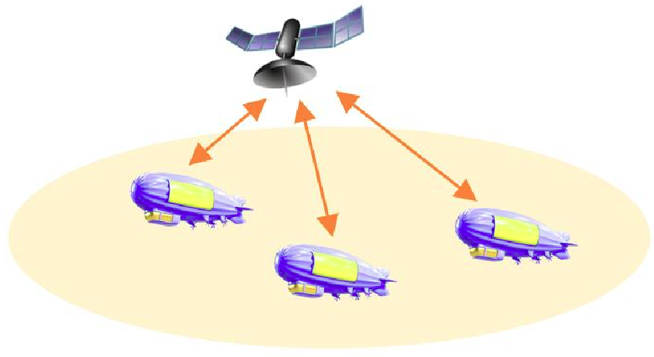
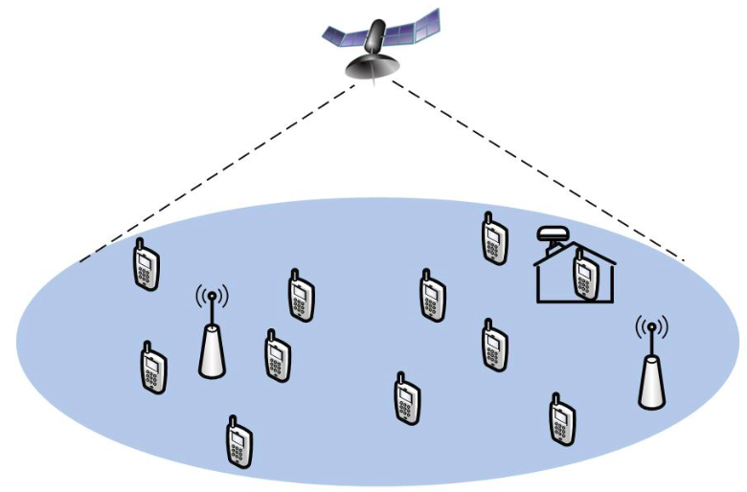
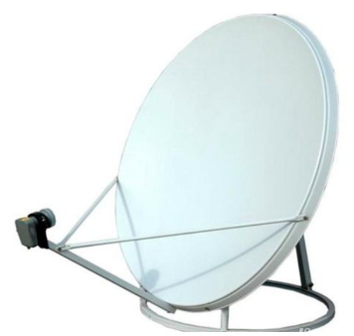
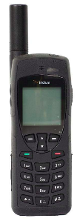
Satellite Applications
Satellite working as backhaul/coordinator
Ka-band
Backhaul
Coordination
Satellite working as remote BS for broadcast/multicast
Below 6GHz
Direct satellite-to-user/terminal links

Slide 22
Ultra-dense Topology Evolution
Current Dilemma
  Seamless coverage v.s. low propagation delay
  For each satellite, long propagation distance leads to degraded spatial diversity due to highly correlated channels
Ultra-dense LEO Satellite Constellation
  Coverage extension via hundreds of satellites
  Spatial diversity can be obtained by satellite coordination
  Backhaul capacity improvement
Notes:
However, there are two issues in current satellite communications. One is the contradiction between . That is, a satellite can cover … In current network, the number of.. Is very limited. To solve these dilemmas, … is proposed. Namely,

Slide 23
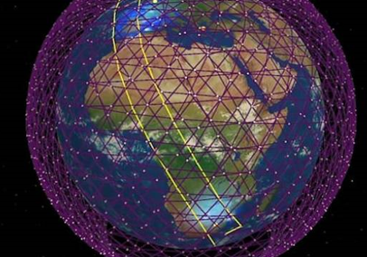
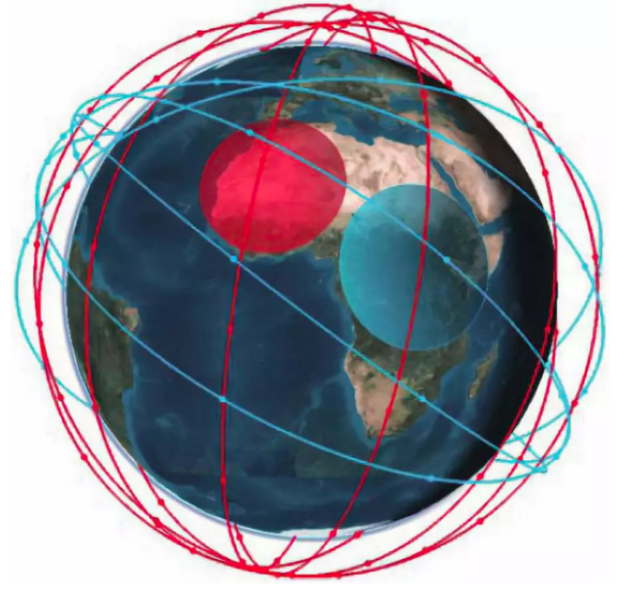
Existing Satellite Projects
SpaceX StarLink Plan
422 satellites launched already
(more on the way)
Weighting 227kg each LEO satellite
Backhaul
TeleSat
117 satellites
Low elevation angles
Two types of orbits:
coverage and hotspot

Slide 24
A2G Channel Models
 | Below 6GHz | Above 6GHz
Rain attenuation | No | Yes
Fast fading | Frequency-selective | Flat
LoS-dominated | Yes (LoS probability varies with elevation angle)
Transmit Noise level | Satellite/HAP: -203dBm
 | UAV: -90dBm
Antenna radio pattern | Small roll-off factor | Large roll-off factor (narrow beam, faster decay with distance)
Channel Model | Rician channel model (Different elevation angles, rain attenuation factors, antenna gain, shadowing)

Slide 25
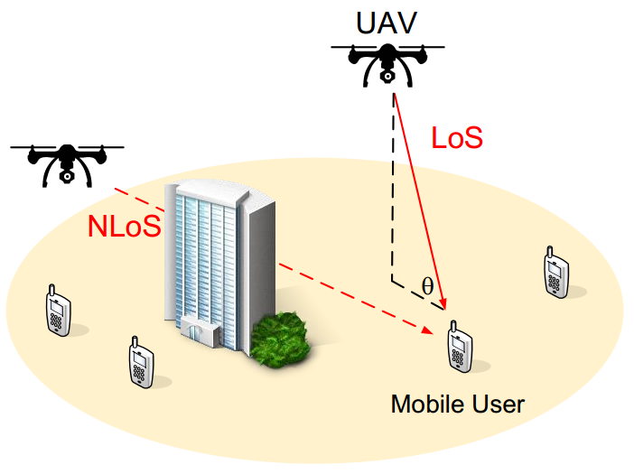
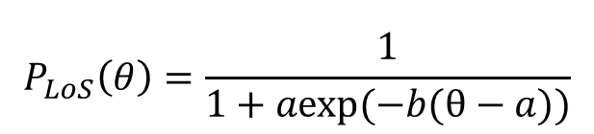
Typical A2G Model below 6GHz
Different from ground communication
  Altitudes and elevation angles
Probability path loss model [1]
  LoS and NLoS with different probabilities of occurrence
    Propagation environment
    and elevation angels
Small-scale fading: Rican
Probability of LoS
$$P_{LoS}\left(θ\right)=\frac{1}{1+aexp(−b(θ−a))}$$
elevation angle
[1] A. Al-Hourani, S. Kandeepan, and S. Lardner, “Optimal LAP altitude for maximum coverage,” IEEE Wireless Commun. Lett., vol. 3, no. 6, pp. 569-572, Dec. 2014.

Slide 26
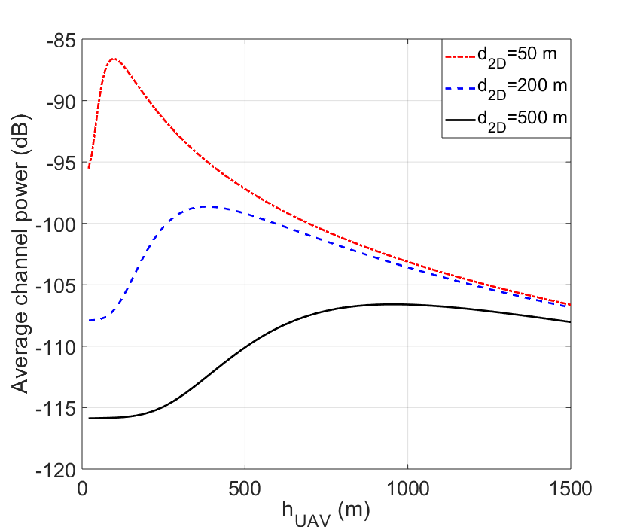
Performance Analysis: Channel Models
Notations
  d_{2D}: horizontal distance between the UAV and the user
  h_{UAV}: the altitude of the UAV
As the UAV altitude grows
  Expected channel power increases first because the probability of LoS increases
  Expected channel power then decreases because the transmission distance increases
Notes:
We take UAV transmission as an example to evaluate the performance given this channel model. From this figure, we observe that as the UAV … This indicates that there exists an optimal altitude for UAV transmission.

Slide 27
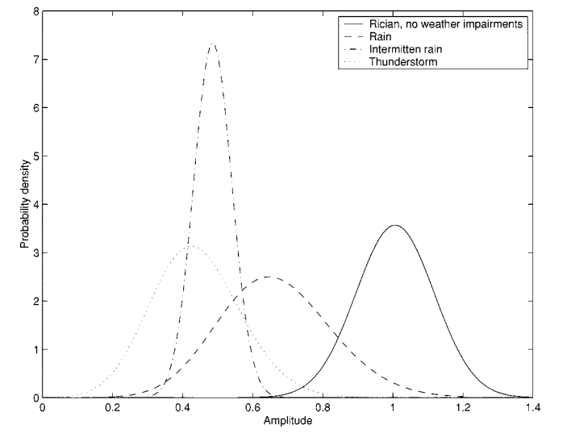
Typical A2G Model above 6GHz
Probability path loss model based on Loo distribution
  LoS (with shadowing) + NLoS (no shadowing) + rain attenuation
Log-normal
Rayleigh
Satellites and HAP
Rain attenuation degrades received signal strength
Source: Wenzhen Li, Choi Look Law, V. K. Dubey, and J. T. Ong, “Ka-Band Land Mobile Satellite Channel Model Incorporating Weather Effects,” IEEE Commun. Lett., 2001.

Slide 28


Typical A2G Model above 6GHz
Probability path loss model based on Loo distribution
  LoS (with shadowing) + NLoS (no shadowing) + rain attenuation
Log-normal
Rayleigh
Difference between HAP/satellite and UAV/terrestrial systems
Aerial channel estimation: only one path -> one angle of departure
angular spread
zero spread

Slide 29

A2A Channel Models
Inter-satellite/HAP, satellite-to-HAP
  Above thermosphere layer: Free-space optics
  Source of propagation loss
Free-space path loss (distance-related) + AWGN
Turbulence from environment: lognormal or Rayleigh
Geometrical loss: related to divergence angle of Tx, θ
radius of Rx’s aperture r, distance l
UAV-to-X
  A2G channel model

Slide 30








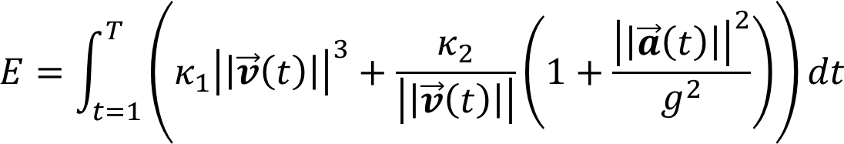
UAV: Mobility and Propulsion Energy
The trajectory of a UAV is a line segment in two successive time slots
Define as the 3D location of the UAV, where the
  velocity
  accelerated velocity
  propulsion energy (velocity is larger than a threshold) [2]
[2] G. J. Leishman, Principles of Helicopter Aerodynamics. Cambridge, U.K.: Cambridge Univ. Press, 2006, pp. 159–193.

Slide 31
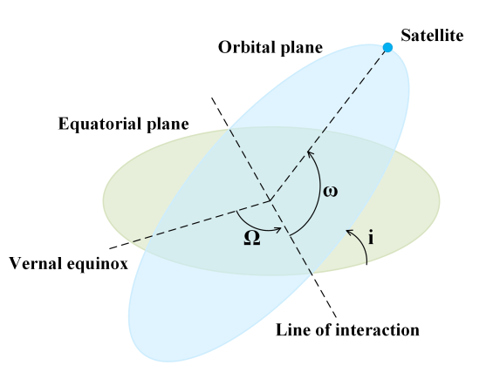
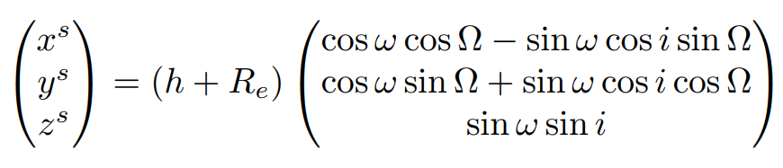


Satellites: Mobility and Coordinate Systems
Trajectory of satellites is pre-planned
Coordinate of each satellite
Radius of Earth
Orbit period divided into T slots
  Coordinate of each satellite on orbit n
  in slot t can be calculated by

Slide 32
AAN and Terrestrial Networks
 | Objects | One-way delay | Coverage | Advantage | Disadvantage
Space | GEO MEO LEO | 270 ms 110 ms ≤ 40 ms | Serval thousands of km | Large coverage; Broadcast; LEO link budget: 50Mbps+ | High propagation delay; Affected by rain attenuation;
Air | HAP UAV | medium | Tens of km | Wide coverage; Low cost; Flexible deployment | Limited capacity of UAVs; Unstable links; High mobility
Terrestrial | Cellular Ad hoc WLAN | Neglectable | 4G: 1~3 km 5G: 100~300 m | Rich sources; High throughput | Limited coverage; Vulnerable to infrastructure failure

Slide 33
Research Challenges
Integration of AAN and terrestrial networks
  Optimization
  Scheduling and Radio Resource Management
  Trajectory Design
  Co-channel Interference cancelation
  Distributed Learning Algorithms
  Protocol Design
  Self-organizing Networks (SON)
  Routing and Handover
  Spectrum-leasing Issues
  Network Deployment and Analysis
  Constellation Design
  Capacity and outage analysis

Slide 34
Table of Contents
Background
  6G Communications and Requirements
  AAN Architecture and Physical-layer Characteristics
Mathematical Tools
  Optimization Theory
  Game Theory
Cellular Internet of UAVs and Applications
  UAV serving as Infrastructure
  UAV serving as Aerial User
HAPS for Wireless Communications
  Cooperative HAPS and Terrestrial Networks
Satellite Networks
  Integration of Ultra-dense LEO and Terrestrial Base Station
Integrating Aerial Access Networks with Terrestrial Networks

Slide 35
Optimization Theory
Convex Set and Convex Functions
Gradient Descent and Newton’s Method
Duality and KKT Condition

Slide 36
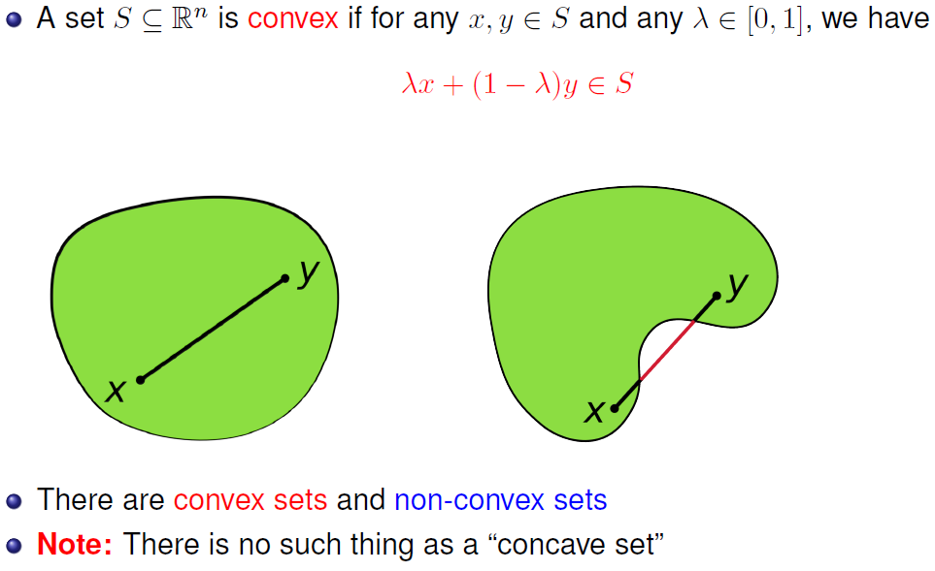
Convex Set

Slide 37
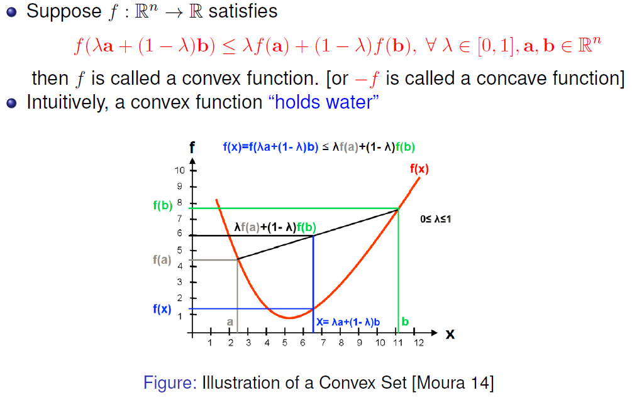
Convex Function

Slide 38
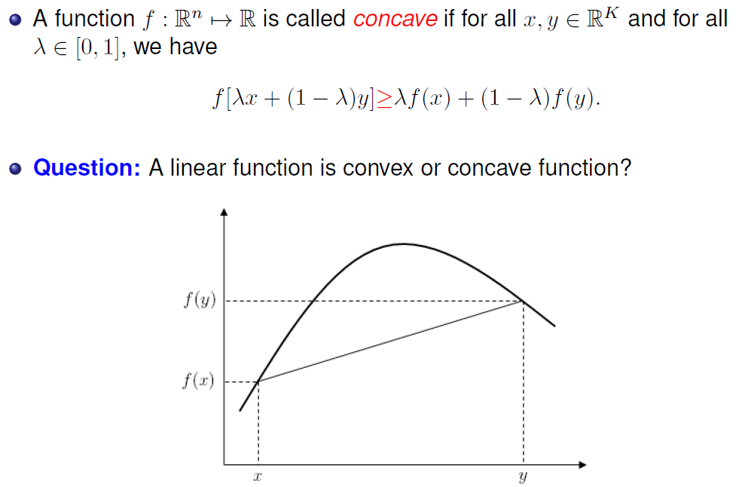
Concave Function

Slide 39
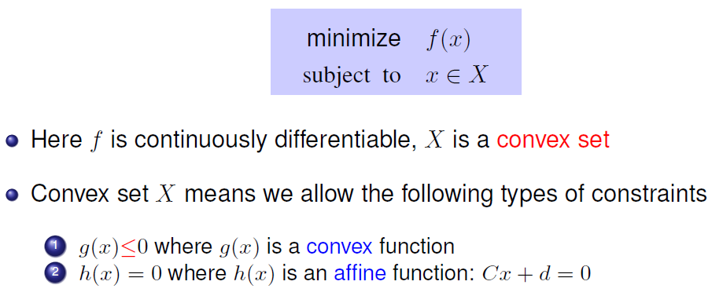
Convex Optimization
Convex means local minimum = global minimum

Slide 40
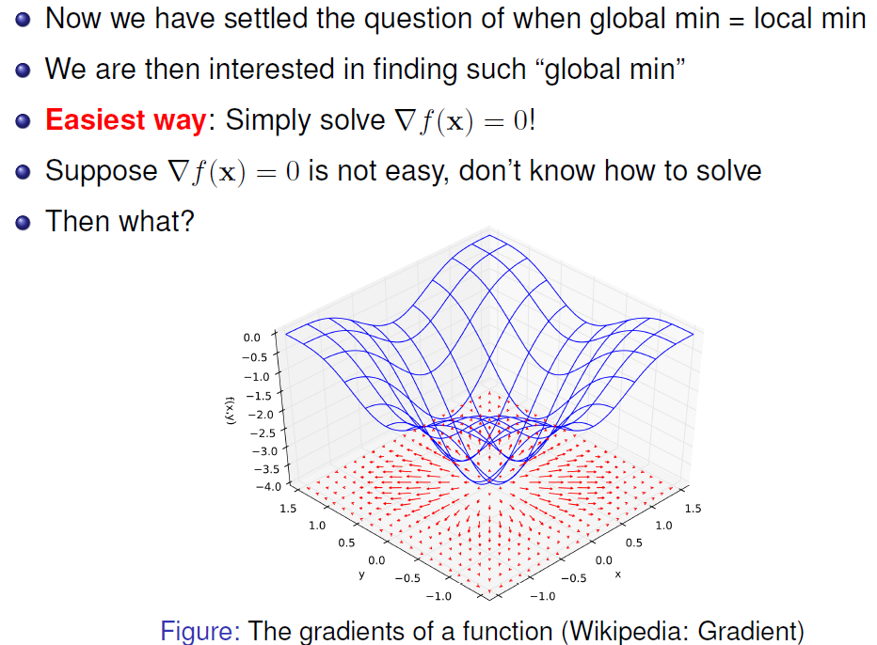
Algorithms to Find Optimum

Slide 41
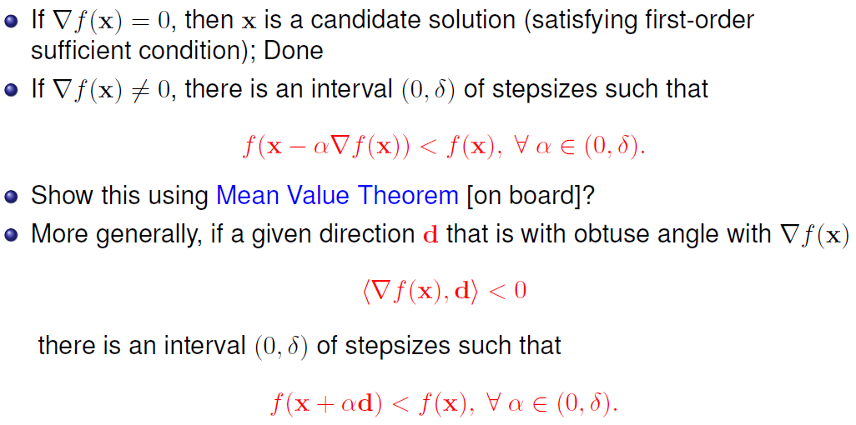
Gradient Descent Method
Notes:
Check what is mean value theorem

Slide 42
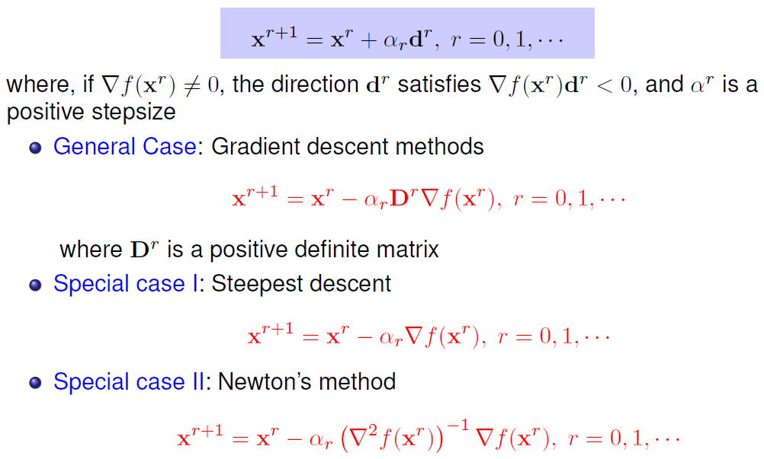
Iterative Descent Method
Step size needs to be adaptive

Slide 43
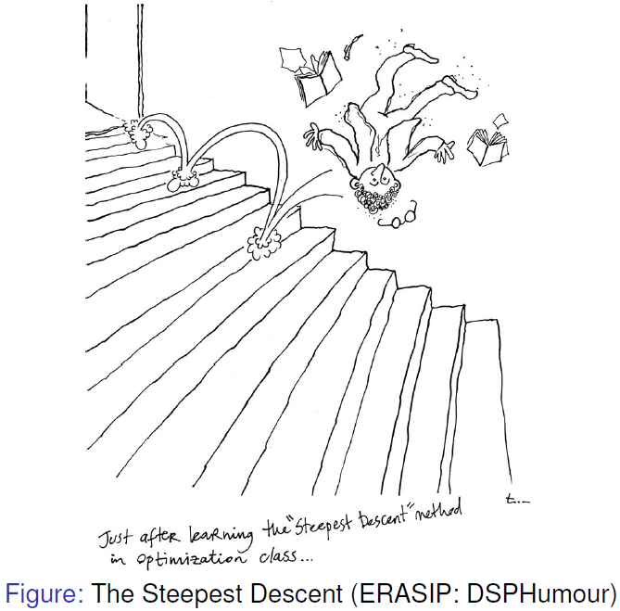
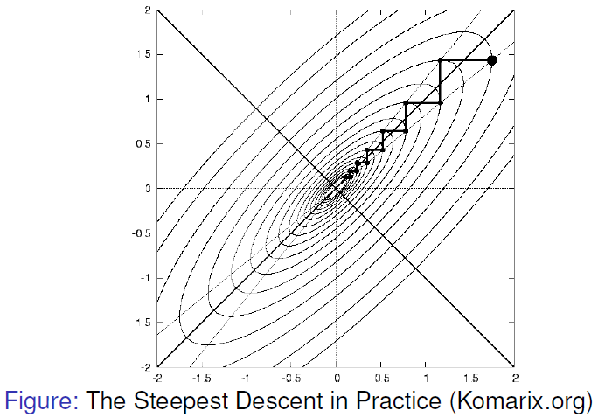
Shortcoming of Gradient Method
However, in practice steepest descent may have slow convergence

Slide 44


Newton’s Method

Slide 45


Lagrangian Multiplier

Slide 46


Duality

Slide 47

Duality
Notes:
Slater’s condition, what is h and what is g

Slide 48

KKT Condition: When to Stop?
Draw a figure on the board
Notes:
Use board to explain

Slide 49

Barrier Function

Slide 50


Interior Point Method

Slide 51
Game Theory
Overview of Game Theory
Matching Theory
Mean Field Game

Slide 52
Introduction
Game theory - mathematical models and techniques developed in economics to analyze interactive decision processes, predict the outcomes of interactions, identify optimal strategies
Game theory techniques were adopted to solve many protocol design issues (e.g., resource allocation, power control, cooperation enforcement) in wireless networks.
Fundamental component of game theory is the notion of a game.
  A game is described by a set of rational players, the strategies associated with the players, and the payoffs for the players. A rational player has his own interest, and therefore, will act by choosing an available strategy to achieve his interest.
  A player is assumed to be able to evaluate exactly or probabilistically the outcome or payoff (usually measured by the utility) of the game which depends not only on his action but also on other players’ actions.

Slide 53

Examples: Rich Game Theoretical Approaches
Non-cooperative Static Game: play once
  Prisoner Dilemma
  Mandayam and Goodman (2001)
Repeated Game: play multiple times
  Threat of punishment by repeated game. MAD: Nobel prize 2005
  Tit-for-Tat (infocom 2003)
Dynamic game: (Basar’s book)
  ODE for state
  Optimization utility over time
  HJB and dynamic programming
  Evolutional game (Hossain and Dusit’s work)
Stochastic game (Altman’s work)
Cooperative Games
  Nash Bargaining Solution
  Coalitional Game
Prisoner Dilemma
Payoff: (user1, user2)

Slide 54
Games in Strategic (Normal) Form
A game in strategic (normal) form is represented by three elements:
  A set of players N
  Set of strategies of player S_{i}
  Set of payoffs (or payoff functions) U_{i}
Notation S_{i}: strategy of a player i while S_{-i} is the strategy profile of all other players.
Notice that one user’s utility is a function of both this user’s and others’ strategies.
A game is said to be one with complete information if all elements of the game are common knowledge. Otherwise, the game is said to be one with incomplete information, or an incomplete information game.

Slide 55

Nash Equilibrium
Dominant strategy is a player's best strategy, i.e., a strategy that yields the highest utility for the player regardless of what strategies the other players choose.
A Nash equilibrium is a strategy profile s* with the property that no player i can do better by choosing a strategy different from s*, given that every other player j ≠ i .
In other words, for each player i with payoff function u_{i}
No user can change its payoff by unilaterally changing its strategy, i.e., changing its strategy while s_{-i} is fixed

Slide 56
The price of Anarchy
Centralized system: In a centralized system, one seeks to find the social optimum (i.e., the best operating point of the system), given a global knowledge of the parameters. This point is in many respect efficient but often unfair
Decentralized: When the players act noncooperatively and are in competition, one operating point of interest is the Nash equilibrium. This point is often inefficient but stable from the players’ perspective.
The Price of Anarchy (PoA), defined as the ratio of the cost (or utility) function at equilibrium with respect to the social optimum case, measures the price of not having a central coordination in the system
PoA is, loosely, a measure of the loss incurred by having a distributed system!

Slide 57
Example: Prisoner’s Dilemma
Two suspects in a major crime held for interrogation in separate cells
  If they both stay quiet, each will be convicted with a minor offence and will spend 1 year in prison
  If one and only one of them finks, he will be freed and used as a witness against the other who will spend 4 years in prison
  If both of them fink, each will spend 3 years in prison
Components of the Prisoner’s dilemma
  Rational Players: the prisoners
  Strategies: Stay quiet (Q) or Fink (F)
  Solution: What is the Nash equilibrium?
Representation in Strategic Form

Slide 58



Example: Prisoner’s Dilemma
Price of Anarchy 3

Slide 59
Algorithms for Finding the NE
For a general N-player game, finding the set of NEs is not possible in polynomial time!
  Unless the game has a certain structure
Some existing algorithms
  Fictitious play (based on empirical probabilities)
  Iterative algorithms (converge for certain classes of games)
  Best response algorithms
    Popular in some games (continuous kernel games for example)
Useful Reference
  D. Fundenberg and D. Levine, The theory of learning in games, the MIT press, 1998.

Slide 60
Matching Theory
Everyone finds a date!
Unstable marriage!
How to design algorithm to prevent unstable results?

Slide 61

Definitions
In economics, matching theory, is a mathematical framework attempting to describe the formation of mutually beneficial relationships over time.
Matching theory in graph:
  Let 𝐺=(𝑉,𝐸) be an undirected graph, where 𝒏=|𝑽 | and 𝒎=|𝑬|;
  A set 𝑀 $⊆$𝐸 is called a matching in G;

Slide 62
Definitions
Basic elements (Stable Marriage):
  Agents: A set of men, and a set of women;
  Preference list: A sorted list of men/women based on her/his preferences;
  Blocking pair (BP) (m,w):
    1). m is unassigned or prefers w to his current partner;
    2). w is unassigned or prefers m to her current partner;
  Stable matching: A matching admit no BPs.
  Gale-Shapley Algorithm: find a stable matching in SM.

Slide 63
Classification 1
One-to-one:
  Stable roommate (SR);
  Stable marriage (SM);
Many-to-one:
  House allocation
  Student admission
Many-to-many
  Worker-Firm (WF)
  Assign paper to reviewer

Slide 64
Classification 2
Matching without external effect:
  The preferences only depend on the identity of their partners
  E.g. Hospital resident problem
Matching with external effect:
  The preferences depend on other agents’ actions
  E.g. multiple users share the same resource band
  Solution: post-matching swap

Slide 65

The House Allocation (HA) problem
Basics:
  A set of applicants and a set of houses
  Houses have capacity limitations
Optimality:
  Pareto optimal
    No applicant can be better off without requiring another one to be worse off
  Popular
    A matching is popular if there’s no other matching that is preferred by the majority of the applicants
  Profile-based optimal
    Satisfy certain condition of agents’ rankings of their partners

Slide 66
HA variant: Reviewer assignment problem

Slide 67
HA & Its Variants
  Reviewer assignment problem (RA)：
  Assignment considerations
    Reviewers’ interest and expertise
    Conflict of interest
    Coverage
    Load balancing
  Solution Techniques
    Heuristics, approximation algorithms, integer programming, polynomial-time algorithms and strategy-proof mechanisms;
  Leximin optimal matching
    Maximize the profile of the worst-off reviewer;
    Fairness.

Slide 68
Wireless-Oriented Matching
Modeling:
  Users, resources: agents;
  System QoS requirements: preference lists;
  System objectives: stability, popularity, Pareto optimality…
  Solutions: distributed, low-complexity algorithms.
Advantages:
  Game theory:
    don’t require other players’ actions;
    two-sided stability;
    Not necessarily utility function needed;
  Centralized optimization: Distributive and fast deployment.

Slide 69
Example: Social Caching in Small Cells
Many-to-many matching between videos and SBSs
Preference: Delay, Popularity
Modified GS
  Pairwise stability (not blocked by individual nor pairs)
Hamidouche, K.; Saad, W.; Debbah, M., "Many-to-many matching games for proactive social-caching in wireless small cell networks," in Modeling and Optimization in Mobile, Ad Hoc, and Wireless Networks (WiOpt), 2014 12th International Symposium on , vol., no., pp.569-574, 12-16 May 2014

Slide 70
Mean Field Games
MFGs study the existence of Nash equilibria in games involving a large number of asymptotically negligible agents modeled by controlled stochastic dynamical systems.
MFGs refer to methods and techniques that study differential games with large population of indistinguishable, rational, and heterogeneous agents
  Indistinguishable - agents share common structure of the model
  Rationality - agents act optimally (maximize utility / minimize cost)
  Heterogeneity – agents can have heterogeneous states
MFGs reduce to a standard control problem and an equilibrium.
Methodologies to solve a MFG
  Dynamic programming -> leads to HJB/FPK pair
  Stochastic maximum principle -> for mean field games

Slide 71

Classical Game vs Mean Field Game
In classical game theory, a fish reacts to what other fishes nearby do.
In mean-field game theory, each fish does not care about each of the other fishes. Rather, it cares about how the fishes nearby, as a mass, globally move. In other words, each fish reacts only to the mass.

Slide 72

Mean Field Game vs Optimal Control

Slide 73





Example: Highway Driving
Consider the state of the highway (location of vehicles) and its evolution with time.
The driver’s goal is to minimize its driving cost by controlling driving speed .
Optimize based on other drivers’ control
Optimize based on distribution

Slide 74


MFG HJB-FPK Solutions: Summary
HJB equation governs the computation of the optimal path of control of the player.
FPK equation governs the evolution of the mean field function of players.

Slide 75

EX1: Dense Drone Small Cell Networks
Integrating drones to overloaded terrestrial networks may offer benefits by offloading traffic, reducing handovers for highly mobile users.
However, such performance enhancement is largely limited by mutual interference and energy availability in dense drone networks.
The interference control problem can be mapped to an altitude control problem. Using Mean-Field Game to obtain the optimal altitude control strategy.

Slide 76

EX2: Wireless Powered Internet of Things
In wireless powered IoT (WP-IoT) networks, there exists severe interference greatly reducing the energy transmission efficiency.
The interference mitigation problem in a WP-IoT can be modeled as a MFG, taking the sensor nodes’ energy and the mutual interference among the sensors into consideration.

Slide 77

EX3: NOMA-Based UAV Networks
Non-orthogonal Multiple Access (NOMA)-based interference mitigation problem
In MFG with dominator, there exists at least one interference dominator, which should not be aggregated in the interference mean field.

Slide 78
EX4: Multi-UAV Emergency Communication Systems
In emergency communication system, a large number of UAVs replace damaged base stations for air-to-ground service, with dense users and wide areas.
A flight strategy of multi-UAVs is solved by a discrete time MFG, which consider the number of users covered by each UAV.
Meanwhile the MFG model also concludes the energy consumption and User's mobility.

Slide 79

EX5: Multi-UAV Wireless Communication Systems
The D2D communication system with Ultra-dense UAVs and ground users.
The power control is modeled as a Discrete-Time Mean Field Game system.
Meanwhile, the system concludes the interference from other D2D pairs and the energy constraint.

Slide 80
Table of Contents
Background
  6G Communications and Requirements
  AAN Architecture and Physical-layer Characteristics
Mathematical Tools
  Optimization Theory
  Game Theory
Cellular Internet of UAVs and Applications
  UAV serving as Infrastructure
  UAV serving as Aerial User
HAPS for Wireless Communications
  Cooperative HAPS and Terrestrial Networks
Satellite Networks
  Integration of Ultra-dense LEO and Terrestrial Base Station
Integrating Aerial Access Networks with Terrestrial Networks

Slide 81

Infrastructure: Base Station
UAVs as base stations -- Low operational cost
  Capacity enhancement
  Data offloading
  Emergency communications

Slide 82

Infrastructure: Relay Station
UAVs as relays -- Flexible deployment
  Coverage extension
  Data aggregation
  Backhauling

Slide 83

Performance Analysis: UAV BS
UAV BS
  The received SNR should be larger than a threshold (0 dB)
  Only consider the pathloss
Remarks
  The UAV cell radius increases with the transmit power
  The radius increases first and then decreases as the altitude of UAV increases
The radius will be 0 when the altitude of the UAV is larger than a threshold due to the large pathloss

Slide 84

Performance Analysis: UAV Relay
UAV Relay
  AF relay
  Distance from user to BS: 165 m
  Data rate is defined as the minimum one
Remarks
  The data rate increases with the altitude of the UAV
  The data rate increases first and then decreases as the distance from the BS increases
The influence is more significant when the UAV altitude is moderate

Slide 85
Research Challenges
Objective
  Guarantee communication quality
Communication
  Frequency allocation
    Interference avoidance, user scheduling
  Power control
    Transmission
Control
  3-dimensional trajectory design/UAV placement
    Trade-off between coverage and data rate

Slide 86
Case Study I: UAV Relay Station
Power and Trajectory Optimization for UAV Relay Networks
[6] S. Zhang, et al., “Power and Trajectory Optimization for UAV Relay Networks,” IEEE Commun. Lett., vol. 22, no. 1, pp. 161-164, Jan. 2018.

Slide 87
Motivation
Conventional relay nodes are fixed in location, and a wide coverage requires high operational cost
UAV relaying is promising due to the high mobility, flexible deployment, and low operational cost
Various topics on UAV relay have been discussed recently. However, most of them consider the location of UAV as a fixed point or on a fixed trajectory
We consider the UAV as a mobile node that is capable to move freely in the 3-dimensional space
The UAV relay adjusts its location and transmission power to minimize the uplink outage probability of a remote mobile device

Slide 88


System Model
System model
  One MD, one UAV, one BS
  Uplink network
  UAV works as a AF relay
    Time slot 1: MD → UAV
    Time slot 2: UAV → BS
      UAV 3D trajectory
Outage probability
  The probability that the SNR falls below a predetermined threshold
Notes:
In two consecutive time slots, the MD transmits signals to UAV in the first time slot, and the UAV amplifies and forwards the received signals from the MD to BS in the second time slot.

Slide 89



Problem Formulation
Minimize outage probability
Total power constraint
UAV speed constraint
Non-convex problem
Problem decomposition
  Trajectory optimization
Power optimization
Notes:
P_M^t: transmit power of MD in time slot t
P_U^t+1: transmit power of UAV relay in time slot t+1
d_M^t: distance between UAV and MD in time slot t
d_B^t+1: distance between UAV and BS in time slot t+1
d_t,t+1: UAV moving distance in time slot t

Slide 90






Trajectory and Power Optimization
Trajectory optimization
  is approximately convex with respect to and
  Gradient descent algorithm
  Set step size as
  Stop moving when the gradient of converges to 0
Power optimization
  The optimal solution satisfies
  The solution is mostly determined by
  An optimal solution can be derived
The method can also be applied to the DF relay [7]
[7] S. Zeng, et al, “UAV Relaying: Power Allocation and Trajectory Optimization using Decode-and-Forward Protocol”, in Proc. IEEE ICC WKHPS, Kansas City, USA, May 2018.

Slide 91
Simulation Results
The performance converges after about 1000 time slots
The proposed power and trajectory optimization algorithm reduces outage probability for about 23%
The performance between the proposed algorithm and exhaustive search is less than 5%
Large transmit power and short transmission distance reduce the outage probability

Slide 92

OFDMA UAV Relay Network
System Model
  OFDMA cellular network
  One BS, multiple users
  A UAV as the AF relay: improve the QoS of cell-edge users
  Different users use orthogonal subcarriers
Transmission Mode
  Cellular mode: Users transmit to the BS directly
  Relay mode: two phases
    User → UAV relay; UAV relay → BS
[8] S. Zeng, et al., “Trajectory Optimization and Resource Allocation for Multi-user OFDMA UAV Relay Networks,” in Proc. IEEE GLOBECOM, Waikoloa, HI, USA, Dec. 2019.

Slide 93

Problem Formulation
Objective
  Improve the sum rate and achieve the fairness among users
  Sum rate maximization based on proportional fairness scheduler
Problem Formulation
Total power constraint
Subcarrier allocation constraint
UAV speed constraint
QoS constraint

Slide 94
Problem Decomposition
Subchannel Allocation
  Given trajectory and power
  Transformed into a many-to-one matching with externalities
  Solved by swap matching algorithm
Trajectory Design
  Given power and subchannel allocation
  Transformed to a series of convex problems
  Solved by existing convex techniques
Power Allocation
  Given trajectory and subchannel allocation
  Transformed to a series of convex problems

Slide 95


Simulation Results
Proposed algorithm outperforms the cellular scheme and the random algorithm in terms of the sum rate
The users in the cell-edge cannot transmit in the cellular mode
The proposed algorithm can achieve a higher fairness than the cellular scheme
The fairness will increase with the maximum transmit power of users

Slide 96
Brief Summary
UAV trajectory
  Moves along the minus gradient of outage probability
  The stable location is collinear with BS and MD
UAV transmission power
  Larger power when UAV is closer to MD
  Lower power when UAV is closer to the BS
Extension: OFDMA UAV Relay
  Subchannel allocation
  Trajectory design
  Power allocation

Slide 97

Cellular assisted UAV Sensing
Future cellular network is able to support UAV sensing applications (cellular Internet of UAVs)
  Larger coverage
  More reliable and flexible
In cellular Internet of UAVs, the UAVs transmit the sensory data to the BS by
  Air-to-ground (A2G) channels
    Probability path loss model
  Air-to-air (A2A) channels
    LoS dominated

Slide 98


User Equipment: Aerial User
UAVs as aerial users -- High mobility
  Various applications
  Cellular Internet of UAVs
    UAV sensing and transmission
Precision Agriculture
Wildfire Surveillance

Slide 99


UAV Sensing Requirements
Rich sensing applications
  Camera
  Air-quality sensor
  Thermometer
Sensing point
  The location of the UAV performing sensing
Probability of successful sensing
  Related to the distance between the UAV and the sensing area
Feasible sensing area
  Probability of successful sensing is higher than a threshold

Slide 100


UAV Communication Requirements
Communication requirements
  URLL: e.g. disastrous/traffic monitoring
    Strict latency constraint
  eMBB: Photographing or filming
    A large amount of sensory data

Slide 101


Interference Analysis
Severe interference between UAVs and terrestrial networks
  Uplink Transmission
    Interference from the UAV to the neighboring BS
  Downlink Transmission
    Interference from the neighboring BS to the UAV
Uplink
Downlink

Slide 102

Interference Analysis: Uplink UAV
The data rate of terrestrial users in neighboring cells decreases when the UAV altitude grows
The interference from the UAV increases first and then decreases as the UAV altitude grows

Slide 103

Interference Analysis: Downlink UAV
The data rate of the UAV increases first and then decreases when the UAV altitude grows
The interference from the neighboring BS/users is more significant when the UAV altitude is higher

Slide 104
Research Challenges
Objective
  Guarantee sensing and communication quality
Sensing:
  3-dimentional trajectory optimization
    High successful sensing probability
Communication
  Frequency allocation
    Interference avoidance, UAV transmission scheduling
  Power control
    Propulsion energy, transmission power

Slide 105
Case Study II: U2X Communications
Cellular UAV-to-X Communications: Design and Optimization for Multi-UAV Networks
[12] S. Zhang, et al, “Cellular UAV-to-X Communications: Design and Optimization for Multi-UAV Networks”, IEEE Trans. Wireless Commun., vol. 18, no. 2, pp. 1346-1359, Feb. 2019.

Slide 106


Motivation
UAVs are capable to provide sensing service for a large area due to its high mobility
When a UAV is remote from the BS, the SNR of the UAV to BS (U2N) link is low, which may not satisfy the data rate requirement
UAV-to-UAV (U2U) transmission can be utilized to improve the transmission quality of the remote UAVs
U2N
U2U

Slide 107
Contributions
In most of the existing works, U2U transmission is discussed in the network where UAVs work as BSs or relays
We consider the UAVs as aerial users that are capable to relay the data from other UAVs to the BS
  A UAV transmits the sensory data to either the BS or another UAV
  The transmission link, spectrum resource, and UAV speed are optimized by the BS jointly
The objective is to maximize the sensory data rate received at the BS side

Slide 108

UAV-to-X Communications
UAVs collect data and transmit to the BS
  UAVs have two communication modes
    U2N transmission: UAVs with high SNR → BS
    U2U transmission: UAVs with low SNR → UAV relay

Slide 109
U2X Communications Objectives
Objective
  Maximize uplink sum-rate by optimizing the subchannel allocation and the UAV speed
  Constraints
    The QoS requirements should be satisfied
    A UAV may stop to satisfy the QoS of U2U communications
      Task completion time for each UAV is constrained
Assumptions
  Each UAV moves along a given trajectory
  U2N transmissions overlay the spectrum of cellular users
  U2U links share the spectrum with U2N or cellular links

Slide 110

U2X Communication Optimization
Problem formulation
Sum-rate
QoS requirement
UAV speed constraint
Task completion time constraint
Transmission resource constraints

Slide 111
Problem Decomposition
NP-Hard
Decompose into three sub-problems
  U2N resource allocation
    Relax to a convex continuous variable problem
  U2U resource allocation
    Use branch-and-bound method to search the solution efficiently
  UAV speed optimization
    Solve successively over different time slots: convex
Solve the three sub-problems iteratively
Notes:
The speed optimization problems over different time slots are solved successively. The problem is convex when the speeds of the UAV over the previous time slots are given.

Slide 112


Simulations and Discussions
The uplink sum-rate increases and then becomes saturated when the number of U2N links increases
Proposed subcarrier allocation improves uplink sum-rate for about 10%
Uplink sum-rate increases with task completion time
The UAV with a higher altitude can provide a higher data rate due to a higher probability of LoS U2N transmission
Notes:
The UAV can stay longer at the position with a higher QoS when the task completion time requirement is looser. Thus, the uplink sum-rate increases with task completion time.

Slide 113
Brief Summary
U2U transmission
  Improve spectrum efficiency
  Provide high transmission rate for remote UAVs
Time consumption and uplink rate trade-off
  Tight completion time constraint corresponds to low uplink sum-rate
  Higher data rate requires longer transmission time, leading to higher task completion latency

Slide 114
Table of Contents
Background
  6G Communications and Requirements
  AAN Architecture and Development
Mathematical Tools
  Optimization Theory
  Game Theory
Cellular Internet of UAVs and Applications
  UAV serving as Infrastructure
  UAV serving as Aerial User
HAPS for Wireless Communications
  Cooperative HAPS and Terrestrial Networks
Satellite Networks
  Integration of Ultra-dense LEO and Terrestrial Base Station
Integrating Aerial Access Networks with Terrestrial Networks

Slide 115


Network Architecture
Users directly connect to HAPs below/above 6GHz
C-band
or
Ka-band
Users connect to HAPs via terrestrial terminals above 6GHz
C-band
Ka-band
(THT)
Notes:
Satellite connectivity is needed particularly in areas where it would not be economically feasible to build terrestrial networks, such as sparsely populated or distant areas, such as the sea, air traffic or frontier areas

Slide 116

HAP Use Cases
Service Ubiquity
  Serving unserved or underserved users suffering from a lack of terrestrial infrastructure
  Economically more efficient to cover a large area with HAPs rather than with a satellite system or many terrestrial base stations.
Users directly connect to HAPs
Standalone
systems
Notes:
HAP is a very flexible infrastructure that combines the advantages of both UAV and satellites

Slide 117

HAP Use Cases
Service Scalability
  Integrated with terrestrial networks for coverage guarantee
  HAPs broadcast/multicast to users characterized by low data rates
  Terrestrial cells serve hot-spot areas with high data rates
Notes:
Satellite connectivity is needed particularly in areas where it would not be economically feasible to build terrestrial networks, such as sparsely populated or distant areas, such as the sea, air traffic or frontier areas

Slide 118

HAP Use Cases
Service Continuity
  HAPs and satellites coordinate to act centralized controllers for handover between fixed/flying small cells
  Users can switch to
  adjacent cells smoothly
  scheduled by inter-
  HAP links and/or HAP-
  satellite links
  Increase fault tolerance
  and prevent system failures

Slide 119




Beam Characteristics
Directivity gain of antenna arrays
n is roll-off factor of the antenna
Beam distortion caused by unstable motion
Crucial for beam alignment and handover criteria design
Horizontal motion
Moving distance of the beam centre

Slide 120





Beam Characteristics
Beam distortion caused by unstable motion
Vertical motion
and remain the same
New beam centre

Slide 121





Beam Characteristics
Beam distortion caused by unstable motion
Inclining motion
Beam widening effect
New beam centre

Slide 122
Research Challenges
Objective: coverage and capacity extension with low latency
System coexistence
  Access control (terrestrial, HAP, etc.) and interference management
  (Frequency division or spatial division)
  Satisfy heterogenous demands on latency and data rates

Slide 123
Research Challenges
Objective: coverage and capacity extension with low latency
System coexistence
  Access control (terrestrial, HAP, etc.) and interference management
  Inter-beam interference
Beamforming and antenna radiation design
  Inter-cell interference
HAP cells can be placed close to terrestrial cells
Adequate control of beam placement

Slide 124
Research Challenges
Objective: coverage and capacity extension with low latency
System coexistence
  Access control (terrestrial, HAP, etc.) and interference management
Topology management
  Energy and traffic aware dynamic topology management
  Switch-on/off and placement of HAPs based on user traffic
  Intra/inter-HAP handover
(minimize path loss while maximizing the achievable coverage)

Slide 125
Case Study III: HAP Communications
User Scheduling and Spectrum Allocation for HAP-Satellite-Terrestrial Systems Coexistence

Slide 126
Motivation
Traditional terrestrial networks with limited backhaul capacity cannot guarantee ubiquitous coverage
Traditional satellite networks induce large propagation delay
HAPs enable dual-connectivity to serve more users
  Serve as a BS, directly connect to users
  Provide backhaul links for the terrestrial BS
By integrating HAPs into satellite-terrestrial networks, a balance between coverage, latency, and spectrum efficiency can be achieved

Slide 127

System Model
Each downlink user can access via three links
  Directly connects to the HAP
  Connects to a terrestrial BS
  which is backhauled by HAP
  c) Connects to a terrestrial BS
  which is backhauled by satellites
User-BS/HAP links
  C-band spectrum
HAP/satellite-enabled backhaul
  Ka-band spectrum

Slide 128



Communication Objectives
Objective: to maximize sum rates of all downlink users
Variables to be determined
  User scheduling
  C-band and Ka-band spectrum allocation
  Power allocation of HAP
Total transmit power
C-band
Ka-band
Constraints
  Total power constraint on HAP -> user and HAP -> BS links
For HAP: choose to serve users or the BS
  Total allocated Ka-band spectrum of HAP-BS and satellite-BS links
  Total allocated C-band spectrum to each user

Slide 129

Problem Formulation
Sum rate
C-band spectrum constraint
Ka-band spectrum constraint
Latency requirement
Power constraint
Backhaul capacity constraint
C-band and Ka-band transmissions are coupled together via HAPs
The problem can be solved by iterative optimization techniques
Notes:
Transmission delay and propagation delay

Slide 130
Table of Contents
Background
  6G Communications and Requirements
  AAN Architecture and Development
Mathematical Tools
  Machine Learning
  Game Theory
Cellular Internet of UAVs and Applications
  UAV serving as Infrastructure
  UAV serving as Aerial User
High-Altitude Platforms for Wireless Communications
  Cooperative HAPs and UAVs
Satellite Networks
  Integration of Ultra-dense LEO and Terrestrial Base Station
Integrating Aerial Access Networks with Terrestrial Networks

Slide 131


Network Architecture
Satellites below 6GHz (C-band)
  Users connect to the satellites directly
C-band
C-band
Satellites above 6GHz (Ka-band)
  Users cannot directly connect to satellites
C-band
Ka-band
(TST)

Slide 132

Spatial Diversity
Traditional 1- or 2- satellite systems: spatial diversity is limited via multiple antennas due to the dominant LoS links of each satellite over high-frequency bands
From ultra-dense topology of LEO satellites
  Multiple satellites as multiple inputs (virtual MIMO)

Slide 133

Spatial Diversity
Traditional 1- or 2- satellite systems: spatial diversity is limited via multiple antennas due to the dominant LoS links of each satellite over high-frequency bands
From hierarchical topology of LEO/MEO/GEO satellites
  Access diversity from multiple layers
Source: Do New Constellations Have to Cost Billions? ITU Small Satellite Panel, May 2017.

Slide 134

Communication Requirements
Seamless Coverage
  Multi-connectivity
  Each TST is covered by at least one satellite
High capacity
  Backhaul links for TST-centered small cells
Successful Transmission
  Angular separation to avoid “in-line”
Delay-tolerant Services
  Propagation delay

Slide 135
Research Challenges
Objective
  Improve spectrum efficiency and provide coverage for more users
Integration with terrestrial networks
  Interference avoidance (scheduling, resource)
  Network and satellite selection
Deployment of LEO satellite constellation
  Lost-cost deployment
    minimum number of deployed satellites
  Seamless coverage by dynamically moving satellites
    Guaranteed backhaul capacity

Slide 136
Case Study IV: Satellite Communications
Ultra-dense LEO: Integrating Terrestrial-Satellite Networks into 5G and Beyond for Data Offloading
[12] B. Di, et al, “Ultra-dense LEO: Integrating Terrestrial-Satellite Networks into 5G and
Beyond for Data Offloading”, IEEE Trans. Wireless Commun., vol. 18, no. 1, pp. 47-62, Jan. 2019.

Slide 137


Motivation
Bottlenecks of traditional heterogenous networks: coverage and limited backhaul capacity
Benefited from ultra-dense topology, LEO satellites can support seamless coverage and high-capacity backhaul
By integrating LEO-based backhaul into terrestrial small-cell networks, more terrestrial users have access to the network and their data rates can be greatly improved
Traditional terrestrial network access
Satellite-backhauled network access

Slide 138
Contributions
In most of the existing works, ideal or fixed backhaul capacity of small cells is assumed. Each user can only connect to a single satellite for network access.
We consider the ultra-dense LEO satellites providing multiple dynamic backhaul links for base stations
  A user uploads to either the traditional base stations or the satellite-backhauled access points over C-band
  The user scheduling, satellite selection, subchannel and power allocation are optimized jointly
  The objective is to maximize the sum rate and the number of active users

Slide 139

Model Description
Each user can access the network via one of the three links
  Upload to the macro base station, backhauled by fiber links
  Upload to the traditional small cell, backhauled by wireless links with limited backhaul capacity
  Upload to the satellite-terrestrial terminal (TST), backhauled by multiple LEO satellites with high backhaul capacity
User to TST/terrestrial cell: C-band
TST to Satellite: Ka-band
Terrestrial cell to Core net: C-band or fiber

Slide 140


Transmission Model
Co-channel interference
  Terrestrial: inter-cell interference
  Space: inter-satellite interference
Propagation delay of satellite links
Backhaul capacity constraints
  Each cell’s sum rate should be no larger than its backhaul capacity
(Related to the angular separation)
Equivalent backhaul capacity
Link capacity
Propagation delay = L/T

Slide 141
Satellite Communications Objectives
Objective
  Maximize the weighted sum of uplink sum-rate and the number of accessed users
Variables
  Optimizing the user scheduling, satellite selection, and resource allocation over both C-band and Ka-band
Constraints
  Backhaul capacity constraint
  Orthogonal use of frequency resources and power constraints
Assumptions
  Each user can only access one base station
  Each TST can connect to multiple satellites

Slide 142

Problem Formulation
Number of accessed users
Sum rate
Orthogonal use of frequency resources over C-band
Backhaul capacity constraint
Transmission resource constraints over Ka-band

Slide 143
Problem Decomposition
Mixed integer programming: NP-Hard
Decompose into two sub-problems via Lagrangian multipliers
  Terrestrial data offloading
    User scheduling and subchannel allocation over C-band
    One-to-one matching problem with externalities
  LEO-based backhaul capacity maximization
    Satellite selection and resource allocation over Ka-band
    One-to-many matching problem with externalities
Solve two sub-problems iteratively
Notes:
The speed optimization problems over different time slots are solved successively. The problem is convex when the speeds of the UAV over the previous time slots are given.

Slide 144


Simulations and Discussions
The uplink sum-rate increases with user density and outperforms the traditional non-integrated network by at least 40%
The proportion of users accessing the LEO-based small cells increases with the amount of traffic load since the influence of propagation delay shrinks
Notes:
The UAV can stay longer at the position with a higher QoS when the task completion time requirement is looser. Thus, the uplink sum-rate increases with task completion time.

Slide 145
Brief Summary
Ultra-dense LEO-based data offloading
  Improve sum rate of users
  Provide high transmission rate for large data traffic
Influence of traffic load on offloading strategy
  Higher traffic load motivates more users to be offloaded by satellite-backhauled cells
Integration of terrestrial and satellite networks performs better than both of these two networks
  Offloading brings less congestion

Slide 146
Case Study V: Satellite Communications
A Straightforward Question:
How Many LEO Satellites Are Enough for Seamless Global Coverage?
[12] R. Deng, et al, “Ultra-dense LEO Satellite Constellation Design for Seamless Global Coverage in Terrestrial-Satellite Networks ”, In revision with IEEE GLOBECOM 2020.

Slide 147
Contributions
Existing works do not consider constellation design that achieves global coverage and QoS requirements jointly
  Only regional coverage with a limited number of satellites
To save the cost of satellite deployment, we design a LEO satellite constellation such that
  The minimum number of satellites is derived to satisfy any QoS and coverage requirements
  Specific deployment is given and satellite motions are taken into account to guarantee services anywhere on the earth any time

Slide 148

Model Description
Each terrestrial-satellite terminal (TST) uploads to multiple satellites over Ka-band
Fully connected network topology
  Each TST connects to all satellites if LoS links exist

Slide 149




Backhaul Capacity Analysis
Requirement: The backhaul capacity of each TST should be larger than C_{th} anytime
Expected data rate of a single TST-satellite link
Expected capacity of each TST
Each TST should connect to at least k_{min} satellites to satisfy the above requirement

Slide 150

Global K-Coverage Problem
Objective: Minimize the number of satellites in the constellation
Constraint: Each TST is covered by at least k_{min} satellites anytime
Three-dimensional k-coverage optimization algorithm
  Initialization: k_{min} times of 1-coverage
  deployment
  Switch on/off rule: a satellite can
  be switched off if its coverage
  can be fully covered by the other
  k_{min} satellites
Notes:
为什么可以cover all the time with Satellite motion？

Slide 151

Simulations and Discussions
The proposed deployment scheme can achieve any QoS requirements for any coverage percentage
When the required backhaul capacity is 100Mbps, each TST should connect to at least 3 satellites simultaneously, and satellites in total are deployed to achieve coverage over the earth
Notes:
The UAV can stay longer at the position with a higher QoS when the task completion time requirement is looser. Thus, the uplink sum-rate increases with task completion time.

Slide 152
Brief Summary
Ultra-dense LEO constellation deployment
  Given coverage and backhaul capacity requirements, a specific constellation of the minimum size can be obtained
Influence of number of polar orbits
  An optimal number of polar orbits exists to minimize the number of deployed satellites
Influence of the density of LEO-based small cells
  A higher density of terrestrial small cells leads to a larger number of satellites

Slide 153
Table of Contents
Background
  6G Communications and Requirements
  AAN Architecture and Development
Mathematical Tools
  Optimization Theory
  Game Theory
Cellular Internet of UAVs and Applications
  UAV serving as Infrastructure
  UAV serving as Aerial User
HAPS for Wireless Communications
  Cooperative HAPS and Terrestrial Networks
Satellite Networks
  Integration of Ultra-dense LEO and Terrestrial Base Station
Integrating Aerial Access Networks with Terrestrial Networks

Slide 154
Recall the Picture of AAN…
How to Integrate all components so as to fully exploit their potentials?

Slide 155

Technical Enablers
Software Defined Network
Redefine the network architecture for centralized control via decoupling the data plane and control plane
Suitable for multi-layer network control
Application in AAN
Challenge: not trivial to coordinate ultra-dense multi-layer AAN
E.g., on-board signal processing ability for all ultra-dense LEO satellites is too expensive
Solution: set a small number of LEO satellites and/or HAPs as controllers
Objective: aerial nodes can be well organized to enable routing and data processing
Notes:
红圈为controller node

Slide 156

Technical Enablers
Cognitive radio
  a group of unlicensed users sense the unoccupied spectrum of those licensed users and share with them to tackle the spectrum scarcity issue
Application in AAN
Challenge: no dedicated spectrum reserved for user-to-air links if these air vehicles do not belong to traditional operators
Solution: secondary users can search vacant spectrum and then upload to aerial nodes
Example: UAV users perform sensing tasks and upload to HAP by spectrum sharing without interfering with terrestrial primary users

Slide 157

Technical Enablers
Caching technique
  Store files at the servers or access points in advance for fast access
Application in AAN
Challenge: where to cache what files to achieve a balance between serving more users v.s. faster access
(broader coverage) (closer to ground users)
Solution: integrated four-layer network
Learning-based caching strategy design
  Multiple metrics (latency, popularity, size of files, speed)
  User interest prediction

Slide 158
An Initial Case Study
Satellite-Aerial Integrated Computing in Disasters: User Association and Offloading Decision
L. Zhang, H. Zhang, C. Guo, H. Xu, L. Song, and Z. Han, “Satellite-Aerial Integrated Computing in Disasters: User Association and Offloading Decision” in ICC, Jun. 2020.

Slide 159
Motivation
Disasters might lead to the collapse of traditional terrestrial infrastructure
UAVs are placed as aerial BS for IoT users to perform sensing tasks
However, the limited payload and short lifetime of UAV greatly degrades data transmission and processing
By leveraging high computing capacity and large coverage of LEO satellites and HAP, more sustainable computation resources are available for IoT users

Slide 160

System Model
LEO satellite with MEC server
Operating in the Ka band
Connected to terrestrial gateway using feeder link
HAPs with MEC servers
Quasi-static at a fixed altitude
Two-tier users
(GUEs and AUEs)
AUE with fixed flying altitude
Limited computation capability

Slide 161

Transmission and Computing
Fronthaul Uplink: From two-tier users to HAP
  HAPs operate in Ka band
  GUEs and AUEs are assigned to different sub-channels
Backhaul Uplink: From HAP to LEO satellite
Computation tasks of two-tier users by
  Locally executed at the HAP
  Offloaded to LEO satellites
Computing rate
Local computation capability
Cycles required to complete 1-bit data
Offloading decision binary variable: whether to fully offload for HAP j at slot k

Slide 162

Problem Formulation
Objective: maximize the sum rate of system during T by jointly optimizing two-tier user association and offloading decisions
Minimum rate constraint of two-tier users
Backhaul rate constraint
Association constraints between GUE and HAP
Association constraints between AUE and HAP
Offloading decision constraint
Hypergraph matching algorithm to solve this NP-hard problem
Binary constraints

Slide 163
AAN in 3GPP
Release 15
TR 38.811 Study on New Radio (NR) to support non-terrestrial networks
  Air-borne or space-borne vehicle to embark a transmission equipment relay node or base station
  NTN channel models and reference parameter
  Doppler and propagation delay characterisation
Release 16
TR 22.822 Study on using Satellite Access in 5G (Stage 1)
  12 Use cases
  Roaming, backhaul, IoT, broadcast and multicast, routing, etc.

Slide 164
Potential Directions
Combining with other techniques
  NOMA (two-layer)
  Smart antenna
  Edge computing (multi-layer)
Signal processing
  Beam alignment in AAN (mobility)
  Network coding
  Secure transmission
Network optimization
  Inter-layer routing and deployment
  Spectrum allocation

Slide 165
Conclusions
Background
  6G Communications and Requirements
  AAN Architecture and Development
Mathematical Tools
  Machine Learning
  Game Theory
Cellular Internet of UAVs and Applications
  UAV serving as Infrastructure
  UAV serving as Aerial User
HAPS for Wireless Communications
  Cooperative HAPS and Terrestrial Networks
Satellite Networks
  Integration of Ultra-dense LEO and Terrestrial Base Station
Integrating Aerial Access Networks with Terrestrial Networks

Slide 166
Publications (1)
UAV assisted Cellular Communications
  UAV Base Station
  Z. Hu, Z. Zheng, L. Song. T. Wang, X. Li, “UAV Offloading: Spectrum Trading Contract Design for UAV-Assisted Cellular Networks”, IEEE Trans. Wireless Commun., vol. 17, no. 9, pp. 6093-6107, Sep. 2018.
  Z. Hu, Z. Zheng, T. Wang, L. Song, “Spectrum Trading Contract Design for UAV Assisted Offloading in Cellular Networks”, IEEE ICC, Kansas City, USA, May 2018.
  J. Wang, C. Jiang, Z. Han, Y. Ren, and H. Lajos, “Taking Drones to the Next Level: Cooperative Distributed Unmanned-Aerial-Vehicular Networks for Small and Mini Drones," IEEE Veh. Technol. Mag., vol. 12, no. 3, pp. 73-82, Sep. 2017.
  UAV Relay
  S. Zhang, H. Zhang, Q. He, K. Bian, and L. Song, “Power and Trajectory Optimization for UAV Relay Networks,” IEEE Commun. Lett., vol. 22, no. 1, pp. 161-164, Jan. 2018.
  S. Zeng, H. Zhang, K. Bian, and L. Song, “UAV Relaying: Power Allocation and Trajectory Optimization using Decode-and-Forward Protocol”, in Proc. IEEE ICC WKHPS, Kansas City, USA, May 2018.
  S. Zeng, H. Zhang, L. Song, “Trajectory Optimization and Resource Allocation for Multi-user OFDMA UAV Relay Networks,” in Proc. IEEE GLOBECOM, Waikoloa, HI, USA, Dec. 2019.
  H. Wang, J. Wang, J. Chen, G. Ding, Y. Li, and Z. Han, “Spectrum Sharing Planning for Full Duplex UAV Relaying Systems with Underlaid D2D Communications," IEEE J. Sel. Area Commun., vol. 36, no. 9, pp. 1986-1999, Sep. 2018.

Slide 167
Publications (2)
Cellular assisted UAV Sensing
  Internet of UAVs
  S. Zhang, H. Zhang, B. Di, and L. Song, “Joint Trajectory and Power Optimization for UAV Sensing over Cellular Networks,” IEEE Commun. Lett., vol. 22, no. 11, pp. 2382 – 2385, Nov. 2018.
  S. Zhang, H. Zhang, B. Di, and L. Song, “Cooperative Sensing and Transmission for Cellular Network Controlled Unmanned Aerial Vehicles”, in Proc. IEEE GLOBECOM, Abu Dhabi, UAE, Dec. 2018.
  S. Zhang, H. Zhang, B. Di, and L. Song, “Cellular Controlled Cooperative Unmanned Aerial Vehicle Networks with Sense-and-Send Protocol”, IEEE IoT Journal, vol. 6, no. 2, pp. 1754-1767, Apr. 2019.
  S. Zhang, J. Yang, H. Zhang, and L. Song, “Dual Trajectory Optimization for a Cooperative Internet of UAVs”, IEEE Commun. Lett., vol. 23, no. 6, pp. 1093-1096, Apr. 2019.
  J. Hu, H. Zhang, and L. Song, “Reinforcement Learning for Decentralized Trajectory Design in Cellular UAV Networks with Sense-and-Send Protocol”, IEEE IoT Journal, vol. 6, no. 4, pp. 6177-6189, Aug. 2019.
  J. Hu, H. Zhang, K. Bian, L. Song, and Z. Han, “Distributed Trajectory Design for Cooperative Internet of UAVs Using Deep Reinforcement Learning”, in Proc. IEEE GLOBECOM, Waikoloa, HI, USA, Dec. 2019.
  J. Hu, H. Zhang, L. Song, Z. Han, and H. V. Poor, “Reinforcement Learning for a Cellular Internet of Unmanned Aerial Vehicles”, IEEE Wireless Commun., vol. 27, no. 1, pp. 116-123, Feb. 2020.
  S. Zhang, H. Zhang, L. Song, Z. Han, and H. V. Poor, “Sensing and Communication Tradeoff Design for AoI Minimization in a Cellular Internet of UAVs,” in Proc. IEEE ICC, Dublin, Ireland, Jun. 2020.

Slide 168
Publications (3)
Cellular assisted UAV Sensing
  Cellular UAV-to-X Communications
  S. Zhang, H. Zhang, B. Di, and L. Song, “Cellular UAV-to-X Communications: Design and Optimization for Multi-UAV Networks”, IEEE Trans. Wireless Commun., vol. 18, no. 2, pp. 1346-1359, Feb. 2019.
  S. Zhang, H. Zhang, B. Di, and L. Song, “Resource Allocation and Trajectory Design for Cellular UAV-to-X Communication Networks in 5G”, in Proc. IEEE GLOBECOM, Abu Dhabi, UAE, Dec. 2018.
  F. Wu, H. Zhang, J. Wu, and L. Song, “Trajectory Design for Overlay UAV-to-Device Communications by Deep Reinforcement Learning,” in Proc. IEEE GLOBECOM, Waikoloa, HI, USA, Dec. 2019.
  H. Zhang, L. Song, Z. Han, and H. V. Poor, “Cooperation Techniques for a Cellular Internet of Unmanned Aerial Vehicles”, IEEE Wireless Commun., vol. 26, no. 5, pp. 167-173, Oct. 2019.
  F. Wu, H. Zhang, J. Wu, and L. Song, “UAV-to-Device Communications Overlaying Cellular Networks by Multi-agent Deep Reinforcement Learning,” IEEE Trans. Commun., to be published.
  S. Zhang, H. Zhang, and L. Song, “Beyond D2D: Full Dimension UAV-to-Everything Communications in 6G,” IEEE Trans. Veh. Technol., to be published.

Slide 169
Publications (4)
Internet of UAV Applications
Y. Yang, Z. Hu and Z. Zheng, “3D Air Pollution Monitoring System in Urban Areas using UAV”, IEEE Commun. Society Student Competition, Best Student Project Award, 2017.
. Z. Hu, Z. Bai, Y. Yang, Z. Zheng, K. Bian, and L. Song, “Aerial-Ground Air Quality Sensing: Architecture, Technologies and Implementation”, IEEE Network Magazine, vol. 33, no. 2, pp. 14-22, Apr. 2019.
Z. Hu, Z. Bai, K. Bian, T. Wang, and L. Song, “Real-time Fine-grained Air Quality Sensing Networks in Smart City: Design, Implementation and Optimization”, IEEE IoT Journal, vol. 6, no. 5, pp. 7526-7542, Oct. 2019.
Y. Yang, Z. Hu, K. Bian, and L. Song, “ImgSensingNet: UAV Vision Guided Aerial-Ground Air Quality Sensing System”, in Proc. IEEE INFOCOM, Paris, France, Apr. 2019.
Y. Yang, Z. Zheng, K. Bian, L. Song, and Z. Han, “Realtime Profiling of Fine-Grained Air Quality Index Distribution using UAV Sensing,” IEEE IoT Journal, vol. 5, no. 1, pp. 186-198, Feb. 2018.

Slide 170
Publications (5)
Satellite and HAP Communications
Boya Di, Lingyang Song, Yonghui Li, Vincent Poor, “Ultra-Dense LEO: Integration of Satellite Access Networks into 5G and Beyond,” IEEE Wireless Communications, vol. 26, no. 2, pp. 62-69, 2019
Boya Di, Hongliang Zhang, Lingyang Song, Yonghui Li, and Geoffery Li, “Ultra-dense LEO: Integrating Terrestrial-Satellite Networks into 5G for Data Offloading”, IEEE Transactions on Wireless Communications, vol. 18, no. 1, pp. 47-62, 2019.
Ruoqi Deng, Boya Di, and Lingyang Song, How Capacity is Influenced by Ultra-dense LEO Topology in Multi-terminal Satellite Systems?” in IEEE WCNC, May 2020.
Ruoqi Deng, Boya Di, and Lingyang Song, “Pricing Mechanism Design for Data Offloading in Ultra-dense LEO-based Satellite-terrestrial Networks”, in IEEE Global Commun. Conf. (Globecom), Puako, HI, Dec. 2019
L. Zhang, H. Zhang, C. Guo, H. Xu, L. Song, and Z. Han, “Satellite-Aerial Integrated Computing in Disasters: User Association and Offloading Decision” in ICC, Jun. 2020.

Slide 171

Publications (6)
Game-theoretical Methods
W. Saad, Z. Han, T. Basar, Me. Debbah, and A. Hjorungnes, “Hedonic Coalition Formation for Distributed Task Allocation among Wireless Agents," IEEE Trans. Mobile Comput., vol. 10, no.9, pp.1327-1344, Sep. 2011.
Z. Han, A. L. Swindlehurst, and K. J. Ray Liu, “Optimization of MANET Connectivity Via Smart Deployment/Movement of Unmanned Air Vehicles," IEEE Trans. Veh. Technol., vol.58, no.7, pp.3533-3546, Sep. 2009.
Z. Hu, Z. Zheng, L. Song. T. Wang, X. Li, “UAV Offloading: Spectrum Trading Contract Design for UAV-Assisted Cellular Networks”, IEEE Trans. Wireless Commun., vol. 17, no. 9, pp. 6093-6107, Sep. 2018.
Z. Zhang, L. Li, X. Liu, W. Liang, Z. Han, “Matching-Based Resource Allocation and Distributed Power Control Using Mean Field Game in the NOMA-Based UAV Networks," in Proc. APSIPA ASC, Honolulu, Hawaii, Nov. 2018.
Y. Xu, L. Li, Z. Zhang, K. Xue, and Z. Han, “A Discrete-Time Mean Field Game in Multi-UAV Wireless Communication System," in Proc. IEEE/CIC ICCC, Beijing, China, August 2018.
Book
H. Zhang, L. Song, and Z. Han, “Unmanned Aerial Vehicle Applications over Cellular Networks for 5G and Beyond,” Springer, 2020.

Slide 172

Thanks for your attending

