Slide 1




Asset Analytics of Smart Grid Infrastructure for Resiliency Enhancement
Doctoral Dissertation
Ali Arab
ADVISORS: PROFESSOR SURESH KHATOR
PROFESSOR ZHU HAN
University of Houston
APRIL 20, 2015

Slide 2
Outline
Introduction
Grid Restoration Considering Economics of Disaster
Pre-hurricane Proactive Planning
Dynamic Maintenance Considering Hurricane Effects
Infrastructure Hardening and Condition-based Maintenance
Conclusions and Future Work
Publications

Slide 3
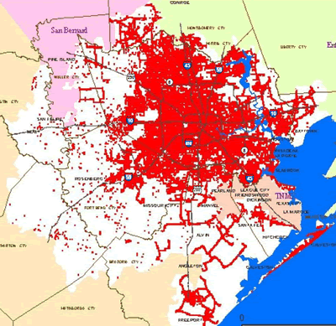
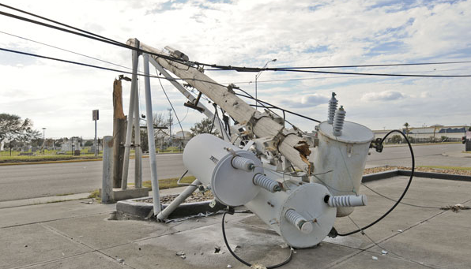
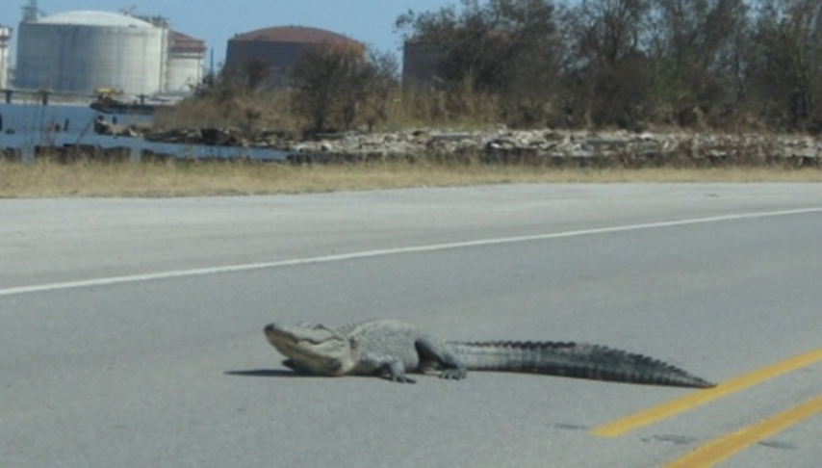
Smart Grid and Natural Disasters
Photo Credit: www.centerpointenergy.com
Photo Credit: www.users.ece.utexas.edu/~kwasinski
Figure: Outage Map and Snapshots of Hurricane Ike, 2008

Slide 4
Contributions
Incorporation of economy of disaster in restoration
Proactive and probabilistic grid restoration model
Maintenance planning considering hurricane effects
Long-term climatological effects in asset analytics

Slide 5

Problem Domain Review
Emergency planning
Physical behaviour
Resource allocation
Outage prediction
Maintenance planning
Reliability analysis
Restoration planning

Slide 6
Solution Domain Review
Mixed-integer programming
Modelling and linearization techniques
Two-stage stochastic programs with recourse
Latin hypercube sampling
Scenario reduction techniques
Benders decomposition
Stress-strength analysis
Markov decision processes
Partially observable Markov decision processes

Slide 7
Outline
Introduction
Grid Restoration Considering Economics of Disaster
Pre-hurricane Proactive Planning
Dynamic Maintenance Considering Hurricane Effects
Infrastructure Hardening and Condition-based Maintenance
Conclusions and Future Work
Publications

Slide 8
Grid Restoration Considering Economics of Disaster
Load Balance
Power Flow
Real Power
Voltage Angels
Unit Commitment
Value of Lost Load
Resource Cost
Physics
& Economics of Restoration
+
=

Slide 9
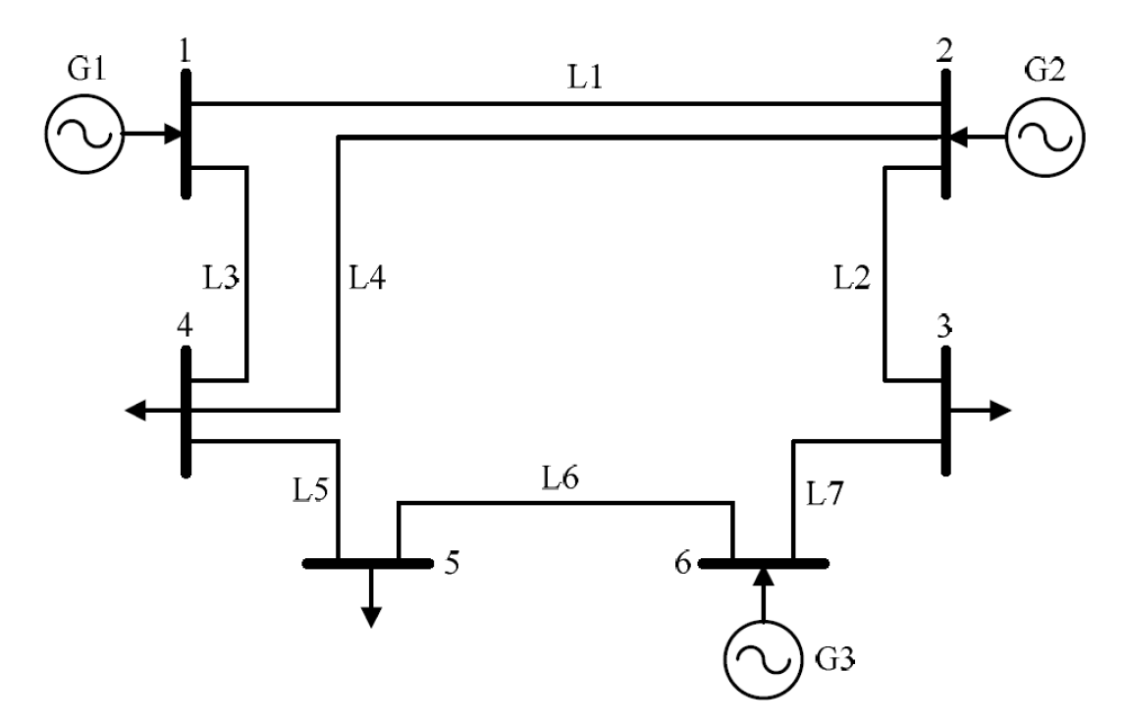

A Typical Power System Under Restoration
Failed
transmission line
Failed
generation unit
Failed bus
Figure: IEEE 6-bus System

Slide 10
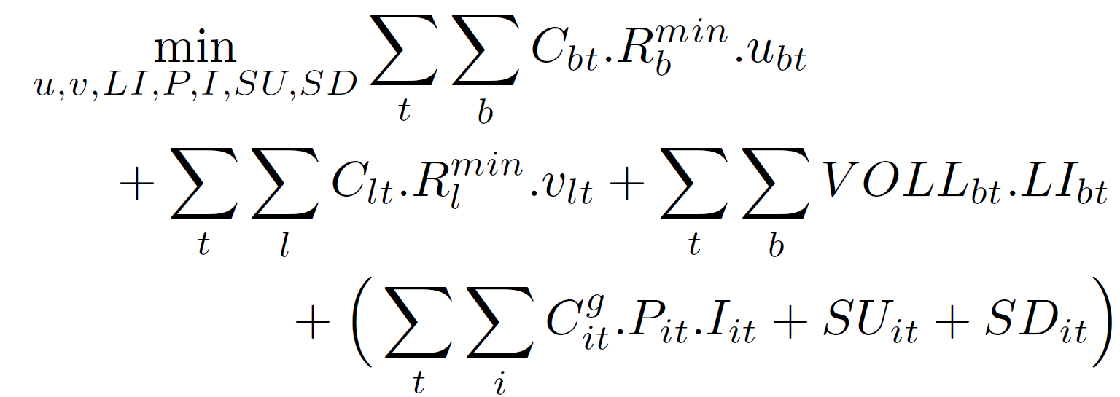
Objective Function
Resource Cost
To minimize restoration cost
To minimize load interruption
To minimize generation cost
Bus Resource
Load Interruption
Value of Lost Load
Resource Cost
Transmission Resource
Generation Cost
Startup cost
Shutdown cost
10

Slide 11
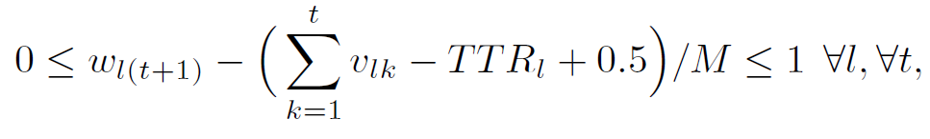
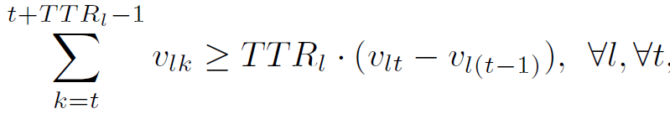
Damage State and Repair Modeling
Damage state of line
Line Resource Allocation Indicator
Line’s Time To Repair
Big Positive
Line Resource Allocation Indicator
Line’s Time To Repair

Slide 12
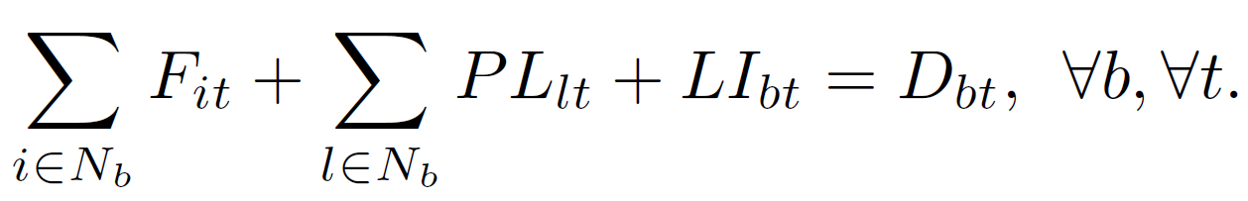
Resource and Load Balance Constraints
Resources use cannot exceed the available resources
The Load Balance Constraint must always hold:
Real Power Generation
Line Power Flow
Load Interruption
Bus Demand

Slide 13
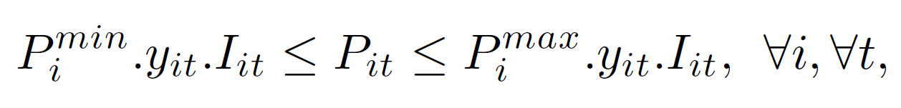
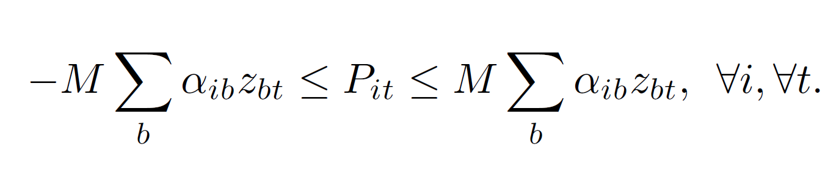
Real Power Generation Constraint
Real power generation
Unit commitment indicator
Element of Gen2Bus incidence matrix
Ramp-up and ramp-down constraints
Minimum uptime and downtime constraints

Slide 14

Line Power Flow Constraints
Line Power Flow
Line Damage State
A Very Large Number
Element of Line2Bus Incidence Matrix

Slide 15
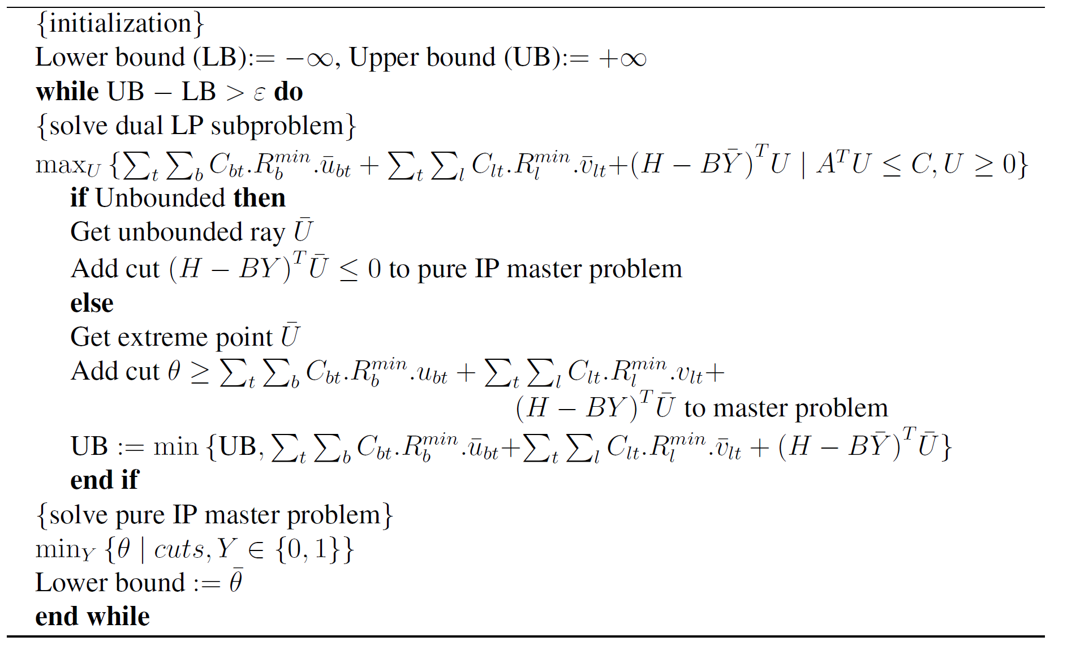
Benders Decomposition Algorithm

Slide 16
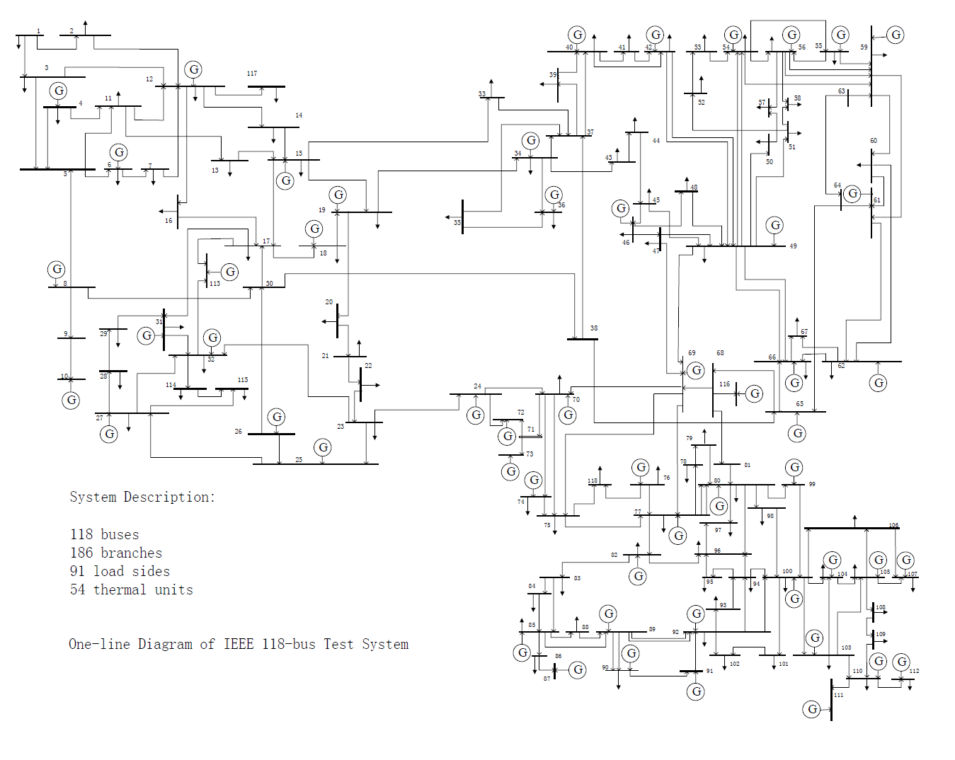
Testing System
Figure: IEEE 118-bus Testing System

Slide 17
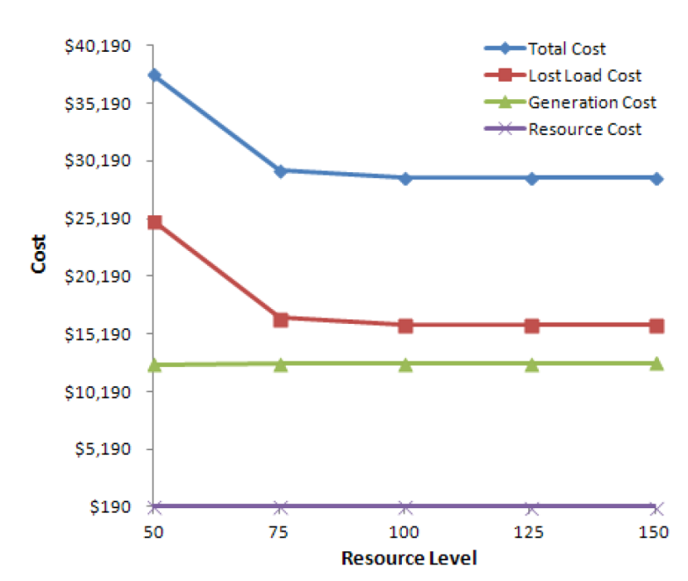
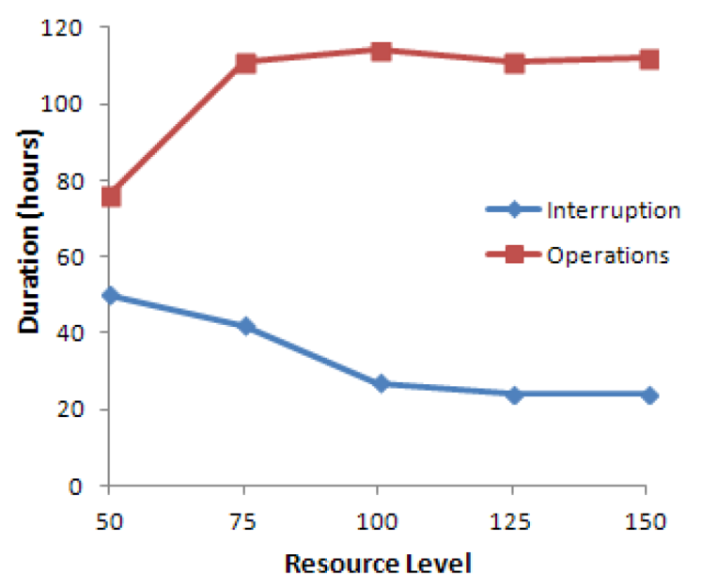
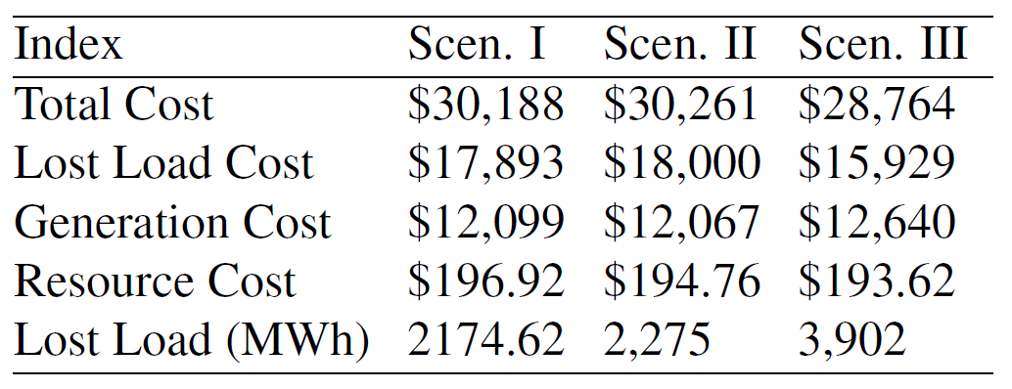
Numerical Results
Figure: Time To Restoration in Scenario IV
Figure: Restoration Costs in Scenario IV
Table: Restoration Costs in Scenarios I-III

Slide 18
Outline
Introduction
Grid Restoration Considering Economics of Disaster
Pre-hurricane Proactive Planning
Dynamic Maintenance Considering Hurricane Effects
Infrastructure Hardening and Condition-based Maintenance
Conclusions and Future Work
Publications

Slide 19
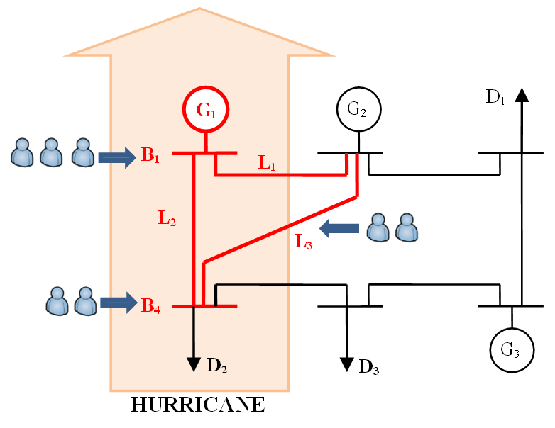
Proactive Hurricane Planning

Slide 20
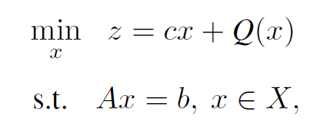
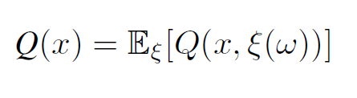
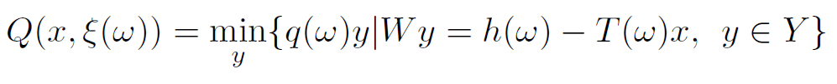
Two-Stage Stochastic Program with Recourse
Expected recourse cost function
Multivariate random variable

Slide 21


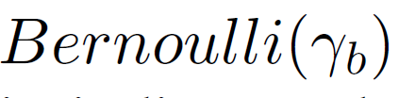

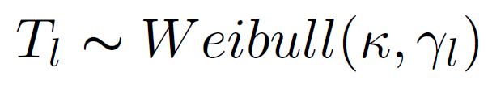
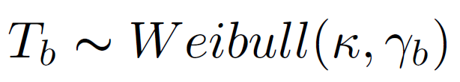
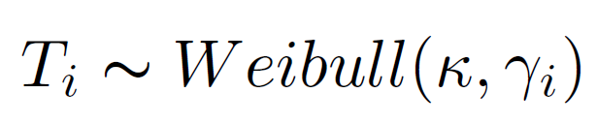
Random Variables
Survival Probability
Line damage state variable
Bus damage state variable
Unit damage state variable
Shape Parameter
Line time to repair
Bus time to repair
Scale Parameter
Unit time to repair

Slide 22
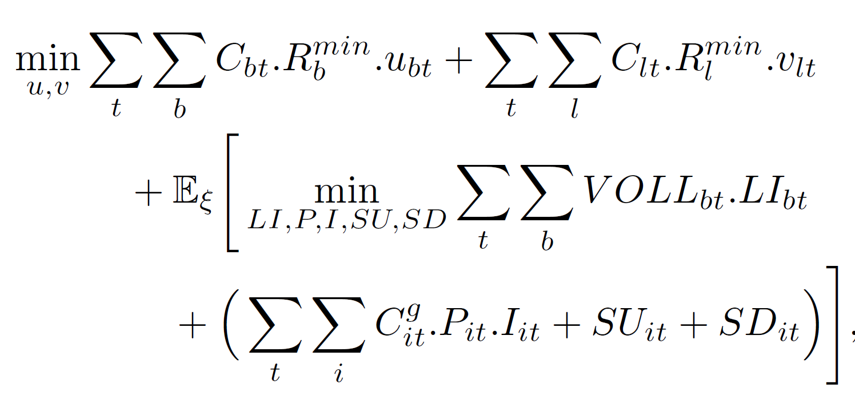
Objective Function
To minimize the primary resource cost
To minimize expected minimum load interruption cost
To minimize expected minimum generation cost
To minimize expected minimum recourse action cost

Slide 23
Constraints in Common with
Post-hurricane Model
Resource constraints
Load balance constraints
Real power generation constraints
Power flow constraints
Startup and shutdown cost constraints
Ramp-up and ramp-down constraints
Minimum uptime and downtime constraints

Slide 24
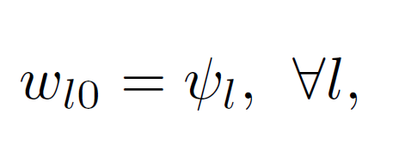
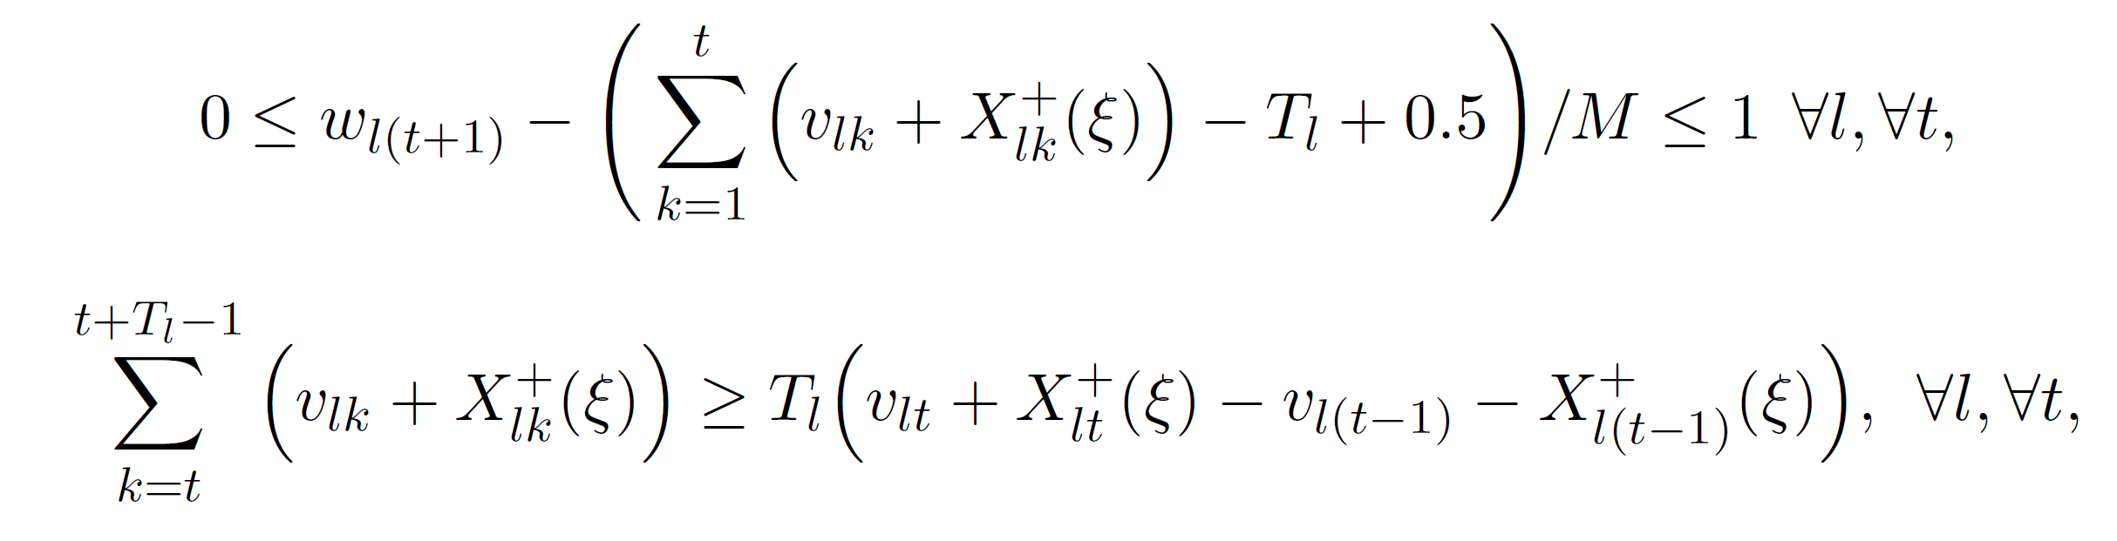
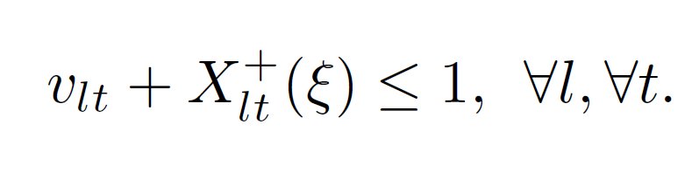
Damage State and Repair Modeling
Line initial damage state
Line time to repair
Line recourse variable
where,

Slide 25
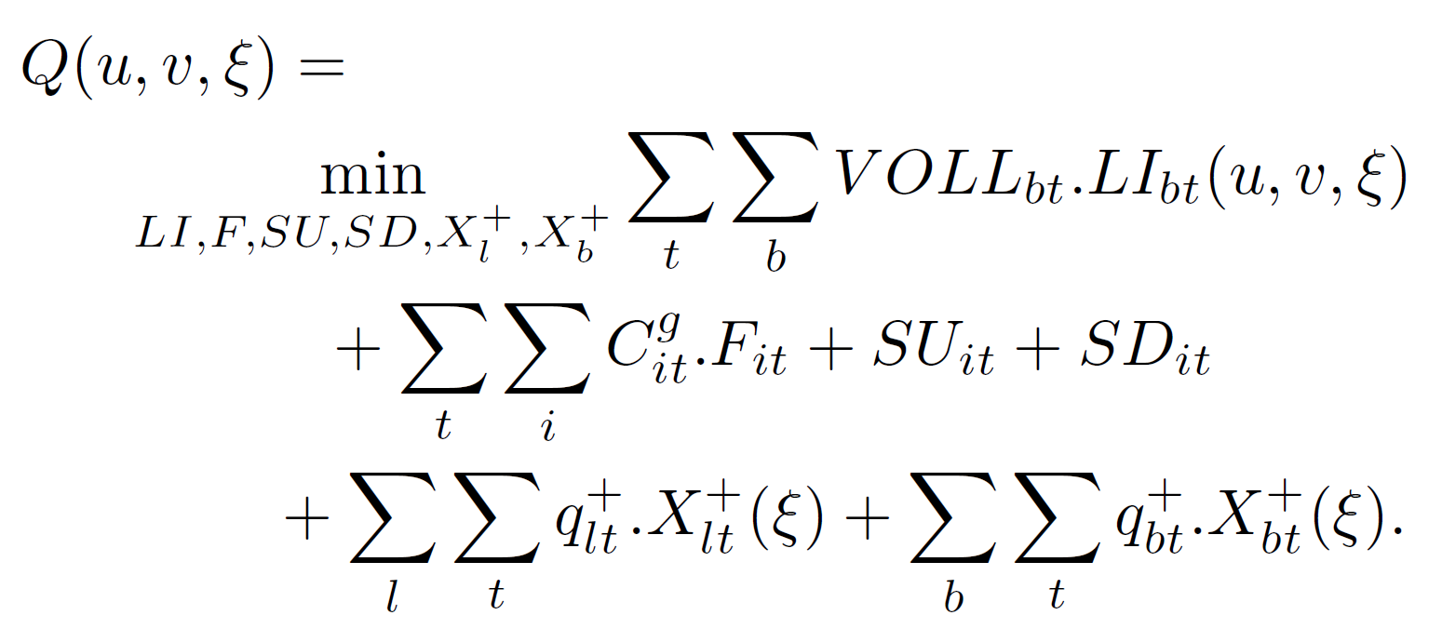
Penalization of Recourse Function
Recourse cost function
Line recourse penalty coefficient
Bus recourse penalty coefficient

Slide 26
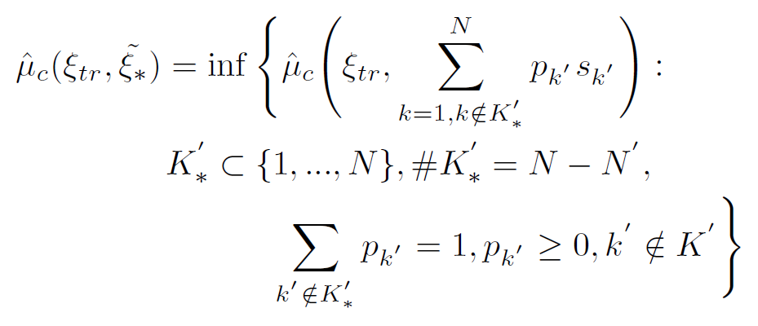
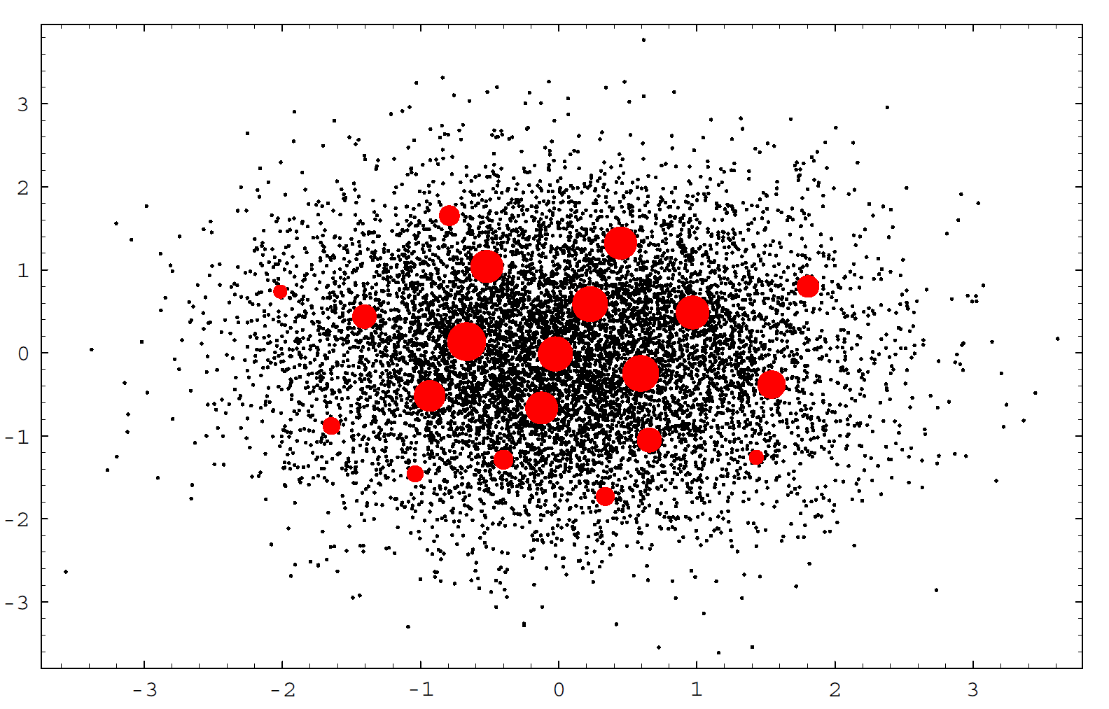
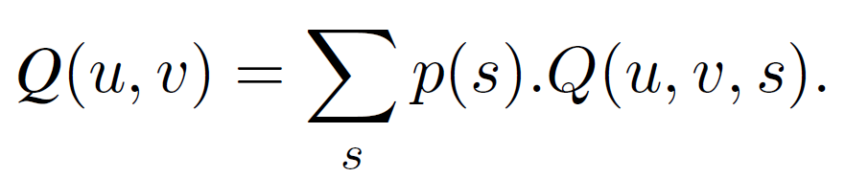
Scenario Construction and Reduction
Scenario generation using Latin hypercube sampling
3000 Scenarios, each with probability of 1/3000
Backward Scenario Reduction
Probability of scenario s
Figure: Schematic View of
Scenario Reduction

Slide 27
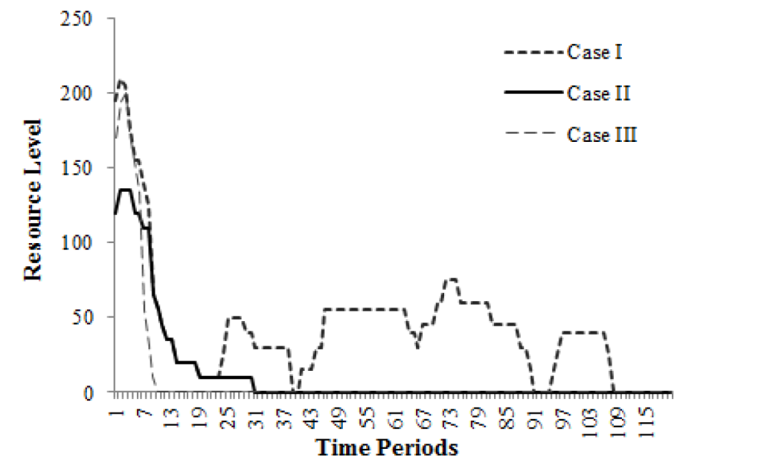
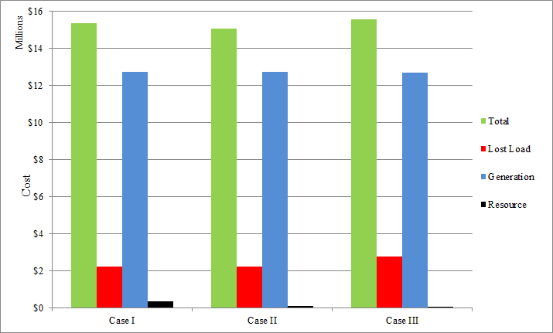
Numerical Results
Figure: Optimal Resource Level Over Time
Figure: Expected Restoration Cost Breakdown

Slide 28
Outline
Introduction
Grid Restoration Considering Economics of Disaster
Pre-hurricane Proactive Planning
Dynamic Maintenance Considering Hurricane Effects
Infrastructure Hardening and Condition-based Maintenance
Conclusions and Future Work
Publications

Slide 29
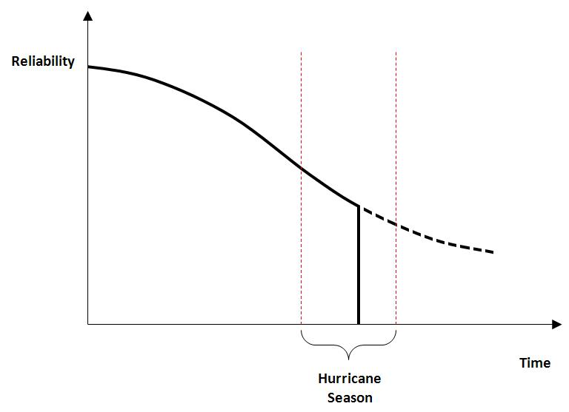
Dynamic Maintenance Considering Hurricane Effects

Slide 30
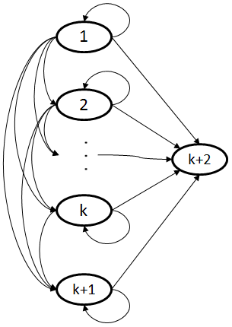
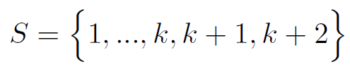

Model Description
State Space:
Action Space:
No Action (NA)
Preventive Maintenance j (PM_{j})
Corrective Maintenance (CR)
Restoration (RS)
Decision Epochs: Each week over a year
Figure: State Transition Diagram
Action Cost Structure:
Maintenance Cost Increases in the State of the System

Slide 31
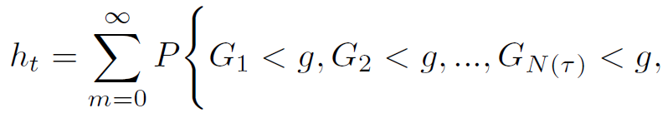
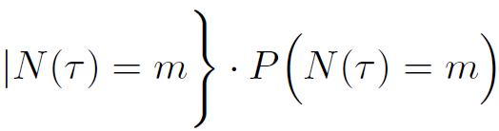
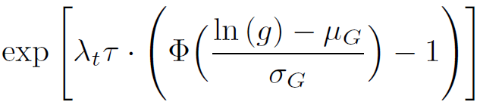

Hurricane Effects Modeling
Wind gust speed
Strength of component
Number of hurricanes
Survival probability to hurricane
Normal CDF

Slide 32
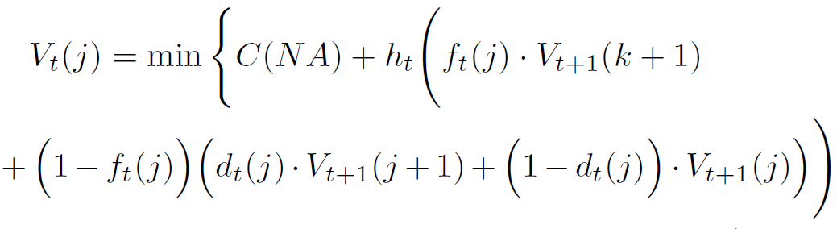
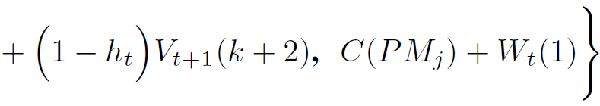

Problem Formulation
Bellman equation:
Cost-to-go
Failure probability
Deterioration probability

Slide 33
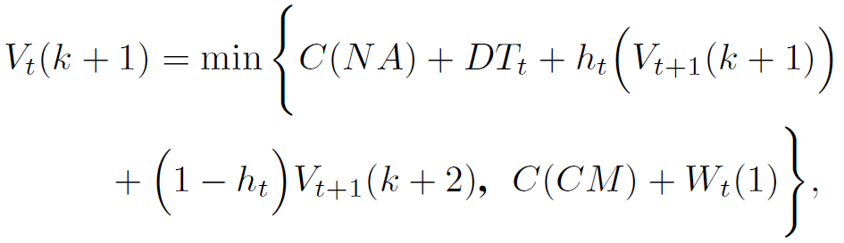
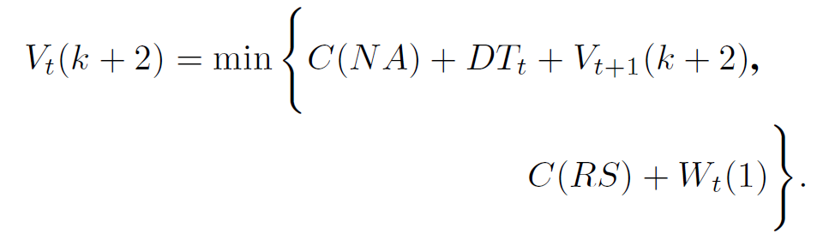
Problem Formulation
Downtime cost
Probability of damage due to hurricane

Slide 34
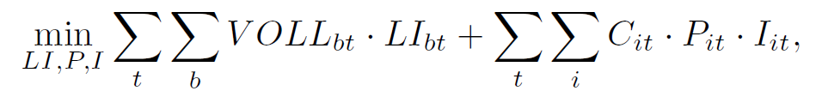
Downtime Cost
Value of lost load
Unit commitment variable
Load interruption
Real power
Subject to:
Load balance equation
Real power constraints
Outage constraints
Power flow constraints
Bus voltage angle constraints
Generation cost
The cost difference of the normal system operation and system operation with contingency is considered as downtime cost

Slide 35
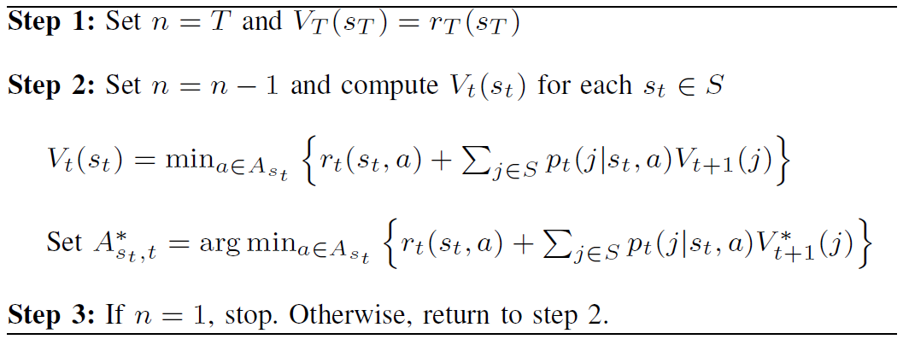
Backward Induction Algorithm

Slide 36
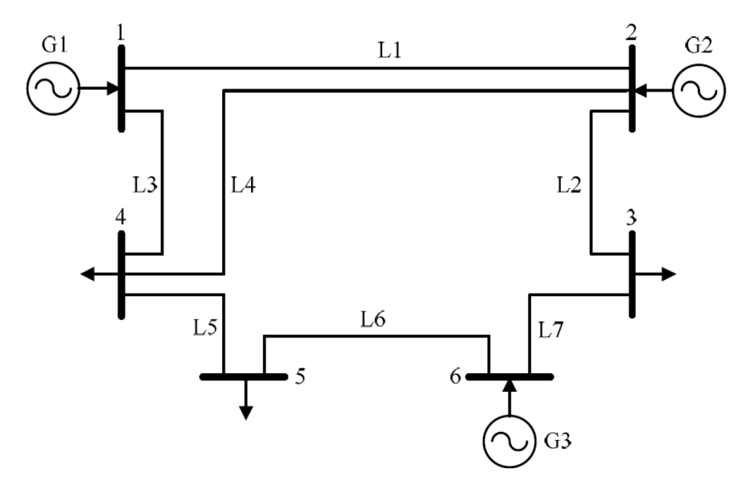
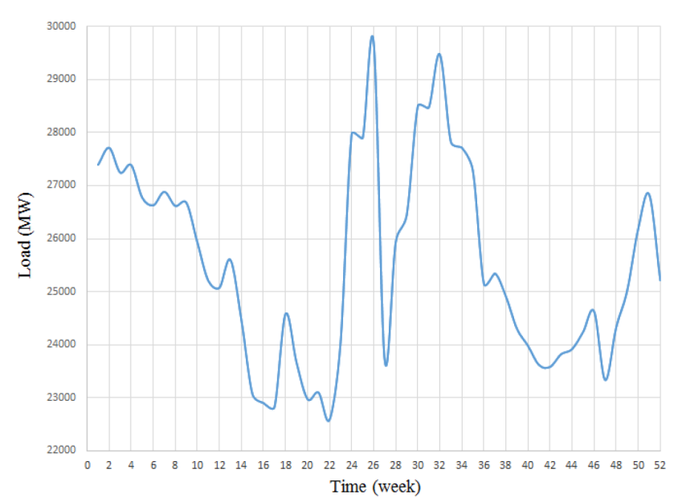
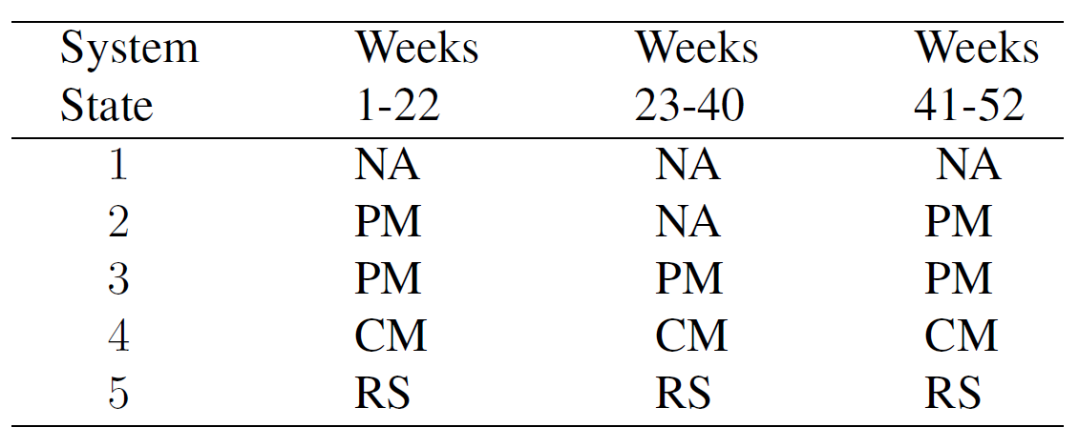
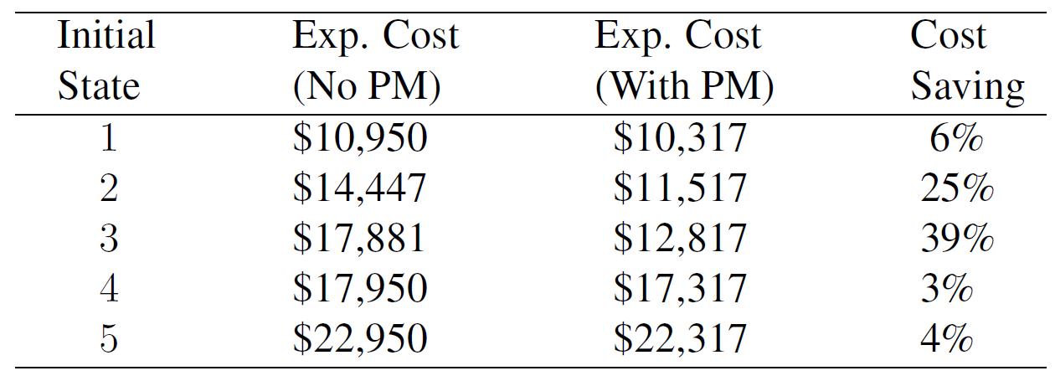
Numerical Results
Figure: IEEE 6-bus System
Figure: Aggregated Load Profile in 52 Weeks
Table: Derived Optimal Policy
Table: Cost Saving With PM Program

Slide 37
Outline
Introduction
Grid Restoration Considering Economics of Disaster
Pre-hurricane Proactive Planning
Dynamic Maintenance Considering Hurricane Effects
Infrastructure Hardening and Condition-based Maintenance
Conclusions and Future Work
Publications

Slide 38
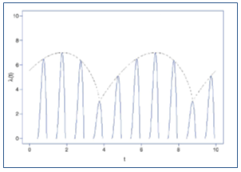

Infrastructure Hardening and Condition-based Maintenance
Under Hurricane Effects
(Long-term)
Under Degradation (Imperfect information)
Call for Synchronized and Non-isolated Decisions on
Asset Management

Slide 39


State Space
Original Two-dimensional State Space
Mixed POMDP-MDP (MOMDP) State Space
Hardening State
Information State

Slide 40
Action Space
No action (NA)
Inspection (IN)
Preventive maintenance (PM)
Corrective maintenance (CM)
Restoration (RS)
Hardening (HH)

Slide 41



Transition Probabilities
Transition probability
Conditional Reliability
Element of Info State in Next Period
Failure Probability

Slide 42


Hurricane Survival Probability
Wind Gust Speed
Strength
Function of hardening state
Number of Strikes
Average Number of Strikes
Lognormal Mean
Hurricane Survival Probability
Lognormal Variance

Slide 43



Problem Formulation
Minimum Expected Cost –to-go
Extreme State k+1
Extreme State k+2
Expected Cost of Hardening
Expected Cost of NA

Slide 44




Problem Formulation
Expected Cost of CM
Expected Cost od RS
Abstract Function
Discount Rate
Expected IN Cost

Slide 45

POMDP Solution Algorithm

Slide 46




Numerical Results
Figure: Expected Asset Management Cost
Figure: Structure of Optimal Policy

Slide 47
Outline
Introduction
Grid Restoration Considering Economics of Disaster
Pre-hurricane Proactive Planning
Dynamic Maintenance Considering Hurricane Effects
Infrastructure Hardening and Condition-based Maintenance
Conclusions and Future Work
Publications

Slide 48
Conclusions
The economics of disaster must be considered in restoration problem.
Investment in restoration resources is paid-off by restoration cost saving.
Preventive maintenance considering hurricane effect results in significant cost reduction.
Considering long-term climatological effects in asset management results in significant savings.
Infrastructure hardening strategy significantly affects the total asset management cost.

Slide 49
Future Work
AC approximation of the power system for restoration problems
Integration of smart grid technology for resiliency enhancement
Restructured power market dynamics in restoration process
Multi-dimensional POMDP algorithms for methodological improvements

Slide 50
Outline
Introduction
Grid Restoration Considering Economics of Disaster
Pre-hurricane Proactive Planning
Dynamic Maintenance Considering Hurricane Effects
Infrastructure Hardening and Condition-based Maintenance
Conclusions and Future Work
Publications

Slide 51
Journal Papers
Journal Papers from Doctoral Dissertation:
[1] A. Arab, A. Khodaei, S. K. Khator, K. Ding, V. Emesih, and Z. Han, “Stochastic Pre-hurricane Restoration Planning for Electric Power Systems Infrastructure,” IEEE Transactions on Smart Grid, Vol. 6, No 2, 1046-1054, 2015.
[2] A. Arab, A. Khodaei, Z. Han, and S. K. Khator, “Proactive Recovery of Electric Power Assets for Resiliency Enhancement”, IEEE Access, Vol. 3, 99-109, 2015.
[3] A. Arab, E. Tekin, A. Khodaei, S. K. Khator, and Z. Han, “Infrastructure Hardening and Condition-based Maintenance for Power Systems Considering El Nino/La Nina Effects,” IEEE Transactions on Reliability, (Under review ).
[4] A. Arab, A. Khodaei, S. K. Khator, Z. Han, “Post-hurricane Restoration and Unit Commitment for Electric Power Systems,” (to be submitted to IIE Transactions).
[5] A. Arab, A. Khodaei, S. K. Khator, Z. Han, “A Linearization Scheme for AC Power Systems: A Letter to Editor, (Working paper).
Journal Papers beside Doctoral Dissertation:
[6] A. Arab and Q. Feng, “Reliability Research on Micro and Nano Electro-Mechanical Systems: A Review,” International Journal of Advanced Manufacturing Technology, Springer, Vol. 44, No. 9-12, pp. 1679-1690, 2014.
[7] K. Rafiee, Q. Feng, A. Arab, and D. W. Coit, “Reliability Analysis and Condition-based Maintenance for Implanted Multi-stent Systems with Stochastic Dependent Competing Risk Processes,” Reliability Engineering & System Safety (Under review).
[8] A. Arab, A. Khodaei, S. K. Khator, Z. Han, “Sustainable Strategic Management of the Utilities of the Future: A Resource-based View on Smart Grids” (Working paper).

Slide 52
Conference Papers/Presentations
Conference Papers from Doctoral Dissertation:
[9] A. Arab, E. Tekin, A. Khodaei, S. K. Khator, and Z. Han, “Dynamic Maintenance Scheduling for Power Systems Incorporating Hurricane Effects,” Proceeding of IEEE Smart Grid Communication Conference, Venice, Italy, 2014.
[10] A. Arab, A. Khodaei, S. K. Khator, K. Ding, Z. Han, “Post-Hurricane Transmission Network Outage Management,” Proceeding of IEEE Great Lakes Symposium on Smart Grid and the New Energy Economy, Chicago, 2013.
[11] A. Arab, A. Khodaei, S. K. Khator, K. Ding, Z. Han, “Optimal Restoration Planning for Smart Grid under Natural Disaster,” Poster Presentation at UT Energy Forum, Austin, TX, 2014.
Conference Papers beside Doctoral Dissertation:
[12] A. Arab, S. K. Khator, Q. Feng, and Z. Han, “Control Theoretic Angiography Scheduling of Implanted Stents in Human Arteries,” Annual Industrial & Systems Engineering Research Conference, Nashville, TN, 2015.
[13] A. Arab, E. Keedy, Q. Feng, S. Song, D.W. Coit, “Reliability Analysis for Implanted Multi-Stent Systems with Stochastic Dependent Competing Risk Processes,” Proceeding of Annual Industrial & Systems Engineering Research Conference, Puerto Rico, 2013.
[14] F. Sangare, A. Arab, M. Pan, L. Qian, S. K. Khator, and Z. Han, “RF Energy Harvesting for WSNs via Dynamic Control of Unmanned Vehicle Charging” Proceeding of IEEE Wireless Communications and Networking Conference, New Orleans, LA, 2015.
[15] J. Sosa, A. Arab, E. Tekin, M. Bennis, S. K. Khator, and Z. Han, “Smart Energy Pricing for Utility Companies Using Reinforcement Learning,” (Working paper).

Slide 53
Many thanks!

