Slide 1
Big Data Analysis and Cross-Layer Optimization for Communication, Caching and Computing (C^3) Networks
Zhu Han
ECE and CS Departments, University of Houston
Thanks for NSF,
work by Prof. Li Wang, Ye Yu, Neetu Raveendran, Xunsheng Du and Kevin Tsai

Slide 2
Outline
Introduction and Motivation for C^3 Networks
Big Data Analysis and Cross Layer Optimization
  Wireless Network Function Virtualization
  Mobile Social Networks over D2D
  Fog Computing
  Deep Learning Analysis
Conclusions

Slide 3
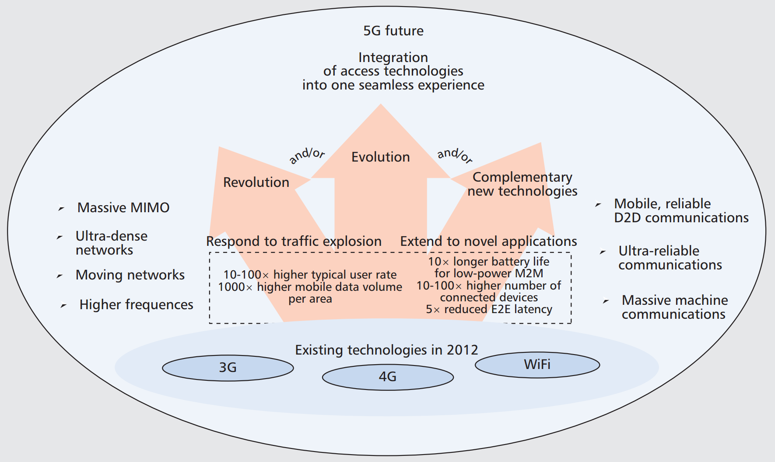
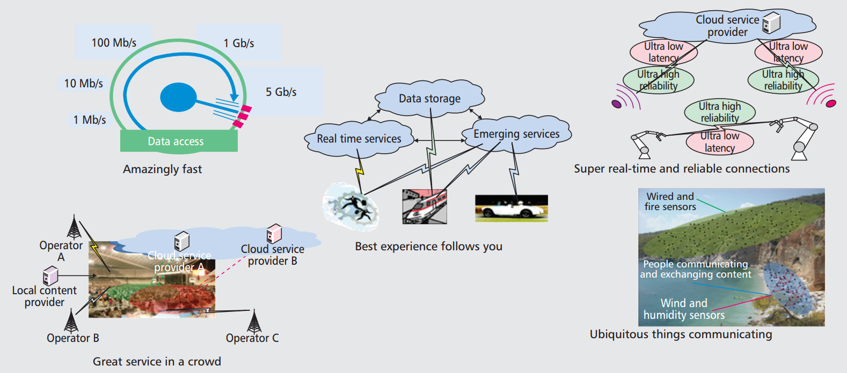
Future 5G Networks
Hyper-connected society
High data rates at the network edge (1–10 Gb/s)
Ultra low end-to-end latency (~1 ms).
Cited from “5G Use Cases and Requirements,” a white paper from Nokia.
* A. Osseiran et al., "Scenarios for 5G mobile and wireless communications: the vision of the METIS project," in IEEE Communications Magazine, vol. 52, no. 5, pp. 26-35, May 2014.

Slide 4
Communication, Caching, and Computing Motivation
Synergy of Computing, Caching, and Communication in heterogeneous networks
Challenges
Transmission data burst
High end-to-end latency in nowadays Cloud Computing
Backhaul burden from repeatedly requested content
Motivations
Enhanced mobile user devices
  Larger storage capabilities
  Higher computation capabilities
Ubiquitous connectivity of machines, devices, and infrastructure
Connection-based services shifted to content-centric services
Embedding Caching and Computing into Heterogeneous networks to bring the resources (radio access, storage, and computation cycles) closer to where they are actually used.
C^3

Slide 5
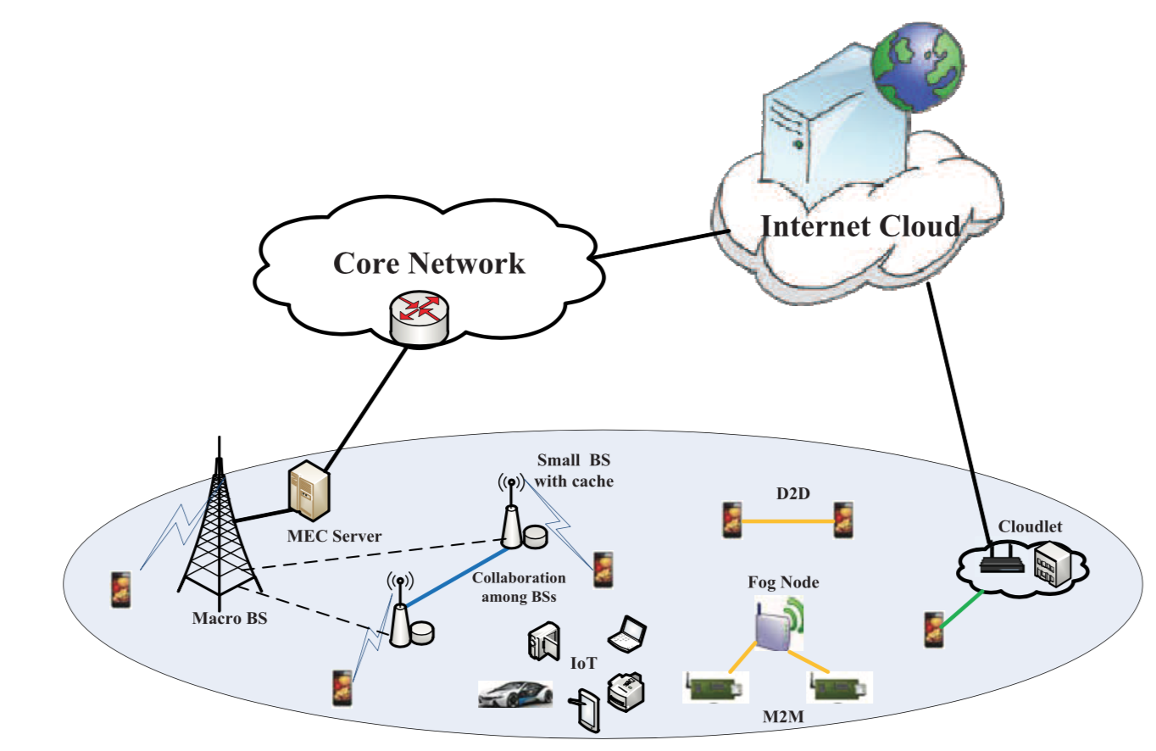
Communication, Caching and Computing Techniques
Communications
  Device-to-Device (D2D)
  Machine-to-Machine (M2M)
  Internet of thing (IoT)
Caching
  Mobile edge caching
Computing
  Mobile edge computing (MEC)
  Fog computing
  Cloudlet
Promising Solutions
  Network (function) virtualization
  Software defined networks (SDN)
Benefits
  Reduced latency
  Bandwidth reduction
  High energy efficiency
  Utilization of context information
Fig. Architecture of mobile edge networks.*
Core: Exploiting characteristics of communication, caching, and computing at the network edge.
*S. Wang, et al. "A Survey on Mobile Edge Networks: Convergence of Computing, Caching and Communications." IEEE Access, Mar. 2017
Notes:
Despite the merits of the above edge paradigms, they make the wireless network heterogeneous and difficult to manage in the traditional way. Emerging technologies such as network function virtualization (NFV) and software defined networks (SDN) are promising solutions which enable the network to be flexible and easy to maintain.

Slide 6
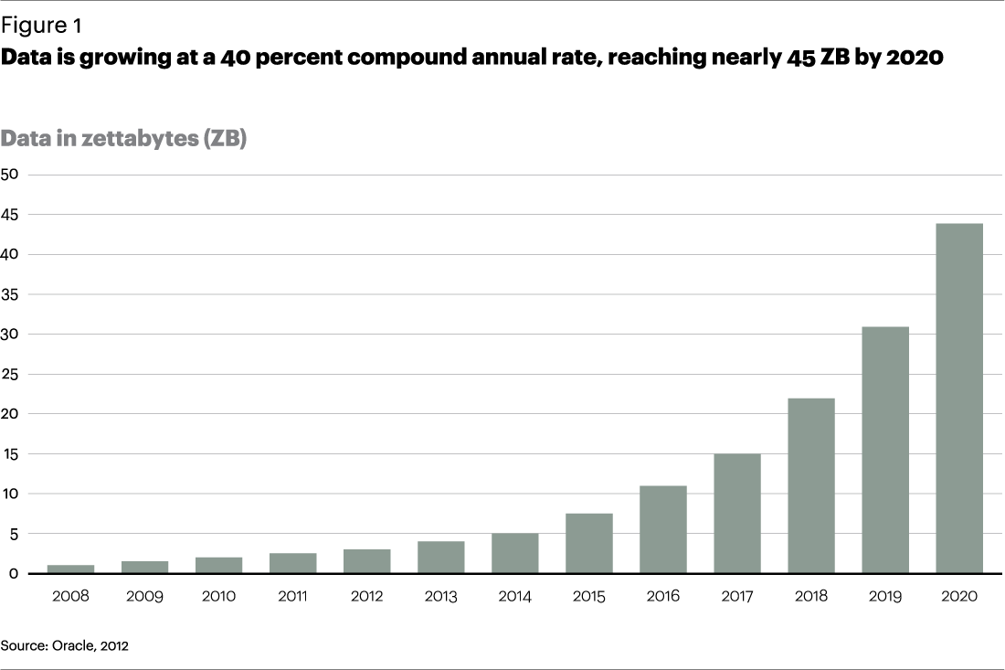
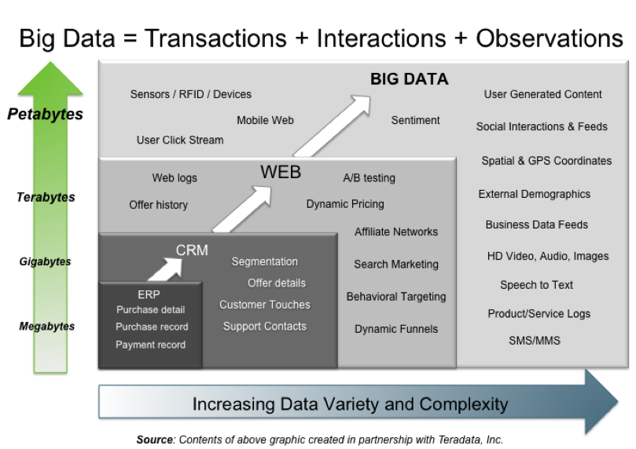
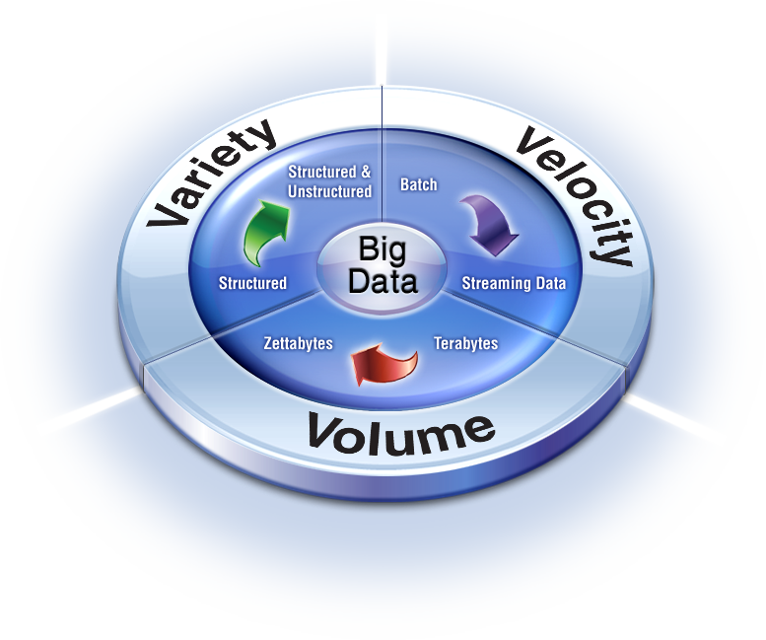
Big Data
Size of data increases exponentially
Types of data are very heterogeneous
Need to calculate fast
Key dimensions
  Volume, Variety and Velocity
3C Networks are Big Data Networks

Slide 7
Outline
Introduction and Motivation for C^3 Networks
Big Data Analysis and Cross Layer Optimization
  Wireless Network Function Virtualization
  Mobile Social Networks over D2D
  Fog Computing
  Deep Learning Analysis
Conclusions

Slide 8
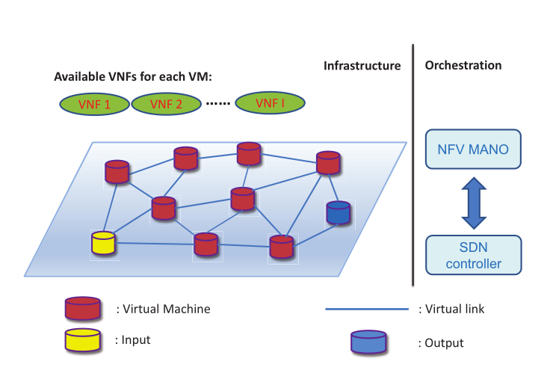
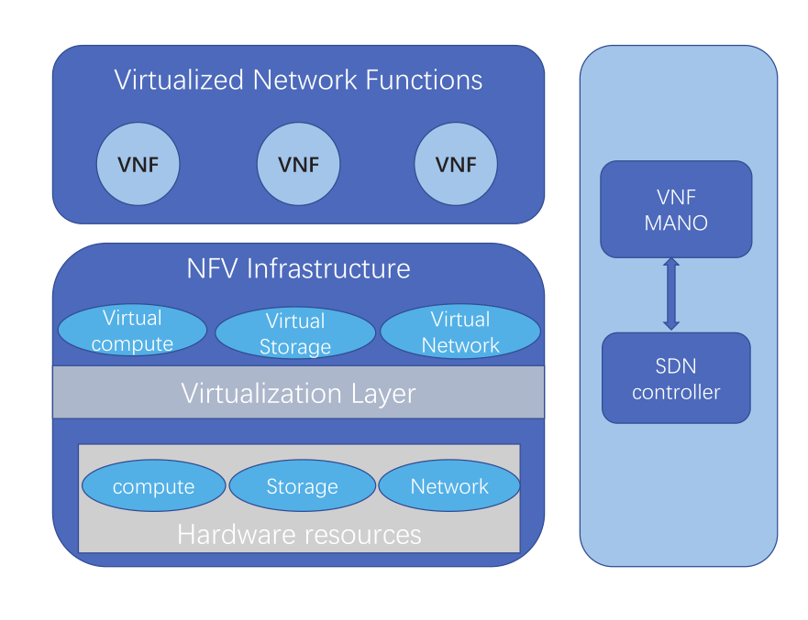
Network (Function) Virtualization
Virtualize entire classes of network node functions into building blocks that may connect, or chain together, to create communication services
Advantages
  Reduce Expenditure; Accelerate Time-to-Market; Deliver Agility and Flexibility
Notes:
The SDN controller determines the logic of the traffic and
passes the status information to the NFV MANO. The NFV MANO can be divided into three
part: the orchestrator, VNFs managers and Virtualized Infrastructure Managers. The placement
of the VNF and the optimization of the traffic path are accomplished by the NFV MANO.

Slide 9

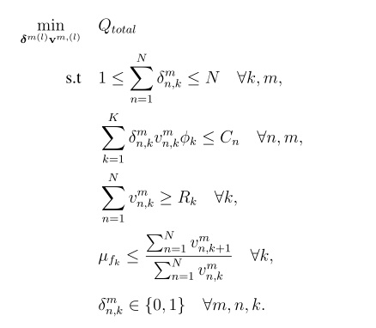






Problem Formulation Example
Mixed Integer Programming
number of the
instances:
VNF placement cost:
VNF number
VM’s capacity
Traffic cost:
Data rate requirement
Total cost function:
Streaming constraint
Variables:
(Integer)
(continuous)

Slide 10
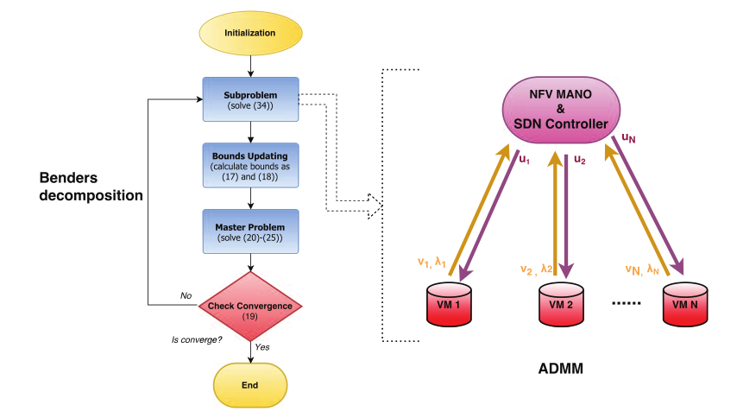
Big Data Computation Structure
Notes:
Flow diagram of illustration the Benders decomposition algorithm procedure and the information exchange in subproblem using ADMM

Slide 11
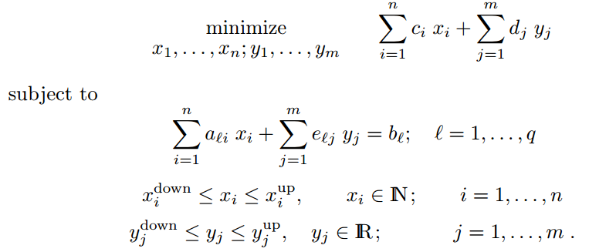
Benders Decomposition
General MILP

Slide 12
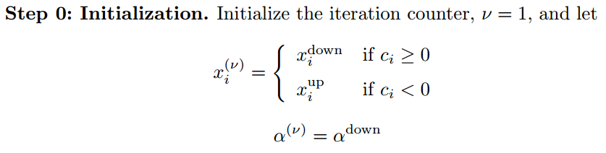
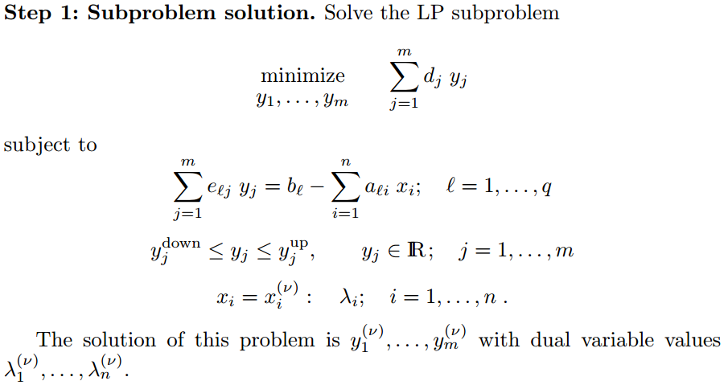
Benders Decomposition

Slide 13
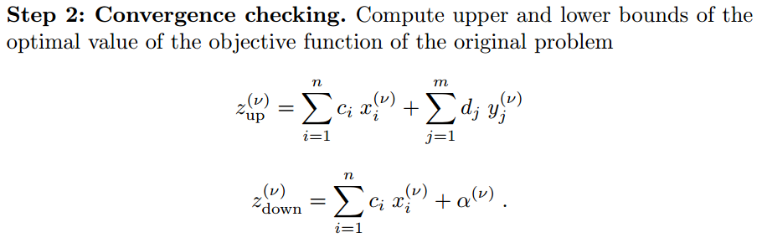
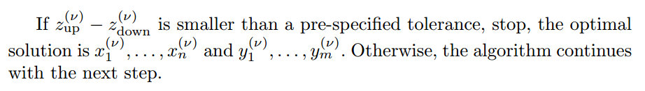
Benders Decomposition

Slide 14
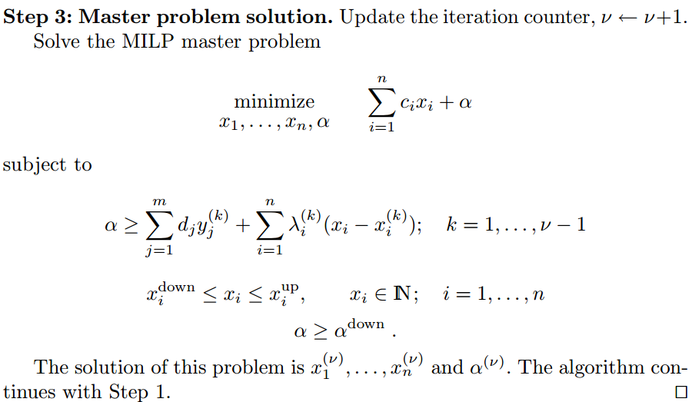
Benders Decomposition
Benders cut
(cutting cakes)

Slide 15
Alternating Direction Method of Multipliers (ADMM) to solve subproblems
Augmented Lagrangian function
Iterative procedure to solve an optimization problem using ADMM
California government
Texas
government
US
Congrress

Slide 16
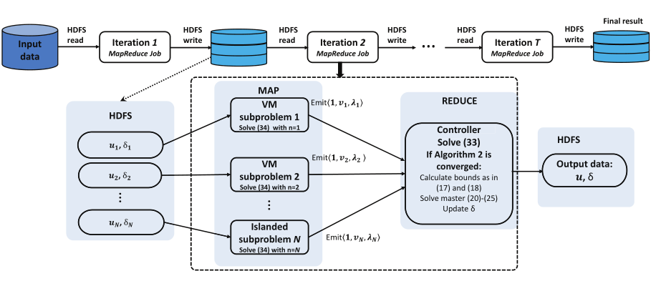
Implementation using Hadoop MapReduce/Spike
Notes:
Data sharing for iterative ADMM using Hadoop MapReduce and the detailed illustration of Map tasks and Reduce task in each MapReduce job in each iteration
No iteration structure

Slide 17
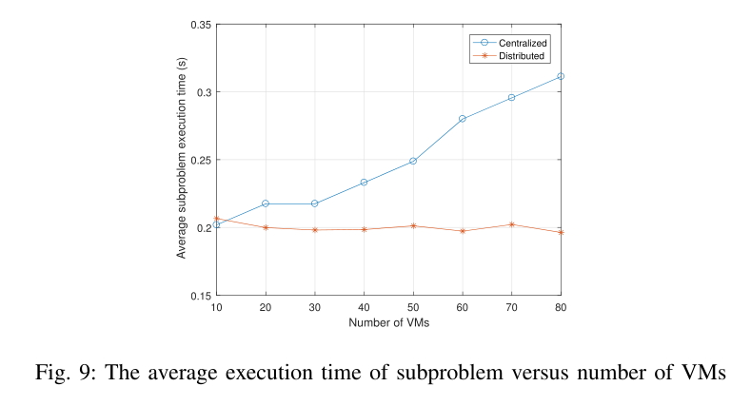
Simulation Results

Slide 18
Outline
Introduction and Motivation for C^3 Networks
Big Data Analysis and Cross Layer Optimization
  Wireless Network Function Virtualization
  Mobile Social Networks over D2D
  Fog Computing
  Deep Learning Analysis
Conclusions

Slide 19
D2D Communication
Device-to-Device (D2D) Communications
  Technology that enables devices to connect directly without relying on infrastructure of access points or base stations.
Type of D2D Communications
  D2D direct link
  Cooperative Relay
  Cluster based communication
Spectrum Sharing
  Unlicensed (Outband) vs.
  licensed (Inband) spectrum
  Underlay vs. Overlay
  UpLink vs. DownLink
  Mode Selection (D2D mode vs. Cellular Mode)
Increase network capacity
Extend (edge) coverage
Offload data
Improve energy efficiency
Create new applications
Figure: Scenario of D2D Communications
TS36.300 v12 (2015.02)
  section 23.10 for D2D Communications
  section 23.11 for D2D Discovery (proximity detection for commercial services)
TS36.211 v12 (2015.10)
section 9: a sidelink is used for ProSe direct communication and ProSe direct discovery between UEs. (ProSe – Proximity Services)

Slide 20



Exploiting D2D in Mobile Social Network
Imminent wireless capacity crunch
  Smartphones with larger storage and higher computing capability
  Mobile social platforms, e.g.,
  Virtual and Social Community
    Social tie (family members, club members…)
    Social relationship with common interest
    Social interactions
  Continuous (uninterrupted ) wireless connection
  File sharing & Online gaming & Video dissemination
D2D---exploit benefits from social networking
  in terms of pairs and clusters
  to offload the increasing traffic from base stations (BSs)
  to meet the higher speed demands for mobile users

Slide 21
Wireless Distributed Storage Systems
Wireless distributed storage:
Store the popular content files at the BS/mobile devices during off-hours to improve the end-to-end performance and reduce backhaul loading at peak-hours
Benefits of wireless storage:
  Capacity enhancement
  Backhaul traffic offloading
  Interference mitigation
Small BS or powerful user nodes
Popular files can be received from the BS and stored in their own cache
Files in its cache can be accessed by other users within its coverage at a later time
Wireless caching schemes:
  Coded caching to create coded multicast opportunities
  Proactive caching to exploit both the spatial and social structure of the wireless networks
  D2D caching networks to reduce number of hops and balance load
  Asymptotic scaling laws in large wireless networks
Focus:
In D2D-based wireless distributed storage systems, resource allocation and content sharing are investigated in different scenarios with different objective functions

Slide 22
D2D-Based Distributed Storage Systems
Upper layer: Content sharing for D2D partners to form Links
Main considerations:
Social relationship
Interest similarity
Physical proximity
Caching capability
Computing capability
Content coding
Lower layer: Resource sharing for CUE and D2D Links in D2D Underlay
  Main considerations:
  Channel state information
  Power control
  Co-channel interference

Slide 23
Matching Game Definitions
Basic elements (Stable Marriage (SM)):
1. Agents: A set of men, and a set of women;
2. Preference list: A sorted list of men/women based on her/his preferences;
3. Blocking pair (BP) (m,w):
    m prefers w to his current partner;
    w prefers m to her current partner;
4. Stable matching: A matching admit no BPs.
5. Gale-Shapley (GS) algorithm: find a stable matching in SM, Nobel prize winning

Slide 24








GS Algorithm
Geeta, Heiki, Irina, Fran
Adam
Fran
Irina, Fran, Heiki, Geeta
Carl > Adam
Bob
Geeta
Geeta, Fran, Heiki, Irina
Carl
Heiki
Irina, Heiki, Geeta, Fran
David > Bob
We reach a stable marriage!
David
Irina

Slide 25
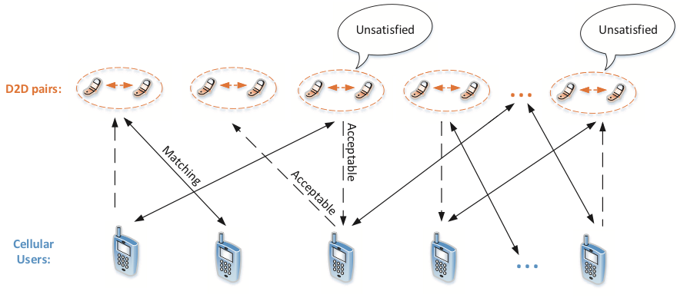
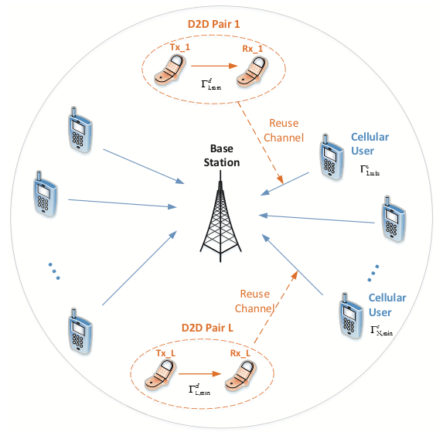
A Case Study for D2D Matching
D2D user pairs (DUs) search for cellular users (CUs) to share spectrum;
Stable marriage model;
Preference lists: channel condition, QoS;
GS: stable one-one matching (DU,CU).
Some DUs are not matched to the best choice,
and have the incentive improve by cheating!
Yunan Gu, Yanru Zhang, Miao Pan, and Zhu Han, “Matching and Cheating in Device to Device Communications Underlaying Cellular Networks," IEEE Journal on Selected Areas on Communications, Special Issue on Recent Advances in Heterogeneous Cellular Networks, vol. 33, no. 10, pp. 2156-2166, October 2015.

Slide 26
Cheating in Matching
Strategic Issue (cheating)
  Achieve better partners by falsifying the preference lists
Coalition Strategy
  Find the cabal set
  Find the accomplices of the cabal
  Falsify the accomplices’ preference lists
  If a cabal exist, then
    Each man in the cabal is strictly better off;
    Each man outside the cabal keeps their partners.
  Many matching game solutions beyond classic ones
A group of men who prefer each other’s partner to its own.
A group of men who would otherwise prevent the cabal to get their desired partners.

Slide 27
Outline
Introduction and Motivation for C^3 Networks
Big Data Analysis and Cross Layer Optimization
  Wireless Network Function Virtualization
  Mobile Social Networks over D2D
  Fog Computing
  Deep Learning Analysis
Conclusions

Slide 28
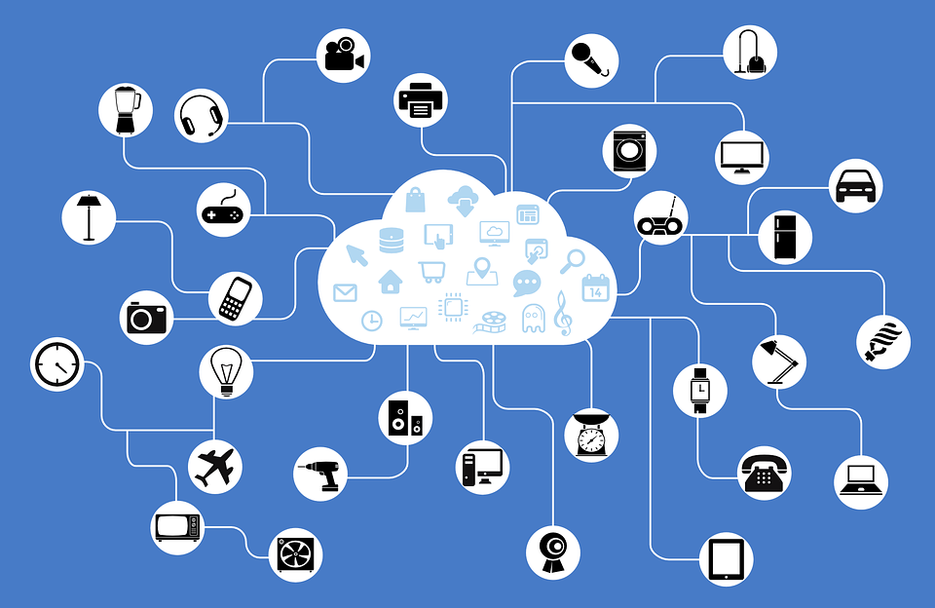

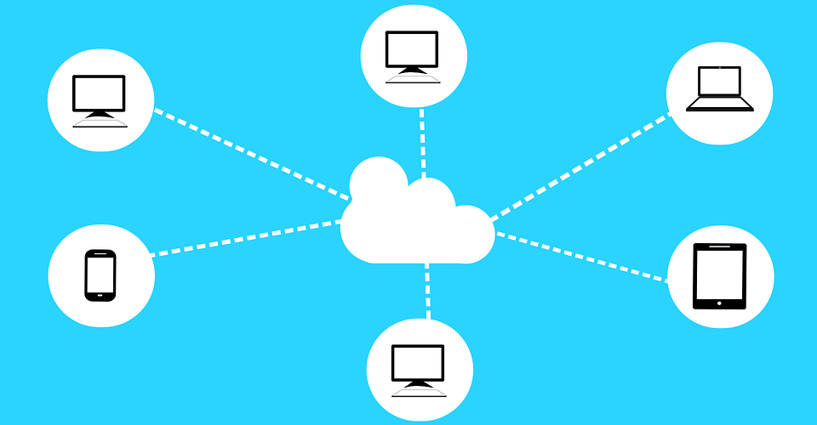
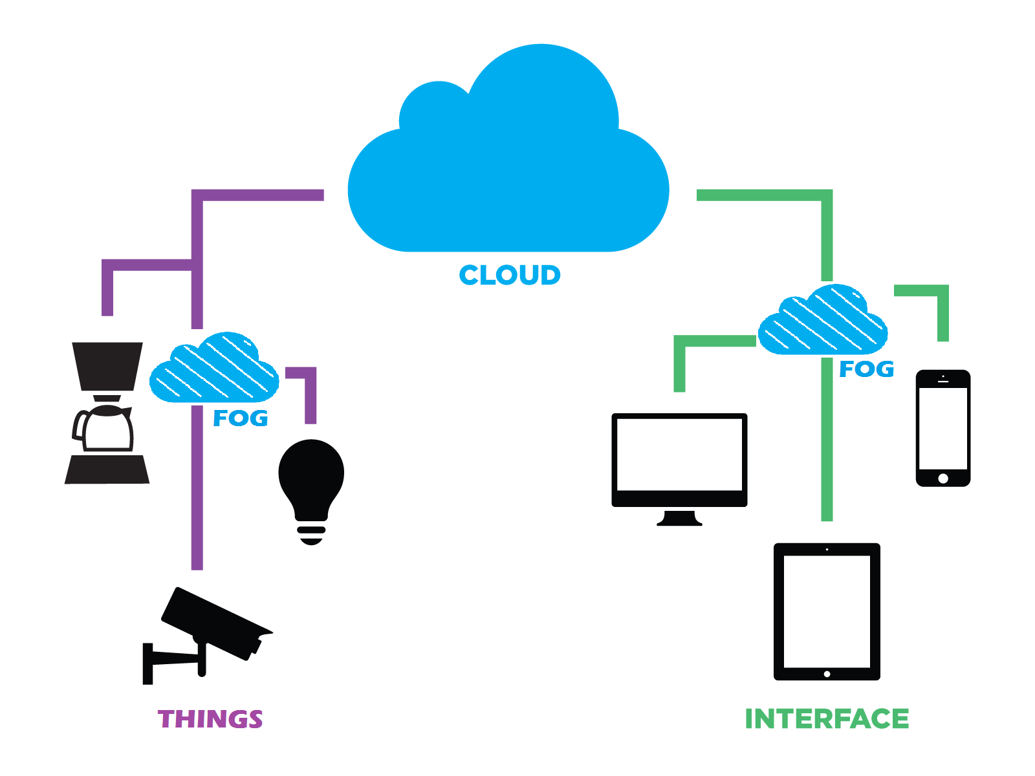
Cloud vs. Fog. vs. Smog Computing
Internet of Things
Big Data
Computing and Storage
Cloud Computing
Fog Computing
Reduce latency and transmission costs
Data Service Operators (DSOs)
Data Centers
Fog Nodes (FNs)
Authorized Data Service Subscribers (ADSSs)
28

Slide 29

Big Data Optimization Motivation
Large number of FNs deployed at various locations
How to manage computing resources?
Equilibrium Problem with Equilibrium Constraints (EPEC)
How to perform large-scale optimization?
Competition among multiple DSOs and ADSSs
How to deal with multiple conflicting entities?
Alternating Direction Method of Multipliers (ADMM)
Proposed method!!!
29

Slide 30
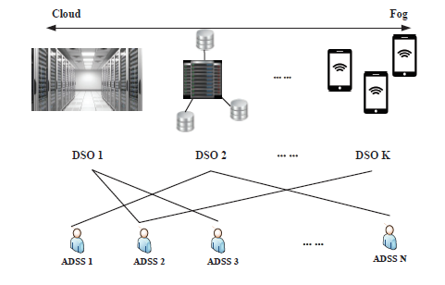
Real Time Data Service Scenario
K DSOs, N ADSSs
Computing resources from data centers or FNs – Computing Resource Blocks (CRBs)
DSOs manage CRBs for serving the ADSSs
ADSSs request for CRBs from the DSOs
30

Slide 31




Utility Functions of DSOs and ADSSs
Price set for one CRB by DSO i for ADSS j – Ɵ_{i,j}
Number of CRBs purchased from DSO i by ADSS j – x_{i,j}
Utility function for DSO i
Utility function for ADSS j
Revenue from the CRBs provided to ADSSs
Cost of service delay
Operational and measurement costs
Revenue from workload data
31

Slide 32
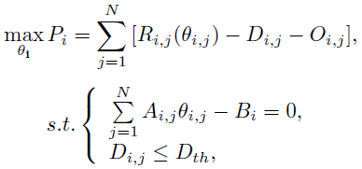
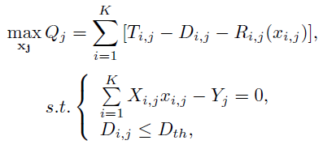
Maximization of Profits for DSOs and ADSSs
Optimization problem for DSO i
Optimization problem for ADSS j
Constraint on available CRBs
Constraint on budget to purchase CRBs
Constraint on service delay
Constraint on service delay
DSOs and ADSSs aim to maximize their own profits (optimal Ɵ_{i,j} and x_{i,j})
DSOs provide incentives to ADSSs, to choose x_{i,j} to obtain optimal Ɵ_{i,j}
No close form solution for lower level (ADSS) optimization
32

Slide 33
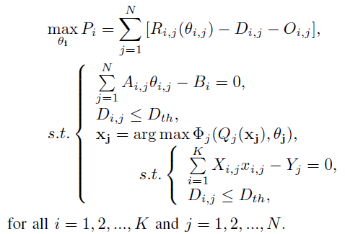
Equilibrium Problem with Equilibrium Constraints (EPEC)
Optimization for the DSOs
Optimization for the ADSSs
Optimization of the utilities of DSOs, while considering the utilities of ADSSs (conflicting objectives)
Two level hierarchical optimization problem
Equilibria and constraints exist at/between both upper and lower levels
Difference to Stackelberg game and Mathematic Programming with Equilibrium Constraint (MPEC)
33

Slide 34
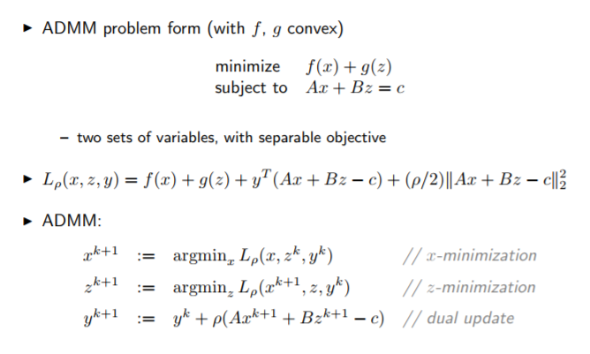
Alternating Direction Method of Multipliers (ADMM)
Objective function of this form
Constraints of this form
Method for large scale optimization
Fast convergence when objective function is convex
EPEC + ADMM
Conflicting objectives + Large network!!!
34

Slide 35
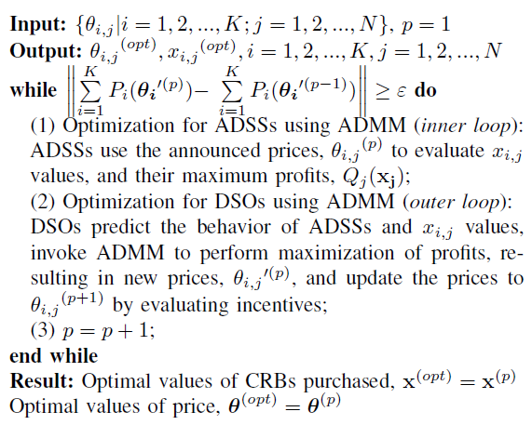
ADMM based EPEC in Fog Computing
Convergence check for outer loop
Optimization for the ADSSs
Optimization for the DSOs
The outer loop terminates when the total profit of the DSOs converges to an optimal value, i.e.,
Value at current iteration – Value at previous iteration < Error threshold
35

Slide 36
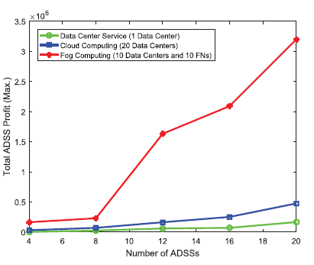
Total Profit of ADSSs vs. Number of ADSSs
Fog Computing
Cloud Computing
Data Center Service
Optimization using ADMM increases the total profit of the ADSSs in Fog Computing compared to Cloud Computing
36

Slide 37
Outline
Introduction and Motivation for C^3 Networks
Big Data Analysis and Cross Layer Optimization
  Wireless Network Function Virtualization
  Mobile Social Networks over D2D
  Fog Computing
  Deep Learning Analysis
Conclusions

Slide 38

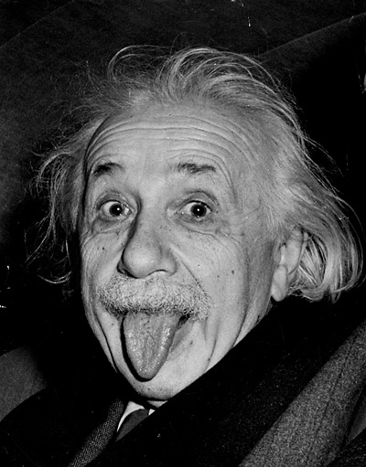

Reinforcement Learning
Effective and Efficient Method
Dummy
Expert
Policy
(Machine)

Slide 39


An Example
1
Today
1
-100
0
Have Fun
0
1
Fencing Event
Study & Discussion
0
100
IEEE INFOCOM
Submit Paper

Slide 40
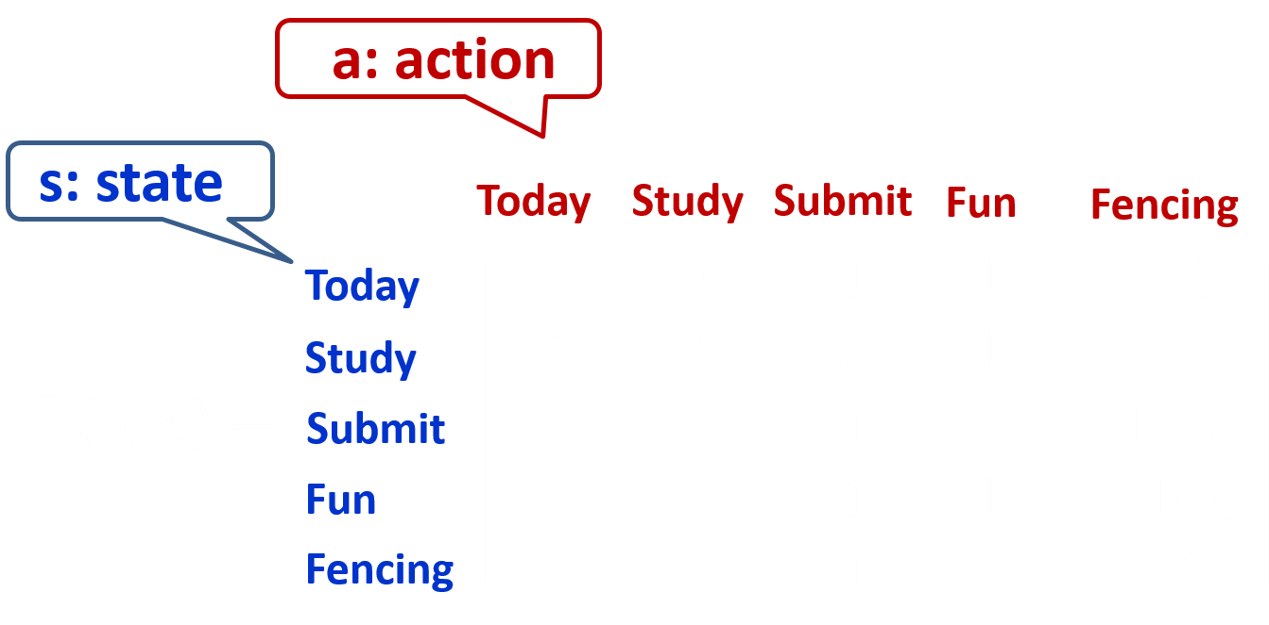

Rewards
Initially set to zero

Slide 41





Q-Learning
Fencing
Study
Fun
Study
Fun

Slide 42


Results
52.2
317182 Games
52.2
Today
-100
1 million steps
Learning rate: 0.9999954
Discount rate: 0.8
Epsilon: 0.1
64
Have Fun
64
52.2
Fencing Event
Study & Discussion
80
100
Submit Paper

Slide 43
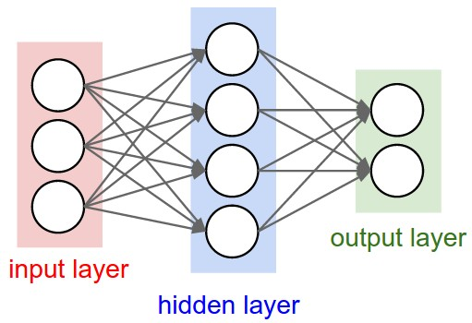
Deep Reinforcement Learning Framework
Information about vehicle transmitters
Deep Neural Network Agent
Observation
(state in networks)
Predicted
Q-Value
Operator
Update Q-Value
Target Q-Value
Update environment
Execute action
AlphaGo Zero beats AlphaGo beats Human
Fit multi objective and utility hard to define cases

Slide 44
Conclusions
Communication, Caching and Computing are potential solutions to achieve 5G
Challenge: Multi-objective, how to write utility
Scenarios vs. solutions
  Network virtualization based on Benders decomposition and ADMM
  Mobile social networks over D2D based on matching
  Fog computing based on EPEC solution
  3C networks based on deep reinforcement learning
Just a small peek on a new paradigm
Hope to find more collaborations

Slide 45
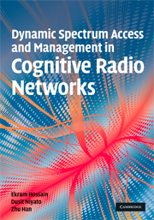

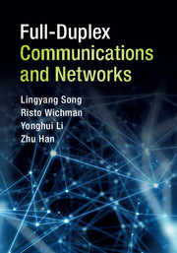


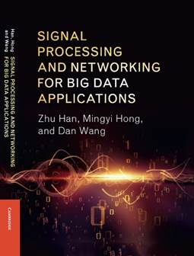
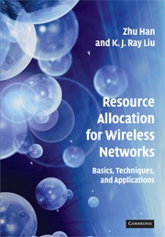
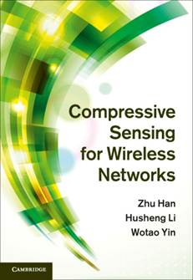
Current Other Research
Application
  Wireless Networking
  Smart Grid
Theory
  Game Theory
  Big Data
  Optimization
Thank group members
  won 3 best journal paper awards (including IEEE JSAC best paper),
  16 IEEE conference best paper awards.
  291 published/accepted transactions/magazines/letters, 327 conference papers, 16 book chapters, and 2 patents.
  google citation is greater than 23,000 with H factor 75
  1% highly cited researcher 2017 according to Web of Science.
  IEEE fellow 2014, IEEE distinguished lecturer since 2015
  8 Cambridge University Press Books and 8 Springer Books

Slide 46
Thank You!
  Theory is something we know why, but it does not work.
  Practice is something works, but we do not know why.
  In our research lab, we have both;
  nothing works and we do not know why.

Slide 47
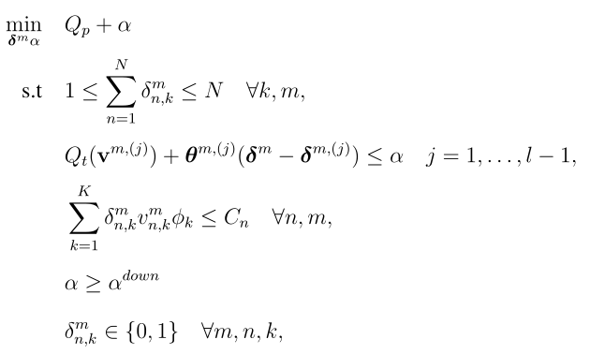
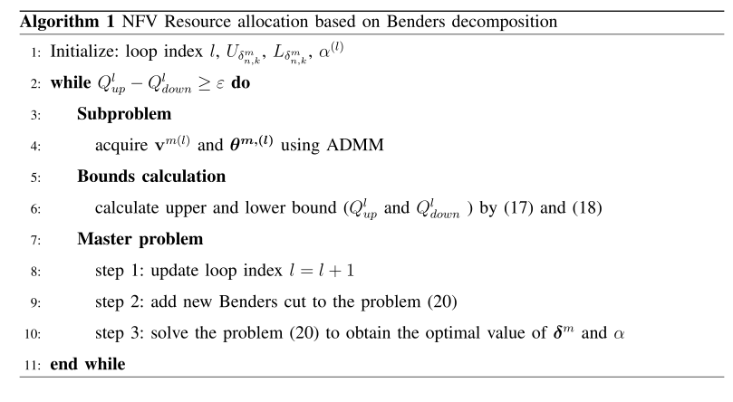
Proposed Algorithm

Slide 48
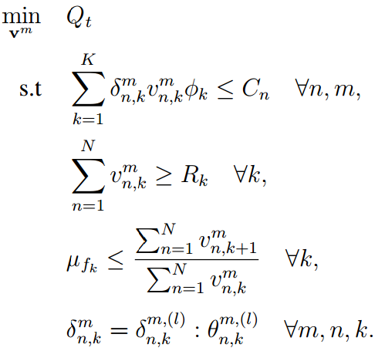
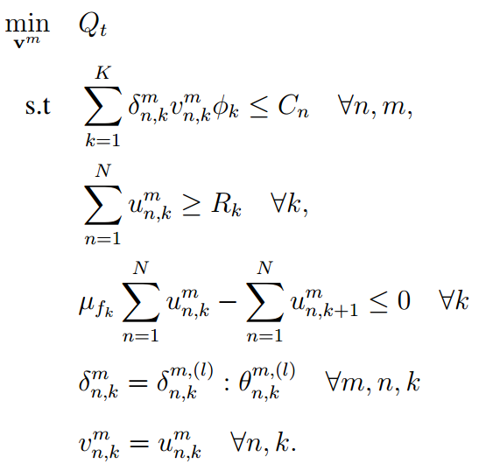
Proposed Algorithm
Transformation of subproblem
Global copy variable

Slide 49
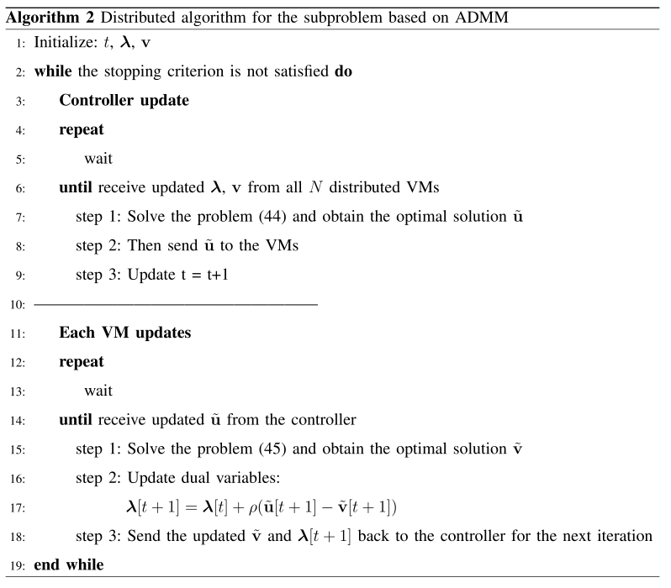
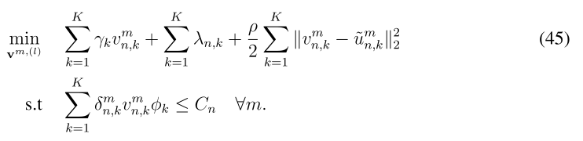
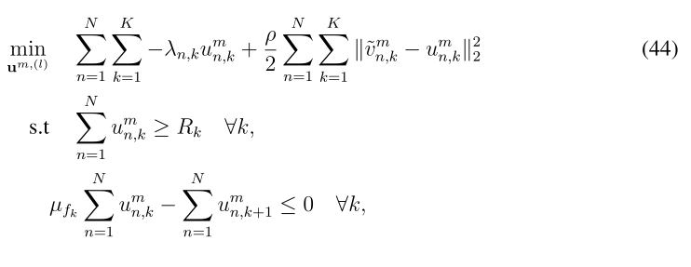
Proposed Algorithm

Slide 50
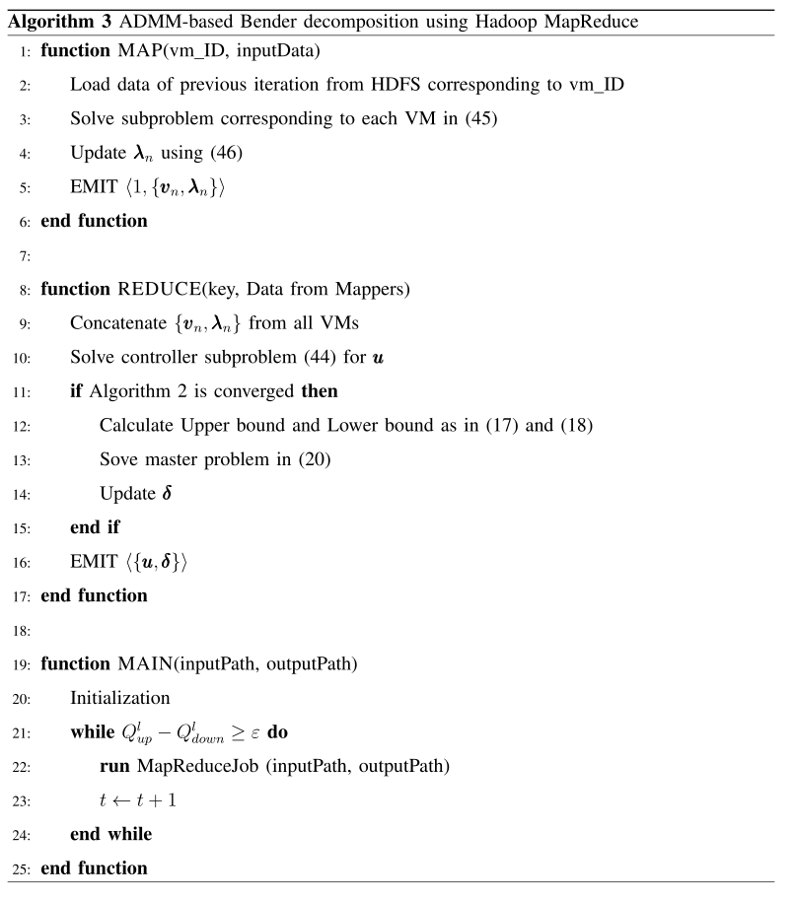
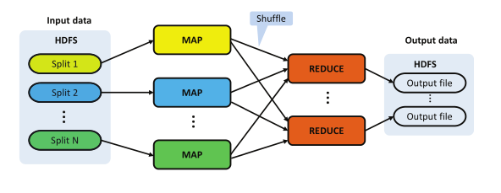
Implementation using Hadoop MapReduce
Notes:
The flow chart of MapReduce programming model

Slide 51
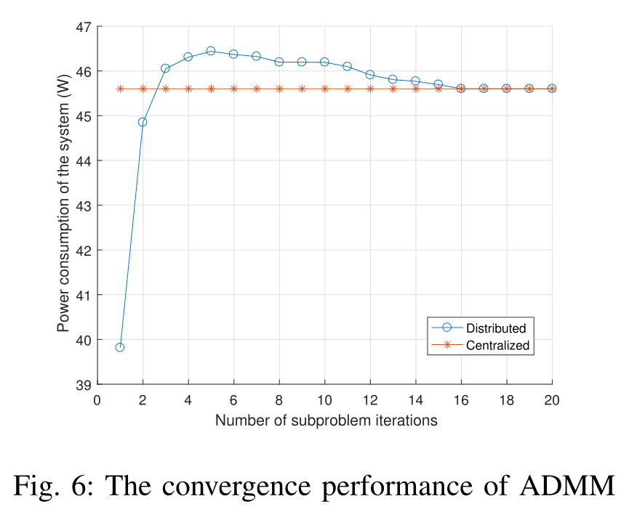
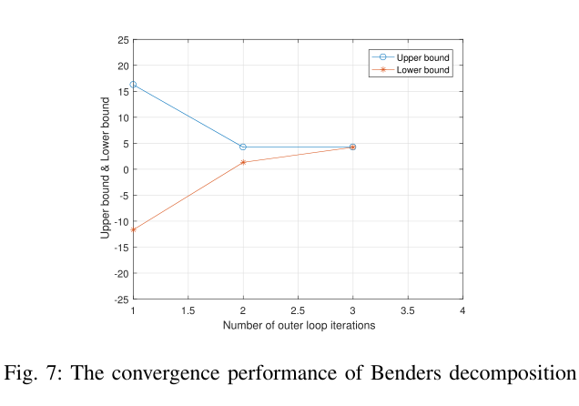
Simulation Results

Slide 52
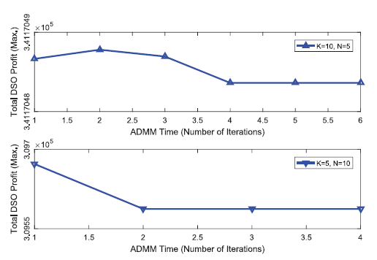
Total Profit of DSOs vs. Number of Iterations
Introduction
Motivation
System Model
Problem Formulation
Algorithm Analysis
Simulation Results
Conclusions
References
Fast convergence (€ = 10⁻⁴)
Optimization using ADMM increases the total profit of the DSOs, while considering the utilities of the ADSSs
52

Slide 53

Total Profit of ADSSs vs. Workload Arrival
Introduction
Motivation
System Model
Problem Formulation
Algorithm Analysis
Simulation Results
Conclusions
References
20 ADSSs
10 ADSSs
5 ADSSs
The total profit of the ADSSs increases with the average workload arrival rate, and the number of ADSSs
53

Slide 54
Conclusions
Introduction
Motivation
System Model
Problem Formulation
Algorithm Analysis
Simulation Results
Conclusions
References
We have proposed an ADMM based EPEC algorithm for a typical fog computing scenario
The proposed ADMM algorithm reaches an optimum point in a distributed manner
The proposed method can be used for EPEC scenarios with a large number of entities
54

Slide 55

Communication, Caching, and Computing Example
* A. Osseiran et al., "Scenarios for 5G mobile and wireless communications: the vision of the METIS project," in IEEE Communications Magazine, vol. 52, no. 5, pp. 26-35, May 2014.

Slide 56


Incentive Function Design
DSOs try to maximize their profits by providing incentives to the ADSSs
Discount on the price per unit of computing resource set by the DSOs
Incentive factor
Incentive function
Price at the end of p^{th} iteration
Price at the beginning of p^{th} iteration
A scalar
56

