Slide 1
How To Draw Well in Paper
Ye Yu & Hui Chen
Oct 2016

Slide 2
Outline
Groups of Different Softwares
Data plotting
Schematic diagram
Data Visualization
One Example
Matplotlib
More Examples

Slide 3
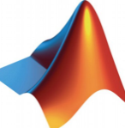
Data plotting
Software | Tools | Advantages | Disadvantages
1 | Matlab, Mathematica | Easy to learn Multiple types of image (2D, 3D) | Lack of beauty Zigzag shape
2 | Python LIB -Matplotlib | Any type of image Contain TeX math syntax Open Source | Difficult to handle 3D image
3 | LaTex -Tikz | Multiple types of image Good interaction between latex document s | Difficult to handle
Notes:
Overview of different type of drawing softwares
Next Application Examples

Slide 4
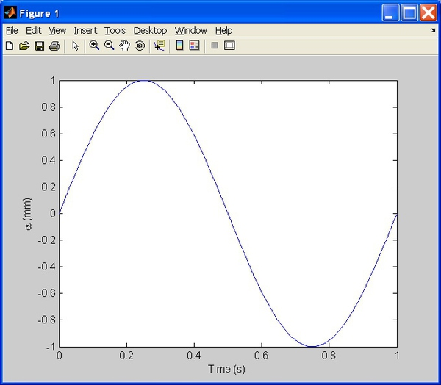
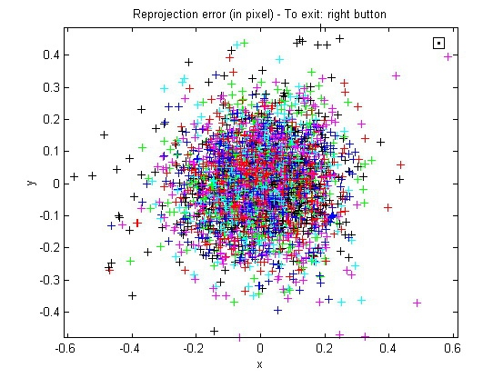
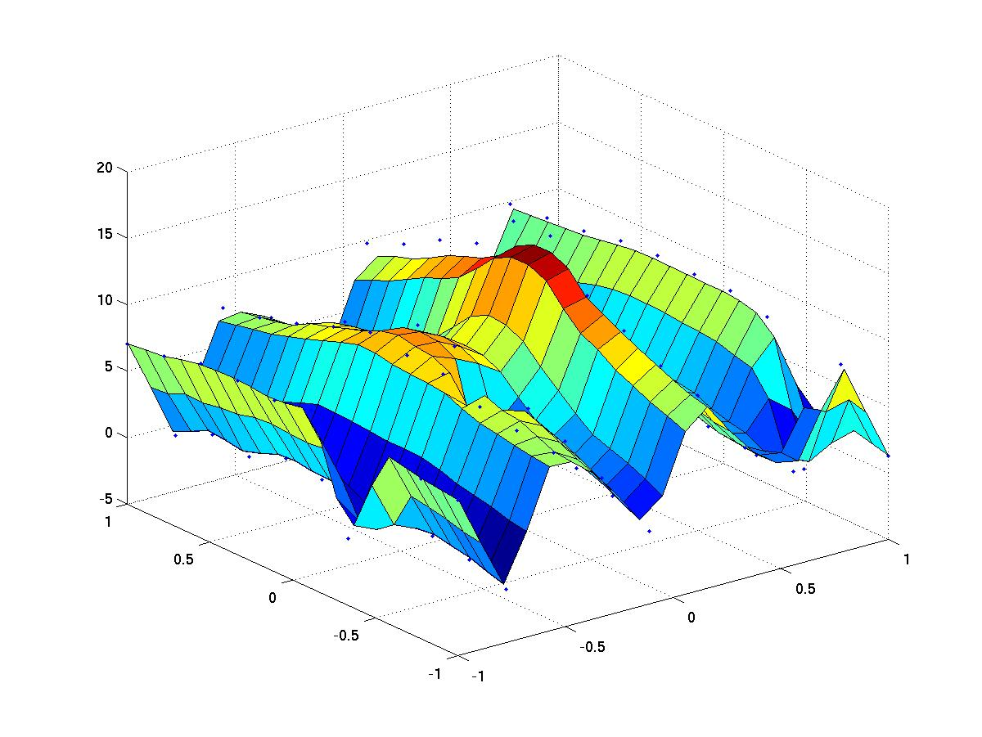
Matlab
Zigzag shape
Notes:
Basic function to draw 2D 3D images

Slide 5
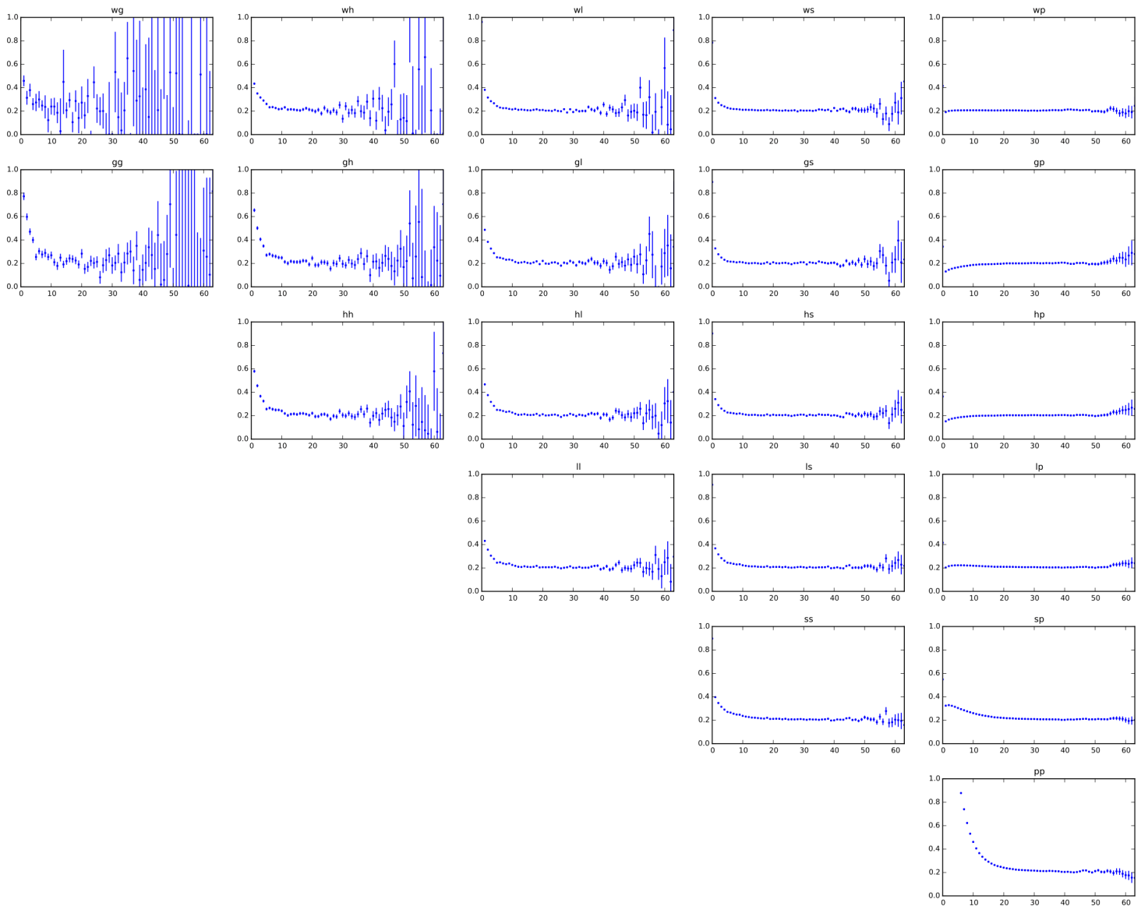
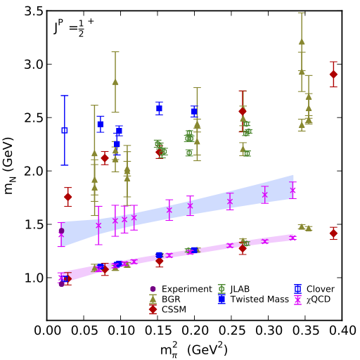
-Matplotlib

Slide 6
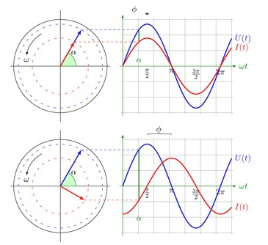
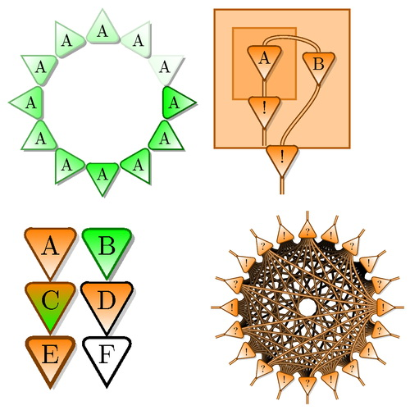
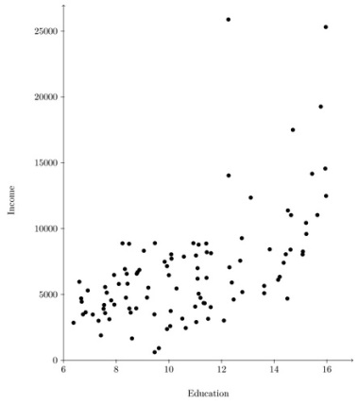
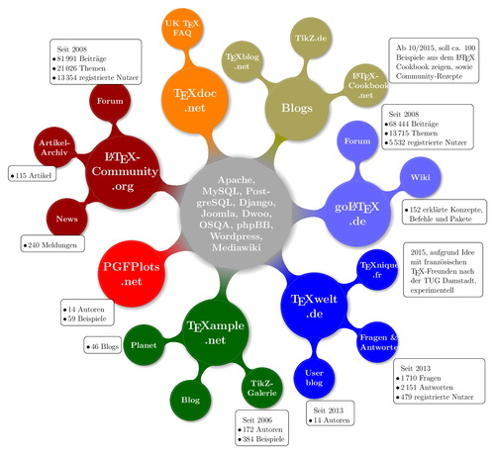
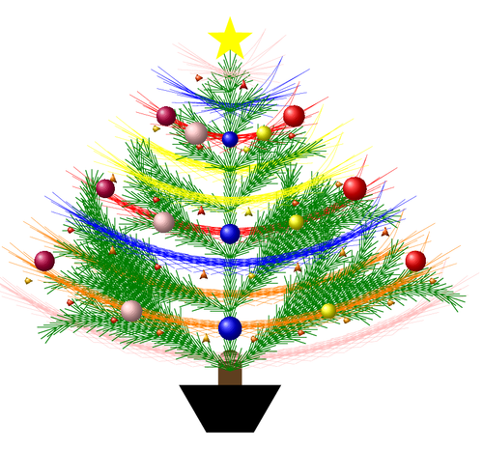
Overall interaction between LaTeX documents
Resources and codes community http://tex.stackexchange.com/
Scatter
Curve
Logic
Structure
Christmas fractal tree
Animated definite integral

Slide 7
Schematic diagram
Software | Tools | Advantages | Disadvantages
4 | Metapost | Schematic diagram , Vector diagram Precisely controlled by code | ——
5 | Visio | Schematic diagram , Flow chart No programming | ——
6 | Blender | 3D Rendering Open Source 3D creation | ——

Slide 8
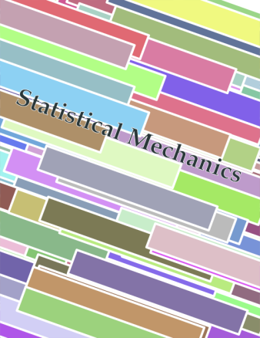
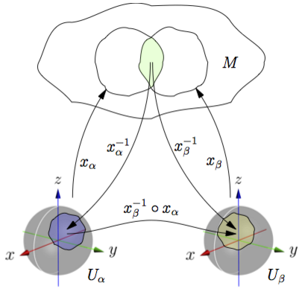
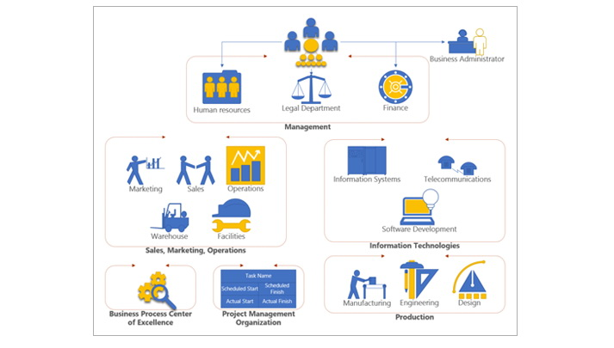
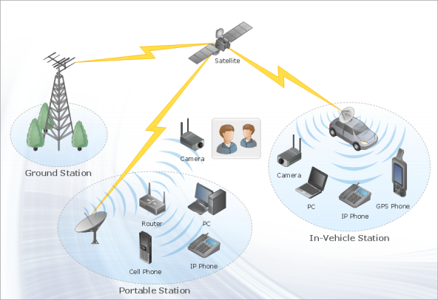
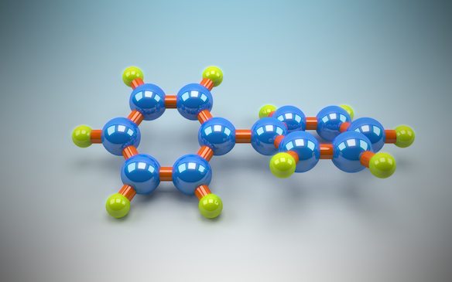
Metapost
Book cover
Mathematic model
Visio
Flow Chart
Communication model
Blender
Lorentzian line
molecule

Slide 9
Data Visualization
Software | Tools | Advantages | Disadvantages
7 | R -ggplot2 | Statistics data visualization | ——
8 | Paraview | variety of data formats and display methods | ——
9 | Tecplot | Convers a large number of data into an easy understandable picture | ——

Slide 10
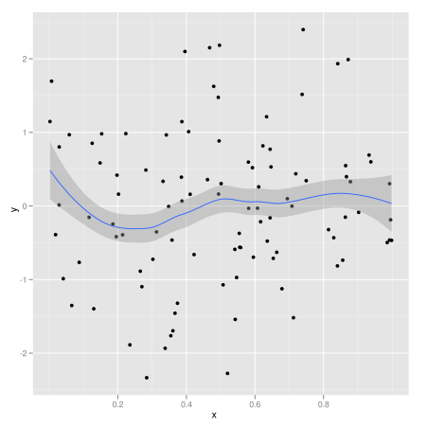
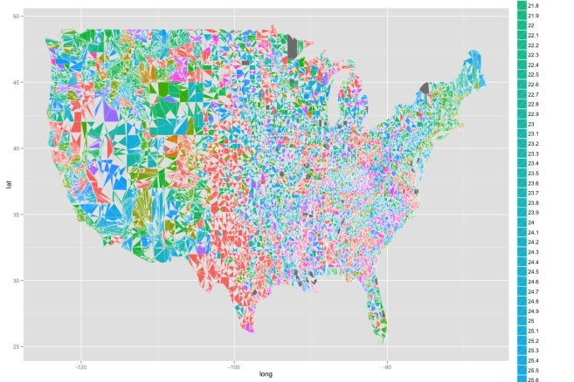
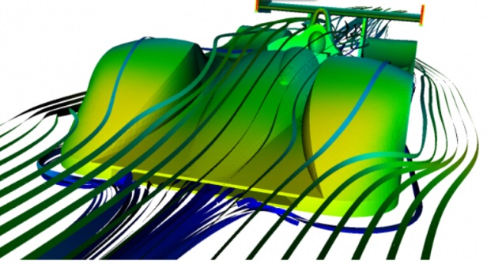
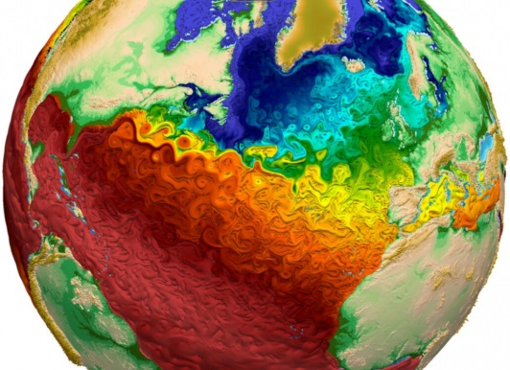
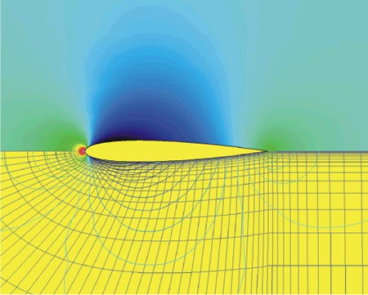
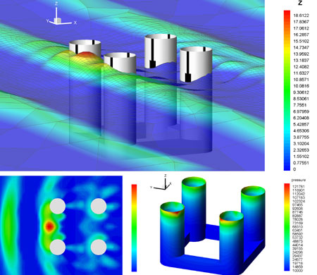
Airflow of the racing car
Global temperature distribution
Airflow of the aircraft wing
Offshore drilling platform

Slide 11
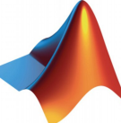
Summary
Software | Tools | Advantages | Disadvantages
1 | Matlab, Mathematica | Easy to learn Multiple types of image (2D, 3D) | Lack of beauty
2 | Python LIB -Matplotlib | Any type of image Contain TeX math syntax | Difficult to handle
3 | Metapost | Sketch Map, Vector diagram Precisely controlled | ——
4 | Blender | Open Source 3D creation | ——
5 | R -ggplot2 | Statistics data visualization | ——
6 | Visio | Schematic diagram , Flow chart | ——
7 | LaTex-Tikz | Multiple types of image | Difficult
8 | Paraview | Variety of data formats and display methods | ——
9 | Tecplot | Convers a large number of data into an easy understandable picture | ——

Slide 12
Outline
Groups of Different Softwares
Data plotting
Schematic diagram
Data Visualization
One Example
Matplotlib
More Examples

Slide 13
matplotlib
One Example
PYTHON
Notes:
More delicate/smooth

Slide 14
Anaconda
Anaconda is a completely free Python distribution (including for commercial use and redistribution). It includes over 195 of the most popular Python packages for science, math, engineering, data analysis.

Slide 15
IDE: Spyder

Slide 16
Function Figure
import numpy as np
import matplotlib.pyplot as plt
x = np.linspace(0, 2 * np.pi, 100)
y1 = np.sin(x)
y2 = np.sin(3 * x)
plt.fill(x, y1, 'b', x, y2, 'r', alpha=0.3)
plt.show()
Notes:
Transparency
Alpha:0~1

Slide 17
Scatter Figure
plt.scatter(x, y, s=area, alpha=0.5)

Slide 18
3D Figure
ax.plot_surface(X, Y, Z, rstride=8, cstride=8, alpha=0.3)
cset = ax.contourf(X, Y, Z, zdir='z', offset=-100, cmap=cm.coolwarm)
cset = ax.contourf(X, Y, Z, zdir='x', offset=-40, cmap=cm.coolwarm)
cset = ax.contourf(X, Y, Z, zdir='y', offset=40, cmap=cm.coolwarm)
Notes:
Rstride: line on y direction
Cstride: line on the x direction

Slide 19
Vector Field Figure
plt.streamplot(X, Y, U, V, color=U, linewidth=2, cmap=plt.cm.autumn) plt.colorbar()
Notes:
If color=V, color will be opposite

Slide 20
Networking
plt.triplot(x, y, triangles, 'go-')
plt.title('triplot of user-specified triangulation')
plt.xlabel('Longitude (degrees)')
plt.ylabel('Latitude (degrees)')

Slide 21
Polarization Figure
ax = plt.subplot(111, polar=True)
bars = ax.bar(theta, radii, width=width, bottom=0.0)
Notes:
Bottom is the inside start point of each sector

Slide 22
Pie Charts
n = 20
Z = np.random.uniform(0,1,n)
pie(Z)
show()

Slide 23
Scatter and Histogram
scatter()
hist()

Slide 24
Plotly
makes interactive, publication-quality graphs online
http://nbviewer.jupyter.org/github/plotly/python-user-guide/blob/master/s0_getting-started/s0_getting-started.ipynb

Slide 25
Xkcd Style
http://jakevdp.github.io/blog/2013/07/10/XKCD-plots-in-matplotlib/
plt.xkcd()
Notes:
comic

Slide 26
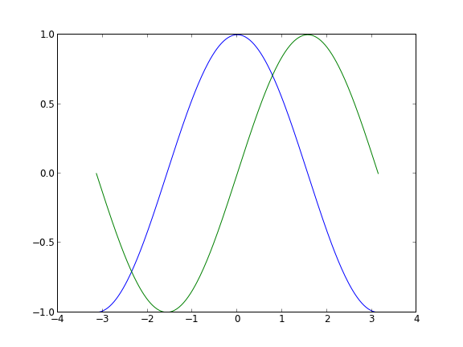
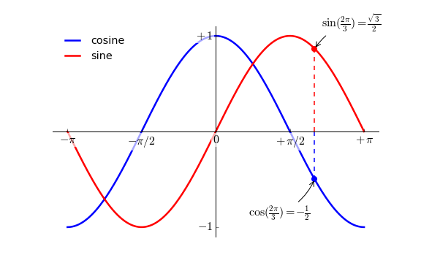
Steps To Make

Slide 27
Default Figure
X = np.linspace(-np.pi, np.pi,256,endpoint=True)
C,S = np.cos(X), np.sin(X)
plot(X,C)
plot(X,S)
show()

Slide 28
Change Color and Width
figure(figsize=(10,6), dpi=80)
plot(X, C, color="blue", linewidth=2.5, linestyle="-")
plot(X, S, color="red", linewidth=2.5, linestyle="-")
Notes:
First of all, we want blue and sine cosine is is red, their lines are slightly thicker. We will also change the image size slightly to make it a bit wider.

Slide 29
Set Boundary
xlim(X.min()*1.1, X.max()*1.1) ylim(C.min()*1.1, C.max()*1.1)
Notes:
The current image boundary is a bit too tight a little, and we want to set aside a little space to make data points more clearly.

Slide 30
Set Tick Labels
xticks([-np.pi, -np.pi/2, 0, np.pi/2, np.pi], [r'$-\pi$', r'$-\pi/2$', r'$0$', r'$+\pi/2$', r'$+\pi$'])
yticks([-1, 0, +1], [r'$-1$', r'$0$', r'$+1$'])
Notes:
The current scale is not ideal, because they don't show is the cosine values we are interested in (+ / - + / - PI, PI / 2). We will change them let them explicitly only those values.

Slide 31
Moving Spines
ax = gca()
ax.spines['right'].set_color('none')
ax.spines['top'].set_color('none')
ax.xaxis.set_ticks_position('bottom')
ax.spines['bottom'].set_position(('data',0))
ax.yaxis.set_ticks_position('left')
ax.spines['left'].set_position(('data',0))
Notes:
Spines are the lines connecting the axis tick marks and noting the boundaries of the data area. They can be placed at arbitrary positions and until now, they were on the border of the axis. We'll change that since we want to have them in the middle. Since there are four of them (top/bottom/left/right), we'll discard the top and right by setting their color to none and we'll move the bottom and left ones to coordinate 0 in data space coordinates.

Slide 32
Add a Legend
plot(X, C, color="blue", linewidth=2.5, linestyle="-", label="cosine")
plot(X, S, color="red", linewidth=2.5, linestyle="-", label="sine")
legend(loc='upper left')
Notes:
Let's add a legend in the upper left corner. This only requires adding the keyword argument label (that will be used in the legend box) to the plot commands.

Slide 33
Annotate Some Points
t = 2*np.pi/3
plt.plot([t,t],[0,np.cos(t)], color ='blue', linewidth=1.5, linestyle="--")
plt.scatter([t,],[np.cos(t),], 50, color ='blue')
plt.annotate(r'$\sin(\frac{2\pi}{3})=\frac{\sqrt{3}}{2}$',
xy=(t, np.sin(t)), xycoords='data',
xytext=(+10, +30), textcoords='offset points', fontsize=16,
arrowprops=dict(arrowstyle="->", connectionstyle="arc3,rad=.2"))
plt.plot([t,t],[0,np.sin(t)], color ='red', linewidth=1.5, linestyle="--")
plt.scatter([t,],[np.sin(t),], 50, color ='red')
plt.annotate(r'$\cos(\frac{2\pi}{3})=-\frac{1}{2}$',
xy=(t, np.cos(t)), xycoords='data',
xytext=(-90, -50), textcoords='offset points', fontsize=16,
arrowprops=dict(arrowstyle="->", connectionstyle="arc3,rad=.2"))
Notes:
Let's annotate some interesting points using the annotate command. We chose the 2π/3 value and we want to annotate both the sine and the cosine. We'll first draw a marker on the curve as well as a straight dotted line. Then, we'll use the annotate command to display some text with an arrow.
latex

Slide 34
Devil Is In The Details
for label in ax.get_xticklabels() + ax.get_yticklabels(): label.set_fontsize(16) label.set_bbox(dict(facecolor='white', edgecolor='None', alpha=0.65 ))
Notes:
The tick labels are now hardly visible because of the blue and red lines. We can make them bigger and we can also adjust their properties such that they'll be rendered on a semi-transparent white background. This will allow us to see both the data and the labels.

Slide 35
Outline
Groups of Different Softwares
Data plotting
Schematic diagram
Data Visualization
One Example
Matplotlib
More Examples

Slide 36
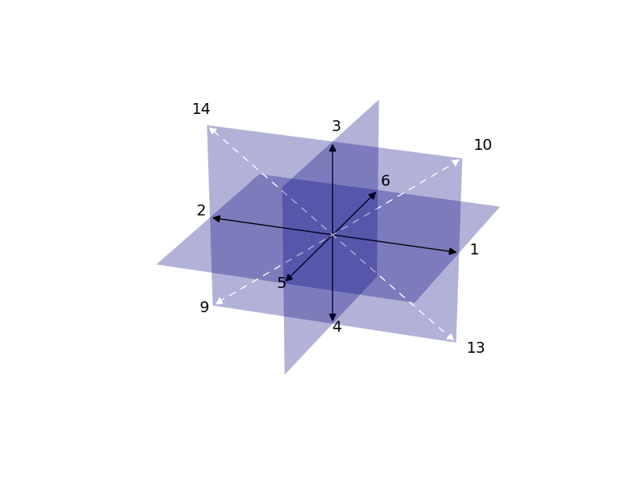
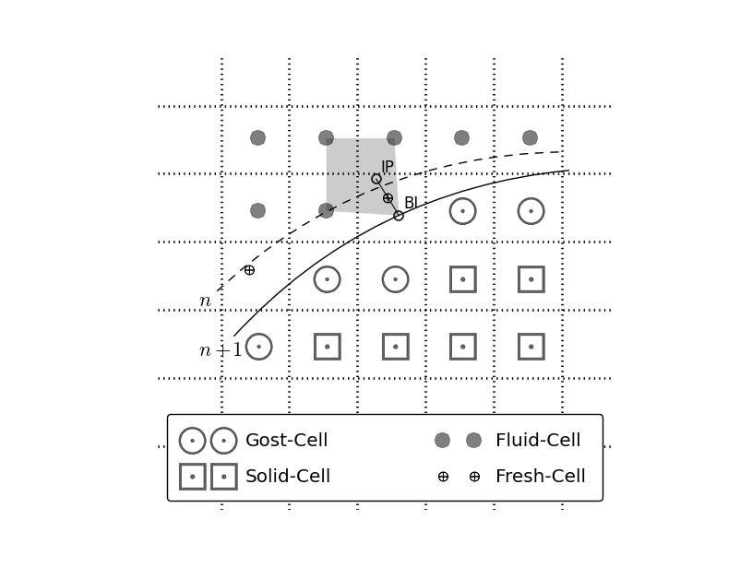
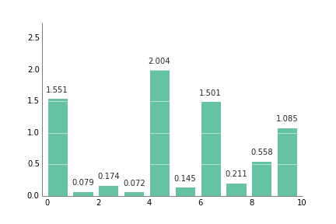
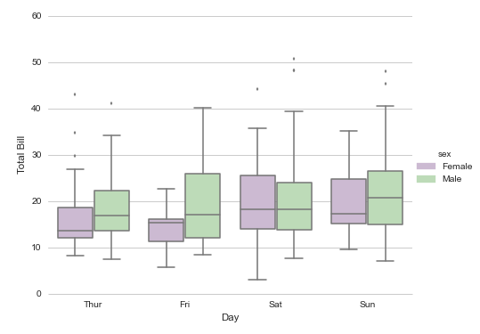

Slide 37
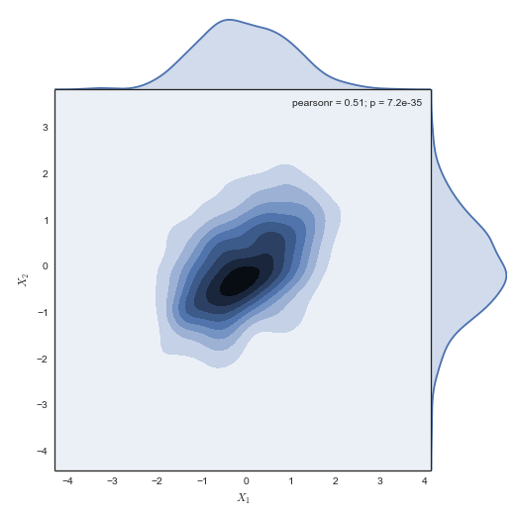
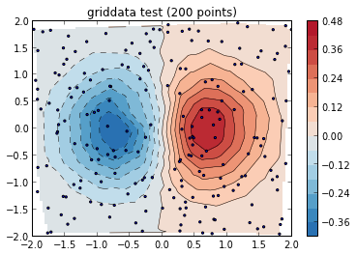
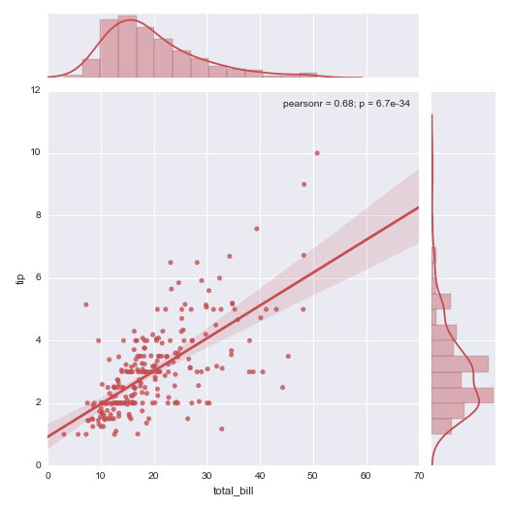
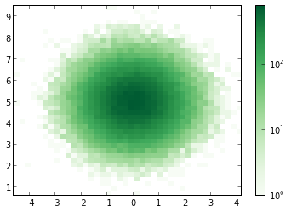

Slide 38
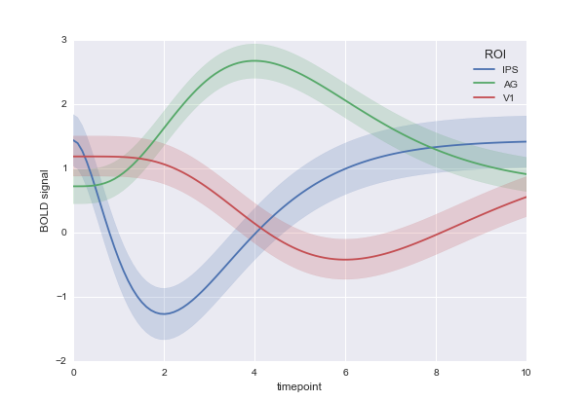
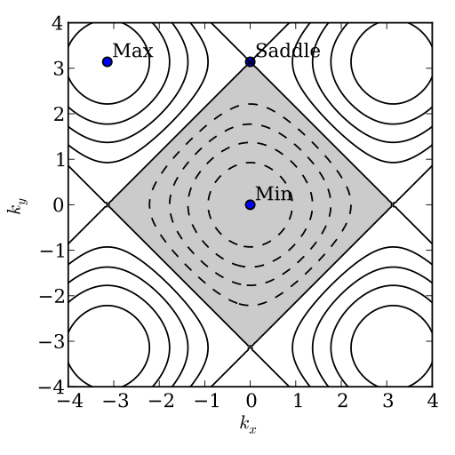
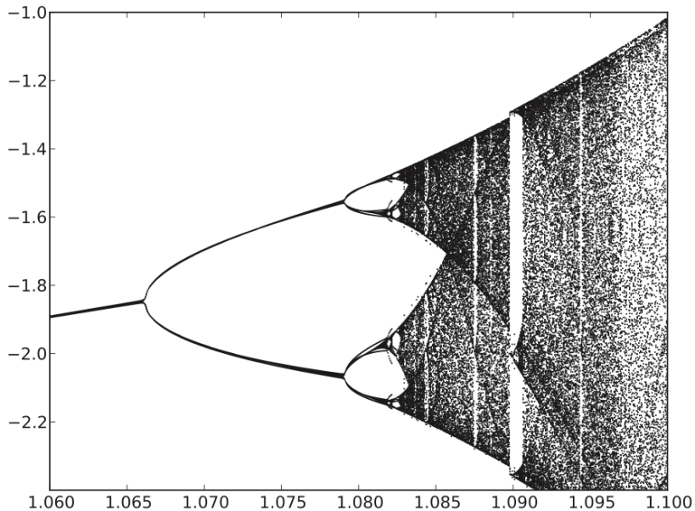
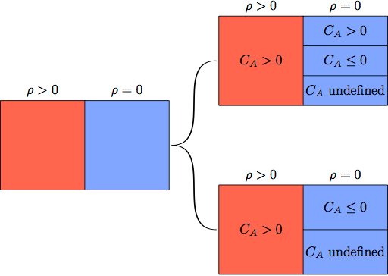

Slide 39
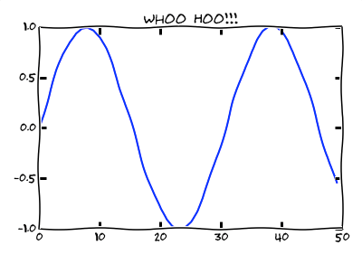
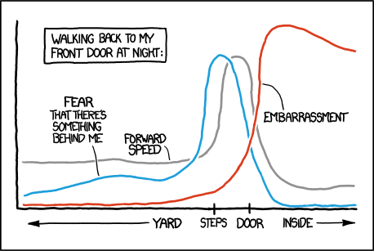
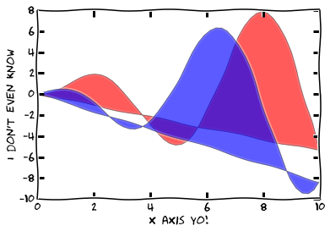
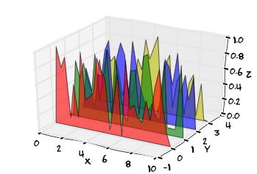

Slide 40
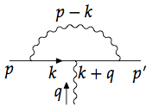
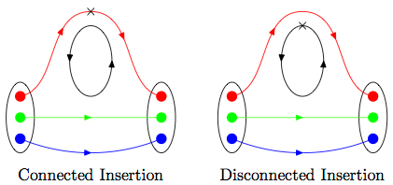

Slide 41
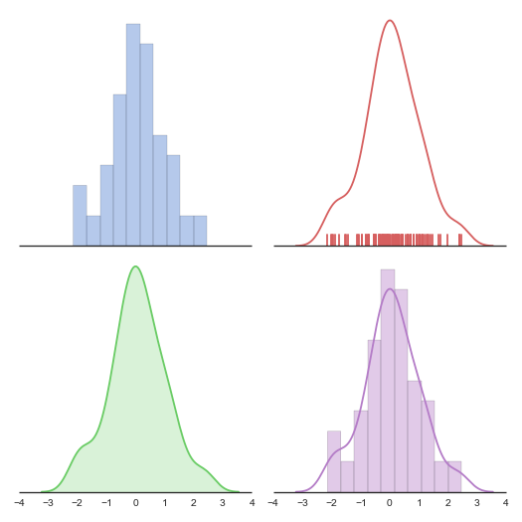

Slide 42
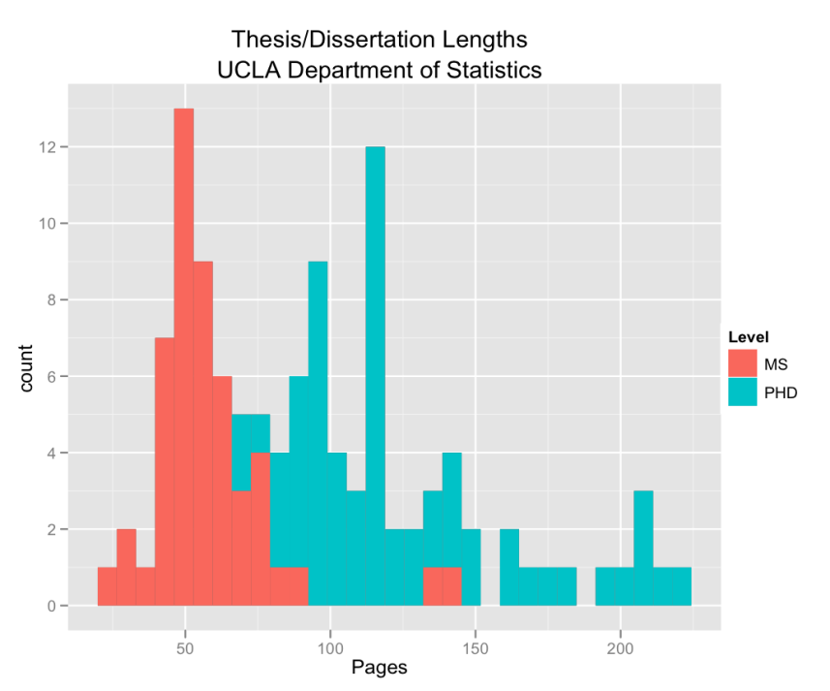
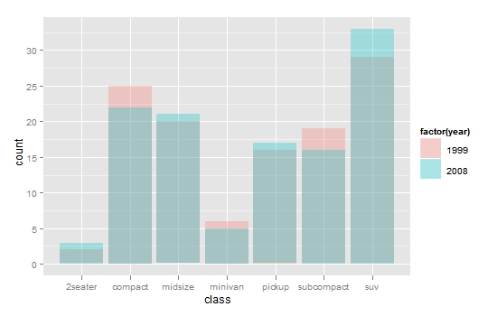
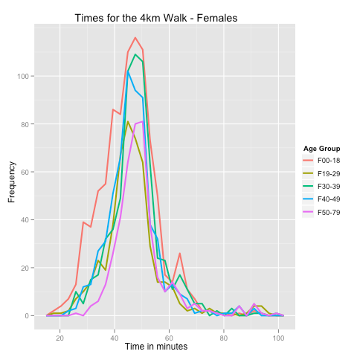
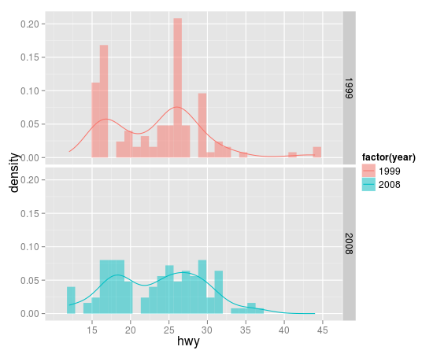

Slide 43
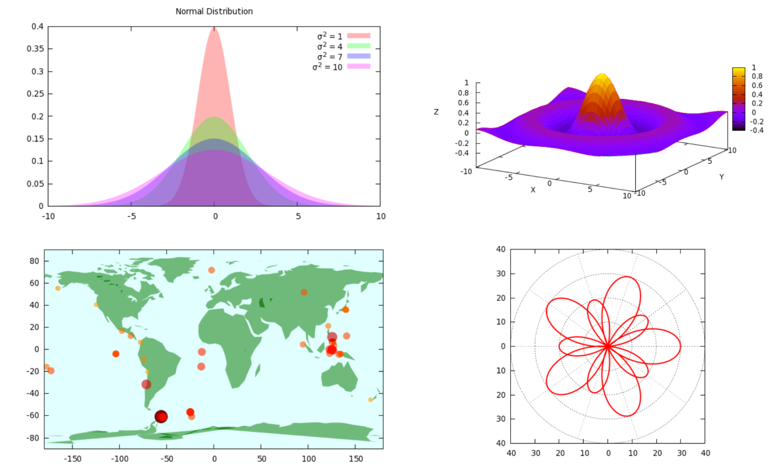

Slide 44
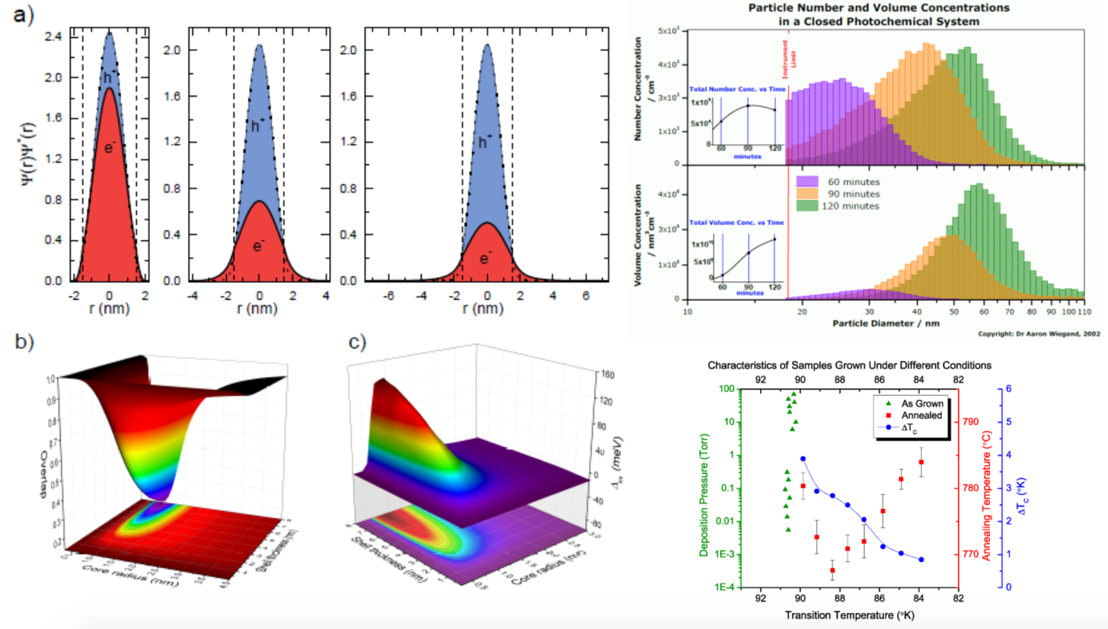

Slide 59
Reference
‘How to draw beautiful illustrations in papers’, [Online]Available:
https://www.zhihu.com/question/21664179?from=timeline&isappinstalled=1 (Oct 5, 2016)
More Examples: http://matplotlib.org/gallery.html

Slide 60
60

