Slide 1
Cryptoeconomics: Economic Mechanisms
behind Blockchains
Zhu Han
John and Rebecca Moores Professor, IEEE/AAAS Fellow
Electrical and Computer Engineering Department
University of Houston
Thanks to Dr. Jing Li, Daniel Doe and NSF
Notes:
Miao Pan, Larry Shi, Hien Van Nguyen, Dusit Niyato, Xiao-Ping Zhang

Slide 2
Outline
Introduction
Blockchain
Cryptoeconomics
Contract Theory
Example I: Incentive Mechanism Design for Mitigating Frontrunning and Transaction Reordering in Decentralized Exchanges.
Example II: Contract-based approach for security deposit in blockchain networks with shards.
Other Work
Conclusion

Slide 3
Introduction - Blockchain
Origins of Blockchain
1998-Nick Szabo designed a mechanism for a decentralized digital currency he called “bit gold”.
1982-David Chaum designed a cryptography-based payment system, i.e., Ecash.
1991 - Stuart Haber et. al introduced the idea of a chain of cashes.
1980-Merkle Raft proposed a data structure, called Merkle Tree.
1998-Wei Dai proposed
B-money.
1980
1982
1991
1997
1998
2008
1982 - Leslie Lamport et.al described the Byzantine Generals Problem.
1997 - Adam Back proposed Hashcash for anti-spam, called Proof of Work.
2008 - Satoshi Nakamoto firstly proposed blockchain in the project Bitcoin.

Slide 4
Introduction - Blockchain
What is Blockchain?
A blockchain is a distributed, decentralized, digital ledger that exists across a peer-to-peer network*.
Block N header
Hash of (N-1) header
Transaction id_1
Transaction id_i
Transaction id_2x
Genesis Block
Block ...
Block N-3
Block N-2
Block N-1
Block N
*https://www.investopedia.com/terms/b/blockchain.asp

Slide 5
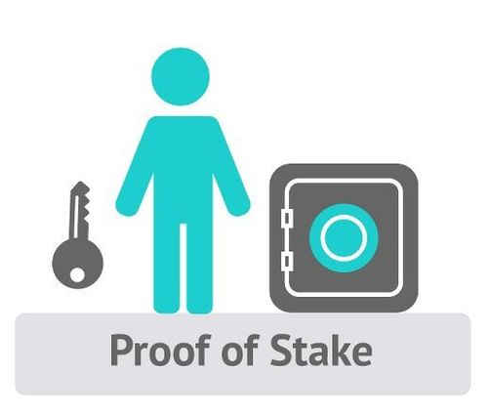
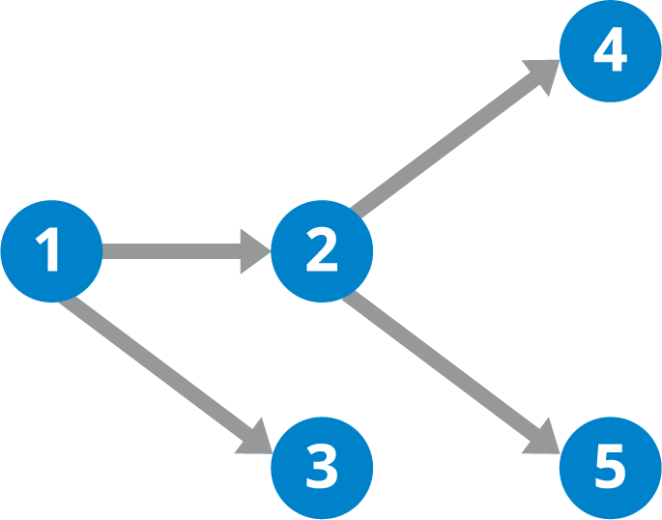
Consensus mechanism （CM）
Question: “who will be the one has the right to insert the next block into blockchain”.
With CM, the information can be announced orderly to all users without involvement of the third party.
Proof based Consensus
Excellent scalability, low transaction throughput, high delay
Normally for unpermissioned public chains, such as: Bitcoin, Ethereum
Voting Based Consensus
Excellent transaction throughput/delay, not scalable
Normally for permissioned chains, e.g., Byzantine Fault Tolerance (BFT)/ Practical BFT (PBFT)/RAFT, etc.
PoW (mining)
PoS (stake)
Direct Acyclic Graph Tangle (DAG)

Slide 6
Proof of Work (PoW) vs. Proof of Stake (PoS)
Proof of Work (PoW)
Proof of Stake (PoS)
Depends on the stake in the network with less computational complexity
Mining capacity depends on computational power
Miners Compete with computing power to solve puzzles for block rewards
Validators collect transaction fees instead of receive block rewards
Hackers need a powerful computer to launch a 51% attack on the network
Hackers need to own 51% of all stakes to launch a 51% attack on the network

Slide 7
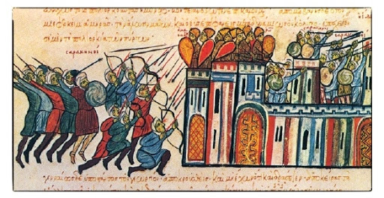
Voting Based CM – Byzantine Generals' Problem
N generals surround a castle.
There are f traitors.
All loyal generals must agree on the same plan of action (attack or retreat) despite the presence of traitors.
Generals can communicate only by message passing.
Traitors may do anything they wish.
Given in total N generals, how many traitors the system can be tolerant?
Fault tolerance: 1/3,
i.e., N > 3f + 1

Slide 8
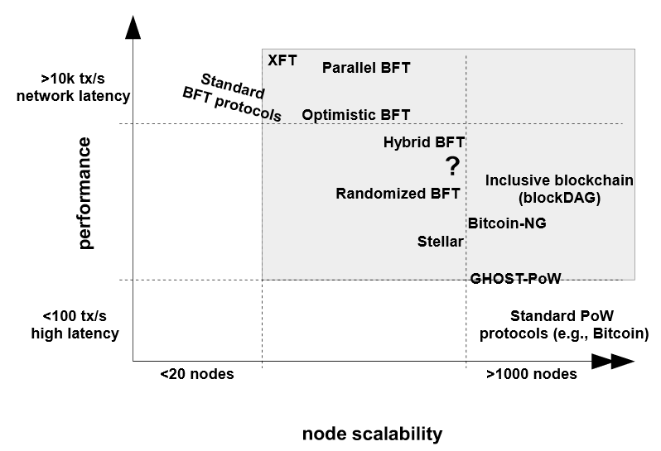
Performance Vs Scalability
Image Source: M. Vukolic: The Quest for Scalable Blockchain Fabric: Proof-of-Work vs. BFT Replication

Slide 9
Introduction - Blockchain
Technology components of Blockchain
Cryptography
Chain of blocks
Consensus
Incentive
Blockchain
The first camp is from implementation point of view
Prevent malicious users
Lack of relevant incentive mechanism design for the distributed systems.
The second camp formulates this issue as Cryptoeconomics.
Provide incentive to rational users
Notes:
incentive is the key part of cryptoeconomics, is not the same as cryptoeconomics

Slide 10
First Camp Case Study: Bitcoin
The first miner that solves a mathematical puzzle will obtain the privilege to create the next block.
Bitcoin uses block rewards and transaction fees to compensate miners for their work, and to incentivize them to mine on the longest chain.
Users in Bitcoin network are anonymous, can entry/exit at any time, any two of them can communicate with each other relatively quickly
Model | Parameters | Security Margin
Honest Majority | Honest users are more than or equal to 2/3 of total users. | 0.5
Uncoordinated Majority | The coordinated users account for less than ½ of total users. | 0.25
Coordinated Majority | The coordinated users account for up to 100% of total users. | N/A
Bribing Attacker | Budget > (block reward + tx_fees) * number_of_blocks | N/A
Bitcoin uses cryptoeconomics to solve two problems:
The weight assignment problem: how to resist the Sybil attack.
The incentive problem: how to motivate the unknown participants to behave correctly.

Slide 11
Second Camps - Cryptoeconomics
What is the relation between Blockchain and Cryptoeconomics?
Blockchain projects and the blockchain-based solutions are the instances of cryptoeconomics.
Bitcoin, Ethereum;
Proof of Work, Proof of Stake;
State Channels, Plasma, Sharding, Roll-up solutions.
What is Cryptoeconomics?
Cryptoeconomics is the application of incentive mechanism design to information security problems. (Vlad, 2015)
Cryptography
Incentive
Security
Malicious attackers
Rational participants
Notes:
Building systems that have certain desired properties:
1. Use cryptography to prove properties about messages that happened in the past.
2. Use economic incentives defined inside the system to encourage desired properties to hold into the future.
For example:
the incentive mechanism has been applied in every step to secure the distributed system, including the transaction confirmation, mining, and longest-chain generation.

Slide 12
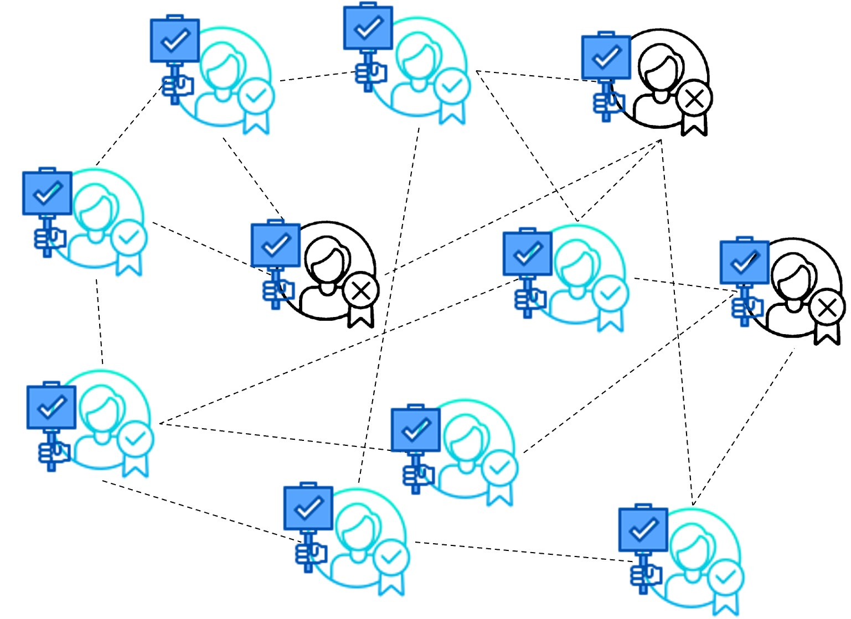
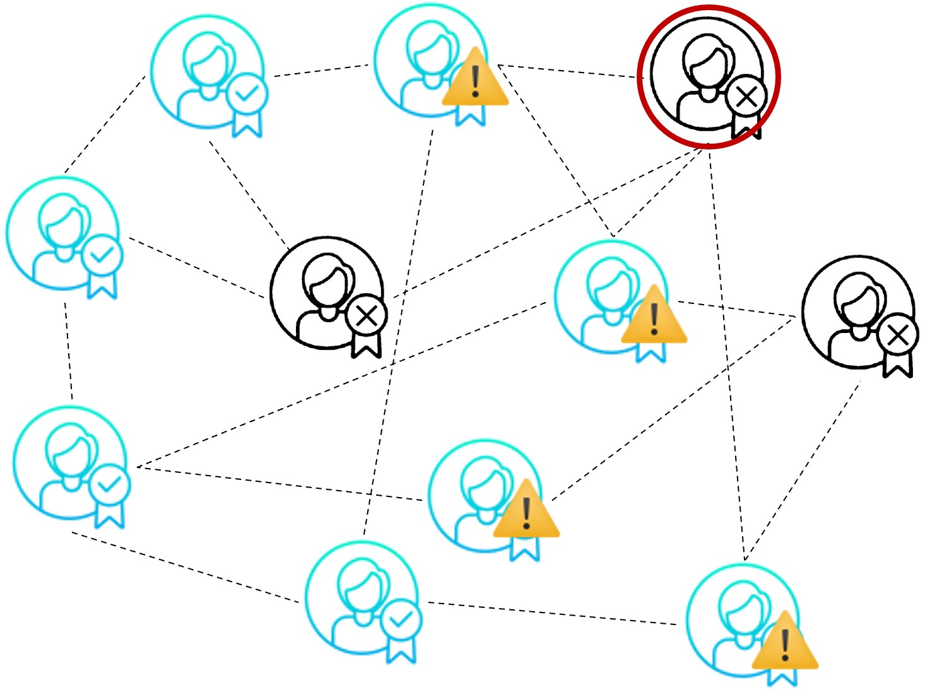
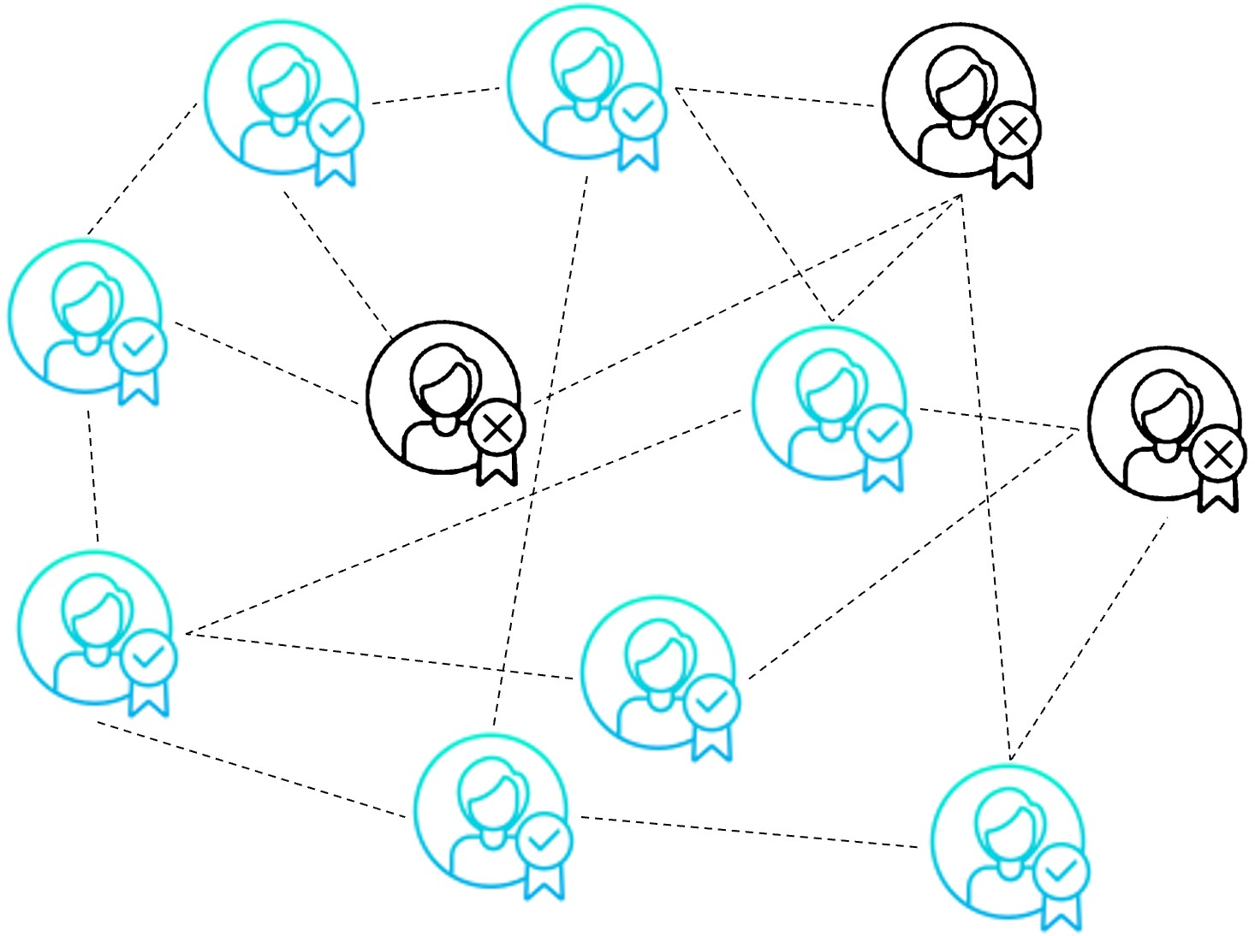
Introduction - Cryptoeconomics
How does the incentives secure a distributed system?
Rewards: increase actors' token balances if they do something good.
Block reward.
Transaction fee.
Penalties: reduce actors' token balances if illegal behavior occurs.
Security deposits.
Privileges: incentivize participants by giving them decision-making right.
Voting weight

Slide 13
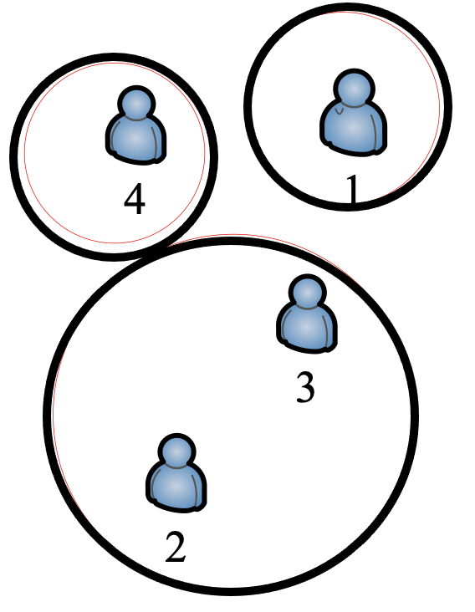
Introduction - Cryptoeconomics
How should we determine the economics incentives?
Mechanism Design:
Auction Theory
Vickrey-Clarke-Groves (VCG) auction
Coalitional Games
E.g. coalition formation games.
Merge/Split Game
Contract Theory
Notes:
Contract theory is a subset of mechanism design, has no enforceability.

Slide 14
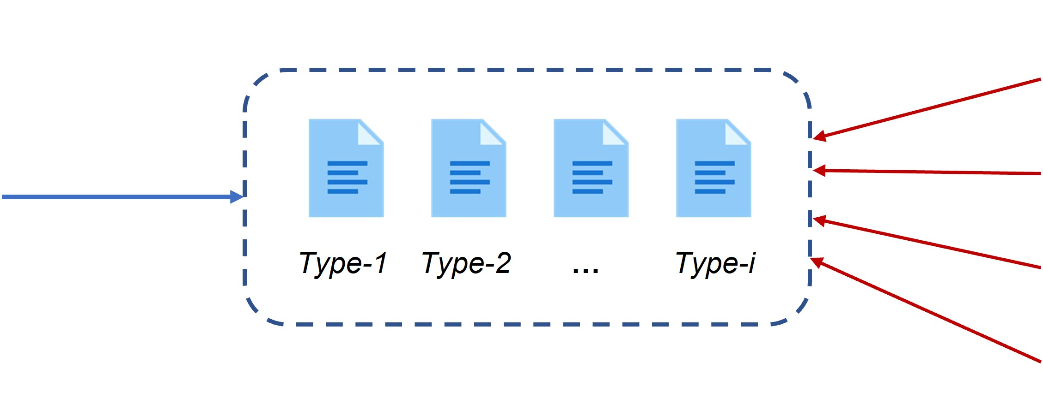
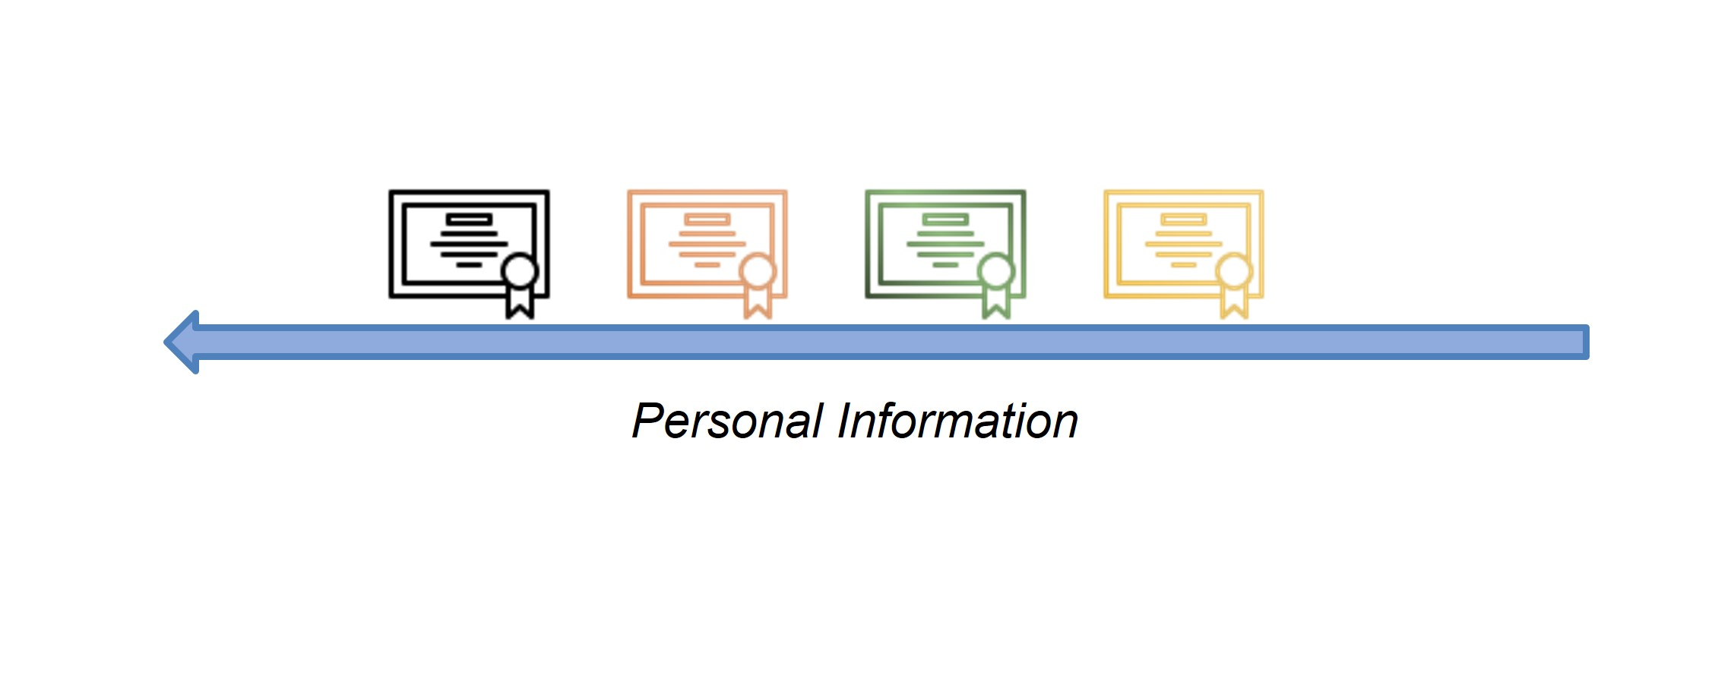
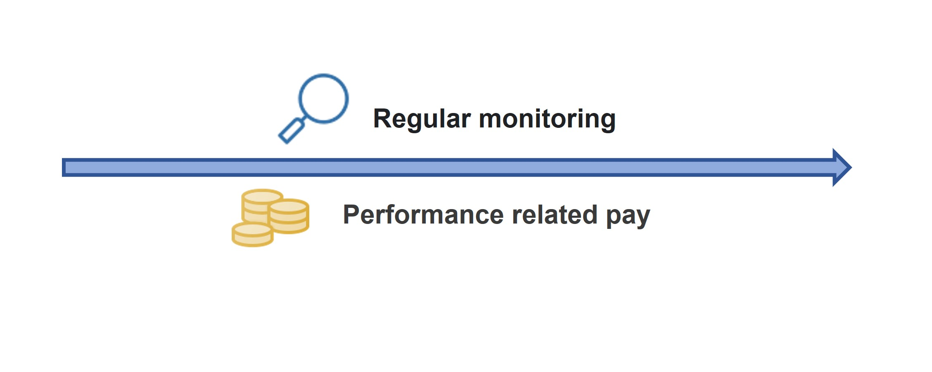
Introduction – Contract Theory
Contract Theory Basics
Contract theory studies how economic actors can and do construct contractual arrangements, generally in the presence of information asymmetry.
Hidden information - Signaling: The sender’s private information may be conveyed to the receiver through observable actions.
Hidden information - Adverse Selection: One agent who has private information on its “type”, its preferences or productivity is unknown to the principal.
Hidden Action – Moral Hazard: The agent’s effort impacts the outcome of task.
Private Information
Jean Tirole - Nobel Prize winner in economic science of 2014

Slide 15
Introduction – Contract Theory
Adverse Selection of PhD Student
Moral Hazard of PhD Student
What my parents thinks I do
What my advisor thinks I do
What I actually do
When advisor presents
When advisor on travel
The plan you try to find the advisor with financial aid
The real plan
The secret plan
“I am going to be a professor at a major research university after I graduate.”
Look for career alternatives
Become a baker/rock star/writer

Slide 16
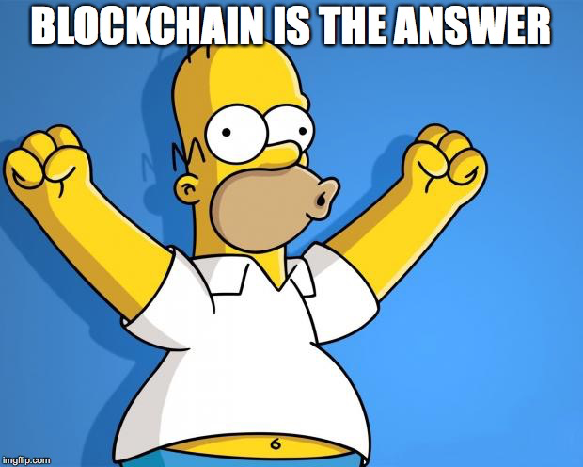
Introduction – Motivation
Problem of Cryptoeconomics
There exists Information Asymmetry in cryptoeconomics.
Participants are anonymous in blockchain.
Most of the participants are rational and not willing to reveal their private information.
The number of participants is large.
Contract Theory can overcome the Information Asymmetry and benefit a large number of rational participants.
Notes:
Little research on Cryptoeconomics.

Slide 17
Outline
Introduction
Blockchain
Cryptoeconomics
Contract Theory
Example I: Incentive Mechanism Design for Mitigating Frontrunning and Transaction Reordering in Decentralized Exchanges.
Example II: Contract-based approach for security deposit in blockchain networks with shards.
Other Work
Conclusion

Slide 18
Motivation
Transaction Frontrunning
Miner intercepts and alters a transaction to include a higher fee at the expense of the original sender.
Transaction 0
Wow! These are great opportunities!
gas price: 10
Transaction 1
Transaction Reordering?
gas price: 20
Miners selectively order transactions in the blocks, which potentially changes the order in which transactions are processed and confirmed on the blockchain.
Transaction 2
gas price: 40
1 | Transaction 4
2 | Transaction 3
3 | Transaction 2
4 | Transaction 1
5 | Transaction 0
Transaction 3
Miner Extractable Value (MEV)
gas price: 50
This include various possibilities of using adversarial ordering optimization (AOO) to extract money from a blockchain smart contract system.
Transaction 4
gas price: 70
Revenue: 190
Notes:
Transaction Frontrunning is done by users or bots to bid high gas prices which increases the chances of getting their transactions mined (included in the next block).
Transaction reordering is done by miners, where they try to selectively reorder transactions that can give them a high utility.
Miner extractable value is the technical term used to describe transaction reordering by miners any other techniques used to extract money from users.
From the figure, assuming the lady submitted her transaction first hence she has a transaction 0. followed by the other entities on the network as transaction 1, 2, 3, and 4.
Ideally, the transactions should be ordered based on when they arrived (timestamp). However, since the miner wants to maximize its utility, It will order transactions in his block based on
Gas fees. Now assume he has space for only 4 transactions as shown in the table, The user with transaction 0 will not be included since her gas fee is lower than the others. The miner will include transaction
4, 3, 2, and 1, respectively.

Slide 19
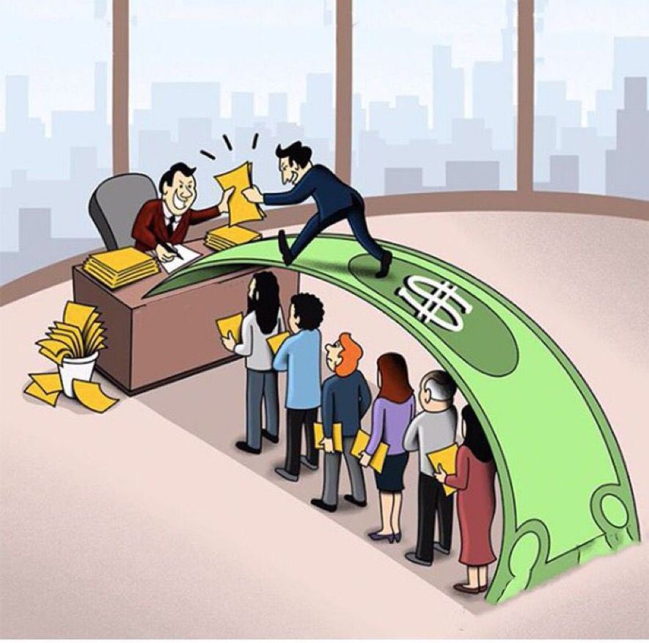
Effects Of Transaction Frontrunning & Reordering
reordering
Transaction delays: prioritize transactions with higher fees, to delay or prevent the confirmation of certain transactions, or to create double-spending attacks.
Unfairness: give an unfair advantage to miners over other users and can negatively impact the performance and security of the blockchain network.
Centralization: lead to centralization of the network by giving an advantage to the users who have more resources to pay for high fees.
Censorship: used to perform censorship attack by delaying or preventing the confirmation of certain transactions, based on the contents of the transaction or the sender's identity.
Selfish mining attack: where miner can manipulate the order of the transactions to increase its own rewards and decrease the rewards of the other miners.
Frontrunning
transactions
Block
Contract
From: 0x690b
To: 0xffee
Contract
From: 0x690b
To: 0xffee
Contract
From: 0x690b.
To: 0xffee..
Notes:
Here we show some images of transaction frontrunning and reordering in fig. 1.
We also present the effects of transaction frontrunning and reordering on blockchain networks.

Slide 20
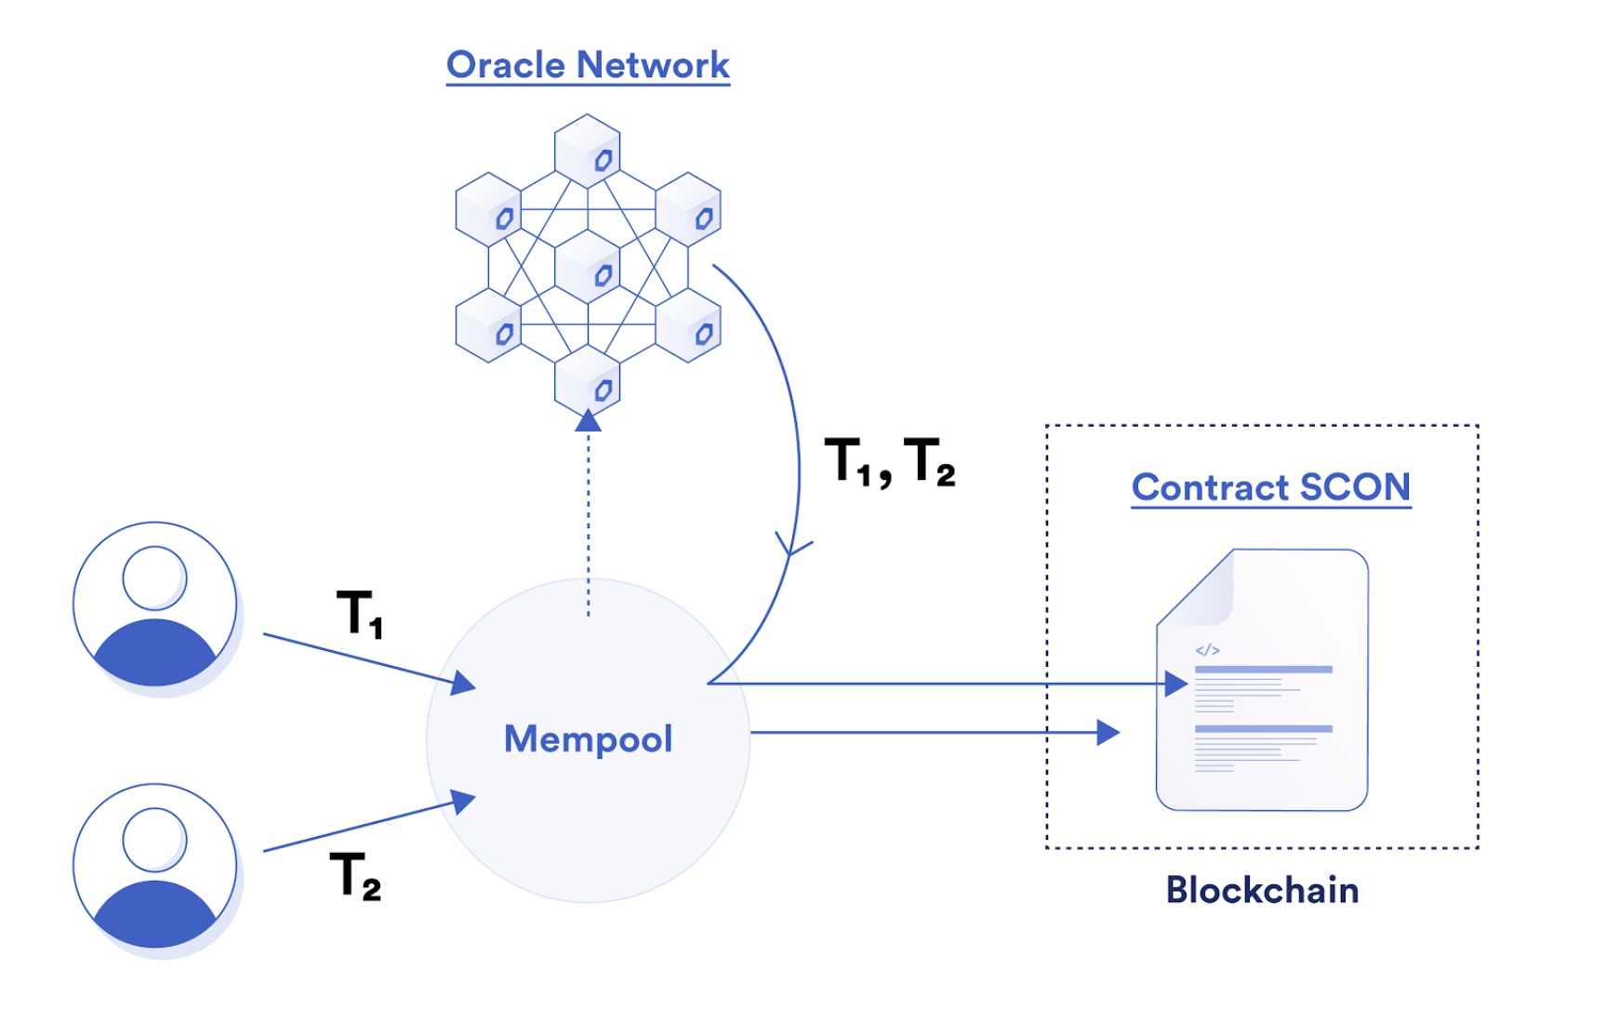
Existing Literature
Related Works
Chainlink Fair Sequencing Services
Use a decentralized oracle network to fairly order transactions sent to an on-chain smart contract. Basically, First Come First Service (FCFS) [FSS]
Auction Theory
Simply auction off the right to reorder transactions within an N-block window to the highest bidder. [MEV Auctions]
Others
Automated market maker (AMM) to reduce users’ costs by leveraging smart contracts (SCs) to alter gas fees upon incoming transaction requests autonomously [A2MM]
FSS = Breidenbach L, et al, Next steps in the evolution of decentralized oracle networks. Chainlink Labs. 2021 Apr 15;1.
MEV Auctions: Piet J, Fairoze J, et al, from the salt mines: Ethereum miners extracting value. arXiv preprint arXiv:2203.15930. 2022 Mar 29.
A2MM: Zhou L, et. al. A2mm: Mitigating frontrunning, transaction reordering and consensus instability in decentralized exchanges. arXiv preprint arXiv:2106.07371. 2021 Jun 14.
Notes:
We introduce some related works in this area.

Slide 21
Motivations and Contributions
Drawbacks
However, these existing approaches failed to consider the users private information (e.g., transaction confidentiality and delay tolerance) in their design.
Motivations
Proposed Mechanism
How could transactions be ordered on the blockchain network to avoid miner extractable value (MEV) centralization and extraction?
How should users with multi-dimensional private information be incentivized to encourage honest behaviors?
How could transaction ordering and multi-dimensional contracts be implemented on the blockchain platform?
Users
Miner
Contributions
Confidentiality
e.g., possible user’s revenue
Delay tolerance
e.g., mining duration
Optimal ordering for maximal utility
We design a weighted transaction ordering mechanism based on users’ multi-dimensional private data
We propose a multi-dimensional contract design to extract user private information.
We deploy the solutions to our optimal contract design and transaction ordering algorithm on a decentralized oracle network.
Multi-dimensional private information
User type characterization
(private information)
Notes:
Since, the miner is not aware of the user’s delay tolerance and confidentiality of transactions (likely revenue it could generate from transaction), the miner is most likely going to act as a selfish entity which is rational since it also want to maximize its utility.
Introducing the users private information, which include confidentiality and delay tolerance can help rank order the priority of each transaction to help the miner order transactions fairly.
Therefore, we have
User confidentiality + User delay tolerance = optimal transaction ordering for maximal utility

Slide 22
Proposed Decentralized Oracle Network (DON)
How Our Proposed Mechanism Design Works
Miners
Users
Decentralized Oracle Network (DON)
Private information
1 | Transactions 1
2 | Transactions 2
3 | Transactions 3
4 | Transactions 4
5 | Transactions 5
Contract 1
Contract 2
Contract 3
transactions
transactions
transactions
transactions
transactions
transactions
Rational users will truthfully review information to DON, but miners will not get private information of users.
Notes:
In our proposed model design, we follow the following steps:
STEP 1: Miners design various contract for users to extract their private information.
STEP 2: Since we don’t want miners to offer the contracts directly to users to avoid any mischievous behaviors or cheating, we introduce a decentralized oracle network (DON) which is made of selected nodes to mediate between miners and users.
DON offers the miners contract to users to promote transparency.
STEP 3: Users accept the contracts that best describe their type, and their private information is revealed by this selection.
STEP 4: The DON uses our proposed weighted sorting algorithm to order transactions for the miner to ensure maximal utility is obtained.

Slide 23
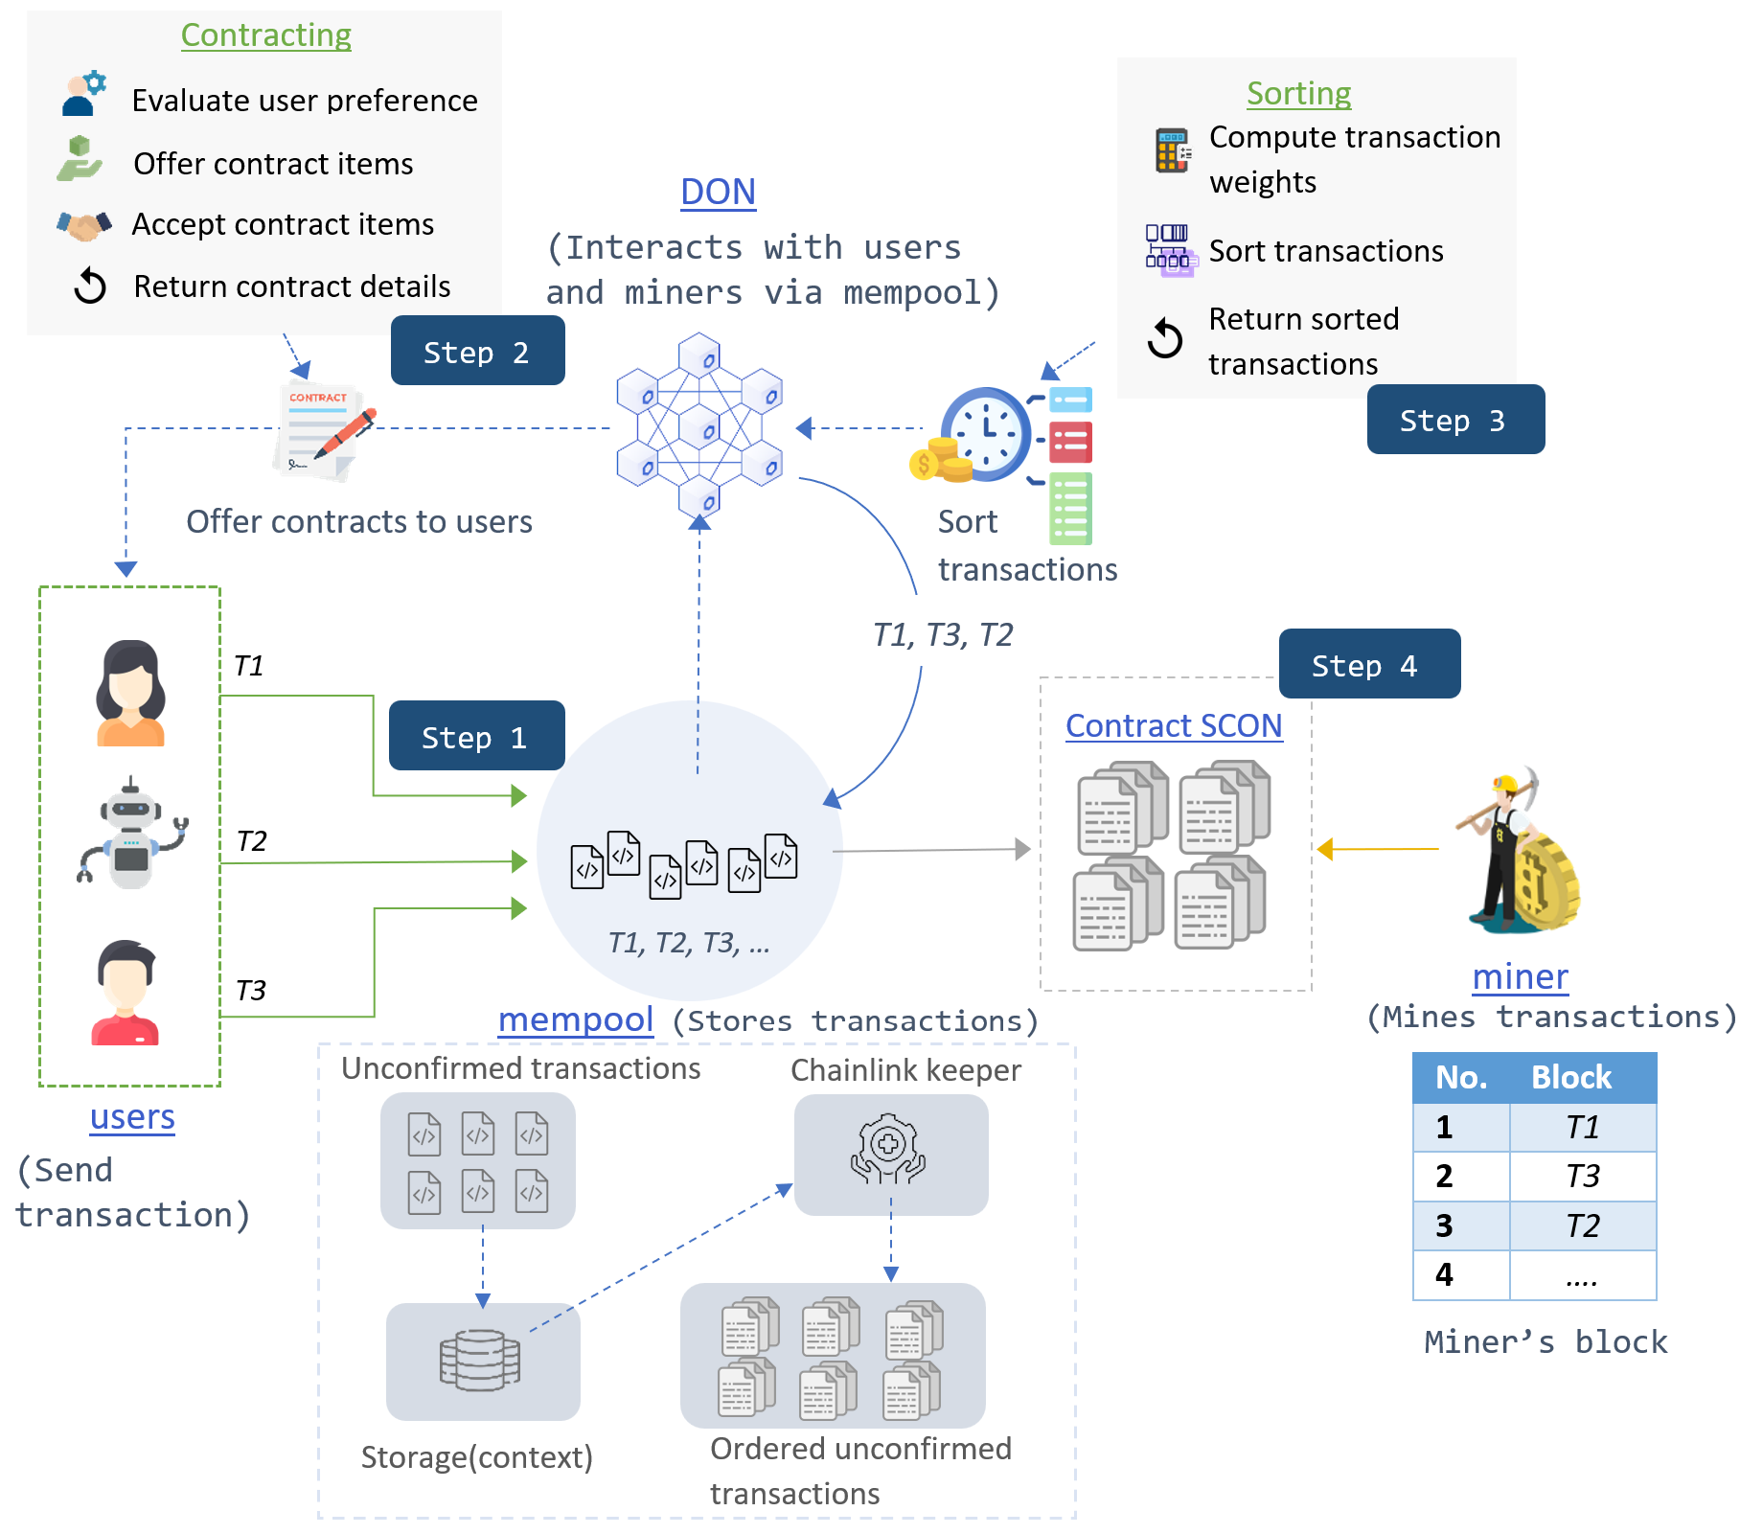
Utility and Payoff
System Model
Utility Model
User confidentiality
Miner’s utility:
Reward paid by users for mining a block
Transaction workload
Ensures miners process transaction on time.
User’s payoff:
User’s evaluation for transaction based on confidentiality $θ_{i}$and
delay tolerance ti
Reward paid to miners for mining with a cost coefficient

Slide 24
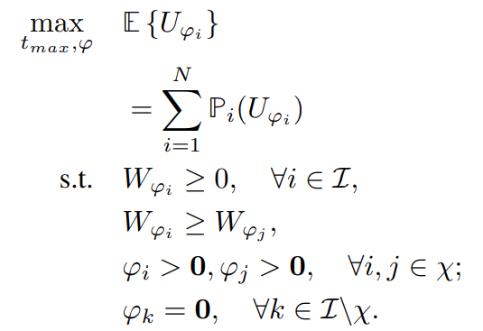
Contracts with Complete and Incomplete Information
Contract Design For Users
Complete Information Scenario
Complete Information Scenario: The miner is aware of each user’s type, which provides an upper bound of its reward compared with the incomplete information scenario.
Individual Rationality: A contract is individually rational if it provides a non-negative payoff to each type that accepts the contract item designed for its type
Incomplete Information Scenario: The miner does not know the user type but only knows the distribution of user types (e.g., the probability that a user belongs to a particular type).
Incomplete Information Scenario
Individual Rationality: A contract is individually rational if it provides a non-negative payoff to each type that accepts the contract item designed for its type
Incentive Compatibility: A contract is incentive compatible if it provides the maximal payoff for each type user when he chooses the contract item designed for its type.
Simplified user group sets.

Slide 25
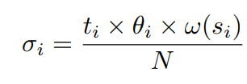
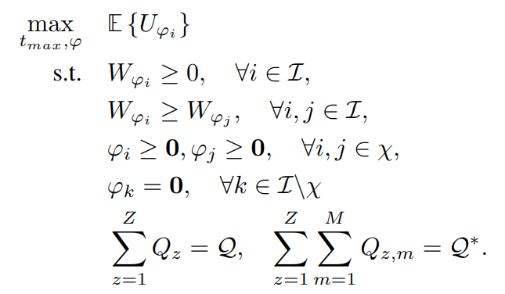
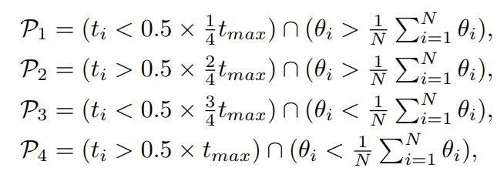
Overall System Architecture
Contract one (complete information)
Compute the transaction weights to determine their ordering
$$w\left(s_{i}\right):transaction as a function of block size$$
Contract two (incomplete information)
Integrating the transaction ordering and contracts into one problem set.
Extract user private information
Transaction Delay Tolerance
Transaction Confidentiality
Sorting algorithm
Priority Levels
Employ counting sort to order transactions for miners
Classifies user’s private information based on very high (VHP), high (HP), medium (MP), and low (LP) priorities
Notes:
Contract one and two comprise the complete information scenario and incomplete information scenario contracts.
Now these contracts are offered to users to extract their respective types (High or low user type in terms of confidentiality and delay)
The extracted user type is used to formulate a weighted sorting algorithm for determining the priority levels of transactions.
Combining the optimization problems for the contracts and sorting algorithm yield the overall optimization problem on the far right.
For the delay and confidentiality, the premise is that, miners are selfish because of the information asymmetry level between the users and them. If the miners can overcome that information asymmetry level then they’ll have to incentive to not reorder transactions in their blocks
The first information asymmetry level is the confidentiality of the transaction, which includes how much money the uses could make from that transaction. The reason here is that some users do not want the content of the transaction transparent until is mined since it could be frontrun by bots or other users. If the miner knows this he can fairly order transactions
Second is delay tolerance, which is how long the users can wait before a transaction is confirmed on the blockchain. Some users don’t mind waiting for an hour or 24hrs. If the miner knows this then we can group people into respective time slots with different priority levels to execute their transactions.

Slide 26
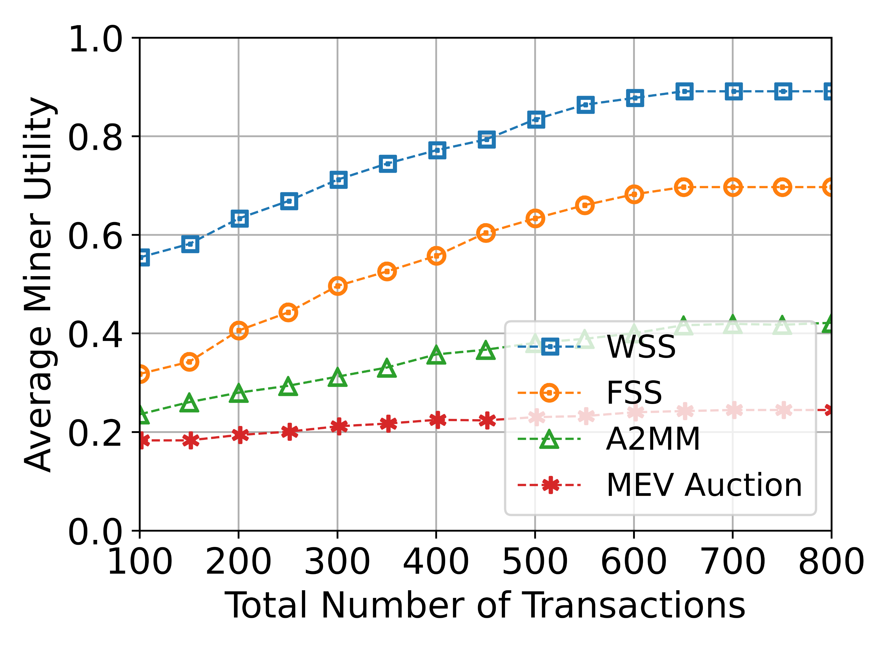
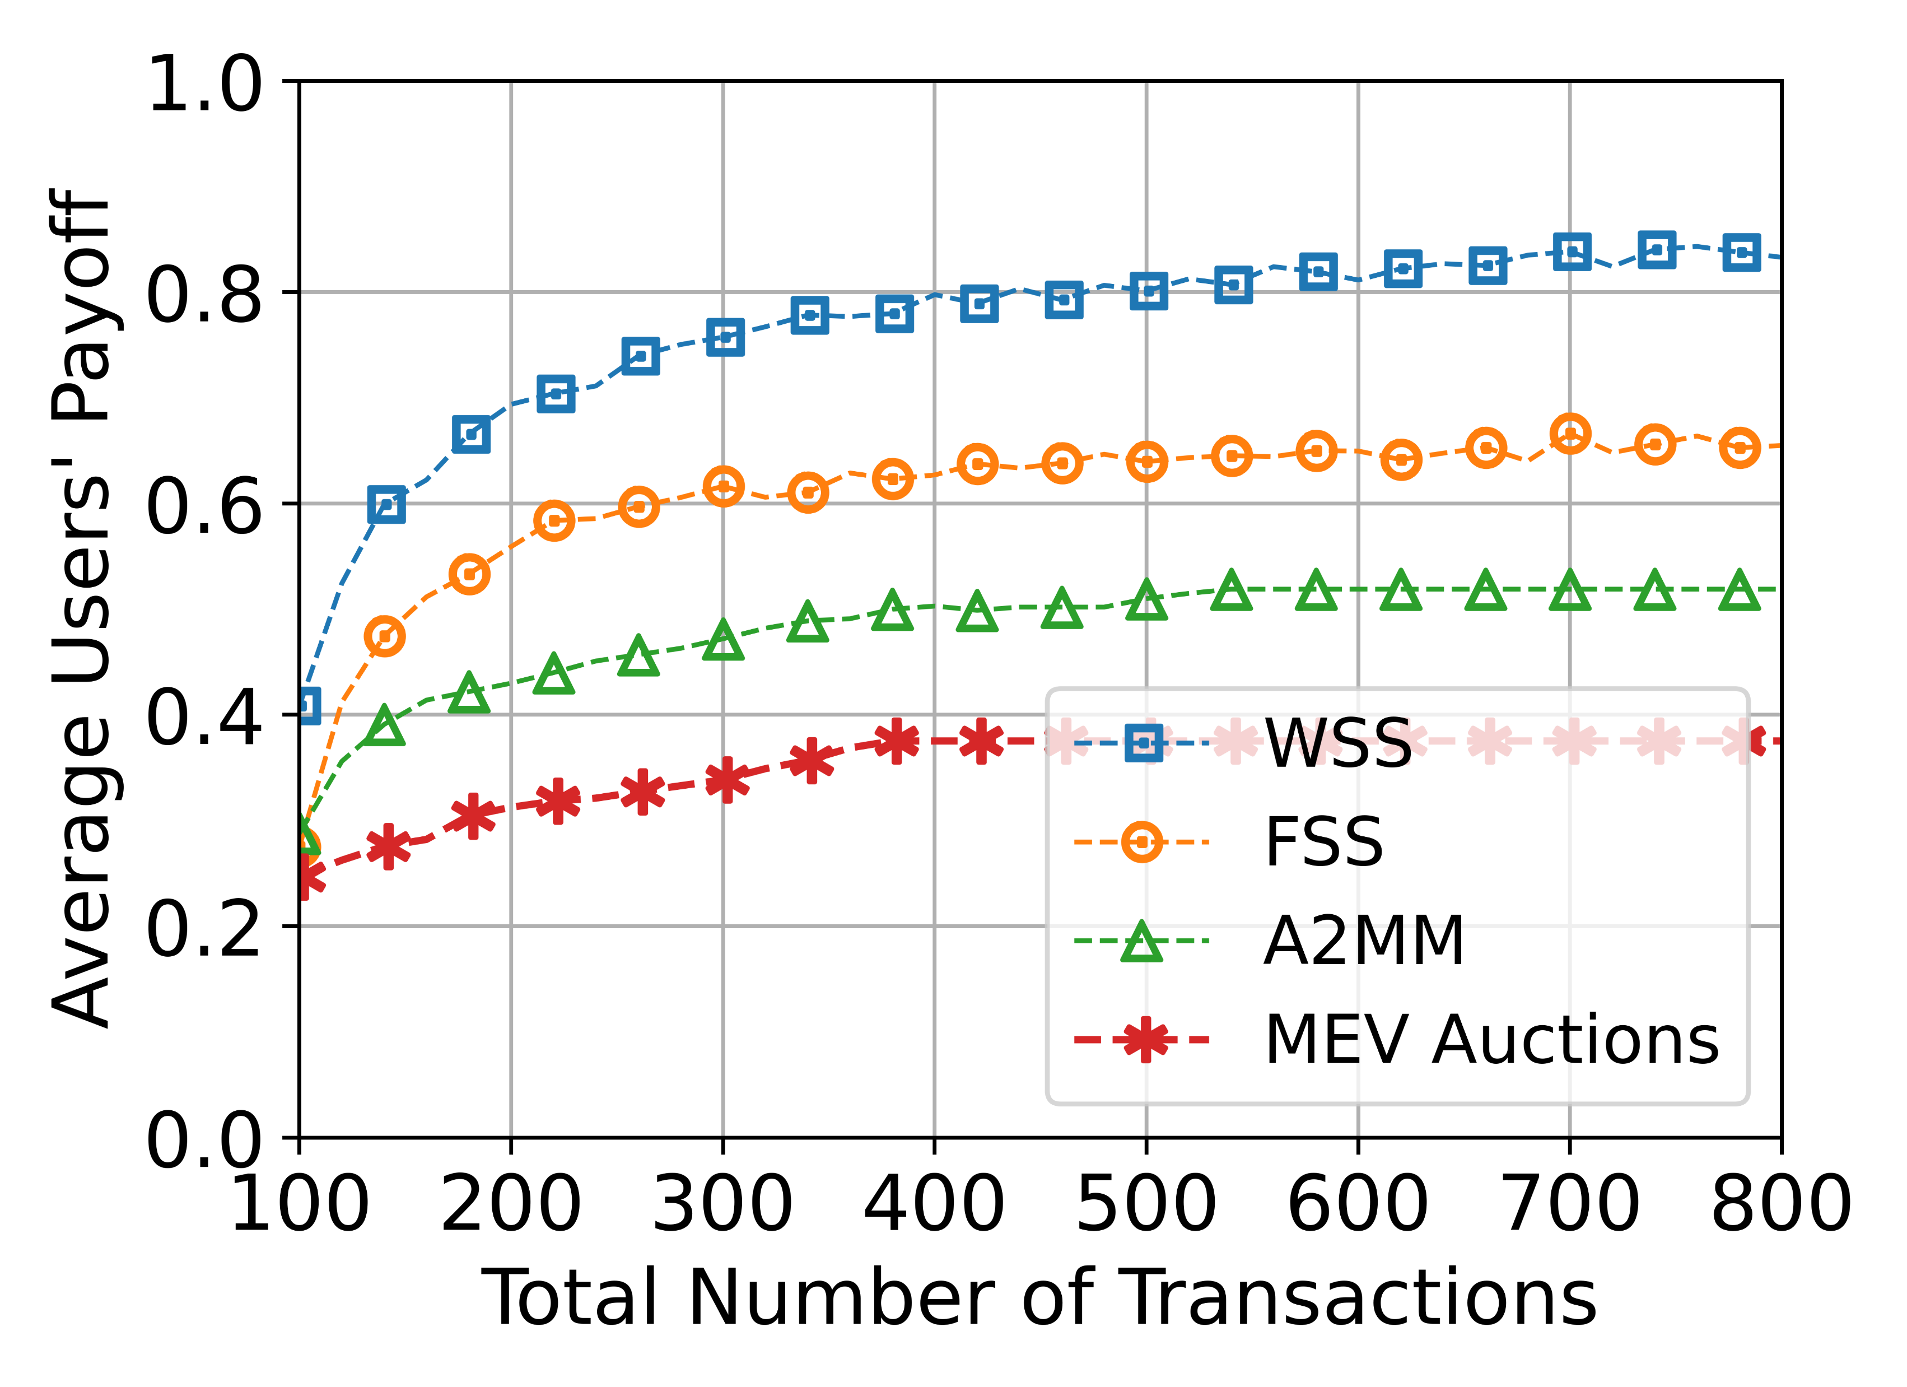
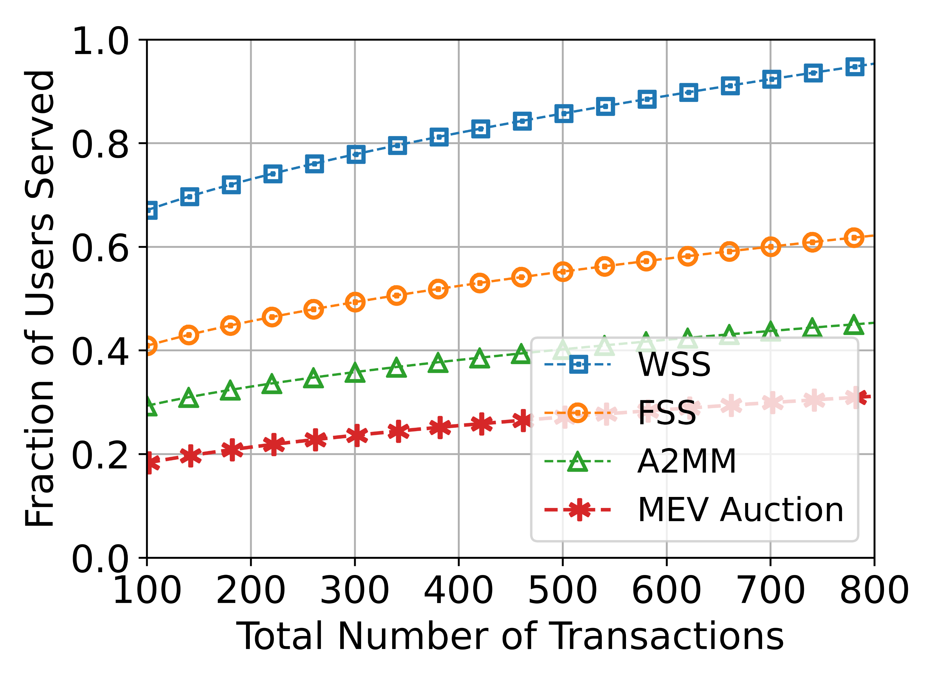
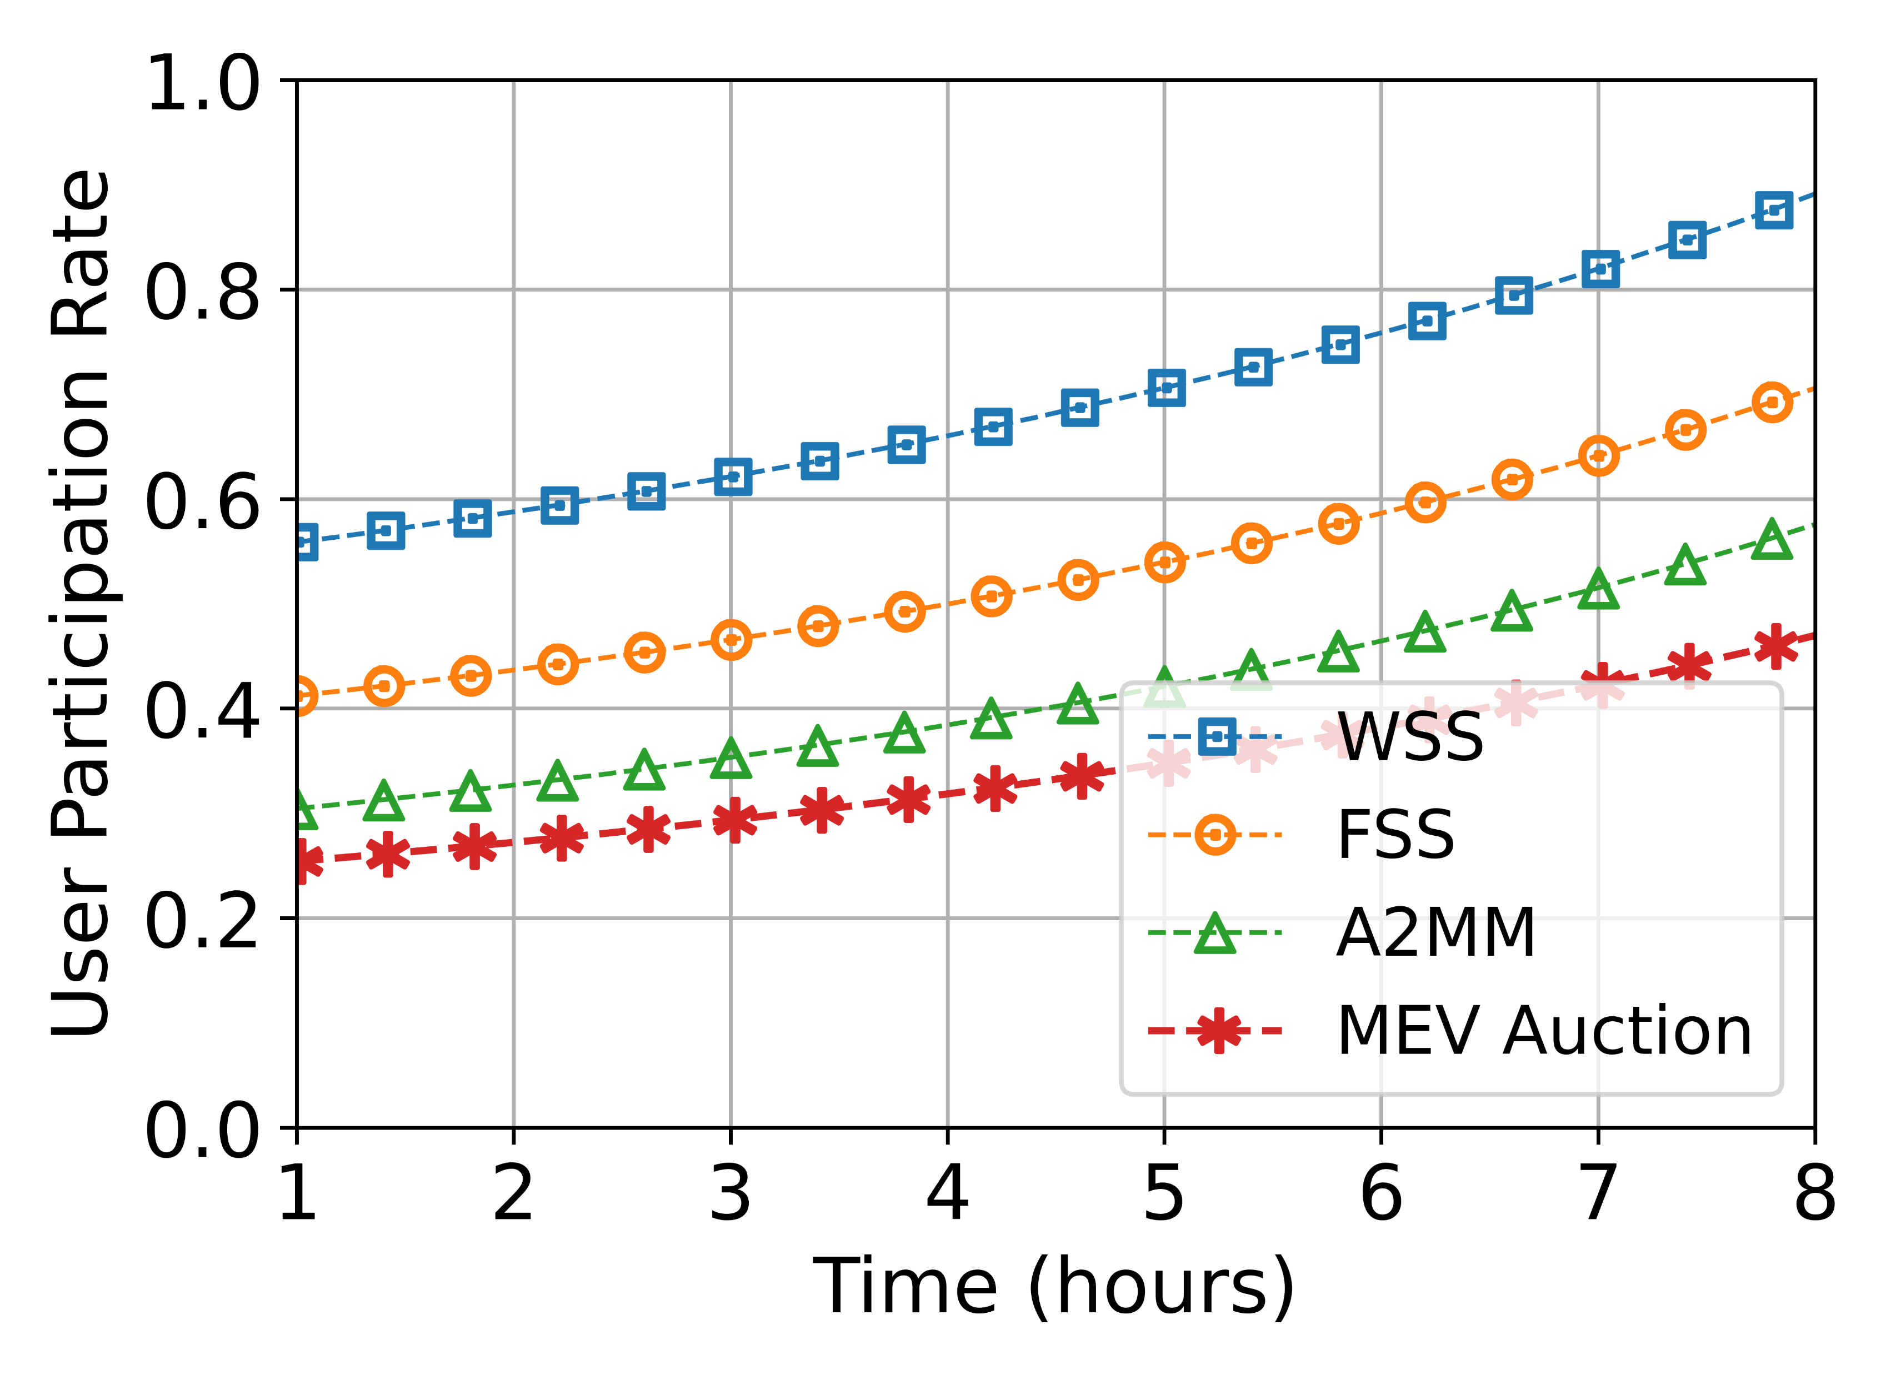
Experiment Results and Analysis
1
2
Benchmarks:
Weighted sequencing services (WSS)-proposed scheme
Fair sequencing services (FSS)-First come first serve
Automated arbitrage market maker (A2MM)
MEV auctions
4
3
Figs. 1 and 2 shows that our proposed scheme offers higher miner’s utility and users’ payoff.
Fig. 3 shows that our proposed scheme performs better in user scalability.
Fig. 4 shows an increasing user participation rate in our proposed scheme

Slide 27
https://github.com/DanielDoe/blockchain-contracts-demo

Slide 28
Summary of Work 1
Use contract theory to elicit users’ private information.
Utilize users’ private information to compute the weights of transactions for ordering by the miner.
Employ counting sort algorithm to sort transactions for miners to process.
D. Doe, et al, “Incentive Mechanism Design for Mitigating Frontrunning and Transaction Recording in Decentralized Exchanges”
Notes:
Discouragement attack is the cheapest way to corrupt the incentive scheme of a PoS-based blockchain.
R is the total reward; N is the total number of validators. M is the total number of validators seen signing the signature.

Slide 29
Outline
Introduction
Blockchain
Cryptoeconomics
Contract Theory
Example I: Incentive Mechanism Design for Mitigating Frontrunning and Transaction Reordering in Decentralized Exchanges
Example II: Contract-based approach for security deposit in blockchain networks with shards
Other Work
Conclusion

Slide 30
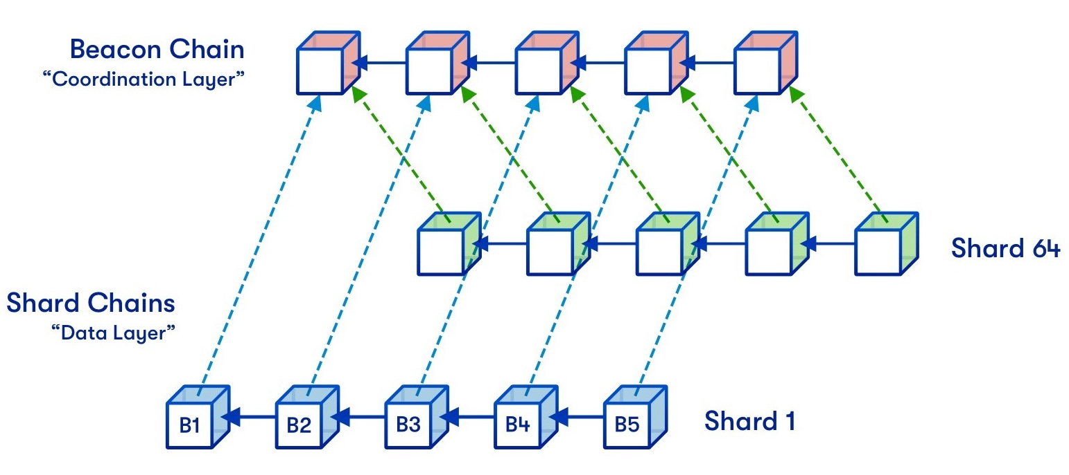
Contract-based approach for security deposit in blockchain networks with shards
Blockchain with sharding
Sharding is used to realize the scalability.
Partition the entities into parallel sub-groups (i.e., committees), which are responsible for generating the sub-blocks (i.e., sharding) synchronously.
Figure Source: https://vitalik.ca/general/2021/04/07/sharding.html

Slide 31
Contract-based approach for security deposit in blockchain networks with shards
Security Deposit
Proof of stake’s security derives from the size of the security deposits.
Security Deposit
32ETH
The deposit that greatly exceeds gain can provide a sufficient security incentive
Motivation
Security incentive: 32-eth is not sufficient for the rich people.
>>32ETH
Economic incentive: Some participants cannot afford 32-eth.
<< 32ETH
Notes:
Proof of stake’s security derives from the size of the security deposits, not the number of validators

Slide 32
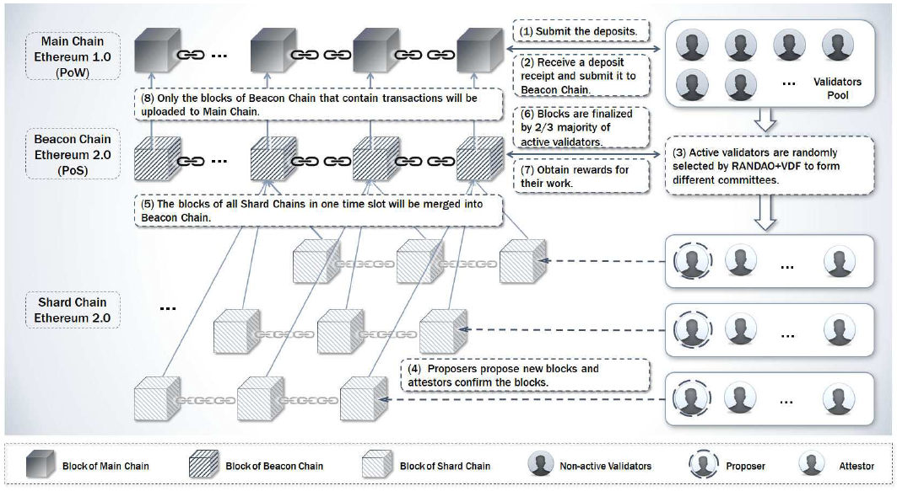
Contract-based approach for security deposit in blockchain networks with shards
System Overview
Let the beacon chain with weak leadership be responsible for designing the contracts.
Submit the deposit;
Receive the deposit receipt;
Validators are randomly selected into the different committees;
Proposers propose new blocks and attestors confirm the blocks;
The blocks from one time slot will be merged into the beacon chain;
Blocks in beacon chain are finalized;
Validators obtain the reward.

Slide 33
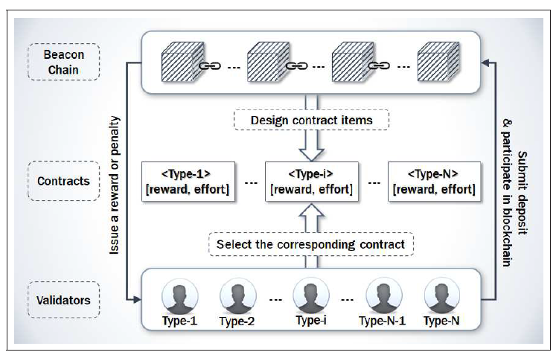
Contract-based approach for security deposit in blockchain networks with shards
Contract Model
Beacon chain designs the contracts according to users’ type information;
The different validators select the corresponding contracts;
The validators submit deposit to beacon chain;
Beacon chain issues the reward or charge a penalty on the validators.
Beacon chain has asymmetric information about how much validators can pay

Slide 34
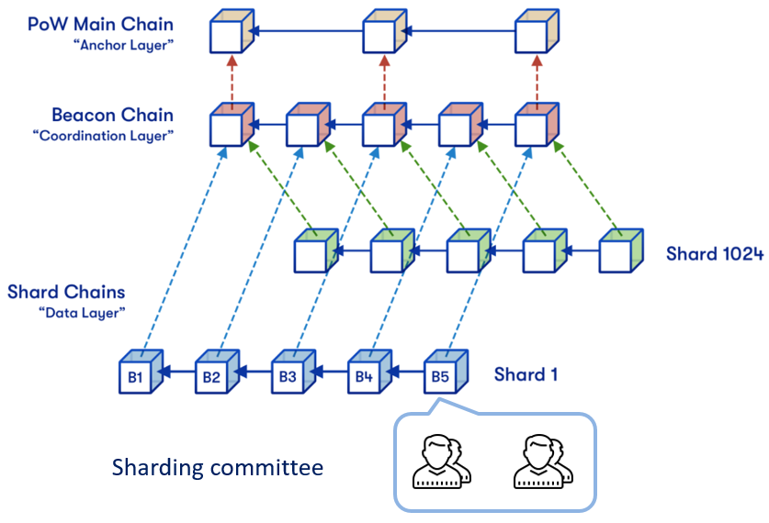
Contract-based approach for security deposit in blockchain networks with shards
System Model
Validator Utility Model
We classify the would-be validators into different types according to their stake values.
The utility function is defined as：
Evaluate the rewards that obtained from beacon chain
The total computation cost
Evaluate the penalty for the type-i validators.

Slide 35
Contract-based approach for security deposit in blockchain networks with shards
System Model
Constrains of Validator Utility Model: Individual Rationality (IR) and Incentive Compatibility (IC):
IR refers to that only when a positive utility assigned to a validator, the validator will accept the contract.
IC refers to that a type-i validator can only obtain the maximum profit by choosing the type-i contract rather than all the other contracts.

Slide 36
Contract-based approach for security deposit in blockchain networks with shards
System Model
Beacon Chain Model
The profit obtained from a validator belonging to type-i is defined as
Evaluation function regarding the validator's time, type and reward
The total cost of rewarding the validators
The type and the related reward in the traditional scheme

Slide 37
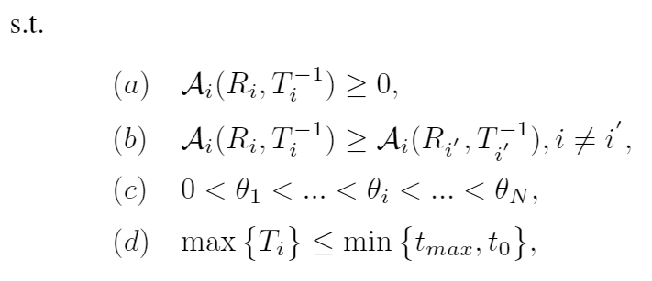
Contract-based approach for security deposit in blockchain networks with shards
Problem Formulation
$${\begin{aligned}max \\ T_{i},R_{i}\end{aligned}}$$
Evaluation function regarding the validator's time, type and reward
The total cost of rewarding the validators

Slide 38
Contract-based approach for security deposit in blockchain networks with shards
Optimal Solution - Constraints Reduction
Monotonicity: The validators with a lower voting time will gain a higher reward.
IR Constraint Reduction: Only when the IR constraint of type-1 is kept, the others can also be satisfied.
IC Constraint Reduction: The downward incentive constraints can be reduced as local downward incentive constraints and the upward incentive constraints can be reduced as local upward incentive constraints.

Slide 39
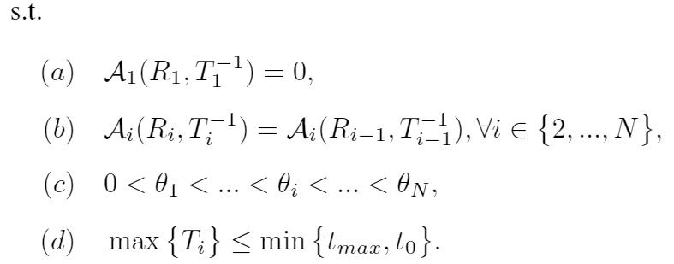
Contract-based approach for security deposit in blockchain networks with shards
Optimal Solution – Closed Form
The optimization problem with reduced constraints:
Derive an expression with the respect to R:

Slide 40
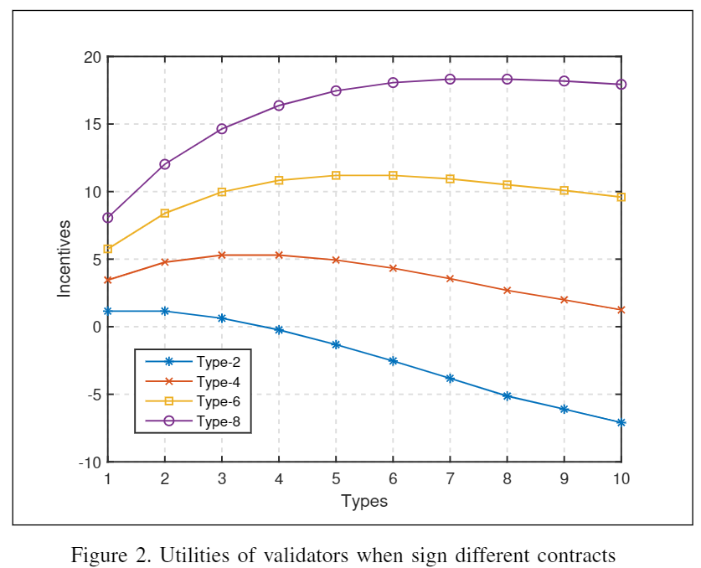
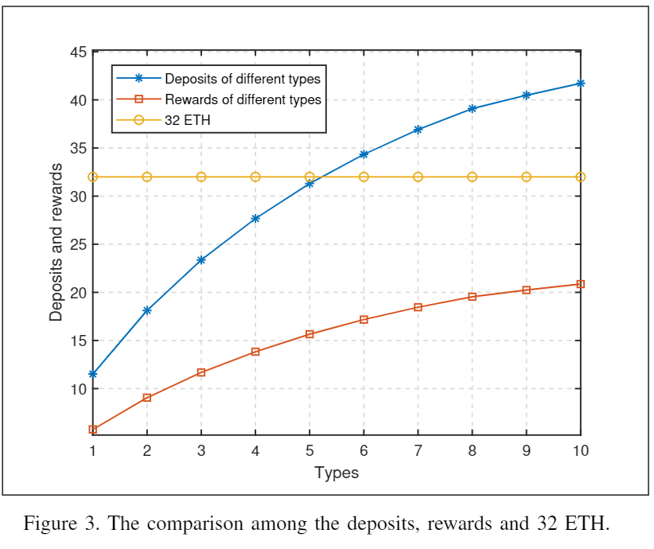
Contract-based approach for security deposit in blockchain networks with shards
Simulation and Analysis
Fig. 2 shows that the validators have the maximum utilities only when choosing the contract designed for their own.
Fig. 3 shows that the higher type validators have more rewards and must submit the more deposits.

Slide 41
Contract-based approach for security deposit in blockchain networks with shards
Summary of Work II
Use contract theory to determine the flexible security deposits
The flexible security deposits can guarantee the economic incentive without reducing the security incentive.
Stackelberg Game
J. Li, et al “Cyber Insurance Design for Validator Rotation in Sharded Blockchain Networks: A Hierarchical Game Based Approach”

Slide 42
Outline
Introduction
Blockchain
Cryptoeconomics
Contract Theory
Work I: Contract-based approach for security deposit in blockchain networks with shards.
Work II: Cyber Insurance Design for Validator Rotation in Sharded Blockchain Networks: A Hierarchical Game Based Approach
Other Work
Conclusion

Slide 43
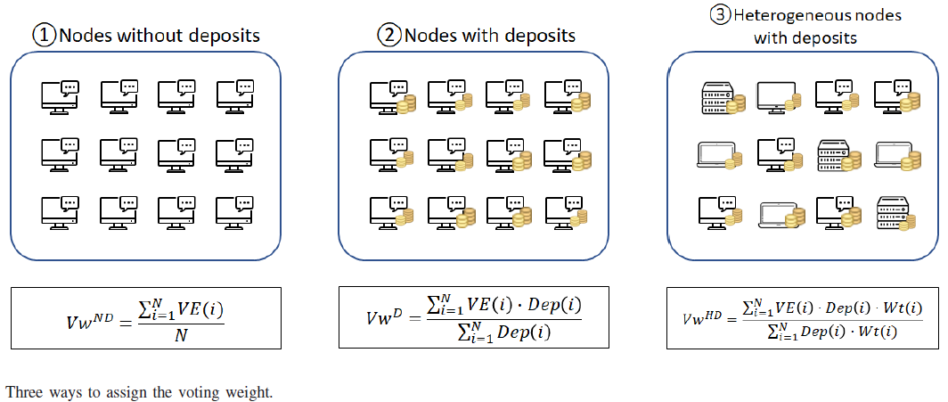
Other Work
Other Work I
Assign Voting Weight using Signaling Model:
Goal: Determine the voting weight with device performance, incentivize the validators to upgrade performance and achieve the vertical scaling.
Methodology: Tullock Contest Theory and Signaling Model.

Slide 44
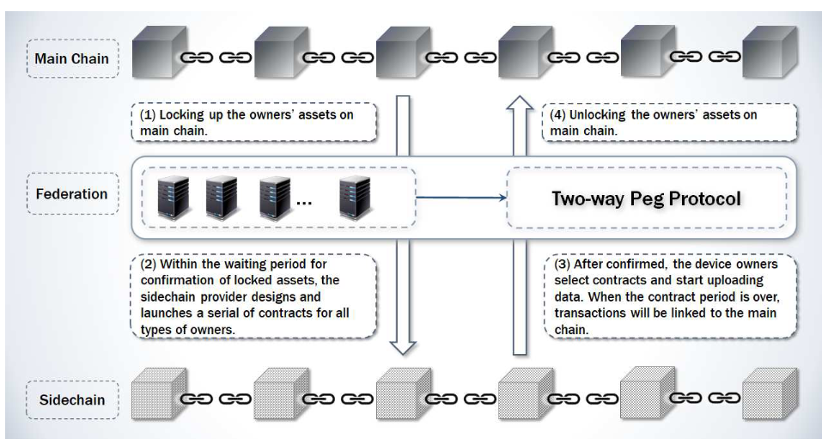
Other Work
Other Work II
Determine Transaction fee of sidechain using Random contract:
Either service or payment is random
Goal: Study the sidechain transaction fee pricing and explore how to maximize the sidechain’s profit using a random contract.
Pros: fit all situations of risk neutral, risk averse and risk seeker
Methodology: Adverse selection model with the random variables. Geometric Brownian Motion.
The transaction fee on the sidechain is affected by the transaction fees on the main chain.

Slide 45
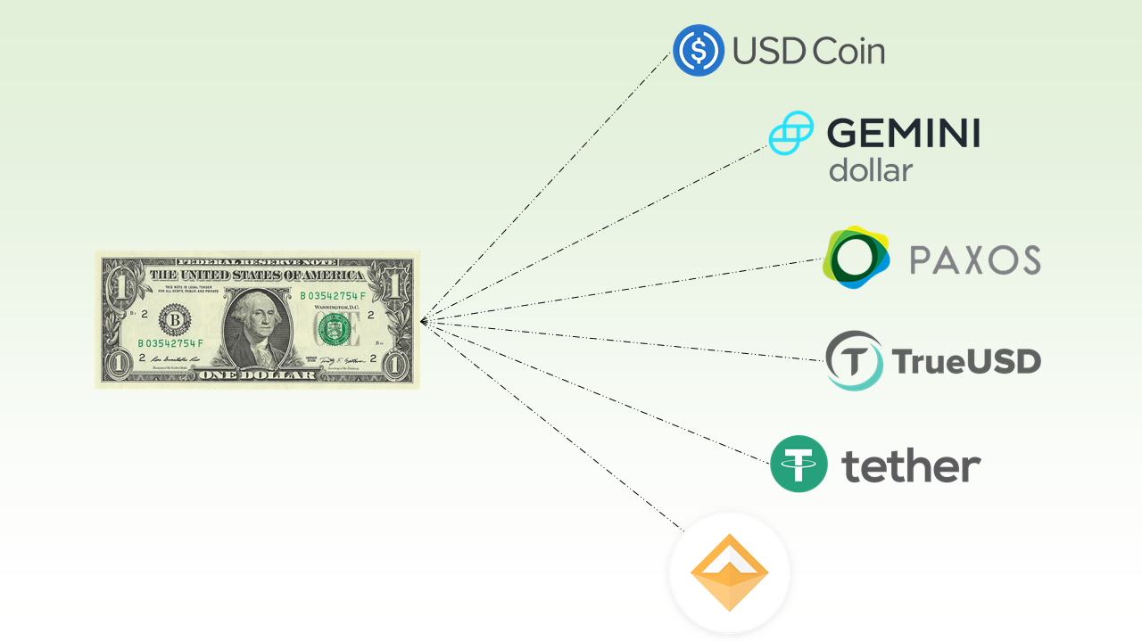
Other Work
Other Work III
Crypto-asset Value Stabilization:
Goal: Offer insurance contracts to the crypto-assets owners, ensure the value will not drop below the reserved price within a required time span.
Methodology: Insurance framework, contract theory (adverse selection), option pricing model, risk parameters, auction, smart contract.

Slide 46
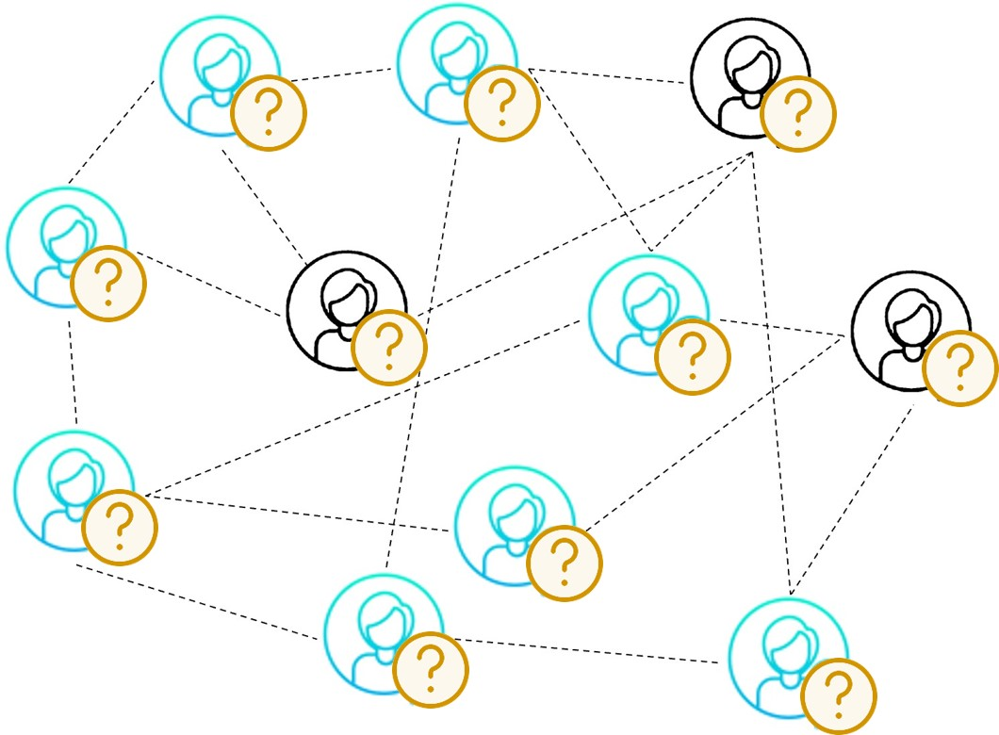
Conclusion
Conclusion
Studied two categories of economic incentives in Cryptoeconomics by using Contract Theory: Reward and Penalty.
Work I: Reward – Knowledge of user types can incentivize miners to order transactions fairly.
Adverse Selection
1 | Transaction 4
2 | Transaction 3
3 | Transaction 2
4 | Transaction 1
Signaling
Private information
Individual Rationality
Incentive Compatibility
Moral Hazard
Order transactions

Slide 47
Conclusion
Conclusion
Studied two categories of economic incentives in Cryptoeconomics by using Contract Theory: Reward and Penalty.
Work I: Reward – Knowledge of user types can incentivize miners to order transactions fairly.
Work II: Penalty – The flexible deposits can incentivize more entries than that of the constant deposits.
Adverse Selection
Contract menu
Type-1 | (T1, R1)
Type-i | (Ti, Ri)
… | …
Type-n | (Tn, Rn)
Private information: Account balances
Signaling
Individual Rationality
Incentive Compatibility
Moral Hazard

Slide 48
Conclusion
Conclusion
Studied two categories of economic incentives in Cryptoeconomics by using Contract Theory: Reward and Penalty.
Work I: Reward – Knowledge of user types can incentivize miners to order transactions fairly.
Work II: Penalty – The flexible deposits can incentivize more entries than that of the constant deposits.
Other Applications of Contract Theory in Cryptoeconomics:
Adverse Selection
Insurance menu
Type-1 | (P1, C1)
Type-i | (Pi, Ci)
… | …
Type-n | (Pn, Cn)
Private information: Historical activeness
Signaling
Individual Rationality
Incentive Compatibility
Moral Hazard
Stackelberg Game

Slide 49
Conclusion
Conclusion
Studied two categories of economic incentives in Cryptoeconomics by using Contract Theory: Reward and Penalty.
Work I: Reward – Knowledge of user types can incentivize miners to order transactions fairly.
Work II: Penalty – The flexible deposits can incentivize more entries than that of the constant deposits.
Other Applications of Contract Theory in Cryptoeconomics:
Deterministic Contract
Random Contract
Jing Li, Dusit Niyato, and Zhu Han, Cryptoeconomics: Economic Mechanisms behind Blockchains, Cambridge University Press, UK, 2023.

Slide 50
Thank you, Questions and Visit us?
http://wireless.egr.uh.edu/

