Slide 1
Distributionally Robust Optimization and Its Applications in Communication and Networking
Zhu Han, IEEE/AAAS Fellow
University of Houston
Thanks to Drs. Lei Fan, Zhuang Ling, Kai-Chu Tsai, Hongliang Zhang, Yali Chen, Yang Yang, and Yuan Zi
http://wireless.egr.uh.edu/research.htm
Notes:
Hello everyone today I will give my presentation about Distributionally Robust Optimization and Its Application in Wireless Communications

Slide 2
Outline
Introduction
Case 1: Discrepancy-based DRO Optimization
Wasserstein distance
Tractability of Wasserstein DRO
Application I: Computation Offloading
Case 2: DRO, Risk Aversion and CVaR
VaR and CVaR in Optimization
Value-at-Risk (VaR) and Conditional Value-at-Risk (CVaR)
Application II: Age of Information
Case 3: DRO based Reinforcement Learning
Distributionally Robust Policy Iteration
Application III: Well Logging
Conclusion
Notes:
This presentation includes four parts. The first part is Distributionally Robust Optimization

Slide 3
Introduction
Optimization Classification
Optimization
Deterministic Optimization
Optimization under Uncertainty
Stochastic
Programming
(SP)
Distributionally
Robust
Optimization
(DRO)
Robust
Optimization
(RO)
Notes:
优化问题分为两大类：传统的确定优化问题以及不确定优化问题。
不确定优化问题又可以分为随机规划、鲁棒优化、分布式鲁棒优化。这三个问题的保守性是逐渐递增的。

Slide 4
Introduction
Optimization Classification
Stochastic Programming (SP)
assumes that the probability distribution of random parameters is known (inferred from the historical data). Objective is to find a decision $x$that minimizes a functional of the expected cost.
Robust Optimization (RO)
assumes that the probability distribution of random parameter is unknown, but its fluctuation range is known. Objective is to find a decision $x$that minimizes the worst-case cost over an uncertainty set.
Distributionally Robust Optimization (DRO)
The distribution is known, but the random parameters of probability distribution is uncertain. In most cases, random parameters can only be estimated by the samples. Objective is to find a decision $x$that minimizes the worst-case expected cost over an uncertainty set.
Notes:
随机规划，假设随机参数的概率分布已知，这个分布可能是从历史数据中推断出来的，目标是找到一个决策x来优化一个期望值形式的目标函数。也就是说它的不确定集是一个概率分布。
鲁棒优化假设随机参数概率分布未知，但知道其波动范围，也就是知道它所有的取值，这个波动范围就是它的不确定集，目标函数是对不确定集中最差的情况进行优化，即worst-case scenario。找到的这个决策x，对于不确定集中的所有情况都要成立。可以看出鲁棒优化是相对保守的一种优化方法。
分布鲁棒优化结合了随机规划和鲁棒优化，假定不仅随机参数是不确定的，随机参数服从的概率分布也具有不确定性。它参数的不确定集不需要包含类似于鲁棒优化中的所有的取值，只需要包含一部分。这里就出现了两种特殊情况，第一，如果它的不确定集小到只包含了随机参数的真实分布，那个它就会变成随机规划；如果不确定集大到包含了所有可能的取值情况，如果取值都是被鲁棒优化的不确定集所支持的，那么分布式鲁棒优化又会变成鲁棒优化。分布式鲁棒优化没有鲁棒优化那么保守。

Slide 5
Introduction: Stochastic Programming
Stochastic Programming (SP)
The probability distribution of random parameters is known (inferred from the historical data). Objective is to find a decision $x$that minimizes a functional of the expected cost.
$$\min_{x∈χ }{E_{P}[h\left(x,ξ\right)]}$$
$x$ -- Decision variables
$χ$ -- Convex set of feasible solutions
𝜉 -- Uncertain parameter follows a certain distribution $P$
$h\left(x,ξ\right)$ -- Objective function in 𝑥 that depends on parameters 𝜉
Classical assumptions in stochastic programming:
The probability distribution of the random parameter vector is independent of decisions
The "true" probability distribution of the random parameter vector is known relaxing it requires addressing distributional uncertainty.
Notes:
We first consider Stochastic Programming which represents uncertain parameters by a random vector - a classical stochastic optimization: the probability distribution of random parameters is known (inferred from the historical data). Objective is to find a decision $x$that minimizes a functional of the expected cost.
The probability distribution of the random parameter vector is independent of decisions - exogenously given relaxing it requires addressing endogenous uncertainty. The "true" probability distribution of the random parameter vector is known relaxing it requires addressing distributional uncertainty.

Slide 6
Introduction: Robust Optimization
Robust Optimization (RO)
The probability distribution of random parameter is unknown, but its fluctuation range is known. Objective is to find a decision $x$that minimizes the worst-case expected cost over an uncertainty set.
$\min_{x∈χ }{\max_{ξ∈U} h}\left(x,ξ\right)$ (2)
$x$ -- Decision variables
$ξ$ -- Uncertain Parameter
$χ$ -- Convex set of feasible solutions
$U$ -- Uncertain set
$h\left(x,ξ\right)$ -- Objective function in $x$ that depends on parameters $ξ$
First find a decision $x$ that minimizes the cost.
Then a parameter $ξ$ which leads to the maximum cost (worst case for given decision)
Notes:
As for Robust Optimization , the probability distribution of random parameter is unknown, but its fluctuation range is known. Objective is to find a decision $x$that minimizes the worst-case expected cost over an uncertainty set. If the uncertain parameter $ξ$ follows a certain distribution $P$: we need to make a reasonable decision (find an $x$) to ensure that the expectation is optimal when the parameters have certain distribution characteristics.

Slide 7
Introduction: DRO
Distributionally Robust Optimization (DRO)
In practice, the random parameters are uncertain.
Although the exact distribution of the random variables may not be known, people usually know partial statistic information via certain observed samples.
Choose an intermediate approach to obtain a robust form of distributed optimization problem (DRO):
$\min_{x∈χ }{E_{P}[h\left(x,ξ\right)]}$ $\min_{x∈χ}{\max_{P∈𝒫}{E_{P}[h\left(x,ξ\right)]}}$
$𝒫$is an uncertain set of probability distributions constructed from the samples.
Objective is to find a decision $x$that minimizes the worst-case expected cost over an ambiguity set.
Notes:
In practice, not only the random parameters are uncertain, but also the probability distribution of the random parameters is uncertain.
Although the exact distribution of the random variables may not be known, people usually know certain observed samples or training data and other statistical information.
Choose an intermediate approach to obtain a robust form of distributed optimization problem (DRO):
Objective is find a decision $x$that minimizes the worst-case expected cost over an ambiguity set.

Slide 8
Introduction: Uncertainty Sets
Key question: How to build ambiguity sets (uncertain sets)?
The probability distribution quantifying the model parameter uncertainty is known ambiguously. When choosing ambiguity sets, we need to consider the following:
Rich enough to contain the true data-generating distribution with high confidence.
Small enough to exclude pathological distributions.
Tractability
Practical (Statistical) Meanings
Performance (the potential loss comparing to the benchmark cases)
The form of ambiguity sets can be used to classify the distributionally robust optimization problems.
Moment-based ambiguity sets : $𝒫=\{ξ:E[ξ]≤μ,E[ξ^{T}ξ]≤Σ,…\}$
Discrepancy-based ambiguity sets:$𝒫=\{P:d(\hat{P_{N}},P)≤ρ\}$
Notes:
Now we have to face a Key question: How to build ambiguity sets (uncertain sets)?
Specially, the probability distribution quantifying the model parameter uncertainty is known ambiguously. When choosing ambiguity sets, we need to consider the following:
Rich enough to contain the true data-generating distribution with high confidence. Chance constraint
Small enough to exclude pathological distributions.
Tractability
Practical (Statistical) Meanings in wireless communication
Performance (the potential loss comparing to the benchmark cases)
The form of ambiguity sets can be used to classify the distributionally robust optimization problems.
Moment-based ambiguity sets and Discrepancy-based ambiguity sets

Slide 9
Outline
Introduction
Case 1: Discrepancy-based DRO Optimization
Wasserstein distance
Tractability of Wasserstein DRO
Application I: Computation Offloading
Case 2: DRO, Risk Aversion, and CVaR
Case 3: DRO Based Reinforcement Learning
Conclusion

Slide 10
Discrepancy-based DRO
Motivation
In many situations, we have an empirical estimate of the underlying probability distributions.
A natural way to hedge against the distributional ambiguity is to consider a neighborhood of the empirical probability distribution
Discrepancy
Ambiguity sets based on probability distance:
$𝒫=\{P:d(\hat{P_{N}},P)≤ε\}$
$\hat{P_{N}}$ -- Empirical probability
$ε$ -- Radius
$d(\hat{P_{N}},P)$ -- Metric of the similarity of two distributions
By selecting a suitable metric, certain infinite-dimensional convex DRO problems can be transformed into finite-dimensional convex optimization problems
Is there a metric that is simple to calculate and suitable for discrete / continuous distributions?
Wasserstein
distance
Notes:
Considering the Discrepancy-based ambiguity sets: we introduce ambiguity sets based on probability distance:
$\hat{P_{N}}$ is Empirical probability$. ε$is Radius. $d(\hat{P_{N}},P)$is the Metric of the similarity of two distributions
By selecting a suitable metric, certain infinite-dimensional convex DRO problems can be transformed into finite-dimensional convex optimization problems
Is there a metric that is simple to calculate and suitable for discrete / continuous distributions? Wasserstein distance

Slide 11
Discrepancy-based DRO
Wasserstein distance
used to measure the distance between two distributions.
Definition:
$${d_{W}\left(P_{1},P_{2}\right)=\inf_{γ\sim ∏(P_{1},P_{2})}{𝔼}}_{(x,y)\sim γ}[\left\|x−y\right\|]$$
$∏(P_{1},P_{2})$: the set of all possible joint distributions of $P_{1}$and $P_{2}$.
$(x, y)\sim γ:$samples under joint distribution $γ$
$\left\|x−y\right\|$: sample distance
$𝔼_{(x,y)\sim γ}[\left\|x−y\right\|]$: expectation of distance for sample $x$ and $y$ under joint distribution $γ$
Wasserstein distance of $P_{1}$and $P_{2}$: the lower bound of this expectation.
Notes:
Wasserstein distance is used to measure the distance between two distributions,w$here ∏(P_{1},P_{2})$is the set of all possible joint distribution of $P_{1}$and $P_{2}$. $\left(x, y\right)\sim γ denotes$samples under joint distribution $γ$ $\left\|x−y\right\|$ is sample distance $𝔼_{(x,y)\sim γ}[\left\|x−y\right\|]$shows expectation of distance for sample $x$ and $y$ under joint distribution $γ$

Slide 12
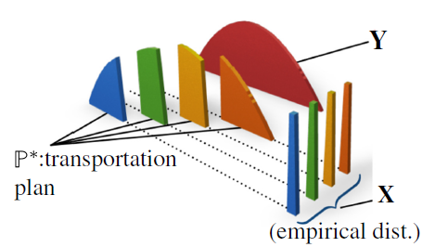
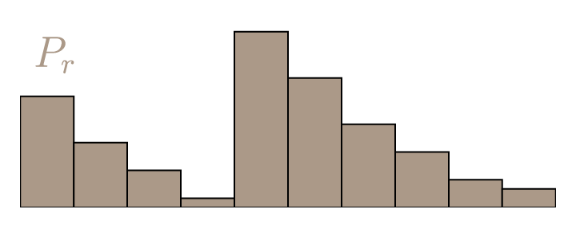
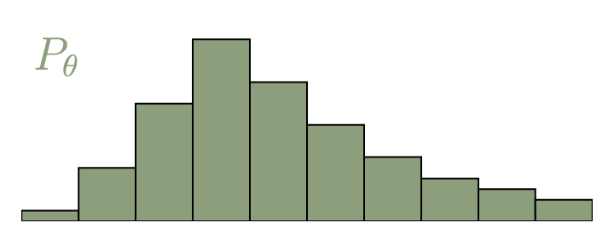
Discrepancy-based DRO
Wasserstein distance
$$P_{1}$$
$$P_{2}$$
$∏(P_{1},P_{2})$: transportation plan
$\left\|x−y\right\|$: distance the soil moves
$Y(x,y)$: amount of moving soil from $x$ to $y$
$𝔼_{(x,y)\sim γ}[\left\|x−y\right\|]$: bulldozing cost
Move mass $P_{1}$ into the shape and position of $P_{2}$.
Bulldozing cost : amount of moving soil multiplied by the distance the soil moves.
Wasserstein distance: the smallest bulldozing cost from $P_{1}$to $P_{2}$.
Notes:
Probability metrics represent distance functions on the space of probability distributions. A general class of Bulldozing Distances just like Move mass $P_{1}$ into the shape and position of $P_{2}$. Bulldozing cost : amount of moving soil multiplied by the distance the soil moves. The decision variable can be viewed as a transportation plan for moving a mass distribution described by P1 to another one described by P2. Thus, the Wasserstein distance between P1 and P2 represents the cost of an optimal mass transportation plan,
$∏(P_{1},P_{2})$: transportation plan $\left\|x−y\right\|$: distance the soil moves $Y(x,y)$: amount of moving soil from $x$ to $y$ $𝔼_{(x,y)\sim γ}[\left\|x−y\right\|]$: bulldozing cost

Slide 13
Discrepancy-based DRO
Wasserstein distance
Wasserstein distance-based ambiguity set:
$𝔹_{ε}\left(\hat{P_{N}}\right)=\{Q:d_{W} (\hat{P_{N},}Q)≤ε\}$
The ambiguity set $Q$can be viewed as a Wasserstein ball which contains all probability distributions whose Wasserstein distance to the empirical distribution $\hat{P_{N}}$ is less than $ε$.
$Q$ will cover the true distribution with a higher probability with a larger value of $ε$.
There exists a trade-off between the accuracy and the complexity
It is important to well design the value of $ε$
Notes:
In the remainder we will examine the ambiguity set
The ambiguity set $Q$can be viewed as the Wasserstein ball of radius$ε$ centered at the empirical distribution $\hat{P_{N}}$. Wasserstein ball contains all possible probability distributions. $Q$ will include the true distribution with a higher probability.
Under a common light tail assumption on the unknown data-generating distribution, this ambiguity set offers attractive performance.

Slide 14
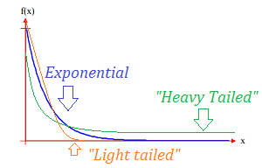
Discrepancy-based DRO
Wasserstein distance
How to calculate $ε \text{of} \text{ambiguity} \text{set}$
Light-tailed distribution assumption: Distribution is call light-tailed if there exists an exponent $a>1$ such that
This assumption requires the tail of the distribution to decay at an exponential rate. The assumption guarantees that the ambiguity set can cover most of the possible distributions.
Radius selection: With this assumption, suppose that $\hat{P_{N}}$ is the empirical distribution, m is related to the dimension and cost parameter, for $m≠2$ and $c_{1},c_{2}>0$, under a confidence level of $1−β$, we have
Number of samples
Notes:
How to calculate $ε \text{of} \text{ambiguity} \text{sets}$
We will introduce Theorem. Suppose that $\hat{P_{N}}$ is the empirical distribution,, and the unknown true distribution $P$ is light-tailed in the sense Then, there are constants $c1, c2>0$ that depend on $P$ only through $α, A$, and $m$ such that for any $η ∈ (0, 1]$the concentration inequality i.e., the Measure concentration can be given as
Theorem provides an a priori estimate of the probability that the unknown data-generating distribution resides outside of the Wasserstein ball. Thus, we can use Theorem to estimate the radius of the smallest Wasserstein ball that contains P with certain confidence. Theorem can be used directly during reformulation.

Slide 15
Discrepancy-based DRO
Tractability of Wasserstein DRO
With Wasserstein ball, the DRO problem can be rewritten as
$$\min_{x∈χ}{\max_{P∈𝔹_{ε}\left(\hat{P_{N}}\right)}{E_{P}[h(x,ξ)]}}$$
Assumption:
The uncertainty set is convex and closed
$h(x,ξ)$ is convex with respect to $ξ$
Challenges to Compute Wasserstein Distances:
Computing the Wasserstein distance between two distributions $\hat{P_{N}}$ and $P_{N}$is NP-hard if one of them is continuous since the dimension will be infinite.
Solution:
Rewrite the problem into a finite-dimensional convex program by leveraging tools from robust optimizations
Notes:
Computing the Wasserstein distance between two discrete distributions amounts to solving a tractable linear program
However, if one of the distributions is continuous, it becomes intractable to compute Wasserstein distance
Computing the Wasserstein distance between two distributions $\hat{P_{N}}$ and $P_{N}$is NP-hard if not both the distributions are discrete.
Even though we cannot compute the Wasserstein distance, we can derive tractable bounds on the worst-case risk in the Wasserstein ball, and exact computation for the worst-case risk in some situations.

Slide 16
Discrepancy-based DRO
Tractability of Wasserstein DRO
How to transform an infinite-dimensional optimization problem into a finite-dimensional convex program:
$\max_{P∈𝔹_{ρ}\left(\hat{P_{N}}\right)}{E_{P}[h(x,ξ)]}=\left\{\begin{aligned}\sup_{Π,P}{\int_{Ξ}{h\left(x,ξ\right)P(dξ)}} \\ s.t. \int_{Ξ^{2}}{\left\|ξ−ξ^{′}\right\|Π(dξ,dξ′)≤ε}\end{aligned}\right.$ $=\left\{\begin{aligned}\sup_{P_{i}∈𝓜(Ξ)}{\frac{1}{N}\sum_{i=1}^{N}{\int_{Ξ}{h\left(x,ξ\right)P_{i} (dξ)}}} \\ s.t. \frac{1}{N}\sum_{i=1}^{N}{\int_{Ξ}{\left\|ξ−\hat{ξ_{i}}\right\|P_{i}(dξ)≤ε}}\end{aligned}\right.$
$Π$ is a joint distribution of $ξ^{′}$ and $ξ$ with marginals distribution $P$ and $\hat{P_{N}}$ of $ξ^{′}$ given $ξ^{′}$= $\hat{ξ_{i}}$,and conditional $P_{i}$of $ξ$. N is number of samples. Due to the law of total probability, we have
$$Π=\frac{1}{N}\sum_{i=1}^{N}{δ_{\hat{ξ_{i}}}⨂P_{i}}$$
$$\hat{P_{N}}=\frac{1}{N}\sum_{i=1}^{N}{δ_{\hat{ξ_{i}}}}$$
Convex reduction
Notes:
How to transform an infinite-dimensional optimization problem into a finite-dimensional convex program:
we can re-express the worst-case expectation as,
Where the $\text{J}\text{oint} \text{distribution} Π$ of $ξ$ and $ξ^{′}$can be constructed from the marginal distribution $\hat{P_{N}}$ of $ξ^{′}$when given $ξ^{′}$= $\hat{ξ_{i}}$,and conditional $P_{i}$of $ξ$. Due to the law of total probability, we may write

Slide 17
Discrepancy-based DRO
Tractability of Wasserstein DRO
Using a standard duality argument, we obtain
$$\max_{P∈𝔹_{ε}\left(\hat{P_{N}}\right)}{E_{P}[h(x,ξ)]}$$
$$=\sup_{P_{i}∈𝓜(Ξ)}\inf_{λ≥0}{\frac{1}{N}\sum_{i=1}^{N}{\int_{Ξ}{h\left(x,ξ\right)P_{i} (dξ)}}}{+λ(ε−\frac{1}{N}\sum_{i=1}^{N}{\int_{Ξ}{\left\|ξ−\hat{ξ_{i}}\right\|P_{i}(dξ)}})}$$
$≤$ $\inf_{λ≥0}\sup_{P_{i}∈𝓜(Ξ)}{λε+\frac{1}{N}\sum_{i=1}^{N}{\int_{Ξ}{(h\left(x,ξ\right){−λ\left\|ξ−\hat{ξ_{i}}\right\|)P}_{i}(dξ}}}{)}$
$=\inf_{λ≥0}λε{+\frac{1}{N}\sum_{i=1}^{N}{\sup_{ξ∈Ξ}(h\left(x,ξ\right)−λ\left\|ξ−\hat{ξ_{i}}\right\|)}}$
Maximum minima is always less than minimum maxima
The uncertainty set contains all distributions
Notes:
Using a standard duality argument, we obtain:

Slide 18
Discrepancy-based DRO
Tractability of Wasserstein DRO
Introducing epigraphical auxiliary variables $s_{i}$, $i≤N$:
$$\max_{P∈𝔹_{ε}\left(\hat{P_{N}}\right)}{E_{P}[h(x,ξ)]}=\left\{\begin{aligned}\inf_{λ,s_{i}}{λε}+\frac{1}{N}\sum_{i=1}^{N}{s_{i}} \\ s.t. \sup_{ξ∈Ξ}\left(h\left(x,ξ\right)−λ\left\|ξ−\hat{ξ_{i}}\right\|\right)≤s_{i}, ∀i≤N \\ λ≥0\end{aligned}\right.$$
As such, the problem is transformed into a finite convex program and can be solved by existing convex optimization techniques.
Notes:
Introducing auxiliary variables $s_{i}$, $i≤N$: we can get the dual norm and the decomposability form

Slide 19
Discrepancy-based DRO
Special Case
For the case of quadratic loss (possibly non-convex and non-concave), we still can derive its exact form.
Assume that $x\left(ξ\right)=ξ^{T}Qξ+{2q}^{T}ξ$ is a (possibly indefinite) quadratic loss function. Then the worst-case risk coincides with the optimal value of a tractable semidefinite program (SDP), that is,
$\max_{P∈𝔹_{ε}\left(\hat{P_{N}}\right)}{E_{P}[h(x,ξ)]}=\left\{\begin{matrix}\inf_{γ,s_{i}}{ γε^{2}}+\frac{1}{N}\sum_{i=1}^{N}{s_{i}} \\ s.t. \left(\begin{matrix}γ−Q & q+γ\hat{ξ_{i}} \\ q^{T}+γ{\hat{ξ_{i}}}^{T} & {s_{i}+\left\|\hat{ξ_{i}}\right\|}_{2}^{2}\end{matrix}\right)≥0\end{matrix}\right.$
Notes:
For the case of quadratic loss (possibly non-convex and non-concave), we still can derive its exact form.
Assume that $x\left(ξ\right)=ξ^{T}Qξ+{2q}^{T}ξ$ is a (possibly indefinite) quadratic loss function. Then the worst-case risk coincides with the optimal value of a tractable semidefinite program (SDP), that is,

Slide 20
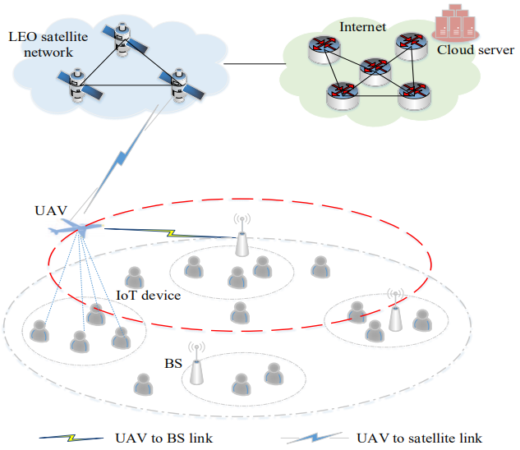
Application 1: Computation Offloading
Space-Air-Ground Integrated Networks:
IoT devices: request services
UAV: collect data from IoT devices
Determine to offload to a nearby BS or offload to a certain satellite and utilize the cloud server
Determine the proportion of tasks to offload, and the others will be done by the UAV
The task request received by the UAV is uncertain
Yali Chen, Bo Ai, Yong Niu, Hongliang Zhang, and Zhu Han, “Energy-Constrained Computation Offloading in Space-Air-Ground Integrated Networks using Distributionally Robust Optimization,” IEEE Transactions on Vehicular Technology (Volume: 70, Issue: 11, Nov. 2021)

Slide 21
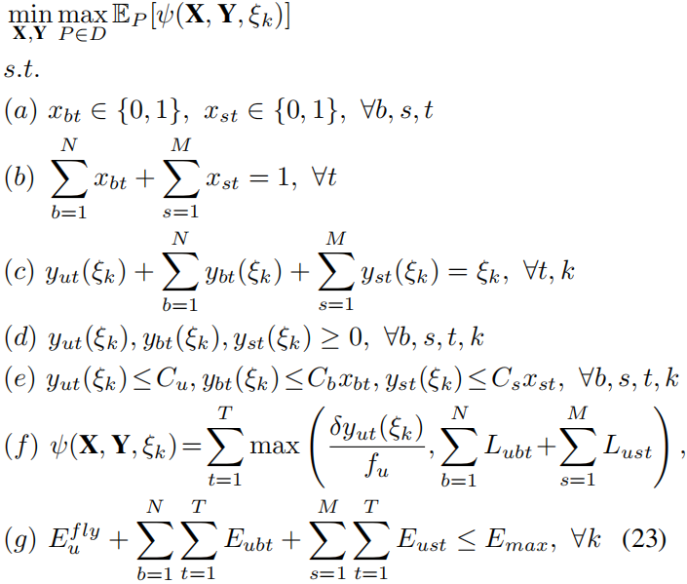
Application 1: Problem Formulation
Objective: minimize the expected total latency of T time slots under the worst-case distribution realization in uncertainty set D
the sum of tasks processed by UAV, all BSs, and all LEO satellites equals to the amount of tasks arrived
ensure the tasks assigned cannot exceed its capacity
total system latency
energy constraint

Slide 22
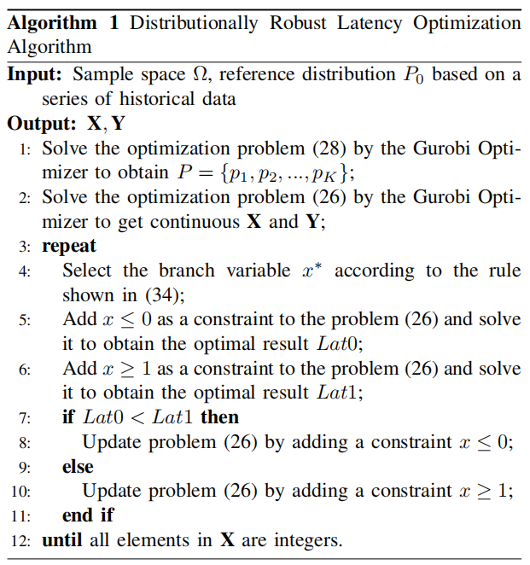
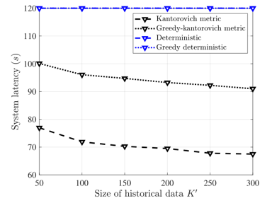
Application 1: Algorithm and Results
The same as Wasserstein metric
For deterministic scheme, many tasks cannot be processed and retransmission is required, leading to a higher latency

Slide 23
Outline
Introduction
Case 1: Discrepancy-based DRO Optimization
Case 2: DRO, Risk Aversion and CVaR
Value-at-Risk (VaR) and Conditional Value-at-Risk (CVaR)
VaR and CVaR in Optimization
Application II: Age of Information
Case 3: DRO based Reinforcement Learning
Conclusion
Notes:
Next I will introduce DRO and Risk Aversion

Slide 24
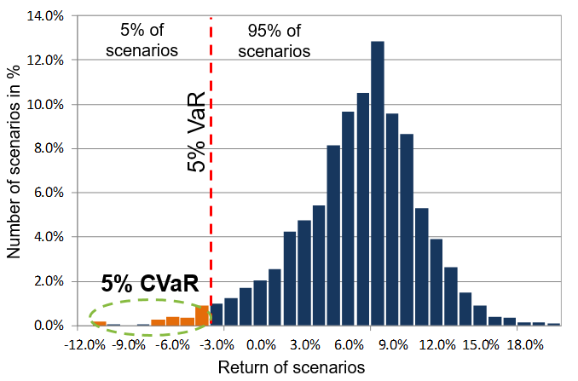
DRO and Risk Aversion
VaR& CVaR Representation
Risk Management is a procedure for evaluating loss distribution in Risk Aversion.
Value-at-Risk (VaR) and Conditional Value-at-Risk (CVaR) are popular function for measuring risk.
Risk functions: graphical representation of VaR, VaR Deviation, CVaR, CVaR Deviation, Max Loss, and Max Loss Deviation.
Notes:
Risk management is a broad concept. From the mathematical perspective considered in this presentation, risk management is a procedure for shaping a loss distribution (for instance, an investor’s risk profile)
From the VaR& CVaR Representation
1. CVaR has nice mathematical properties versus VaR for instance, the CVaR of a portfolio is a continuous and convex function with respect to positions in instruments, whereas the VaR may be even a discontinuous function.
2. Risk management with CVaR functions can be done very efficiently
CVaR can be optimized and constrained with convex and linear programming methods, whereas VaR is relatively difficult to optimize
3. VaR does not control scenarios exceeding VaR
The indifference of VaR risk measure to extreme tails may be a good property if poor models are used for building distributions.
The indifference of VaR to extreme tails may be quite an undesirable property, allowing to take high uncontrollable risks
4. CVaR accounts for losses exceeding VaR
CVaR provides an adequate picture of risks reflected in extreme tails.
This is a very important property if the extreme tail losses are correctly estimated.

Slide 25
DRO and Risk Aversion
VaR & CVaR
Let X be a random variable, with the X may have meaning of loss or gain.
VaR Definition
A lower α-percentile of the random variable X.
is nonconvex and discontinuous function of the confidence level α for discrete distributions.
Difficult to control/optimize for non-normal distributions: VaR has many extremums for discrete distributions.
Notes:
Based on the above example, Let X be a random variable with the X may have meaning of loss or gain.
We first give VaR Definition， which is a lower α-percentile of the random variable X.
VaR is non convex and discontinuous function of the confidence level α for discrete distributions
Difficult to control/optimize for non-normal distributions: VaR has many extremums for discrete distributions

Slide 26
DRO and Risk Aversion
VaR& CVaR
CVaR Definition
The CVaR of $X$with confidence level $α ∈\left[0, 1\right]$is the mean of the generalized $α$-tail distribution:
where the distribution in question is the one with distribution function defined by
For random variables with continuous distribution functions, ${\text{CVaR}}_{α}$(X) equals the conditional expectation of X subject to $Z ≥ {VaR}_{α} (X).$
CVaR is continuous with respect to $α.\text{CVaR} \text{is} \text{convex} \text{in} X$
Notes:
As for CVaR Definition The CVaR of $X$with confidence level $α ∈\left[0, 1\right]$is the mean of the generalized $α$-tail distribution:
where the distribution in question is the one with distribution function defined by
For random variables with continuous distribution functions, ${\text{CVaR}}_{α}$(X) equals the conditional expectation of X subject to $Z ≥ {VaR}_{α} (X).$

Slide 27
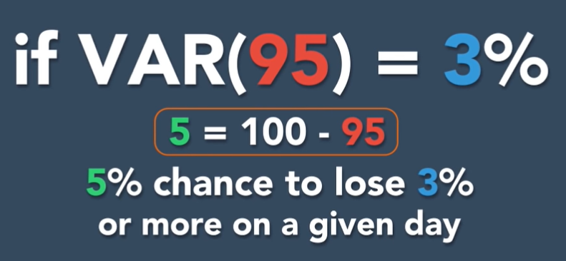
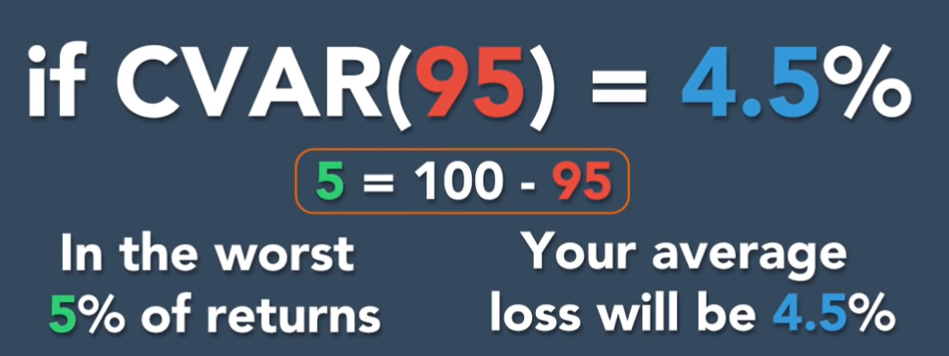
DRO and Risk Aversion
VaR& CVaR Example
Main focus:
Value-at-Risk (VaR) and Conditional Value-at-Risk (CVaR) [Rockafellar and Uryasev, 2000].
CVaR gives us an average expected loss
VaR gives us a range of potential losses
If more than lost 3% happens with 5%, but we still do not know average lost.
CVAR describes the average lost conditioned on VaR happens.
Notes:
VaR is a percentile of a loss distribution
CVaR approximately (or exactly, under certain conditions) equals the average of some percentage of the worst-case loss scenarios.
For example if VaR 95 equal to 3 percent, you have 5% chance to lose 3%
If CVaR 95 is equal to 4.5%, we will know in the worst case you have 5% chance to lose averge 4.5%

Slide 28
DRO and Risk Aversion
Equivalence of Chance Constraints and VaR Constraints
In portfolio management, often it is required that portfolio loss at a certain future time is, with high reliability, at most equal to a certain value.
Let $f(x, y)$be the loss associated with the decision vector $x$and the random vector $y$.
$Prob\{f_{i}\left(x,y\right)\}≤0\}≥p_{i}$ $, i=1,…,m.$
Let${ VaR}_{α}$ $\left(x\right)$be the${ VaR}_{α}$ of a loss function $f(x,y)$
Then the following holds:
$$Prob\left\{f\left(x,y\right)≤ζ\right\}≥α↔Prob\left\{f\left(x,y\right)>ζ\right\}≤1−α↔{VaR}_{α}(x)≤ζ$$
In general, ${ VaR}_{α}$ $\left(x\right)$ is nonconvex w.r.t. $x$, (e.g., discrete distributions)
Notes:
I will introduce Equivalence of Chance and VaR Constraints
In portfolio management, often it is required that portfolio loss at a certain future time is, with high reliability, at most equal to a certain value.
Let $f(x, y)$be the loss associated with the decision vector $x$and the random vector $y$.
Let${ VaR}_{α}$ $\left(x\right)$be the${ VaR}_{α}$ of a loss function $f(x,y)$
Then the following holds:
In general, ${ VaR}_{α}$ $\left(x\right)$ is nonconvex w.r.t. $x$, (e.g., discrete distributions)
${VaR}_{α}(x)≤ζ$ and $Prob\left\{f\left(x,y\right)≤ζ\right\}≥α$ may be non convex constraints

Slide 29
DRO and Risk Aversion
Minimization and CVaR Constraints
The underlying probability distribution of $y$ will be assumed for convenience to have density $p(y)$. The $α$-CVaR of the loss associated with a decision x is the value
The main idea is to define a function that can be used in connection with VaR and CVaR
1. is convex with respect to α;
2. is a minimum point of function w.r.t. ;
3. As a function of , is finite and convex (hence continuous), :
Notes:
Nowadays, VaR has achieved the high status, however, It is difficult to optimize VaR numerically when losses are not normally distributed.
So, we will consider Minimization and CVaR Constraints
The underlying probability distribution of $y$ will be assumed for convenience to have density $p(y)$. The $α$-CVaR of the loss associated with a decision x is the value
The main idea is to define a function that can be used in connection with VaR and CVaR

Slide 30
DRO and Risk Aversion
Chance constrained programs
It is known that distributionally robust chance constraints can be conservatively approximated by Worst-Case Conditional Value-at-Risk (CVaR) constraints.
$x$ is the decision vector and c is a cost vector
$Pr$ can be unknown arbitrary distribution
The chance constraint requires a set of $m$ uncertainty-affected inequalities to be jointly satisfied with a probability of at least $1−ε.$
Notes:
It is known that Distributionally robust chance constraints can be conservatively approximated by Worst-Case Conditional Value-at-Risk (CVaR) constraints.
where x ∈ Rn is the decision vector, X ⊆ Rn is a convex closed set that can be represented by semidefinite constraints, and c ∈ Rn is a cost vector.
The chance constraint in (1) requires a set of m uncertainty-affected inequalities to be jointly satisfied with a probability of at least 1−$ε$, where $ε$∈ (0, 1) is a desired safety factor specified by the modeler

Slide 31
DRO and Risk Aversion
Distributionally robust approach
A natural way to immunize the chance constraint against uncertainty in the probability distribution is to adopt the following ambiguous or distributionally robust chance constraint.
denotes the distribution belongs to an uncertainty set with certain known structural properties.
the worst case
Distributionally robust chance constraint means satisfies the probability at least $1−ε$in the presence of channel uncertainties.
For m = 1, the feasible set is denoted by
Notes:
A natural way to immunize the chance constraint against uncertainty in the probability distribution is to adopt the following ambiguous or distributionally robust chance constraint.
Robust chance constraint means the worst case satisfies the probability at least $1−ε$in the presence of channel uncertainties.
For m = 1 we can get the feasible set

Slide 32
DRO and Risk Aversion
CVaR chance constraints
The CVaR at $ε$level with respect to is defined as
CVaR essentially evaluates the conditional expectation of loss above the (1 −$ε$)-quantile of the loss distribution. It can be shown that CVaR represents a convex functional of the random variable
Notes:
In CVaR chance constraints The CVaR at $ε$level with respect to P is defined as
CVaR essentially evaluates the conditional expectation of loss above the (1 −$ε$)-quantile of the loss distribution. It can be shown that CVaR represents a convex functional of the random variable L kexi
The chance Constraint problems can be transformed this form

Slide 33
Application 2: Age of Information
Age of Information Minimization in Healthcare IoT Using Distributionally Robust Optimization [2]
How can I deal with channel state information (CSI) errors in Healthcare IoT system ?
The retransmission scheme is investigated against CSI errors to reduce the AoI.
The retransmission will lead to the energy consumption of the IoT device increase dramatically, especially when the IoT device is used to retransmit the same updates for infinite times
The perturbations in CSI are modeled to be statistically unbounded according to Gaussian distribution and Rayleigh distribution.
These statistical channel assumptions may not match the healthcare IoT applications perfectly.
A key open problem is to consider the case of imperfect CSI and investigate how CSI error effects may be mitigated through quantitative designs.
[2] Z. Ling, F. Hu, H. Zhang and Z. Han, "Age of Information Minimization in Healthcare IoT Using Distributionally Robust Optimization," IEEE Internet of Things Journal, to be appeared.
Notes:
Now I will introduce Application 2: Age of Information Minimization in Healthcare IoT Using Distributionally Robust Optimization

Slide 34
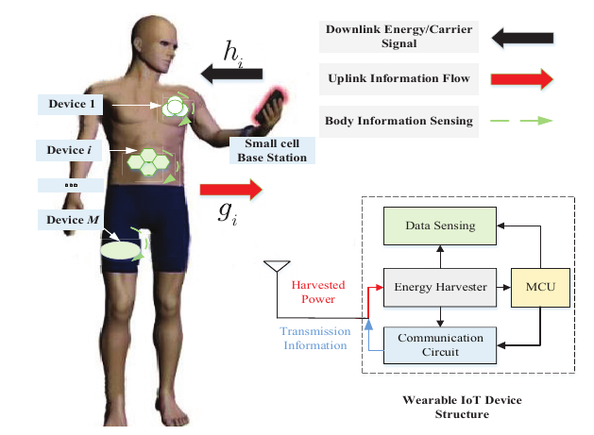
Application 2: Body Area Networks
System model
As shown in this picture, we consider a single-hop cellular IoT to support healthcare IoT applications:
the wearable IoT devices harvest wireless RF energy from a dedicated power cell BS
the wearable IoT devices send their sensing physiological information signals to a separate information receiving cell BS.
Notes:
Now I will introduce Application 2: Age of Information Minimization in Healthcare IoT Using Distributionally Robust Optimization
To keep the freshness of the data received at the cell BS, the wearable IoT device needs to update the data of the sensing physiological information tasks frequently in a period to minimize the average AoI.
There is an inherent tradeoff about the average AoI, where the wearable device energy consumption grows as the transmit power increases, while the average AoI of the healthcare IoT decreases as them increases.

Slide 35
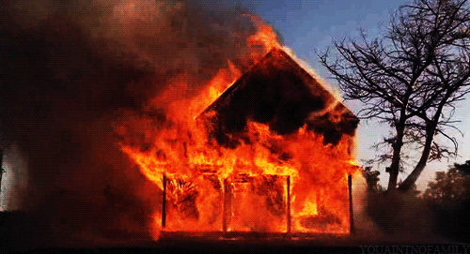
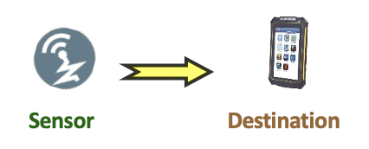
Application: Age of Information
Age of Information= Time – Timestamp
Measure the “age of information” that destination know about a source node.
Potential application: UAV, Uplink, Down link system in wireless communication IoT network, etc.
Evolutions of AoI function.

Slide 36
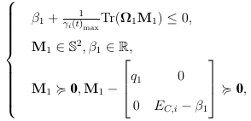
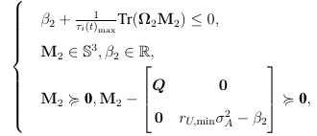
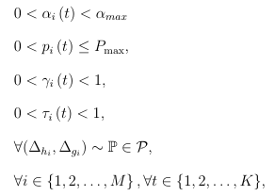
Application 2: Problem Formulation
CVaR constraint.
CVaR constraint.
Power constraint
Outage probability constraint for energy harvesting.
Outage probability constraint for transmission
Notes:
Through the CVaR based method, we can reformulate each of the individual distributionally robust chance constraints in terms of tractable Linear Matrix Inequalities (LMIs) to get the optimal average AoI under the uncertain errors chance constraint region. The final formulation can be shown as

Slide 37
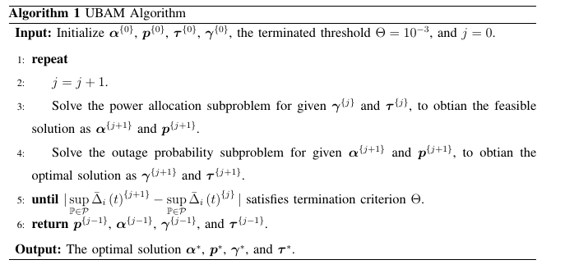
Application 2: CVAR Algorithm
To get the optimal average AoI, we propose a low-complexity upper bound of AoI minimization (UBAM) algorithm in an iterative manner to address the distributionally robust optimization problem.
Notes:
Our objective is to minimum the upper bound of AoI, by jointly optimizing transmission power ,energy harvesting outage probability, and information transmission outage probability with respect to the CVaR constraints. However, simultaneous optimization over these variables would result in a non-convex optimization problem, and such problem is known to be NP-hard in general. Thus, we introduce an efficient iterative algorithm to solve it suboptimally by applying the BCD techniques. In each iteration, we optimize different blocks of variables alternatively.

Slide 38
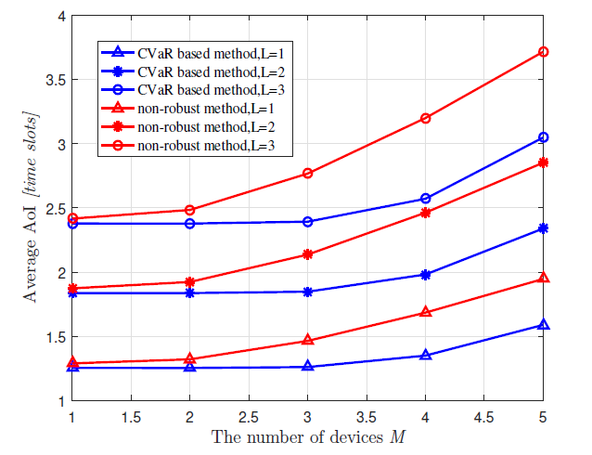
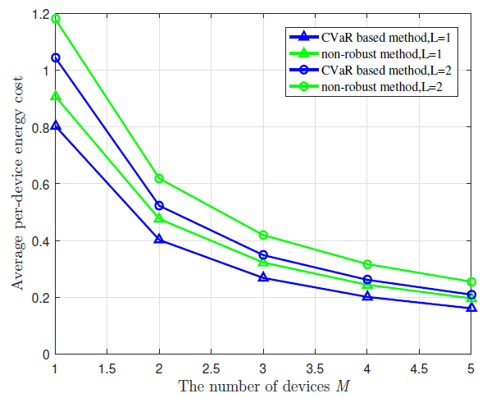
Application 2: Results
The energy harvesting and information transmission successful opportunities for each link become lower with more wearable IoT devices. In this sense, we find an AoI-energy tradeoff in the healthcare IoT system.

Slide 39
Outline
Introduction
Case 1: Discrepancy-based DRO Optimization
Case 2: DRO, Risk Aversion, and CVaR
Case 3: DRO Based Reinforcement Learning
Distributionally Robust Policy iIteration
Application III: Well Logging
Conclusion
Notes:
Typical procedure of reinforcement learning
Reinforcement learning: An agent keeps observing the environment, obtain external feedback (game reward points, etc.) after taking actions

Slide 40
Motivation
Previous works considering robustness in Reinforcement Learning
Mainly focus on uncertain environment for searching strategies to achieve best performance
Robust reinforcement learning
Guard against common systematic perturbation situations
Robust Adversarial Reinforcement Learning
Conquer rare, catastrophic events
DRO RL
Not only consider uncertainty in environment
Limited collected samples when training
→ Affect how to transit to new state based on current state and action
Estimation error in Policy Iteration
Concentrate on learning process for agent itself
Conservative policy in unknown environment
Optimistic policy in familiar environment
Estimation error

Slide 41
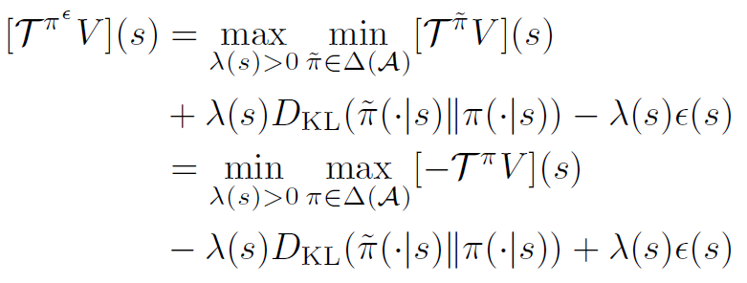
Distributionally robust policy evaluation
Uncertainty set:
Adversarial Bellman operator:
Evaluate with an adversarial policy
Rewrite the maximum problem by
Distributionally robust modified policy iteration (MPI)
Policy improvement:
Policy evaluation:
$$D_{KL}≤ε$$
Considered possible policies
Best policy
$$π^{ }$$
$${\tilde{π}}^{ }$$
worse case
$$π^{ε }$$
$$π^{ }$$
$$π^{ε }$$
$$a_{1}$$
$$a_{2}$$
$$a_{3}$$
$$a_{1}$$
$$a_{2}$$
$$a_{3}$$
adversarial policy
Re-weight policy action probabilities opposite
to Q-values
Adversarial
temperature
Notes:
The idea for the distributionally robust policy evaluation: policy is a distribution(possibility of taking each actions), the goal is to find a optimal policy in a space. But during the iteration, Instead of choosing the looks best policy , sometimes choosing the most cowardly policy located near this policy coule result a better final end.
As mentioned before, DR RL using Discrepancy-based DRO way to build the uncertainty set: KL divergency.
For example, current policy is around (0.1, 0.8, 0.1) since the q value said the action 2 is very valuable with ignorant confidence. But the uncertainty in the real world always teach people to be humble, so based on the level of uncertainty the agent will have a seems cowardly but wisely action maybe (0.3, 0.5, 0.3). Thoughtful coward is better than ignorant pioneer.
All this classical reinforcement learning algorithm face a problem of high dimensional of real word: the value space is huge and the action space is huge. After introduced the deep neural network to estimate the value and predict the action, the reinforcement learning is enter the modern period.
Then Let's introduce the current SOTA algorithms in Reinforcement learning filed and it's DRO version.

Slide 42
Regularized Bellman Optimality Operator
Rewritten of Bellman operator for value function
${[T}^{π}V]\left(s\right)≔E_{a\sim π(∙|s)}\left[\sum_{t≥0}{γ^{t}r_{t}|}s_{0}=s, π\right]$
${= E}_{a\sim π(∙|s)}\left[r\left(s,a\right)+γ{ E}_{s^{′}\sim p\left(s^{′} | s,a\right)}\left[V\left(s^{′}\right)\right]\right]$
= $<π\left(∙ | s\right),Q_{V}\left(s,a\right)>$ … inner product of the policy and Q-function
$$Q_{V}\left(s,a\right)$$
Regularized Bellman optimality operator
${[T}^{π,Ω}V]\left(s\right)≔T^{π}V−Ω(π)$ is a Fenchel dual function and can be seen as the normal value function minus the baseline.
Set of optimal policies
Lengendre-Fenchel duality (Conjugate function)
Fenchel dual : ${[Ω}^{⬆}V]\left(Q_{V}\right)=\max_{π∈ΔA}{(<π,Q_{V}>−Ω(π))}_{}^{}$
Gradient form: ${[∇Ω}^{⬆}V]\left(Q_{V}\right)=\underset{π∈ΔA}{argmax}{(<π,Q_{V}>−Ω(π))}_{}^{}$
Soft distributionally robust modified policy
Distributionally robust soft actor-critic
$$=λ× ( )$$
Notes:
First formulate Bellman Funtion by writing Bellman Operator

Slide 43
Extension to Entropy-Regularized Policy Maximum Entropy
Soft distributionally robust modified policy
Policy improvement:
Policy evaluation:
Soft adversarial Bellman operator
Here, we take entropy form into consideration to obtain robustness guarantees on exploration process.
Adversarial entropy-regularized policy
Recall the adversarial policy
entropy form
$$E_{a\sim π\left(∙ | s\right)}log⁡[π(a|s)]$$
Regularized policy

Slide 44
Extended to Continuous Control
Apply this distributional robust MPI to the continuous control problem.
The formulation is intractable and we get the approximate formula as follows:
Regularized Bellman operator can be written in terms of Fenchel conjugate
Fenchel conjugate
Regularization parameter
Prior policy
$$=λ× ( )$$
Logarithm of moment-generating function
Taylor expansion
reward shaping
Potential-based reward shaping
When it come to the implementation, it‘s quite simple. Just change the reward
encourage the agent to visit states with smaller variance
Notes:
To extend the Distributional Policy iteration to the SAC which invented to solve the Continuous Control problem is not easy. The Formulation is intractable, but with several Taylor first order Approximation derivations, we can get this formular to guide design of the distributional SAC and other Distributional algorithms: Shape the reward to encourage the agent visit the state with smaller Q variance under prior policy. The uncertain level is depend on the ½Lamda which depend on the visited count of states. If the agent has visited this state many times, it is familiar with this state, then the Lamda is big, the reward is certainy, doesn't need the variance to correct the reward. If the state is not familiar to the state, the lamda is small, the variance regularizer is essential.
Real-world applications usually operate in continuous state/action space.
So in this part, the authors formulate the distributionally robust soft actor-critic by extending the previous distributionally robust approach to continuous case.
Again, the regularized Bellman operator can be written as the conjugate function.
And the regularization parameter is the KL-divergence based regularization with the prior policy mu.
The Fenchel conjugate of omega_lambda can be expressed by the logarithm of moment-generating function.
By doing the Taylor expansion and potential-based reward shaping, we can get the last formula.
The goal of the reward shaping is to make the learning faster.
Corollary 2 (by other papers)

Slide 45
Distributionally Robust Soft Actor-Critic (DRSAC)
In this continuous control case: the distribution of the policy is Normal distribution.
parametrized Gaussian policies
Approximation the variance of Q-values by using the 1st order Taylor approximation of Q-values
around the mean action
Combined with the soft-actor critic algorithm
1st order Taylor approximation of
Q-values around the mean action
Independent actions
Importance: entropy V.S. reward
Haarnoja, T., Zhou, A., Abbeel, P., and Levine, S. Soft actor-critic: Off-policy maximum entropy deep reinforcement learning with a stochastic actor. arXiv preprint arXiv:1801.01290, 2018a.

Slide 46
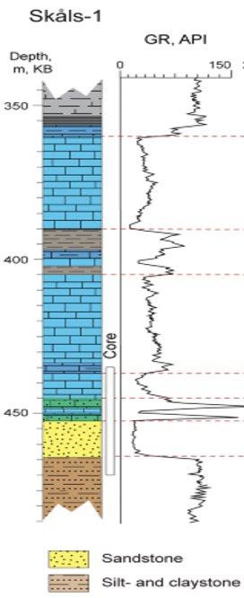
Application 3: Signal Localization
Well 1
Well 2
Gamma-Ray Signal Localization Task
Many 1D signals containing the same signal pattern are collected by the well-logging process and sent to human-expert to do hand-picking for oil&gas localization.
Traditional methods
The human experts pick the patterns associated with interested rock based on one reference signal:
Recognize the pattern with domain prior knowledges.
Roughly matching with correlation matching methods.
Yuan Zi, Lei Fan, Jiefu Chen, and Zhu Han, “Active Gamma-ray Log Pattern Localization with Distributional Robust Reinforcement Learning,” submitted to IEEE Transactions on Neural Networks and Learning Systems.
Notes:
Now I will introduce Wasserstein DRO Application 1: A Transactive Energy Framework for Coordinated Energy Management of Networked Microgrids With Distributionally Robust Optimization
Transactive Energy Management Framework
A transactive market is organized by the Distribution Network Operator to coordinate the energy management of the DS and MGs in the operation
DS is connected with the HV system and the DNO needs to manage the power exchange between the DS and the HV system.

Slide 47
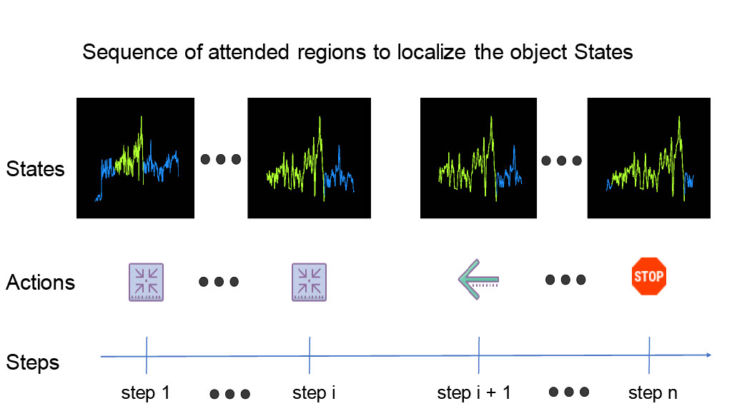
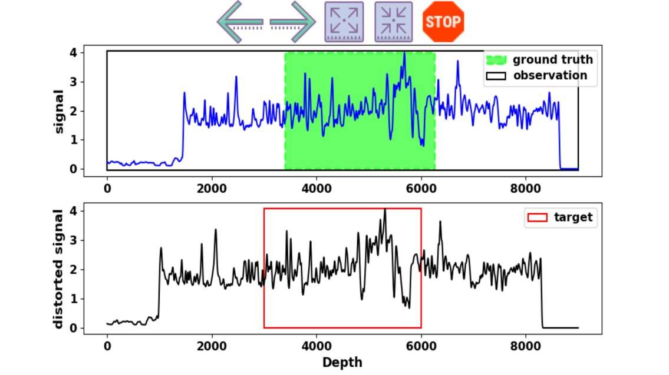
Application 3: Signal Localization
Reinforcement Learning Signal Localization Scheme
Thoroughly studied log with interested signal fragment as reference/target.
In the new log, there is a signal fragment that has the same pattern as the reference
Initial the whole new log trace as the agent's observation.
Let the agent move (left, right, expand, shrink) to search the reference pattern.
Notes:
Optimization Model of Distribution Network Operator
cost for the scheduled power exchange between the DS and HV system
generation cost of the MTs in the DS.
the cost for the deviant power exchange between the DS and HV system
settlement between the DS and MGs
the power exchange between the DS and MG m by the solutions of the MGs' energy scheduling optimization

Slide 48
Conclusion
Motivation
DRO accounts for the fact that one is never able to exactly specify a probability distribution in practice.
Due to the finite experience sample, the distribution of the real experience is hard to get.
DRO Optimization
The Wasserstein distributionally robust problems can often be reformulated as (or tightly approximated by) finite convex programs within a certain Wasserstein distance from the empirical distribution constructed from training samples.
CVAR
Distributionally robust chance constraints can be conservatively approximated by worst-case CVaR constraints.
DRO RL
The risk-averse exploration in approximate RL setting is required and we can use the distributionally robust modified policy iteration scheme that implements safety in policy evaluation step w.r.t. estimation errors to avoid.
Implement DRO to the Reinforcement Learning is just add one safe regularizer to encourage agent visit the state with smaller variance.
Notes:
And finally I will give some conclusions.
DRO accounts for the fact that one is never able to exactly specify a probability distribution in practice.
Distributionally robust chance constraints can be conservatively approximated by worst-case CVaR constraints.
The Wasserstein distributionally robust problems can often be reformulated as (or tightly approximated by) finite convex programs within a certain Wasserstein distance from the empirical distribution constructed from training samples.

Slide 49
Main References
Rahimian H, and Mehrotra S.
Distributionally robust optimization: A review. 2019
Zymler S, Kuhn D, and Rustem B.
Distributionally robust joint chance constraints with second-order moment information. 2013
Esfahani P M, and Kuhn D.
Data-driven distributionally robust optimization using the Wasserstein metric: Performance guarantees and tractable reformulations. 2018
T. Haarnoja, A. Zhou, P. Abbeel, and S. Levine.
Soft actor-critic: Off-policy maximum entropy deep reinforcement learning with a stochastic actor. 2018
B. Scherrer, M. Ghavamzadeh, V. Gabillon, B. Lesner, and M. Geist.
Approximate modified policy iteration and its application to the game of tetris. Journal of Machine Learning Research, 16:1629–1676, 2015
E. Smirnova, E. Dohmatob, J. Mary.
Distributionally robust reinforcement learning. 2019
Notes:
They are main references

Slide 50
Thank You Very Much
for
Your Attention !

Slide 51
DRO and Risk Aversion
Conditional value-at-risk in optimization
In problems of optimization under uncertainty, CVaR can be used in the objective or the constraints, or both.
Optimization shortcut
CVaR accounts for losses exceeding VaR. So when CVaR is considering, VaR can be ignored
Notes:
As for CVaR in optimization
In problems of optimization under uncertainty, CVaR can enter into the objective or the constraints, or both. We can derive minimiza CVaR equal to minimize x kexi F alpha x kexi and finally, get the optimal solution
CVaR accounts for losses exceeding VaR.
So when CVaR is considering, VaR can be ignored
As for risk shaping we can get the CVaR constraints

