Slide 1
Introduction to Deep Learning
Presented by Zhu Han
Major work from Ms. Xunsheng Du
Department of Electrical and Computer Engineering
University of Houston
Houston,TX

Slide 2
Outline
Background: from perceptron to deep learning networks
Important neural networks and algorithms
Restricted Boltzmann Machine
Constrastive Divergence Algorithm
Stochastic Gradient Decent and Backpropagation
Deep Neural Networks
Deep Belief Networks
Convolutional Neural Networks
Recurrent Neural Networks
Applications
Conclusion

Slide 3
Deep Learning

Slide 4
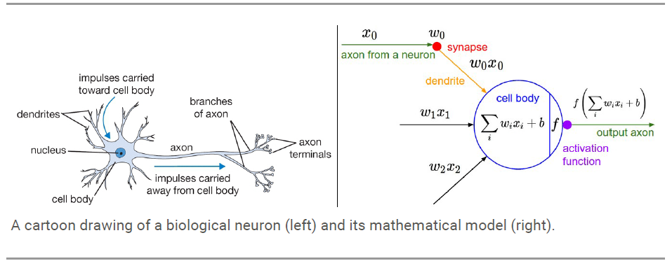
Biological Neuron and Modeling

Slide 5
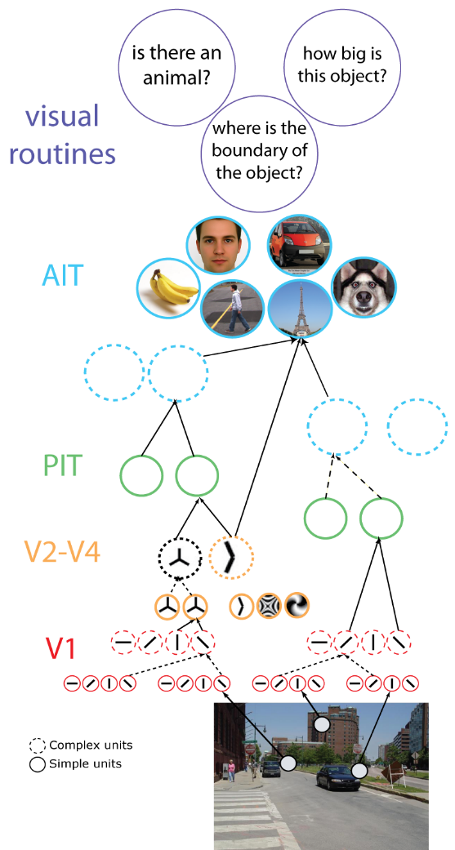
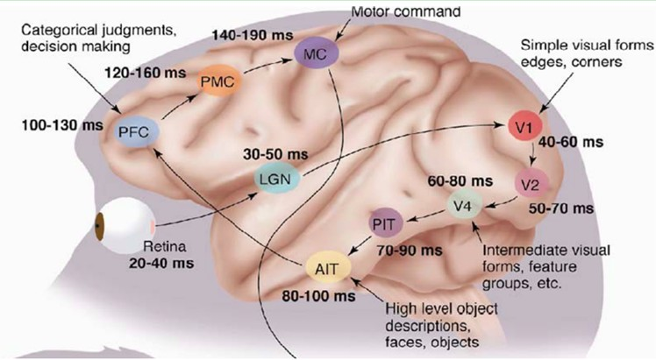
Herarchical Structure
1981, David Hubel & Torsten Wiesel: The Mamalian Visual Cortex is Hierarchical

Slide 6
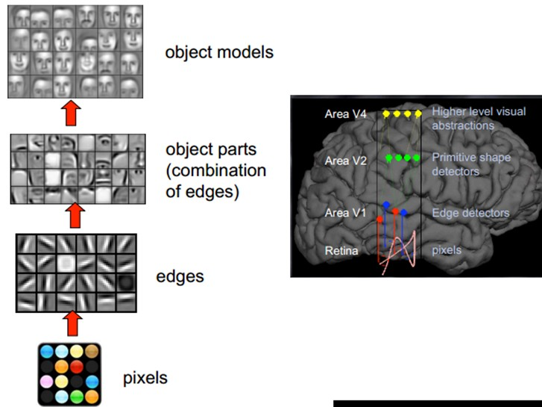
Deep Learning Structure

Slide 7
Outline
Background: from perceptron to deep learning networks
Important neural networks and algorithms
Restricted Boltzmann Machine
Constrastive Divergence Algorithm
Stochastic Gradient Decent and Backpropagation
Deep Neural Networks
Deep Belief Networks
Convolutional Neural Networks
Recurrent Neural Networks
Applications
Conclusion

Slide 8
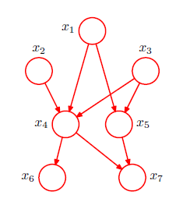
Graphical Model
Graph Model: Dependency structure between random variables
Nodes -> random variables; Edges ->dependencies
- Directed(Bayesian Networks)
- Undirected(Markov random fields, Boltzmann machines)
- Hybrid(Deep Belief Networks)
Directed Graphical Models
The joint distribution defined as the product of a conditional distribution for each node conditioned on its parents

Slide 9
Markov Random Fields
Undirected Graphical Model
C
A
B
Each potential function is a mapping from joint conﬁgurations of random variables in a clique to non-­‐ negative real numbers.
The choice of potential functions is not restricted to having speciﬁc probabilistic interpretations.
D
Potential functions are often represented as exponentials:
where E(x) is called an energy function.
Boltzmann distribution
.
terms!
Suppose x is a binary random vector with
If x is 100-­‐dimensional, we need to sum over
Computing Z is often very hard. This represents a major limitation of undirected model

Slide 10
Undirected Graphical Model

Slide 11
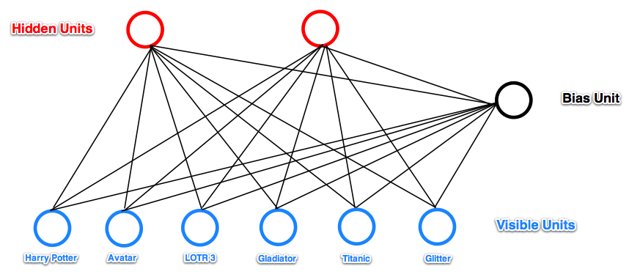
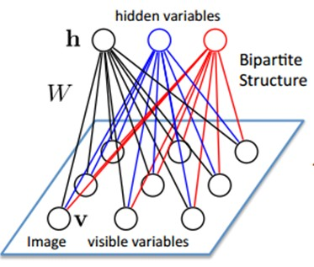
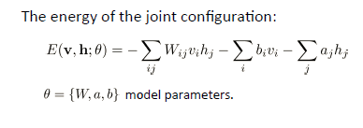
Restricted Boltzmann Machine
Each link associates with a probability; It is parametric

Slide 12
Restricted Boltzmann Machine
Probability of the joint configuration is given by the Boltzmann distribution:

Slide 13
Restricted Boltzmann Machine
We can get the P(v) and P(h) according to joint probability and conditional probability
Given a set of training examples $D=\{v^{1},v^{2},…,v^{n}\}$
Learn the model parameters $θ=\{W,a,b\}$
Maximize the log-likelihood function
Derivative of the log-likelihood
Difficult to compute, should use MCMC (Markov Chain Monte Carlo)
Easy to compute

Slide 14
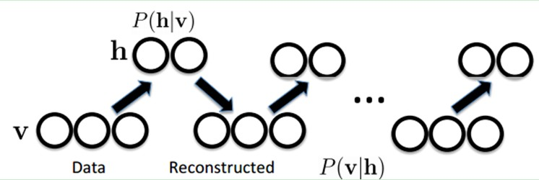
Contrastive Divergence
Approximation to the gradient of log-likelihood objective:
Use CD (Contrast Divergence) to finish this process
Or the derivation of log likelihood over also can written as follows:

Slide 15
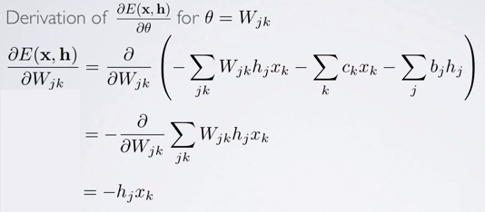
Contrastive Divergence

Slide 16
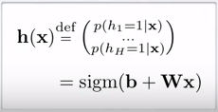
Contrastive Divergence

Slide 17
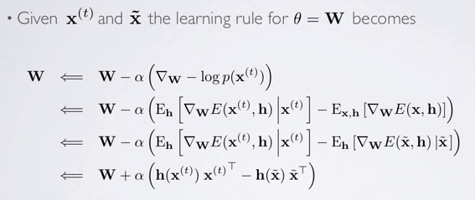
Contrastive Divergence

Slide 18
Contrastive Divergence
The overall procedure of CD algorithm:

Slide 19
Outline
Background: from perceptron to deep learning networks
Important neural networks and algorithms
Restricted Boltzmann Machine
Constrastive Divergence Algorithm
Stochastic Gradient Decent and Backpropagation
Deep Neural Networks
Deep Belief Networks
Convolutional Neural Networks
Recurrent Neural Networks
Applications
Conclusion

Slide 20
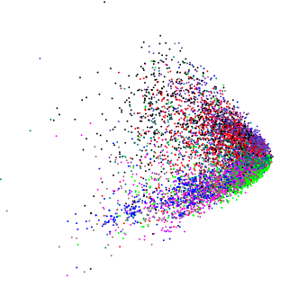
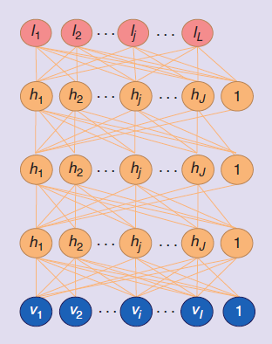
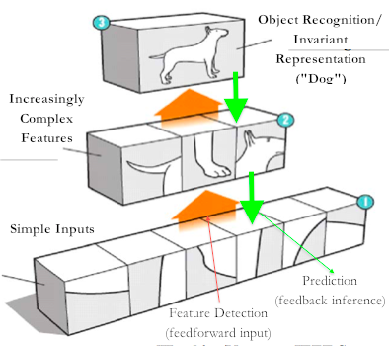
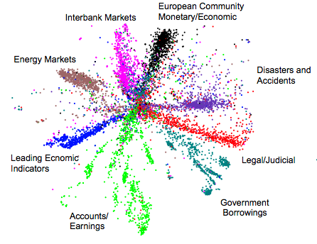
Deep Learning Layered Structure
After learning an RBM, treat the activation probabilities of its hidden units as the data for training the RBM one layer up
Stacking a number of the RBMs learned layer by layer from bottom-up gives
“Trained” methods for better clustering

Slide 21
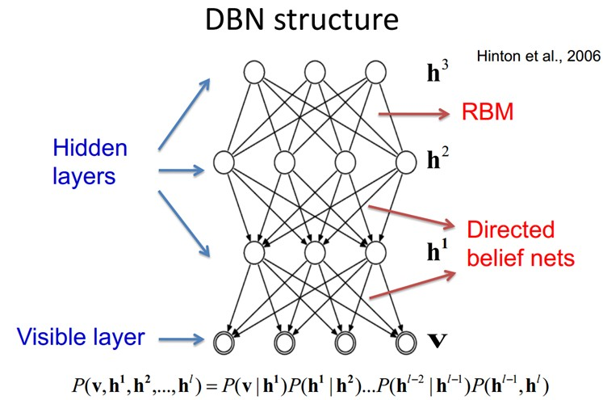
Deep Belief Networks
Sigmoid Function
Question: how to train DBM?

Slide 22
Stochastic Gradient Decent
Learning Rule

Slide 23
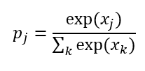
Stochastic Gradient Decent
Take softmax function as example:
$x$ represents sample vector
Softmax function also can be called normalized exponential
(Input data)
P represents the probability of x classified into one class
The cost function is defined as :

Slide 24
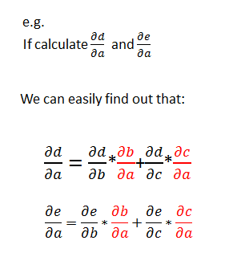
Backpropagation
a
b
c
d
e
f
The gradient written in red is repeatedly calculated

Slide 25
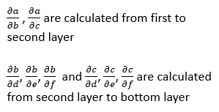
Backpropagation
Since in reality, the number of layers and neurons is large, the computation complexity is hugely enlarged
a
So we consider a way to compute gradient from top to the bottom:
b
c
d
e
f

Slide 26
Outline
Background: from perceptron to deep learning networks
Important neural networks and algorithms
Restricted Boltzmann Machine
Constrastive Divergence Algorithm
Stochastic Gradient Decent and Backpropagation
Deep Neural Networks
Deep Belief Networks
Convolutional Neural Networks
Recurrent Neural Networks
Applications
Conclusion

Slide 27
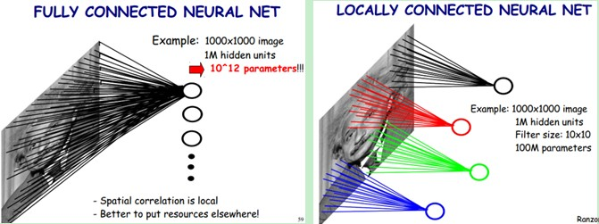
Convolutional Neural Networks
Use filters to reduce the number of weights

Slide 28
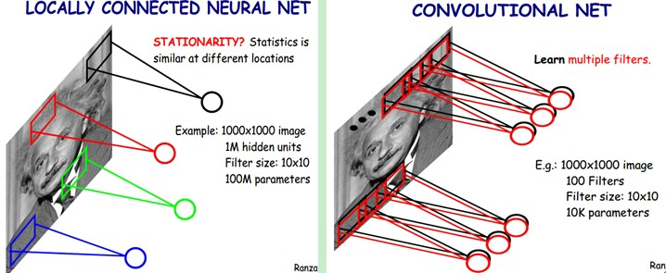
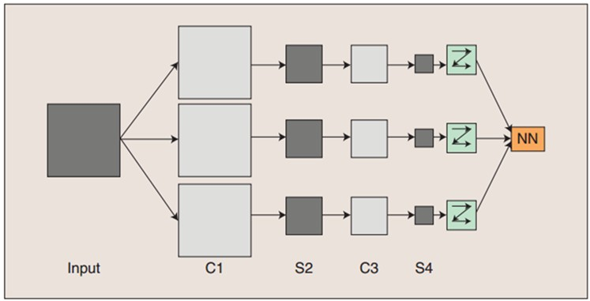
Convolutional Neural Networks
Feature Map
Down Sampling
Can use different filters to learn the image
The hidden units number determined by the image size, filter size, and stride

Slide 29
Convolutional Neural Networks
The structure of networks is more similar to biological structure than other neural networks
Dramatically reduce the number of parameters and complexity of computation
Because of the same parameter for the same filter, computation process can be parallelized, it can achieve high computing efficiency on graphics processing units
Convolutional computation can reduce the noise and make signal more intense
Sampling function
can be defined as
different way:
Maximum
Average
Sigmoid
…

Slide 30
Recurrent Neural Networks
RNNs is also trained using error backpropagation
Notes:
t

Slide 31
Comparisons
 | Similarities | Differences
Convolutional Neural Networks | Multiple Layers Use Back-propagation Algorithm for training Can be combined together to create more powerful networks | More suitable for data with grid structures Much fewer parameters Very efficient training with GPUs
 |  | Having memory of past (suitable for tasks like speech recognition) Not able to take big input such as images or videos
Recurrent Networks
 |  | Generative model (can generate realistic looking data after initializing at random variable) Used much less due to inefficiency
Deep Belief Networks

Slide 32
Outline
Background: from perceptron to deep learning networks
Important neural networks and algorithms
Restricted Boltzmann Machine
Constrastive Divergence Algorithm
Stochastic Gradient Decent and Backpropagation
Deep Neural Networks
Deep Belief Networks
Convolutional Neural Networks
Recurrent Neural Networks
Applications
Conclusion

Slide 33
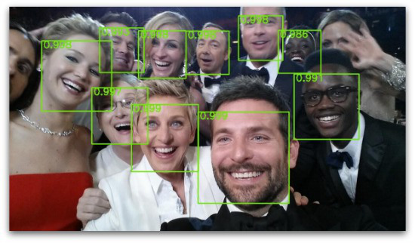
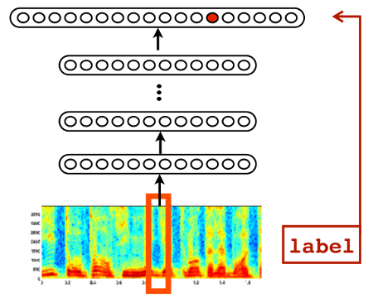
Classic Applications
Facial Recognition, speech recognition, driverless technology

Slide 34
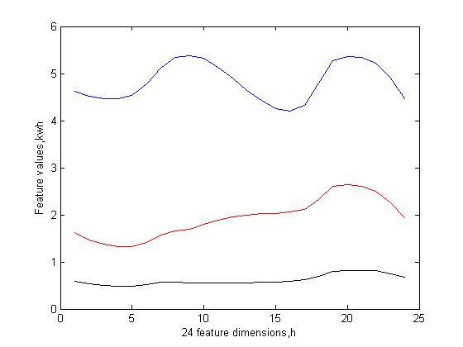
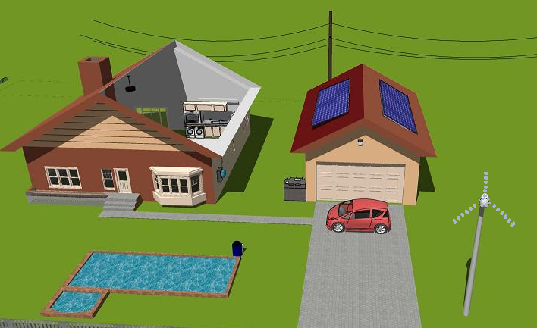
Smart Grid Applications (UH)
When you enter your smart meter number
Study your behavior
Tell if you are CEO, middle class, or Ph.D. students
Sell you an energy plan that you cannot deny

Slide 35
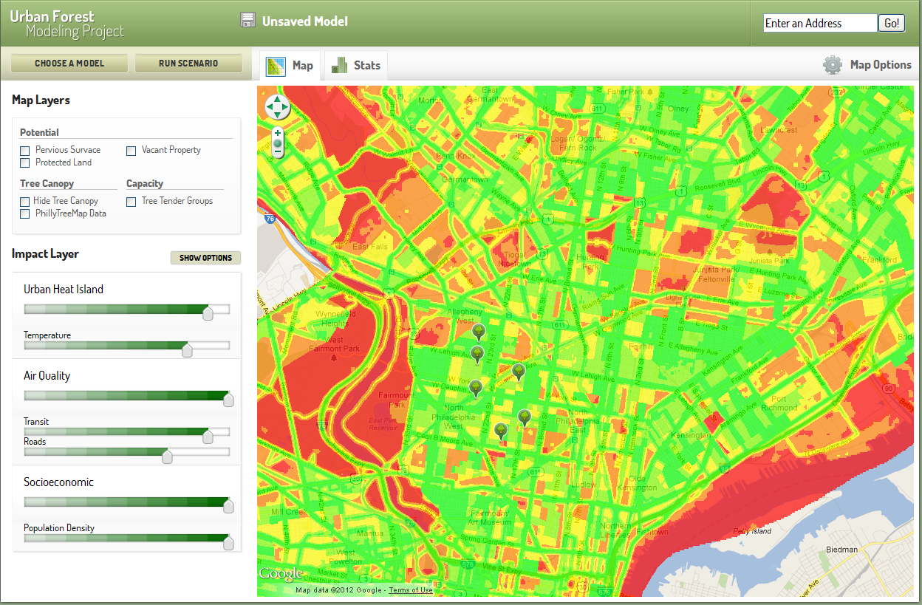
Wireless Networking Applications (UH)
Monitor spectrum map, detect abnormality

Slide 36
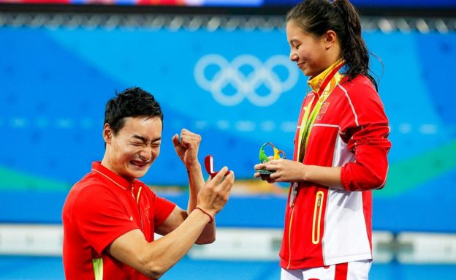
Language (UH)
Propose in Olympic

Slide 37
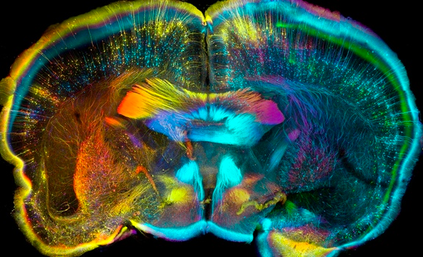
Bio Medical Applications (UH)
Rat brain: How many brain cells are growing and damaged?

Slide 38
Conclusions
Background information about neural networks
Basic idea for deep learning and importance of features
Important algorithms to train deep networks
Contrastive divergence
Backpropagation
Important types of deep neural networks
Deep belief networks
Convolutional neural networks
Recurrent neural networks
Applications in industry and studies in UH

Slide 39
Thank you ! Q & A

