Slide 1
Statistical Bayesian Inversion of Directional Electromagnetic Logging Data
Qiuyang Shen
Advisors: Dr. Jiefu Chen and Dr. Zhu Han
Ph.D. Dissertation Defense
September 2019

Slide 2

Outline
Introduction
Statistical Inversion
Future Works
Conclusions
Ref link @https://www.azernews.az/oil_and_gas/127728.html. Photograph by Trend.
Notes:
To briefly outline the contents of this presentation, it will cover

Slide 3
Outline
Introduction
  Research background
  Dissertation scope: motivations and contributions
Bayesian statistical inversion
  Bayesian inference and sampling methods
  A hybrid sampling scheme
  Self-parameterizing method: trans-dimensional MCMC
  Accelerate Bayesian inference: tempering method
Future works
  Hierarchical Bayesian modeling
  2D inverse modeling
  Deep-learning assisted statistical inversion
Conclusions
Notes:
In detail,

Slide 4
Outline
Introduction
Research Background
  Logging while drilling (LWD)
  Directional Electromagnetic (EM) LWD service
  Azimuthal resistivity LWD tools
  Inverse problems
Dissertation scope
  Challenges and motivations
  Research contributions
Statistical Inversion
Statistical Inversion
Future Works
Future Works
Conclusions
Conclusions
Notes:
We start from the introduction of my research background

Slide 5
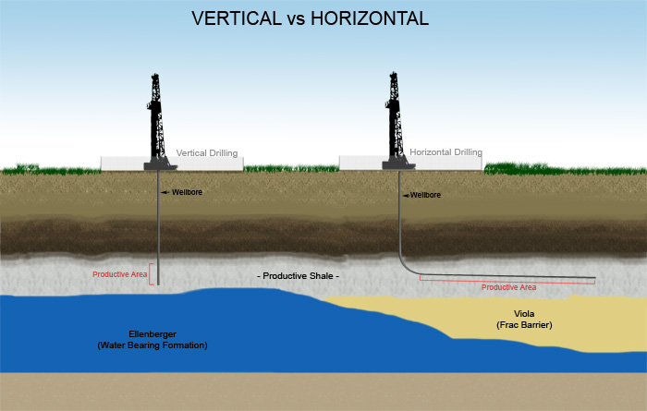
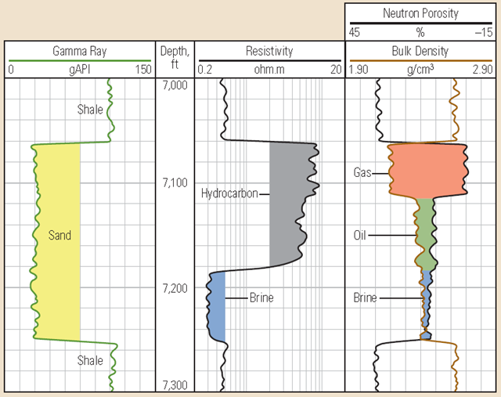
Logging While Drilling (LWD)
Well logging
  A practice of making a detailed record of geologic formations
  Physical properties of rocks
Log types
  Gamma ray/Resistivity/Neutron porosity/NMR/borehole image/…
Logging while drilling
  A technique that conveys well logs
  Transmit data back to surface
  For real-time decision support
Ref link @https://production-technology.org/how-to-read-a-well-log/
Ref link @https://www.azernews.az/oil_and_gas/127728.html

Slide 6
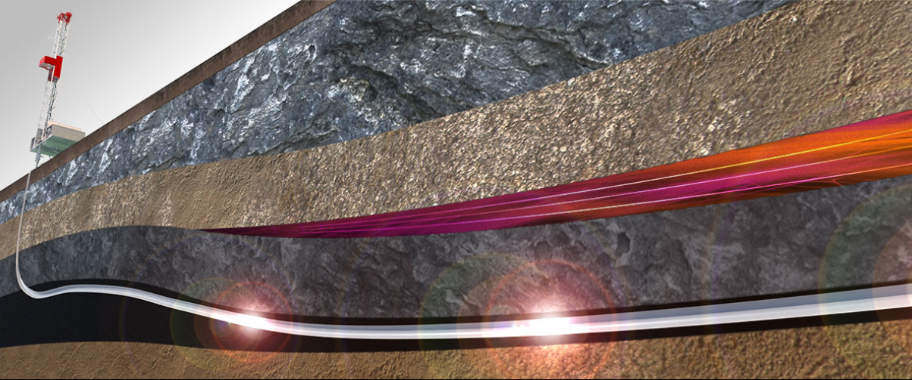
Directional Electromagnetic (EM) LWD service
Directional Drilling
  A practice of controlling the direction and deviation of wellbore
Electromagnetic sensing system
  Transmitter antenna propagates EM waves in the earth formation
  Receivers capture the EM signal and record
Directional EM LWD service
  Understand the earth electrical properties
  Distinguish conductive saltwater and resistive hydrocarbons
Ref link @https://halliburtonblog.com/tech-paper-a-new-ultra-deep-azimuthal-electromagnetic-lwd-sensor-for-reservoir-insight/
Copyright by Halliburton

Slide 7
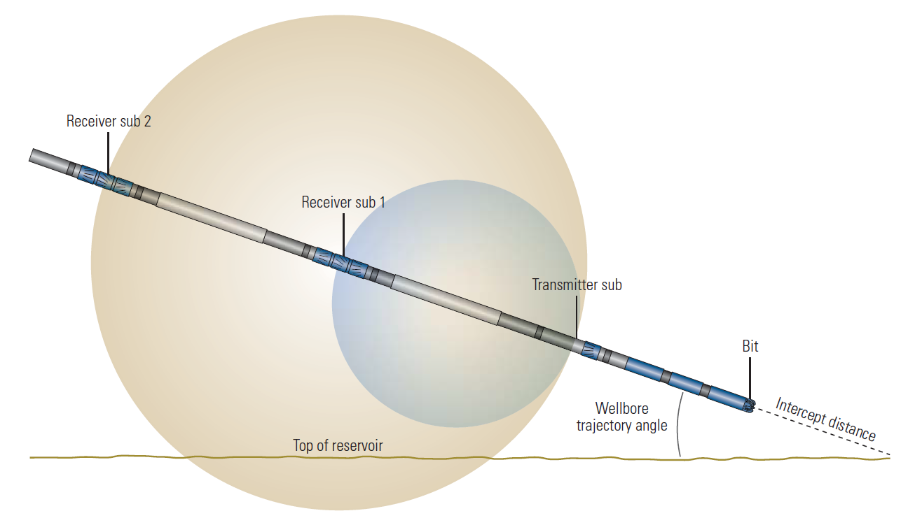
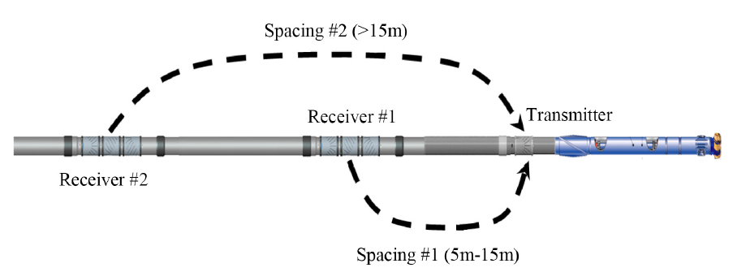
Directional Resistivity LWD Tools
Ultra-deep Directional Resistivity LWD Tools
Tilted antennas
Multiple transmitter and receiver pairs
Multiple working frequencies and T-R spacings
Lower frequency and longer T-R spacing
Propagates EM fields extend the depth of investigation (DoI) to over hundred feet
Figure ref: SPE-177883-MS
Notes:
By adopting the concepts described before, one of the most popular tools is introduced decades ago.
Within a few years, the type of tools are greatly enhanced with much larger detecting range and such type of tools we call it…

Slide 8
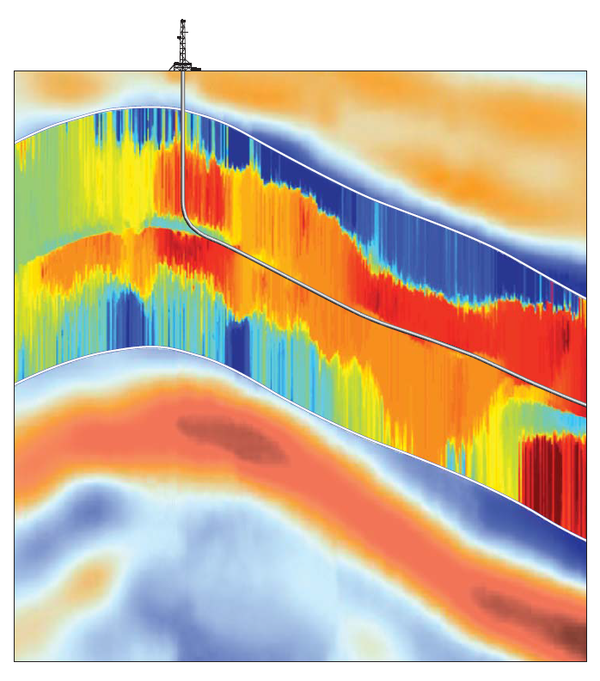
Ultra-deep Directional EM LWD Services
Geostopping
  Avoid drilling hazards
  Landing well
Geosteering
  Stay in target zone and avoid reservoir exits
  Timely steering decision
Geomapping
  Identify extent and shape of reservoir and location of hydrocarbons
Example of Geo-mapping
Mapping-while-drilling service provided by Schlumberger
Reference: Bø, Øystein, et al. "Reservoir Mapping While Drilling." Oilfield Review 27.1 (2015).
Notes:
The ultra .. Tools make a broad range of services possible.
To implement a reliable service with maximal performance, the logging data interpretation is one key step

Slide 9
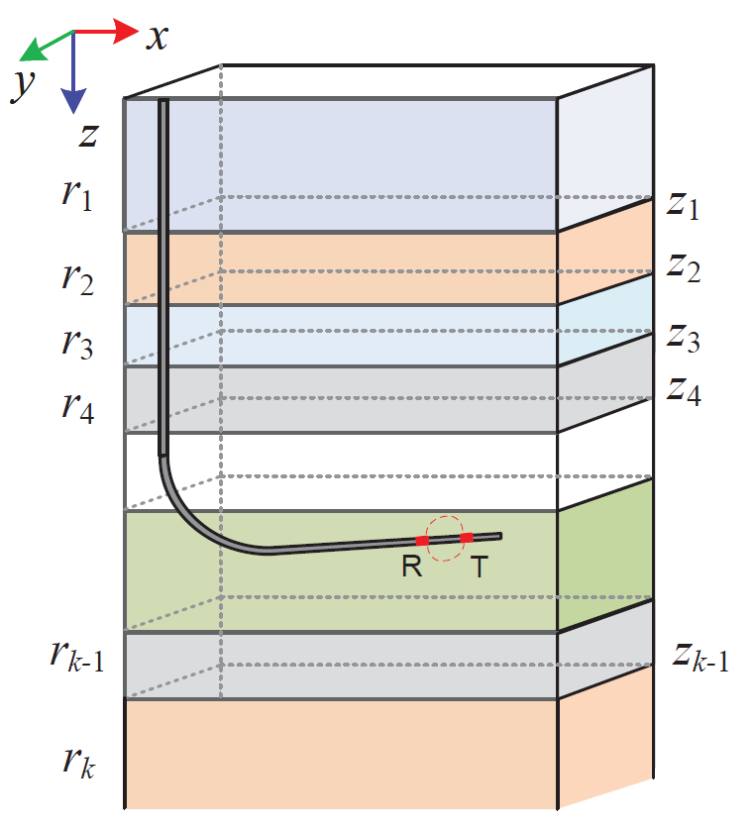
EM logging data interpretation
1D parameterization
  Layered model
  Constant physical properties in each layer
Forward modeling
  Solve Maxwell’s equations to answer the projection from model parameters to signal response
Inverse modeling
  Determine a certain earth model which reproduces the EM response as measured
Notes:
So before we move on to the motivation of dissertation, we will give some definitions of the problem

Slide 10
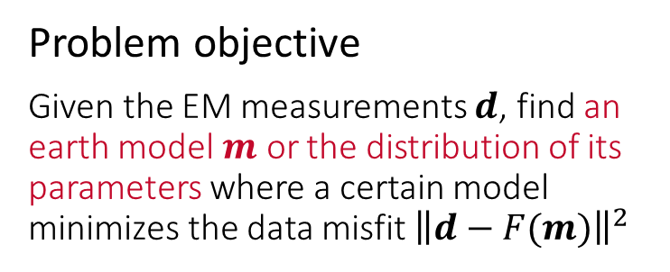
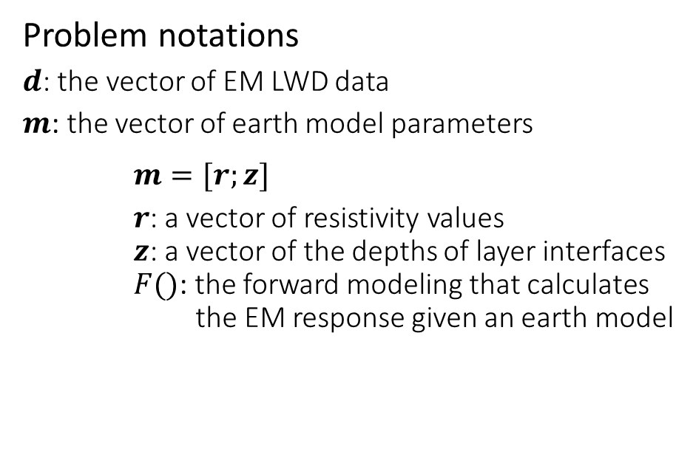
Definitions and Objective
Problem notations
$d$: the vector of EM LWD data
$m$: the vector of earth model parameters
$m=[r;z]$
$r$: a vector of resistivity values
$z$: a vector of the depths of layer interfaces
$F()$: the forward modeling that calculates the EM response given an earth model
Problem objective
Given the EM measurements $d$, find an earth model $m$ or the distribution of its parameters where a certain model minimizes the data misfit ${\left\|d−F(m)\right\|}^{2}$

Slide 11
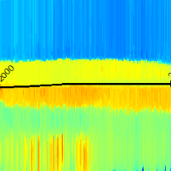
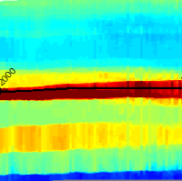
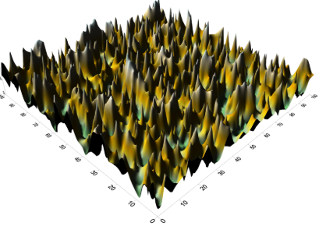
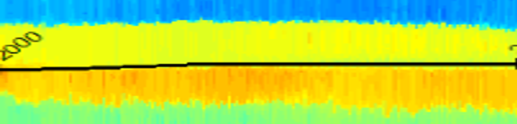
Challenge I - nonlinearity
Ultra-deep sensitivity introduces a much larger DoI
With larger DoI, more geological features are within the scope
The earth model to be invert becomes complicated
The EM response to the earth formation becomes very complex
2D resistivity profile grouped by multiple 1D inverse results
The inverse modeling is very complicated where the problem is
High dimensional
Highly nonlinear in solution space
Many local minima
Reference: Schlumberger Geosphere HD Mapping While Drilling Service
Demo from: https://indd.adobe.com/view/37a5d5eb-2e7e-44dc-811b-b0d23f0f257d
Notes:
Solving the inverse problem is never an easy task. Our dissertation is motivated by several challenges.

Slide 12
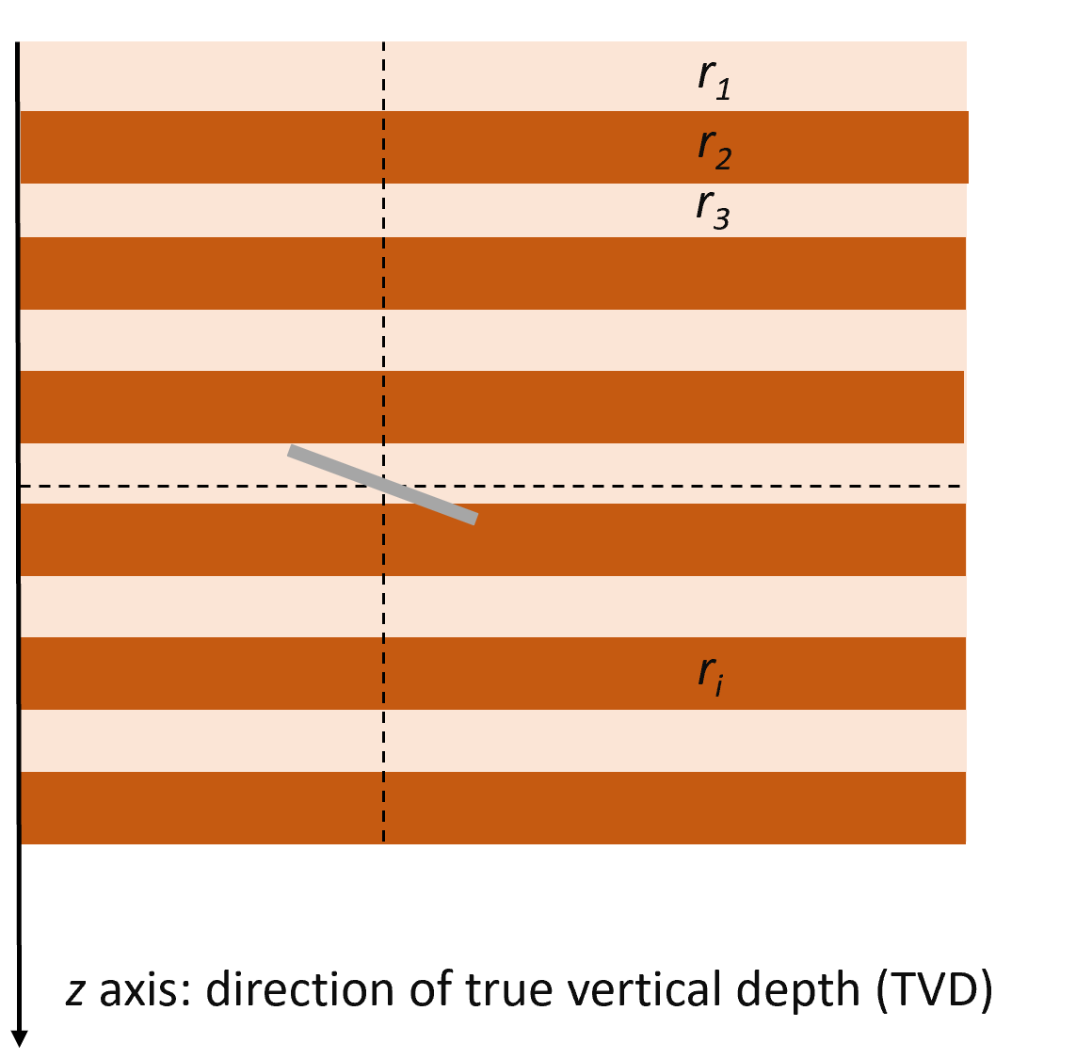
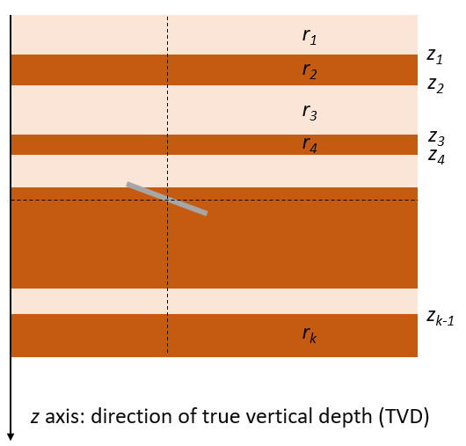
Challenge II – model selection
How many layers do we need?
  A pre-defined the number of layers may cause a model
    under-parameterized or over-parameterized
  Pixel-based inversion may cause an inverse problem
    Underdetermined;
    A regularization → low resolution
A self-parameterizing scheme is required

Slide 13
Challenge III – efficiency
Directional LWD workflow
Real-time Drilling
Feed drilling data
Data Interpretation
Navigate drilling direction
A prompt formation evaluation workflow is in need for decision-making

Slide 14

Dissertation scope contributions
Thrust I: Statistical inversion method that interprets ultra-deep EM logging data
- Statistical Bayesian inference
Thrust II: Self-parameterizing method for model complexity interpretation
- Trans-dimensional Markov chain Monte Carlo
Thrust III: High-efficient framework for real-time formation evaluation
- Hybrid Monte Carlo and parallel tempering
Notes:
To brief summarize our dissertation contributions, they are made through several thrusts.

Slide 15
Outline
Introduction
Introduction
Bayesian inference and sampling methods
  Bayesian inference
  Markov chain Monte Carlo method
  Metropolis-Hastings algorithm
Beyond random-walk: a hybrid Monte Carlo
  Hamiltonian dynamic
  Hybrid Monte Carlo sampling
Self-parameterizing method: trans-dimensional MCMC
  Reversible-jump MCMC
  Birth-death simulation
Accelerate Bayesian inference: tempering method
  Optimization and probabilistic function
  Parallel tempering method
Statistical Inversion
Future Works
Future Works
Conclusions
Conclusions

Slide 16

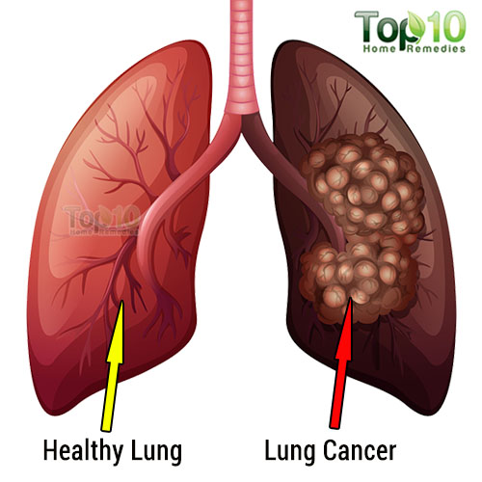



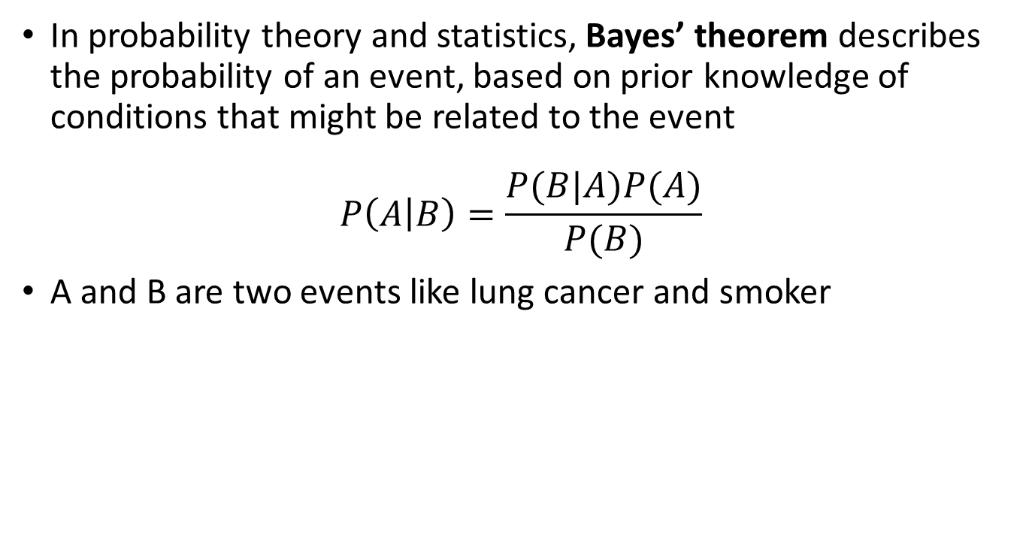
Bayes’ theorem
In probability theory and statistics, Bayes’ theorem describes the probability of an event, based on prior knowledge of conditions that might be related to the event
$$P\left(A | B\right)=\frac{P(B|A)P(A)}{P(B)}$$
A and B are two events like lung cancer and smoker
Thomas Bayes (1701 - 1761)
$$P(Lung cancer)$$
$$P(Lung cancer|smoker)$$
Conditional probability
Notes:
For example, if lung cancer is related to smoking, then, using Bayes’ theorem, a smoker can be used to more accurately assess the probability that has lung cancer, compared to the assessment of the probability of cancer made without knowledge of the person’s smoking behavior.

Slide 17

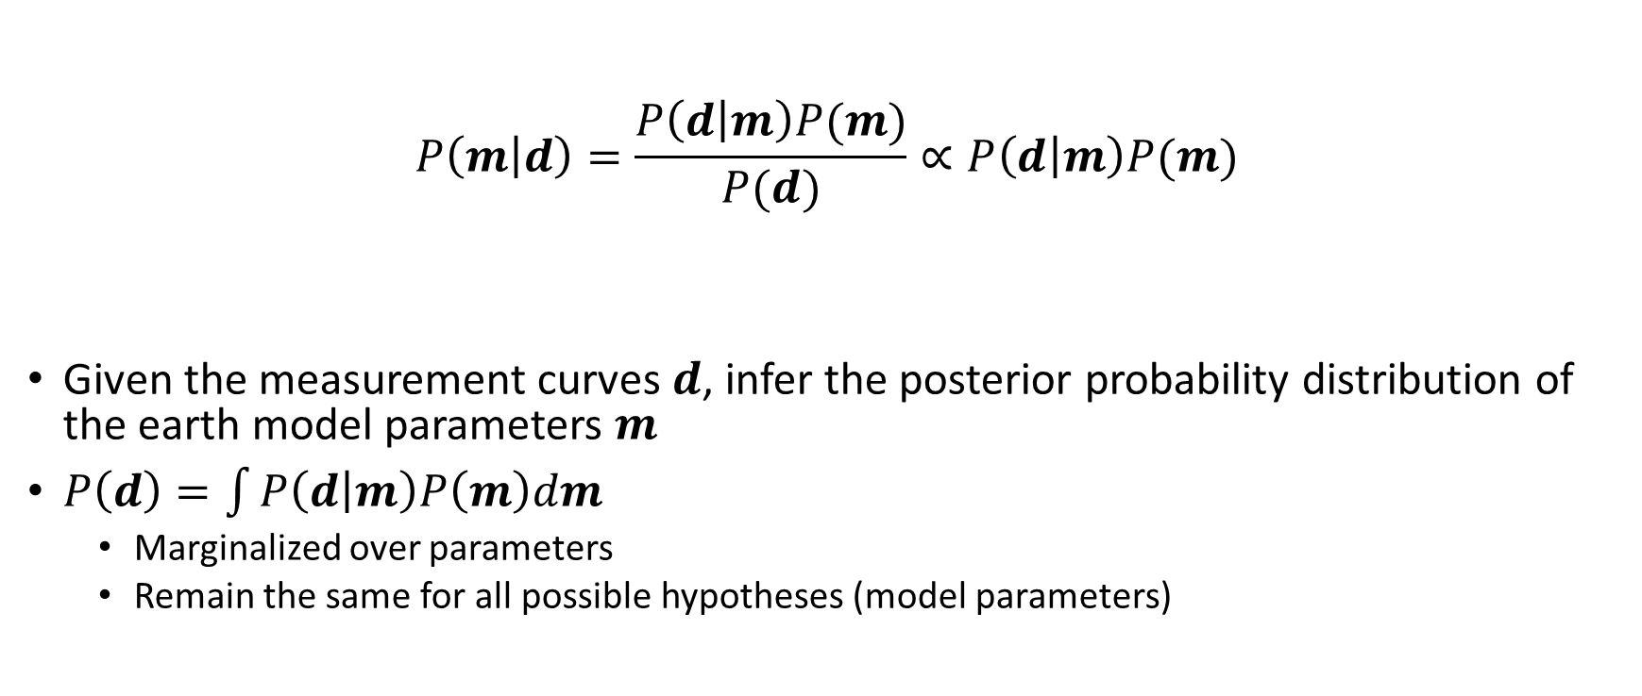
Bayesian inference
Likelihood
Prior
Posterior
$$P\left(m | d\right)=\frac{P\left(d | m\right)P(m)}{P(d)}∝P\left(d | m\right)P(m)$$
Given the measurement curves $d$, infer the posterior probability distribution of the earth model parameters $m$
$P\left(d\right)=\int{P\left(d | m\right)P\left(m\right)dm}$
  Marginalized over parameters
  Remain the same for all possible hypotheses (model parameters)
Evidence
Notes:
Bayesian inference is a method of statistical inference in which Bayes' theorem is used to update the probability for a hypothesis as more evidence or information becomes available.
evidence is the distribution of the observed data marginalized over the parameter

Slide 18
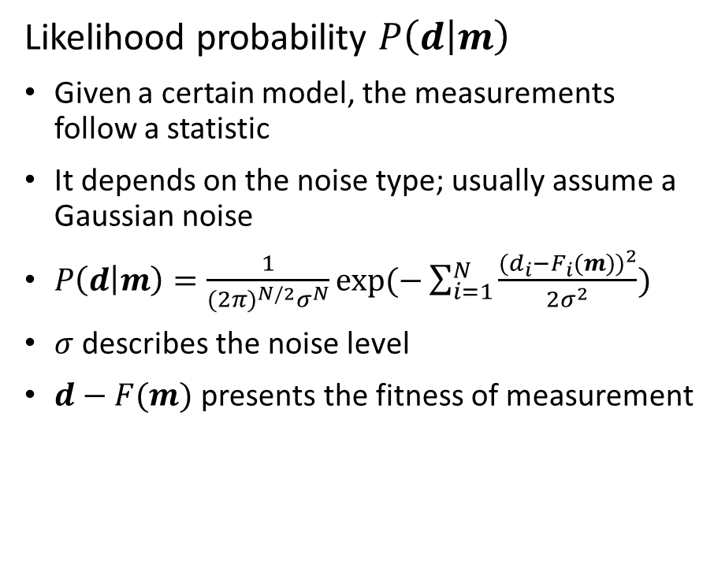
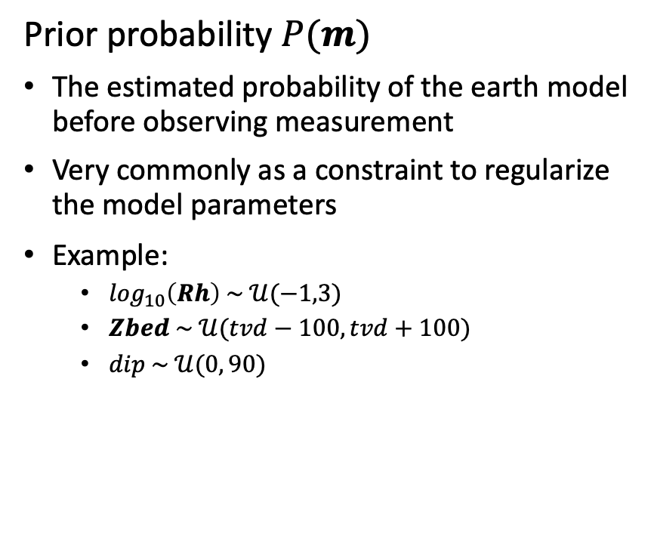
Likelihood and prior
Likelihood probability $P\left(d | m\right)$
Given a certain model, the measurements follow a statistic
It depends on the noise type; usually assume a Gaussian noise
$P\left(d | m\right)=\frac{1}{{(2π)}^{N/2}σ^{N}}exp⁡(−\sum_{i=1}^{N}{\frac{{(d_{i}−F_{i}(m))}^{2}}{2σ^{2}}})$
$σ$ describes the noise level
$d−F(m)$ presents the fitness of measurement
Prior probability $P(m)$
The estimated probability of the earth model before observing measurement
Very commonly as a constraint to regularize the model parameters
Example:
  $\log_{10}\left(Rh\right) \sim 𝒰(−1,3)$
  $Zbed \sim 𝒰(tvd−100, tvd+100)$
  $dip \sim 𝒰(0, 90)$
Notes:
* The likelihood function measures goodness-of-fit
* The prior distribution represents prior information about the inferred quantities

Slide 19



Markov Chain Monte Carlo (MCMC) method
posterior probability: $P\left(m | d\right)=\frac{P(d|m)P(m)}{\int{P(d|m)P\left(m\right)dm}}$
To understand the posterior probability distribution, we need a sampling method
MCMC Methods
A class of algorithms sample from a probability distribution
By constructing a Markov chain whose stationary distribution is the same as posterior distribution
Mean?
Posterior Distribution?
Mode?
Range?
Variance?
Notes:
-END A problem is how this mechanism can accommodate a construction of a stationary distribution

Slide 20
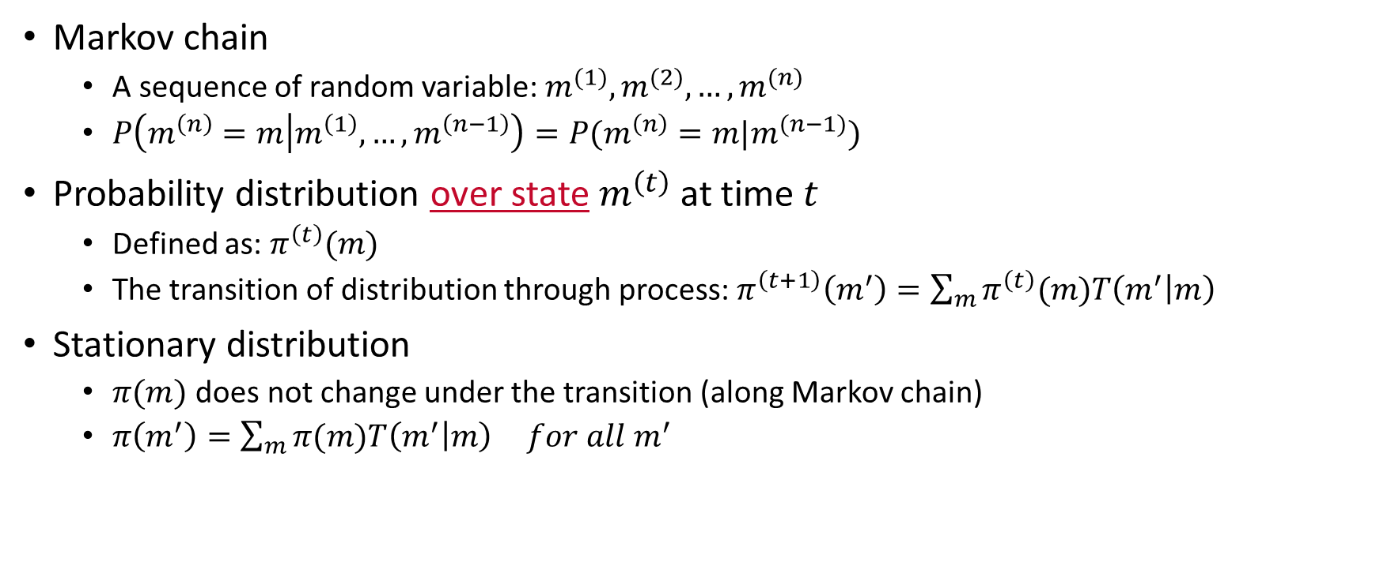

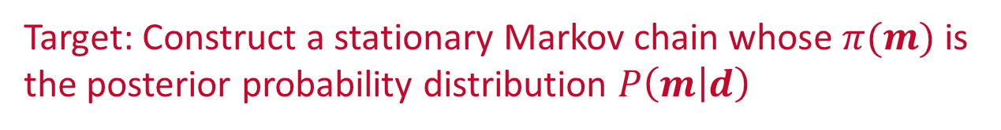
Construct a stationary Markov chain
Markov chain
  A sequence of random variable: $m^{(1)},m^{(2)},…,m^{(n)}$
  $P\left(m^{\left(n\right)}=m | m^{\left(1\right)},…,m^{\left(n−1\right)}\right)=P(m^{\left(n\right)}=m|m^{(n−1)})$
Probability distribution over state $m^{\left(t\right)}$ at time $t$
  Defined as: $π^{\left(t\right)}(m)$
  The transition of distribution through process: $π^{\left(t+1\right)}\left(m^{′}\right)=\sum_{m}{π^{\left(t\right)}(m)T\left(m^{′} | m\right)}$
Stationary distribution
  $π(m)$ does not change under the transition (along Markov chain)
  $π\left(m^{′}\right)=\sum_{m}{π(m)T\left(m^{′} | m\right)} for all m^{′}$
  Transition kernel $T(m^{′}|m)$
Target: Construct a stationary Markov chain whose $π(m)$ is the posterior probability distribution $P\left(m | d\right)$
Notes:
- the probability of nth event depends only on the state attained in the previous event
- A system does not have only one state, but has a distribution over state

Slide 21
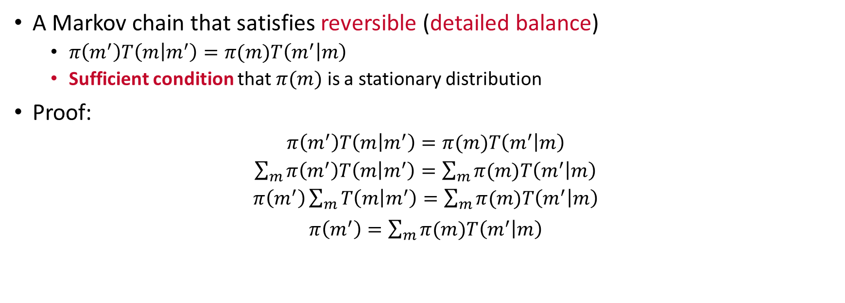
Construct a stationary Markov chain
A Markov chain that satisfies reversible (detailed balance)
  $π\left(m^{′}\right)T\left(m | m^{′}\right)=π(m)T\left(m^{′} | m\right)$
  Sufficient condition that $π(m)$ is a stationary distribution
Proof:
$π\left(m^{′}\right)T\left(m | m^{′}\right)=π(m)T\left(m^{′} | m\right)$
$\sum_{m}{π\left(m^{′}\right)T\left(m | m^{′}\right)}=\sum_{m}{π(m)T\left(m^{′} | m\right)}$
$π\left(m^{′}\right)\sum_{m}{T\left(m | m^{′}\right)}=\sum_{m}{π(m)T\left(m^{′} | m\right)}$
$π\left(m^{′}\right)=\sum_{m}{π(m)T\left(m^{′} | m\right)}$
How to design a transition kernel to achieve detailed balance?
Notes:
The transition of chain distribution from current state to the next state equals to its reverse transition
Because the summation of the probability from m prime to all possible m equals to one

Slide 22
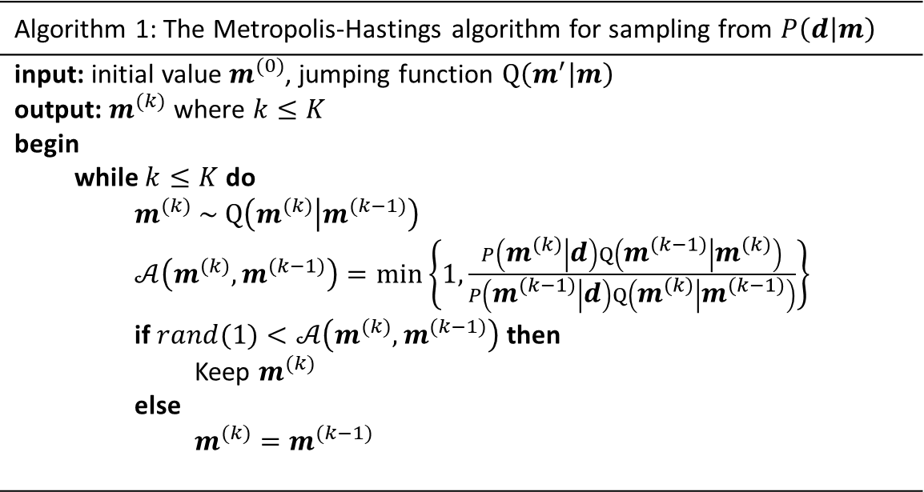
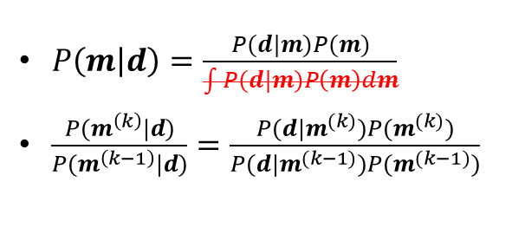
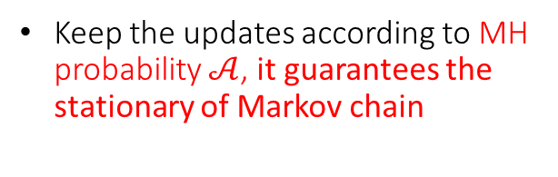
Metropolis-Hastings algorithm
A method that generate a sequence of random samples from a probability distribution iteratively
Algorithm 1: The Metropolis-Hastings algorithm for sampling from $P\left(d | m\right)$
input: initial value $m^{(0)}$, jumping function $Q\left(m^{′} | m\right)$ output: $m^{(k)}$ where $k≤K$ begin while $k≤K$ do $m^{(k)} \sim Q\left(m^{(k)} | m^{(k−1)}\right)$ $𝒜\left(m^{(k)},m^{(k−1)}\right)=\min\left\{1,\frac{P\left(m^{(k)} | d\right)Q\left(m^{(k−1)} | m^{(k)}\right)}{P\left(m^{(k−1)} | d\right)Q\left(m^{(k)} | m^{(k−1)}\right)}\right\}$ if $rand(1)<𝒜\left(m^{(k)},m^{(k−1)}\right)$ then Keep $m^{(k)}$ else $m^{(k)}=m^{(k−1)}$
$P\left(m | d\right)=\frac{P(d|m)P(m)}{\int{P(d|m)P\left(m\right)dm}}$
$\frac{P(m^{\left(k\right)}|d)}{P(m^{\left(k−1\right)}|d)}=\frac{P(d|m^{(k)})P(m^{(k)})}{P(d|m^{(k−1)})P(m^{(k−1)})}$
Keep the updates according to MH probability $𝒜$, it guarantees the stationary of Markov chain
Notes:
Denominator

Slide 23
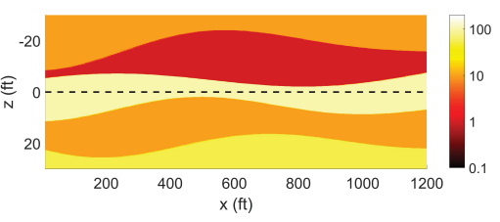
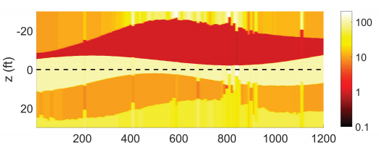
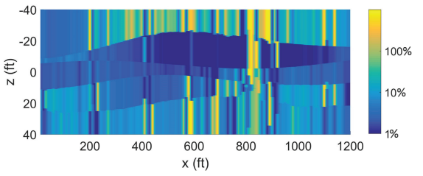
example on earth model interpretation
Multiple logging stations
Inverse model (mean)
True synthetic model (120 points)
Lu, Han, Qiuyang Shen, Jiefu Chen, Xuqing Wu, and Xin Fu. “Parallel Multiple-Chain DRAM MCMC for Large-Scale Geosteering Inversion and Uncertainty Quantification.” Journal of Petroleum Science and Engineering, accepted.
Uncertainty of Rh (variance)
Notes:
At each logging point, use mean value of MC samples as the inverse result and variance as its uncertainty

Slide 24
Outline
Introduction
Introduction
Bayesian inference and sampling methods
  Bayesian inference
  Markov chain Monte Carlo method
  Metropolis-Hastings algorithm
Beyond random-walk: a hybrid Monte Carlo
  Hamiltonian dynamic
  Hybrid Monte Carlo sampling
Self-parameterizing method: trans-dimensional MCMC
  Reversible-jump MCMC
  Birth-death simulation
Accelerate Bayesian inference: tempering method
  Optimization and probabilistic function
  Parallel tempering method
Statistical Inversion
Future Works
Future Works
Conclusions
Conclusions

Slide 25
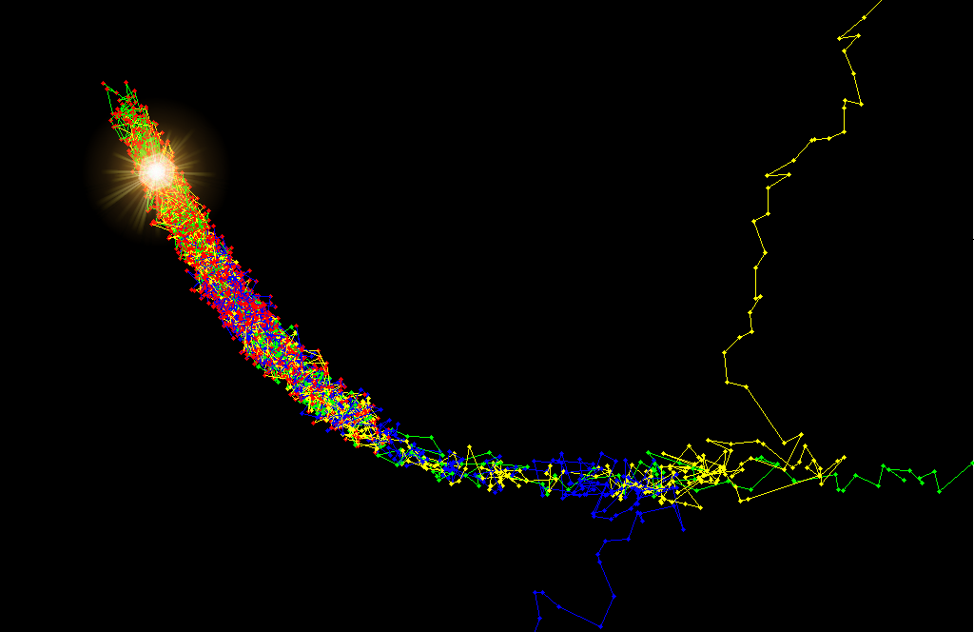
Hybrid Monte Carlo
Motivation
  Statistical inversion conquers a local minima problem via sampling approach
  Random-walk behaves slow moving
  A combination of gradient-based method with sampling brings help
Hybrid Monte Carlo
  Simulated Hamiltonian dynamical system
  The candidate follows a gradient drift
  Boost sampling speed
A gradient-drifted sampling method
Notes:
The previous section introduced the foundation of statistical Bayesian inference using random-walk. It stresses on the local minima problem by introducing a stochastic process.

Slide 26

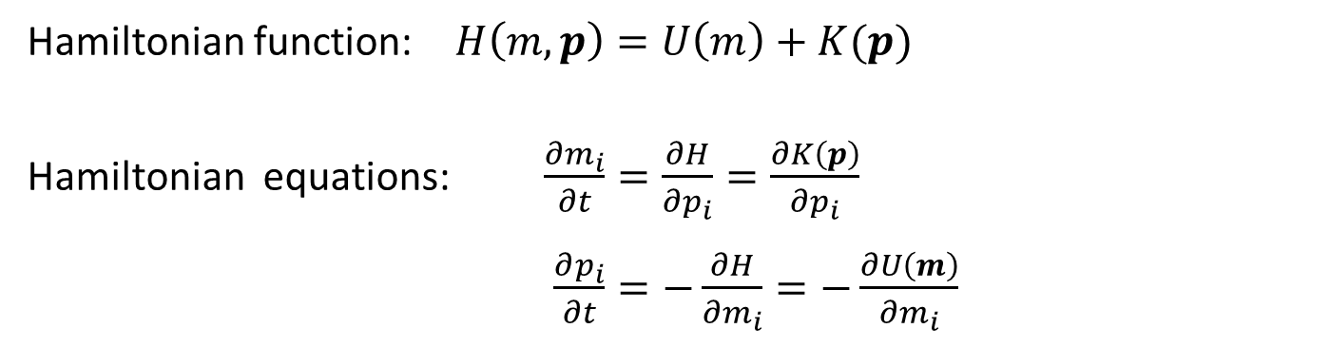
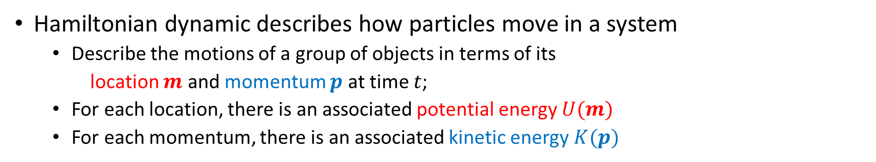
Hamiltonian Dynamic
Hamiltonian dynamic describes how particles move in a system
  Describe the motions of a group of objects in terms of its
  location $m$ and momentum $p$ at time $t$;
  For each location, there is an associated potential energy $U(m)$
  For each momentum, there is an associated kinetic energy $K(p)$
Hamiltonian function: $H\left(m,p\right)=U\left(m\right)+K(p)$
Hamiltonian equations: $\frac{∂m_{i}}{∂t}=\frac{∂H}{∂p_{i}}=\frac{∂K\left(p\right)}{∂p_{i}}$
$\frac{∂p_{i}}{∂t}=−\frac{∂H}{∂m_{i}}=−\frac{∂U\left(m\right)}{∂m_{i}}$
The total energy
Conversion between potential and kinetic energy

Slide 27
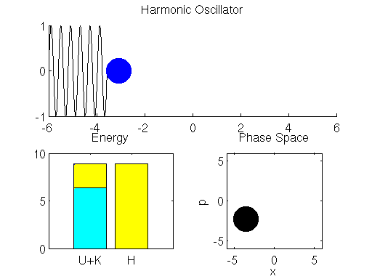
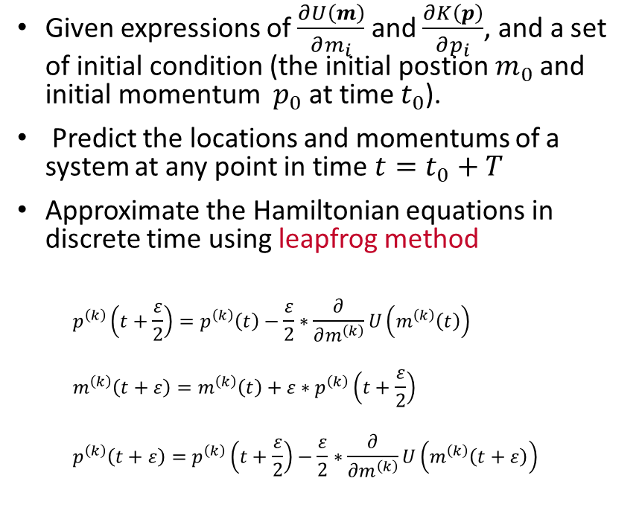
Hamiltonian Dynamic
Given expressions of $\frac{∂U\left(m\right)}{∂m_{i}}$ and $\frac{∂K\left(p\right)}{∂p_{i}}$, and a set of initial condition (the initial postion $m_{0}$ and initial momentum $p_{0}$ at time $t_{0}$).
Predict the locations and momentums of a system at any point in time ${t=t}_{0}+T$
Approximate the Hamiltonian equations in discrete time using leapfrog method
  $$p^{\left(k\right)}\left(t+\frac{ε}{2}\right)=p^{\left(k\right)}\left(t\right)−\frac{ε}{2}∗\frac{∂}{∂m^{\left(k\right)}}U\left(m^{\left(k\right)}\left(t\right)\right)$$
  $$m^{\left(k\right)}\left(t+ε\right)=m^{\left(k\right)}\left(t\right)+ε∗p^{\left(k\right)}\left(t+\frac{ε}{2}\right)$$
  $$p^{\left(k\right)}\left(t+ε\right)=p^{\left(k\right)}\left(t+\frac{ε}{2}\right)−\frac{ε}{2}∗\frac{∂}{∂m^{\left(k\right)}}U\left(m^{\left(k\right)}\left(t+ε\right)\right)$$
Discretizing step size
m
Ref: Simple Harmonic Movement from Physics GIFs @https://gifsdefisica.com/2019/01/23/movimento-harmonico-simples-sistema-massa-mola-2/

Slide 28
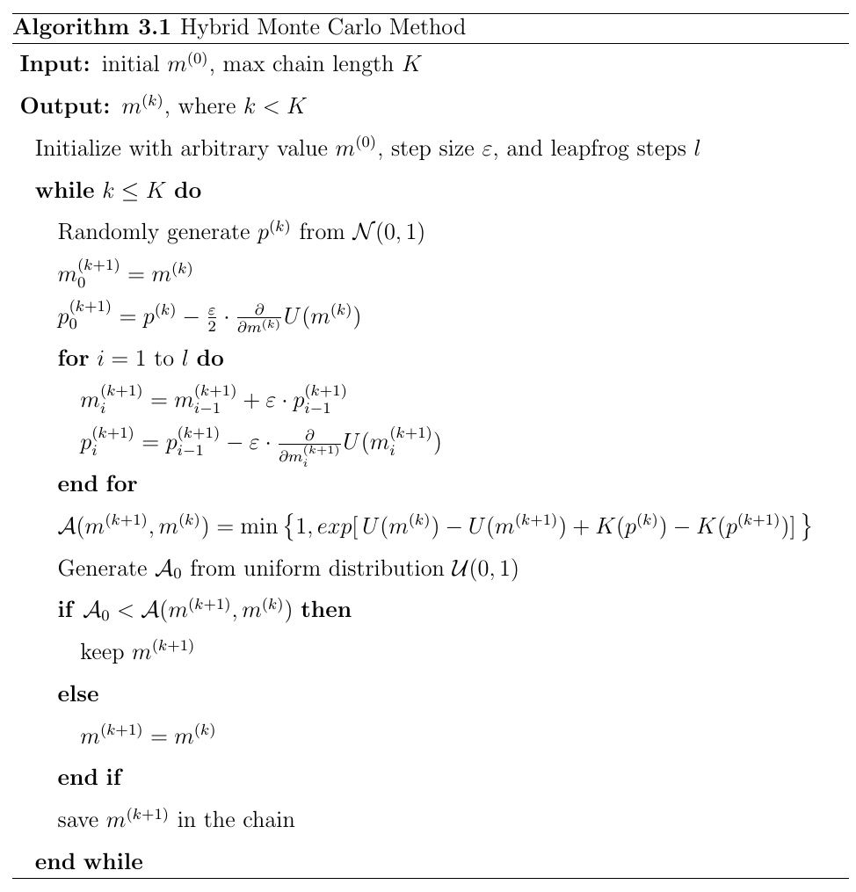
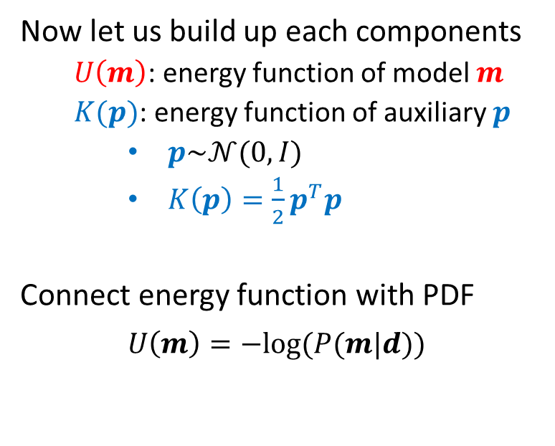
Hybrid Monte Carlo
Now let us build up each components
  $U\left(m\right)$: energy function of model $m$
  $K(p)$: energy function of auxiliary $p$
    $p\sim 𝒩(0,I)$
    $K\left(p\right)=\frac{1}{2}p^{T}p$
Connect energy function with PDF
$U\left(m\right)=−log⁡(P(m|d))$
Notes:
Now we need to accommodate each components in H dynamic to a Bayesian inference problem and see how to construct a sampling method.
- In fact, any optimization problem can transfer to a statistical sampling problem through a transformation ... But we will…

Slide 29
Hybrid Monte Carlo
Current sample
Leapfrog simulation of Hamiltonian dynamic
Candidate
MH accepting rule
New sample

Slide 30
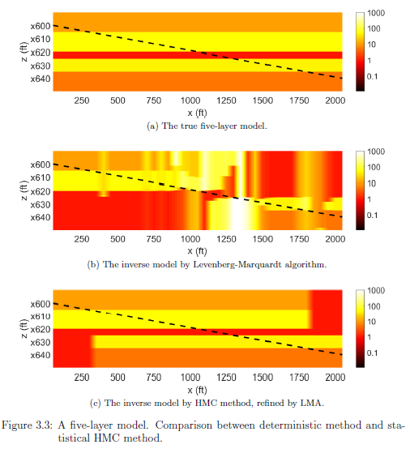
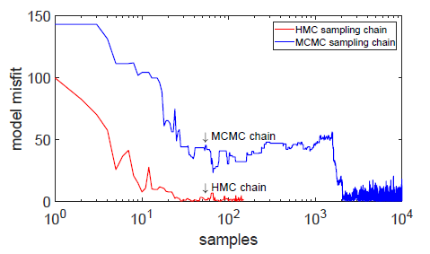
Simulation example
Sampling efficiency compared to random-walk MCMC.
The gradient information drifts HMC sampler to the region where the acceptance rate is much higher
A comparison of using deterministic method with Hybrid MC

Slide 31
Outline
Introduction
Introduction
Bayesian inference and sampling methods
  Bayesian inference
  Markov chain Monte Carlo method
  Metropolis-Hastings algorithm
Beyond random-walk: a hybrid Monte Carlo
  Hamiltonian dynamic
  Hybrid Monte Carlo sampling
Self-parameterizing method: trans-dimensional MCMC
  Reversible-jump MCMC
  Birth-death simulation
Accelerate Bayesian inference: tempering method
  Optimization and probabilistic function
  Parallel tempering method
Statistical Inversion
Future Works
Future Works
Conclusions
Conclusions

Slide 32


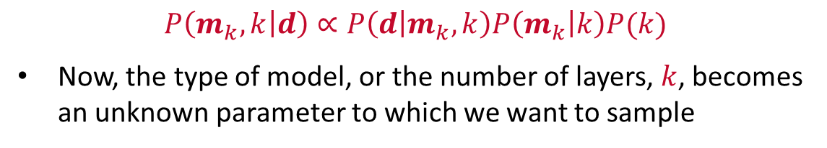
Trans-dimensional MCMC method
2 ohm.m
Dip = 78°
100 ohm.m
Which model is better??
The tool provides rich but complex information
The problem becomes much harder to solve while even the assumption of earth model is uncertain.
3 ohm.m
Three-layer model
1 ohm.m
20 ohm.m
2 ohm.m
Dip = 78°
100 ohm.m
$$P\left(m_{k},k | d\right)∝P\left(d | m_{k},k\right)P\left(m_{k} | k\right)P(k)$$
Now, the type of model, or the number of layers, $k$, becomes an unknown parameter to which we want to sample
$$P\left(m | d\right)∝P\left(d | m\right)P(m)$$
3 ohm.m
50 ohm.m
3 ohm.m
Seven-layer model
Notes:
tMCMC is an extension to standard MCMC that allows simulation of the posterior distribution on spaces of varying dimensions.
Thus, the simulation is possible even if the number of parameters in the model is not known.

Slide 33
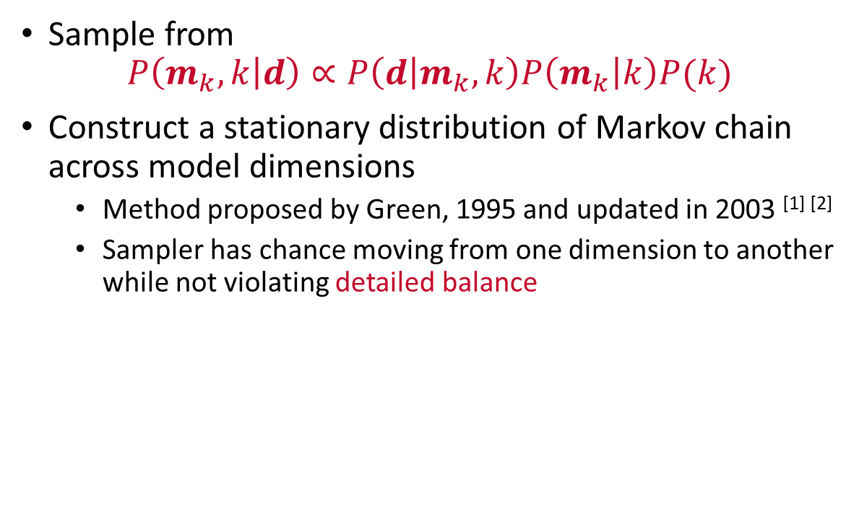
Reversible-jump MCMC
Sample from
$$P\left(m_{k},k | d\right)∝P\left(d | m_{k},k\right)P\left(m_{k} | k\right)P(k)$$
Construct a stationary distribution of Markov chain across model dimensions
  Method proposed by Green, 1995 and updated in 2003 ^{[1] [2]}
  Sampler has chance moving from one dimension to another while not violating detailed balance
4d
2d
3d
[1] Green, P.J. and Hastie, D.I., 2009. Reversible jump MCMC. Genetics, 155(3), pp.1391-1403.
[2] Green, P.J., 2003. Trans-dimensional Markov chain monte Carlo. Oxford Statistical Science Series, pp.179-198.
Notes:
Across model simulation
the different dimensions are sampled proportional to this support by the observed data, resulting in an efficient approach to sampling a trans-dimensional space. Hence, trans-dimensional sampling can be more efficient than sampling a sequence of individual state spaces.

Slide 34
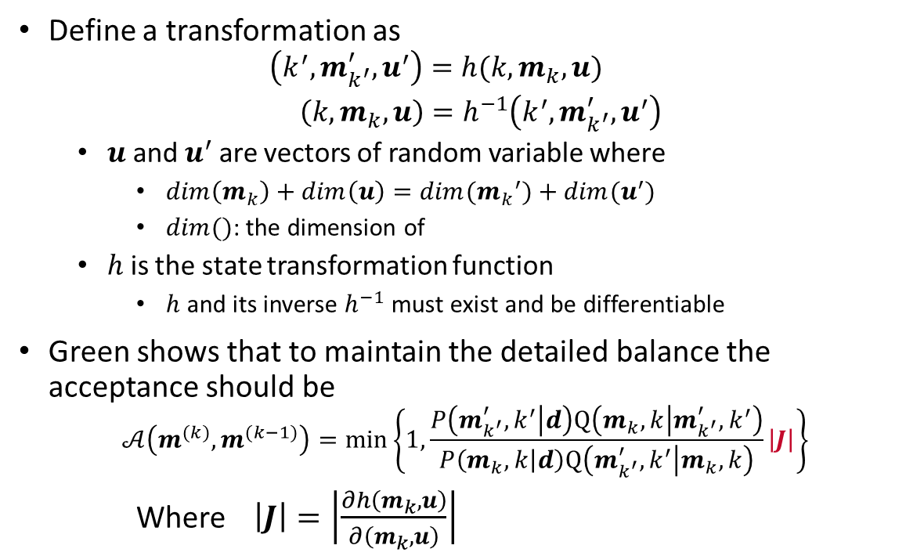
Reversible-jump MCMC
Define a transformation as
  $$\left(k^{′},m_{k^{′}}^{′},u^{′}\right)=h(k,m_{k},u)$$
  $\left(k,m_{k},u\right)=h^{−1}\left(k^{′},m_{k^{′}}^{′},u^{′}\right)$
  $u$ and $u^{′}$ are vectors of random variable where
    $dim\left(m_{k}\right)+dim\left(u\right)=dim({m_{k}}^{′})+dim(u^{′})$
    $dim()$: the dimension of
  $h$ is the state transformation function
    $h$ and its inverse $h^{−1}$ must exist and be differentiable
Green shows that to maintain the detailed balance the acceptance should be
$$𝒜\left(m^{(k)},m^{(k−1)}\right)=\min\left\{1,\frac{P\left(m_{k^{′}}^{′},k^{′} | d\right)Q\left(m_{k},k | m_{k^{′}}^{′},k^{′}\right)}{P\left(m_{k},k | d\right)Q\left(m_{k^{′}}^{′},k^{′} | m_{k},k\right)}\left|J\right|\right\}$$
Where $\left|J\right|=\left|\frac{∂h\left(m_{k},u\right)}{∂\left(m_{k},u\right)}\right|$
4d
2d
3d
the determinant of the Jacobian for the diffeomorphism $h$ from $\left(k,m_{k}\right)$to $\left(k^{′},m_{k^{′}}^{′}\right)$
Notes:
The introduction of u preserve the dimensional changes and therefore deducting to an updated acceptance probability
The Jacobian term “normalizes” the difference in volume between two spaces of different dimension.

Slide 35
Birth-death simulation
Death move: select an existing interface randomly and remove it;
Birth move: insert an artificial interface at a random depth;
We start from a two-layer model with one interface…
Merge two neighboring layers;
Perturb one model parameter of a newborn layer;

Slide 36
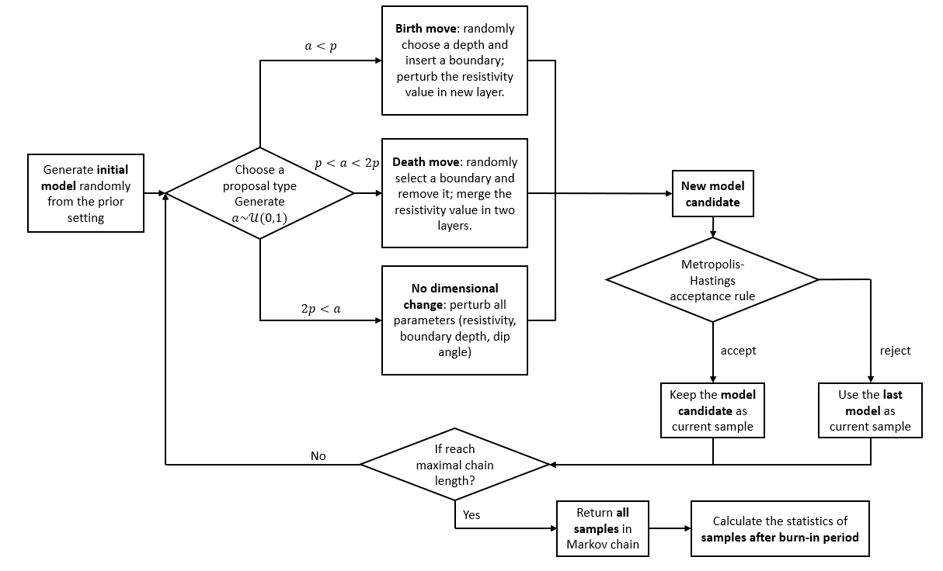
Birth-Death simulation

Slide 37
example on earth model interpretation
A synthetic five-layer model
Prior constraint (all uniform)
  $k:2 \sim 20$ layers
  $Zbed:0 \sim 100$ feet
  $Rh:0.1 \sim 1000 ohmm$ in logarithm
  Minimum bed thickness: 1 ft
The initial state of random sample is randomly drawn from the prior distribution of earth model parameters.
10 ohm.m
16 ft
100 ohm.m
15 ft
1 ohm.m
8 ft
21 ft
50 ohm.m
10 ohm.m

Slide 38
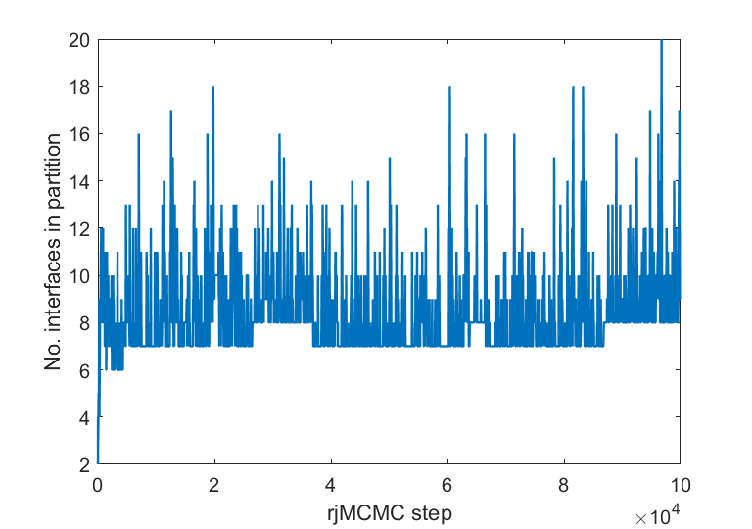
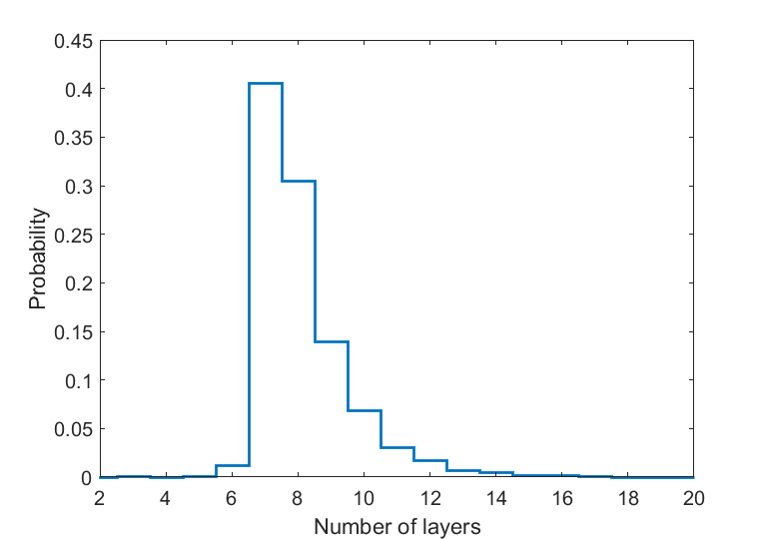
Example: sampling across models
Number of layers along the MC chain steps
Histogram of number of layers

Slide 39
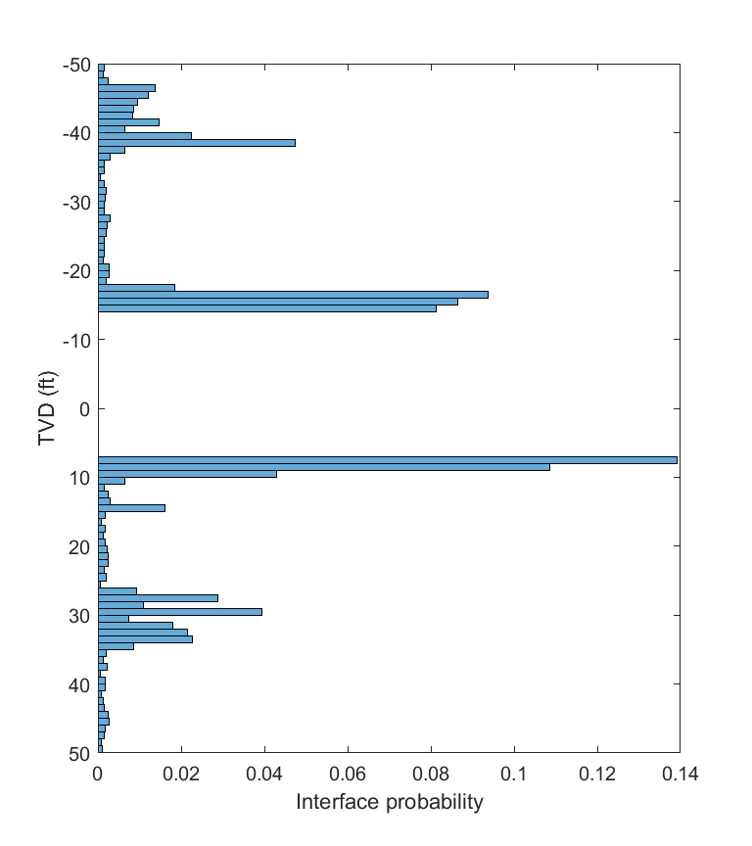
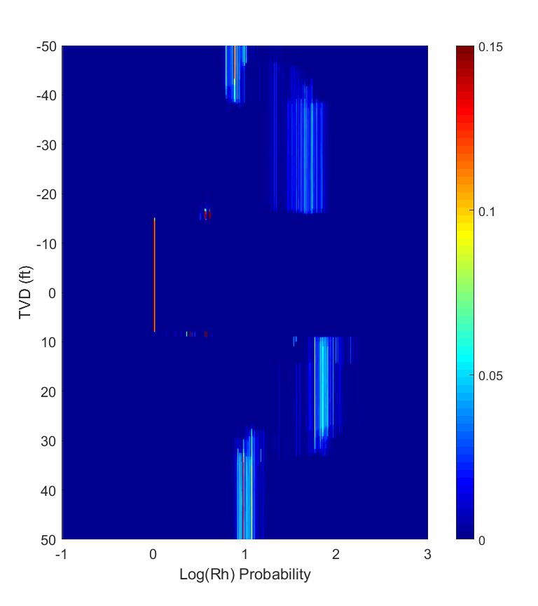
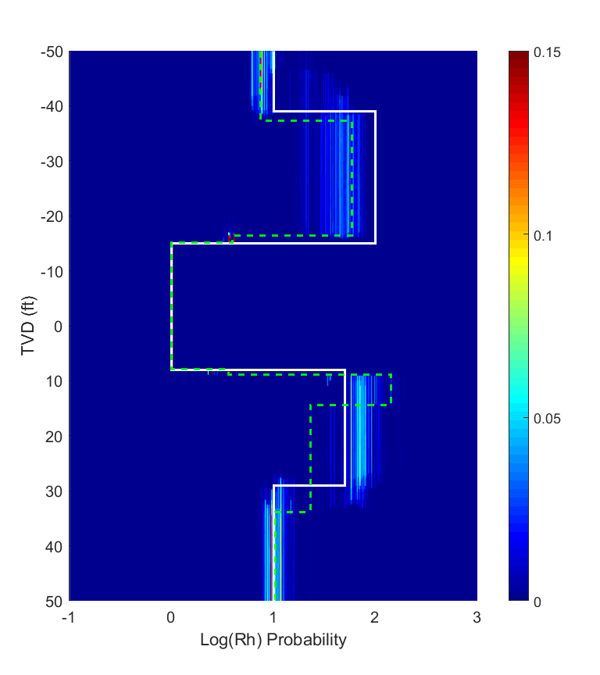
Histogram of possible model interfaces
Probability heatmap of resistivity value
Comparison of true model (white) mean model (green)

Slide 40
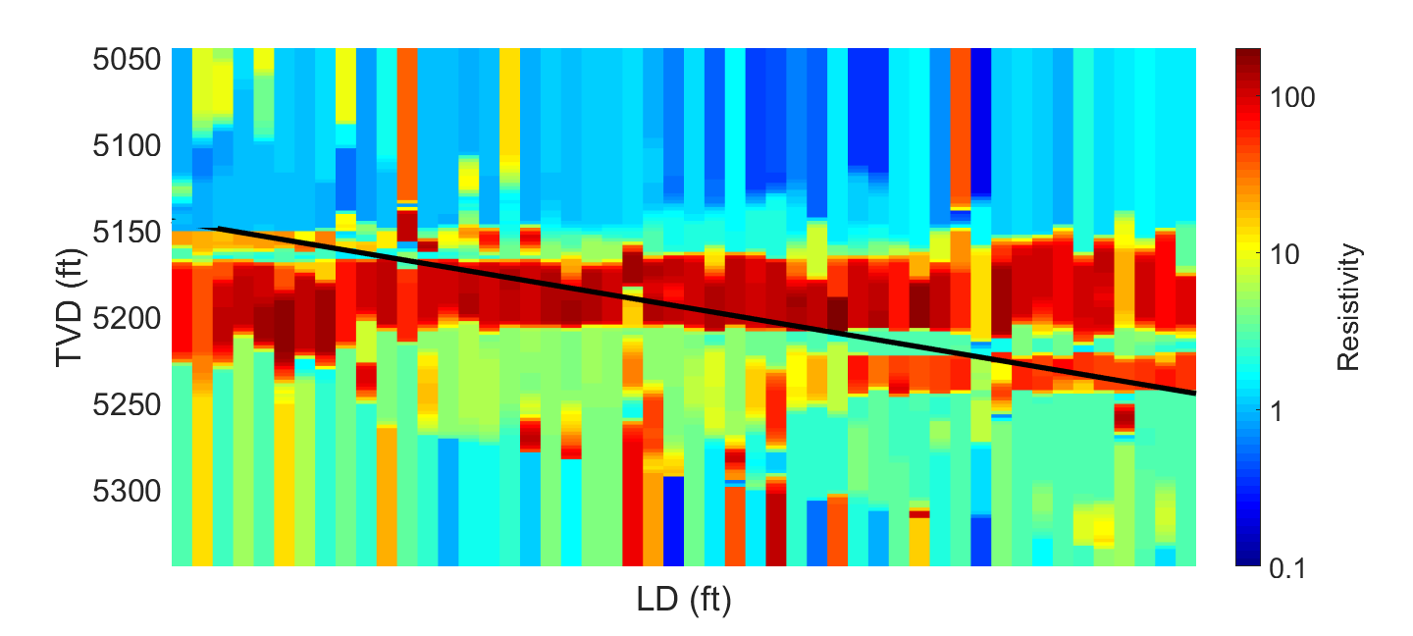
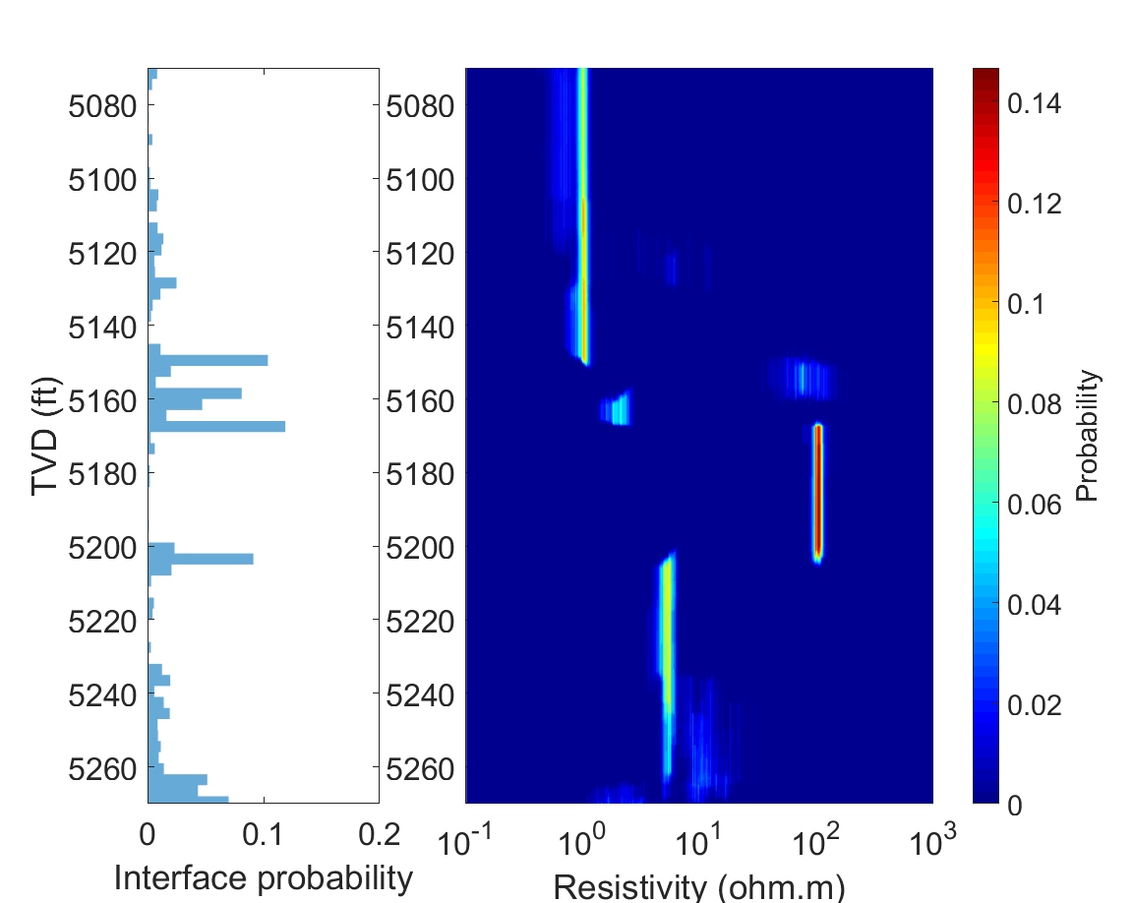

Example on SDAR 7-Layer model interpretation
Notes:
Instead of sampling independently from different dimensions, tMCMC tells which model has higher probability

Slide 41
Outline
Introduction
Introduction
Bayesian inference and sampling methods
  Bayesian inference
  Markov chain Monte Carlo method
  Metropolis-Hastings algorithm
Beyond random-walk: a hybrid Monte Carlo
  Hamiltonian dynamic
  Hybrid Monte Carlo sampling
Self-parameterizing method: trans-dimensional MCMC
  Reversible-jump MCMC
  Birth-death simulation
Accelerate Bayesian inference: tempering method
  Optimization and probabilistic function
  Parallel tempering method
Statistical Inversion
Future Works
Future Works
Conclusions
Conclusions

Slide 42


Accelerate Bayesian inference
The pains of sampling methods
  tMCMC makes acceptance rate worse
  Sequential process no parallism
Some ways to draw samples in parallel?
Try to launch multiple samplers at the same time.

Slide 43



Optimization and probabilistic function
Connect optimization problem to dynamic energy system
  Instead find a unique solution of $φ\left(m\right)=\left\|d−F(m)\right\|$
  Sampling from its probability density function (PDF)
    $π\left(m,T\right)=e^{−φ\left(m\right)/T}$
    The global minimal of $φ\left(m\right)$ maximize its PDF $π\left(m,T\right)$
Notes:
A common way to connect an optimization problem to a dynamic energy system

Slide 44


From the view of energy:
Tempering
Tempering rescales the optimization function
  $T=1$: the target PDF
  $T→0:$ a delta function at maxima $δ(m^{∗})$
  $T→∞:$ a uniform PDF (flat)
As temperature raising, the shape of $π\left(m,T\right)$ becomes flatter
Temperature controls the prominence of local and global optima
Tempering in Bayesian posterior
  $π\left(m,T\right)=c^{−1}{P(d|m)}^{1/T}P(m)$
A bimodal distribution
Notes:
So what does temperature control?

Slide 45



Parallel tempering
Replica exchange MCMC
  Multiple chains run in indifferent temperatures $T_{1},T_{2}, …,T_{N} (T_{N}≥1)$
  The chain at $T_{1}=1$ samples the target distribution
  Two randomly chosen states swap at each iteration
Advantage
  The states at higher temperatures have higher chance to jump out from high correlated regions
How to ensure the detailed balance?
$$𝒜\left(i,j \right)=\min\left\{1,{\left[\frac{P(m_{j}|d)}{P(m_{i}|d)}\right]}^{1/T_{i}}{\left[\frac{P(m_{i}|d)}{P(m_{j}|d)}\right]}^{1/T_{j}}\right\}$$
Notes:
* While the chains at other temperatures sample the distributions flattened from the original one
* Because the sampled distributions are flatter

Slide 46


SDAR A3 model – 151 logging points
8k iterations and 40s each point
Single chain
8k iterations and 50s each point
16 chains

Slide 47

Look into the single point (Convergence PT)
Sampling iterations

Slide 48


Look into the single point (UQ map)

Slide 49


SDAR B1 model – 221 logging
20k iterations and 2.6 mins each point
Single chain
20k iterations and 3 mins each point
16 chains

Slide 50
Outline
Introduction
Introduction
Hierarchical Bayesian modeling
2D inverse modeling
Deep-learning assisted statistical inversion
Statistical Inversion
Statistical Inversion
Future Works
Conclusions
Conclusions

Slide 51



Hierarchical Bayesian
Hierarchical modeling is used when information is available on several different levels of observational units
  $P(m,θ|d)∝P\left(d | m\right)P\left(m | θ\right)P(θ)$
  $P(m,θ,φ|d)∝P\left(d | m\right)P\left(m | θ\right)P(θ|φ)P(φ)$
  Trans-dimensional MCMC is one realization of hierarchical Bayesian
The prior probability itself is a subjective believe (a human mind rather than physical probability)
The prior evolves along the learning process
Hierarchical model extends the prior to more particular event
Instead of sampling the objective parameters, sample the joint probability of parameters and hyperparameters
- Make a prior of prior
A way to a full data-driven
Next generation Geosteering: Machine Assisted workflow. Service StarSteer from ROGII.

Slide 52


2D trans-dimensional sampling
2D inversion of directional EM LWD data
  Slow forward modeling
  Large number of model parameters in grid system
  Necessarily needed for more challenging tasks like resolving a fault or a pinch-out
A self-parameterizing method in 2D scheme
  Voronoi cell parameterization
  tMCMC determines the number of cells
- A new parameterizing scheme
1D pixel-based inversion
2D pixel-based inversion
Thiel, Michael, and Dzevat Omeragic. "Azimuthal Imaging Using Deep-Directional Resistivity Measurements Reveals 3D Reservoir Structure." SPWLA 59th Annual Logging Symposium, 2018.

Slide 53


Deep learning assisted inversions
Forward and inverse modeling using end-to-end ML model has not yielded a desiring outcome
Physical-driven processing workflow has a bright future
The community of statistical sampling suggests one successful combination of MCMC with GAN
- Too many techniques, just choose one?
Bergen, Karianne J., et al. "Machine learning for data-driven discovery in solid Earth geoscience." Science 363.6433 (2019): eaau0323.
Laloy, Eric, et al. "Training‐image based geostatistical inversion using a spatial generative adversarial neural network." Water Resources Research 54.1 (2018): 381-406.

Slide 54
Outline
Introduction
Introduction
Conclusions
Publications
Q & A
Statistical Inversion
Statistical Inversion
Future Works
Future Works
Conclusions

Slide 55
Conclusions
The ultra-deep directional EM LWD service enriches the downhole reservoir-scale applications, whereas the challenge shows when interpreting complex logging data.
Statistical inversion of direction EM logging data using Bayesian inference is studied, which stresses on the local minima problem in the deterministic methods.
A Hybrid Monte Carlo method which combines gradient-drift with random sampling is provided to overcome the low sampling rate problem.
A self-parameterizing scheme using trans-dimensional Markov chain Monte Carlo method is designed to infer the model complexity, which avoid over-parameterizing or under-parameterizing problems.
A meta-technique, parallel tempering, is studied to take full advantage of parallel computing system and boost the sampling efficiency greatly.

Slide 56
Publications
Journal
Wang, Shirui, Qiuyang Shen, Xuqing Wu, and Jiefu Chen. "Automated Gamma-ray Log Pattern Alignment and Depth Matching by Machine Learning." Interpretation (2019). Submitted.
Shen, Qiuyang, Jiefu Chen, Xuqing Wu, Zhu Han, and Yueqin Huang. "Parallel Tempered Trans-dimensional Bayesian Inference for the Inversion of Ultra-deep Directional Logging-while-drilling Resistivity Measurements." Journal of Petroleum Science and Engineering (2019). Revision submitted.
Yan, Li, Qiuyang Shen, Han Lu, Hanming Wang, Xin Fu, and Jiefu Chen. "Geological Features Interpretation and Uncertainty Assessment of Ultra-deep Azimuthal Resistivity Logging-while-drilling Measurements Using Particle Swarm Optimization." Journal of Applied Geophysics (2019). Submitted.
Jin, Yuchen, Qiuyang Shen, Xuqing Wu, Jiefu Chen, and Yueqin Huang. "A Physical-driven Deep-learning Network for Solving Nonlinear Inverse Problems." Petrophysics (2019). Submitted.
Shen, Qiuyang, Jiefu Chen, and Hanming Wang. "Data-Driven Interpretation of Ultra-Deep Azimuthal Propagation Resistivity Measurements: Trans-dimensional Stochastic Inversion and Uncertainty Quantification." Petrophysics 59, no. 6 (2018).
Lu, Han, Qiuyang Shen, Jiefu Chen, Xuqing Wu, and Xin Fu. "Parallel multiple-chain DRAM MCMC for large-scale geosteering inversion and uncertainty quantification." Journal of Petroleum Science and Engineering 174 (2019): 189-200.
Shen, Qiuyang, Xuqing Wu, Jiefu Chen, Zhu Han, and Yueqin Huang. "Solving geosteering inverse problems by stochastic Hybrid Monte Carlo method." Journal of Petroleum Science and Engineering 161 (2018): 9-16.
Shen, Qiuyang, Xuqing Wu, Jiefu Chen, and Zhu Han. "Distributed Markov Chain Monte Carlo Method on Big-Data Platform for Large-Scale Geosteering Inversion Using Directional Electromagnetic Well Logging Measurements." Applied Computational Electromagnetics Society Journal 32, no. 5 (2017).
Conference
Shen, Qiuyang, Jiefu Chen, and Hanming Wang. "Systematic Uncertainty Analysis of Reservoir Image from New Generation LWD Azimuthal Resistivity Measurements." In SPE Annual Technical Conference and Exhibition. Society of Petroleum Engineers, 2018.
Shen, Qiuyang, Jiefu Chen, Xuqing Wu, Zhu Han, and Hanming Wang. "Transdimensional geosteering inversion: A data-driven schematic for geophysical interpretation and uncertainty quantification." In SEG Technical Program Expanded Abstracts 2018, pp. 749-753. Society of Exploration Geophysicists, 2018.
Wang, Hanming, Qiuyang Shen, and Jiefu Chen. "Sensitivity Study and Uncertainty Quantification of Azimuthal Propagation Resistivity Measurements." In SPWLA 59th Annual Logging Symposium. Society of Petrophysicists and Well-Log Analysts, 2018.
Yan, Li, Han Lu, Qiuyang Shen, Hanming Wang, Xin Fu, and Jiefu Chen. "Multilayer-geosteering inversion using particle-swarm optimization." In SEG Technical Program Expanded Abstracts 2018, pp. 744-748. Society of Exploration Geophysicists, 2018.
Lu, Han, Qiuyang Shen, Xuqing Wu, Jiefu Chen, and Xin Fu. "MCMC for large-scale geosteering inversion with a scalable MPI implementation." In URSI National Radio Science Meeting (USNC-URSI NRSM), 2018 United States National Committee of, pp. 1-2. IEEE, 2018.
Shen, Qiuyang, Han Lu, Xuqing Wu, Xin Fu, Jiefu Chen, Zhu Han, and Yueqin Huang. "Statistical geosteering inversion by Hamiltonian dynamics Monte Carlo method." In SEG Technical Program Expanded Abstracts 2017, pp. 900-904. Society of Exploration Geophysicists, 2017.
Shen, Qiuyang, Jiefu Chen, and Zhu Han. "Total variation denoising of azimuthal resistivity inversion in geosteering." In SEG Technical Program Expanded Abstracts 2016, pp. 719-723. Society of Exploration Geophysicists, 2016.

Slide 57


Q&A
“Iron and Thunder” by Patrick Soper

