Slide 1


Machine Learning for Multi-access Edge Computing and Autonomous Driving
PhD Candidate: Dawei Chen Advisor: Dr. Zhu Han
Department of Electrical and Computer Engineering
Date: 11/15/2021
Thank support from Toyota & NSF.

Slide 2
Outline
Introduction
  Machine Learning
  Multi-access Edge Computing
Work I: Edge Resource Prediction in Vehicular Networks
Work II: Low-Latency High Definition Map Updating Mechanism
Work III: Mechanism Design for MEC Assisted Federated Learning
Conclusion

Slide 3
What is Machine Learning?
Machine Learning
Machine learning (ML) is the study of computer algorithms that improve automatically through experience and by the use of data.
- Wikipedia
Figure cited from https://www.wordstream.com/blog/ws/2017/07/28/machine-learning-applications

Slide 4
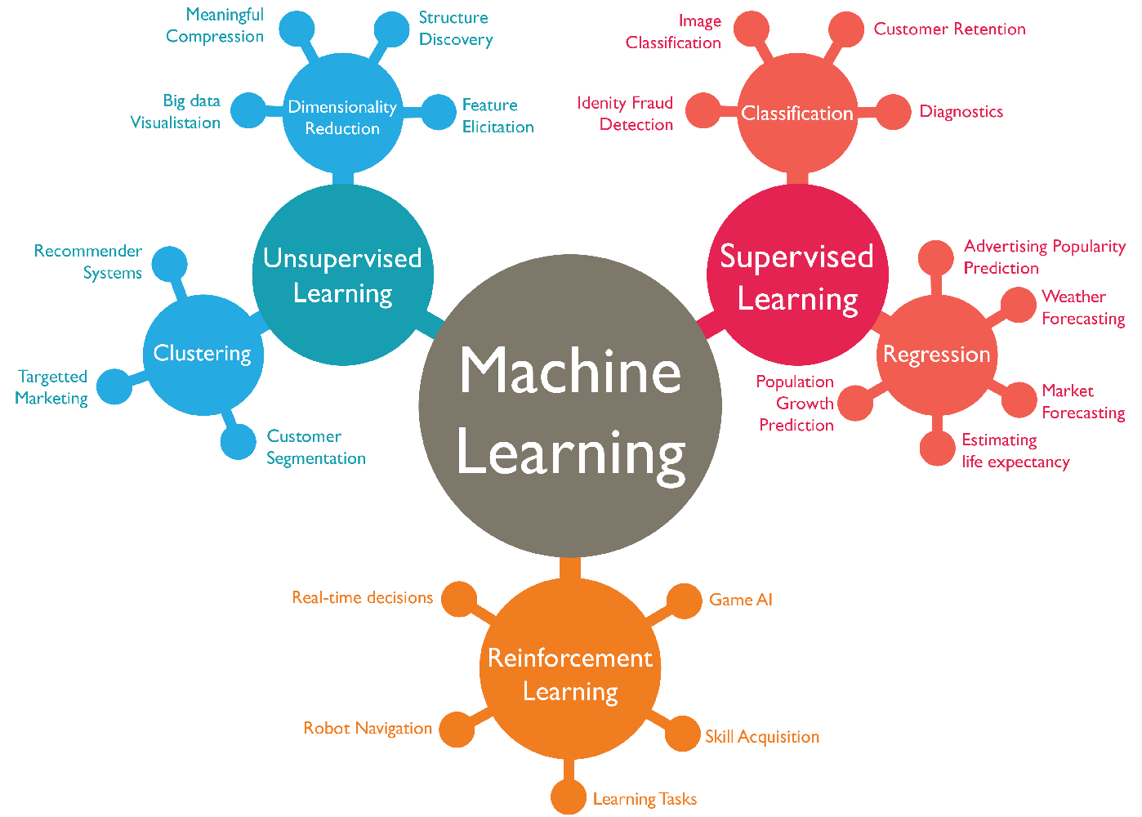
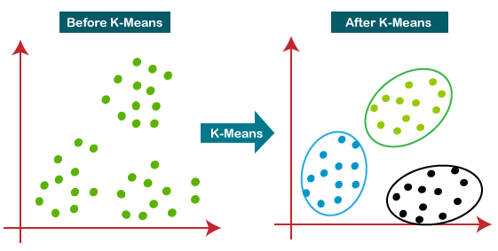
What is Machine Learning?
Unsupervised Learning
  No desired output
  Discovering structure in data
Figure cited from https://www.wordstream.com/blog/ws/2017/07/28/machine-learning-applications

Slide 5
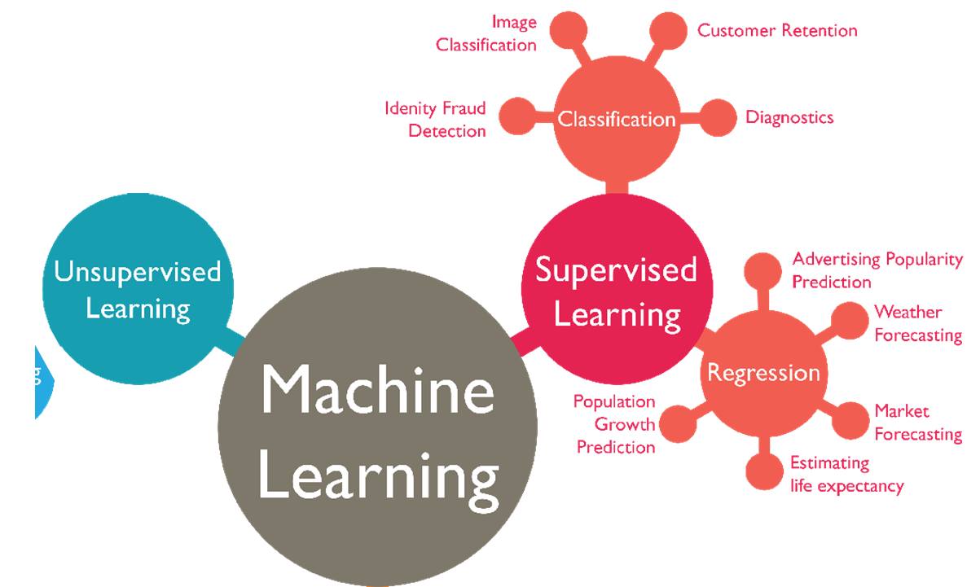
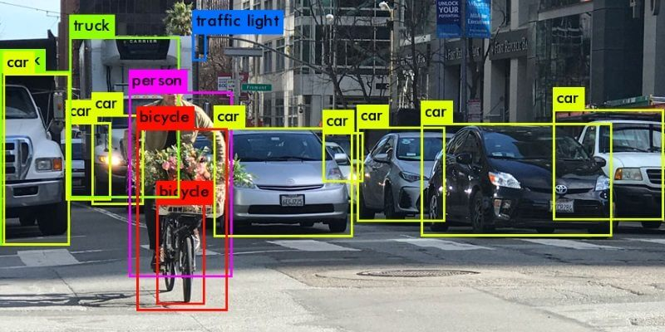
What is Machine Learning?
Supervised Learning
  Given desired output
  Training a machine by showing examples
  Tweaking the parameter when the output is wrong
  Classification: from data to discrete classes
Figure cited from https://www.wordstream.com/blog/ws/2017/07/28/machine-learning-applications

Slide 6
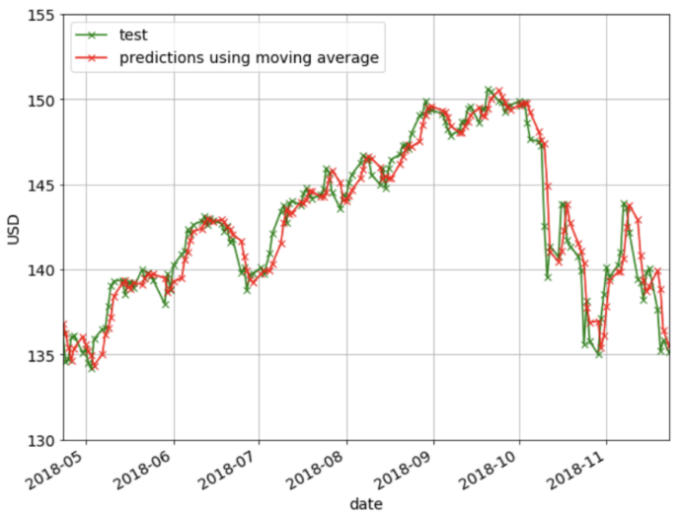
What is Machine Learning?
Supervised Learning
  Given desired output
  Training a machine by showing examples
  Tweaking the parameter when the output is wrong
  Regression: predicting a numeric value
Figure cited from https://www.wordstream.com/blog/ws/2017/07/28/machine-learning-applications

Slide 7
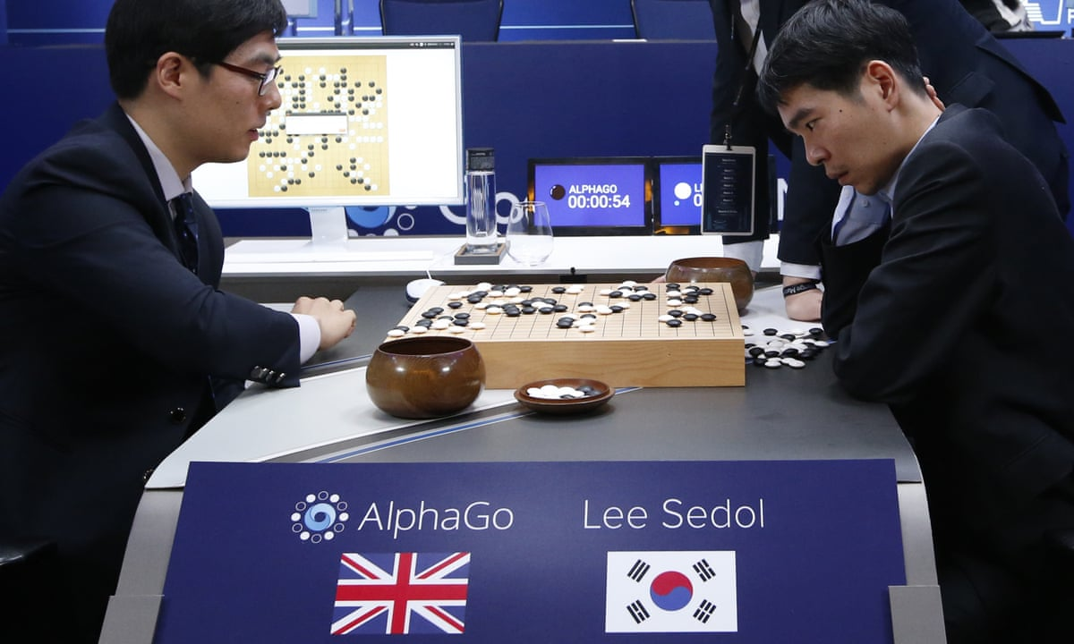
What is Machine Learning?
Reinforcement Learning
  Problems involving an agent interacting with an environment, which provides numeric reward signals
  Learn how to take actions in order to maximize reward
  Game AI: AlphaGo
Figure cited from https://www.wordstream.com/blog/ws/2017/07/28/machine-learning-applications

Slide 8
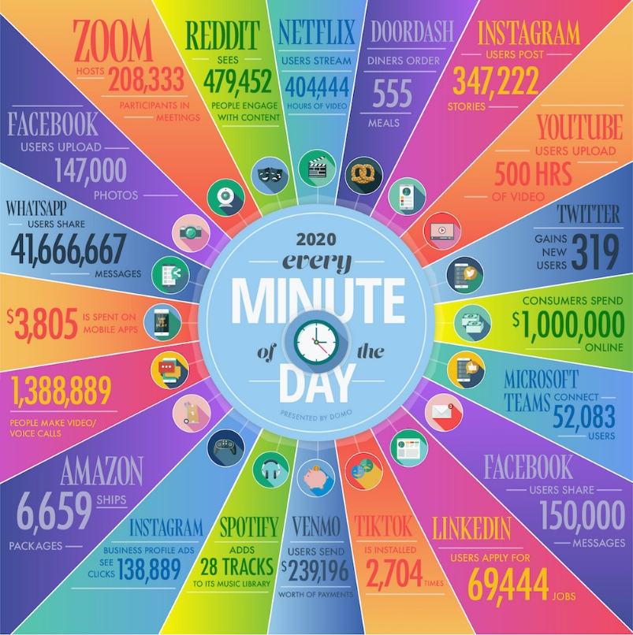
Intro. to Machine Learning
What makes machine learning powerful?
The huge amount of available data.
Source: https://web-assets.domo.com/blog/wp-content/uploads/2020/08/20-data-never-sleeps-8-final-01-Resize.jpg

Slide 9
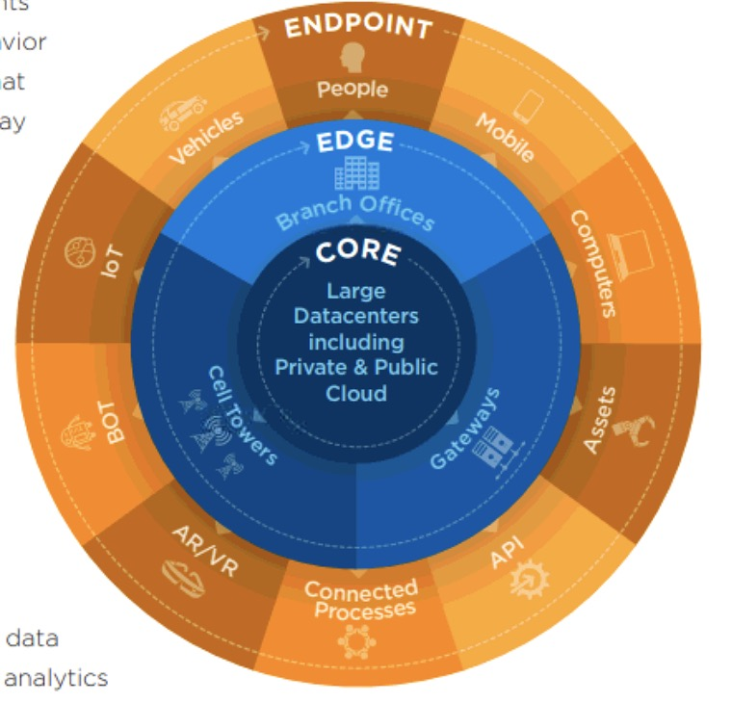
Intro. to Machine Learning
Can data live at the edge?
Although more and more data processing is moving on device
  Because
    Better battery life
    Better CPU (and GPU)
  Advantages:
    Reducing latency
    Works offline
    Privacy advantages
What about analytics?
What about learning?
Source: D. Reinsel, J. Gantz, and J. Rydning, “The digitization of the world from edge to core,” IDC White Paper, 2018.

Slide 10
Outline
Introduction
  Machine Learning
  Multi-access Edge Computing
Work I: Edge Resource Prediction in Vehicular Networks
Work II: Low-Latency High Definition Map Updating Mechanism
Work III: Mechanism Design for MEC Assisted Federated Learning
Conclusion

Slide 11
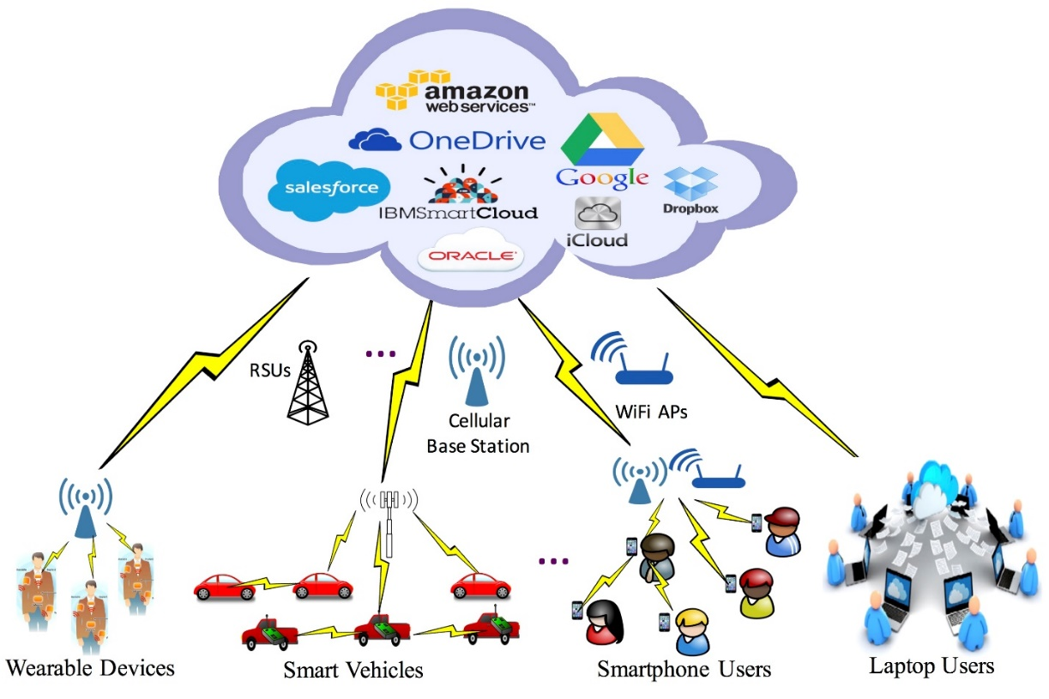
Multi-access Edge Computing
Cloud computing as a solution
Traditionally: a centralized paradigm
Drawbacks:
Communication cost
High latency
Low QoS
Centralized Cloud/ Data Center
Mobile Devices

Slide 12
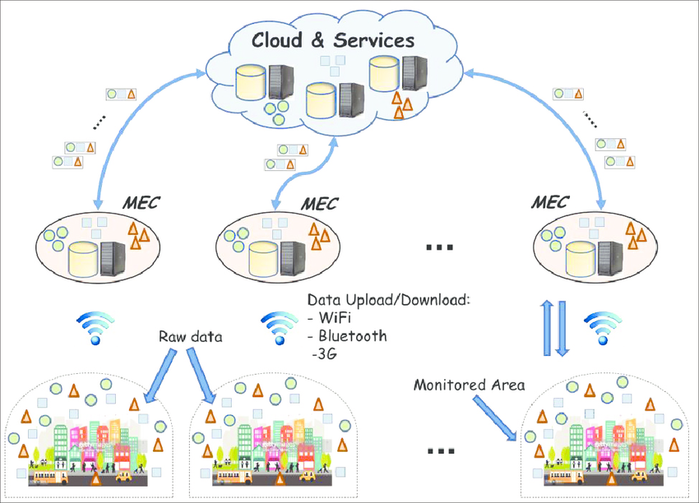
Multi-access Edge Computing
What is edge computing?
In a distributed paradigm
Cloud server
- Highest computational power
Edge server
A small size server
More powerful than the end device but less than the server
Mobile devices
Generate data
Resource constrained device
Low computation/ transmission power

Slide 13
Outline
Introduction
  Machine Learning
  Multi-access Edge Computing
Work I: Edge Resource Prediction in Vehicular Networks
Work II: Low-Latency High Definition Map Updating Mechanism
Work II: Mechanism Design for MEC Assisted Federated Learning
Conclusion

Slide 14
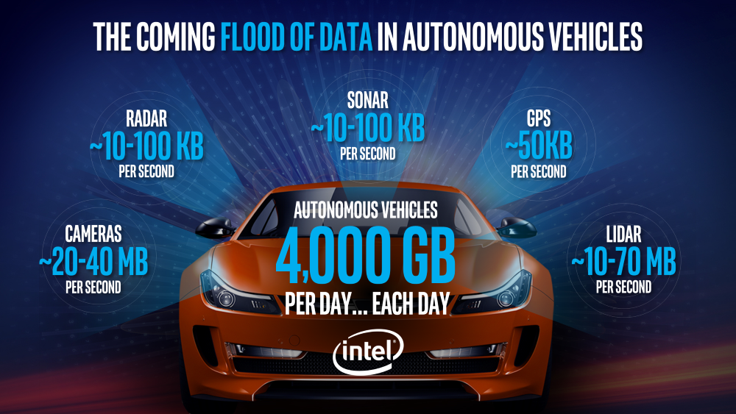
Edge Resource Prediction in Vehicular Networks
Background and Motivation
With the development of autonomous vehicular technologies, the execution tasks become more memory-consuming and computation-intensive. Based on the forecast of Intel, one autonomous vehicle will generate 4TB data per day.
Source: Intel. Data is the new oil in the future of automated driving. [Online]. Available: https://newsroom.intel.com/editorials/krzanich-the-future-of-automated-driving/#gs.jpzzzs.

Slide 15
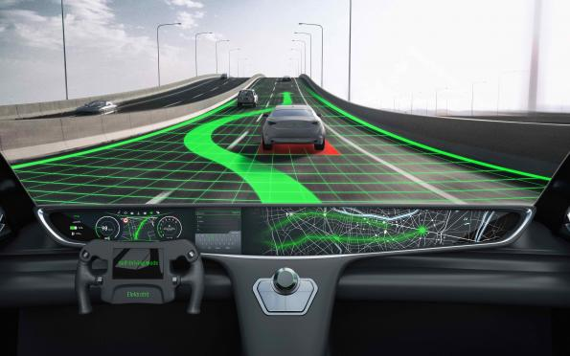
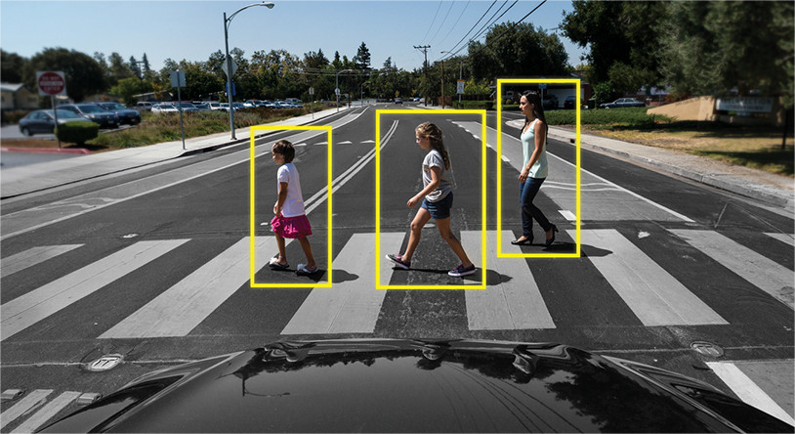
Edge Resource Prediction in Vehicular Networks
Background and Motivation
Meanwhile, a certain portion of tasks are latency-sensitive, such as path planning, real-time pedestrian detection etc. In this case, edge computing can be an effective way to help.
Lane Passing
Pedestrian Detection

Slide 16
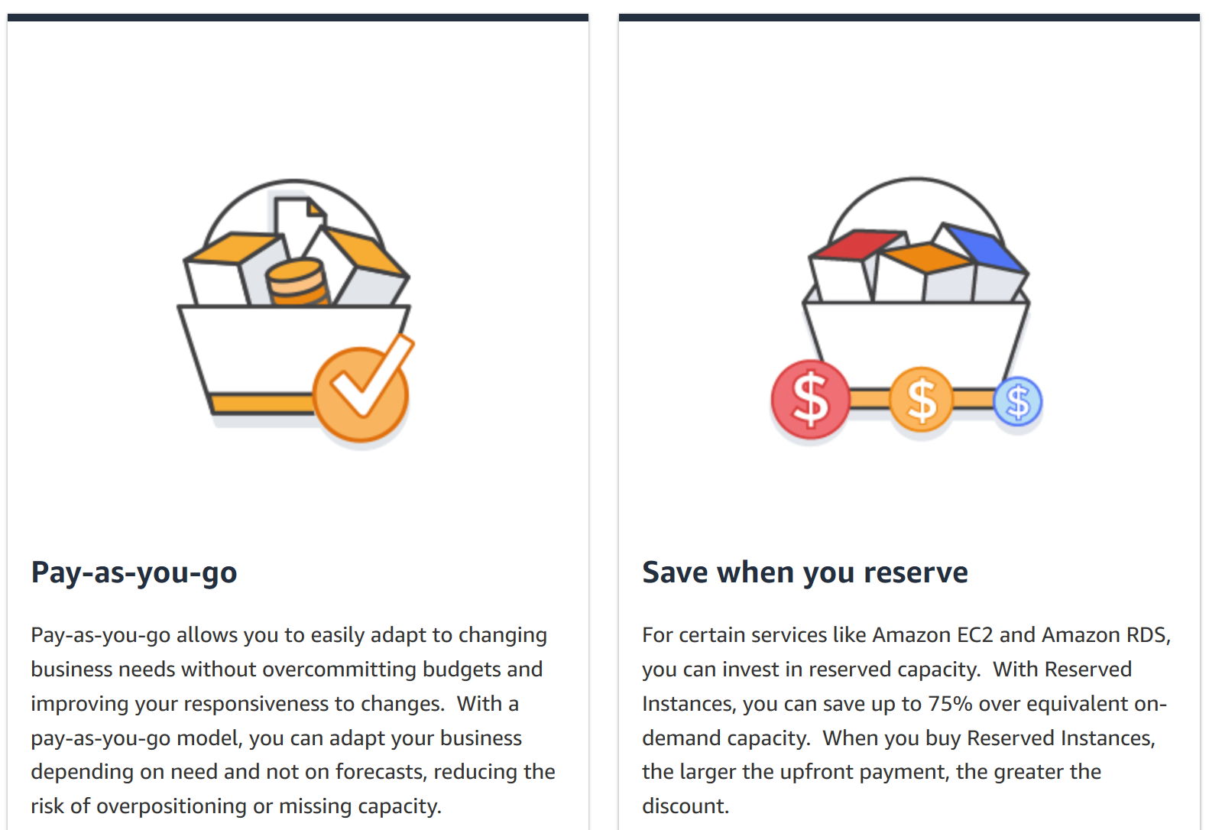
Edge Resource Prediction in Vehicular Networks
Background and Motivation
From the commercial perspective, the typical edge resource purchase schemes are subscription/ reservation and pay by use. And the unit price for reservation is cheaper than pay by use.

Slide 17
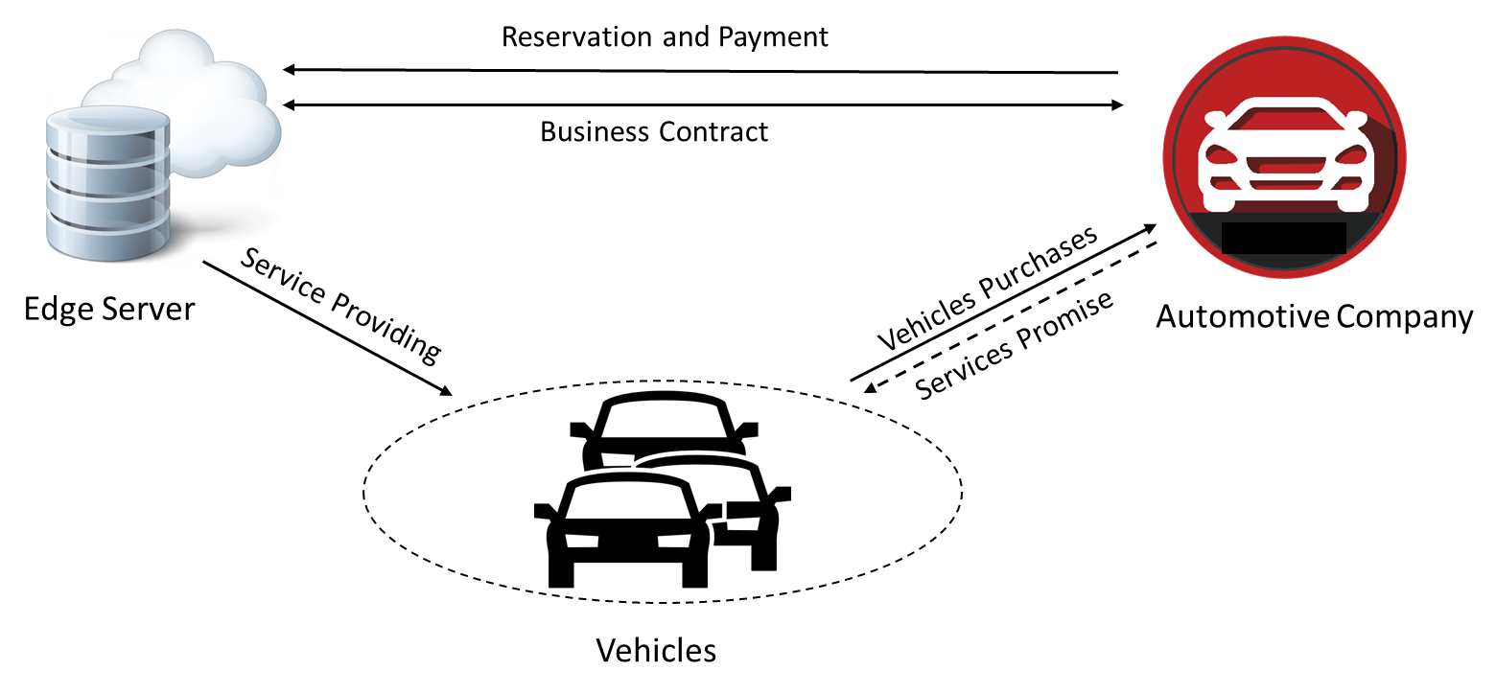

Edge Resource Prediction in Vehicular Networks
Scenario Description
Consider an edge computing platform deploying edge nodes and providing edge computing services.
The automotive company provides services to the autonomous vehicle customers for intelligent applications.

Slide 18


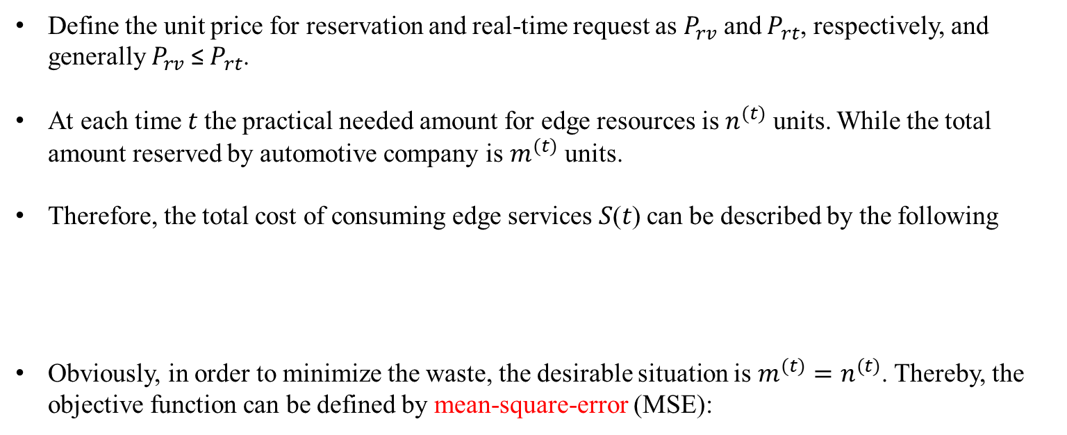
Edge Resource Prediction in Vehicular Networks
Problem Description
Define the unit price for reservation and real-time request as $P_{rv}$ and $P_{rt}$, respectively, and generally $P_{rv}$ ≤ $P_{rt}$.
At each time 𝑡 the practical needed amount for edge resources is $n^{(t)}$ units. While the total amount reserved by automotive company is $m^{(t)}$ units.
Therefore, the total cost of consuming edge services 𝑆(𝑡) can be described by the following
Obviously, in order to minimize the waste, the desirable situation is $m^{(t)}=n^{(t)}$. Thereby, the objective function can be defined by mean-square-error (MSE):

Slide 19
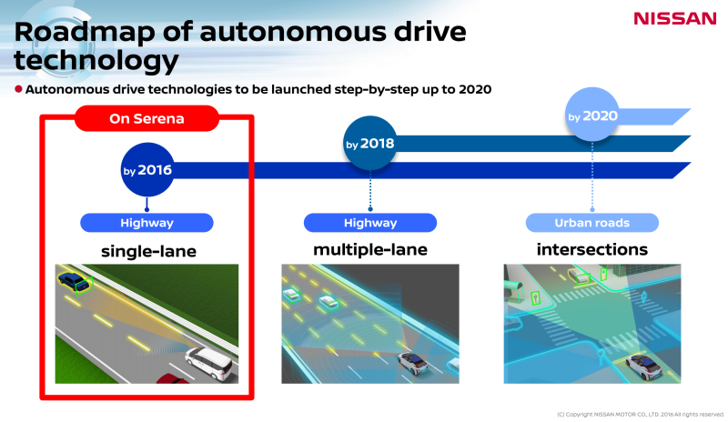
Edge Resource Prediction in Vehicular Networks
Problem Description
Diverse road types brings different difficulty level for autonomous driving.
For example, road map of autonomous driving technology of Nissan.
Can we predict edge server resources consumption accurately for all kinds of road maps?

Slide 20
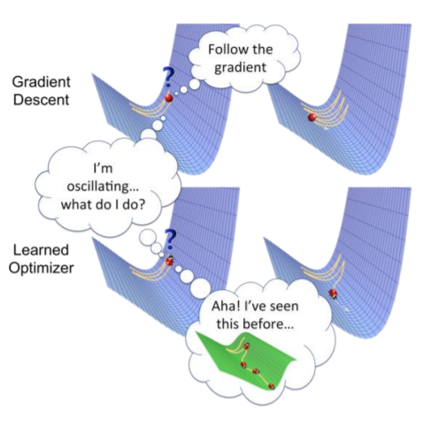
Edge Resource Prediction in Vehicular Networks
Methods
What is Meta-Learning?
  If you’ve learned 100 tasks already, can you figure out how to learn more efficiently?
  Can we explicitly learn priors from previous experience that lead to efficient downstream learning?
  Now having multiple tasks is a huge advantage!
  Meta-learning = learning to learn

Slide 21
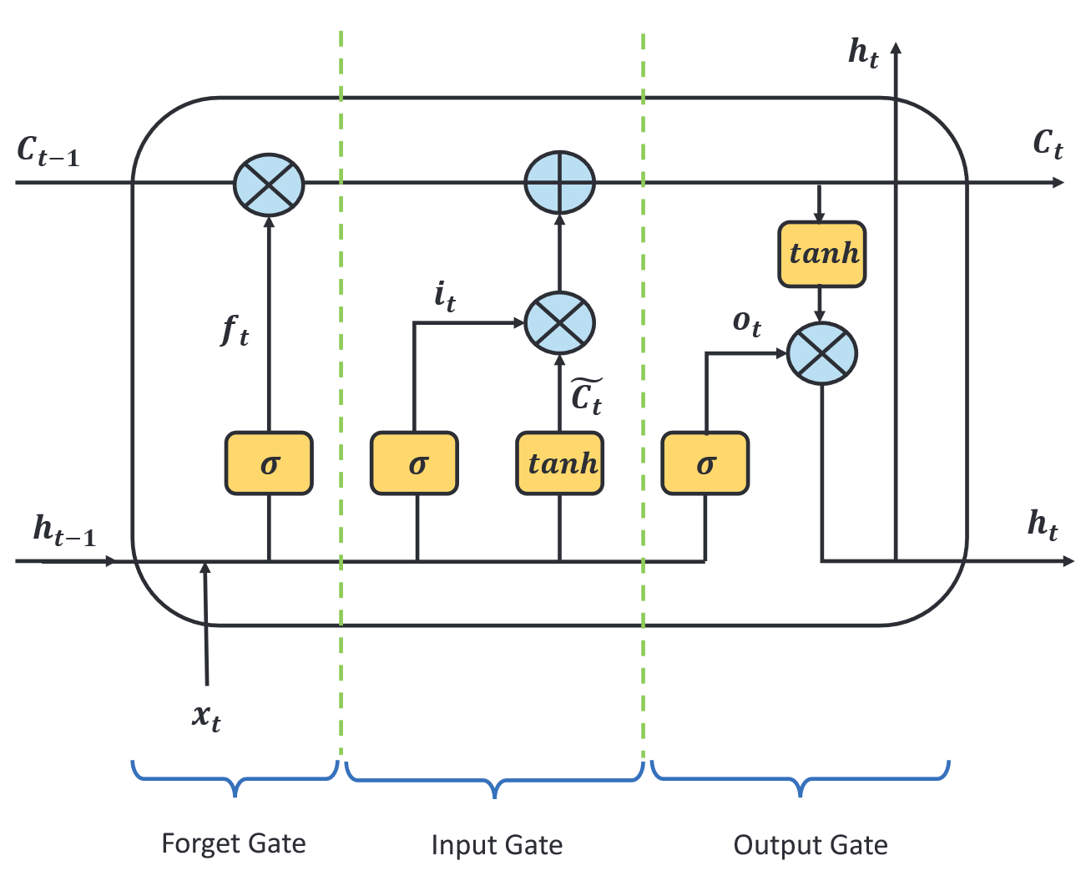
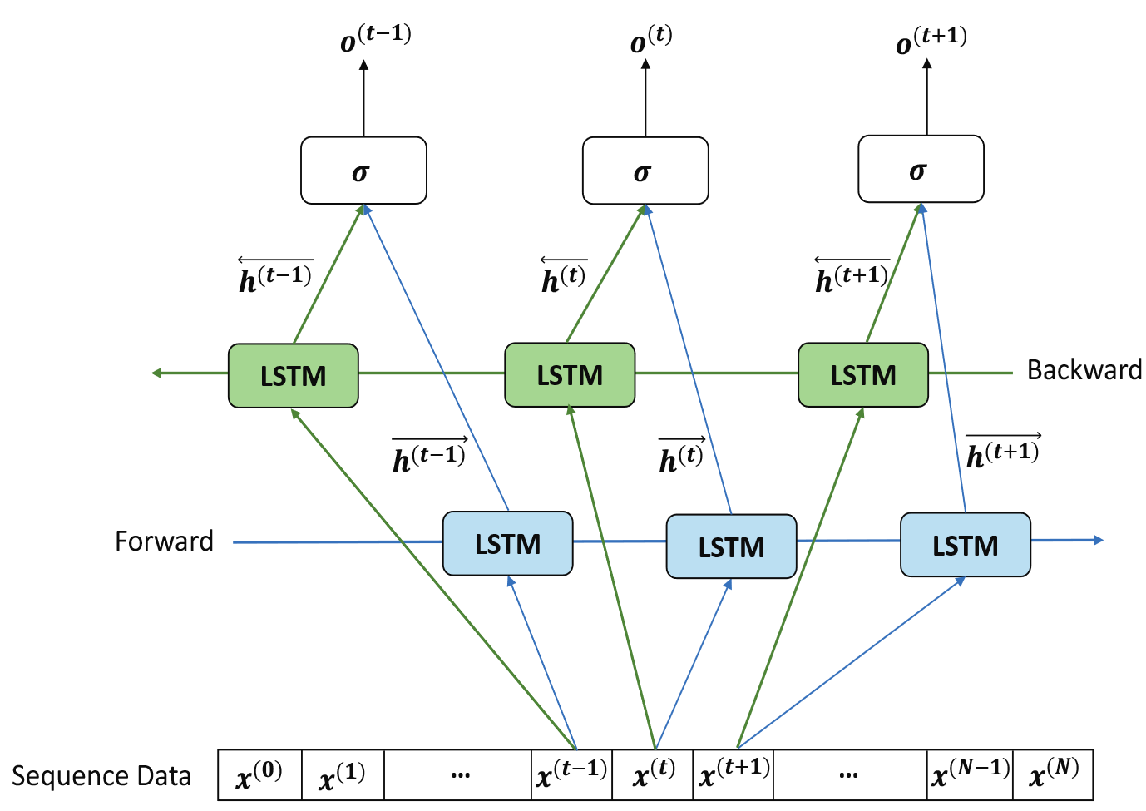
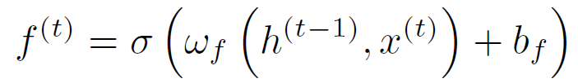
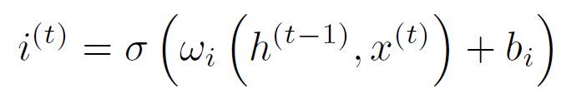
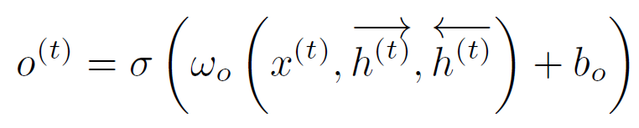
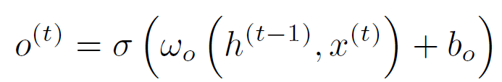
Edge Resource Prediction in Vehicular Networks
Methods
Since edge server resource consumption is time series data. We adopt recurrent neural network family as algorithm space.
LSTM
Bidirectional LSTM (BiLSTM)
Forget gate:
Input gate:
Output gate:

Slide 22
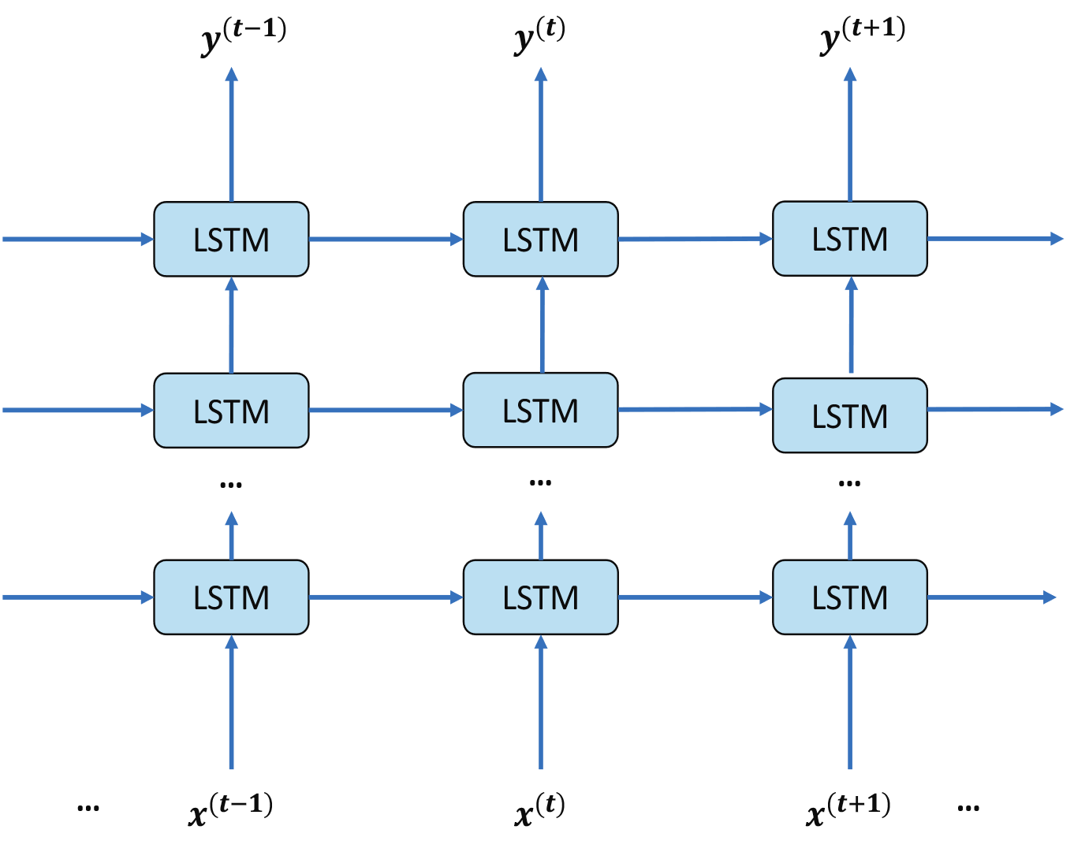
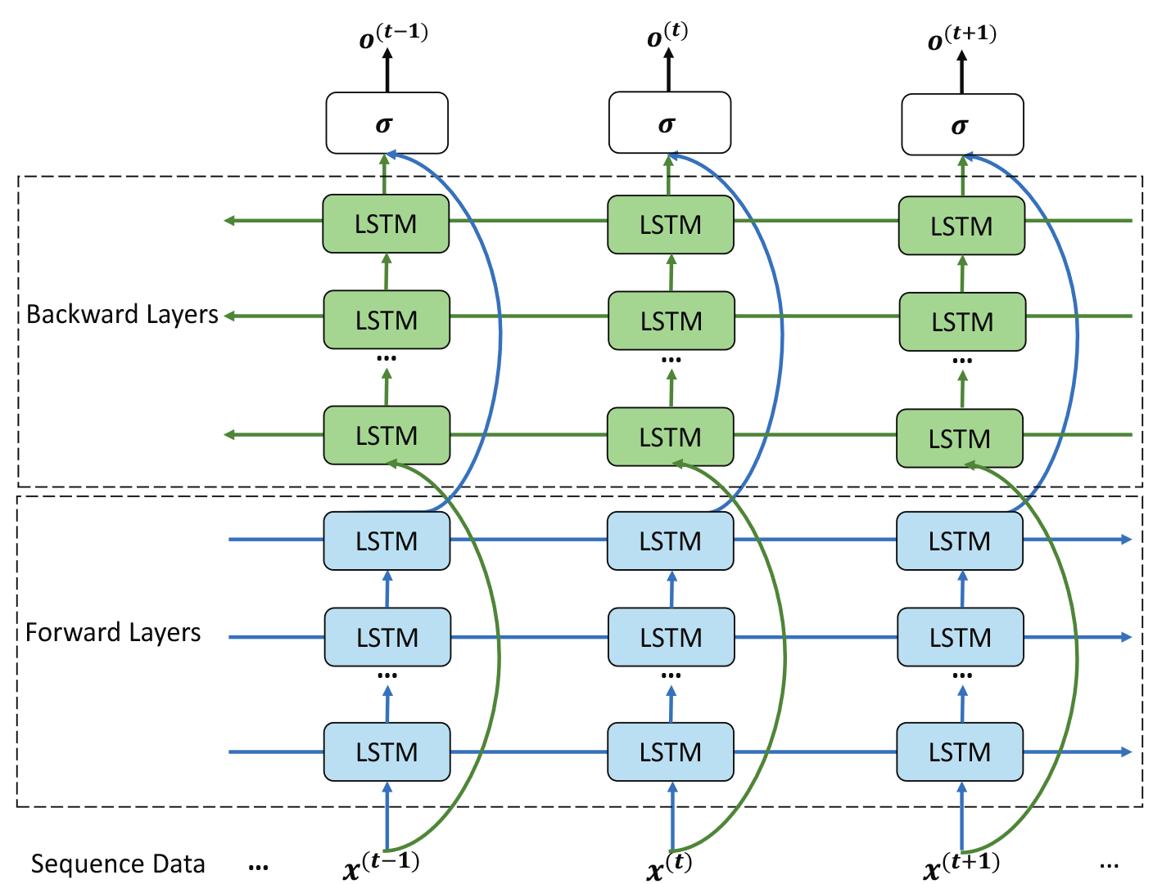
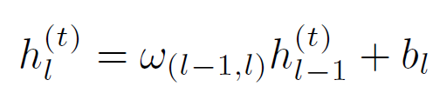
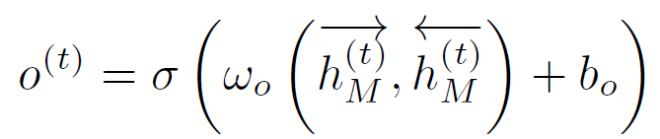
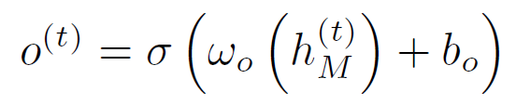
Edge Resource Prediction in Vehicular Networks
Methods
Two more deep models.
Stacked LSTM (SLSTM)
Stacked BiLSTM

Slide 23
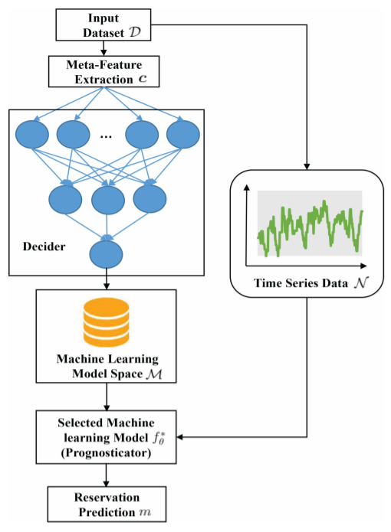
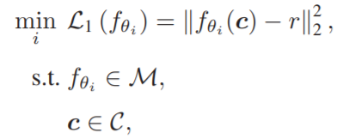
Edge Resource Prediction in Vehicular Networks
Methods
Proposed Two Stage Meta-learning Framework
First stage: to decide which machine learning model should be selected based on history data.
Intuitively, the objective function or loss function of this stage can be written as
The Selected Model
Suggested Model
Model Set
Feature Set

Slide 24
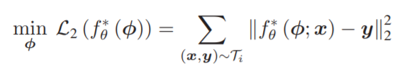
Edge Resource Prediction in Vehicular Networks
Methods
Proposed Two Stage Meta-learning Framework
Second stage: to use the obtained algorithm to predict the edge resource consumption.
In this stage, what needs to be done is to optimize the parameters of so as to fit the new dataset. The objective function can be defined as
Model Parameter
Ground truth
Input Data

Slide 25
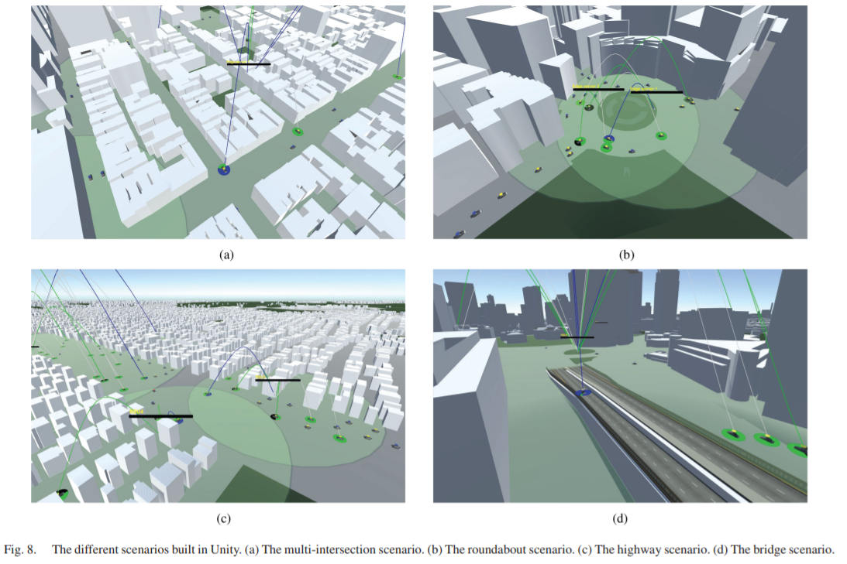
Edge Resource Prediction in Vehicular Networks
Simulation Results
Data Generation
  We build up the 3D model of real-world Manhattan area as the geographical background in Unity and choose four different road maps to simulate traffic flow.

Slide 26
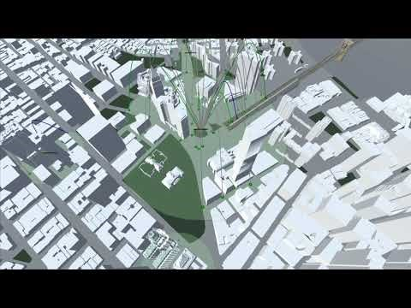
Edge Resource Prediction in Vehicular Networks
Simulation Results
Simulation Scenario

Slide 27



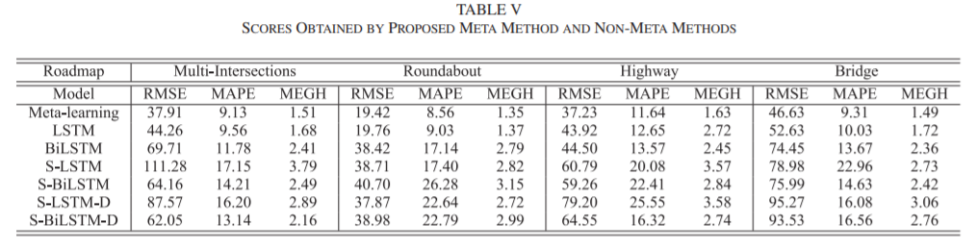
Edge Resource Prediction in Vehicular Networks
Simulation Results
Evaluation Metrics: root mean square error (RMSE), mean absolute percentage (MAP), and mean GEH (MGEH)
Obviously, we can find that our proposed method always achieves the best evaluation scores among all the roadmaps.
Prediction
Ground Truth

Slide 28
Outline
Introduction
  Machine Learning
  Multi-access Edge Computing
Work I: Edge Resource Prediction in Vehicular Networks
Work II: Low-Latency High Definition Map Updating Mechanism
Work II: Mechanism Design for MEC Assisted Federated Learning
Conclusion

Slide 29
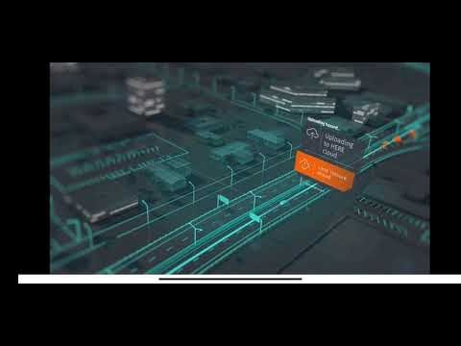
Low-Latency HD Map Updating Mechanism
What is High Definition Map?
  A map overlaid with various information
    (e.g.) Traffic situations, access ways, street furniture within city streets and sub-surface ducts
  High resolution
    Precision at the centimeter level (10 -20cm or better*) with frequent update
Notes:
So what is high definition map? Beyond the current map we use like Google map, it contains more road attributes like lane markings and surrounding vehicles or pedestrian positions, also it has high level resolution which is 10 to 20 cm. Because it includes dynamic objects, it requires frequent updating. And the most common use case for high definition map is autonomous drving.

Slide 30
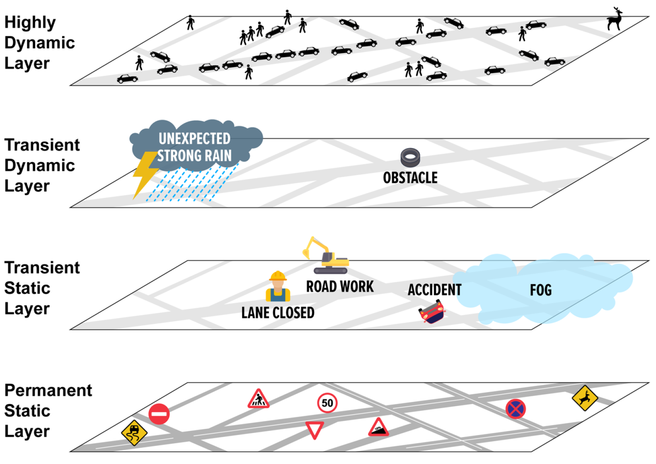
Low-Latency HD Map Updating Mechanism
What is High Definition Map?
Update interval: Less than several seconds
  (e.g.) Position and state information of pedestrians, vehicles, bicycles, motorbikes and so on.
Update interval: Less than several minutes
  (e.g.) Fallen objects, illegally parked vehicles, trash, local weather such as unexpected heavy rain and tornados
Update interval: Less than several hours
  (e.g.) Position and state information of road work, lane closures, broken-down vehicles, accidents
Update intervals: one day or longer
  (e.g.) Lanes, traffic signals and the three-dimensional structure of the road

Slide 31
FA Based HD Map Updating Mechanism
Challenges for HD Map Generation and Updating
Challenge
  As more vehicles and their sensors come online, the challenge is how to handle the huge volume of data and to extract the salient information from it
  Since different layers have different requirements for updating and accuracy level, how to build an efficient mechanism for HD map updating needs to be considered

Slide 32
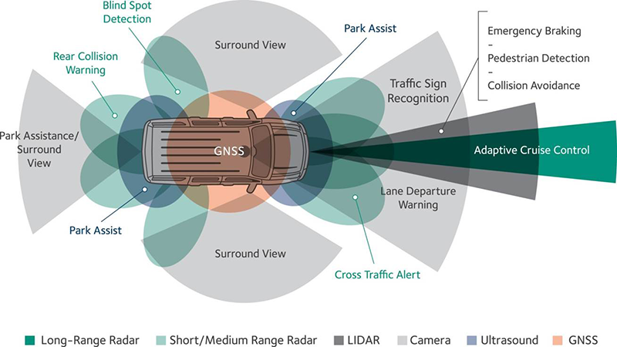
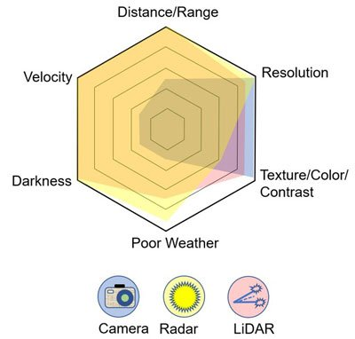
Low-Latency HD Map Updating Mechanism
Sensor Systems in Autonomous Vehicles
HD map is created by on various board sensors generated data.
Challenge: How to quantify the contribution of sensors?

Slide 33
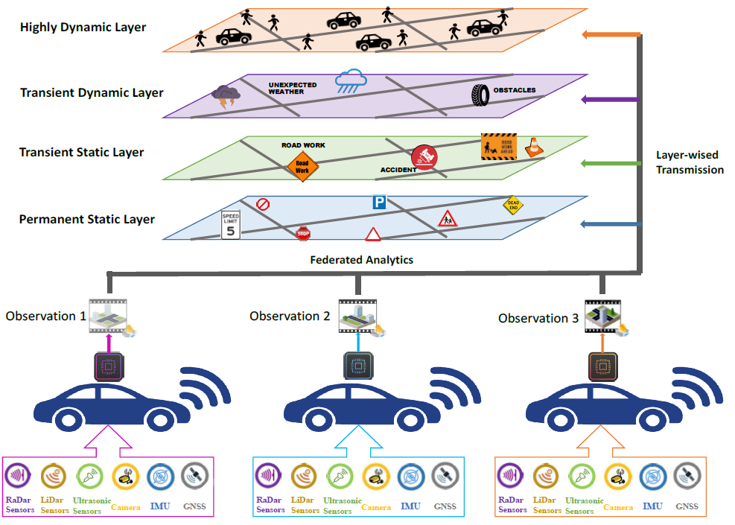

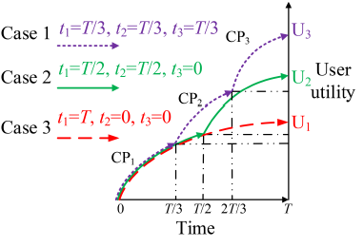
Low-Latency HD Map Updating Mechanism
Framework Design and Modeling
A) Love of Variety based vehicle utility quantification
The love of variety approach assumes that each consumer has a demand for multiple varieties of a product over a given time period.
Constant coefficients

Slide 34


Low-Latency HD Map Updating Mechanism
Framework Design and Modeling
B) Data Quality for Federated Analytics
If the global optimization problem is convex, the needed number of global iterations can be given as
Global accuracy level
constant
Local accuracy level
If the data quality of participants is better, higher accuracy can be achieved when the number of global aggregation is fixed.
constant

Slide 35



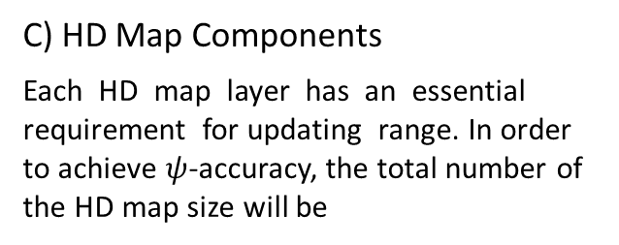
Low-Latency HD Map Updating Mechanism
Framework Design and Modeling
C) HD Map Components
Each HD map layer has an essential requirement for updating range. In order to achieve $ψ$-accuracy, the total number of the HD map size will be
constant
range
D) Communication Model
Transmission rate:
Transmission time:
Percentage transmitted by edge
Constant delay

Slide 36

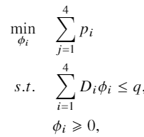
Low-Latency HD Map Updating Mechanism
Framework Design and Modeling
E) Age of Information Penalty
Since the delay requirement for HD map updating is very strict, the penalty increases non-linearly.
constant
F) Problem Formulation
In order to minimize the time staleness for HD map updating, the problem can be formulated as
Available capacity of edge

Slide 37
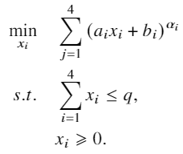



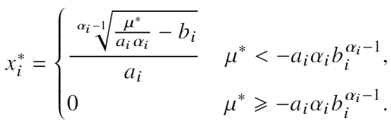




Low-Latency HD Map Updating Mechanism
Deterministic Case
Reformulating
KKT conditions
Stationarity condition
Complementary slackness
Primal feasibility
and
Dual feasibility

Slide 38
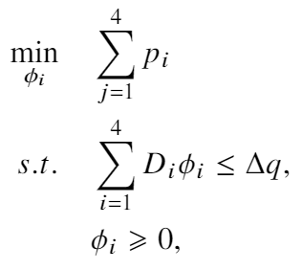
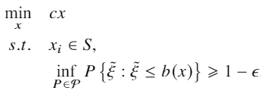


Low-Latency HD Map Updating Mechanism
Uncertain Case
Practically, an edge server provides services to multiple attached devices simultaneously, such that the available capacity q for the autonomous vehicle is variational.
Decision variables
Equivalent
uncertainty of available capacity
Parameters
Deterministic constrains on $x$
Feasible Region
Chance constrain specified by the ambiguity set

Slide 39
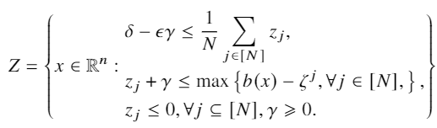
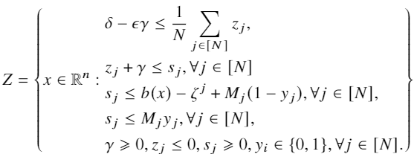

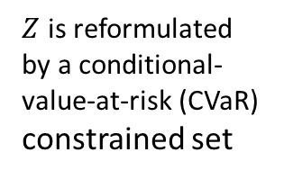

Low-Latency HD Map Updating Mechanism
Uncertain Case
Practically, an edge server provides services to multiple attached devices simultaneously, such that the available capacity q for the autonomous vehicle is variational.
Strong duality
Equivalent
$$Z_{R}⊆Z$$
Mixed integer representable
Scale is large!
Approximation
$Z$ is reformulated by a conditional-value-at-risk (CVaR) constrained set

Slide 40


Low-Latency HD Map Updating Mechanism
Simulation Results – Deterministic Case
All of the curves indicate decreasing trend with the increase of edge server capacity.
In any case, the highly dynamic layer is always allocated the majority of edge resources.

Slide 41

Low-Latency HD Map Updating Mechanism
Simulation Results – Uncertain Case
Risk Tolerance
Wasserstein Ball Radius
In terms of approximation accuracy, CVaR model is better. Since the existence of uncertainty, the optimality gap is inevitable but 1% - 3% difference is also acceptable.
To obtain the optimal solution, the time consumption can be up to 10 seconds. However, the CVaR model execution time is typically less than one second.

Slide 42
Outline
Introduction
  Machine Learning
  Multi-access Edge Computing
Work I: Edge Resource Prediction in Vehicular Networks
Work II: Low-Latency High Definition Map Updating Mechanism
Work III: Mechanism Design for MEC Assisted Federated Learning
Conclusion

Slide 43






Mechanism Design for MEC Assisted FL
Background
Disadvantages:
Delayed update
Limited bandwidth/ high communication cost
Privacy concern
Why federated learning?
  - Traditional practice
1. Model running on device
3. Training on server
Device 1
2. Collect data
Device 2
……
4. Update model
Device $M$

Slide 44

Mechanism Design for MEC Assisted FL
Motivation
Challenges:
  1. Once the end devices are invited, they will unconditionally take part in the federated learning tasks which ignores their willingness.
    Computation cost, remained energy…
  2. There are many available edge nodes in a MEC network, how to parallelly perform multiple federated learning tasks needs to be considered.
  3. Information exchanging cannot be done entirely in large scale IoTs scenarios.
  4. In a MEC network, the end devices are always on the go, which means the time of devices localizing within the network is limited.

Slide 45


Mechanism Design for MEC Assisted FL
System Model
Number of data sample
Computation Model
Communication Model
Required cycles
Accuracy index
CPU frequency
Edge Server Preference
Model size
Channel gain
Device Preference
Bandwidth
Transmission power
Noise power
45

Slide 46



Mechanism Design for MEC Assisted FL
Problem Formulation
The total amount of time consumed can be written as
Latency minimization problem
$𝒪(m^{n})$. Utilizing matching to find a suboptimal solution
Assignment index, binary variable
A client can connect to maximum one edge server
At least there should be one client connected to the server so as to finish the task
The total number of connections cannot exceed capacity of edge server
46

Slide 47



Mechanism Design for MEC Assisted FL
Method
Complete Preference List (CPL) vs. Incomplete Preference List (IPL)
CPL: each player can find a stable matching.
More Practical
IPL: Only part of candidates can have stable matching due to lacking info. Some players may not be assigned a matching. The others might need to be assigned manually.

Slide 48

Mechanism Design for MEC Assisted FL
Method
Building preference list based on utility functions for edge servers and participants.
Matching based on preference list.
Capacity checking: If the number of selected participants exceeds edge node capacity, edge node will only keep those desirable participants within capacity and reject the applications of the others.
Partial matching checking: If there are still any participants who are willing to join unassigned, they will be assigned to available edge node randomly.

Slide 49


Mechanism Design for MEC Assisted FL
Simulation Results
Impact of user numbers and edge node numbers
Our proposed method is close to the performance of complete preference list (CPL) case and achieves a relatively low latency.

Slide 50
Conclusion
Introduction to machine learning and edge computing.
Providing a theoretical research between machine learning, multi-access edge computing, and autonomous vehicles.
Mainly focus on how to use machine learning or optimization method to allocate edge computing resources. Also, we discuss the mechanism design to optimize the machine learning framework.
Simulation results show our methods can achieve better accuracy for edge computing resource prediction or objects like low latency for edge assisted applications.

Slide 51


Future Work
Adaptive resolution with communication resources constrained HD updating
Efficiency or quality of service (QoS) guaranteed HD map distribution scheme

Slide 52
Publications
Journal:
Dawei Chen, Xiaoqin Zhang, Li Wang, and Zhu Han, “Prediction of Cloud Resources Demand Based on Hierarchical Pythagorean Fuzzy Deep Neural Network,” to be published in IEEE Transactions on Services Computing.
Dawei Chen, Yin-Chen Liu, BaekGyu Kim, Jiang Xie, Choong Seon Hong, and Zhu Han, “Edge Computing Resources Reservation in Vehicular Networks: A Meta-Learning Approach”, IEEE Transactions on Vehicular Technology, vol. 69, no. 5, pp. 5634-5646, May 2020.
Dawei Chen, Choong Seon Hong, Li Wang, Yiyong Zha, Xin Liu, and Zhu Han, “Matching Theory Based Low-Latency Scheme for Multi-Task Federated Learning in MEC Networks”, IEEE Internet of Things Journal, vol. 8, no. 14, pp. 11415-11426, January 2021.
Dawei Chen, Choong Seon Hong, Yiyong Zha, Yunfei Zhang, Xin Liu, and Zhu Han, “FedSVRG Based Communication Efficient Scheme for Federated Learning in MEC Networks”, IEEE Transactions on Vehicular Technology, vol. 70, no. 7, pp. 7300-7304, June, 2021.
Dawei Chen, Dan Wang, Yifei Zhu, and Zhu Han, “Digital Twin for Federated Analytics Using a Bayesian Approach”, IEEE Internet of Things Journal, vol. 8, no. 22, pp. 16301-16312, July, 2021.
Dawei Chen, Yifei Zhu, Dan Wang, Haoxin Wang, Jiang Xie, Xiao-Ping Zhang, and Zhu Han, “Love of Variety based Latency Analysis for High Definition Map Updating: Age of Information and Distributional Robust Perspectives”, submitted to IEEE Transactions on Vehicular Technology.
Conference:
Dawei Chen, Xiaoqin Zhang, Li Wang, and Zhu Han, “Prediction of Cloud Resources Demand Based on Fuzzy Deep Neural Network”, in Global Communication Conference (GLOBECOM), Abu Dhabi, UAE, Dec. 2018.
Dawei Chen, Jiang Xie, BaekGyu Kim, Choong Seon Hong, Li-Chun Wang, and Zhu Han, “Federated Learning Based Mobile Edge Computing for Augmented Reality Applications,” in International Conference on Computing, Networking and Communications (ICNC), Big Island, HI, Feb. 2020.
Dawei Chen, Yifei Wei, Li Wang, Choong Seon Hong, Li-Chun Wang, and Zhu Han, “Deep Reinforcement Learning Based Strategy for Quadrotor UAV Pursuer and Evader Problem,” in International Conference on Communications (ICC) Workshop, Dublin, Ireland, June, 2020.
Patent Application:
Dawei Chen, Yin-Chen Liu, and BaekGyu Kim, “Methods and systems for selecting machine learning models to predict distributed computing resources”, US Patent App. 16/710,590.
Dawei Chen, BaekGyu Kim, and Roger Melon, “Digital twin based edge server switching decision”, US Patent App. 16/839,505.
Roger Melon, Dawei Chen, BaekGyu Kim, “Switching decision for vehicle computational offloading to roadside edge server”, US Patent App. 16/827,451.
Dawei Chen, BaekGyu Kim, “Vehicular edge server switching mechanism based on historical data and digital twin simulations”, US Patent App. 16/854,736.
Book :
Choong Seon Hong, Latif U. Khan, Mingzhe Chen, Dawei Chen, Walid Saad, and Zhu Han, “Federated Learning for Wireless Networks”, contracted with Springer Science + Business Media, LLC.

Slide 53


Thank support from Toyota & NSF.

