Slide 1


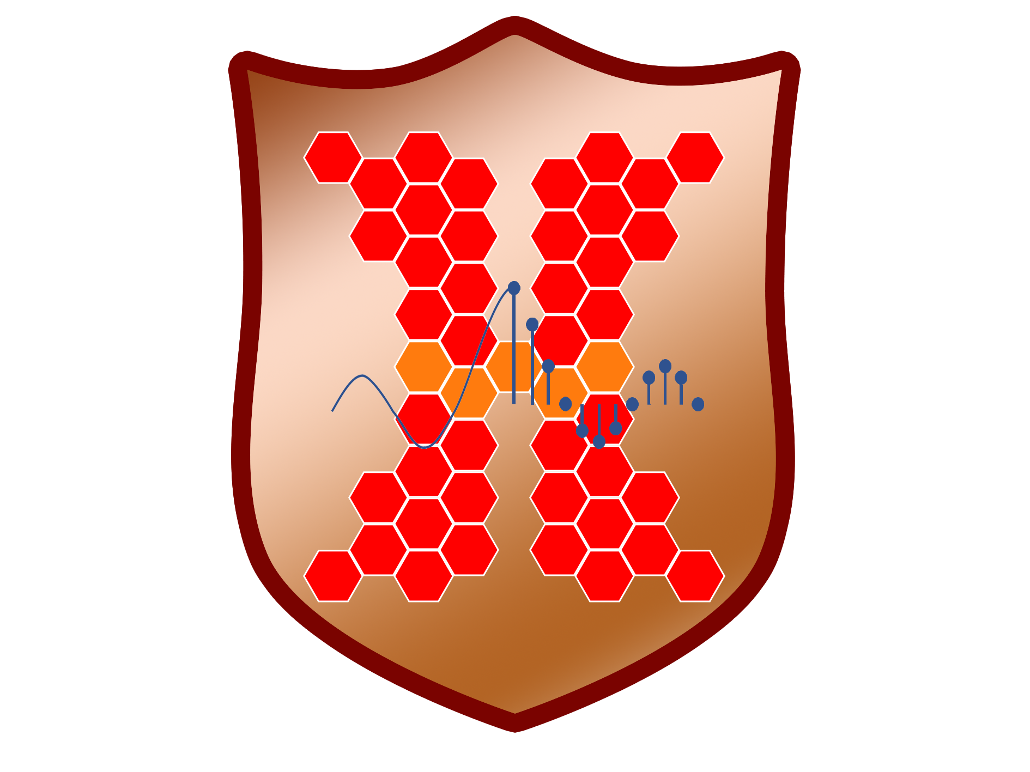
Neetu Raveendran
Advisor: Dr. Zhu Han
Ph.D. Defense
December 2019
Game Theoretic and Machine Learning Techniques for Efficient Resource Allocation in
Next Generation Wireless Networks

Slide 2
Outline
Introduction
Next Generation Wireless Networks
Motivations
Contributions
Resource Allocation Frameworks
Conclusions
Future Research Directions

Slide 3
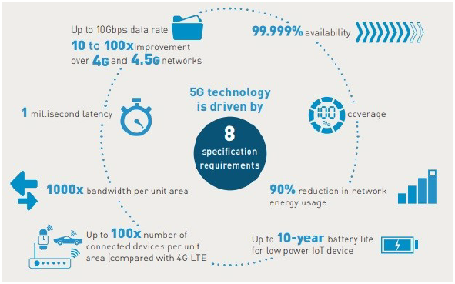
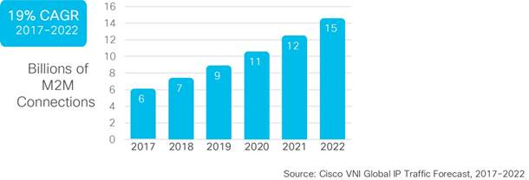
Introduction
Massive growth in number of Machine-to-Machine (M2M) connections due to Internet of Things (IoT) ecosystem

Slide 4


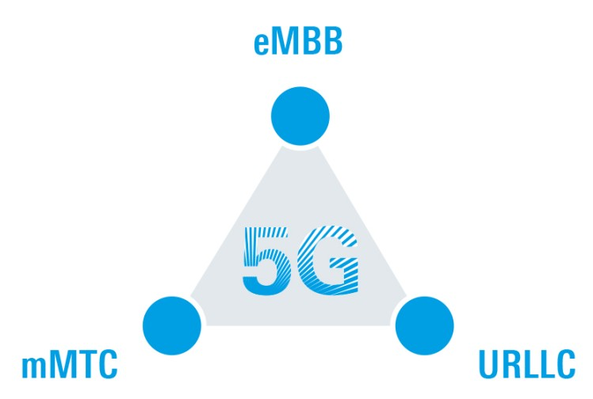


Next Generation Wireless Networks
10 Gbps
peak data rate
100 X
connections
1 ms
latency

Slide 5
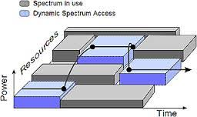
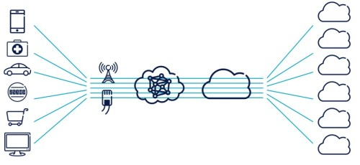
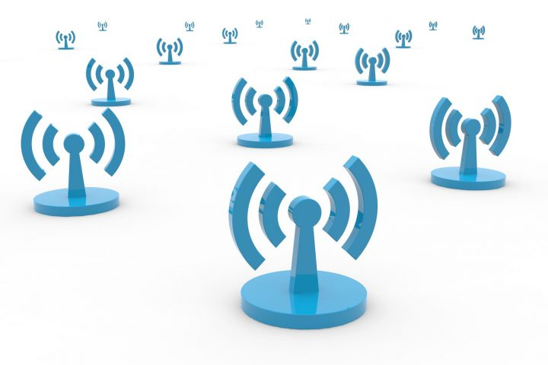

Motivations
Network virtualization
Tremendously high data rates
Network flexibility
Extremely low latency
Spectrum sharing
Spectrum efficiency
Low latency
Fog computing
5G
Significantly high QoS
Traffic offloading
Heterogeneous networks

Slide 6



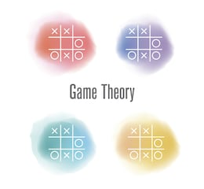


Motivations
  Diversity in use cases and devices
  Distributed algorithms more desirable
    Different sets of autonomous entities
    Model their interrelationships
    Strategic decision making
  Powerful mathematical models needed

Slide 7
Contributions
  Distributed resource allocation frameworks based on game theory and Machine Learning for next generation wireless networks
    Network virtualization
      Matching theory based distributed resource allocation model by considering both virtual network slices and user requirements
    Fog computing
      Large-scale optimization of resource pricing for operators and resource purchasing for users along with optimization of fog resource allocation
    Heterogeneous networks
      Data transmission routing optimization for a heterogeneous network while simultaneously optimizing the revenue of the mobile users
    Spectrum sharing
      Attack detection model for dynamic spectrum sharing to identify malicious users and improve spectrum usage efficiency

Slide 8
1. Network Virtualization

Slide 9
a) Wireless Network Virtualization
  Abstraction, isolation, sharing of resources among different entities
  Great flexibility, higher network efficiency, and easier migration to new technologies
  Traditional: Decouples resource allocation/user service management
    Preconfigured virtual resources/service packages offered to users
    Lacks flexibility for specific user requirements
  Proposed: Resource allocation by considering three entities of abstraction
Radio spectrum slices
Physical infrastructure slices
Mobile users
Resource allocation
User service management

Slide 10
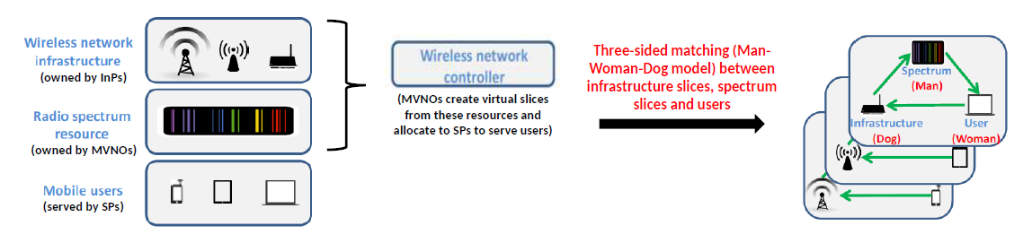
System Model
  Spectrum band slices need to be assigned to users, and they need to be assigned to infrastructure slices
  Need a distributed algorithm that considers the localized preferences of all three sets of entities
  Potential candidate: Matching theory
Notes:
Need transition to next slides for matching

Slide 11
Two-sided Matching (Gale-Shapley Algorithm)
Geeta, Heiki, Irina, Fran
Adam
Fran
Irina, Fran, Heiki, Geeta
Carl > Adam
Bob
Geeta
Geeta, Fran, Heiki, Irina
Carl
Heiki
Irina, Heiki, Geeta, Fran
David > Bob
Irina
David
We reach a Stable Marriage (SM)

Slide 12

Three-sided Stable Matching Game
Three-Dimensional Stable Marriage (3DSM) model
  Three types of matching agents: men, women, and dogs
3DSM-CYC model
  Preference list: Each agent arranges its preferences of another type of agent cyclically
  Men rank only women in their order of preference, women’s lists contain only dogs, and dogs rank only men
  Three-sided matching between K spectrum band slices (S), N physical infrastructure slices (B), and M users (U)
Stability
  Matching with no blocking triple (triple with desire to get matched with each other than current partners)
3DSM-CYC allows a strongly stable matching? NP-complete
Men
Women
Dogs

Slide 13



R-TMSC
Three-sided Matching with Size and Cyclic Preference (TMSC)
  Variant of 3DSM-CYC, allows each agent to have multiple partners
Stable matching exists in an instance of TMSC? NP-hard
Restricted Three-sided Matching with Size & Cyclic Preference (R-TMSC)
  The preference lists of spectrums are derived from a master preference list
  The infrastructures are indifferent with the spectrums
Preference list creation for each entity
Users in the descending order of offer prices
Infrastructures in the descending order of the offered QoS
Tie with all spectrums ranked the same

Slide 14
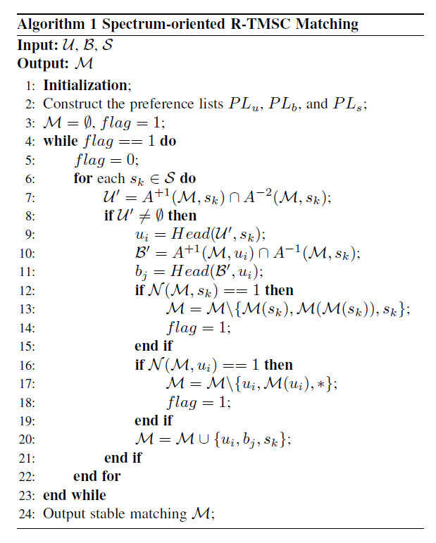

Spectrum-oriented R-TMSC
Select a spectrum initially
  Matching from the perspective of spectrum
  Searches for the best triple and adds this triple to the matching in each iteration
  The R-TMSC algorithm outputs a stable matching after a finite no. of steps
The best user for this spectrum is chosen
The best infrastructure for this user is chosen

Slide 15
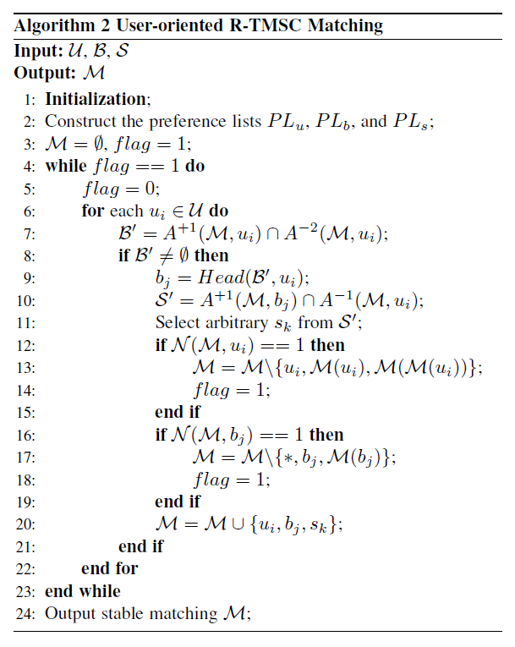

User-oriented R-TMSC
Select a user initially
  Matching from the perspective of user
  Searches for the best triple and adds this triple to the matching in each iteration
  The R-TMSC algorithm outputs a stable matching after a finite no. of steps
The best infrastructure for this user is chosen
An arbitrary spectrum for this infrastructure is chosen

Slide 16
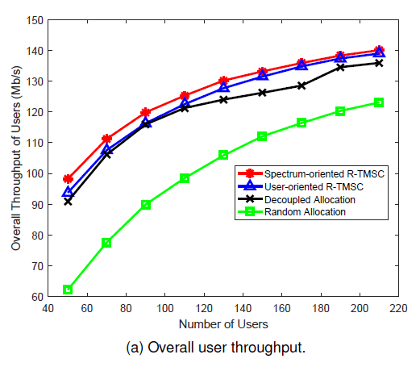
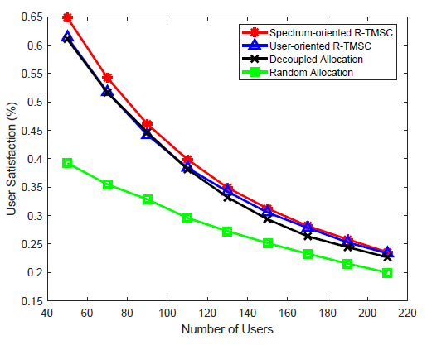
Simulation Results
  The proposed algorithm is evaluated through MATLAB simulations
    R = 800 m, K = 20 spectrum bands, N = 5 infrastructures, M = [50, 210] users
    Capacity: 44 Mbps (infrastructure), 11 Mbps (spectrum), Min. SINR: 25 dB
  Spectrum-oriented R-TMSC outperforms the centralized approach
User throughput improved
User satisfaction improved

Slide 17
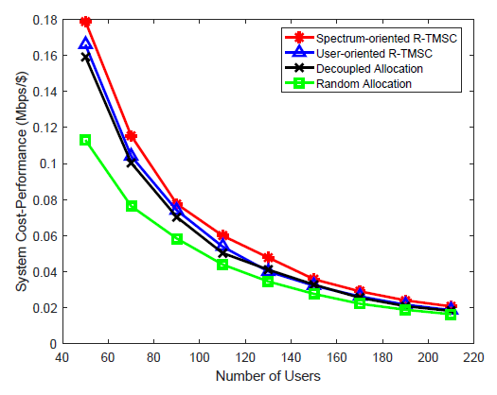
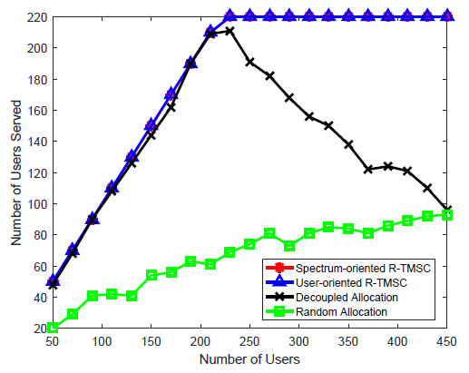
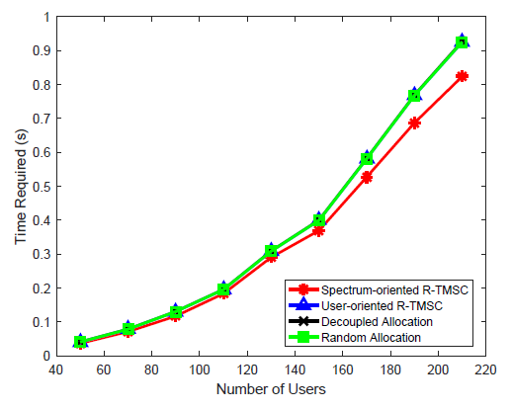
Simulation Results
  Proposed algorithms serve more users than other approaches
System cost-performance enhanced
More number of users served
Algorithm run time reduced

Slide 18
b) Network Function Virtualization (NFV)
  One of the prime enablers of 5G networks
  Decouples physical network infrastructure from the network functions that run on top of it
  Mobile network components virtualized and placed as software components on virtualization platform
  Maximizes network resource utilization and minimizes service costs
Disintegrate
Host
Wireless services in Tracking Areas (TAs)
Set of Virtual Network Functions (VNFs)
Software on Cloud Networks (CNs)

Slide 19
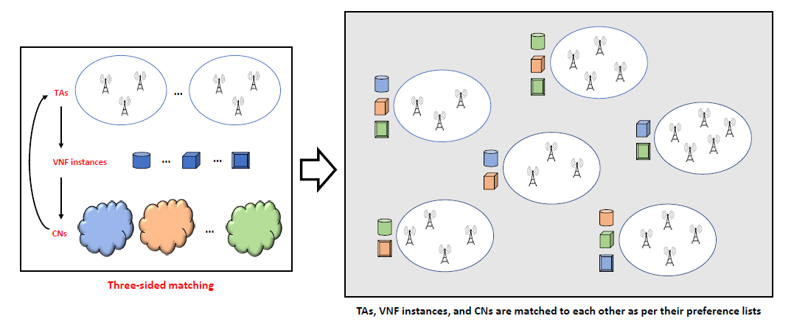



R-TMSC for NFV in 5G Core Network
VNF instances in the ascending order of service costs
CNs in the descending order of the offered QoS
Tie with all TAs ranked the same

Slide 20
2. Fog Computing

Slide 21
Fog Nodes (FNs)
  Data Service Operators (DSOs) provide efficient services to the Authorized Data Service Subscribers (ADSSs)
    Small-scale flexible computing devices deployed close to the ADSSs
    Low latency due to proximity
  NFV integrated fog computing
    Resource requirements of ADSSs as per VNFs initiated to serve them
    DSOs allocate computing resources from FNs to ADSSs accordingly
  Traditional: Centralized management by NFV Orchestrator (NFVO)
  Proposed: Distributed allocation considering DSOs, ADSSs, and FNs

Slide 22
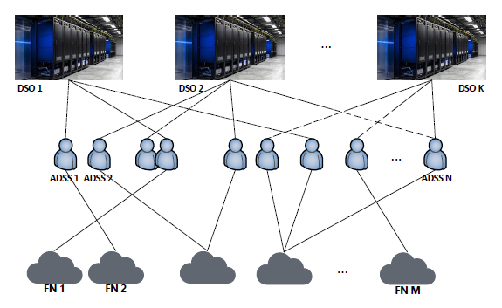
System Model
  DSOs allocate Computing Resource Blocks (CRBs) from FNs to ADSSs
    Competition among all DSOs for providing services to maximize profits
    Competition among all ADSSs for purchasing resources to minimize costs
    DSOs have preferences on FNs, FNs need to meet VNF needs of ADSSs
IoT fog computing scenario with K DSOs, N ADSSs, and M FNs

Slide 23
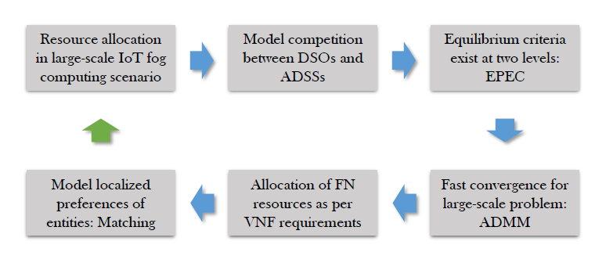
System Model
  Need distributed algorithms
    Model the competition between DSOs and ADSSs
    Allocate FN resources to meet VNF requirements of ADSSs

Slide 24
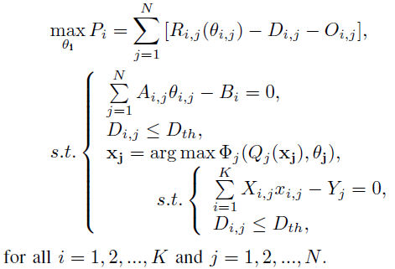
a) EPEC Optimization
  Equilibrium Problem with Equilibrium Constraints (EPEC)
    Hierarchical optimization problem with equilibrium criteria at both levels
    Represents the competition between both sets of entities
    DSOs provide incentives to the ADSSs to control competition
    Need a model for large scale fog network optimization
Revenue optimization for DSOs
Revenue optimization for ADSSs

Slide 25
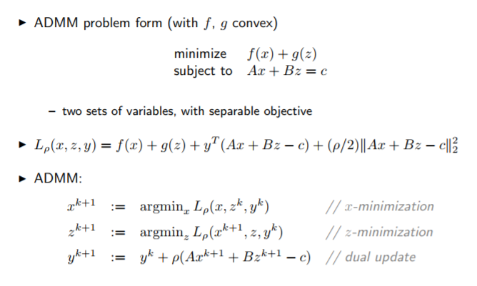
a) ADMM for Large-scale Problem
  Alternating Direction Method of Multipliers (ADMM)
    Well-suited for large-scale fog scenario with conflicting objectives
    Fast convergence when objective function is convex
Optimization problem of this form
Augmented Lagrangian

Slide 26
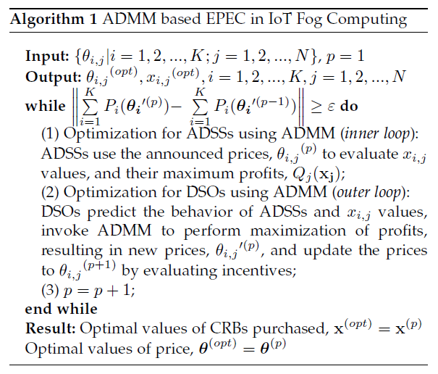
a) ADMM for EPEC in Fog Computing
  Outer loop terminates when total profit of DSOs converges
  Optimal resource prices for DSOs and optimal amounts of resources to be purchased by ADSSs are obtained
Optimization for ADSSs using the announced CRB prices from DSOs
Optimization for DSOs using the number of CRBs to be purchased by ADSSs

Slide 27
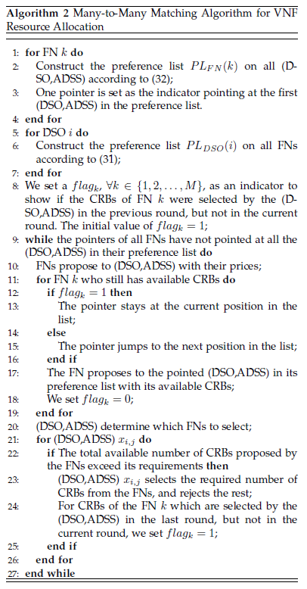


b) Matching for Allocation of FN Resources
  DSOs need to allocate FN resources to ADSSs using optimal values
    CRBs to be purchased by ADSSs (VNF demands)
  DSOs and FNs have preferences on each other
  Many-to-many matching as per capacity constraints of FNs
FNs in the ascending order of CRB prices
(DSO, ADSS)s in the descending order of CRB requirement

Slide 28
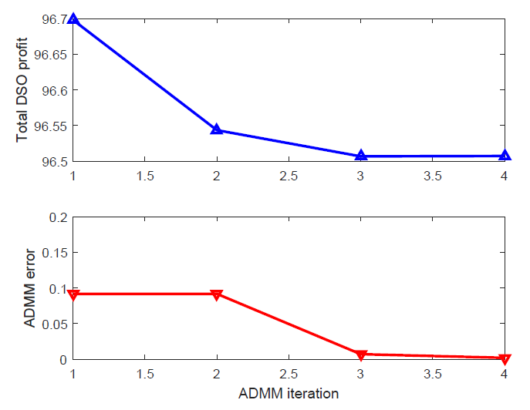
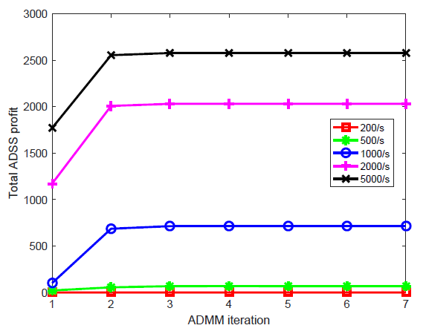
Simulation Results
  The proposed algorithm is evaluated through MATLAB simulations
    R = 1 km, K = 5 DSOs, N = 20 ADSSs, M = 25 FNs
    ADSS workload arrival: Poisson distributed with mean = 1000 /s
DSO profit and ADMM error converge
ADSS profit converges, increases with workload

Slide 29
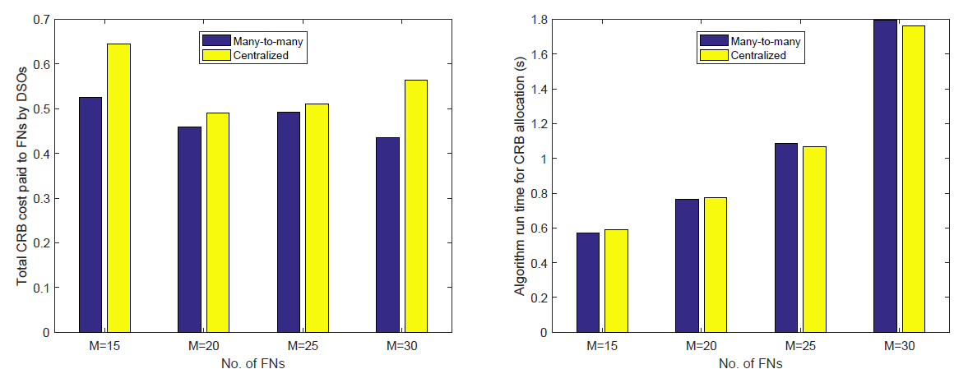
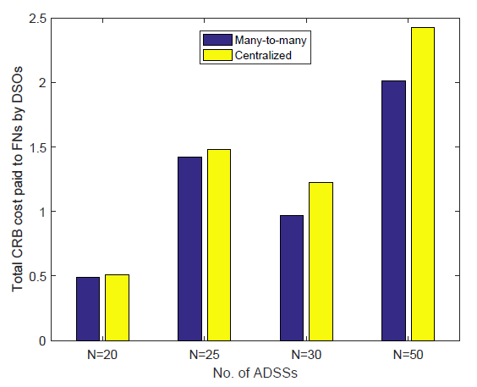
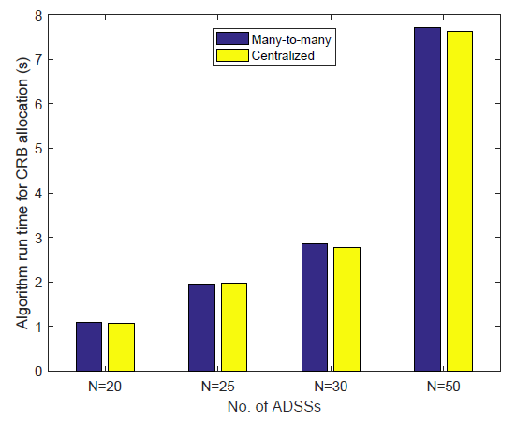
Simulation Results
Total CRB cost paid to FNs is lesser in proposed method
Not much difference in run time since distributed method
When M and N values are not close, difference is more
Difference increases with no. of entities

Slide 30
3. Heterogeneous Networks

Slide 31
VLC-D2D Heterogeneous Network
  RF spectrum crunch triggers harnessing of other bandwidth sources
  Visible Light Communication (VLC)
    High capacity due to vast bandwidth, but limited coverage
  Device-to-Device (D2D) communication
    Mobile devices transmit data directly between each other
  VLC-D2D heterogeneous network to increase capacity and coverage
  Data transmission routes from VLC transmitters to end mobile devices
    Traditional: Centralized calculation by VLC Service Provider (VLCSP)
    Proposed: Distributed method with D2D revenue optimization

Slide 32
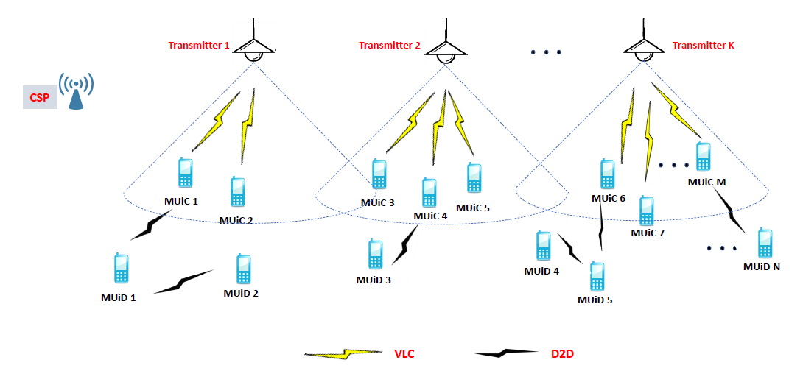
System Model
  Data transmission environment for VLC-D2D highly dynamic
  Centralized solution feasible for VLCSP and mobile devices difficult
  Need optimal distributed routing for stochastic environment
Indoor downlink scenario with K VLC transmitters of a VLCSP, a CSP, and T mobile users
Mobile Users as Relays (MUaRs): M Mobile Users in Coverage area (MUiCs), and N Mobile Users in Darkness (MUiDs)

Slide 33
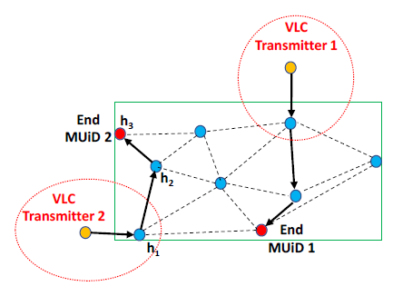
Multi-hop Data Transmission Route
  Dynamic and unpredictable environment
  Reinforcement Learning (RL) helps learn behavior through trial-and-error interactions
    Model-free method
  RL based route determination
    Distributed method based on local information
  Q-learning
    Direct and popular RL method
We need to find an L-hop route for the data transmission from the VLC transmitter to the end MUiD

Slide 34
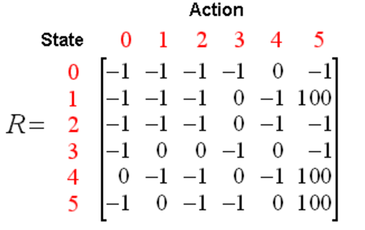
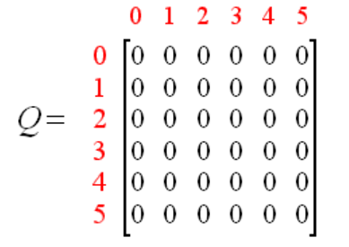
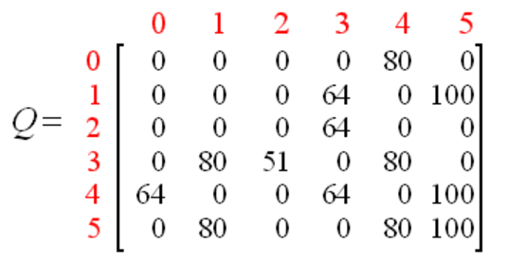
Q-Learning for Route Determination
  Agent: Transmitted data from a VLC transmitter to an end MUiD
  State: Current positions of all the transmitted data
  Action: Transmission direction of the agent
  Reward: Payoff obtained by performing an action from a state

Slide 35
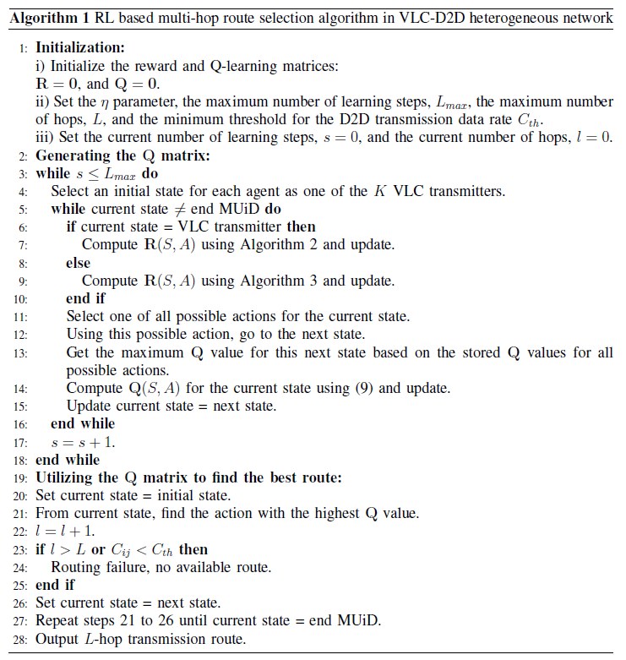
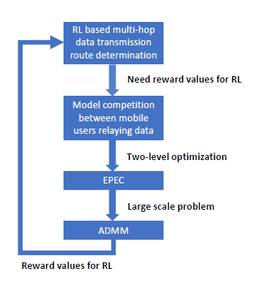
RL Based Route Selection Algorithm

Slide 36
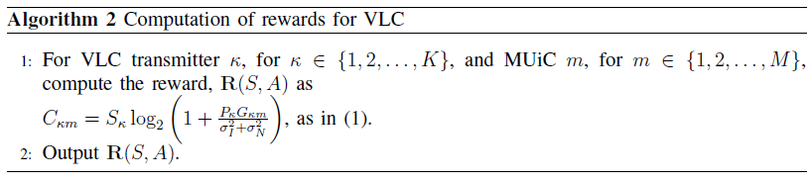
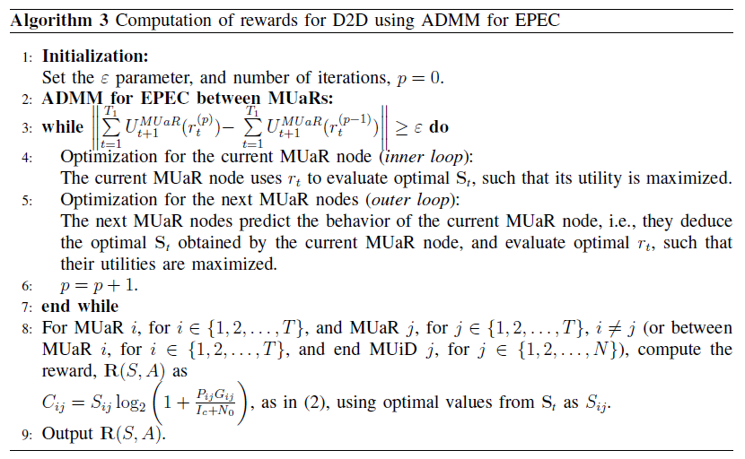
Computation of Rewards for RL
To compute rewards for RL when current state is VLC transmitter
Rewards computed using capacity equation
To compute rewards for RL when current state is MUaR
Rewards computed from bandwidth values obtained using ADMM

Slide 37
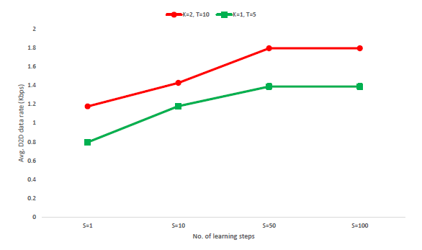
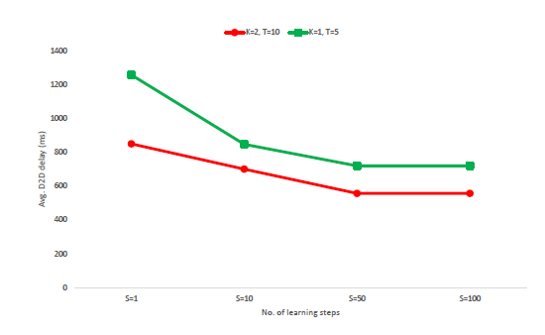
Simulation Results
  The proposed algorithm is evaluated through MATLAB simulations
    5 m x 5 m room, VLC spectrum: 1 GHz, Power: 1 W, User power: 300 mW
    Max. hops: 3, Max. learning steps: [1, 100], Discount factor: [0.3, 0.8]
  RL increases data rate and decreases delay for D2D transmission
Avg. D2D data rate increased
Avg. D2D delay decreased

Slide 38
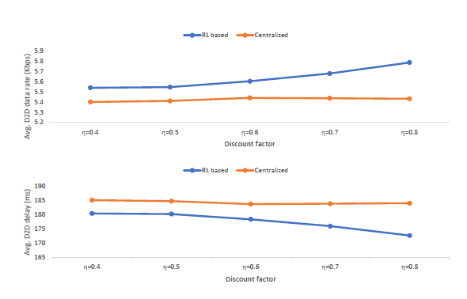
Simulation Results
  Avg. D2D data rate increases and delay decreases with increase in discount factor
No change for centralized route calculation by VLCSP
Better performance with emphasis on future rewards

Slide 39
4. Spectrum Sharing

Slide 40
Cognitive Radio Network (CRN)
  Intelligent network allowing dynamic configuration of parameters
    Communication protocol, frequency band, modulation scheme, etc.
  Enables Dynamic Spectrum Access (DSA) for efficient spectrum use
    Unlicensed or Secondary Users (SUs) constantly sense spectrum used by licensed or Primary Users (PUs), to detect and utilize unused bands
    The bands are vacated by SUs upon sensing the presence of PU signals
  Exploited by Primary User Emulation (PUE) attackers
    Mislead SUs into leaving the spectrum by emulating PU signals
  Need to detect PUE attacks to ensure efficient spectrum utilization

Slide 41
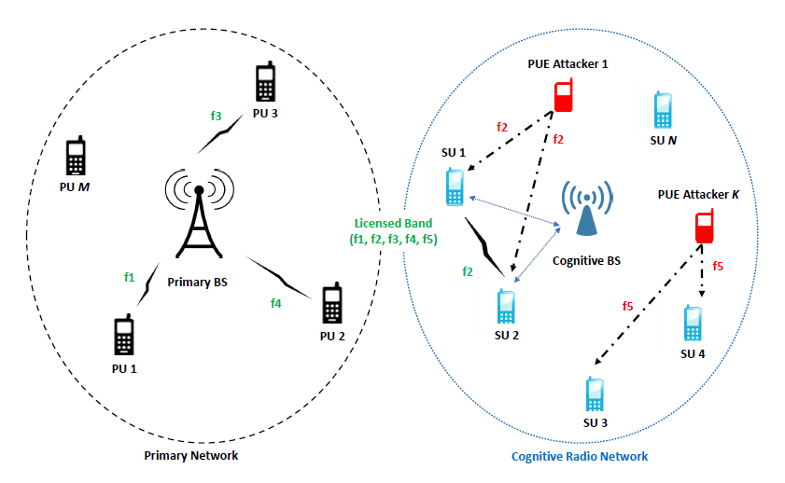
System Model
  Primary BS communicates with PUs using licensed channels f1-f5
  Cognitive BS senses spectrum, allocates unused channels to SUs
f2 and f5 to be sensed but are emulated by PUE attackers
f1, f3, and f4 are occupied

Slide 42
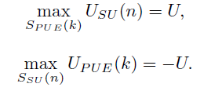
Two-player Zero-sum Game
  PUE attackers jeopardize spectrum opportunities of SUs by emulating PU signals
    Noncooperative game between PUE attackers and SUs
  Spectrum gain for attackers = spectrum loss for SUs and vice versa
    Two-player zero-sum game
    Nash equilibrium solution is the minimax solution
  Need to successfully detect attacks to maximize U and let SUs win
Max payoff for SU n given PUE attacker k’s strategy
Max payoff for PUE attacker k given SU n’s strategy

Slide 43
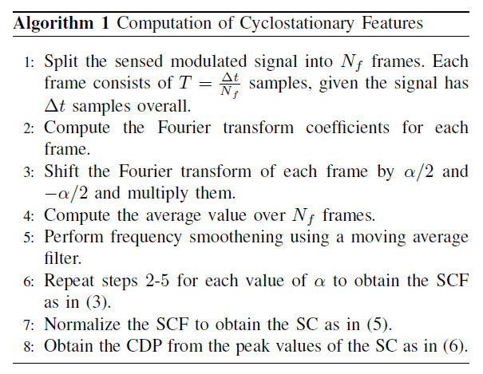



Cyclostationary Feature Computation
Spectral Correlation Function (SCF)
Describes the cross-spectral density of all pairs of frequency-shifted versions
  Signal features of only PUs known
    Detect PUE attackers based on different signal features
Spectral Coherence (SC)
Normalized form of SCF
Cyclic Domain Profile (CDP)
Max SC for each α value

Slide 44
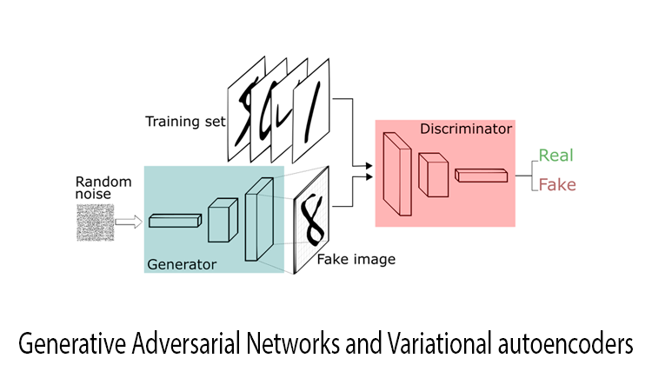
GAN for Classification
  Promising candidate for feature based classification: Deep learning
  Potential network for limited data: Generative Adversarial Network (GAN)
  Two deep learning networks competing against each other
    Discriminator (D) and Generator (G)
  Easier to train version of GAN: Wasserstein GAN (WGAN)
D tries to discriminate between samples from data and model distributions
G tries to ‘trick’ D by generating hard to discriminate samples

Slide 45
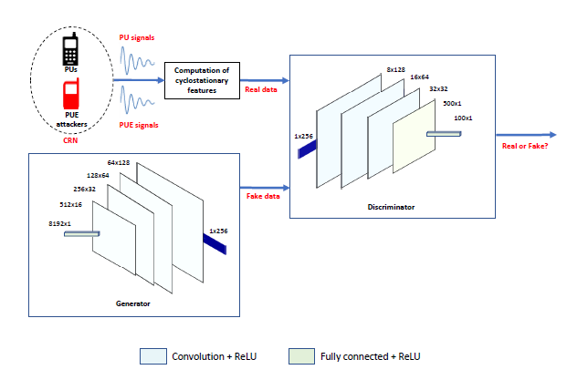
Proposed WGAN Architecture
  Convolutional Neural Networks (CNNs) as G and D in WGAN
    The CDP plot values from Algorithm 1 serve as inputs for classification

Slide 46
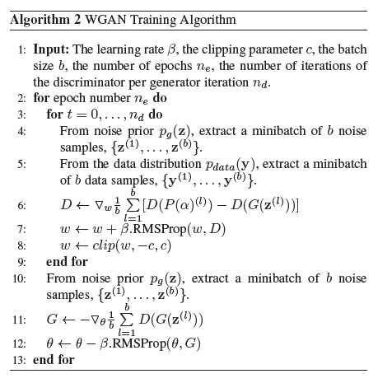
WGAN Training
  RMSProp optimizer to divide learning rate by running average of recent gradients
Discriminator training
Generator training

Slide 47
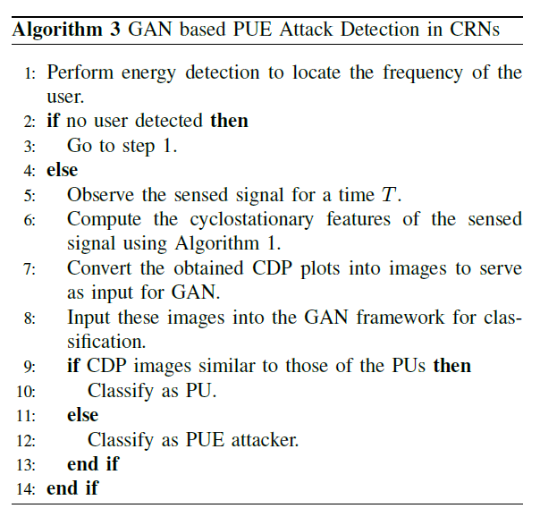
WGAN Based PUE Attack Detection
Energy detection to locate user frequency
Computation of cyclostationary features to find CDP values
Input CDP values into GAN for classification
Classify as PU or PUE attacker

Slide 48
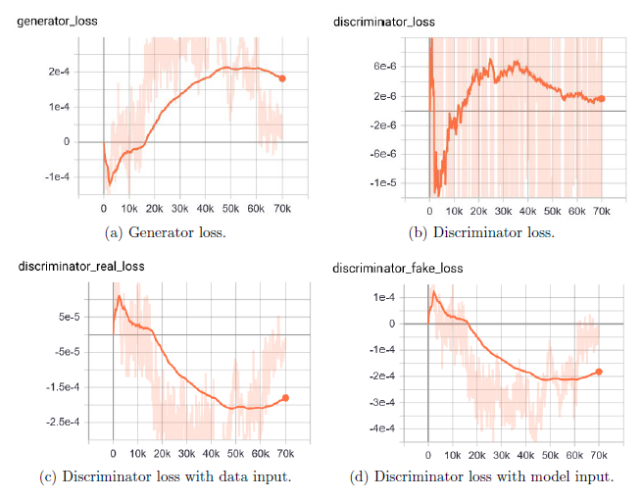
Simulation Results
  Algorithm 1 – MATLAB, Algorithms 2 & 3 – Python (Tensorflow)
Training dataset (22000 samples)
β = 0.00005
c = 0.01
5 D per G
256 features 22 per batch
70 epochs
Losses converging, training effective

Slide 49
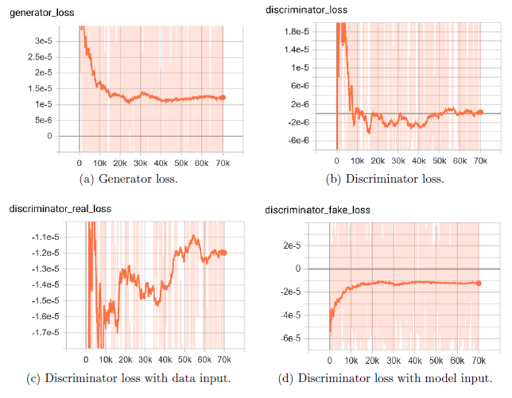
Simulation Results
Testing dataset (2000 samples)
β = 0.00005
c = 0.01
5 D per G
256 features
2 per batch
70 epochs
Losses converging, classification effective

Slide 50



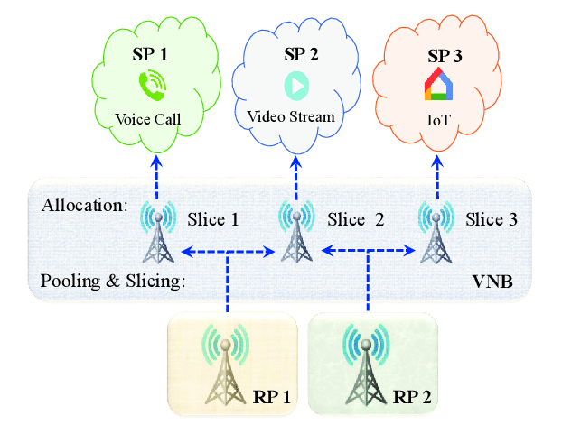
Conclusions
Existing
Network virtualization
Proposed
Users
Users
(SPs)
Spectrum slices
Spectrum & Infrastructure slices (MVNOs)
Infrastructure slices
Higher throughput and more users served
More flexibility to user requirements due to three-sided model

Slide 51



Conclusions
Existing
Fog computing
Proposed
CRB prices (DSOs)
Optimal CRB prices
No. of CRBs (ADSSs)
Optimal no. of CRBs
FN CRBs (NFVOs)
FN CRBs
Revenue optimized for both DSOs and ADSSs
Lower FN resource cost achieved

Slide 52

Conclusions
Existing
Heterogeneous networks
Proposed
RL
VLCSP calculation
ADMM for EPEC
Revenue optimization for D2D users
Higher average data rate and lower delay

Slide 53

Conclusions
Existing
Spectrum sharing
Proposed
Cyclostationarity based methods
Cyclostationarity based GAN classifier
Better attack detection due to signal feature learning by GAN
Data augmentation for limited samples

Slide 54

Future Research Directions
User mobility in wireless network virtualization
  Need to update preference lists more frequently
  Execute R-TMSC algorithm repeatedly
  Algorithms like Roth-Vande Vate (RVV)
  (Sequence of matchings, each obtained from previous, satisfying a blocking pair)
Infrastructures in the descending order of the offered QoS

Slide 55

Future Research Directions
Diverse requirements of IoT fog computing
  FN preference lists: CRB requirements of VNF instances
  Demand patterns of VNF instances can be studied as per use cases
  Use in further reducing CRB cost paid to FNs
(DSO, ADSS)s in the descending order of CRB requirement

Slide 56
Publications
Book Chapters
N. Raveendran, K. Bian, L. Song, and Z. Han, “A Social Choice Theoretic Approach for Analyzing User Behavior in Online Streaming Mobile Applications,” Game Theory for Networking Applications, EAI/Springer, editors: Ju Bin Song, Husheng Li, and Marceau Coupechoux, 2019.
Transactions Publications
N. Raveendran, S. Ahmadian, G. Xue, C. S. Hong, L.-C. Wang, and Z. Han, “Defending Primary User Emulation Attacks in Cognitive Radio Networks by Generative Adversarial Networks,” submitted to IEEE Transactions on Mobile Computing.
N. Raveendran, H. Zhang, L. Song, L.-C. Wang, C. S. Hong, and Z. Han, “Pricing and Resource Allocation Optimization for IoT Fog Computing and NFV: An EPEC and Matching Based Perspective,” submitted to IEEE Transactions on Mobile Computing.
N. Raveendran, Y. Gu, C. Jiang, N. H. Tran, M. Pan, L. Song, and Z. Han, “Cyclic Three-Sided Matching Game Inspired Wireless Network Virtualization,” IEEE Transactions on Mobile Computing, DOI 10.1109/TMC.2019.2947522.
N. Raveendran, H. Zhang, D. Niyato, F. Yang, J. Song, and Z. Han, “VLC and D2D Heterogeneous Network Optimization: Equilibrium Problem with Equilibrium Constraints and Learning Approaches,” IEEE Transactions on Wireless Communications, vol. 18, no. 2, pp. 1115-1127, February 2019.
Conference Publications
N. Raveendran, Y. Zha, Y. Zhang, X. Liu, and Z. Han, “5G Virtual Core Resource Allocation for Cloud Gaming: A Three-Sided Matching and Reinforcement Learning Perspective,” submitted to IEEE Conference on Computer Communications (INFOCOM), Beijing, China, April 2020.
N. Raveendran, Y. Zha, Y. Zhang, X. Liu, and Z. Han, “Virtual Core Network Resource Allocation in 5G Systems using Three-Sided Matching,” IEEE International Conference on Communications (ICC), Shanghai, China, May 2019.
N. Raveendran, K. Bian, L. Song, and Z. Han, “A Social Choice Theoretic Approach for Analyzing User Behavior in Online Streaming Mobile Applications,” invited, 8th EAI International Conference on Game Theory for Networks (GameNets), Seoul, South Korea, May 2018.
N. Raveendran, H. Zhang, Z. Zheng, L. Song, and Z. Han, “Large-Scale Fog Computing Optimization using Equilibrium Problem with Equilibrium Constraints,” IEEE Global Communications Conference (Globecom), Singapore, December 2017.

Slide 57
Neetu Raveendran nraveendran@uh.edu
Thank you!

