Slide 1
Ph.D. Dissertation Defense
Applied Machine Learning with Latent Space Representation and Manipulation
Xunsheng Du
Advisor: Dr. Zhu Han
University of Houston
Electrical and Computer Engineering Department
Date: 07/30/2020

Slide 2
Introduction
  Machine Learning (ML) Basics
  Latent Space Basics
  Latent Space Manipulation
    Invasive Grass Detection for Environment Protection
    Unexploited Seismic Data Inversion
  Latent Space Representation
    Real-Time Monitoring of Cutting Volume in Drilling and Borehole Cleaning
    Virtual Relay Selection in V2V networks
Future Works
Conclusions

Slide 3
Introduction
  Machine Learning (ML) Basics
  Latent Space Basics
  Latent Space Manipulation
    Invasive Grass Detection for Environment Protection
    Unexploited Seismic Data Inversion
  Latent Space Representation
    Real-Time Monitoring of Cutting Volume in Drilling and Borehole Cleaning
    Virtual Relay Selection in V2V networks
Future Works
Conclusions

Slide 4
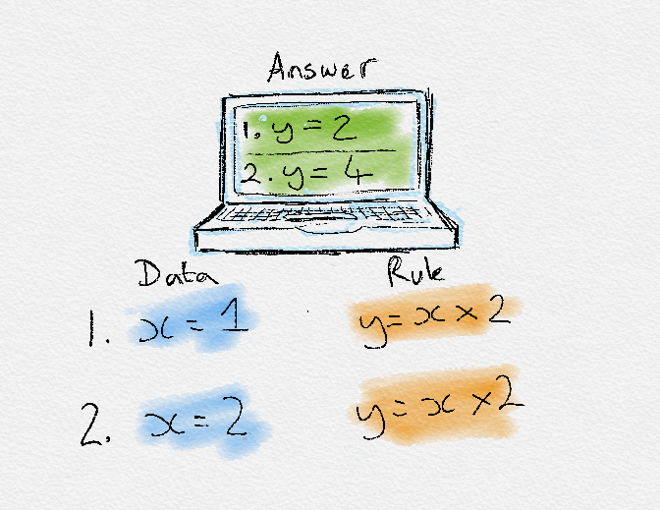
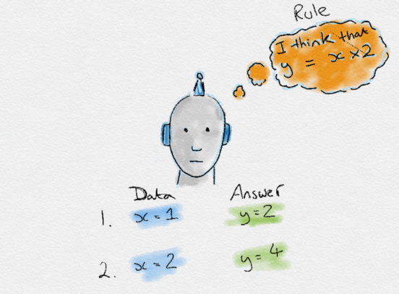
Traditional Programming
Why ML:
vs
Machine Learning
Given rule and input, get output
Given input and output, get rule
Notes:
Machine learning is a computation algorithm that doesn’t need to be explicitly programmed
Ml advantage makes it intelligent

Slide 5
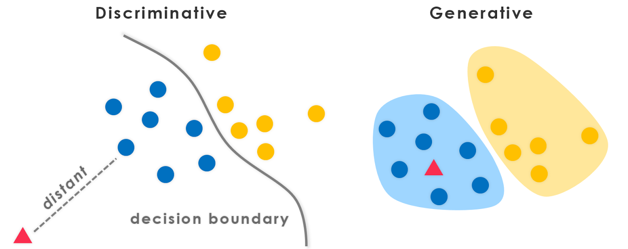
From the application point of view, ML can be classified into:
vs

Slide 6
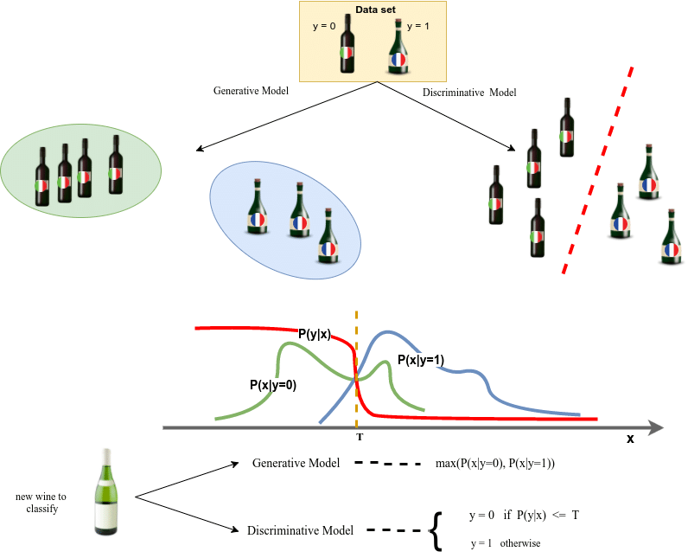
ML not only judges but also creates:
figure cited: Kaplan, Sinan. (2017). “DEEP GENERATIVE MODELS FOR SYNTHETIC RETINAL IMAGE GENERATION.” Thesis
Notes:
Discriminative model: conditional probability
Generative model: joint probability first then Bayes rule to calculate p(y|x)
GAN optimize in a way that the discriminator try his best to distinguish the real and fake data while the generator try his best generate fake data looks pretty real to fool the discriminator.

Slide 7
Introduction
  Machine Learning (ML) Basics
  Latent Space Basics
  Latent Space Manipulation
    Invasive Grass Detection for Environment Protection
    Unexploited Seismic Data Inversion
  Latent Space Representation
    Real-Time Monitoring of Cutting Volume in Drilling and Borehole Cleaning
    Virtual Relay Selection in V2V networks
Future Works
Conclusions

Slide 8
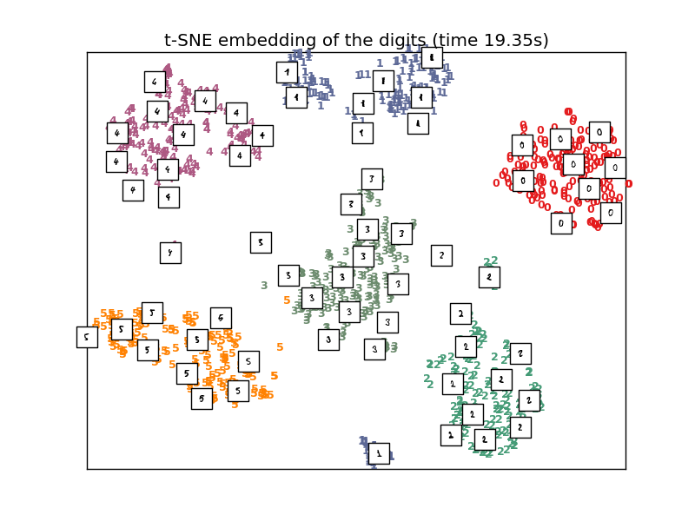
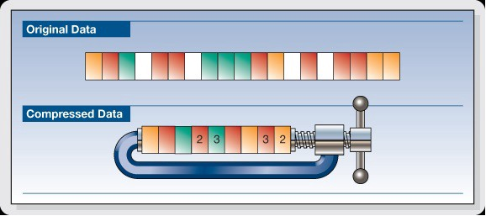
What is latent space?
In short, latent space is a representation of compressed data.

Slide 9
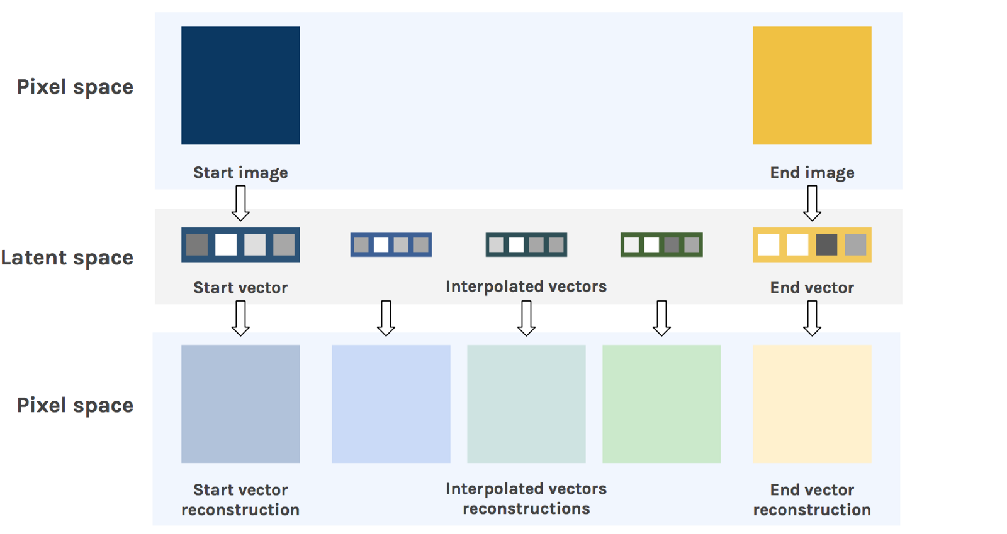
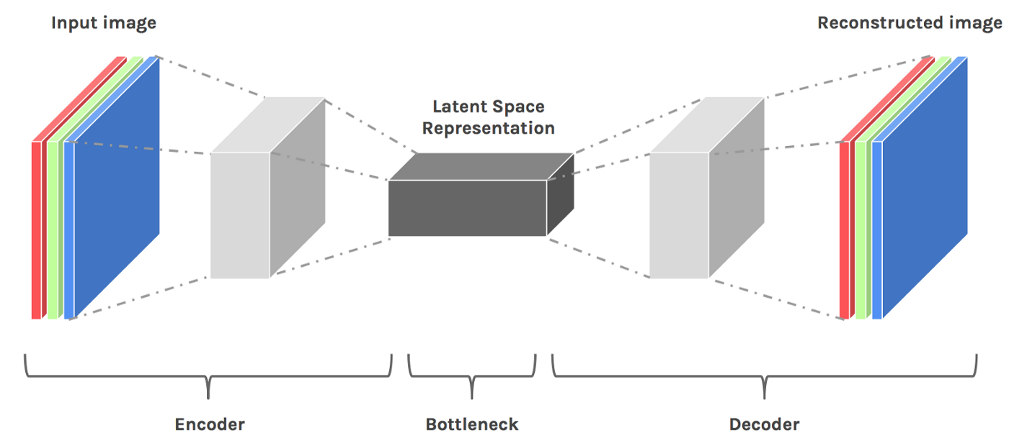

Why latent space? --- Latent Space Representation
1. Provide insightful statistics inside data
2. Serves as feature for downstream ML
application
The autoencoder stores important information for reconstructing input in latent space.

Slide 10
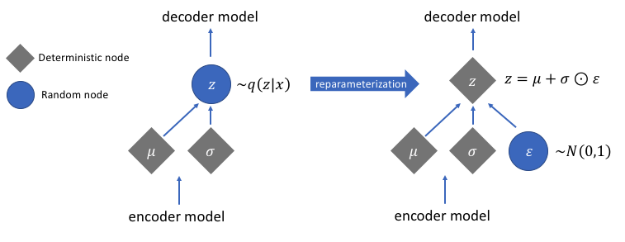
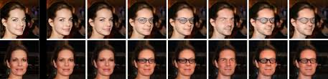
Why latent space? --- Latent Space Manipulation
variational autoencoder
Variational autoencoder “wear glasses” for original input by vector arithmetic
Reveal the statistics of the input which we can easily understand
Manipulate the output reconstruction as what we want
Notes:
Variational autoencoder: “variational” means how we treat the latent space. Traditionally, the latent space of the autoencoder is just a group neural networks parameters. In VAE, we want reparameterize into something that have explicit statistic meaning of the data samples for example mean, and variance. We set a prior to say that the latent space follow a certain distribution, such as normal distribution. In this way, we can manipulate the latent space by manually play with the statistics of the data.
Vector arithmetic: train the networks twice. First time without glasses, Second time with glasses, then add the difference

Slide 11
Introduction
  Machine Learning (ML) Basics
  Latent Space Basics
  Latent Space Manipulation
    Invasive Grass Detection for Environment Protection
    Unexploited Seismic Data Inversion
  Latent Space Representation
    Real-Time Monitoring of Cutting Volume in Drilling and Borehole Cleaning
    Virtual Relay Selection in V2V networks
Future Works
Conclusions

Slide 12

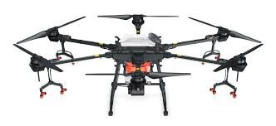
Problem Description:
Data set provided by Chevron Corporation
Detect and pinpoint invasive grass on vast background grassland. Images are taken by UAV over national parks
Notes:
Detect and pinpoint invasive grass on vast background grassland on images taken by UAV over national parks. The dataset is provided by Chevron Corporation and already sent for patent application.

Slide 13
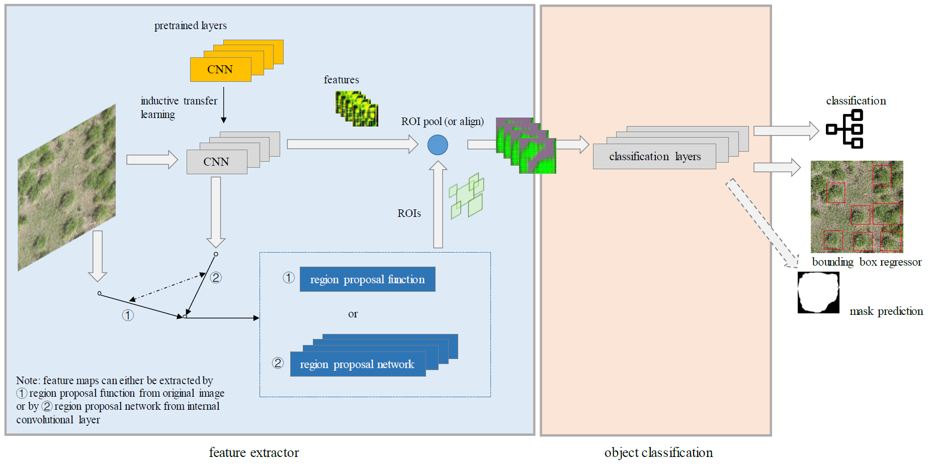
Start from Deep Learning-based Object Detection:
Proposed solution pipeline:
traditional methods (baseline)
Data Augmentation
Object Detection
Transfer Learning
synthesis by generative models (proposed)
implemented by Tensorflow API
learning from the checkpoint of other pre-trained models on other datasets. e.g., COCO^{[1]} dataset
Challenge:
Small data volume
Hard to distinguish from the background vegetation
[1] COCO is a large-scale object detection, segmentation, and captioning dataset.

Slide 14






Data Augmentation:
Traditional approach
Synthesis by generative models
Flip
Real Distribution
Rotation
Scale
training data sample
testing data sample
Crop
missing (or uncertain) data sample
Add noise
Synthetic Distribution
“Highly Relied on Original Data”

Slide 15
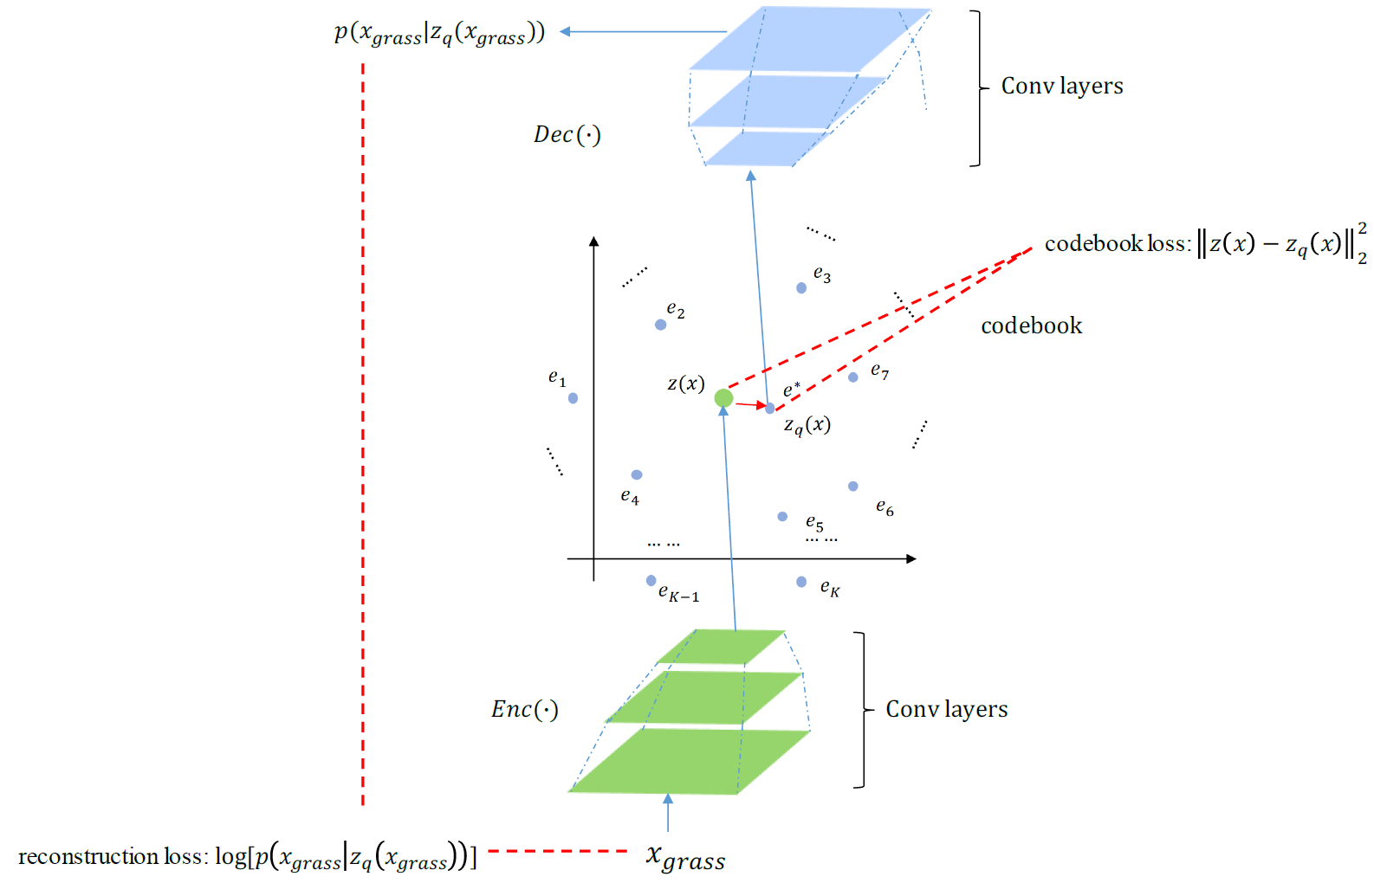
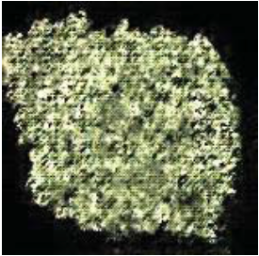
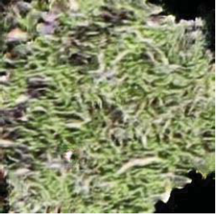
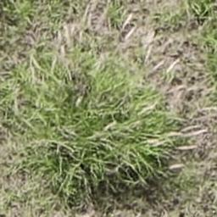
High-fidelity Grass Synthesis:
convert continuous latent space to discrete latent space
GAN:
Wasserstein GAN:
VQ-VAE:
Vector Quantised Variational AutoEncoder (VQ-VAE)

Slide 16
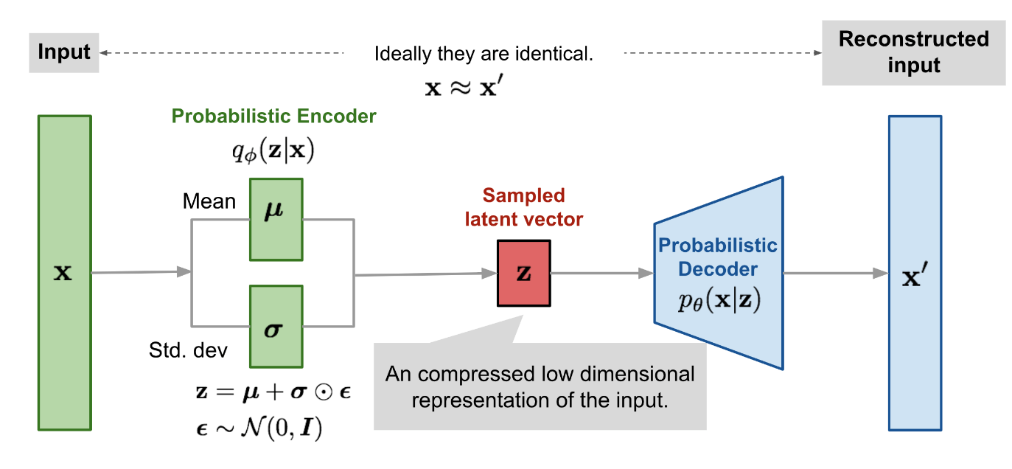
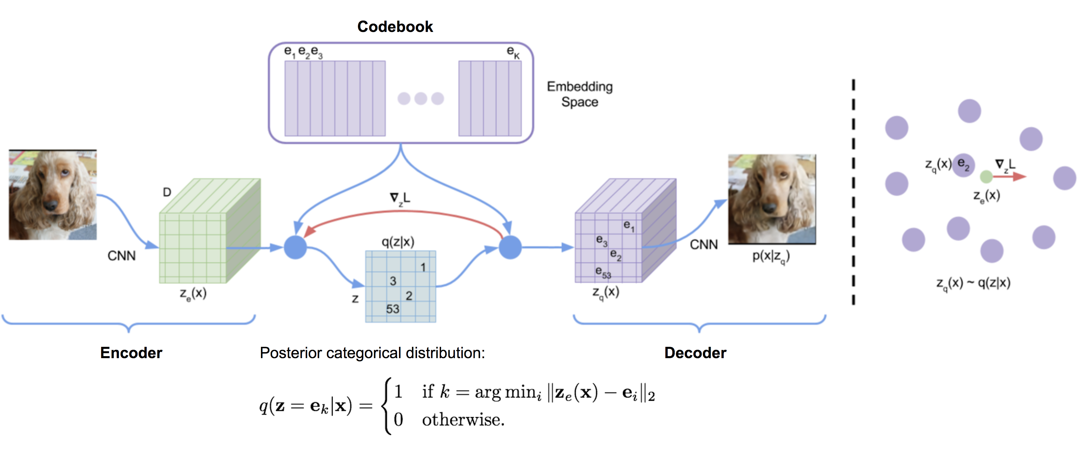
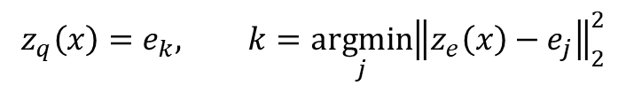

Why “Discrete” works here: compared with beta VAE
Continuous
Discrete embedding contains more statistics than a continuous latent representation
Solve posterior collapse problem
Discrete
Discrete embedding mapping:
$$z_{q}\left(x\right)=e_{k}, k=\underset{j}{argmin}{{\left\|z_{e}\left(x\right)−e_{j}\right\|}_{2}^{2}}$$
Total loss:
$$L=\log{p\left(x | z_{q}\left(x\right)\right)+{\left\|sg\left[z_{e}\left(x\right)\right]−e\right\|}_{2}^{2}+β{\left\|z_{e}\left(x\right)−sg\left[e\right]\right\|}_{2}^{2}}$$
$sg\left[∙\right]$ is the stop gradient operation

Slide 17
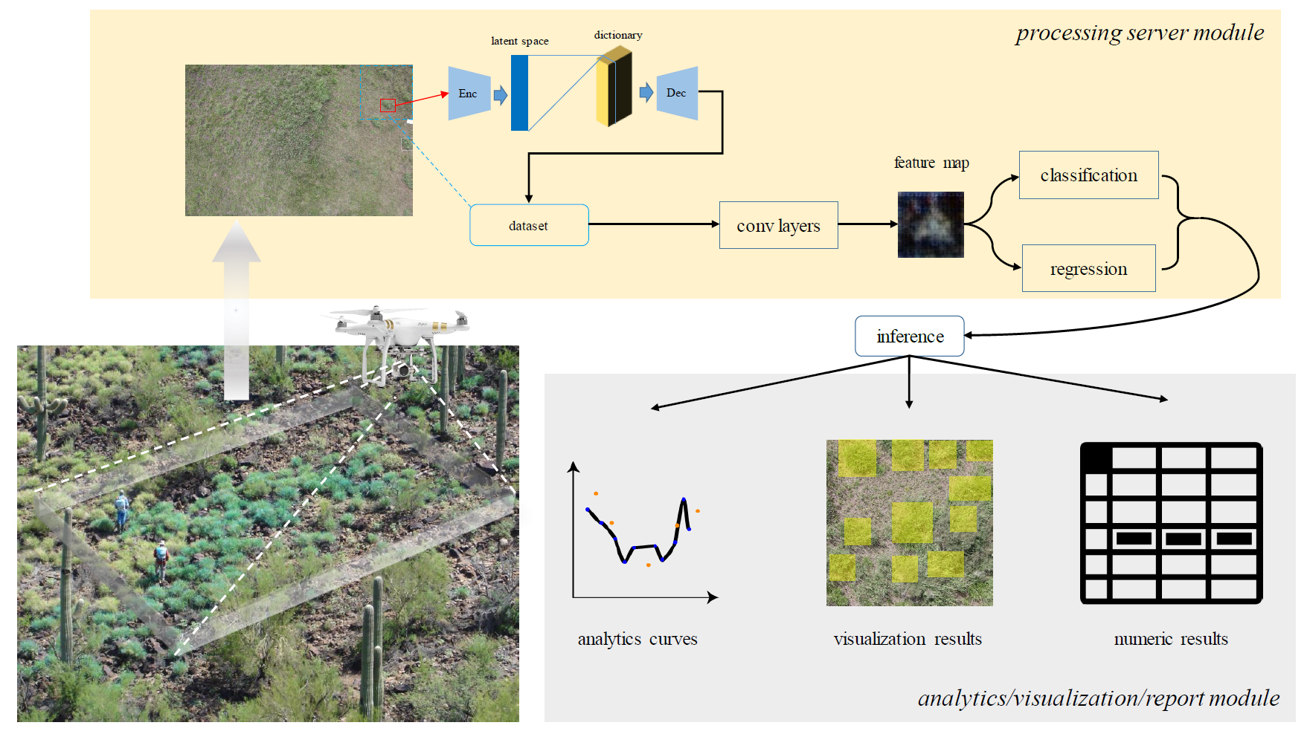
Overall Solution:

Slide 18
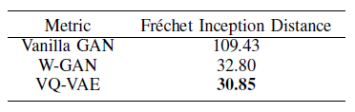
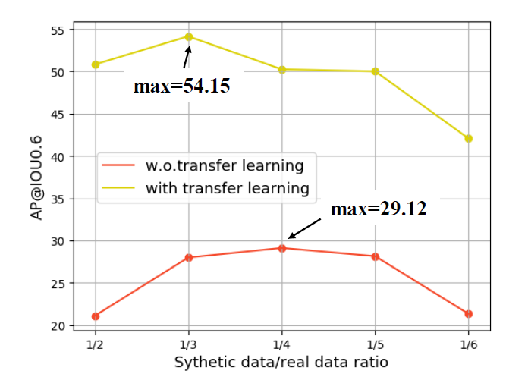
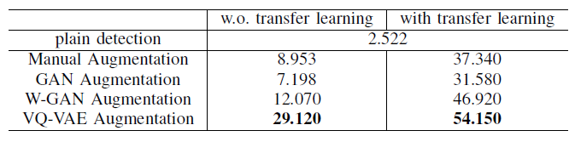
Performance Evaluation:
Synthesis results:
Blending different ratios of synthetic images for detection
Testing results
AP^{[1]}@IOU^{[2]}0.6
[1] AP is the abbreviation for average precision which computes the average precision value for recall value over 0 to 1.
[2] IOU stands for intersection over union, e.g., IOU0.6 means 60% or more overlapping will determine a detected object

Slide 19
Introduction
  Machine Learning (ML) Basics
  Latent Space Basics
  Latent Space Manipulation
    Invasive Grass Detection for Environment Protection
    Unexploited Seismic Data Inversion
  Latent Space Representation
    Real-Time Monitoring of Cutting Volume in Drilling and Borehole Cleaning
    Virtual Relay Selection in V2V networks
Future Works
Conclusions

Slide 20
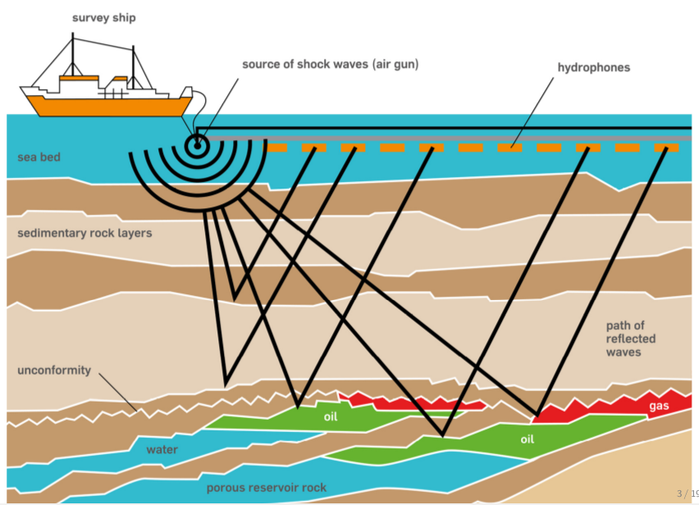
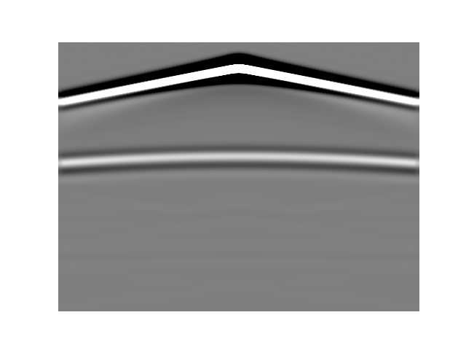

Problem description
measurements
forward
inversion
velocity map
Notes:
Seismic inversion problem is using seismic measurement to infer the subsurface model.

Slide 21
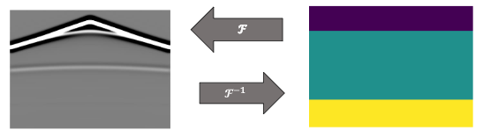
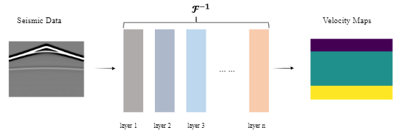
Data-Driven Approach:
Data-Driven Inversion
Deep Networks-Based Inversion

Slide 22
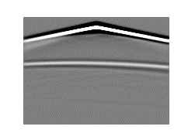

Adaptation to Unexploited Seismic Data: the Challenge
problem proposed and
justified by Chevron
bad performance
catastrophic forget
reuse ?
or
retrained ?
unexploited data
black box

Slide 23
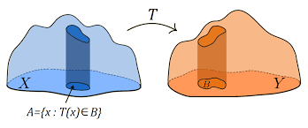
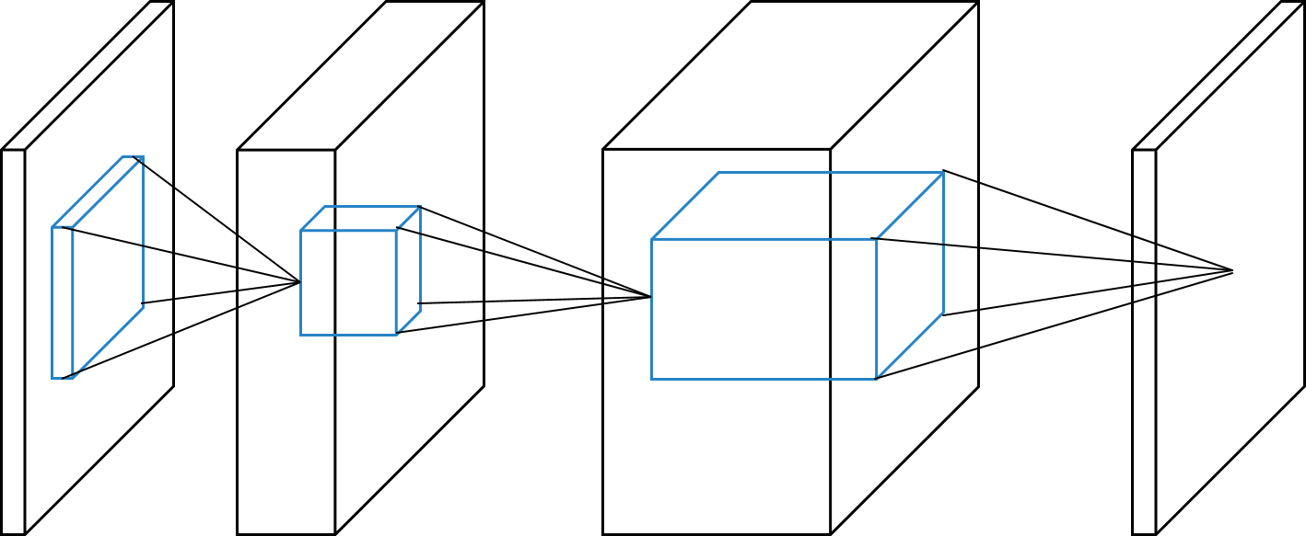





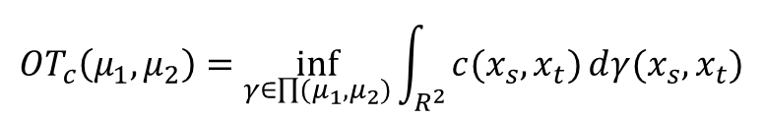
Applied Optimal Transport (OT) to mitigate adaptation gap
$${OT}_{c}\left(μ_{1},μ_{2}\right)=\inf_{γ∈\prod{(μ_{1},μ_{2})}}{\int_{R^{2}}{c(x_{s},x_{t})ⅆγ(x_{s},x_{t})}}$$
Basic OT formulation
transport cost
transport plan
Joint Distribution OT formulation (JDOT), replace cost $c(x_{s},x_{t})$ with
$$d\left(x_{i}^{s},y_{i}^{s};x_{j}^{t},y_{j}^{t}\right)=αc\left(x_{i}^{s},x_{j}^{t}\right)+λL(y_{i}^{s},y_{j}^{t})$$
distance in feature space
distance in label space
$$\min_{γ∈\prod{\left(μ_{1},μ_{2}\right)},f,g}{\sum_{i}{\sum_{j}{γ_{ij}}}}d\left(g(x_{i}^{s}),y_{i}^{s};{g(x}_{j}^{t}),f(g(x_{j}^{t})) \right)$$
JDOT with Deep Learning formulation
surrogate of
$g$:
$f$:
$$y_{j}^{t}$$
latent space
Avoid two-steps adaptation
feature extractor
classifier

Slide 24
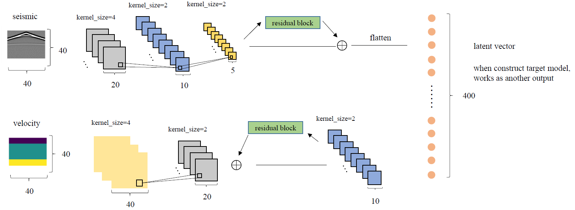
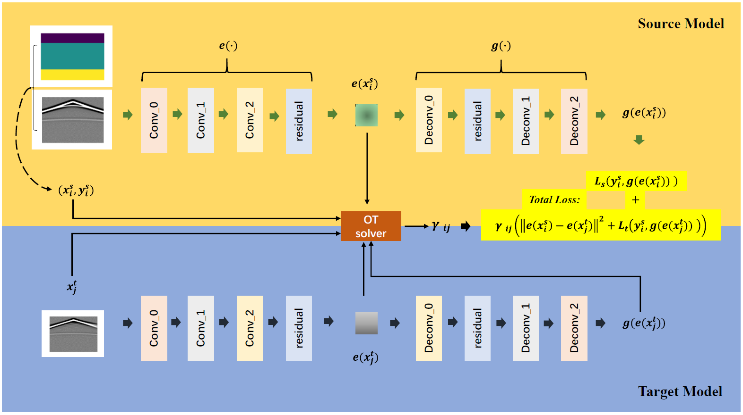
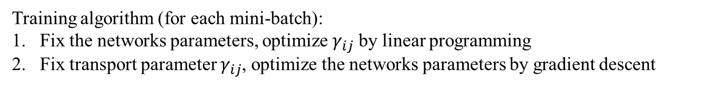
Training algorithm (for each mini-batch):
Fix the networks parameters, optimize $γ_{ij}$ by linear programming
Fix transport parameter $γ_{ij}$, optimize the networks parameters by gradient descent
put latent space into the loss function for aligning two domains
Encoder-Decoder Networks
Overall Framework

Slide 25
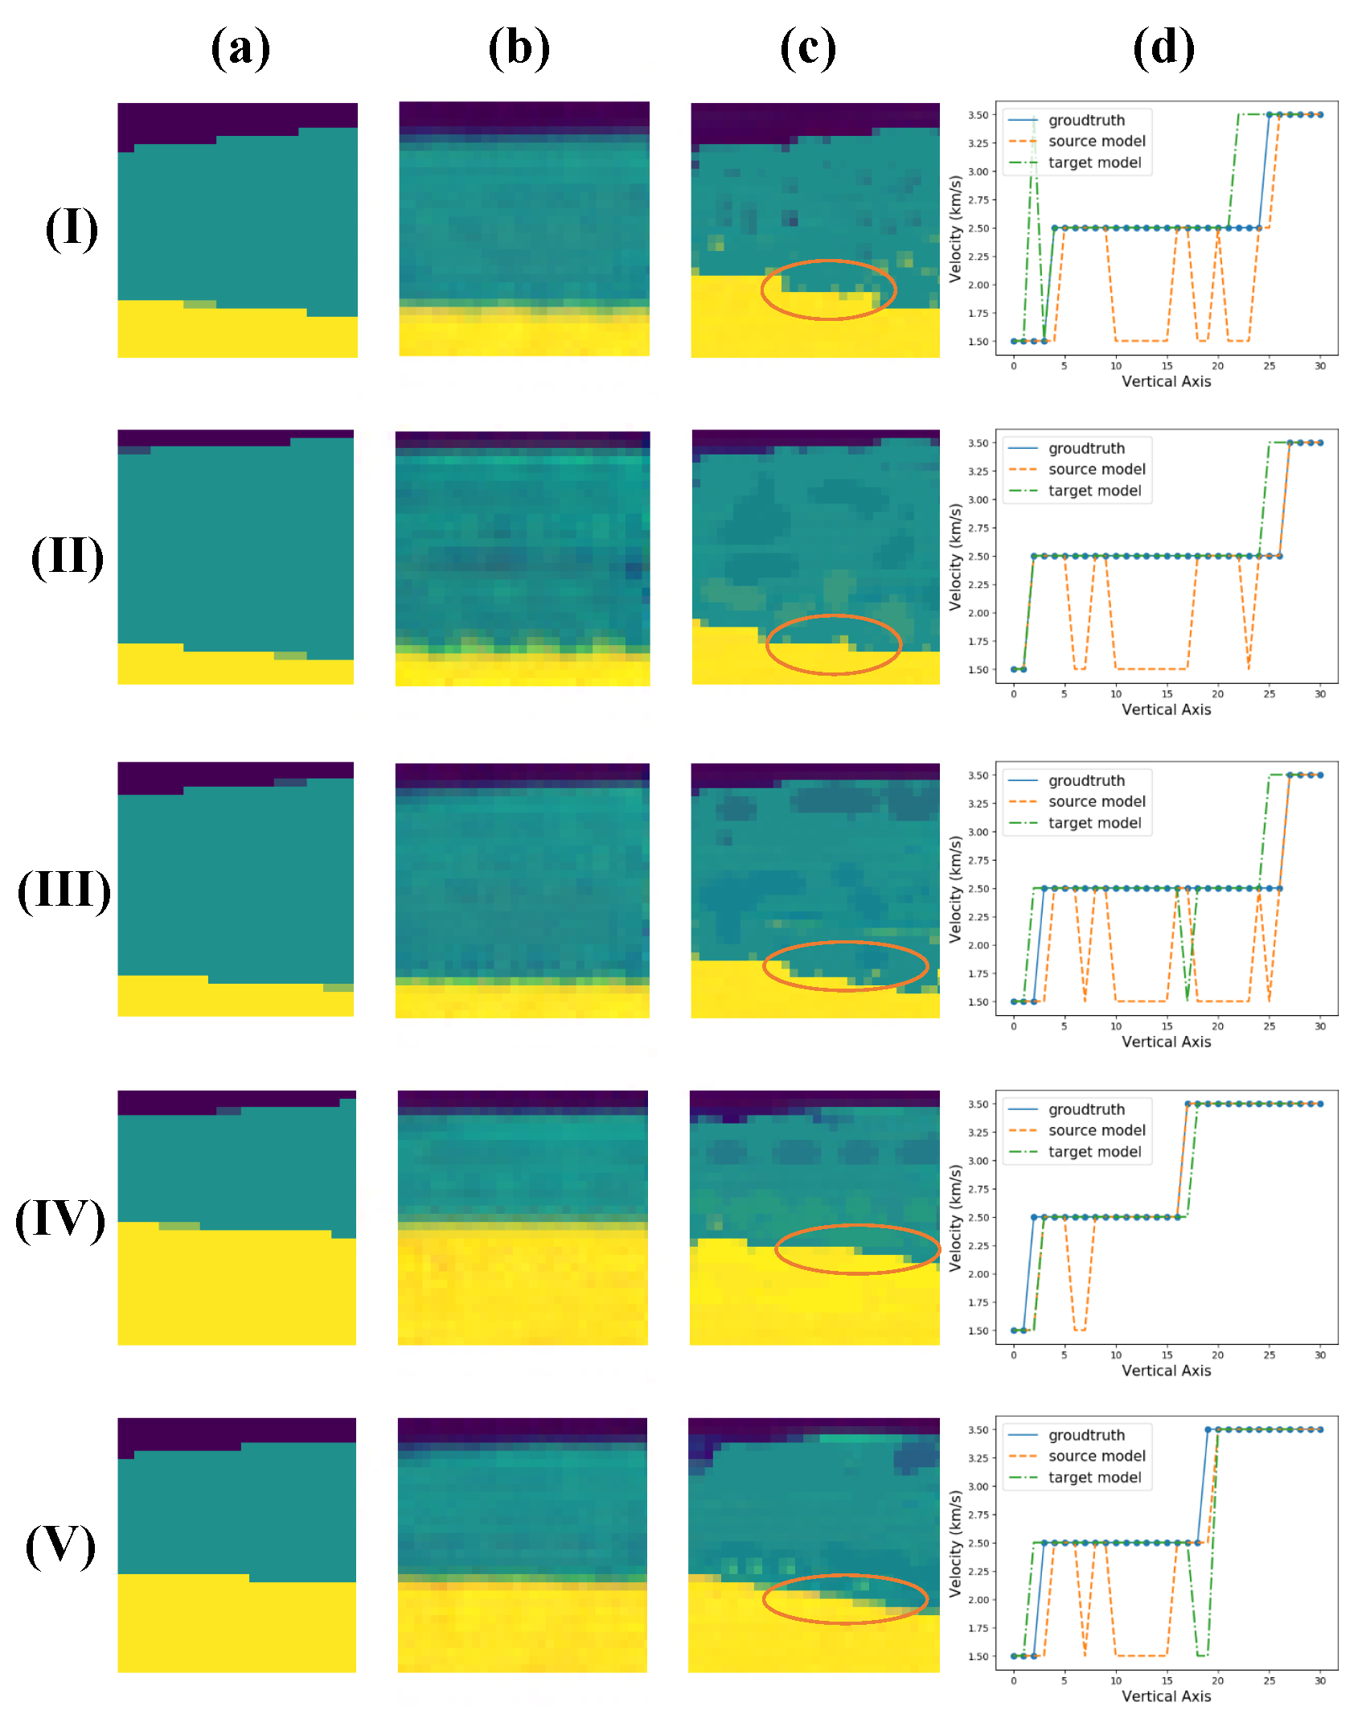
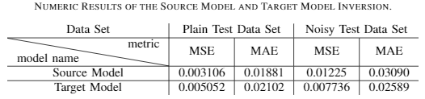
Performance Evaluation:
Target model (c) and source model (b) compared with the groundtruth of the noisy data set (a)
MSE: mean squared error MAE: mean absolute error

Slide 26
Introduction
  Machine Learning (ML) Basics
  Latent Space Basics
  Latent Space Manipulation
    Invasive Grass Detection for Environment Protection
    Unexploited Seismic Data Inversion
  Latent Space Representation
    Real-Time Monitoring of Cutting Volume in Drilling and Borehole Cleaning
    Virtual Relay Selection in V2V networks
Future Works
Conclusions

Slide 27
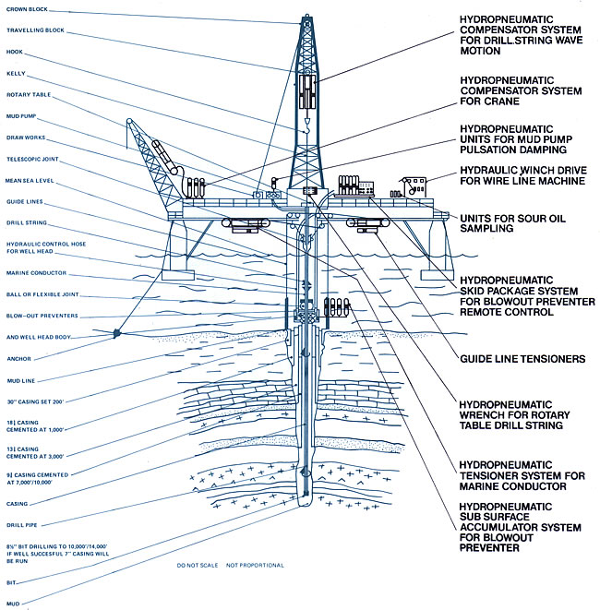
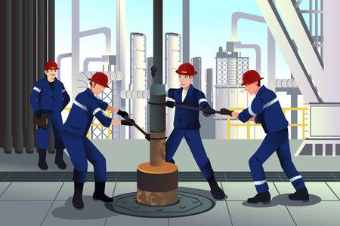
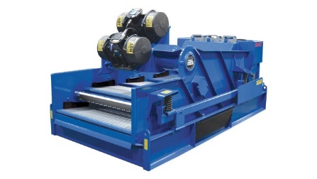
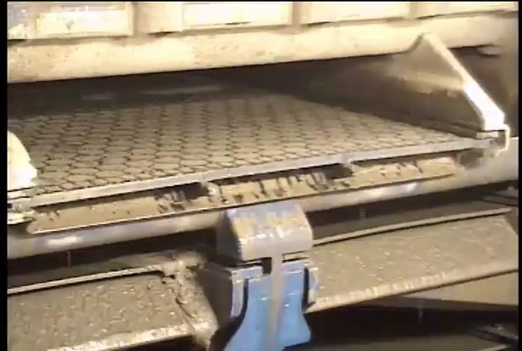
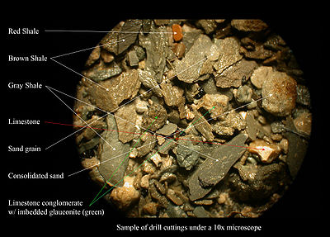
Problem Description & Solution Overview:
Time Consuming & Costly
human labor on the rig
traditional monitoring
hydraulic and torque-and-drag model
several clean-up circles
Another solution: Unmanned monitoring ?
Solution overview:
an object detection model for ROI selection
multi-thread engine for video decoding/encoding
a CNN networks with data-preprocessings
figure cited from http://petroleum-uir.blogspot.com/2011/03/peralatan-pemboran-lepas-pantai.html
Notes:
Monitoring cutting volume is import for borehole cleaning. Traditional methods needs consistent human labor and hydraulic and torque-and-drag model.

Slide 28
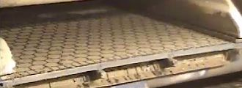
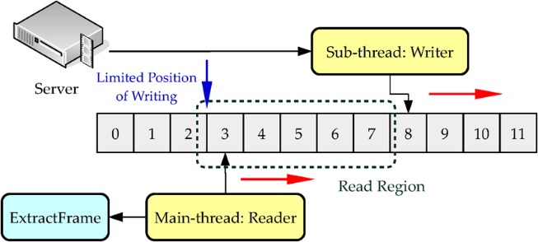

Solution Step by Step:
1. an object detection model for ROI selection with subsampling
group of frames
2. multi-thread engine for video decoding/encoding
read frames into memory

Slide 29
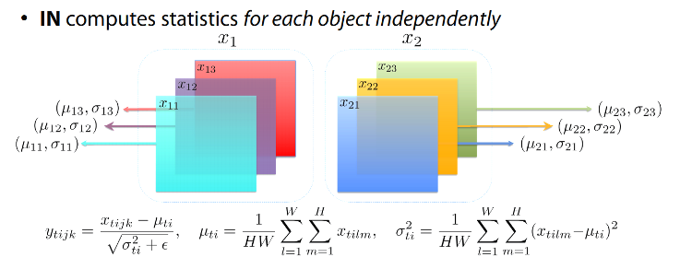
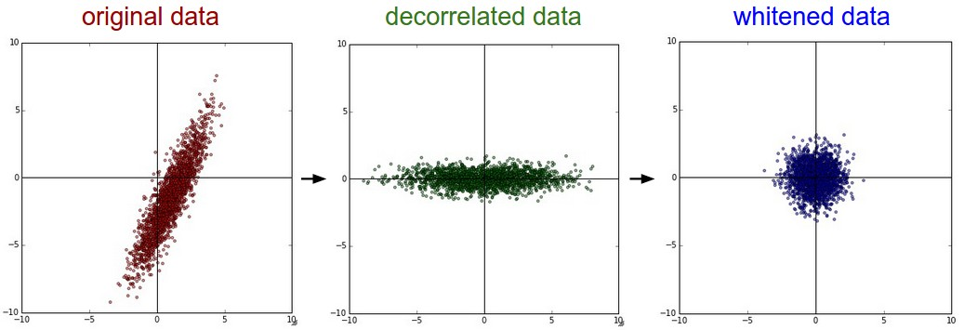

Solution Step by Step:
3. Data Preprocessing
Instance Normalization
$\left\{\begin{aligned}{IN}_{l}\left(d_{xy}\right)=\frac{d_{xy}−μ_{l}}{\sqrt{σ_{l}^{2}+ε}} \\ μ_{l}=\frac{1}{HW}\sum_{y=1}^{H}{\sum_{x=1}^{W}{d_{xyl}}} \\ σ_{l}^{2}=\frac{1}{HW}\sum_{y=1}^{H}{\sum_{x=1}^{W}{{{(d}_{xyl}−μ_{l})}^{2}}}\end{aligned}\right.$
PCA Whitening
  $d←d−\frac{1}{WH}∙\sum{d}$
  $Σ=Cov\left(d\right)=E\left[dd^{T}\right]$
  $Σ=UΛU^{−T}$
  Apply $U^{−T}$ to original data to complete the process
Notes:
PCA whitening: zero-mean; get covariance matrix; conduct eigen decomposition.

Slide 30
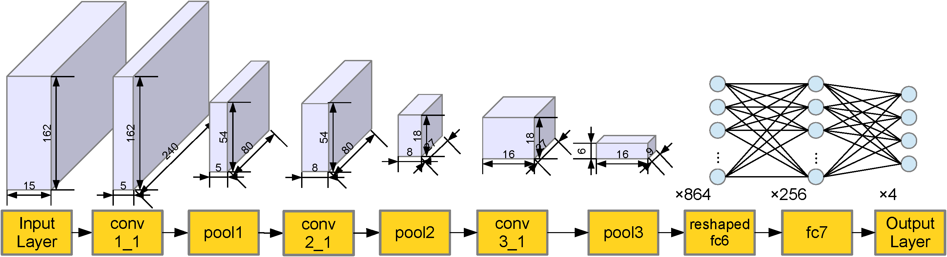
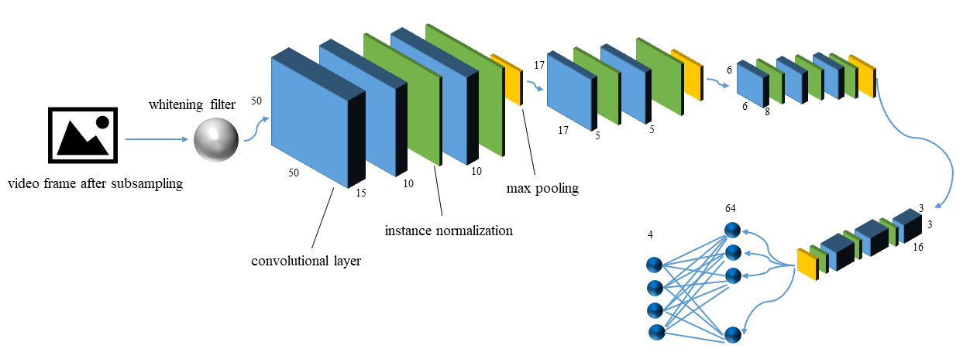
Solution Step by Step:
4. Proposed Networks
Baseline VGG Networks
Proposed VGG16 networks adaptation
Note that: the input of our network is concatenation of 5 frames of video which make the input have 15 channels
By proper preprocessing, latent space contains less extraneous information for obtained desirable results

Slide 31
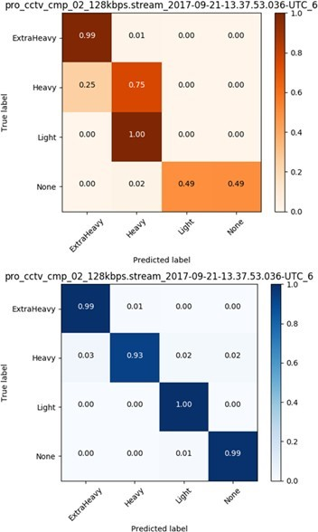
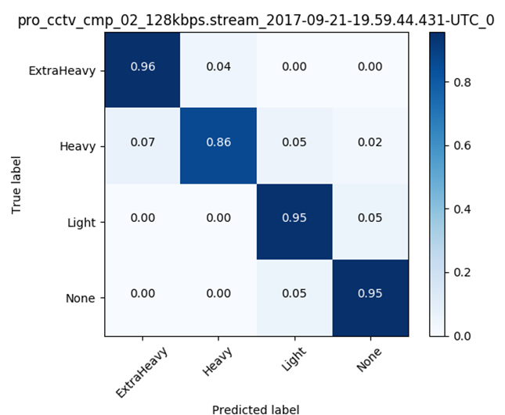





Performance Evaluation:
already deployed on rig by Shell
Testing results (each ~1 hour), good inference results on most cases for adaptation model inference. The orange is baseline

Slide 32
Introduction
  Machine Learning (ML) Basics
  Latent Space Basics
  Latent Space Manipulation
    Invasive Grass Detection for Environment Protection
    Unexploited Seismic Data Inversion
  Latent Space Representation
    Real-Time Monitoring of Cutting Volume in Drilling and Borehole Cleaning
    Virtual Relay Selection in V2V networks
Future Works
Conclusions

Slide 33


System Model
State: traffic and V2V communication topology $S_{t}$= ($S_{traffic}$ , $S_{comm}$)
Action: base station $e$ virtually selects a spot where a vehicle relay (vehicle, UAV or RSU) $v_{e}$ can receive the data and relays to the vehicle $u$(UAV, RSU) around it
Reward: achievable rate between $e$ and $v_{e}$, $v_{e}$ and $u$ are denoted as $r_{v_{e}}^{e}$ and $r_{u}^{v_{e}}$
Goal: optimize the rewards by maximizing the achievable rates $r_{v_{e}}^{e}$ and $r_{u}^{v_{e}}$
Notes:
We consider the base station will virtually select a spot on the map to transmit data. If there is a vehicle at that spot, it will receive the data and transmit it to other vehicles around it. If there is no vehicle, we can use a RSU or UAV as alternative. At every time step, the relay spot will either moves a adjacent spot or stay at the current spot.

Slide 34




Problem Formulation
Current state only related to the last state: Markov Chain
$$P\left(s_{t} | s_{1},a_{1},s_{2},a_{2},…,s_{t−1},a_{t−1}\right)=P(s_{t}|s_{t−1},a_{t−1})$$
current state: [$S_{traffic}$ , $S_{comm}$]
previous action: move the relay spot
$$r_{t}=β_{r(e,v_{e})}∙r_{v_{e}}^{e}\left(t\right)+β_{r(v_{e},u)}∙\sum_{u}{r_{u}^{v_{e}}\left(t\right)}$$
Current reward function (at time stamp $t$)
data rate between base station and relay
data rate between relay and connected vehicles
$$w_{t}=\sum_{τ=t}^{∞}{χ^{τ−t}}∙r_{τ}$$
future reward (time scale will extend to infinity or a certain objective achieved)
estimation of cumulative data rate in the future
$$V^{π}\left(s_{t}\right)=r_{t}+χ∙V^{π}\left(s_{t+1}\right)=r_{t}+w_{t+1}$$
Current reward + future reward
$\max_{π}V^{π}\left(s_{t}\right)$ $∀s_{t}$
objective function

Slide 35

Deep Q-Learning based solution (double networks)
Q-Value:
$$Q_{k+1}\left(s,a\right)←\left(1−η\right)Q_{k}\left(s,a\right)+η(r+χ∙\max_{a^{′}}Q_{k}\left(s^{′},a^{′}\right))$$

Slide 36


Performance Evaluation
DDQN scheme: Double Deep Q-Networks
Greedy scheme: seeking the maximum adjacent traffic volume
Random scheme: randomly choose next relay spot
cumulative rewards: total rewards over action steps
average rewards: total cumulative rewards/action steps

Slide 37
Introduction
  Machine Learning (ML) Basics
  Latent Space Basics
  Latent Space Manipulation
    Invasive Grass Detection for Environment Protection
    Unexploited Seismic Data Inversion
  Latent Space Representation
    Real-Time Monitoring of Cutting Volume in Drilling and Borehole Cleaning
    Virtual Relay Selection in V2V networks
Future Works
Conclusions

Slide 38


Future Works
Future improvement of deep domain adaptation:
  Adapt task A to task B: how to define A and B?
  From one-task adaptation to multi-tasks adaptation?
  How to achieve better performance on regression task?
Future exploration of self-supervised learning:
  How to choose pretext tasks and pre-trained models?
  How to do fine-tuning for the target task?
  How to align multiple pretext representations?

Slide 39
Conclusions
Introduction to machine learning and latent space
From the perspective of theories:
  The latent space representation for classification and reinforcement learning is studied
  The continuous latent space is upgraded to discrete representation to tackle posterior collapse problem
  The latent vectors are contributed to cost function for domain adaptation gap alignment
From the perspective of applications:
  In the field of oil and gas industry, we represent well-preprocessed latent space to classify cutting volume and manipulate latent space for learning adaptation gap for seismic inversion
  In the field of environment protection, we manipulate latent space for a better data augmentation
  In the field of V2V communication, we represent latent space for selecting resource allocation actions
Future works involving deep domain adaptation and self-supervised learning

Slide 40
Publications
Journal:
Xunsheng Du, Hien Van Nguyen, Chunxiao Jiang, Yong Li, Richard Yu, and Zhu Han. "Virtual Relay Selection in LTE-V: A Deep Reinforcement Learning Approach to Heterogeneous Data." in IEEE Access, vol. 8, pp. 102477-102492, 2020, doi: 10.1109/ACCESS.2020.2997729..
Xiaoyuan Liang, Xunsheng Du, Guiling Wang and Z. Han, "A Deep Reinforcement Learning Network for Traffic Light Cycle Control," in IEEE Transactions on Vehicular Technology, vol. 68, no. 2, pp. 1243-1253, Feb.2019.doi:10.1109/TVT.2018.2890726.
Xunsheng Du, Yuchen Jin, Xuqing Wu, Yu Liu, Xianping Wu, Omar Awan, Joey Roth, Kwee Choong See, Nicolas Tognini, Jiefu Chen, and Zhu Han. "Classifying Cutting Volume at Shale Shakers in Real-Time Via Video Streaming Using Deep Learning Techniques.“ in SPE Drilling and Completion, Feb, 2020, doi:10.2118/194084-PA
Xunsheng Du, Shuxing Cheng, Christian Haselwimmer, and Zhu Han. "Buffelgrass Detection by Unmanned Aerial Vehicle Monitoring with High-Fidelity Data Augmentation by Vector Quantised Generative Model." under revision in IEEE Geoscience and Remote Sensing.
Xunsheng Du, Shuxing Cheng, and Zhu Han. “Unexploited Seismic Data Inversion by Joint Distribution Optimal Transport with Deep Encoder-Decoder Networks." submitted to IEEE Geoscience and Remote Sensing.
Patent Application:
Xunsheng Du, Shuxing Cheng, Christian Haselwimmer, and Zhu Han. “Learning-based Invasive Grass Detection by UAV”
Xunsheng Du, Shuxing Cheng, and Zhu Han. “Unexploited Seismic Data Inversion Using Learning Model”
Conference:
Xuelin Cao, Zuxun Song, Bo Yang, Xunsheng Du, Lijun Qian, and Zhu Han"Deep reinforcement learning MAC for backscatter communications relying on Wi-Fi architecture." In IEEE Global Communications Conference (GLOBECOM), pp. 1-6., Waikoloa, HI, Dec. 2019.
Xunsheng Du, Yuchen Jin, Xuqing Wu, Yu Liu, Xianping Wu, Omar Awan, Joey Roth, Kwee Choong See, Nicolas Tognini, Jiefu Chen, and Zhu Han. "The Embedded VGG-Net Video Stream Processing Framework for Real-Time Classification of Cutting Volume at Shale Shaker." In International Petroleum Technology Conference. International Petroleum Technology Conference, Beijing, China, Mar. 2019.
Xunsheng Du, Yuchen Jin, Xuqing Wu, Yu Liu, Xianping Wu, Omar Awan, Joey Roth, Kwee Choong See, Nicolas Tognini, Jiefu Chen, and Zhu Han. "Deep Learning Model for Classifying Cutting Volume at Shale Shakers in Real-Time Via Video Streaming." in Society of Petroleum Engineers/IADC International Drilling Conference and Exhibition, Hague, The Netherlands, Mar. 2019.
Francesco Chiti, Romano Fantacci, Benedetta Picano, Yunan Gu, Xunsheng Du, and Zhu Han. "A Low Complexity Matching Game Approach for LTE-Unlicensed," 2017 IEEE 86th Vehicular Technology Conference (VTC-Fall), Toronto, ON, 2017, pp. 1-5. doi: 10.1109/VTCFall.2017.8288191.
Xunsheng Du, Huaqing Zhang, Hien Van Nguyen, and Zhu Han. "Stacked LSTM Deep Learning Model for Traffic Prediction in Vehicle-to-Vehicle Communication," 2017 IEEE 86th Vehicular Technology Conference (VTC-Fall), Toronto, ON, 2017, pp. 1-5. doi: 10.1109/VTCFall.2017.8288312

Slide 41



