Slide 1
Ph.D. Thesis Defense: Matching Theory Framework for 5G Wireless Communications
Yunan Gu
Advisor: Zhu Han
University of Houston
Electrical and Computer Engineering Department
Date: 11/29/2016

Slide 2
Outline
Introduction
Matching theory basics
Wireless-Oriented Matching Applications:
Dynamic stability in LTE-Unlicensed
Content sharing in LTE V2X communications
Device-to-device (D2D) communications
Facebook content caching
Fog Computing
Wireless network virtualization
Mobile crowd sensing
Future Works
Dynamic stability in LTE V2X communications
Stable multiple activity matching in HetNets
Conclusion
Motivations
University of Houston

Slide 3
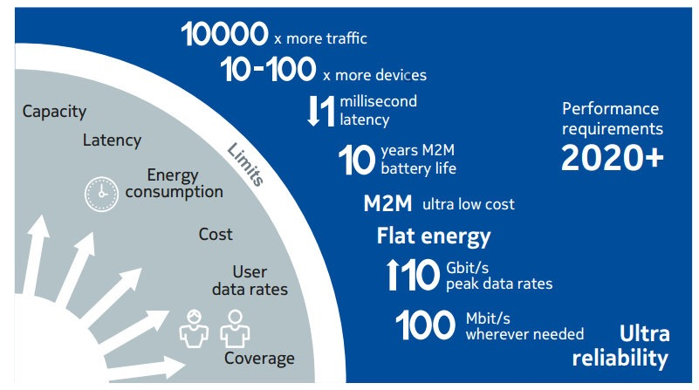
5G features
5G features:
Higher data rates
Reduced end-to-end latency
Higher energy efficiency
Better network coverage
Enhanced security
Ultra reliability
and so on…
Cited from “5G Use Cases and Requirements,” a white paper from Nokia.
University of Houston

Slide 4
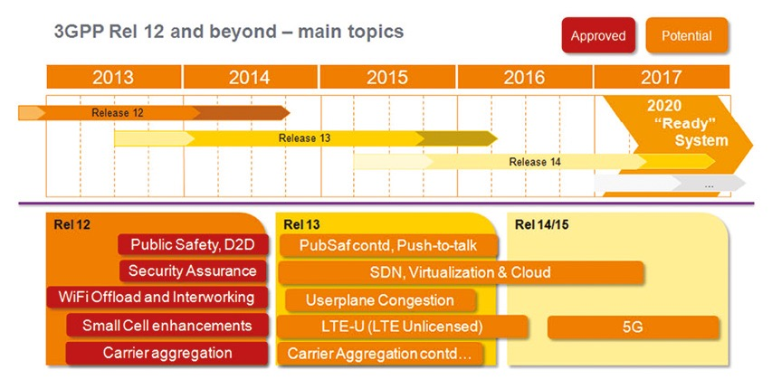
5G key technologies
New paradigms:
Device-to-device (D2D) communication
Network virtualization
LTE-Unlicensed
Small cell (SC) deployment
Cloud-based radio access network (C-RAN)
Massive multiple-input multiple-output (MIMO)
Internet of Things
And so on…
Cited from: http://www.eurescom.eu/news-and-events/eurescommessage/eurescom-message-1-2014/3gpp-system-standards-heading-into-the-5g-era.html
University of Houston

Slide 5
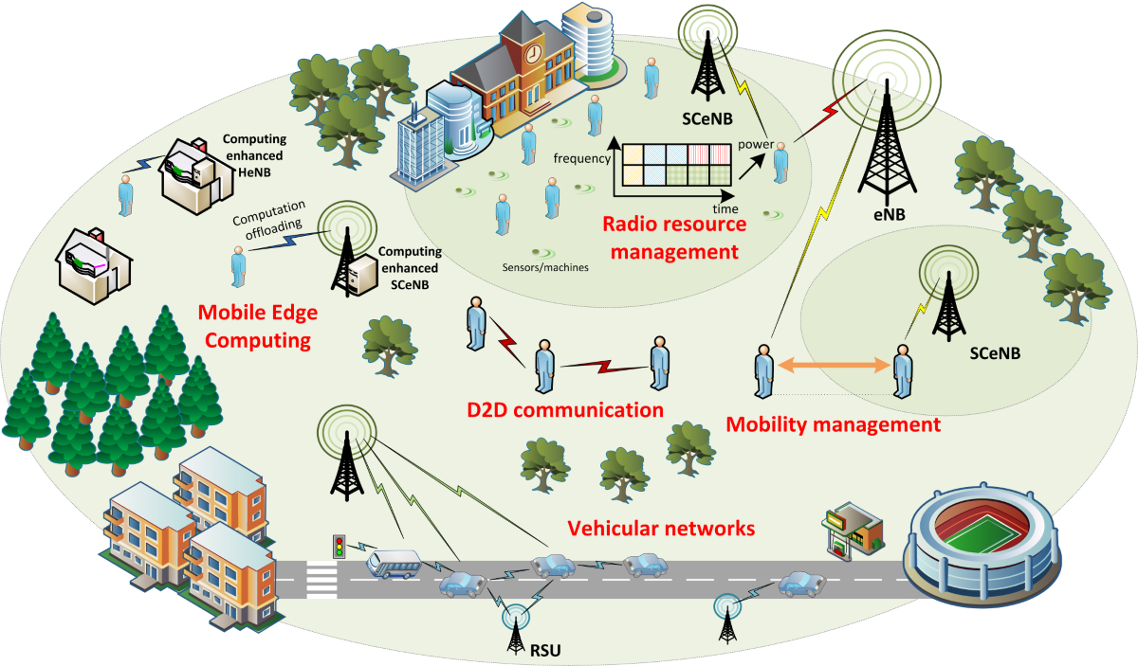
5G resource allocation
Challenges:
Exponential data increase
Node/cell heterogeneous characteristics
Rich communication content
Various QoS requirements
Mobility management
Centralized solution:
Global information
Significant overhead
High computation complexity
High service latency
Cited from: http://5gmobile.fel.cvut.cz/activities/
Shift from centralized mechanism to self-organized distributive solutions.
University of Houston

Slide 6
Distributive solutions
Game theory:
Study of mathematical models of conflict and cooperation between intelligent rational decision-makers
Knowledge of other players’ actions
Specific utility function
Matching theory:
Mathematical framework attempting to describe the formation of mutually beneficial relationships over time
Players make local decisions
Preference lists replace specific utilities
University of Houston

Slide 7
Outline
Introduction
Motivations
Wireless-Oriented Matching Applications:
Dynamic stability in LTE-Unlicensed
Content sharing in LTE V2X communications
Device-to-device (D2D) communications
Facebook content caching
Fog Computing
Wireless network virtualization
Mobile crowd sensing
Future Works
Dynamic stability in LTE V2X communications
Stable multiple activity matching in HetNets
Conclusion
Matching theory basics
University of Houston

Slide 8
Everyone finds a date!
Unstable marriage!
How to design algorithm to prevent unstable results?
University of Houston

Slide 9
Lloyd Stowell Shapley (born June 2, 1923) is a distinguished American mathematician and economist. He is a professor Emeritus at UCLA, affiliated with departments of Mathematics and Economics.
Alvin Elliot Roth (born December 18, 1951) is the Craig and Susan McCaw professor of economics at Stanford University and the Gund professor of economics and business administration emeritus at Harvard University.
Alvin E. Roth and Lloyd S. Shapley shared the 2012 Nobel Prize in Economic Science.
Shapley, designed theoretical constructs and algorithms to study and compare different matching methods.
Roth, built on his work, using experimental economics and market design to solve real-world problems.
University of Houston

Slide 10
Definitions
Basic elements (Stable Marriage (SM)):
Agents: A set of men, and a set of women;
Preference list: A sorted list of men/women based on her/his preferences;
Blocking pair (BP) (m,w):
m is unassigned or prefers w to his current partner;
w is unassigned or prefers m to her current partner;
Stable matching: A matching admit no BPs.
Gale-Shapley (GS) algorithm: find a stable matching in SM
University of Houston

Slide 11
Geeta, Heiki, Irina, Fran
Adam
Fran
Irina, Fran, Heiki, Geeta
Carl > Adam
Bob
We reach a stable marriage!
Geeta
Geeta, Fran, Heiki, Irina
Carl
Heiki
Irina, Heiki, Geeta, Fran
David > Bob
David
Irina

Slide 12
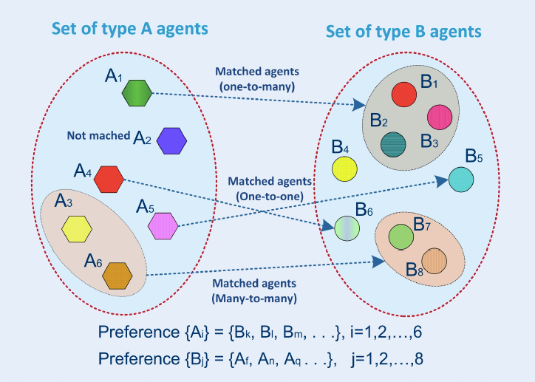
Conventional classification 1
One-to-one matching:
Stable roommate (SR);
Stable marriage (SM);
Many-to-one matching:
House allocation (HA)
College admission (CA)
Many-to-many matching:
Worker-Firm (WF)
Assign paper to reviewer
University of Houston

Slide 13
Conventional classification 2
Bipartite matching problem with two-sided preferences.
Assign junior doctors to hospitals
Assign purples to schools
Bipartite matching problem with one-sided preferences.
Campus housing allocation
DVD rental markets
Non-bipartite matching problem with preferences.
Form pairs of agents for chess tournaments
Create partnership in P2P network
Kidney exchange market
University of Houston

Slide 14
Matching in wireless resource allocations
Matching modeling:
Users, resources: agents/players
System requirements: preference lists
System objectives: stability, maximum weight, Pareto optimality…
Stability notion:
Robustness to deviations that can benefit both the resource owners and the users in the wireless resource allocations
Advantages:
Suitable models for specific issues
Preference lists to satisfy various system requirements
Stability guaranteed
Semi-distributive implementations and close-optimal results
University of Houston

Slide 15
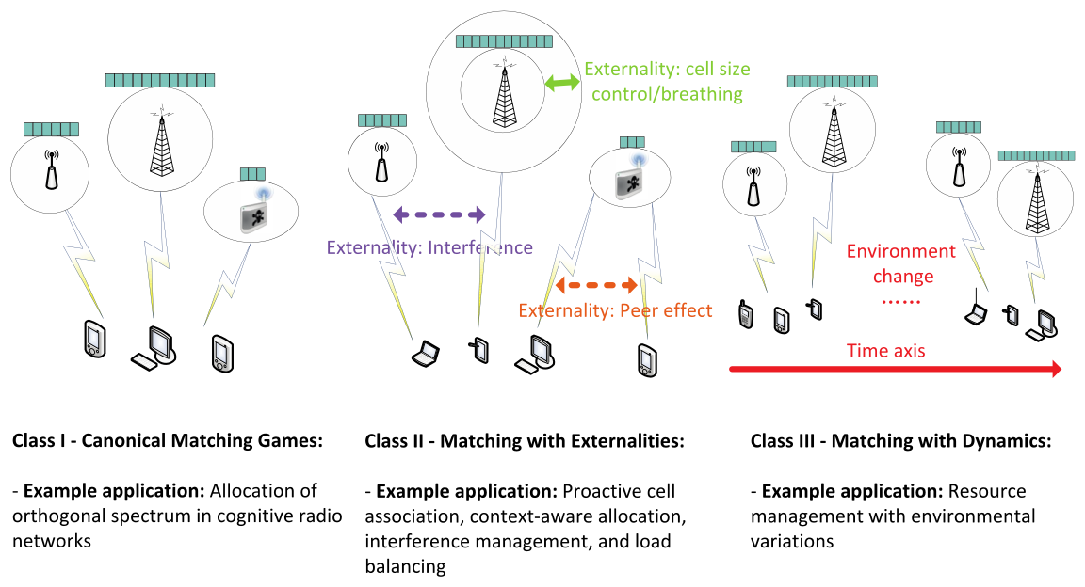
Wireless-oriented classification
University of Houston

Slide 16
Information exchange in matching
Initialize:
preference lists (PLs) set up
Preference list set up:
Users/resources collect information locally
Interference, propagation gain, transmission rate, monetary offer…
Channel sensing, communication...
Proposing:
Communication signals with proposal overhead
Update preference lists and partner lists
Accepting/rejecting:
Make decisions and send communication signals with reject/accept overhead
Update partner lists
Detection of blocking pair or other operations:
Require the PLs of both type of users
Centralized agents (eNBs or Wi-Fi Aps)
Semi-distributive implementation
Propose:
Each user proposes to its most favorite resource; and delete it from its PL;
Accept/reject:
Each resource keeps the most favorite user(s) w.r.t. its PL and quota from the proposals; and reject the rest;
No
Check:
If all users are matched?
No
Check:
If all users’ PLs are empty?
Yes
Yes
Terminate:
A stable matching between users and resources.
University of Houston

Slide 17
Outline
Introduction
Motivations
Matching theory basics
Wireless-Oriented Matching Applications:
Content sharing in LTE V2X communications
Device-to-device (D2D) communications
Facebook content caching
Fog Computing
Wireless network virtualization
Mobile crowd sensing
Future Works
Dynamic stability in LTE V2X communications
Stable multiple activity matching in HetNets
Conclusion
Dynamic stability in LTE-Unlicensed
University of Houston

Slide 18
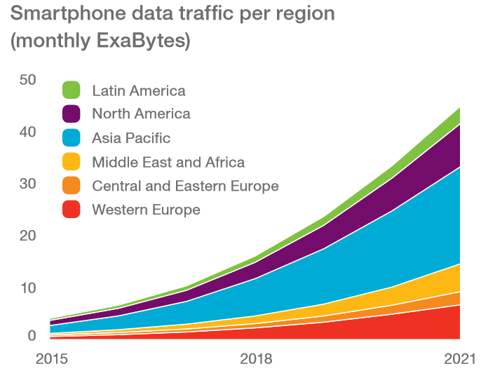
LTE-Unlicensed
Enhanced user experience
Thanks to LTE Advanced anchor in licensed spectrum with robust mobility
LTE in Licensed Spectrum
700MHz to 3.8GHz
Co-channel interference:
Unlicensed transmission: CSMA/CA
Licensed transmission: QoS
Fair coexistence?
Carrier
aggregation
LTE in Unlicensed Spectrum
5 GHz
Coexistence with Wi-Fi
Features to protect Wi-Fi neighbors
University of Houston

Slide 19
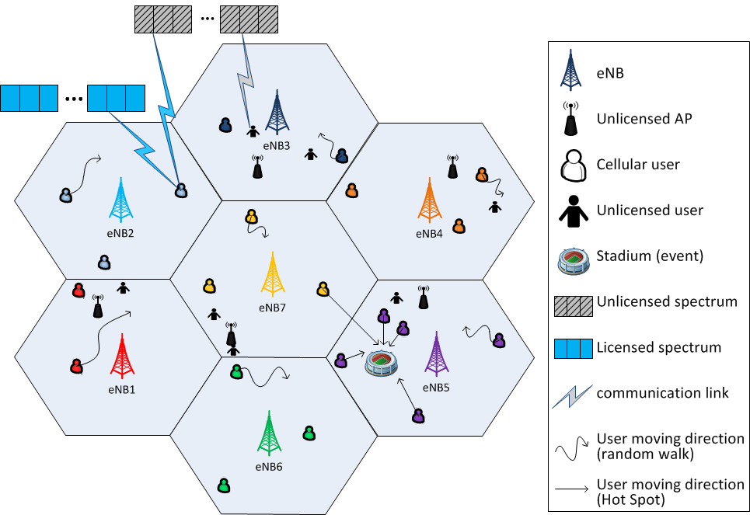
LTE-Unlicensed system model
One-to-one:
Cellular users (CUs) , unlicensed users (UUs)
Many-to-one:
UUs, unlicensed bands
Coexistence issues:
interference from co-channel UUs to CUs
interference from co-channel CUs to UUs
interference between co-channel CUs
University of Houston

Slide 20
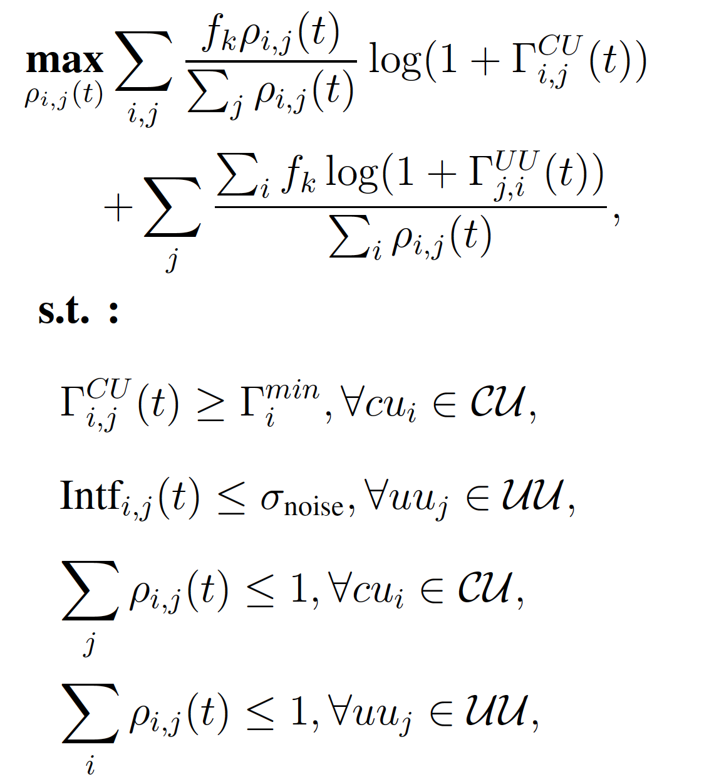
Problem formulation
{0,1}: indicating the sharing between CU and UU
Unlicensed band
maximizing both CUs and UUs’ throughput
SINR
minimum SINR requirement for CUs
Interference
maximum interference allowed for UUs
CU capacity
UU capacity
University of Houston

Slide 21
Solution discussion
Stable marriage game:
one-to-one matching between CUs and UUs
Preferences of CU over UU
Preferences of UU over CU
Coexistence issue 1 & 2:
By set up the preference lists of CUs and UUs
Coexistence issue 3:
By adopting TDMA for multiple co-channel CUs
University of Houston

Slide 22
Matching externality
CUs’ preferences change due to TDMA
uneven channel allocation
unstable matching
Co-channel interfering CUs and UUs
hidden terminal problem
invalid (cu, uu) pairs
Inter-channel cooperation (ICC) algorithm
assistance from eNBs (centralized)

Slide 23
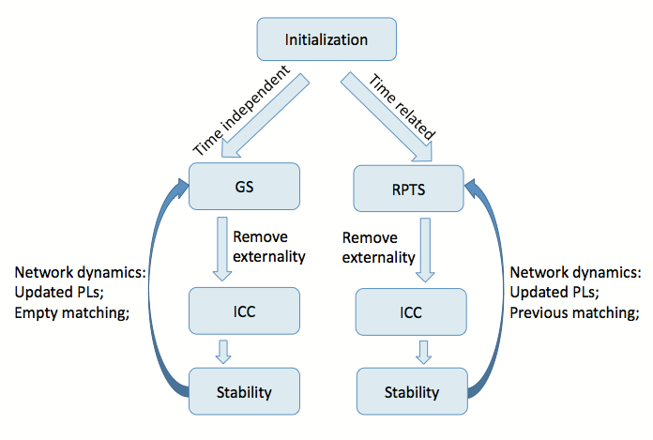
Dynamic stability
Network dynamics:
user mobility
channel fading
Time-independent implementation
GS repeated over time
ICC to remove externality
Time-related implementation
random path to stability (RPTS)
re-stabilize the previous matching
divorce and remarry operations
University of Houston

Slide 24
GS algorithm
Initialize: CU and UU PLs set up
Propose:
Each CU proposes to its most favorite UU;
then delete it from its PL;
Accept/reject:
Each UU keeps the most favorite CU from the proposals; then reject the rest;
No
Check:
If all CUs are matched?
No
Check:
If all CUs’ PLs are empty?
Yes
Yes
Terminate

Slide 25
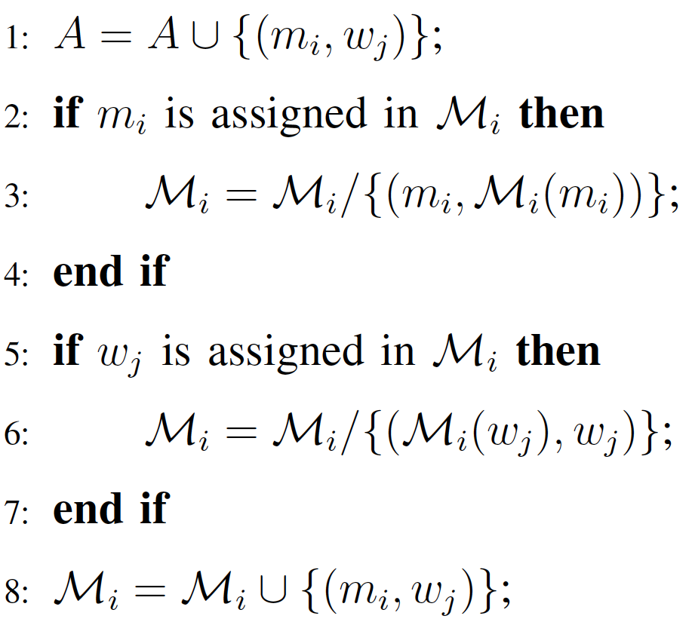
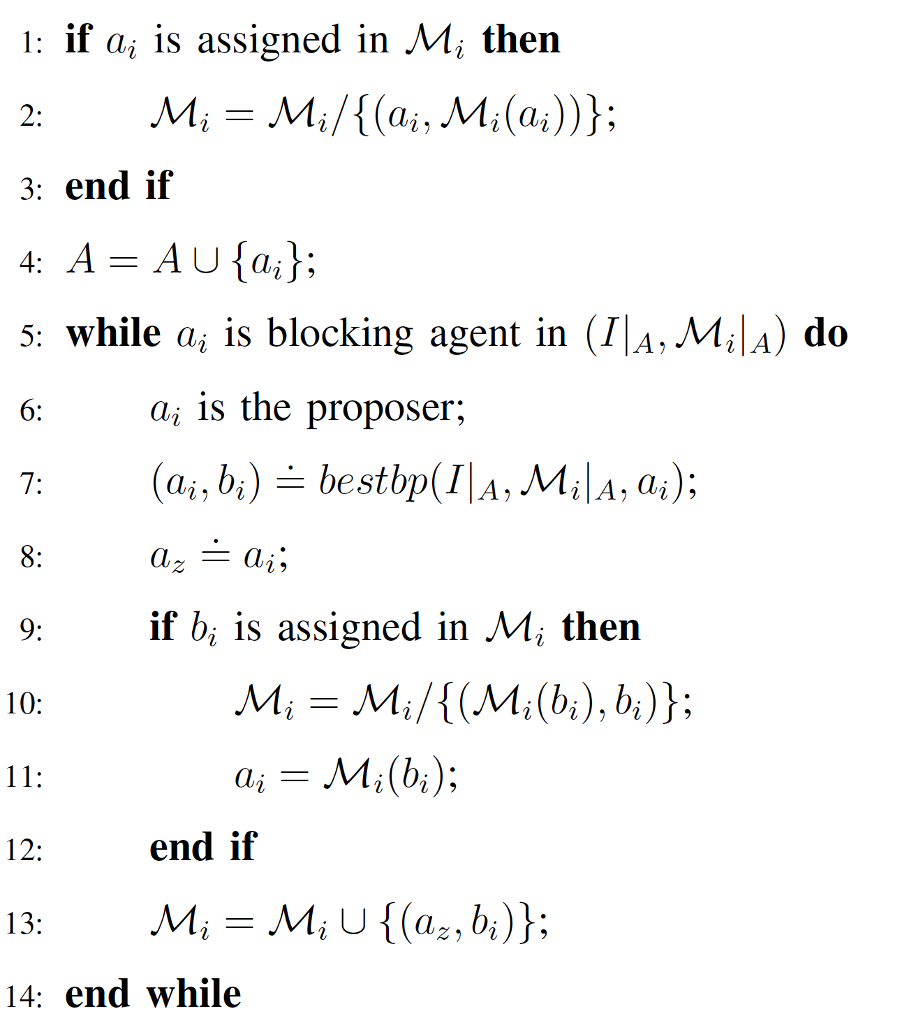
RPTS algorithm
SATISFY
ADD
Initialize:
CU and UU PLs set up; set A as empty set;
Detection of BPs:
eNBs search for BP(s) in the current matching
Convergence of RPTS:
set A increase by 1 or 2 each iteration
continuous size increase of set A
If no BP detected
If BP(a,b) detected
ADD or SATISFY:
if both a,b are not in A, call SATISFY; otherwise call ADD
ifs
idd
Terminate

Slide 26
ICC algorithm
Remove invalid (cu,uu) pairs
Removes the second type of externality:
hidden terminal problem
Removes the first type of externality:
preference change due to TDMA
Search all BPs in the current matching
Check if each BP is allowed to switch partners:
system throughput improve?
If any BP exists
Find the optimal BP with most throughput improvement;
Allow the optimal BP to switch partners;
update the current matching
If no BP exists
Convergence of ICC:
unreversability of each swap
Terminate

Slide 27
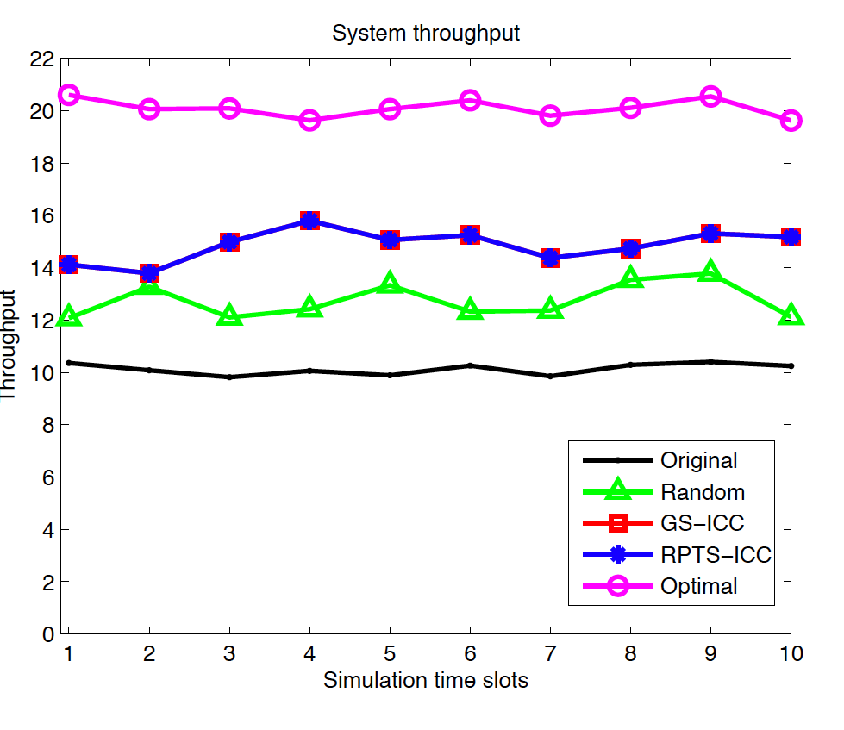
Time dynamic evaluation
Complexity evaluation in random waypoint (RWP):
RPTS achieves lower complexity than GS
ICC requires 6 or 7 swaps averagely
System throughput in RWP:
RPTS and GS achieve similar system throughput
ICC further improves system throughput
RPTS and GS achieve similar close-optimal system throughput
University of Houston

Slide 28
Outline
Introduction
Motivations
Matching theory basics
Wireless-Oriented Matching Applications:
Dynamic stability in LTE-Unlicensed
Device-to-device (D2D) communications
Facebook content caching
Fog Computing
Wireless network virtualization
Mobile crowd sensing
Future Works
Dynamic stability in LTE V2X communications
Stable multiple activity matching in HetNets
Conclusion
Content sharing in LTE V2X communications
University of Houston

Slide 29
LTE assisted V2X communications
Connected vehicles
road safety
traffic efficiency
entertainment
LTE assisted vs 802.11p-based V2X:
Safety critical applications
Better efficiency and reliability
Lower latency
University of Houston

Slide 30
LTE V2X communications system model
eNB
V2I
V2V
Vehicles
carry various data
information value: type, quantity
user interest
Infrastructures:
eNBs, APs, RSUs
Optimize information dissemination
data information value
communication link quality
RSU
OBU
University of Houston

Slide 31
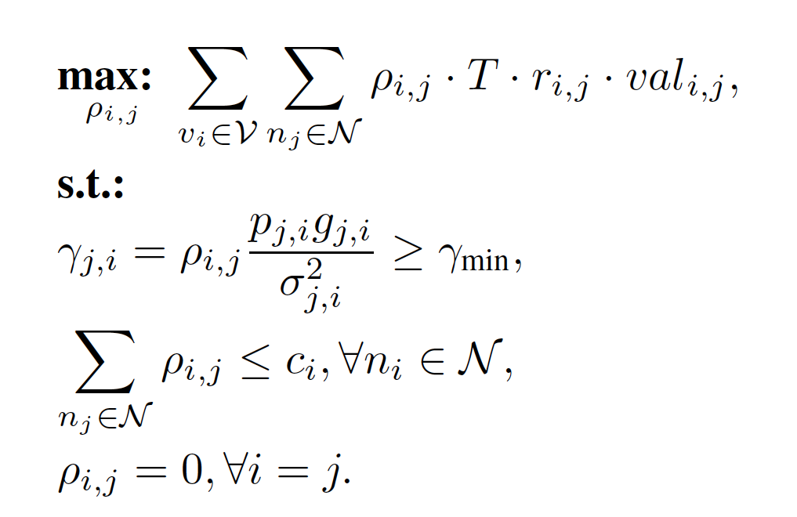
Problem Formulation
{0,1}: indicating the link connection between nodes
communication period
information value of exchanged data
maximizing system information exchange
data rate
minimum SINR requirement for vehicles
node (vehicle/infrastructure) capacity
not self sharing
University of Houston

Slide 32
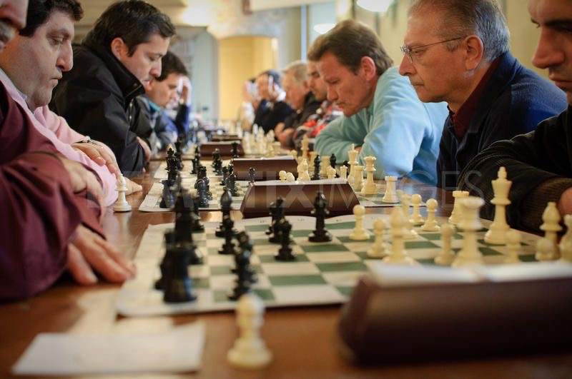
The stable fixture (SF) game
The SF problem stems from chess tournament, where players play against one another.
Definitions:
A set of players X
The quota for each player c
A preference structure PL
LTE assisted V2X modeling:
many-to-many matching
connections independent from each other
University of Houston

Slide 33
The Irving’s stable fixture (ISF) algorithm
Preferences:
ISF algorithm:
reduce preference lists
construct player set S
ordered pairs
Phase 1:
proposing and rejecting
Phase 2:
finding and removing rotations
A stable matching may not exist in SF
Termination conditions:
is odd
player has a short list
degree of player
University of Houston

Slide 34
Rotation
Rotation:
a sequence of ordered pairs
Search rotation:
Start by any node with a long list
Stop when any node is visited twice
Eliminate rotation:
reconstruct set S
reduce preference list
last player in the preference list
First player in the preference not in S
University of Houston

Slide 35
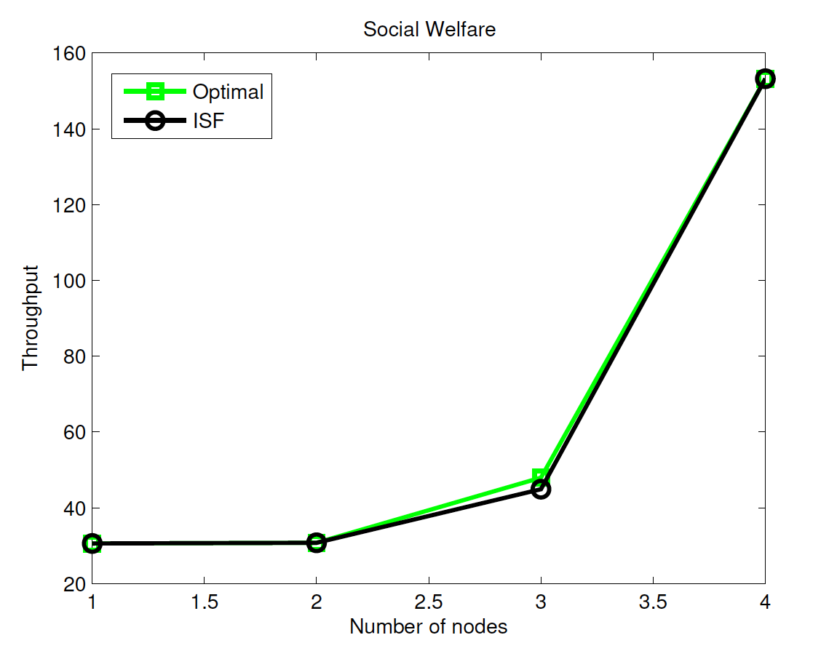
Simulation results
Social welfare & average user throughput evaluation:
ISF performs best vs ISF-unweighted, Proximity V2V, ISF-One, Without V2V
Considering data weight further improves performance
Many-to-many matching improves data sharing than one-to-one
ISF achieves close-optimal result
University of Houston

Slide 36
Outline
Introduction
Motivations
Matching theory basics
Wireless-Oriented Matching Applications:
Dynamic stability in LTE-Unlicensed
Content sharing in LTE V2X communications
Fog Computing
Wireless network virtualization
Mobile crowd sensing
Future Works
Dynamic stability in LTE V2X communications
Stable multiple activity matching in HetNets
Conclusion
Device-to-device (D2D) communications
Facebook content caching
University of Houston

Slide 37
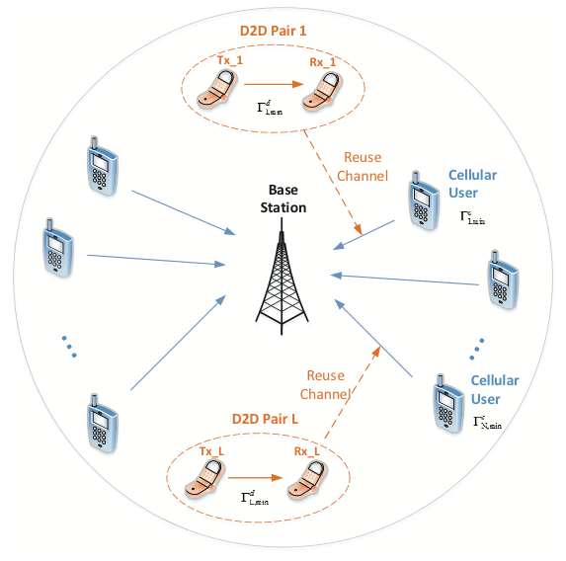
D2D communications
Spectrum sharing:
Cellular users (CUs) and D2D users (DUs)
Interference by channel reuse
Optimize the system throughput:
QoS requirements
Solutions steps:
Admission control
Optimal power allocation
SM matching: GS algorithm
Strategic issue:
cheating: falsify preference lists
Coalition strategy (CS)
improve DU and system performance
University of Houston

Slide 38
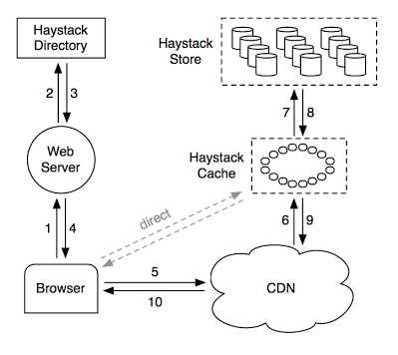
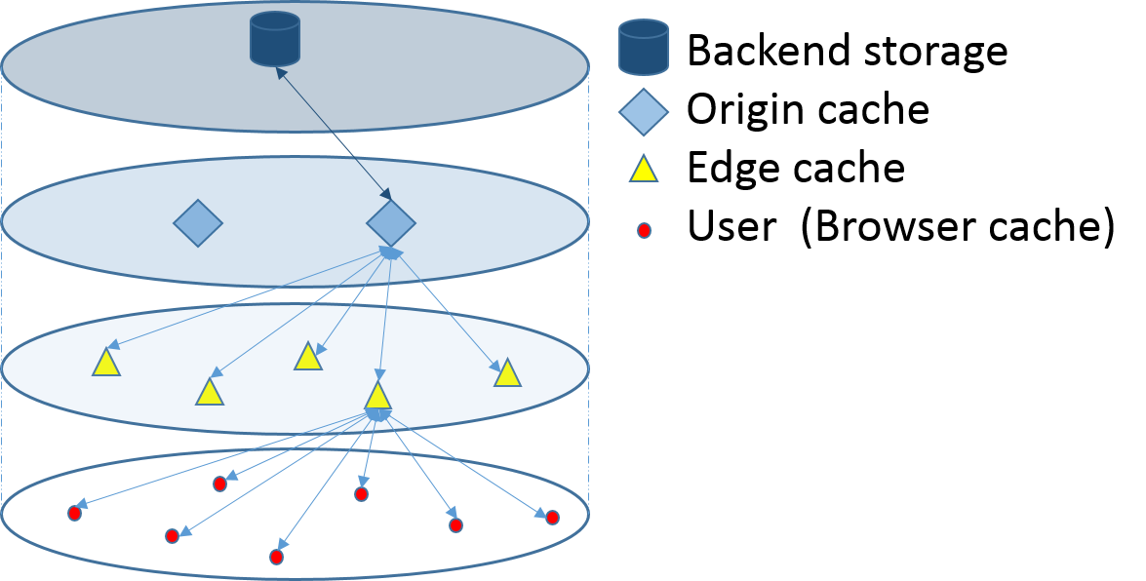
Facebook content caching
Facebook Haystack storage system:
Lower caching layer has lower latency
Cache in the same layer has geography diversity
Cache center has capacity limit
Optimize average service delay
content popularity
cache center service delay
College admission (CA) game:
many-to-one extension of SM
University of Houston

Slide 39
Outline
Introduction
Motivations
Matching theory basics
Wireless-Oriented Matching Applications:
Device-to-device (D2D) communications
Facebook content caching
Dynamic stability in LTE-Unlicensed
Content sharing in LTE V2X communications
Future Works
Dynamic stability in LTE V2X communications
Stable multiple activity matching in HetNets
Conclusion
Fog Computing
Wireless network virtualization
Mobile crowd sensing
University of Houston

Slide 40
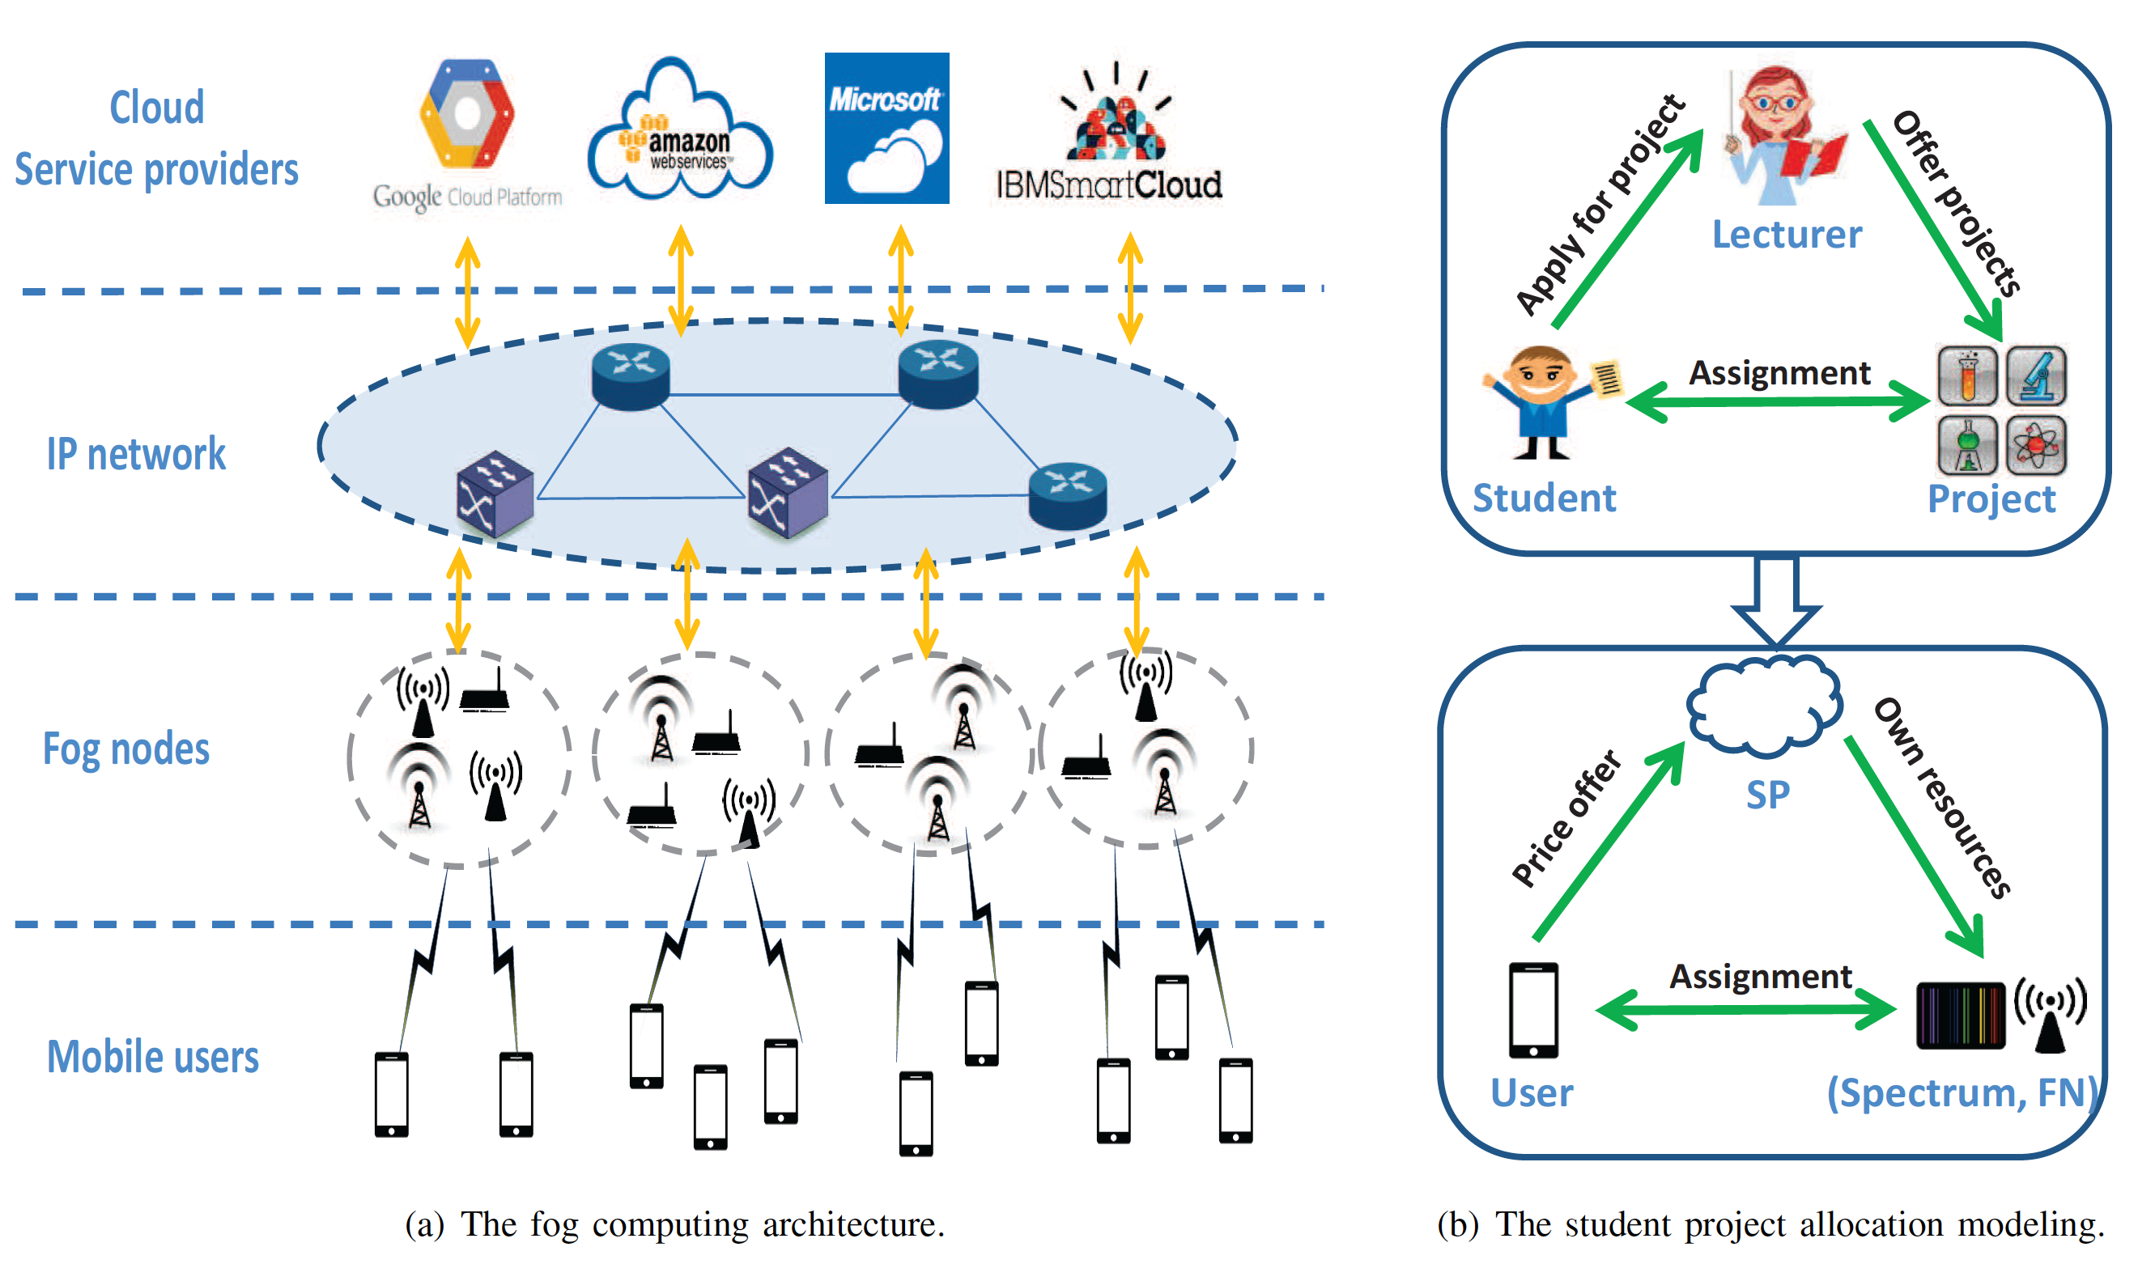
Fog computing
Fog computing:
bring cloud closer to users
large scale distribution at edge
delay sensitive tasks
Joint computational and radio resource allocations
computational: fog node (CPU)
radio: spectrum band
Optimize average service delay
Student project allocation (SPA) model
University of Houston

Slide 41
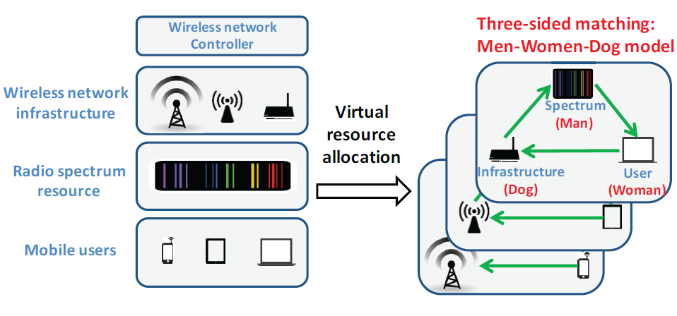
Wireless network virtualization
Wireless network virtualization:
Abstraction, isolation and sharing of wireless resources
Radio resource, physical infrastructure and mobile users
Great flexibility, higher network efficiency and new services;
Joint service generation and service allocation
Three-dimension stable marriage (3DSM)
man-woman-dog
cyclic preferences
University of Houston

Slide 42
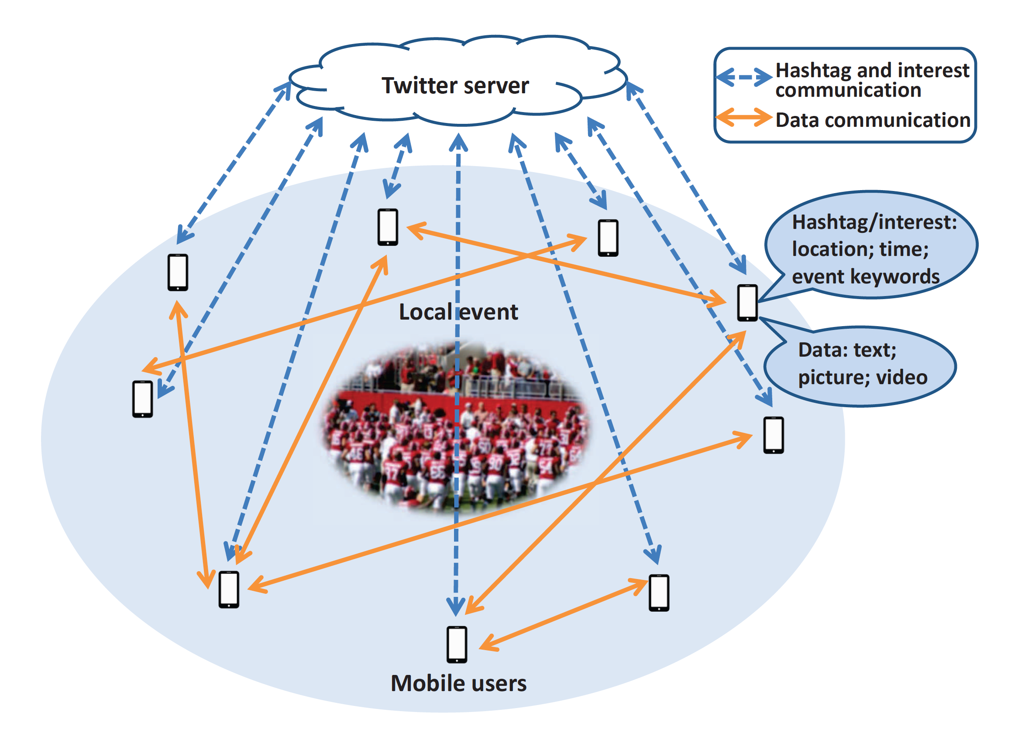
Mobile crowd sensing
Mobile crowd sensing:
smart phone sensing
social networking
environment surveillance, marketing, health monitoring…
A local event sharing:
Twitter server: only upload Hashtag
Real-time information exchange
Hashtag#: location, time, data type&size, keywords
Stable fixture game
many-to-many matching
University of Houston

Slide 43
Outline
Introduction
Motivations
Matching theory basics
Wireless-Oriented Matching Applications:
Dynamic stability in LTE-Unlicensed
Content sharing in LTE V2X communications
Device-to-device (D2D) communications
Facebook content caching
Fog Computing
Wireless network virtualization
Mobile crowd sensing
Future Works
Conclusion
Dynamic stability in LTE V2X communications
Stable multiple activity matching in HetNets
University of Houston

Slide 44
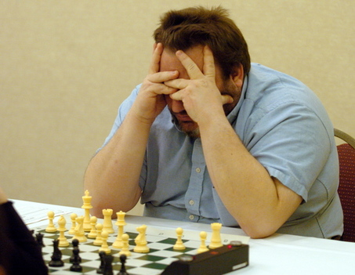
Dynamic stability in LTE V2X communications
LTE V2X communications
safety critical applications
better efficiency and reliability
lower latency
Mobility management in vehicular network:
user mobility
CSI information change
real-time support
Dynamic stability in the one-sided matching:
stable fixture game
satisfying blocking pairs
University of Houston

Slide 45
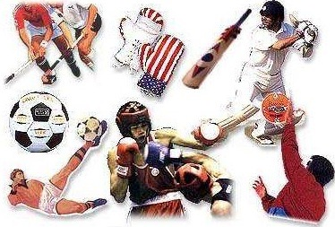
Stable multiple activity matching in HetNets
HetNet communications:
user device types
communication contents
QoS requirements
Diverse partnerships between two players
video stream sharing
voice call
texting
Stable multiple activities (SMA)
Agents participate in multiple partnerships with multiple agents
Improve user satisfaction and resource utilization
University of Houston

Slide 46
Conclusion
Given a general introduction of matching theory
Provided the bridge between wireless communication and matching theory:
Select suitable models to capture the problem
Define preference lists to meet system requirements
Select/ modify algorithm to guarantee stability
Analyzed the performance:
Theoretically
Simulation
Wise choice for future wireless resource allocation problems.
University of Houston

Slide 47
Publications
Book:
Z. Han, Y. Gu, W. Saad, “Matching Theory for Next-Generation Wireless Networks ”, under editing, Springer, 2016.
Book chapter:
Y. Gu, L. Cai, L. Song, and Z. Han, “LTE-Unlicensed: Overview and Distributed Coexistence Design” In Vincent W.S. Wong, Robert Schober, Derrick Wing Kwan Ng, and Li-Chun Wang, “Emerging Technologies for 5G Wireless Systems”, under editing, Cambridge University Press, 2016.
Journal and Magazine:
Y. Gu, Y. Zhang, M. Pan and Z. Han, "Matching and Cheating in Device to Device Communications Underlying Cellular Networks," in IEEE Journal on Selected Areas in Communications (JSAC), vol. 33, no. 10, pp. 2156-2166, Oct. 2015.
Y. Gu, W. Saad, M. Bennis, M. Debbah and Z. Han, "Matching theory for future wireless networks: fundamentals and applications," in IEEE Communications Magazine, vol. 53, no. 5, pp. 52-59, May 2015.
Y. Gu, Y. Zhang, L. Cai, M. Pan, L. Song, and Z. Han, “LTE-Unlicensed Co-existence Mechanism: A Matching Game Framework, ” to appear in IEEE Wireless Communications Magazine, 2016.
Y. Gu, C. Jiang, L. Cai, M. Pan, L. Song, and Z. Han, “Dynamic Path To Stability in LTE-Unlicensed with User Mobility: A Matching Framework”, under revision of IEEE Transactions on Wireless Communications, 2016.
F. Chiti, R. Fantacci, Y. Gu, and Z. Han, “Content Sharing in Internet of Vehicles: Two Matching-Based User-Association Approaches”, to appear in Vehicular Communications, 2016.
Conference:
Y. Gu, M. Pan and W. Li, "Maximizing the lifetime of delay-sensitive sensor networks via joint routing and sleep scheduling," Computing, Networking and Communications (ICNC), 2014 International Conference on, Honolulu, HI, 2014.
Y. Gu, M. Pan and W. Li, "Joint sleep scheduling and routing for lifetime optimization in delay-sensitive sensor networks," 2013 IEEE International Conference on Sensing, Communications and Networking (SECON), New Orleans, LA, 2013.
Y. Gu, Y. Zhang, M. Pan and Z. Han, "Cheating in matching of device to device pairs in cellular networks," IEEE Global Communications Conference (GLOBECOM), Austin, TX, Dec. 2014.
Y. Zhang, Y. Gu, M. Pan, and Z. Han, “Distributed Matching Based Spectrum Allocation in Cognitive Radio Networks,” IEEE Globe Communication Conference (GLOBECOM), Austin, TX, Dec. 2014.
Y. Pang, Y. Zhang, Y. Gu, M. Pan, and Z. Han, “Efficient Data Collection for Wireless Rechargeable Sensor Clusters in Harsh Terrains Using UAVs,” IEEE Globe Communication Conference (GLOBECOM), Austin, TX, Dec. 2014.
Y. Gu, Y. Zhang, M. Pan and Z. Han, "Student admission matching based content-cache allocation," IEEE Wireless Communications and Networking Conference (WCNC), New Orleans, LA, Mar. 2015.
Y. Zhang, Y. Gu, L. Liu, M. Pan, Z. Dawy and Z. Han, "Incentive mechanism in crowdsourcing with moral hazard," IEEE Wireless Communications and Networking Conference (WCNC), New Orleans, LA, Mar. 2015.
Y. Gu, Y. Zhang, L. Cai, M. Pan, L. Song, and Z. Han, “Exploiting Student-Project Allocation Matching for Spectrum Sharing in LTE-Unlicensed," IEEE Global Communications Conference (GLOBECOM), San Diego, CA, Dec. 2015.
Y. Zhang, Y. Gu, L. Song, M. Pan, Z. Dawy and Z. Han, "Tournament Based Incentive Mechanism Designs for Mobile Crowdsourcing," IEEE Global Communications Conference (GLOBECOM), San Diego, CA, Dec. 2015.
Z. Chang, Y. Gu, Z. Han, X. Chen, and T. Ristaniemi, “Context-Aware Data Caching for 5G Heterogeneous Small Cells Networks”, IEEE International Conference on Communications (ICC), Kuala Lumpur, Malaysia, May 2016.
Y. Gu, L. Wang, M. Pan and Z. Han, “Exploiting the Stable Fixture Matching Game for Mobile Crowd Sensing: A Local Event Sharing Framework”, submitted to the IEEE International Conference on Communications(ICC), May 2017.
Y. Gu, C. Jiang, N. Hoang Tran, M. Pan, L. Song and Z. Han, Cyclic Three-Sided Matching Game Inspired Wireless Network Virtualization, submitted to the IEEE International Conference on Communications(ICC), May 2017.
F. Chiti, M. Fantacci, B. Picano, Y. Gu and Z. Han, “A Low Complexity Matching Game Approach for LTE-Unlicensed,” submitted to the IEEE International Conference on Communications(ICC), May 2017.
Y. Gu, Z. Chang, M. Pan, L. Song and Z. Han, “Joint Radio and Computational Resource Allocation in Fog Computing: A Student Project Allocation Matching”, submitted to 2017 IEEE International Conference on Computer Communications (INFOCOM), Jul. 2017.
Y. Gu, L. Cai, M. Pan, L. Song and Z. Han, “Exploiting the Stable Fixture Matching Game for Content Sharing in D2D-based LTE-V2X Communications”, IEEE Global Communication Conference (GLOBECOM), Washington, D.C., Dec. 2016.
University of Houston

Slide 49
University of Houston

