Slide 1


Modern Delay Analysis for Networking:
From MCMC, Martingale, Stochastic Network Calculus, Lyapunov to Age of Information
Zhu Han
Department of Electrical and Computer Engineering
University of Houston, Houston, TX, USA
Related Presentation Slides at
http://wireless.egr.uh.edu/research.htm
ACK: Qiuyang Shen, Yun Hu, Tingting Liu, Yan Zhu, Ruoguang Li, Zirui Zhuang, and Yuhan Kang

Slide 2
Table of Contents
Background
Mathematical Tool Set 1
  MCMC Algorithm
  Martingale Bounds
  Stochastic Network Calculus
Mathematical Tool Set 2
  Lyapunov and Stability Theory
  Lyapunov Optimization
  Lyapunov Reinforcement Learning
Mathematical Tool Set 3
  Age of Information
  AoI Applications

Slide 3
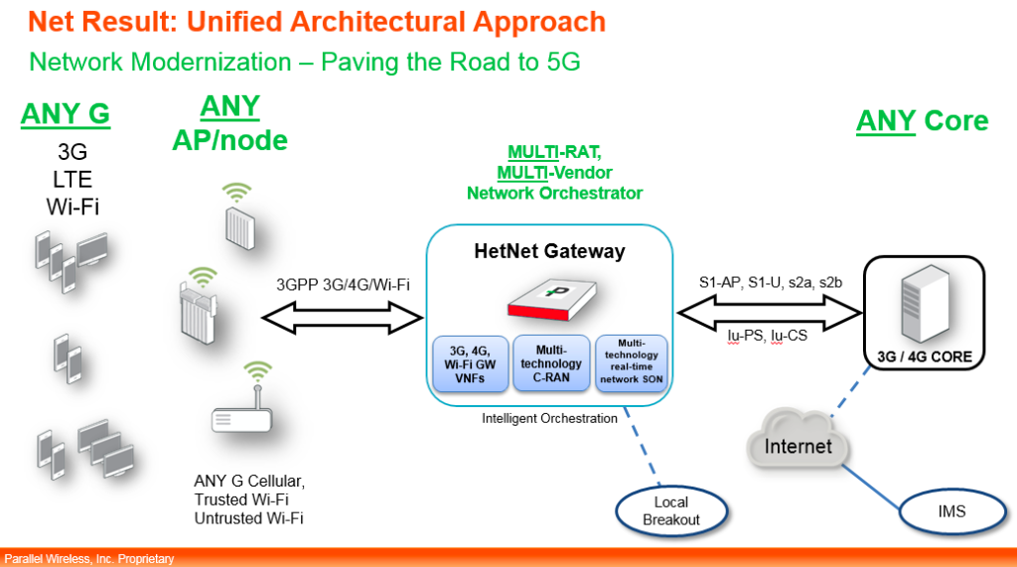
Future Heterogeneous Networks (HetNets)
8/20/20

Slide 4





Delay Analysis
Different multimedia applications have different delay requirement
  Voice/gaming: strict
  Email/Twitter/Wechat: relatively low
  Video/multimedia has different requirement
8/20/20
3

Slide 5
Tools for delay analysis
Network calculus: deterministic network calculus (DNC) and stochastic network calculus (SNC)
DNC: deterministic arrival envelope and deterministic service envelope (work-conserving constant rate servers and leaky-bucket traffic regulators) —> worst case quality of service
SNC: statistical envelopes follow from moment generation functions (MGFs) by use of Chernoff’s bound
  Effective bandwidths theory: end-to-end probabilistic network calculus; inaccurate results for bursty arrivals
  Martingale theory: investigate end-to-end delay performance of different data services
Lyopunov stability
Age of Information
4

Slide 6
Table of Contents
Background
Mathematical Tool Set 1
  MCMC Algorithm
    Bayesian Inference
    Algorithms
  Martingale Bounds
  Stochastic Network Calculus
Mathematical Tool Set 2
  Lyapunov and Stability Theory
  Lyapunov Optimization
  Lyapunov Reinforcement Learning
Mathematical Tool Set 3
  Age of Information
  AoI Applications

Slide 7
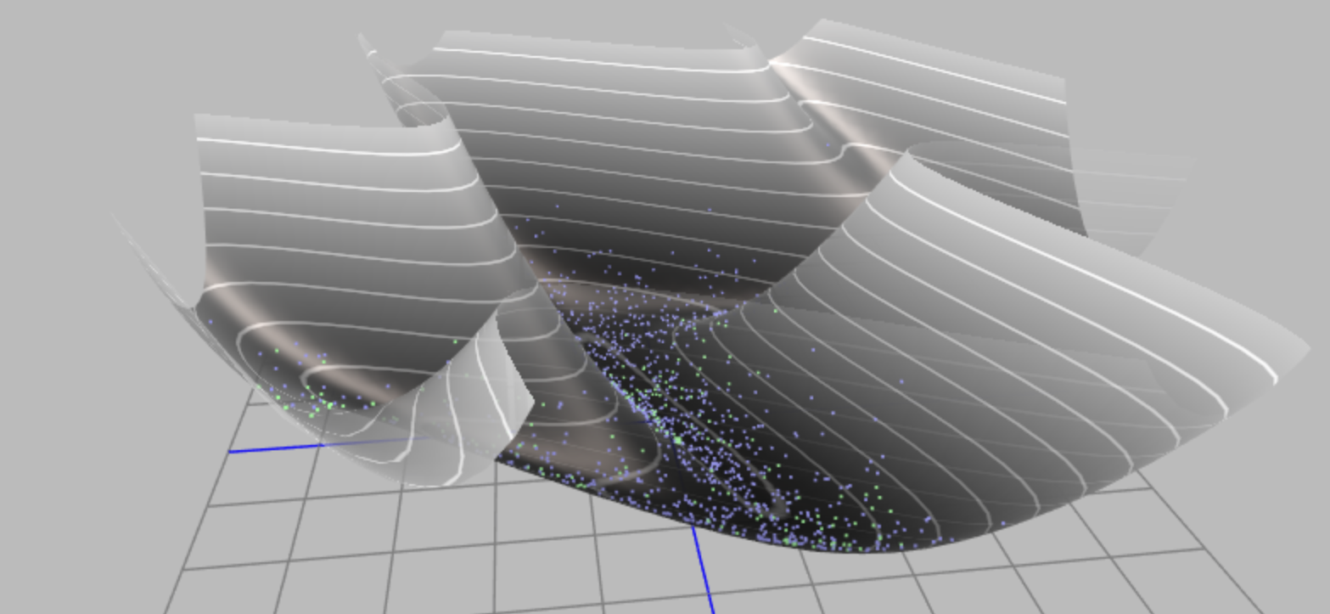
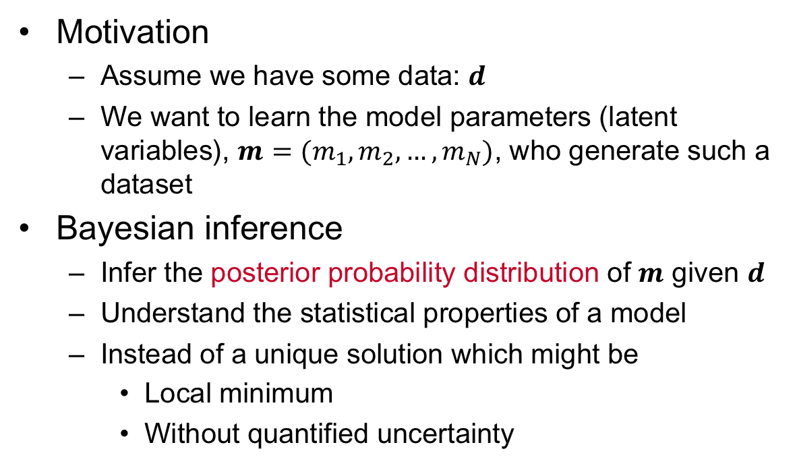
Bayesian inference
Motivation
  Assume we have some data: $d$
  We want to learn the model parameters (latent variables), $m=(m_{1},m_{2},…,m_{N})$, who generate such a dataset
Bayesian inference
  Infer the posterior probability distribution of $m$ given $d$
  Understand the statistical properties of a model
  Instead of a unique solution which might be
    Local minimum
    Without quantified uncertainty

Slide 8

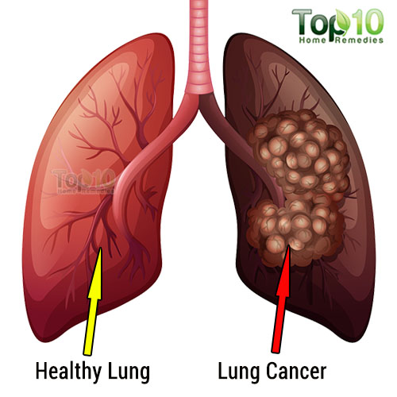


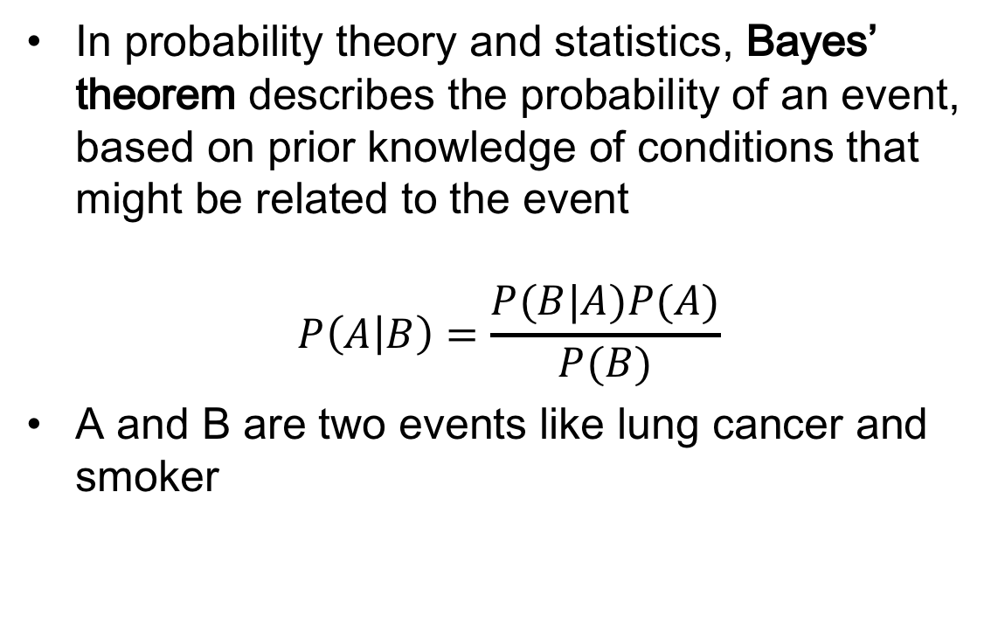

Bayes’ Theorem
In probability theory and statistics, Bayes’ theorem describes the probability of an event, based on prior knowledge of conditions that might be related to the event
$$P\left(A | B\right)=\frac{P(B|A)P(A)}{P(B)}$$
A and B are two events like lung cancer and smoker
Thomas Bayes (1701 - 1761)
$$P(Lung cancer)$$
$$P(Lung cancer|smoker)$$
Conditional probability

Slide 9

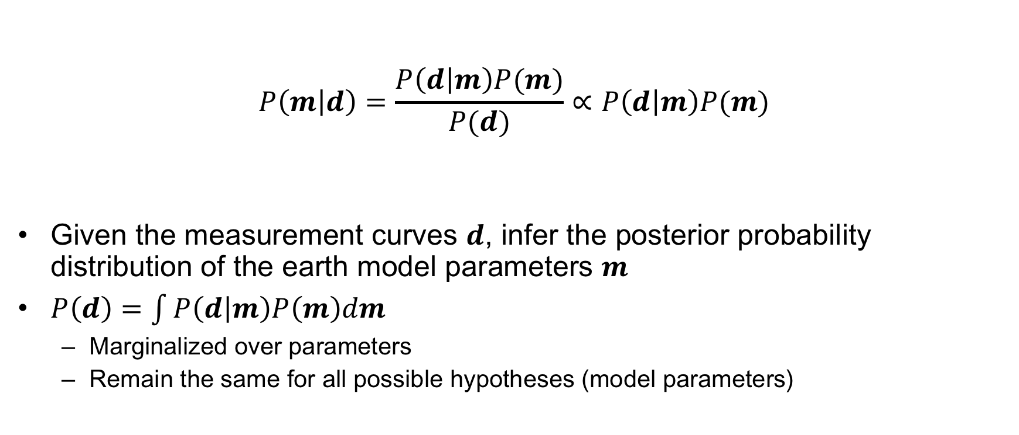
Bayesian Inference
Likelihood
Prior
Posterior
$$P\left(m | d\right)=\frac{P\left(d | m\right)P(m)}{P(d)}∝P\left(d | m\right)P(m)$$
Given the measurement curves $d$, infer the posterior probability distribution of the earth model parameters $m$
$P\left(d\right)=\int{P\left(d | m\right)P\left(m\right)dm}$
  Marginalized over parameters
  Remain the same for all possible hypotheses (model parameters)
Evidence

Slide 10
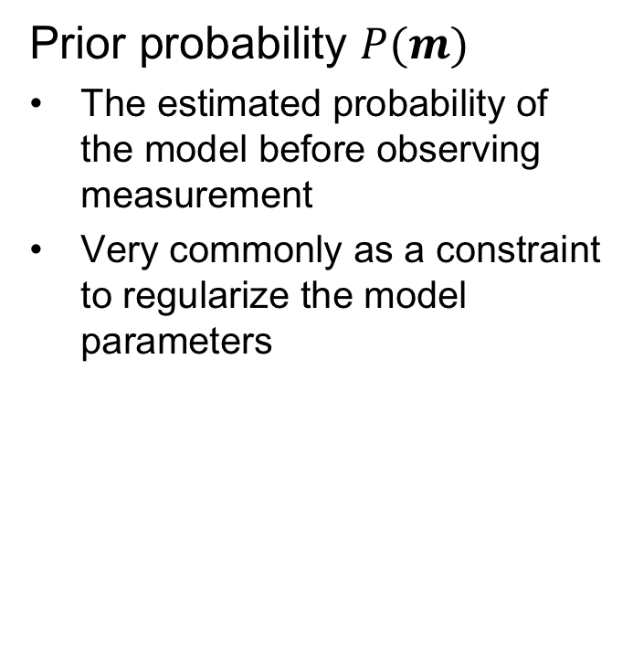
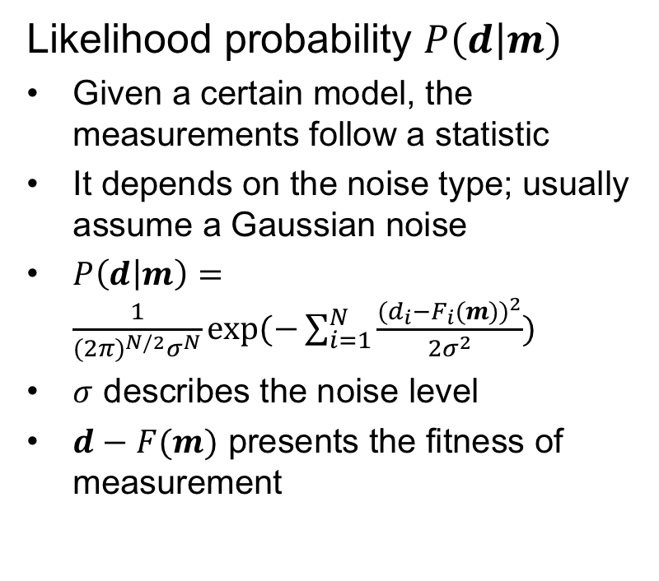
Likelihood and prior
Likelihood probability $P\left(d | m\right)$
Given a certain model, the measurements follow a statistic
It depends on the noise type; usually assume a Gaussian noise
$P\left(d | m\right)=\frac{1}{{(2π)}^{N/2}σ^{N}}exp⁡(−\sum_{i=1}^{N}{\frac{{(d_{i}−F_{i}(m))}^{2}}{2σ^{2}}})$
$σ$ describes the noise level
$d−F(m)$ presents the fitness of measurement
Prior probability $P(m)$
The estimated probability of the model before observing measurement
Very commonly as a constraint to regularize the model parameters

Slide 11



Markov Chain Monte Carlo (MCMC) Method
posterior probability: $P\left(m | d\right)=\frac{P(d|m)P(m)}{\int{P(d|m)P\left(m\right)dm}}$
To understand the posterior probability distribution, we need a sampling method
MCMC Methods
A class of algorithms sample from a probability distribution
By constructing a Markov chain whose stationary distribution is the same as posterior distribution
Mean?
Posterior Distribution?
Mode?
Range?
Variance?

Slide 12
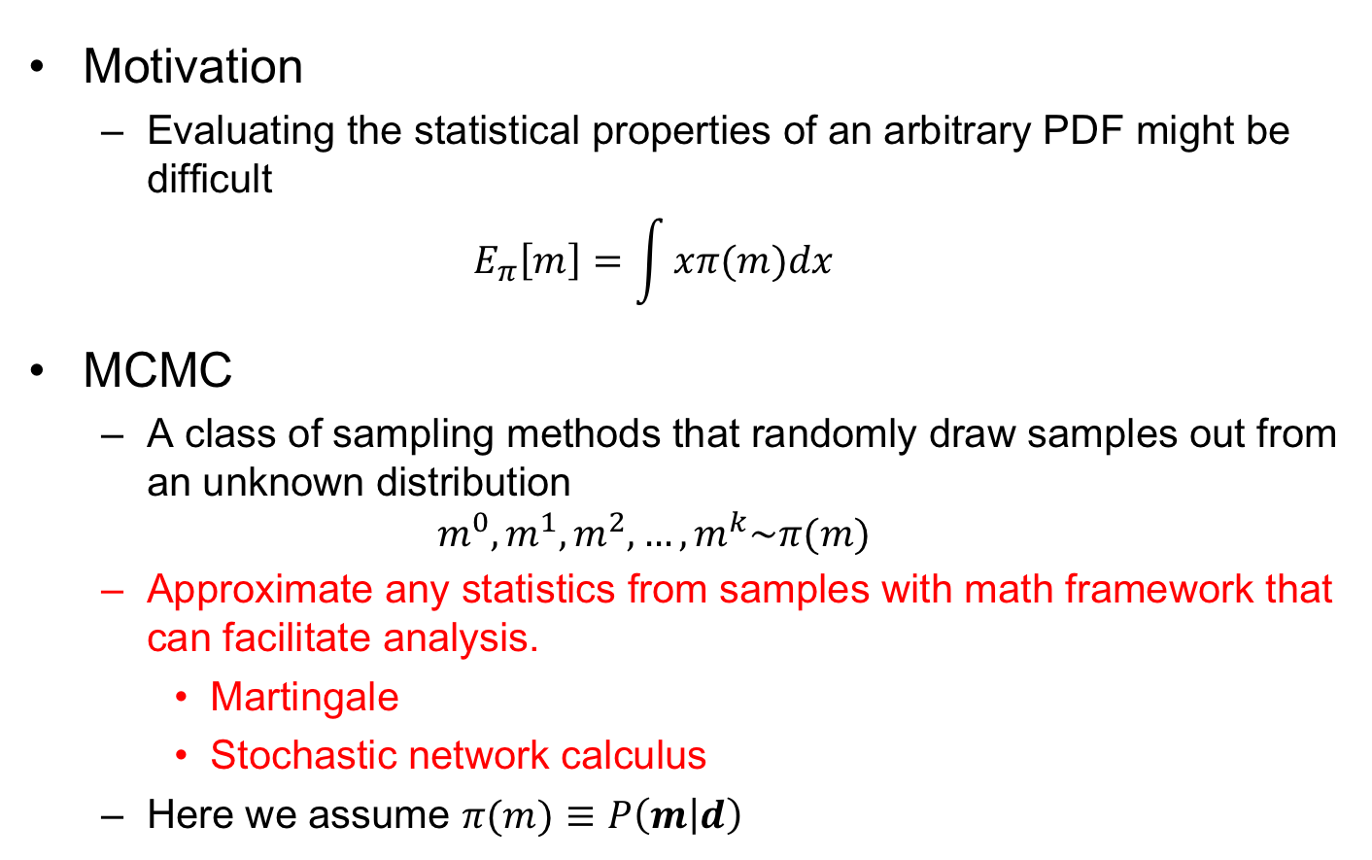
Markov chain Monte Carlo method
Motivation
  Evaluating the statistical properties of an arbitrary PDF might be difficult
  $$E_{π}\left[m\right]=\int{xπ(m)dx}$$
MCMC
  A class of sampling methods that randomly draw samples out from an unknown distribution
  $$m^{0},m^{1},m^{2},…,m^{k}\sim π(m)$$
  Approximate any statistics from samples with math framework that can facilitate analysis.
    Martingale
    Stochastic network calculus
  Here we assume $π(m)≡P\left(m | d\right)$

Slide 13
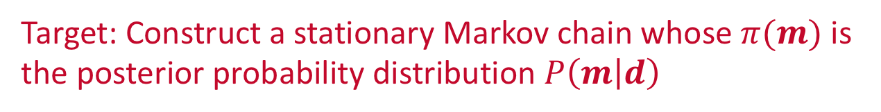
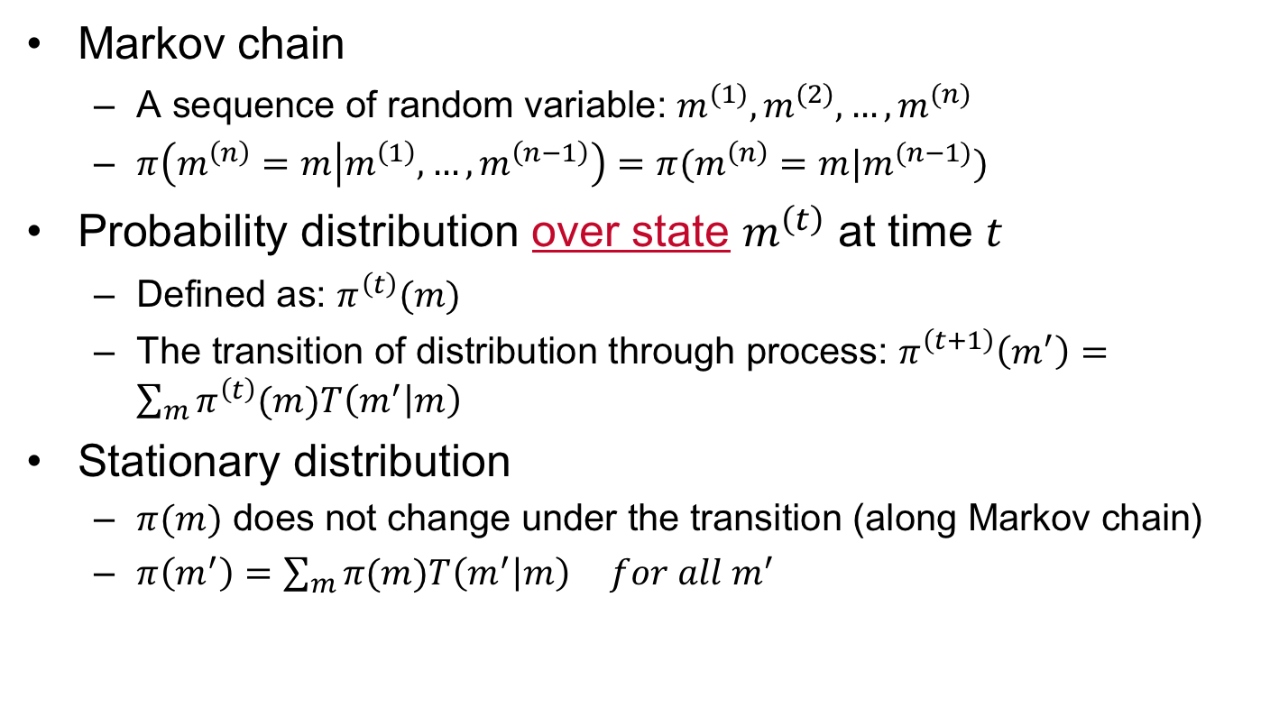

Construct a stationary Markov chain
Markov chain
  A sequence of random variable: $m^{(1)},m^{(2)},…,m^{(n)}$
  $π\left(m^{\left(n\right)}=m | m^{\left(1\right)},…,m^{\left(n−1\right)}\right)=π(m^{\left(n\right)}=m|m^{(n−1)})$
Probability distribution over state $m^{\left(t\right)}$ at time $t$
  Defined as: $π^{\left(t\right)}(m)$
  The transition of distribution through process: $π^{\left(t+1\right)}\left(m^{′}\right)=\sum_{m}{π^{\left(t\right)}(m)T\left(m^{′} | m\right)}$
Stationary distribution
  $π(m)$ does not change under the transition (along Markov chain)
  $π\left(m^{′}\right)=\sum_{m}{π(m)T\left(m^{′} | m\right)} for all m^{′}$
  Transition kernel $T(m^{′}|m)$
Target: Construct a stationary Markov chain whose $π(m)$ is the posterior probability distribution $P\left(m | d\right)$

Slide 14
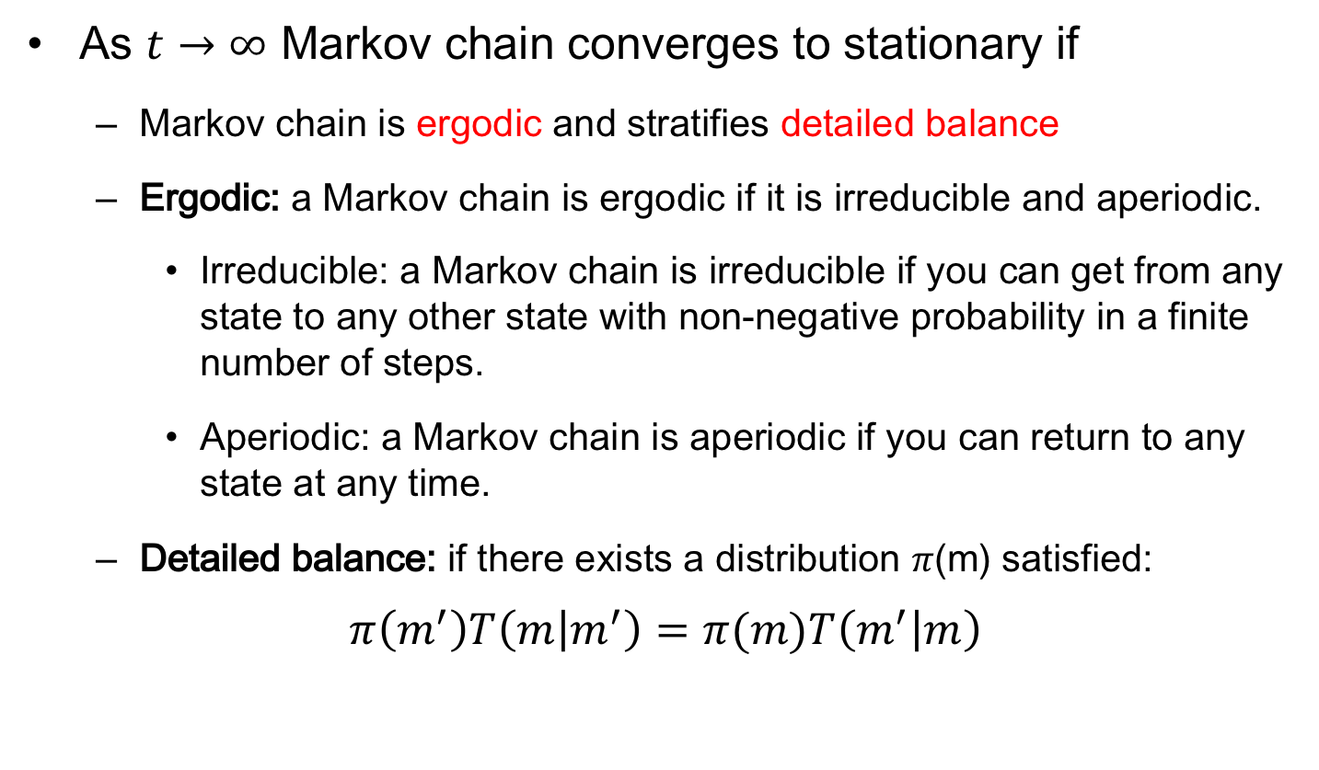
stationary distribution
As $t→∞$ Markov chain converges to stationary if
  Markov chain is ergodic and stratifies detailed balance
  Ergodic: a Markov chain is ergodic if it is irreducible and aperiodic.
    Irreducible: a Markov chain is irreducible if you can get from any state to any other state with non-negative probability in a finite number of steps.
    Aperiodic: a Markov chain is aperiodic if you can return to any state at any time.
  Detailed balance: if there exists a distribution 𝜋(m) satisfied:
$$π\left(m^{′}\right)T\left(m | m^{′}\right)=π(m)T\left(m^{′} | m\right)$$

Slide 15
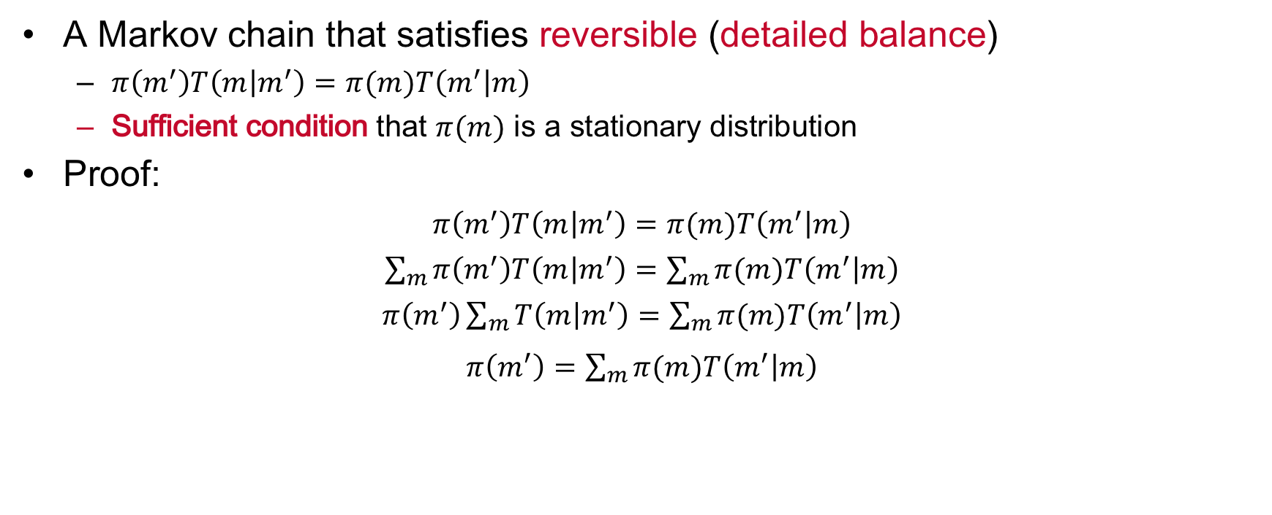
Construct a stationary Markov chain
A Markov chain that satisfies reversible (detailed balance)
  $π\left(m^{′}\right)T\left(m | m^{′}\right)=π(m)T\left(m^{′} | m\right)$
  Sufficient condition that $π(m)$ is a stationary distribution
Proof:
$π\left(m^{′}\right)T\left(m | m^{′}\right)=π(m)T\left(m^{′} | m\right)$
$\sum_{m}{π\left(m^{′}\right)T\left(m | m^{′}\right)}=\sum_{m}{π(m)T\left(m^{′} | m\right)}$
$π\left(m^{′}\right)\sum_{m}{T\left(m | m^{′}\right)}=\sum_{m}{π(m)T\left(m^{′} | m\right)}$
$π\left(m^{′}\right)=\sum_{m}{π(m)T\left(m^{′} | m\right)}$
How to design a transition kernel to achieve detailed balance?

Slide 16
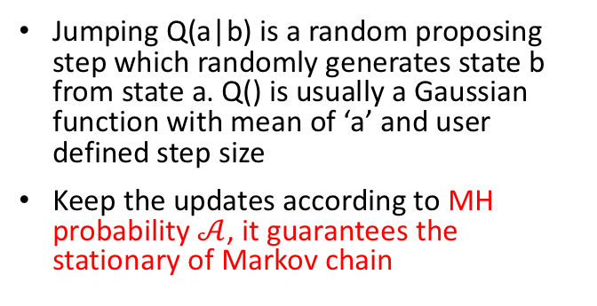
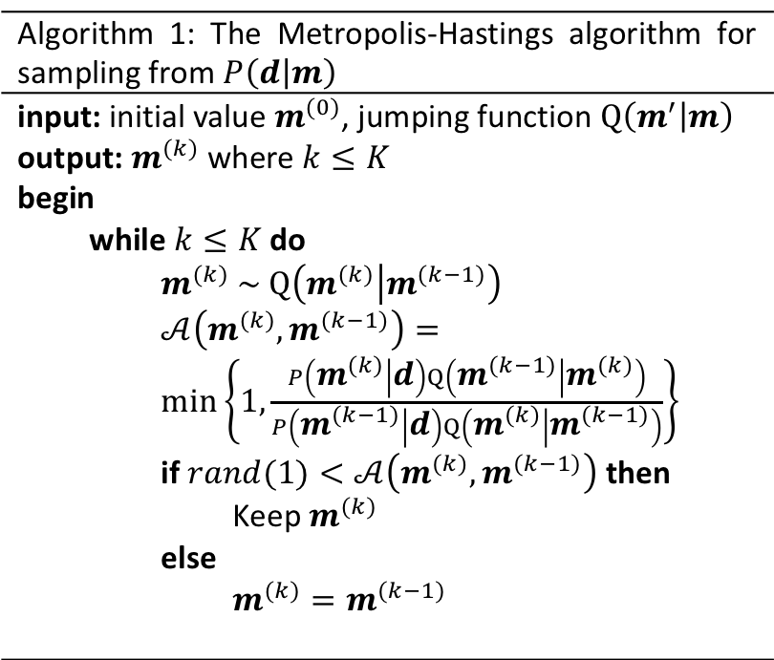
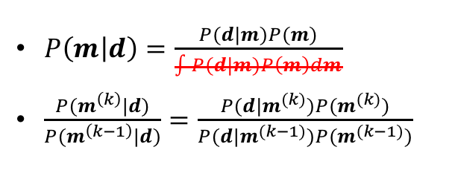
Metropolis-Hastings algorithm
A method that generate a sequence of random samples from a probability distribution iteratively
Algorithm 1: The Metropolis-Hastings algorithm for sampling from $P\left(d | m\right)$
input: initial value $m^{(0)}$, jumping function $Q\left(m^{′} | m\right)$ output: $m^{(k)}$ where $k≤K$ begin while $k≤K$ do $m^{(k)} \sim Q\left(m^{(k)} | m^{(k−1)}\right)$ $𝒜\left(m^{(k)},m^{(k−1)}\right)=\min\left\{1,\frac{P\left(m^{(k)} | d\right)Q\left(m^{(k−1)} | m^{(k)}\right)}{P\left(m^{(k−1)} | d\right)Q\left(m^{(k)} | m^{(k−1)}\right)}\right\}$ if $rand(1)<𝒜\left(m^{(k)},m^{(k−1)}\right)$ then Keep $m^{(k)}$ else $m^{(k)}=m^{(k−1)}$
$P\left(m | d\right)=\frac{P(d|m)P(m)}{\int{P(d|m)P\left(m\right)dm}}$
$\frac{P(m^{\left(k\right)}|d)}{P(m^{\left(k−1\right)}|d)}=\frac{P(d|m^{(k)})P(m^{(k)})}{P(d|m^{(k−1)})P(m^{(k−1)})}$
Jumping Q(a|b) is a random proposing step which randomly generates state b from state a. Q() is usually a Gaussian function with mean of ‘a’ and user defined step size
Keep the updates according to MH probability $𝒜$, it guarantees the stationary of Markov chain

Slide 17
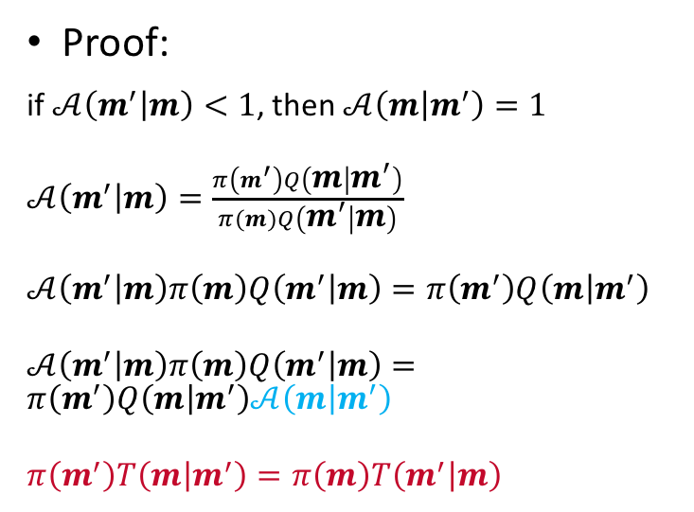
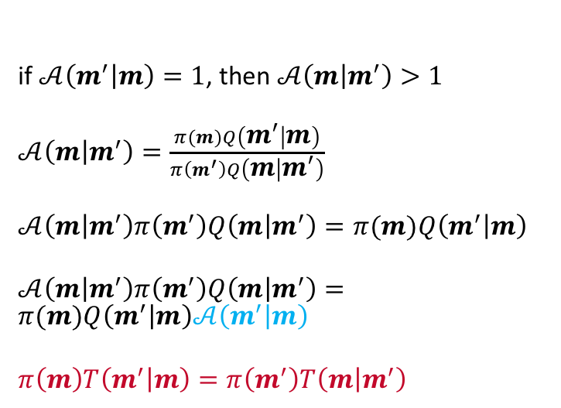
Metropolis-Hastings algorithm
Recall: sufficient condition that $π(m)$ is a stationary distribution
  $π\left(m^{′}\right)T\left(m | m^{′}\right)=π(m)T\left(m^{′} | m\right)$
Proof:
if $𝒜\left(m^{′} | m\right)<1$, then $𝒜\left(m | m^{′}\right)=1$
$𝒜\left(m^{′} | m\right)=\frac{π\left(m^{′}\right)Q\left(m | m^{′}\right)}{π(m)Q\left(m^{′} | m\right)}$
$𝒜\left(m^{′} | m\right)π\left(m\right)Q\left(m^{′} | m\right)=π\left(m^{′}\right)Q\left(m | m^{′}\right)$
$𝒜\left(m^{′} | m\right)π\left(m\right)Q\left(m^{′} | m\right)=π\left(m^{′}\right)Q\left(m | m^{′}\right)𝒜\left(m | m^{′}\right)$
$π\left(m^{′}\right)T\left(m | m^{′}\right)=π\left(m\right)T\left(m^{′} | m\right)$
if $𝒜\left(m^{′} | m\right)=1$, then $𝒜\left(m | m^{′}\right)>1$
$𝒜\left(m | m^{′}\right)=\frac{π(m)Q\left(m^{′} | m\right)}{π\left(m^{′}\right)Q\left(m | m^{′}\right)}$
$𝒜\left(m | m^{′}\right)π\left(m^{′}\right)Q\left(m | m^{′}\right)=π(m)Q\left(m^{′} | m\right)$
$𝒜\left(m | m^{′}\right)π\left(m^{′}\right)Q\left(m | m^{′}\right)=π(m)Q\left(m^{′} | m\right)𝒜\left(m^{′} | m\right)$
$π\left(m\right)T\left(m^{′} | m\right)=π\left(m^{′}\right)T\left(m | m^{′}\right)$

Slide 18
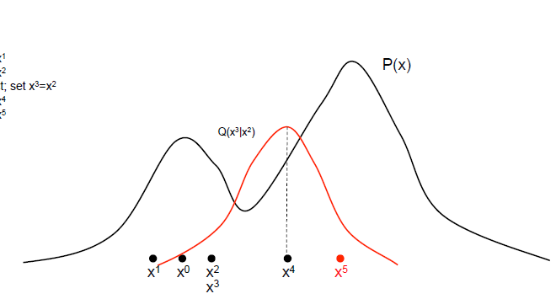
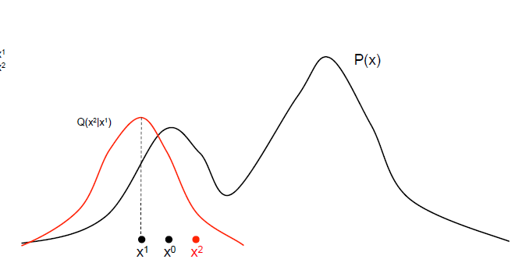
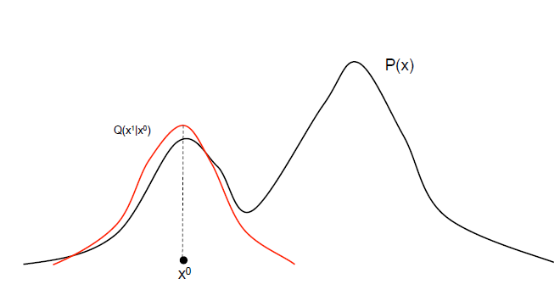
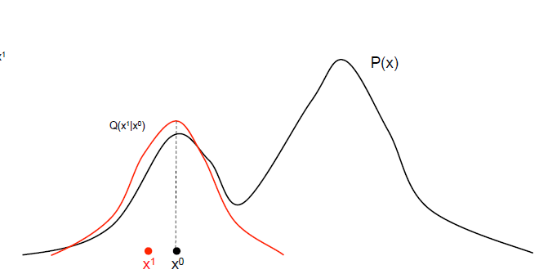
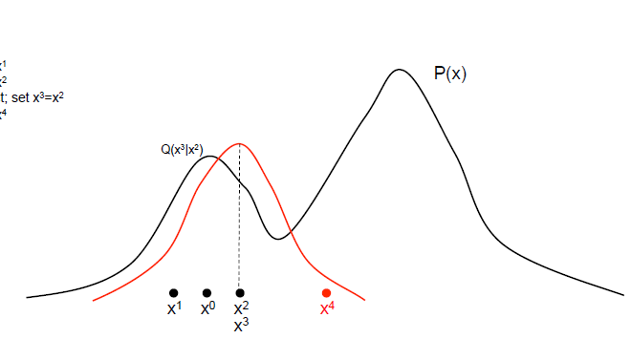
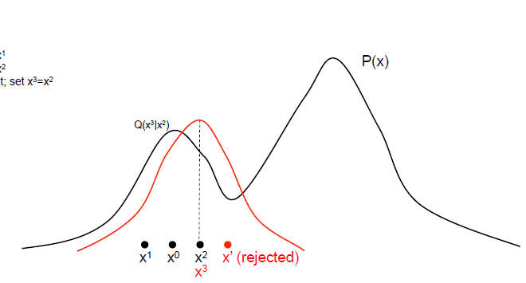
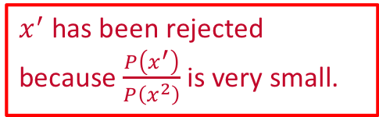
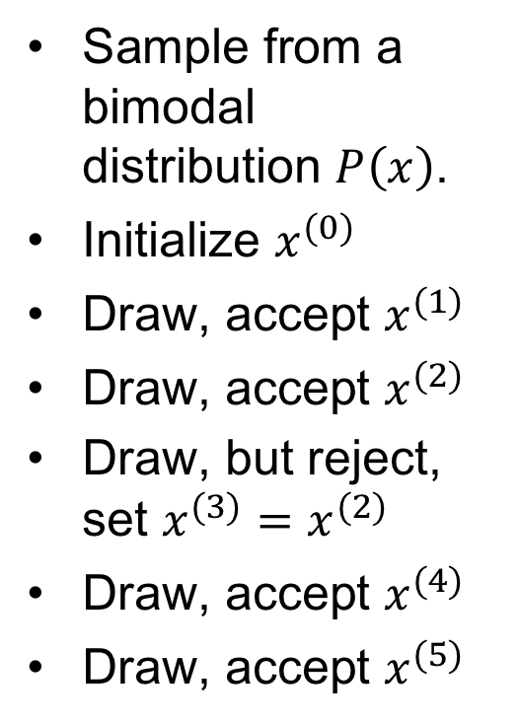
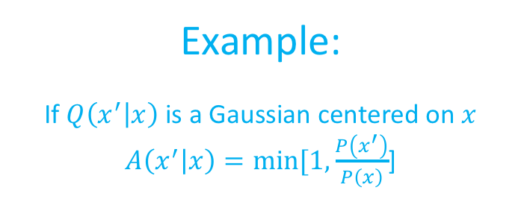
Example:
If $Q\left(x^{′} | x\right)$ is a Gaussian centered on $x$
$A\left(x^{′} | x\right)=min⁡[1, \frac{P\left(x^{′}\right)}{P\left(x\right)}$]
Sample from a bimodal distribution $P\left(x\right)$.
Initialize $x^{(0)}$
Draw, accept $x^{(1)}$
Draw, accept $x^{(2)}$
Draw, but reject, set $x^{(3)}=x^{(2)}$
Draw, accept $x^{(4)}$
Draw, accept $x^{(5)}$
$x^{′}$ has been rejected because $\frac{P\left(x^{′}\right)}{P\left(x^{2}\right)}$ is very small.

Slide 19
Example:
Collect sufficient samples (depends on the problem)
Evaluate the statistics
Draw a histogram

Slide 20
Variation MCMC
A Hybrid Monte Carlo method which combines gradient-drift with random sampling is provided to overcome the low sampling rate problem.
A self-parameterizing scheme using trans-dimensional Markov chain Monte Carlo method is designed to infer the model complexity, which avoid over-parameterizing or under-parameterizing problems.
MCMC is able to mimic the irregular distributions of the active period and inactive period of satellite links, which makes the communications system more accurate.
Summary: MCMC is A bridge from practical data to analysis tools
Qiuyang Shen, Xuqing Wu, Jiefu Chen, and Zhu Han, “Solving Geosteering Inverse Problems by Stochastic Hybrid Monte Carlo Method,” Journal of Petroleum Science and Engineering, vol. 161, p.p. 9-16, February 2018.

Slide 21
Table of Contents
Background
Mathematical Tool Set 1
  MCMC Algorithm
  Martingale Bounds
    Theory
    High Speed Train Example
  Stochastic Network Calculus
Mathematical Tool Set 2
  Lyapunov and Stability Theory
  Lyapunov Optimization
  Lyapunov Reinforcement Learning
Mathematical Tool Set 3
  Age of Information
  AoI Applications

Slide 22

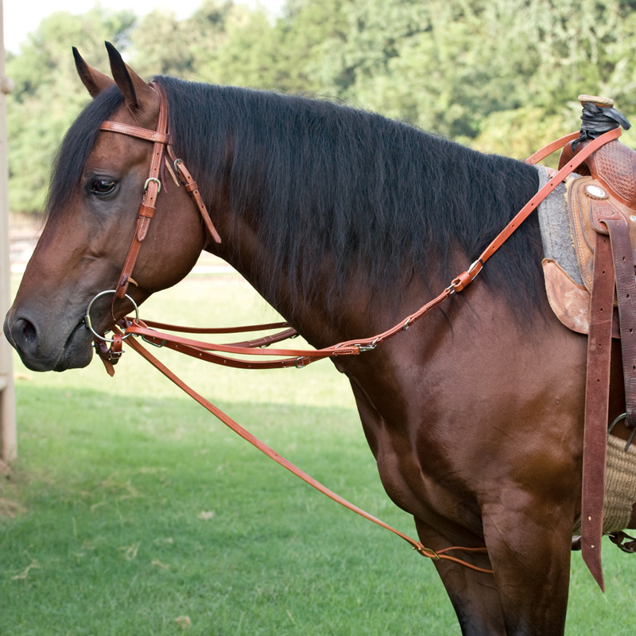
Martingale Concept
Martingale!
Horse’s Cage Set

Slide 23
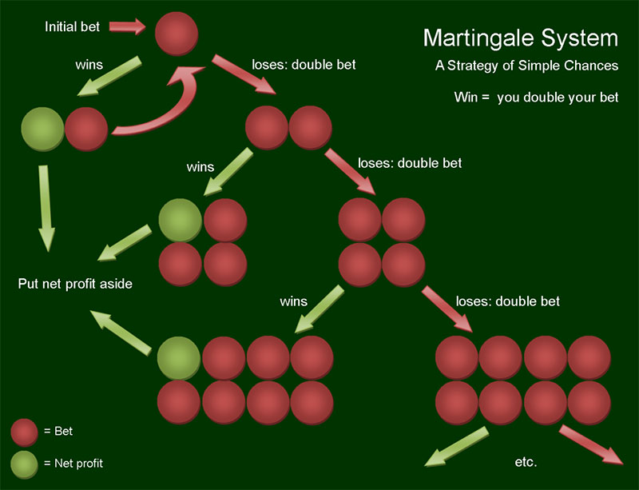
Martingale in Betting System
gambler double his bet after every loss
Betting strategy in 18th-century France: Gambler wins his stake if a coin comes up heads and loses it if the coin comes up tails
first win recover all previous losses plus win a profit equal to the original stake

Slide 24
Martingale in Betting System
Exponential growth of the bets would eventually bankrupt gamblers who chose to use the martingale
Wealth and available time approach infinity;
Probability of eventually flipping heads approaches 1;
Martingale betting strategy seem like a sure thing

Slide 25
Basic Definition of Martingale Process
A discrete-time martingale is a discrete-time stochastic process (a sequence of random variables) that satisfies for any time n
Due to the linearity of expectation,
or

Slide 26
Martingale sequences with respect to another sequence
A sequence is a martingale with respect to another sequence if for all n
A continuous-time martingale:
The conditional expectation of an observation at time t, given all the observations up to time s , is equal to the observation at time s.

Slide 27
Submartingales
A sequence of integrable random variables satisfying
Discrete time:
Continuous time:
Examples:
  Every martingale is a submartingale;
  A convex function of a martingale is a submartingale;
  Betting strategy: suppose that the coin may be biased, so that it comes up heads with probability p. If p is greater than 1/2, the gambler wins money on average, and the gambler's fortune over time is a submartingale.

Slide 28
Supermartingales
A sequence of integrable random variables satisfying
Discrete time:
Continuous time:
Examples:
  Every martingale is a supermartingale;
  A concave function of a martingale is a supermartingale;
  Betting strategy: suppose that the coin may be biased, so that it comes up heads with probability p. If p is less than 1/2, the gambler wins money on average, and the gambler's fortune over time is a supermartingale.

Slide 29
Stopping Time
A stopping time with respect to a sequence of random variables is a random variable with integral values and the property that for each , the occurrence or non-occurrence of the event depends only on the values of .
Playing exactly five games corresponds to the stopping time τ = 5, is a stopping rule.
Playing until he has the maximum amount ahead he will ever be is not a stopping rule and does not provide a stopping time: Require information about the future, the present and past.

Slide 30
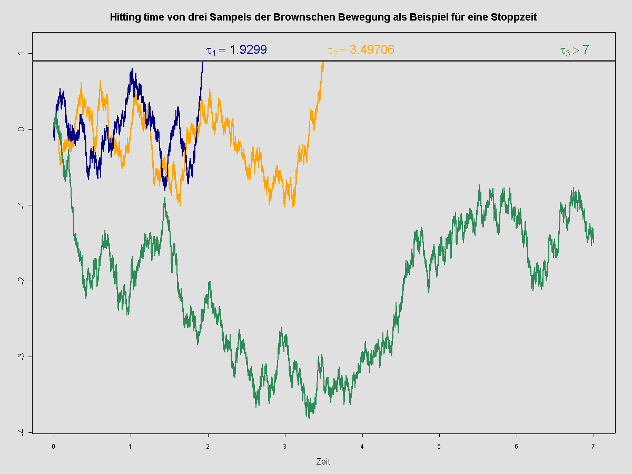
Stopping Time
River
Drunk guy
A hitting time of Brownian motion. The process starts and is stopped as soon as it hits threshold.

Slide 31
Stopping Time Process
X is a process and τ is a stopping time, then X^{τ} is used to denote the process X stopped at time τ:
Stopping times are frequently used to generalize certain properties of the stochastic processes
Local martingale process: A process X is a local martingale if it is right continuous left limit. There exists a sequence of stopping times τ_{n} , :
is a martingale for every n.
Locally integrable process:

Slide 32
Optimal Stopping Theory
The expected value of a martingale at a stopping time is equal to the expected value of its initial value:
  is a discrete time martingale and τ is a stopping time:
  A gambler’s fortune can be modeled as a martingale process in a fair game. It says that on the average nothing can be gained by stopping to play the game based on the information obtainable so far (i.e., by not looking into the future).

Slide 33
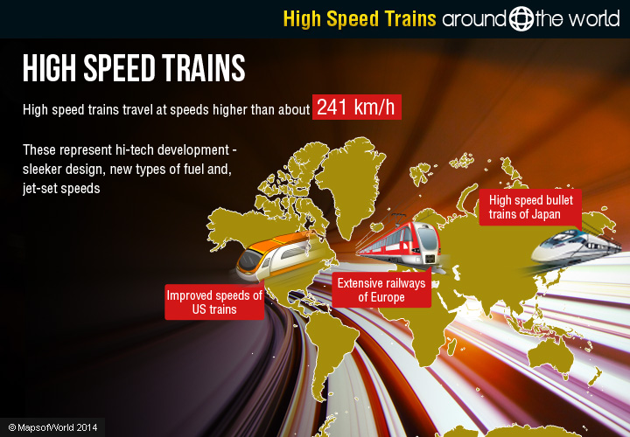

High Speed Train Communication System
Very high Doppler effect
Short, bursty and periodic time for access point
Yun Hu, Zheng Chang, Hongyan Li, Tapani Ristaniemi, and Zhu Han, “Service Provisioning and User Association for Heterogeneous Wireless Railway Networks,” IEEE Transactions on Communications, vol. 65, no. 7, pp. 3066-3078, July 2017
Yun Hu, Hongyan Li, Zheng Chang, Jiandong Li, and Zhu Han, “Scheduling Strategy for Multimedia Heterogeneous High-Speed Train Networks,” IEEE Transactions on Vehicular Technology, vol. 66, no. 4, pp. 3264–3279, April 2017.
8/20/20

Slide 34
Martingale Delay Analysis for High-Speed Train System
1. Voice over IP (VoIP): hard to guarantee successive voice service
2. Multimedia (gaming, UDP): delay insensitive, different delay requirements
3. Trackside access points (TAPs): heavy Doppler effect, time varying fast fading channel
4. Base stations (BSs): comparative slow speed channel
For a high-speed train system, an accurate and adaptive delay bound analysis is necessary!

Slide 35
Network Topology
What is the end-to-end delay bound of VoIP and multimedia when traversing the servers BS or TAP under a specific scheduling policy such as first in first out (FIFO) or earliest deadline first (EDF)?

Slide 36
Key Notations
Bivariate arrival process
Bivariate service process
  Service process acts like an impulse-response in linear and time invariant system
  Service curves describe versatile network functions such as routers, schedulers, and links in SNC
Departure process

Slide 37
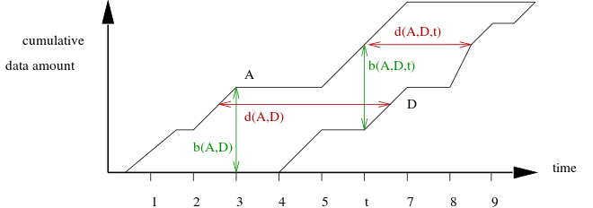
Physical Meaning
Delay process: the horizontal distance
Arrival process:
Martingale envelop
Q(A,D,t)
W(A,D,t)
Q(A,D)
Service process:
Martingale envelop
W(A,D)
Backlog process: the vertical distance

Slide 38
Key Notations
Backlog process :
  Amount of data at time n comprising of the stored data in the buffer and that are in transmission
  Queue length of the system at time n
Delay process :
  The time a data unit would have stayed in the system if it had departed at time unit n

Slide 39
Some Definitions
(Supermartingale Envelope for Arrivals). For monotonically increasing function and for every , it is said that the arrival flow admits -supermartingale envelope, such that the process
is bounded by the arrival supermartingale .
(Supermartingale Envelope for Services). For monotonically increasing function and for every , it is said that the service process admits
-supermartingale envelope, such that the process
is bounded by the service supermartingale .
Martingale sample-path bound for
Markov arrivals and services;
Exponential transform determines
the decay rate of queuing metrics;
Very flexible analysis for arrival process and service process

Slide 40
Arrival Process Model
Bursty source is modelled by a Markov-Modulated On-Off (MMOO) process
is a Markov chain with state space
successful transmission probability
Transition matrix of the Markov chain
Steady-state distribution
failure transmission probability
Peak transmission rate in state 1

Slide 41
Service Process Model
CSMA/CA channel: Carrier sense and collision avoidance by transmitting only when the channel is sensed to be ‘‘idle’’
Service process: Markov chain with state space
probability of a successful transmission
Transition matrix of service process
Steady-state distribution
probability of a unsuccessful transmission

Slide 42
Martingale Envelope Parameters
exponential transition matrix for Markov process X(n) as A(n) or S(n)
spectral radius, largest positive eigenvalue
corresponding right eigenvector
for arrival supermartingale envelope
for service supermartingale envelope
threshold
41

Slide 43
Per-Flow Delay Analysis
Theorem 1. (Martingale Delay Bound for FIFO). The FIFO server schedules the arrival data units of A_{a} (n) and A_{b} (n) according to their coming times. The extended bivariate stochastic service process for FIFO scheduling algorithm can be presented as

Slide 44
Martingale Delay Bound for FIFO
Arrival processes bounded by
Service process bounded by
According to independence assumption, for
is a newly constructed supermartingale
By stationary, time-shifted supermartingale process is also a supermartingale

Slide 45
Martingale Delay Bound for FIFO
Backlog process:
Define a stopping time N for
Applying optimal stopping theorem
Expectation of a supermartingale is non-increasing
violation value of backlog

Slide 46
Martingale Delay Bound for FIFO
Backlog process distribution for A_{a} (n)
Delay process distribution for A_{a} (n)
initial value of supermartingale

Slide 47
Per-Flow Delay Analysis by Martingale
Theorem 2. (Martingale Delay Bound for EDF). An EDF server process is constructed by combing the relative deadlines and the arriving process. In EDF scheduling, all data units are transmitted in the order of their remaining deadlines. Here we use the definition of the extended bivariate stochastic service process for EDF scheduling algorithm from
where y denotes the difference of two arrivals’ deadlines.

Slide 48
Martingale Delay Bound for EDF
Delay process distribution for A_{a} (n):
for y>0,
for y<0,

Slide 49
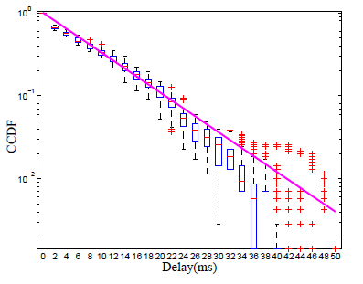
Simulation Results—FIFO
continuous line represents martingale bound, boxplot represents simulation result
Complementary cumulative distribution function (CCDF) of end-to-end delay for FIFO with VoIP and multimedia data sets

Slide 50
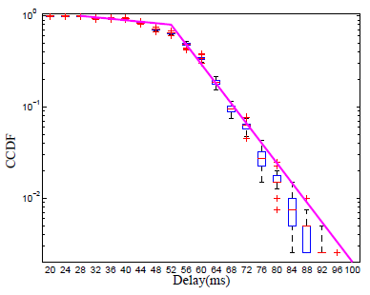
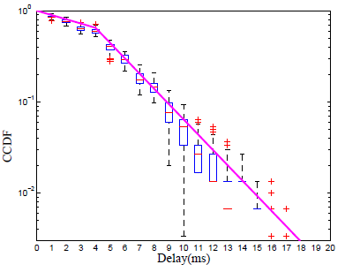
Simulation Results—EDF
Deadline of A_{a} (VoIP) is set 50ms, deadline of A_{b} (multimedia) is set 500ms
CCDF of end-to-end delay for EDF1 /EDF2 with VoIP and multimedia data sets

Slide 51
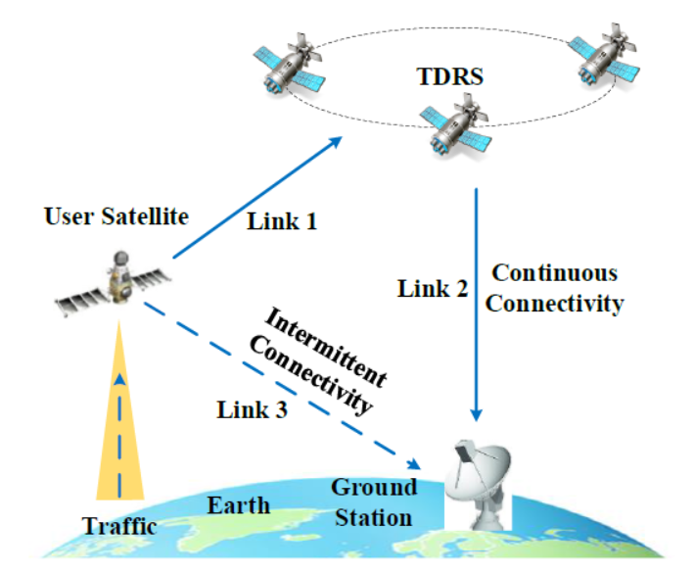
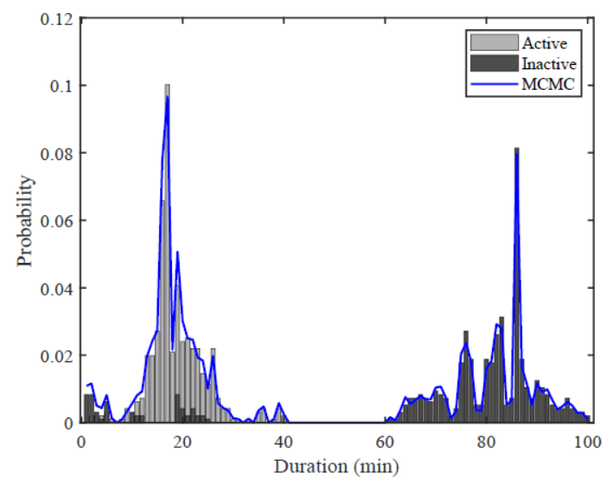
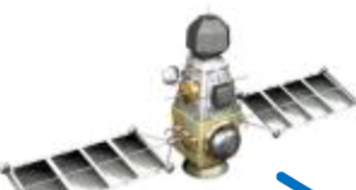



Satellite Communications System
1. Multimedia (VoIP, image, video): delay insensitive, different delay requirements
2. Ground Stations (GSs): time varying, fast speed intermittent channel
3. Relay Satellites (RSs): comparative slow speed channel
Fig. Intermittent link feature
User satellite
Traffic input
For a high-dynamic satellite system, an accurate and adaptive delay bound analysis is necessary!
Continuous
link
Intermittent
link
Ground
station
Relay
satellite
Yan Zhu, Min Sheng, Jiandong Li, Di Zhou, and Zhu Han, “Minimum Delay Based Traffic Allocation in Satellite Networks with Heterogeneous Links,” IEEE Transactions on Vehicular Technology.

Slide 52
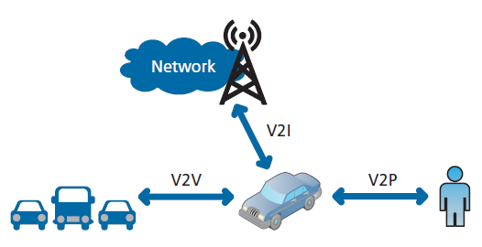
VANETS
Third Generation Partnership Project (3GPP) approves LTE support for vehicle-to-everything (V2X) services
V2X service covers LTE-based communication for vehicle-to-vehicle (V2V), vehicle-to-infrastructure (V2I), and vehicle-to-pedestrian (V2P) service
Tingting Liu, Linlin Sun, Riqing Chen, Feng Shu, Xiaobo Zhou, Zhu Han, “Martingale Theory-based Optimal Task Allocation in Heterogeneous Vehicular Networks,” IEEE Access, vol. 7, pp. 122354–122366, May 2019.
Yun Hu, S Hongyan Li, Zheng Chang, and Zhu Han, “End-to-End Backlog and Delay Bound Analysis based on Martingale Theory for Multi-Hop Vehicular Ad Hoc Networks,” IEEE Transactions on Wireless Communications, vol. 16, no. 10, p.p. 6808-6821, October 2017

Slide 53
Table of Contents
Background
Mathematical Tool Set 1
  MCMC Algorithm
  Martingale Bounds
  Stochastic Network Calculus
Mathematical Tool Set 2
  Lyapunov and Stability Theory
  Lyapunov Optimization
  Lyapunov Reinforcement Learning
Mathematical Tool Set 3
  Age of Information
  AoI Applications

Slide 54
Outline For SNC
Stochastic Network Calculus
Arrival Envelopes
Service Envelopes
Backlog and Delay Bounds
Applications
Convolution-Form Networks
Statistical Multiplexing

Slide 55


Stochastic Network Calculus
How long will
it take?
Processing time is
too long.
Wait or not?
How to evaluate the network performance metrics?

Slide 56
Network Calculus
R.Cruz. lays the foundation of Network Calculus.
[1] R. L. Cruz. A calculus for network delay, Part I: Network elements in isolation. IEEE Transactions on Information Theory, 37(1):114-131, January 1991.
[2] R. L. Cruz. A calculus for network delay, Part II: Network analysis. IEEE Transactions on Information Theory, 37(1):132-141, January 1991.
Goal:
A theoretical framework to analyze performance guarantees (maximum delays, maximum buffer space requirements…) in network.
Transform complex non-linear network systems into analytically tractable linear systems.
However, performance too poor with classic models such as M/M/1 and also need to a search for bound.

Slide 57
DNC Network Calculus
Deterministic Network Calculus (DNC)
Provides deterministic service guarantee that all packets of a flow arrive at the destination within its required performance (as throughput, delay, and loss bounds).
Provides the highest QoS level.
Drawback---must reserve network resources based on the worst-case scenario and hence leaves a significant portion of network resources unused.

Slide 58
SNC Network Calculus
Stochastic Network Calculus (SNC)
Provides stochastic service guarantee that allows the QoS to be guaranteed with a probability .
Allowing some packets to violate the required QoS measures.
Advantage—better exploit the statistical multiplexing gain at network links and hence improve network utilization.

Slide 59
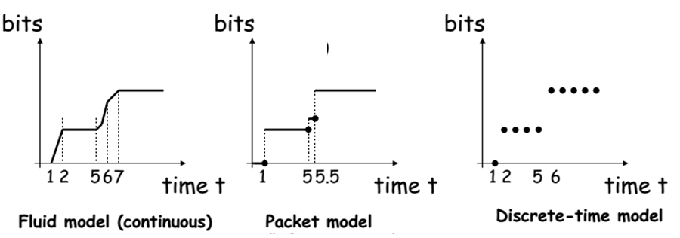
QoS
Cumulative function
Describe the data flow as the number of bits in time interval.
A1(t)
A2(t)
A3(t)

Slide 60


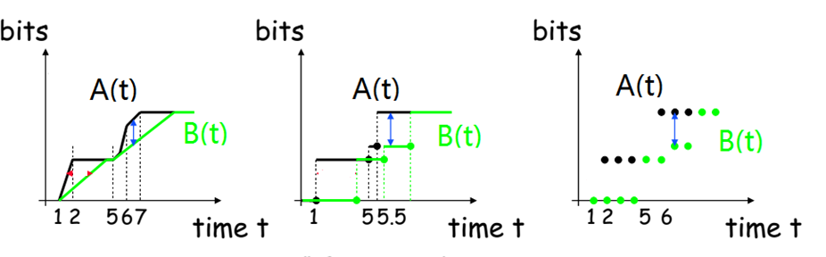
QoS---Backlog
Definition: For a lossless system
The amount of bits that are held inside the system.
vertical deviation between input and output functions

Slide 61
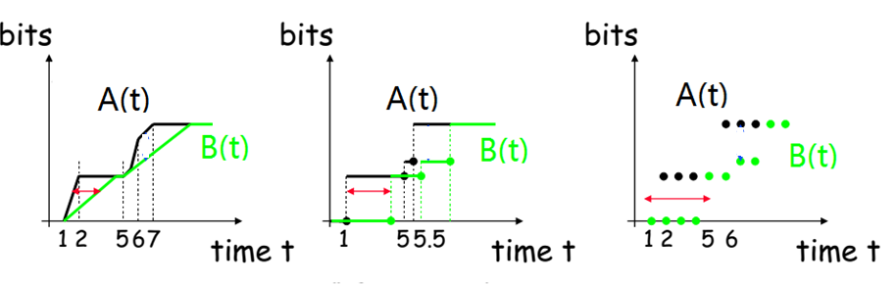
QoS ---Delay
Definition: For a lossless system, the virtual delay is
$$d\left(t\right)=inf⁡\{τ≥0:A(t)≤B(t+τ)\}$$
The delay that would be experienced by a bit arriving at time t if all bits received before it are served.
Horizontal deviation

Slide 62
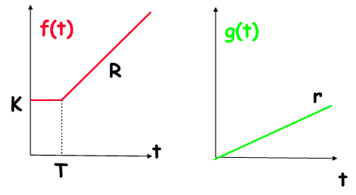
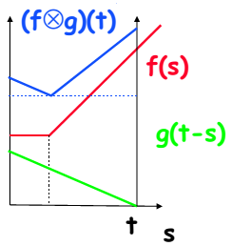
Mathematical basis for NC
Four network operations----reduce the complexity
Min-plus
algebra

Slide 63


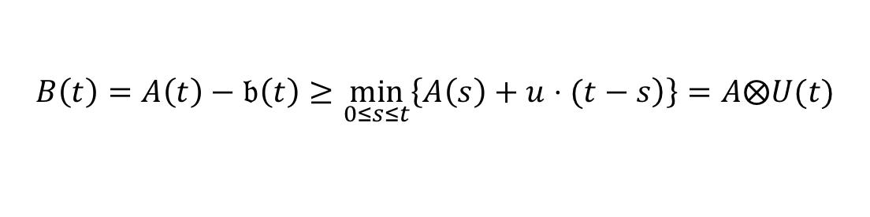
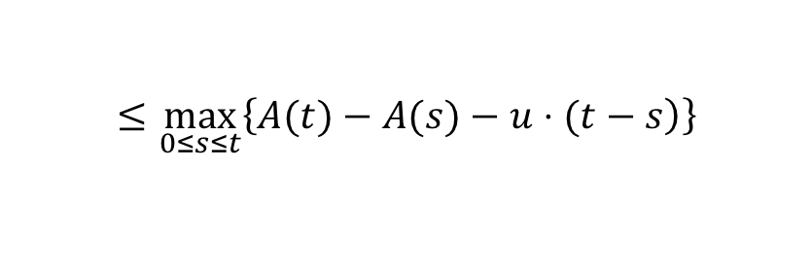
Ex: Why use convolution
Scenario
Service element has constant service rate u
Assumption
No data is lost or produced inside the service element
Backlog
New arrivals
$$b\left(t\right)≔A\left(t\right)⊖B\left(t\right)=A\left(t\right)−B(t)$$
Processed data
Service envelope
Backlog at time t
$$≤\max_{0≤s≤t}\left\{\left.A(t)−A(s)−u⋅(t−s\right)\right\}$$
$$B\left(t\right)=A\left(t\right)−𝔟\left(t\right)≥\min_{0≤s≤t}\left\{\left.A\left(s\right)+u⋅(t−s\right)\right\}=A⨂U(t)$$

Slide 64
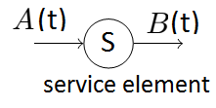
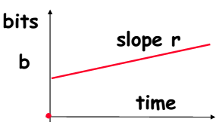


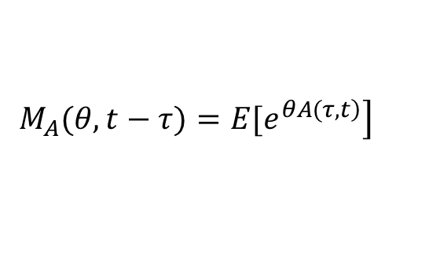
Arrival Envelopes
For any times 0 ≤ s ≤ t, the cumulative flow A(.) satisfies
$A\left(t\right)−A(s)≤ρ(t−s)$+b
A drawback of the deterministic envelope is it considers the worst-case but cannot take advantage of the statistical nature of traffic
Solution: introducing the Moment Generating Function (MGF)
$$ρ$$
$$\left.M_{A}(θ,t−τ)=E[e^{\left.θA(τ,t\right)}\right]$$

Slide 65




Arrival Envelopes
MGF
$$\left.M_{A}(θ,t−τ)=E[e^{\left.θA(τ,t\right)}\right]$$
MGF envelope [4], [8]
$$E\left[e^{\left.θA(τ,t\right)}\right]≤e^{θ\left(ρ(t−τ)+σ\right)}$$
A related statistical envelope, referred to as Exponentially Bounded Burstiness (EBB), is defined in [9] to provide a guarantee of the form
$$\left.P[A(τ,t)>ρ(t−τ)+b]≤ε(b\right)$$
$$ε\left(b\right)=αe^{−θb}≜e^{θσ}e^{−θb}$$
[4] C.-S. Chang, Performance Guarantees in Communication Networks London, U.K.: Springer-Verlag, 2000.
[8] C.-S. Chang, “Stability, queue length and delay of deterministic and stochastic queueing networks,” IEEE Trans. Autom. Control, vol. 39, no. 5, pp. 913–931, May 1994.
[9] O. Yaron and M. Sidi, “Performance and stability of communication networks via robust exponential bounds,” IEEE/ACM Trans. Netw., vol. 1, no. 3, pp. 372–385, Jun. 1993.

Slide 66





Arrival Envelopes
The EBB model is directly connected to the MGF envelope by the Chernoff’s bound
$$\left.P[X≥x]≤e^{−θx}E[e^{θX}\right]$$
We obtain
$$ε\left(b\right)=e^{θσ}e^{−θb}$$
$$\left.P[A(τ,t)>ρ(t−τ)+b]≤ε(b\right)$$
Extend to the arbitrary
$$τ$$
$$\left.P[∃τ∈\left[0,t\right]:A(τ,t)>ρ′(t−τ)+b]≤ε′(b\right)$$

Slide 67


Arrival Envelopes
By the union bound
$$P[∃i:X_{i}≥x]≤∑_{i}P[X_{i}≥x]$$
We have
$$\begin{matrix}\left.P[∃τ∈[0,t]:A(τ,t)>ρ′(t−τ)+b\right] \\ ≤\sum_{τ=0}^{t}{e^{θσ}e^{\left.−θ(b+δ(t−τ)\right)}} \\ ≤e^{θσ}e^{−θb}\sum_{τ=0}^{∞}{e^{−θδτ}} \\ =\frac{e^{θσ}e^{−θb}}{1−e^{−θδ}}=ε′(b)\end{matrix}$$
Let ρ’ = ρ + δ.
where θ > 0 and δ > 0 are free parameters that can be optimized.
We obtain the relationship between the θ, σ, ε’, δ and b.

Slide 68



Service Envelopes
A service element has the input-output pair A and B.
The service element provides a service curve
$$B\left(t\right)−A(s)≥U(t−s)$$
A deterministic definition of service envelope for all t ≥τ ≥ 0 is
S(τ, t) ≥ ρ(t − τ ) − b

Slide 69



Service Envelopes
An affine envelope of the MGF can be defined for θ ≥ 0 as
$$E\left[e^{\left.−θS(τ,t\right)}\right]≤e^{−θ\left(ρ\left(t−τ\right)−σ\right)}$$
Statistical service envelopes that mirror the concept of EBB are defined in [27] as the so-called Exponentially Bounded Fluctuation (EBF) model with parameters ρ > 0, b ≥ 0 and
$$\left.P[S\left(τ,t\right)>ρ\left(t−τ\right)−b]≤ε(b\right)$$
$$ε\left(b\right)=αe^{−θb}≜e^{θσ}e^{−θb}$$
[27] K. Lee, “Performance bounds in communication networks with variablerate links,” in Proc. ACM SIGCOMM, Aug. 1995, pp. 126–136.

Slide 70





Service Envelopes
With the Chernoff’s lower bound
$$\left.P[X≤x]≤e^{θx}E[e^{−θX}\right]$$
We obtain
$$ε\left(b\right)=e^{θσ}e^{−θb}$$
$$\left.P[S\left(τ,t\right)>ρ\left(t−τ\right)−b]≤ε(b\right)$$
Extend to the arbitrary
$$τ$$
$$\left.P[∃τ∈\left[0,t\right]:S\left(τ,t\right)>ρ^{′}\left(t−τ\right)−b]≤ε′(b\right)$$

Slide 71




Service Envelopes
By the union bound
$$P[∃i:X_{i}≥x]≤∑_{i}P[X_{i}≥x]$$
We have
$$\begin{matrix}\left.P[∃τ∈\left[0,t\right]:S\left(τ,t\right)>ρ^{′}\left(t−τ\right)−b\right] \\ ≤\sum_{τ=0}^{t}{e^{θσ}e^{\left.−θ(b+δ(t−τ)\right)}} \\ ≤e^{θσ}e^{−θb}\sum_{τ=0}^{∞}{e^{−θδτ}} \\ =\frac{e^{θσ}e^{−θb}}{1−e^{−θδ}}=ε′(b)\end{matrix}$$
Let ρ’ = ρ - δ.
$$\left.P[S\left(τ,t\right)>ρ\left(t−τ\right)−b]≤ε(b\right)$$
$$ε\left(b\right)=αe^{−θb}≜e^{θσ}e^{−θb}$$
where θ > 0 and δ > 0 are free parameters that can be optimized.
We obtain the relationship between the θ, σ, ε’, δ and b.

Slide 72





Backlog and Delay Bounds
Consider arrivals with envelope
$$A(τ,t)≤ρ′_{A}(t−τ)+b_{A}$$
Also, consider service with envelope
$$S(τ,t)≥ρ′_{S}(t−τ)+b_{S}$$
Backlog bound
$$B\left(t\right)≤A\left(t\right)⊘S\left(t\right)=\max_{\left.τ∈[0,t\right]}\{A(τ,t)−S(τ,t)\}.$$
$$b=\max_{\left.τ∈[0,t\right]}\{ρ′_{A}(t−τ)+b_{A}−{\left[ρ′_{S}(t−τ)−b_{S}\right]}_{+}\}.$$
$$P[B(t)>b]≤ε′_{A}(b_{A})+ε′_{S}(b_{S})=ε′$$

Slide 73





Backlog and Delay Bounds
Substitute and into b’s expression
$$ρ′_{A}=ρ_{A}+δ$$
$$ρ′_{S}=ρ_{S}−δ$$
We have
$$b=b_{A}+b_{S}\frac{ρ_{A}+δ}{ρ_{S}−δ}$$
Delay bound
$$W(t)≤min\left\{ω≥0:\max_{\left.τ∈[0,t\right]}\{A(τ,t)−S(τ,t+ω)\}≤0\right\}$$
= $min\left\{ω≥0:A⊘S(τ,t+ω)\}≤0\right\}$
Similarly，we can get
$$ω=\frac{b_{A}+b_{S}}{ρ_{S}−δ}$$

Slide 74



Backlog and Delay Bounds
We fix , according to the relationship between $b_{A}$ and ε’ and between $b_{S}$ and ε’, we have
$$ε′_{A}=ε′_{S}=ε′/2$$
$$\begin{matrix}b_{A}=σ_{A}−\frac{1}{θ}\left(ln\left(\frac{ε′}{2}\right)+ln\left(1−e^{−θδ}\right)\right) \\ b_{S}=nσ_{S}−\frac{1}{θ}\left(ln\left(\frac{ε′}{2}\right)+nln\left(1−e^{−θδ}\right)\right)\end{matrix}$$

Slide 75
Calculations Procedure
Step 1
Define the parameters of the MGF envelopes of the arrivals and service
Step 2
Transit from MGF to EBB envelopes
Step 3
Find backlog and delay bounds under the stability condition
MGF can be replaced by Martingale?

Slide 76




Convolution-Form Network
Concatenation-Theorem
The whole system has the service curve

Slide 77

Convolution-Form Network
For the MGF of the min-plus convolution of two statistically independent and stationary service processes, it is known as
$$\begin{matrix}E\left[e^{\left.−θ(S_{1}⊗S_{2})(τ,t\right)}\right]=E\left[e^{\left.−θ\min_{\left.v∈[τ,t\right]}\{S_{1}(τ,v)+S_{2}(v,t)\right\}}\right] \\ ≤\sum_{v=τ}^{t}{E\left[e^{\left.−θS_{1}(τ,v\right)}\right]}E\left[e^{\left.−θS_{2}(v,t\right)}\right] \\ =\sum_{v=0}^{t−τ}{\left.M_{S_{1}}(−θ,v)M_{S_{2}}(−θ,t−τ−v\right)} \\ \left.=M_{S_{1}}∗M_{S_{2}}(−θ,t−τ\right)\end{matrix}$$

Slide 78



Convolution-Form Network
The MGF of the service process of an n node network follows by recursive insertion as
$$\begin{matrix}\left.M_{S_{net}}(−θ,t)≤M_{S_{1}}∗M_{S_{2}}∗...∗M_{S_{n}}(−θ,t\right) \\ =\sum_{τ_{i}≥0:\sum_{i=1}^{n}{τ_{i}=t}}{\left.M_{S_{1}}(−θ,τ_{1})M_{S_{2}}(−θ,τ_{2})...M_{S_{n}}(−θ,τ_{n}\right)}\end{matrix}$$
$$\left(\begin{matrix}t+n−1 \\ n−1\end{matrix}\right)$$
There are summands in the above equation [29], [30].
$$M_{S_{net}}(−θ,t)≤e^{nθσ}\left(\begin{matrix}t+n−1 \\ n−1\end{matrix}\right)e^{−θρt}$$
[29] S. Ross, A First Course in Probability, 6th ed. Upper Saddle River, NJ, USA: Prentice-Hall, 2002.
[30] H. Al-Zubaidy, J. Liebeherr, and A. Burchard, “A (min,x)-network calculus for multi-hop fading channels,” in Proc. IEEE INFOCOM, Apr. 2013, pp. 1833–1841.

Slide 79



Convolution-Form Network
With the Chernoff’s bound (EBB calculation)
$$P\left[S_{net}\left(τ,t\right)<ρ\left(t−τ\right)−b\right]≤{e^{θ(ρ\left(t−τ\right)−b)}M}_{S_{net}}\left(−θ,t−τ\right)$$
$$≤e^{nθσ}\left(\begin{matrix}t−τ+n−1 \\ n−1\end{matrix}\right)e^{−θb}$$
By the union bound
$$P\left[{∃τ∈\left[0,t\right]:S}_{net}\left(τ,t\right)<ρ′\left(t−τ\right)−b\right]$$
$$≤\frac{e^{nθσ}e^{−θb}}{{(1−e^{−θδ})}^{n}}=ε′(b)$$
So far we have known the relationship between $b_{S}$ and ε’. With respect to the arrival envelope and the relationship between $b_{A}$ and ε’, we can obtain the expression of backlog bound and delay bound.

Slide 80


Statistical Multiplexing
Statistical multiplexing is the reason for the resource efficiency of packet data networks.
The aggregate arrival process of the superposition of m arrival processes is
If the arrival processes $A_{i}$each have MGF envelope with parameters $ρ_{A}$ and $σ_{A}$ it follows that

Slide 81
Statistical Multiplexing
For homogeneous case
For heterogeneous case
Then observing the service envelope and with help of Chernoff bound and union bound, we could further have the backlog bound and delay bound.

Slide 82
Summary for SNC
SNC is another performance analysis method which can provide the performance bound to complex network.
SNC is feasible to the concatenation network by the mean of convolutional operation.
SNC is able to deal with the network multiplexing performance evaluation including homogeneous case and heterogeneous case.
Yan Zhu, Di Zhou, Min Sheng, Jiandong Li, and Zhu Han, “Stochastic Delay Analysis for Satellite Data Relay Networks with Heterogeneous Traffic and Services,” IEEE Transaction on Wireless Communications

Slide 83
Table of Contents
Background
Mathematical Tool Set 1
  MCMC Algorithm
  Martingale Bounds
  Stochastic Network Calculus
Mathematical Tool Set 2
  Lyapunov and Stability Theory
  Lyapunov Optimization
  Lyapunov Reinforcement Learning
Mathematical Tool Set 3
  Age of Information
  AoI Applications

Slide 84
Outline For Lyapunov
1
Lyapunov and Stability Theory
- Lyapunov
- Lyapunov stability
- Asymptotically stability
- Second Method of Lyapunov
- Discrete form in time-slotted systems
2
Lyapunov Optimization
- Static Networks with Fixed States
- Dynamic Networks
- Queue Model
- Queue Stability
- Lyapunov Optimization
- Details
- Performance-Backlog Tradeoff
- Application to Mobile Networks with Unreliable Channels
3
Applications
4
Lyapunov-Based Reinforcement Learning

Slide 85


Lyapunov and Stability Theory
Aleksandr Mikhailovich Lyapunov, 1857-1918
  a mathematician, mechanician and physicist
Known for his contribution to the analysis of the stability of nonlinear dynamical systems
Original work done by Lyapunov in 1890s
Improved by N. G. Chetaev in 1930s
Skyrocketed in aerospace guidance systems in 1960s

Slide 86


Lyapunov and Stability Theory
System Stability in the Sense of Lyapunov
  System state $x(t)∈X⊆R^{n}$
  System function $\dot{x}=f\left(t\right),f:X→R^{n}$
  $$∀ε>0,∃δ>0,$$
  $$\left\|x\left(0\right)−x_{e}\right\|<δ⇒\left\|x\left(t\right)−x_{e}\right\|<ε,∀t>0$$
System state starts “close enough” to the equilibrium
remains “close enough” forever

Slide 87


Lyapunov and Stability Theory
Asymptotical Stability
  System state $x(t)∈X⊆R^{n}$
  System function $\dot{x}=f\left(t\right),f:X→R^{n}$
  $$∀ε>0,∃δ_{e}>0,$$
  $$\left\|x\left(0\right)−x_{e}\right\|<δ_{e}⇒\lim_{t→∞}\left\|x\left(t\right)−x_{e}\right\|=0$$
System state starts “close enough” to the equilibrium
remains “close enough” forever,
eventually converges to the equilibrium

Slide 88


Lyapunov and Stability Theory
Direct Method
a.k.a. the Second Method of Lyapunov
  $$V\left(x\right)=0, if x=x_{e}$$
  $$V\left(x\right)>0, if x≠x_{e}$$
  $$\dot{V}\left(x\right)=\frac{d}{dt}V\left(x\right)=\sum_{i=1}^{n}{\frac{∂V}{∂x_{i}}f_{i}\left(x\right)}=∇V∙f\left(x\right)$$
  $\dot{V}\left(x\right)≤0⇒$ Lyapunov stability
  $\dot{V}\left(x\right)<0⇒$ asymptotic stability
Lyapunov function
$$V\left(x\right)$$
There is no need of explicitly knowing the systems’ functions.
It is extremely suitable for non-linear complex networked systems.

Slide 89

Lyapunov and Stability Theory
Discrete form in time-slotted systems
  Define distance function $d:R^{n}→R$
  System Stability in the Sense of Lyapunov
  $$∀ε>0,∃δ>0,∀x,y∈X$$
  $$d\left(x,y\right)<δ⇒d\left(f^{n}\left(x\right),f^{n}\left(y\right)\right)<ε, ∀n∈N$$
  Asymptotical Stability
  $$∃δ_{e}>0, ∀x,y∈X$$
  $$d\left(x,y\right)<δ_{e}⇒\lim_{n→∞}d\left(f^{n}\left(x\right),f^{n}\left(y\right)\right)=0$$

Slide 90

Lyapunov Optimization
Static Networks with Fixed States
General One-Shot Optimization Framework
$\min{z=h\left(x_{1},⋯,x_{n}\right)}$
s.t. $g_{1}\left(x_{1},⋯,x_{n}\right)≤a_{1}$
$g_{2}\left(x_{1},⋯,x_{n}\right)≤a_{2}$
…
$g_{m}\left(x_{1},⋯,x_{n}\right)≤a_{m}$
This optimization framework generally does not consider
the system-level features (e.g., stability of the system).

Slide 91




Lyapunov Optimization
Dynamic Networks
Random events, time variation, and uncertainty
  Wireless mesh networks with opportunistic scheduling
  Ad-hoc mobile networks with peer-to-peer communications
  Smart grid architecture with energy distribution
  ……
Focuses on queueing system
Time-average optimization subject to time-average constraints and queue stability
$$\overline{g_{m}}=\frac{1}{τ}\sum_{t=0}^{τ−1}{g_{m}\left(t\right),}∀m∈\left\{1,2,…,M\right\}$$
$$\min{\overline{z}}$$
$\overline{g_{m}}≤0,∀m∈\left\{1,2,…,M\right\}$
$$\overline{z}=\frac{1}{τ}\sum_{t=0}^{τ−1}{z(t)}$$
other constraints within current time slot
queue stability

Slide 92


Lyapunov Optimization
Queue Model [1]
Fig.1 Queue Model
Queue Dynamics (Backlog): A single-server discrete-time queueing system
$$Q_{i}(t+1)=max\left\{Q_{i}(t)−b_{i}(t),0\right\}+a_{i}(t),∀t∈\left\{1,2,...\right\}$$
  $a_{i}\left(t\right)$ and $b_{i}(t)$ are assumed to be non-negative
  $a_{i}\left(t\right)$ is generally a Poisson process
  $Q_{i}(0)$ is assumed to be a non-negative real valued random variable for all slots t
[1] M. J. Neely, “Stochastic network optimization with application to communication and queueing systems,” in Synthesis Lectures on Com- munication Networks. San Rafael, CA, USA: Morgan & Claypool, 2010, vol. 3, pp. 1211, 1

Slide 93



Lyapunov Optimization
Queue Stability
Rate Stable: A queue $Q_{i}\left(t\right)$ is rate stable if
$$\lim_{τ→∞}{\frac{Q_{i}\left(τ\right)}{τ}}=0$$
with probability 1
Mean Rate Stable: A queue $Q_{i}\left(t\right)$ is mean rate stable if
$$\lim_{τ→∞}{\frac{E\left\{\left|Q_{i}\left(τ\right)\right|\right\}}{τ}}=0$$
Strongly Stable: A queue $Q_{i}\left(t\right)$ is strongly stable if
$$\lim_{t→∞}{sup}\frac{1}{t}\sum_{τ=1}^{t−1}{\sum_{i=1}^{N}{E\left\{\left|Q_{i}\left(τ\right)\right|\right\}}}<∞$$
Considers the time average expected backlog

Slide 94

Lyapunov Optimization
Lyapunov Optimization
Sender
Receiver
Fig.2 Design algorithm to control the backlog
Two goals
  Make sure the queue to remain strongly stable
  Minimize the penalty/cost or maximize the reward
Tradeoff
  More departure in queue (good for queue stability) →larger departure rate→larger cost (i.e. more power consumption)
  →increased penalty
  Decrease penalty →smaller cost (less power consumption) →less departure in queue (bad for queue stability)
Find the tradeoff between objective optimization and queue stability

Slide 95






Lyapunov Optimization
Details
$$L\left(Q\left(t\right)\right)=\frac{1}{2}\sum_{i=1}^{N}{Q_{i}^{2}\left(t\right)}$$
Lyapunov Function:
i.i.d.: One-time slot
$$△\left(Q\left(t\right)\right)=E\left(L\left(Q\left(t+1\right)\right)−L\left(Q\left(t\right)\right)|Q\left(t\right)\right)$$
Lyapunov Drift:
Non i.i.d.: T-time slot
$$△\left(Q\left(t\right)\right)=E\left(L\left(Q\left(t+T\right)\right)−L\left(Q\left(t\right)\right)|Q\left(t\right)\right)$$
Tackle the time average constraint $\overline{g_{m}}≤0,∀m∈\left\{1,2,…,M\right\}$ : introducing the virtual queues
$$Z_{m}(t+1)=max\left\{Z_{m}(t),0\right\}+g_{m}(t),∀m∈\left\{1,2,…M\right\}$$
“Virtual” means $Z_{m}(t)$ does not represent a real data backlog, instead it is a way to turn
the time average inequality constraint into a pure queue stability problem.
$$L\left(Θ\left(t\right)\right)=\frac{1}{2}\sum_{i=1}^{N}{Q_{i}^{2}\left(t\right)}+\frac{1}{2}\sum_{m=1}^{M}{Z_{m}^{2}\left(t\right)}$$
Lyapunov Function:
i.i.d.: One-time slot
$$△\left(Θ\left(t\right)\right)=E\left(L\left(Θ\left(t+1\right)\right)−L\left(Θ\left(t\right)\right)|Θ\left(t\right)\right)$$
Lyapunov Drift:
Non i.i.d.: T-time slot
$$△\left(Θ\left(t\right)\right)=E\left(L\left(Θ\left(t+T\right)\right)−L\left(Θ\left(t\right)\right)|Θ\left(t\right)\right)$$

Slide 96




Lyapunov Optimization
Important Inequality (e.g. one time slot drift)
$$L\left(Q\left(t+1\right)\right)−L\left(Q\left(t\right)\right)=\frac{1}{2}\sum_{i=1}^{N}{\left[Q_{i}^{2}\left(t+1\right)−Q_{i}^{2}\left(t\right)\right]}$$
$$=\frac{1}{2}\sum_{i=1}^{N}{\left[{\left(max\left[Q_{i}\left(t\right)−b_{i}\left(t\right)\right]+a_{i}\left(t\right)\right)}^{2}−Q_{i}^{2}\left(t\right)\right]}$$
$≤$ $\frac{1}{2}\sum_{i=1}^{N}{\frac{a_{i}^{2}\left(t\right)+b_{i}^{2}\left(t\right)}{2}}$+$\sum_{i=1}^{N}{Q_{i}\left(t\right)\left[a_{i}\left(t\right)−b_{i}\left(t\right)\right]}$
where we use the fact that
${\left(max\left[Q_{i}\left(t\right)−b_{i}\left(t\right)\right]+a_{i}\left(t\right)\right)}^{2}≤Q_{i}^{2}\left(t\right)$+$a_{i}^{2}\left(t\right)$+$b_{i}^{2}\left(t\right)$+2$Q_{i}\left(t\right)\left[a_{i}\left(t\right)−b_{i}\left(t\right)\right]$
Finally, we have
$△\left(Q\left(t\right)\right)=E\left(L\left(Q\left(t+1\right)\right)−L\left(Q\left(t\right)\right)|Q\left(t\right)\right)$ $≤$ B+$\sum_{i=1}^{N}{Q_{i}\left(t\right)E\left[a_{i}\left(t\right)−b_{i}\left(t\right)|Q_{i}\left(t\right)\right]<0}$

Slide 97


Lyapunov Optimization
Connection Between Objective and Queue
Drift plus penalty (minus reward) function:
$$△\left(Q\left(t\right)\right)+VE\left(z\left(t\right)|Q\left(t\right)\right)$$
V: 1. non-negative control parameter
2. larger V leads to more emphasis on penalty minimization
Optimize the drift plus penalty (minus reward) function:
$$△\left(Q\left(t\right)\right)+VE\left(z\left(t\right)|Q\left(t\right)\right)≤B+VE\left(z\left(t\right)|Q\left(t\right)\right)+\sum_{i=1}^{N}{Q_{i}\left(t\right)E\left(a_{i}\left(t\right)−b_{i}\left(t\right)|Q\left(t\right)\right)}$$
Obtain the control decision by minimizing the right-hand-side of the inequality at every time slot t

Slide 98




Lyapunov Optimization
Performance-backlog Tradeoff
The time-average queue length yields:
$$\lim_{τ→∞}{sup\frac{1}{τ}\sum_{t=0}^{τ−1}{\sum_{i=1}^{N}{E\left\{Q_{i}\left(t\right)\right\}}}}≤\frac{B+V[z^{opt}−z_{min}]}{ε}$$
i.i.d.
Non i.i.d.
$\lim_{τ→∞}{sup\frac{1}{τ}\sum_{t=0}^{τ−1}{\sum_{i=1}^{N}{E\left\{Q_{i}\left(t\right)\right\}}}}≤\frac{DT}{ε}+\frac{V[z^{opt}−z_{min}]}{ε}$+$\frac{T−1}{2}\sum_{i=1}^{N}{max\left[a_{i}^{max},b_{i}^{max}\right]}$
Minimum penalty bound:
$$\lim_{τ→∞}{sup\frac{1}{τ}\sum_{t=0}^{τ−1}{E\left\{z\left(t\right)\right\}}}≤z^{opt}+\frac{B}{V}$$
i.i.d.
[O(V),O(1/V)] tradeoff
$$\lim_{τ→∞}{sup\frac{1}{τ}\sum_{t=0}^{τ−1}{E\left\{z\left(t\right)\right\}}}≤z^{opt}+\frac{D}{V}$$
Non i.i.d.
Tuning V to be sufficiently large so that the minimum penalty can be achieved (+)
Time average queue backlog bound increase linearly with V. (-)

Slide 99
Example to Mobile Networks with Unreliable Channels
= Stationary Node
= Locally Mobile Node
= Fully Mobile Node
= Sink

Slide 100


Application to Mobile Networks with Unreliable Channels
Time slotted system ($t∈\{0, 1 , 2, …\}$)
t
0 1 2 3 …
Assumptions:
Random Arrivals $A(t)$ i.i.d. over slots.
Rate vector $λ$ (bits/slot)
2) Random Channel states $S(t)$i.i.d. over slots.
3) Transmission Rate Function $μ(P\left(t\right),S(t))$
$P(t)$--- Power allocation during slot t $(P\left(t\right)∈Π)$
$S(t)$--- Channel state during slot t
λ₁
λ₂
λ_{N}
Good
rate μ_{i}
Med
Bad
power P

Slide 101

Application to Mobile Networks with Unreliable Channels
Time slotted system ($t∈\{0, 1 , 2, …\}$)
t
0 1 2 3 …
Control: Allocate power ($P\left(t\right)∈Π$) in reaction to current channel state and current queue backlogs.
Goal: Stabilize with Minimum Average Power while also maintaining Low Average Delay.
Avg. Power and Avg. Delay are Competing Objectives
maximize: $\sum_{i=1}^{N}{\left[U_{i}\left(t\right)μ_{i}\left(P\left(t\right),S(t)\right)−VP_{i}\right]}$
subject to: $P∈Π$
λ₁
λ₂
λ_{N}
Good
rate μ_{i}
Med
Bad
power P

Slide 102


Application to Mobile Networks with Unreliable Channels
Average Power Versus Delay
[Neely, Urgaonkar 2006, 2009]
Avg. Power
Avg. Delay
Performance-Delay Tradeoff: [O(1/V), O(V)]

Slide 103


Dynamic cache placement, node association, and power allocation
Contributions [2]
Try to investigate the cache placement, node association, and resource allocation in the time slotted system.
Model the dynamic content popularity evolution.
Utilize Lyapunov optimization framework to connect utility maximization and queue stability.
Use greedy method and Generalized Benders decomposition to solve the proposed problem (online MINLP) at every time slot.
System Model
  Library of video files $f∈\left\{1,2,…F\right\}$
  Edge Node (EN) $i∈\left\{1,2,…N\right\}$
  Mobile user $j∈\left\{1,2,…M\right\}$
  Slotted time t
  Assumptions
  Channel state information (CSI) changes every time slot.
  Node association is pre-scheduled.
  TDMA is implemented during transmission.
Edge Caching in Fog-aided wireless Networks
Ruoguang Li, Li Wang, Yanmin Gong, Mei Song, Miao Pan, and Zhu Han," Dynamic cache placement, Node association, and power allocation in fog aided networks,", 2019 Global Communications Conference (Globecom), Waikoloa, HI, USA.
Journal version appear on IEEE TMC

Slide 104

Dynamic cache placement, node association, and power allocation
Optimization Problem Formulation
Utility function
Caching decision
User-fog association decision
Average power consumption constraint
Storage capacity constraint

Slide 105




Dynamic cache placement, node association, and power allocation
Lyapunov Optimization
Step 1: construct a virtual queue, to eliminate the time-average constraint
Step 2: define Lyapunov function
Step 3: define T-slot Lyapunov drift
Step 4: define drift-minus-reward

Slide 106


Dynamic cache placement, node association, and power allocation
Lyapunov Optimization
We have the inequality
Solving the right-hand-side, we define the new objective function
Greedy + Generalized Benders decomposition

Slide 107


Dynamic cache placement, node association, and power allocation
Simulation Results
Average queue length becomes stable over a period of time and oscillates around a certain value;
Larger V leads to lager utility, as well as larger average queue length.

Slide 108
Outline for Lyapunov
1
Lyapunov Stability
2
Lyapunov Optimization
3
Dynamic Cache Placement, Node Association, and Power Allocation
4
Lyapunov-Based Reinforcement Learning for Network Routing
- Challenges for Communication Networks Today
- State of the Art
- System Model
- Queuing Dynamics
- Lyapunov Drift
- Lyapunov-Based Reinforcement Learning
- Simulation Results
5
Conclusions

Slide 109
Lyapunov-Based Reinforcement Learning for Network Routing
Challenges for communication networks today
Multimedia streaming services generate a large volume of delay-sensitive network traffic.
Emerging IoT services generate massive sensory and time-series data.
The network traffic burst as social event happens, exceeding the capacity on critical links.
The network operators face increasing cost on expanding the network’s capacity as we enters the Post-Moore Era.
We need to find out how to route the network traffic more optimally
Zirui Zhuang, Jingyu Wang, Qi Qi, Jianxin Liao, and Zhu Han, “Adaptive and Robust Routing with Lyapunov-Based Deep RL in MEC Networks,” IEEE Internet of Things Journal.
Zirui Zhuang, Jingyu Wang, Qi Qi, Jianxin Liao, Zhu Han, “Adaptive and Robust Network Routing Based on Deep Reinforcement Learning with Lyapunov Optimization,” IWQoS 2020

Slide 110
Lyapunov-Based Reinforcement Learning for Network Routing
State of the Art
Stochastic network optimization, usually based on the Lyapunov’s methods, can be used to enforcing the networked system’s stability.
  Yet these methods maximizing the system’s stability and minimizing the penalty in the sense of t-time-slot time-average.
Reinforcement learning based methods are used to provide adaptive network control, maximizing the system’s rewards (minimizing the penalty),
  yet without mathematically proven stability guarantees.

Slide 111

Lyapunov-Based Reinforcement Learning for Network Routing
System Model
The arrival of network traffic can be modelled by a Markovian Arrival Process (MAP).
  MAP is sufficiently dense so it can be used to approximate any arbitrary stochastic point process. Not just limited to a Poisson process.
  MAP can represent the time-correlation in arrival network traffic.
The control policy $μ$ decides the routing function, where its element $μ_{i,j,k}$ denotes the bandwidth allocated on link from node $i$ to node $j$ for traffic destined to node $k$.

Slide 112

Lyapunov-Based Reinforcement Learning for Network Routing
Queuing Dynamics
$$μ_{i,j}^{A}\left(t\right)=\sum_{a∈V}{μ_{a,i,j}\left(t\right)}$$
$$μ_{i,j}^{D}\left(t\right)=\sum_{b∈V}{μ_{i,b,j}\left(t\right)}$$
Queuing dynamics
$$Y_{i,j}\left(t+1\right)=Y_{i,j}\left(t\right)+I_{i,j}\left(t\right)+μ_{i,j}^{A}\left(t\right)−μ_{i,j}^{D}\left(t\right)$$
Departure by forwarding
Queue backlog size
Markovian arrival
Arrival by forwarding

Slide 113

Lyapunov-Based Reinforcement Learning for Network Routing
Lyapunov Drift
Define Lyapunov function
$$L\left(t\right)=\frac{1}{2}\sum_{i=1}^{n}{\sum_{j=1}^{n}{{Y_{i,j}\left(t\right)}^{2}}}$$
Lyapunov Drift
$$∆L=L\left(t+1\right)−L\left(t\right)=\frac{1}{2}\sum_{i=1}^{n}{\sum_{j=1}^{n}{{\left[Y_{i,j}\left(t\right)+I_{i,j}\left(t\right)+μ_{i,j}^{A}\left(t\right)−μ_{i,j}^{D}\left(t\right)\right]}^{2}}}−\frac{1}{2}\sum_{i=1}^{n}{\sum_{j=1}^{n}{{Y_{i,j}\left(t\right)}^{2}}}≤B+\sum_{i=1}^{n}{\sum_{j=1}^{n}{Y_{i,j}\left(t\right)𝔼\left[I_{i,j}\left(t\right)+μ_{i,j}^{A}\left(t\right)−μ_{i,j}^{D}\left(t\right)|Y\left(t\right)\right]}}$$
$$B=\frac{1}{2n}\sum_{i=1}^{n}{\sum_{j=1}^{n}{{\left[I_{i,j}\left(t\right)+\max_{a}{μ_{a,i,j}\left(t\right)}\right]}^{2}+{\left[\max_{b}{μ_{i,b,j}\left(t\right)}\right]}^{2}}}$$

Slide 114

Lyapunov-Based Reinforcement Learning for Network Routing
Lyapunov Drift
Define Lyapunov function
$$L\left(t\right)=\frac{1}{2}\sum_{i=1}^{n}{\sum_{j=1}^{n}{{Y_{i,j}\left(t\right)}^{2}}}$$
Lyapunov Drift
$$∆L≤B+\sum_{i=1}^{n}{\sum_{j=1}^{n}{Y_{i,j}\left(t\right)𝔼\left[I_{i,j}\left(t\right)+μ_{i,j}^{A}\left(t\right)−μ_{i,j}^{D}\left(t\right)|Y\left(t\right)\right]}}$$
  Prerequisite: the arrival of network traffic is within the system’s capacity region, which leads to
  $$𝔼\left[I_{i,j}\left(t\right)+μ_{i,j}^{A}\left(t\right)−μ_{i,j}^{D}\left(t\right)|Y\left(t\right)\right]<−ε, ε>0$$
  If the queue backlog size is sufficiently large, say $\sum_{i=1}^{n}{\sum_{j=1}^{n}{Y_{i,j}\left(t\right)}}≥B/ε$
  Then $∆L≤0$
It is possible to design a control policy to make the queue backlog size stable

Slide 115



Lyapunov-Based Reinforcement Learning for Network Routing
Lyapunov-Based Reinforcement Learning
Optimization objective
  Minimizing the Lyapunov Drift to achieve better stability
  Minimizing the end-to-end latency of network traffic
  Drift plus penalty
  $$f=∆L+V∙P$$
Deep Reinforcement Learning
Environment
State $Y\left(t\right)$
Rewards
Action $μ\left(t\right)$
Lyapunov Optimization

Slide 116

Lyapunov-Based Reinforcement Learning for Network Routing
Lyapunov-Based Reinforcement Learning
Drift plus penalty
  $$f=∆L+V∙P$$
Deep Reinforcement Learning
  Rewards: Two Reinforcement learning neural networks
  $$r^{L}=\frac{1}{2}\sum_{i=1}^{n}{\sum_{j=1}^{n}{{Y_{i,j}\left(t\right)}^{2}}}−\frac{1}{2}\sum_{i=1}^{n}{\sum_{j=1}^{n}{{Y_{i,j}\left(t−1\right)}^{2}}}$$
  $$r^{P}=P\left(t\right)−P\left(t−1\right)$$
  Q value update:
  $$ΔQ^{x}\left(s,a\right)=α\left[r^{x}+γ\min_{a^{′}}{Q^{x}\left(s^{′},a^{′}\right)}−Q^{x}\left(s,a\right)\right]$$
  Action selection:
  $$a^{∗}≔\underset{a^{′}}{argmin}\left[\hat{Q^{L}}\left(s,a^{′}\right)+V∙\hat{Q^{P}}\left(s,a^{′}\right)\right]$$

Slide 117
Experiment Setup
Link bandwidth 100 Mbps
Imbalance propagation delay
The propagation delay will shift from -10% to 10% every 4 seconds.
The traffic is generated using an ON-OFF model with probability p.
The mean value of traffic volume is from a set of uniformly generated traffic matrix.
The transition between the states follows a fixed state transition matrix.
10 ms
10 ms
10 ms
10 ms
10 ms
10 ms
10 ms
100 ms
10 ms

Slide 118
Lyapunov-Based Reinforcement Learning for Network Routing
Simulation Results
The proposed method achieves better stability compared with basic Lyapunov optimization method without reinforcement learning
The lower value of p is, the higher burstiness there will be in the system.

Slide 119
Lyapunov-Based Reinforcement Learning for Network Routing
Simulation Results
Also shows a tradeoff between queue stability and penalty minimization.
A larger V leads to smaller end-to-end latency, while the queue backlog size becomes larger as well.

Slide 120
Summary for Lyapunov
  Content popularity evolves over time, how to design caching strategy under this scenario?
  New method to predict the content popularity, deep learning way, Monte Carlo Markov Chain…
  The true story behind Lyapunov optimization, the theoretical analyses of queue length bound, the choice of control parameter, etc.
  New solutions to handle the coupling of integer variables, e.g. McCormick envelope, big-M method, etc.
  Using Lyapunov-based reinforcement learning to solve problems where there are sophisticated pattern and time-correlation in the arrival process.

Slide 121

Table of Contents
Background
Mathematical Tool Set 1
  MCMC Algorithm
  Martingale Bounds
  Stochastic Network Calculus
Mathematical Tool Set 2
  Lyapunov and Stability Theory
  Lyapunov Optimization
  Lyapunov Reinforcement Learning
Mathematical Tool Set 3
  Modeling and Optimization of
  Age of Information
  AoI Applications
If a same message is repeated several times, they are useless!

Slide 122

Why we need fresh data
Two conventional performance metrics:
Packet delay tracks the time that elapsed from the generation of the packet until its delivery,
Inter-delivery time is the time between two successive deliveries.
However, these metrics are not sufficient to maintain fresh information at the destination, since packet generation time not equal to information time.

Slide 123


Modeling and Optimization of Age of Information (AoI)
Measure the “age of information” that destination know about a source node.

Slide 124
Why we need fresh data
Timely updating
If transmitter send updates as fast as possible, the messages will be backlogged.
Maximizing the utilization of the system
Minimizing time delay.
Reduce the update rate
Cause outdated status information at the receiver
S. Kaul, R. Yates, and M. Gruteser, “Real-time status: How often should one update?” IEEE INFOCOM 2012

Slide 125
Definition of AoI
AOI = Time – Timestamp
AoI is an end-to-end metric that can be used to characterize latency in status updating systems and applications and captures the timeliness of the information.
An update packet with timestamp u is said to have age t-u at a time t≥u.
An update is said to be fresh when its timestamp is the current time t and its age is zero.
When the monitor’s freshest received update at time t has timestamp u(t), the age is the random process Δ(t) = t - u(t).
Potential application: UAV, Uplink, Down link system in wireless communication IoT network, etc.

Slide 126

An illustrative example
• t0,t1,t2,… times that are updates are generated
• to’,t1’, t2’,… times that updates are received at the monitor
• For the n-th received update
• Yn = tn-tn-1 interarrival time
• Tn system time
• Dn = tn’-tn-1 ’ interdeparture time
• The drop of AoI when a new update arrives depends on the interarrival time.
A. Kosta, N. Pappas, V. Angelakis, “Age of Information: A New Concept, Metric, and Tool”, Foundations and Trends in Networking: Vol. 12, No. 3, 2017.
R. D. Yates, Y. Sun, D. R. Brown III, S. K. Kaul, E. Modiano, and S. Ulukus, “Age of Information: An Introduction and Survey,” arXiv:2007.08564, Jul. 2020

Slide 127



Time Average AoI
Yn = tn-tn-1 interarrival time
Tn system time

Slide 128



Peak AoI
Alternative and more tractable metric than AoI
Def:

Slide 129
Non-linear Ageing
AoI grows over time linearly, the performance degradation caused by information aging may not be a linear function of time.
One way to capture the nonlinear behavior of information aging is to define freshness and staleness as nonlinear functions of AoI.
Requirement of such functions: Non- decreasing.
Y. Sun, E. Uysal-Biyikoglu, R. Yates, C. E. Koksal, and N. B. Shroff, “Update or wait: How to keep your data fresh,” IEEE Trans. Inf. Theory, 2017.
A. Kosta, N. Pappas, A. Ephremides, and V. Angelakis, “Age and value of information: Non-linear age case,”IEEE ISIT 2017.
Y. Sun and B. Cyr, “Sampling for data freshness optimization: Nonlinear age functions,” JCN 2019.
A. Kosta, N. Pappas, A. Ephremides, and V. Angelakis, “The cost of delay in status updates and their value: Non-linear ageing,” Accepted, IEEE TCOM 2020.

Slide 130
Example of the Nonlinear version of AOI:
Cost of Update Delay
C(t) = fs(t-u(t))
fs(t) is a monotonically increasing function
u(t) timestamp of the most recently received update
Different cost functions fs can represent different utilities.
A. Kosta, N. Pappas, A. Ephremides, V. Angelakis, "Age and Value of Information: Non-linear Age Case", IEEE ISIT 2017.
A. Kosta, N. Pappas, A. Ephremides, V. Angelakis, "The Cost of Delay in Status Updates and their Value: Non-linear Ageing", Accepted, IEEE TCOM, 2020.

Slide 131






Three types of CoUD:

Slide 132




Value of Information of update (VoIU)
• It captures the degree of importance of an update arrived at
Example: V2>V3
Property: In the linear CoUD case, VoIU is independent of the cost assigned per time unit →the Value is independent of the slope.

Slide 133

Modeling and Optimization of AoI
1.Single-source and single-server systems
3 basic queue models. (FCFS discipline)
• M/M/1
• M/D/1
• D/M/1
i.i.d. interarrival times with expected value E[Y]
λ=1/ E[Y] : arrival rate
E[S] : expected service time
μ=1/ E[S] : service rate
ρ = λ/ μ : offered load
M/M/1 model captures a system with limited resources that consists of one source and one server, where
status updates are generated according to a Poisson process with mean arrival rate λ.

Slide 134





3 basic queue models
M/M/1:
Average AOI=
ρ = λ/ μ : offered load
The optimal age is achieved for
• M/D/1:
Average AOI=
• D/M/1:
Average AOI= where

Slide 135

Simulation result about average AoI vs offload
• At low load, randomness in the interarrivals dominates the average age.
• At high load, M/D/1 and D/M/1 substantially outperform M/M/1 because the determinism in either arrivals or service helps to reduce the average queue length.
• For each queue, we observe a unique value of ρ that minimizes the average age.

Slide 136

Age of Information in a Cellular Internet of UAVs:
Sensing and Communication Trade-off Design
Outline:
• Research Background
• Model Description
• Sensing and Transmission Trade- off Design
• Simulation Results
• Conclusion
Shuhang Zhang, Hongliang Zhang, Lingyang Song, Zhu Han, and H. Vincent Poor, “Age of Information in a Cellular Internet of UAVs: Sensing and Communication Trade-off Design,” to appear IEEE Transactions on Wireless Communications.

Slide 137
Research background
UAVs sense various data and transmit to the BS
Age of Information: a metric to measure the data freshness
• Given total time
  How much time for UAV sensing?
  How much time for UAV transmission?

Slide 138
Model Description
• UAV sensing and transmission network
A UAV performs several sensing tasks and transmit the sensory data back to BS.
The data is transformed before next sensing task.
• Goal: Minimizing the total AoI of the network.

Slide 139
Model Description
UAV sensing
  Successful sensing probability for once: P=e^{-λd}
  Success probability with consecutive sensing: P_{sensing}=1-Π(1-P)
UAV transmission
  UAV air-to-ground transmission model
  Transmission is completed when the transmitted data is larger than the collected data in UAV sensing

Slide 140
Problem formulation
Goal: Minimizing the total AoI of N tasks.
Constraints:
UAV height, velocity
Successful sensing probability
SNR, Quality of service (QoS) of transmission
• Variables:
  Trajectory
  Time and location for UAV sensing and UAV transmission
  Task scheduling
Sensing process
Transmission process

Slide 141
Problem reformulation
UAV time and trajectory design for one task
  • Given a task with unfixed length of time
  • Design the length of time for UAV sensing and UAV transmission, and the corresponding trajectory
UAV time and trajectory design for multiple tasks
  • Given the design of UAV sensing and transmission for one task
  • Design the order of the tasks to be sensed in a given length of time

Slide 142
Optimization for one task
UAV time and trajectory design for one task
Minimize the average AoI reduction per time slot.
Four parts: Sensing flight design, Data sensing design,
Transmission flight design, Data transmission design.

Slide 143
Optimization for one task
• Sensing flight design
  Given the time for UAV sensing, solve the optimal time for sensing flight
  Trajectory: greedy method
• Data sensing design
  Given the solution to the sensing flight design, design the number of sensing units.
  Prove to be a concave function.
  Find the optimal solution with binary search.
  • Transmission flight design
  UAV moves to the location that satisfies transmission QoS requirement.
  • Data transmission design
  UAV transmits sensory data to the BS, and can move concurrently.
  Trajectory: gradient descent method

Slide 144


Optimization for multiple tasks
Task scheduling
  Given the sensing and transmission design for every single task.
  Design the tasks to be sensed in a given length of time.
Convert to a knapsack problem
  Action: Start to sense a task at a time slot
  Reward of an action: AoI reduction
  Cost of an action: Time consumption
  Number of actions: Number of tasks * Number of time slots (The reward is affected by the task and the time that the UAV starts sensing)
  Recursion function: $R(P(t+1))=max⁡\{R(P\left(t\right),R(P(t)\backslash C(t)){+r}_{i}(t+1)\}$

Slide 145


Simulation results
The AoI of the proposed algorithm is about 15% lower greedy algorithm, and over 40% lower than the random algorithm.
UAV spends more time for sensing when the minimum threshold of successful sensing probability is larger than 99%. Otherwise, it spends more time for transmission.
UAV spends more time for sensing when the successful sensing threshold is high, and spends more time for transmission when the transmission QoS requirement is high.

Slide 146
Summary of AoI
• Study the sensing and transmission trade-off in a cellular Internet of UAVs
• Formulate an AoI minimization problem.
• Solve the NP-hard problem in two steps
  • UAV sensing and transmission design for one task.
  • UAV sensing and transmission design for multiple tasks.
• Only one optimal trade-off exists between the time for UAV sensing and that for UAV transmission.
UAV spends more time for sensing when the successful sensing threshold is high, and spends more time for transmission when the transmission QoS requirement is high.

Slide 147
Conclusion
Old school class delay analysis is based on M/M/1, etc.
Three types of new Kongfu
  MCMC+Martingale+SNC
  Lyapunov stability
  Age of Information
5G URLLC delay is important for many applications
  Unmaned driving, industry 5.0, gaming, etc.

Slide 148






Thanks for your listening
Join our adventure? Tuition and Pension provided. Visitor welcome

Slide 149

Thanks for your attending

