Slide 1
Contract Theory Framework for Cryptoeconomics
Ph.D. Candidate: Jing Li
Committee Chair: Zhu Han
Committee Member: Miao Pan, Larry Shi, Hien Van Nguyen, Dusit Niyato, Xiao-Ping Zhang
Notes:
Miao Pan, Larry Shi, Hien Van Nguyen, Dusit Niyato, Xiao-Ping Zhang

Slide 2
Outline
Introduction
Blockchain
Cryptoeconomics
Contract Theory
Work I: Contract-based approach for security deposit in blockchain networks with shards.
Work II: Cyber Insurance Design for Validator Rotation in Sharded Blockchain Networks: A Hierarchical Game Based Approach
Conclusion and Future Work

Slide 3
Introduction - Blockchain
What is Blockchain?
A blockchain is a distributed, decentralized, digital ledger that exists across a peer-to-peer network*.
Block N header
Hash of (N-1) header
Transaction id_1
Transaction id_i
Transaction id_2x
Genesis Block
Block ...
Block N-3
Block N-2
Block N-1
Block N
*https://www.investopedia.com/terms/b/blockchain.asp

Slide 4
Introduction - Blockchain
Origins of Blockchain
1998-Nick Szabo designed a mechanism for a decentralized digital currency he called “bit gold”.
1982-David Chaum designed a cryptography-based payment system, i.e., Ecash.
1991 - Stuart Haber et. al introduced the idea of a chain of cashes.
1980-Merkle Raft proposed a data structure, called Merkle Tree.
1998-Wei Dai proposed
B-money.
1980
1982
1991
1997
1998
2008
1982 - Leslie Lamport et.al described the Byzantine Generals Problem.
1997 - Adam Back proposed Hashcash for anti-spam, called Proof of Work.
2008 - Satoshi Nakamoto firstly proposed blockchain in the project Bitcoin.

Slide 5
Introduction - Blockchain
Technology components of Blockchain
Cryptography
Chain of blocks
Consensus
Incentive
Blockchain
Lack of relevant incentive mechanism design for the distributed systems.
The second camp formulates this issue as Cryptoeconomics.
Notes:
incentive is the key part of cryptoeconomics, is not the same as cryptoeconomics

Slide 6
Introduction - Cryptoeconomics
What is the relation between Blockchain and Cryptoeconomics?
Blockchain projects and the blockchain-based solutions are the instances of cryptoeconomics.
Bitcoin, Ethereum;
Proof of Work, Proof of Stake;
State Channels, Plasma, Sharding, Roll-up solutions.
What is Cryptoeconomics?
Cryptoeconomics is the application of incentive mechanism design to information security problems. (Vlad, 2015)
incentive
security
Cryptography
Security
Incentive
Malicious attackers
Rational participants
Notes:
Building systems that have certain desired properties:
1. Use cryptography to prove properties about messages that happened in the past.
2. Use economic incentives defined inside the system to encourage desired properties to hold into the future.
For example:
the incentive mechanism has been applied in every step to secure the distributed system, including the transaction confirmation, mining, and longest-chain generation.

Slide 7
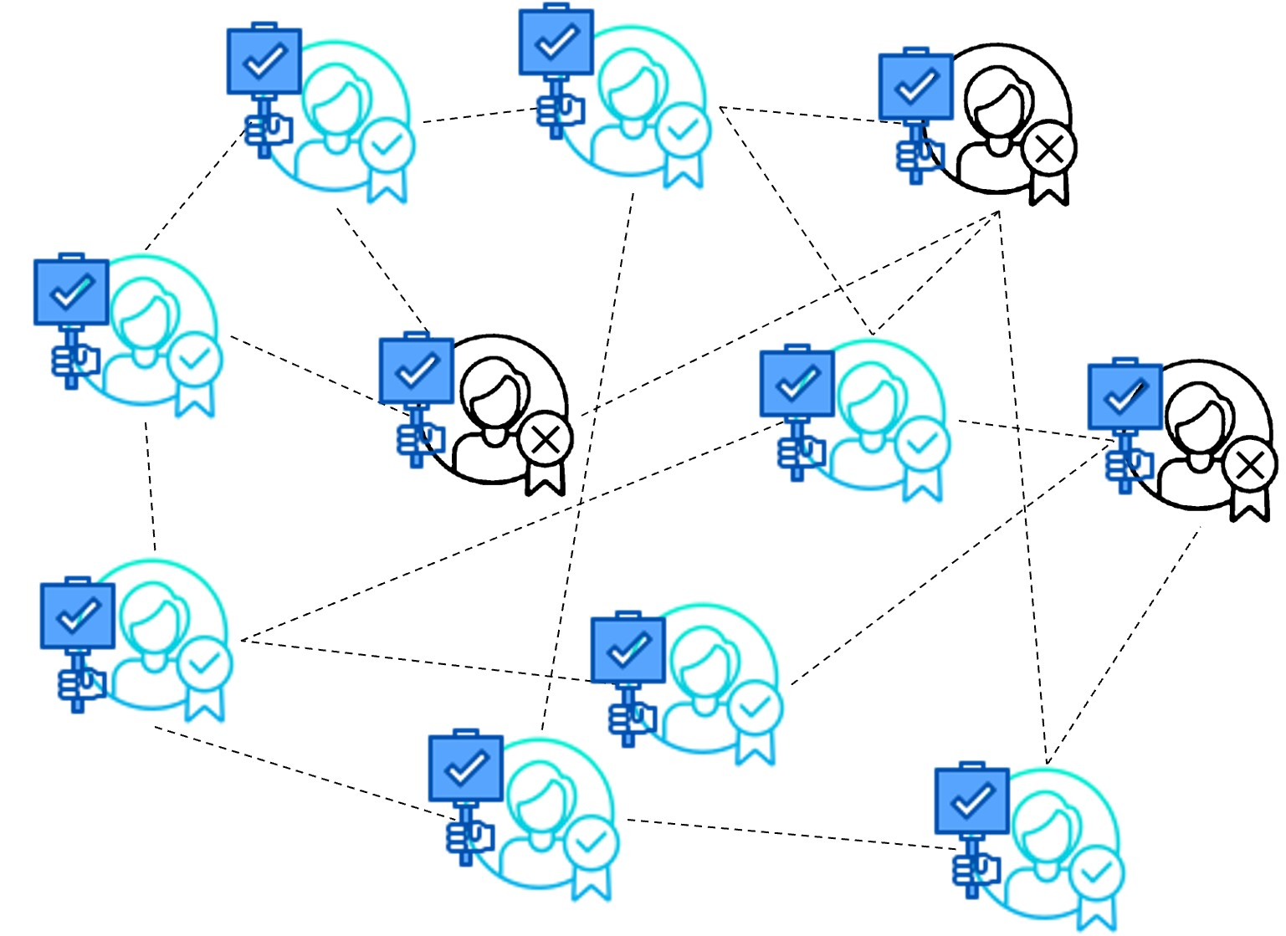
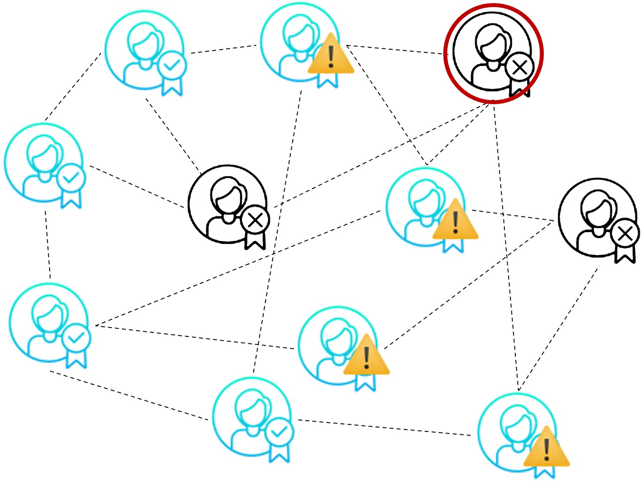
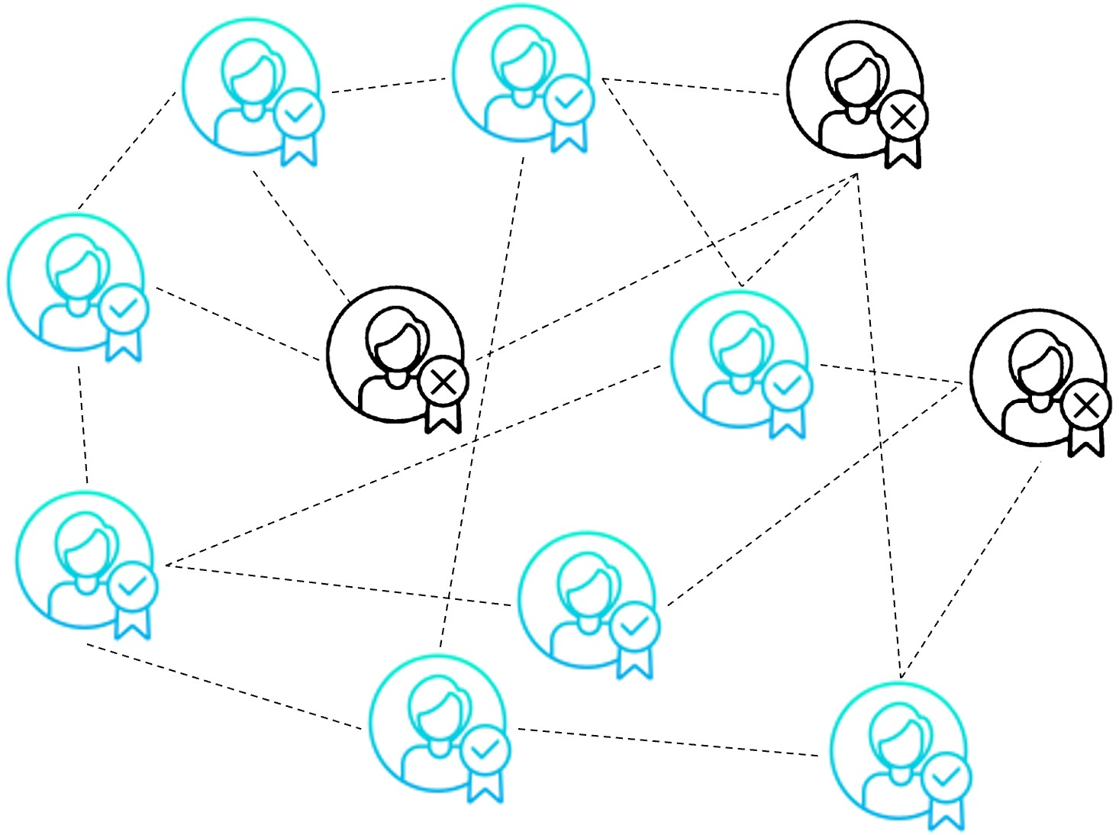
Introduction - Cryptoeconomics
How does the incentives secure a distributed system?
Rewards: increase actors' token balances if they do something good.
Block reward.
Transaction fee.
Penalties: reduce actors' token balances if illegal behavior occurs.
Security deposits.
Privileges: incentivize participants by giving them decision-making right.
Voting weight

Slide 8
Introduction - Cryptoeconomics
How should we determine the economics incentives?
Mechanism Design:
Auction Theory
E.g. Vickrey-Clarke-Groves (VCG) auction.
Coalitional Games
E.g. coalition formation games.
Contract Theory
Notes:
Contract theory is a subset of mechanism design, has no enforceability.

Slide 9
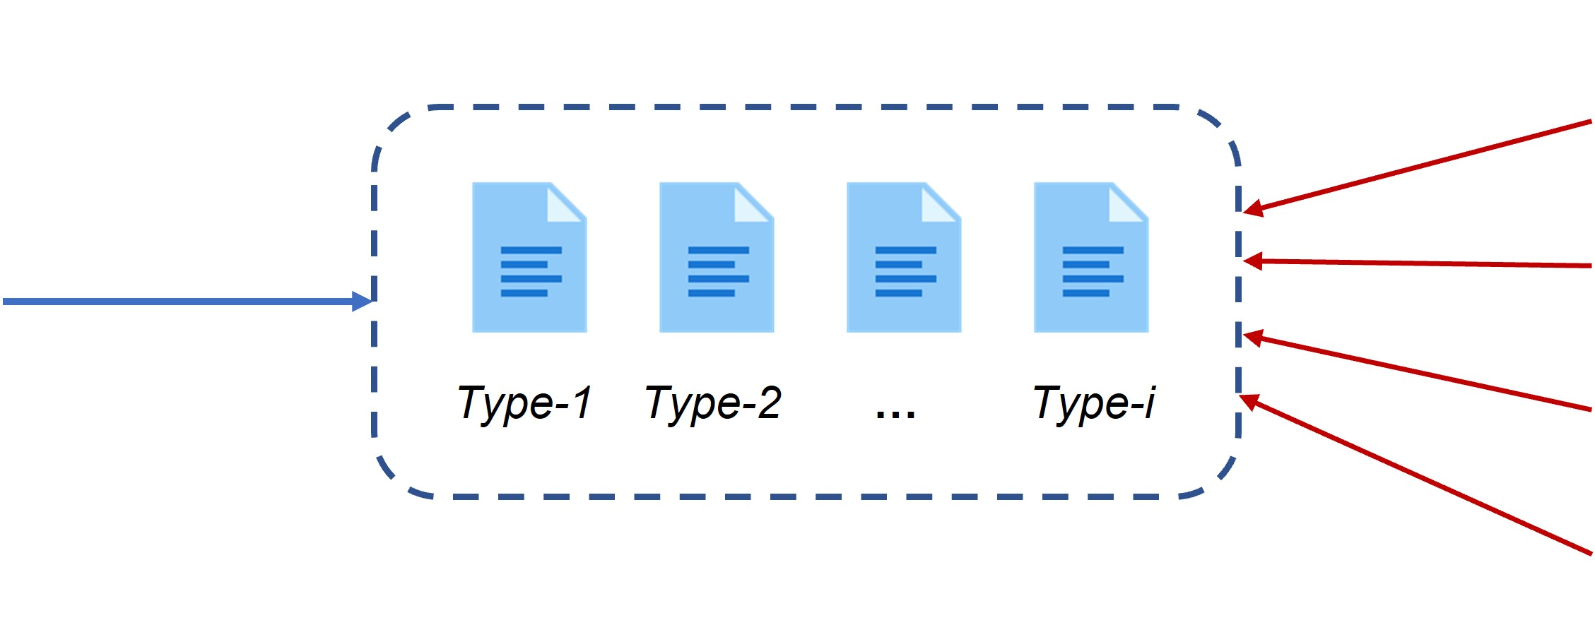
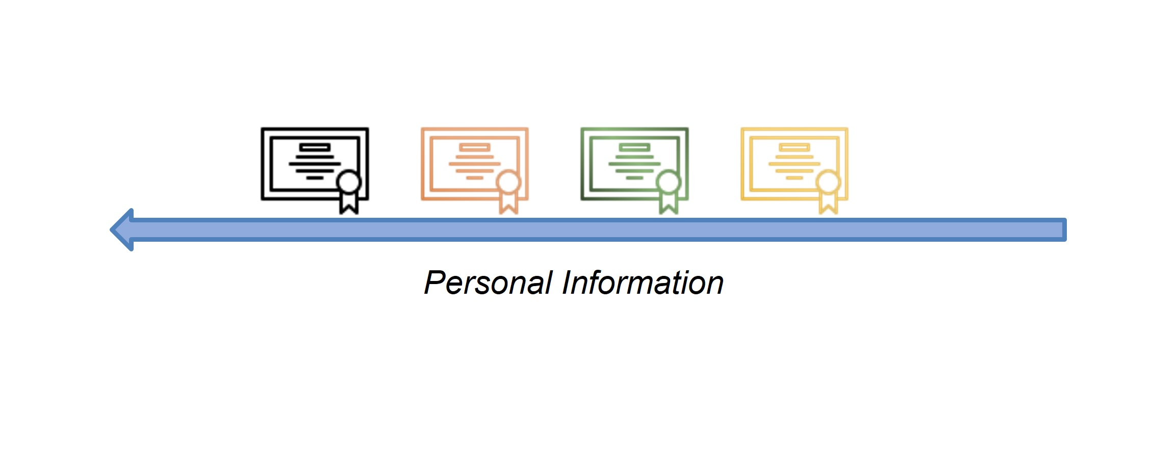
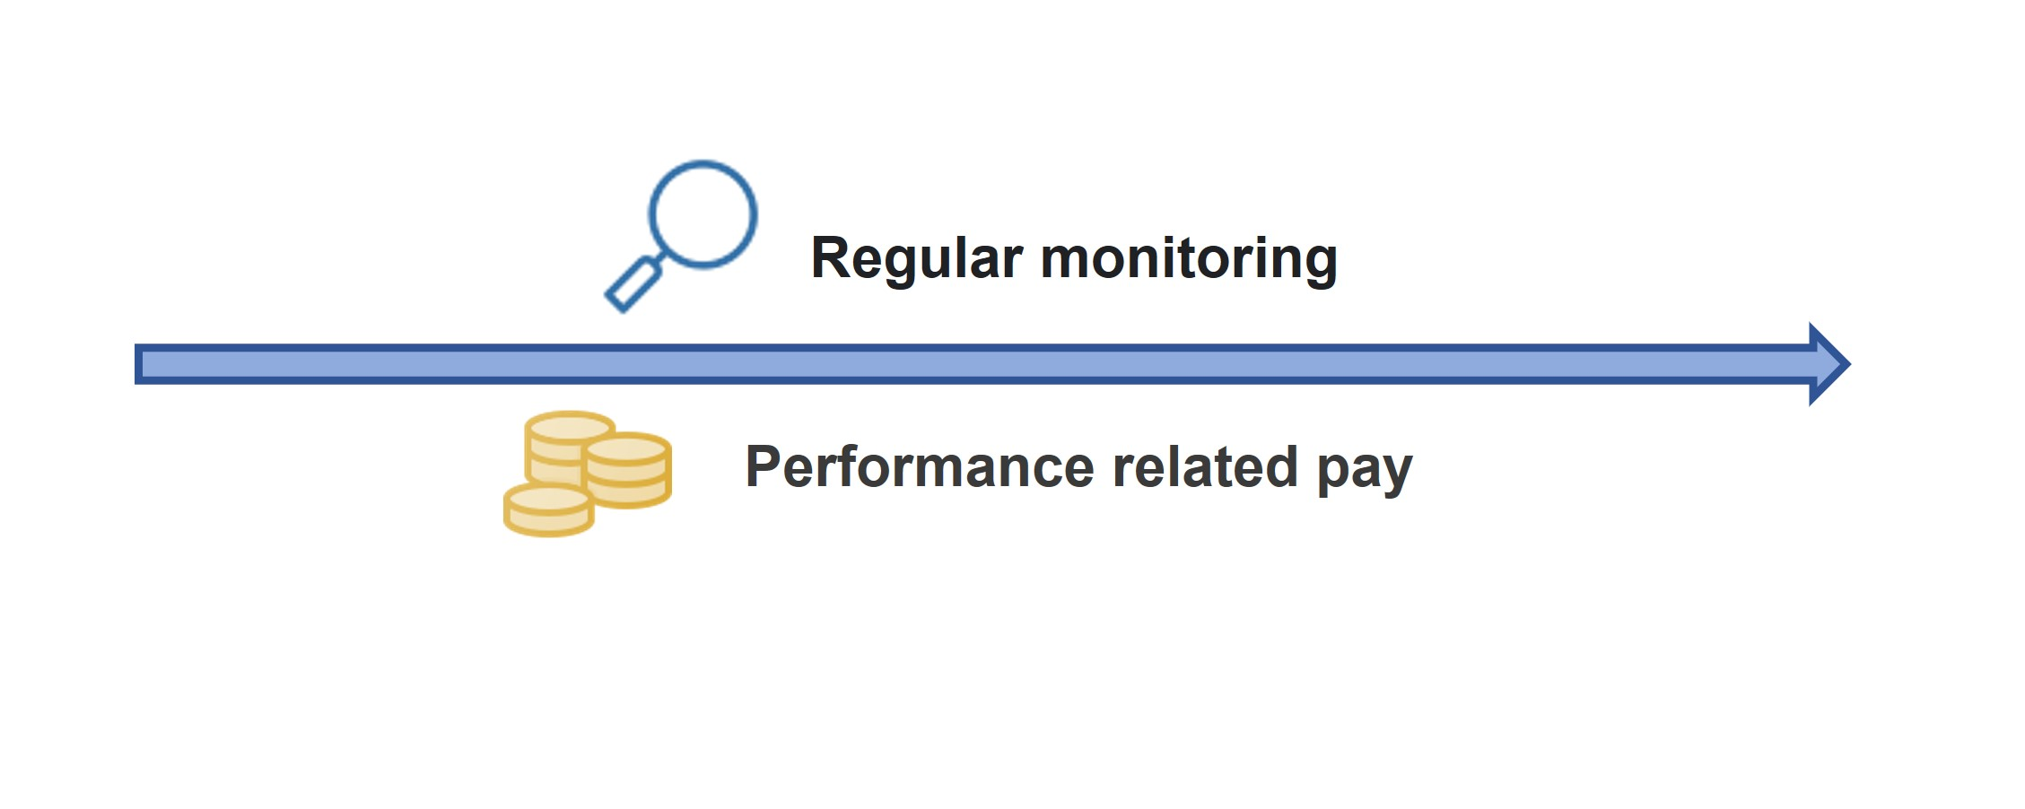
Introduction – Contract Theory
Contract Theory Basics
Contract theory studies how economic actors can and do construct contractual arrangements, generally in the presence of information asymmetry.
Hidden information - Adverse Selection: One agent who has private information on its “type”, its preferences or productivity is unknown to the principal.
Hidden information - Signaling: The sender’s private information may be conveyed to the receiver through observable actions.
Hidden Action – Moral Hazard: The agent’s effort impacts the outcome of task.
Private Information

Slide 10
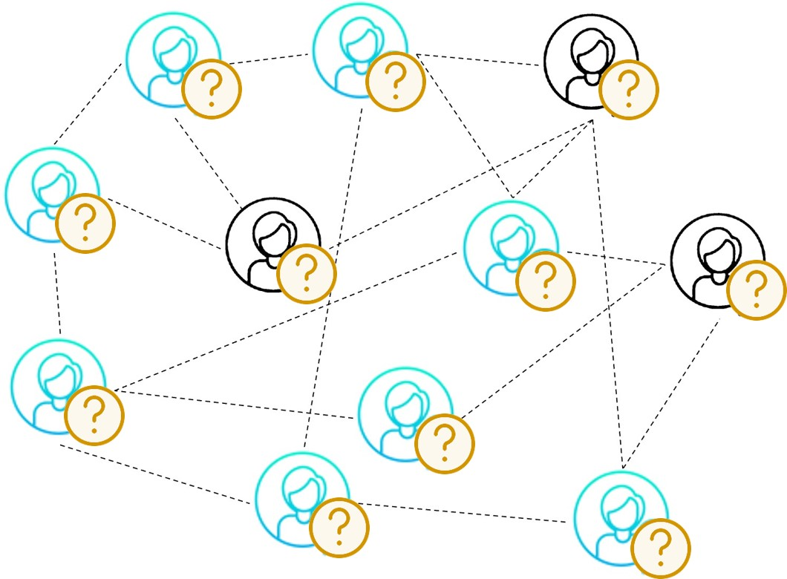
Introduction – Motivation of This PhD Study
Problem of Cryptoeconomics
There exists Information Asymmetry in cryptoeconomics.
Participants are anonymous in blockchain.
Most of the participants are rational and not willing to reveal their private information.
The number of participants is large.
Incentives
Mechanism
Contract Theory can overcome the Information Asymmetry and benefit a large number of rational participants.
Notes:
Little research on Cryptoeconomics.

Slide 11
Introduction – Motivation of This PhD Study
Solution to Cryptoeconomics
Contract Theory can overcome the Information Asymmetry and benefit a large number of rational participants.
Contract-based approach for security deposit in blockchain networks with shards.
Notes:
Little research on Cryptoeconomics.

Slide 12
Outline
Introduction
Blockchain
Cryptoeconomics
Contract Theory
Work I: Contract-based approach for security deposit in blockchain networks with shards.
Work II: Cyber Insurance Design for Validator Rotation in Sharded Blockchain Networks: A Hierarchical Game Based Approach
Conclusion and Future Work

Slide 13
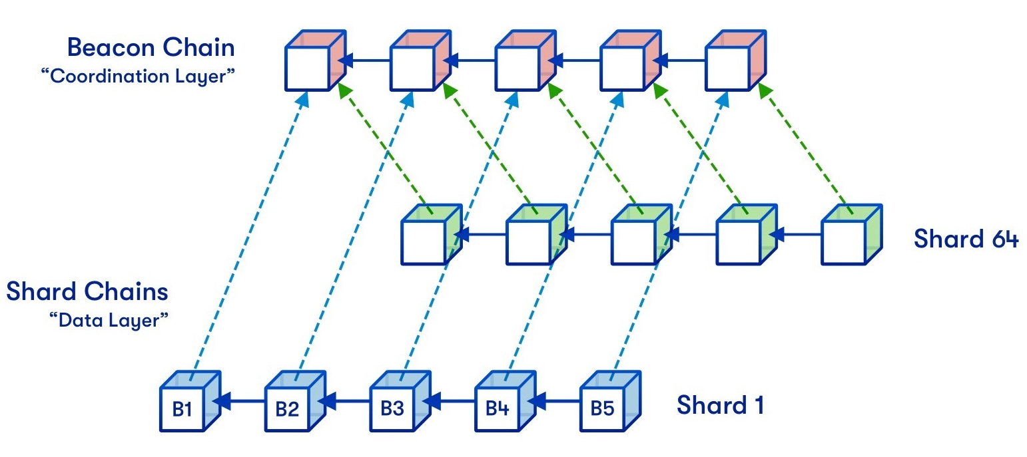
Contract-based approach for security deposit in blockchain networks with shards
Blockchain with sharding
Sharding is used to realize the scalability.
Partition the entities into parallel sub-groups (i.e., committees), which are responsible for generating the sub-blocks (i.e., sharding) synchronously.
Figure Source: https://vitalik.ca/general/2021/04/07/sharding.html

Slide 14
Contract-based approach for security deposit in blockchain networks with shards
Security Deposit
Proof of stake’s security derives from the size of the security deposits.
Security Deposit
32ETH
The deposit that greatly exceeds gain can provide a sufficient security incentive
Motivation
Security incentive: 32-eth is not sufficient for the rich people.
>>32ETH
Economic incentive: Some participants cannot afford 32-eth.
<< 32ETH
Notes:
Proof of stake’s security derives from the size of the security deposits, not the number of validators

Slide 15
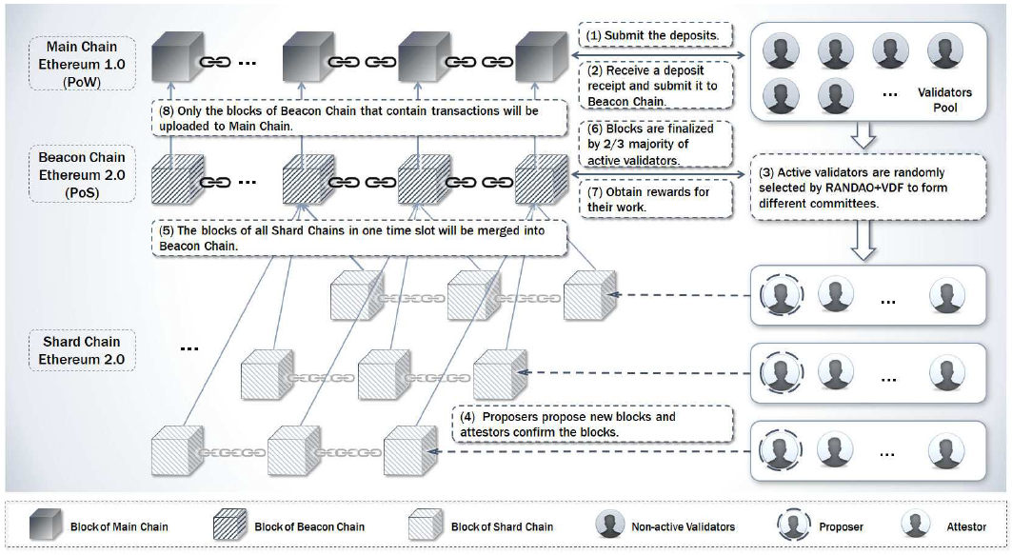
Contract-based approach for security deposit in blockchain networks with shards
System Overview
Let the beacon chain with weak leadership be responsible for designing the contracts.
Submit the deposit;
Receive the deposit receipt;
Validators are randomly selected into the different committees;
Proposers propose new blocks and attestors confirm the blocks;
The blocks from one time slot will be merged into the beacon chain;
Blocks in beacon chain are finalized;
Validators obtain the reward.

Slide 16
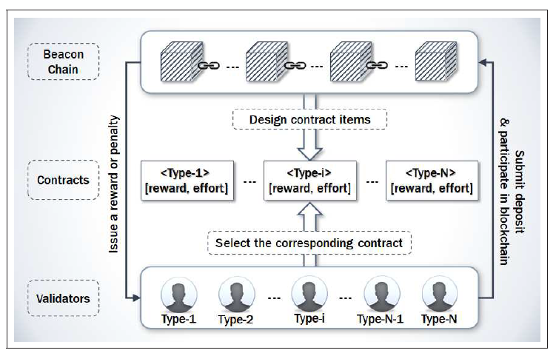
Contract-based approach for security deposit in blockchain networks with shards
Contract Model
Beacon chain designs the contracts according to users’ type information;
The different validators select the corresponding contracts;
The validators submit deposit to beacon chain;
Beacon chain issues the reward or charge a penalty on the validators.

Slide 17
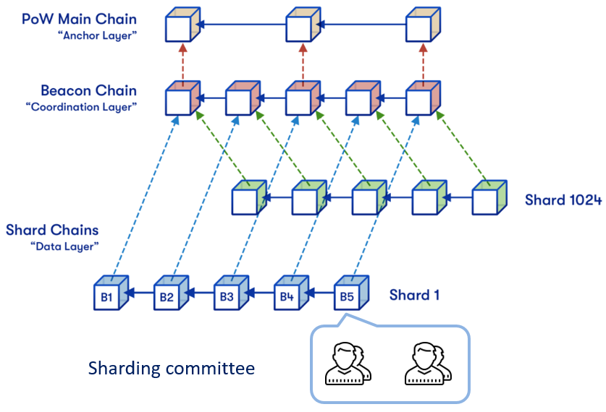
Contract-based approach for security deposit in blockchain networks with shards
System Model
Validator Utility Model
We classify the would-be validators into different types according to their stake values.
The utility function is defined as：
Evaluate the rewards that obtained from beacon chain
The total computation cost
Evaluate the penalty for the type-i validators.

Slide 18
Contract-based approach for security deposit in blockchain networks with shards
System Model
Constrains of Validator Utility Model: Individual Rationality (IR) and Incentive Compatibility (IC):
IR refers to that only when a positive utility assigned to a validator, the validator will accept the contract.
IC refers to that a type-i validator can only obtain the maximum profit by choosing the type-i contract rather than all the other contracts.

Slide 19
Contract-based approach for security deposit in blockchain networks with shards
System Model
Beacon Chain Model
The profit obtained from a validator belonging to type-i is defined as
Evaluation function regarding the validator's time, type and reward
The total cost of rewarding the validators
The type and the related reward in the traditional scheme

Slide 20
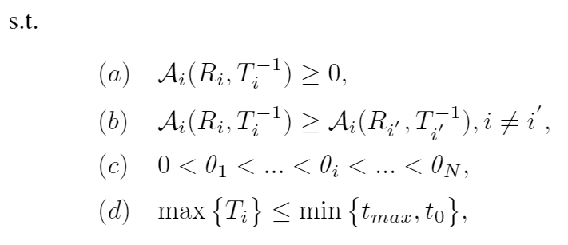
Contract-based approach for security deposit in blockchain networks with shards
Problem Formulation
Evaluation function regarding the validator's time, type and reward
The total cost of rewarding the validators

Slide 21
Contract-based approach for security deposit in blockchain networks with shards
Optimal Solution - Constraints Reduction
Monotonicity: The validators with a lower voting time will gain a higher reward.
IR Constraint Reduction: Only when the IR constraint of type-1 is kept, the others can also be satisfied.
IC Constraint Reduction: The downward incentive constraints can be reduced as local downward incentive constraints and the upward incentive constraints can be reduced as local upward incentive constraints.

Slide 22
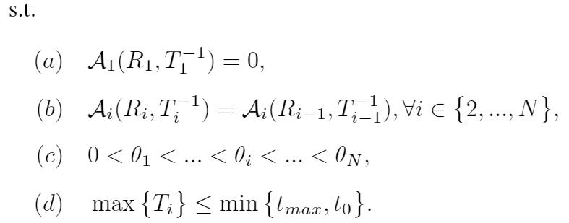
Contract-based approach for security deposit in blockchain networks with shards
Optimal Solution – Closed Form
The optimization problem with reduced constraints:
Derive an expression with the respect to R:

Slide 23
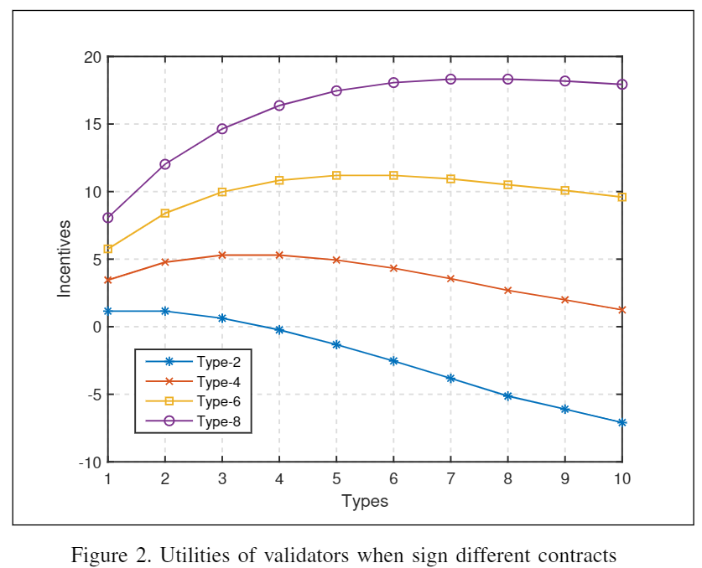
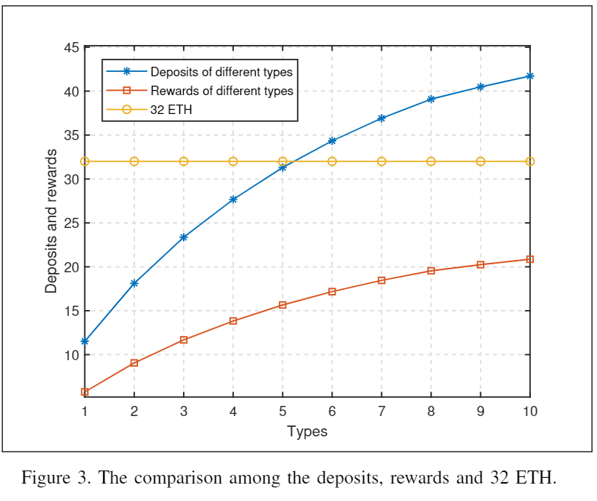
Contract-based approach for security deposit in blockchain networks with shards
Simulation and Analysis
Fig. 2 shows that the validators have the maximum utilities only when choosing the contract designed for their own.
Fig. 3 shows that the higher type validators have more rewards and must submit the more deposits.

Slide 24
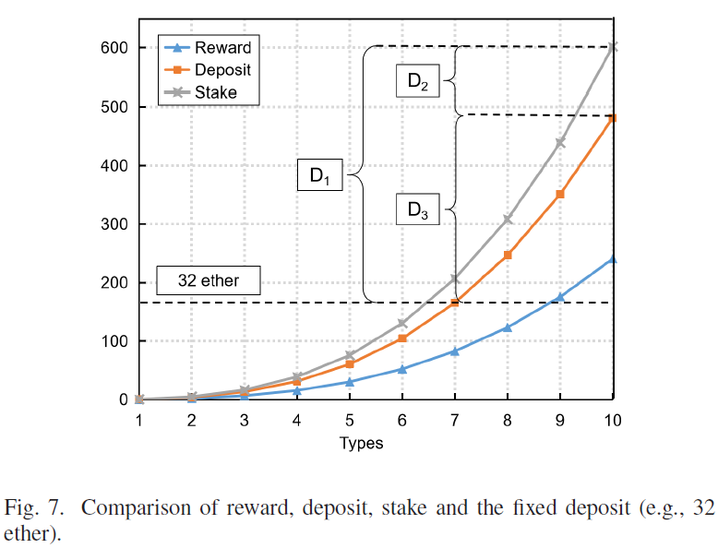
Contract-based approach for security deposit in blockchain networks with shards
Simulation and Analysis
32-ether blocks out these validators whose types are lower than type-7.
The total amount of security deposit as follows:
$\sum_{i=1}^{10}{λ_{i}D_{i}≥}$ $\sum_{i=7}^{10}{λ_{i}D_{7}}$

Slide 25
Contract-based approach for security deposit in blockchain networks with shards
Summary of Work I
Use contract theory to determine the flexible security deposits
The flexible security deposits can guarantee the economic incentive without reducing the security incentive.
Stackelberg Game
Cyber Insurance Design for Validator Rotation in Sharded Blockchain Networks: A Hierarchical Game Based Approach

Slide 26
Outline
Introduction
Blockchain
Cryptoeconomics
Contract Theory
Work I: Contract-based approach for security deposit in blockchain networks with shards.
Work II: Cyber Insurance Design for Validator Rotation in Sharded Blockchain Networks: A Hierarchical Game Based Approach
Conclusion and Future Work

Slide 27
Cyber Insurance Design for Validator Rotation in Sharded Blockchain Networks: A Hierarchical Game Based Approach
Background - Discouragement Attack
A discouragement attack means the attackers would act maliciously inside a consensus mechanism to gradually reduce other validators’ revenue.
Some honest users have left, the others remain in the committee.
No honest users in the committee.
Conventional Reward distribution: $\frac{R}{N}$
Figure Source: https://hackingresear.ch/discouragement-attacks/
Notes:
Discouragement attack is the cheapest way to corrupt the incentive scheme of a PoS-based blockchain.
R is the total reward; N is the total number of validators. M is the total number of validators seen signing the signature.

Slide 28
Cyber Insurance Design for Validator Rotation in Sharded Blockchain Networks: A Hierarchical Game Based Approach
Background - Discouragement Attack
A discouragement attack means the attackers would act maliciously inside a consensus mechanism to gradually reduce other validators’ revenue.
Conventional Reward distribution: $\frac{R}{N}$
Upgraded Reward Distribution: $\frac{R}{N}∗\frac{M}{N}$
The key point here is the following: the fewer validators seen signing a message, the lower everyone's reward.
Figure Source: https://hackingresear.ch/discouragement-attacks/
Notes:
Discouragement attack is the cheapest way to corrupt the incentive scheme of a PoS-based blockchain.
R is the total reward; N is the total number of validators. M is the total number of validators seen signing the signature.

Slide 29
Cyber Insurance Design for Validator Rotation in Sharded Blockchain Networks: A Hierarchical Game Based Approach
Background – Withdraw Delay
Vitalik explored a new type of attack that may bring down the whole blockchain network, which is called Discouragement Attack.
To prevent the attack, the system should set a withdraw delay instead of allowing the validators entry/exit quickly.

Slide 30
Cyber Insurance Design for Validator Rotation in Sharded Blockchain Networks: A Hierarchical Game Based Approach
Motivation
The blockchain network requires an appropriate incentive scheme to encourage the validators to stay online and neutralize the whole network’s risk.
Discouragement Attack
Withdraw Delay
Cyber insurance Framework
Contract Theory
Stackelberg Game
*Vitalik Buterin. Discouragement attacks. https://github.com/ethereum/research/blob/master/papers/discouragement/discouragement.pdf. Dec 16,2018

Slide 31
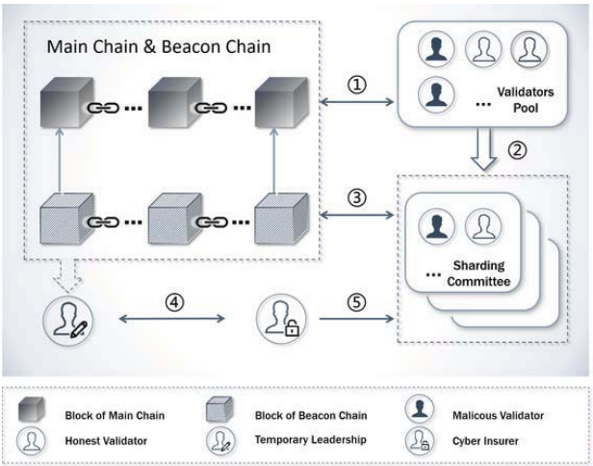
Cyber Insurance Design for Validator Rotation in Sharded Blockchain Networks: A Hierarchical Game Based Approach
System Overview:
1) The main chain is recruiting the validators.
2) The malicious validators are blend in with other honest validators.
3) Let the beacon chain be a temporary leader to design the contracts.
4) A block manager signs the insurance contract with the cyber insurer.
5) The cyber insurer will pay the claim for the victims if there exists a discouragement attack.

Slide 32
Cyber Insurance Design for Validator Rotation in Sharded Blockchain Networks: A Hierarchical Game Based Approach
System Model
Reward Distribution Function and Expected Loss
Censored validator’s loss function
Uncensored validator’s loss function
Expected loss function
$\frac{\hat{k}}{N−\hat{n}}$ denotes the probability of being censored, and $\frac{N−\hat{k}−\hat{n}}{N−\hat{n}}$denotes the probability of not being censored.

Slide 33
Cyber Insurance Design for Validator Rotation in Sharded Blockchain Networks: A Hierarchical Game Based Approach
System Model
Cyber Insurer Utility Model
For the cyber insurer, it can get profit from the gap between the premium and the claim:
Premium.
Claim.

Slide 34
Cyber Insurance Design for Validator Rotation in Sharded Blockchain Networks: A Hierarchical Game Based Approach
System Model
Blockchain Utility Model
The blockchain infrastructure provider acts as an intermediary between the cyber insurer and the validators:
Blockchain’s gains from validators’ activeness and delay.
Compensatory premium paid for the cyber insurer.
The compensatory claim for the validators.

Slide 35
Cyber Insurance Design for Validator Rotation in Sharded Blockchain Networks: A Hierarchical Game Based Approach
System Model
Validator Utility Model – Type classification
For a certain range of activeness $[a_{i},a_{i+1}),$ we model it as a truncated normal distribution $A_{i}$, which is expressed as:

Slide 36
Cyber Insurance Design for Validator Rotation in Sharded Blockchain Networks: A Hierarchical Game Based Approach
System Model
Validator Utility Model – No contract
If the validator does not sign any contract, it will bear the total loss caused by the discouragement attack.
where $π\left(⋅\right)$ is the activeness contains a random noise:

Slide 37
Cyber Insurance Design for Validator Rotation in Sharded Blockchain Networks: A Hierarchical Game Based Approach
System Model
Validator Utility Model – With contract
With Single Contract: If the validator signs the contract with the cyber insurer directly, it can only obtain the insurance contract $\left(p_{i},β_{i}\right)$ without any compensation factors:
With Mixed Contract: The mixed contract contains a discount factor and a compensation factor:
The utility function is
The benefit from the observed activeness.
Effort cost
The capital lockup cost

Slide 38
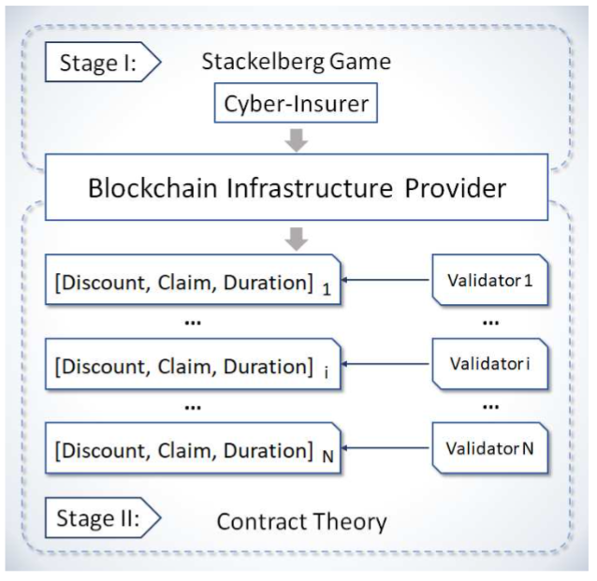
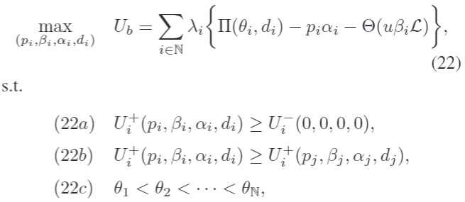
Cyber Insurance Design for Validator Rotation in Sharded Blockchain Networks: A Hierarchical Game Based Approach
Problem Formulation
The utility function of the cyber insurer in the Stage I is expressed as follows:
The utility function of the beacon chain in the Stage II is expressed as follows:

Slide 39
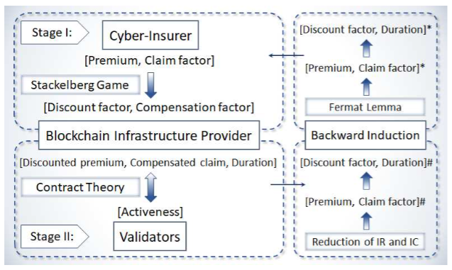
Cyber Insurance Design for Validator Rotation in Sharded Blockchain Networks: A Hierarchical Game Based Approach
Optimal Solution
We will first solve the problem in Stage II by assuming that the solution of Stage I is given and reducing the IR and IC constraints under the contract framework.
Optimal solution of Stage II:
The optimal solutions of contract theory framework are the followers’ solutions. As a result, we can work out the leader’s optimal solution using Backward Induction.

Slide 40
Cyber Insurance Design for Validator Rotation in Sharded Blockchain Networks: A Hierarchical Game Based Approach
Simulation and Analysis
Fig. 2 The comparison with the single contract, and how the utility varies when signing different contracts.
Fig. 2(a) presents that the premium in both cases increases with the validators' type.
Fig. 2(b) shows that the ‘mixed contract’ case can provide more insurance claim than a ‘single contract’ case.
Fig. 2(c) proves that the feasibility of the proposed contract by illustrating the IR and IC constraints.

Slide 41
Cyber Insurance Design for Validator Rotation in Sharded Blockchain Networks: A Hierarchical Game Based Approach
Summary of Work II
Analyze Discouragement Attack model.
Devise a cyber insurance framework using contract theory.
The cyber insurance can neutralize the cyber risks.
The contract theory can determine the different withdraw delays.

Slide 42
Outline
Introduction
Blockchain
Cryptoeconomics
Contract Theory
Work I: Contract-based approach for security deposit in blockchain networks with shards.
Work II: Cyber Insurance Design for Validator Rotation in Sharded Blockchain Networks: A Hierarchical Game Based Approach
Conclusion and Future Work

Slide 43
Conclusion and Future Work
Conclusion
Studied two categories of economic incentives in Cryptoeconomics by using Contract Theory: Penalty and Reward.
Work I: Penalty – The flexible deposits can incentivize more entries than that of the constant deposits.
Adverse Selection
Contract menu
Type-1 | (T1, R1)
Type-i | (Ti, Ri)
… | …
Type-n | (Tn, Rn)
Private information: Account balances
Signaling
Individual Rationality
Incentive Compatibility
Moral Hazard

Slide 44
Conclusion and Future Work
Conclusion
Studied two categories of economic incentives in Cryptoeconomics by using Contract Theory: Penalty and Reward.
Work I: Penalty – The flexible deposits can incentivize more entries than that of the constant deposits.
Work II: Reward – We devised a cyber insurance framework by using a hierarchical game model to resist the discouragement attack.
Adverse Selection
Insurance menu
Type-1 | (P1, C1)
Type-i | (Pi, Ci)
… | …
Type-n | (Pn, Cn)
Private information: Historical activeness
Signaling
Individual Rationality
Incentive Compatibility
Moral Hazard
Stackelberg Game

Slide 45
Conclusion and Future Work
Conclusion
Studied two categories of economic incentives in Cryptoeconomics by using Contract Theory: Penalty and Reward.
Work I: Penalty – The flexible deposits can incentivize more entries than that of the constant deposits.
Work II: Reward – We devised a cyber insurance framework by using a hierarchical game model to resist the discouragement attack.
Other Applications of Contract Theory in Cryptoeconomics:
Deterministic Contract
Random Contract

Slide 46
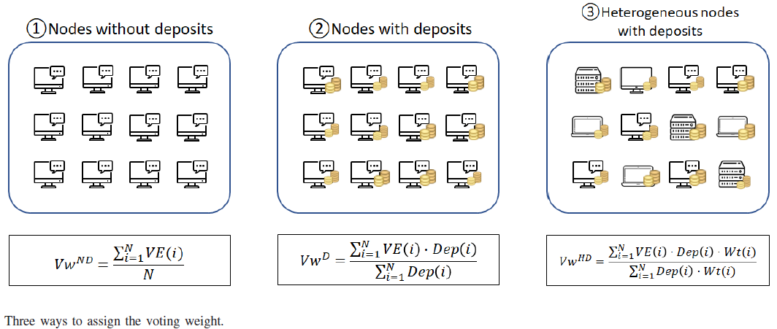
Conclusion and Future Work
Future Work I
Assign Voting Weight using Signaling Model:
Goal: Determine the voting weight with device performance, incentivize the validators to upgrade performance and achieve the vertical scaling.
Methodology: Tullock Contest Theory and Signaling Model.

Slide 47
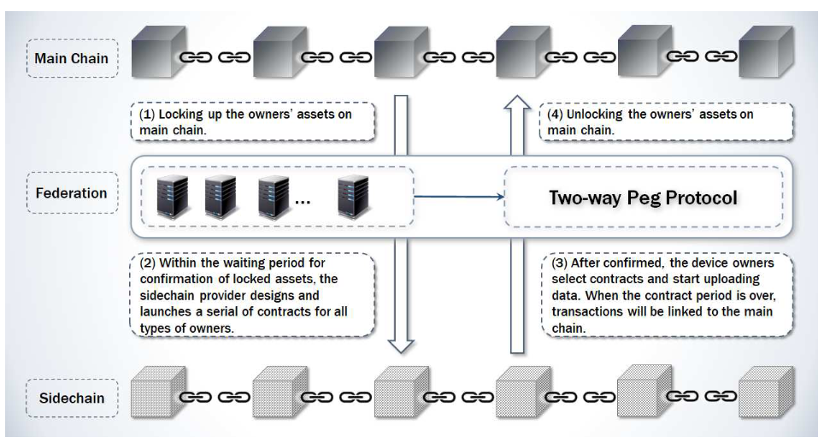
Conclusion and Future Work
Future Work II
Determine Transaction fee of sidechain using Random contract:
Goal: Study the sidechain transaction fee pricing and explore how to maximize the sidechain’s profit using a random contract.
Methodology: Adverse selection model with the random variables. Geometric Brownian Motion.
The transaction fee on the sidechain is affected by the transaction fees on the main chain.

Slide 48
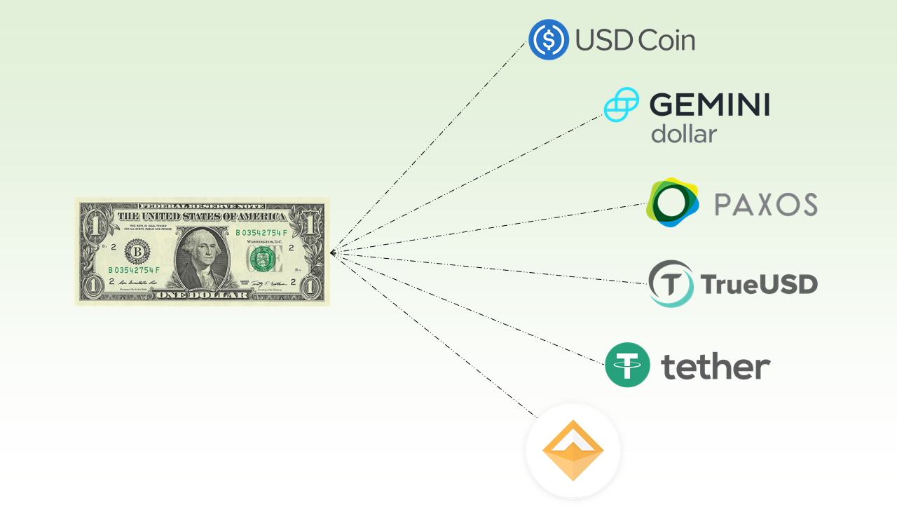
Conclusion and Future Work
Future Work III
Crypto-asset Value Stabilization:
Goal: Offer insurance contracts to the crypto-assets owners, ensure the value will not drop below the reserved price within a required time span.
Methodology: Insurance framework, contract theory (adverse selection), option pricing model, risk parameters, auction, smart contract.

Slide 49
Publications
Tutorial and Book
J Li, D Niyato, Z Han. Cryptoeconomics: Economic Mechanisms behind Blockchains, contract with Cambridge University Press, UK, 2021.
J Li, L Zhang, S Kanhere, D Niyato, Z Han. Blockchain and Cryptoeconomics for Cyber-physical System and Wireless Networks, tutorial in IEEE Global Communications Conference (GLOBECOM), 2021.
Journal:
J Li, D Niyato, CS Hong, KJ Park, L Wang, Z Han. “Cyber Insurance Design for Validator Rotation in Sharded Blockchain Networks: A Hierarchical Game Based Approach”, IEEE Transactions on Network and Service Management, vol. 18, no. 3, pp. 3092—3106, 2021.
J Li, T Liu, D Niyato, P Wang, J Li, Z Han. “Contract-Theoretic Pricing for Security Deposits in Sharded Blockchain with Internet of Things (IoT), IEEE Internet of Things Journal”, vol. 8, no. 12, pp. 10052—10070, 2021.
J Wang, J Li, Z Gao, Z Han, C Qiu, XF Wang. “Resource Management and Pricing for Cloud Computing based Mobile Blockchain with Pooling”, IEEE Transactions on Cloud Computing, 2021, Early Access.
J Li, Dusit Niyato, Jun Li, Zhen Gao, Xiao Ping Zhang and Zhu Han. “Weight Assignment and Deposit Strategy in Proof of Stake Blockchain Network using Tullock Contest and Signaling game”, IEEE Transactions on Network and Service Management, 2021, Major Revision.
J Li, T Liu, D Niyato, J Li, Z Han. “On Sidechain-Assisted Transactions Management for Smart Community: A Random Contract Approach”, IEEE Transactions on Network Science and Engineering, 2021, Major Revision.
Conference:
J Li, T Liu, D Niyato, P Wang, J Li, Z Han. Contract-based approach for security deposit in blockchain networks with shards, IEEE International Conference on Blockchain, pp. 75-82, 2019.
J Li, D Niyato, CS Hong, KJ Park, L Wang, Z Han. A contract-theoretic cyber insurance for withdraw delay in the blockchain networks with shards, 2020 IEEE International Conference on Communications (ICC), pp. 1-7, 2020.

Slide 50
Thank You
Q & A

