Slide 1
Department of Electrical and Computer Engineering
Big Data Analysis of Complex Networks Using Machine Learning Methods
Erte Pan
Supervisor: Dr. Zhu Han
Department of Electrical and Computer Engineering
University of Houston

Slide 2
Outline
Introduction and Motivation
  Big Data
  Machine Learning
  Smart Grid & Trajectory
Motivation: energy user data analysis via machine learning; pricing design and big data solution.
Research Work
  User Pattern Recognition: Probabilistic Clustering Analysis of Load Profiling for Big Smart Meter Data
  Pricing and Sampling Method: Analyzing Big Smart Metering Data Towards Differentiating User Services: A Sublinear Approach
  Trajectory Analysis: Tensor Voting Techniques and Applications in Mobile Trace Inference
Future Work

Slide 3
Dissertation Contributions
Theoretical Contributions:
  Proposed a novel iterative probabilistic clustering algorithm based on the modified Mahalanobis distance
  Proposed a new strong separation index to characterize the separability of clustering performance
  Proposed a differentiating user service model for pricing electricity usage
  Proposed a novel sublinear algorithm with theoretically proved error bound and confidence to effectively reduce the computation,
Application Contributions:
  Applied tensor voting theory in trajectory inference
  Applied fractal dimension analysis to the feature extraction in trajectory analysis

Slide 4
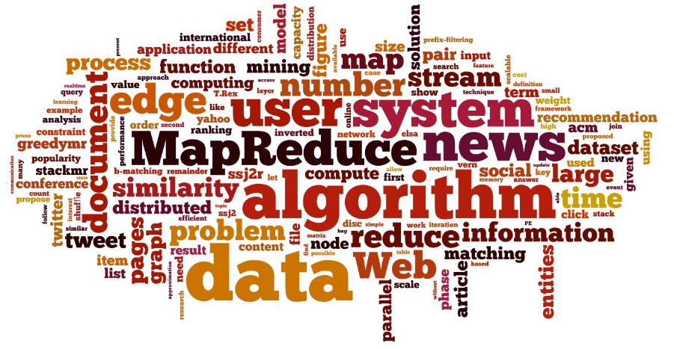
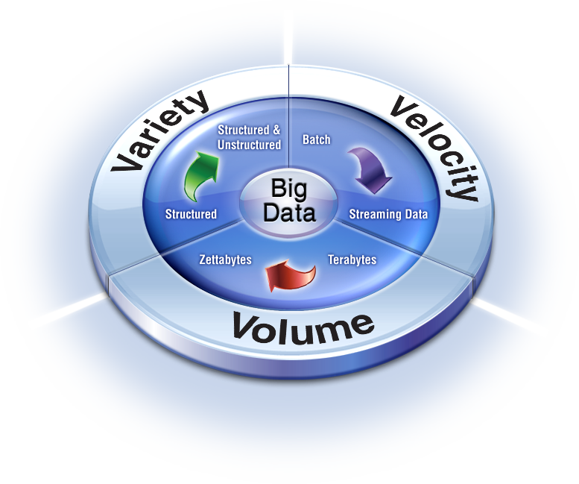
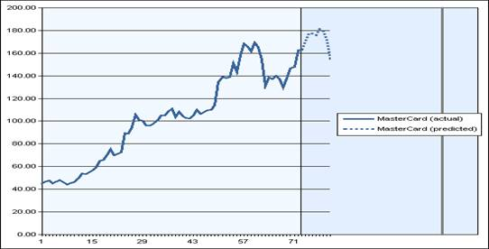
Introduction
Big data era
Data analysis:
  Classification
  Prediction

Slide 5
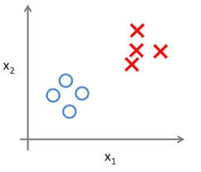
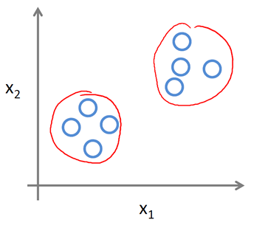
Introduction
Machine Learning
  Supervised learning: SVM, deep learning, etc.
  Unsupervised learning: clustering, mean shift, KNN, non-parametric Bayesian, etc.
  Reinforcement learning: active learning, semi-supervised learning, etc.

Slide 6
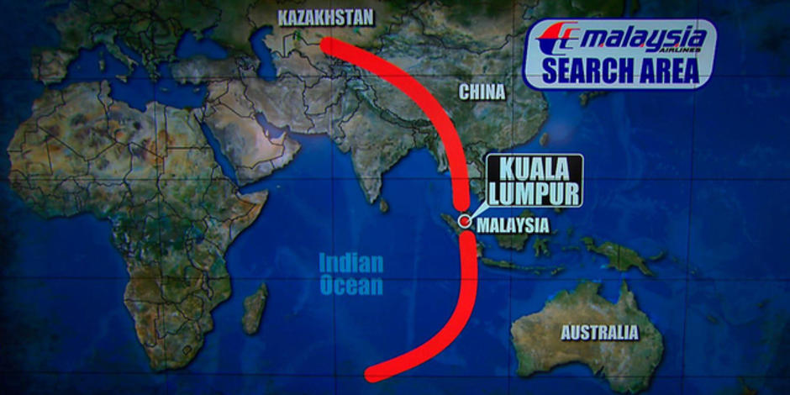
Motivations
Smart Grid (supported by EPAC Consortium):
  Understand electricity users’ behavior
  Develop algorithm for online user classification and design pricing scheme accordingly
Trajectory Analysis
  Location services based on personal devices
  Security issues

Slide 7
Motivations
Challenges:
  How to extract typical user behavior based on proper feature extraction?
  How to enable user classification under big data context?
  How to infer incomplete trajectory and recognize different trajectory patterns?
Proposed Methods:
  Probabilistic clustering based on modified Mahanalobis distance
  Profile classification based on sublinear algorithms
  Tensor voting method combined with supervised learning

Slide 8
Outline
Introduction and Motivation
  Big Data
  Machine Learning
  Smart Grid & Trajectory
Research Work
  Probabilistic Clustering Analysis of Load Profiling for Big Smart Meter Data
  Analyzing Big Smart Metering Data Towards Differentiating User Services: A Sublinear Approach
  Trajectory Analysis: Tensor Voting Techniques and Applications in Mobile Trace Inference
Future Work and Timeline

Slide 9
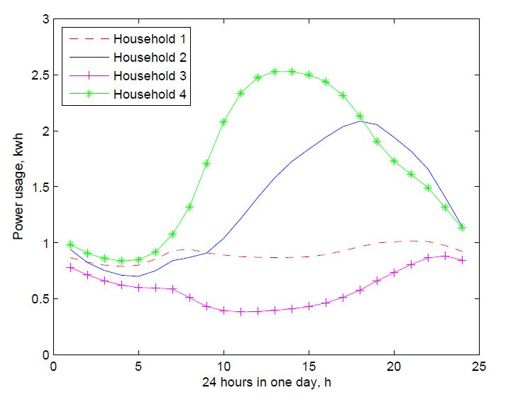
Data description and Load Profiles
Data set: smart meter data from the utility company over the entire Houston city area
Over 2 million users
Data Sampling frequency: every 15 min
Recorded from 2013 ~ 2014
Data size over 150 GB
Load profiles of electricity users: a graph of the variation in the electrical load versus time.
Load profiles of some typical energy users

Slide 10
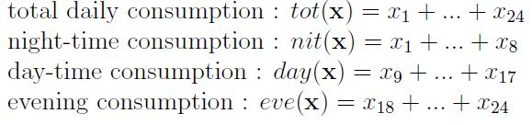
Pragmatic Features
Data compression by key pragmatic features
Perform Principal Component Analysis (PCA) to pragmatic features
Use PCA results as the input feature points {X}

Slide 11


Probabilistic Clustering Formulation
Formulate clustering problem:
  M: number of clusters, N: number of users
Clustering objective
Total within-cluster scatter
Cluster indicator
Cluster centroid
Distance measure
Cluster indicator matrix

Slide 12

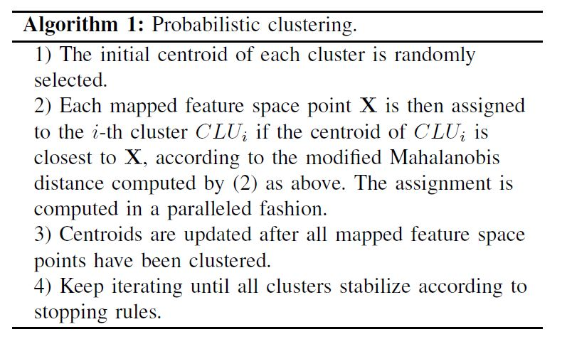
Distance Measure
Distance measure: modified Mahalanobis distance
Clustering algorithm:
Mahanalobis distance
Determinant of cov matrix

Slide 13

Stopping Rule
Stopping rule:
  Stability indicator: clustering shift ξ(k)
size of set difference between CLUm(k) and CLUm(k+1)
cardinality of the m-th cluster generated at the k-th iteration

Slide 14
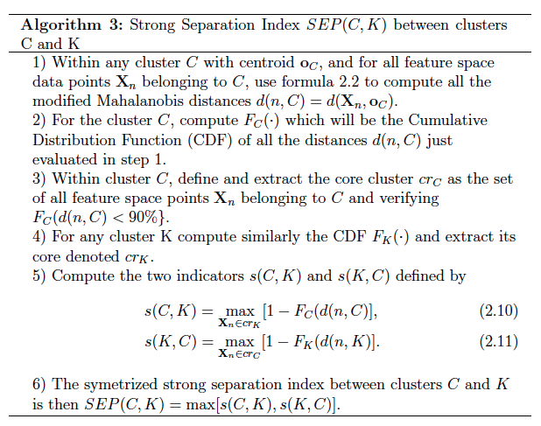

Clustering Quality
Separation indicator: strong separation index, SEP.
Definition and algorithms for SEP:
Quality of terminal clustering (the smaller the better):

Slide 15
Probabilistic Clustering: Overall Algorithm
1> Data preprocessing to corrupted recordings
2> Extract pragmatic features
3> GMM analysis of TOT values for subgroup splitting and outlier detection
4> PCA to de-correlate the pragmatic features
5> Iterate probabilistic clustering with the modified Mahalanobis distance
6> Compute quality of terminal clustering by the strong separation index

Slide 16
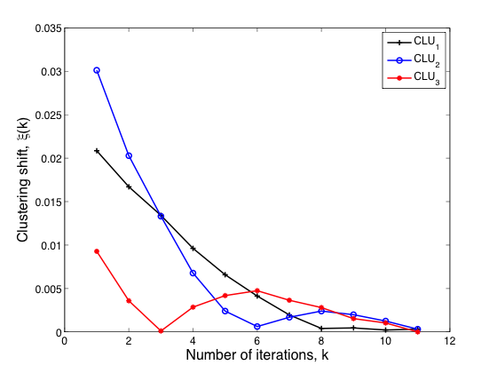
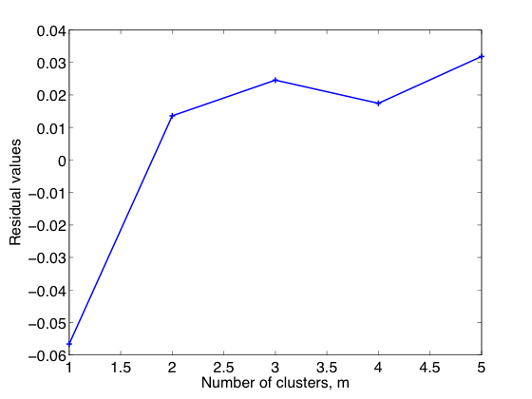
Probabilistic Clustering: Numerical Results
Gap statistic to infer optimal number of clusters
Fast convergence speed
Gap statistic to determine optimal number
of clusters, M
Convergence performance of proposed algo.

Slide 17
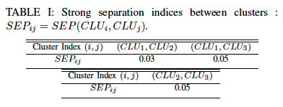
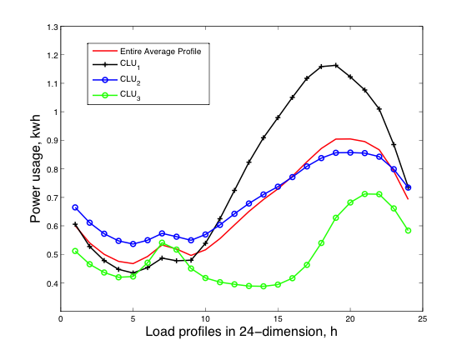
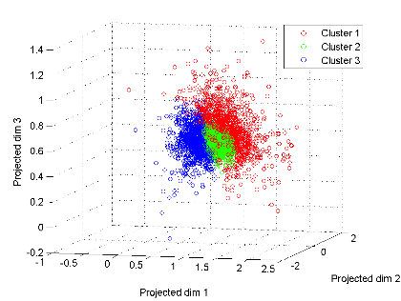
Probabilistic Clustering: Numerical Results
Separation quality by SEP and visualization:
3-d visualization of 3 terminal clusters

Slide 18
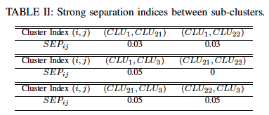
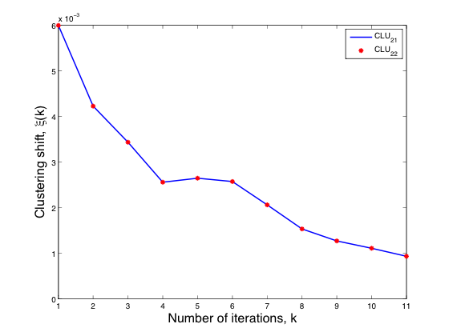
Probabilistic Clustering: Numerical Results
Convergence and separation quality for sub-clustering:
Stability/Convergence of sub-clustering CLU2

Slide 19
Outline
Introduction and Motivation
  Big Data
  Machine Learning
  Smart Grid & Trajectory
Research Work
  Probabilistic Clustering Analysis of Load Profiling for Big Smart Meter Data
  Analyzing Big Smart Metering Data Towards Differentiating User Services: A Sublinear Approach
  Trajectory Analysis: Tensor Voting Techniques and Applications in Mobile Trace Inference
Future Work and Timeline

Slide 20
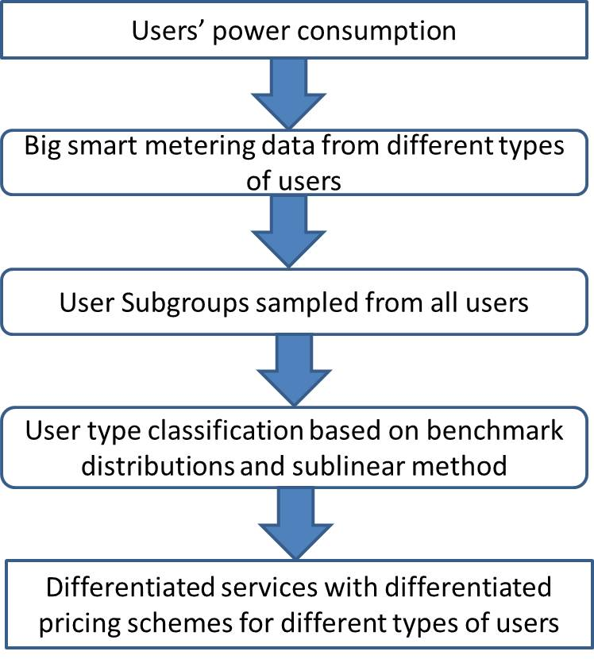

Pricing and Sublinear Algorithms: Motivation
Overall picture:

Slide 21
Pricing and Sublinear Algorithms
Objectives:
  Design a differentiating user services model for profit gain computing based on different types of users
  Enable the services model staying efficient in big data context with performance guarantees
Underlying philosophy: classify users first and then use corresponding typical user behavior instead of actual user usage as the approximation and estimation
Advantages:
  Able to perform prediction
  Fast computation speed
  Save storage capacity

Slide 22



Pricing and Sublinear Algorithms: Pricing Model
Differentiating user service model:
Simplify into 2 types of users in total, i.e., L=2:
user type indicator
load profiling expectation of m-th type user
N: # of users
L: # of user types
total bill gain
bill charge for typical m-th type user

Slide 23

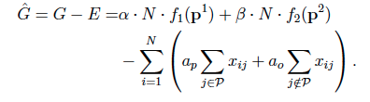
Pricing and Sublinear Algorithms: Pricing Model
Model the expense:
Total net profit gain:
Xij: i-th user energy usage at time instant j
ap: cost coeff to buy energy at peak hour
ao: cost coeff to buy energy at off-peak hour

Slide 24

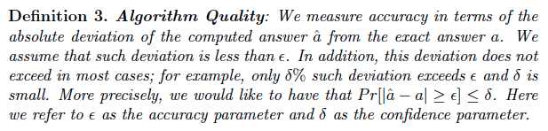
Pricing and Sublinear Algorithms
Classify users to compute α and β:
Algorithm quality:

Slide 25
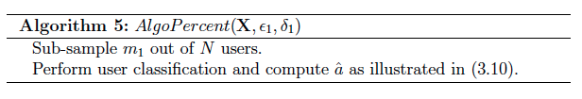
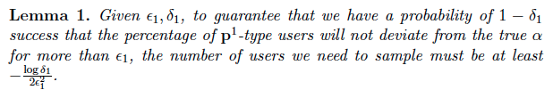
Pricing and Sublinear Algorithms
Sublinear on percentage calculation: “no need of every user for the computation”
Not a function of N, complexity O(1)

Slide 26
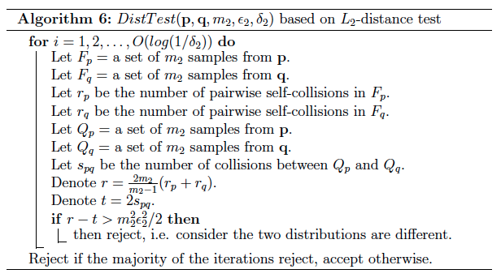
Pricing and Sublinear Algorithms
Sublinear on classification/distribution comparison: “no need of every data points for the comparison”
Existent sublinear algorithm for L2-distance test:

Slide 27

Pricing and Sublinear Algorithms
Drawbacks: confidence remains undetermined when the L2-distance of two testing distributions is truly in interval [ε2/2, ε2]
Proposed solution: utilize the existent algorithm twice

Slide 28
Pricing and Sublinear Algorithms
1> Employ the traditional sublinear sampling and obtain labeled results as set {S1}
2> Employ the traditional sublinear sampling with twice larger of the error bound and obtain labeled results as set {S1}
3> Keep the labeled 1 in {S1} and reject all the labeled 2
4> Keep the labeled 2 in {S2} and reject all the labeled 1
5> Combine the retained labels into {S3}: if the same user is both labeled as 1 in {S1} and 2 in {S2}, his/her label is randomly decided
6> Output {S3} as the final classification results

Slide 29
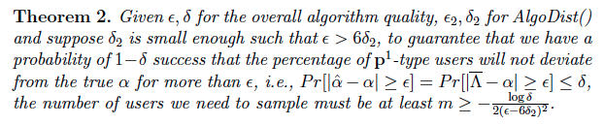
Pricing and Sublinear Algorithms
Overall algorithm flow:
  Call AlgoPercent() to sample a small portion of users for classification
  Call AlgoDist() to sample a small portion of each user’s distribution data points.

Slide 30
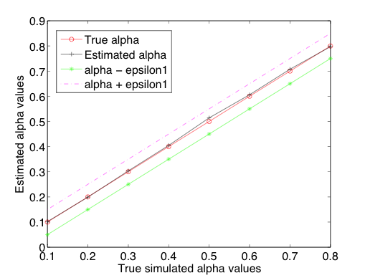
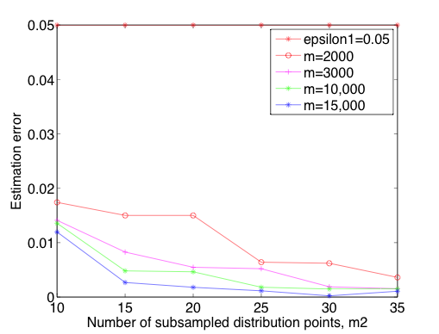
Pricing and Sublinear Algorithms: Numerical Results
Bounded error vs. different parameterizations:
Estimation errors vs. number of sub-sampling
data points from the entire distribution
Performance on estimating α

Slide 31
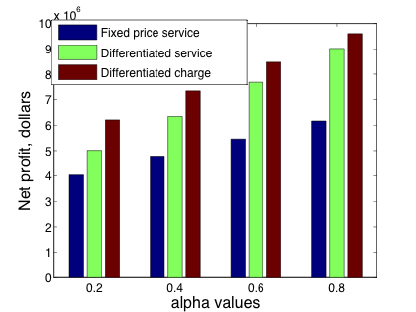
Pricing and Sublinear Algorithms: Numerical Results
Profit gains vs. other pricing plans; reduced computation burdens:
Net profits from different pricing strategies
Reduced data amount vs. overall
confidence parameter

Slide 32
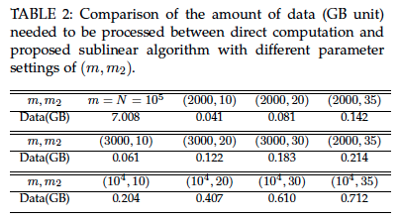
Pricing and Sublinear Algorithms: Numerical Results
reduced computation burdens vs. varying parameters and error & confidence settings:
Reduced data amount vs. overall
error bound parameter

Slide 33
Outline
Introduction and Motivation
  Big Data
  Machine Learning
  Smart Grid & Trajectory
Research Work
  Probabilistic Clustering Analysis of Load Profiling for Big Smart Meter Data
  Analyzing Big Smart Metering Data Towards Differentiating User Services: A Sublinear Approach
  Trajectory Analysis: Tensor Voting Techniques and Applications in Mobile Trace Inference
Future Work and Timeline

Slide 34
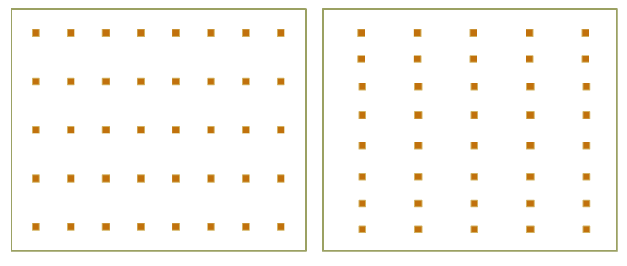


Trajectory Analysis: Tensor Voting Framework
Objective: infer “hidden” objects—gaps and broken parts.
Gestalt principles: the presence of each input token implies a hypothesis that structure passes through it.
Inclined to infer those structures by red lines:
Proximity
Closure
Continuity
Proximity
Closure
Continuity

Slide 35
Trajectory Analysis: Normal Space
Normal Space: encodes structure information; spanned by normal vectors.
Tensor: describes the linear relation of vectors; outer product.
stick tensor – surface element
Structure types in 3D: surfaces; curves; volumes.
White arrows: normal vectors
Blue regions: normal space
Red shape: structure element
plate tensor – curve element
ball tensor – point element

Slide 36
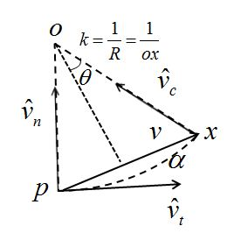
Trajectory Analysis: Tensor Inference
Consider a voter point p on a surface
Normal is a single vector with saliency (magnitude)
Information propagates to its neighboring votee point x
The most likely smooth path: arc of the osculating circle
Tensor(structure information) received at x:

Slide 37
Tensor Voting Framework-Tensor Decomposition
Sum up votee’s acquired voted tensors into one tensor matrix T.
Eigen-decomposition to extract the saliensies:
Surface saliency: normal:
Curve saliency: normals: and
Junction saliency: normals: , and
generic tensor
Capable to detect outliers or noise; robust to noisy data.
Direct application original noisy data imposes tremendous computation.

Slide 38
Trajectory Analysis: Inference Algorithm
1> Input initial trace with missing parts
2> Perform token refinement
3> Mark sparse voting region to define potential votees
4> Perform tensor voting to infer structures
5> Decompose results & add determined votees to the previous trace
6> Re-input the thinned trace and iterate the whole procedure starting with 2>
No
Iterate enough times?
Yes
7> Output final trace result

Slide 39
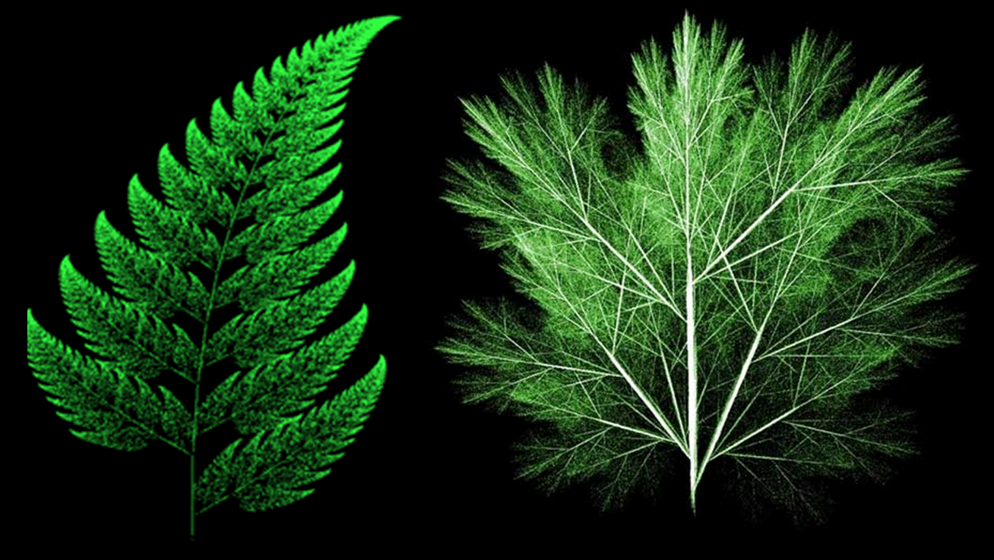
Trajectory Analysis: Pattern Recognition
Trajectory features:
  Spatial:
    Directional distance
    Trajectory mean
    Fourier descriptor
  Temporal:
    Average velocity
  Scale invariant:
    Fractal dimension
Trace separation: logistic regression/clustering

Slide 40
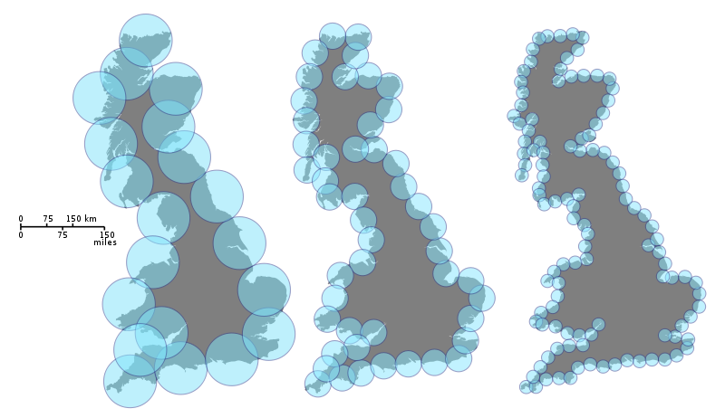
Trajectory Analysis: Fractal Dimension
Fractal dimension: Self-similarity and repeating patterns exhibit in the objects in nature.
Hausdorff Dimension:
ε : a unit “ruler” for measurement.
N(ε) : number of objects obtained by continuously covering the whole graph
using ε

Slide 41
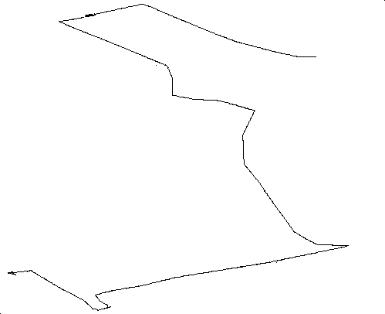

Trajectory Analysis: Numerical Results
Data: human mobility data collected in New York city by GPS, listed in the reference
Experiment set-up:
  Convert traces into 2D binary images of 314 x 351
  Random pollute the images to have broken gaps with ~7 pixels on average
  Scale of voting, σ, is tested from 1 to 50
Original complete trace(ground truth)
Polluted trace as algorithm input

Slide 42
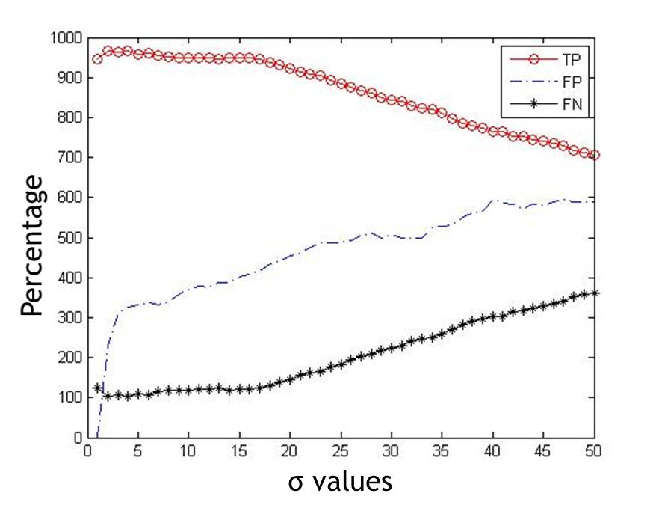


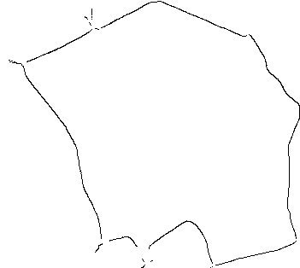
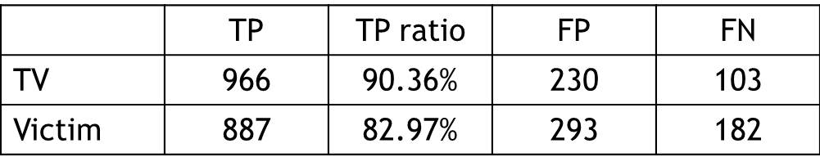
Trajectory Analysis: Results and Conclusions
Inference results:
Number of pixels
Polluted trace as algorithm input
Tensor voting with σ=1
Tensor voting with σ=2
σ values
Compared with victim method:

Slide 43
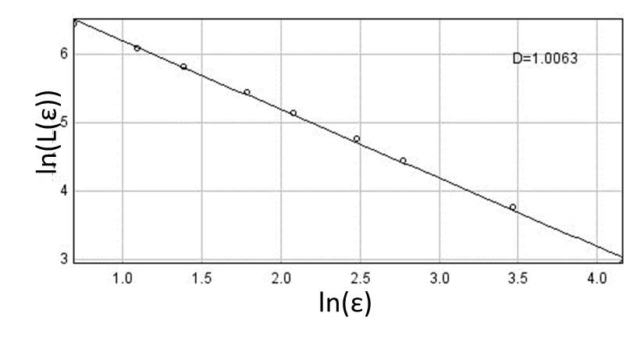
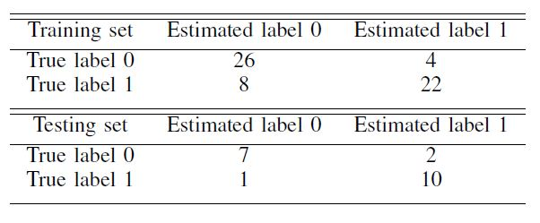
Trajectory Analysis: Results and Conclusions
Fractal dimension results:
Trajectory Pattern Recognition via logistic regression:
Training accuracy 80%
Testing accuracy 85%

Slide 44
Conclusions
Theoretical Side:
  Clustering analysis: novel distance measurement; stopping rules; clustering quality criteria.
  Smart grid systems: pricing scheme based on differentiating user patterns.
  Novel sublinear sampling for on-line user classification and big data challenge, guaranteed bounds with theoretical proofs and numerical validations.
Application Side:
  Tensor voting for incomplete trajectory inference.
  Fractal dimension analysis as trajectory features.

Slide 45
Future Works
Investigate the deep learning model for biomedical image analysis.
Develop a nonparametric Bayesian model for user classification in networking problems.
Extend the tensor theory for data compression and manifold learning.
Investigate the initialization of clustering analysis for choosing the optimal number of clusters.

Slide 46
Publication List
Journal Publications:
Erte Pan, Miao Pan, and Zhu Han. “Tensor Voting Techniques and Applications in Mobile Trace Inference”. IEEE Access, Vol. 3, pp. 3000-3009, October 2015.
Yanru Zhang, Erte Pan, Lingyang Song, Walid Saad, Zaher Dawy, and Zhu Han. “Social Network Aware Device-to-Device Communication in Wireless Networks”. IEEE Transactions on Wireless Communications, Vol 14, No. 1, pp. 177-190, January 2015.
Erte Pan, Dan Wang, and Zhu Han. “Analyzing Big Smart Metering Data Towards Dierentiating User Services: A Sublinear Approach”. Submitted. IEEE Transactions on Big Data.
Erte Pan, Robert Azencott, and Zhu Han. “Clustering Analysis of Load Proling for Big Smart Meter Data”. Submitted.
Erte Pan and Zhu Han. “Smart Meter Data Analysis Based on Tensor Voting and Nonparametric Bayesian”. Submitted.
Conference Publications:
Erte Pan, Husheng Li, Lingyang Song, and Zhu Han. “Kernel-Based Nonparametric Clustering for Load Proling of Big Smart Meter Data”. IEEE Wireless Communications and Networking Conference, pp. 2251-2255, New Orleans, LA, March 2015.
Erte Pan and Zhu Han. “Non-parametric Bayesian Learning with Deep Learning Structure and Its Applications in Wireless Networks”. IEEE Globalsip, pp. 1233-1237, Atlanta, GA, December 2014.
Erte Pan, Miao Pan, Zhu Han, and Vernaldo Wright. “Mobile Trace Inference Based on Tensor Voting”. IEEE Global Communications Conference, pp. 4891-4897, Austin, TX, December 2014.
Yanru Zhang, Erte Pan, Lingyang Song, Walid Saad, Zaher Dawy, and Zhu Han. “Social Network Enhanced Device-to-Device Communication Underlaying Cellular Networks”. IEEE ICCC, D2D Workshop, pp. 182-186, Xi’an China, August 2013.

Slide 47

Thanks

