Slide 1




Federated Learning and Analysis In Mobile Edge Computing
2021 International Conference on Big Data and Intelligent Decision Making (BDIDM)
Zhu Han,
John and Rebecca Moores Professor, IEEE Fellow, AAAS Fellow
Department of Electrical and Computer Engineering
University of Houston, TX, USA
Thanks to Dawei Chen, Latif U. Khan, Choong Seon Hong, Nguyen Tran, Lixin Li, Minh Nguyen, Tra Huong Thi Le, Chunxiao Jiang, Yue Yu, Zibo Wang, Wenbo Wang, Yifei Zhu, Siping Shi, Dan Wang and NSF & Toyota

Slide 2

Outline
Background and Fundamentals
  Background
  Machine Learning (ML) Point of View
  Optimization Point of View
Federated Learning for Wireless Networks
  Unsupervised Federated Learning for Unbalanced Data
  Matching Theory Based Low-Latency Scheme for Multi-Task Federated Learning in MEC Networks
From Federated Learning to Federated Analysis
  Federated Skewness Analytics in Heterogeneous Decentralized Data Environments
  Federated Anomaly Analytics for Local Model Poisoning Attack
Open problems and Conclusions

Slide 3
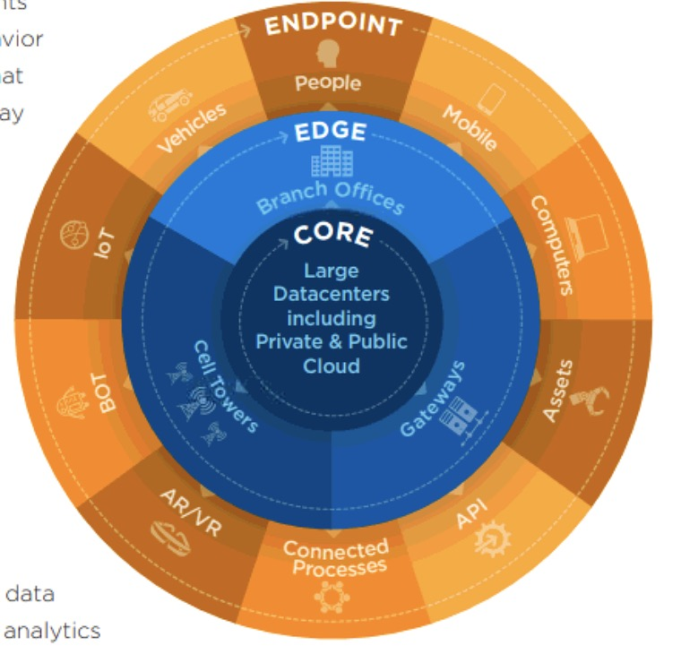
Background
Can data live at the edge?
  Billions of phones & IoT devices constantly generate data
  Data processing is moving on device:
    Improved latency
    Works offline
    Better battery life
    Privacy advantages
What about analytics?
What about learning?
Sources: D. Reinsel, J. Gantz, and J. Rydning, “The digitization of the world from edge to core,” IDC White Paper, 2018.

Slide 4
ML Point of View
What is Federated Learning?
  General workflow
Server (Aggregator)
Client 1
Client 2
Client 3
Client 4

Slide 5
ML Point of View
What is Federated Learning?
  General workflow
Server (Aggregator)
Broadcast initial model
Client 1
Client 2
Client 3
Client 4

Slide 6
ML Point of View
What is Federated Learning?
  General workflow
Server (Aggregator)
Clients generate local data
Client 1
Client 2
Client 3
Client 4

Slide 7
ML Point of View
What is Federated Learning?
  General workflow
Server (Aggregator)
Clients train the initial model
based on local dataset
Client 1
Client 2
Client 3
Client 4

Slide 8
ML Point of View
What is Federated Learning?
  General workflow
Privacy principle
Focused collection
Devices report only what is needed for this computation
Server (Aggregator)
Upload updated model
Client 1
Client 2
Client 3
Client 4

Slide 9
ML Point of View
What is Federated Learning?
  General workflow
Combine individual models
Server (Aggregator)
Repeat these process until convergence
Client 1
Client 2
Client 3
Client 4

Slide 10
Advantages
Advantages:
  Generally, the data generated by different users are non-i.i.d. data due to the various behavior characteristics. However, the task aims at obtaining a model that is suitable for each individual user. FL has been proved to be an effective way to tackle with non-i.i.d. data [1], which is perfectly suitable for multi-user scenario.
  Communication cost can be easily relieved by FL because what are transmitted between edge devices and datacenter are the machine learning model or the model parameters, whose data size is greatly smaller than the original dataset [2].
  In addition, because the original data will not be uploaded, FL is an effective way to reduce the probabilities of eavesdropping, which means the user's privacy can be ensured [3].
[1]. Y. Zhao, M. Li, L. Lai, N. Suda, D. Civin, and V. Chandra, “Federatedlearning with non-iid data,”arXiv preprint arXiv:1806.00582, 2018.
[2]. J. Koneˇcn`y, H. B. McMahan, F. X. Yu, P. Richtárik, A. T. Suresh, andD. Bacon, “Federated learning: Strategies for improving communicationefficiency,”arXiv preprint arXiv:1610.05492, 2016.
[3]. R. C. Geyer, T. Klein, and M. Nabi, “Differentially private federatedlearning: A client level perspective,” inthe 31st Conference on NeuralInformation Processing Systems, Long Beach, CA, December 2017.

Slide 11
Optimization POV
Characteristics (Major challenges)
  Non-IID
    The data generated by each user are quite different
  Unbalanced
    Some users produce significantly more data than others
  Limited communication
    Unstable mobile network connections
  Massively distributed
    # mobile device owners >> avg # training samples on each device

Slide 12

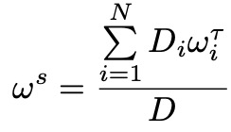
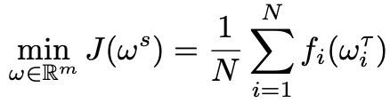
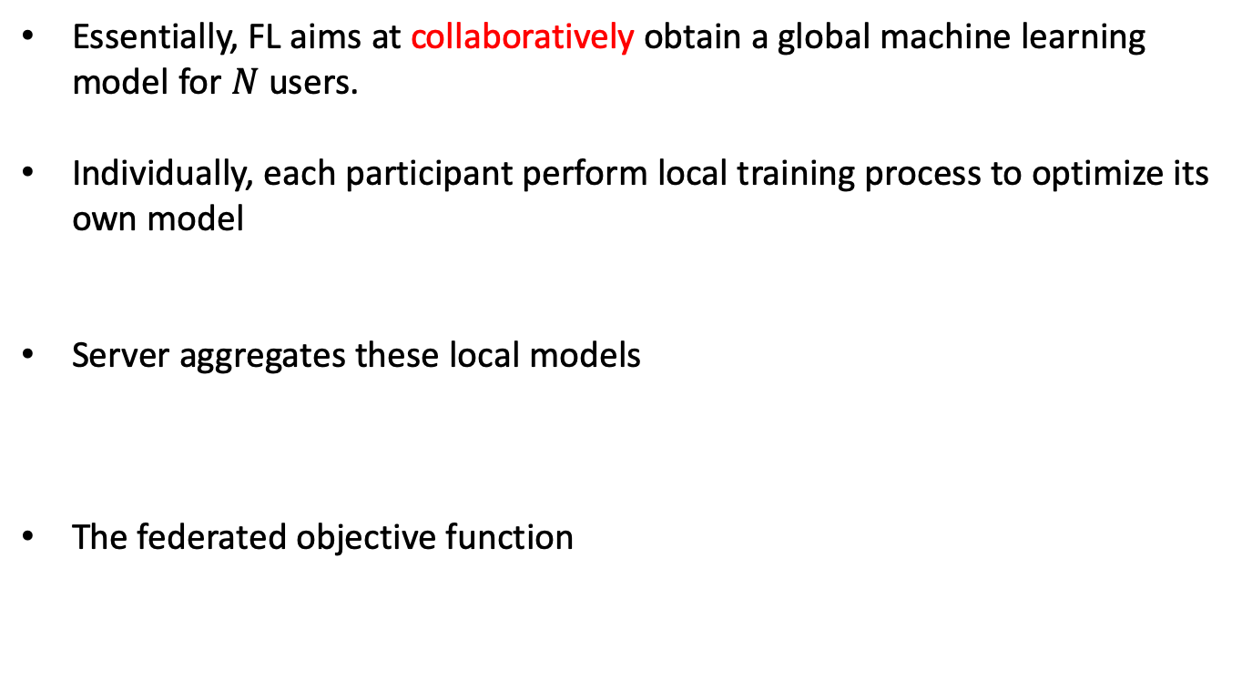
Optimization POV
Essentially, FL aims at collaboratively obtain a global machine learning model for $N$ users.
Individually, each participant perform local training process to optimize its own model
Server aggregates these local models
The federated objective function
Local data size and weight
Global weight
Total data size
Number of clients
Notes:
Need to add animation for definition of terms

Slide 13

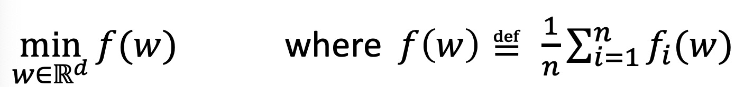
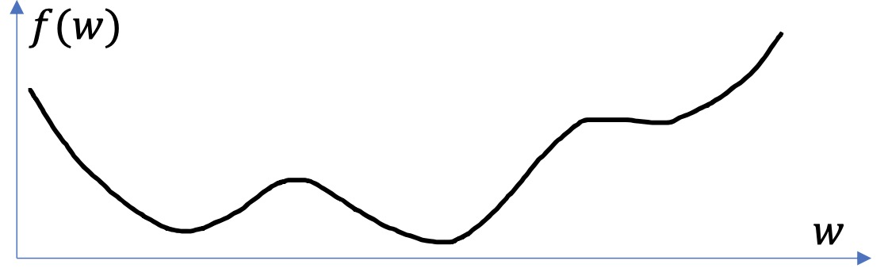
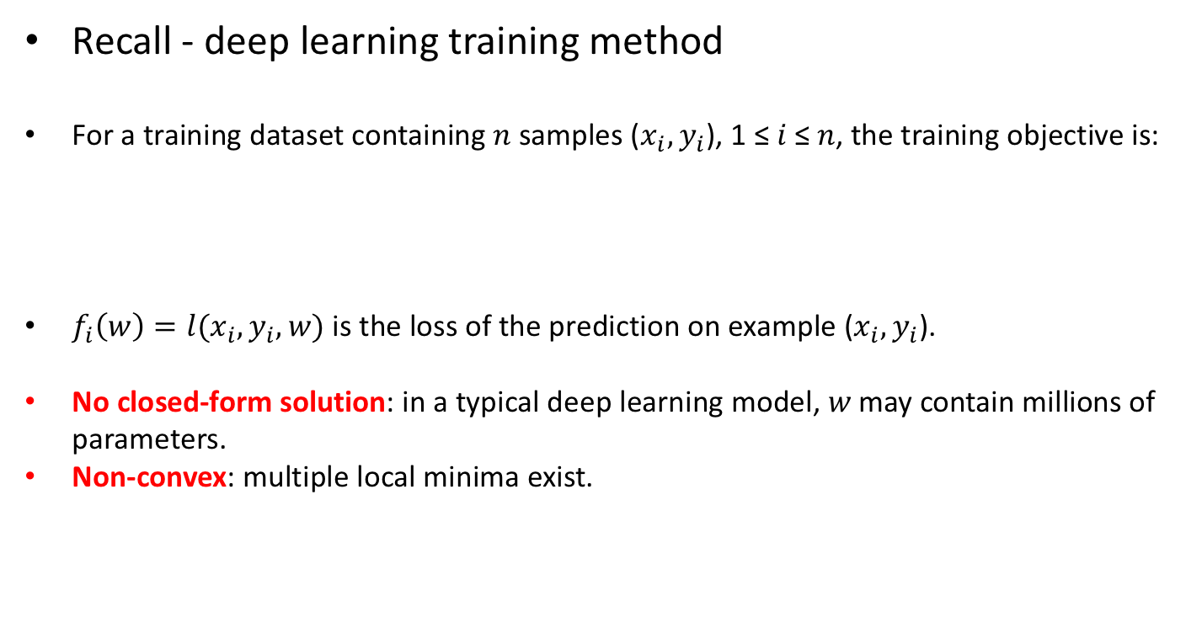
Optimization POV
Recall - deep learning training method
For a training dataset containing 𝑛 samples ($x_{i},y_{i}$), 1 ≤ 𝑖 ≤ 𝑛, the training objective is:
$f_{i}\left(w\right)=l(x_{i},y_{i},w)$ is the loss of the prediction on example ($x_{i},y_{i}$).
No closed-form solution: in a typical deep learning model, 𝑤 may contain millions of parameters.
Non-convex: multiple local minima exist.
Notes:
Need to add animation for definition of terms

Slide 14
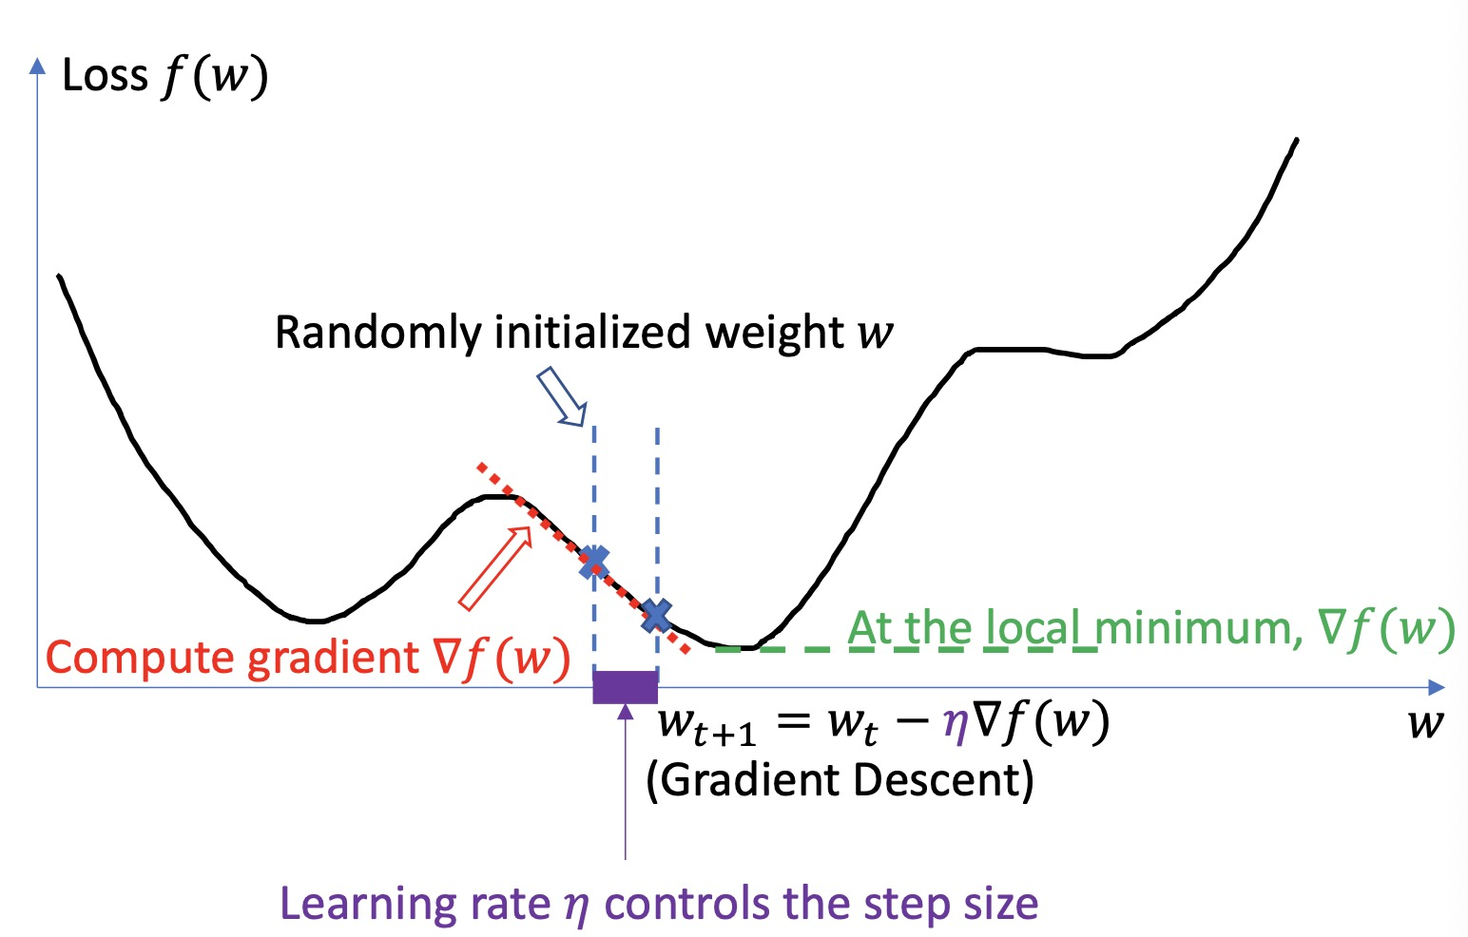
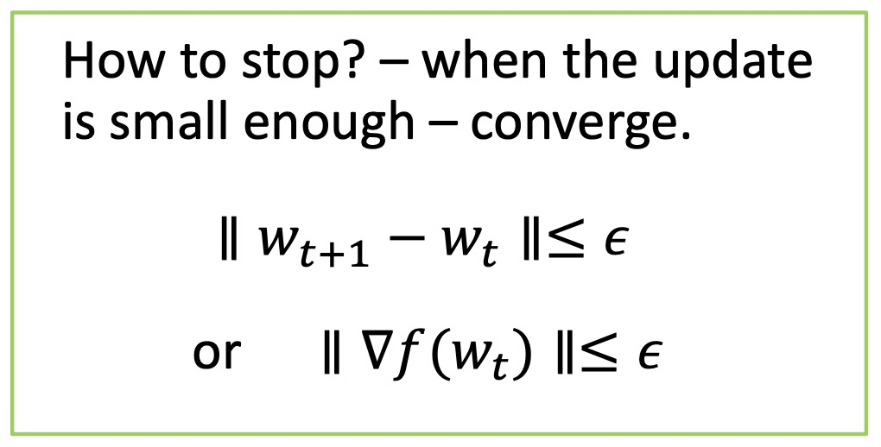

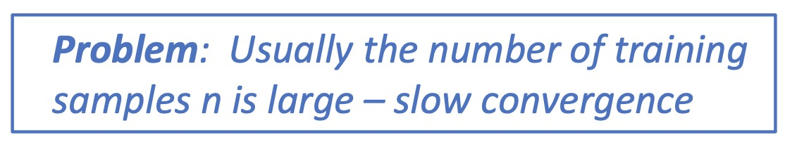
Optimization POV
Recall – gradient descent
Predefined threshold

Slide 15
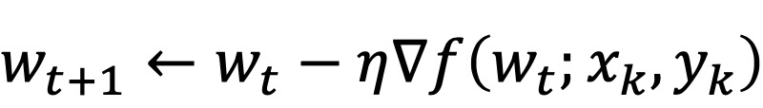
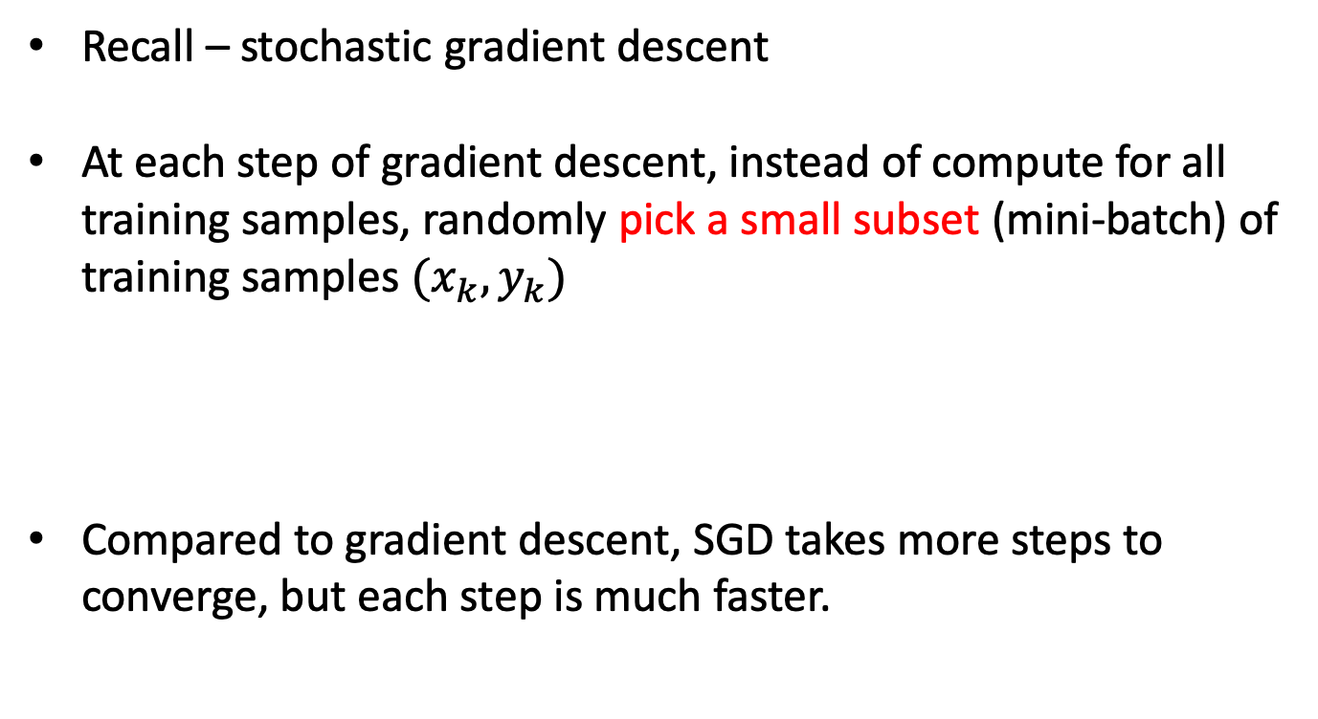
Optimization POV
Recall – stochastic gradient descent
At each step of gradient descent, instead of compute for all training samples, randomly pick a small subset (mini-batch) of training samples $(x_{k},y_{k})$
Compared to gradient descent, SGD takes more steps to converge, but each step is much faster.
Learning rate

Slide 16



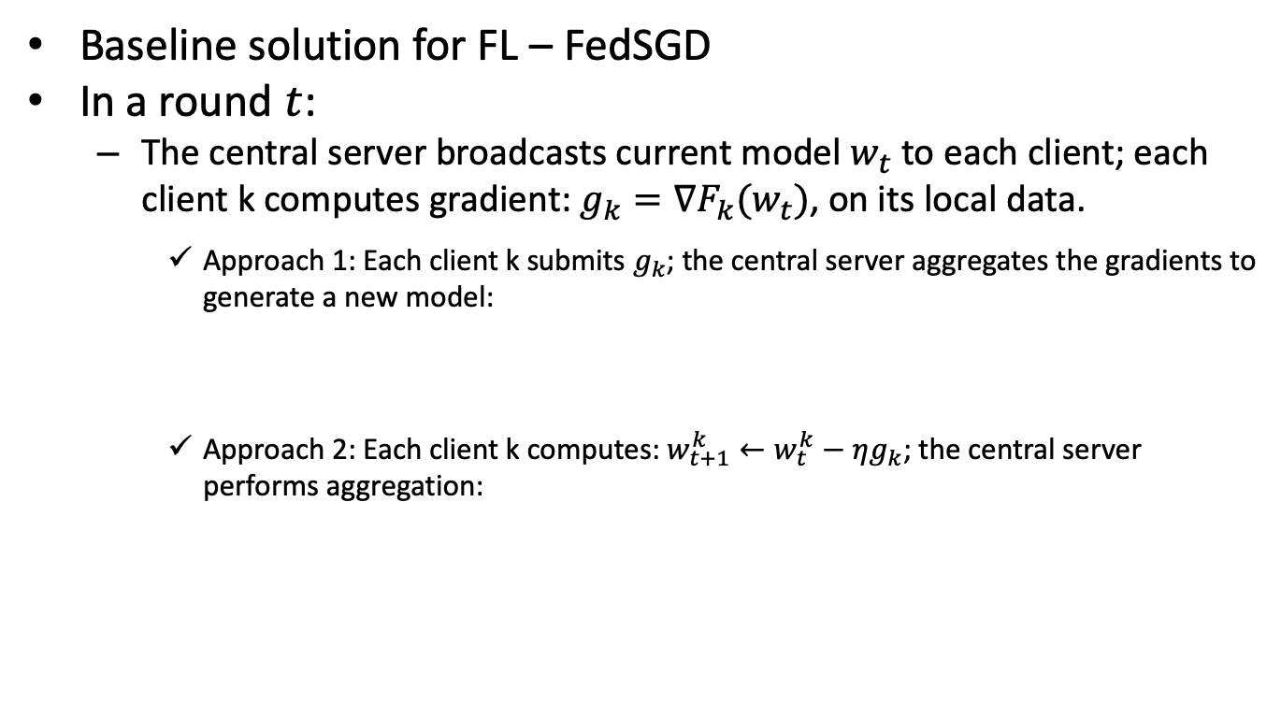
Optimization POV
Baseline solution for FL – FedSGD
In a round $t$:
  The central server broadcasts current model $w_{t}$ to each client; each client k computes gradient: $g_{k}=∇F_{k}(w_{t})$, on its local data.
    Approach 1: Each client k submits $g_{k}$; the central server aggregates the gradients to generate a new model:
    Approach 2: Each client k computes: $w_{t+1}^{k}←w_{t}^{k}−ηg_{k}$; the central server performs aggregation:
For multiple times ⟹ Federated Averaging (FedAvg)

Slide 17
Optimization POV
Federated learning - deal with limited communication
  Due to the enormous number of end devices and limited bandwidth, the communication cost dominates the federated learning process
Increase computation
  Select more clients for training between each communication round
  Increase computation on each client

Slide 18
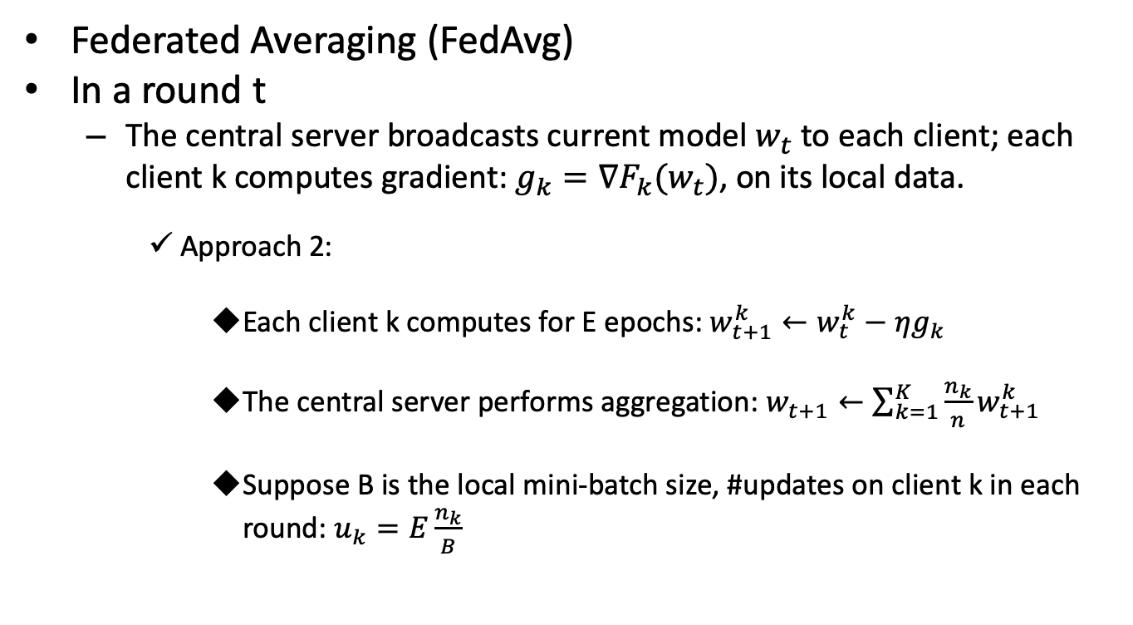
Optimization POV
Federated Averaging (FedAvg)
In a round t
  The central server broadcasts current model $w_{t}$ to each client; each client k computes gradient: $g_{k}=∇F_{k}(w_{t})$, on its local data.
    Approach 2:
      Each client k computes for E epochs: $w_{t+1}^{k}←w_{t}^{k}−ηg_{k}$
      The central server performs aggregation: $w_{t+1}←\sum_{k=1}^{K}{\frac{n_{k}}{n}w_{t+1}^{k}}$
      Suppose B is the local mini-batch size, #updates on client k in each round: $u_{k}=E\frac{n_{k}}{B}$

Slide 19
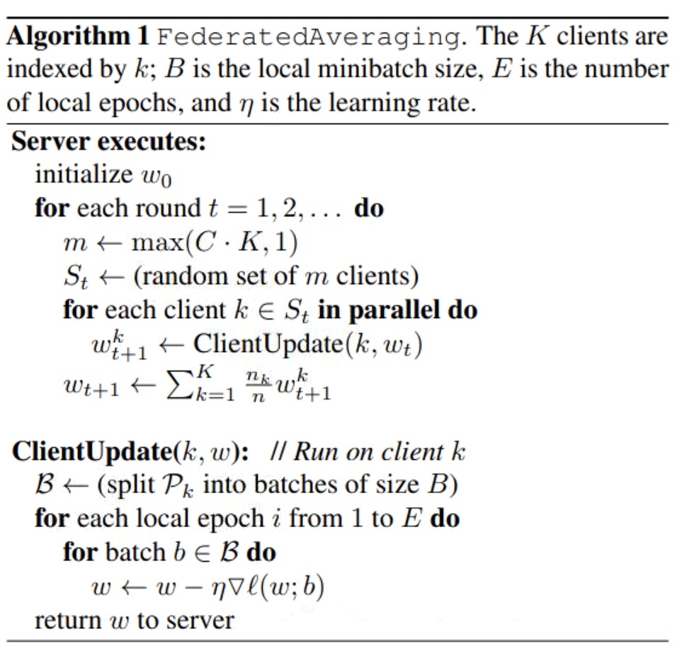
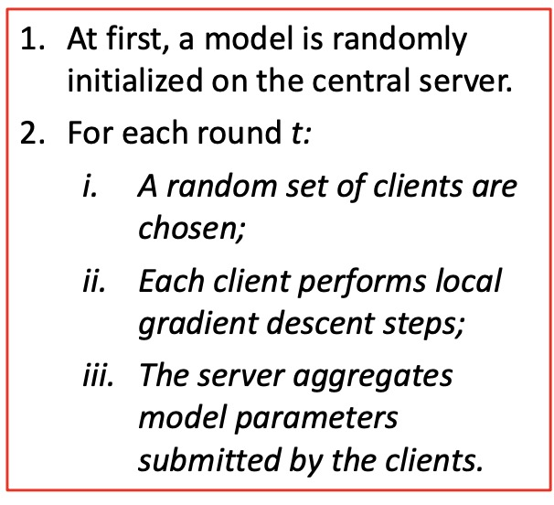
Optimization POV
Federated Averaging (FedAvg)
Overall procedures:

Slide 20



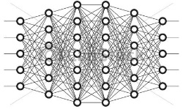



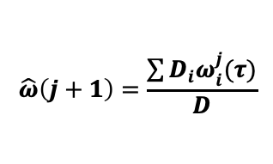










Methodology
Federated Learning Based Mobile Edge Computing
Centralized Cloud
④ Global Aggregation
$$\hat{ω}\left(j+1\right)=\frac{\sum{D_{i}ω_{i}^{j}(τ)}}{D}$$
⑤ Model Updating
$$ω_{1}^{j}(τ)$$
$$ω_{M}^{j}(τ)$$
$$\hat{ω}(j+1)$$
③Local Updates
①
Selected Devices
② Download Naive Model
$$f_{1}(ω_{1}^{j}(k))$$
$$f_{2}(ω_{2}^{j}(k))$$
$$ω_{1}^{0}(τ)$$
$$f_{M}(ω_{M}^{j}(k))$$
……
$$D_{1}$$
$$D_{2}$$
$$D_{M}$$
Device 1
Device 2
Device $M$

Slide 21
Outline
Background and Fundamentals
  Background
  Machine Learning (ML) Point of View
  Optimization Point of View
Federated Learning for Wireless Networks
  Unsupervised Federated Learning for Unbalanced Data
  Matching Theory Based Low-Latency Scheme for Multi-Task Federated Learning in MEC Networks
From Federated Learning to Federated Analysis
  Federated Skewness Analytics in Heterogeneous Decentralized Data Environments
  Federated Anomaly Analytics for Local Model Poisoning Attack
Open problems and Conclusions

Slide 22
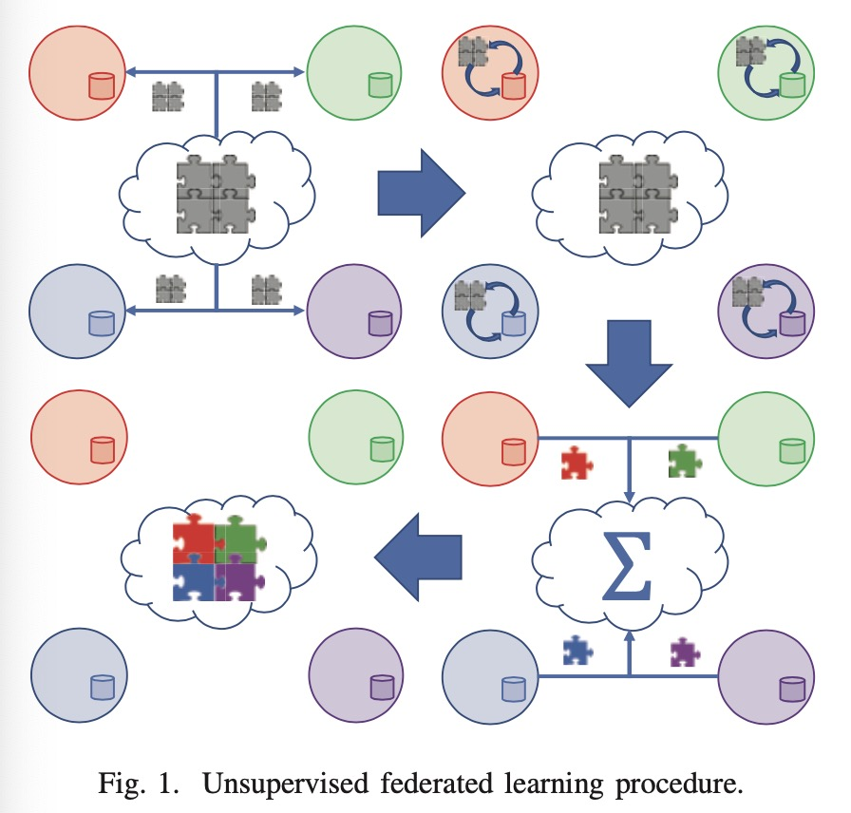
Motivation
Unsupervised learning tasks being implemented within the federated learning framework
Challenges:
the accuracy of federated learning training reduces significantly when the data is nonuniformly distributed across devices.

Slide 23
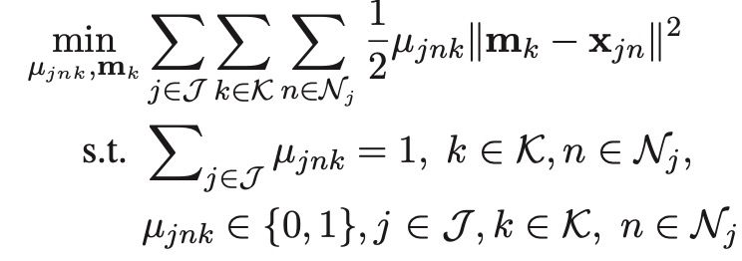
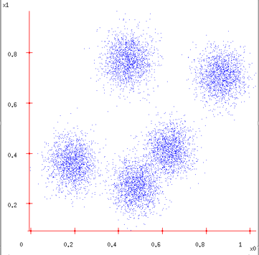
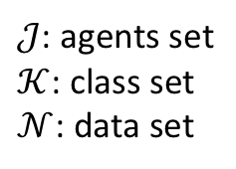
Formulation
The goal is to assign each observation point to a particular cluster and estimate the cluster centroid, considering hard assignment scheme, i.e., each point only belongs to one cluster.
$𝒥$: agents set
$𝒦$: class set
$𝒩$: data set
Centroid
Data sample
Class membership indicator

Slide 24
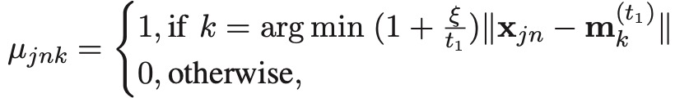


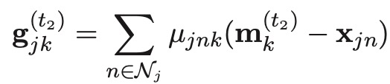
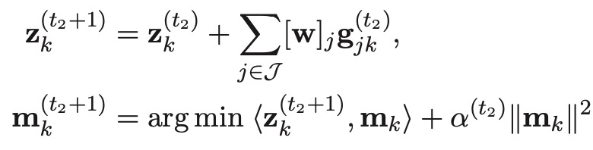
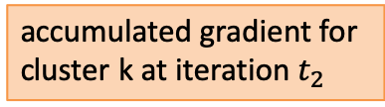
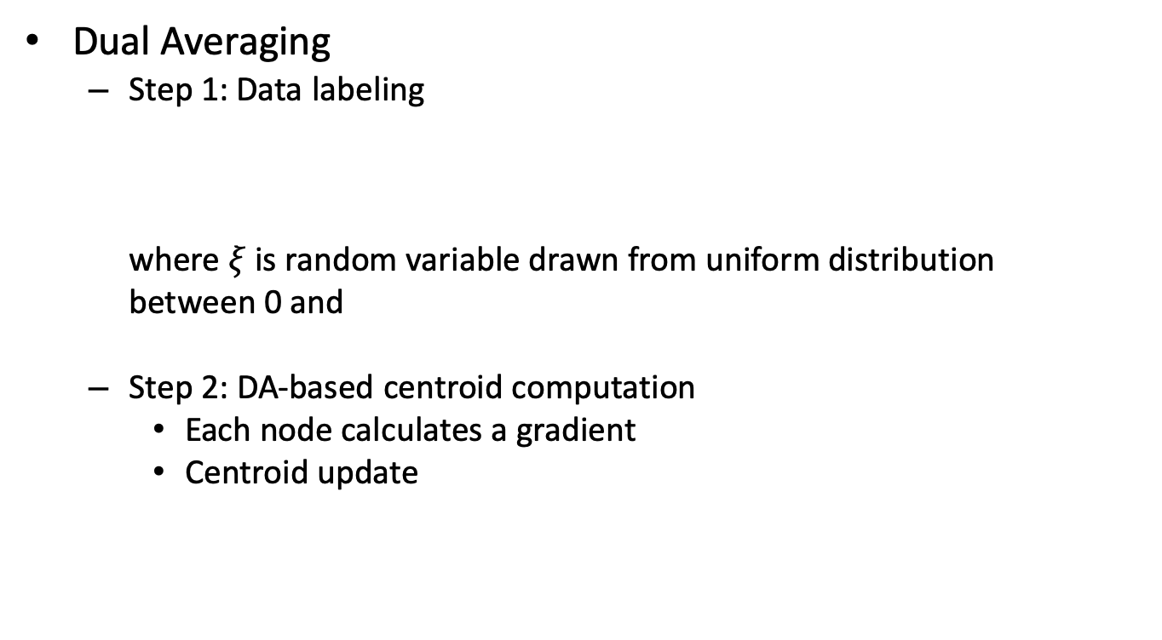
Methodology
Dual Averaging
  Step 1: Data labeling
  where $ξ$ is random variable drawn from uniform distribution
  between 0 and
  Step 2: DA-based centroid computation
    Each node calculates a gradient
    Centroid update
accumulated gradient for cluster k at iteration $t_{2}$
first-order approximation of the objective
regularization term

Slide 25
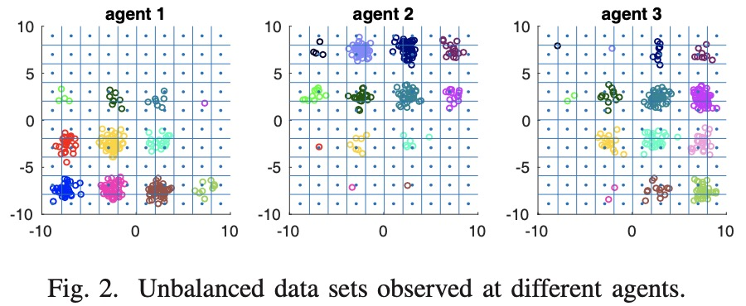
Methodology
Dual Averaging
  Step 3(a): Weight computation via bin method
    assign the weights by dividing the data space into a grid with uniform-sized bins and calculate the number of points (as weight) falling into a particular bin (a region of the grid) at each node.
Notes:
Consider the scenario shown in Fig. 2, where 3 sensor nodes observe data points from 16 clusters indicated by different colors. It is clear that each agent in the figure only has partial observations of the entire dataset. It is intuitive to weigh the gradients that correspond to each cluster by the number of points that are observed at agent j. In particular, it can be seen that agent 1 will have the highest weight for the cluster at the bottom left of the grid in Fig. 2, while agents 2 and 3 will have zero weight as this cluster is not observed by those agents. Unfortunately, weights cannot be computed in this fashion because the data labels remain unknown before clustering is done. Therefore, it is proposed to assign the weights by dividing the data space into a grid with uniform-sized bins as shown in Fig. 2 and calculate the number of points falling into a particular bin (a region of the grid) at each node. The number of points for each bin is sent to the central server from each agent so that the weight for each particular bin at each agent can be computed as the number of points falling in that bin at that agent divided by the total number of points in that bin from all agents.

Slide 26
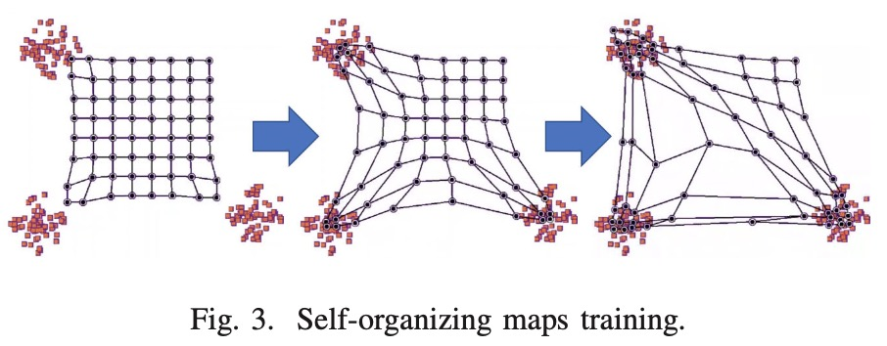
Methodology
Dual Averaging
  Step 3(b): Weight computation via self-organizing maps
    All neurons are initialized with small values of their weights.
    For each data point, the neurons compute the distance to the data point and the closest neuron is declared as the winner.
    The winning neuron determines the neighborhood of excited neurons and these neurons adjust their individual weights towards the data point.
    Neurons decrease neighborhood radius and learning rate.
Repeat until
convergence

Slide 27
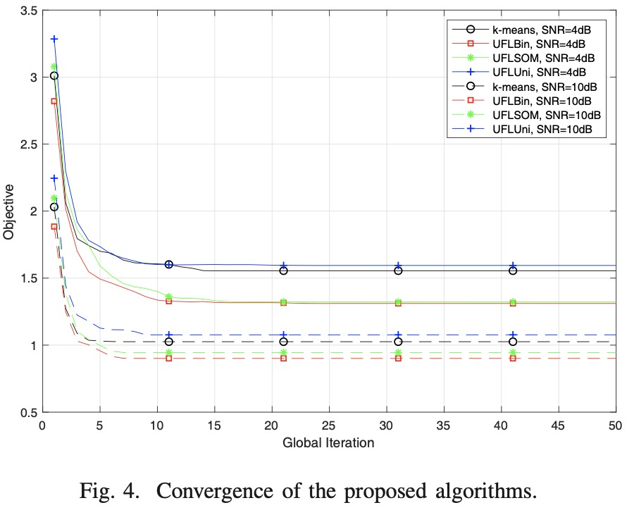
Simulation Results
Data are generated at random from K = 16 classes, with vectors from each class generated from a symmetric Gaussian distributions.
UFLBin: Bin based DA
UFLSOM: SOM based DA
UFLUNI: uniform gradient weighting
K-means as baseline
The proposed methods have been shown to achieve good results compared to uniform gradient weighting and the centralized k-means.
Mykola Servetnyk, Carrson C. Fung, and Zhu Han, ``Unsupervised Federated Learning for Unbalanced Data," IEEE Globecom, 2020.

Slide 28
Outline
Background and Fundamentals
  Background
  Machine Learning (ML) Point of View
  Optimization Point of View
Federated Learning for Wireless Networks
  Unsupervised Federated Learning for Unbalanced Data
  Matching Theory Based Low-Latency Scheme for Multi-Task Federated Learning in MEC Networks
From Federated Learning to Federated Analysis
  Federated Skewness Analytics in Heterogeneous Decentralized Data Environments
  Federated Anomaly Analytics for Local Model Poisoning Attack
Open problems and Conclusions

Slide 29
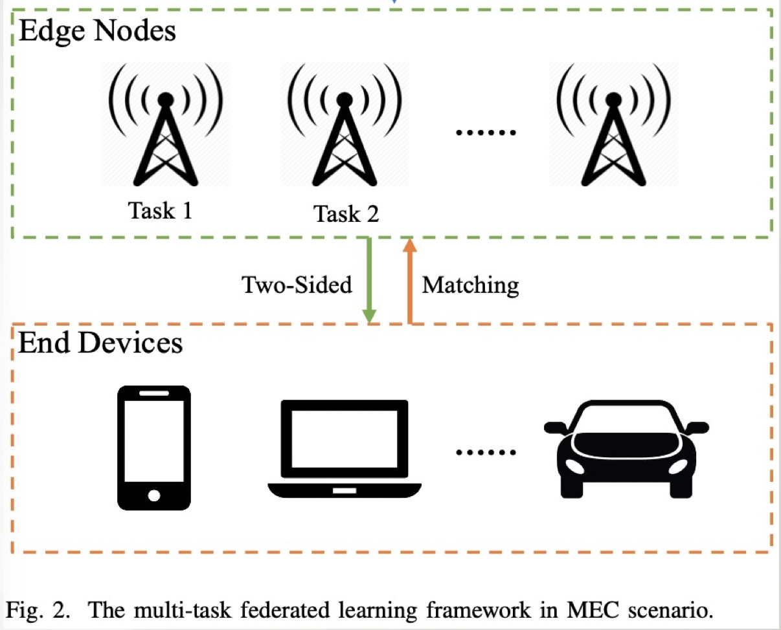
Motivation
Challenges:
  Once the end devices are invited, they will unconditionally take part in the federated learning tasks which ignores their willingness.
    Computation cost, remained energy…
  There are many available edge nodes in a MEC network, how to parallelly perform multiple federated learning tasks needs to be considered.
  Information exchanging cannot be done entirely in large scale IoTs scenarios.
  Matching Game Framework with incomplete preference list
Dawei Chen, Choong Seon Hong, Li Wang, Yiyong Zha, Yunfei Zhang, Xin Liu and Zhu Han, ``Matching Theory Based Low-Latency Scheme for Multi-Task Federated Learning in MEC Networks," IEEE Transactions on Mobile Computing.

Slide 30
Stable Marriage Matching
Basic elements (Stable Marriage):
  Agents: A set of men, and a set of women;
  Preference list: A sorted list of men/women based on her/his preferences;
  Blocking pair (BP) (m,w):
    1). m is unassigned or prefers w to his current partner;
    2). w is unassigned or prefers m to her current partner;
  Stable matching: A matching admit no BPs.
  Gale-Shapley Algorithm: find a stable matching in SM.

Slide 31
GS algorithm
Geeta, Heiki, Irina, Fran
Adam
Fran
Irina, Fran, Heiki, Geeta
We reach a stable marriage!
Geeta
Bob
What if the preference list is incomplete?
Geeta, Fran, Heiki, Irina
Carl
Heiki
Irina, Heiki, Geeta, Fran
David
Challenge: Incomplete preference list
Irina

Slide 32
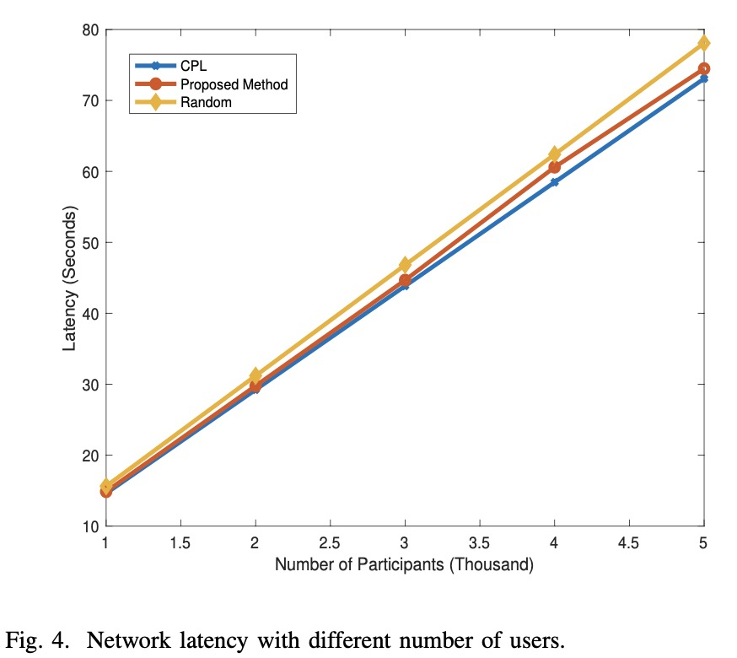
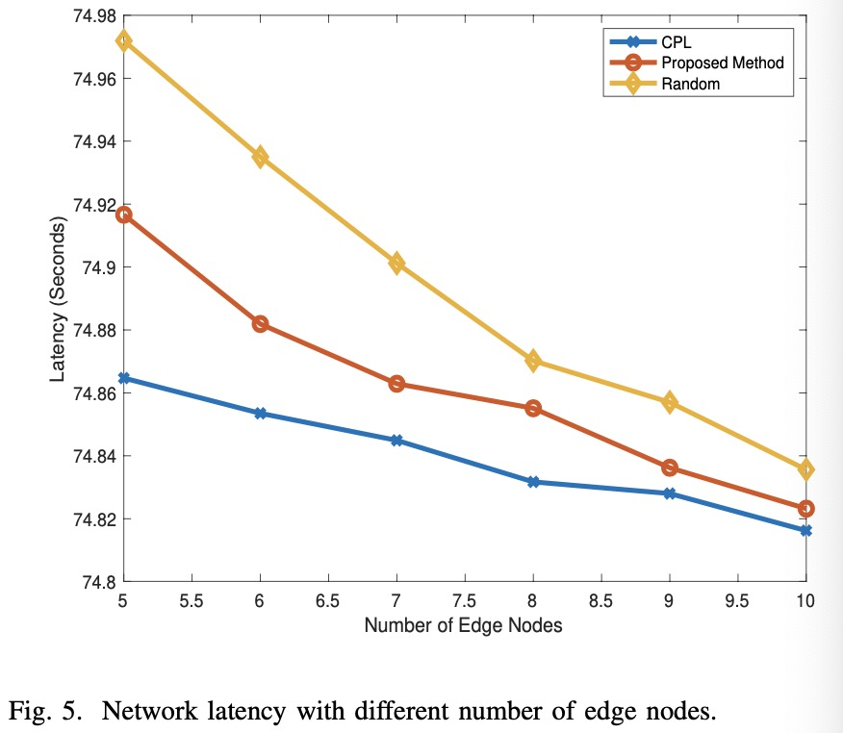
Simulation Results
Impact of user numbers and edge node numbers
Evidently, the network latency is positively related to the number of participants while is negatively correlated with number of edge nodes.
Our proposed method is close to the performance of complete preference list (CPL) case.

Slide 33
Outline
Background and Fundamentals
  Background
  Machine Learning (ML) Point of View
  Optimization Point of View
Federated Learning for Wireless Networks
  Unsupervised Federated Learning for Unbalanced Data
  Matching Theory Based Low-Latency Scheme for Multi-Task Federated Learning in MEC Networks
From Federated Learning to Federated Analysis
  Federated Skewness Analytics in Heterogeneous Decentralized Data Environments
  Federated Anomaly Analytics for Local Model Poisoning Attack
Open problems and Conclusions

Slide 34
















Beyond Federated Learning: Federated Analytics
Covid-19$
idc$
bgt$
tweetdeck$
Out-of-dictionary words
Model efficiency
Popular songs/trends
Federated Analytics is the practice of applying data science methods to the analysis of raw data that is stored locally on users’ devices.
Originally defined in https://ai.googleblog.com/2020/05/federated-analytics-collaborative-data.html

Slide 35








Federated Analytics: A Closer Look
Terminology
  Insights are derived by clients and sent to server
  Aggregation are performed by server for global knowledge construction
Characteristics
  No raw data exchange
  Focus on population-level knowledge
  Interactive/non-interactive
  Privacy guaranteed
Aggregation
Non-interactive: Interactive: multiple rounds
one-shot analytic
Insight
Insight
Insight
Federated learning Workflow

Slide 36
Federated Analytics vs. Others
To Federated Learning
To Distributed Data Mining
 | Federated Learning | Federated Analytics
Goal | Training ML models | Non-training tasks (data science)
Aggregation approach | FedAvg | Task dependent
 |  | Tree | Bayesian | MPC | etc.
Local insights | Model weights | Task dependent
 |  | Partial info | Distilled info | etc.
 | Distributed Data Mining | Federated Analytics
Raw data transmission | Redistribution assumed | Stay where it origins
Clients (nodes) and server | Trusted | Untrusted (privacy & Byzantine attack)
Data & device heterogeneity | Little concerned | Focused

Slide 37





FedACS: a Federated Analysis Example
FedACS: a stand-alone FA instance assisting some other federated tasks
  Measuring data heterogeneity (skewness) and create a client-pool with low data skewness
  when assisting FL, it reduces 65.6% of accuracy loss and speeds up for 2.4x
Goal: data heterogeneity measurement
Insight: weight reuse
Aggregation: Hoeffding inequality based
Goal: client selection
Challenge: non-stationary measurement
Solution: dueling bandit
Step 1
measure data heterogeneity
Step 2
select high-quality clients
“FedACS: Federated Skewness Analytics in Heterogeneous Decentralized Data Environments”, Z. Wang, Y. Zhu, D. Wang, Z. Han, accepted by IWQoS 2021

Slide 38
Outline
Background and Fundamentals
  Background
  Machine Learning (ML) Point of View
  Optimization Point of View
Federated Learning for Wireless Networks
  Unsupervised Federated Learning for Unbalanced Data
  Matching Theory Based Low-Latency Scheme for Multi-Task Federated Learning in MEC Networks
From Federated Learning to Federated Analysis
  Federated Skewness Analytics in Heterogeneous Decentralized Data Environments
  Federated Anomaly Analytics for Local Model Poisoning Attack
Open problems and Conclusions

Slide 39
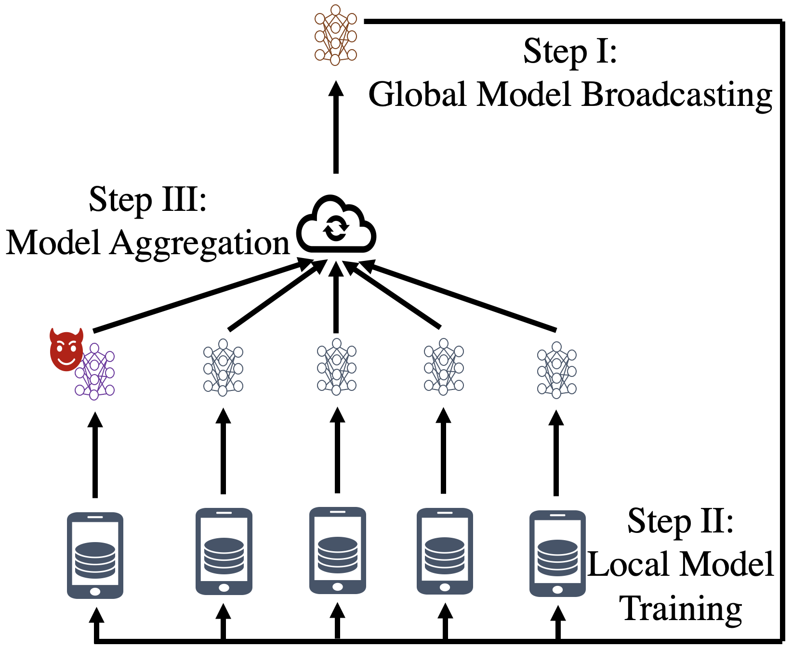
Federated Anomaly Analytics for Local Model Poisoning Attack
Local model poisoning attack
Threat model
The attacker can manipulate the shared local models not the local data during the process of federated learning.
Impact
Slowing down the convergence rate of the learning process.
Degrading the prediction accuracy of the learned global mode.
Most defense methods are passive
Treat the normal local models and the poisoned local models indiscriminately, such as GeoMed and Trimmed Mean.
(a) Federated Learning under local model poisoning attack
It cannot eliminate all the poisoned local models, thus the training performance is affected to some degree, i.e., the accuracy of learned global model is reduced.
Siping Shi, Chuang Hu, Dan Wang, Yifei Zhu, and Zhu Han, ``Federated Anomaly Analytics for Local Model Poisoning Attack," to appear IEEE Journal on Selected Areas in Communication

Slide 40
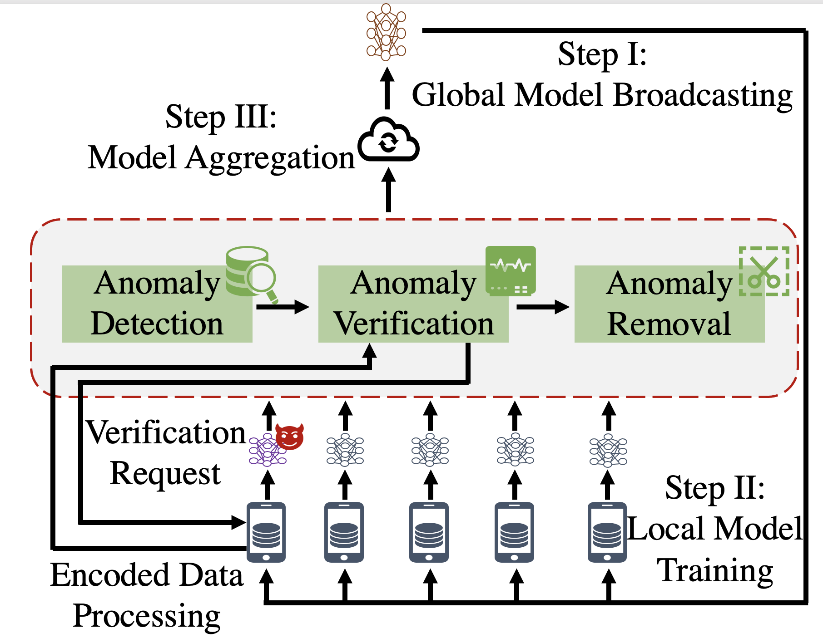
Motivation, Challenges and Methodology
Motivation
Leverage the new federated analytics paradigm to develop a proactive defense method with privacy and performance guarantee.
Challenge
Data heterogeneity caused by federated scenarios increases the difficulty in anomaly analytics.
Methodology of federated analysis framework with three modules
Anomaly detection module
Identify the potential malicious local model updates with a light-weight anomaly detection algorithm
FAA-DL allows greater compatibility with various anomaly detection algorithms. Support Vector Machine (SVM) is selected in our paper.

Slide 41
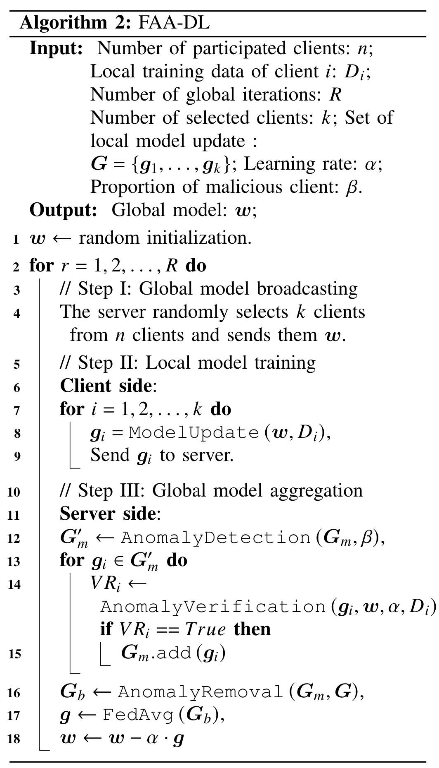
Methodology (cont.)
Anomaly verification module
Request encrypted local data from potential malicious clients which identified in the anomaly detection module.
The server computes the corresponding gradient with the receiving encrypted local data based on functional encryption method.
Verify whether the potential malicious client is true malicious by comparing the gradients.
Anomaly removal module
Remove the verified malicious local model updates from aggregation.

Slide 42
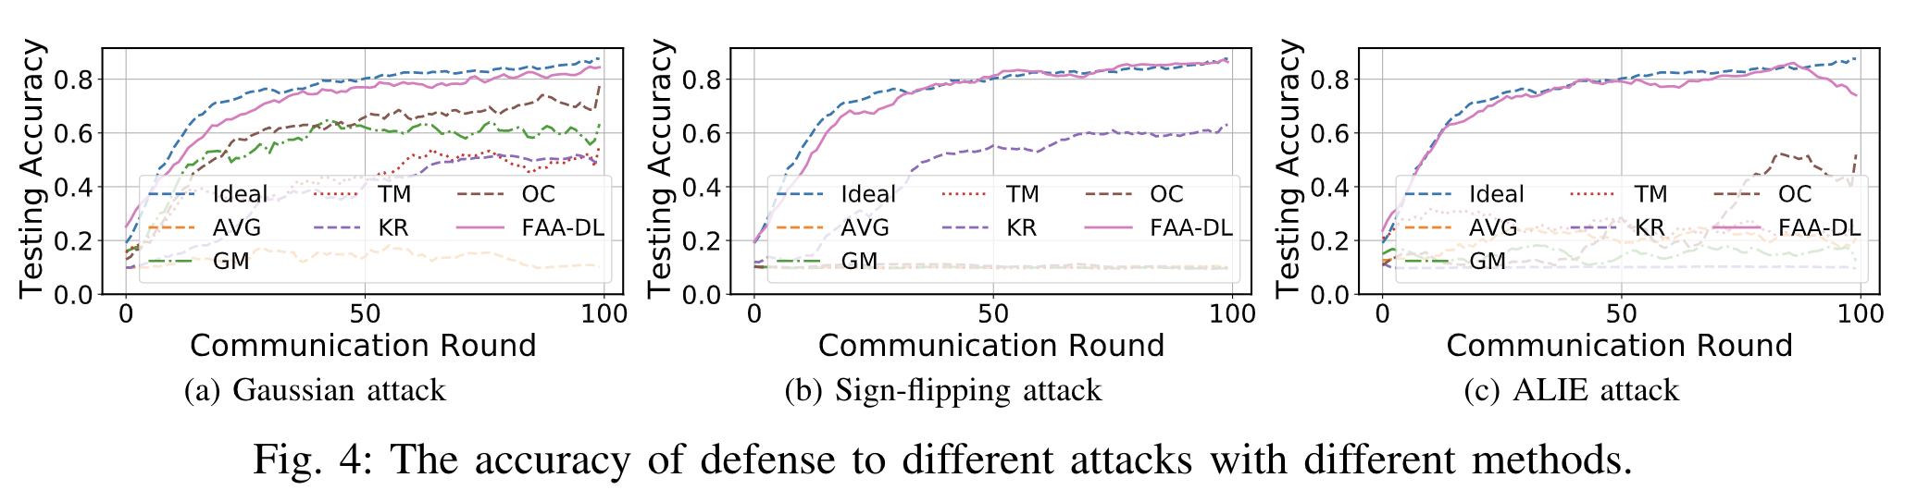
Experiments
Accuracy:
  FAA-DL outperforms other defense methods on the accuracy of the learnt global model.
  The performance gap of FAA-DL is within 0.92% –2.48% of the ideal baseline across all tested attacks.

Slide 43
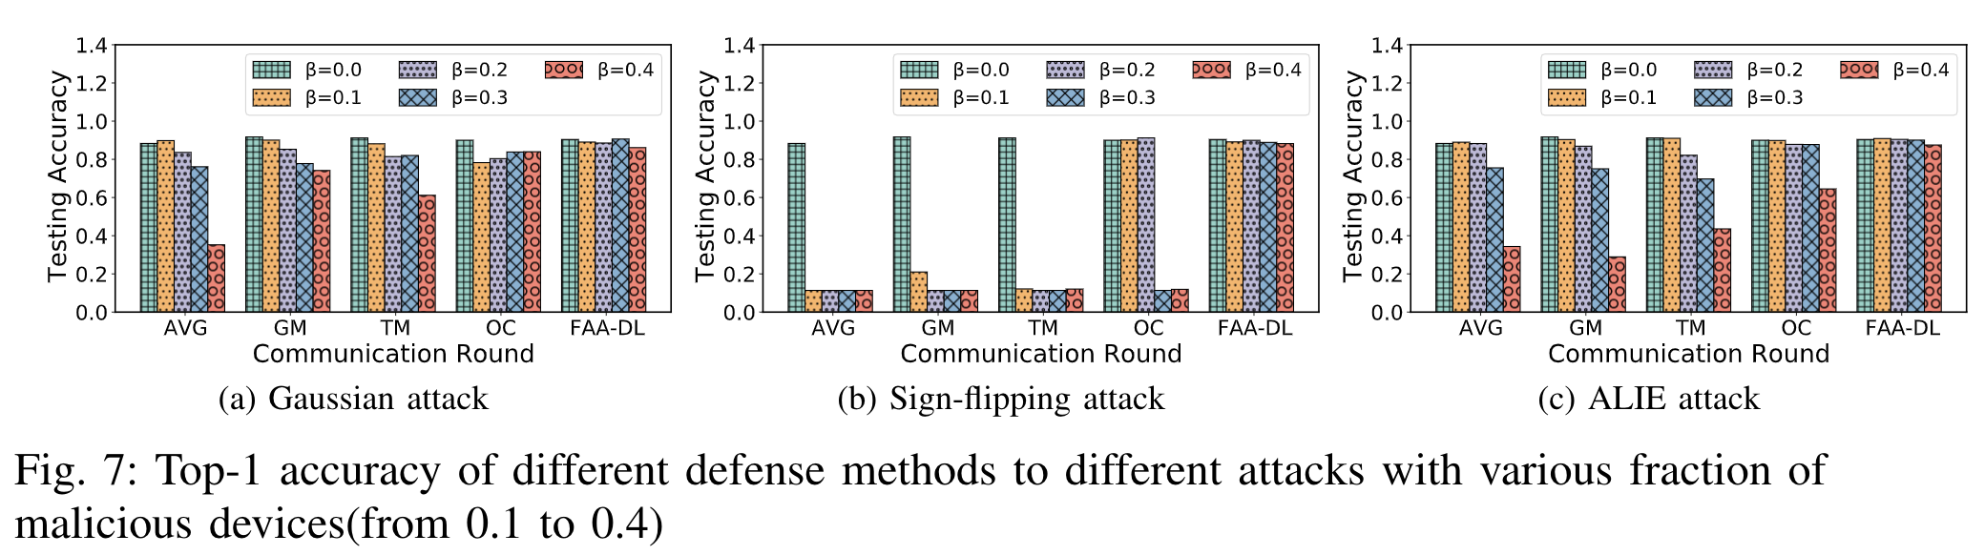
Experiments
Robustness :
  FAA-DL remains nearly the same accuracy as the ideal baseline when the proportion of attacked devices increased from 0.1 to 0.4,
  while other methods decreased greatly epically in sign-flipping attack.

Slide 44
Open Problems
Some open areas in Federated learning
  Optimization algorithms for FL, particularly communication-efficient algorithms tolerant of non-IID data
  Approaches that scale FL to larger models, including model and gradient compression techniques
  Novel applications of FL, extension to new learning algorithms and model classes.
  Not everyone has to have the same model (multi-task and pluralistic learning, personalization, domain adaptation)
  Bias and fairness in the FL setting (new possibilities and new challenges)
  Enhancing the security and privacy of FL, including cryptographic techniques and differential privacy

Slide 45
Conclusions
Federated learning will be a major part of learning paradigm
  Mobile massively decentralized, naturally arising (non-IID) partition
  Availability of distributed clients
  Address communication bottleneck
  Privacy concern
We explore different aspects and applications to integration of federated learning and wireless networks
  Formulations
  Problem specific solution
  Link machine learning, computation, communication, networking, and operational research together
  From federated learning to federate analysis

Slide 46



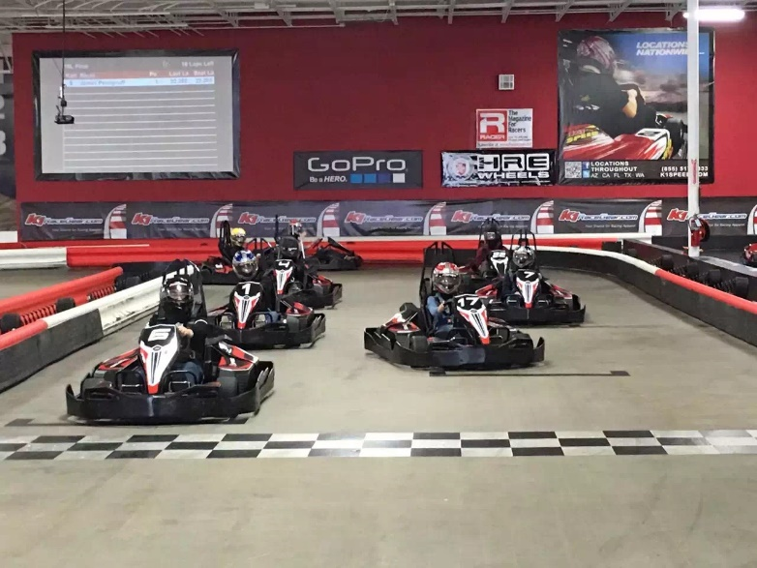




Join or Visit Our Lab
http://wireless.egr.uh.edu/
http://www2.egr.uh.edu/~zhan2

Slide 47

THANK YOU

