Slide 1




Federated Learning In Mobile Edge Computing
Zhu Han
Department of Electrical and Computer Engineering
University of Houston, TX, USA
Thanks to Dawei Chen, Latif U. Khan, Choong Seon Hong, Nguyen Tran, Lixin Li, Minh Nguyen, Tra Huong Thi Le, Chunxiao Jiang, Yue Yu, and NSF & Toyota

Slide 2

Outline
Background and Fundamentals
  Background
  Machine Learning (ML) Point of View
  Optimization Point of View
Federated Learning for Wireless Networks
  Federated Learning Based Mobile Edge Computing for Augmented Reality Applications
  Unsupervised Federated Learning for Unbalanced Data
  Self Organizing Federated Learning Over Wireless Networks: A Socially Aware Clustering Approach
  Matching Theory Based Low-Latency Scheme for Multi-Task Federated Learning in MEC Networks
Open problems and Conclusions

Slide 3
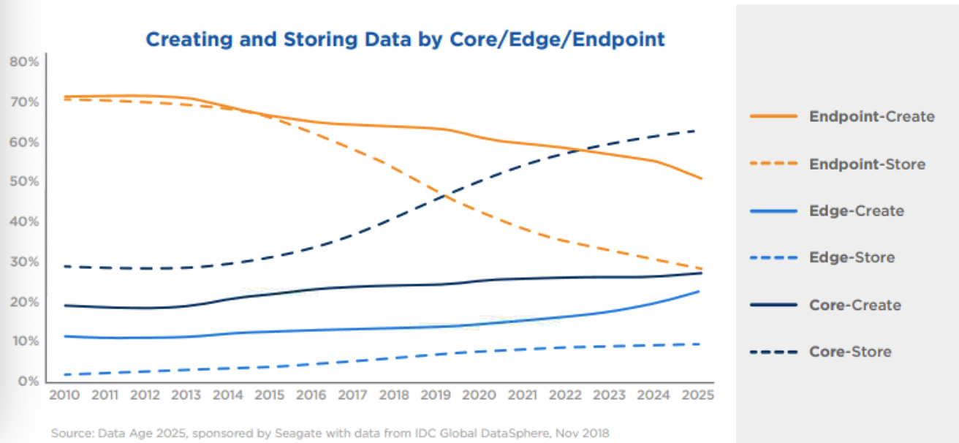
Background
Data is born at the endpoint
  Billions of phones & IoT devices constantly generate data
  Data enables better products and smarter models

Slide 4
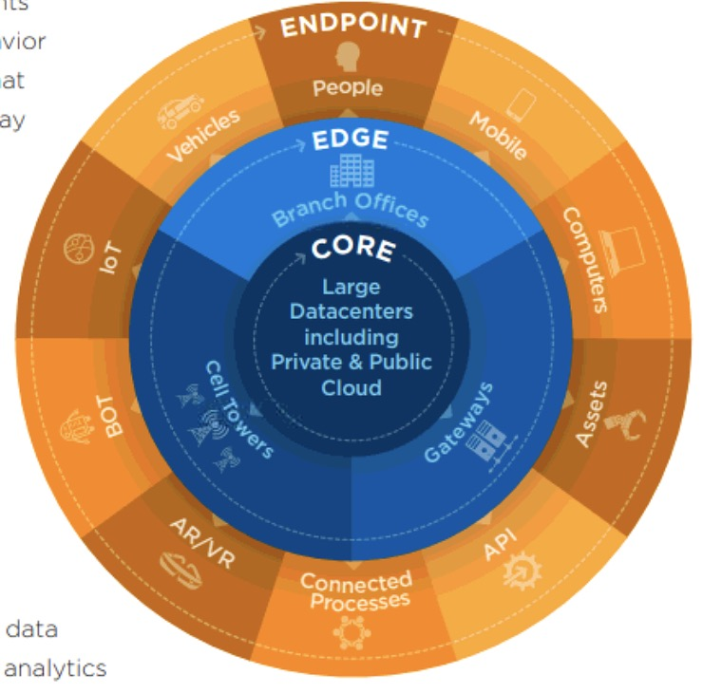
Background
Can data live at the edge?
  Billions of phones & IoT devices constantly generate data
  Data processing is moving on device:
    Improved latency
    Works offline
    Better battery life
    Privacy advantages
What about analytics?
What about learning?
Sources: D. Reinsel, J. Gantz, and J. Rydning, “The digitization of the world from edge to core,” IDC White Paper, 2018.

Slide 5
Background
Generally we have three options:
Do not use data to improve products and services
Log the data centrally anyway
Find a new solution
Find a new solution
Choose your poison

Slide 6
Background
Luckily we find it:
Do not use data to improve products and services
Log the data centrally anyway
Federated learning and analytics
Find a new solution

Slide 7
ML Point of View
What is Federated Learning?
  General workflow
Server (Aggregator)
Client 1
Client 2
Client 3
Client 4

Slide 8
ML Point of View
What is Federated Learning?
  General workflow
Server (Aggregator)
Broadcast initial model
Client 1
Client 2
Client 3
Client 4

Slide 9
ML Point of View
What is Federated Learning?
  General workflow
Server (Aggregator)
Clients generate local data
Client 1
Client 2
Client 3
Client 4

Slide 10
ML Point of View
What is Federated Learning?
  General workflow
Server (Aggregator)
Clients train the initial model
based on local dataset
Client 1
Client 2
Client 3
Client 4

Slide 11
ML Point of View
What is Federated Learning?
  General workflow
Privacy principle
Focused collection
Devices report only what is needed for this computation
Server (Aggregator)
Upload updated model
Client 1
Client 2
Client 3
Client 4

Slide 12
ML Point of View
What is Federated Learning?
  General workflow
Combine individual models
Server (Aggregator)
Repeat these process until convergence
Client 1
Client 2
Client 3
Client 4

Slide 13
Advantages
Advantages:
  Generally, the data generated by different users are non-i.i.d. data due to the various behavior characteristics. However, the task aims at obtaining a model that is suitable for each individual user. FL has been proved to be an effective way to tackle with non-i.i.d. data [1], which is perfectly suitable for multi-user scenario.
  Communication cost can be easily relieved by FL because what are transmitted between edge devices and datacenter are the machine learning model or the model parameters, whose data size is greatly smaller than the original dataset [2].
  In addition, because the original data will not be uploaded, FL is an effective way to reduce the probabilities of eavesdropping, which means the user's privacy can be ensured [3].
[1]. Y. Zhao, M. Li, L. Lai, N. Suda, D. Civin, and V. Chandra, “Federatedlearning with non-iid data,”arXiv preprint arXiv:1806.00582, 2018.
[2]. J. Koneˇcn`y, H. B. McMahan, F. X. Yu, P. Richtárik, A. T. Suresh, andD. Bacon, “Federated learning: Strategies for improving communicationefficiency,”arXiv preprint arXiv:1610.05492, 2016.
[3]. R. C. Geyer, T. Klein, and M. Nabi, “Differentially private federatedlearning: A client level perspective,” inthe 31st Conference on NeuralInformation Processing Systems, Long Beach, CA, December 2017.

Slide 14
Optimization POV
Characteristics (Major challenges)
  Non-IID
    The data generated by each user are quite different
  Unbalanced
    Some users produce significantly more data than others
  Limited communication
    Unstable mobile network connections
  Massively distributed
    # mobile device owners >> avg # training samples on each device

Slide 15

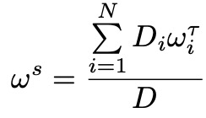
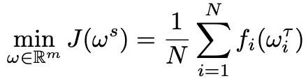
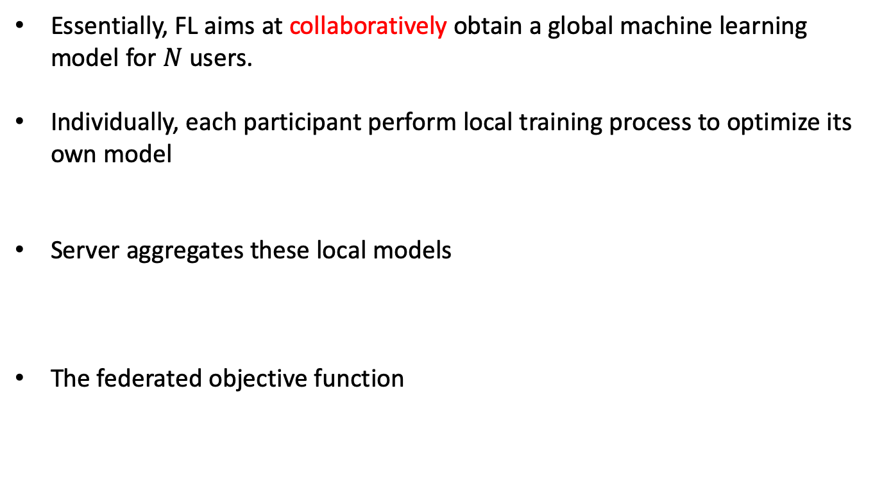
Optimization POV
Essentially, FL aims at collaboratively obtain a global machine learning model for $N$ users.
Individually, each participant perform local training process to optimize its own model
Server aggregates these local models
The federated objective function
Local data size and weight
Global weight
Total data size
Number of clients
Notes:
Need to add animation for definition of terms

Slide 16

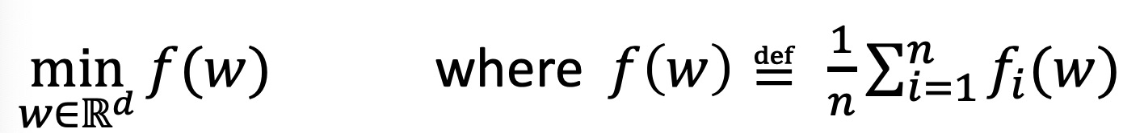
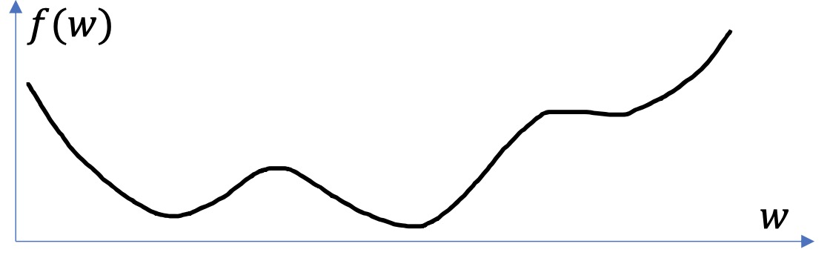
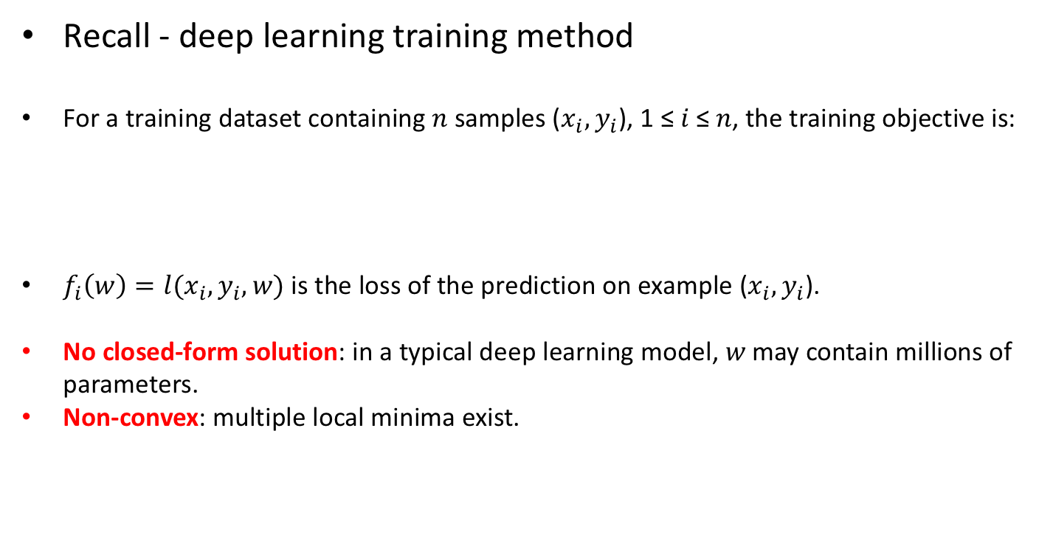
Optimization POV
Recall - deep learning training method
For a training dataset containing 𝑛 samples ($x_{i},y_{i}$), 1 ≤ 𝑖 ≤ 𝑛, the training objective is:
$f_{i}\left(w\right)=l(x_{i},y_{i},w)$ is the loss of the prediction on example ($x_{i},y_{i}$).
No closed-form solution: in a typical deep learning model, 𝑤 may contain millions of parameters.
Non-convex: multiple local minima exist.
Notes:
Need to add animation for definition of terms

Slide 17
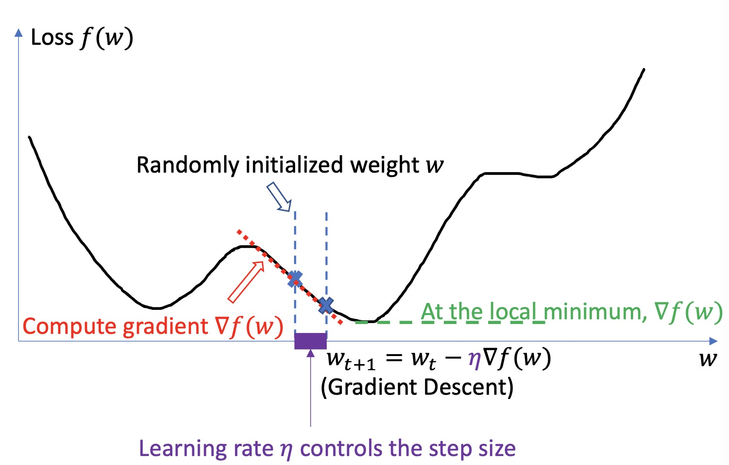
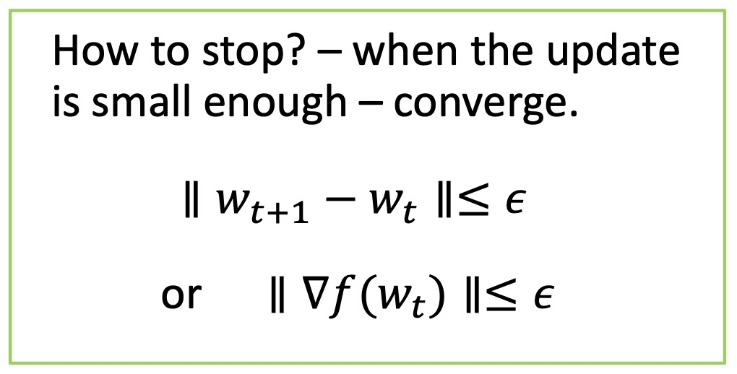

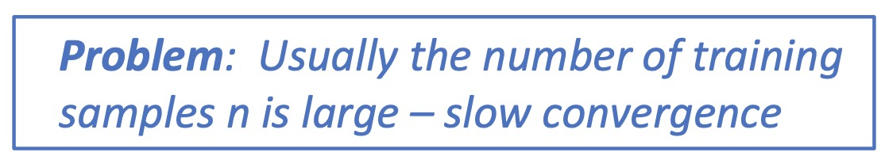
Optimization POV
Recall – gradient descent
Predefined threshold

Slide 18
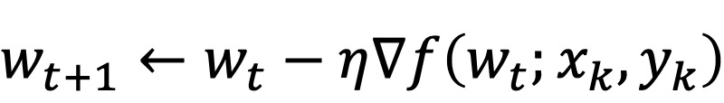
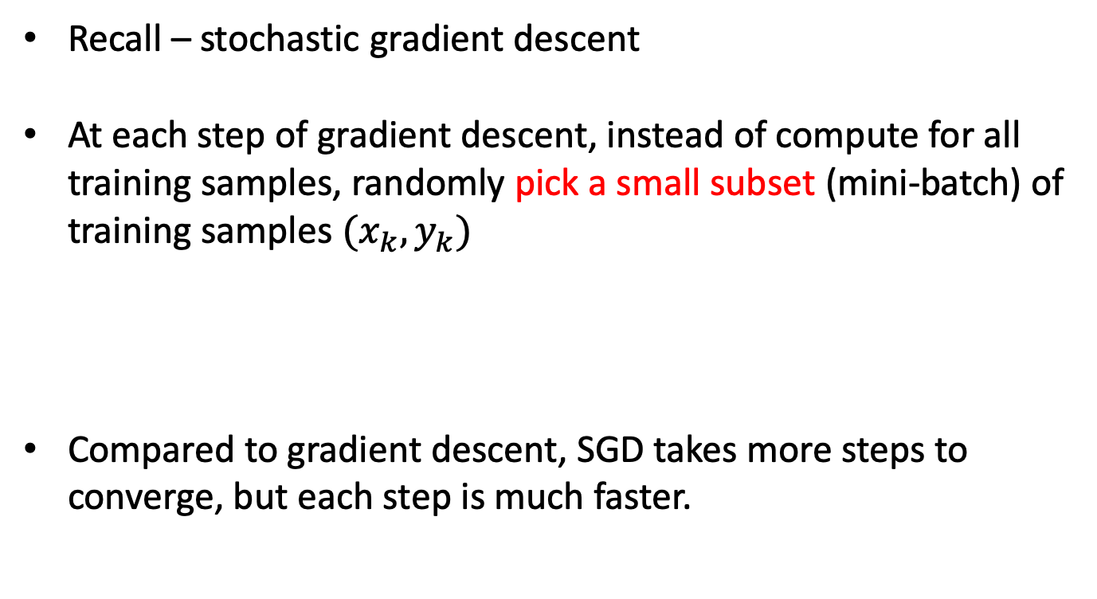
Optimization POV
Recall – stochastic gradient descent
At each step of gradient descent, instead of compute for all training samples, randomly pick a small subset (mini-batch) of training samples $(x_{k},y_{k})$
Compared to gradient descent, SGD takes more steps to converge, but each step is much faster.
Learning rate

Slide 19



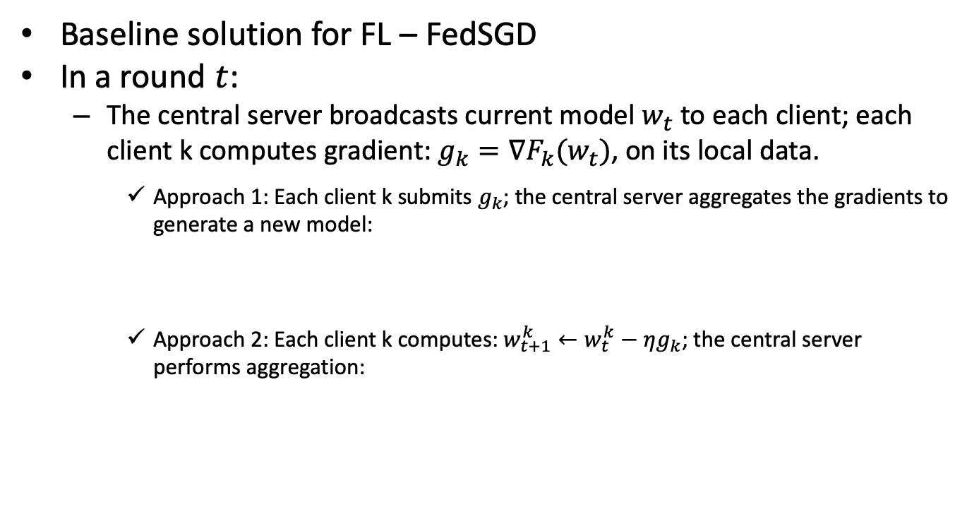
Optimization POV
Baseline solution for FL – FedSGD
In a round $t$:
  The central server broadcasts current model $w_{t}$ to each client; each client k computes gradient: $g_{k}=∇F_{k}(w_{t})$, on its local data.
    Approach 1: Each client k submits $g_{k}$; the central server aggregates the gradients to generate a new model:
    Approach 2: Each client k computes: $w_{t+1}^{k}←w_{t}^{k}−ηg_{k}$; the central server performs aggregation:
For multiple times ⟹ Federated Averaging (FedAvg)

Slide 20
Optimization POV
Federated learning - deal with limited communication
  Due to the enormous number of end devices and limited bandwidth, the communication cost dominates the federated learning process
Increase computation
  Select more clients for training between each communication round
  Increase computation on each client

Slide 21
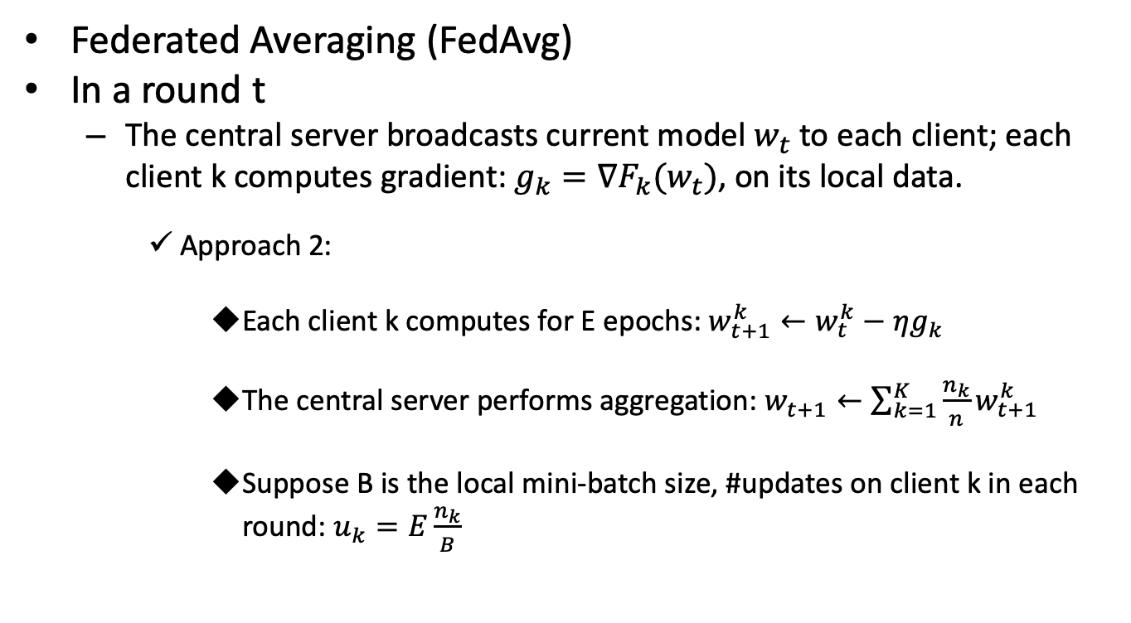
Optimization POV
Federated Averaging (FedAvg)
In a round t
  The central server broadcasts current model $w_{t}$ to each client; each client k computes gradient: $g_{k}=∇F_{k}(w_{t})$, on its local data.
    Approach 2:
      Each client k computes for E epochs: $w_{t+1}^{k}←w_{t}^{k}−ηg_{k}$
      The central server performs aggregation: $w_{t+1}←\sum_{k=1}^{K}{\frac{n_{k}}{n}w_{t+1}^{k}}$
      Suppose B is the local mini-batch size, #updates on client k in each round: $u_{k}=E\frac{n_{k}}{B}$

Slide 22
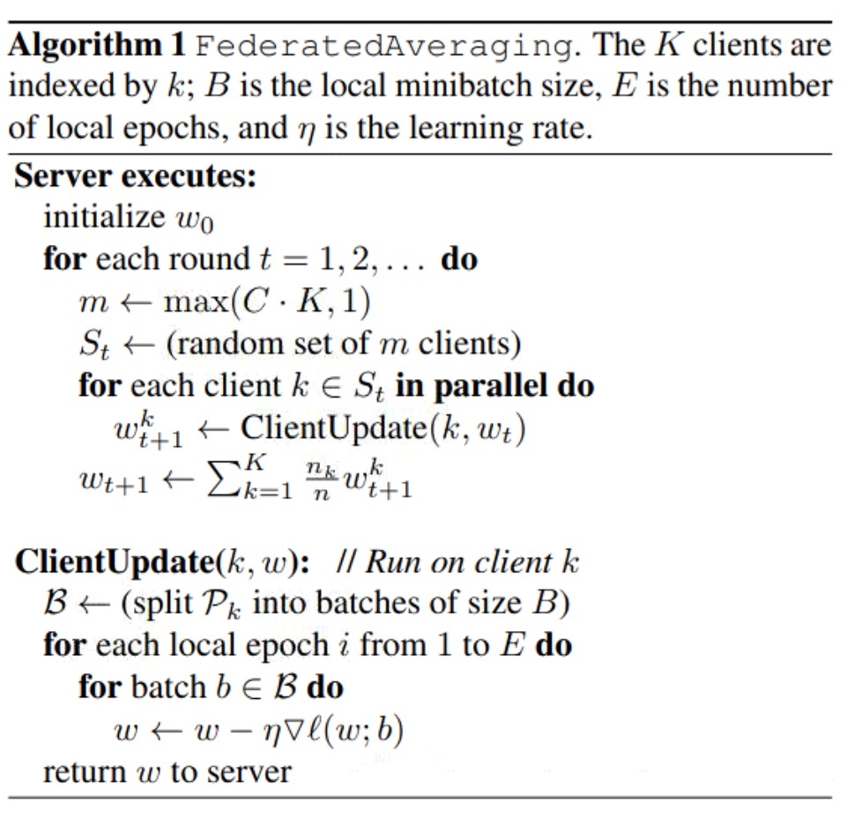
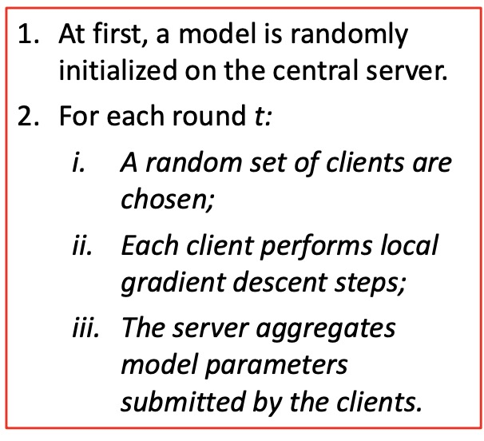
Optimization POV
Federated Averaging (FedAvg)
Overall procedures:

Slide 23
Outline
Background and Fundamentals
  Background
  Machine Learning (ML) Point of View
  Optimization Point of View
Federated Learning for Wireless Networks
  Federated Learning Based Mobile Edge Computing for Augmented Reality Applications
  Unsupervised Federated Learning for Unbalanced Data
  Self Organizing Federated Learning Over Wireless Networks: A Socially Aware Clustering Approach
  Matching Theory Based Low-Latency Scheme for Multi-Task Federated Learning in MEC Networks
Open problems and Conclusions

Slide 24
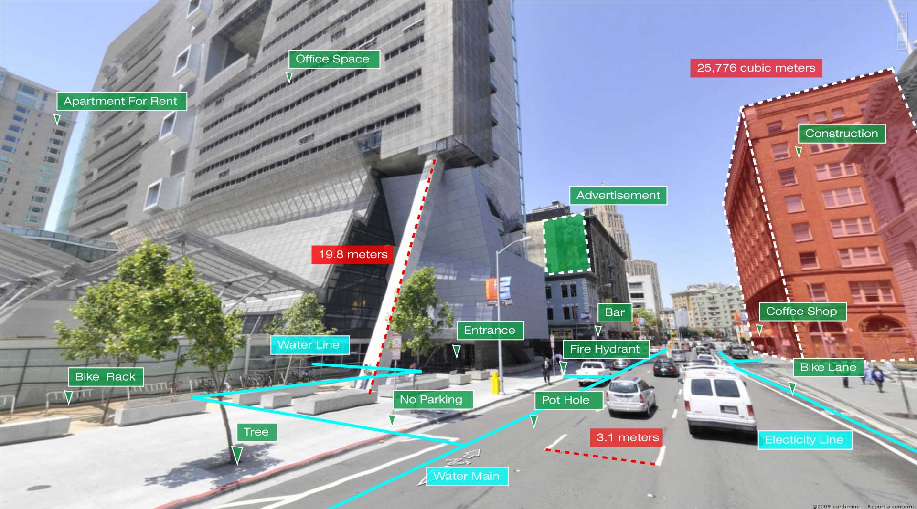
Motivation
What AR does is to implant 3-D virtual objects in a real-world context.
Challenges:
  Latency
    Real-time interaction
    Dizziness
  Accuracy
    Object recognition and matching
Source: Yassir El Filaili and Salah-ddine Krit, “Augmented Reality Types and Popular Use cases”, in International Journal of Engineering, Science and Mathematics, vol. 8, no. 4, April, 2019.
Notes:
The picture aims to describe the importance of accuracy.

Slide 25
Motivation
What AR do is to implant 3-D virtual objects in a real-world context.
Challenges:
  Latency
    Real-time interaction
    Dizziness
  Accuracy
    Object recognition and matching
  Multi-user
    Non-i.i.d. data
Solutions:
  Low latency
    Edge computing paradigm
  Accuracy
    Convolutional neural network
  Multi-user
    Federated learning
Source: Yassir El Filaili and Salah-ddine Krit, “Augmented Reality Types and Popular Use cases”, in International Journal of Engineering, Science and Mathematics, vol. 8, no. 4, April, 2019.
Notes:
The picture shows the Marker based AR. While Markerless one utilizes like GPS to localize the object.

Slide 26

Problem Description
As is discussed in previous section, what AR does is to implant the 3D virtual objects into a real-world context, which means the accuracy for object classification is vital so that the correct objects can be placed correspondingly.
We assume a scenario that contains 𝑀 AR glasses wearers. The target is to find an optimal model that can classify the objects obtained by all the AR glasses correctly.
Objective function– mean square error:
min
Parameters Set
Input Image
Ground truth

Slide 27



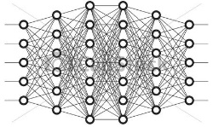



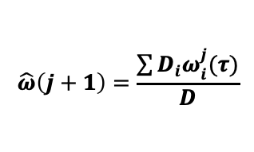










Methodology
Federated Learning Based Mobile Edge Computing
Centralized Cloud
④ Global Aggregation
$$\hat{ω}\left(j+1\right)=\frac{\sum{D_{i}ω_{i}^{j}(τ)}}{D}$$
⑤ Model Updating
$$ω_{1}^{j}(τ)$$
$$ω_{M}^{j}(τ)$$
$$\hat{ω}(j+1)$$
③Local Updates
①
Selected Devices
② Download Naive Model
$$f_{1}(ω_{1}^{j}(k))$$
$$f_{2}(ω_{2}^{j}(k))$$
$$ω_{1}^{0}(τ)$$
$$f_{M}(ω_{M}^{j}(k))$$
……
$$D_{1}$$
$$D_{2}$$
$$D_{M}$$
Device 1
Device 2
Device $M$

Slide 28
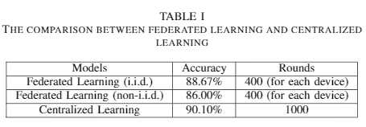
Experiments
We perform the experiments on CIFAR 10. The number of users are set as five. To generate i.i.d. data, each user is randomly assigned a uniform distribution over 10 classes. For non-i.i.d., we sorted the data and each user is randomly assigned equally from two classes.
Results:
Accuracy: Centralized Learning > FL (i.i.d.) > FL (non-i.i.d.)
Notes:
We can see that from the perspective of accuracy, the centralized learning gets better performance. Since the model is trained on the whole dataset, the bias from some individual devices cannot make a difference. However, to achieve the 88.67% accuracy with i.i.d. data and 86.00% accuracy with non-i.i.d. data, FL takes 600 rounds fewer than the centralized learning, which is significantly faster.

Slide 29
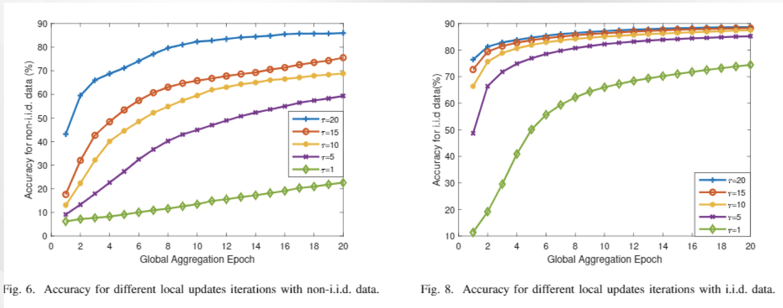

Experiments
The effect of different iterations of local updates:
  Federated learning is indeed suitable for non-i.i.d. data.
  More local updates lead to more accurate models and loss decreases faster.
  $τ$ is the number iterations between each global update
Notes:
In addition, we explore the influence of different local update iteration on accuracy and loss. Obviously, if the local update performs more rounds between the two global aggregation, the accuracy can be better and the loss is reduced more quickly. This is because, with more local iterations, the uploaded local models are more mature or well trained. In other words, the parameters are more suitable for the corresponding local data distributions. The benefits are continuously obtained by the global model via weighted average.

Slide 30
Outline
Background and Fundamentals
  Background
  Machine Learning (ML) Point of View
  Optimization Point of View
Federated Learning for Wireless Networks
  Federated Learning Based Mobile Edge Computing for Augmented Reality Applications
  Unsupervised Federated Learning for Unbalanced Data
  Self Organizing Federated Learning Over Wireless Networks: A Socially Aware Clustering Approach
  Matching Theory Based Low-Latency Scheme for Multi-Task Federated Learning in MEC Networks
Open problems and Conclusions

Slide 31
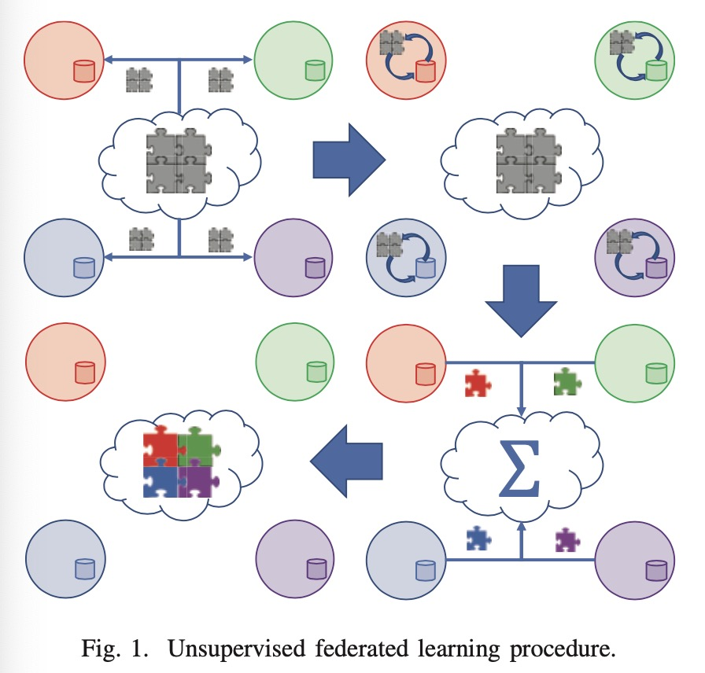
Motivation
Unsupervised learning tasks being implemented within the federated learning framework
Challenges:
the accuracy of federated learning training reduces significantly when the data is nonuniformly distributed across devices.

Slide 32
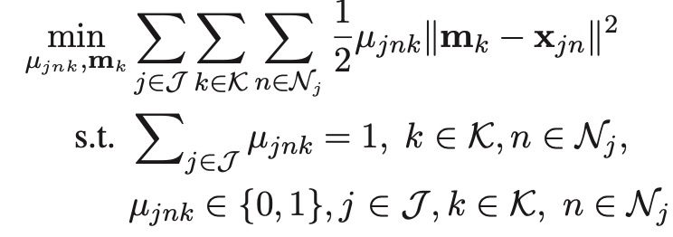
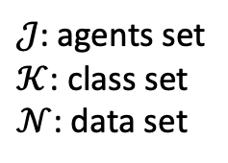
Formulation
The goal is to assign each observation point to a particular cluster and estimate the cluster centroid, considering hard assignment scheme, i.e., each point only belongs to one cluster.
Centroid
Data sample
$𝒥$: agents set
$𝒦$: class set
$𝒩$: data set
Class membership indicator

Slide 33
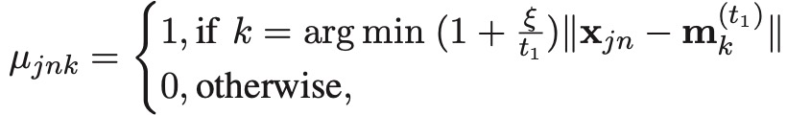


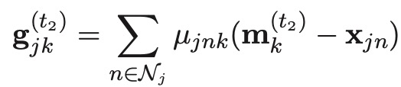
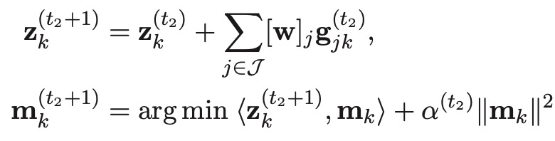
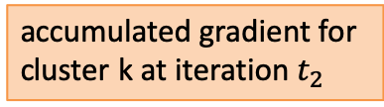
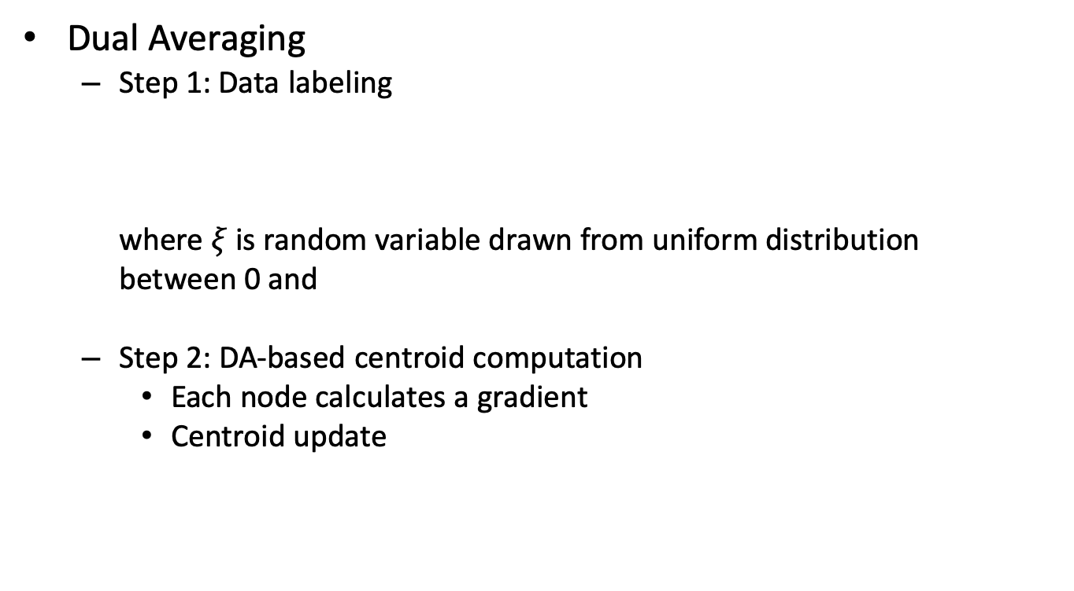
Methodology
Dual Averaging
  Step 1: Data labeling
  where $ξ$ is random variable drawn from uniform distribution
  between 0 and
  Step 2: DA-based centroid computation
    Each node calculates a gradient
    Centroid update
accumulated gradient for cluster k at iteration $t_{2}$
first-order approximation of the objective
regularization term

Slide 34
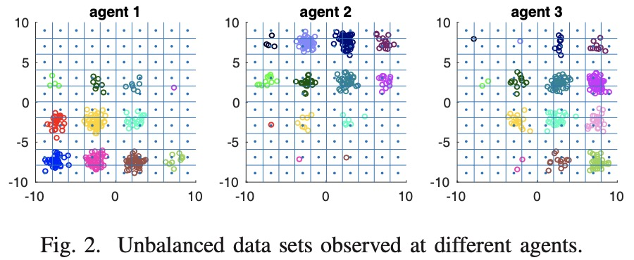
Methodology
Dual Averaging
  Step 3(a): Weight computation via bin method
    assign the weights by dividing the data space into a grid with uniform-sized bins and calculate the number of points (as weight) falling into a particular bin (a region of the grid) at each node.
Notes:
Consider the scenario shown in Fig. 2, where 3 sensor nodes observe data points from 16 clusters indicated by different colors. It is clear that each agent in the figure only has partial observations of the entire dataset. It is intuitive to weigh the gradients that correspond to each cluster by the number of points that are observed at agent j. In particular, it can be seen that agent 1 will have the highest weight for the cluster at the bottom left of the grid in Fig. 2, while agents 2 and 3 will have zero weight as this cluster is not observed by those agents. Unfortunately, weights cannot be computed in this fashion because the data labels remain unknown before clustering is done. Therefore, it is proposed to assign the weights by dividing the data space into a grid with uniform-sized bins as shown in Fig. 2 and calculate the number of points falling into a particular bin (a region of the grid) at each node. The number of points for each bin is sent to the central server from each agent so that the weight for each particular bin at each agent can be computed as the number of points falling in that bin at that agent divided by the total number of points in that bin from all agents.

Slide 35
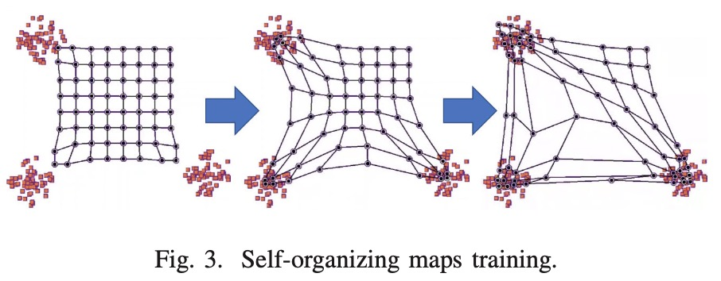
Methodology
Dual Averaging
  Step 3(b): Weight computation via self-organizing maps
    All neurons are initialized with small values of their weights.
    For each data point, the neurons compute the distance to the data point and the closest neuron is declared as the winner.
    The winning neuron determines the neighborhood of excited neurons and these neurons adjust their individual weights towards the data point.
    Neurons decrease neighborhood radius and learning rate.
Repeat until
convergence

Slide 36
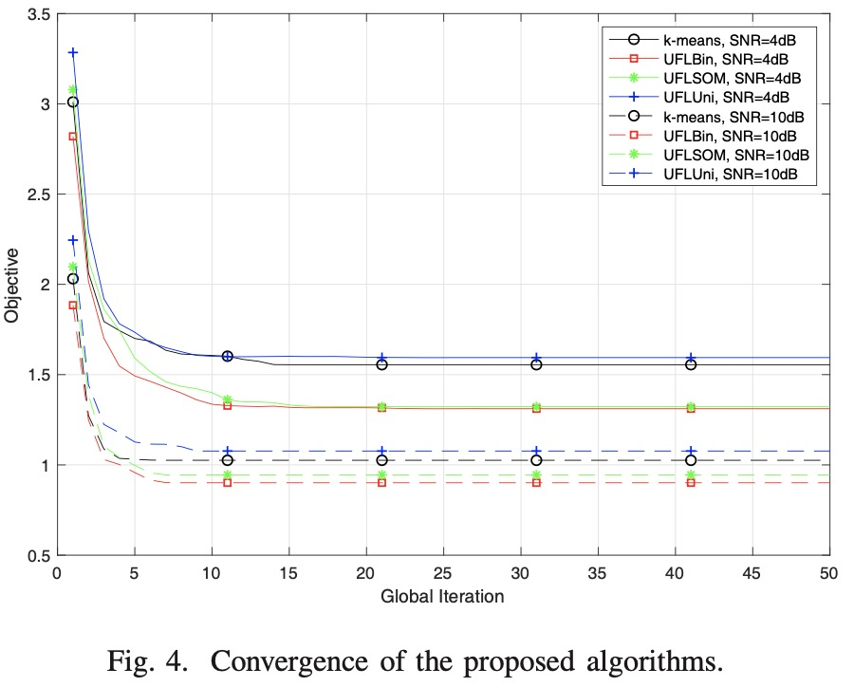
Simulation Results
Data are generated at random from K = 16 classes, with vectors from each class generated from a symmetric Gaussian distributions.
UFLBin: Bin based DA
UFLSOM: SOM based DA
UFLUNI: uniform gradient weighting
K-means as baseline
The proposed methods have been shown to achieve good results compared to uniform gradient weighting and the centralized k-means.

Slide 37
Outline
Background and Fundamentals
  Background
  Machine Learning (ML) Point of View
  Optimization Point of View
Federated Learning for Wireless Networks
  Federated Learning Based Mobile Edge Computing for Augmented Reality Applications
  Unsupervised Federated Learning for Unbalanced Data
  Self Organizing Federated Learning Over Wireless Networks: A Socially Aware Clustering Approach
  Matching Theory Based Low-Latency Scheme for Multi-Task Federated Learning in MEC Networks
Open problems and Conclusions

Slide 38
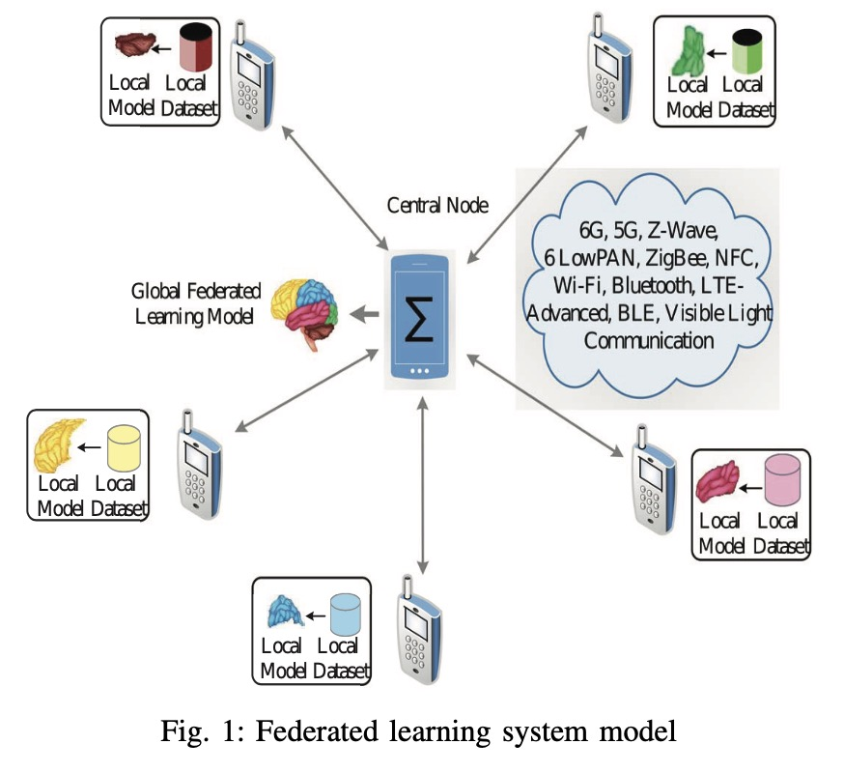
Motivation
Although federated learning offers a striking feature of privacy preservation. However, it suffers mainly from two prominent challenges:
Malfunctioning of a centralized server at a cloud/edge server due to a physical damage results in failure of the federated learning process.
A set of users involved in the federated learning process might not be able to access the centralized cloud/edge server due to lack of communication resources.

Slide 39
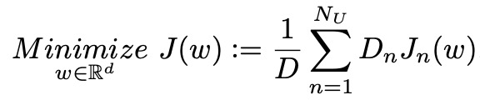


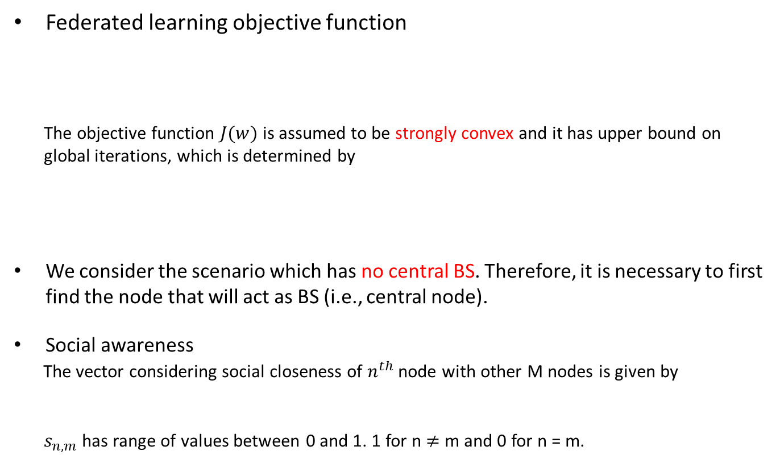
System Model
Federated learning objective function
The objective function $J(w)$ is assumed to be strongly convex and it has upper bound on
global iterations, which is determined by
We consider the scenario which has no central BS. Therefore, it is necessary to first find the node that will act as BS (i.e., central node).
Social awareness
The vector considering social closeness of $n^{th}$ node with other M nodes is given by
$s_{n,m}$ has range of values between 0 and 1. 1 for n $≠$ m and 0 for n = m.
Local data size and loss function
Total data size
Global model accuracy
Local model accuracy
Notes:
We consider the scenario which has no central BS. Therefore, it is necessary to first find the node that will act as BS (i.e., central node).

Slide 40


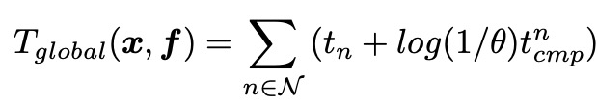

System Model
Communication model
Computation model
Time consumption
Indicator for block assignment
SNR
CPU-cycles/bit
Data size (bit)
CPU frequency
Transmission time

Slide 41
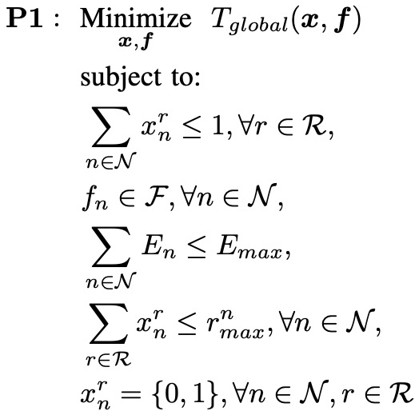

Formulation
Minimize federated learning delay
Restricts the assignment of one resource block to a maximum of one user
Restricts the selection of local device operating frequencies from a predefined discrete set
Energy consumption cannot exceed the maximum limit
Assigned number of resource blocks cannot exceed the maximum limit
Resource block assignment indicator

Slide 42
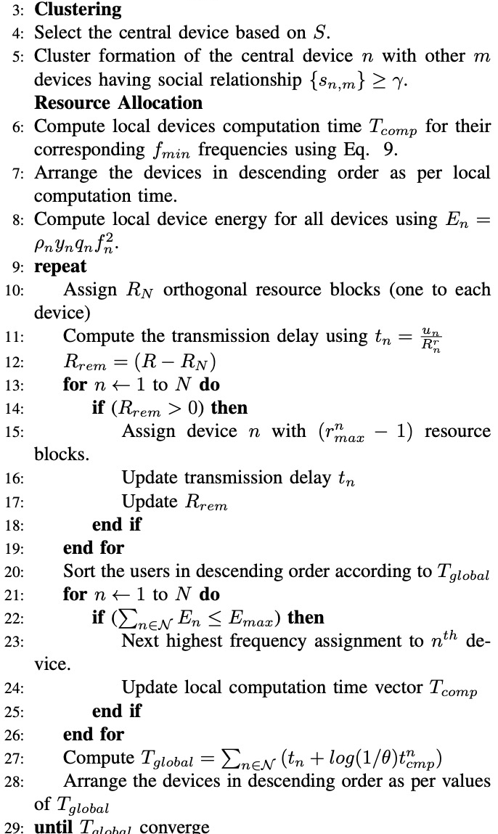
Methodology
The matrix S is used to find the central node
Local model computation and energies are computed, and arrange the devices in descending order based on time consumption
Assign devices having high computational latency with more resource blocks and computing transmission delay
Assignment of higher operating frequencies to the devices with higher transmission time

Slide 43
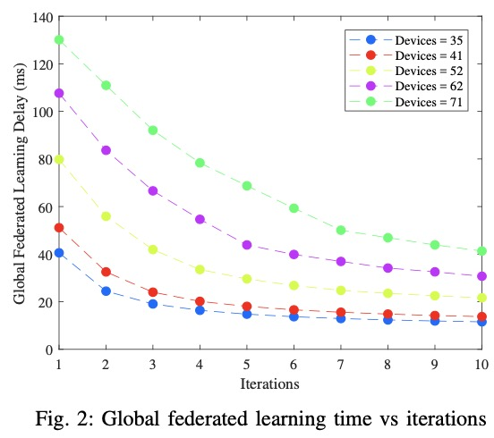
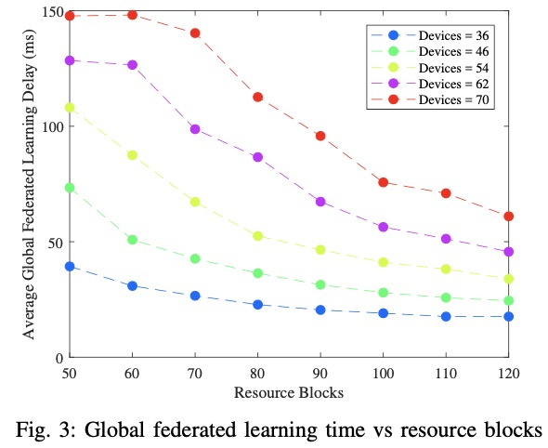
Simulation Results
Global federated learning time increases for an increase in the number of devices for fixed communication resources.
Model computation time decreases with more number of resource blocks.
Notes:
For less number of devices such as 40, average global federated learning time does not suffer from a clear decrease with an increase in a number of resource blocks. This is because we are having sufficient resource blocks to fulfill the communication needs of less devices. However, for higher number of devices the global federated learning model computation time is higher for lower number of resource blocks. On the other hand, if we consider the global federated learning time for higher values of resource blocks, the computation time is low with less difference for different number of devices. This is because of the presence of sufficient communication resource blocks.

Slide 44
Outline
Background and Fundamentals
  Background
  Machine Learning (ML) Point of View
  Optimization Point of View
Federated Learning for Wireless Networks
  Federated Learning Based Mobile Edge Computing for Augmented Reality Applications
  Unsupervised Federated Learning for Unbalanced Data
  Self Organizing Federated Learning Over Wireless Networks: A Socially Aware Clustering Approach
  Matching Theory Based Low-Latency Scheme for Multi-Task Federated Learning in MEC Networks
Open problems and Conclusions

Slide 45
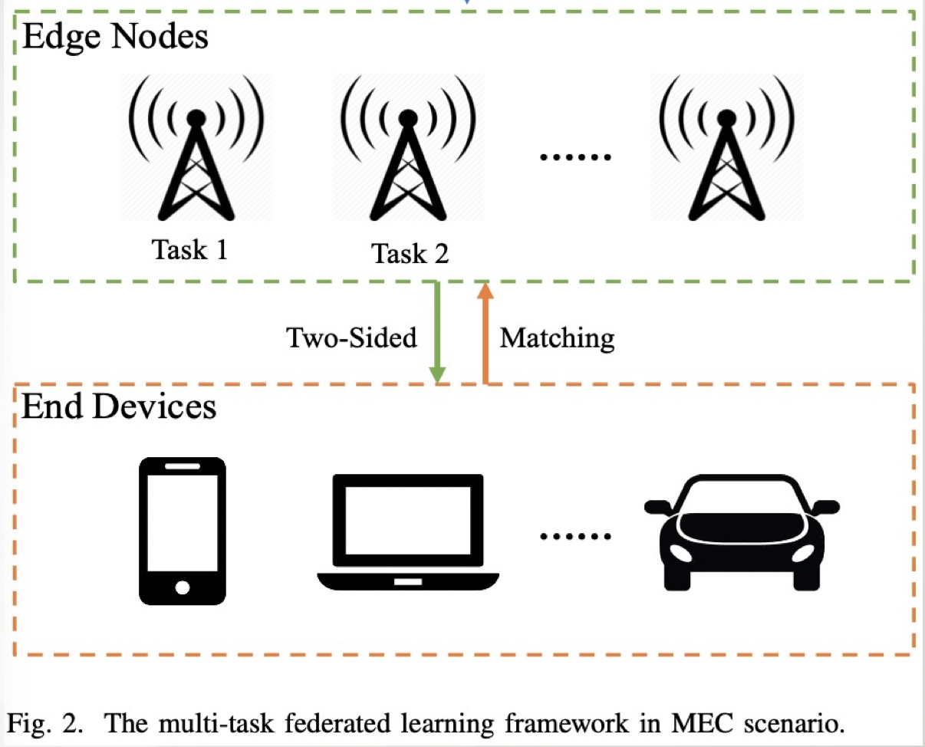
Motivation
Challenges:
  Once the end devices are invited, they will unconditionally take part in the federated learning tasks which ignores their willingness.
    Computation cost, remained energy…
  There are many available edge nodes in a MEC network, how to parallelly perform multiple federated learning tasks needs to be considered.
  Information exchanging cannot be done entirely in large scale IoTs scenarios.

Slide 46
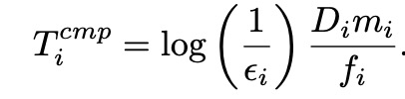
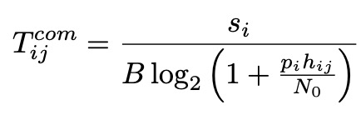
System Model
Computation model:
Communication model:
Number of data sample
Required cycles
Accuracy index
CPU frequency
Model size
Channel gain
Bandwidth
Transmission power
Noise power

Slide 47

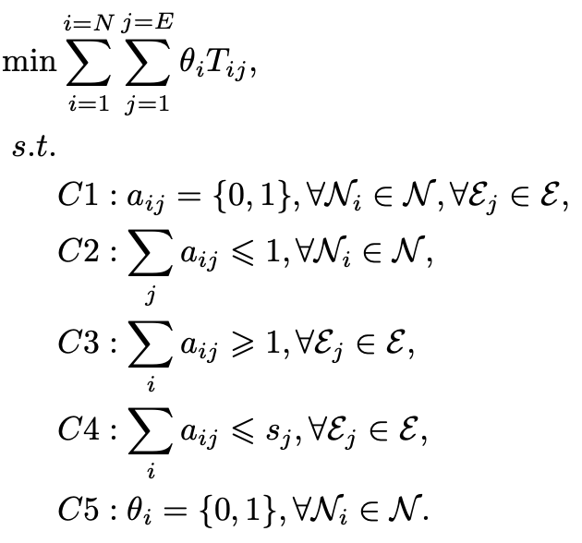
Problem formulation
The total amount of time consumed can be written as
Latency minimization problem
Utilizing matching to find a suboptimal solution
Assignment index, binary variable
A client can connect to maximum one edge server
At least there should be one client connected to the server so as to finish the task
The total number of connections cannot exceed capacity of edge server
Willingness indicator, determined by battery life

Slide 48
Methodology
Matching game theory:
  We seek to find a stable matching such that
    There does not exist any pair of players, i and j matches, respectively to players, a and b but..
    j prefers a to b and a prefers j to i
  How can we find a stable matching?
    many approaches(minimizing sum/ max of ranks, minimizing diff of total ranks, Gale and Shapley algorithm)
    Most popular: Deferred acceptance or GS algorithm
    Based on preference list

Slide 49
Stable Marriage Matching
Basic elements (Stable Marriage):
  Agents: A set of men, and a set of women;
  Preference list: A sorted list of men/women based on her/his preferences;
  Blocking pair (BP) (m,w):
    1). m is unassigned or prefers w to his current partner;
    2). w is unassigned or prefers m to her current partner;
  Stable matching: A matching admit no BPs.
  Gale-Shapley Algorithm: find a stable matching in SM.

Slide 50
GS algorithm
Geeta, Heiki, Irina, Fran
Adam
Fran
Irina, Fran, Heiki, Geeta
We reach a stable marriage!
Geeta
Bob
What if the preference list is incomplete?
Geeta, Fran, Heiki, Irina
Carl
Heiki
Irina, Heiki, Geeta, Fran
David
Irina

Slide 51
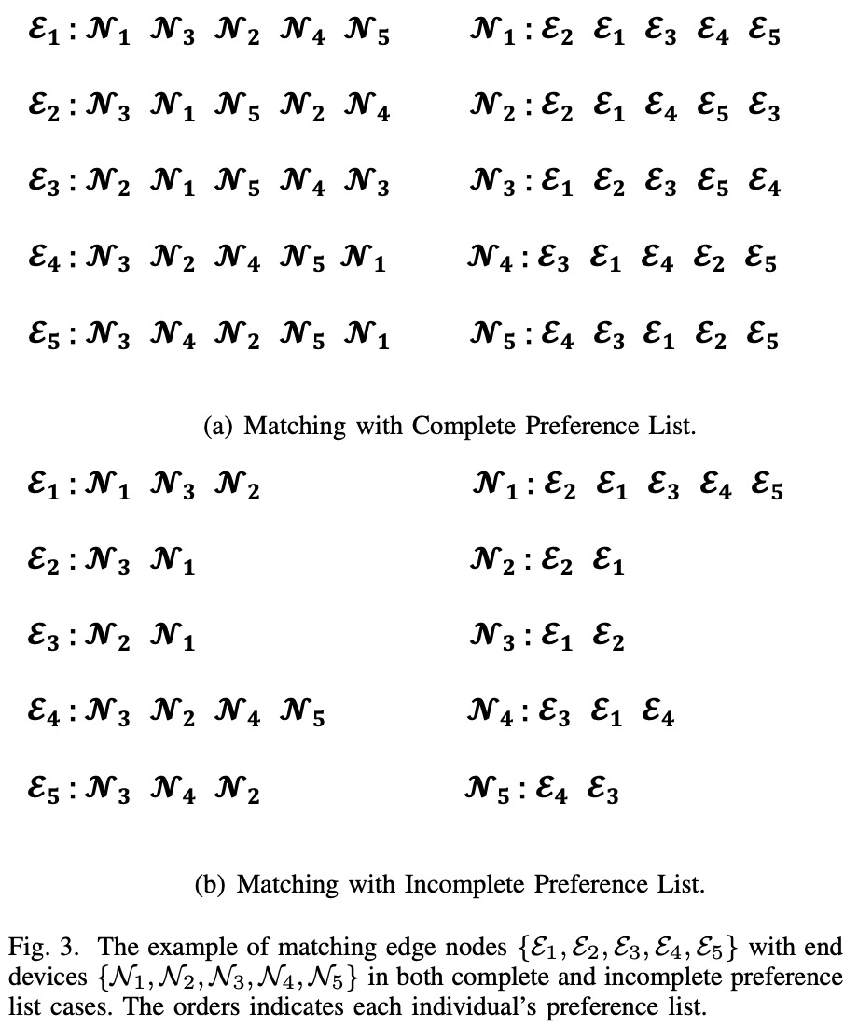


Methodology
Complete preference list (CPL) vs. incomplete preference list (IPL)
CPL: each player can find a stable matching.
IPL: Only part of candidates can have stable matching due to lacking info. Some players may not be assigned a matching. The others might need to be assigned manually.

Slide 52
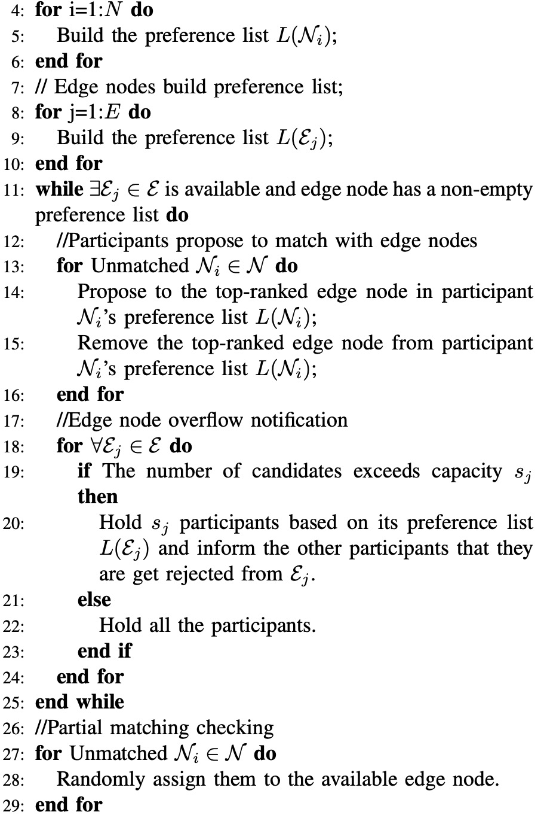
Methodology
Building preference list based on utility functions for edge servers and participants.
Matching based on preference list.
Capacity checking: If the number of selected participants exceeds edge node capacity, edge node will only keep those desirable participants within capacity and reject the applications of the others.
Partial matching checking: If there are still any participants who are willing to join unassigned, they will be assigned to available edge node randomly.

Slide 53
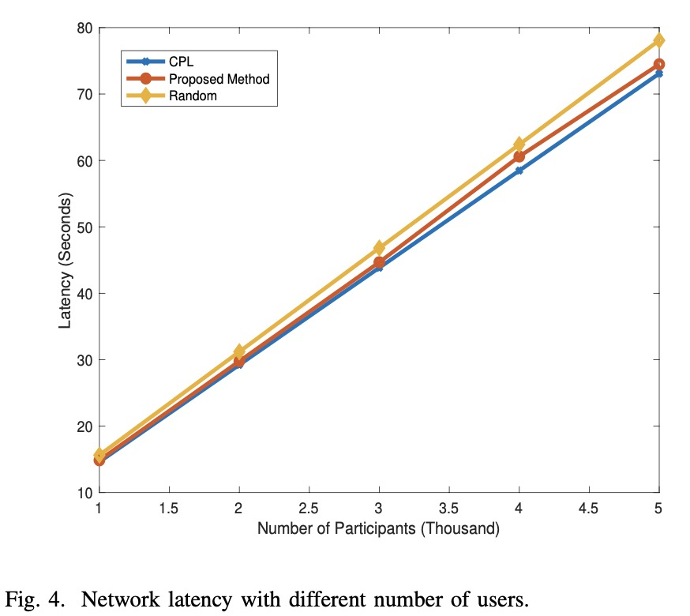
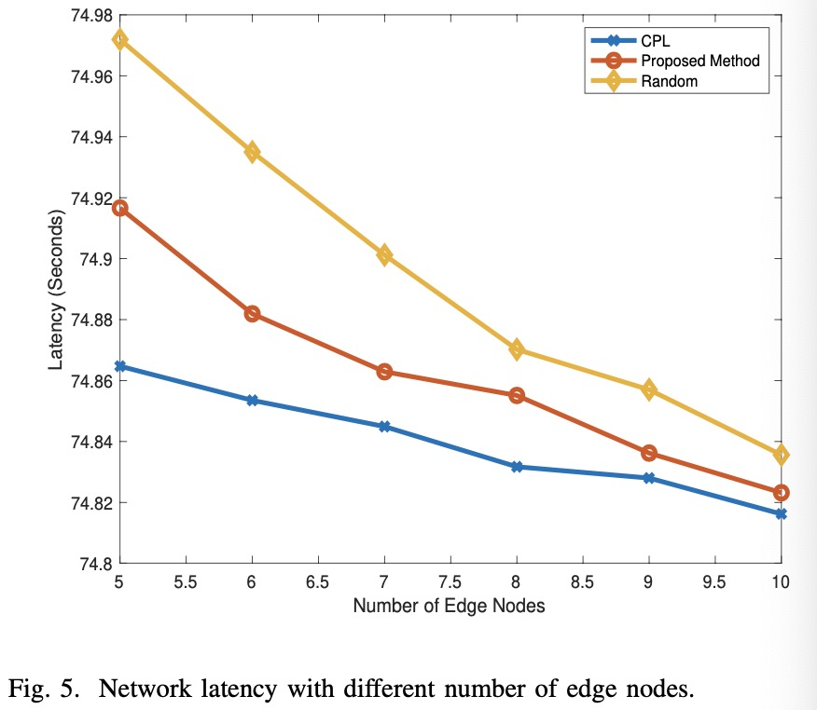
Simulation Results
Impact of user numbers and edge node numbers
Evidently, the network latency is positively related to the number of participants while is negatively correlated with number of edge nodes.
Our proposed method is close to the performance of complete preference list (CPL) case.

Slide 54
Open Problems
Some open areas in Federated learning
  Optimization algorithms for FL, particularly communication-efficient algorithms tolerant of non-IID data
  Approaches that scale FL to larger models, including model and gradient compression techniques
  Novel applications of FL, extension to new learning algorithms and model classes.
  Not everyone has to have the same model (multi-task and pluralistic learning, personalization, domain adaptation)
  Bias and fairness in the FL setting (new possibilities and new challenges)
  Enhancing the security and privacy of FL, including cryptographic techniques and differential privacy
  Federated Analysis

Slide 55
Conclusions
Federated learning will be a major part of learning paradigm
  Mobile massively decentralized, naturally arising (non-IID) partition
  Availability of distributed clients
  Address communication bottleneck
  Privacy concern
We explore different aspects and applications to integration of federated learning and wireless networks
  Formulations
  Problem specific solution
  Link machine learning, computation, communication, networking, and operational research together

Slide 56








Join or Visit Our Lab
http://wireless.egr.uh.edu/

Slide 57

THANK YOU

