Slide 1


Full-Duplex Communication
and Networks:
Fundamentals, Technologies, and Applications
Lingyang Song* and Zhu Han⁺
* School of Electronics Engineering and Computer Science,
Peking University, Beijing, China
⁺ Department of Electrical and Computer Engineering
University of Houston, Houston, TX, USA
Acknowledgement
Tianyu Wang, Hongyu Cui, Boya Di, Yun Liao, Kun Yang, Chao Yao, Mingxin Zhou, Meng Ma, Bingli Jiao, Radwa Sultan, Siavash Bayat, and Yongui Li
Slides: http://wireless.egr.uh.edu/research.htm

Slide 2
Table of Content
Fundamentals
  5G Evolutions
  Full-duplex Communication Introduction
  Working Scenarios
Technologies
  Adaptive Switching
  Antenna Pairing and Relay Selection
  Subcarrier and Power Allocation
Applications
  Full-duplex Cognitive Radio
Conclusions

Slide 3
Full-duplex Communication Basics
  Background
    5G Requirement
  Full-duplex communication system
    Motivations
    Self-interference Cancellation
    Signal and Interference Model
    Application Scenarios
    Research Problems
    Working Assumptions

Slide 4
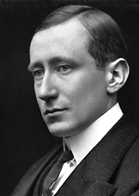
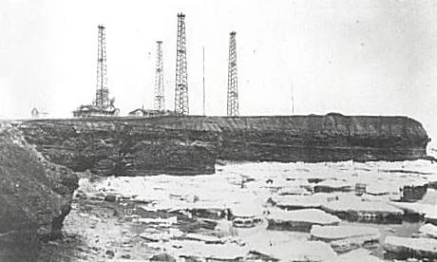
1900: Famous patent No. 7777, "tuned or syntonic telegraphy"
1900: Marconi's Wireless Telegraph Company Limited founded
History of Mobile Communications
1901: Transmitting the first wireless signals across the Atlantic between Poldhu, Cornwall, and St. John's, Newfoundland, a distance of 2100 miles.
1909: The Nobel Prize in Physics

Slide 5

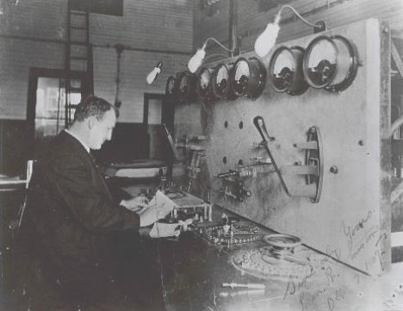
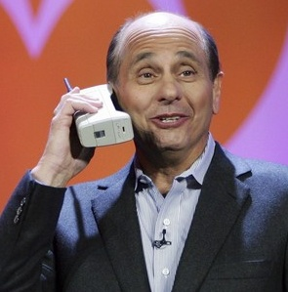
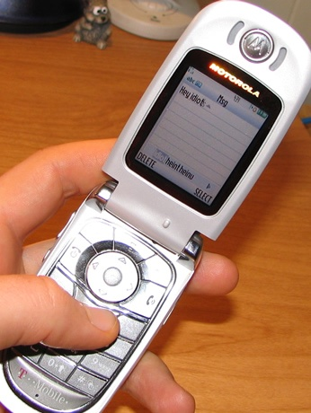

A Market Needs both Technology and Application
From data …
to voice …
to everything

Slide 6
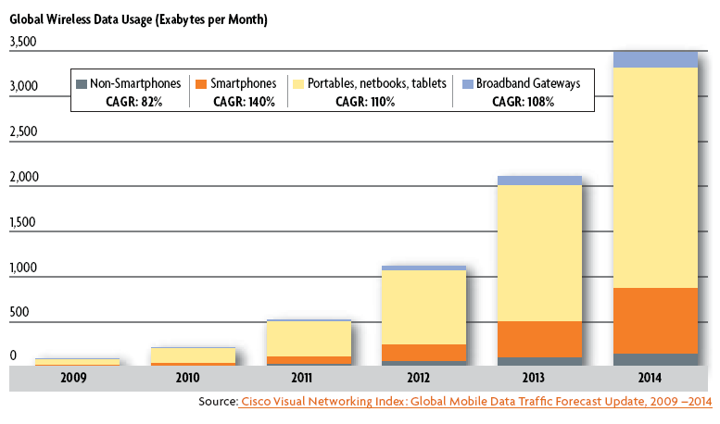
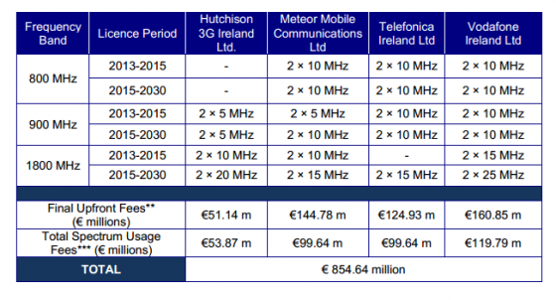
Future Wireless Challenges
Explosion of data traffic
VS
Limited spectrum
Source: Irish Regulator ComReg Announces Results of its 4G Spectrum Auction
Fig. 2 Results of Irish 4G Spectrum Auction
Fig.1 Cisco Visual Networking Index Global Mobile Data Traffic Growth

Slide 7

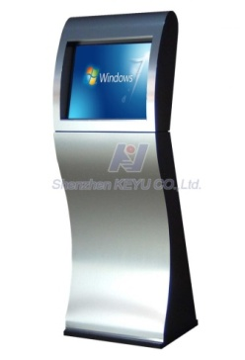




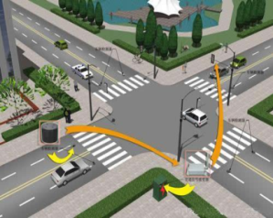

KPIs
Key Performance Indicators (KPIs)
10Gbps
1000X Capacity
(Traffic and Connections)
10X User Rate Anywhere
(100M-1Gbps)
10X Peak Data Rate
(10+Gbps)
6 Key Requirements
1000X Energy&Cost Reduce
10X Low Latency,
High reliability
5-10X Spectrum Efficiency

Slide 8
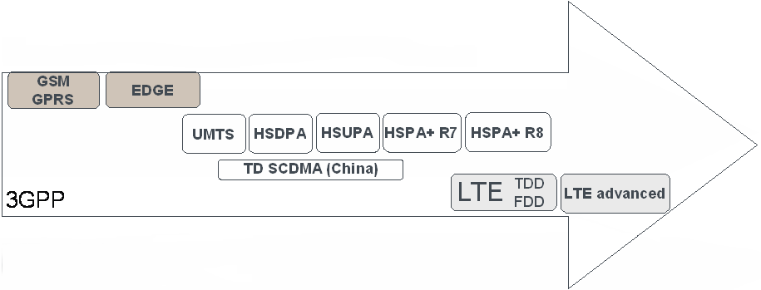
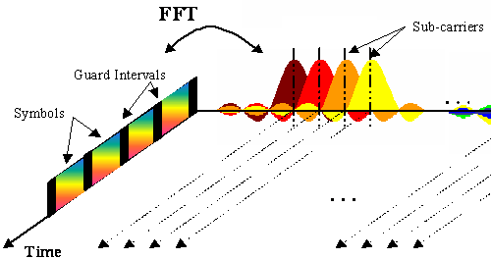
Standardization Facilitates Technology Evolution
Each new evolution builds on the established market of the previous
Backwards-compatible evolution
But larger technology steps require revolutions:
1995
2000
2005
2010
2015
From TDMA:
to CDMA:
to OFDMA:

Slide 9
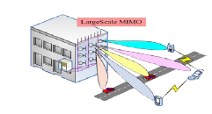





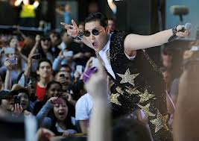



Link Efficiency: Massive MIMO, 3D-BF, Full-duplex
    More Scenarios and Use Case： M2M, D2D, V2X
Signal to Noise plus Interference Radio
Scaled Transmission Time
Capacity：C = N * W * T * log(1 + SINR)
Bandwidth
No. of APs
Ultra Dense Deployment:
LTE-Hi and Further Evolution
    New Spectrum： mmWaves, LTE-U, Cognitive radio

Slide 10



10X Peak Rate
10 X Peak Rate
5G Requirement
Full Duplex, NOMA
1Gbps
4G
Full-duplex communication can be one possible solution to meet the future wireless challenges
Ultra High Spectrum
10Mbps
Immediately Downloading
3G
100Kbps
Ultra-Dense Network
3D-UHDTV
2G
High Spectrum, mmWave
10Gbps Peak Rate

Slide 11
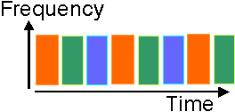
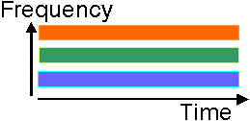
Background of Full-Duplex Techniques
Traditional half duplex: using orthogonal resources
  Time-division duplex
  Frequency-division duplex
Problems
  The orthogonal resources are allocated for reception and transmission.
Solutions
  The same resources are allocated for reception and
  transmission
Fig. 3 Time-division duplex
Fig. 4 Frequency-division duplex
Spectral loss
Full-duplex
Comms

Slide 12
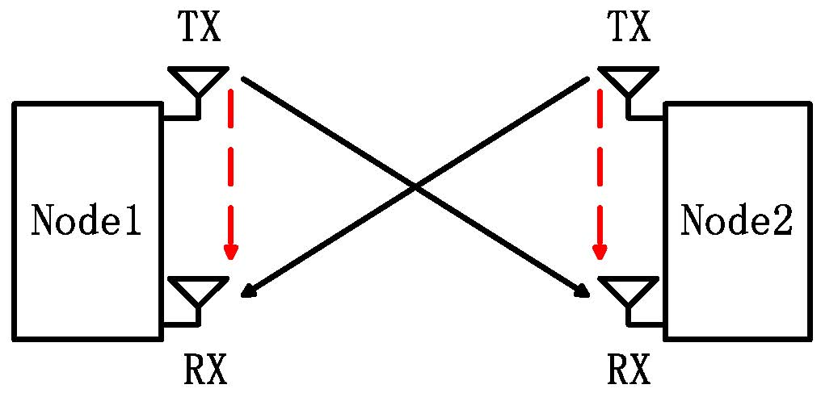
Full Duplex Introduction
A full duplex system allows communication at the same time and frequency resources.
Advantages
  High spectral efficiency
    Same time & same frequency band
  Low cost
    Readily use the existing MIMO radios
    Hardware advancement, etc
: Signal of interest
: Self interference
Fig. 5 Full duplex communication

Slide 13
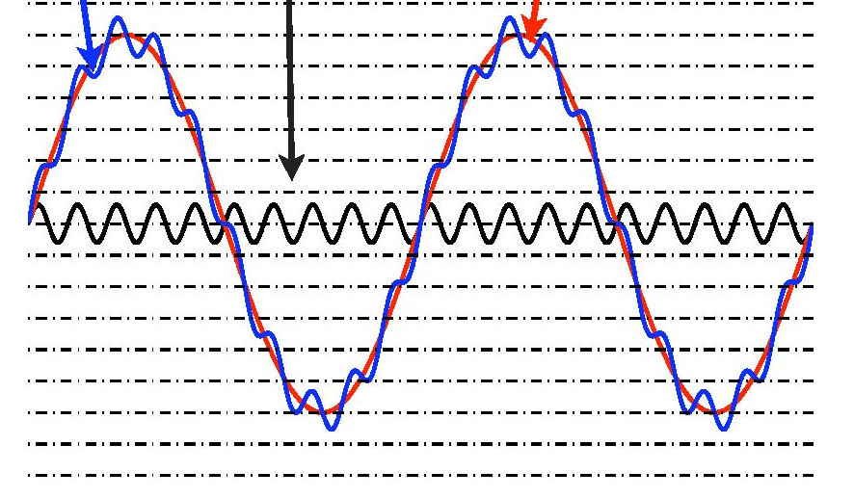
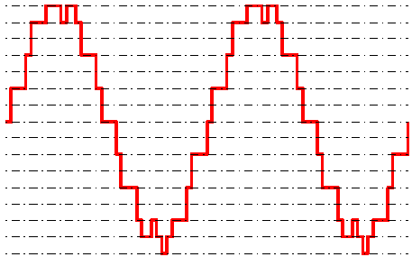
Main Challenges
Traditional Challenges
  Very large self interference
    50-110dB larger than signal of interest
    Depending on inter-node distance
  ADC is the bottleneck
    Limited dynamic range: saturation distortion.
    Limited precision: signal of interest is less than noise.
      For 12 bit ADC, INR(dB) > SNR(dB) + 35 dB implies self interference is too strong
Need to reduce interference before ADC
Received signal
Signal of interest
Self interference
Fig. 6 Very large Self interference
Fig. 7 Signal after quantization

Slide 14
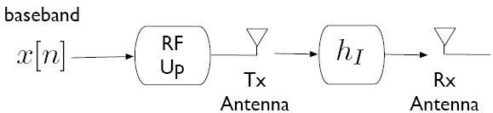
Self-interference Cancellation
Self interference channel
Passive propagation suppression
  Design antennas to increase propagation loss of h_{I}
Active cancelation
  Active analog cancelation
    Cancel interference through analog part
  Active digital cancelation
    Cancel interference in the baseband

Slide 15
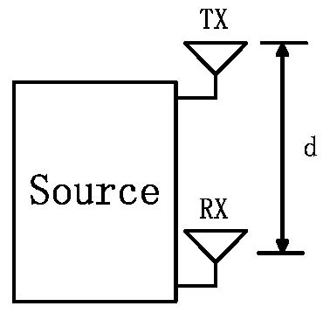
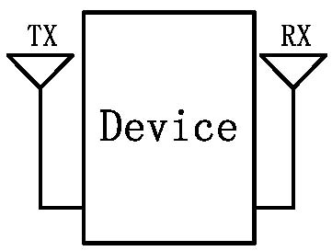
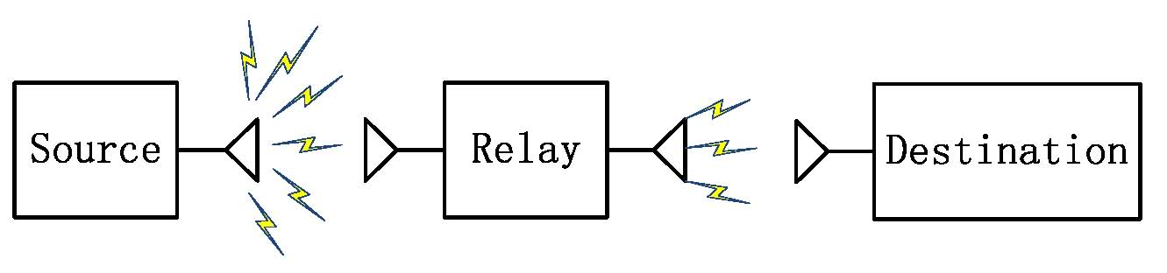
Passive Propagation Cancellation
Antenna placement
  Separation d between TX and RX
  Place antennas at opposite sides of the device
Directional antenna
  Used in full-duplex relays
Fig. 7 Antenna separation
Fig. 8 Device cancellation
Fig. 9 Directional antenna

Slide 16
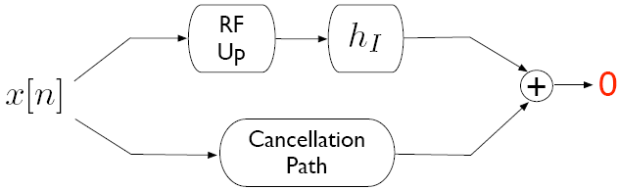
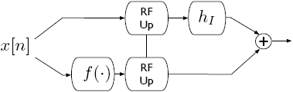
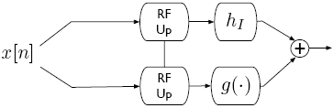
Active Analog Cancelation (1)
Objective is to achieve exact 0 at the Rx antenna
  Cancellation path = negative of interfering path
These techniques need analog parts
Pre-mixer Post-mixer

Slide 17
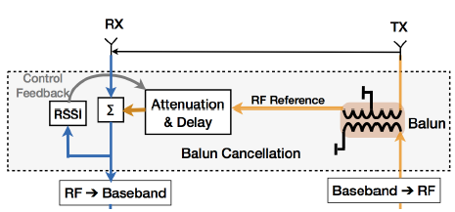
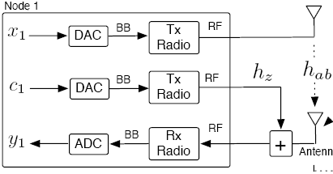
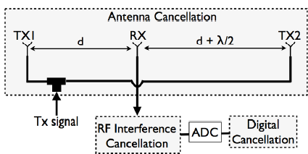
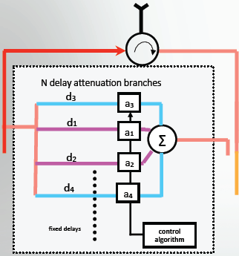
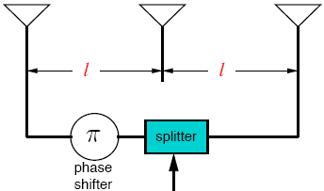
Active Analog Cancelation (2)
Post-mixer
Pre-mixer
Post-mixer
Post-mixer
x
Post-mixer
x
DAC
ADC

Slide 18
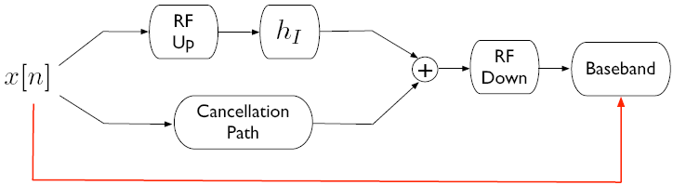
Active Digital Cancelation
Conceptually simpler – requires no new “parts”
Two-step cancellation:
  Estimate the self residual interference channel h_{RI} through training symbols
  Cancel h_{RI}x[n] at baseband
Useless if interference is too strong (ADC bottleneck)

Slide 19
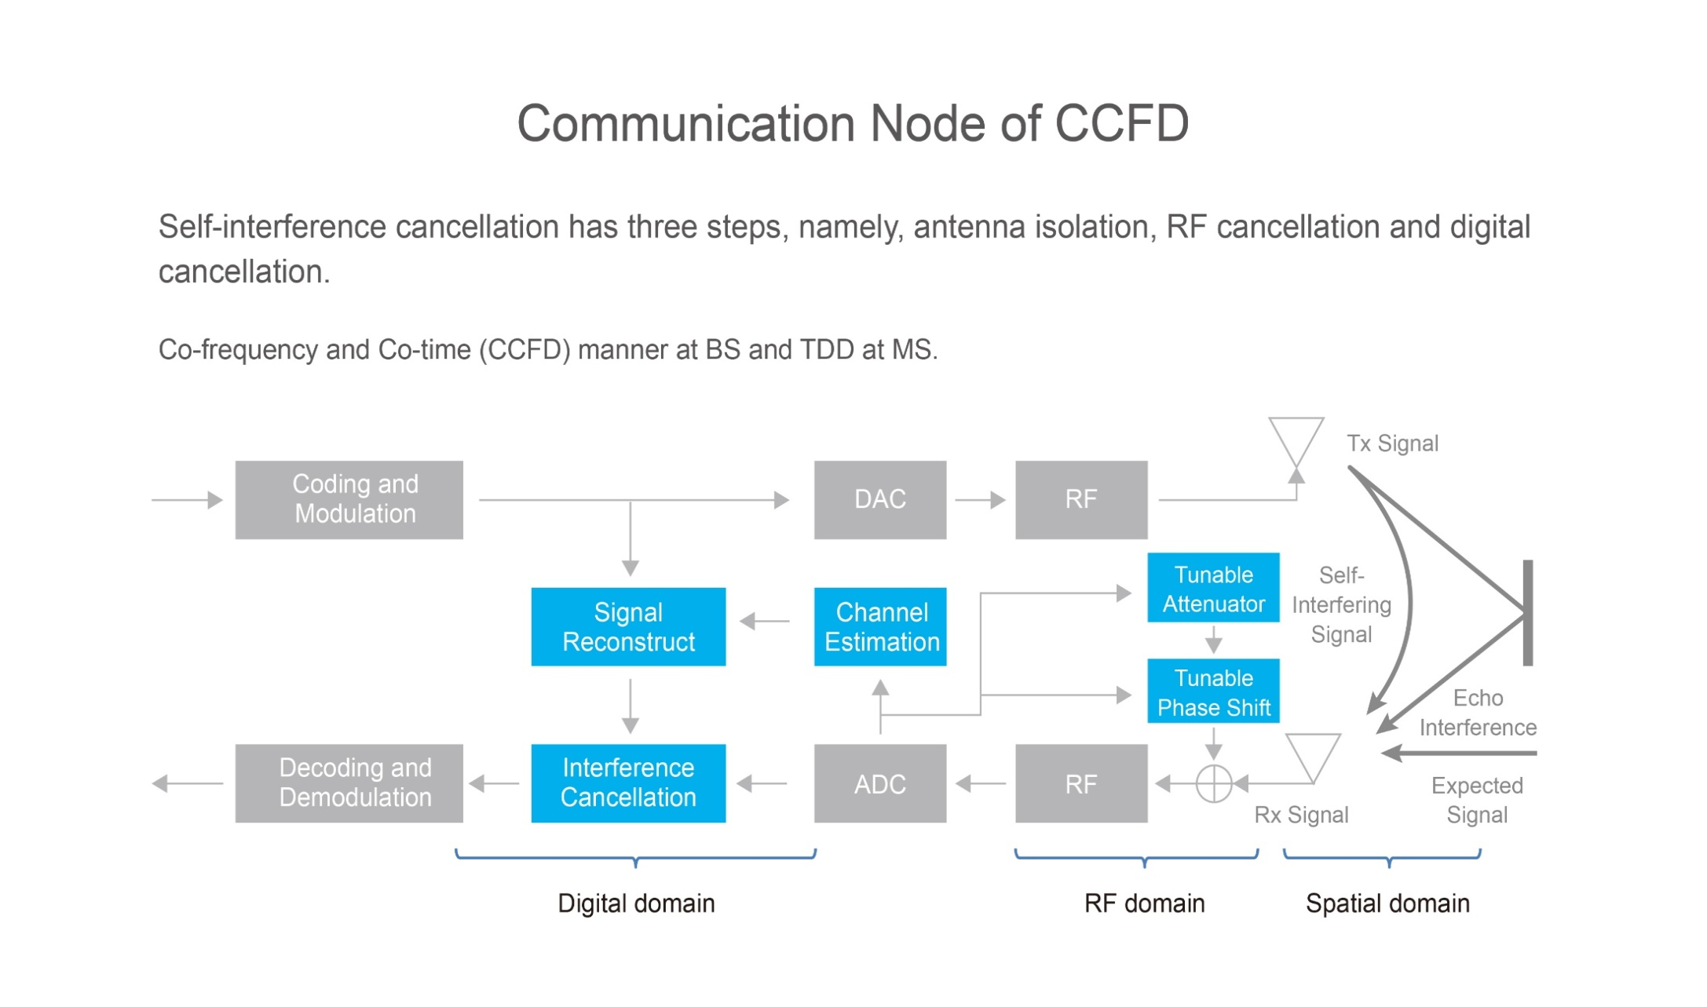
System Implementation in PKU (1)

Slide 20
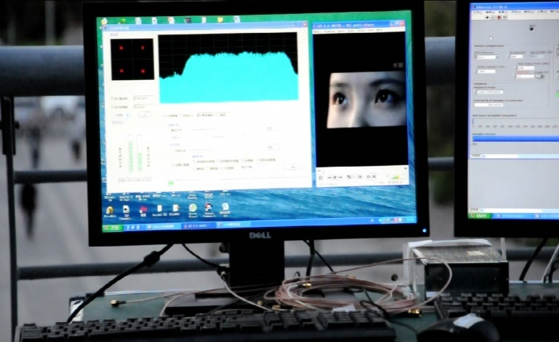
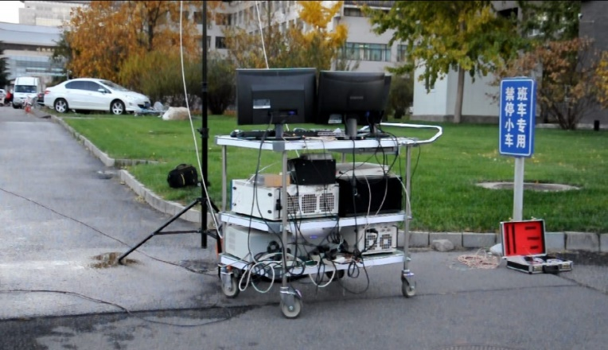
System Implementation in PKU (2)
In 2014, Peking University has constructed a demo to show the FD BS in communication with one MS over cell coverage of 500 meters.
BS Node
500m
MS Node

Slide 21
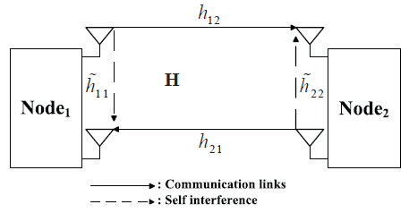
Full-Duplex Communication: Signal Model
It presents a two-node full-duplex system, where each node
  transmits signal xi, i = 1, 2 to the other
  has one antenna for transmission with another for reception
  concurrently transmit sand receive s the signals at the same frequency carrier and time interval

Slide 22


Full-Duplex Communication: Signal Model
Each source receives a combination of the signal transmitted by the other source, the RSI, and noise
The instantaneous SINR at source i’s receiver for full-duplex is
The RSI depends largely on the transmit power, and also varies due to the practical constraint.
The values of |h_{ji}|², |h_{ii}|², and P_{s} have strong impact on SINR, which will affect the system performance significantly.
Thus, proper resource allocation that can further reduce the effects of residual self-interference is crucial for full-duplex communication.

Slide 23
Working Assumptions
Residual self interference after cancelation techniques
  Rayleigh fading (or Rican fading)
  Gaussian noise
  Perfectly eliminated
Distortion caused by limited dynamic range
  Gaussian
    Consider it as Gaussian noise for lower bound
  Ignored
    residual self interference is small enough
Imperfect CSI
  Estimation error of communication channel
  Estimation error of self-interference channel

Slide 24
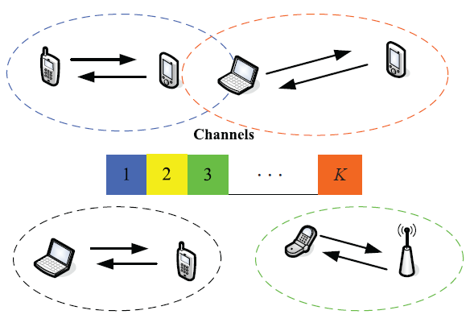
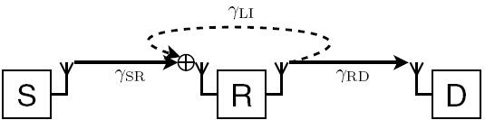
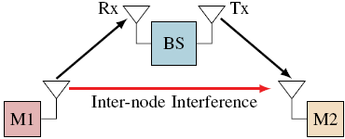
Main Application Scenarios
Full-Duplex Distributed Communication Systems
  Two-node bi-directional MIMO system
Centralized Full-Duplex Communication Systems
  Full-duplex relay network
    DF relay
    AF relay
    Two-way relay
  Full-duplex wireless network
    FD cellular network
    FD HetNet

Slide 25
Research Problems
Two nodes bidirectional full-duplex systems
  Self-interference channel estimation
  Self-interference cancellation
  Achievable sum rate bounds
  Optimal power allocation
Full-duplex MIMO systems
  Adaptive Switching
  Antenna selection
  Interference-aware beamforming
Full duplex cooperative systems
  Full duplex AF/DF relay design
  Hybrid full duplex/half duplex relay
  Node selection: relay/antenna selection
  Antenna selection
Full duplex cellular/HetNet network
  Distributed full duplex, use side-channel to cancel interference
  Radio resources and users allocation

Slide 26
Useful info for Research on FD Comms
Full-duplex communication website
  http://wireless.pku.edu.cn/home/songly/fd.html
    Tutorial and survey, books, technical papers, standardization…
Books
  Yun Liao, Tianyu Wang, Lingyang Song, and Zhu Han, “Listen-and-Talk: Full-Duplex Cognitive Radio,” SpringerBieft, 2016
  Lingyang Song, Risto Wichman, Yonghui Li, and Zhu Han, “Full-Duplex Communications and Networks,” Cambridge University Press, UK, 2016
  Tutorials
  Lingyang Song and Zhu Han, “Resource Allocation for Full-Duplex Wireless Communication and Networks,” IEEE International Conference on Communications (ICC), London, UK, Jun. 2015
  Lingyang Song and Zhu Han, “Full-Duplex Wireless Communication and Networks: Key Technologies and Applications,” IEEE International Conference on Communications in China (ICCC 2014), Shanghai, China, Oct. 2014

Slide 27
Table of Content
Key Technologies
  Full-duplex MIMO Systems
    Adaptive switching
    X-duplex systems
    Antenna pairing
  Full-duplex Cooperative Networks
    Antenna and relay selection
  Full-duplex OFDMA Networks
    Matching theory
    Subcarrier and power allocation

Slide 28
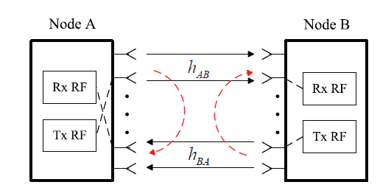
Full-Duplex MIMO Communication
Resource Allocation Problems
  Power control
  Interference-aware beamforming
  Switching between full-duplex and multiplexing
  Antenna selection

Slide 29
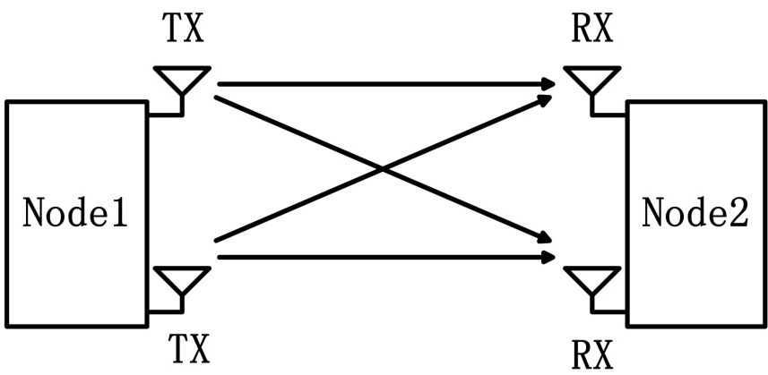
Full-duplex and Spatial Multiplexing Switching
    Received signal at node I by full duplex
Full duplex
Spatial Multiplexing
Signal of interest
Residual self interference
: Average SNR
: Average INR
Mingxin Zhou, Hongyu Cui, Lingyang Song, and Yonghui Li, “Is Full Duplex Configuration Better than MIMO Spatial Multiplexing?,” IEEE International Conference on Communications in China (ICCC), Shenzhen, China, Nov. 2015 (Invited paper).

Slide 30
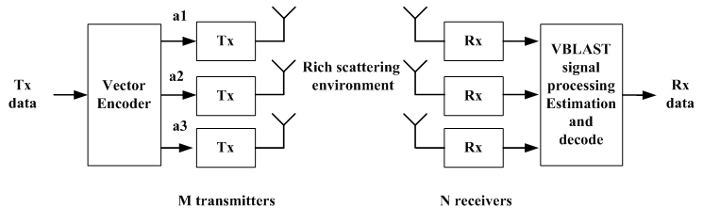
MIMO Spatial Multiplexing (1): System Model
MIMO: Strong candidate for the future wireless standards
  Higher data rate
  Better protection against errors by utilizing diversity
At the transmitter: sptial multiplexing
  FEC can be applied before the data gets demulplexed.
At the receiver: ZF, MMSE, etc, can be used to reover the signals
  M<=N, for large capacity

Slide 31
MIMO Spatial Multiplexing (2): Signal Model
Full duplex & Spatial multiplexing
  Received signal at node I by spatial multiplexing
Full duplex
Spatial Multiplexing
: a white random matrix
separable correlation model
  : the correlation at the transmitter
  : the correlation at the receiver
  e.g.

Slide 32
Full-duplex and MIMO Communications
Two limitations
  Full duplex (FD): Self interference
  Spatial multiplexing (SM): Spatial correlation
Optimal switching
  Maximize the ergodic capacity
Suboptimal switching
  Maximize the asymptotic capacity at high SNR
FD
Adaptive switch
SM
Criterion
Self interference
?
Spatial correlation

Slide 33
Optimal Switching Criterion (1)
Maximize the ergodic capacity
  Ergodic capacity of full duplex
Fig. Full duplex
is the exponential integral function of the first order

Slide 34


Optimal Switching Criterion (2)
Maximize the ergodic capacity
  Ergodic capacity of spatial multiplexing
Spatial multiplexing
: eigenvalues of the transmit and receive correlation matrixes
$${Φ_{T}^{}, Φ}_{R}^{}$$

Slide 35
Optimal Switching Criterion (3)
Capacity of the optimal switching criterion
  Switched by the exact switching threshold
Optimal but very complicated

Slide 36

Suboptimal Switching Criterion (1)
Maximize the asymptotic capacity at high SNR
  Asymptotic Performance
    Full duplex
    Spatial multiplexing
$γ$is Euler’s constant
High-SNR capacity for FD without interference
Capacity degradation caused by the self interference
High-SNR capacity for independent fading SM
Capacity degradation due to the correlations

Slide 37
Suboptimal Switching Criterion (2)
Combining the asymptotic capacities
  Consider the exponential correlation model
Relative degradation of SM
Relative degradation of FD
Determined by and
Independent of

Slide 38
Suboptimal Switching Criterion (3)
Maximize the asymptotic threshold at high SNR
  The system selects the mode with better performance at high SNR.
  It can be used at low SNR, with a bearable capacity loss.
  The capacity loss decreases with the growth of SNR.
Suboptimal, but low-complexity

Slide 39
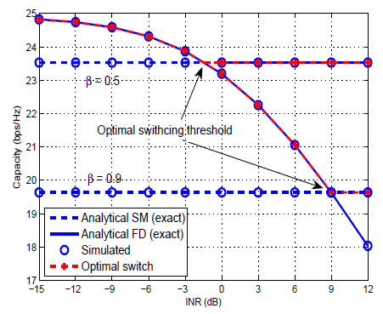
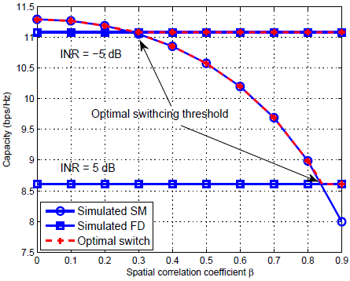
Some Results
Ergodic capacities for FD, SM and the optimal switch versus INR
Ergodic capacities for FD, SM and the optimal, suboptimal switching

Slide 40
Conclusions
To better understand the FD system, we have made comparisons with the HD systems by spatial-multiplexing.
  When the self interference is severe, the SM mode outperforms the FD mode;
  When the spatial correlation is large, the FD mode is a better selection;
We proposed an adaptive switching scheme between FD and SM to improve system capacity by two criteria:
  One is based on the exact threshold of the ergodic capacity of the two modes, optimal but complex.
  The other is suboptimal and switched by an approximate threshold at high SNR with a reduced complexity.

Slide 41
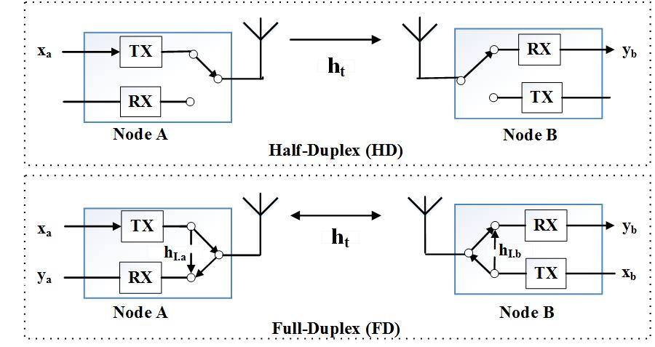
X-duplex: Flexible Switching between Full-duplex and Half-duplex Radios
Introduction and Motivation
  Full-duplex (FD):
    Pros: improve performance of transmission.
    Cons: residual self interference
  Half-duplex (HD):
    Pros: avoiding the self interference.
    Cons: half the symbol rate, performance degradation due to spatial correlation
X-Duplex: properly switches between FD and HD based on the instantaneous channel state information (CSI).
Chao Yao, Kun Yang, Lingyang Song, and Yonghui Li, “X-Duplex: Adapting of Full-Duplex and Half-Duplex,” The 33nd IEEE International Conference on Computer Communications (INFOCOM) (Poster), HK, Apr. 2015.

Slide 42
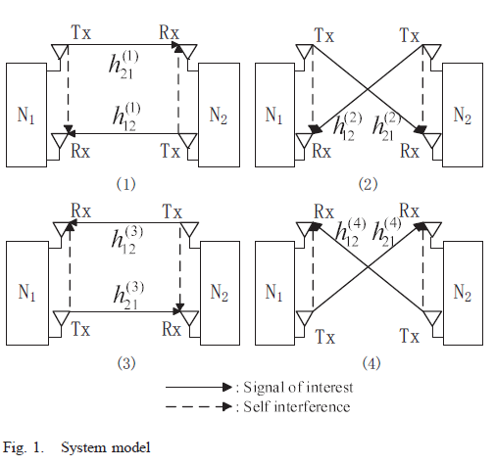
Transmit-Receive Antenna Pair Selection
A novel transmit-receive antenna pair selection scheme is proposed for bidirectional full duplex (FD) communications between two nodes, where each node is equipped with two antennas, used for either transmission or reception.
One transmit and receive antenna combination is selected from four possible pairs based on two system performance criteria:
  Maximum sum-rate and
  Minimum symbol-error-rate
Mingxin Zhou, Hongyu Cui, Lingyang Song, and Bingli Jiao, “Transmit-Receive Antenna Pair Selection in Full Duplex Systems,” IEEE Wireless Communications Letters, vol. 3, no. 1, pp. 34-37, Feb. 2014.
Mingxin Zhou, Lingyang Song, Yonghui Li, and Xuelong Li, “Simultaneous Bidirectional Link Selection in Full Duplex MIMO Systems,” to appear, IEEE Transactions on Wireless Communications.

Slide 43
Selection Criterion: Max-Sum Rate
Maximum sum-rate criterion
where
An upper bound is calculated as

Slide 44
Selection Criterion: Min-Sum SER
Minimum symbol-error-rate criterion
  An approximate min-max criterion
  A lower bound is calculated as

Slide 45
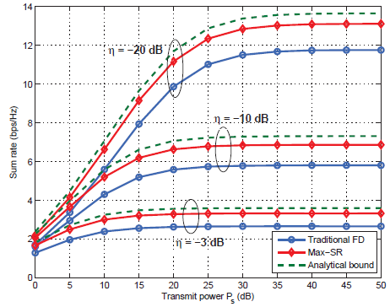
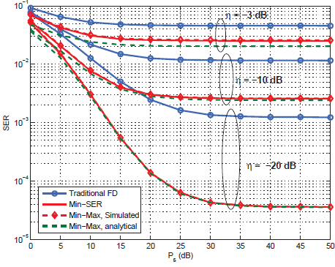
Some Results
Analytical and simulated sum rate versus transmit power
Analytical and simulated SER versus transmit power

Slide 46
Conclusions
We have introduced antenna selection into FD systems, and proposed two effective selection approaches, i.e. Max-SR and Min-SSER
  to obtain maximum sum rate and minimum sum SER, respectively.
We have also shown that the interference cancelation capability is a key factor to affect the AS performance
  the selection gains increase with the decrease of the residual self interference.
Furthermore, the sum rate has an upper bound
  the sum SER gain always increases with the decrease of residual interference.

Slide 47
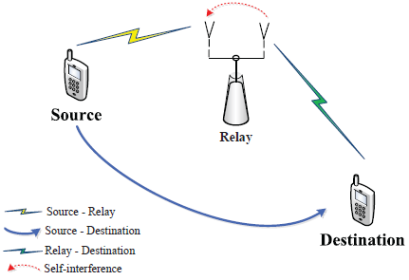
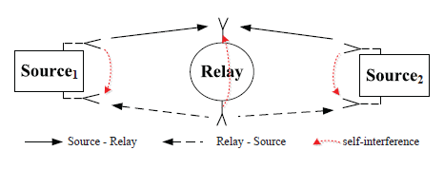
Full-Duplex Cooperative Communication
Full-duplex cooperative relaying
Full-duplex two-way relaying
Resource allocation problems
  Adaptive switching
  Power control
  Relay and antenna selection
  Radio resource allocation

Slide 48

Why Cooperation?
Mobile Station (MS) 2
Base station
(BS)
Why Cooperation in wireless networks?
Increased coverage
Reduced transmission power
Cooperative diversity
Cooperative coding gain
Mobile Station (MS) 1

Slide 49
Cooperative Communications
User 1
User 1
data
User 2
User 2
data
t1
t2
Time
Non cooperation
Cooperation
Applications
Cellular networks
Wireless sensor networks
Wireless Ad Hoc networks

Slide 50
2-Hop Relay Networks
Source
Destination
Relay
2-hop relay network with a direct link
Two phases transmission:
I: Source broadcasts to relay and destination
II: Relay forwards to the destination

Slide 51
Relaying Protocols
Amplify and forward (AF)
Decode and forward (DF)
Adaptive Relaying Protocol (ARP)
Compress and forward (CF)
Source
Destination
Relay

Slide 52
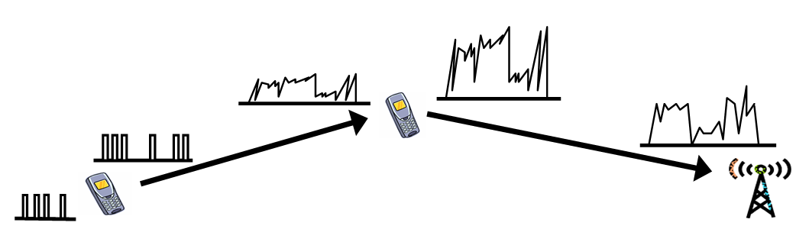
Amplify and Forward (AF)
Relay is used as an Amplifier
Amplify both signal and noise

Slide 53

Decode and Forward (DF)
Introduce error propagation when decoding errors occur
DF is superior to AF when the S-R channel quality is good enough because DF can eliminate the effect of noise
AF is superior to DF when the S-R channel quality is poor because DF will introduce serious error propagation

Slide 54
Full-Duplex Cooperative Relaying
It illustrates a simplest FD relay network consisting of one HD source, one HD destination, and one FD cooperative relay node.
Both the source and relay nodes use the same time-frequency resource and the relay nodes work in the FD mode with two antennas.
Full-duplex cooperative relaying
The communication process
The source transmits signals to both the FD relay and destination;
At the same time the FD relay forwards the signals received in the previous time slots to the destination.

Slide 55

Joint Antenna and Relay Selection
A joint relay and antenna selection scheme is studied in general full-duplex (FD) relay networks.
The system has one source, one destination and N FD amplify-and-forward relays.
Each FD relay is equipped with two antennas, one for receiving and one for transmitting.
Kun Yang, Hongyu Cui, Lingyang Song, and Yonghui Li, “Joint Relay and Antenna Selection for Full-Duplex AF Relay Networks,” IEEE International Conference on Communications, Sydney, Australia, Jun. 2014.
Kun Yang, Hongyu Cui, Lingyang Song, and Yonghui Li, “Efficient Full-Duplex Relaying with Joint Antenna-Relay Selection and Self-Interference Suppression,” to appear, IEEE Transactions on Wireless Communications.

Slide 56


Selection Criteria (1)
Antenna selection criterion:
  Assumption: each antenna of the relay is able to transmit/receive the signal.
  The relay configures the Tx/Rx antenna via the channel state information.
  Maximum end-to-end SINR criterion
Mode 1: Rx antenna T₁ and Tx antenna T₂
Mode 2: Rx antenna T₂ and Tx antenna T₁

Slide 57
Selection Criteria (2)
Joint antenna and relay selection scheme
  Maximum end-to-end SINR criterion
  2N candidate configurations
$$\left\{R_{opt},{mode}_{opt}\right\}=arg\max_{i}{\max_{}\left\{γ_{i}^{mode1},γ_{i}^{mode2}\right\}}$$

Slide 58


Some Results
Average SER of AS-ORS scheme versus the transmit power
Average SER of AS-ORS scheme versus the transmit power

Slide 59
Conclusions
We proposed a joint relay and antenna selection scheme for the multiple FD relay networks with one source, one destination and N FD relays.
By adaptively selecting the Tx and Rx antennas at each FD relay node, the proposed scheme can achieve an additional spatial diversity at the destination.
Thus, a significant performance improvement than the conventional relay selection scheme with fixed Tx and Rx antenna configuration at the relay.
Comparatively, the RAMS scheme achieves:
  twice of the diversity order at low to medium SNRs and
  a much lower error floor at high SNRs.

Slide 60
Two-way Relaying Networks (1)
Conventional Bi-Directional Relay Protocal

Slide 61
Two-way Relaying Networks (2)
Decode-and-Forward Bi-Directional Relay Protocal

Slide 62
Two-way Relaying Networks (3)
Amplify-and-Forward Bi-Directional Relay Protocal
Analog Network Coding

Slide 63
Full-Duplex Two-Way Relaying
The FD two-way relay system consists of two sources, and one relay node and all nodes work in the FD mode with two antennas, one for transmission and one for reception.
The direct link between two source nodes does not exist due to the shadowing effect.
Full-duplex two-way relaying
The communication process
Two source nodes transmit signals to the relay node, while receiving the signal sent from the relay node at the same time
The relay broadcasts the signals received in the previous time slot to both source nodes and meanwhile receiving the signals from the sources.

Slide 64

Two-way Full-Duplex Relay Selection
We analyze and optimize the two-way FD relay system using amplify and-forward protocol, when the multi-relay scenario is considered.
The optimal relay selection scheme in maximizing the effective signal-to-interference and noise ratio is proposed, which significantly improves the system performance than a single relay network.
Hongyu Cui, Lingyang Song, and Bingli Jiao, “Relay Selection for Two-Way Full Duplex Relay Networks with Amplify-and-Forward Protocol,” IEEE Transactions on Wireless Communications, vol. 13, no. 7, pp. 3768-3876, Jul. 2014.

Slide 65





Problem Formulation
The received signal at the relay is
The amplified signal of the relay satisfies
                where
The received signal at the source is
Therefore

Slide 66


Selection Criteria
The received SINR is
It can be verified that the optimal selection criteria
is equivalent to

Slide 67


Some Results

Slide 68
Conclusions
The multiple-relay scenario is considered
  the two-way full duplex relay of AF protocol was analyzed and optimized.
  the optimal power allocation and the optimal choice of duplex mode for the two-way relay are obtained in minimizing the outage probability.
Results reveal that the two-way FD relay has the better performance than two-way HD relay, if the residual self-interference is sufficiently small.

Slide 69

  Full-Duplex Heterogeneous Networks
A FD-HetNet consists of a single BS and multiple FAPs, all equipped with 2 antennas.
Each cell has multiple users that attempt to connect either to the BS or the FAPs.
Both BS and FAPs work in the FD mode.
Full-Duplex Heterogeneous Networks
Radwa Sultan, Lingyang Song, and Zhu Han, “Impact of Full Duplex on Resource Allocation for Small Cell Networks,” The IEEE Global Conference on Signal and Information Processing (GlobalSIP), December 3-5, 2014. Atlanta, Georgia, USA.
Radwa Aly Sultan, Lingyang Song, Karim G Seddik, Yonghui Li, and Zhu Han, “Mode Selection, User Pairing, Subcarrier Allocation and Power Control in Full-Duplex OFDMA HetNets,” IEEE ICC 2015 - 4th International Workshop on Small Cell and 5G Networks (SmallNets) , London, UK, June 2015.

Slide 70

Results and Conclusions
Both uplink and downlink users are connected to the BS;
The uplink user is connected to the BS but the downlink user is connected to the FAP;
Both the uplink and downlink users are connected to the FAP;
The uplink user is connected to the FAP and the downlink user is connected to the BS.

Slide 71
Resource Allocation Problem Summary (1)
Mode Switch
  Half-duplex radio
    Due the limited size of transmitter and receiver, many wireless communication systems suffer from the spatial correlation which degrades the performance gain of HD mode.
  Full-duplex radio
    It allows a node to send and receive signals at the same time in the same frequency band.
    However, it is practically impossible to have perfect self interference cancelation, and thus, the amount of RSI greatly affects the performance of FD system.
    As a result, in some scenarios, the HD mode may outperform the FD mode for certain RSI values.
This motivates the adaptive mode switching between the FD and HD modes based on the RSI and channel conditions to maximize the ergodic capacity.

Slide 72
Resource Allocation Problem Summary (2)
Power Control
  due to RSI, power control algorithm needs to be properly redesigned in order to maximize system performance of all users.
    FD-MIMO:
      The antennas at the FD node are divided into transmit and receive antenna sets
      Water-filling power allocation can be applied at the transmit antenna set to maximize the sum rate based on individual power constraint.
    FD-Relay:
      In FD-Relay networks with individual power constraint at each relay, the relayed signals are corrupted by the RSI,
      Power allocation can be considered to reduce RSI subject to total and individual power constraints

Slide 73
Resource Allocation Problem Summary (3)
Power Control
  FD-OFDMA: for FD-OFDMA with one FD BS and HD multiple users, uplink (transmit) and downlink (receive) users are paired to communicate with FD BS at the same time.
    The transmit power can be allocated at the BS side with total power constraint by splitting the power among all he subcarriers for different user pairs.
    At the user side, power control needs to take into account the inter-user distance among the transmit-receiver user pair.
  FD-HetNet:
    Similar to FD-OFDMA, the power control can be performed for the FD BS and femtocell access points (FAPs) and HD users in FD-HetNet to optimize the network performance.
    However, both the inter-cell interference and RSI need to be considered jointly in optimizing the overall network performance.

Slide 74
Resource Allocation Problem Summary (3)
Transmit Beamforming:
  The robust transmit beamforming algorithms can improve the signal strength at the receiver side,
  and meanwhile reduce the self interference subject to various design criteria.
    FD-MIMO: the transmit antenna set at each FD nodes can perform beamforming to simultaneously transmit information and reduce the interference to its own received signals
    FD-OFDMA:
      The FD BS is equipped with multiple antennas, consisting of transmit and receive antenna sets,
      while the users only operate in the HD transmission mode due to hardware constraint.
      The BS can construct beamformer to support multiple users in the downlink while maximizing the received SNRs at BS by minimizing the RSI.

Slide 75
Resource Allocation Problem Summary (4)
Link Selection
  For a FD communication system, each antenna can be configured to transmit or receive the signals.
  This will create multiple possible virtual links between two nodes, with one virtual link representing the channel from a transmit antenna of one node to a receive antenna of the other.
  An important question arisen is how to optimally select the link for each direction to optimize the system performance.
    Antenna selection in FD-MIMO systems
    Joint antenna and relay selection in FD-Relay systems
    Coordinated multiple point transmission

Slide 76
Resource Allocation Problem Summary (5)
Subcarrier Allocation
  In a FD-OFDMA network consisting of one FD BS with N_{f} subcarriers, N_{u} uplink users, and N_{d} downlink users,
    a fundamental challenge is how to pair uplink and downlink users, and allocate subcarrier across these user pairs;
    The subcarrier allocation involves
      allocating the different subsets of subcarriers to different users
      taking into account the RSI at the BS and the co-channel interference between the uplink and downlink users within each user pair.
  In FD-Relay networks, consisting of multiple source and destination nodes, and FD relay nodes using OFDM transmission,
    the corresponding subcarriers should be also properly allocated at the relay for different source-destination pairs.

Slide 77
Matching Theory
Game Theory Basics
Introduction to Matching Theory
Classification
Stable Marriage problem
  Definitions
  Optimal Matching
  Algorithms
  Variants
A Many-to-one Matching Example
A Many-to-many Matching Example

Slide 78


History of Game Theory
John von Neuman (1903-1957) co-authored, Theory of Games and Economic Behavior, with Oskar Morgenstern in 1940s, establishing game theory as a field.
John Nash (1928 - ) developed a key concept of game theory (Nash equilibrium) which initiated many subsequent results and studies.
Since 1970s, game-theoretic methods have come to dominate microeconomic theory and other fields.
Nobel Prizes
  Nobel prize in Economic Sciences 1994 awarded to Nash, Harsanyi (Bayesian games) and Selten (subgame perfect equilibrium).
  2005, Auman and Schelling got the Nobel prize for having enhanced our understanding of cooperation and conflict through game theory.
  2007 Leonid Hurwicz, Eric Maskin and Roger Myerson won Nobel Prize for having laid the foundations of mechanism design theory.

Slide 79
Introduction
Game theory - mathematical models and techniques developed in economics to analyze interactive decision processes, predict the outcomes of interactions, identify optimal strategies
Game theory techniques were adopted to solve many protocol design issues (e.g., resource allocation, power control, cooperation enforcement) in wireless networks.
Fundamental component of game theory is the notion of a game.
  A game is described by a set of rational players, the strategies associated with the players, and the payoffs for the players. A rational player has his own interest, and therefore, will act by choosing an available strategy to achieve his interest.
  A player is assumed to be able to evaluate exactly or probabilistically the outcome or payoff (usually measured by the utility) of the game which depends not only on his action but also on other players’ actions.

Slide 80

Examples: Rich Game Theoretical Approaches
Non-cooperative Static Game: play once
  Mandayam and Goodman (2001)
  Virginia tech
Repeated Game: play multiple times
  Threat of punishment by repeated game. MAD: Nobel prize 2005.
  Tit-for-Tat (infocom 2003):
Dynamic game: (Basar’s book)
  ODE for state
  Optimization utility over time
  HJB and dynamic programming
  Evolutional game (Hossain and Dusit’s work)
Stochastic game (Altman’s work)
Cooperative Games
  Nash Bargaining Solution
  Coalitional Game
Prisoner Dilemma
Payoff: (user1, user2)
Notes:
John Edwards

Slide 81
Games in Strategic (Normal) Form
A game in strategic (normal) form is represented by three elements:
  A set of players N
  Set of strategies of player Si
  Set of payoffs (or payoff functions) Ui
Notation s_{i} strategy of a player i while s_{-i} is the strategy profile of all other players.
Notice that one user’s utility is a function of both this user’s and others’ strategies.
A game is said to be one with complete information if all elements of the game are common knowledge. Otherwise, the game is said to be one with incomplete information, or an incomplete information game.

Slide 82

Nash Equilibrium
Dominant strategy is a player's best strategy, i.e., a strategy that yields the highest utility for the player regardless of what strategies the other players choose.
A Nash equilibrium is a strategy profile s* with the property that no player i can do better by choosing a strategy different from s*, given that every other player j ≠ i .
In other words, for each player i with payoff function u_{i} ,
No user can change its payoff by Unilaterally changing its strategy, i.e., changing its strategy while s_{-i} is fixed

Slide 83
The price of Anarchy
Centralized system: In a centralized system, one seeks to find the social optimum (i.e., the best operating point of the system), given a global knowledge of the parameters. This point is in many respect efficient but often unfair.
Decentralized: When the players act noncooperatively and are in competition, one operating point of interest is the Nash equilibrium. This point is often inefficient but stable from the players’ perspective.
The Price of Anarchy (PoA), defined as the ratio of the cost (or utility) function at equilibrium with respect to the social optimum case, measures the price of not having a central coordination in the system
PoA is, loosely, a measure of the loss incurred by having a distributed system!

Slide 84
Example: Prisoner’s Dilemma
Two suspects in a major crime held for interrogation in separate cells
  If they both stay quiet, each will be convicted with a minor offence and will spend 1 year in prison
  If one and only one of them finks, he will be freed and used as a witness against the other who will spend 4 years in prison
  If both of them fink, each will spend 3 years in prison
Components of the Prisoner’s dilemma
  Rational Players: the prisoners
  Strategies: Stay quiet (Q) or Fink (F)
  Solution: What is the Nash equilibrium of the game?
Representation in Strategic Form

Slide 85
Example: Prisoner’s Dilemma
Price of Anarchy 3
 | P2 Quiet | P2 Fink
P1 Quiet | 1,1 | 4,0
P1 Fink | 0,4 | 3,3
Pareto optimal
(recall we’re minimizing)
Nash Equilibrium

Slide 86
Algorithms for Finding the NE
For a general N-player game, finding the set of NEs is not possible in polynomial time!
    Unless the game has a certain structure
Some existing algorithms
  Fictitious play (based on empirical probabilities)
  Iterative algorithms (can converge for certain classes of games)
  Best response algorithms
    Popular in some games (continuous kernel games for example)
  Useful Reference
  D. Fundenberg and D. Levine, The theory of learning in games, the MIT press, 1998.

Slide 87
Introduction
Labor economics
  Describe the formation of new jobs
  Describe other human relationships like marriage
  Allocate scare resources
  To their most efficient uses
Examples
  Matching doctors and hospitals
  Matching students and high-schools
  Matching kidneys and patients
  Hiring employees

Slide 88


Introduction
The Nobel Prize in Economic Sciences 2012
Lloyd S. Shapley
  Developed the theory in the 1960s
Alvin E. Roth
Generated further analytical
development
practical design of market institutions

Slide 89
Introduction
Definition on Wikipedia
  A mathematical framework attempting to describe the formation of mutually beneficial relationships over time.
Where is it used
  The U.S. National Resident Matching Program (NRMP) for medical school graduates
  Public schools in Boston and NYC
  Many medical and other labor markets across

Slide 90
Classification
Bipartite matching problem with two-sided preferences
  One-to-one (stable marriage)
  One-to-many (College admission)
Bipartite matching problem with one-sided preferences
  Campus housing allocation
  Assign reviewers to papers
Non-bipartite matching problem with preferences
  Many-to-many (Create partnership in P2P network)

Slide 91
Stable Marriage Problem (SM)
women and men be matched
respecting their individual preferences
Fran
Adam
Geeta
Bob
Carl
Heiki
David
Irina

Slide 92


Stable Marriage Problem (SM)
Definitions
  Preference list:
    Strictly orders all members of the opposite sex
    If a man m prefers w₁ to w₂, we write
  A matching μ
Blocking pair

Slide 93
Blocking Pair
X
Adam
Geeta
David
Heiki
Geeta prefers Carl to Adam!
Blocking Pair
X
Bob
Irina
Carl
Fran
Carl likes Geeta better than Fran!

Slide 94
Stable Matching
Adam
Heiki
David
Irina
Unfortunately,
Irina loves David better!
Stable Matching: a matching without blocking pairs
Bob and Irina are not a blocking pair
Bob
Fran
Carl
Geeta
Bob likes Irina better than Fran!

Slide 95





Optimal Matching
Four optimization criteria for the quality of stable matchings
Minimum regret stable matching
Egalitarian stable matching
Sex-equalness stable matching
Maximum stable matching

Slide 96
Algorithms
How can we find a stable matching?
  many approaches (minimizing sum/ max of ranks, minimizing difference of total ranks, Gale and Shapley algorithm, linear programming)
  Most popular: Deferred acceptance or GS algorithm
GS algorithm
    National Resident matching program (NRMP) in US since 1997
    Higher education admission in China, Germany, Hungary, Spain and Turkey
    Online dating in US
  Roth-Vande Vate Mechanism (RVV)

Slide 97
Gale-Shapley (GS) Algorithm
The Gale-Shapley algorithm can be set up in two alternative ways:
  men propose to women
  women propose to men
Each man proposing to the woman he likes the best
  Each woman looks at the different proposals she has received (if any)
  retains what she regards as the most attractive proposal (but defers from accepting it) and rejects the others
The men who were rejected in the first round
  Propose to their second-best choices
  The women again keep their best offer and reject the rest
Continues until no men want to make any further proposals
Each of the women then accepts the proposal she holds
The process comes to an end

Slide 98
GS Algorithm
Geeta, Heiki, Irina, Fran
Adam, Bob, Carl, David
Adam
Fran
Irina, Fran, Heiki, Geeta
Carl, David, Bob, Adam
Bob
Geeta
Geeta, Fran, Heiki, Irina
Carl, Bob, David, Adam
Carl
Heiki
Irina, Heiki, Geeta, Fran
Adam, Carl, David, Bob
David
Irina

Slide 99
GS Algorithm
Geeta, Heiki, Irina, Fran
Adam
Fran
Carl > Adam
Irina, Fran, Heiki, Geeta
This is a stable matching
Geeta
Bob
Geeta, Fran, Heiki, Irina
Carl
Heiki
Irina, Heiki, Geeta, Fran
David > Bob
David
Irina

Slide 100
GS Algorithm
The setup of the algorithm have important distributional consequences
  It matters a great deal whether
    the right to propose is given to the women or to the men
  If the women propose
    the outcome is better for them than if the men propose
  Conversely, the men propose
    leads to the worst outcome from the women’s perspective
Optimality is defined on each side, difficult to guarantee on both sides
  The matching may not be unique

Slide 101
Different Stable Matchings
1: a c b d a: 2 4 1 3
2: b d c a b: 3 1 2 4
3: c a d b c: 4 2 3 1
4: d b a c d: 1 3 4 2
1: a c b d a: 2 4 1 3
2: b d c a b: 3 1 2 4
3: c a d b c: 4 2 3 1
4: d b a c d: 1 3 4 2
Women get best satisfactory
1: a c b d a: 2 4 1 3
2: b d c a b: 3 1 2 4
3: c a d b c: 4 2 3 1
4: d b a c d: 1 3 4 2
1: a c b d a: 2 4 1 3
2: b d c a b: 3 1 2 4
3: c a d b c: 4 2 3 1
4: d b a c d: 1 3 4 2
Men get better satisfactory
1, 2, 3, 4 represent men
a, b, c, d represent women

Slide 102
Extensions to New Markets
Prices are not part of the process for the previous implementation
  Does the absence of a price mechanism in the basic Gale-Shapley algorithm limit its applicability?
  Not necessarily
Algorithms including prices work in much the same way
  produce stable matches with similar features
  Matching with prices is closely related to auctions
    objects are matched with buyers and where prices are decisive
  Matching vs. Auction
    Synergistic but more about matching, less about pricing

Slide 103
Other Algorithms
  Roth-Vande Vate Mechanism (RVV)
    A stable matching can be obtained from an arbitrary matching, by iteratively satisfying a blocking pair (randomly chosen), with probability of 1.
    But there can be cycle if the “wrong” blocking pair is chosen.
Random Order Mechanism (ROM)
  Modified RVV: start from an empty matching.
  More natural to assume that agents arrive one at a time.
  But some stable matchings can never be reached by ROM.

Slide 104
Variants of SM Matching
Stable marriage with ties (SMT)
  Indifferences (ties) in the list
Stable marriage with incomplete preferences (SMI)
Incomplete lists
Stable marriage with forbidden pairs (SMF)
Stable marriage with forced pairs (SMFD)
2: (c a) (e b d)
2: c a e

Slide 105
Stable Marriage with Ties (SMT)
Theorem: Any SMT instance admits at least one (weakly) stable matching
1: a (c b d) a: 2 4 1 3
2: b d c a b: (3 2 1) 4
3: (c a) d b c: 4 2 (3 1)
4: d b a c d: 1 3 (4 2)
1: a b c d a: 2 4 1 3
2: b d c a b: 1 2 3 4
3: a c d b c: 4 2 3 1
4: d b a c d: 1 3 2 4

Slide 106



Stable Marriage with Ties (SMT)
Super-stability
Weak stability
Strong stability
Theorem:
A weakly stable matching always exists and can be found in polynomial time

Slide 107
Stable Marriage with Incomplete Preferences (SMI)
  1: a c b a: 2 1 3 4 5
  2: c a b: 2 1
  3: b a c: 1 2
  4: c b d e d: 3 1 4
  5: c d b e: 4 3
Matching may be partial
Theorem [Gale, Sotomayor 1985]
There may be more than one stable matchings, but their size is all the same and one of them can be obtained in poly time.

Slide 108
Many-to-one Matching
Example: hospitals/residents problem (HR)
We consider men as residents and women as hospitals
Each hospital declares the quota, that specifies the number of residents the hospital can accept
Reduce to SM
  Replace each hospital with a quota q by its q copies
  Most of the results established for SM hold for HR
Rural Hospital Theorem
  The same residents are assigned in all stable matchings
  Each hospital is assigned the same number of residents in all stable matchings
  Any hospital that is undersubscribed in one stable matching is assigned exactly the same set of residents in all stable matchings

Slide 109
Many-to-Many Matching Example: Femtocells
Femtocell access points (FAPs) are
  low-power wireless access points that
    operate in macrocells’ access points (MAPs) licensed spectrum to
    connect standard mobile devices to a wireless operator’s (WOs) network
  using residential DSL or cable broadband connections
Challenges:
  Random spacial placement of FAPs and huge interference.
  MAPs to FAPs, FAPs to MAPs and FAPs to FAPs interference.
  No distributed mechanism to handle the final users (FUs)-FAPs and FAPs-WOs allocation.

Slide 110



Many-to-Many Matching Example: Femtocells
First matching problem:
Matching the FAPs to WOs
Second matching problem:
Matching FUs to FAPs
Matching sub-channels to Fus
Power allocation
Money transfer
Operators
Femto-cells
Money transfer
Sub-channels
Users
Users
Femto-cells

Slide 111
Table of Content
Basic of Full-duplex Communications
Resource Allocation and Game Theoretical Study
  Matching Theory
  Full-duplex OFDMA Networks
    Introduction
    System model
    Algorithms
    Simulation Results
  Full-duplex Heterogeneous Networks
Applications
Conclusions

Slide 112
Introduction
Full-duplex OFDMA schemes help achieve the single band simultaneous bidirectional communication
Consists of a common base station (BS), and multiple users as transmitters (TXs) and receivers (RXs).
Open Problem: maximizing the sum-rate of the network
  How to make the transmitters and the receivers paired
  How to allocate the subcarriers to the transmitter-receiver pairs
  How to allocate the transmitted power of the BS to the receivers
Boya Di, Siavash Bayat, Lingyang Song, and Yonghui Li, “Radio Resource Allocation for Full-Duplex OFDMA Networks Using Matching Theory,” IEEE INFOCOM - Student Activities (Posters), Toronto, Canada, May, 2014.
Lingyang Song, Yonghui Li, and Zhu Han, “Resource Allocation in Full-Duplex Communications for Future Wireless Networks,” to appear, IEEE Wireless Communications Magazine [arxiv: http://arxiv.org/abs/1505.02911]

Slide 113

System Model
One BS, M transmitters (TXs), M receivers (RXs), and K subcarriers
A transceiver unit
  A base station, a
  transmitter and a receiver
Self interference between
antennas
Transceiver-subcarrier pairing
  One TX can only be paired with one RX
  One subcarrier can only be paired with one TX-RX pair
The transmit power of the BS is fixed
Fig. 1: System Model

Slide 114


System Model
Optimization problem
the transmitter power allocated to the pair
Constraints
Each TX can only be paired with one RX and vice versa
Each subcarrier can only be assigned to one transceiver unit and vice versa
The total transmit power of the BS is subject to its peak power constraint P_{s}

Slide 115
Matching Formulation
Objective: matching the TXs, RXs, and subcarriers to each other and adjust the BS power level in each subcarrier such that the total network’s sum-rate is maximized.
Defining a subcarrier-RX (SR) unit that consists of one subcarrier and one RX.
Matching: M TXs on one side and M×K SR units on the other side.
Stability: there is no pair consisting of any TX_{i} and any SR unit such that they prefer other combinations over their current ones.

Slide 116

Proposed Algorithm
First the BS allocates equal power levels to all the transceiver units.
Define a price for each SR unit and set the price to 0.
Unmatched TX_{i} proposes to its most preferred SR_{k,j}
Matching: when RX_{j} and subcarrier k both receive only one offer, which comes from TX_{i}, they will be matched together.
The conflict part raises its price each iteration.
Ending: the bid and matching continues until there is no one willing to make new offers.
Fig 2: One-to-one matching algorithm

Slide 117

Simulation Results
Random matching algorithm:
the TXs, the RXs, and
subcarriers are randomly
matched with each other
Complexity level: the
iteration number is much
smaller than that of the
centralized algorithm
The performance is close to
the centralized algorithm
Performs much better than the random algorithm
Fig. 3: Total sum-rate vs. transmitted power of each user p_{u}

Slide 118
Table of Content
Main Applications
  Cognitive Radio Preliminaries
  Full-duplex Cognitive Radio Networks
  Listen-and-talk Protocol
  Collaborative Spectrum Sensing
  Decentralized Dynamic MAC in FD-CRNs
  RRM in Centralized MAC in FD-CRNs

Slide 119
Cognitive Radio Preliminaries
Introduction
Spectrum sensing
Spectrum allocation
Spectrum sharing

Slide 120

Introduction (1): Motivation
The electromagnetic radio spectrum is a precious natural resource, which is of fundamental importance in wireless communications.
But the Problem is:
Spectrum Scarcity
Low Utilization Efficiency

Slide 121

Introduction (2): Solution
Cognitive Radio (CR)was proposed for promoting the utilization efficiency of spectrum by exploiting the existence of spectrum holes.
Spectrum Hole
  A spectrum hole is a band of frequencies assigned to a primary user, but, at a particular time and specific geographic location, the band is not being utilized by that user.
Spectrum utilization
  This can be improved significantly by making it possible for a secondary user (who is not being serviced) to access a spectrum hole unoccupied by the primary user at the right location and the time.

Slide 122
Introduction (3): Two Main Problems
How to find the spectrum holes ?
  Spectrum sensing
      Detection of spectrum holes in some interested band;
      Collection of the changing information of the external wireless environment periodically ;
  How to allocate and sharing the spectrum resource ?
  Spectrum allocation and sharing
      Promotion of the utilization efficiency of spectrum;
      Most research is base on spectrum pooling policy;

Slide 123
Spectrum Sensing (1): Introduction
One main aspect of cognitive radio is related to autonomously exploiting locally unused spectrum to provide new paths to spectrum access.
Converse the sensing problem into one that determines whether the primary user's signal and noise are co-existential or there's only noise, which belongs to a 2-variable's sensing problem.
All the techniques are based in these two assumptions:
  All the CR user must suspend any activity during sensing the spectrum holes
  Worst scenario must be considered: None-line of sight(NLOS) between CR user’ receiver and the primary user’ transmitter

Slide 124

Spectrum Sensing (2): Techniques

Slide 125
Spectrum Sensing (3): Transmitter Detection
Based on the detection of the weak signal from a primary transmitter through the local observations of CR users;
Basic hypothesis model for transmitter detection can be defined as follows:
Three detection schemes:
  Matched-filter Detection
  Energy Detection
  Cyclostationary Feature Detection

Slide 126

Spectrum Sensing (4): Receiver Detection
Interference-based Detection:
  Interference is typically regulated in a transmitter-centric way, However, interference actually takes place at the receivers;
  A new model for measuring interference, referred to as interference temperature has been introduced by the FCC :

Slide 127

Spectrum Sensing (5): Cooperative Detection
Receiver uncertainty and shadowing uncertainty require the cooperative detection;

Slide 128

Spectrum Sensing (6): Detection Process
Sensor network is deployed in the desired target area and senses the spectrum;
  Operational network uses the sensing information to determine the available spectrum;

Slide 129
Spectrum Sensing (7): Techniques
Centralized Manner
  Base-station plays a role to gather all sensing information from the CR users and detect the spectrum holes.
Distributed Manner
  Every CR user exchanges the observation to make the final determination.
Three integration Rules
  OR principle;
  AND principle;
  Chair-Varshney principle ;

Slide 130
Spectrum Sensing (8): Features
Cooperative detection can improve the performance of the spectrum sensing;
Increasing the burden on the network and taking up more system resources;
Fail to solve the uncertainties caused by inability to know the position of primary users.

Slide 131
Spectrum Allocation (1): Introduction
The basic idea of spectrum allocation between primary users (PUs) and secondary users (SUs) in CR is to open licensed spectrum to secondary users while limiting the interference perceived by primary users.
Spectrum
Allocation
Underlay Approach
Overlay Approach

Slide 132

Spectrum Allocation (2): Underlay
In spectrum underlay, the concept interference temperature is introduced
  The secondary transmitters can work as long as the total interference received by the primary receivers is below the interference temperature.
  Imposes severe constraints on the transmission power of secondary users so that they operate below the noise floor of primary users.

Slide 133
Spectrum Allocation (3): Overlay
In spectrum overlay, the technology spectrum pooling is introduced to enhance spectral efficiency by overlaying a new mobile radio system within the same frequency range and without any changes to the actual licensed system.
From this common spectrum pool hosted by the so-called licensed system public rental, users may temporarily rent spectral resources during idle periods of licensed users.
Spectrum Sensing is necessary in overlay to detect the spatial, temporal and spectral holes.

Slide 134
Spectrum Allocation (4): DSA
Dynamic Spectrum Access (DSA) is the opposite of the current static spectrum management policy.
  To achieve a better use of the spectrum, give the many variations present in wireless communication.
  Various approaches are possible to make the spectrum management more adaptive.
  Our focus will be on those approaches that involve coexistence, or dynamic spectrum sharing.

Slide 135

Spectrum Sharing
This model for spectrum sharing assumes that all networking nodes have equal regulatory status.
Classification :
  Spectrum sharing between nodes of a single network.
  Spectrum planning between different networks using the same access technology.
  Spectrum sharing across heterogeneous networks.

Slide 136
Listen-and-Talk Protocol
We propose a novel “listen-and-talk” (LAT) protocol with the help of the full-duplex technique that allows SUs to simultaneously sense and access the vacant spectrum.
Unique features of the LAT is discussed and comparison between the LAT and the conventional protocol is presented.
Yun Liao, Tianyu Wang, Lingyang Song, and Zhu Han, “Listen-and-Talk: Full-duplex Cognitive Radio Networks,” in Proc. IEEE Globecom’14, Austin, TX, Dec. 2014. Best Paper Award
Yun Liao, Lingyang Song, Yonghui Li, and Zhu Han, “Full-Duplex Cognitive Radio: A New Design Paradigm for Enhancing Spectrum Usage,” IEEE Communications Magazine, vol. 53, no. 5, pp. 138-145, May 2015. [arxiv: http://arxiv.org/abs/1503.03954]

Slide 137
Listen-and-Talk Protocol
Conventional CR: Listen-before-Talk Protocol
  The LBT Protocol
  Problems of the LBT
  Motivation of a New Protocol Design
Listen-and-Talk Protocol
  System Model
  The Proposed LAT Protocol

Slide 138
The LBT Protocol
SUs sense the spectrum before transmission
  Sensing and transmission separate in time domain

Slide 139
Problems of the LBT
Discontinuous transmission
  Can never fully utilize spectrum holes for transmission
Discontinuous sensing
  Inevitable collision and spectrum waste
Notes:
The SUs have to sacrifice the transmitting time for spectrum sensing, and even if the spectrum hole is long and continuous, the data transmission needs to be split into small discontinuous slots.
During SU’s transmission, the SUs cannot detect the change of PU’s states, which leads to collision when the PU arrives and spectrum waste when the PU leaves.

Slide 140
Problems of the LBT
Discontinuous transmission
  Can never fully utilize spectrum holes for transmission
Discontinuous sensing
  Inevitable collision and spectrum waste
Notes:
The SUs have to sacrifice the transmitting time for spectrum sensing, and even if the spectrum hole is long and continuous, the data transmission needs to be split into small discontinuous slots.
During SU’s transmission, the SUs cannot detect the change of PU’s states, which leads to collision when the PU arrives and spectrum waste when the PU leaves.

Slide 141
Motivation of a New Protocol Design
Continuous
Discontinuous transmission
  Can never fully utilize spectrum holes for transmission
Discontinuous sensing
  Inevitable collision and spectrum waste
Continuous
Full-duplex technique can be one possible solution to improve CRNs
Detect PU’s state change in no time

Slide 142
Listen-and-Talk Protocol
Conventional CR: Listen-before-Talk Protocol
  The LBT Protocol
  Problems of the LBT
  Motivation of a New Protocol Design
Listen-and-Talk Protocol
  System Model
  The Proposed LAT Protocol

Slide 143
System Model
One PU
  Non-slotted
One FD-SU pair
  Each with two antennas
  SU₁: secondary transmitter
  SU₂: secondary receiver
  Slotted

Slide 144
Listen-and-Talk Protocol (1)
Ant₁ of SU₁ senses the spectrum, while Ant₂ transmits if a spectrum hole is detected simultaneously.
Sensing result of one slot determines SU’s activity in the next slot.

Slide 145
Listen-and-Talk Protocol (2)
Four states of the system:
  1: only the PU uses the spectrum
  2: only SUs use the spectrum
  3: neither the PU nor SUs use the spectrum – spectrum waste
    3-A: change of PU’s state – PU leaves in a slot
    3-B: sensing error – false alarm
  4: both the PU and SUs use the spectrum – collision
    4-A: change of PU’s state – PU arrives in a slot
    4-B: sensing error – miss detection

Slide 146


Sensing Threshold (1)
The received signal in sensing varies in association with SU₁’s activity.
  Active SU₁
  Silent SU₁
Thus, the sensing threshold needs to change according to SU₁’s state to achieve better sensing performance.
RSI
$$x=\left\{\begin{matrix}h_{s}s_{p}+w+u & H_{11} \\ w+u & H_{10}\end{matrix}\right.$$
$$x=\left\{\begin{matrix}{ h}_{s}s_{p}+u & H_{01} \\ u & H_{00}\end{matrix}\right.$$

Slide 147
Sensing Threshold (2)
How to set ε₀ and ε₁?

Slide 148
Sensing Threshold (3)

Slide 149
Sensing Threshold (4): Sensing Error
Sensing error includes two parts: false alarm and miss detection, which are defined as, respectively,

Slide 150
Sensing Threshold (5): State Transition
State Transition is simplified as a discrete-time Markov chain, and the probabilities that the system is at each state can be obtained.
Notes:
consider the steady-state distribution of the Markov chain

Slide 151
Sensing Threshold (6): Collision Ratio
The sensing thresholds are determined by the constraint of the maximum collision ratio, which is defined as

Slide 152
Power-Throughput Tradeoff (1): SU Throughput
The secondary throughput is
  R is the rate of transmission
  P_{w} is the time ratio of spectrum waste, defined as

Slide 153

Power-Throughput Tradeoff (2)
Increase with RSI
There may exist a tradeoff between secondary transmit power and the throughput, and an optimal transmit power can be derived.

Slide 154
Adaptive Switching (1)
There exist limitations for both LBT and LAT protocols:
  The LBT:
    reduced sensing and transmission time
    Spatial correlation
  The LAT:
    Impact of RSI

Slide 155


Adaptive Switching (2)
Spatial correlation factor
Sensing duration / Slot length
Adaptive switching of the two protocol
Full utilization of spectrum holes
Comparison of the spectrum usage
Lower spectrum waste ratio
under strict constraint

Slide 156
Main Application Scenarios
Distributed Full-Duplex Cognitive Radio Networks
  Two-node bi-directional MIMO system
Centralized Full-Duplex Cognitive Radio Networks
  Full-duplex relay network
    DF relay
    AF relay
    Two-way relay
  Full-duplex wireless network
    FD cellular network
    FD HetNet

Slide 157
Cooperative Spectrum Sensing (1)
Consider a CRN consisting of one PU, one FC, and k SUs each of which equips two antennas
We study the LAT based cooperative spectrum sensing to further improve the sensing performance and spectrum usage.
Yun Liao, Tianyu Wang, Lingyang Song, and Bingli Jiao, “Cooperative Spectrum Sensing for Full-Duplex Cognitive Radio Networks,” in Proc. IEEE ICCS’14, Macau, China, Nov. 2014.
Yun Liao, Kaigui Bian, Lingyang Song and Zhu Han, “Robust Cooperative Spectrum Sensing in Full-duplex Cognitive Radio Networks,”International Conference on Ubiquitous and Future Networks (ICUFN 2015 ), July, Japan.

Slide 158

Cooperative Spectrum Sensing (2)
Hard combination, OR-rule
CSS cannot lift the upper bound of secondary throughput.
LAT CSS outperforms other protocols when sensing SNR is low.

Slide 159

Decentralized Dynamic MAC in FD-CRNs (1)
Consider a CRN consisting of one channel with several PUs and M FD-enabled SUs
Each SU can sense the channel and transmit simultaneously, and they are allowed to access the spectrum only when the PU is absent.
Liao Yun, Tianyu Wang, Kaigui Bian, Lingyang Song and Zhu Han, “Decentralized Dynamic Spectrum Access in Full-Duplex Cognitive Radio Networks,” IEEE International Conference on Communications (ICC), London, UK, June 2015. [Best paper Award]
Yun Liao, Kaigui Bain, Lingyang Song,and Zhu Han, “Full-duplex MAC Protocol Design and Analysis," IEEE Communications Letters, vol. 19, no. 7, pp. 1185-1188, Jul. 2015.
Yun Liao, Kaigui Bian, Lingyang Song and Zhu Han, “Full-duplex WiFi: Achieving Simultaneous Sensing and Transmission for Future Wireless Networks,” ACM Mobihoc (poster), Hangzhou, China, 2015.

Slide 160

Decentralized Dynamic MAC in FD-CRNs (2)
Sensing with FD: With FD techniques, SUs can keep sensing during transmission.
Contention window: determine the optimal backoff length.
Handling the RSI: the RSI results in false alarm and miss detection problems.

Slide 161


RRM in Centralized MAC in FD-CRNs
Consider a network with one PU, one SBS and N SUs.
The primary network is an OFDM system, in which the PU transmits on K orthogonal channels.
The secondary network is a spectrum overlay-based cognitive cellular network consisting of one SBS and N SUs.
The SBS, equipped with two antennas, is a full-duplex device with strong SIS capability.
Tianyu Wang, Yun Liao, Baoxian Zhang, and Lingyang Song, “Joint Spectrum Access and Power Allocation in Full-Duplex Cognitive Cellular Networks,” IEEE International Conference on Communications (ICC), London, UK, June 2015.
Lingyang Song, Yonghui Li, and Zhu Han, “Resource Allocation in Full-Duplex Communications for Future Wireless Networks,” IEEE Wireless Communications Magazine, vol. 22, no. 4, pp. 88-96, Aug. 2015. [arxiv: http://arxiv.org/abs/1505.02911]

Slide 162
Full-duplex Cognitive Radio Summary
We proposed a novel “listen-and-talk” protocol based on full-duplex techniques, which allows simultaneous sensing and transmission.
The unique power-throughput tradeoff was analyzed in the LAT, which indicates an optimal transmit power of SUs.
We extended the LAT into cooperative spectrum sensing scenario to further improve the sensing performance.
Key research problems in FD CRNs like decentralized MAC protocol and centralized RRM algorithm have been studied.

Slide 163
Conclusions
This tutorial presented the recent development of FD basics.
It then introduced representative FD communication scenarios:
  FD-MIMO, FD-Relay, FD-OFDMA, and FD-HetNet networks.
The associated problems and solutions are discussed:
  e.g. mode switch, power control, link selection and pairing, interference-aware beamforming, and subcarrier assignment.
A few examples on FD resource allocation are illustrated:
  Simultaneous link selection for FD-MIMO networks by Max-SR and Min-SER criteria;
  How matching theory can be applied to solve the user and subcarrier pairing problems in FD-OFDMA system.
FD communication is promising, which enables many potential applications, e.g.,
  FD cognitive radio networks: it allows SUs to simultaneously sense and access the spectrum for better use of vacant spectrum

Slide 164
Useful info for Research on FD Comms
Full-duplex communication website
  http://wireless.pku.edu.cn/home/songly/fd.html
    Tutorial and survey, books, technical papers, standardization…
Books
  Yun Liao, Tianyu Wang, Lingyang Song, and Zhu Han, “Listen-and-Talk: Full-Duplex Cognitive Radio,” SpringerBieft, 2016
  Lingyang Song, Risto Wichman, Yonghui Li, and Zhu Han, “Full-Duplex Communications and Networks,” Cambridge University Press, UK, 2016
  Tutorials
  Lingyang Song and Zhu Han, “Resource Allocation for Full-Duplex Wireless Communication and Networks,” IEEE International Conference on Communications (ICC), London, UK, Jun. 2015
  Lingyang Song and Zhu Han, “Full-Duplex Wireless Communication and Networks: Key Technologies and Applications,” IEEE International Conference on Communications in China (ICCC 2014), Shanghai, China, Oct. 2014

Slide 165
References (1)
Full-duplex MIMO Networks
Mingxin Zhou, Lingyang Song, Yonghui Li, and Xuelong Li, “Simultaneous Bidirectional Link Selection in Full Duplex MIMO Systems,” IEEE Transactions on Wireless Communications, vol. 14, no. 7, pp. 3991-4005, Jul. 2015.
Mingxin Zhou, Hongyu Cui, Lingyang Song, and Bingli Jiao, “Transmit-Receive Antenna Pair Selection in Full Duplex Systems,” IEEE Wireless Communications Letters, vol. 3, no. 1, pp. 34-37, Feb. 2014.
Mingxin Zhou, Hongyu Cui, Lingyang Song, and Yonghui Li, “Is Full Duplex Configuration Better than MIMO Spatial Multiplexing?,” IEEE International Conference on Communications in China (ICCC), Shenzhen, China, Nov. 2015
Chao Yao, Kun Yang, Lingyang Song, and Yonghui Li, “X-Duplex: Adapting of Full-Duplex and Half-Duplex,” The 33nd IEEE International Conference on Computer Communications (INFOCOM) (Poster), HK, Apr. 2015.
Full-duplex Cooperative Networks
Kun Yang, Hongyu Cui, Lingyang Song, and Yonghui Li, “Efficient Full-Duplex Relaying with Joint Antenna-Relay Selection and Self-Interference Suppression,” IEEE Transactions on Wireless Communications, vol. 14, no. 7, pp. 4052-4062, Jul. 2015.
Kun Yang, Hongyu Cui, Lingyang Song, and Yonghui Li, “Joint Relay and Antenna Selection for Full-Duplex AF Relay Networks,” IEEE International Conference on Communications, Sydney, Australia, Jun. 2013.
Hongyu Cui, Lingyang Song, and Bingli Jiao, “Relay Selection for Two-Way Full Duplex Relay Networks with Amplify-and-Forward Protocol,” IEEE Transactions on Wireless Communications, vol. 13, no. 7, pp. 3768-3876, Jul. 2014.
Full-duplex OFDMA Networks
Lingyang Song, Yonghui Li, and Zhu Han, “Game-theoretical Methods for Full-Duplex Communications and Networks,” to appear, IEEE Wireless Communications Magazine.
Lingyang Song, Yonghui Li, and Zhu Han, “Resource Allocation in Full-Duplex Communications for Future Wireless Networks,” IEEE Wireless Communications Magazine, vol. 22, no. 4, pp. 88-96, Aug. 2015.
Boya Di, Siavash Bayat, Lingyang Song, and Yonghui Li, “Radio Resource Allocation for Full-Duplex OFDMA Networks Using Matching Theory,” 2014 IEEE INFOCOM - Student Activities (Posters), Toronto, Canada, May, 2014.
Radwa Sultan, Lingyang Song, and Zhu Han, “Impact of Full Duplex on Resource Allocation for Small Cell Networks,” The IEEE Global Conference on Signal and Information Processing (GlobalSIP), Dec. 3-5, 2014. Atlanta, USA.
Radwa Aly Sultan, Lingyang Song, Karim G Seddik, Yonghui Li, and Zhu Han, “Mode Selection, User Pairing, Subcarrier Allocation and Power Control in Full-Duplex OFDMA HetNets,” IEEE ICC 2015 - 4th International Workshop on Small Cell and 5G Networks (SmallNets) , London, UK, June 2015.

Slide 166
References (2)
Full-duplex Cognitive Radio Networks
Yun Liao, Lingyang Song, Yonghui Li, and Zhu Han, “Full-Duplex Cognitive Radio: A New Design Paradigm for Enhancing Spectrum Usage,” to appear, IEEE Communications Magazine, vol. 53, no. 5, pp. 138-145, May 2015. [arxiv: http://arxiv.org/abs/1503.03954]
Yun Liao, Kaigui Bain, Lingyang Song,and Zhu Han, “Full-duplex MAC Protocol Design and Analysis," IEEE Communications Letters, vol. 19, no. 7, pp. 1185-1188, Jul. 2015.
Yun Liao, Tianyu Wang, Lingyang Song,ang Zhu Han, “Listen-and-Talk: Full-duplex Cognitive Networks”, IEEE Globecom Conference, Austin, Tx, Dec. 2014. [Best paper award]
Yun Liao, Tianyu Wang, Lingyang Song, and Zhu Han, “Cooperative Spectrum Sensing for Full-Duplex Cognitive Radio Networks,” 14th IEEE International Conference on Communication Systems (ICCS), Macau, Nov. 2014.
Liao Yun, Tianyu Wang, Kaigui Bian, Lingyang Song and Zhu Han, “Decentralized Dynamic Spectrum Access in Full-Duplex Cognitive Radio Networks,” IEEE International Conference on Communications (ICC), London, UK, June 2015. [Best paper award]
Tianyu Wang, Yun Liao, Baoxian Zhang, and Lingyang Song, “Joint Spectrum Access and Power Allocation in Full-Duplex Cognitive Cellular Networks,” IEEE International Conference on Communications (ICC), London, UK, June 2015.
Yun Liao, Kaigui Bian, Lingyang Song and Zhu Han, “Full-duplex WiFi: Achieving Simultaneous Sensing and Transmission for Future Wireless Networks,” ACM Mobihoc (poster), Hangzhou, China, 2015.
Yun Liao, Kaigui Bian, Lingyang Song and Zhu Han, “Robust Cooperative Spectrum Sensing in Full-duplex Cognitive Radio Networks,” International Conference on Ubiquitous and Future Networks (ICUFN 2015 ), July, Japan.
Yun Liao, Boya Di, Kaigui Bian, Lingyang Song, Niyato Tao, and Zhu Han, “Cross-layer Protocol Design for Distributed Full-duplex Networks,” IEEE Globe Communication Conference (Globecom), San Diego, USA, Dec. 2015

Slide 167
Other Tutorials
Device-to-device Communications
  Lingyang Song and Zhu Han, “Device-to-Device Communications and Networks,” IEEE Global Communication Conference (Globecom), Atlanta, USA, Dec. 2013.
  Lingyang Song and Zhu Han, “Resource Allocation for Device-to-Device Communications,” IEEE International Conference on Communications in China (ICCC), Xi’an, Aug. 2013.
  Lingyang Song and Zhu Han, “Game-theoretic Approach for Device-to-Device Communications and Networks,” IEEE International Conference on Communications (ICC), Sydney, Australia, Jun. 2014.
Smart Grid
  Zhu Han and Lingyang Song, “Smart Grid Communications and Networking, IEEE International Conference on Communications (ICC), Budapest, Hungary, Jun. 2013.
  Zhu Han and Lingyang Song , “Smart Grid Communications and Networking,” 7th International Conference on Communications and Networking in China (ChinaCom 2012), China, Aug. 2012
Physical-layer Security
  Lingyang Song and Zhu Han, “Resource Allocation for Physical-Layer Security,” 2013 IEEE Wireless Communications and Networking Conference (WCNC), China, Apr. 2013.

Slide 168
Thanks for your attending!
  Call for Participation
  Lingyang Song and Zhu Han, “Full-Duplex Communications and Networks,” IEEE VTC 2016 Spring, May 16-18, Nanjing, China.
Slides are available at :
http://wireless.egr.uh.edu/research.htm

