Slide 1


Holographic Radio: A New Paradigm for Ultra-Massive MIMO
Zhu Han
John and Rebecca Moores Profssor, IEEE/AAAS Fellow
Department of ECE, University of Houston, USA
Long Version (IEEE GC’ 22 MILCOM’22 Tutorials) can be found on our Lab website http://wireless.egr.uh.edu/
ACK: Boya Di, Hongliang Zhang, Lingyang Song, Ruoqi Deng, Yutong Zhang, Haobo Zhang, Xiaoyu Zhang, Xinyuan Hu, and National Science Foundation
Notes:
全息多址接入

Slide 2

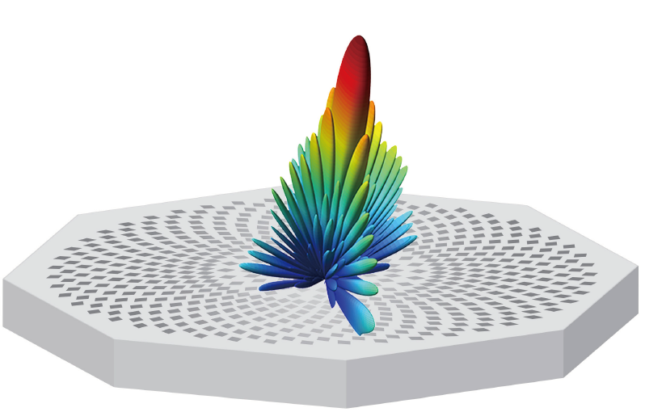
Outline
Background
  6G Communications and Requirements
  Holographic Radio Basics
  Comparison of RHS and RIS
Holographic Radar:
  Optimal Beamformer Design
  Detection Accuracy Maximization
  Implementation
Holographic Integrated Sensing and Communication
  RHS implements amplitude-controlled analog beamforming
  jointly optimizing the digital and analog beamformers
  Hardware implementation and Experiment
Our Lab
Conclusion

Slide 3
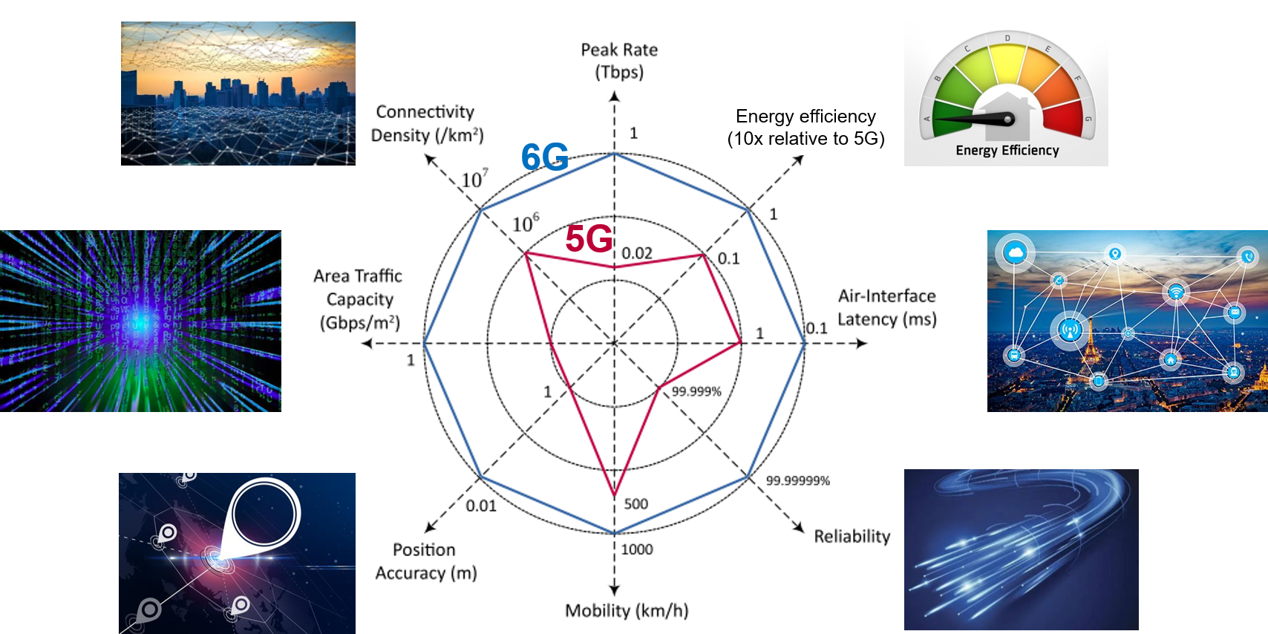
General 6G KPI Targets
Peak spectral efficiency 3x
Peak data rate 50x
[1] W. Jiang, B. Han, M. A. Habibi and H. D. Schotten, "The Road Towards 6G: A Comprehensive Survey," IEEE Open J. Commun. Society, vol. 2, pp. 334-366, Feb. 2021
Notes:
相比于5G，6G对通信的各项指标如通信速率，能量速率，通信可靠性，可支持用户数量等都提出了更高标准的要求，比如，6G要求通信速率达到Tbps量级，同时是要求能量效率，可支持用户数目都达到5G的10倍等等，这些要求对现有通信技术提出了极大的挑战

Slide 4
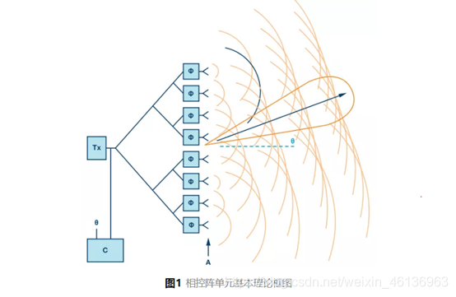
Current Technology
Massive multiple input multiple output (MIMO)
  Principle: Exploit spatial diversity through highly directional beamforming
  Development: MIMO → Massive MIMO →Ultra-massive MIMO
    Phase-controlled beamforming achieved by phased array
    Scaling up MIMO and size of phased array for significant
    capacity enhancement and massive connectivity
MIMO
From single-antenna system to multi-antenna system
Massive MIMO
Scaling up MIMO by orders of magnitude
Ultra-massive MIMO
To meet the explosively increasing mobile data demands in 6G era
Notes:
为了实现6G高速率，海量连接的通信要求，目前所广泛采用的技术是空分多址技术，也就是SDMA，它通过高方向性的波束成形技术来实现空间分集，为了实现发射机可以在空间中发射出多个定向波束，具体的实现方法是采用MIMO多天线技术，利用相控阵对电磁波的相位进行控制从而产生定向波束，为了进一步提升通信系统的系统容量，可进一步扩大MIMO天线阵列的规模形成大规模MIMO乃至超大规模MIMO

Slide 5

Dilemma in Conventional Massive MIMO
Ultra-massive MIMO with phased array is hard to realize in practice
  Costly hardware components and high power consumption limit the scale of the phased array
Novel antenna technologies are required to meet the 6G KPI target.
Cost
Costly components
High power consumption
Scale
Notes:
但是，利用传统的相控阵天线来实现超大规模MIMO在实际工程中是难以实现的，原因主要有两点，一是考虑工艺制造难度和天线性能，相控阵的单元间距一般为半波长，这样的间距便会限制在给定天线尺寸下相控阵的方向性增益，二是，相控阵依赖于昂贵的移相器和复杂的移相电路来实现波束成形，因此随着MIMO规模的不断增大，相控阵的硬件成本和功率损耗都会变得非常高，因此，需要新的天线技术来满足6G时代的通信要求

Slide 6

Solution: Reconfigurable Metamaterial-Based Antenna
  Low hardware cost
    Regulate electromagnetic waves via software instead of costly hardware components
  Low power consumption
    No active amplification internally and complex phase-shifting circuits
Reconfigurable metamaterial-based antenna is a promising solution to realize ultra-massive MIMO
¹ According to the effective medium theory.
Notes:
随着近年来超材料的不断发展，可重构超材料天线成为了一个很有前景的解决方案，首先，超材料天线的超材料单元排布更加紧密，单元间距通常小于四分之一波长，其次，超材料天线可以通过软件而不是昂贵的硬件器材来调控电磁波，因此它的硬件成本是很低的，最后，超材料天线内部没有功率放大器或者复杂的移相电路，功耗是很低， 因此可重构超材料天线可以有效克服相控阵的三大不足之处，是实现超大规模MIMO的有效手段

Slide 7
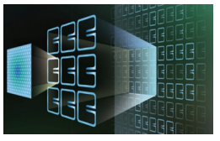
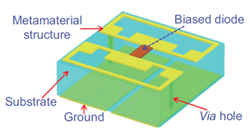
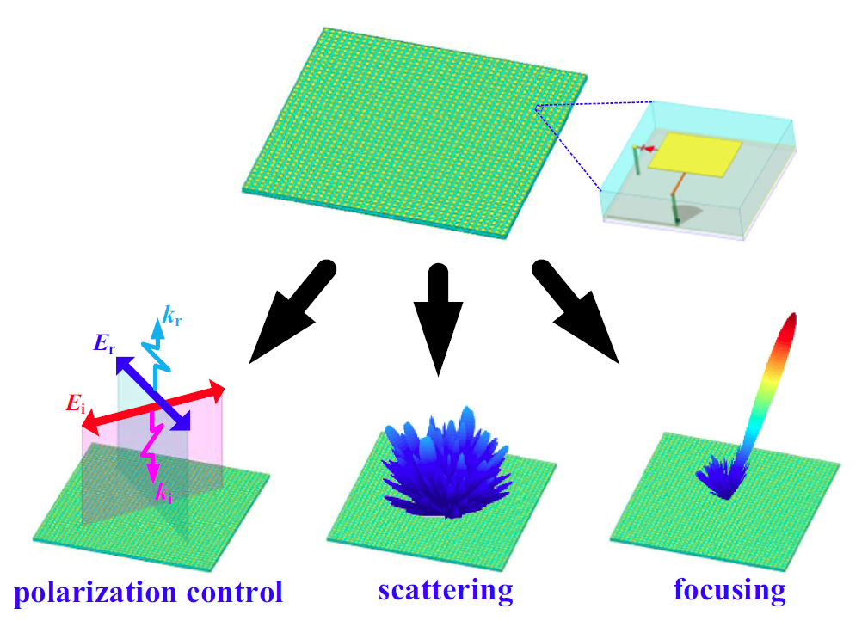
Reconfigurable Metamaterials
Metamaterials
  Artificial structures that are non-existent in nature with
  powerful electromagnetic (EM) wave control capability
  Element spacing can be far less than half-wavelength due to the unique structure
  Two technology fields studying metamaterials – Optics and Microwave
Reconfigurable metamaterial elements
  Reconfiguration principle: EM waves can be regulated by controlling the biased voltage applied to the diodes
  Characteristics: dynamic control for polarization, scattering, and pointing of beams
Example of a programmable metamaterial element
Notes:
但是，利用传统的相控阵天线来实现超大规模MIMO在实际工程中是难以实现的，原因主要有两点，一是考虑工艺制造难度和天线性能，相控阵的单元间距一般为半波长，这样的间距便会限制在给定天线尺寸下相控阵的方向性增益，二是，相控阵依赖于昂贵的移相器和复杂的移相电路来实现波束成形，因此随着MIMO规模的不断增大，相控阵的硬件成本和功率损耗都会变得非常高，因此，需要新的天线技术来满足6G时代的通信要求

Slide 8
Method 1: Reconfigurable Holographic Surface
Ultra-thin reconfigurable metamaterial-based antennas integrated with transceivers
  The feed inputs the reference wave to antennas, each feed is connected to an RF chain
The reference wave carries the transmit signal
  ② The reference wave propagates on the surface
③ When the reference wave arrives at each RHS element, it radiates part of energy into the space (i.e., EM response)
Reference wave on the surface
The phase/amplitude response at each RHS element can be controlled by the diode embedded in each element
④ The radiated signals from multiple RHS elements superpose in the free space and form a directional beam
which is known as objective wave
Notes:
在这里我们介绍超材料天线的一个代表，也就是可重构全息超表面，英文简称为RHS，RHS是一种特殊的漏波天线，简单来说，电磁波在RHS的波导中传播时，通过波导上的狭缝不断泄漏到自由空间中，与此同时，RHS的辐射模式是根据全息原理进行控制的，从而可以产生定向波束，RHS有两大独特的优势，一是由于它是漏波天线，因此是串联馈电的方式，也就是说馈源产生电磁波后，电磁波便在波导中传播到达各个单元，这种馈电方式相较于相控阵的需要利用功分器的并联馈电方式更为简单，第二是，RHS利用全息原理可以在一固定频点动态调控波束方向，因此克服了传统漏波天线在固定频点波束方向不可调控的缺点

Slide 9



Optical Holographic Principle
    Record the interference between the reference wave and the object wave: $Ψ_{intf}=$ $Ψ_{obj}Ψ_{ref}^{∗}$
    Reference wave illuminating the interference: $Ψ_{intf}{ Ψ}_{ref}∝$ $Ψ_{obj}{ |Ψ}_{ref}|2$→ Holographic Imaging
Object wave • real-valued constant
Imaging
object
3D Virtual Image
Illumination wave
Object wave
Reference wave
reappear
Reference wave
Photographic Plate
Photographic Plate
Imaging
Record
9
Notes:
下面我将具体为大家介绍RHS的工作原理，RHS的工作原理是光学全息原理在微波波段的延伸，我将首先为大家介绍基础的光学全息原理，光学全息主要分为两个步骤，光学全息记录和光学全息再现，
光学全息记录就是用一束照明波去照射这个待成像物体，物体产生的反射波和一束参考光波所形成的干涉图样会被记录在感光底片上，我们用。。。表示。。用。。。表示。。那么干涉图像可以表示为。。。
那么之后再用同样的一束参考光波去照亮这个感光底片，也就是用。。。去乘。。。，我们可以看到乘后产生的波束就是目标物体的反射波，那么也就会会出现待成像物体的一个虚像。

Slide 10



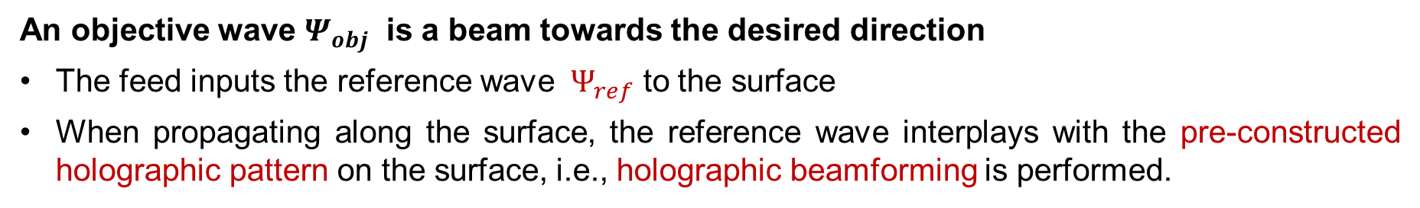


Microwave Holographic Principle
An objective wave $Ψ_{obj}$ is a beam towards the desired direction
The feed inputs the reference wave ${ Ψ}_{ref}$ to the surface
When propagating along the surface, the reference wave interplays with the pre-constructed holographic pattern on the surface, i.e., holographic beamforming is performed.
Holographic pattern $Ψ_{holo}=$ $Ψ_{obj}Ψ_{ref}^{∗}$
Desired object wave $Ψ_{obj}$
$Ψ_{holo}{ Ψ}_{ref}∝$ $Ψ_{obj}{ |Ψ}_{ref}|2$
Feed
Holographic beamforming
The objective wave is generated
Reference wave ${ Ψ}_{ref}$
Holographic pattern $Ψ_{holo}=$ $Ψ_{obj}Ψ_{ref}^{∗}$
After the holographic beamforming, the reference wave turns into the objective wave, projected towards the target direction
Notes:
在微波波段的全息原理和光学全息原理是一样的，RHS 会在超表面上创建全息图案来记录馈源产生的参考波和目标波束的干涉，当馈源发出的参考波激励全息图案时，RHS就能产生目标波束

Slide 11




Mathematical Details of the Working Principle
  1. Holographic pattern construction
$$Ψ_{ref}\left(r_{n_{y},n_{z}}^{k}\right)=exp\left(−jk_{s}⋅r_{n_{y},n_{z}}^{k}\right)$$
Reference wave
Propagation vector of the reference wave
The distance vector from feed $k$ to the element
Desired object wave $Ψ_{obj}$
$$Ψ_{obj}\left(r_{n_{y},n_{z}},θ_{0},φ_{0}\right)=exp\left(−jk_{f}⋅r_{n_{y},n_{z}}\right)$$
Feed
Objective wave
Reference wave ${ Ψ}_{ref}$
Propagation vector in free space
Position of the element
Holographic pattern $Ψ_{holo}=$ $Ψ_{obj}Ψ_{ref}^{∗}$
Holographic pattern
$$Ψ_{\text{holo} }\left(r_{n_{y},n_{z}}^{k},θ_{0},φ_{0}\right)=Ψ_{obj}Ψ_{ref}^{∗}$$
Notes:
在微波波段的全息原理和光学全息原理是一样的，RHS 会在超表面上创建全息图案来记录馈源产生的参考波和目标波束的干涉，当馈源发出的参考波激励全息图案时，RHS就能产生目标波束

Slide 12

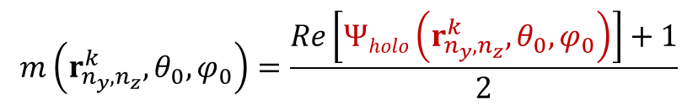
Mathematical Details of the Working Principle
  1. Holographic pattern construction
To construct the holographic pattern, we record its real-part information using the amplitude response m of the element, which can adjusted by the embedded diode:
$$m\left(r_{n_{y},n_{z}}^{k},θ_{0},φ_{0}\right)=\frac{Re\left[Ψholo\left(r_{n_{y},n_{z}}^{k},θ_{0},φ_{0}\right)\right]+1}{2}$$
$$Re[Ψholo(r_{n_{y},n_{z}}^{k} ,θ_{0}, φ_{0})]=\cos{(k_{s}∙r_{n_{y},n_{z}}^{k}−k_{f}{∙r}_{n_{y},n_{z}})}$$
  Key idea: when the phase shift of the reference wave at an element is different from that of the objective wave, the element is detuned and radiates little energy into free space (small amplitude). Otherwise, the element is tuned to radiate much energy (large amplitude).
Desired object wave $Ψ_{obj}$
Feed
Reference wave ${ Ψ}_{ref}$
Holographic pattern $Ψ_{holo}=$ $Ψ_{obj}Ψ_{ref}^{∗}$
Notes:
在微波波段的全息原理和光学全息原理是一样的，RHS 会在超表面上创建全息图案来记录馈源产生的参考波和目标波束的干涉，当馈源发出的参考波激励全息图案时，RHS就能产生目标波束

Slide 13
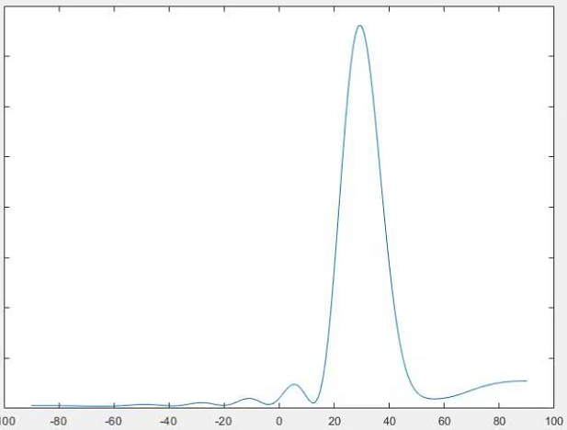

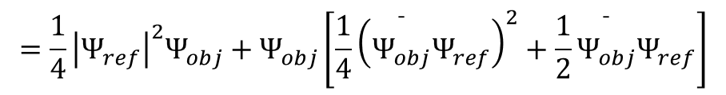
Mathematical Details of the Working Principle
  2. Holographic beamforming: generate the objective wave towards the target direction
The reference wave $Ψ_{ref}$ interferes with the holographic pattern ($r_{n_{y},n_{z}}^{k}$ is omitted for convenience)
$$\begin{aligned}m\left(θ_{0},φ_{0}\right)⋅Ψ_{ref}&=\frac{Re\left[Ψ_{holo}\left(θ_{0},φ_{0}\right)\right]+1}{2}⋅Ψ_{ref} \\ &=\frac{1}{4}Ψ_{obj}\left(θ_{0},φ_{0}\right){\left|Ψ_{ref}\right|}^{2}+\frac{1}{4}Ψ_{obj}^{∗}\left(θ_{0},φ_{0}\right)Ψ_{ref}^{2}+\frac{1}{2}Ψ_{ref} \\ & \\ \\ \\ a \\ =\frac{1}{4}\left(Ψ_{obj}\left(θ_{0},φ_{0}\right)\right)\left[{\left|Ψ_{ref}\right|}^{2}+C\right]\end{aligned}$$
Example: desired signal towards 30⁰
$$=\frac{1}{4}{\left|Ψ_{ref}\right|}^{2}Ψ_{obj}+Ψ_{obj}\left[\frac{1}{4}{\left(\overset{¯}{Ψ_{obj}}Ψ_{ref}\right)}^{2}+\frac{1}{2}\overset{¯}{Ψ_{obj}}Ψ_{ref}\right]$$
Neglectable sidelobe item
Desired object wave $Ψ_{obj}$
The desired signal is projected towards the target direction
Neglectable item
Feed
Reference wave ${ Ψ}_{ref}$
Holographic pattern $Ψ_{holo}=$ $Ψ_{obj}Ψ_{ref}^{∗}$
Notes:
在微波波段的全息原理和光学全息原理是一样的，RHS 会在超表面上创建全息图案来记录馈源产生的参考波和目标波束的干涉，当馈源发出的参考波激励全息图案时，RHS就能产生目标波束

Slide 14
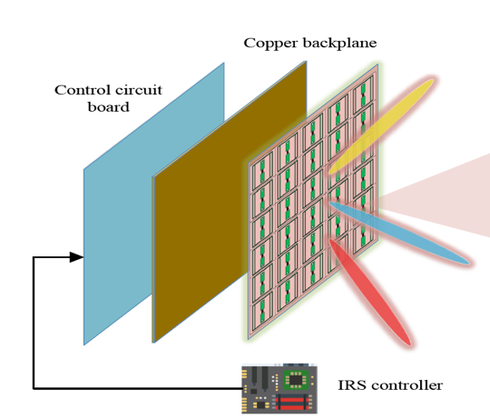
Method 2: Reconfigurable Intelligent Surface
  Reconfigurable intelligent surface (RIS)
Middle layer
—— An ultra-thin metasurface composed of multiple layers
Inner layer
Outer layer: A 2D-array of RIS elements which directly interacts with incident signals
Middle layer: A copper plate which prevents the signal energy leakage
Inner layer: A printed circuit which connects the RIS elements to the RIS controller
Outer layer
RIS controller
PIN diode
RIS element
Low-cost sub-wavelength programmable metamaterial particle
Reflect incident RF signals and impose a controllable phase shift
RIS element

Slide 15
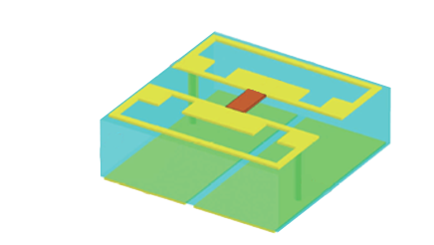

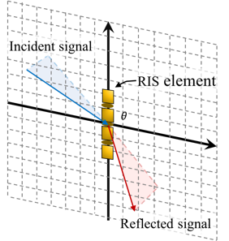

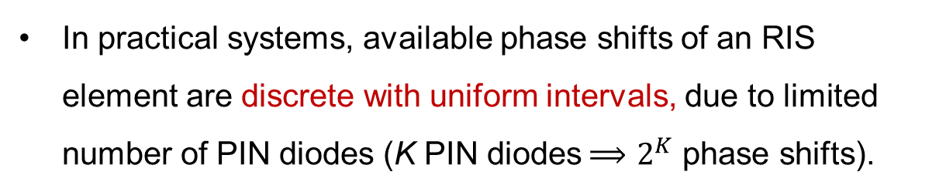





Working Principle of the RIS
  RIS works as a beamformer
Reflect: $e^{j2πft+θ}$
Incident: $e^{j2πft}$
Incident EM wave generates induced current
Signals can be reflected or transmitted (emitted from the induced current)
Phase shift of the radiation is controlled by PIN diodes’ bias voltages (ON/OFF of the diode)
Programming the ON/OFF of all diodes
collectively realize different beamforming modes
Refract: $e^{j2πft+θ}$
RIS element
Mechanism
Incident EM wave
$$x$$
Phase shifts
$$Γ,θ$$
In practical systems, available phase shifts of an RIS element are discrete with uniform intervals, due to limited number of PIN diodes (K PIN diodes$⟹$ $2^{K}$ phase shifts).
$$y$$
Emitted EM radiation
from induced
current

Slide 16
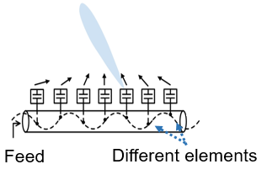
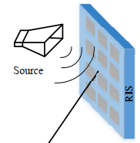
Differences Between RHS and RIS
Technology | Physical Structure | Operating Mechanism | Typical Applications
RHS | RF front end is integrated into a PCB No extra control link | Leaky-wave antenna Series feeding | Transmit/Receive antennas Mounted on mobile platforms Sensing, microwave imaging
RIS | RF front end is on the outside of the meta-surface Extra control link | Reflection antenna Parallel feeding | Passive relays Deployed in the cell edge for cell-edge users’ performance improvement
Simultaneous reflection

Slide 17
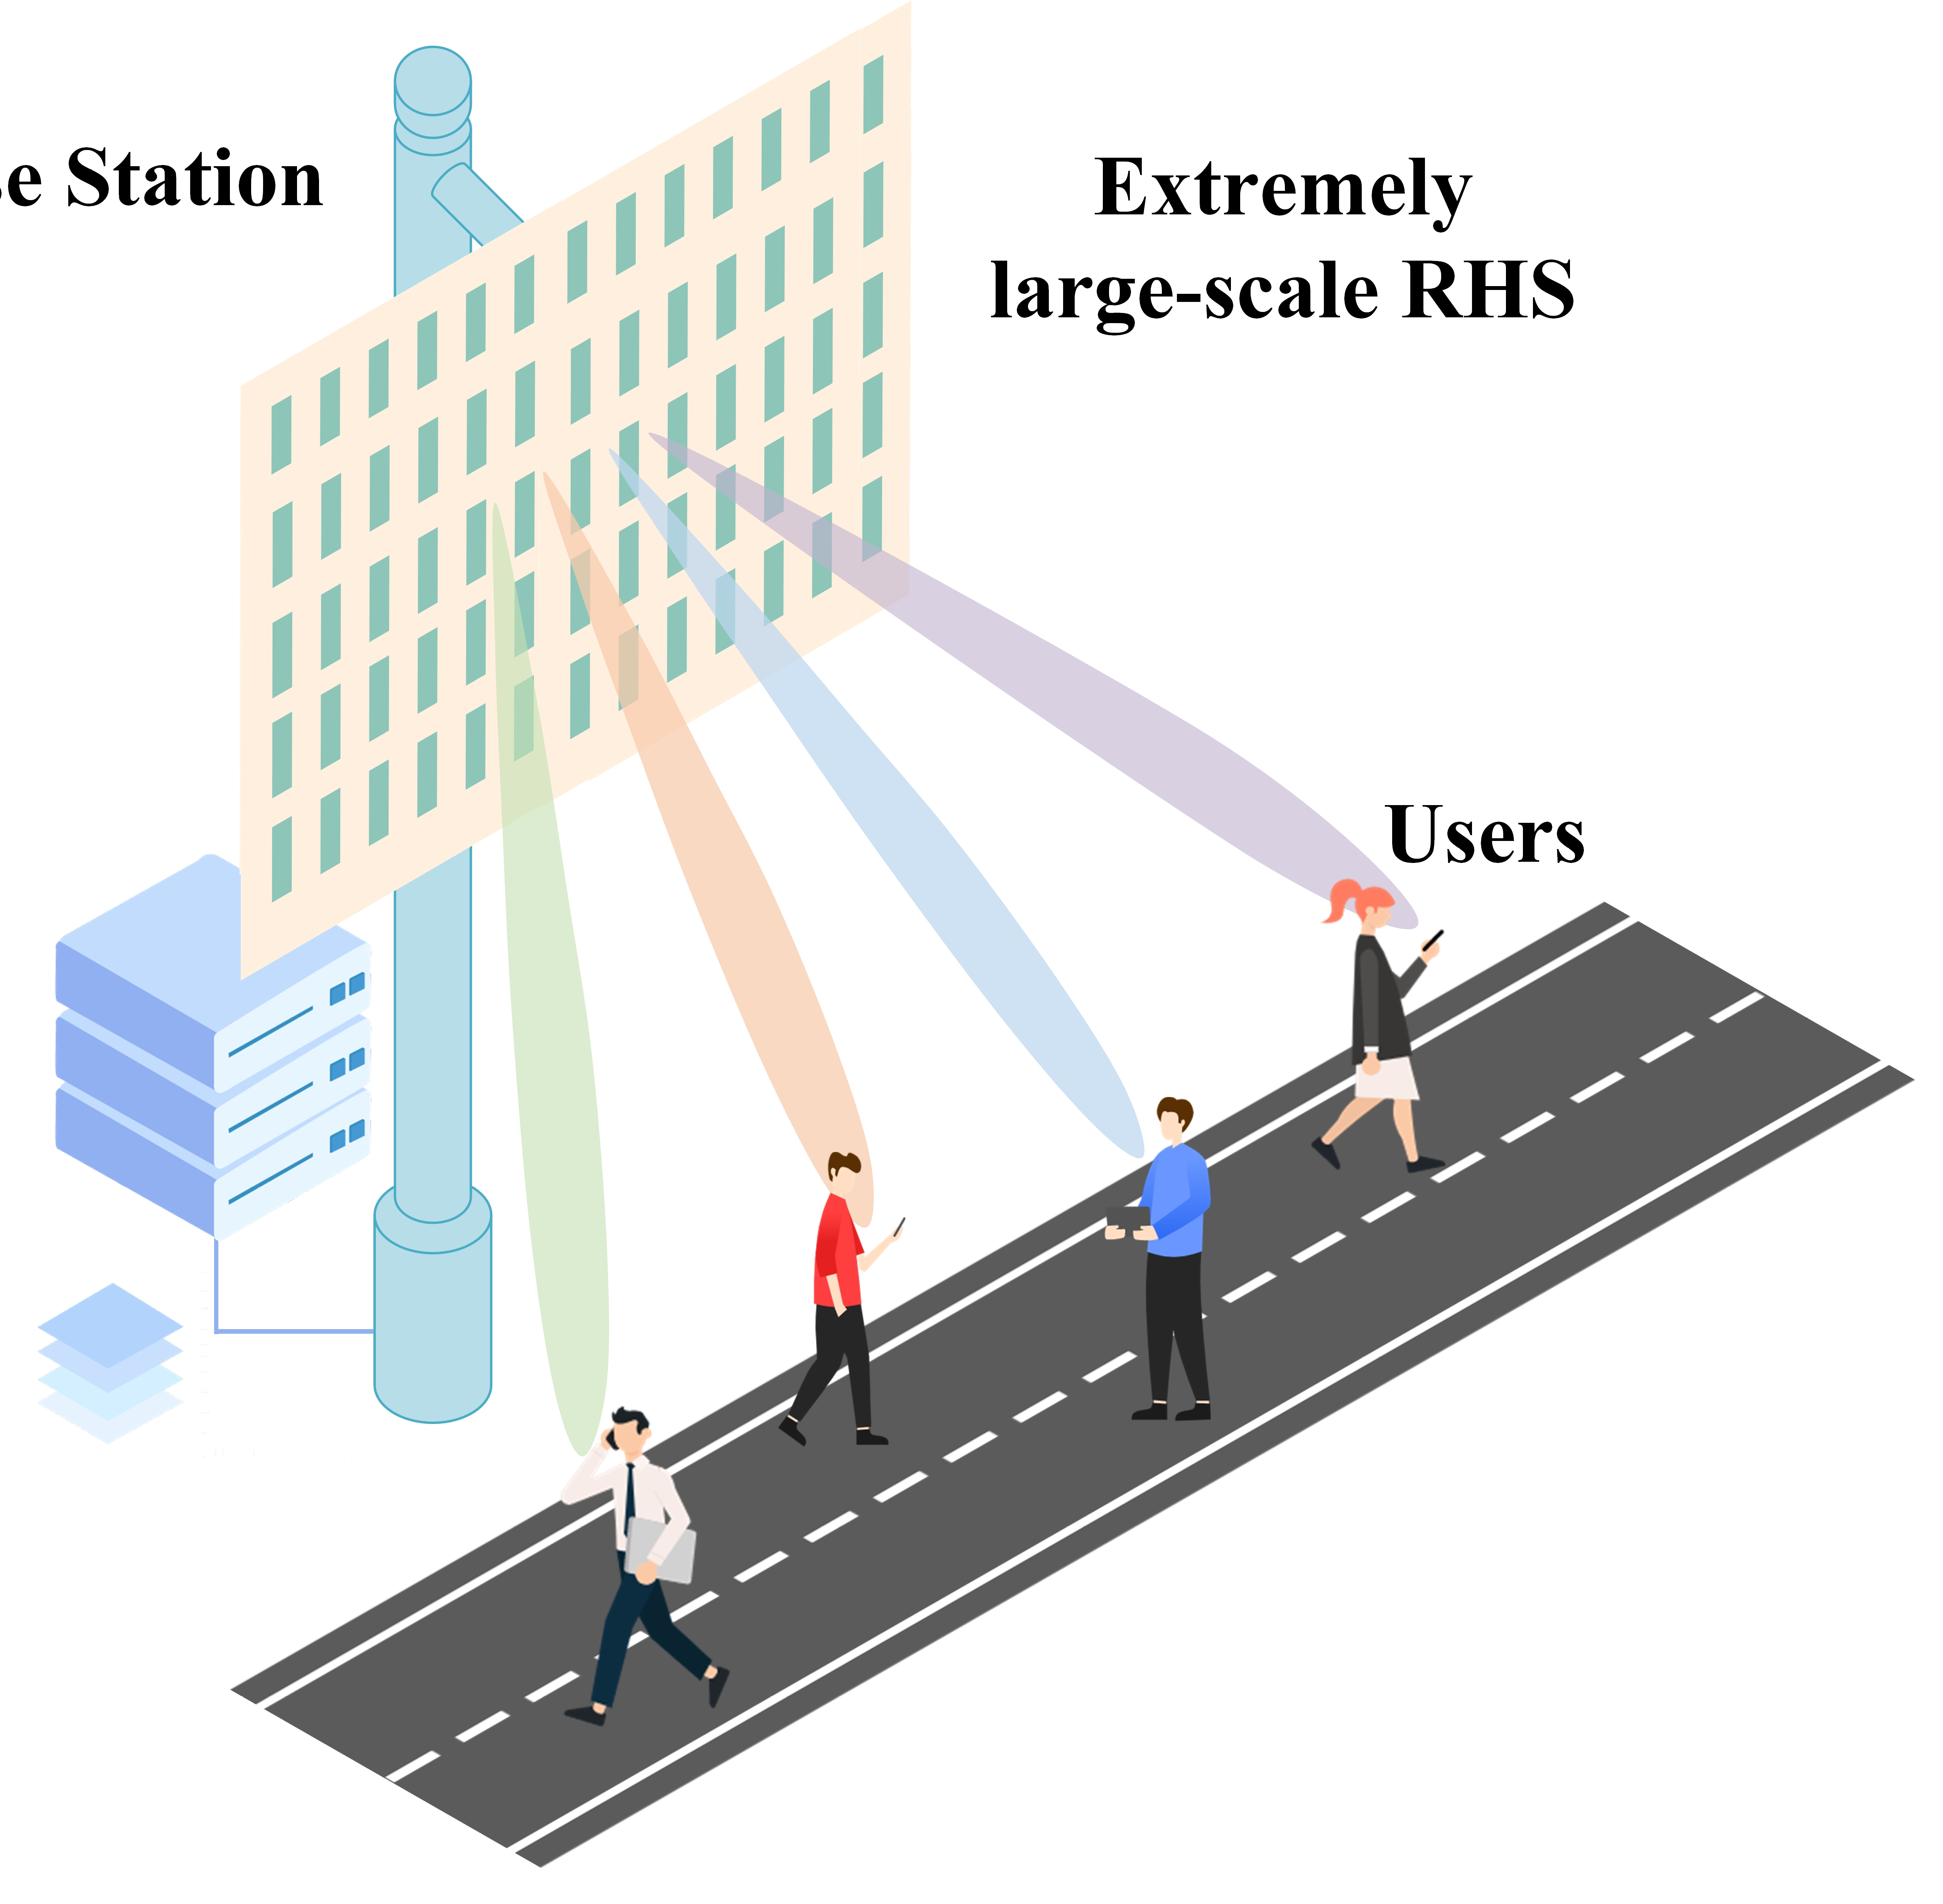

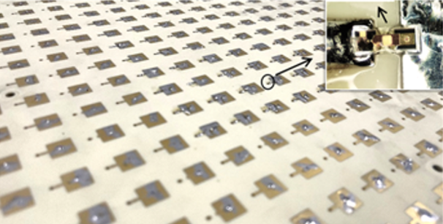

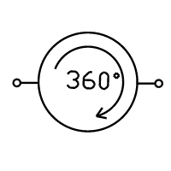

Applications: Wireless Communications
Spectrum efficiency enhancement
Large-scale deployment of RHS provides higher spatial diversity gain
Energy efficiency improvement
RHS has no active amplification internally and complex phase-shifting circuits
  Spectrum efficiency
BS
RHS
  Energy efficiency

Slide 18
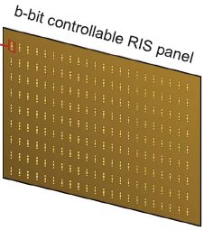

Applications: Sensing
RHS radar
Enhance the detection accuracy by leveraging the superior beam-steering capability of the RHS
Reduce the complexity and cost of the radar system
RHS-aided integrated sensing and communication
Increase the integration density of the ISAC system due to the low profile of the RHS
RHS
TX RHS
Transmitter
Target
Receiver
RX RHS
Beam-steering capabilities

Slide 19
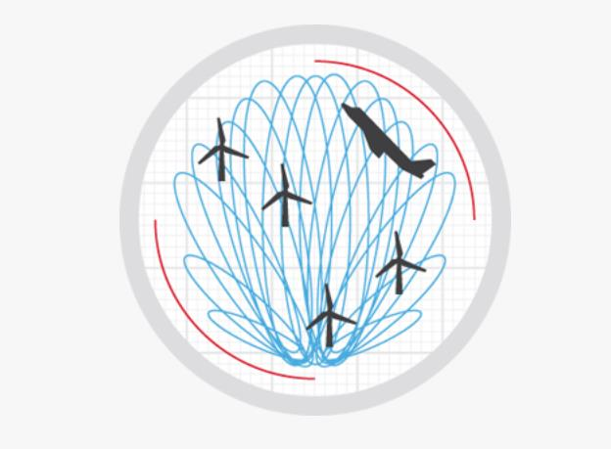
Outline
Background
  6G Communications and Requirements
  Holographic Radio Basics
  Comparison of RHS and RIS
Holographic Radar:
  Optimal Beamformer Design
  Detection Accuracy Maximization
  Implementation
Holographic Integrated Sensing and Communication
  RHS implements amplitude-controlled analog beamforming
  jointly optimizing the digital and analog beamformers
  Hardware implementation and Experiment
Conclusion
Our Lab
Haobo Zhang, Hongliang Zhang, Boya Di, Zhu Han, and Lingyang Song, Holographic Radar: Optimal Beamformer Design for Detection Accuracy Maximization,” IEEE Radar Conference 2023.

Slide 20
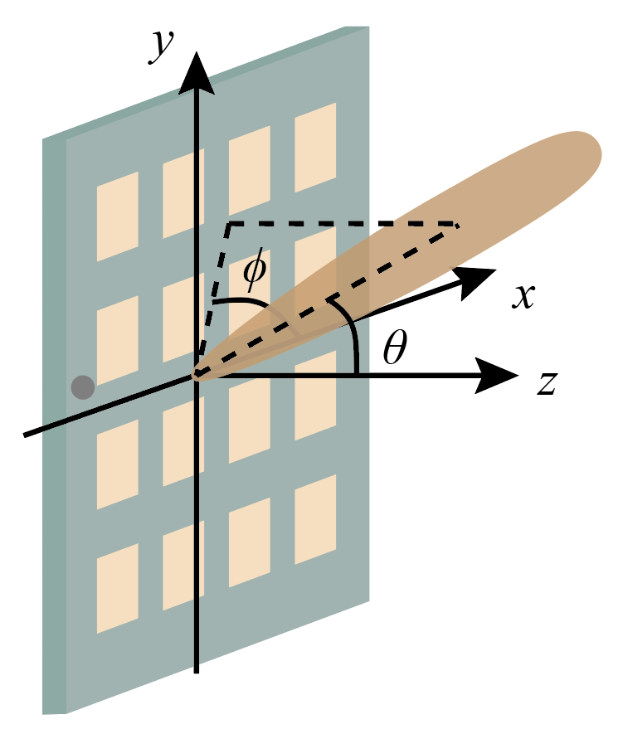
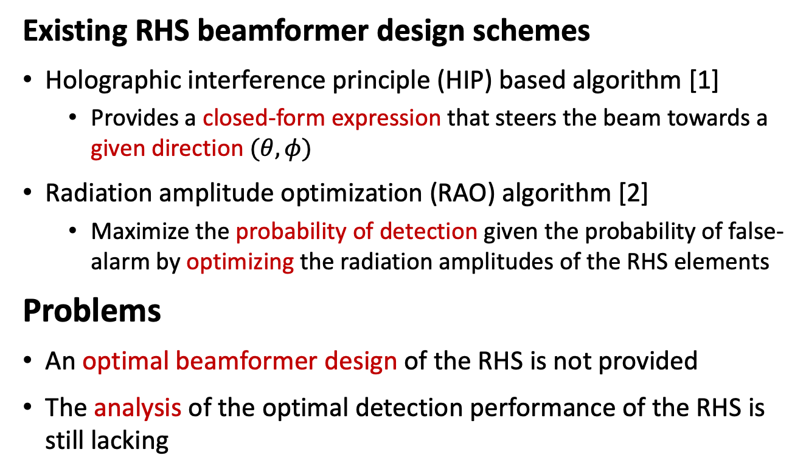
Introduction
Existing RHS beamformer design schemes
Holographic interference principle (HIP) based algorithm [1]
  Provides a closed-form expression that steers the beam towards a given direction $(θ,φ)$
Radiation amplitude optimization (RAO) algorithm [2]
  Maximize the probability of detection given the probability of false-alarm by optimizing the radiation amplitudes of the RHS elements
Problems
An optimal beamformer design of the RHS is not provided
The analysis of the optimal detection performance of the RHS is still lacking
Probability
Probability of detection
$$0$$
Signal
Threshold
Probability of false alarm
Notes:
In the literature, several beamformer design schemes for RHS have been investigated for radar sensing. In reference 1, the authors introduced a closed-form expression for RHS beamformer design according to the holographic interference principle. In reference 2, a co-located radar enabled by RHSs was
considered, and a radiation amplitude optimization algorithm is designed to maximize the probability of detection given the probability of false-alarm by optimizing the radiation amplitudes of the RHS elements. However, the above works have not provided an optimal beamformer design of the RHS, and the analysis of the corresponding optimal detection performance is still lacking.

Slide 21
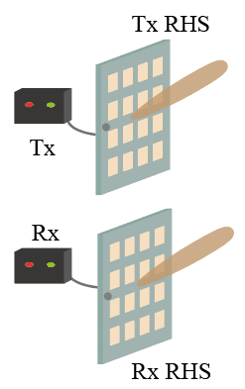
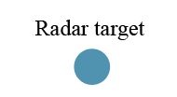
Introduction
Holographic radar enabled by RHSs
2 RHSs as antennas
A far-field target to be detected
Contribution
We formulate the target detection problem to maximize the probability of detection.
We propose a global optimal beamformer with a closed-form expression to solve the formulated problem.
We prove the optimality of the proposed expression and provide an approximate expression of the maximum probability of detection with high accuracy.
Simulation results verify the benefits of the proposed scheme in promoting detection accuracy compared with existing schemes.
Notes:
In this paper, we propose the holographic radar enable by the RHSs, where two RHSs serve as transmit and receive antennas for the detection of a far-field target. A target detection problem is formulated, where the beamformers of the RHSs are optimized to maximize the SNR. To solve the formulated problem, a global optimal beamformer with a closed-form expression is derived. To the best of our knowledge, this is the first study on the optimal beamformer for the RHS-enabled radar systems. The optimality of the proposed expression is theoretically proved, and an approximate expression of the maximum SNR with high accuracy is provided based on the proposed optimal beamformer. Simulation results verify the benefits of the proposed scheme in promoting detection accuracy compared with existing schemes.

Slide 22
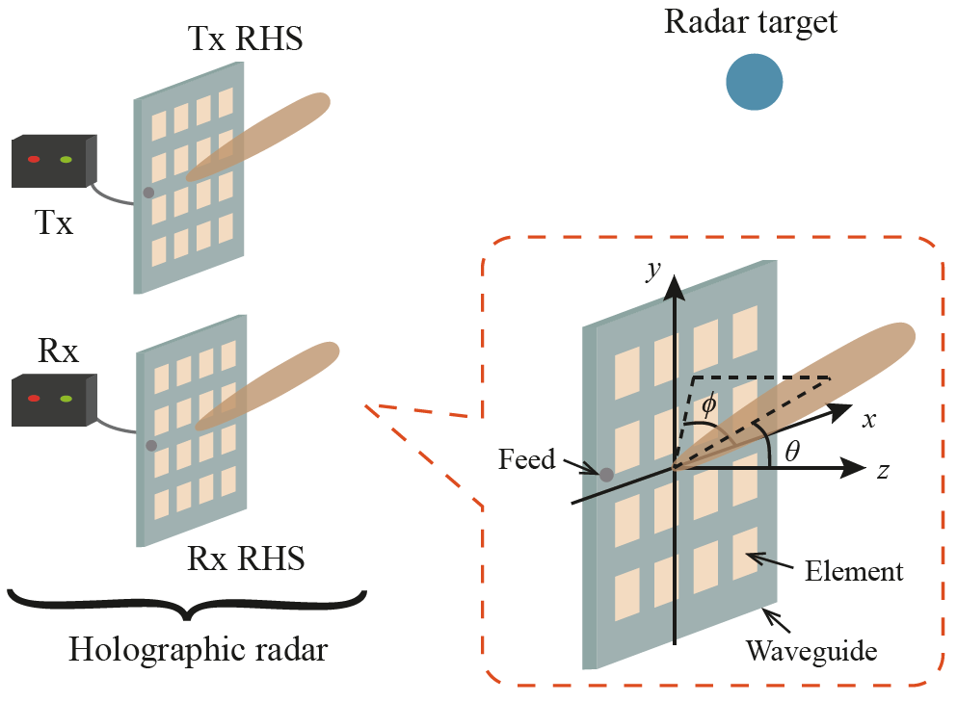

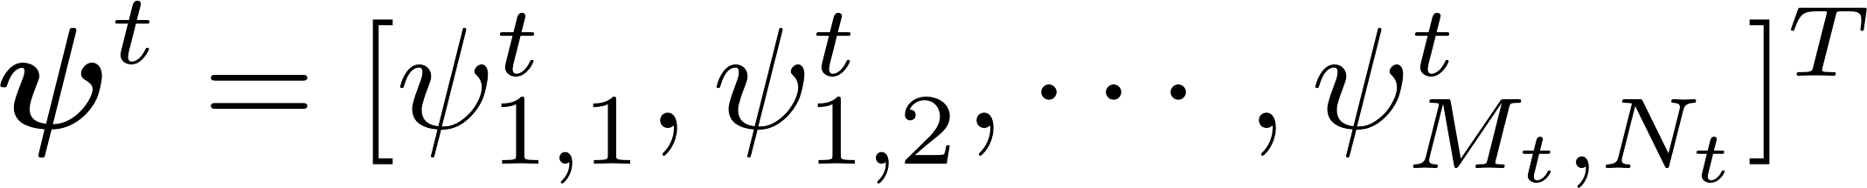
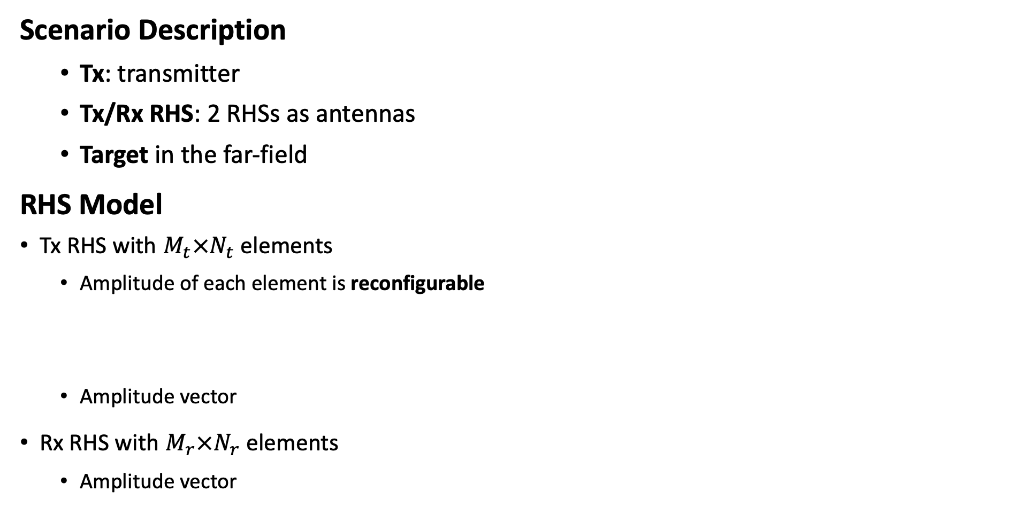
System Model
Scenario Description
  Tx: transmitter
  Tx/Rx RHS: 2 RHSs as antennas
  Target in the far-field
RHS Model
Tx RHS with $M_{t}×N_{t}$ elements
  Amplitude of each element is reconfigurable
  Amplitude vector
Rx RHS with $M_{r}×N_{r}$ elements
  Amplitude vector
  Rx: receiver
Signal at the feed
Radiated signal
Amplitude
Phase shift
Notes:
Next, we will talk about the system model. We consider a co-located holographic radar system composed of a transmitter Tx a receiver Rx, and two RHSs as antennas named as Tx RHS and Rx RHS. And there is a target in the far-field direction theta, phi. We consider a Tx RHS with M t times N t elements, where the amplitude of each element is reconfigurable. The transmitted signal at the nth elements can be modeled as the product of three terms, which are the radiation amplitude psi, the phase shift q of the signal propagating from the feed to the element, and the radar signal at the feed x. We define the amplitude vector of the Tx RHS as psi superscript t, and that of the Rx RHS as psi superscript r.

Slide 23
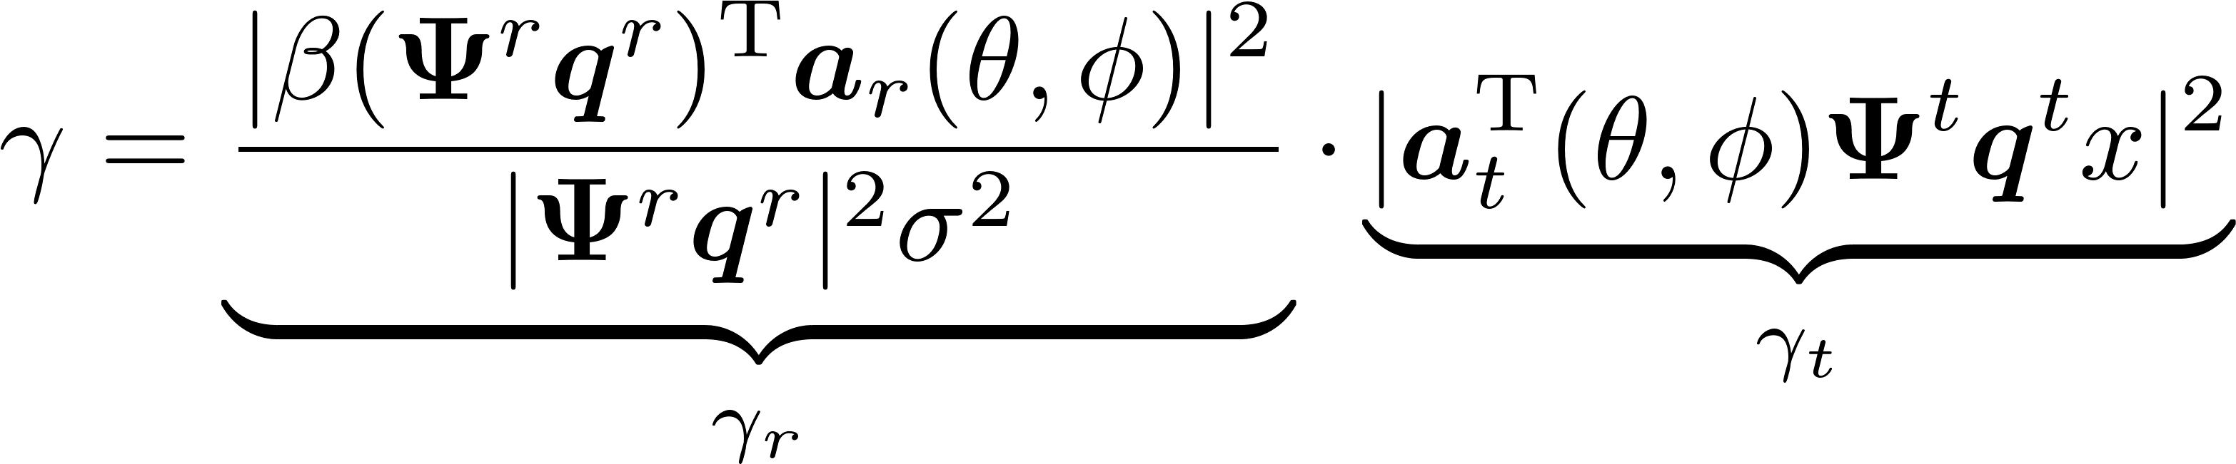
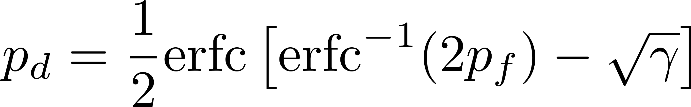





System Model
A target exists in direction $(θ, φ)$
Received signal
Signal-to-noise ratio (SNR) of the received signal
Probability of detection (given the probability of false alarm) [2]
  Positively related to $γ$
Target reflection coefficient
Received signal
steering vectors
Noise
diag($ψ^{r}$)
diag($ψ^{t}$)
SNR related to $ψ^{t}$
SNR related to $ψ^{r}$
Complementary error function
Probability of false alarm
Notes:
The received signal can be expressed as the sum of the received echo signal reflected by the target and the noise. Based on this, the SNR of the received signal can be derived, which can be expressed as the product of two terms. The first term is the SNR related to the amplitude vector of the Tx RHS, and the second term is the SNR related to the Rx RHS. According to reference 2, we provide the expression of the probability of detection given the probability of false alarm. We can observe that the probability of detection is positively related to the SNR, which means we can improve the detection accuracy by increasing the SNR.

Slide 24
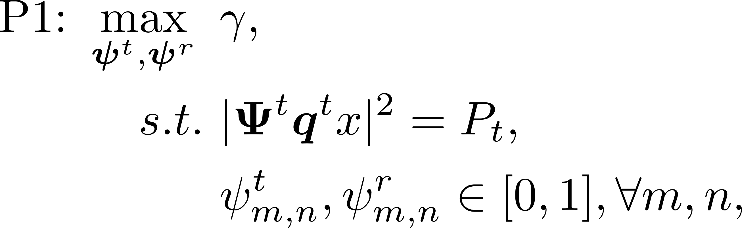
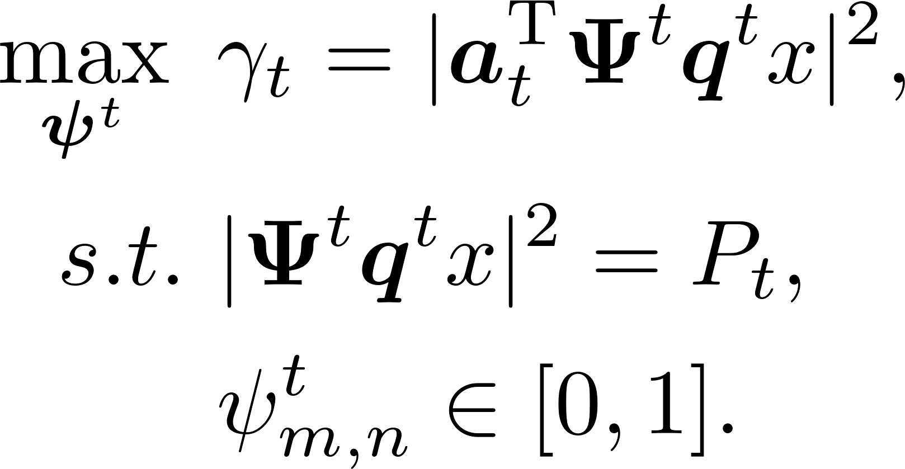
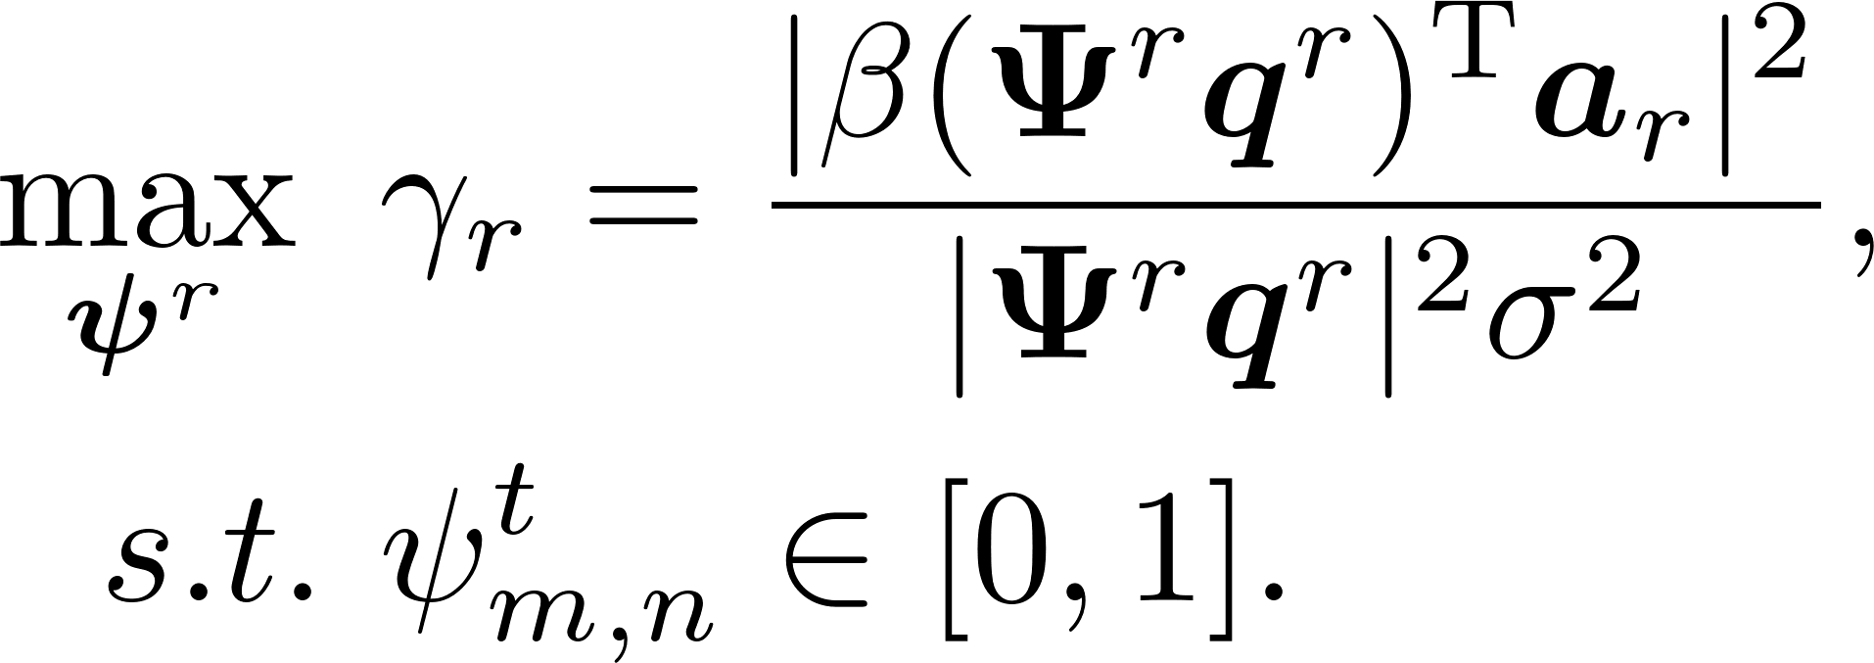
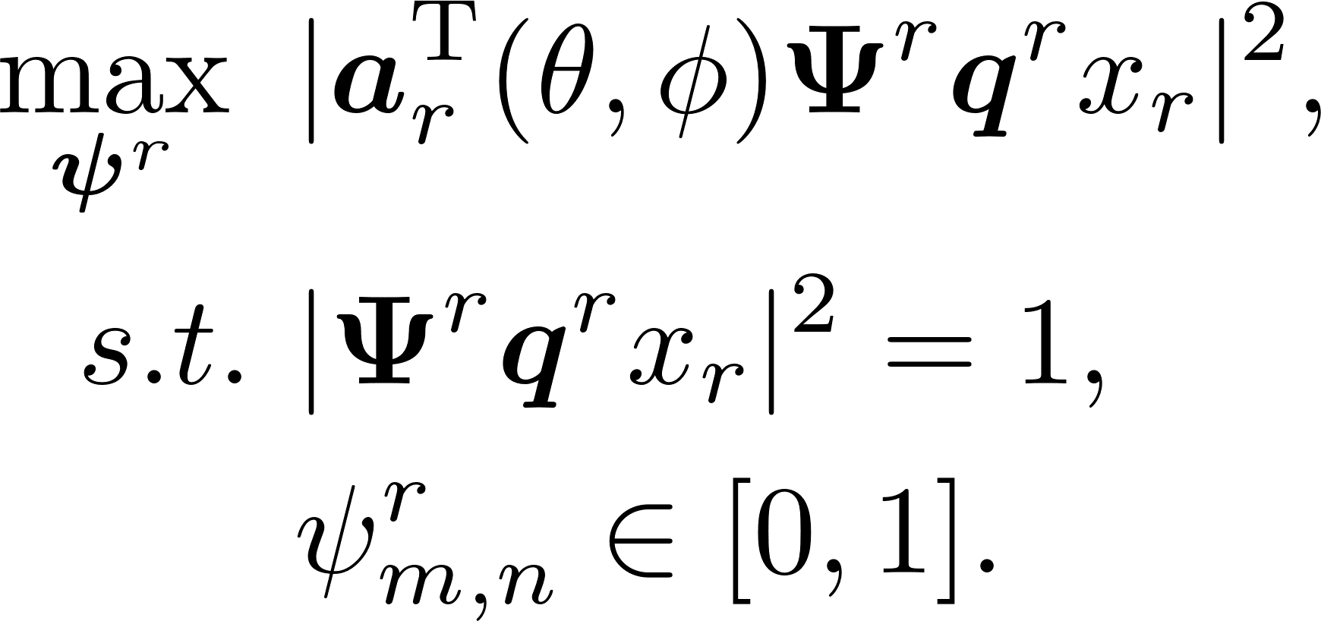
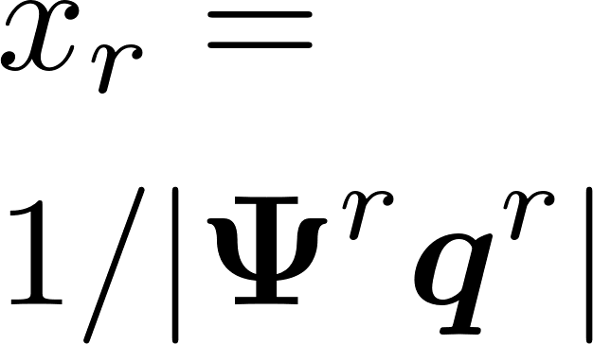

Problem Formulation
Optimization problem:
Maximize the probability of detection (SNR) given the constraints of power and radiation amplitudes
Decomposition of the problem:
Variables $ψ^{t}$ and $ψ^{r}$ can be optimized separately since they are decoupled in both the objective function ($γ=γ_{t}γ_{r}$) and constraints
Maximum radiation power of the RHS
Transmit subproblem
Receive subproblem
Similar
form
Notes:
Now we formulate the optimization problem. The objective is to maximize the SNR given the constraints of power and radiation amplitudes.
The formulated problem can be solved by separately optimizing the beamformers of the Tx and Rx RHS. This is because they are
decoupled in both the objective function and the constraints.
Consequently, we solve the optimization problem by solving the transmit and receive sub-problem which are independent of each other. Note that the objective function of the receive subproblem is fractional and difficult to solve, we introduce a variable x subscript r to replace the denominator in gamma subscript r, and the receive sub-problem can be reformulated as the form in the right, which is similar to the form of the transmit subproblem.

Slide 25
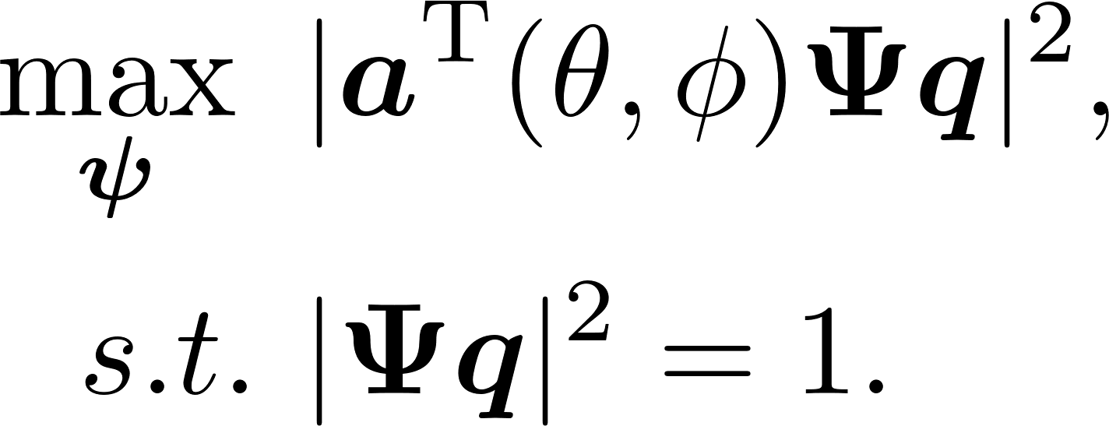
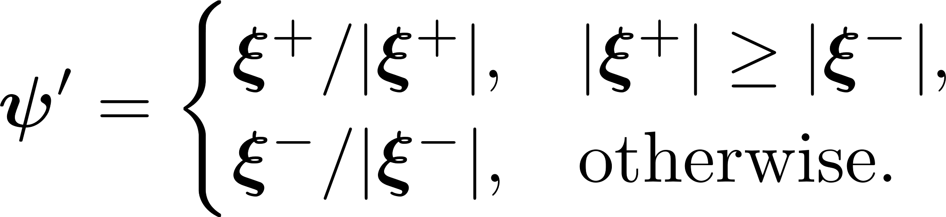
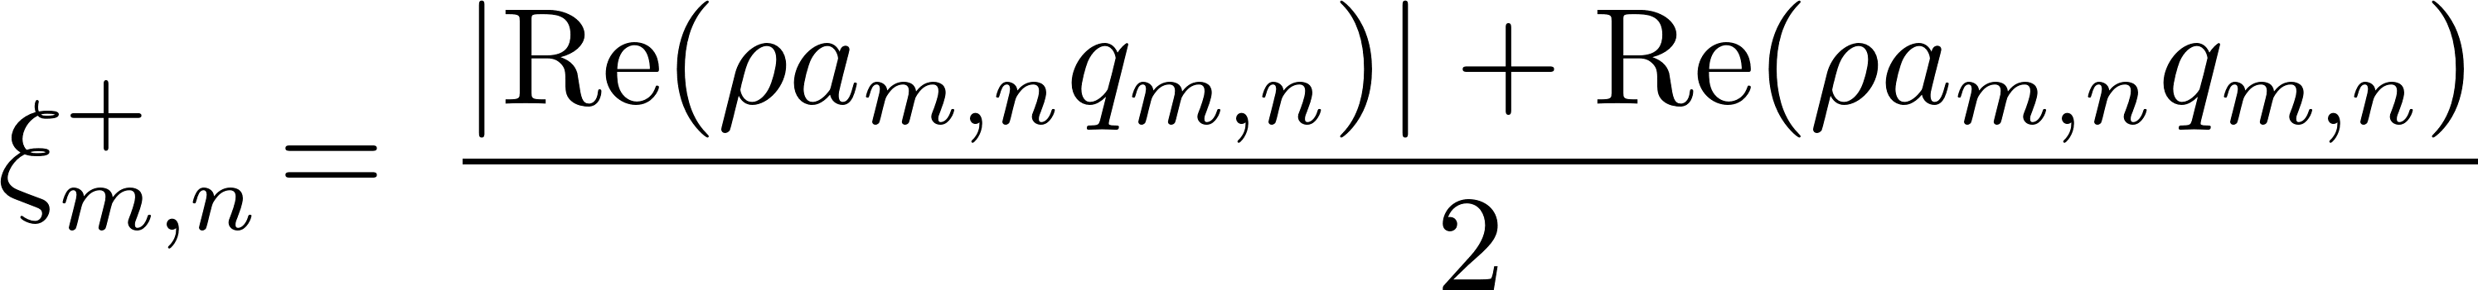

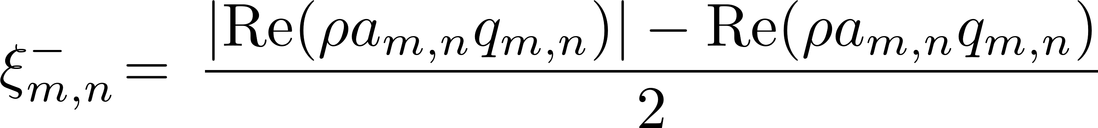

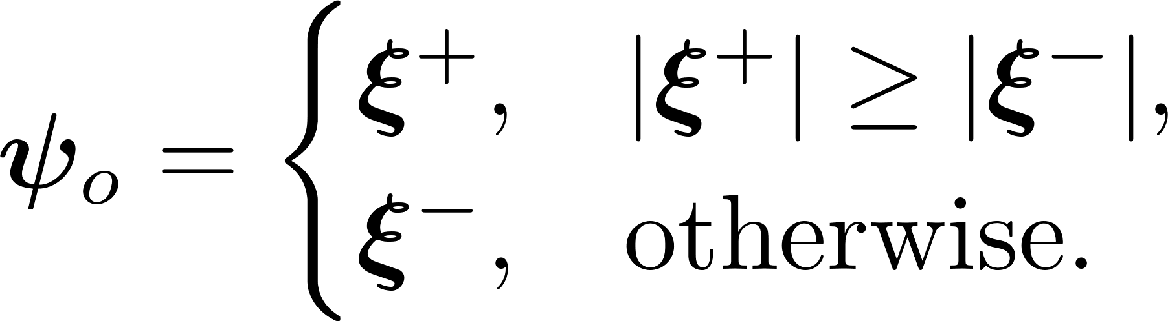
Optimal Beamformer Design
Optimization of the sub-problem
Transmit and receive subproblems can be optimized using the same procedure
  Relaxation: constraint of radiation amplitudes
  Normalization:
Optimal solution
With closed-form expression
Optimal solution of the subproblem
Notes:
Since the transmit and receive subproblems have the similar form, they can be optimized using the same procedure. The first step of the optimization procedure is relaxation. We first relax the constraint of radiation amplitude, and derive the optimal solution of the relaxation problem. The solution is then normalized to obtain the optimal solution of the original problem. The optimality of the solution is also theoretically proved.

Slide 26
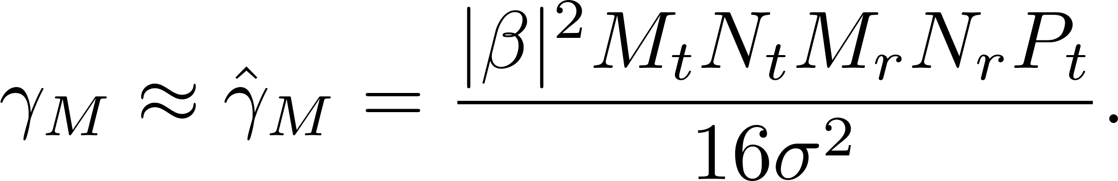
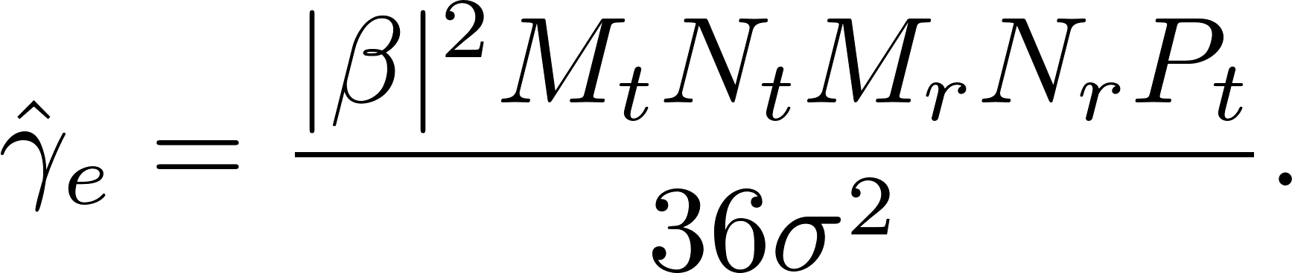





Analysis of the Optimal Beamformer
Radiation Pattern Gain:
Maximum SNR obtained by the proposed beamformer
Maximum SNR obtained by the holographic interference principle [1]
$$M_{t}$$
Proposition 1: The amplitude of the main lobe of an RHS with the proposed optimal beamformer can be approximated by $MN\left|x\right|/4$。
Tx RHS
$$N_{t}$$
Approximated SNR
3.52dB gain
$$N_{r}$$
Rx RHS
$$M_{r}$$
Notes:
Here, we analyze the radiation pattern gain obtained by the proposed optimal beamformer. In proposition 1, we prove that the amplitude of the main lobe of an RHS with the proposed optimal beamformer can be approximated by MNx divided by 4. As a result, we can give the maximum SNR obtained by the proposed beamformer. Compared with the maximum SNR obtained by the holographic interference principle, the maximum SNR obtained by the proposed beamformer has a gain of 3.52dB.

Slide 27
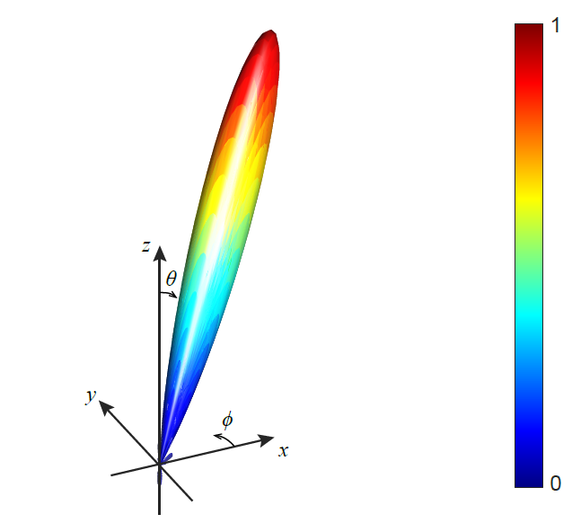
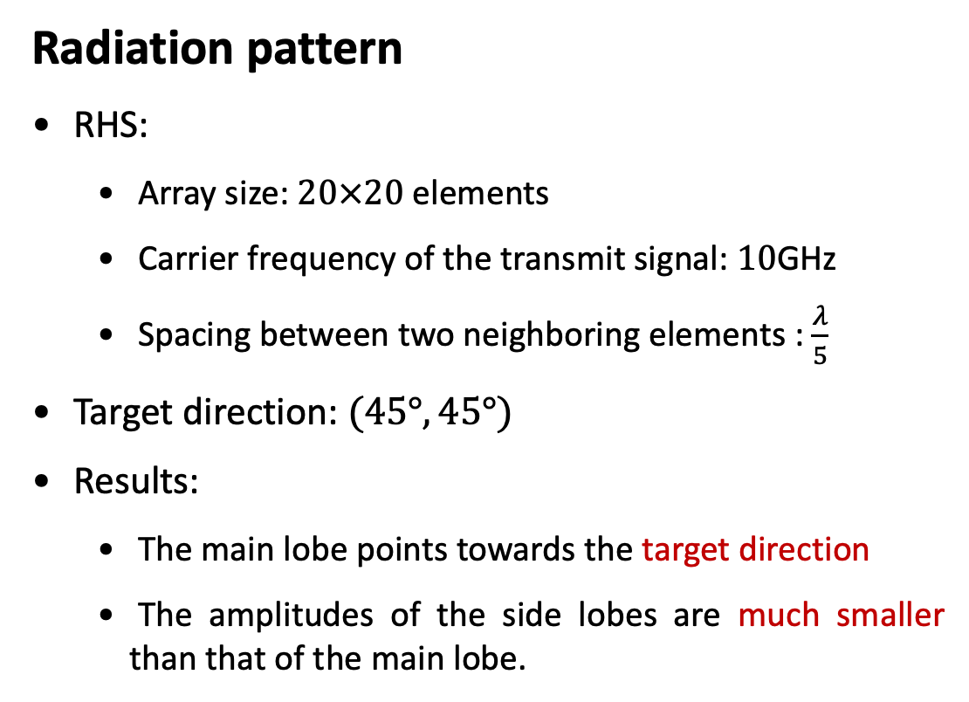
Simulation Results
Radiation pattern
RHS:
  Array size: $20×20$ elements
  Carrier frequency of the transmit signal: $10$GHz
  Spacing between two neighboring elements : $\frac{λ}{5}$
Target direction: $(45°, 45°)$
Results:
  The main lobe points towards the target direction
  The amplitudes of the side lobes are much smaller than that of the main lobe.
Notes:
Simulation results are presented to evaluate the performance of the proposed optimal beamformer. We use an RHS with 20 times 20 elements. The carrier frequency of the transmit signal is 10 gigahertz, the spacing between two neighboring elements is one fifth the wavelength. The target direction is 45 degree and 45 degree. We can observe that the direction of the main lobe is also the target direction. Besides, we can find that the amplitudes of
the side lobes are much smaller than that of the main lobe, verifying the effectiveness of the proposed scheme.

Slide 28
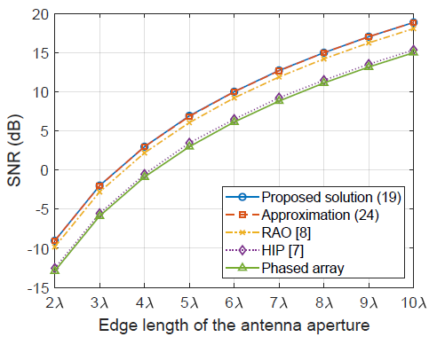
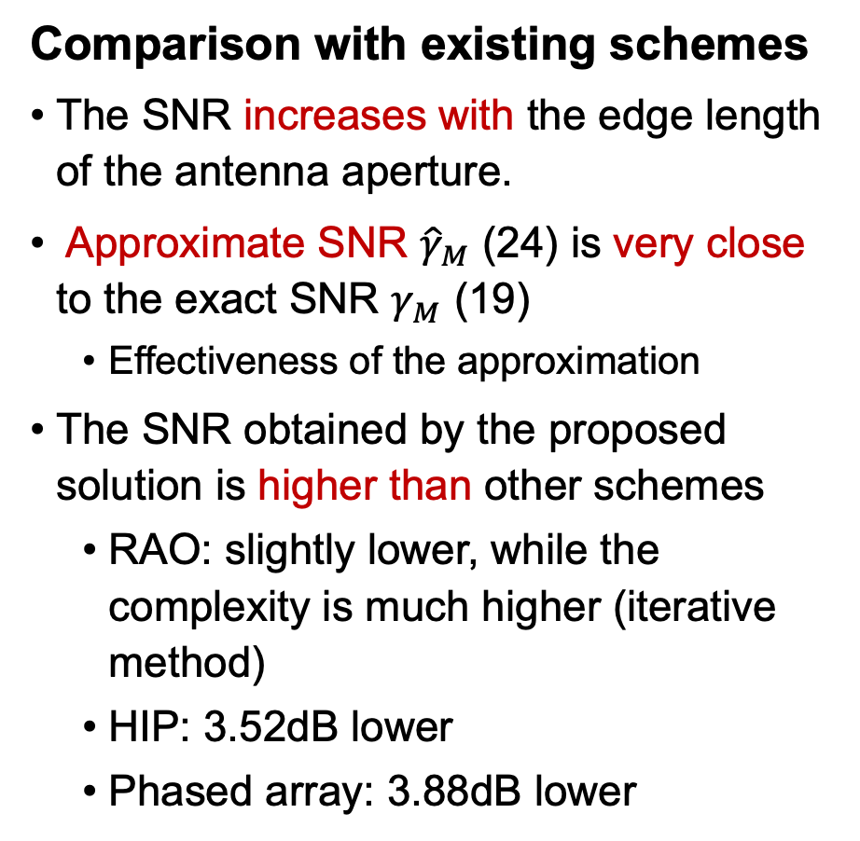
Simulation Results
Comparison with existing schemes
The SNR increases with the edge length of the antenna aperture.
Approximate SNR ${\hat{γ}}_{M}$ (24) is very close to the exact SNR $γ_{M}$ (19)
  Effectiveness of the approximation
The SNR obtained by the proposed solution is higher than other schemes
  RAO: slightly lower, while the complexity is much higher (iterative method)
  HIP: 3.52dB lower
  Phased array: 3.88dB lower
Notes:
In this figure, we compare the performance of the proposed beamformer with other schemes, such as RAO, H I P, and phased array-based schemes. Note that the first two methods are proposed for RHS-empower radars. We can observe that the SNR increases with the edge length of the antenna aperture. Besides, the SNR gamma subscript M derived from the proposed solution in equation 19 is very close to the approximate SNR in equation 24, which verifies the validity of the approximation.
Moreover, the SNRs obtained by the proposed scheme are higher than those obtained by the H I P-based scheme and the phased array-based scheme. In addition, although the SNR obtained by the RAO scheme is only slightly lower than the SNR obtained by the proposed method, the complexity of the iterative method in the RAO scheme is much higher than that of the proposed closed-form expression-based scheme, which shows the superiority of proposed scheme in reducing the computational complexity.

Slide 29
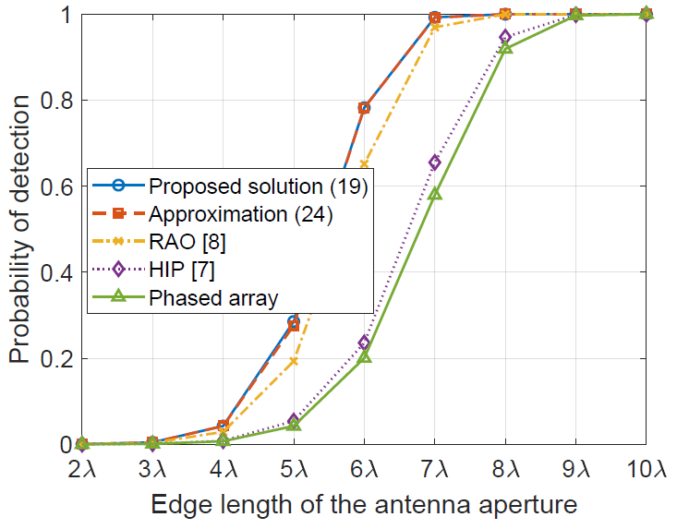

Simulation Results
Comparison with existing schemes
Probability of false alarm: ${10}^{−4}$
The probability of detection increases with the edge length of the aperture
The probability of detection obtained by the proposed solution is the highest.
  Consistent with the SNR results
The probabilities of detection become saturated when the edge length is sufficiently large
  SNR of the echo signal is adequately high for the correct determination of the existence of the target.
Notes:
In this figure, we give the simulation results about the probability of detection. We can observe that the probability of detection increases with the edge length of the antenna aperture and that the probability of the detection obtained by the proposed method is higher than those obtained by other methods since the SNR obtained by the proposed method is the highest. Besides, we can also observe that the probabilities of detection become saturated when the edge length of the antenna aperture is sufficiently large. This is because the SNR of the received signal is adequately high for the correct determination of the existence of the target.

Slide 30



Implementation
RHS
  An one-dimension array with a size of $15×3×0.17cm^{3}$
  Working frequency: $11$GHz
  Components:
    Two SMA (Subminiature (version A) connectors: one serves as the feed and the other joins the RHS and a load
    A multi-layer substrate: two F4B layers and two copper layers
    16 Metamaterial elements: two PIN diodes laid on each element for radiation amplitude adjustment.

Slide 31



Prototype of the RHS
RHS beam pattern measurement
  Control circuit (FPGA) for PIN diodes state control
  Vector network analyzer (VNA) for measurement
  Standard horn antenna
Experimental results of one-dimensional RHS
  Good agreement between the experiment and the full-wave analysis
  Transmit and receive beam patterns are almost the same → Transceiver reciprocity
Theoretical angle: 0°
Theoretical angle: 30°
31
Notes:
\

Slide 32




Prototype of the RHS
Experimental results of two-dimensional RHS
  We show the beam pattern obtained by the three-dimensional holographic beamforming
E-plane pattern
H-plane pattern
32

Slide 33

Outline
Background
  6G Communications and Requirements
  Holographic Radio Basics
  Comparison of RHS and RIS
Holographic Radar:
  Optimal Beamformer Design
  Detection Accuracy Maximization
  Implementation
Holographic Integrated Sensing and Communication
  RHS implements amplitude-controlled analog beamforming
  jointly optimizing the digital and analog beamformers
  Hardware implementation and Experiment
Conclusion
Our Lab
Integration Sensing
and Communication
H. Zhang, H. Zhang, B. Di, M. Di Renzo, Z. Han, H. V. Poor, and L. Song, “Holographic Integrated Sensing and Communication,” IEEE J. Sel. Areas Commun., vol. 40, no. 7, pp. 2114-2130, Jul. 2022.
H. Zhang, H. Zhang, B. Di, and L. Song, “Holographic Integrated Sensing and Communications: Principles, Technology, and Implementation,” IEEE Commun. Mag., Early Access, Feb. 2023.

Slide 34

Motivations and Contributions
Motivations
  Existing ISAC systems are based on MIMO arrays
    Limited size $→$ small antenna gain and insufficient ISAC
  RHS is a promising solution to achieve large size
    Large aperture $→$ superior beam-steering capabilities
Contributions
  We propose a holographic beamforming scheme for ISAC
    BS implements digital beamforming
    RHS implements amplitude-controlled analog beamforming
  We develop a holographic beamforming optimization algorithm to optimize the ISAC performance by jointly optimizing the digital and analog beamformers
  Simulation results show that the holographic beamforming can effectively enhance the maximum beamforming gain of the system
  Experimental results verify the practicality of the proposed holographic beamforming scheme

Slide 35


System Model
Scenario
  A base station equipped with an RHS and a MIMO antenna array
  RHS: 𝐾 feeds, 𝑀 radiation elements
  𝐿 mobile users
  Several targets to be sensed
Holographic beamforming scheme
  Digital beamforming at the BS
    $L$ data streams and $K$ radar waveforms are mixed
  Analog beamforming at the RHS

Slide 36

Problem Formulation
Performance metrics
  Radar utility: $δ=P_{d}−ρRMSC$
    Average beampattern gain: $P_{d}=\frac{1}{D}\sum_{d=1}^{D}{P(θ_{d},φ_{d})}$
      Larger beampattern gain, higher SINR of the received radar echo signals
    Root mean square cross-correlation:
      Lower RMSC, easier to separate the echo signals reflected by different targets
    Weighting factor: $ρ$
  SINR of the communication users: $γ_{l}, l=1, ⋯, L$
Holographic ISAC problem
  Maximize the radar utility $δ$ given SINR and power constraints by optimizing digital beamformer $B$ and analog beamformer $Ψ$
Number of angular grids in the region of interest
Beampattern gain in $(θ, φ)$
Cross-correlation between transmit signals in $(θ_{d}, φ_{d})$ and $(θ_{d′}, φ_{d′})$

Slide 37

Holographic Beamforming Optimization Algorithm
Overall iterative algorithm
  Two beamformers are optimized sequentially in each iteration
  Algorithm ends when the difference of the radar utilities between two consecutive iterations is less than a predefined threshold 𝜖
Optimization of beamformers
  Digital beamformer: semidefinite relaxation (SDR) technique
  Analog beamformer: SDR + alternating optimization (AO)
    Relax the discrete constraint (discrete amplitude of the RHS element), and solve the relaxed problem by using SDR technique
    Quantize the beamformer obtained by solving the relaxed problem and further optimize this beamformer by using AO technique
Start
Optimize the digital beamformer $B$
Optimize the analog beamformer $Ψ$
No
$$δ_{t}−δ_{t−1}>ε?$$
Yes
Amplitude of RHS element:
End

Slide 38







Performance Analysis
Beampattern gain
  RHS (lower bound): $P_{L}≈MP_{M}/6$
  Hybrid MIMO array (upper bound): $P_{A}=M_{A}P_{M}$
  Ratio of RHS to MIMO array (same transmit power)
$$ι≥{P_{L}}/{P_{A}}≈M/{6M_{A}}$$
    Hybrid MIMO array: 64 or 128 elements
    RHS: 1024 elements or larger (16 or 8 times)
Cost-effectiveness analysis
  Cost saving of using an RHS instead of using a MIMO array
$$η≥1−\frac{6ν_{R}δ+χ_{C}}{ν_{A}δ+χ_{C}}$$
    Typically $ν_{A}≈10ν_{R}$ because the structure of an RHS element is much simpler than that of a phase shifter.
$$M_{x}$$
Number of RHS elements
Number of MIMO antennas
Transmit power
$$M_{y}$$
RHS: $M=M_{x}×M_{y}$
$$M_{A, x}$$
Cost of an RHS element
$$M_{A,y}$$
Cost related to RF chains
Cost of a phase-shifting element
MIMO array:
$M_{A}=M_{A,x}×M_{A,y}$

Slide 39



Simulation Results
By setting a large value of $ρ$, the signals in different target directions can be uncorrelated to accurately discriminate among targets
Holographic beamforming can effectively enhance the maximum beamforming gain

Slide 40


Simulation Results
Trade-off: radar utility decreases when the SINR threshold for communication or the number of communication users increases. (K, no. of feeds, M and N, no. of RHS and BS antennas)
Radar utility can be increased given communication performances by enlarging RHS size

Slide 41

Implementation
ISAC transceiver module
  Transmits ISAC signals and receives echo signals for radar detection
  Components:
    Intel NUC as the host computer
    FPGA-based controller for RHS
    USRP and frequency converter
    Tx antenna: RHS
    Rx antenna: horn antenna
User module
  Receives and decodes the ISAC signals to retrieve the communication stream.
Target module
  Simulates radar targets by generating controllable radar echo signals.

Slide 42


Experimental Results
Radar sensing: one of the main lobes of the radiation pattern is steered towards the direction of the target ($−50°, 0°,$ or $20°$), and the estimated range is close to the real range.
Communication: the other main lobe of the radiation pattern points towards the direction of the user and is able to support real-time data transmission.

Slide 43
Conclusion
  RHS provides a promising alternative to traditional large-scale antennas
    An ultra-thin, lightweight metamaterial antenna
    A more cost-effective solution for pursing high data rates
    Great potential in capacity improvement and enhancing massive connectivity
  Different aspects related to holographic communications and sensing
    Limited radiation amplitudes effect
    Amplitude-controlled holographic beamforming design
    A novel multiple access technique: HDMA
    RHS radar for target detection
    Holographic integrated sensing and communication
    RHS-aided communication platform verification
    Another method: IOS-aided communication platform verification

Slide 44
Amigo Lab Overview
  Three current research centers
    U.S. Department of Transportation UTC Tier 1: Transportation Cybersecurity Center for Advanced Research and Education (CYBERCARE), just started
    U.S. National Science Foundation The Industry University Cooperative Research Brain Centers (IUCRC Brain), Phase 2 just started
    DoD Research Laboratory SMART Hub, just started
  Current Funding
    1 MURI: Advanced Mean-Field Game Theory for Complex Physical & Soci-Economical Systems
    3 NSF funding (CMMI-2222810, CNS-2128368m CNS-2107216)
    2 Industrial gift support: Toyota and Amazon Research Award
  Previous Support
    15 NSF funding (career 2010), 1 AFOSR, 1 Department of Interior, 1 Gulf of Mexico Research Initiative
    5 industry, 1 consortium, 1 Qatar national research, 4 European research and 2 internal funding
  Group members
    Currently 15 Ph.D. students and 1 postdoc (career goal 54: a deck of cards)
    Graduated 26 Ph.D. (include 7 females and 1 African American) and 4 M.S., 4 former postdoc

Slide 45





Major Research Areas (Game Theory)
  Link game theory with communication and networking
    Matching theory, 2012 Nobel Prize
    Contract theory, 2014 Nobel Prize
    Auction theory, 2020 Nobel Prize
    Coalition formation/Nash Bargaining game (NSF Career)
    Bilevel optimization: MPEC/EPEC
    Game guided machine learning
    Mean field game
  Cambridge University Books
45

Slide 46











5G, 6G and Beyond
Topics
RF Energy Harvesting and Transfer
Full Duplex
D2D
mmWave
Femtocell
Backscatter
RF charging
IoT
Edge Computing/Network
Virtualization/Software defined network
RHS and RIS
Airial Access Networks: Game Theory
Aerial Access Networks: Integration of UAVs,
HAPs, and Satellites, Cambridge University Press 23

Slide 47








Data Science and Machine Learning
Machine Learning
  Deep learning and federated learning
  Bayesian nonparamentric learning: IGMM, Gibbs sampling
  Multiarm Bandit: Exploration and exploitation
  Quantum Computing
  1. Simulated annealing QUBO
  2. Hybrid Quantum and Classic CPU Computing
  (Distributionally) Robust Optimization
Compressive Sensing
Big Data

Slide 48









Other Research Areas
Security and Privacy
  Device identification by Bayesian nonparametricc
  Trust management and belief network/propagation
  Quickest detection
  Physical layer security
  Differential Privacy
Blockchain/Crypto-economy
  Web3.0
  Crypto Economy (Contract theory)
Smart Grid
  False data injection attack
  PHEV optimization
  Distributed microgrid control
  Demand side management
  Renewable energy
  Smart meter
Decarbonization
Cryptoeconomics: Economic Mechanisms behind Blockchains
Cambridge University Press 2023
Summary from my student’s facebook
  Theory is something we know why, but it does not work.
  Practice is something works, but we do not know why.
  In our research lab, we have both:
  nothing works and we do not know why.

Slide 49








Thanks for students and visitors
Lab Website: http://wireless.egr.uh.edu/
Personal Website: http://www2.egr.uh.edu/~zhan2/

