Slide 1
A Hierarchical Game Framework for Distributive Resource Allocation in Future HetNet
-----------------PH.D. THESIS DEFENSE -----------------
Huaqing Zhang
Advisor: Zhu Han
Wireless Networking, Signal Processing and Security Lab
Department of Electrical and Computer Engineering
University of Houston, TX, USA
Nov 2017

Slide 2
Overview
Introduction
  Development of Wireless Network
  Service Architecture
A Hierarchical Game Framework for Heterogeneous Network
Multi-Tier Wireless Network
Zero-Determinant Strategy
LTE Unlicensed
A Multi-Leader Multi-Follower Stackelberg Game
Fog Computing
A Three-Layer Hierarchical Game
Future Works
Conclusions
2

Slide 3

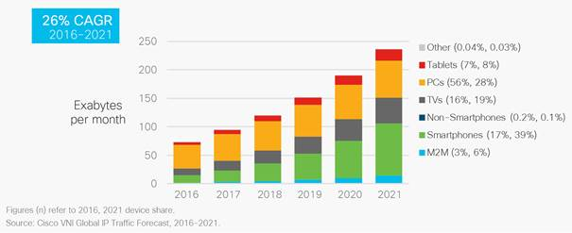
Introduction
Various Applications in Future Wireless Data service
Increasing demands in mobile data traffic
3

Slide 4


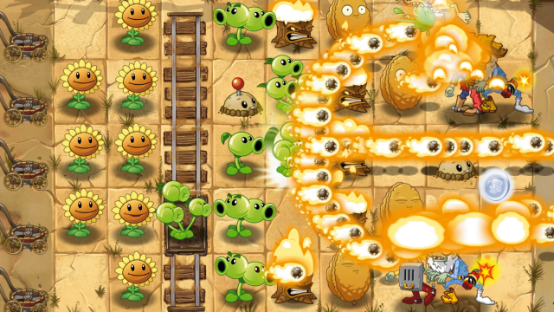
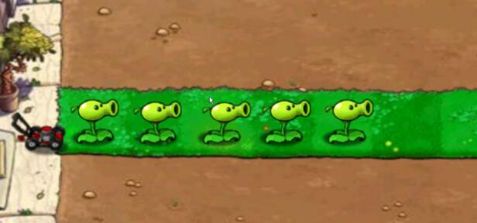



Insight from Plants vs. Zombies
Real-Time Requirement
Wireless Network
Task of Data Transmission
Be Advanced
Get Helpers
Be the God
4

Slide 5
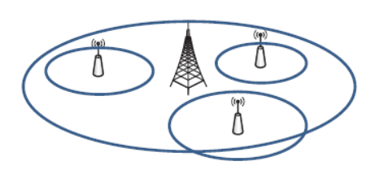
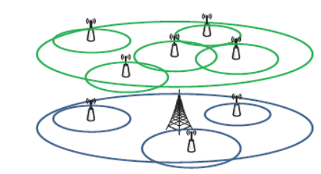
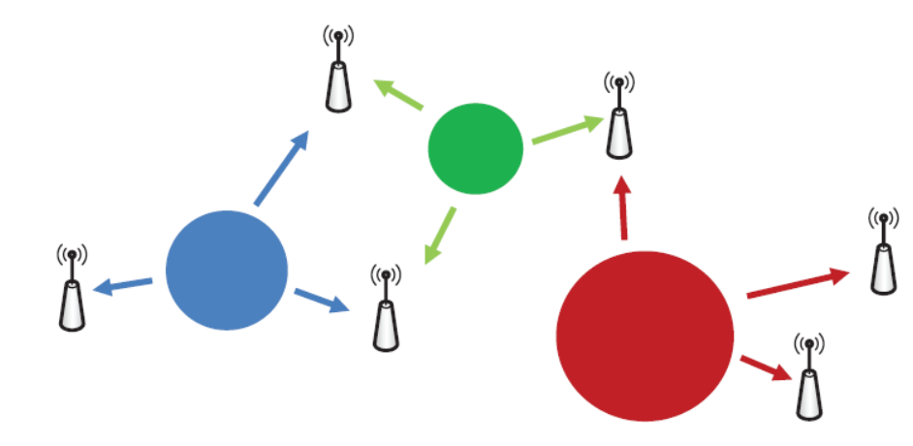
Development of Wireless Network
Be Advanced
Get Helpers
Be the God
Multi-Layer Wireless Network
Cooperations of Multiple Networks
Network Virtualization
How to manage the distributive behaviors of autonomous individuals?
5

Slide 6








Service Architecture
Service Layer: Authentication, Billing, Mobility Management, Routing, …
Resource Layer: Spectrum, Time, Code, Power, …
Infrastructure Layer: Wireline Network,
Base Stations, Relays, …
User Layer: Various Mobile Applications
6

Slide 7
Traditional Wireless Network
Service Provider
Service Provider
Service Provider
Service
Layer
Service
Layer
Service
Layer
Resource
Layer
Resource
Layer
…
Resource
Layer
Infrastructure Layer
Infrastructure Layer
Infrastructure Layer
End Users
End Users
End Users
7

Slide 8
Hierarchical Game Framework
Service Layer
Service Layer
Service Layer
Static Game
Resource Layer
Resource Layer
Resource Layer
Sequential Game
Infrastructure Layer
Infrastructure Layer
Infrastructure Layer
Mobile Users
Mobile Users
Mobile Users
8

Slide 9
Contributions
Modeled a distributive four-layer service architecture for future heterogeneous network
Proposed a hierarchical game framework to analyze the distributive resource management
Zero-determinant strategy in infrastructure layer with the application of small cell network.
A multi-leader multi-follower Stackelberg game between service layer and user layer with the application of LTE Unlicensed.
A multi-layer hierarchical game in the general distributive service architecture with the application of fog computing.
Numerical analysis and simulations in practical scenarios are employed with stable and high QoS.
9

Slide 10
RoadMap
Be Advanced
Multi-Layer Wireless Network
Small Cell Network
Hierarchical
Game Framework
Get Helpers
Cooperations of Multiple Networks
LTE Unlicensed
Be the God
Network Virtualization
Fog Computing
10

Slide 11


Small Cell Network
Macro-cell
Small Cell
Service
Layer
Service
Layer
Resource
Layer
Infrastructure Layer
Infrastructure Layer
End Users
End Users
Macrocell base station
Small cell base station
Macrocell user
Small cell user
11

Slide 12

Motivation
Interference between macrocells and small cells
Cooperations of resource sharing between macrocell and small cells
Moreover, due to
Weak communication signals
Cheating strategies
Some small cells may unexpectedly stop cooperation unilaterally.
Macrocell is responsible to maintain the social welfare in high values.
12

Slide 13




The Game of Chicken
When considering the interaction between different autonomous decision makers, we apply game theory to solve the problem.
The Game of Chicken
13

Slide 14



The Game of Chicken
Player
AoC: Administrator of Cooperation (Macrocell)
PoC: Participant of Cooperation (Small cell)
Chicken-Dare Game
Strategy
 | Chicken | Dare
Chicken | (R,R) | (S,T)
Dare | (T,S) | (P,P)
PoC
Chicken: Low transmit power
AoC
Dare: High transmit power
Utility
Revenue for both X and Y
$$U^{A}={\left[\begin{matrix}R & S & T & P\end{matrix}\right]}^{T}$$
T > R > S > P
$$U^{P}={\left[\begin{matrix}R & T & S & P\end{matrix}\right]}^{T}$$
14

Slide 15
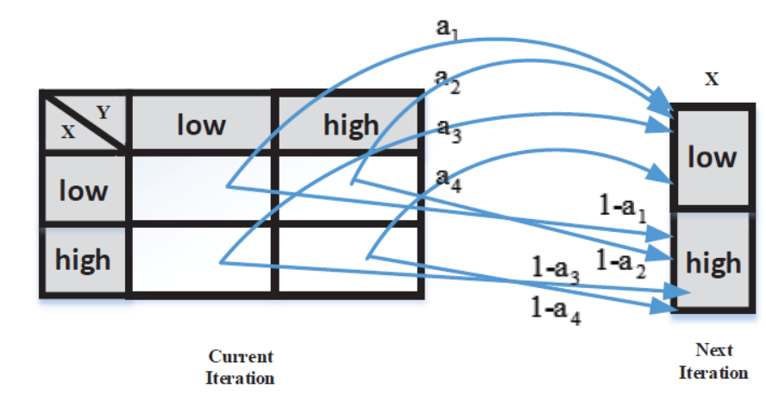
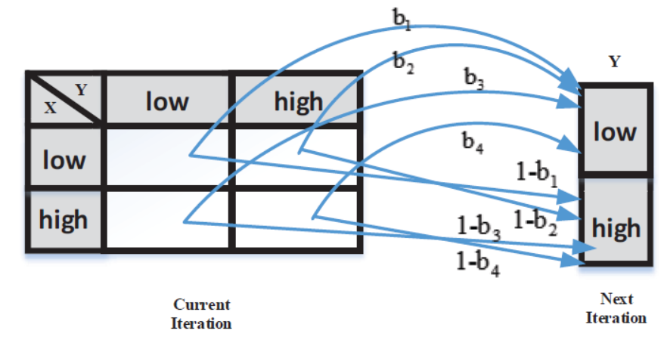
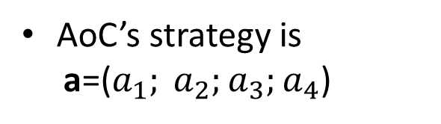
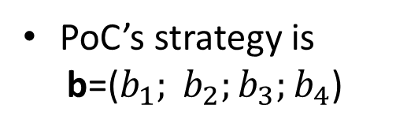
Strategy Profile
AoC’s strategy is
a=($a_{1}; a_{2};a_{3};a_{4}$)
PoC’s strategy is
b=($b_{1}; b_{2};b_{3};b_{4}$)
15

Slide 16
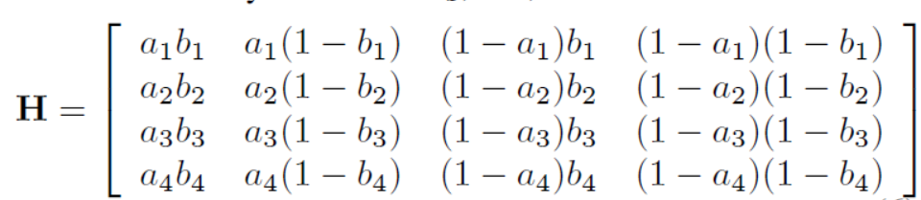
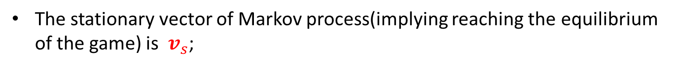
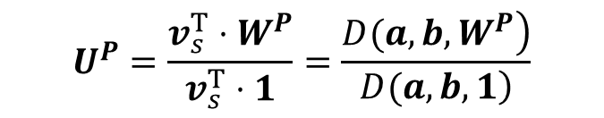
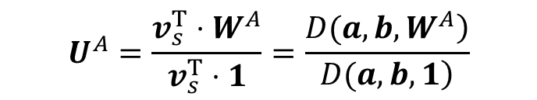
Markov and Utility
Unnecessary to simulate the play of strategies a against b move by move, we adopt Markov process:
The transition matrix
The stationary vector of Markov process(implying reaching the equilibrium of the game) is $v_{s}$;
The expected utilities of both players AoC and PoC are, respectively,
$$U^{A}=\frac{v_{s}^{T}⋅W^{A}}{v_{s}^{T}⋅1}=\frac{\left.D(a,b,W^{A}\right)}{\left.D(a,b,1\right)}$$
$$U^{P}=\frac{v_{s}^{T}⋅W^{P}}{v_{s}^{T}⋅1}=\frac{\left.D(a,b,W^{P}\right)}{\left.D(a,b,1\right)}$$
16

Slide 17




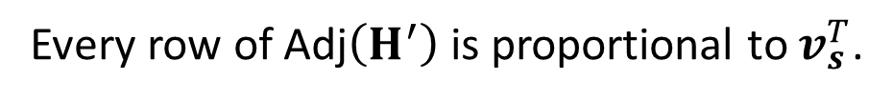
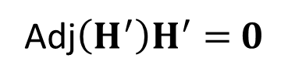
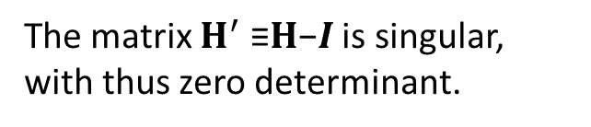
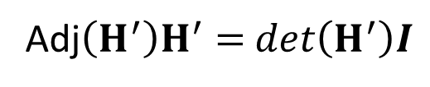
Zero-Determinant Method
Cramer’s rule
$$v_{s}^{T}H=v_{s}^{T}$$
Adj$\left(H^{′}\right)H^{′}=$ $det\left(H^{′}\right)I$
( Adj$\left(H^{′}\right)$is the adjugate matrix of $H^{′}$ )
We set
$$H^{′}=H−I$$
The matrix $H^{′}$ ≡$H$−$I$ is singular, with thus zero determinant.
$$v_{s}^{T}H′=0$$
Adj$\left(H^{′}\right)H^{′}=$ $0$
Every row of Adj$\left(H^{′}\right)$ is proportional to $v_{s}^{T}$.
17

Slide 18
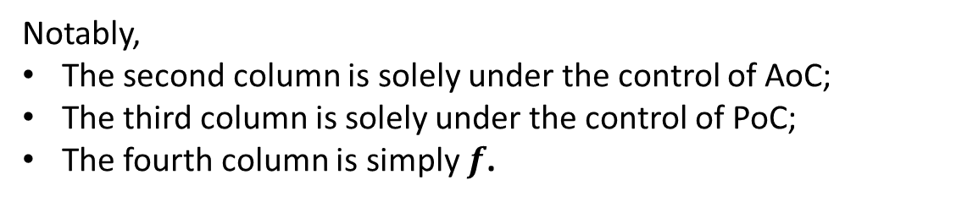
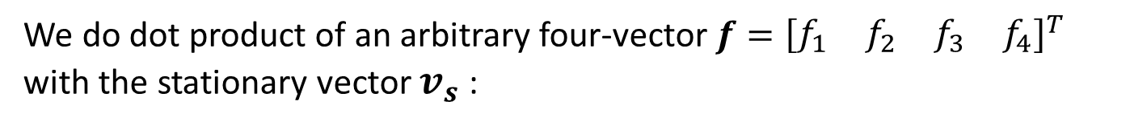


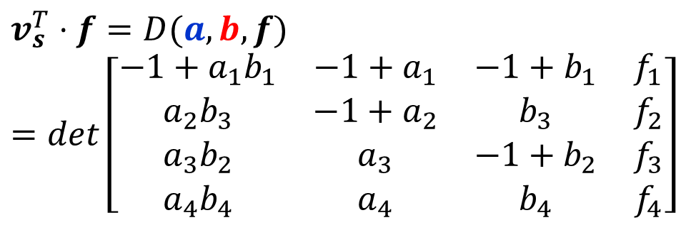
Zero-Determinant Method
We do dot product of an arbitrary four-vector$f={\left[\begin{matrix}f_{1} & f_{2} & f_{3} & f_{4}\end{matrix}\right]}^{T}$ with the stationary vector $v_{s}$:
$$v_{s}^{T}⋅f=D(a,b,f)=det\left[\begin{matrix}−1+a_{1}b_{1} & −1+a_{1} & −1+b_{1} & f_{1} \\ a_{2}b_{3} & −1+a_{2} & b_{3} & f_{2} \\ a_{3}b_{2} & a_{3} & −1+b_{2} & f_{3} \\ a_{4}b_{4} & a_{4} & b_{4} & f_{4}\end{matrix}\right]$$
$$=\tilde{a}$$
$$=\tilde{b}$$
Notably,
The second column is solely under the control of AoC;
The third column is solely under the control of PoC;
The fourth column is simply $f$.
18

Slide 19
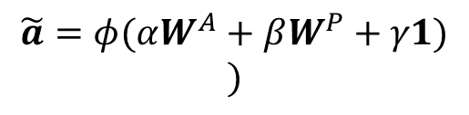



Zero-Determinant Method
We suppose
$$f=αW^{A}+βW^{P}+γ1$$
Both AoC and PoC have the possibility of choosing unilateral strategies that will make the determinant in the numerator vanish.
i.e.
If AoC chooses a strategy that satisfies
$$\tilde{a}=φ(αW^{A}+βW^{P}+γ1)$$
$$)$$
or if PoC chooses a strategy that satisfies
$$\tilde{b}=φ(αW^{A}+βW^{P}+γ1)$$
Then the determinant vanishes and a linear relation between the two scores,
$$αU^{A}+βU^{P}+γ1=0$$
We call these zero-determinant (ZD) strategies.
19

Slide 20
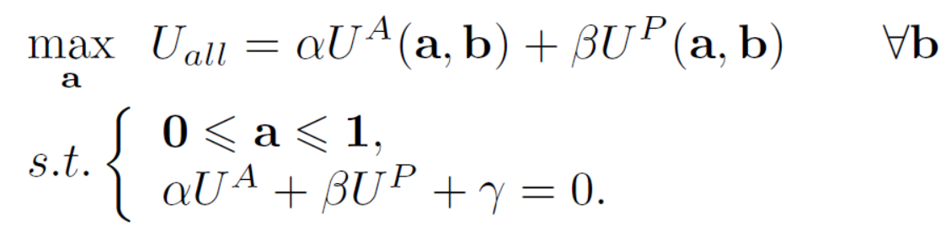
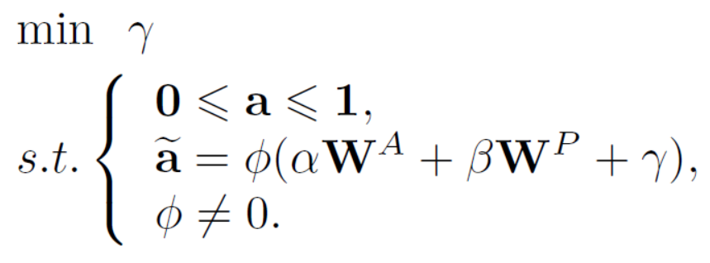
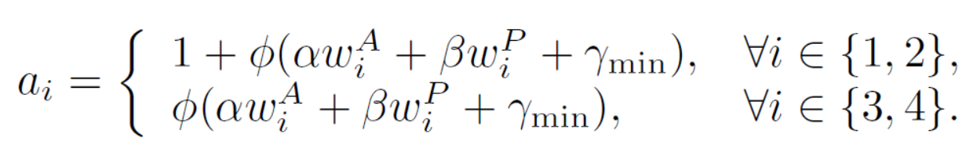
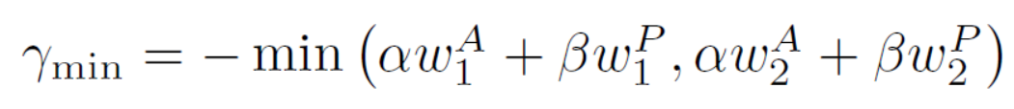

Constraints
Social Welfare
Whatever the strategy of PoC, by adopting strategy $a$, AoC is able to unilaterally maintain the social welfare in high and fixed value
Zero-determinant Strategy
Ratio Relationship
Optimal Strategy
Maximum Social Welfare
20

Slide 21
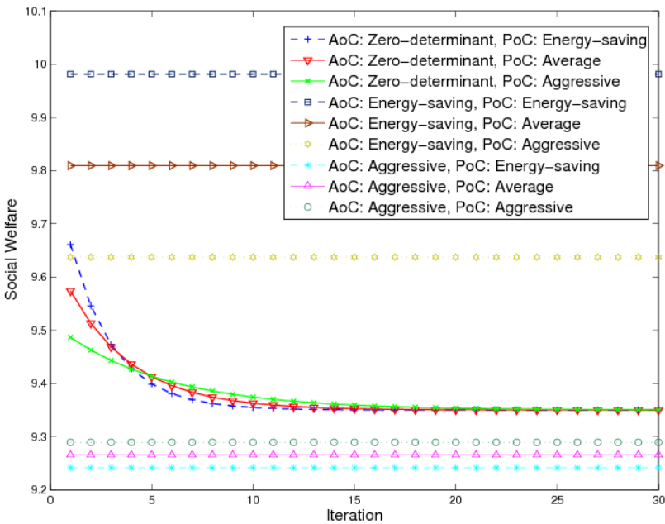
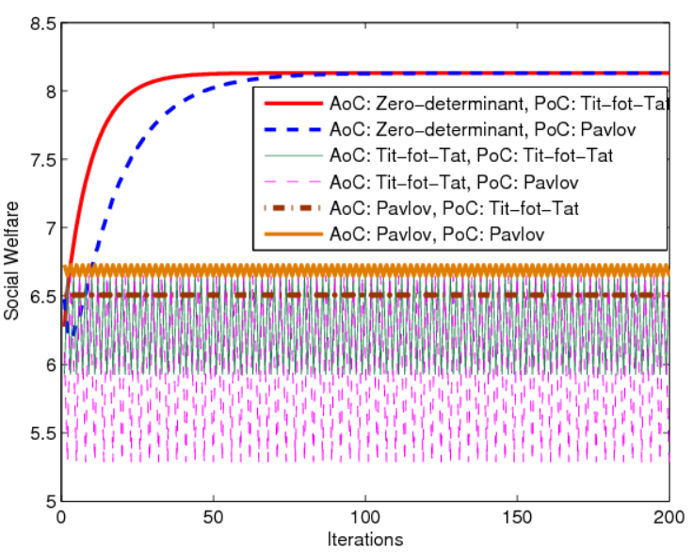
Simulations
Energy-Saving
Aggressive
Tit-for-Tat
Pavlov
Whatever the behaviors of the other component, zero-determinant strategy is able to maintain the social welfare in fixed and high values
21

Slide 22
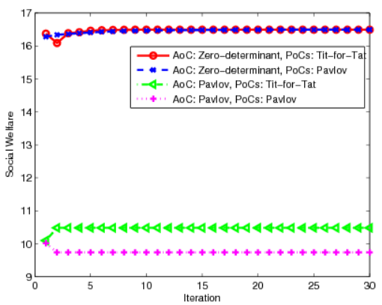
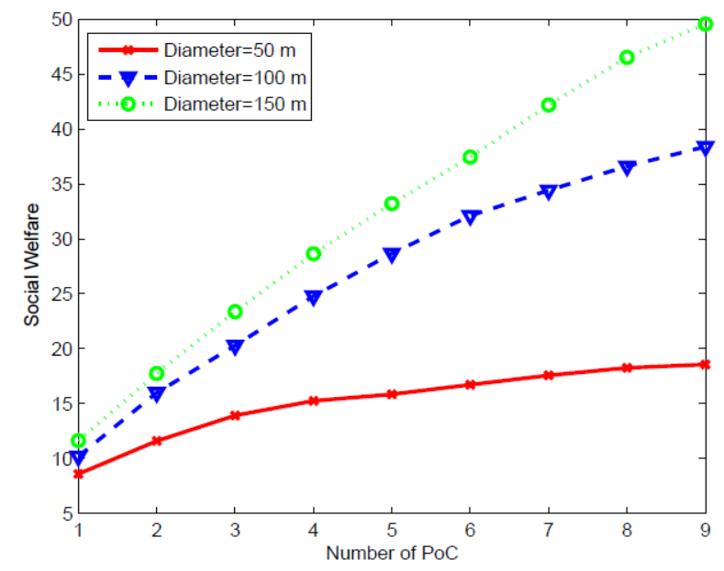
Simulations
With the number of PoCs increasing, and the number of actions increasing, the maintained social welfare increases
22

Slide 23
RoadMap
Be Advanced
Multi-Layer Wireless Network
Small Cell Network
Hierarchical
Game Framework
Get Helpers
Cooperations of Multiple Networks
LTE Unlicensed
Be the God
Network Virtualization
Fog Computing
23

Slide 24
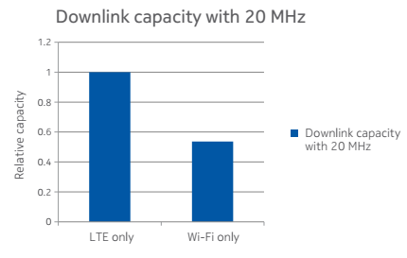
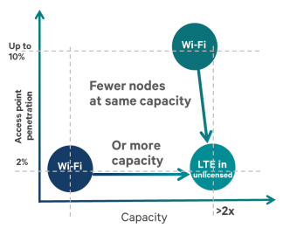
LTE Unlicensed
Wireless Operator
Wi-Fi
Integrate unlicensed carrier into the overall LTE system by adapting LTE air interface to operate in the unlicensed spectrum
Service
Layer
Service
Layer
Resource
Layer
Resource
Layer
Infrastructure Layer
Infrastructure Layer
End Users
End Users
24

Slide 25
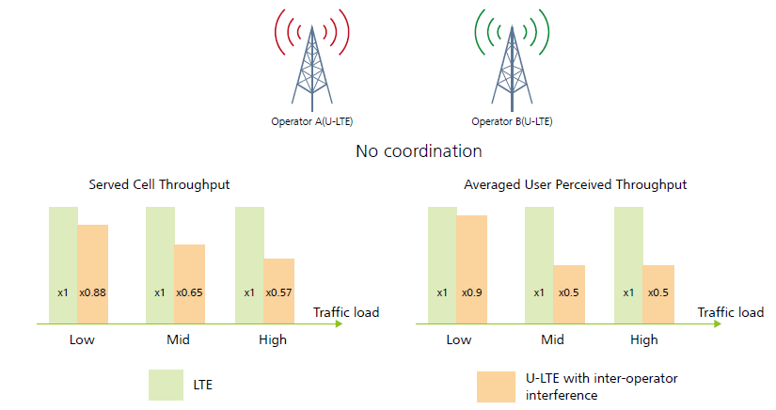
Motivation
25

Slide 26
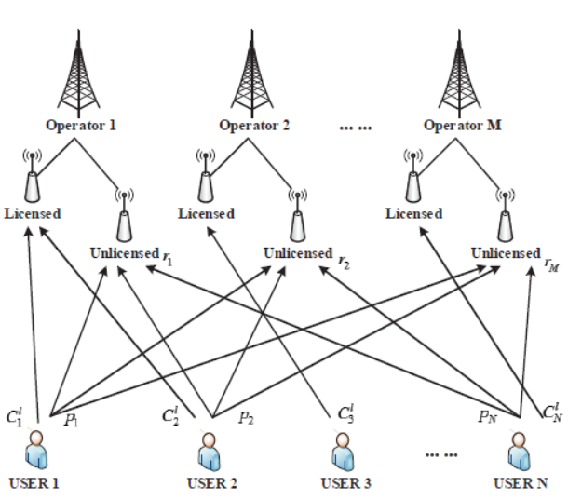
Game Framework
Non-cooperative Game
Multi-Leader Multi-Follower Stackelberg Game
Matching
26

Slide 27
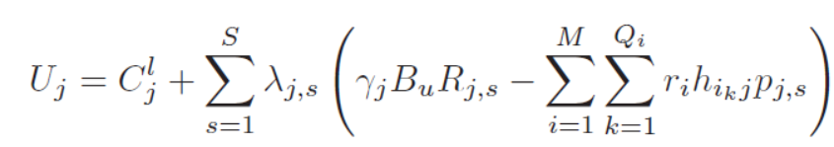


Utility
Revenue the user j obtain for unit data transmission
Transmit power of the user j in the unlicensed spectrum
User:
Binary number determine if the sub-band s in unlicensed spectrum is allocated to user j
Price set by the operator i in the unlicensed spectrum
where
Interference in the sub-band s of the unlicensed spectrum
First-Mover Advantage
Operator:
27

Slide 28
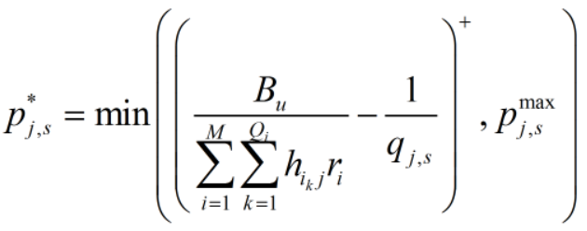
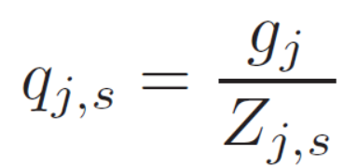
Strategy of Users
Backward Induction
Strategies of Users
Sub-bands and Users
Strategies of Operators
The utility of the user j is convex.
We take the first derivative with respective to $p_{j,s} equal to zero.$
where
The maximum transmit power constraint of the user j in the unlicensed spectrum
28

Slide 29
Gale-Shapley Algorithm
Stable Marriage Matching Problem
Geeta, Heiki, Irina, Fran
Adam
Fran
Irina, Fran, Heiki, Geeta
Carl > Adam
Bob
Geeta
This is a stable matching
Geeta, Fran, Heiki, Irina
Carl
Heiki
Irina, Heiki, Geeta, Fran
David > Bob
David
Irina
29

Slide 30
Sub-band Allocation
Adam, Bob, Carl, David
Geeta, Heiki, Irina, Fran
Adam
Fran
Carl, David, Bob, Adam
USER
SUB-BAND
Geeta
Bob
Irina, Fran, Heiki, Geeta
Carl, Bob, David, Adam
Geeta, Fran, Heiki, Irina
Carl
Heiki
Adam, Carl, David, Bob
David
Irina
Irina, Heiki, Geeta, Fran
30

Slide 31
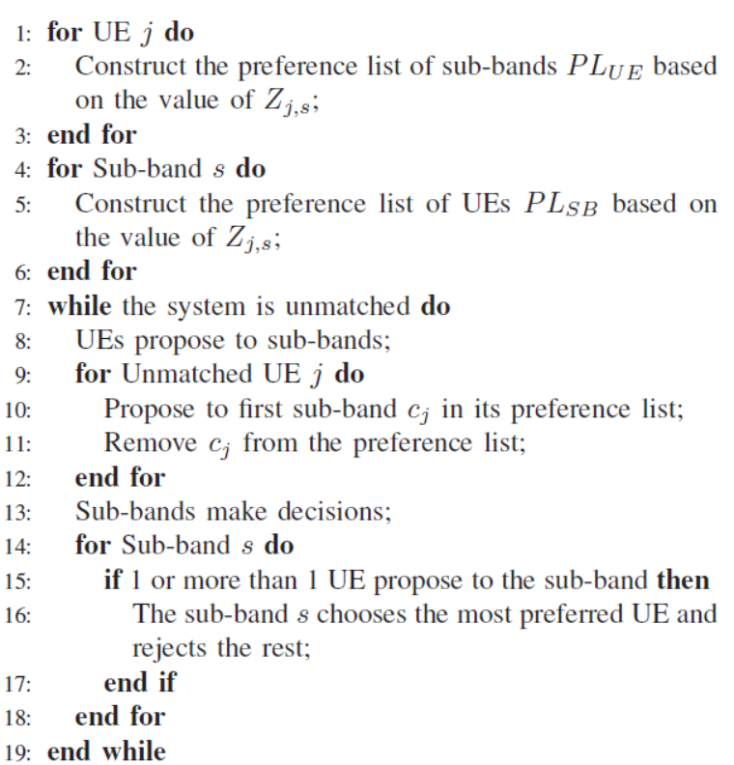
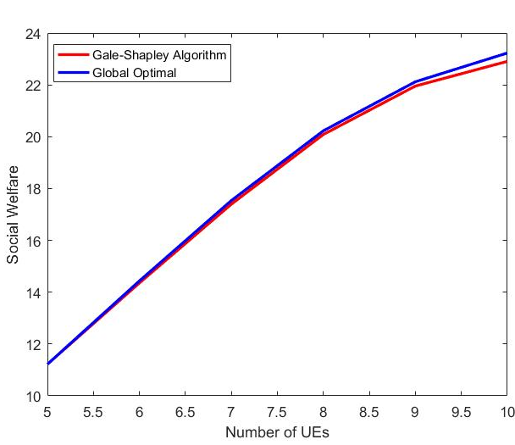
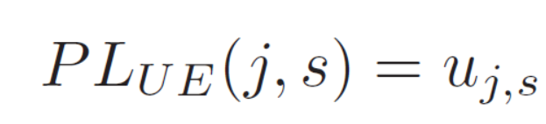
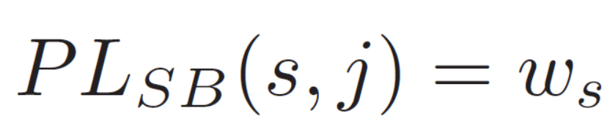
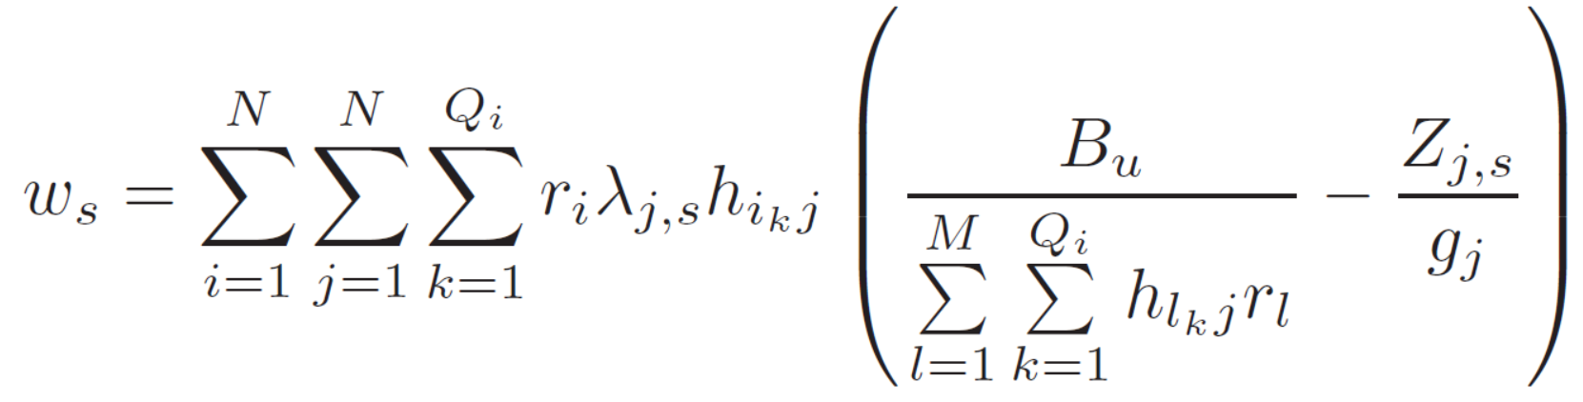
Sub-band Allocation with Matching
Preference Lists
Man → User
Woman → Sub-band
where
Algorithm
Evaluation
31

Slide 32
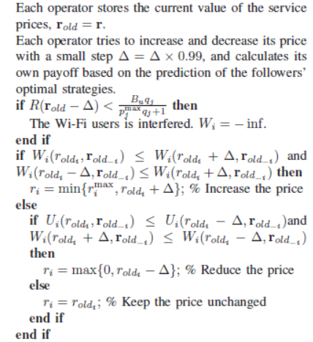
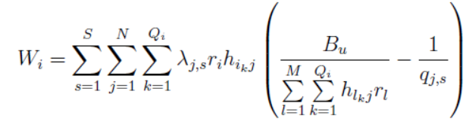
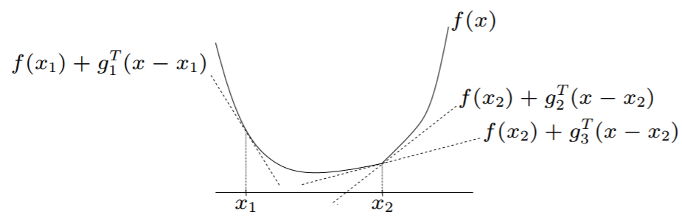
Non-cooperative Strategies for Operators
We put the optimal solution $p_{j,s}^{∗}$ and sub-band allocation into the utility function of operators
Subgradient Method
Algorithm
32

Slide 33
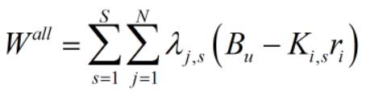
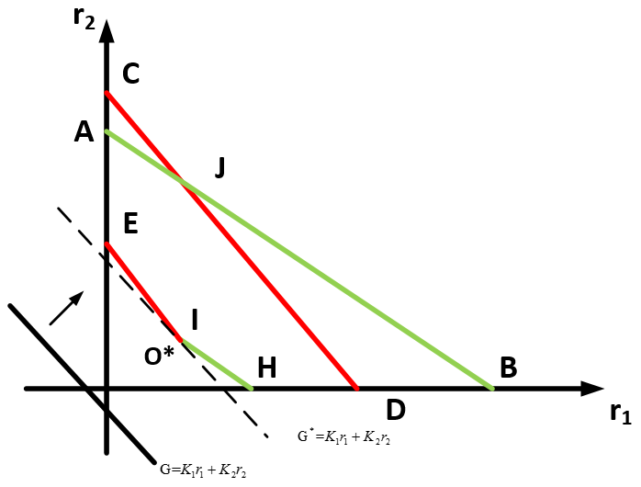
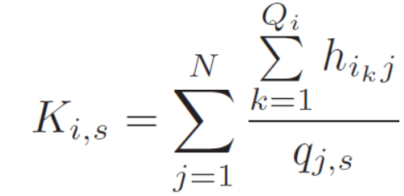
Cooperative Strategies for Operators
where
33

Slide 34
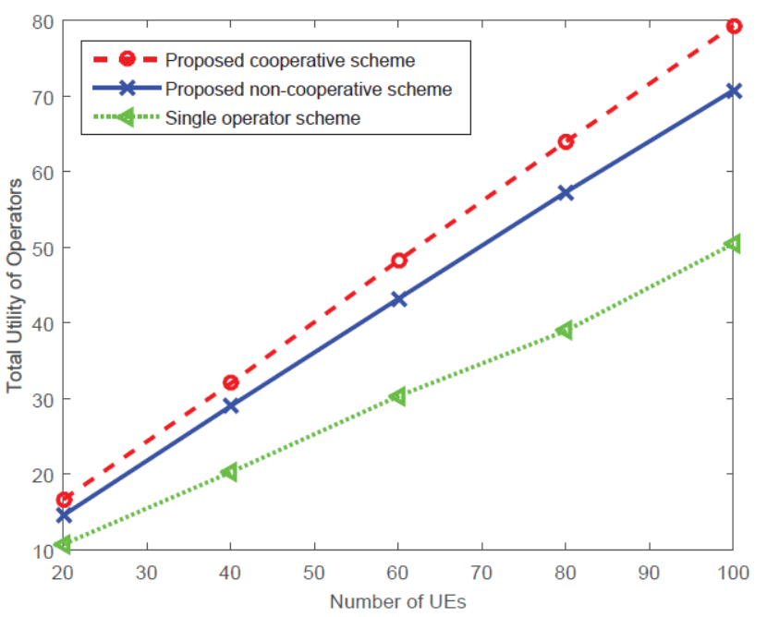

Simulation Results
The utility of operators generally increases with number of UE increasing
The interference from Wi-Fi affect the performance UE and the utility of operators
34

Slide 35
RoadMap
Be Advanced
Multi-Layer Wireless Network
Small Cell Network
Hierarchical
Game Framework
Get Helpers
Cooperations of Multiple Networks
LTE Unlicensed
Be the God
Network Virtualization
Fog Computing
35

Slide 36




Cloud Computing
36

Slide 37




Fog Computing
Fog computing is an architecture that uses one or a collaborative multitude of end-user clients or near-user edge devices to carry out a substantial amount of storage, communication, and control, configuration, measurement and management.
Data Center/Cloud
Non-real-time data action, storage
Fog
Local data analysis and filtering
Device
Local data collection
37
Notes:
November 19, 2015. On November 19, 2015, Cisco Systems, ARM Holdings, Dell, Intel, Microsoft, and Princeton University, founded the OpenFog Consortium, to promote interests and development in fog computing.

Slide 38

System Architecture
FN: Fog node
DSO: Data Service Operator
DSS: Data Service Subscriber
38

Slide 39
Wireless Network Virtualization
Service Layer
Service Layer
Service Layer
Service Layer
Service Providers
Resource Layer
Resource Layer
Resource Layer
Resource Layer
Resource Providers
Infrastructure Layer
Infrastructure Layer
Infrastructure Layer
Infrastructure Layer
Infrastructure Providers
…
Mobile Users
Mobile Users
Mobile Users
Mobile Users
39

Slide 40



Utility Functions
Workload rate
Unit price of receiving service from DSO i
Cost due to the delay
DSS
Indicating if DSS j is served by DSO i or not
Amount of Computing Resource Blocks (CRBs) need to pay to DSO
Cost of network delay
Cost of computation delay
where
Service rate

Slide 41


Utility Functions
Motivation price of FN k
Amount of CRBs offloaded to FN k
DSO
Amount of CRBs served in massive data center servers
Preferences of FN k to DSO i
Amount of CRBs applied to server DSS j
FN
Increment cost if the FN k serves DSS j

Slide 42



Problem Formulation
DSS
FN
DSO

Slide 43

Hierarchical Game Framework
Matching Game:
DSOs and FNs
Matching Games:
FNs and DSSs
Stackelberg Games:
DSOs and DSSs
43

Slide 44





Virtualized Network between DSOs and DSSs
Second derivative less than zero
DSS
First derivative equal to zero
Put optimal amount of purchasing resource into optimization problem of DSO
DSO
44

Slide 45


Matching between DSOs and FNs
Preference List
DSO
FN
Algorithm
DSO
DSO
......
DSO
DSO
Motivation
FN
FN
FN
......
FN
45

Slide 46


Matching between FNs and DSSs
Preference List
FN
DSS
Algorithm
DSO
Motivation
Motivation
......
Motivation
FN
FN
FN
DSS
DSS
DSS
Purchase
Purchase
......
Purchase
DSO
46

Slide 47


Simulations
High Benefits and Necessity of FNs when the number of DSSs is large
47

Slide 48


Future Works
A Complex Hierarchical Game Framework
Future Works
Combining Hierarchical Game with Reinforcement Learning
48

Slide 49
Complex Hierarchical Game
Service Layer
Service Layer
Service Layer
Coalition Formation
Resource Layer
Resource Layer
Resource Layer
Infrastructure Layer
Infrastructure Layer
Infrastructure Layer
Position Switch
Mobile Users
Mobile Users
Mobile Users
49

Slide 50


















Multi-Agent Reinforcement Learning
Learning rate
Discount factor
$$Q_{t+1}^{x}(s,a)=(1−α_{t})Q_{t}^{x}(s,a)+α_{t}[R_{t}^{x}(s,a)+γ\prod_{x^{′}}{π^{x^{′}}\left(s^{′}\right)Q_{t}^{x}(s′) }]$$
$$∀x$$
$$s^{′}$$
……
$$π^{x}(s^{′})$$
$$∀x$$
Hierarchical Game Framework
$$s^{′′}$$
……
$$π^{x}(s^{′′})$$
$$∀x$$
$$\max_{π^{x}(s^{′})}$$
$$Q_{t}^{x}(s′)$$
$$∀x$$
$$\max_{π^{x^{′}}(s^{′})}$$
$$Q_{t}^{x}(s′)$$
$$∀x$$
$$s.t.$$
$$π^{x^{′}}\left(s^{′}\right)= argmax{ Q}_{t}^{x^{′}}(s′)$$
$$∀x′≠x$$
$$s.t.$$
$$π^{x}\left(s^{′′}\right)= argmax{ Q}_{t}^{x}(s′′)$$
$$∀x$$
Nash Equilibrium
Stackelberg Equilibrium
50

Slide 51
Publications
Book
H. Zhang, S. Khairy, L. X. Cai, and Z. Han, “Resource Allocation in Unlicensed Long Term Evolution HetNets," contracting with Springer Science + Business Media, LLC.
H. Zhang and Z. Han, “Distributed Resource Allocation for Network Virtualization,” Book chapter in Handbook of Cognitive Radio, Springer.
Book Chapter
Journal & Magazine
H. Zhang, Y. Zhang, Y. Gu, D. Niyato, and Z. Han, “A Hierarchical Game Framework for Resource Management in Fog Computing,” in IEEE Communication Magazine, vol. 55, no. 8, Aug. 2017.
H. Zhang, Y. Xiao, S. Bu, D. Niyato, R. Yu, and Z. Han, “Computing Resource Allocation in Three-Tier IoT Fog Networks: a Joint Optimization Approach Combining Stackelberg Game and Matching,” in IEEE Internet of Things Journal, vol. 4, no. 5, pp. 1204-1215, Oct. 2017.
H. Zhang, Y. Xiao, L. X. Cai, D. Niyato, L. Song, and Z. Han, "A Multi-Leader Multi-Follower Stackelberg Game for Resource Management in LTE Unlicensed," in IEEE Transactions on Wireless Communications, vol. 16, no. 1, pp. 348-361, Jan. 2017.
H. Zhang, D. Niyato, L. Song, T. Jiang, and Z. Han, “Zero-determinant Strategy for Resource Sharing in Wireless Cooperation,” IEEE Transactions on Wireless Communications, vol. 15, no. 3, pp. 2179-2192, Mar. 2016.
H. Zhang, W. Ding, F. Yang, J. Song, and Z. Han, "Resource Allocation in Heterogeneous Network with Visible Light Communication and D2D: A Hierarchical Game Approach," submitted to Transactions on Communication.
H. Zhang, B. Di, Z. Chang, X. Liu, L. Song, and Z. Han, "Equilibrium Problems with Equilibrium Constraints Analysis for Power Control and User Scheduling in NOMA Networks," submitted to Transactions on Wireless Communication.
Z. Chang, L. Lei, H. Zhang, T. Ristaniemi, S. Chatzinotas, B. Ottersten, Z. Han, "Secure and Energy-Efficient Resource Allocation for Multiple-Antenna NOMA with Wireless Power Transfer," to be submitted to Transactions on Green Communications and Networking.
H. Zhang, X. Tang, R. A. Banez, P. Ren, L. Song, and Z. Han, "An EPEC Analysis for Power Allocation in LTE-V Networks,"accepted for IEEE GLOBECOM 2017.
N. Raveendran, H. Zhang, Z. Zheng, L. Song, Z. Han, "Large-Scale Fog Computing Optimization using Equilibrium Problem with Equilibrium Constraints"accepted for IEEE GLOBECOM 2017.
X. Chen, H. Zhang, and Z. Han, "Delay-Tolerant Resource Scheduling in Large-Scale Virtualized Radio Access Networks," IEEE International Conference on Communications (ICC), Paris, France, May 2017.
H. Zhang, W. Ding, J. Song, and Z. Han, "A Hierarchical Game Approach for Visible Light Communication and Multi-Hop D2D Heterogeneous Network", 2016 IEEE Global Communications Conference (GLOBECOM), Washington, DC, Dec. 2016.
H. Zhang, X. Chen, and Z. Han, "A Zero-Determinant Approach for Power Control of Multiple Wireless Operators in LTE Unlicensed", 2016 IEEE Global Communications Conference (GLOBECOM), Washington, DC, Dec. 2016,
H. Zhang, Y. Xiao, S. Bu, D. Niyato, R. Yu, and Z. Han, “Fog Computing in Multi-Tier Data Center Networks: A Hierarchical Game Approach,” IEEE International Conference on Communications (ICC), Kuala Lumpur, Malaysia, May 2016.
H. Zhang, Y. Xiao, L. X. Cai, L. Song, N. Dusit, and Z. Han, "A Hierarchical Game Approach for Multi-Operator Spectrum Sharing in LTE Unlicensed," IEEE Global Communications Conference, San Diego, CA, Dec. 2015.
H. Zhang, D. Niyato, L. Song, T. Jiang, and Z. Han, "Equilibrium Analysis for Zero-Determinant Strategy in Resource Management of Wireless Network," IEEE Wireless Communications and Networking Conference, New Orleans, LA, Mar. 2015.
H. Zhang, D. Niyato, L. Song, T. Jiang, and Z. Han, "Zero-Determinant Strategy in Cheating Management of Wireless Cooperation," IEEE Global Communications Conference, Austin, TX, Dec. 2014.
H. Zhang, M. Bennis, Luiz A. DaSilva, and Z. Han, "Multi-leader Multi-follower Stackelberg Game among Wi-Fi, Small Cell and Macrocell Networks," IEEE Global Communications Conference, Austin, TX, Dec. 2014.
H. Zhang, F. Li, N. Dusit, L. Song, T. Jiang, and Z. Han, "Zero-determinant Strategy in Power Control of Small Cell Network", invited, IEEE International Conference on Communication Systems (ICCS), Macau, China, Nov. 2014.
Conference
51

Slide 52
Conclusions
A Hierarchical Game Framework for Future Heterogeneous Network Architecture
Hierarchical Game Analysis is Adopted For the Distributive Resource Allocation
Multi-Tier Wireless Network
Zero-Determinant Strategy
LTE Unlicensed
A Multi-Leader Multi-Follower Stackelberg Game
Fog Computing
A Three-Layer Hierarchical Game
Conclusions
Future Networks
Complex hierarchical game framework
A hierarchical game in reinforcement learning
52

Slide 53
Thank You!
Huaqing Zhang
markasjunior@gmail.com
Wireless Networking, Signal Processing and Security Lab
Department of Electrical and Computer Engineering
University of Houston, TX, USA

