Slide 1
Big Data Optimization for Distributed Resource Management in Smart Grid
Ph.D. Research Defense
Hung Khanh Nguyen
Advisor: Dr. Zhu Han
April 21, 2017

Slide 2
Outline
Introduction and motivation
Research works
  Incentive mechanism for peak ramp minimization
  Big data algorithm for microgrid optimal scheduling
  Other works
Future work
Conclusions

Slide 3
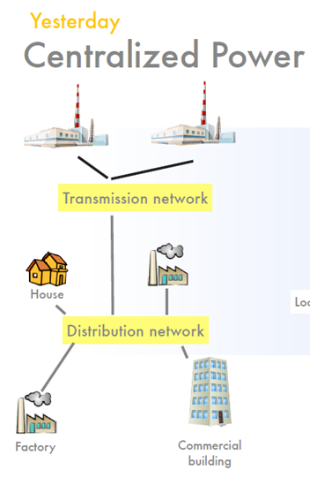
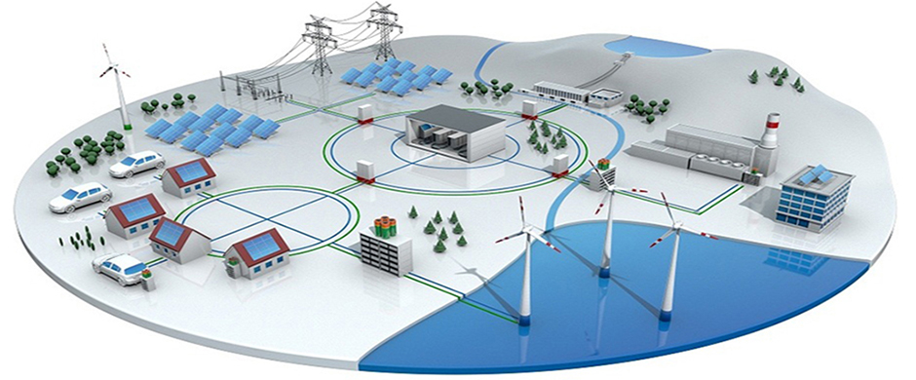
Introduction and motivation
Distributed generation
The grid gets older

Slide 4

Introduction and motivation

Slide 5
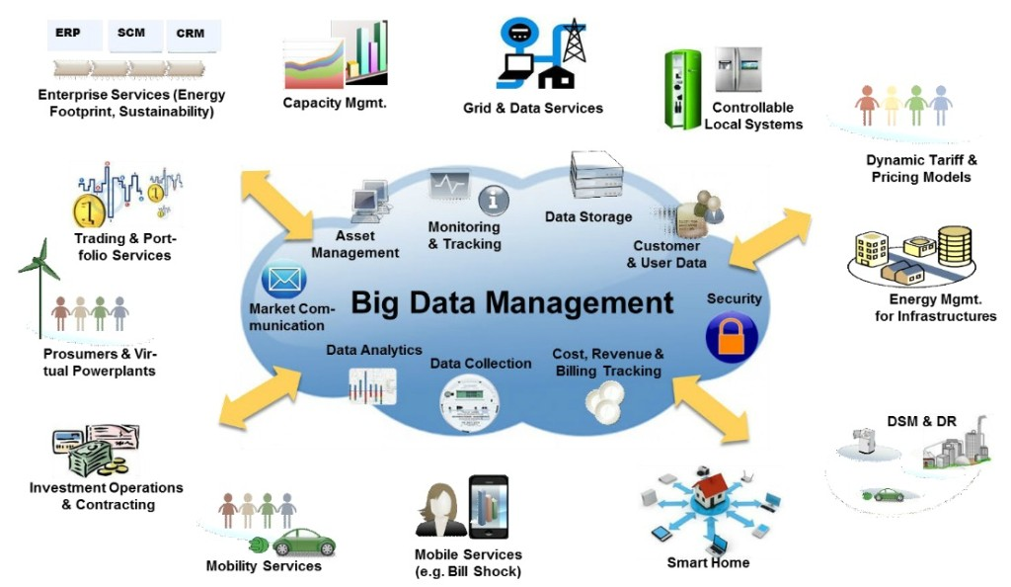
Introduction and motivation

Slide 6
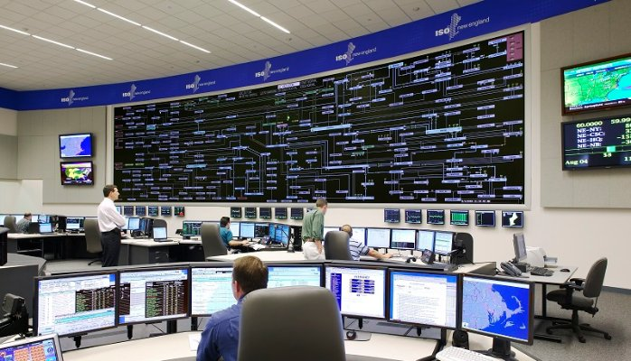
Introduction and motivation

Slide 7
Dissertation contributions
Proposed new resource management model to improve efficiency and reliability:
  Incentive mechanism to mitigate ramping effect
  Optimal scheduling for microgrids with minimal load curtailment
  Decentralized reactive power compensation
Proposed new computational frameworks for distributed resource management:
  Propose scalable algorithms which can perform in synchronous for asynchronous fashion
Applied big data optimization technique to implement large-scale and distributed computation:
  Implement algorithms using Hadoop MapReduce framework

Slide 8
Outline
Introduction and motivation
Research works
  Incentive mechanism for peak ramp minimization
  Big data algorithm for microgrid optimal scheduling
  Other works
Future work
Conclusions

Slide 9
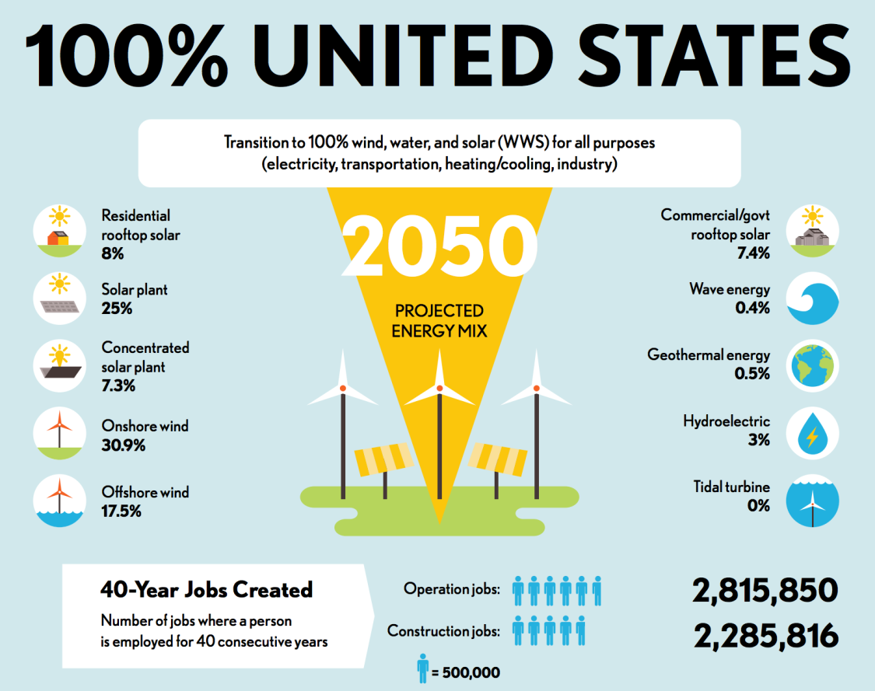
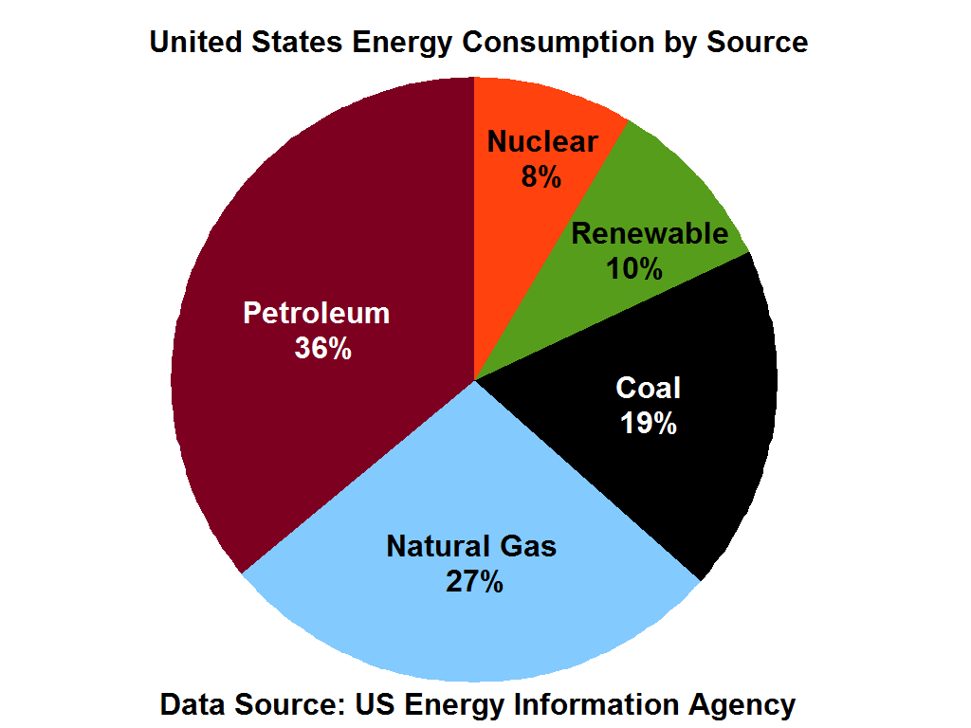


Motivation
2014

Slide 10
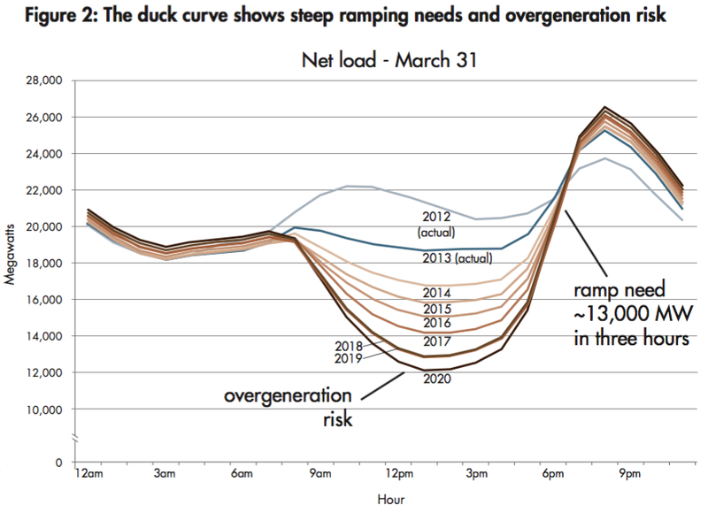
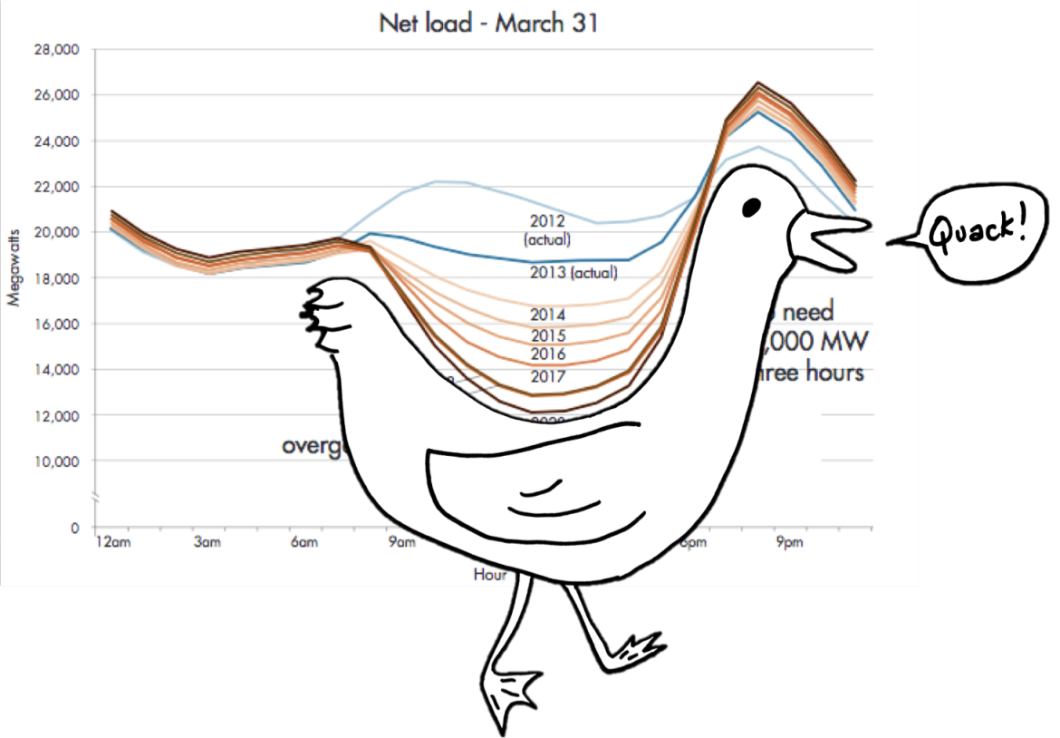
Threat
Duck curve
microgrids reschedule energy resource to minimize the peak ramp

Slide 11







System model
power link
communication link
DSO
Residential load
….
Microgrid 1
Microgrid 2
Microgrid N
A set of N microgrids and a distribution system operator (DSO)
Set of T energy consumption periods

Slide 12
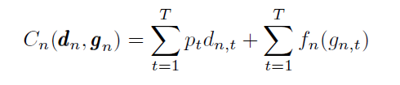
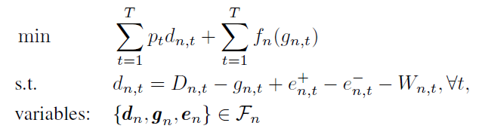

Microgrid energy cost
price
Power buy from the grid
Power generate locally
Power buy from the grid
Total demand
Local generation
Power from energy storage
Renewable generation
Power balance
Total cost

Slide 13



Microgrid ‘s payoff
Net load
Ramp between 2 time slots
Peak ramp
Extra cost when microgrid deviates from the original optimal point
New total cost
Microgrid’s payoff
Reimbursement

Slide 14

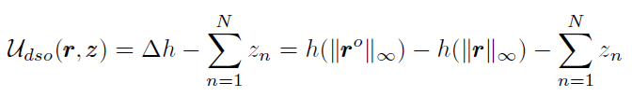
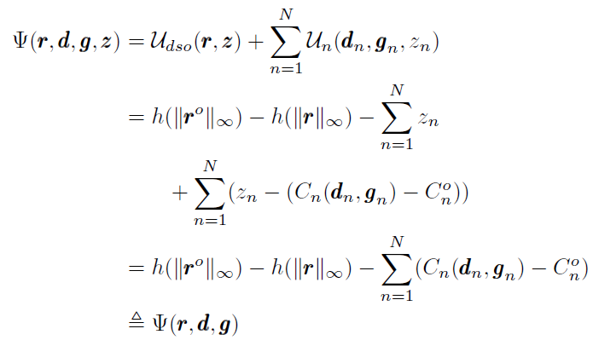

DSO’s payoff
Saving cost due to peak ramp reduction
Cost function to satisfy the peak ramp
DSO’s payoff
max
Social welfare
Cannot determine the reimbursement

Slide 15

Nash bargaining solution
Nash bargaining game is a simple two-player game used to model bargaining interactions. In the Nash bargaining game, two players demand a portion of some good (usually some amount of money)
Maximize the Nash’s product (U1 – d1)*(U2-d2)
Fairness

Slide 16
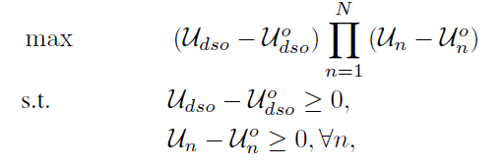
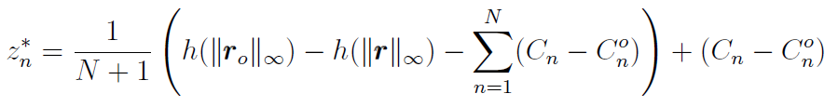

Nash bargaining solution
DSO’s payoff
microgrid’s payoff
Solution
maximizes the social welfare problem
Extra cost
Social welfare

Slide 17
Alternating Direction Method of Multipliers (ADMM)
Augmented Lagrangian function
Iterative procedure to solve an optimization problem using ADMM

Slide 18
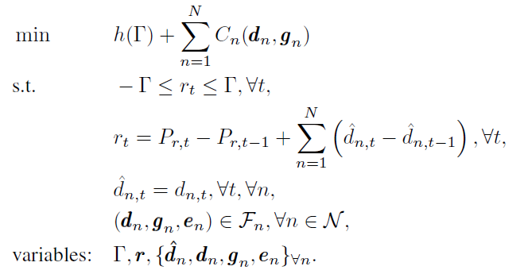
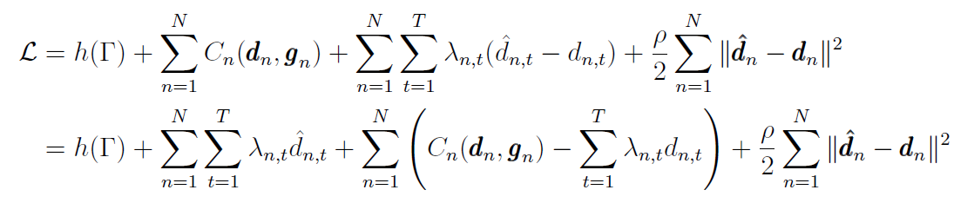
Distributed algorithms for NBS
Transform into an equivalent problem
The augmented Lagrangian function
Penalty term
Lagrange multiplier

Slide 19
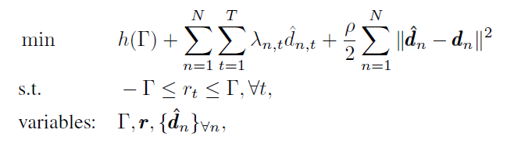
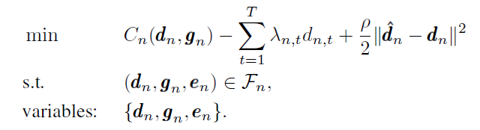

Problem decomposition
DSO problem
Individual microgrid problem
Dual variables update:

Slide 20
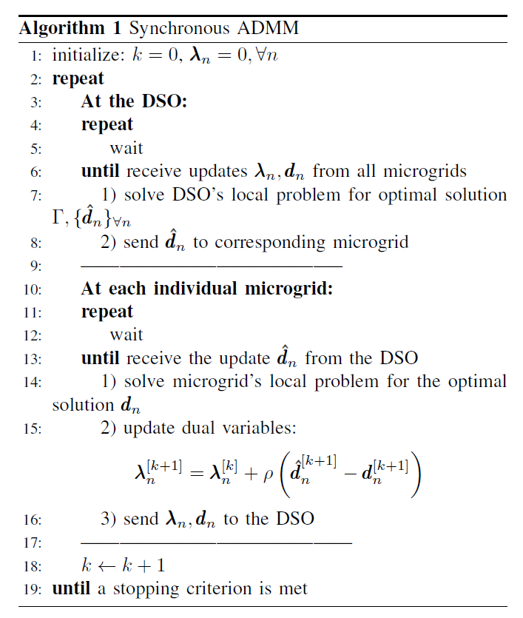





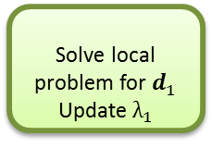

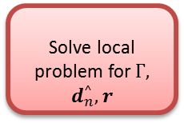

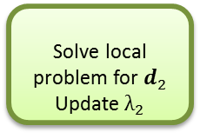
Synchronous ADMM
DSO
Solve local problem for $Γ,$ $d_{n}^{^}, r$
$$d_{2}^{^}$$
$d_{N}^{^}$
$$λ_{1},d_{1}^{}$$
$$d_{1}^{^}$$
$$λ_{2},d_{2}^{}$$
$$λ_{N},d_{N}^{}$$
Microgrid 1
Microgrid 2
Microgrid N
Solve local problem for$d_{1}^{}$
Update $λ_{1}$
Solve local problem for$d_{2}^{}$
Update $λ_{2}$
…
Solve local problem for$d_{N}^{}$
Update${ λ}_{N}$
DSO
Microgrid 1
idle
idle
Microgrid 2
……
idle
idle
Microgrid N
Iteration k = 0
Iteration k = 1

Slide 21
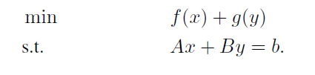
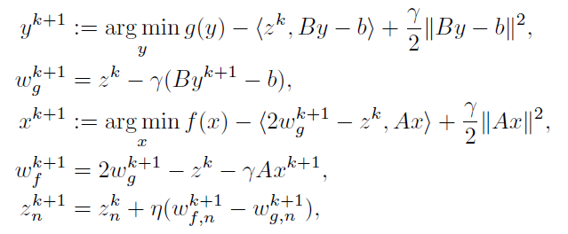
Asynchronous ADMM
Consider an optimization problem
Solve in asynchronous fashion

Slide 22
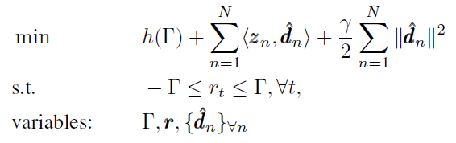
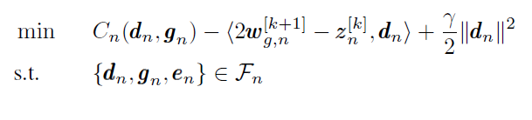
Asynchronous ADMM
DSO problem
Individual microgrid problem

Slide 23
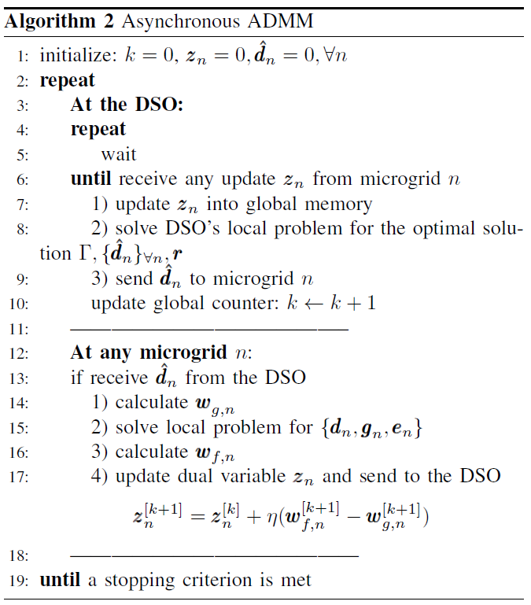
Asynchronous ADMM
DSO
Microgrid 1
Microgrid 2
……
…
Microgrid N
Iteration k = 0
1
2
3
4
5
6
7
8

Slide 24
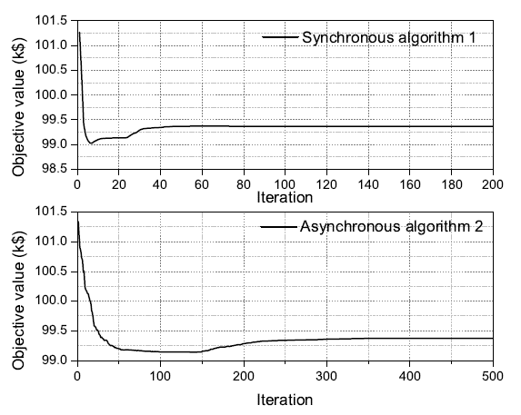
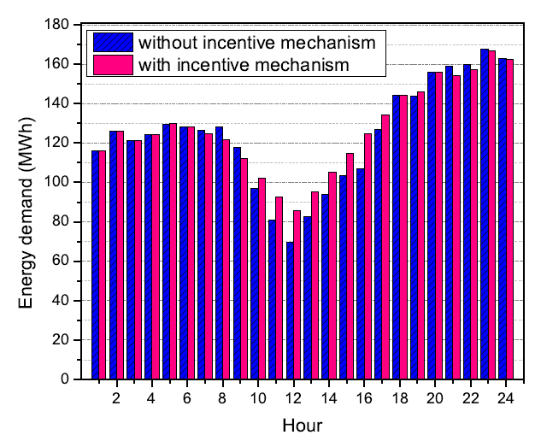
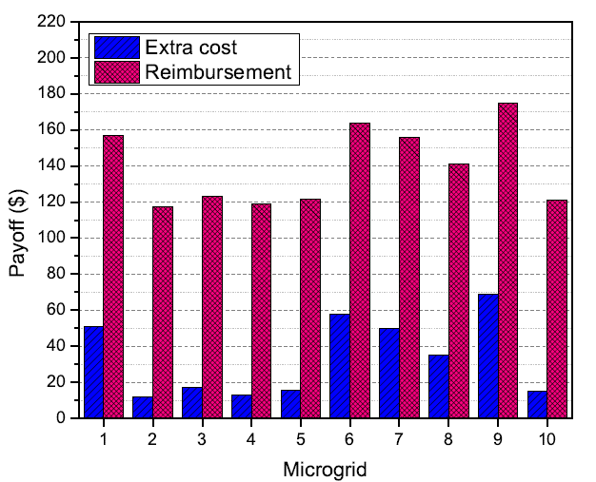
Simulation results
Synchronous Alg. 1 converges after about 70 iterations (497 sec.). Asynchronous Alg. 2 needs 250 iterations (325 sec.)
Peak ramp reduces 53% compared to original net load
Microgrids receive benefit by participating in peak ramp minimization problem

Slide 25
Outline
Introduction and motivation
Research works
  Incentive mechanism for peak ramp minimization
  Big data algorithm for microgrid optimal scheduling
  Other works
Future work
Conclusions

Slide 26
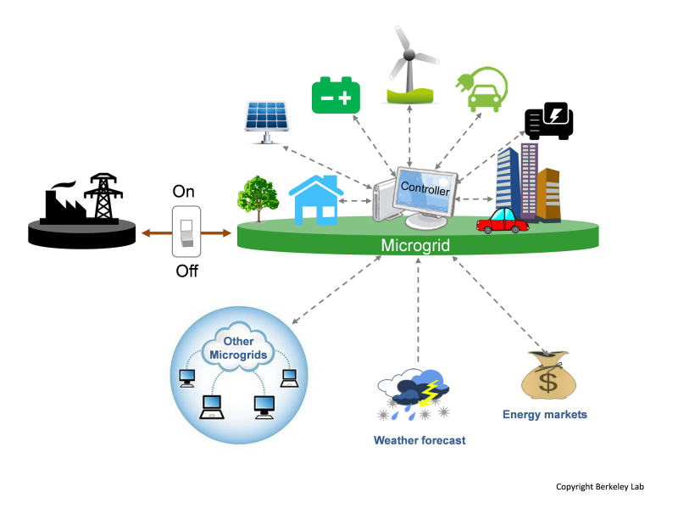
Motivation
Joint optimal scheduling for gird-connected and islanded operation

Slide 27










System model
Main grid
…
Microgrid 1
Microgrid 2
Microgrid N
Power balance constraints
Self generation
Power from main grid
Power from neighbors

Slide 28
Islanded operation
Main grid
…
Microgrid 1
Microgrid 2
Microgrid N

Slide 29

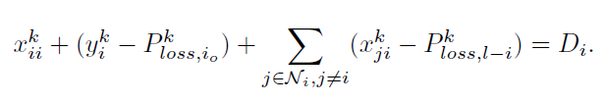


Islanded constraints
For microgrid in islanded mode
Fraction of load curtailment
For microgrid in normal mode
Ramping constraints

Slide 30
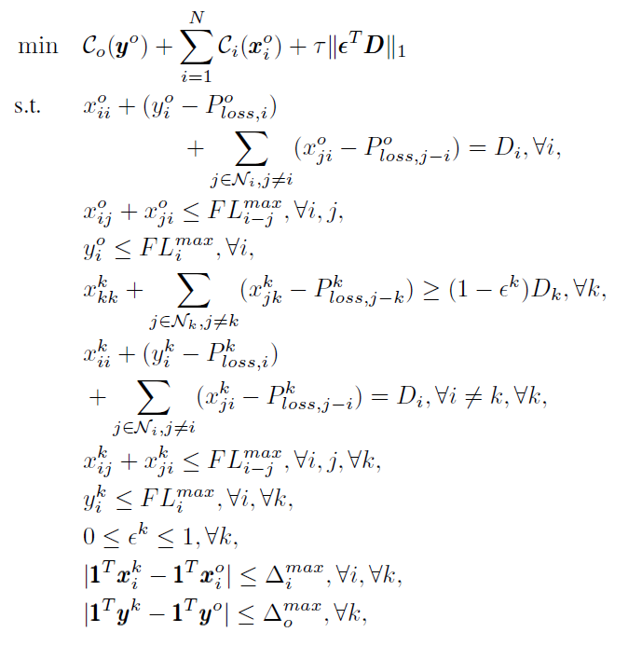
Problem formulation
Microgrid generation cost and load curtailment minimization problem
Large-scale problem

Slide 31
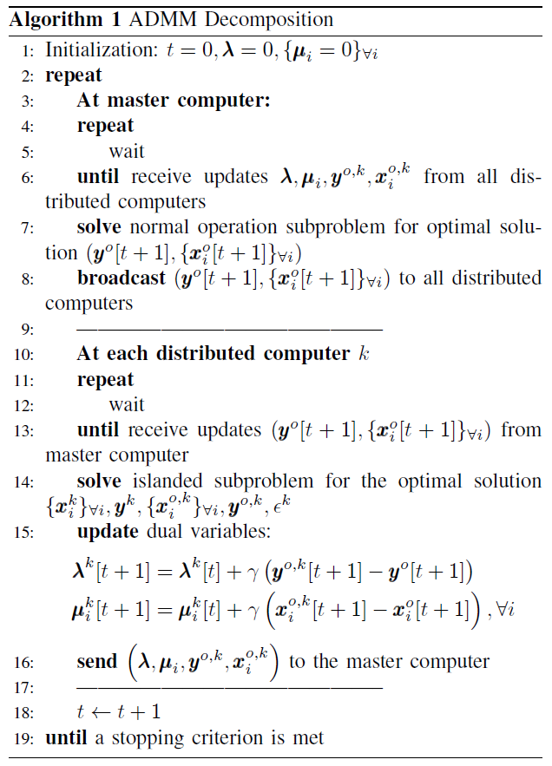


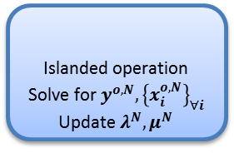

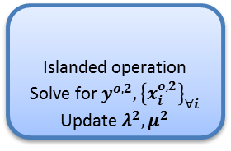

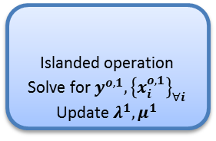

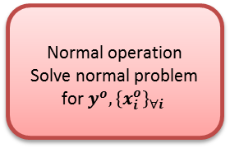

Parallel algorithm
Normal operation
Solve normal problem for $y^{o},{\left\{x_{i}^{o}\right\}}_{∀i}$
Master computer
$y^{o,1}, {\left\{x_{i}^{o,1}\right\}}_{∀i}$,$λ^{1},μ^{1}$
$$y^{o}{,\left\{x_{i}^{o}\right\}}_{∀i}$$
$y^{o}{,\left\{x_{i}^{o}\right\}}_{∀i}$
$$y^{o}{,\left\{x_{i}^{o}\right\}}_{∀i}$$
$y^{o,2}, {\left\{x_{i}^{o,2}\right\}}_{∀i}$,$λ^{2},μ^{2}$
$y^{o,N}, {\left\{x_{i}^{o,N}\right\}}_{∀i}$,$λ^{N},μ^{N}$
Computer 1
Computer 2
Computer N
Islanded operation
Solve for $y^{o,1}, {\left\{x_{i}^{o,1}\right\}}_{∀i}$
Update $λ^{1},μ^{1}$
Islanded operation
Solve for $y^{o,2}, {\left\{x_{i}^{o,2}\right\}}_{∀i}$
Update $λ^{2},μ^{2}$
Islanded operation
Solve for$y^{o,N}, {\left\{x_{i}^{o,N}\right\}}_{∀i}$
Update $λ^{N},μ^{N}$

Slide 32
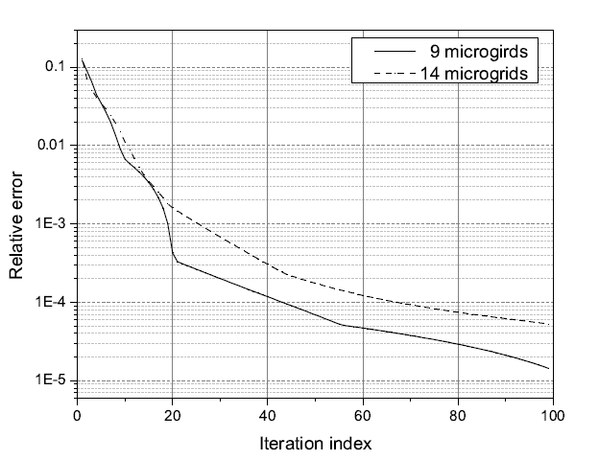
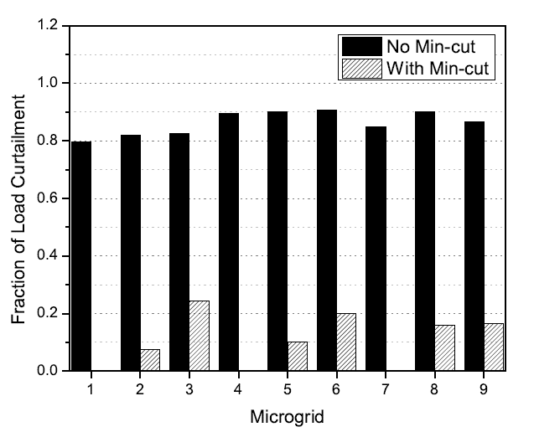
Simulation results
Converge to optimum after about 40 iterations
The fraction of load curtailment
when switching into the islanded mode: sparse number of microgrids have to reduce loads

Slide 33
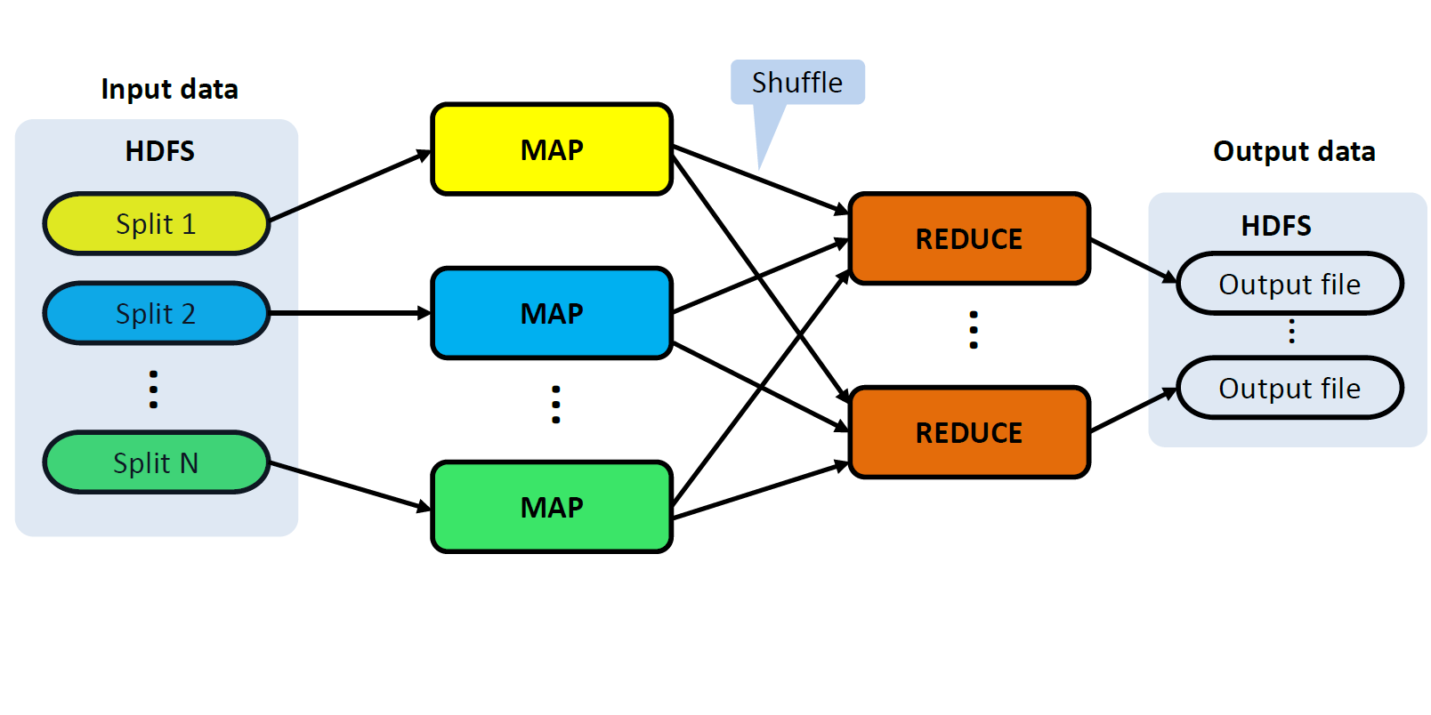
Big data algorithm implementation
MapReduce programming model
Normal operation
Solve normal problem for $y^{o},{\left\{x_{i}^{o}\right\}}_{∀i}$
Master computer
Islanded operation
Solve for $y^{o,1}, {\left\{x_{i}^{o,1}\right\}}_{∀i}$
Update $λ^{1},μ^{1}$
Computer 1
Islanded operation
Solve for $y^{o,2}, {\left\{x_{i}^{o,2}\right\}}_{∀i}$
Update $λ^{2},μ^{2}$
Computer 2
Islanded operation
Solve for$y^{o,N}, {\left\{x_{i}^{o,N}\right\}}_{∀i}$
Update $λ^{N},μ^{N}$
Computer N

Slide 34
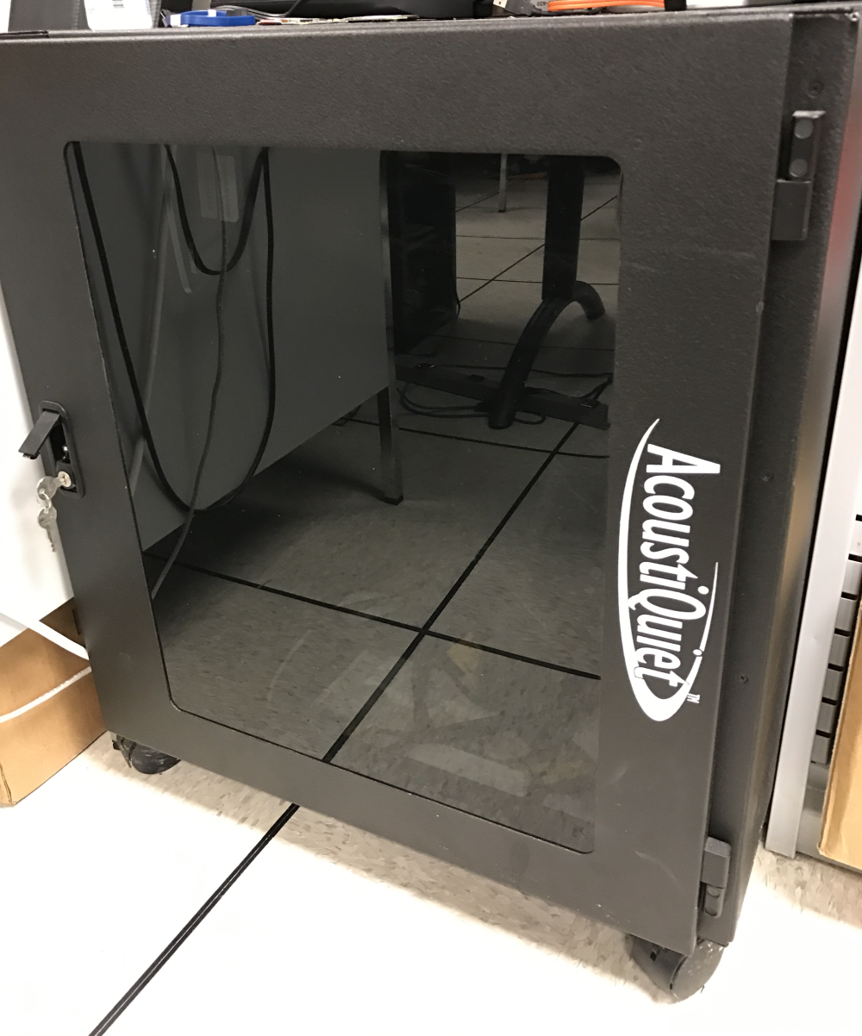
MapRedcue algorithm for ADMM

Slide 35
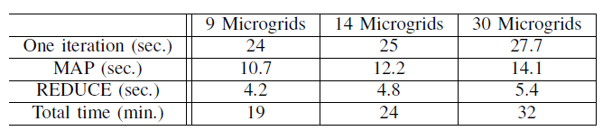
Running time on cluster
Faster with a larger number of microgrids

Slide 36
Outline
Introduction and motivation
Research works
  Incentive mechanism for peak ramp minimization
  Big data algorithm for microgrid optimal scheduling
  Other works
Future work
Conclusions

Slide 37
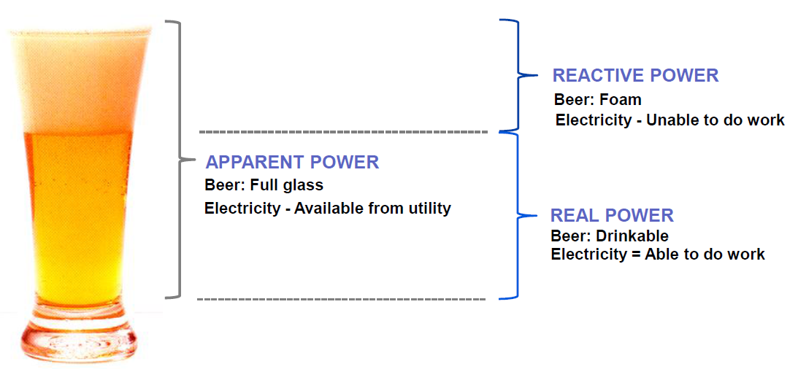

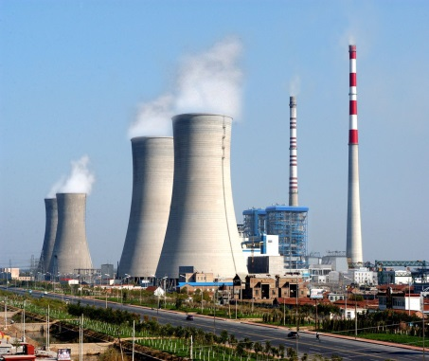



Decentralized reactive power compensation
Active power
reactive power
Is better than

Slide 38
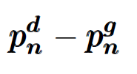

System model
0
n-1
n
n+1
N
Reactive power injection
P_{n} + jQ_{n}
P_{n+1} + jQ_{n+1}
demand
generation

Slide 39
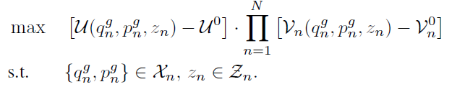
Nash bargaining solution
Optimization problem for NBS
company’s payoff
user’s payoff

Slide 40
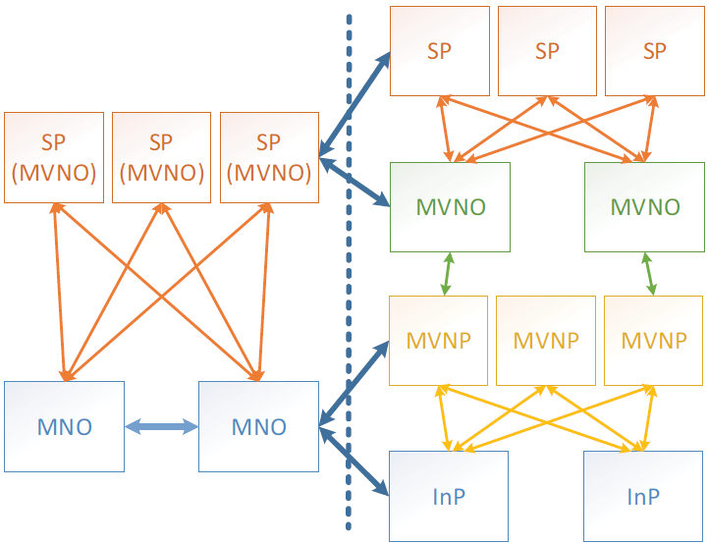
Resource allocation for
wireless network virtualization
Virtualization has become a popular concept in different areas: virtual memory, virtual machines…
Wireless network virtualization:
  Network infrastructure is decoupled from the services that it provides
InP: owns the infrastructure and wireless network resources
SP: concentrates on providing services to its subscribers
MVNP: leases the network resources and creates virtual resources
MVNO: operates and assigns the virtual resources to SPs

Slide 41
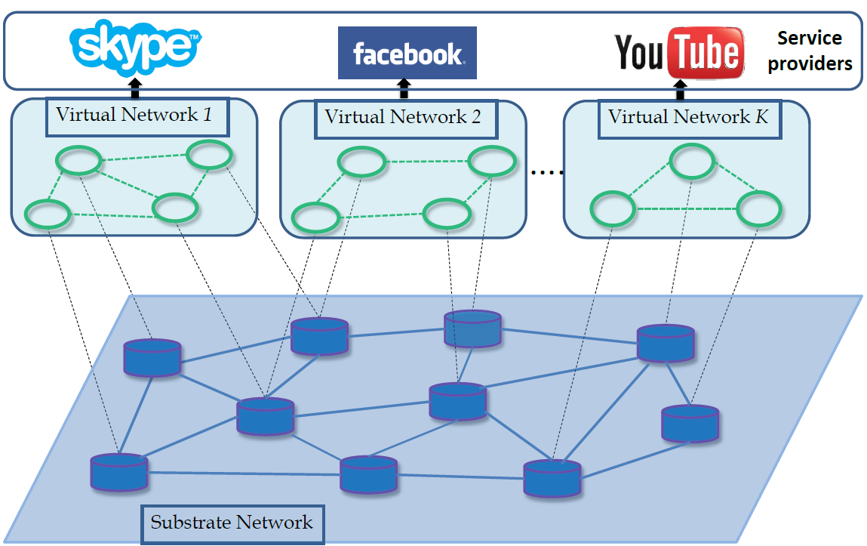
Network Model

Slide 42
Preventive traffic disruption
original routing flow
New routing flow
Substrate link failure

Slide 43
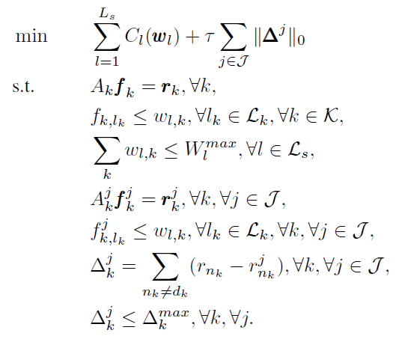
Resource allocation problem
Optimization problem for preventive traffic disruption model
Normal state
Link failure state

Slide 44
Outline
Introduction and motivation
Research works
  Incentive mechanism for peak ramp minimization
  Big data algorithm for microgrid optimal scheduling
  Other works
Future work
Conclusions

Slide 45

Prosumers
3
1
1
1
2
2
Future state based on evolving energy landscape
  More automated and digital, with more sophisticated voltage control and protection schemes
  Facilitates increasing renewables & two-way power flow
  Cyber mitigation must be included
1
1
2
2
1
3

Slide 46

Local energy trading
Economic + control

Slide 47
Economic & Robustness Optimization
There is a fundamental trade-off between economic efficiency and robustness –we’re now also trying to resolve this system problem in a larger spatial and time context.
High
Economics + controls
What are the range of options?
An what is an acceptable set of solutions?
Economic Optimization
Low
Low
Operational Robustness
High

Slide 48
Conclusions
Big data optimization for distributed resource management in smart grid and wireless network virtualization
Benefit for microgrids and users
Improved system reliability and security

Slide 49
Publications
Journal:
H. K. Nguyen, A. Khodaei and Z. Han, "Incentive Mechanism Design for Integrated Microgrids in Peak Ramp Minimization Problem," IEEE Transaction on Smart Grids, accepted.
H. K. Nguyen, Y. Zhang, Z. Chang and Z. Han,, "Parallel and Distributed Resource Allocation with Minimum Traffic Disruption for Wireless Network Virtualization," in IEEE Transactions on Communications, vol. 65, no. 3, pp. 1162-1175, Mar. 2017.
H. K. Nguyen, A. Khodaei and Z. Han, "A Big Data Scale Algorithm for Optimal Scheduling of Integrated Microgrids," in IEEE Transaction on Smart Grids, accepted.
H. K. Nguyen, H. Mohsenian-Rad, A. Khodaei, and Z. Han, "Decentralized Reactive Power Compensation using Nash Bargaining Solution," in IEEE Transaction on Smart Grids, accepted.
H. K. Nguyen, J. B. Song, and Z. Han, "Distributed Demand Side Management with Energy Storage in Smart Grid," in IEEE Transaction on Parallel and Distributed Systems, vol.26, no.12, pp.3346-3357, Dec., 2015
X. Niu, J. Sun, H. K. Nguyen, Z. Han, “Privacy-preserving Computation for Large-scale Security-Constrained Optimal Power Flow Problem”, to be submitted to IEEE Transaction on Parallel and Distributed Systems
Y. Yu, H. K. Nguyen, Z. Han, “Distributed Resource Allocation for Network Function Virtualization based on Benders decomposition and ADMM”, to be submitted to IEEE Transaction on Wireless Communication
G. M. Santos, H. K. Nguyen, M. P. Arnob, Z. Han, W. Shih, “Compressed sensing hyperspectral imaging in the 1-2.5um near-infrared wavelength range using digital micro-mirror device and InGaAs linear array detector”, to be submitted
H. K. Nguyen, A. Khodaei and Z. Han, “Distributed energy trading for prosumers in Transactive Energy,” in preparation
Conference:
H. K. Nguyen, A. Khodaei, and Z. Han, "Distributed Algorithms for Peak Ramp Minimization Problem in Smart Grid," 2016 IEEE International Conference on Smart Grid Communications (SmartGridComm), Sydney, 2016, pp. 174-179.
H. Xu, H. K. Nguyen, X. Zhou, Z. Han, “Stackelberg Differential Game based Charging Control of Electric Vehicles in Smart Grid,” submitted to IEEE Globecom 2017

Slide 50
Thank You!
Question
&
Answer

