Slide 1
Department of Electrical and Computer Engineering
Multi-Block ADMM for Big Data Optimization in Smart Grid
Lanchao Liu and Zhu Han
Department of Electrical and Computer Engineering
Department of Computer Science
University of Houston
Supported by Centerpoint, LLC and Direct Energy, LLC
through electric power analytics consortium
Supported by NSF CMMI-1434789

Slide 2
Outline
Introduction for big data and smart grid
Alternating Direction Method of Multipliers (ADMM) Basics
Direct Extension to Multi-block
Gauss-Seidel Type Extension
Jacobian Type Extension
Multi-block ADMM
Variable Splitting ADMM
ADMM with Gaussian Back Substitution
Proximal Jacobian ADMM
Summary of All Variations
Case Study: SCOPF for Smart Grid Security
Security-constrained Optimal Power Flow Problem (SCOPF)
Conclusion

Slide 3
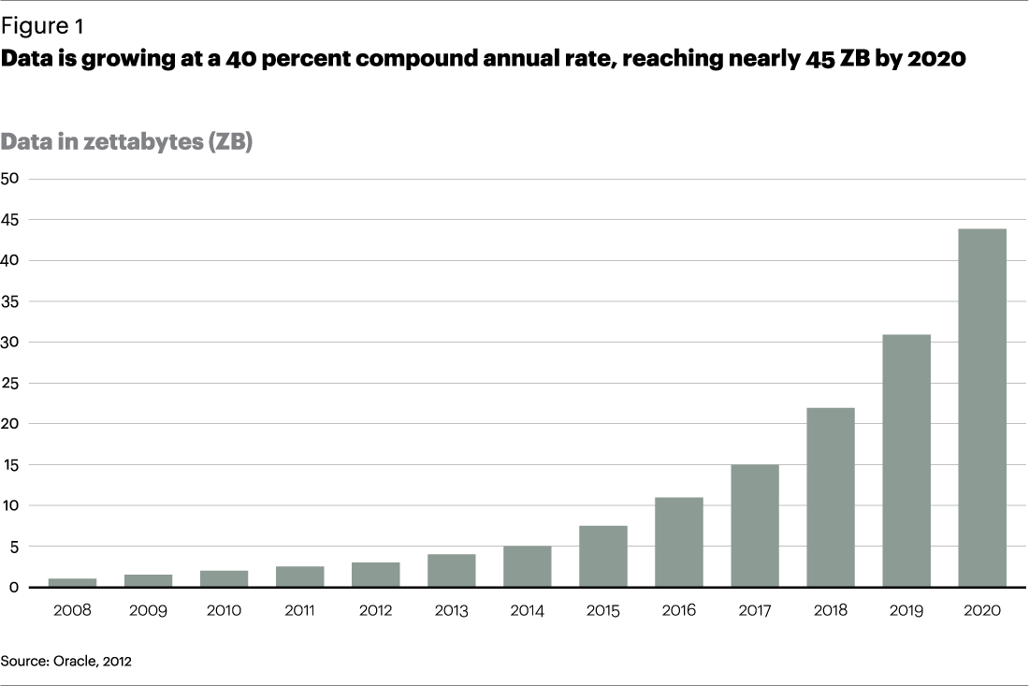
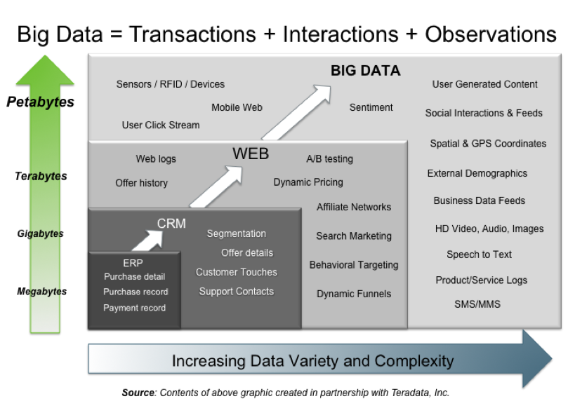
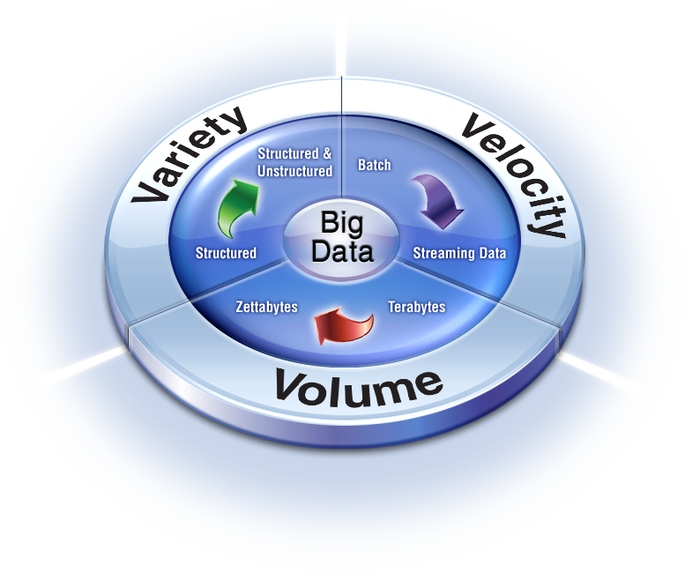
Big Data
Size of data increases exponentially
Types of data are very heterogeneous
Technology makes it possible to analyze ALL available data
Need to calculate fast
Key dimensions
Volume, Velocity and Variety

Slide 4
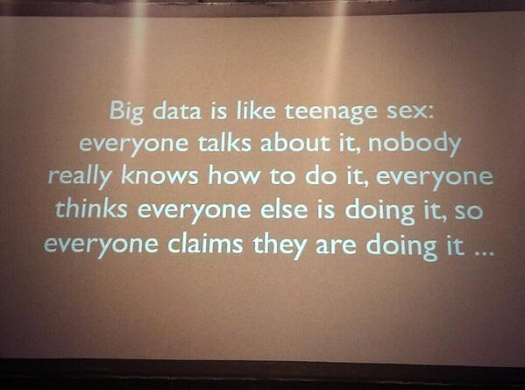
However
Nobody knows exactly how to handle big data
We zoom in one algorithm and one application
Alternating Direction Method of Multipliers (ADMM)
Security-constrained Optimal Power Flow Problem

Slide 5
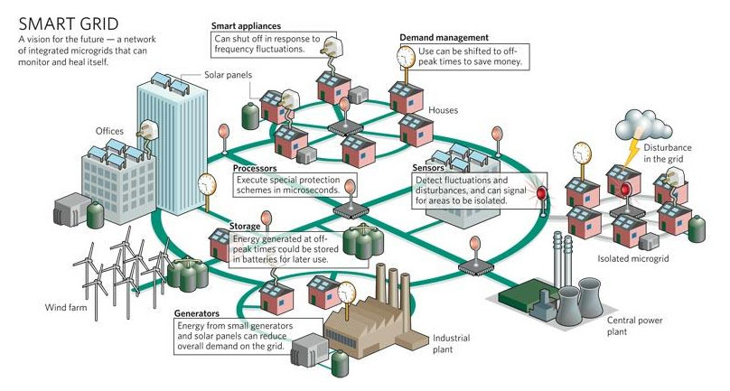
Smart Grid (SG)
In 2009, “American Recovery and Reinvestment Act”
$3.4 billion for SG investment grant program
$615 million for SG demonstration program
It leads to a combined investment of $8 billion in SG capabilities.
Utility and service companies have a lot of big data, but they do know how to use

Slide 6
Outline
Introduction for big data and smart grid
Alternating Direction Method of Multipliers (ADMM) Basics
Direct Extension to Multi-block
Gauss-Seidel Type Extension
Jacobian Type Extension
Multi-block ADMM
Variable Splitting ADMM
ADMM with Gaussian Back Substitution
Proximal Jacobian ADMM
Summary for All Variations
Case Study: SCOPF for Smart Grid Security
Security-constrained Optimal Power Flow Problem (SCOPF)
Conclusion

Slide 7
ADMM Basics
Divide one problem into multiple subproblems
Augmented Lagrangian function with quadratic penalty
ADMM embeds a Gauss-Seidel decomposition:
The third step is consensus that needs to be exchanged.
Each iteration is not feasible, converge O(1/k) speed
California Government
Texas Government
US Congress

Slide 8
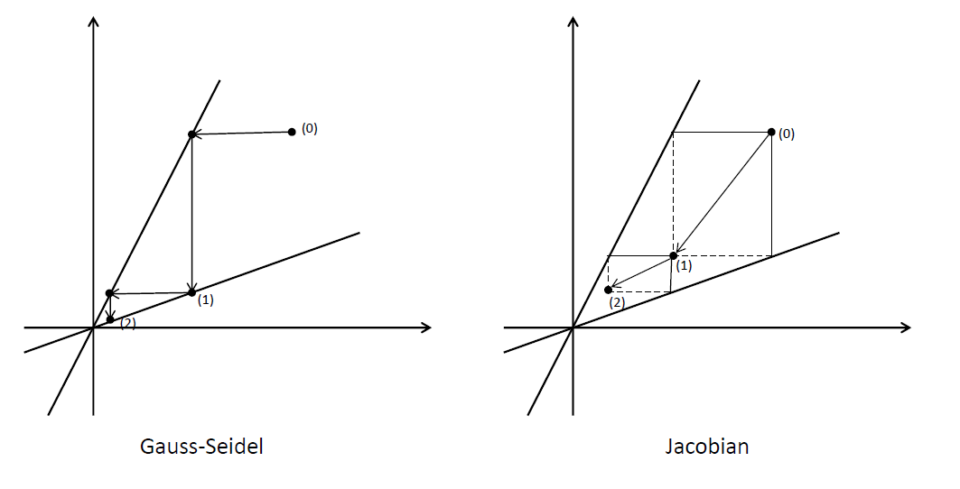
Guass-Seidel v.s. Jacobian
Solve the linear system Ax = b.

Slide 9
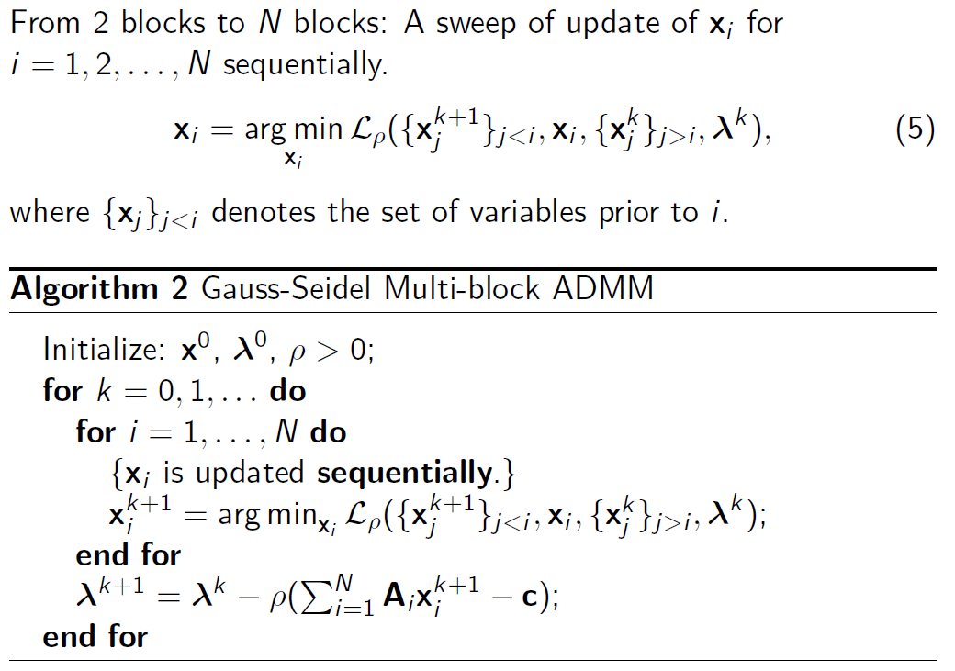
Gauss-Seidel type extension

Slide 10
Gauss-Seidel Type Extension
Direct extension of Gauss-Seidel multi-block ADMM is not necessarily convergent.
Hong proved the convergence of Algorithm 2 with sufficient small step size for Lagrangian multiplier update and additional assumptions on the problem.
Ye conjugates that an independent uniform random permutation of the update order for blocks in each iteration will result in a convergent iteration scheme.
Some slightly modified versions of Algorithm 2 with provable convergence and competitive iteration simplicity and computing efficiently have been proposed.

Slide 11
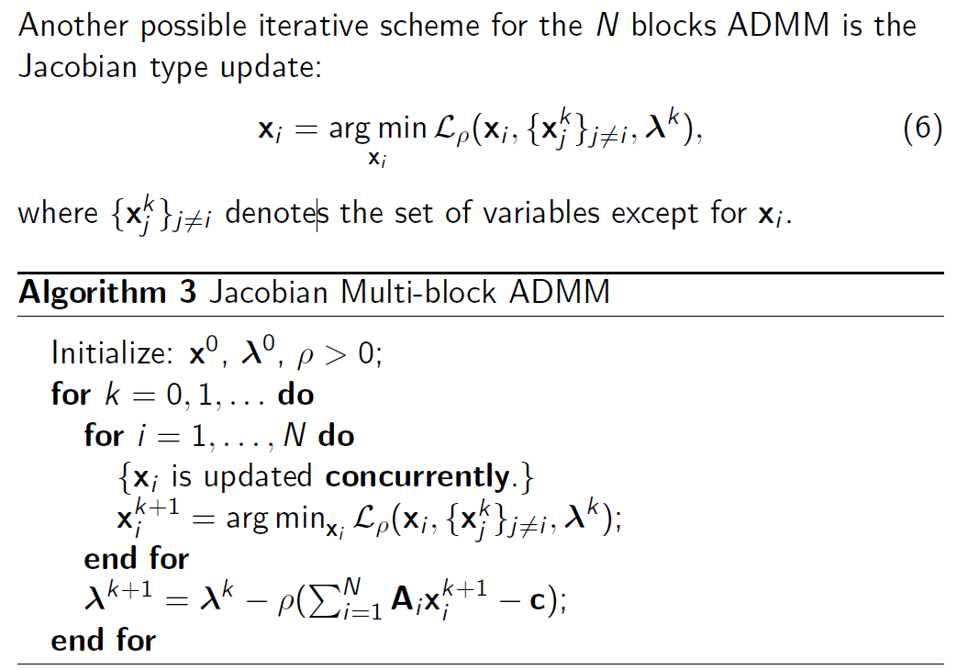
Jacobian Type Extension

Slide 12
Jacobian Type Extension
More computational efficient in the sense of parallelization.
Algorithm 3 is not necessarily convergent in the general case, even in the 2 blocks case.
Yin proves that if matrices Ai are mutually near-orthogonal and have full column-rank, the Algorithm 3 converges globally.
A proximal Jacobian ADMM with provable convergence is also proposed.

Slide 13
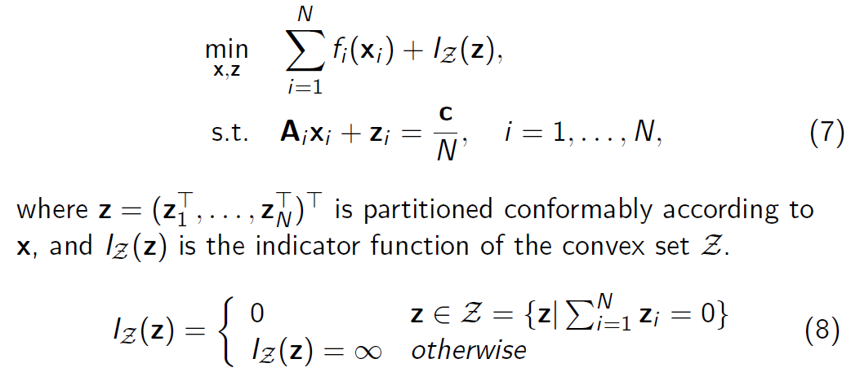
Variable Splitting ADMM
The optimization problem can be reformulated by introducing auxiliary variable z to deal with the multi-block case.

Slide 14
Variable Splitting ADMM

Slide 15
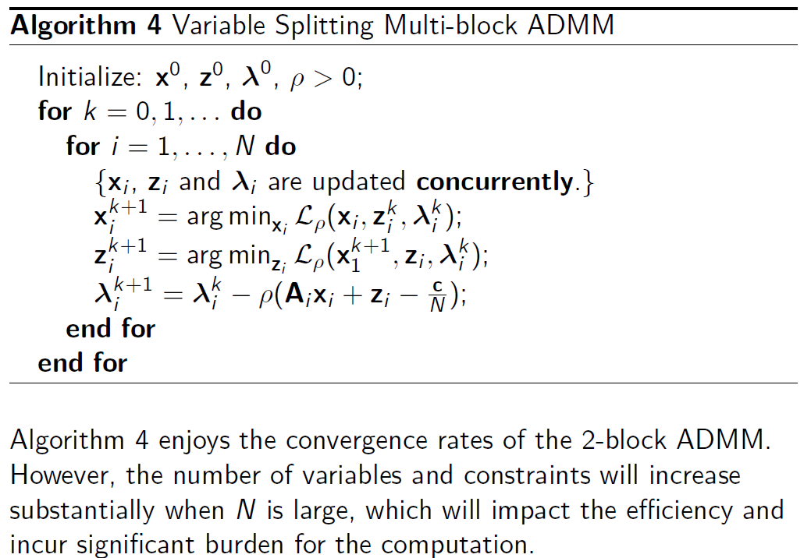
Variable Splitting ADMM

Slide 16
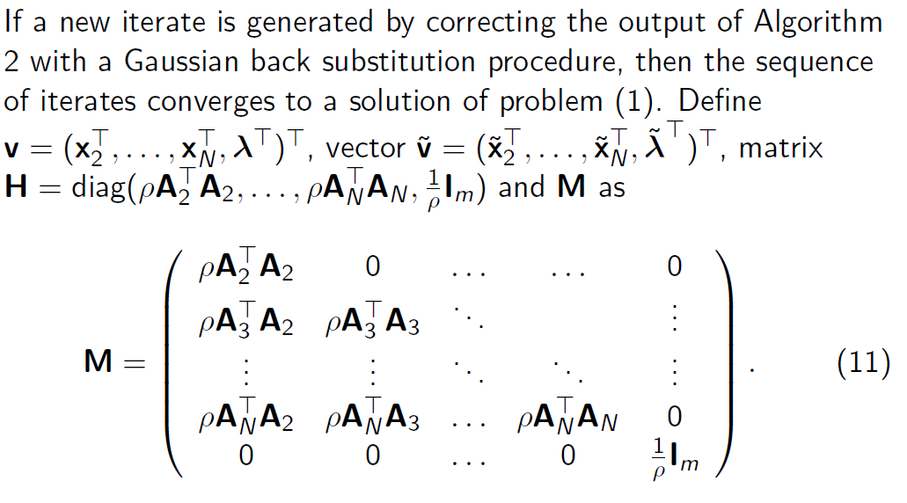
ADMM with Gaussian Back Substitution

Slide 17
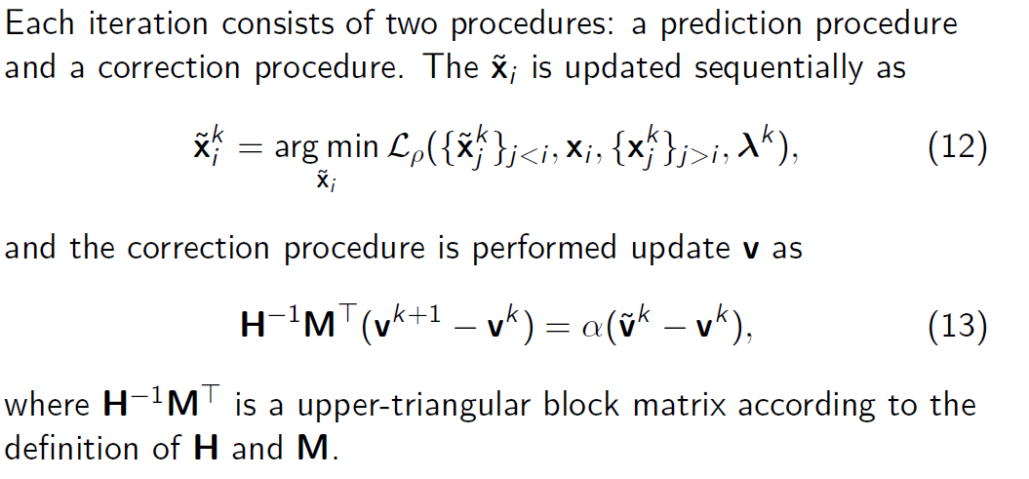
ADMM with Gaussian Back Substitution

Slide 18
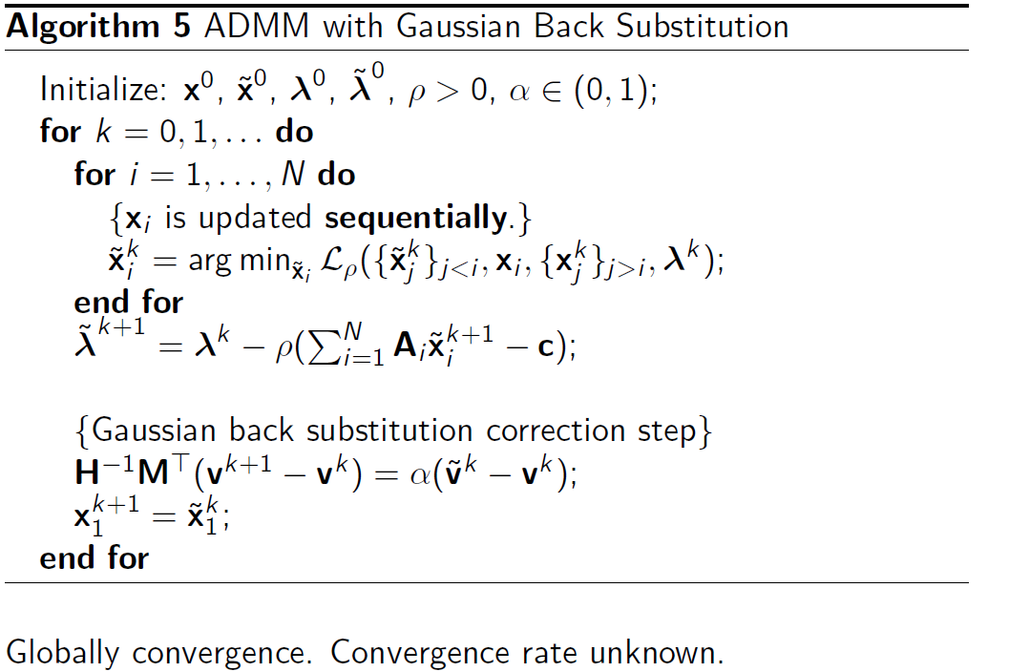
ADMM with Gaussian Back Substitution

Slide 19
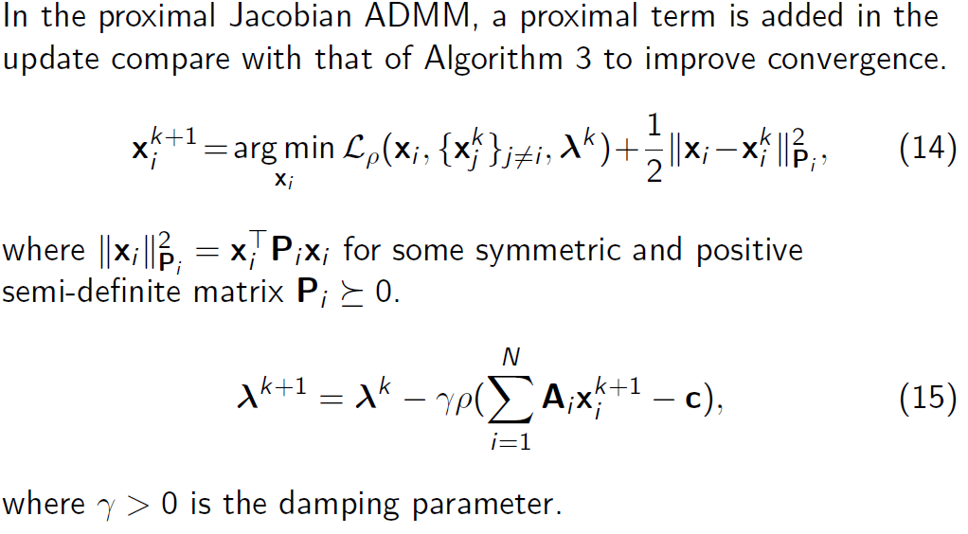
Proximal Jacobian ADMM

Slide 20
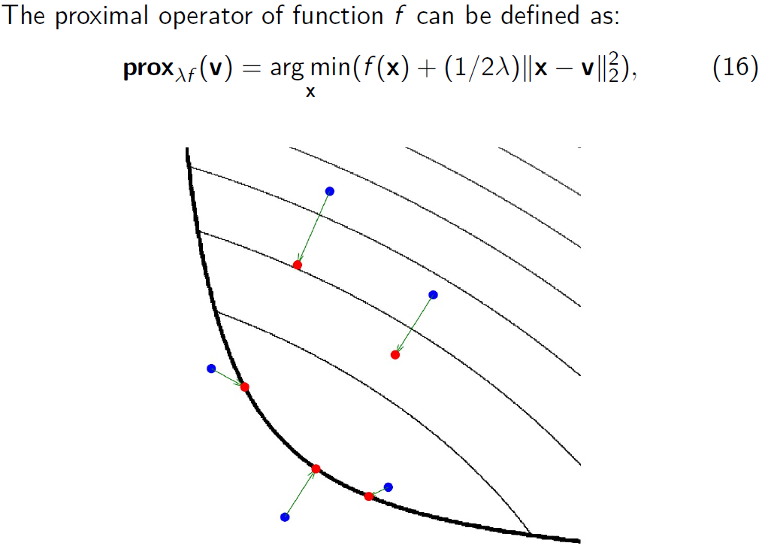
Proximal Operator
Feasibility
Boundary
Penalty for Large Step
Can Suffer infeasibility

Slide 21
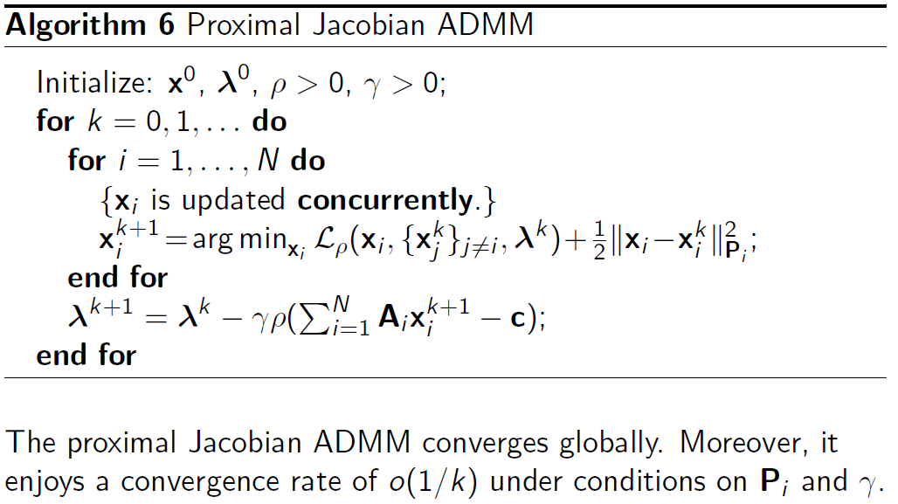
Proximal Jacobian ADMM

Slide 22
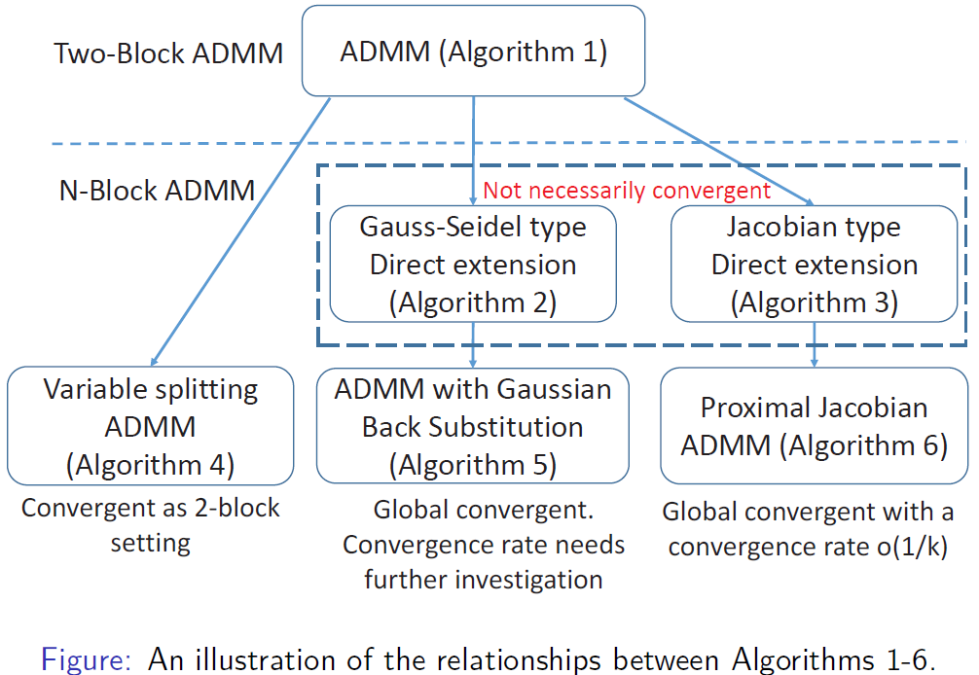
Summary For Different Types

Slide 23
Outline
Introduction for big data and smart grid
Alternating Direction Method of Multipliers (ADMM) Basics
Direct Extension to Multi-block
Gauss-Seidel Type Extension
Jacobian Type Extension
Multi-block ADMM
Variable Splitting ADMM
ADMM with Gaussian Back Substitution
Proximal Jacobian ADMM
Summary of All Variations
Case Study: SCOPF for Smart Grid Security
Security-constrained Optimal Power Flow Problem (SCOPF)
Conclusion

Slide 24
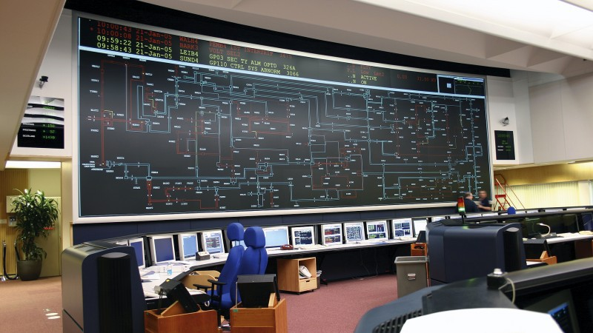
Contingency Analysis in Power Grid
Contingency analysis
Assess the ability of the power grid to sustain component failures.
Currently focused on mostly select “N-1” scenarios.
Security-constrained Optimal Power Flow Problem (SCOPF)
Determines the optimal control of power systems under constraints arising from a set of postulated contingencies
Supervisory Control and
Data Acquisition
(SCADA) Center

Slide 25
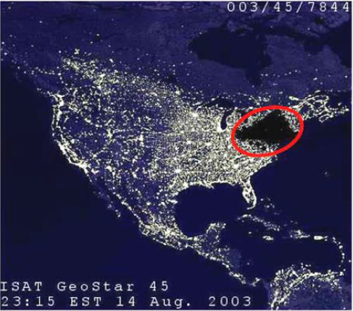
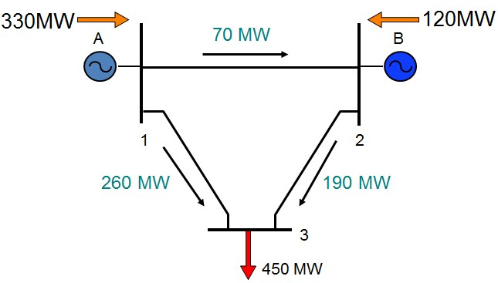
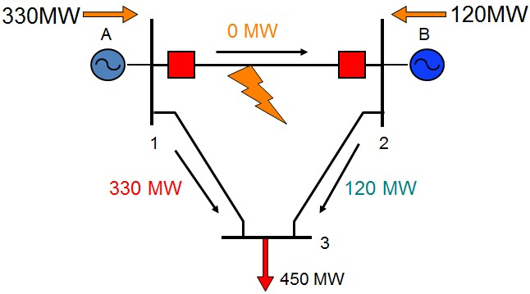
Security-constrained Optimal Power Flow
Example
Limit 300MW
Base Case
Contingency Case
Unacceptable because overload of line 1-3 could lead to a cascade trip and a system collapse

Slide 26
Security-constrained Optimal Power Flow
Scheduling Objective
Power flow equations for
base case, Kirchoff's law
Subject to:
Operating limits for the base case
Power flow equations for contingency k
Operating limits for contingency k
Security constrained
Subscript 0 indicates value of variables in the base case
Subscript k indicates value of variables for contingency k

Slide 27
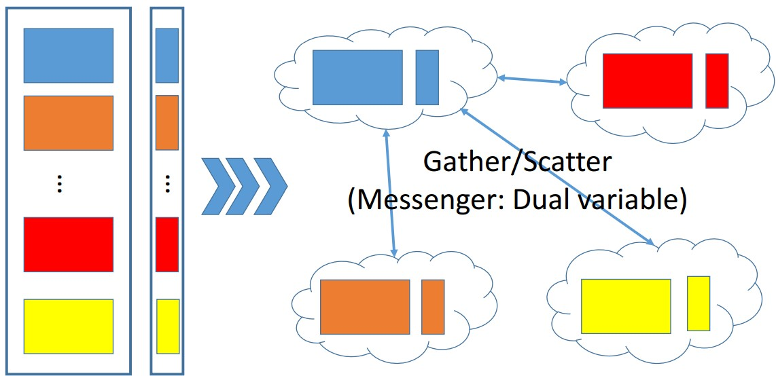
SCOPF Using ADMM
Base Case
Contingency 1
Contingency 2
Contingency K
Implemented on High Performance Center in UH using Message Passing Interface

Slide 28
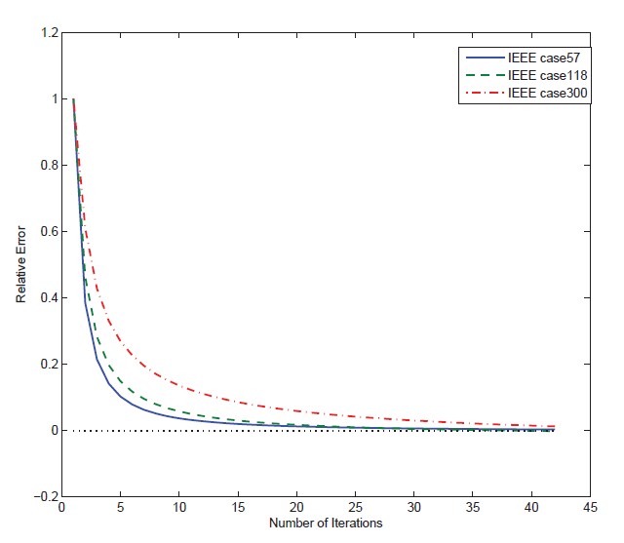
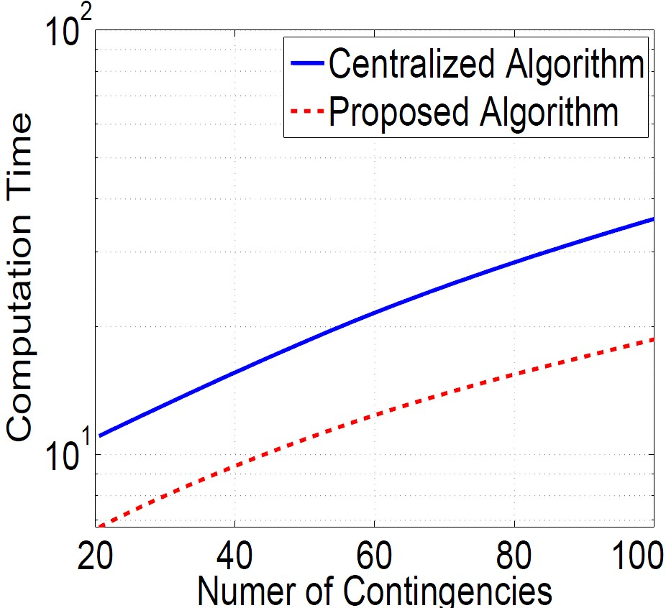
Results
Converge to the optimal solution
Speed up the computation of the optimization problem
Even faster for a sufficiently accurate solution
Lanchao Liu, Amin Khodaei, Wotao Yin, and Zhu Han, “A Distribute Parallel Approach for Big Data Scale Optimal Power Flow with Security Constraints," IEEE SmartGridComm, Vancouver, CA, October 2013

Slide 29
Conclusion
Big data is a very hot topic today
but hard to define problems
Smart grid is another hot topic, with a lot of big data
But the utility and service companies do not know how to use
Zoom in
Alternating direction method of multipliers (ADMM)
Security-constrained Optimal Power Flow Problem (SCOPF)
Multiblock ADMM
Investigate 6 Algorithms
Multi-block ADMM is not necessarily convergent.
Sophisticated modifications are needed to ensure convergence.
Large-scale computing facilities are ready for the “big data“ optimization.
Applications are prevalent.
Only touch trivial parts of the whole picture

Slide 30
Ad and Thanks
Many slides are available on http://wireless.egr.uh.edu/research.htm
Dan Wang and Zhu Han, “Sublinear Algorithms for Big Data Applications,” in print, Springer Science + Business Media, LLC.
Zhu Han, Mingyi Hong, and Dan Wang, Signal Processing and Networking for Big Data Applications, contract with Cambridge University Press, UK.

