Slide 1
Installation Guide of GNU RADIO On Ubuntu
By,
Sathya S.
Tushar A.
Kiran K.
Veera B.

Slide 2
SOFTWARE RADIO
A software (defined) radio is a radio that includes a transmitter in which the operating parameters of the transmitter, including the frequency range, modulation type or maximum radiated or conducted output power can be altered by making a change in software without making any hardware changes.
A technique for moving digital signal processing as close as
possible to the antenna.
Replacing rigid Hardware with flexible software based solutions.

Slide 3
What is GNU radio
Free software toolkit for:
Building and deploying software radios
Creating new kinds of radios, modulations, protocols, development environments...
GNU Radio is a free software toolkit for learning about, building, and deploying software-defined radio systems.

Slide 4
Framework
An open source software toolkit
Supports, Linux, Mac OS and Windows
Creating signal processing applications
Defining waveforms in software
Processing waveforms in software
A hardware platform
USRP,
USRP 2

Slide 5
Free Software
All the software are free (Python and C++ source code/Linux environment)
In most condition, no need expensive RF test machine.
Only a development board needed (Universal Software Radio Peripheral 2)
Flexible
Software:
Reconfigurable for many other modulation methods for both standardize radio or self-defined radio.
Hardware:
Rx and Tx are selectable .
Intermediate frequency is controllable.

Slide 6
Extensive Knowledge Involved
Software and Environment:
Python/Numeric python library/wxPython
C++/boost C++ libraries
Linux environment and lots of support packages: FFTW/cppunit/SWIG/SDCC/
GNU Radio architecture
Communications and RF:
DSP
Digital communications
Wireless communications theory
FPGA and Assemble language may be used

Slide 7
STEPS INVOLVED IN INSTALLATION AND SETUP OF GNURADIO

Slide 8
Step: 1- Upgrading Ubuntu 9.04 (Jaunty Version)
# apt–get update
Step: 2- Install Required Packages
sudo apt-get -y install swig g++ automake1.9 libtool python2.5-dev fftw3-dev \ libcppunit-dev libboost1.35-dev sdcc-nf libusb-dev \ libsdl1.2-dev python-wxgtk2.8 subversion git guile-1.8-dev \ libqt4-dev python-numpy ccache python-opengl libgsl0-dev \ python-cheetah python-lxml doxygen qt4-dev-tools \ libqwt5-qt4-dev libqwtplot3d-qt4-dev pyqt4-dev-tools

Slide 9
Step: 3- Installing Boost (required for lower versions)
# cd boost_1_36_0 # BOOST_PREFIX=/usr/bin/boost # ./configure --prefix=/usr/bin/boost --with-libraries=thread, date_time # make # make install

Slide 10
Step: 4- Downloading & Compiling GNU Radio
Install GNU Radio either from: -SVN svn co http://gnuradio.org/svn/gnuradio/trunk gnuradio or from git: -git clone http://gnuradio.org/git/gnuradio.git cd gnuradio -export LD_LIBRARY_PATH=$BOOST_PREFIX/lib # As per the instructions for installing Boost -./bootstrap -./configure --with-boost=$BOOST_PREFIX # As per the instructions for installing Boost -make -make check -sudo make install
Ref. [2]

Slide 11
Step 5:Logging in as root
Why as Root?
- Its easy to access secured files when as root.
Also we can access hardware components and drivers easily.
How to do so?
- Under the home directory of terminal command “su” will let us into the root directory which will thereby prompt us the root password which is set under our discretion.
- To exit the root use ctrl + d

Slide 12
Step: 6- Testing
When in root:
Verify if the USRP2 is avaliable to Ubuntu:
#find_usrps
If USRP2 is connected the following result is displayed:
00:50:c2:85:32:95 hw_rev = 0xo400
Verify if GNU Radio works with the USRP:
Python interface to USRP
# cd gnuradio-examples/python/usrp # ./usrp_benchmark_usb.py
C++ interface to USRP
# cd usrp/host/apps # ./test_usrp_standard_tx # ./test_usrp_standard_rx

Slide 13
Error correction on linking phase
1) Make a copy from the current ld.so.conf file and save it in a temp folder:
2) Add /usr/local/lib path to it :
3) If you installed Boost (version 1_37_0 for example) manually, then add its library path to the file:
4) Delete the original ld.so.conf file and put the modified file instead:
5) Do ldconfig:
cp /etc/ld.so.conf /tmp/ld.so.conf
echo /usr/local/lib >> /tmp/ld.so.conf
echo /opt/boost_1_37_0/lib >> /tmp/ld.so.conf
sudo mv /tmp/ld.so.conf /etc/ld.so.conf
sudo ldconfig

Slide 14
Demonstrations

Slide 15
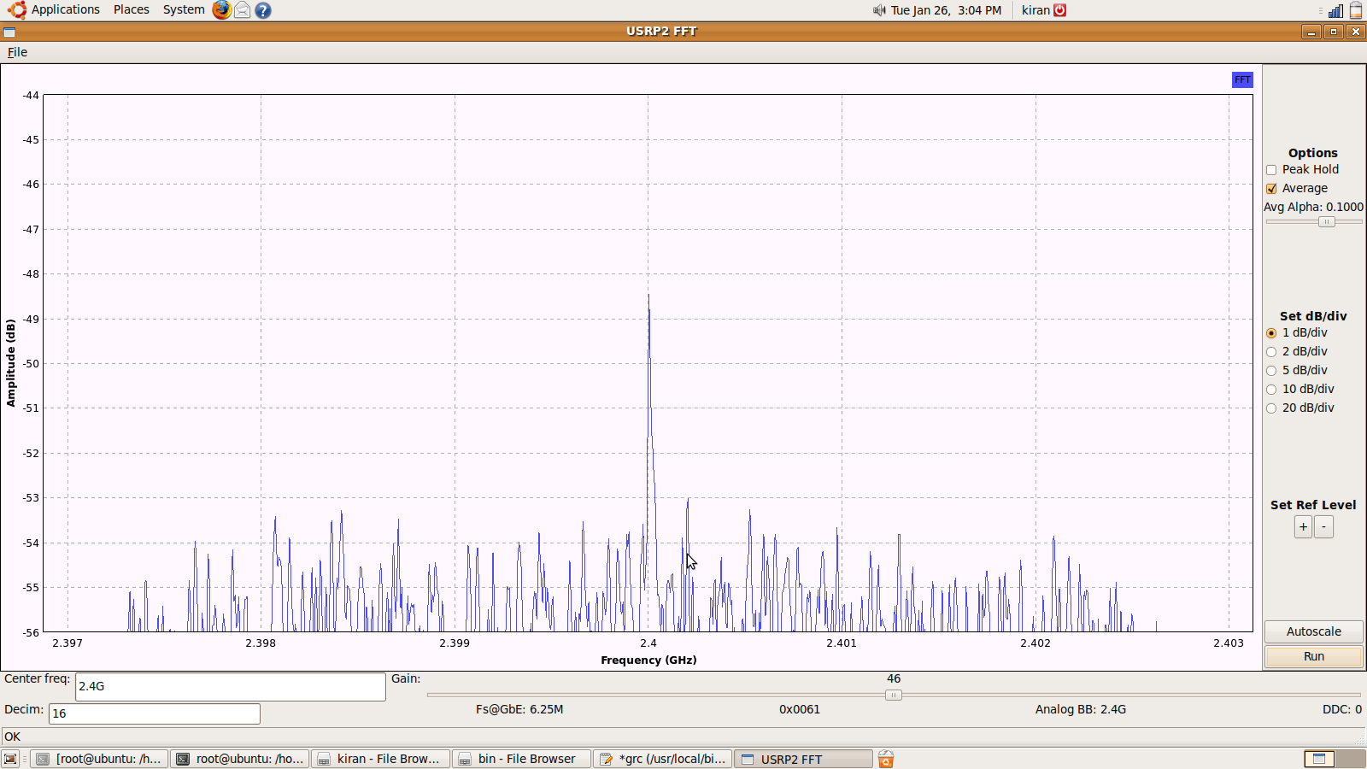
Experiment: 1
Fast Fourier Transform
# cd gnuradio-3.2.2/gnuradio-examples/python/usrp2 #./usrp2_fft.py -R B -d 250 –f 2.4G –g 10

Slide 16
References
http://gnuradio.org/download
http://gnuradio.org/redmine/wiki/gnuradio/UbuntuInstall
http://www.wu.ece.ufl.edu/projects/softwareRadio/documents/Library_20061129.doc.

Slide 17
THANK YOU

