Slide 1
Compressive Sensing in Wireless Communications
Ph. D Dissertation Defense
Presented by: Jia (Jasmine) Meng
Committee Chair: Dr. Zhu Han
Wireless Networking, Signal Processing & Security Lab
University of Houston, USA
November 15, 2010
Notes:
1
1

Slide 2
Acknowledgement
Advisor:
  Dr. Zhu Han
Coauthors:
  Dr. Wotao Yin, Dr. Ekram Hossain, Dr. Husheng Li, Dr. Javad Ahmadi-Shokouh, Dr. E. Joe Charlson, Dr. Sima Noghanian, and Dr. Yinying Li.
Committee members:
  Dr. Richard Liu, Dr. Haluk Ogmen, Dr. Lijun Qian, Dr. Wotao Yin, and Dr. Rong Zheng
Lab mates
Friends and Families

Slide 3
Agenda
Compressive sensing (CS) framework: Brief review
  Basic
  Matrix Form CS
    Joint sparsity model
    Matrix completion
Four CS applications in wireless communications
  App. #1: High resolution OFDM channel estimation
  App. #2: Collaborative spectrum sensing in cognitive radio networks
  App. #3: Low speed ADC for 60 GHz UWB wireless communication
  App. #4: Sparse events detection in wireless sensor networks
Summary of previous work
Future work: Overview

Slide 4
CS Concept
Sparse X
Random linear projection
Dimension reduction from X to Y
Recovery algorithm for ill-posed linear equations
K<m<<n

Slide 5
Compressive Sensing Theory: Summing-up
Compressible signal: Signal sparsity
  A signal is K-sparse if only K of its elements are nonzero (on some basis), usually K<<N.
Linear, incoherent measurement matrix
  We take a measurement of x as , where and is called the measurement matrix;
  guarantees stable recovery.
  has to satisfy the RIP condition;
  In practice, i.i.d. random, Toeplitz or circulant matrices are used as CS measurement matrices;
Two categories of stable recovery algorithms
  ℓ1 norm minimization
  Greedy search
Note: x and Φ can be complex numbers

Slide 6
CS in Matrix Form – Joint Sparsity Model
In many distributed sensing applications, such as sensor networks and arrays, the sensing information often exhibits strong spatial correlations.
In a typical distributed sensing scenario, a number of sensors measure signals that are each individually sparse in some basis and also correlated from sensor to sensor.
A typical joint sparsity matrix form signal :
  All column vectors of signal matrix share the same sparse pattern.

Slide 7
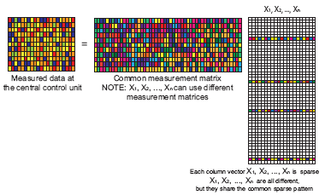
Joint Sparsity Measurement and Recovery
Measurement
  Each column vector take independent CS measurement via independent or common measurement matrix.
Signal recovery algorithm
  Solving weighted ℓ1-norm minimization;
  Using the existing CS signal recovery algorithms.
Merits
  Known or predictable signal sparsity pattern;
  Joint decoding can recover signals using far fewer measurements than those required for independent CS recovery.

Slide 8
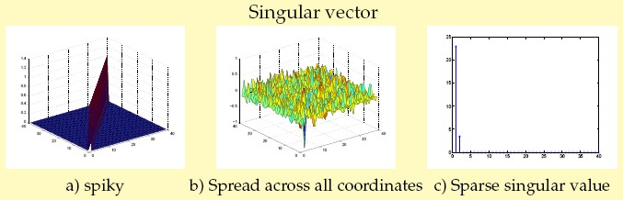
The Art of Matrix Completion
Latest development in mathematics claims that if a matrix satisfies the following conditions, we can fulfill it with confidence from a small number of its uniformly random revealed entries using nuclear norm minimization.
  Low Rank: Only a small number of none-zero singular values;
  Incoherent Property: Singular vectors well spread across all coordinate.

Slide 9
Matrix Completion Resembles Compressive Sensing
Not exactly part of CS framework, but share a similar underlying story
  Matrix should be low rank (limited number of nonzero singular values);
    Resembles the signal sparsity in CS framework;
  Incoherent property (singular vectors are incoherent);
    Resembles the incoherent property for measurement matrix in CS framework;
  Randomly revealed entries;
    Resembles the randomness requirement in CS framework;
  Nuclear norm minimization for signal recovery;
    Resembles the ℓ1-norm minimization in CS framework.

Slide 10
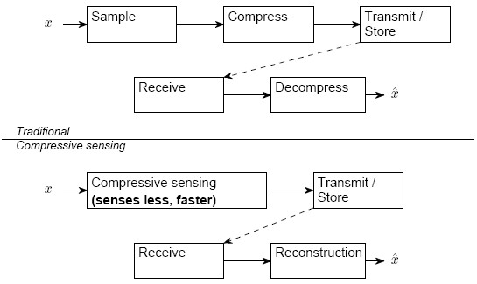
Compressive Sensing Rocks
Data acquisition + Compression + Dimension reduction + Optimization
Either acquire the same data with fewer samples or achieve higher resolution with the same number of samples.

Slide 11
Part II: CS in Wireless Communications
– Targeted Problem Areas
Signal acquisition and processing is technically difficult or expensive:
  Extremely high Nyquist rate;
  ADC cost.
Underlying signal sparsity:
  Time domain;
  Spatial domain;
  Frequency domain.
Linear, incoherent measurement is feasible:
  Note: This is the bottleneck for CS applications.
Goal:
  Reduce sensing redundancy;
  Reduce sensing cost;
  Make distributed sensor networks communicate cheaply.

Slide 12
Contributions
We noticed and took advantage of the underlying signal sparsity in several wireless communication scenarios:
  Sparse channel impulse response in time domain in OFDM system and in 60 GHz UWB communication systems;
  Sparse primary user activity in cognitive radio networks;
  Spatial and time sparsity of sensor activity in wireless sensor networks;
We designed according to the requirement of CS theory unique measurement procedures:
  For OFDM system, we use pilot with random phases to get high resolution channel estimation with low speed ADC;
  For distributed sensing problem in cognitive radio networks, we proposed to equip each CR with a frequency selective filter set and use both the joint sparsity recovery algorithm and matrix completion algorithm for efficient spectrum sensing;
  For 60 GHz UWB communication system, we design a system with random modulator, mixer and integrator to take compressed measurement and thus reduce the ADC speed dramatically;
  For wireless sensor networks, we use a small number of randomly located monitoring tubes to take compressed measurements and decoding with Bayesian framework and heuristic algorithm.

Slide 13
Application #1:
OFDM Channel Estimation
OFDM background
OFDM channel estimation:
  Challenges and current status
OFDM system model
Difficulties for CS to fit:
  Random linear projection is not feasible
  Random sampling is difficult to realize
  ℓ1 minimization may not work well
Solutions:
  Random convolution as CS measurement
  Uniformly down-sample
  CS-OFDM algorithm
Results

Slide 14
OFDM Background
Orthogonal frequency-division multiplexing (OFDM) has been widely applied in wireless communication systems
  High rate transmission capability;
  High bandwidth efficiency;
  Robust with regard to multipath fading and delay.
Pilot (the reference signal known by both transmitters and receivers) assisted channel estimation is widely used;
Two key issues in designing channel estimation scheme for OFDM systems:
  The arrangement of pilot information;
  The design of an estimator with both low complexity and good channel estimation capability.

Slide 15
OFDM Channel Estimation
– Current Status and Challenges
Current Status
  Most of the existing pilot-assisted OFDM channel estimation schemes rely on the use of a large number of pilots to increase to estimation accuracy; the spectral efficiency is therefore reduced.
Challenges
  OFDM system requires fast, accurate (high-resolution), and low-complexity channel estimation;
  Pilot assisted channel estimation suffers from a tradeoff between the spectrum efficiency and the channel estimation accuracy;
  Channel resolution is tightly bounded by ADC speed;
  It is costly to increase ADC speed.

Slide 16
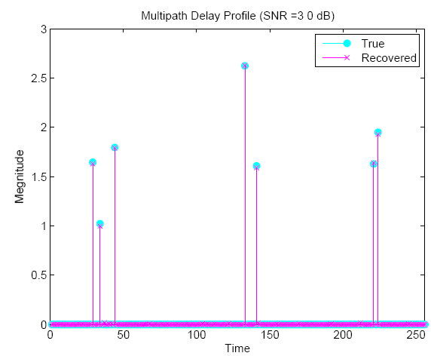
Channel Sparsity
Channel impulse response (CIR) is sparse in the time domain;
CS can help increase channel estimation resolution.

Slide 17
OFDM System
At the transmitter
  XN: input frequency-domain vector
  IDFT(XN) → DAC → xN: time-domain signal
In the air
  xN: signal sent out by source;
  hN: channel impulse response (CIR) has only a small number of spikes;
  xN * hN + ω → zN: time-domain signal arrived at receiver
At the receiver
  zN → ADC→ yM
  DFT(yM) → YM: output frequency vector

Slide 18
Difficulties for CS to Fit
CS favors linear projection with i.i.d. random matrices, which are proven optimal, but OFDM only allows convolution (which is “much less random” );
We want higher resolution channel estimation, which is limited by the ADC speed;
CS favors random sampling, which is difficult to realize on hardware;
General ℓ1 minimization works best for random measurement matrix, which we cannot realize in OFDM system.

Slide 19
Solution – Random Convolution
Math: convolution of signal and channel has an alternative representation:
  Matrix-vector form: , where
  is circulant, denotes the IDFT matrix, and denotes the DFT matrix.
We design X, which is the pilot signal as a complex vector whose entries have uniform magnitude and random phases;
Then we have random convolution;
The similar random convolution has been adopted in several works, with different ways of constructing the matrix C, and has been proved effective and efficient.

Slide 20
Difficulties
CS favors linear projection with i.i.d. sub-Gaussian random sensing, which are proven optimal (in terms of order of magnitude), but OFDM only allows convolution (which is “much less random” );
We want higher resolution channel estimation, which is limited by the ADC speed;
CS favors random sampling, which is difficult to realize on hardware;
General ℓ1 minimization works best for random measurement matrix, which we cannot realize in OFDM system.

Slide 21
Solution – Asymmetric DAC and ADC
Increase DAC speed
  DAC speed can be increased at low cost.
Keep ADC at low speed
  ADC price goes up steeply with the speed increase.
This system design reduced the dimension from input to output (compression);
If we can decode from a few output of low speed ADC, the use of high speed DAC offers high resolution channel estimation.

Slide 22
Difficulties
CS favors linear projection with i.i.d. sub-Gaussian random sensing, which are proven optimal (in terms of order of magnitude), but OFDM only allows convolution (which is “much less random” );
We want higher resolution channel estimation, which is limited by the ADC speed;
CS favors random sampling, which is difficult to realize on hardware;
General ℓ1 minimization works best for random measurement matrix, which we cannot realize in OFDM system.

Slide 23
Solution
– Uniformly Down-sample with Low Speed ADC
We have to use low speed ADC, which actually performed uniform down-sample on convolution results
is very different from partial Fourier sampling :
  Partial Fourier sampling, used by general CS, requires a random sampling locations Ω to avoid the aliasing artifacts in the recovery;
  But the proposed, with random-phased X, permits both random and uniform down-sample.
Note: we do not offer theoretical proof, but we demonstrate numerically the encoding efficiency of random convolution + uniform down sampling.
Note: Ω is a data set shows where we should take sample

Slide 24
Difficulties
CS favors linear projection with i.i.d. sub-Gaussian random sensing, which are proven optimal (in terms of order of magnitude), but OFDM only allows convolution (which is “much less random” );
We want higher resolution channel estimation, which is limited by the ADC speed;
CS favors random sampling, which is difficult to realize on hardware;
General ℓ1 minimization works best for random measurement matrix, which we cannot realize in OFDM system.

Slide 25
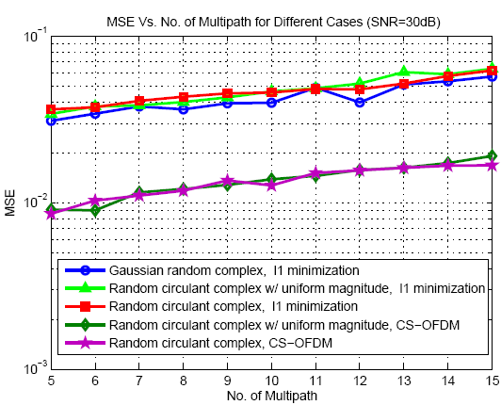
Solution – CS-OFDM algorithm
Recover hN from using:
  Truncated ℓ1 minimization + Iterative support detection
  Regardless of sensing scheme, CS-OFDM shows an average of 5 dB gain in MSE compared with ℓ1 minimization alone.

Slide 26
Application #1: Results – MSE Performance
Thanks to CS, we can make DAC 16 times faster than ADC;
Transmitter: 1024 point IDFT Vs. Receiver: 64 point DFT
As number of multipath increases, MSE increases;
Noise decrease the performance obviously.

Slide 27
Application #1: Results – Noise Performance
Recovered SNR shows an average gain of 10 dB over sensing SNR.

Slide 28
Application #1: Results – CRLB
Variance of the estimation channel is close to the Cramer-Rao Lower Bound especially when SNR is low.

Slide 29
Application #1: Result Highlights
Recover high-resolution channel response with low speed ADC;
Robust to noise: solution SNR ≈ sensing SNR;
CS-OFDM algorithm outperforms the ℓ1 minimization algorithm;
The CS estimated channel variance is close to the CRLB, especially so at low SNR and small number of multipath.

Slide 30
Application #2:
Spectrum Sensing in Cognitive Radio Networks
The scenario
  Cognitive radio (CR) nodes need to detect and use the spectrum holes;
  CR nodes in a network must collaborate to overcome the limited local observation and maximize the chance of their transmission.
The sparsity
  The channel occupancy status vector is sparse, since the appearance of primary user (PR) is sparse.
The problem
  Spectrum scan performed by each CR is time consuming;
  Power limitation and channel fading limited the available channel sensing information;
  Missing and erroneous reports due to random transmission loss are inevitable.

Slide 31
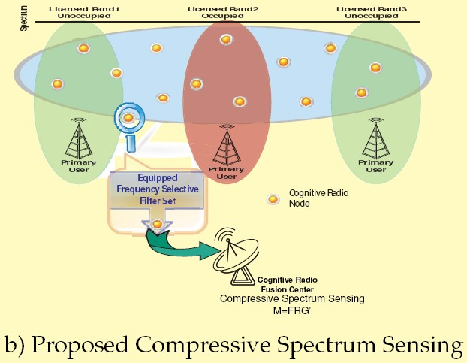
We Propose
Each CR sense as many channels as possible simultaneously
  Save time
Equip each CR with a set of frequency selective filters, with random coefficients
  Blended data

Slide 32
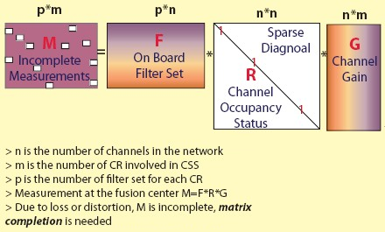
Signal Model – Matrix Completion
M is incomplete;
F, R, G makes M qualified for applying matrix completion technique on;
We completed M first, and solve R using linear programming, from the knowledge of M, F and G.

Slide 33
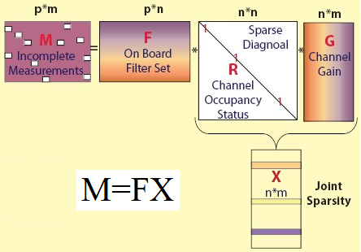
Signal Model – Joint Sparsity
Non-zero rows of X=R*G denote the occupied channels;
Each column vector in X is sparse;
All column vectors have the same sparsity pattern;
The ith column of M is related only to the ith column of X;
F is designed, and known exactly at the fusion center;
Reduced to multiple CS recovery problems;
What’s better, each recovered column of X acts as cross check for the others, increase POD.

Slide 34
Simulation Settings – Parameters
Due to the different properties each algorithm holds, we choose different parameters to test their performance and carry out comparison between the two algorithms.
We chose to test the joint sparsity algorithm for CSS with such settings:
  A set of 500 channels;
  20 (Maximum) CR nodes collaboratively detecting the occupied channels;
  The number of occupied channels is 1 to 15.
We chose to test the matrix completion algorithm for CSS with such settings:
  A set of 35 channels;
  20 (Maximum) CR nodes collaboratively detecting the occupied channels;
  The number of occupied channels is 1 to 4.

Slide 35

Simulation Settings – Evaluation
Performance was evaluated in terms of Probability of Detection (POD), False Alarm Rate (FAR) and Miss Detection Rate (MDR):
  FAR = No. False/(No. False + No. Hit)
  MDR = No. Miss/(No. Miss + No. Correct)
  POD = No. Hit/(No. Hit + No. Miss)
Sampling Rate is defined as:

Slide 36
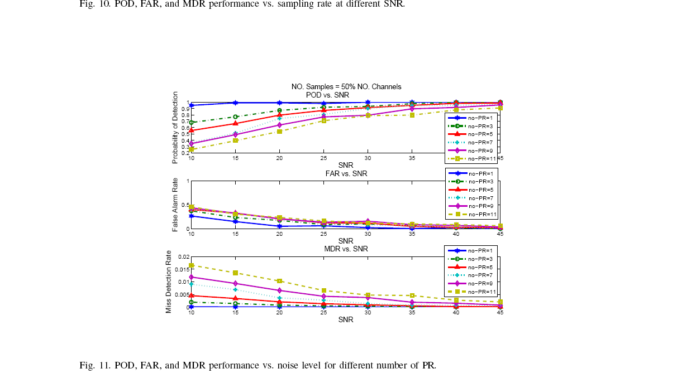
Application #2: Results – Joint Sparsity Noisy
POD, FAR and MDR performance vs. Noise Level for Different Number of PR.
With sampling rate as low as 50%, at SNR = 35 dB, Probability of detection is above 95% for sparse (< 1%) channel occupancy (red line).

Slide 37
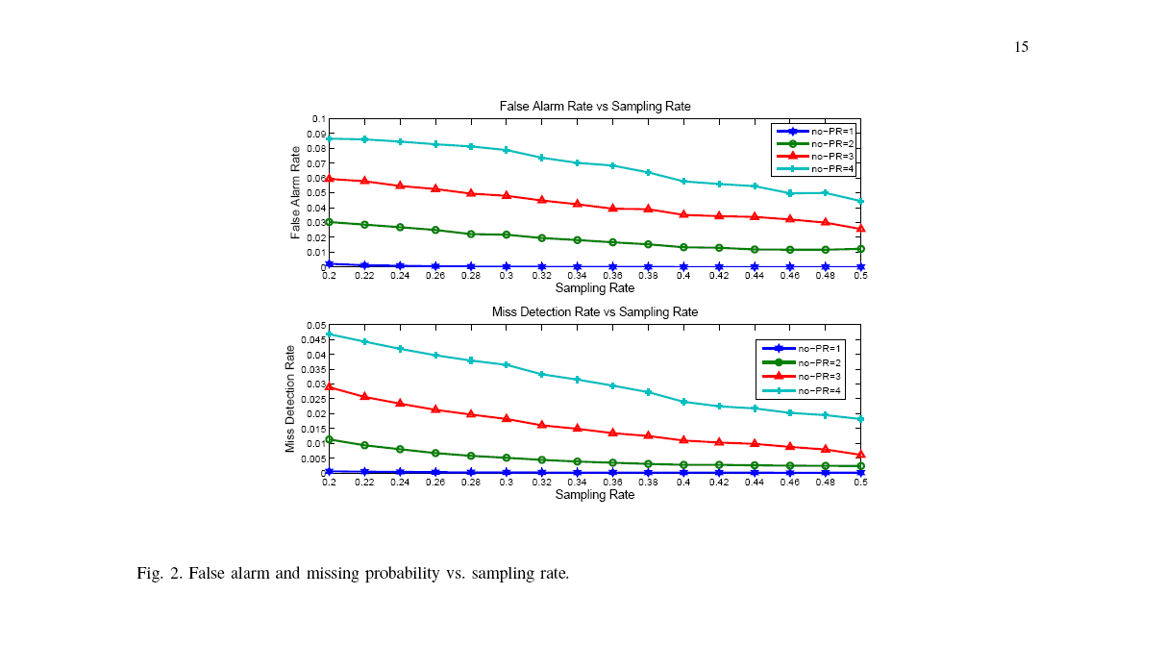
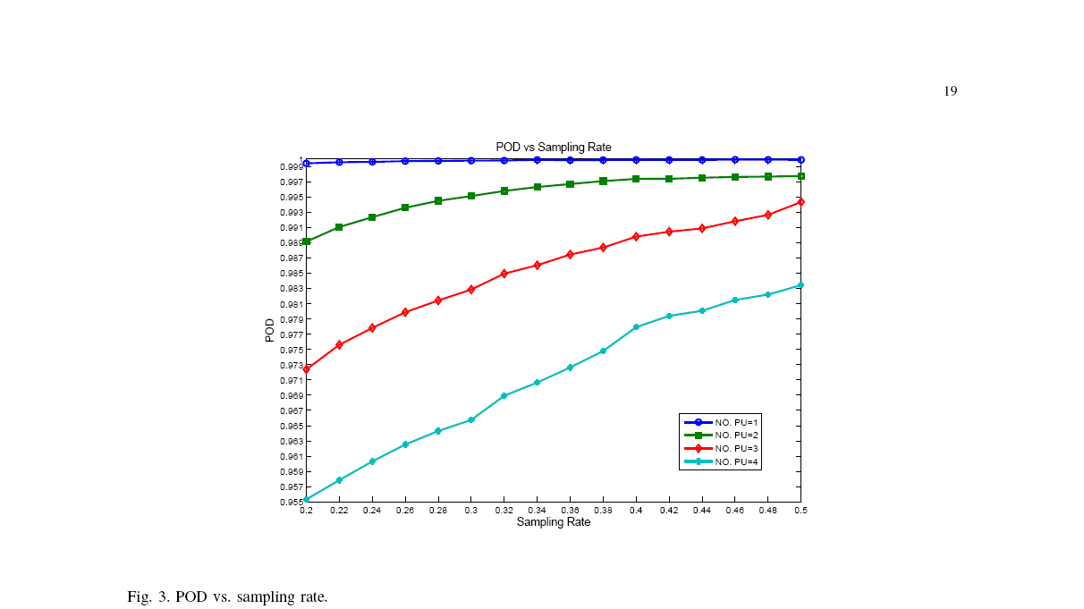
Application #2: Results – Matrix Completion
FAR < 2.5%,
MDR < 1%
@ 50% sampling rate, >10% channel occupancy rate (red lines)
POD > 99.5%
@ 50% sampling rate, >10% channel occupancy rate (red line)

Slide 38
Application #2: Results – Compare the Two Algorithms
Joint sparsity recovery algorithm has the advantage of low computational complexity which enables fast computation in large scale networks, with relatively low spectrum utilization;
Matrix completion algorithm is good for small scale networks, with relatively high spectrum utilization.
What if we have a large scale network with relatively high spectrum utilization?
  Divide it into several small networks.

Slide 39
Application #3:
60 GHz UWB Communication
The scenario
  60 GHz
    7 GHz of unlicensed spectrum, high frequency reuse rate;
    Very limited multipath components (Sparsity).
  UWB
    Less sensitive to multipath effects;
    Low transmission power, low interference.
  60 GHz + UWB is favored by new wireless communication applications.
The problem
  Employing ADC directly at the receiving antenna would require Nyquist rate A/D conversion, which is economically impossible;
  Sub-Nyquist rate sampling: how?
  Sparse multipath components

Slide 40
Signal Acquisition with Compressed Sensing
Received analog signal is segmented or time-windowed and CS is applied to each segment independently.
Mixer for signal modulation
  Modulate signal by a pseudorandom Bernoulli sequence of ±1’s;
  Alternate speed between values is equal to or faster than the Nyquist rate of the input signal;
  The mixer compute .
Integrator
  Throughout each segment or time-window, the mixer outputs are integrated as input for low speed ADC.
Multiple copies of mixer & integrator chain
  Each integrator out put is one element in the measurement vector;
  Total number of copies needed is decided by the signal sparsity level, usually, 3~5 times of the number of significant component is enough for exact signal recovery.

Slide 41
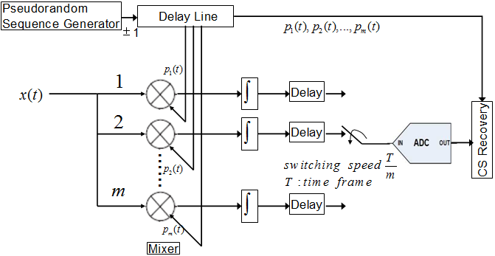
CS 60GHz UWB Channel Estimation
Hardware Configuration
  Delay line is used for making p2 ~ pm a time shifted copy of p1;
  Simplify the PN generation part, as well as save the storage space for the PN sequence in the CS recovery part ;
  ADC input switches among the m lines, and ADC speed decrease to m per time frame.

Slide 42
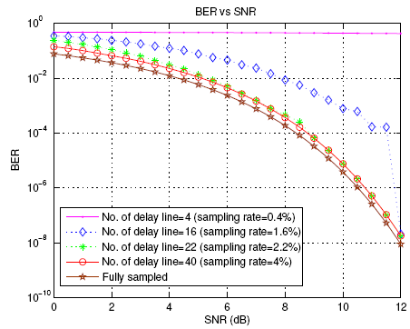
Application #3: Simulations Results
With limited significant multipath components (<1%), 4% sampling rate only introduces 0.3dB BER performance lost (red line).

Slide 43
Application #4:
Time and Spatial Sparse Events Detection
The scenario
  Large number of sensor nodes, large area;
  Only limited active nodes at limited time slots (Sparsity).
The problem in gathering sensor status information
  Takes long time to scan separate sensor-control center channels;
  Common channel suffers from inter channel interference.
Compressive sensing based solution
  Limited number of randomly located monitoring tube;
  Take measurement from many sensor nodes simultaneously;
  Bayesian framework with marginal likelihood maximization algorithm and a heuristic algorithm.

Slide 44
CS Sparse Events Detection System Model
Dimension of the sensor filed is 500* 500;
256 sensors randomly located within this area;
At certain times, less than 5 percent active sensors at random locations.
Monitoring Tubes (M)
Active Sensors (K Events)
Silent Sensors

Slide 45
Application #4: Results
In the ideal environment -- no noise, a sampling rate of as low as 24% offers almost perfect detection probability.

Slide 46
Part III: Summary of Previous Work
We review the emerging field of compressive sensing;
We survey the history and challenges in signal acquisition and processing;
We implement CS technique to solve several problems in the signal acquisition and processing for wireless communication;
For each of the proposed CS application, we
  Analyze signal sparsity in a proper domain;
  Design a measurement scheme with physical meaning while satisfies the requirements of CS theories;
  Propose a customized signal recovery algorithm for the designed system;
  Perform numerical simulations and demonstrate the results.

Slide 47
Publications and Funding
Funded by NSF (ECCS-1028782):
  Compressive spectrum sensing in cognitive radio networks.
Submitted NSF Proposal:
  Multi-spectral infrared imaging for offshore oil spill detection using compressive sensing.
Collaborative Spectrum Sensing from Sparse Observations in Cognitive Radio Networks. Accept for publication in the IEEE JSAC Special Issue on Cognitive Radio Networking and Communications.
Collaborative Spectrum Sensing from Sparse Observations Using Matrix Completion for Cognitive Radio Networks. The 35th International Conference on Acoustics, Speech, and Signal Processing (ICASSP), 2010.
High Resolution OFDM Channel Estimation with Low Speed ADC using Compressive Sensing. Submitted to International Conference on Communications (ICC) 2011. Journal in preparation.
Sampling rate reduction for 60 GHz UWB communication using compressive sensing, Asilomar Conference on Signals, Systems & Computers, 2009. Journal in preparation.
Sparse event detection in wireless sensor networks using compressive sensing”, The 43rd Annual Conference on Information Sciences and Systems (CISS), 2009.

Slide 48
Part IV: Future Work
Wireless Communication (In preparation for submission)
  Dynamic CS for Wireless Communication Applications;
  Joint Sparsity Recovery Algorithm for MIMO System;
  Derive the performance bound for random convolution, and extend to other wireless channel estimation applications.
Others
  Seismic Data Simultaneous Acquisition using CS;
  Concrete Flaw Detection using CS;
  Compressive Sensing for Pipe Line Leakage Detection;
  Compressive Sensing for Human Vision Model;
  Compressive Sensing for Gene Regulatory Networks;
  Multi-spectral Infrared Imaging for Offshore Oil Spill Detection using Compressive Sensing (NSF proposal).

Slide 49
Multi-spectral Infrared Imaging for Offshore Oil Spill Detection using Compressive Sensing
The Problem
  Despite the recent high-profile BP accident, effective early detection of offshore oil spill has not become a technological reality.
Proposal
  Use a thermal camera to measure the temperature contrast to separate water and oil;
  Sensing bottleneck: hard to sense in every wavelength and collect them separately;
  Compressible data
    The thermal emission from a region of interest have the sparse representation: f (x; y; λ), where λis the spectral.
    In the spectral domain, there are only J sinusoid-like curves representing J oil thickness values and one representing water.
  Image recovery using ℓ1 and total variation (TV) minimization (edge detection)

Slide 50
One Example
Left: Ideal multi-spectral infrared image of water with oil floating
Middle: 25% pixel samples from the thermal camera
Right: CS based multi-spectral infrared image recovery

Slide 51
Design Challenges
Measurement
  Sensing matrix satisfy RIP;
  Practically hardware realization.
Signal recovery
  Balance oil-water edge detection (Total variation minimization) and overall spectrum image recovery (ℓ1 minimization)

Slide 52
Comments and Questions
52
Notes:
52

Slide 53


Slide 55
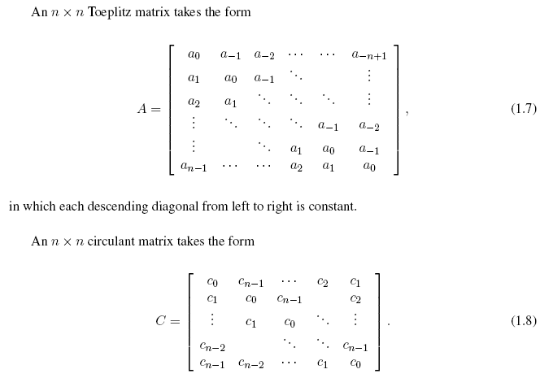

Slide 56
Restricted Isometry Properties (RIP)
A necessary and sufficient condition for the CS problem to be well conditioned is that, for any vector v sharing the same K nonzero entries as v and for some > 0
Necessary condition is that the matrix Φ must preserve the lengths of these K-sparse vectors.
A sufficient condition for a stable solution for K-sparse signals is that Φ satisfies the above equation for any arbitrary 2K-sparse vector v.
This condition is referred to as the Restricted Isometry Property (RIP)
Back

