Slide 1
Department of Electrical and Computer Engineering
A survey of wireless charging technologies: fundamentals, standards, and network applications
Xiao Lu, Ping Wang, Dusit Niyato, Dong In Kim, and Zhu Han
March 2015

Slide 2
Contents (1/2)
Department of Electrical and Computer Engineering
Introduction
History and Commercialization
Fundamentals of Wireless Charging
Wireless Charging Technologies
Applications of Wireless Charging
Wireless Charging System Overview
Wireless Power Propagation Models
Wireless Charging Standards and Implementations
International Charging Standards
Implementations of International Charging Standards
Mobile Charger Dispatch Strategy
Offline Charger Dispatch Strategy
Online Charging Dispatch Strategy

Slide 3
Contents (2/2)
Static Wireless Charger Scheduling Strategies
Charging Strategies for Hybrid Access Point
Charging Strategies for Dedicated Energy Access Point
Charging Strategies for Relay with Hybrid Access Pointr Multi-antenna Energy Access Point
Wireless Charger Deployment Strategies
Static Wireless Charger Deployment
Mobile Wireless Charger Deployment
Open Research Issues and Future Directions
Open Research Issues
Future Directions
Conclusion

Slide 4
Introduction
Technology that enables to transmit electromagnetic energy from a power source to an electrical load across an air gap, without interconnecting cords.
Attracting a wide range of applications, from low-power toothbrush to high-power electric vehicles, because of its convenience and better user experience.
Many leading smartphone manufacturers, such as Samsung, Apple and Huawei, begin to release new-generation devices featured with built-in wireless charging capability.

Slide 5
Wired vs. Wireless Information and Power Transfer
Wired (e.g. power-line communication)
Frequency duplex: low-freq. for power transfer, high-freq. for information transfer
Minimal cross-talk between information/energy transmissions and among different wires/lines
Wireless
Limited bandwidth: thus suboptimal with orthogonal (over time or freq.) information and energy transmissions in general
Co-channel interference present due to wireless broadcast nature

Slide 6
Benefits over cord charging
Improves user-friendliness as the hassle from connecting cables is removed. Different brands and different models of devices can also use the same charger.
Renders the design and fabrication of much smaller devices without the attachment of batteries.
Provides better product durability (e.g., waterproof and dustproof) for contact-free devices.
Enhances flexibility, especially for the devices for which replacing their battery or connecting cable for charging is costly, hazardous, or infeasible (e.g., body implanted sensors).
Can provide on-demand power, avoiding an overcharging problem and minimizing energy cost.

Slide 7
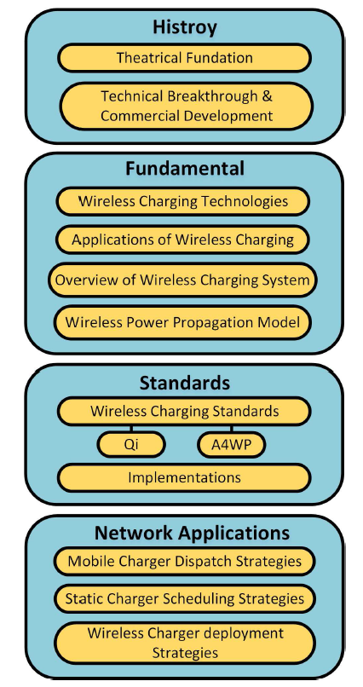
Outline
Comprehensive survey of the emerging wireless charging systems with regard to the fundamental technologies, international standards as well as applications in wireless communication networks
Focus on the transmit-side designs

Slide 8
Contents (1/2)
Department of Electrical and Computer Engineering
Introduction
History and Commercialization
Fundamentals of Wireless Charging
Wireless Charging Technologies
Applications of Wireless Charging
Wireless Charging System Overview
Wireless Power Propagation Models
Wireless Charging Standards and Implementations
International Charging Standards
Implementations of International Charging Standards
Mobile Charger Dispatch Strategy
Offline Charger Dispatch Strategy
Online Charging Dispatch Strategy

Slide 9
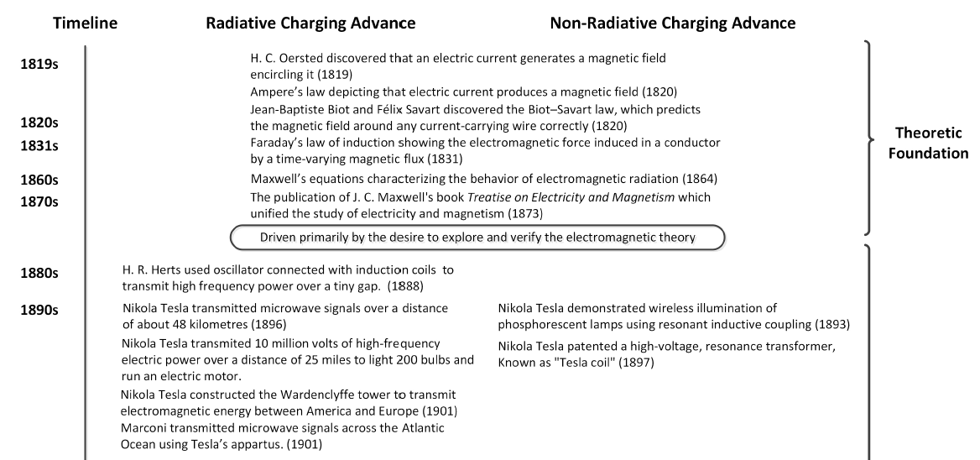
History and Commercialization

Slide 10
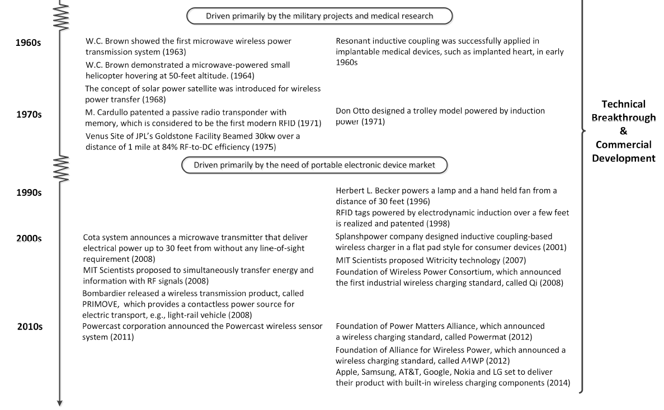
History and Commercialization

Slide 11
Contents (1/2)
Department of Electrical and Computer Engineering
Introduction
History and Commercialization
Fundamentals of Wireless Charging
Wireless Charging Technologies
Applications of Wireless Charging
Wireless Charging System Overview
Wireless Power Propagation Models
Wireless Charging Standards and Implementations
International Charging Standards
Implementations of International Charging Standards
Mobile Charger Dispatch Strategy
Offline Charger Dispatch Strategy
Online Charging Dispatch Strategy

Slide 12
Fundamentals of Wireless Charging
A. Wireless Charging Technologies:
Wireless charging is usually realized through inductive coupling, resonance coupling, and non-directive RF radiation
Notes:
In capacitive coupling, the achievable amount of coupling capacitance is dependent on the available area of the device. However, for a normal size portable electronic device, it is hard to generate sufficient power density for charging, which imposes a challenging design limitation.
For directive RF power beamforming, the limitation lies in that the charger needs to know the exact location of the energy receiver. Due to the obvious limitation of above 2 techniques, wireless charging is usually realized
through other three techniques, i.e., magnetic inductive coupling, magnetic resonance coupling, and non-directive RF radiation.

Slide 13
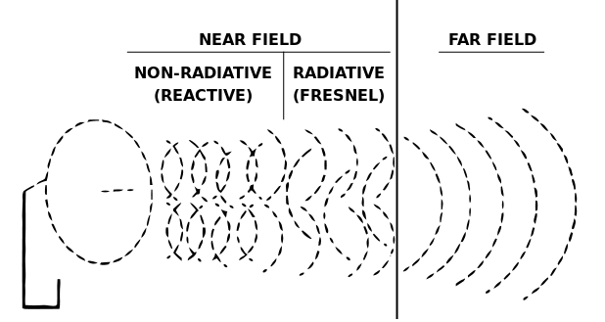
The near field (or near-field) and far field (or far-field) are regions of the electromagnetic field around an object, such as a transmitting antenna, or as a result of radiation scattering off an object.
Non radiative 'near field' behaviors of electromagnetic fields dominate close to the antenna or scattering object, while electromagnetic radiation 'far field' behaviors dominate at greater distances.
Near field behaviors decay rapidly with distance away from an object, whereas the far-field radiative field's intensity decays with an inverse square law.
http://en.wikipedia.org/wiki/Near_and_far_field
Notes:
Differences between Fraunhofer diffraction and Fresnel diffraction.

Slide 14
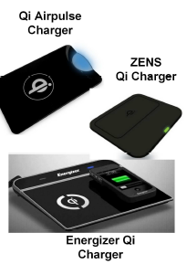
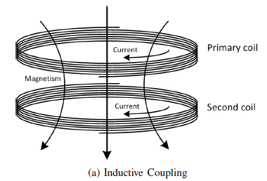
Fundamentals of Wireless Charging
Department of Electrical and Computer Engineering
Inductive Coupling
Magnetic coupling that delivers electrical energy between two coils tuned to resonate at the same frequency
Power transfer happens when a primary coil of an energy transmitter generates predominant varying magnetic field across the secondary coil of the energy receiver within the field (< wavelength). The near-field magnetic power then induces voltage/current across the secondary coil of the energy receiver within the field.
Very strong and very efficient, but on very short distance only

Slide 15
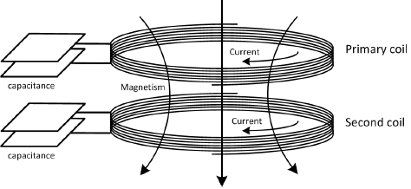
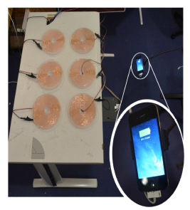
Fundamentals of Wireless Charging
Magnetic Resonance Coupling
Evanescent wave-coupling that generates and transfer electrical energy between two resonators
As two resonant coils at the same resonant frequency, are strongly coupled, high energy transfer efficiency can be achieved with small leakage to non-resonant externalities. This property also provides the advantage of immunity to neighboring environment and line-of-sight transfer requirement.
Strong and efficient, but under short distances only
Notes:
Additionally, magnetic resonant coupling can be applied between one transmitting resonator and many receiving resonators. Therefore, it enables concurrent charging of multiple devices

Slide 16
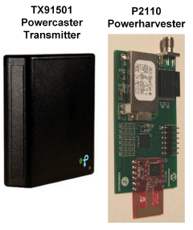
Fundamentals of Wireless Charging
RF Energy Transfer
Radio signals (3KHz-300GHz) carry energy in a form of electromagnetic radiation
The power transmission starts with the AC-to-DC conversion, followed by a DC-to-RF conversion through magnetron at the transmitter side.
After propagated through the air, the RF/microwave captured by the receiver rectenna are rectified into electricity again. The energy transfer can use other electromagnetic waves such as infrared and X-rays.
Notes:
Besides longer transmission distance, microwave radiation offers the advantage of compatibility with existing communications system. Microwaves have been advocated to deliver energy and transfer information at the same time. The amplitude and phase of microwave are used to modulate information, while the radiation and vibration of microwaves are used to carry energy. This concept is referred to as simultaneous wireless information and power transfer (SWIPT). By contrast, the deployment of dedicated power beacons overlaid with existing communication system has also been proposed as an alternative because of its cost-effectiveness and applicability. However, because of health concern of RF radiations, the power beacons should be constrained following RF exposure regulations, such as the FCC regulation, and the maximum permissible exposure levels specified in IEEE C95.1-2005 standard. Therefore, dense deployment of power beacons is required to power hand-held cellular mobiles with lower power and shorter distance.

Slide 17
Fundamentals of Wireless Charging
Summary

Slide 18
Fundamentals of Wireless Charging
B. Applications of Wireless Charging
Inductive coupling (~kW)
robot manipulation
automated underwater vehicles
induction generators
Induction motors
real-time power for public transportation (monorail systems, people-mover systems, railway-powered electric vehicles)
Online electric vehicle (OLEV)
Plug-in hybrid electric vehicle (PHEVs)

Slide 19
Fundamentals of Wireless Charging
B. Applications of Wireless Charging
Magnetic coupling (~MW)
biomedical implants
household devices and portable devices (inductive toothbrush, TV, lighting, wall switch, heating system)
Portable devices (RAVPower’s Qi charger, Verizon Qi charging pad, Duracell Powermat, Energizer Qi charger, ZENS Qi charging pad, Airpulse charging pad)
Energy industry (oil wells, off-shore energy harvesting, coal mine, E-bike, sensors, wearable devices, implantable systems, RFID, LED display, power line communication, and smart grid)
Notes:
As the charging distance is much larger than the coil dimension, resonance coupling enables smaller implanted device size with a normal charging range. The state-of-the-art implementation can results in above 70% charging efficiency in bio-tissue environments

Slide 20
Fundamentals of Wireless Charging
B. Applications of Wireless Charging
Far-field Charging:
Non-directive: wireless renewable sensor networks (WRSNs), RFID systems, wireless body area networks (WBANs), Internet of Things (IoT), machine-to-machine (M2M) communication, smart grids
Directive beamforming: solar power satellite (SPS), UAVs, microwave-driven unmanned vehicles, high altitude electric motor powered platforms (HAPP), Raytgeon Airborne Microwave Platform (RAMP), and stationary high altitude relay program (SHARP), medium-power applications for recharging portable electronic devices (e.g. Cota system).
Notes:
As the charging distance is much larger than the coil dimension, resonance coupling enables smaller implanted device size with a normal charging range. The state-of-the-art implementation can results in above 70% charging efficiency in bio-tissue environments

Slide 21
Fundamentals of Wireless Charging
B. Applications of Wireless Charging
Far-field Charging:
Non-directive: wireless renewable sensor networks (WRSNs), RFID systems, wireless body area networks (WBANs), Internet of Things (IoT), machine-to-machine (M2M) communication, smart grids
Directive beamforming: solar power satellite (SPS), UAVs, microwave-driven unmanned vehicles, high altitude electric motor powered platforms (HAPP), Raytgeon Airborne Microwave Platform (RAMP), and stationary high altitude relay program (SHARP), medium-power applications for recharging portable electronic devices (e.g. Cota system).
Notes:
As the charging distance is much larger than the coil dimension, resonance coupling enables smaller implanted device size with a normal charging range. The state-of-the-art implementation can results in above 70% charging efficiency in bio-tissue environments

Slide 22
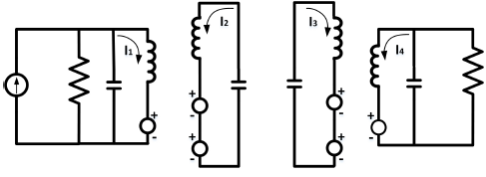
Fundamentals of Wireless Charging
C. Wireless Charging Systems Overview (Near field)
Architecture
Notes:
As the charging distance is much larger than the coil dimension, resonance coupling enables smaller implanted device size with a normal charging range. The state-of-the-art implementation can results in above 70% charging efficiency in bio-tissue environments

Slide 23
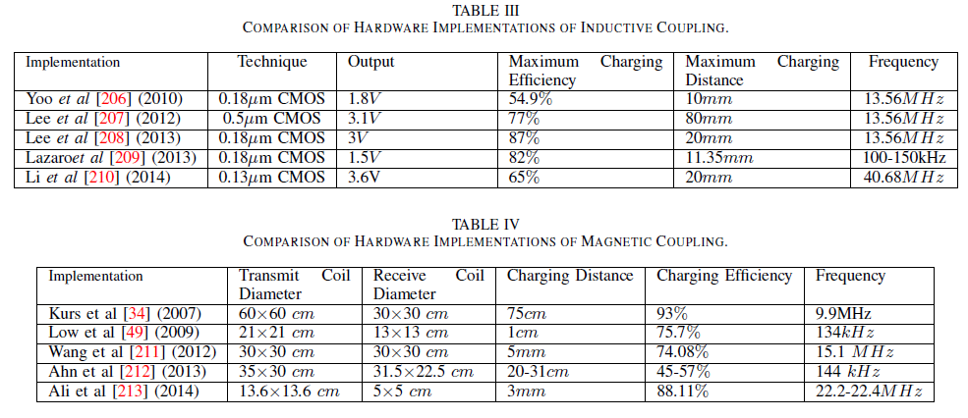
Fundamentals of Wireless Charging
C. Wireless Charging Systems Overview (Near-field)
Recently developed hardware implementation

Slide 24
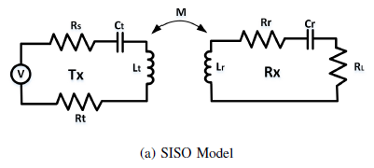
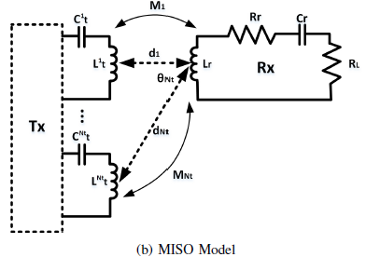
Fundamentals of Wireless Charging
D. Wireless Power Propagation Models (Near-field)
Hardware Design and Implementation
Point-to-point transmission reference models

Slide 25
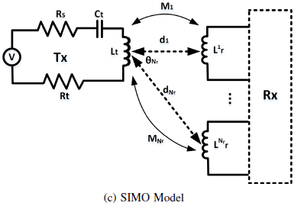
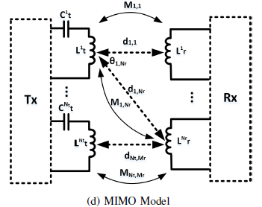
Fundamentals of Wireless Charging
D. Wireless Power Propagation Models (Near-field)
Hardware Design and Implementation
Point-to-point transmission reference models

Slide 26
Contents (1/2)
Department of Electrical and Computer Engineering
Introduction
History and Commercialization
Fundamentals of Wireless Charging
Wireless Charging Technologies
Applications of Wireless Charging
Wireless Charging System Overview
Wireless Power Propagation Models
Wireless Charging Standards and Implementations
International Charging Standards
Implementations of International Charging Standards
Mobile Charger Dispatch Strategy
Offline Charger Dispatch Strategy
Online Charging Dispatch Strategy

Slide 27
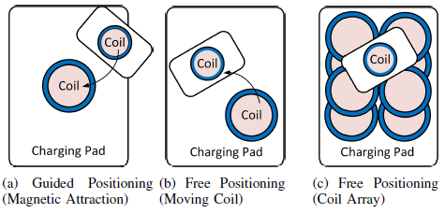
Wireless Charging Standards and Implementations
International Charging Standard: Qi
Developed by Wireless Power Consortium (WPC)
Specifies interoperable wireless power transfer and data communication between wireless charger and charging device
Allows charging device to be in control of charging procedure.
To achieve tight coupling, a mobile device must be strictly placed in proper alignment with the charger: three alignments

Slide 28
Wireless Charging Standards and Implementations
International Charging Standard: Qi
Qi-compliant charger is capable of adjusting transmit power density as requested by the charging device through signaling.
Uses magnetic inductive coupling technique, typically within the range of 40mm

Slide 29
Wireless Charging Standards and Implementations
International Charging Standard: A4WP
A4WP aims to provide spatial freedom for wireless power: Does not require precise alignment and even allows separation between a charger and charging devices.
Proposes to generate a larger electromagnetic field with magnetic resonance coupling.
The maximum charging distance is up to several meters.
Multiple devices can be charged concurrently with different power requirement; foreign objects can be placed on an operating A4WP charger without causing any adverse effect.

Slide 30
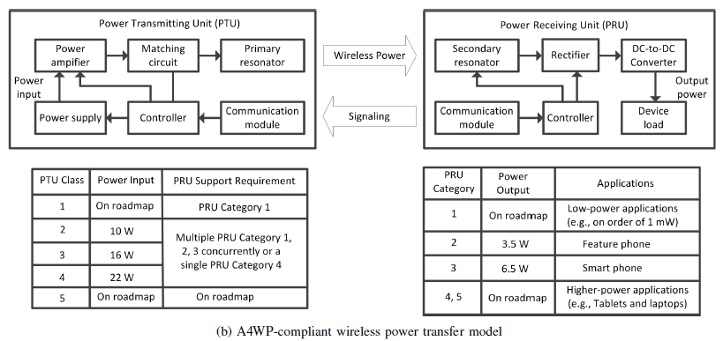
Wireless Charging Standards and Implementations
International Charging Standard: A4WP
Wireless power: generated at 6.78MHz ISM frequency
Unlike Qi, out-of-band communication for control signaling: adopted and operating at 2.4 GHz, i.e., ISM.

Slide 31
Wireless Charging Standards and Implementations
Implementations of the International Charging Standards
Due to the ease of implementation and early announcement, most of the existing implementations are based on Qi standard.

Slide 32
Contents (1/2)
Department of Electrical and Computer Engineering
Introduction
History and Commercialization
Fundamentals of Wireless Charging
Wireless Charging Technologies
Applications of Wireless Charging
Wireless Charging System Overview
Wireless Power Propagation Models
Wireless Charging Standards and Implementations
International Charging Standards
Implementations of International Charging Standards
Mobile Charger Dispatch Strategy
Offline Charger Dispatch Strategy
Online Charging Dispatch Strategy

Slide 33
Mobile Charger Dispatch Strategy
Generally, there are five issues to be addressed:
Given a nbr of distributed devices and locations, obtain the best charging location for a mobile charger to visit so that wireless charging can cover all devices.
Given a nbr of charging locations for a mobile charger to visit, determine an optimal travel path for the charger to visit all the locations so that certain goal(s) can be achieved.
Given a nbr of sojourn locations for a mobile charger to visit, obtain an optimal charging duration for the charger to dwell in each location so that none of the devices is under-charged.
Given a nbr of devices, their locations and data flow requirement, obtain the best data flow rates and data routing paths for the devices so that overall data gathering performance is optimized.
In collaborative energy provisioning with multiple chargers, determine the min nbr of chargers to be deployed to meet a certain objective (min cost)

Slide 34
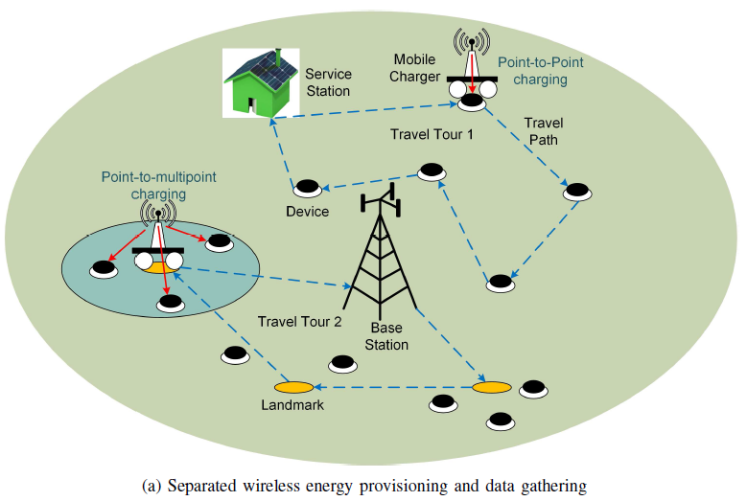
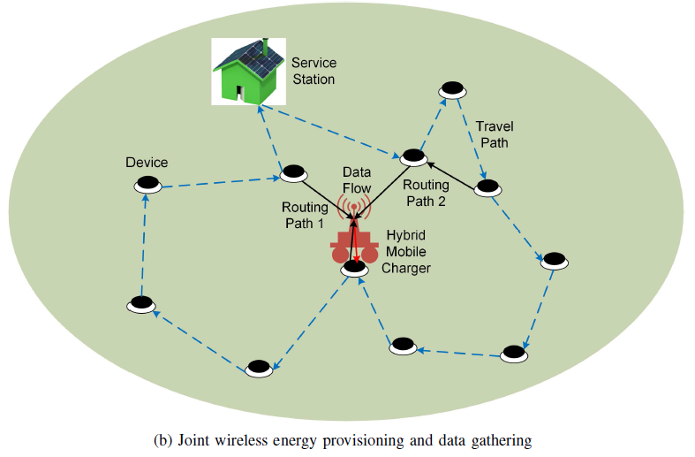
Mobile Charger Dispatch Strategy
Two typical systems considered for mobile charger dispatch planning
Notes:
Fig. 12a: while wireless charging is performed by the mobile charger(s), data gathering is done by a data sink (or a base station). Thus, the data flow routing and energy consumption rate of network devices do not depend on the movement of the charger. Usually, a charger is sent out from a service station or a data sink. After each travel tour, the charger returns to the service station and receives energy to replenish its battery. A mobile charger can adopt point-to-point charging or point-to-multipoint charging technology, examples of which are shown as Travel Tour 1 and Travel Tour 2. For point-to-multipoint charging scenario, the charger can transfer energy to multiple target devices within its charging range concurrently at a selected landmark location.
Fig. 12b: The second system model employs a hybrid charger that can perform both data forwarding and wireless power transfer. Data can be forwarded to the hybrid charger when it visits a charging location, either in a single-hop or multi-hop fashion shown as Routing Path 1 and Routing Path 2. This model enables joint wireless energy provisioning and data gathering. In this case, dynamic routing is required due to time-varying charger’s location.

Slide 35
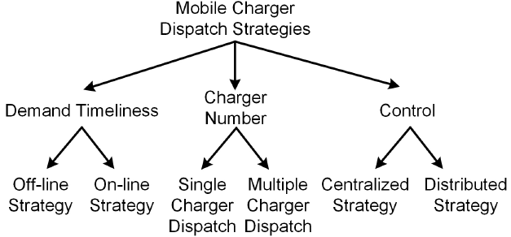
Mobile Charger Dispatch Strategy
Taxonomy of mobile chargers dispatch strategies:
From the perspective of timeliness of demand: offline vs. online dispatch planning.
Single-charger vs. multiple-charger strategies.
Based on control structure: centralized and distributed approaches.

Slide 36
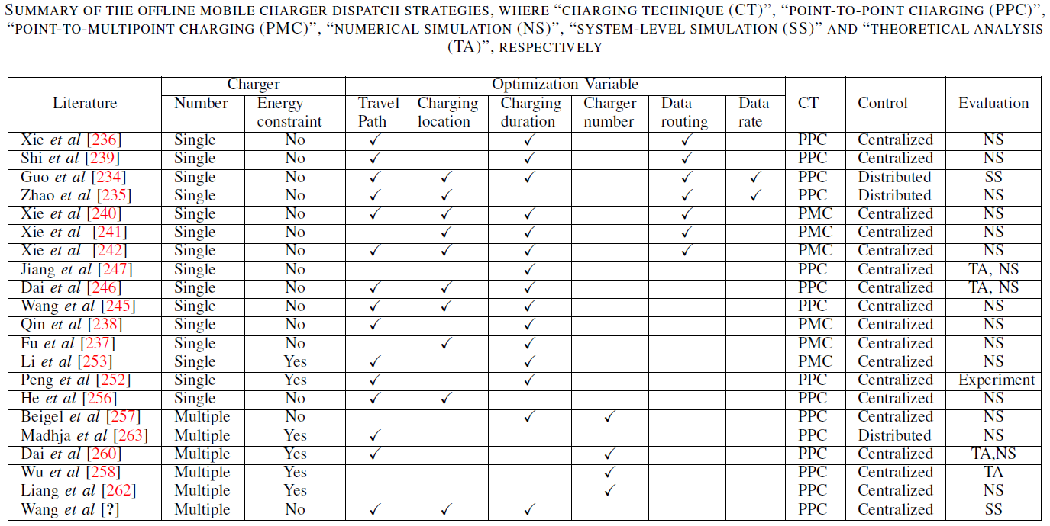
Mobile Charger Dispatch Strategy: Offline
Notes:
Most of the existing works rely on centralized control to schedule mobile charger(s). Distributed algorithms are less studied, especially for multiple-charger dispatch strategies. Moreover, all the existing multiple-charger dispatch strategies employ point-to-point charging. Future work may incorporate landmark selection to reduce the length of travel tours for multiple chargers.

Slide 37
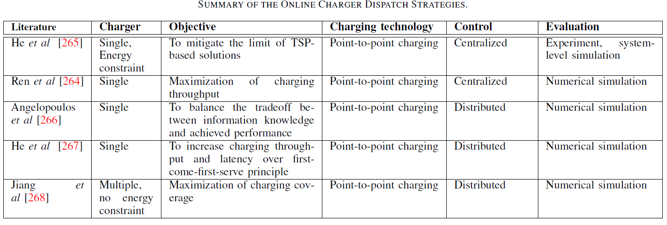
Mobile Charger Dispatch Strategy: Online
Notes:
Only reference [268] provides the solution for multiple chargers. However, as aforementioned, efficient coordination among chargers is missing. How to coordinate
chargers for online strategy, especially with distributed control, is challenging. Moreover, how to manage multiple charging requests by utilizing point-to-multipoint charging can be a future direction for online algorithms.

Slide 38
Contents (2/2)
Static Wireless Charger Scheduling Strategies
Charging Strategies for Hybrid Access Point
Charging Strategies for Dedicated Energy Access Point
Charging Strategies for Relay with Hybrid Access Point Multi-antenna Energy Access Point
Wireless Charger Deployment Strategies
Static Wireless Charger Deployment
Mobile Wireless Charger Deployment
Open Research Issues and Future Directions
Open Research Issues
Future Directions
Conclusion

Slide 39
Static Wireless Charger Scheduling Strategies
Wireless Powered Communication Networks (WPCN): Wireless devices communicate using only the harvested energy from wireless chargers categorized in two types:
Energy Access Point (E-AP): dedicated to provide wireless charging
Hybrid Access Point (H-AP): supports data communication and work as a data assess point (D-AP)
For the research efforts for WPCNs, there are two major directions:
Exclusive wireless charging: wireless power transfer and information transmission are separated
Simultaneous wireless information and power transfer (SWIPT): wireless charging and information transmission are coupled to achieve some tradeoff

Slide 40
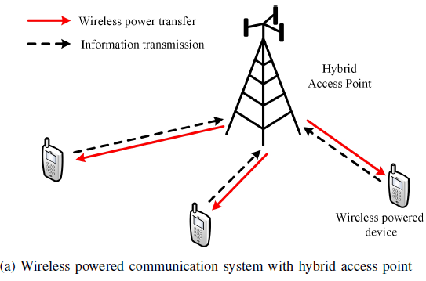
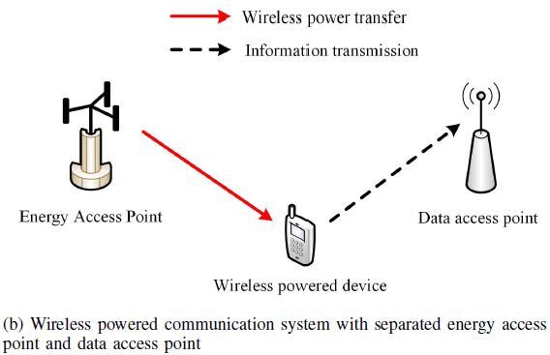
Static Wireless Charger Scheduling Strategies
The existing literature considers four types of system models:
WPCN with H-AP: employs an H-AP to perform DL wireless charging to and receive information transmission from a user device.
WPCN with dedicated E-AP: DL wireless charging and UL information reception are conducted separately by an E-AP and a D-AP, respectively.

Slide 41
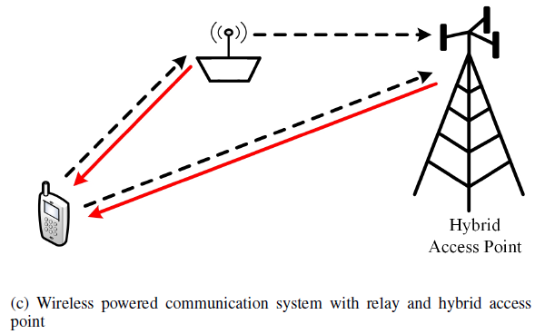
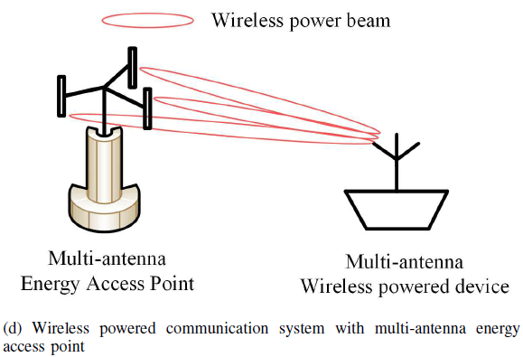
Static Wireless Charger Scheduling Strategies
The existing literature considers four types of system models:
Relay-based WPCN with H-AP: facilitates the UL transmission from a device to the H-AP.
WPCN with multi-antenna E-AP: adopts multiple antennas/coils at the E-AP to improve the charging efficiency by steering the power beam spatially toward the direction of a device. Energy beamforming strategy is the main focus, while information transmission is considered separately with wireless charging.

Slide 42
Contents (2/2)
Static Wireless Charger Scheduling Strategies
Charging Strategies for Hybrid Access Point
Charging Strategies for Dedicated Energy Access Point
Charging Strategies for Relay with Hybrid Access Pointr Multi-antenna Energy Access Point
Wireless Charger Deployment Strategies
Static Wireless Charger Deployment
Mobile Wireless Charger Deployment
Open Research Issues and Future Directions
Open Research Issues
Future Directions
Conclusion

Slide 43
Wireless Charger Deployment Strategies
Wireless charger deployment involves planning of charger placement to support the sustainable operation of a wireless network. The deployment problems can be divided into two types:
Placement of static chargers
Since the effective coverage range is only few meters for coupling-based wireless chargers, and tens of meters for RF-based chargers, it is suitable and practical only in small areas. In a large network, a full-coverage static charger deployment is costly and incurs high overhead
Point provisioning
Path provisioning
Multihop provisioning
Placement of mobile chargers
Landmark provisioning

Slide 44
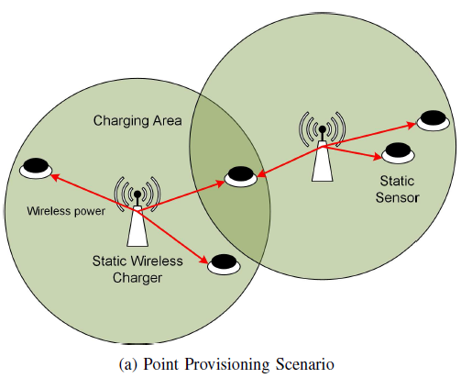
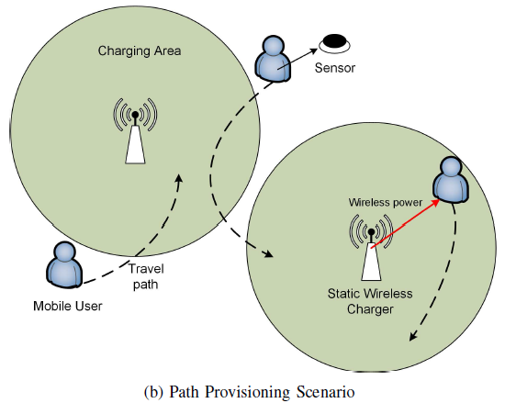
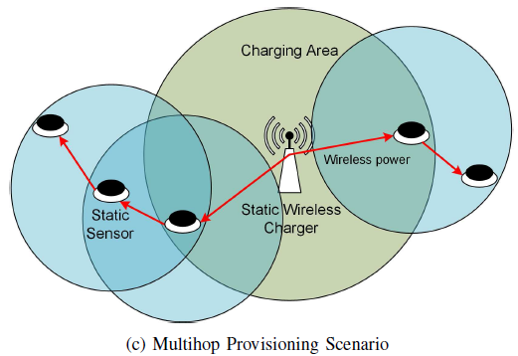
Wireless Charger Deployment Strategies
Placement of static chargers
Notes:
Point Provisioning: deals with the placement of static chargers to support static devices with wireless power.
Path provisioning: aims to deploy static chargers to charge mobile devices (e.g., wearable or implanted sensors by human) in their travel paths.
Multihop provisioning determines the locations to place static chargers in a static network, where the devices are also enabled with wireless power transfer function and can share energy with each other.

Slide 45
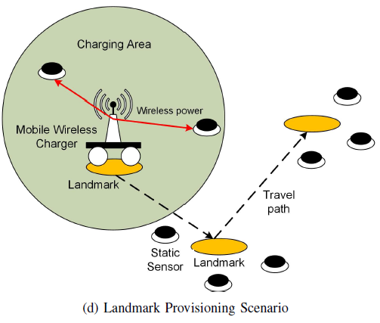
Wireless Charger Deployment Strategies
Placement of and mobile chargers
Notes:
Landmark provisioning involves two steps:
Selection of landmarks for the mobile chargers to visit by turns: The landmarks are the locations to park the charger to provide concurrent charging for multiple static devices in the vicinity.
Clustering landmarks as groups to deploy mobile chargers.

Slide 46
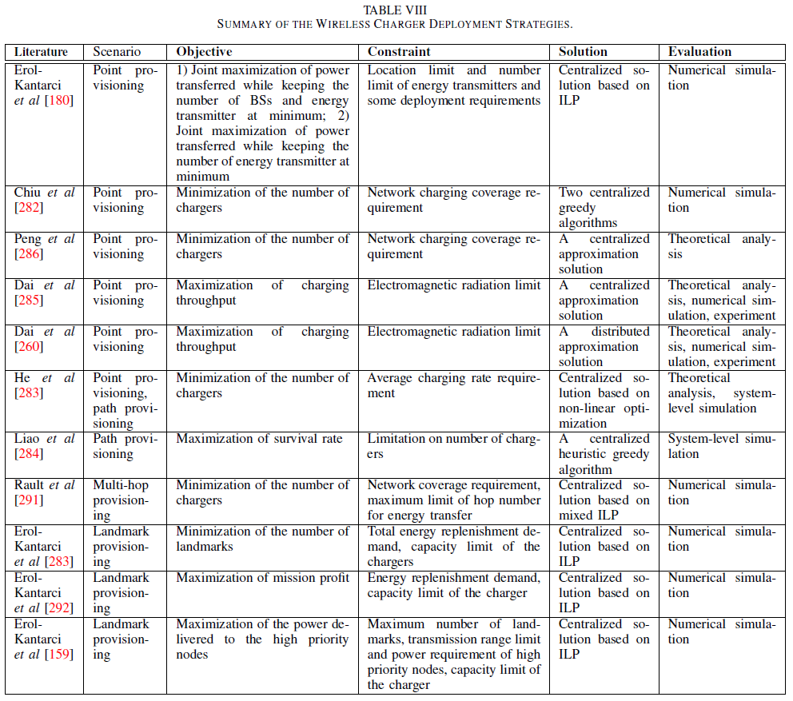
Wireless Charger Deployment Strategies
Notes:
Clearly, multi-hop provisioning is less investigated, only in [291].
For the deployment scenarios, none of the existing work considers the deployment of mobile chargers in mobile networks. Mobile charger deployment strategies based on the mobility pattern of user devices can be studied.
Moreover, we observe that the deployment problems are formulated mostly as optimization problems with different objectives and constraints. Alternatively, decentralized approaches based on local information that relax the communication requirement can be one of the important future directions. Moreover, most of the proposals are evaluated by numerical simulation. Only references [283] and [284] provide system-level simulation. There is a need for future research to conduct more assessment through system-level simulations and real experiments to understand the empirical performance.

Slide 47
Contents (2/2)
Static Wireless Charger Scheduling Strategies
Charging Strategies for Hybrid Access Point
Charging Strategies for Dedicated Energy Access Point
Charging Strategies for Relay with Hybrid Access Pointr Multi-antenna Energy Access Point
Wireless Charger Deployment Strategies
Static Wireless Charger Deployment
Mobile Wireless Charger Deployment
Open Research Issues and Future Directions
Open Research Issues
Future Directions
Conclusion

Slide 48
Open Research Issues in Wireless Charging
Open Issues in Inductive coupling:
The increase of wireless charging power density gives rise to several technical issues, e.g., thermal, electromagnetic compatibility, and electromagnetic field problems. This requires high-efficient power conversion techniques to mitigate the power loss at an energy receiver and battery modules with effective ventilation design.
Open issues in Resonance coupling:
Large charging area and capable of charging multiple devices simultaneously. However, they also cause increased electromagnetic interference with a lower efficiency compared to inductive charging. Another limitation with resonance coupling is the relatively large size of a transmitter. The wireless charging distance is generally proportional to the diameter of the transmitter. Therefore, wireless charging over long distance typically requires large receiver size.

Slide 49
Open Research Issues in Wireless Charging
Open Issues in Near-field beamforming:
Computation of magnetic-beamforming vector on the transmission side largely depends on the knowledge of the magnetic channels to the receivers. The design of channel estimation and feedback mechanisms is of paramount importance. With the inaccuracy of channel estimation or absence of feedback, the charging performance severely deteriorates. Additionally, there exists a hardware limitation that the impedance matching hardware is optimally operated only within a certain range
Localization for RF-based energy beamforming:
As aforementioned, energy beamforming is able to enhance the power transfer efficiency. However, the energy transmitter needs to know the location of the energy receiver to steer the energy beam to. Localization needs to make real-time spatial estimations for two major parameters, i.e., angle and distance.
Notes:
Other issues relate to heating effect, and energy conversion efficiency

Slide 50
Open Research Issues in Data Communication
Duplex communication and multiple access:
The current communication protocols support simplex communication (e.g., from a charging device to charger). However, there are some important procedures which require duplex communication. For example, the charging device can request for a certain charging power, while the charger may request for battery status of the charging device. Moreover, the current protocols support one-to-one communication.
Secure communication:
The current protocols support plain communication between a charger and charging device. They are susceptible for eavesdropping attacks (e.g., to steal charging device’s and charger’s identity) and man-in-the-middle attacks (e.g., malicious device manipulates or falsifies charging status). The security features have to be developed in the communication protocols, taking unique wireless charging characteristics into account.
Notes:
Other issues relate to heating effect, and energy conversion efficiency

Slide 51
Open Research Issues in Data Communication
Inter-charger communication:
The protocols support only the communication between a charger and charging device (i.e., intra-charger). Multiple chargers can be connected and their information as well as charging devices’ information can be exchanged (i.e., inter-charger). Although the concept of wireless charger networking has been proposed, there are some possible improvements. For example, wireless chargers can be integrated with a wireless access point, which is called a hybrid access point, to provide both data communication and energy transfer services.
Notes:
Other issues relate to heating effect, and energy conversion efficiency

Slide 52
Future Directions
Wireless Charger Network:
Similar to wireless communication networks that provide data service, wireless charger network can be built up to deliver energy provisioning service to distributed users. The wireless charger network that connects a collection of distributed chargers through wired or wireless links allows to exchange information (e.g., include availability, location, charging status, and cost of different chargers) to schedule the chargers. Such scheduling can either be made in a distributed or centralized manner to optimize certain objectives (e.g., system energy efficiency, total charging cost). Furthermore, far-field charger (e.g. Powercaster and cota system) can be employed to cover remote devices with low-power requirement and some local movement requirement, (e.g., wearable devices, MP3, watches, Google glasses, and sensors in smart building).
Notes:
Other issues relate to heating effect, and energy conversion efficiency

Slide 53
Future Directions
Full-Duplex Self-energy-recycling Information Transmitter:
Full-duplex transmitter can be equipped with multiple antennas to transmit information and receive energy simultaneously in the same frequency band. But they suffer from self-interference as part of the transmitted RF signal is received by the transmitter itself. Self-interference is undesirable because it degrades the desired information signal. However, with RF energy harvesting capability, self-interference can actually be desirable as it facilitates energy saving.
Millimeter-wave Enhanced Wireless Powered Network:
Operates at 30 ~ 300 GHz; new frontier for next-generation wireless systems. Due to high frequencies, it is a natural system to facilitate wireless energy beamforming.Moreover, frequency is a key factor that affects the physical size of a rectenna based microwave power conversion system . At high frequency ranges, the required size of the antennas is small, which consequently renders a small form factor for the system.
Notes:
Other issues relate to heating effect, and energy conversion efficiency

Slide 54
Conclusion
WPT offers the possibility of removing the last remaining cord connection required to replenish portable electronic devices. This promising technology has significantly advanced during the past decades and brings about a large amount of user-friendliness applications.
Comprehensive survey on the paradigm of wireless charging compliant communication networks. Starting from the development history, we introduced the fundamental, international standards and network applications of wireless charging, followed by the discussion of open issues and envision of future applications.
The integration of wireless charging with existing communication networks creates new opportunities as well as challenges for network resource allocation. This survey has shown the existing solutions of providing seamless wireless power transfer through mobile charger dispatch, static charger scheduling and wireless charger deployment.

Slide 55
Thank you very much

