Slide 1

Resource Allocation in Wireless Communications: A Matching Game Theory Framework
Zhu Han
ECE/CS Department
University of Houston
Ph.D work of Dr. Yunan Gu

Slide 2
Outline
Motivation
  Future Networks
  Distributive Solutions
Matching Theory Basics:
  Definitions
  Classifications
  Examples
Wireless Oriented Matching:
  Modeling
  Applications

Slide 3
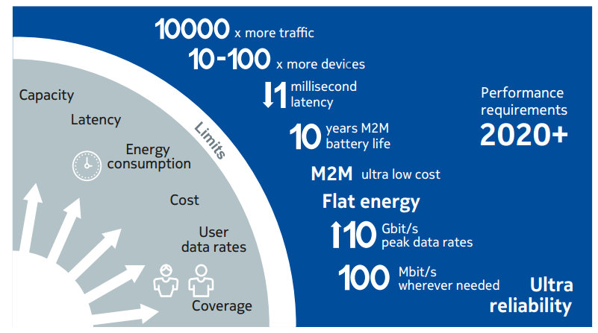
Fifth Generation (5G) Communications
Challenges:
More mobile devices;
Richer communication contents;
5G features:
Higher data rates and capacity;
Reduced end-to-end latency;
Higher energy efficiency;
Better network coverage;
Enhanced user experience;
and so on…
Cited from “5G Use Cases and Requirements,” a white paper from Nokia.

Slide 4
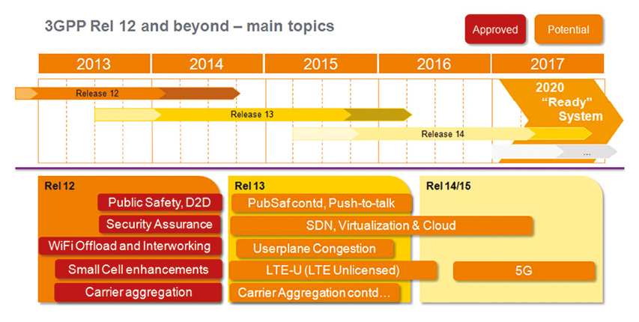
5G Key Technologies
New paradigms:
Device-to-device (D2D) communication;
Network virtualization;
LTE-Unlicensed;
Small cell (SC) deployment;
Cloud-based radio access network (C-RAN);
Massive multiple-input multiple-output (MIMO);
Internet of Things;
And so on…
Cited from: http://www.eurescom.eu/news-and-events/eurescommessage/eurescom-message-1-2014/3gpp-system-standards-heading-into-the-5g-era.html

Slide 5
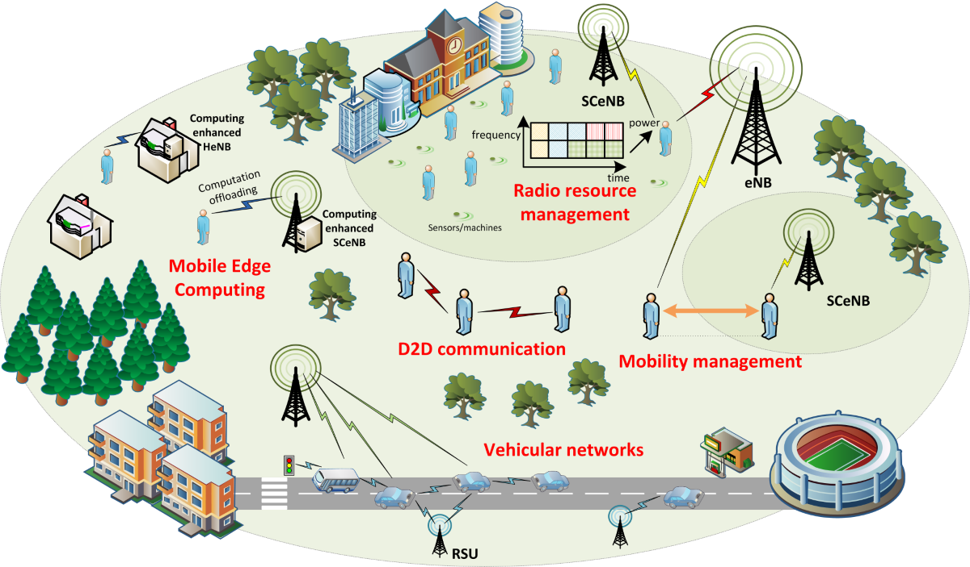
5G Resource Allocation
5G challenges:
Node/cell heterogeneous characteristics;
Ultra-dense network;
Mobility management;
Centralized solution:
Global information;
Significant overhead;
Network management complexity;
High latency.
Cited from: http://5gmobile.fel.cvut.cz/activities/
Shift from centralized mechanism to self-organized distributive solutions.

Slide 6
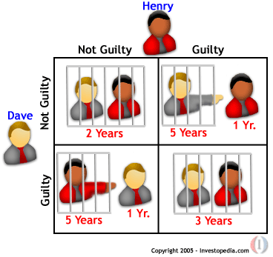
Rich Game Theoretical Approaches
Non-cooperative static game: play once
  Prisoner Dilemma
  Payoff: (user 1, user 2)
  Mandayam and Goodman (2001)
  Virginia tech
Repeated game: play multiple times
  Threat of punishment by repeated game.
  MAD: Nobel prize 2005
  Tit-for-Tat (infocom 2003)
Dynamic game: (Basar’s book)
  ODE for state
  Optimization utility over time
  HJB and dynamic programming
  Evolutional game (Hossain and Dusit’s work)
Stochastic game (Altman’s work)
Notes:
John Edwards

Slide 7
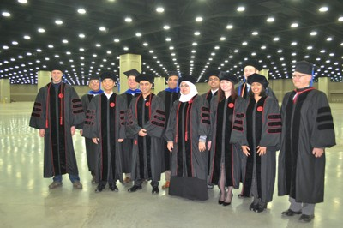


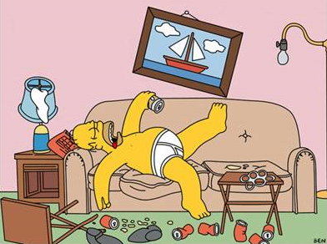
Contract Theoretical: Asymmetry Information
Noble Prize 2014: Adverse Selection and Moral Hazard
Moral Hazard of my PhD student
What my parents thinks I do
What my advisor thinks I do
What I actually do
  When advisor presents
  When advisor on travel

Slide 8

Auction Theory
  Myerson (Nobel Prize 2007), Matching/Contract Theory (Nobel Prize 2012)

Slide 9
Outline
Motivation
  Future Networks
  Distributive Solutions
Matching Theory Basics:
  Definitions
  Classifications
  Examples
Wireless Oriented Matching:
  Modeling
  Applications

Slide 10
Everyone finds a date!
Unstable marriage!
How to design algorithm to prevent unstable results?

Slide 11
Lloyd Stowell Shapley (born June 2, 1923) is a distinguished American mathematician and economist. He is a professor Emeritus at UCLA, affiliated with departments of Mathematics and Economics.
Alvin Elliot Roth (born December 18, 1951) is the Craig and Susan McCaw professor of economics at Stanford University and the Gund professor of economics and business administration emeritus at Harvard University.
Alvin E. Roth and Lloyd S. Shapley shared the 2012 Nobel Prize in Economic Science.
Shapley, designed theoretical constructs and algorithms to study and compare different matching methods.
Roth, built on his work, using experimental economics and market design to solve real-world problems.

Slide 12
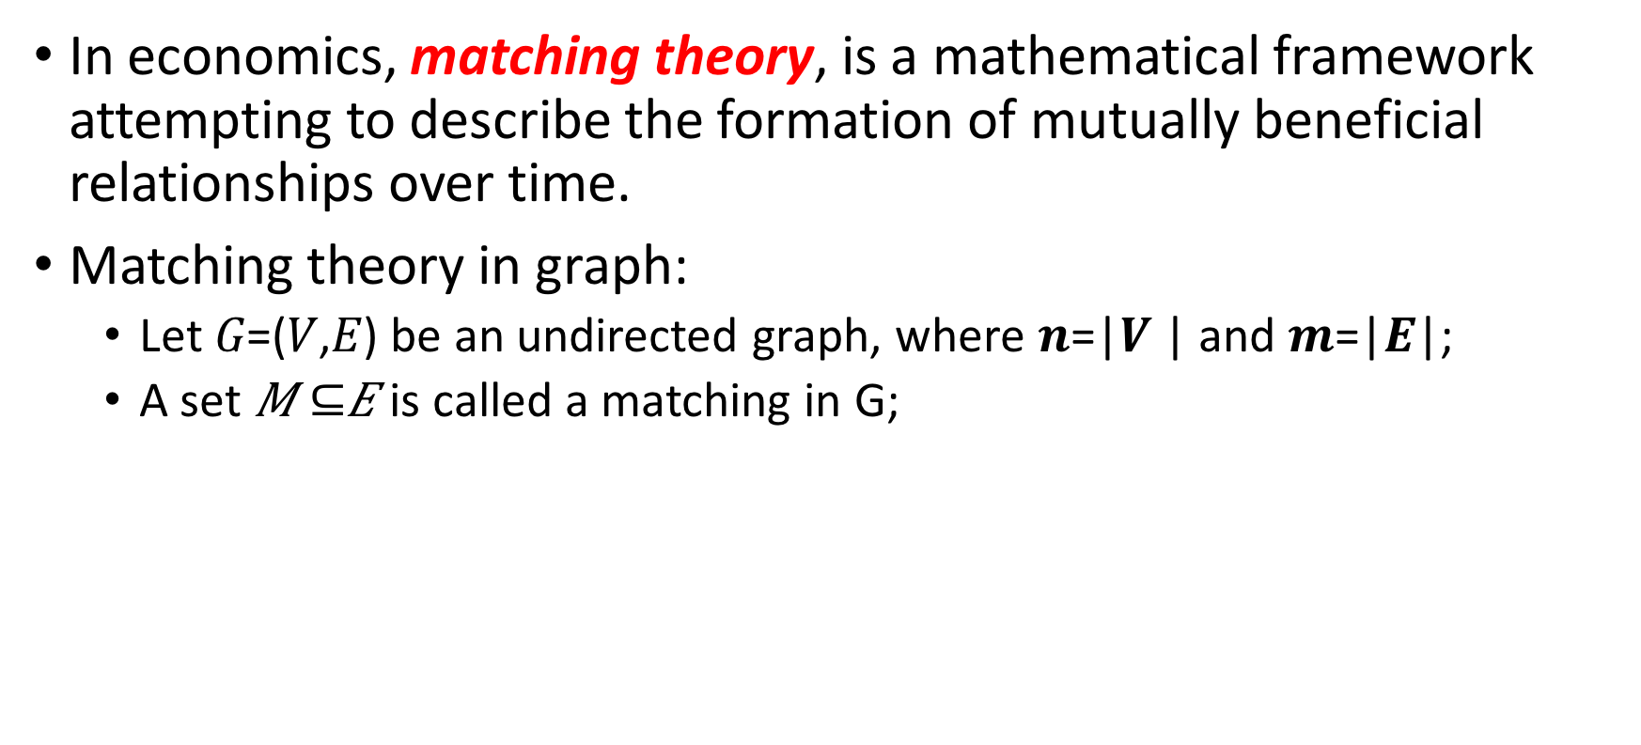
Definitions
In economics, matching theory, is a mathematical framework attempting to describe the formation of mutually beneficial relationships over time.
Matching theory in graph:
  Let 𝐺=(𝑉,𝐸) be an undirected graph, where 𝒏=|𝑽 | and 𝒎=|𝑬|;
  A set 𝑀 $⊆$𝐸 is called a matching in G;

Slide 13
Definitions
Basic elements (Stable Marriage):
  Agents: A set of men, and a set of women;
  Preference list: A sorted list of men/women based on her/his preferences;
  Blocking pair (BP) (m,w):
    1). m is unassigned or prefers w to his current partner;
    2). w is unassigned or prefers m to her current partner;
  Stable matching: A matching admit no BPs.
  Gale-Shapley Algorithm: find a stable matching in SM.

Slide 14
GS algorithm
Geeta, Heiki, Irina, Fran
Adam
Fran
Irina, Fran, Heiki, Geeta
Carl > Adam
We reach a stable marriage!
Geeta
Bob
Geeta, Fran, Heiki, Irina
Carl
Heiki
Irina, Heiki, Geeta, Fran
David > Bob
David
Irina
6

Slide 15
Outline
Motivation
  Future Networks
  Distributive Solutions
Matching Theory Basics:
  Definitions
  Classifications
  Examples
Wireless Oriented Matching:
  Modeling
  Applications

Slide 16
Classification 1
One-to-one:
  Stable roommate (SR);
  Stable marriage (SM);
Many-to-one:
  House allocation
  Student admission
Many-to-many
  Worker-Firm (WF)
  Assign paper to reviewer

Slide 17
Classification 2
Bipartite matching problem with two-sided preferences.
  Assign junior doctors to hospitals
  Assign purples to schools
Bipartite matching problem with one-sided preferences.
  Campus housing allocation
  DVD rental markets
Non-bipartite matching problem with preferences.
  Form pairs of agents for chess tournaments
  Create partnership in P2P network
  Kidney exchange market

Slide 18
Classification 3
Matching without external effect:
  The preferences only depend on the identity of their partners
  E.g. Hospital resident problem
Matching with external effect:
  The preferences depend on other agents’ actions
  E.g. multiple users share the same resource band
  Solution: post-matching swap

Slide 19
Classification 4
Matching without transfer:
  No transactions between any two agents
  E.g. stable marriage problem
Matching with transfer:
  Transactions between the matched agents
  Transfer: money, credit, service, resources and so on…
  E.g. spectrum trading between PU and SU
  Solution: the assignment game

Slide 20
Outline
Motivation
  Future Networks
  Distributive Solutions
Matching Theory Basics:
  Definitions
  Classifications
  Examples
Wireless Oriented Matching:
  Modeling
  Applications
The Hospital Resident problem (Bipartite two-sided);
The House Allocation problem (Bipartite one-sided);
The Stable Roommate problem (Non-bipartite);
The Assignment problem (Matching with transfers).

Slide 21
The Hospital Resident (HR) problem
Basics:
  A set of hospitals, a set of residents;
  Hospitals have capacity restriction;
Generalized GS algorithm
Rural Hospital Theorem:
  The same residents are assigned in all stable matchings;
  Each hospital is assigned the same number of residents in all stable matchings;
  Any hospital that is undersubscribed in one stable matching is assigned exactly the same set of residents in all stable matchings.

Slide 22
HR & its variants
Three gender SM problem (3GSM):
  Men, women and dogs
  Strictly-ordered preferences over pairs
  Preferences over individual agents
HR with Couples (HRC):
  Couples want to be allocated to the same hospital
Mapping workers to firms (WF):
  many-to-many matching
  Individual/group preferences

Slide 23

The House Allocation (HA) problem
Basics:
  A set of applicants and a set of houses
  Houses have capacity limitations
Optimality:
  Pareto optimal
    No applicant can be better off without requiring another one to be worse off
  Popular
    A matching is popular if there’s no other matching that is preferred by the majority of the applicants
  Profile-based optimal
    Satisfy certain condition of agents’ rankings of their partners

Slide 24
HA variant: Reviewer assignment problem

Slide 25
HA & its variants
  Reviewer assignment problem (RA)：
  Assignment considerations
    Reviewers’ interest and expertise
    Conflict of interest
    Coverage
    Load balancing
  Solution Techniques
    Heuristics, approximation algorithms, integer programming, polynomial-time algorithms and strategy-proof mechanisms;
  Leximin optimal matching
    Maximize the profile of the worst-off reviewer;
    Fairness.

Slide 26
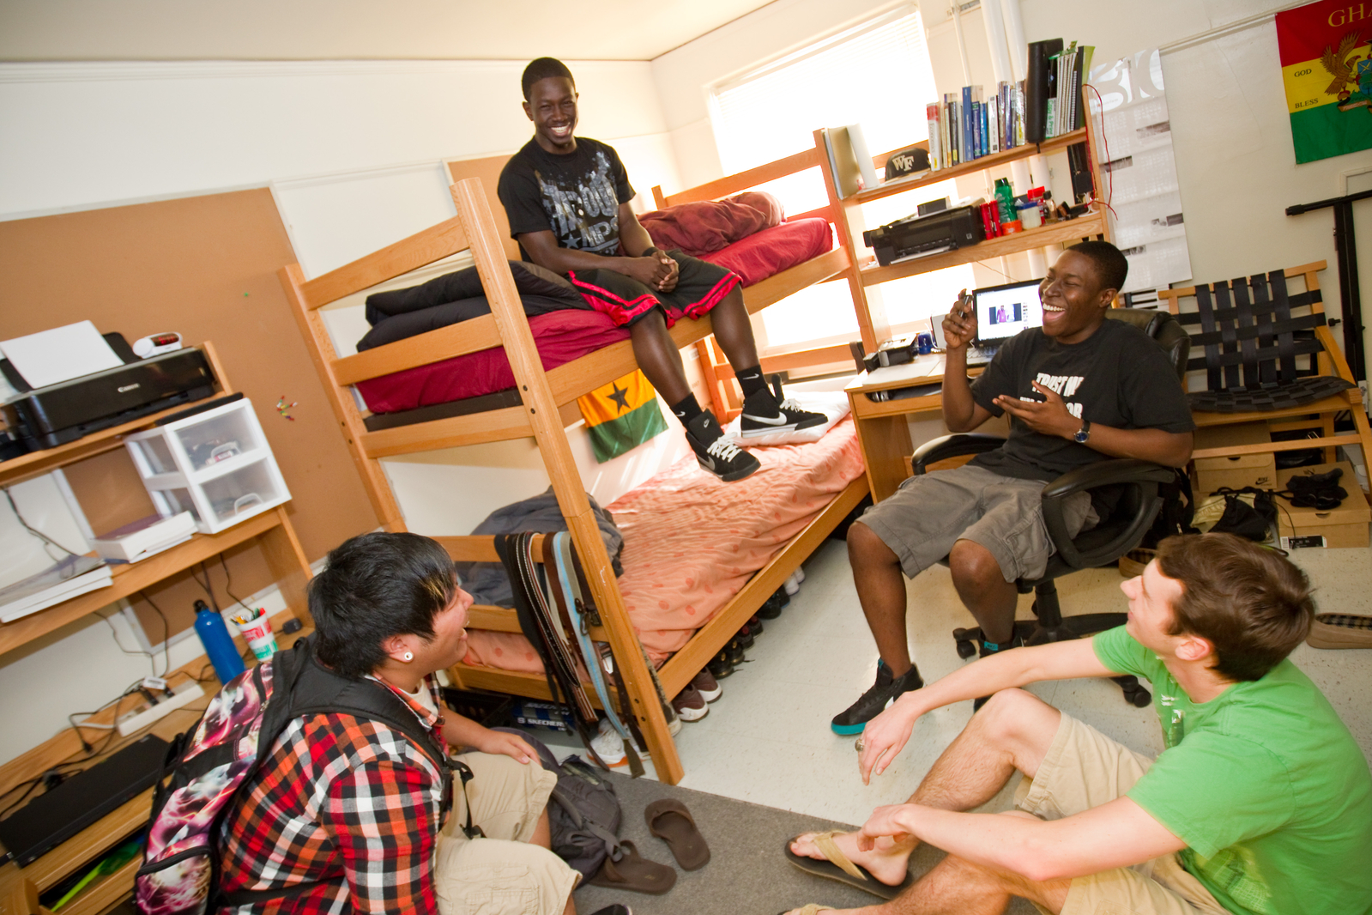
The stable roommate (SR) problem
Basics:
  A set of students looking for roommates;
  One-to-one pair;
Stability:
  Stable matching may not exist;
Algorithm:
  Irving’s algorithm;
  Tan-Hsueh algorithm (conceptional simpler)

Slide 27

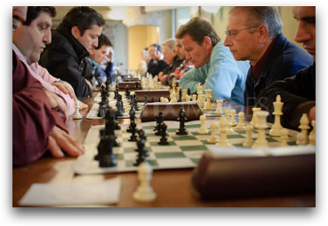
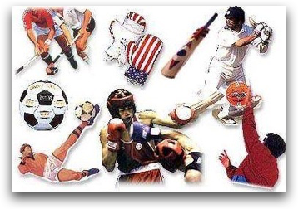
SR & its variants
Stable activity (SA)
Stable multiple activity (SMA)
Stable crews (SC)
Stable fixtures (SF)

Slide 28
The Assignment Game

Slide 29
The Assignment Game
A two-sided buyer-seller market:
  Seller owes one product, and buyer seeks for one product;
  Product (indivisible) exchange for money;
Formulation: binary linear programming
Distributed algorithm
  Feasible solution
  Making sequential price offer
  Reaching competitive equilibrium (stability)

Slide 30
Outline
Motivation
  Future Networks
  Distributed Solutions
Matching Theory Basics:
  Definitions
  Classifications
  Examples
Wireless Oriented Matching:
  Modeling
  Applications

Slide 31
Wireless-Oriented Matching
Modeling:
  Users, resources: agents;
  System QoS requirements: preference lists;
  System objectives: stability, popularity, Pareto optimality…
  Solutions: distributed, low-complexity algorithms.
Advantages:
  Game theory:
    don’t require other players’ actions;
    two-sided stability;
    Not necessarily utility function needed;
  Centralized optimization: Distributive and fast deployment.

Slide 32
Applications
LTE-Unlicensed: static and dynamic stability
D2D communication
Physical player security
Social caching in small cell
LTE assisted V2X communication

Slide 33
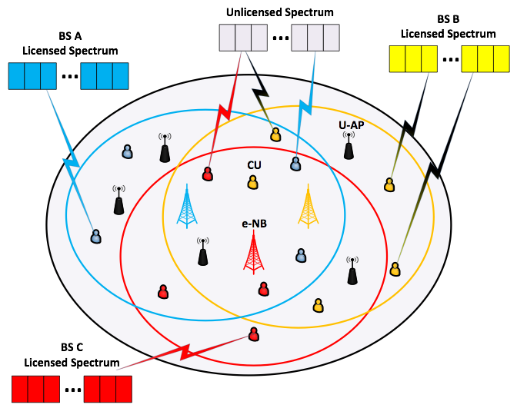


LTE-Unlicensed: Static
700MHz to 3.8GHz
LTE in Licensed Spectrum
Primary carrier
Uplink/Downlink
Carrier
Aggregation
Secondary carrier
LTE in Unlicensed Spectrum
5 GHz
Better network performance
Unified network management
Enhanced user experience
Coexistence issue?
Y. Gu, Y. Zhang, L. X. Cai, M. Pan, L. Song and Z. Han, "Exploiting Student-Project Allocation Matching for Spectrum Sharing in LTE-Unlicensed," 2015 IEEE Global Communications Conference (GLOBECOM), San Diego, CA, 2015, pp. 1-6.

Slide 34
LTE-Unlicensed Coexistence Issues
Impact of cellular users (CUs) on unlicensed users (UUs):
  Listen before talk for UUs;
Impact of UUs on CUs:
  Minimum SINR requirement for CUs;
Impact of CUs on other CUs:
  TDMA to avoid CU-CU interference;
  The more CUs, the smaller share of resource;
  External effect in matching!

Slide 35
Student Project Allocation Model
CU → student, UU → Project, LTE-U BS→ Lecturer;
Acceptable lists: coexistence constraints;
Preference of CU over UU:
Preference of LTE-U BS over (CU,UU):
SPA-(S,P) algorithm to find stable matching.

Slide 36
Initialize:
Build PLs;
Propose:
Students propose;
Stability is only guaranteed in conventional case.
TDMA brings external effect!
How to transform the matching into stable again?
Accept/Reject:
Lecturers make decisions;
No
No
Check:
Every student matched?
Check:
Every student’s PL empty?
Yes
Yes
Terminate:
A stable matching.

Slide 37
Inter Channel Cooperation (ICC)
Stability
  Only CUs can make changes;
  Two-sided stability becomes one-sided: Pareto optimal
  No player is better off without any other player(s) being worse off;
ICC steps:
  Firstly, search “unstable” CU-CU pairs regarding the current matching;
  Secondly, check if the exchange is allowed (beneficial to all CUs);
  Thirdly, find the allowed pair with the greatest throughput improvement, switch their partners, and update the current matching;
  Keep searching “unstable” CU-CU pairs, until a trade-in-free environment.
The convergence is guaranteed by the unreversibility of each switch.

Slide 38
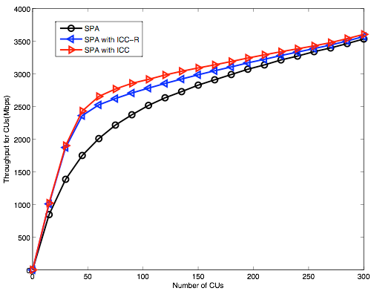
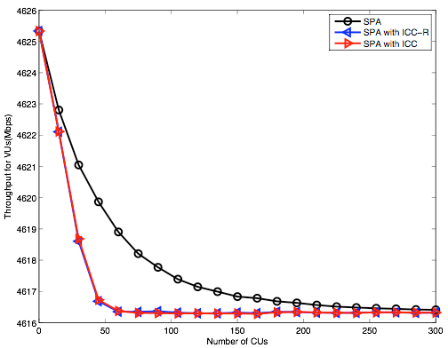
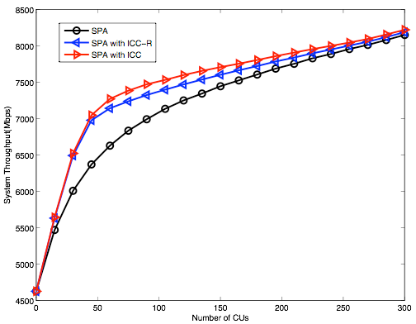
Performance Evaluation
(a) CUs’ throughput (b) UUs’ throughput (c) System throughput
Throughput comparison: SPA, SPA with ICC-R, SPA with ICC.
  Both ICC-R/ICC further improve CU/system throughput than SPA;
  Both ICC-R/ICC slightly decrease UU throughput than SPA;
  ICC outperforms ICC-R w.r.t. CU/system throughput.

Slide 39
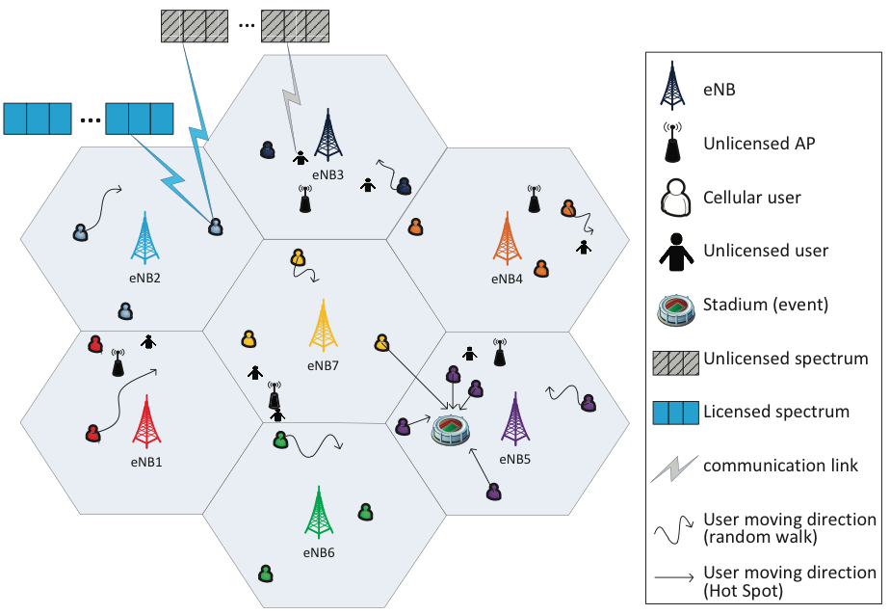
Dynamic Stability in LTE-Unlicensed
User Mobility
Network dynamic
Dynamic Stability?
Yunan Gu, Lin X. Cai, Chunxiao Jiang, Lingyang Song, Miao Pan, Zhu Han, submitted to“ Dynamic Path to Stability in LTE-Unlicensed with User Mobility: a matching theory framework”, submitted to IEEE Transactions on Wireless Communications.

Slide 40
Random Path to Stability
One-to-one:
  Roth-Vande Vate (RVV) algorithm
  Divorcing and remarrying operations
Many-to-many (many-to-one):
  Pairwise stability
  RPTS algorithm
  Increase internal stable set by satisfying a blocking agent/pair
Compared with repeated GS
  Make use of the previous matching instead of staring from empty;
  Reduce complexity.

Slide 41
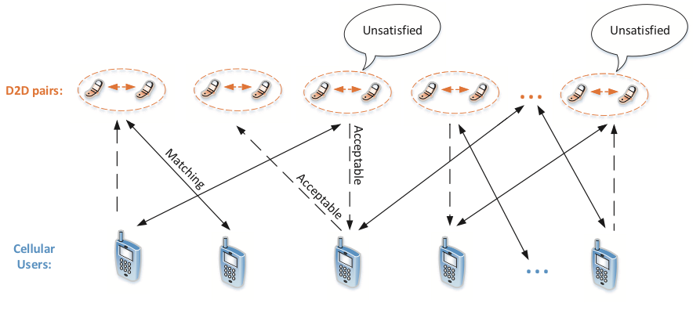
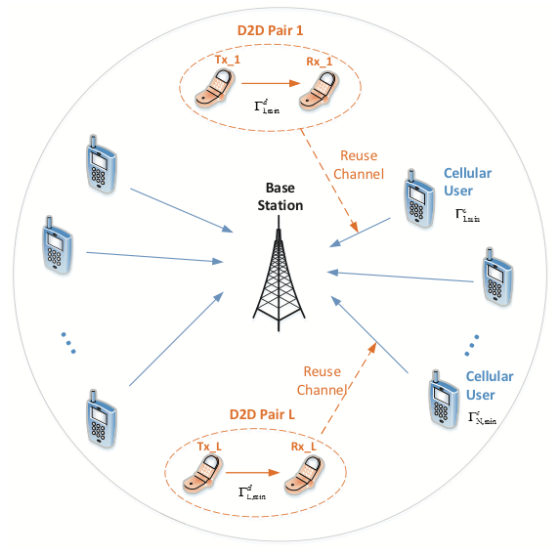
D2D Communications
D2D user pairs (DUs) search for cellular users (CUs) to share spectrum;
Stable marriage model;
Preference lists: channel condition, QoS;
GS: stable one-one matching (DU,CU).
Some DUs are not matched to the best choice,
and have the incentive improve by cheating!
Yunan Gu, Yanru Zhang, Miao Pan, and Zhu Han, “Matching and Cheating in Device to Device Communications Underlaying Cellular Networks," IEEE Journal on Selected Areas on Communications, Special Issue on Recent Advances in Heterogeneous Cellular Networks, vol. 33, no. 10, pp. 2156-2166, October 2015.

Slide 42
D2D Communications
Strategic Issue (cheating)
  Achieve better partners by falsifying the preference lists;
Coalition Strategy
  Find the cabal set
  Find the accomplices of the cabal
  Falsify the accomplices’ preference lists
  If a cabal exist, then
    Each man in the cabal is strictly better off;
    Each man outside the cabal keeps their partners.
A group of men who prefer each other’s partner to its own.
A group of men who would otherwise prevent the cabal to get their desired partners.

Slide 43
Physical Layer Security
Form the (source, jammer) pair
Decide the monetary compensation
The assignment game!
Each jammer makes a price offer to source
Source propose the the best jammer
Jammer decides accept/reject, and increase the price by a certain amount
Terminate with no new offer
Competitive equilibrium (stability)
Bayat, S.; Louie, R.H.Y.; Zhu Han; Vucetic, B.; Yonghui Li, "Physical-Layer Security in Distributed Wireless Networks Using Matching Theory," in Information Forensics and Security, IEEE Transactions on , vol.8, no.5, pp.717-732, May 2013

Slide 44
Social Caching in Small Cells
Many-to-many matching between videos and SBSs
Preference: Delay, Popularity
Modified GS
  Pairwise stability (not blocked by individual nor pairs)
Hamidouche, K.; Saad, W.; Debbah, M., "Many-to-many matching games for proactive social-caching in wireless small cell networks," in Modeling and Optimization in Mobile, Ad Hoc, and Wireless Networks (WiOpt), 2014 12th International Symposium on , vol., no., pp.569-574, 12-16 May 2014

Slide 45





LTE Assisted V2X communications
eNB
V2I
V2V
LTE assisted vs 802.11p-based V2X:
  Safety critical applications;
  Better reliability;
  Lower latency;
  More efficient content sharing;
Optimize content sharing;
  Data class diversity;
  Communication link quality;
Stable fixture (SF) model;
  Coalition formation/clustering;
  Flexible many-to-many matching.
RSU
OBU
Y. Gu, L. X. Cai, M. Pan, L. Song and Z. Han, "Exploiting the Stable Fixture Matching Game for Content Sharing in D2D-based LTE-V2X Communications," IEEE Global Communications Conference (GLOBECOM), Washington DC, MA, 2016.

Slide 46
Conclusion
Matching theory offers:
  Suitable models for specific issues;
  Preference lists to satisfy various system constraints and requirements;
  Stability guaranteed;
  Efficient and distributive algorithms;
  Close-optimal results.
Wise choice for resource allocation problems in 5G.
  MIMO: [1]
  Cognitive radio:[2][3]
  Joint UL and DL resource allocation: [4]
  User association in small cells: [5][7][9]
  Machine-to-machine communication: [6]
  Content caching: [8]
  Network Virtualization…
Nobel Prize to answer the ultimate question for man

Slide 47
References
[1] Ziwei Fu; Quansheng Guan; Fei Ji; Shengming Jiang; Yiqin Lu, "Stable user pairing in virtual MIMO systems: A game theoretical perspective," in Communications in China (ICCC), 2013 IEEE/CIC International Conference on , vol., no., pp.430-435, 12-14 Aug. 2013
[2] Li Huang; Guangxi Zhu; Xiaojiang Du; Kaigui Bian, "Stable multiuser channel allocations in opportunistic spectrum access," in Wireless Communications and Networking Conference (WCNC), 2013 IEEE , vol., no., pp.1715-1720, 7-10 April 2013
[3]Siavash Bayat*, Raymond H. Y. Louie, Branka Vucetic and Yonghui Li, “Dynamic decentralized algorithms for cognitive radio relay networks with multiple primary and secondary users utilizing matching theory”
[4] El-Hajj, A.M.; Dawy, Z.; Saad, W., "A stable matching game for joint uplink/downlink resource allocation in OFDMA wireless networks," in Communications (ICC), 2012 IEEE International Conference on , vol., no., pp.5354-5359, 10-15 June 2012
[5] Namvar, N.; Saad, W.; Maham, B.; Valentin, S., "A context-aware matching game for user association in wireless small cell networks," in Acoustics, Speech and Signal Processing (ICASSP), 2014 IEEE International Conference on , vol., no., pp.439-443, 4-9 May 2014
[6] Bayat, S.; Yonghui Li; Zhu Han; Dohler, M.; Vucetic, B., "Distributed massive wireless access for cellular machine-to-machine communication," in Communications (ICC), 2014 IEEE International Conference on , vol., no., pp.2767-2772, 10-14 June 2014
[7] Pantisano, Francesco, et al. "Proactive user association in wireless small cell networks via collaborative filtering." Signals, Systems and Computers, 2013 Asilomar Conference on. IEEE, 2013.
[8] Gu, Yunan, et al. "Student admission matching based content-cache allocation." Wireless Communications and Networking Conference (WCNC), 2015 IEEE. IEEE, 2015.
[9] Bayat, S.; Louie, R.H.Y.; Zhu Han; Vucetic, B.; Yonghui Li, "Distributed User Association and Femtocell Allocation in Heterogeneous Wireless Networks," in Communications, IEEE Transactions on , vol.62, no.8, pp.3027-3043, Aug. 2014

Slide 48
Overview of Wireless Amigo Lab
Lab Overview
  Currently: 9 Ph.D. students,1 postdoc, and many visitors
  Alumni: 11 Ph.D. and 3 joint postdocs.
  Supported by 11 NSF funding, DOD, DOI, Gulf of Mexico Research Initiative, Power consortium and Qatar grants
Current Concentration
  Game Theoretical Approach
    Spectrum sensing; UAV; Vehicular network; Physical layer security; MIMO/Relay network; Social network; Context aware network; Femtocell; Device to device network
  Compressive Sensing and Big Data
  Machine Learning
      Bayesian nonparamentric learning: IGMM, Gibbs sampling
      Deep learning
      Multiarm Bandit: Exploration and exploitation
  RF Energy Harvesting and Transfer
  Full Duplex/D2D/mmWave/femtocell

Slide 49
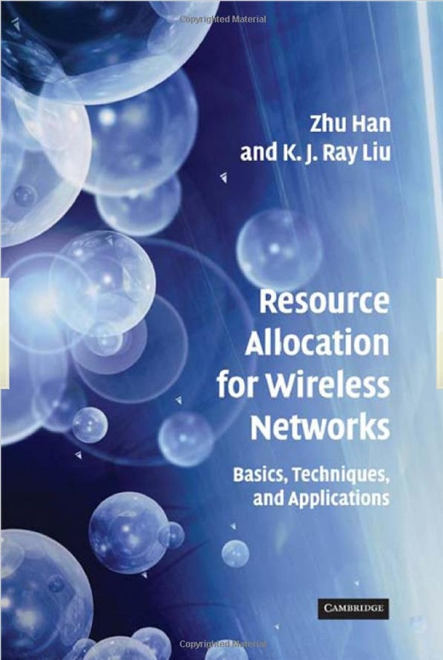
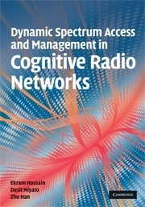
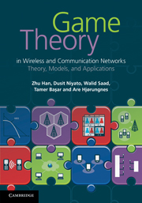
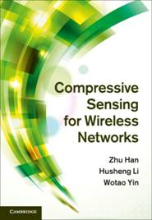
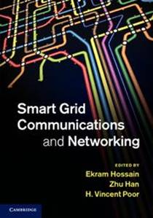
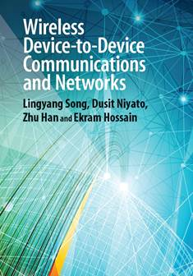
Research Lab Summary
  Security
    Device identification by Baysian nonparametric method
    Trust management and belief network/propagation
    Quickest detection
    Physical layer security
    Primary user emulation attack
  Smart Grid
    False data injection attack
    PHEV optimization
    Distributed microgrid control
    Renewable energy
    Smart meter
    Demand side management
Summary from my student’s facebook
  Theory is something we know why, but it does not work.
  Practice is something works, but we do not know why.
  In our research lab, we have both: nothing works and we do
  not know why.

Slide 50

Thank you

