Slide 1
Secure Computing with Privacy Preservation for Cyber-Physical Systems
Ph.D. Defense
Sai Mounika Errapotu
Advisors: Dr. Miao Pan and Dr. Zhu Han
April 2018

Slide 2
Outline
Introduction
Privacy Preservation in Cyber Physical Systems:
  Cost Aware Appliance Scheduling Using Fog Computing in Smart Home
  Clock Auction for Emergency Demand Response in Colocation Data Centers
  Matching based Dynamic Spectrum Trading for Cognitive Radio Networks
Future works
Conclusion

Slide 3
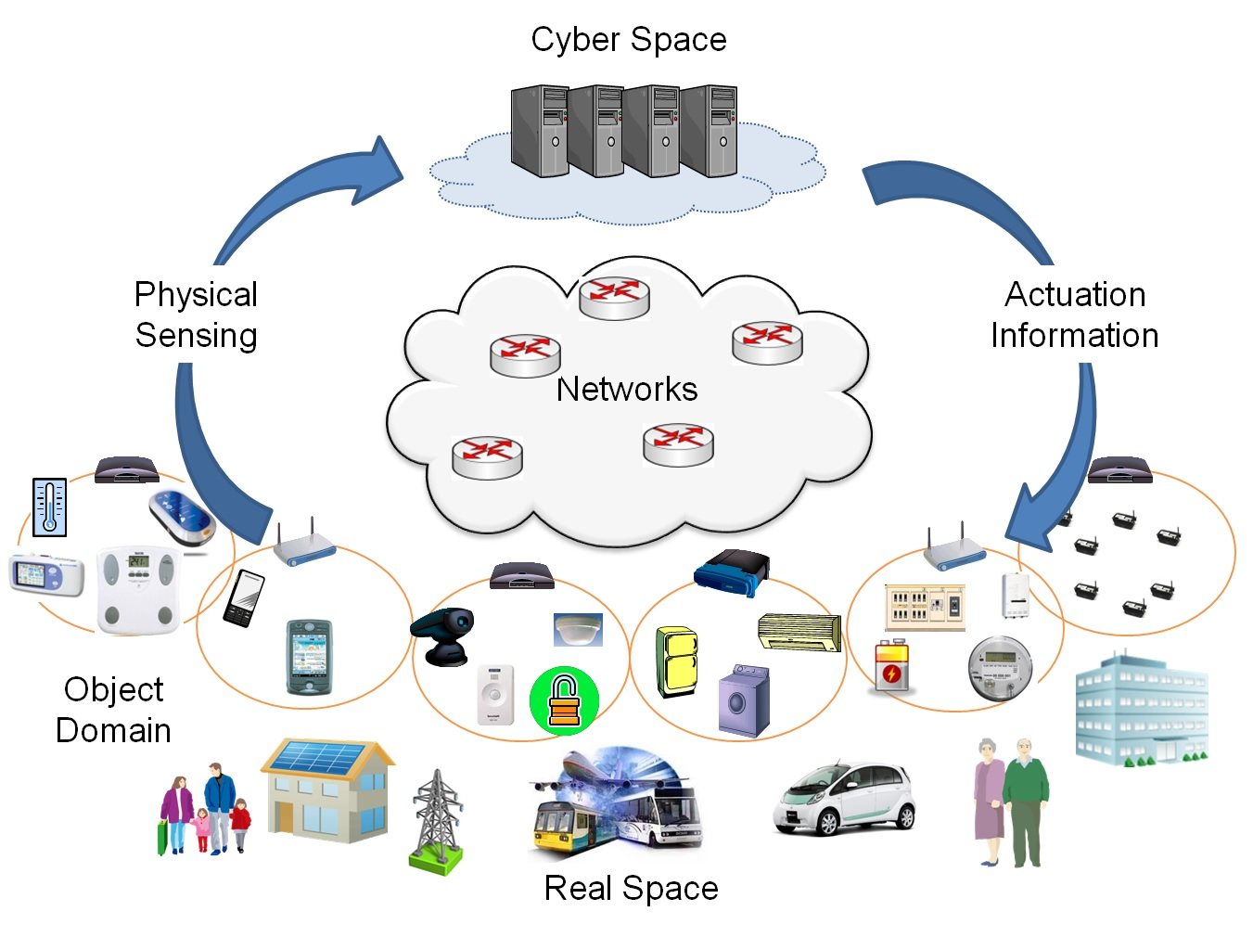
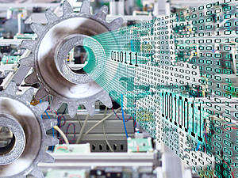
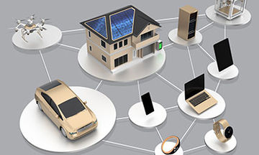

Cyber Physical Systems
“Cyber-physical systems (CPS) are engineered systems that are built from, and depend upon, the seamless integration of computational algorithms and physical components” - NSF
Notes:
Software and physical components are increasingly integrated into network systems—so-called "Cyber-Physical Systems" (CPS)—for solving problems

Slide 4
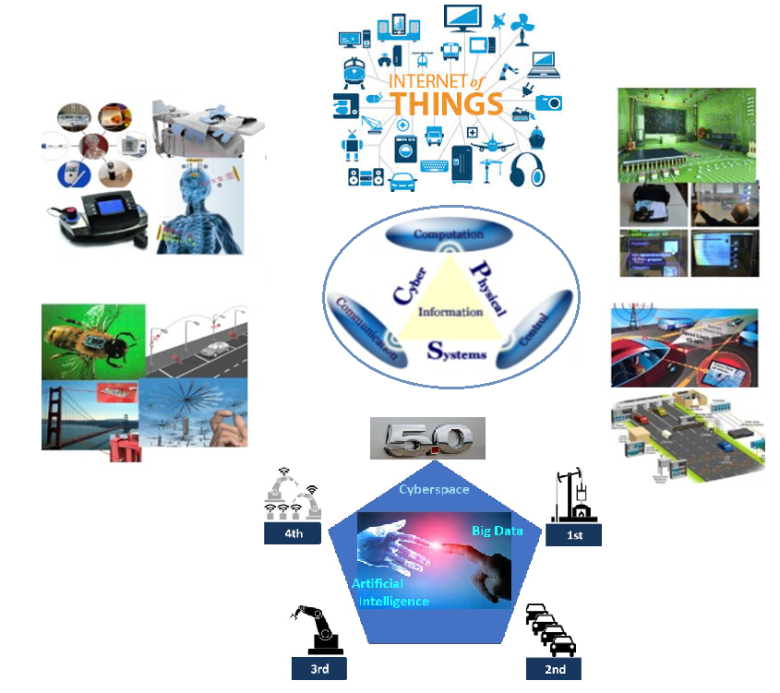


Security and Privacy in CPS
IoT
Medical
Smart spaces
Sensors
Transportation
Industry 5.0
Notes:
Today computer software controls airbags in cars, the temperature of buildings and the timing of cardiac pacemakers.

Slide 5
Contributions of my PhD work
Cyber Physical Systems
Modeling
Applied Cryptography
Privacy Preserving Computing for Cyber Physical Systems
Thrust I : Cost Aware Appliance Scheduling for Smart Home
(Alternating Direction Method of Multipliers + Paillier Cryptosystem)
Thrust II : Emergency Demand Response in Colocation Data Centers
(Clock Auction + Privacy Preserving Aggregation)
Thrust III : Dynamic Spectrum Sharing in Cognitive Radio Networks
(Matching Theory+ Paillier Cryptosystem)

Slide 6
Thrust - I
Privacy Preserving ADMM for Smart Home:
Cost Aware Appliance Scheduling Using Fog Computing

Slide 7
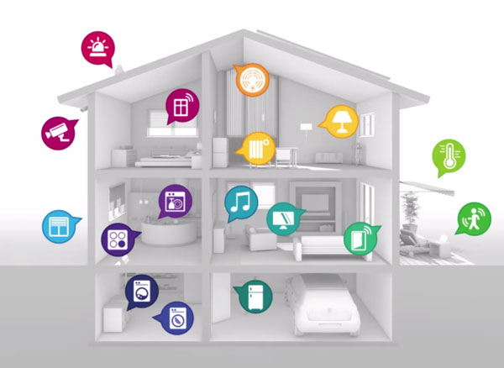


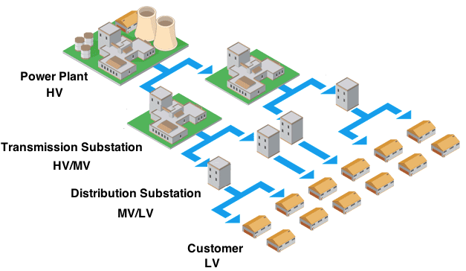


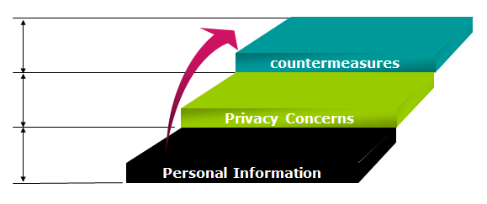
Smart Home
Effective household energy monitoring and control
Handling uncertainties,
Demand side management
Personally identifiable information

Slide 8
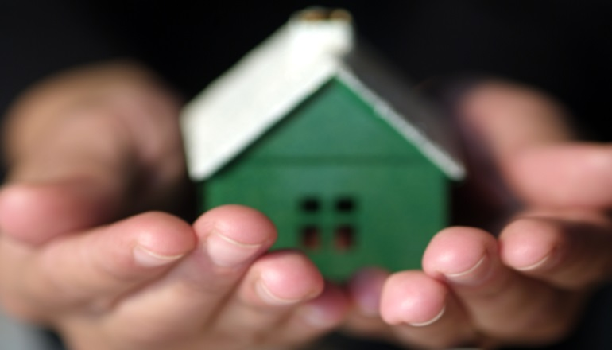
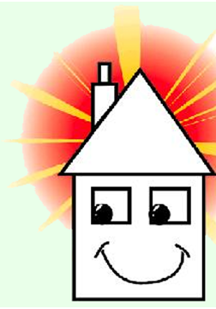
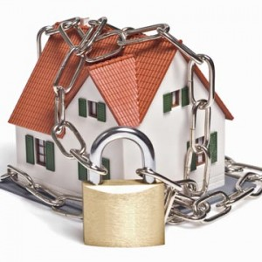
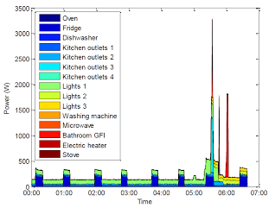
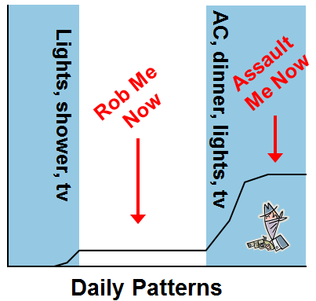
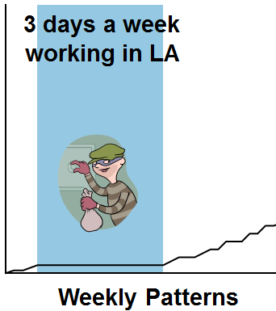
Privacy Concerns in Smart Home
Smart home knows?
What time you go to bed, get up
What time you leave for, come from work
Your vehicle charging information
That you have a brand new $5,000 4K TV

Slide 9



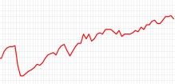
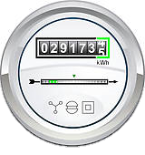
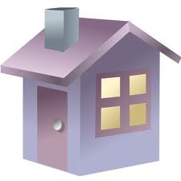












Cost Minimization + User Privacy Preservation?
Utility Provider:
- Cost minimization
- Computational capacity (Fog)
Smart Home User:
- Privacy concerns (Paillier)
- Appliance scheduling
Utility provider
Large Scale Optimization Problem
. . .

Slide 10


Fog Computing
Advantages
In close proximity to the users
Low latency => beneficial for time-critical applications
Location awareness and improved QoS
Suitable for distributed real time applications
Fog 1
Fog 2
Fog j
Fog N
Expensive to Affordable Computing

Slide 11




Alternating Direction Method of Multipliers
Solves global problem by decomposing into local sub-problems
Scalable enough to process high dimensional big data sets in parallel or distributed fashion
Convergence properties and decomposability of dual ascent
Objective and constraints can be decoupled
Augmented lagrangian multiplier
x,z update
Dual variable update
Notes:
ADMM problem form with f,g convex: two sets of variables with separable objective
. It takes the form of a decomposition-coordination procedure, in which the solutions to small local subproblems are coordinated to find a solution to a large global problem.

Slide 12
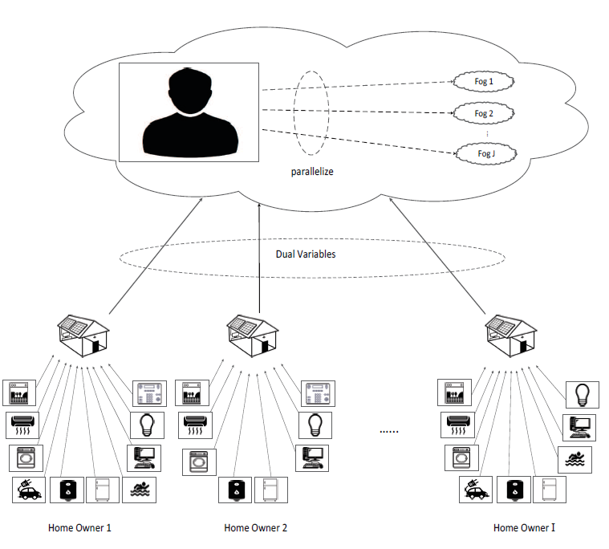


System Architecture
Computation by untrusted fog nodes
Eavesdropping attack by external adversaries
Utility provider
ADMM

Slide 13
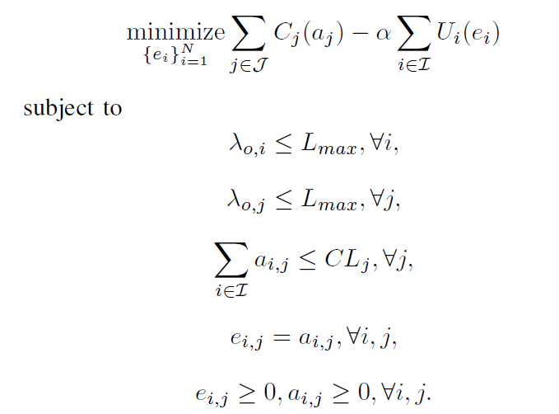
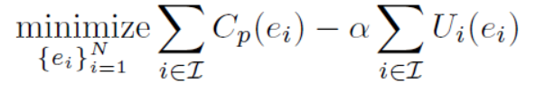
Solving Optimization Problem with ADMM
Optimization problem to minimize the expenditure at utility provider’s end considering latency and computational capacity
Max latency
Fog 2
…
Fog 1
Fog N
Computational limit
Auxiliary variable
Notes:
ADMM: two sets of variables with separable objective
Augmented lagrangian update, x z update, dual variable update

Slide 14







Paillier Encryption
Additive Homomorphism:
$$E\left(m_{1},r_{1}\right)= {r_{1}}^{n}g^{m_{1}} E\left(m_{2},r_{2}\right)={r_{2}}^{n}g^{m_{2}}$$
$E\left(m_{1},r_{1}\right)×E\left(m_{2},r_{2}\right)$
$={r_{1}}^{n}g^{m_{1}}×{r_{2}}^{n}g^{m_{2}}$
$={(r_{1}r_{2})}^{n}g^{m_{1}+m_{2}}$
$=E(m_{1}+m_{2},r_{1}r_{2})$
C₁ . C₂ = E(m₁$+$m₂)
Product of cipher texts will decrypt to the
sum of corresponding
plain texts.
publish
D_{s}(Ep(A+B+C+D)) = A+B+C+D
Aggregator => E_{p}(A) E_{p}(B) E_{p}(C) E_{p}(D)
E_{p}(A)
E_{p}(D)
E_{p}(B)
E_{p}(C)

Slide 15
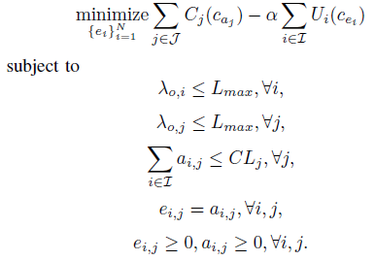

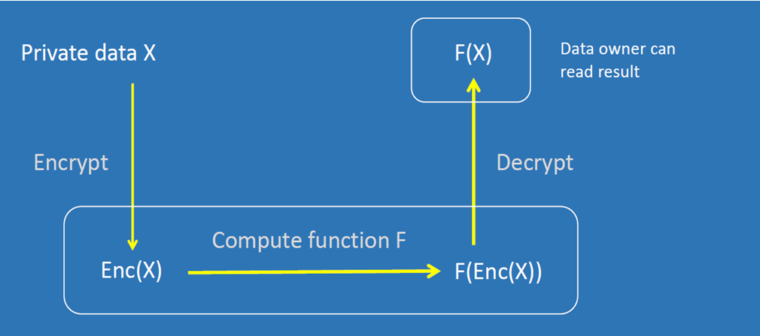

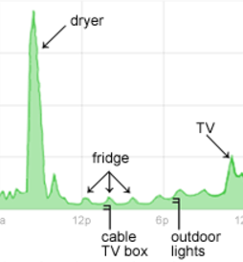


Secure ADMM
Solving ADMM in Fog on Paillier Encrypted User Energy Profiles
Paillier Decrypt

Slide 16
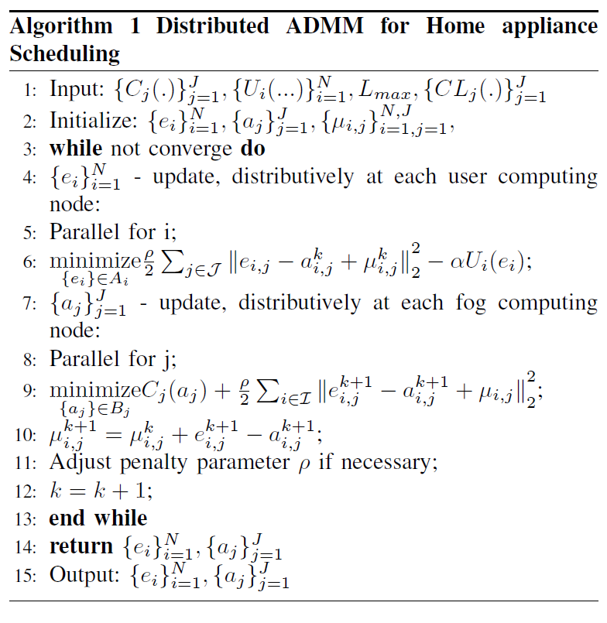
ADMM for Home Scheduling
Paillier Encryption
User Update
Fog Update
Dual Variable Update

Slide 17
Simulation Settings
5 min Location Marginal Prices at Palo Alto, CA
Time horizon of 1 week: 2016 5-min periods
Hourly average solar radiance from Measurement and Instrumentation Data Center at National Energy Renewable Energy Laboratory
Time horizon of 1 week: 168 1-hour slots
8 appliances: both elastic and non-elastic loads

Slide 18
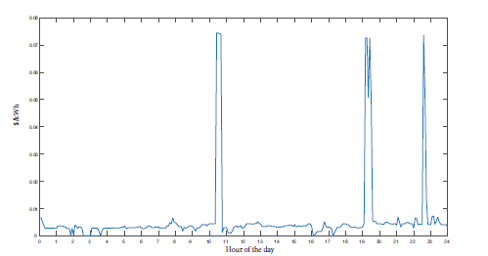
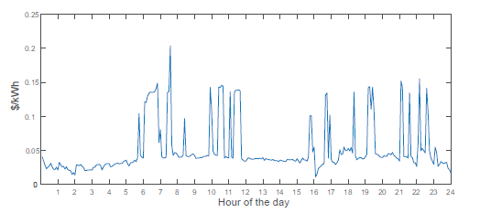
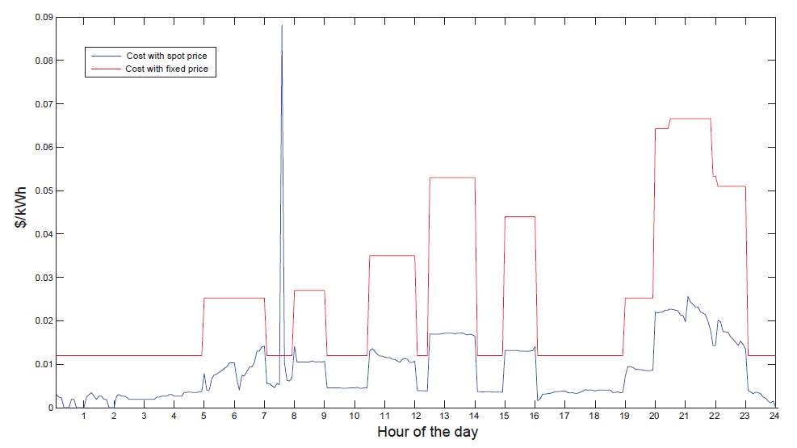
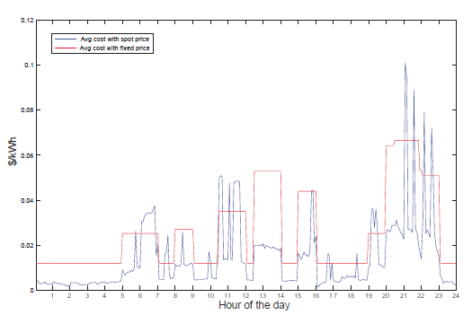
Performance Analysis
One day
One week
Gain: 3.05
Gain: 1.85
Spot price plans with optimal energy usage reduces the consumption cost of the users

Slide 19
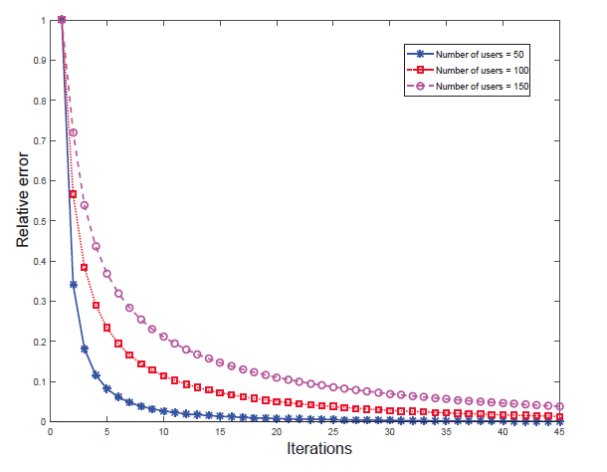
Security and Performance Analysis
As the no. of users increases, the proposed scheme converges with only small increment of iterations
Confidentiality:
Privacy and confidentiality of energy profiles and updates are effectively protected from outside attackers by Paillier cryptosystem.
Privacy preservation in fog during optimization:
Fog cannot learn users’ energy profile while solving the optimization problem.
Notes:
As the no. of users increases, the proposed scheme converges with only small increment of iterations

Slide 20
Thrust - II
Privacy Preserving Clock Auction for Emergency Demand Response in Colocation Data Centers

Slide 21
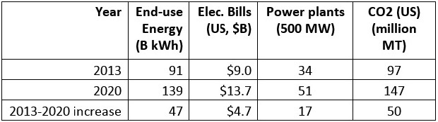
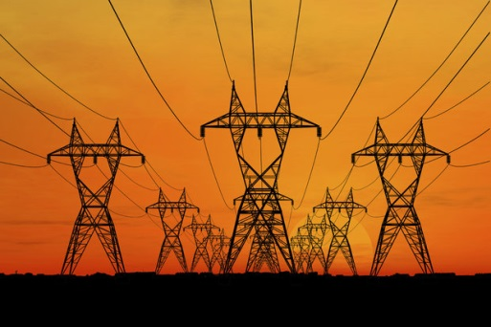
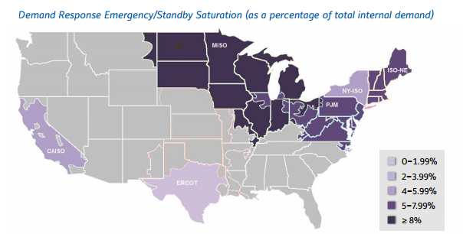
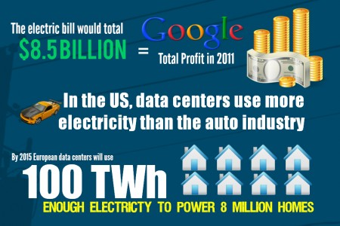
Motivation
Escalating power demand => Need for energy efficiency
Emergency Demand Response:
Shedding load in emergencies or contingencies including system power losses for incentives

Slide 22
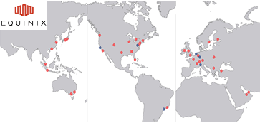
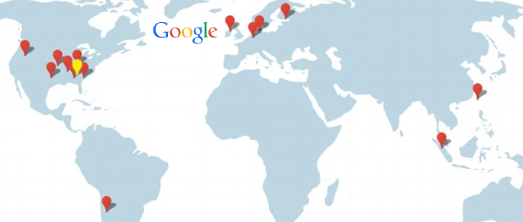
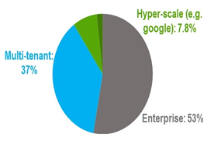
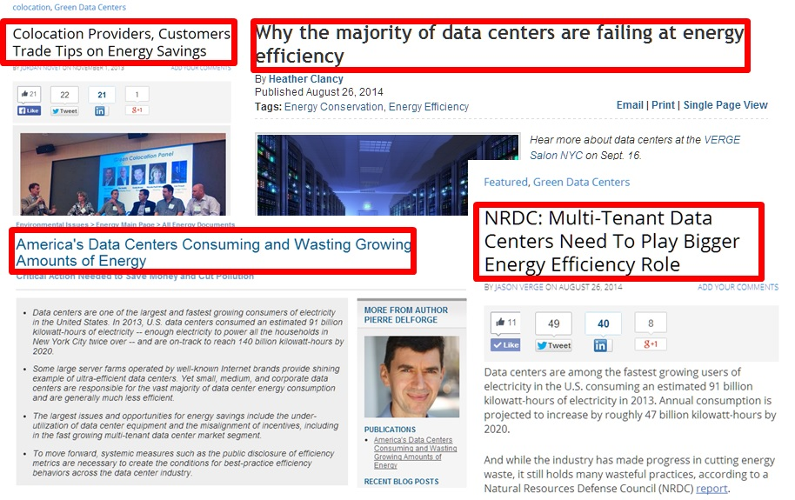
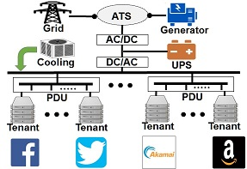
Motivation
Owner operated data centers consume 8% of total data center energy usage
(NRDC data)
Owner operated data centers
Multi-tenant colocation data centers consume 37% of total data center energy usage

Slide 23
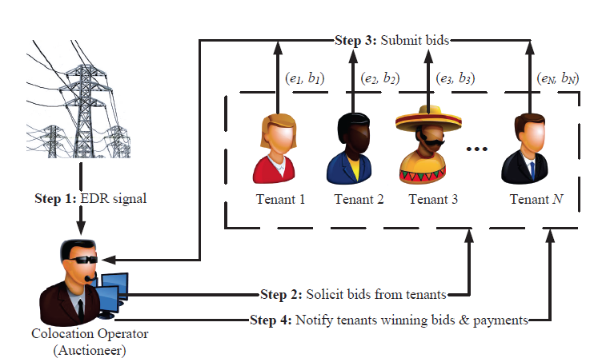

Privacy Issues in Colocation Data Centers
Smart Grid:
Demand – Supply balance during EDR
Grid reliability
Colocation Tenants:
Receive incentives
Privacy preservation during aggregation
Encryption protects tenants’ private information from outside attackers, but how to protect it from semi-honest colocation operators.
Methodology : Clock Auction with Privacy Preserving Aggregation

Slide 24
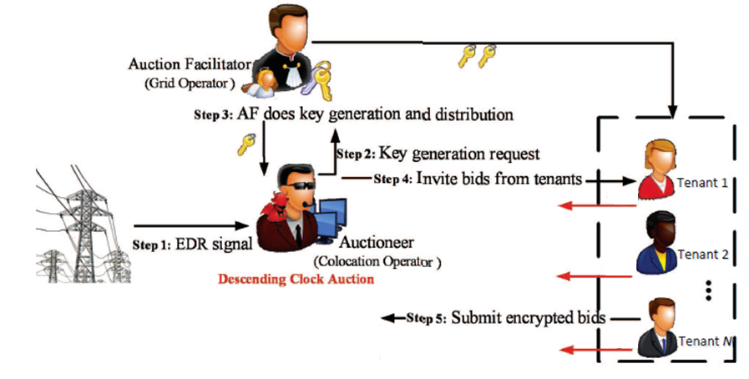
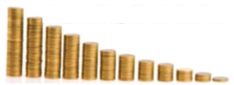

Overall Idea of the Proposed Solution
E(p₁)
E(e₁)
E(p₂)
E(e₂)
E(e_{N})
E(p_{N})

Slide 25
Clock Auction with PP-Aggregation
Goal: Meet the EDR target under budget while preserving the tenants’ bids from the auctioneer
Advantages Clock Auction:
Fast and simple in meeting EDR compared to reverse auction
Bidders receive incentives close to their evaluation.
Privacy Preserving Aggregation for EDR:
Effective in finding aggregated energy/price without revealing the individual energy/price quoted by the bidding tenants.
Collusion with the auctioneer or Collusion among group of participating tenants does not leak the bids of other tenants
Notes:
Only needs information relevant to price and quantity to know the excess demand in every round and little scope for collusion

Slide 26







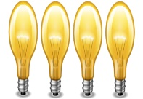













Descending Clock Auction
EDR target:
Time
Reward
Tenant 1
Tenant 2
Tenant 3
Tenant 4
t₀
t₁
t_{n}
t_{n+1}

Slide 27

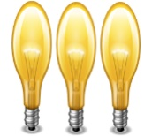


Descending Clock Auction
Time
Reward
Tenant 1
Tenant 2
…
Tenant n
t₀
E
E
E
Modified Homomorphic Encryption :
Cyclic group G of prime order p
Generator g ∈ G
Hash function H : Z G
Keys sk₁,sk₂ … sk_{n} ∈ Z_{p}
To preserve tenant privacy:
Operator secret key: sk₀
Tenants secret keys: sk₁, sk₂ … sk_{n}
N
∑ sk_{i} = 0
i=0

Slide 28


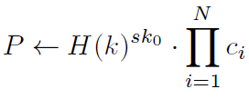


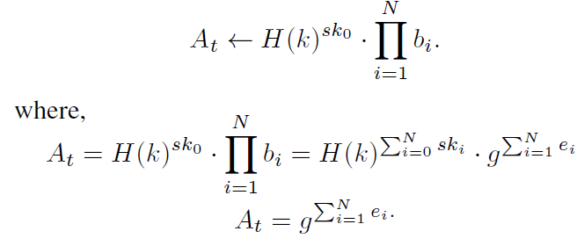
Privacy Preserving Energy Aggregation
Private value
Tenant’s secret key
Encryption:
- Cipher text
- Plain text
Decryption:
Operator’s secret key
Tenants’ bid encryption in price descending clock auction:
Energy willing to reduce
Auctioneer Energy Aggregation
Tenant’s bid
N
∑ sk_{i} = 0
i=0

Slide 29
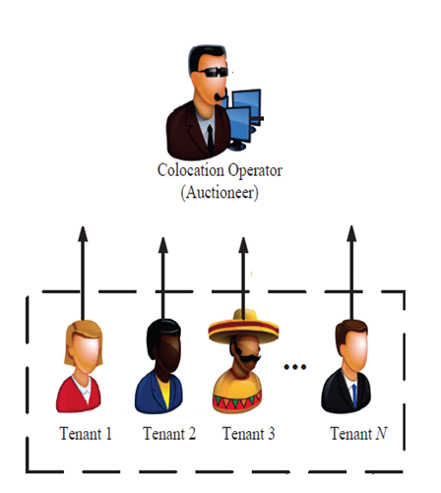
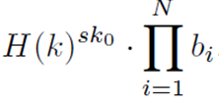
DP-Computation with Untrusted Aggregator
N
∑ e_{i}
Dec(sk₀,b₁, b₂,b₃,…,b_{N}) =
i=1
N
∑ sk_{i} = 0
i=0
b₁= Enc(sk₁,e₁)
b₂
b₃
b_{N}= Enc(sk_{N},e_{N})

Slide 30
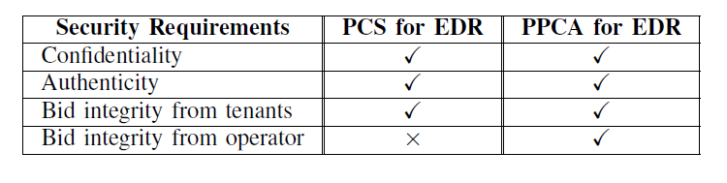
Security Analysis
Differential Privacy Preservation:
Auctioneer can learn aggregated energy value
Cannot learn individual values
Confidentiality:
Tenants’ bids are encrypted using the proposed homomorphic encryption scheme that guarantees bid privacy and confidentiality.
PPCA for EDR - Privacy preserving clock auction for EDR
PCS for EDR - Paillier cryptosystem for EDR
(Compared our scheme with Paillier cryptosystem used for aggregation in EDR)

Slide 31
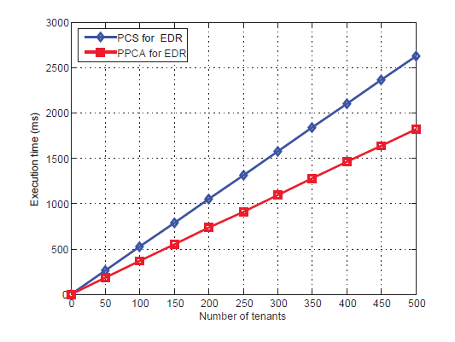
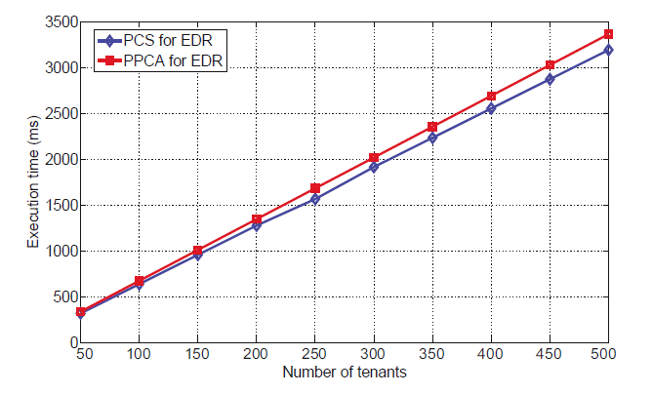
Simulation Results
Price DCA
Energy DCA
1024 – bit keys
The communication overhead increases with the number of rounds in the auction as well as with increase in participating tenants for EDR
Trade off between the communication overhead and tenants’ privacy protection from the operator

Slide 32
Thrust - III
Privacy Preserving Dynamic Matching based Spectrum Trading for Cognitive Radio Networks

Slide 33



Motivation
Global Mobile Data Traffic
Cellular Mobile Network Capacity

Slide 34




Solution and Challenges
Dynamic Spectrum Accessing
$15
Bid Manipulation
$10
$8
$9
$11
$11
Collusion
Notes:
Spectrum Trading is a way of dynamic spectrum sharing in which the licensed users (Primary users) lease their spectrums to the unlicensed users (Secondary users), when the spectrum are vacant.
Spectrum trading provides monetary gains to the primary users and better spectrum accessing opportunities for the secondary users.
Spectrum trading improves the inefficient spectrum utilization to meet the ever – growing need for spectrum.

Slide 35

Centralized vs Distributed
Centralized scheme:
Advantages:
Design property can be guaranteed (e.g., incentive compatibility, user’s rationale, budget balance)
Consider spatial reuse
Disadvantages:
Need to have infrastructure to execute auction
Scalability
Privacy concerns
Previous Distributed scheme:
Advantages:
more “Green”
Can capture instantaneous opportunities.
Disadvantages:
No consideration of spatial reuse
Privacy concerns
Our Contribution
Consider both distributed (matching) & spatial reuse in spectrum trading preserving bidders privacy to improve spectrum utilization and increase monetary gains.

Slide 36
Matching Theory
In economics, matching theory, is a mathematical framework attempting to describe the formation of mutually beneficial relationships over time.
One-to-one:
  Stable roommate (SR)
  Stable marriage (SM)
Many-to-one:
  House allocation
  Student admission
Many-to-many
  Worker-Firm (WF)
  Paper to reviewer

Slide 37
Stable Marriage
Agents
Preference lists
Geeta, Heiki, Irina, Fran
Adam
Fran
Carl > Adam
Blocking Pair
Irina, Fran, Heiki, Geeta
We reach a stable marriage!
Geeta
Bob
Geeta, Fran, Heiki, Irina
Carl
Heiki
Irina, Heiki, Geeta, Fran
David > Bob
David
Irina
  Gale-Shapley Algorithm: find stable matching in Stable Marriage

Slide 38





Matching : Worker Firm
>
1
3
1
3
4
1
  Suppose after matching:
A>B>C
A
{1,3,4}>{1,3}>{2,5}
2
:
B>A>C
A
B
{2}>{2,5}>{1,3,4}
1
3
3
C>A>B
If there is no pairwise block in the matching, then final matching result is pairwise stable.
B
Pairwise Block
4
A>C>B
C
{1,3}>{2,4,5}>{3}
:
Our Research is a modified WF problem
WF is complex than Stable Marriage problem, there is no “Standard” algorithm to solve it (like GS in Stable Marriage).
C
2
4
5
5
B>A>C
>
A
C

Slide 39



Problem Formulation
Conflict Graph
Maximal Independent Set (MIS):
(i) Co- band Interference:
Interference that exists when the receiver of one SU transmission pair is within the interference range of transmitter of another SU pair; when two different SUs
are using the same band
(ii) Radio Interference:
Interference due to SU pair transmission over two or more bands at the same time.
MIS of PU_{A} :
{1,2,7}
{2,4,7}
{3,4,6}
{4,5,7}

Slide 40


Dynamic Matching based Spectrum Trading
Preference of SUs
To maximize their data rate
Preference of PUs
- Maximize revenue by providing access to as many non-conflicting SUs with high bids
{1,4,6}
{1,3,6}
{2,4,6}
{1,3,5}
Bid encryption
b_{i}
E(b_{i})

Slide 41




Dynamic Matching based Spectrum Trading
=>
C₁ / C₂ = E(m₁$−$m₂)
MIS comparison
Decrypting the result we get M₁ - M₂, intuitively, we consider how much M₁ is higher than M₂.

Slide 42






Overview of the Scheme
E(b₁)
n₁ , g₁
E(b₂)
< n₁ , g₁ >
n₂ , g₂
$λ$₁ , µ₁
$λ$₂ , µ₂
$λ$_{m}, µ_{m}
n_{m} , g_{m}
E(b₆)
Winner => {2,4,6}

Slide 43


Security and Performance Analysis
PU sends the comparison vector to the trusted coordinator without identifier and element positions interchanged.
Trusted coordinator cannot collude with SUs.
Key generation and evaluation can be done by multiple trusted coordinators in a distributed way to make the scheme more secure.
PPDMST scheme improves the performance

Slide 44


Complexity Analysis
PPDMST has relatively higher communication overhead

Slide 45

Other Research
Primary Users’ Operational Privacy Preservation through Data-Driven Optimization
- Secondary Users Concerns :
Maximize data rates
- Primary Users Concerns :
Temporal Privacy Preservation - Obfuscation
Tradeoff : PUs’ temporal privacy and SUs’ network performance
PUs’ Obfuscation - change the distribution of temporal spectrum availability to confuse the adversary
Consideration – Utility of SUs and try best to satisfy SUs’ uncertain traffic demands
Tradeoff
Notes:
Consideration of spatial reuse feature of the spectrum to improve the spectrum allocation.
Preservation of the bidders’ privacy using Paillier cryptosystem
Semi - distributed framework based on matching to improve the inefficient spectrum utilization.

Slide 46



Other Research
Differentially Private Optimization for Flexible and Efficient Energy Consumption
- Smart Home Users Privacy Preservation:
Distributed Differential Privacy
- Flexible Energy Consumption: ADMM
Differential Privacy
Notes:
Consideration of spatial reuse feature of the spectrum to improve the spectrum allocation.
Preservation of the bidders’ privacy using Paillier cryptosystem
Semi - distributed framework based on matching to improve the inefficient spectrum utilization.

Slide 47

Differential Private Optimization Challenges
The users don’t trust data curator.
Every consumer adds sufficient noise
Aggregated noisy statistic has too much noise
No Accuracy
Every consumer adds less noise
Not safe for individual user
Secure Multiparty Computation
(or ) Homomorphic Encryption
Every consumers submit discrete data
Distributed Perturbation Algorithm(DLPA)
i.e., Gamma, Gauss, Geometric distribution
Every user adds discrete Laplace function noise and submit
to the data curator.

Slide 48
Future Works

Slide 49





Utility-Privacy Tradeoff in Big Data
Exploring Tradeoff between Data Utility and Privacy :
BIG DATA ANALYTICS
vs
Data Privacy
Data Utility
Homomorphic encryption
Secure multiparty computation
Differential privacy

Slide 50



Mobile Crowd Sensing/Sourcing with DP
Crowd Sensing : Data Driven Approaches
Participants Privacy : Differential Privacy

Slide 51
Publications
Journal
Sai Mounika Errapotu, Jingyi Wang, Xuanheng Li, Zaixin Lu, Wei Li, Miao Pan and Zhu Han, “Bid Privacy Preservation in Matching Based Multi-Radio Multi-Channel Spectrum Trading,” in IEEE Transactions on Vehicular Technology.
Jingyi Wang, Yan Long, Jie Wang, Sai Mounika Errapotu, Hongyan Li, Miao Pan and Zhu Han, "D-FROST: Distributed Frequency Reuse Based Opportunistic Spectrum Trading via Matching with Evolving Preferences" in IEEE Transactions on Wireless Communications.
Sai Mounika Errapotu, Hongning Li, Rong Yu, Shaolei Ren, Qingqi Pei, Miao Pan and Zhu Han, “Clock Auction Inspired Privacy Preserving Emergency Demand Response in Colocation Data Centers,” major revision, IEEE Transactions on Dependable and Secure Computing.
Jingyi Wang, Sai Mounika Errapotu, Yanmin Gong, Lijun Qian, Riku Jantti, Miao Pan and Zhu Han, "Primary Users' Operational Privacy Preservation via Data-Driven Optimization" major revision, IEEE Transactions on Cognitive Communications and Networking.
Sai Mounika Errapotu, Jingyi Wang, Yanmin Gong, Jin-Hee Cho, Miao Pan and Zhu Han, "SAFE : Secure Appliance Scheduling for Flexible and Efficient Energy Consumption for Smart Home IoT" submitted to IEEE Internet of Things Issue on AI Powered Network Management: Data Driven Approaches under Resource Constraints.
Conference
Sai Mounika Errapotu, Justin Loveless, Rong Yu, Shaolei Ren, Miao Pan, and Zhu Han, “Privacy Preserving Clock Auction for Emergency Demand Response in Colocation Data Centers,” in IEEE International Conference on Communications, Paris, France, May 2017.
Sai Mounika Errapotu, Jingyi Wang, Zaixin Lu, Wei Li, Miao Pan, and Zhu Han, “Bidding Privacy Preservation for Dynamic Matching Based Spectrum Trading,” in IEEE Global Communications Conference (GLOBECOM), Washington, DC, Dec. 2016.
Jingyi Wang, Yan Long, Jie Wang, Sai Mounika Errapotu, Yuanxiong Guo, and Miao Pan, “Distributed Spectrum Trading via Dynamic Matching with Evolving Preferences” in IEEE/CIC International Conference on Communications in China (ICCC), Chengdu, China , July 2016.

Slide 52
Conclusion
Privacy preservation in Cyber-Physical Systems is extremely important to build high-confidence and secure CPS.
Our interdisciplinary research work integrates privacy preservation with modeling for various CPS :
  Descending Clock Auction based Emergency Demand Response in Colocation Data Centers
  ADMM for Cost Aware Appliance Scheduling in Smart Home
  Dynamic Spectrum Sharing in Cognitive Radio Networks
Future IoT big data processing systems must consider distributed computation along with privacy preservation to achieve desired utility.

Slide 53


