Slide 1
Dissertation Defense
Game Theoretical Framework for Distributed
Dynamic Control in Smart Grids
Najmeh Forouzandehmehr
Advisor: Dr. Zhu Han
Wireless Networking, Signal Processing and Security Lab
Department of Electrical Engineering
University of Houston, TX, USA

Slide 2
Outline
Introduction
Smart Grid
Smart Buildings
Game Theory Preliminary
Differential Game
Satisfaction Game
Contributions
Hydrothermal Scheduling
Smart Building Controls
Distributed HVAC Control
Conclusion and Future Work

Slide 3
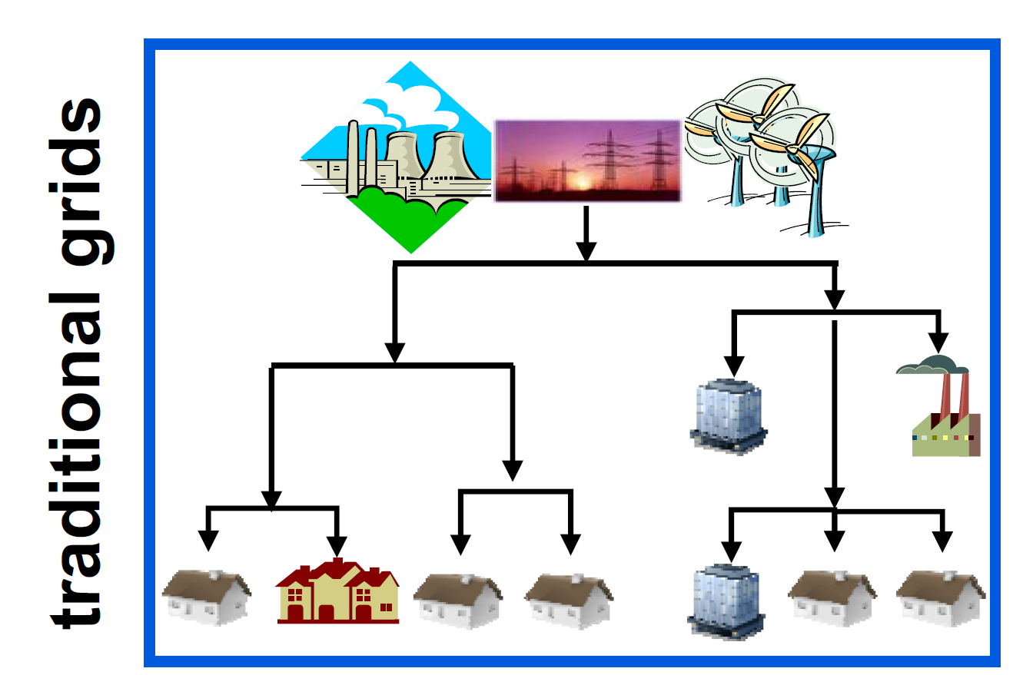
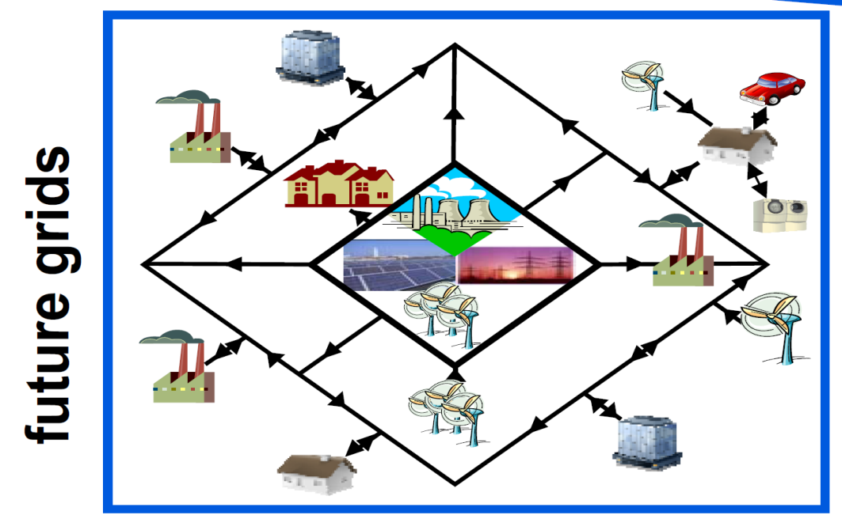
Introduction: Smart Girds
Centralized power generation
One-directional power flow
Generation follows load
Operation based on historical experience
Limited grid accessibility
for new producers
Distributed power generation
Intermittent renewable generation
Consumers become also producers
Multi-directional power flow
Load adapted to production
Operation based more
on real-time data
Notes:
communications and controls for end-use devices
and systems to reduce (or, in special cases, increase) their demand
for electricity at certain times.
Distributed generation (DG): small engine or turbine generator sets,
wind turbines, and solar electric systems connected at the distribution
level.

Slide 4
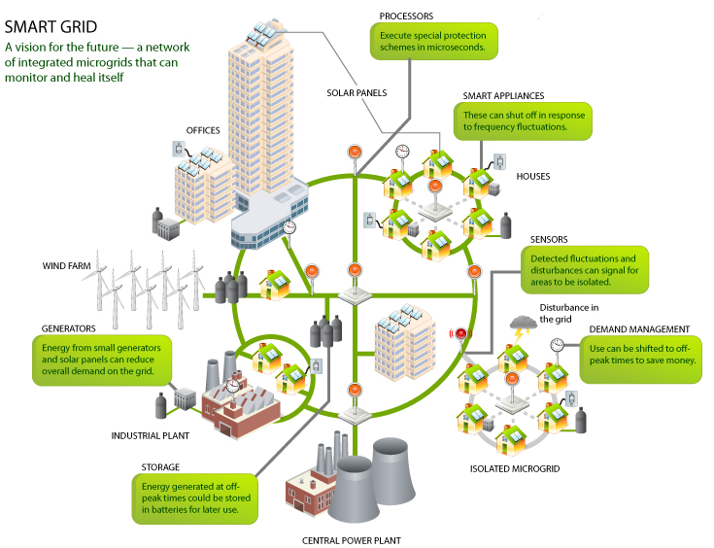
Introduction: Smart Girds
Integration from supply to demand

Slide 5
Introduction: Smart Buildings
Buildings are a major source of demand side energy efficiency
Buildings consume over 40% of total energy in the EU and US
Between 12% and 18% by commercial buildings the rest residential.
Implementing the US Building Directive (22% reduction) could save 40Mtoe (million tons of oil equivalent) by 2020.
Consumption profiles may vary but Heating, Cooling and Ventilation (HVAC) and lighting are the major energy users in buildings
Up to 28% HVAC
Up to 20% lighting
Retail Buildings
37% Lighting
30% Space Heating
10% Space Cooling
6% Water Heating
17% Other
Healthcare Buildings
28% Water Heating
23% Space Heating
16% Lighting
6% Office Equipment
27% Other

Slide 6
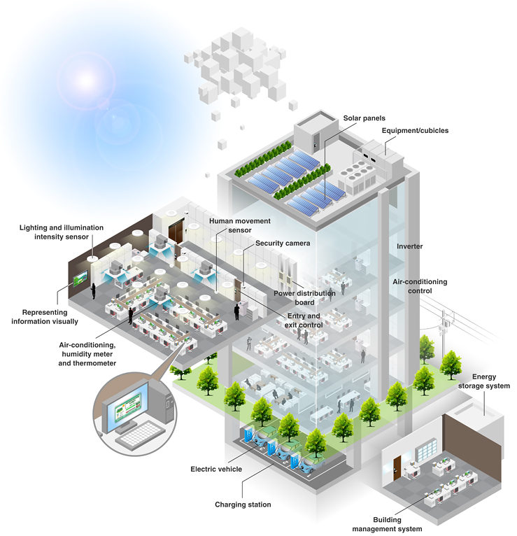
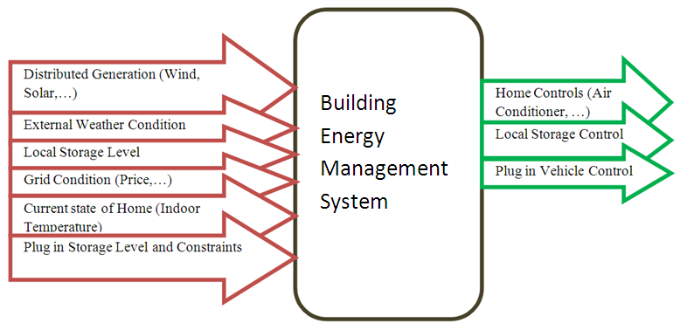
Introduction: Smart Buildings
Building Energy
Management Systems

Slide 7
Outline
Introduction
Smart Grid
Smart Buildings
Game Theory Preliminary
Differential Game
Satisfaction Game
Contributions
Hydrothermal Scheduling
Smart Building Controls
Distributed HVAC Control
Conclusion and Future Work

Slide 8
Game Theory
Motivations for game theoretical frameworks implementation in smart grids
There is a need to deploy novel models and algorithms that can capture
The need for distributed operation of the smart grid nodes
The heterogeneous nature of the smart grid
The need for efficiently integrating advanced techniques
The need for algorithms that can efficiently represent competitive or collaborative scenarios
Game theory could constitute a robust framework that can address many of these challenges
Games can be
Static: one-shot
Dynamic: takes place not instantaneously but over a whole interval of time

Slide 9
Game Theory
Game theory is concerned with the situation where
A set of players N
Set of strategies of player Si
Set of payoffs (or payoff functions) Ui
Different from control, a game play needs to against nature as well as the other players
Outcome of a game
A Nash equilibrium is a strategy profile s* with the property that no player i can do better by choosing a strategy different from s*, given that every other player j ≠ i .
We concentrate on
Differential Games : dynamic nature of energy storages, room temperature, battery, carbine dioxide,…
Satisfaction Games: preventing abusing the limited resources
Notes:
: takes place not instantaneously but over a whole interval of time

Slide 10
Differential Games
To study a differential game, we need to understand the standard model of the optimal control theory:
Ordinary differential equation (ODE):
x: state, f: a function, u: control
Payoff:
g: running payoff, h: terminal payoff

Slide 11
Differential Games
Solution using dynamic programming
Define the value function v(x,t) to be the greatest payoff possible
and
Theorem: Assume that the value function Hamilton-Jacobi-Bellman is suitably smooth, then the solution is
Backward induction: change to a sequence of constrained optimization

Slide 12
Differential Games
Differential Game:
Each player solves the optimal control problem
Different players share a state that obeys a dynamic equation
x: state, f: a function, u1, u2,..., uN: controls
Overall Payoff
Running Payoff
Terminal Payoff
Notes:
, if there exist suitably smooth functions Vi that satisfy HJB equation

Slide 13
Differential Games
For an N-person differential game, the information structure could be:
Open Loop, if
Closed-loop perfect state, if
Memoryless perfect state, if
Feedback perfect state, if

Slide 14
Differential Games
For special case of Stochastic linear quadratic differential game:
The value function can be written as:
where T satisfies the following Riccati differential equations
State dynamics
Payoff Function

Slide 15
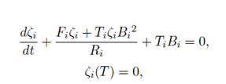
Differential Games
Riccati Solution
and
can be obtained from the following differential equation:
Finally, the optimal control variable can be obtained as follows:
The optimal control function constitutes a feedback Nash Equilibrium to the stochastic differential game

Slide 16
Satisfaction Games
In real life distributed systems :
Players may not observe the actions of their opponents
Players are concerned by the satisfaction of their individual constraints rather than the optimization of their performance metric
New equilibrium concepts are needed that :
Do not require complete information
Achievable through learning, over repeated play

Slide 17
Satisfaction Games
Satisfaction Equibliruim
A satisfaction-based reasoning:
If a player is satisfied by its current payoff, it should keep playing the current strategy, instead of further improving the utility
An unsatisfied player may decide to change its strategy according to some exploration function
In other word, if player is satisfied, it will not change its strategy anymore, even though its utility can be improved
A Satisfaction equilibrium will arise when all players are satisfied.
Different from Nash equilibrium

Slide 18
Outline
Introduction
Smart Grid
Smart Buildings
Game Theory Preliminary
Differential Game
Satisfaction Game
Contributions
Hydrothermal Scheduling
Smart Building Controls
Distributed HVAC Control
Conclusion and Future Work

Slide 19
Contributions
Stochastic dynamic hydrothermal scheduling in Smart grid networks
Modeling competitive interactions between an autonomous pumped-storage plant as an energy storage and a thermal-power plant
Optimizing power generation and storage
The proposed framework and games can reduce the peak to average ratio and total energy generation for the thermal plant
Autonomous demand response using stochastic differential games
Modeling a distributed energy management system of smart residential buildings
Controlling of HVAC and storage units to minimize the users total cost
The proposed method reduces the overall power consumption of all users
Distributed Control of HVAC Systems in Smart Buildings
Modeling a distributed control of HVAC system in a smart building based on occupancy
The interaction among several autonomous HVAC units is studied using satisfaction game and a trial-and-error learning algorithm
The proposed method significantly increase the energy efficiency of smart buildings

Slide 20
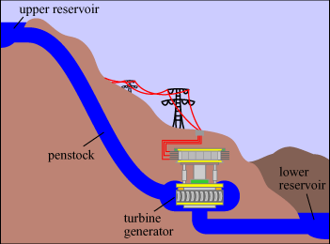
Hydrothermal Scheduling
Energy storages can help balancing supply and demand
The pumped-storage plant has the largest available capacity
Stores off-peak energy for generation during peak periods
Converts intermittent renewable energy into a firm, dispatchable resource

Slide 21
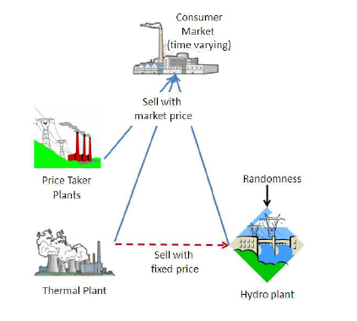
Hydrothermal Scheduling
Two types of power plants
Each power plant tries to maximize its own profit
Thermal plant action:
, how much power to sell to the market
Pumped-storage plant action:
, the discharged water from the dam
State:
, the reservoir volume

Slide 22
Hydrothermal Scheduling
Nash-Cournot Price Model
The spot price can be obtained as:
System Dynamics
Total Demand
Power generated by thermal plant
Power generated by hydro plant
Power stored by thermal plant
Natural income to reservoir
Storage leakage rate
Total water discharged by reservoir
Notes:
O PRICE TAKER GENERATION

Slide 23
Hydrothermal Scheduling
Hydro Plant Payoff
Power bought from thermal plant
Price
Hydro generation
Total Payoff
Value Function
Terminal Condition

Slide 24
Hydrothermal Scheduling
Thermal Plant Payoff
Power sold to hydro plant
Thermal Generation
Price
Cost of Thermal Generation
Total Payoff
Value Function
Terminal Condition

Slide 25
Hydrothermal Scheduling
Derived optimal control for hydro plant
Derived optimal control for thermal plant
where

Slide 26
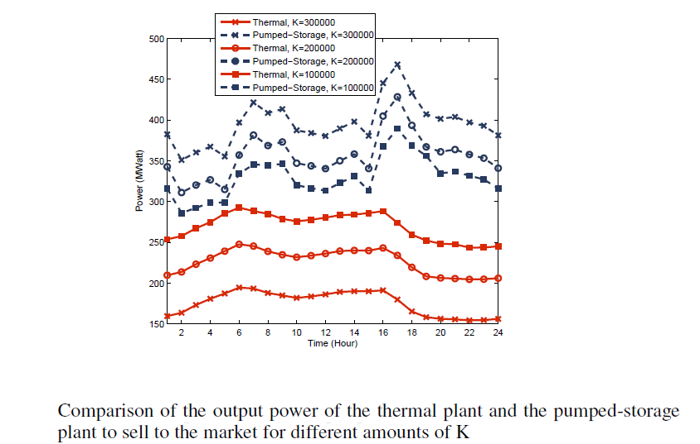
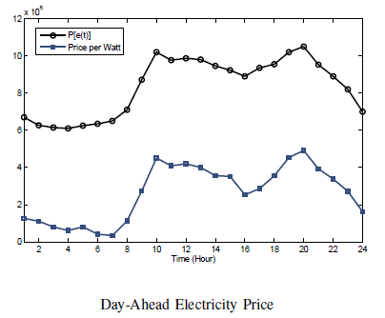
Hydrothermal Scheduling
By increasing the price per Watt (K) the thermal plant finds
Selling its output power to the pumped-storage plant more beneficial than selling it to the market

Slide 27
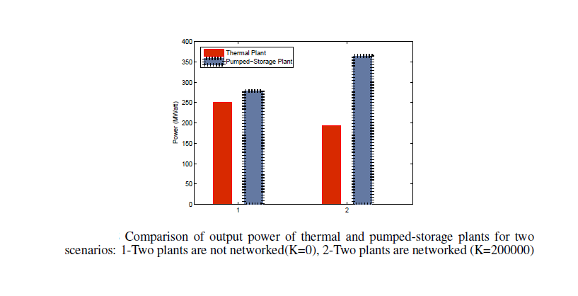
Hydrothermal Scheduling
Comparison of output power of thermal and pumped-storage plants for two scenarios
1-Two plants are not networked(K=0),
2-Two plants are networked (K=200000)
In case 2, the participation of pumped-storage plant in demand satisfaction increases, which yields a greener choice

Slide 28
Outline
Introduction
Smart Grid
Smart Buildings
Game Theory Preliminary
Differential Game
Satisfaction Game
Contributions
Hydrothermal Scheduling
Smart Building Controls
Distributed HVAC Control
Conclusion and Future Work

Slide 29
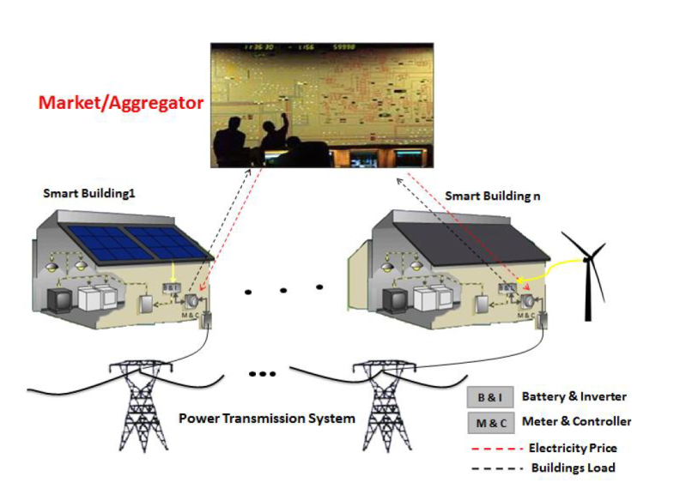
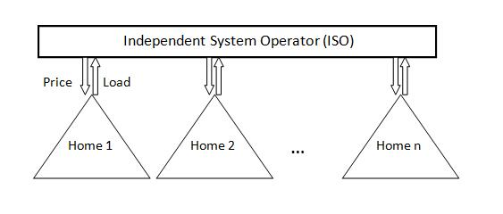
Smart Buildings Controls
System Model
Upper Level: Independent System Operator
Solves a social welfare maximization problem,
Decides how much power to buy from generators and what are prices.
Lower Level: Number of buildings
Solves a electricity bill minimization problem
Decides HVAC and energy storage controls

Slide 30
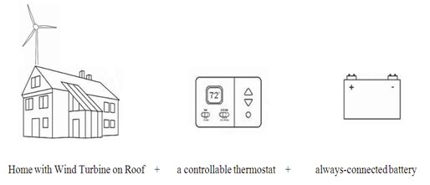
Smart Buildings Controls
System states:
x₁ : The amount of electricity energy stored in the battery array
x₂ : The indoor temperature of the home
Control Variables:
u₁: The amount of power from battery to home usage
u₂: Air conditioner usage of electricity

Slide 31
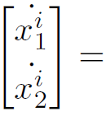
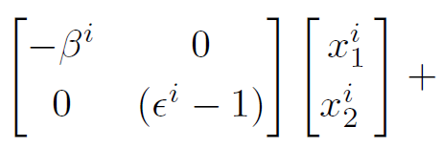
Smart Buildings Controls
Battery Storage Dynamics:
β= Rate of energy loss of the battery

Slide 32
Smart Buildings Controls
Temperature Dynamics [P. Constantopoulos, 1991]:
ε= The thermal time constant of the building
γ= Efficiency of the air conditioning unit
tOD = Outside temperature

Slide 33
Smart Buildings Controls
Building i
Consumption
Building i
Generation
Price Model
Cost:
Constant Price
Penalty of Violating
Desired Temperature
Price
Building consumption

Slide 34
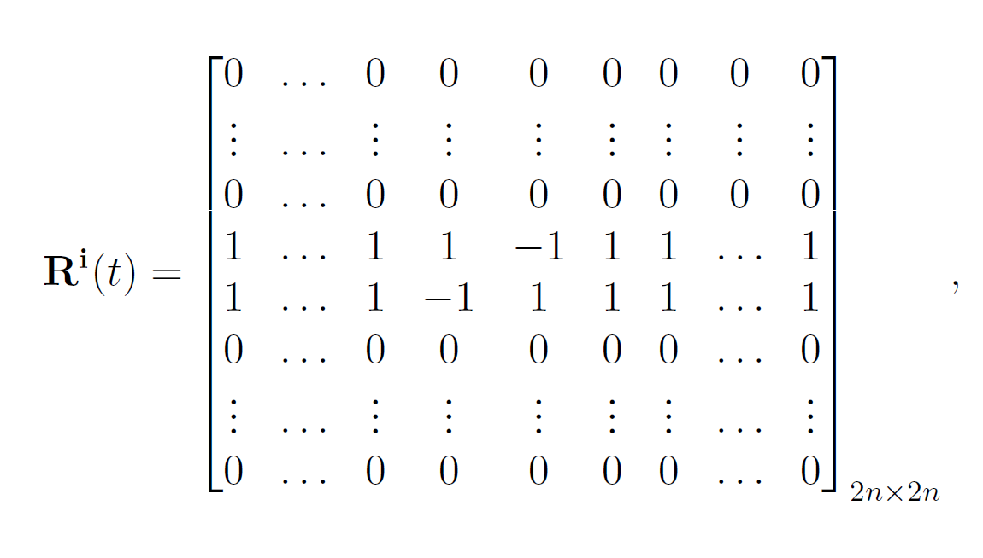
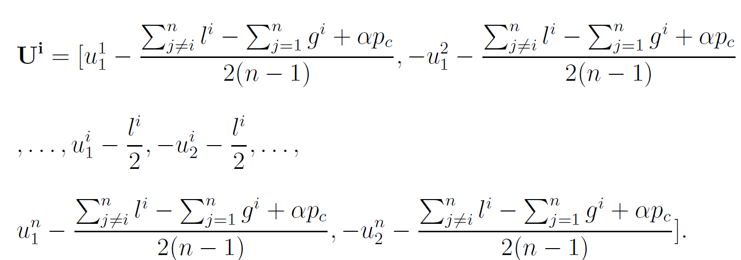
Smart Buildings Controls
The optimal control strategy for building i can be obtained as
where
Solution of Ricatti equation

Slide 35
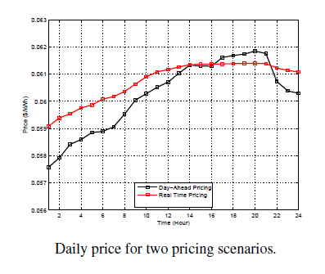
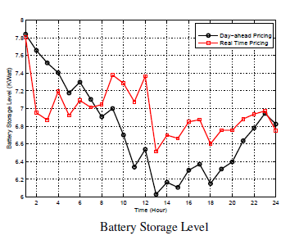
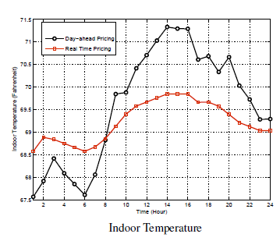
Smart Buildings Controls
Simulation Results
All the houses connected to one bus are assumed to be homogeneous
As price increases, the battery tends to discharge in order to cover a portion of the building power consumption and the indoor temperature tends to increase due to lowering HVAC consumption
load during peak hours.

Slide 36
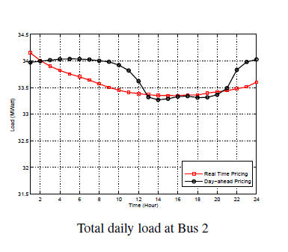
Smart Buildings Controls
Simulation Results
All the houses connected to one bus are assumed to be homogeneous
For both day-ahead and real-time pricing techniques, the peak load is reduced around 8 PM

Slide 37
Outline
Introduction
Smart Grid
Smart Buildings
Game Theory Preliminary
Differential Game
Satisfaction Game
Contributions
Hydrothermal Scheduling
Smart Building Controls
Distributed HVAC Control
Conclusion and Future Work

Slide 38
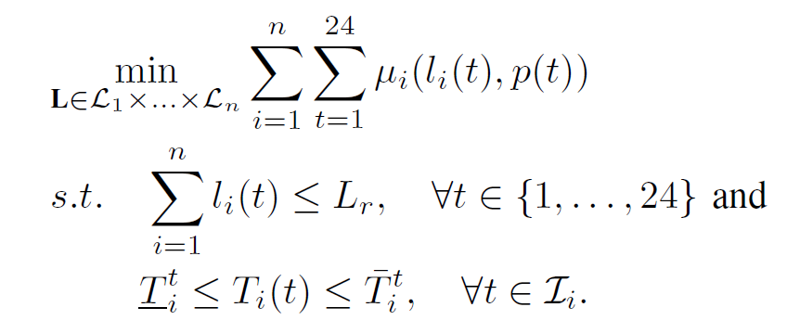
Distributed HVAC Control
System Model
There are a total of n zones in an energy-smart building
At the beginning of each 24 hours, the temperature control unit of zone i decides:
A constrained daily electricity cost optimization
Electricity cost of building i at time t
Distribution feeder load Constraint
Indoor Temperature comfort range

Slide 39
Distributed HVAC Control
System Model
There are a total of n zones in an energy-smart building
At the beginning of each 24 hours, the temperature control unit of zone i decides:
A constrained daily electricity cost optimization for each zone
Price
HVAC ‘s Efficiency
Thermal constant
Outdoor Temperature

Slide 40
Distributed HVAC Control
Game in Normal Form :
Set of players: zones temperature control units
Set of strategies: HVAC units power consumption quantized vectors amounts
Set of payoffs:
Indicator for satisfaction of constraints
Electricity cost
Payoff Function
Distribution load constraint

Slide 41
Distributed HVAC Control
Game in Satisfaction Form :
Set of players: zones temperature control units
Set of strategies: HVAC units power consumption quantized vectors amounts
Satisfaction functions:

Slide 42
Distributed HVAC Control
Satisfaction Equilibrium
An equilibrium is observed when all players are simultaneously satisfied

Slide 43
Distributed HVAC Control
Proposed Learning Algorithm
The state of each player:
Mood : content (c) and discontent (d)
Benchmark Strategy
Benchmark Payoff

Slide 44
Distributed HVAC Control
Properties
The players’ actions at the stochastically stable state of the learning algorithm maximize the social welfare of all players
By selecting the stochastically stable state of the game is such that the largest set of players is satisfied.

Slide 45
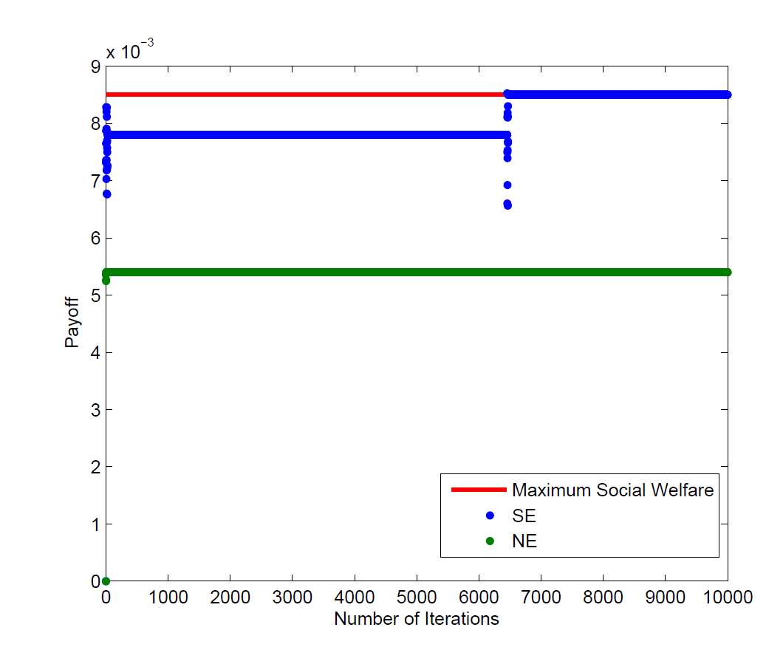
Distributed HVAC Control
Simulation Results
The proposed learning algorithm is able to meet the optimal solution for most of the time (stochastically stable state)
At NE, the payoff of players is considerably lower than the maximum social welfare

Slide 46
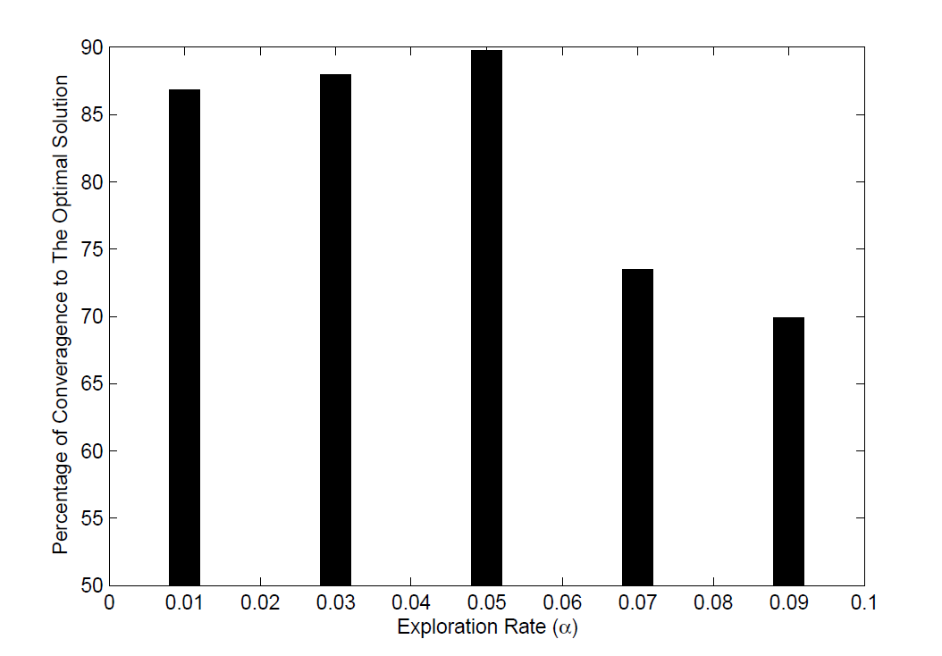
Distributed HVAC Control
Simulation Results
The effect of exploration rate on the convergence of the game
By decreasing the exploration rate from 0.05 to 0.01, the players tend to stick to their choices
By increasing the exploration rate from 0.05 to 0.09, the payoff decreases, players choose their actions more dynamically

Slide 47
Outline
Introduction
Smart Grid
Smart Buildings
Game Theory Preliminary
Differential Game
Satisfaction Game
Contributions
Hydrothermal Scheduling
Smart Building Controls
Distributed HVAC Control
Conclusion and Future Work

Slide 48
Conclusions
Distributed dynamic controls for smart grid applications including distributed generation, storage and demand response
Stochastic differential game for optimal control of generation and storage in a hydrothermal system
The proposed framework and games can reduce the peak to average ratio and total energy generation for the thermal plant
Stochastic differential for optimal control of HVAC units and energy storage in smart buildings
The proposed method reduces the overall power consumption of all users
Satisfaction game with try and error learning for distributed control of HVAC units in buildings’ multiple zones
The proposed method significantly increase the energy efficiency of smart buildings

Slide 49
Future Work
Developing a multi-stage game-theoretic framework for obtaining joint optimal trading price and optimal power plants generation for distributed generation
Developing mean-field games for scenarios with extremely large number of buildings, PHEVs,…
Integrating states and dynamics of electricity and water meters, lighting, HVAC systems, geothermal pumps and other subsystems for design of more efficient building energy management system

Slide 50
Thanks

Slide 51
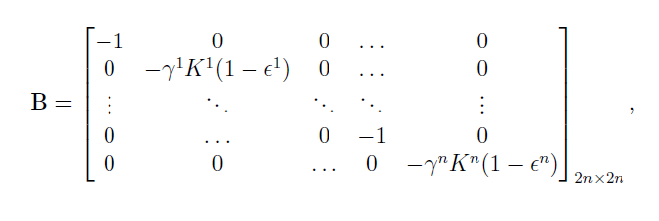
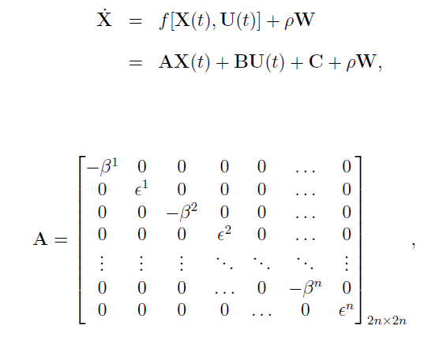
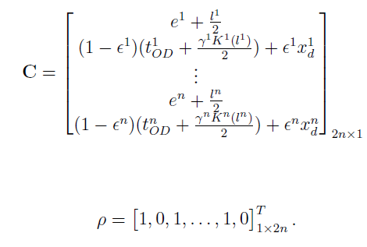

Slide 52
Moore–Penrose Pseudoinverse
SVD
MP Pseudoinverse

