Slide 1
A NONPARAMETRIC BAYESIAN FRAMEWORK FOR MOBILE DEVICE SECURITY AND LOCATION BASED SERVICES
Dissertation Defense
Nam Tuan Nguyen
Advisors: Dr. Zhu Han and Dr. Rong Zheng.
ECE Dept., University of Houston, USA.

Slide 2
Defense outlines
Introduction.
Security for wireless network and contributions.
Location based services for wireless devices and contributions.
Preliminary: Nonparametric classification techniques.
Security for wireless devices.
Masquerade attack and Sybil attack.
Location based services.
LOIRE: Indoor place identification.
Prediction: Dynamic Hidden Markov Model.
Prediction: Deep Learning.
Conclusion and future work.

Slide 3
Presentation outlines
Introduction.
Security for wireless network and contributions.
Location based services for wireless devices and contributions.
Nonparametric classification techniques.
Security for wireless devices.
Masquerade attack and Sybil attack.
Location based services.
LOIRE
Dynamic Hidden Markov Model
Deep Learning
Conclusion and future work.

Slide 4
Security Enhancement for Wireless Network
Introduction: Security
Department of Electrical and Computer Engineering
Masquerade attack
Sybil attack
Use device dependent radio-metrics as fingerprints.
Contributions:
Unique and hard-to-spoof device fingerprint
An unsupervised and passive attack detection method.
Upper bound and lower bound of classification performance.
Notes:
Security is a more general term. Maybe you can be more specific here and talk about Device fingerprinting

Slide 5
Introduction: Location Based Service (LBS)

Slide 6
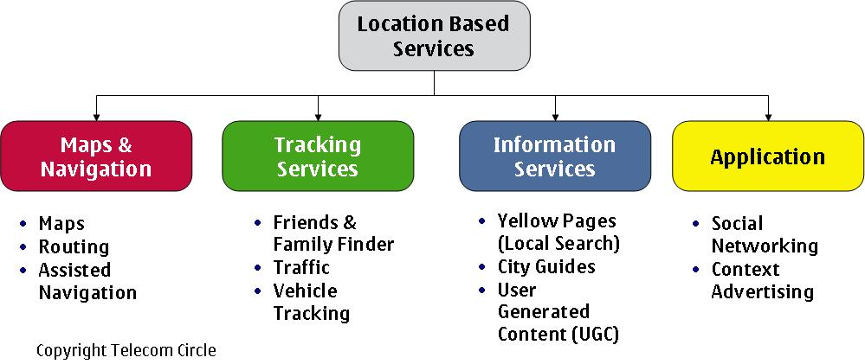
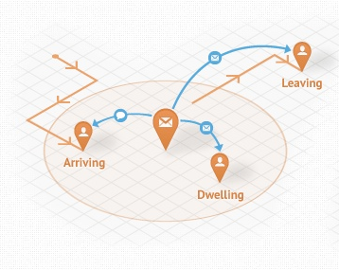
Introduction: LBS
Major tasks to enable LBS:
Localize.
Estimate dwelling time.
Prediction: Where to go next?

Slide 7
Introduction: LBS
Contributions:
Development of the complete framework, from localizing users, to predicting future whereabouts.
Incomplete data handling.
Online classification technique.
Profiling free.
Using experimental data to validate the performance.
Novel dynamic hidden Markov model.
Using Deep Learning to predict future locations.

Slide 8
Presentation outlines
Introduction.
Security for wireless network and contributions.
Location based services for wireless devices and contributions.
Preliminary: Nonparametric classification techniques.
Security for wireless devices.
Masquerade attack and Sybil attack.
Location based services.
LOIRE
Dynamic Hidden Markov Model
Deep Learning
Conclusion and future work.

Slide 9
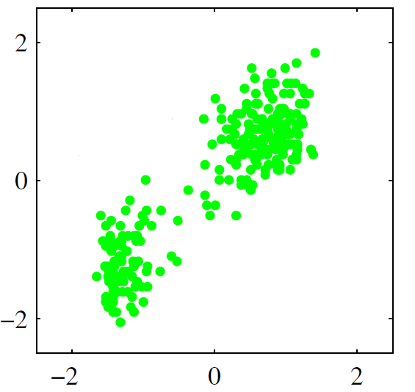
Preliminary: Nonparametric classification
Nonparametric:
Either no assumption about the distributions is made.
Or no prior information about the number of classes is given.
Goal:

Slide 10
Nonparametric classification: IGMM
Infinite Gaussian mixture model: Generative model.
Stick(α)
π₁
π∞
1
π₂
2
3
4
5
6
7
∞
Infinite number of faces/classes
Indicators are created according to multinomial distribution.
z₁, z₂ .. = 1
z₂₀, z₂₁ .. = 2
X_{1:N}
The observations follows a distribution such as Gaussian.
µ₁
Σ₁
µ₂
Σ₂
µ∞
Σ∞

Slide 11
Nonparametric classification: IGMM
IGMM inference model: Chinese restaurant process
(1)
(2)
?
?

Slide 12
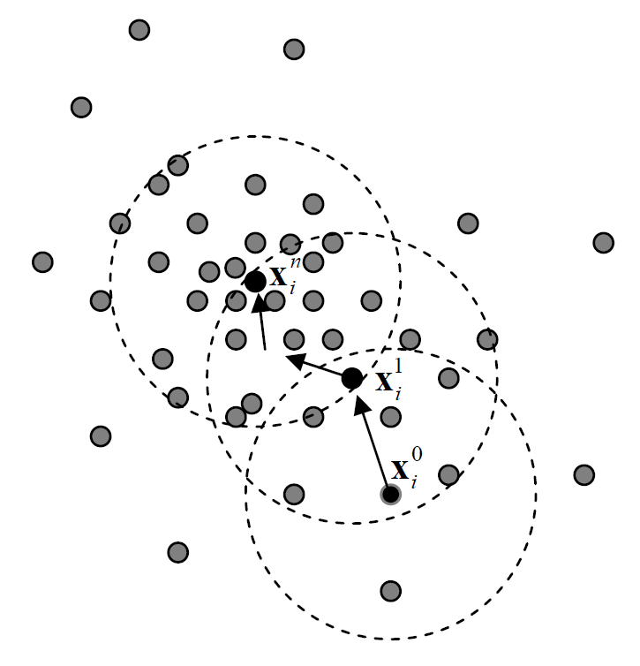
Nonparametric classification: Mean shift
Density estimation:
The gradient of the density:
Move toward the densest region of the observations, i.e., the region with 0 gradient.

Slide 13
Presentation outlines
Introduction.
Security for wireless network and contributions.
Location based services for wireless devices and contributions.
Nonparametric classification techniques.
Security for wireless devices.
Masquerade attack and Sybil attack.
Location based services.
LOIRE
Dynamic Hidden Markov Model
Deep Learning
Conclusion and future work.

Slide 14
Wireless device security
Masquerade attack
Sybil attack
Mechanism:
If the number of devices can be found, compare that number to the number of associated devices to detect an attack.
Based on the label of the observations generated from the devices to mark the malicious nodes.
Device1
00-B0-D0-86-BB-F7
Device2
00-0C-F1-56-98-AD
Device1
00-B0-D0-86-BB-F7
00-0C-F1-56-98-AD
Device2
00-A0-C9-14-C8-29
Device3
00-0C-F1-56-98-AD

Slide 15
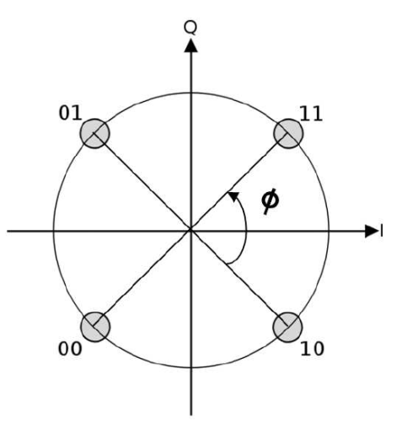
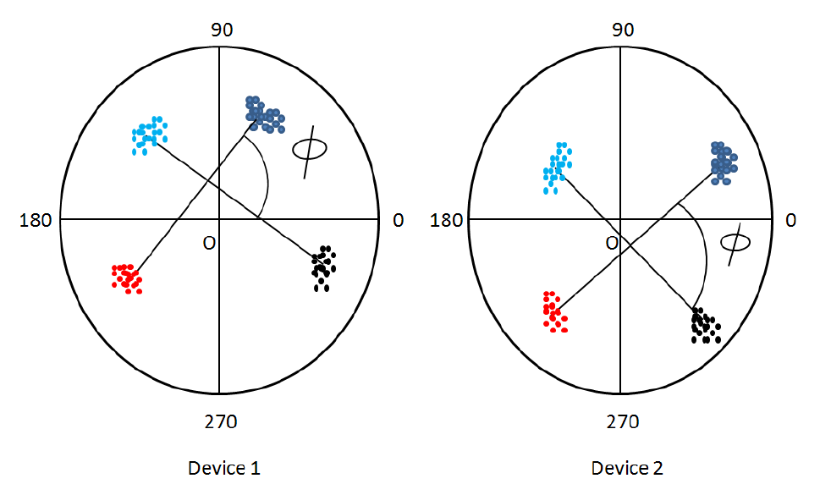
Security – Features selection
The Carrier Frequency Difference (CFD)
Defined as the difference between the carrier frequency of the ideal signal and that of the transmitted signal.
Depends on the oscillator within each device.
The Phase Shift Difference (PSD)
Using QPSK modulation technique.
Transmitter amplifiers for I-phase and Q-phase might be different. Consequently, the degree shift can have some variances.

Slide 16
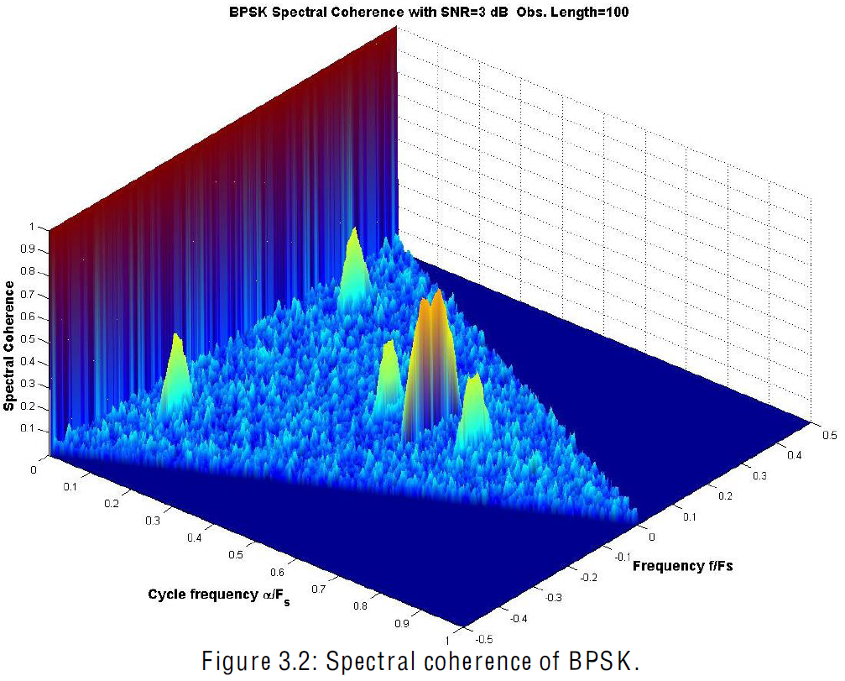
Security – Features selection
Autocorrelation
BPSK Spectral coherence
The Second-Order Cyclostationary Feature (SOCF)
The Received Signal Amplitude
Spectral coherence
Cycle frequency
Frequency

Slide 17
Security – Gibbs sampler
Start with random indicator for each observation.
Remove the current i^{th} observation from its cluster
Update the indicator z_{i} according to (1) and (2) given all the other indicators
No
Converge?
Yes
STOP

Slide 18
Security – Inference Algorithm
Collect data
Unsupervised clustering method
Two clusters with the same MAC addresses?
Two MAC address with the same cluster?
No
No
Yes
Yes
Masquerade attack.
Sybil attack.
Determine the number of attackers
Update the “black” list with the Mac address

Slide 19
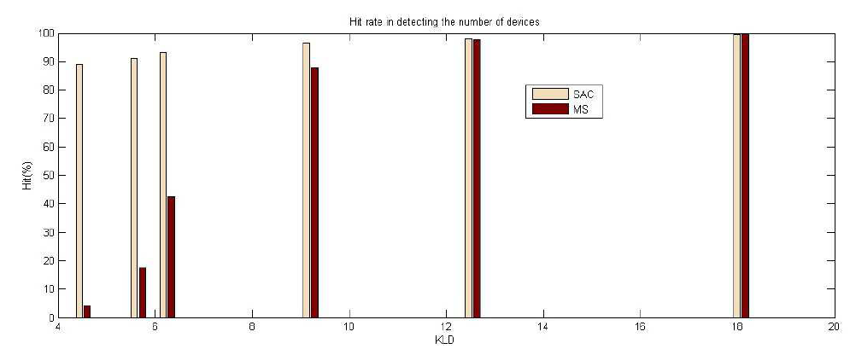
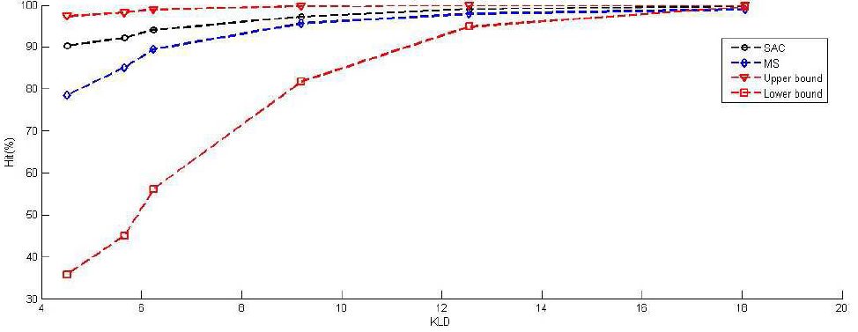
Security - Evaluation
Hit rate in detecting the number of devices
IGMM
MS
Hit rate (%)
KLD
I
Am
Nam
July
IGMM
MS
Upper bound
Lower bound
Hit rate (%)
KLD
Notes:
What is SAC?

Slide 20
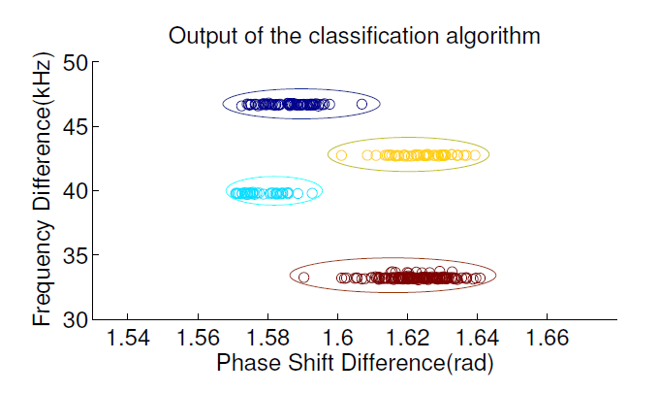
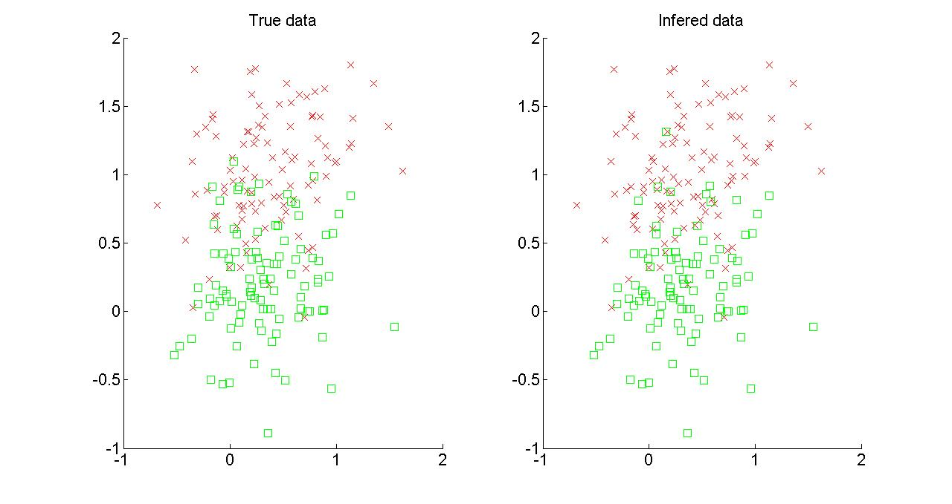
Security - Evaluation
Simulation results of IGMM – Kullback Leibler Distance = 4.5
Use USRP2 to collect experimental data
Only two dimensions are displayed for
the demonstration purpose.
Almost 100% in identifying an attack.

Slide 21
Presentation outlines
Introduction.
Security for wireless network and contributions.
Location based services for wireless devices and contributions.
Nonparametric classification techniques.
Security for wireless devices.
Masquerade attack and Sybil attack.
Location based services.
LOIRE
Dynamic Hidden Markov Model
Deep Learning
Conclusion and future work.

Slide 22
LBS – Problem statements
What’s given:
Mobile devices are in indoor environments.
WiFi scans.
Goals:
Identifying revisited location.
Automatically profiling new location.
Unsupervised approach. No labeling required.
Online sampling to reduce the complexity.
Predicting the next possible locations.

Slide 23
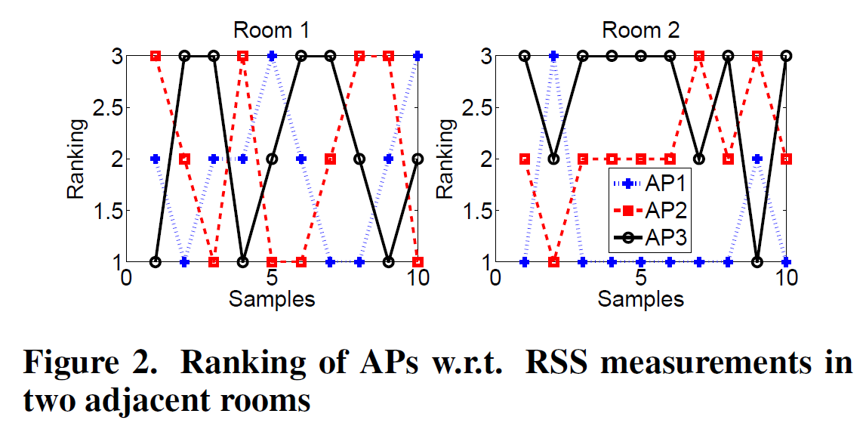
LBS – Current indoor localization solutions
Ngram:
Based on the order of the APs.
Need at least 400 samples per each location to achieve a good result → not energy efficient.
SensLoc:
Solely based on APs names → not fine grained.
Continuously scans for WiFi signals → not energy efficient.

Slide 24
LBS – Indoor place identification (LOIRE)
LOIRE is different from the previous approaches the following aspects:
Unsupervised and nonparametric approach.
Energy efficiency (requires only 50 samples/place).
A framework to handle missing data.
An online batch sampling approach.
A quickest way to stop the algorithm.

Slide 25
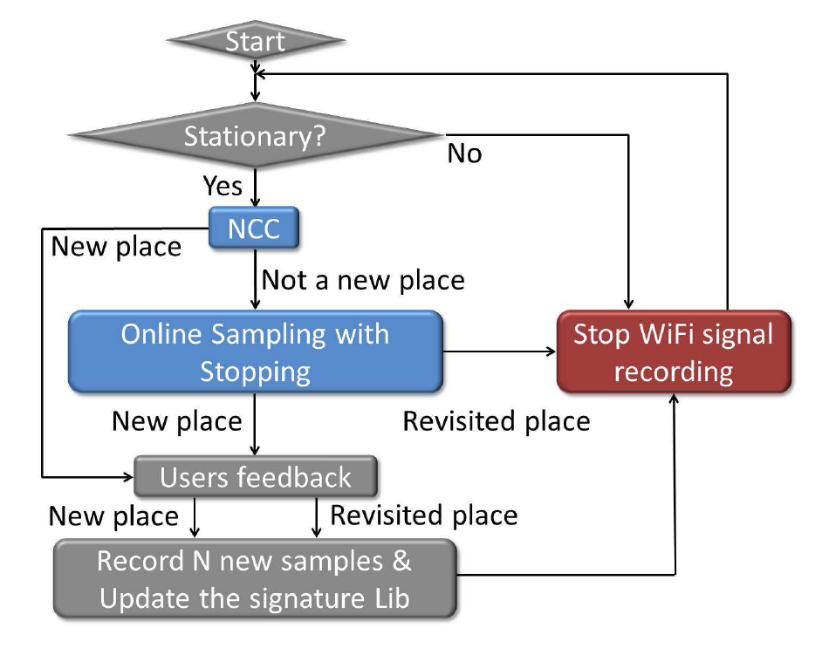
LBS – Indoor place identification (LOIRE)

Slide 26
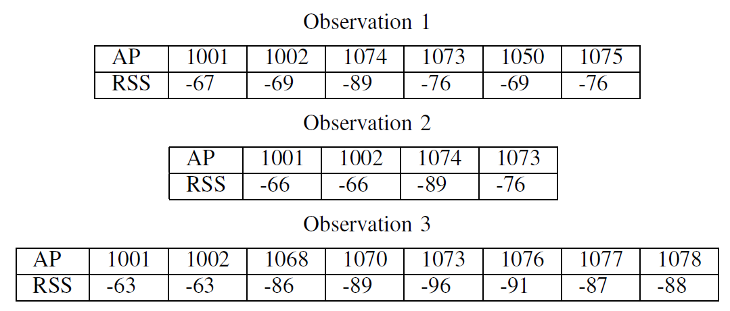
LBS – Missing data
Use WiFi scans as signature to identify a revisited place and to detect a new place.
Problems:
Variable length observations
1 room
Or
2 rooms?
Missing
Missing

Slide 27
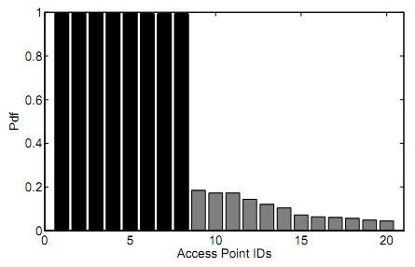
LBS – Missing data: Nonparametric categorical clustering
Calculate the Jaccard distance of two vectors of APs with different length:
Given the distance, we propose a kernel density estimation approach based on the Mean Shift to classify the places in coarse grained level.
Rooms within the same region share the same list of APs. Strongest common APs will be chosen based on the frequencies of their appearances in the WiFi scan list (red circle).

Slide 28
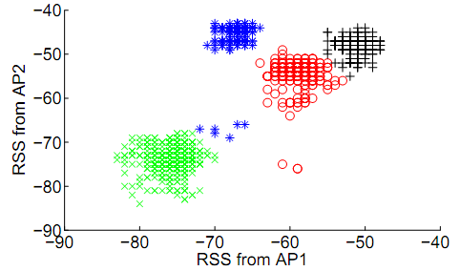
LBS: IGMM
The number of rooms is not given:
How to identify revisited room?
How to detect a new room?
Batch sampling, how to utilize?
WiFi scans from 4 rooms share the same list of Aps.

Slide 29
LBS: Online sampling
Assume there are K stored places.
Place identification purpose:
Find a label, z_{i}, for a new observed WiFi scan, X_{i}, in the set of 1:K.
Detect a new place:
Find the label, z_{i}, for a new observed WiFi scan, X_{i} to see if z_{i} = K+1 (a new place).
A stochastic way to detect a new place, not a threshold based approach.

Slide 30
LBS: Online sampling
Derive two posterior probabilities:
$P(z_{i}=\{1:K\}|X_{i})$ : Largely depends on the stored signature.
Choose $P_{old}=max⁡\{P(z_{i}=\{1:K\}|X_{i})\}$
$P_{new}=P(z_{i}=K+1|X_{i})$: Solely depends on priors.
Construct a distribution [$P_{old},P_{new}$]
Propose a Successive Sampler to sample the label for z_{i}. Maximum A Posteriori (MAP) is not suitable, since it always choose the hypothesis with the highest posterior. Solved the problem of detecting a new place.
PDF
P_{new}
P_{old}

Slide 31
LBS: Online sampling
For the problem of place identification: Use MAP to find the best candidate at every sampling step.
MAP works now, since the parameters are updated after every single sampling step → Place identification solved.
Quickest problem?

Slide 32
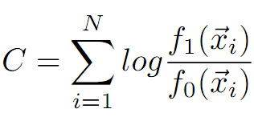
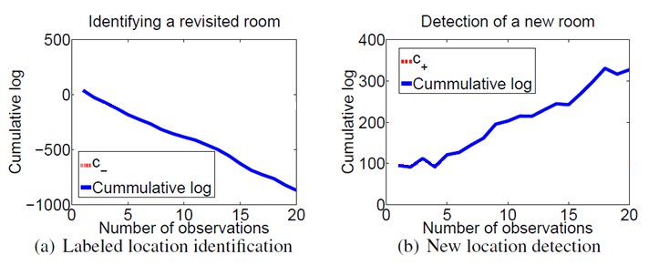
LBS : Stopping rule
Quickest detection for multiple hypotheses.
Use the accumulate log posterior ratio:
, f₁ is P_{old}, f₀ is P_{new}

Slide 33
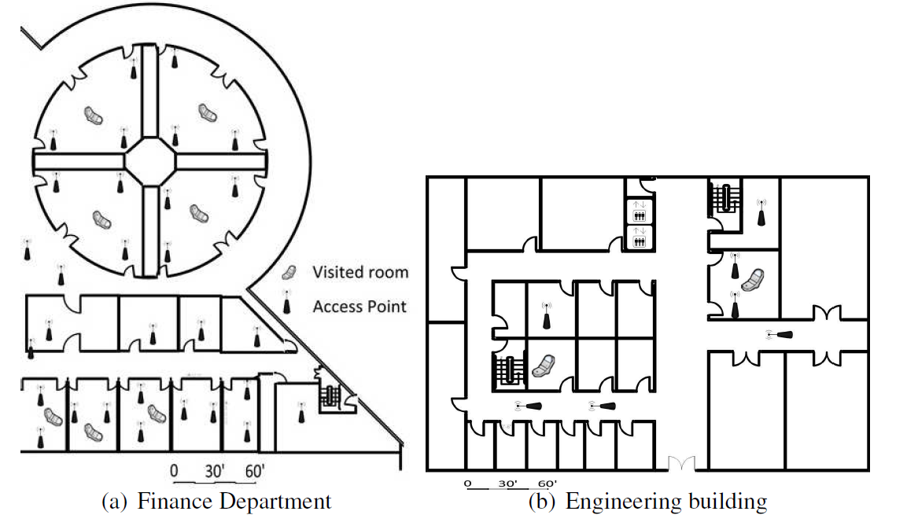
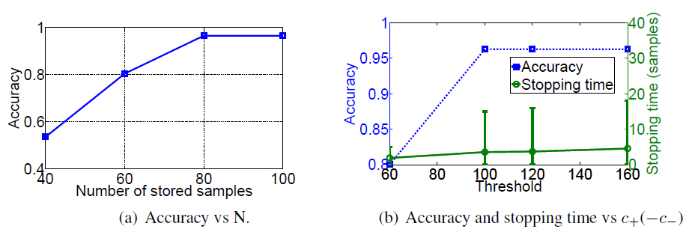
LBS – Experimental results.
Dataset:
4 weeks long
5 phones

Slide 34
LBS – Future location prediction
Once the locations can be determined, we can build algorithm to predict the next visiting location.
Propose two models to predict
Based on Markov model: A Dynamic Hidden Markov Model.
Based on Deep Learning.

Slide 35
Proposed Dynamic hidden Markov model (DHMM)
LBS – Future location prediction 1
Hidden States/locations: propose to use NBC to determine the states.
Dimensions of the observations : GPS coordinates, time and RSS from either WiFi signal or cell tower signal.
Dynamic Hidden Markov Model: Every time the user comes to a new place, the model automatically updates itself with the new state.
Rss₁
Rss₂
Rss₃
Rss_{K}
S₁
S₂
S₃
S_{K}

Slide 36
Proposed algorithm
LBS – Future location prediction 1
Schedule tolerant data package:
Each data package has a deadline to be sent.
When to sent?
Wait until the signal strength profile is at its best to send.
How to predict the future signal strength?
Predict the next locations of the users, estimate the signal strength at the locations.
Use Markov Decision Process (MDP) to calculate the expected reward.
N data points-Training data
Observe more data
Gibb Sampler
Determine the number of states and the current state.
DHMM:
Calculate the transition matrix
Calculate the distributions of signal strengths in each state
MDP
Optimal scheduling result

Slide 37
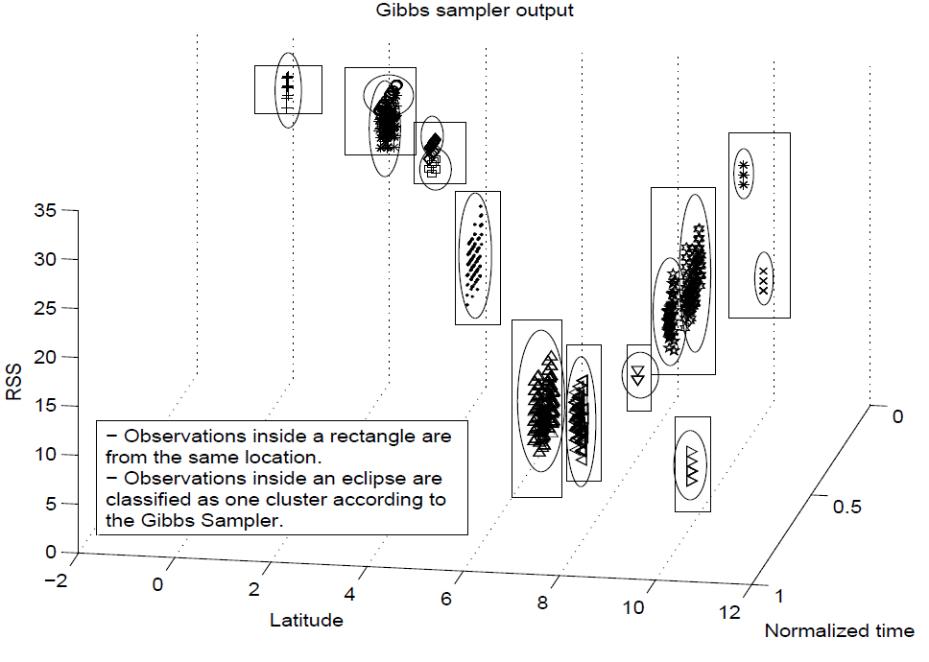
Simulation results
LBS – Future location prediction 1
Two states
Same room
Notes:
Discuss the dataset

Slide 38
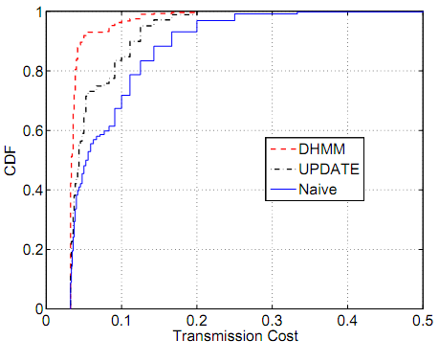
Cost saving
LBS – Future location prediction 1
Proposed
Approach
Naïve: Send immediately
UPDATE

Slide 39
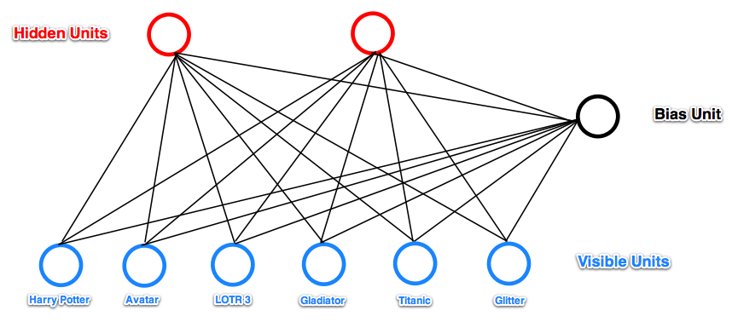
Based on Deep Learning
LBS – Future location prediction 2
Purpose: Find the typical moving patterns (E1, E2), based on that, identify users and predict the future locations.
User identification:
E1
E2
Location prediction:

Slide 40
Deep Learning – Restricted Bolzman Machine (RBM)
LBS – Future location prediction 2

Slide 41
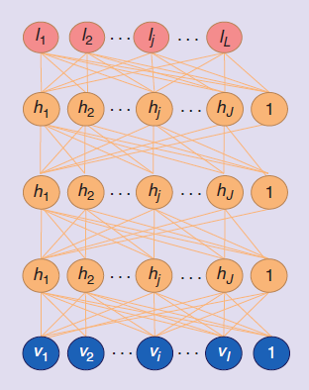
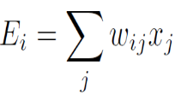
Deep learning - basics
LBS – Future location prediction 2
Stacking a number of the RBMs learned layer by layer from bottom-up gives rise to a DBN:
After learning an RBM we treat the activation probabilities of its hidden units as the data for training the RBM one layer up
- Start with random weights, learn about activation energy
and the probability to turn on the hidden units:
- Then, the energy of any configuration is determined
- Finally, optimum weights are chosen based on the
difference between generated data and observations
(1)

Slide 42
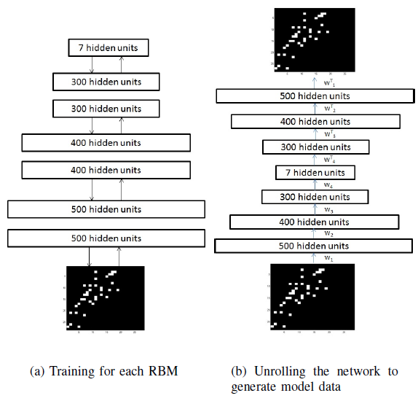
LBS – Future location prediction 2
Bottom up:
Initiate random weights.
Learn the activation energy of the first hidden layer.
Treat the first hidden layer as the observation layer for the second layer. Repeat the process for all layers.
Top down:
Regenerate the observations based on the parameters and optimize the weights according to equation (1).
Repeat the above two steps until converge.
Notes:
Not sure what problem are you try to solve. Why is deep learning a good method? If the same problem as before, why not compare the results of the two methods?

Slide 43
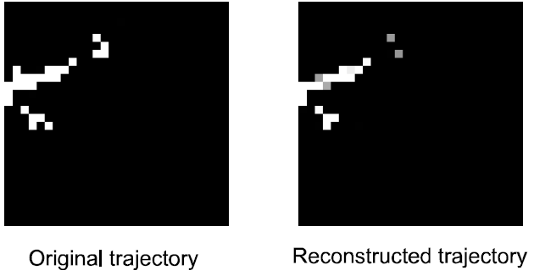
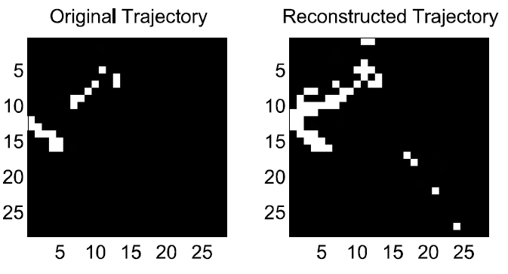
Experiment results
LBS – Future location prediction 2
Deep
learning:
PCA:

Slide 44
Presentation outlines
Introduction.
Security for wireless network and contributions.
Location based services for wireless devices and contributions.
Nonparametric classification techniques.
Security for wireless devices.
Masquerade attack and Sybil attack.
Location based services.
LOIRE
Dynamic Hidden Markov Model
Deep Learning
Conclusion and future work.

Slide 45
Conclusion
Unsupervised approaches.
Resolve the incomplete data problem
Invent an online sampling approach
Two novel approaches in predicting users’ future whereabouts.
Energy-efficient research direction.
Proven success with experiment evaluations.

Slide 46
Future works
Develop a new sampling approach for the security framework.
Incorporate other sensory data like magnetic field from the magnetometer or lighting sensory data.
Working on the problem of Quickest Detection to determine stopping rules.
Integrate HDMM into LOIRE.
Complete the prediction part using Deep Learning.
Develop applications based on the current LBS framework and integrate different types of services:
Micro-climate control.
Geofencing application.

Slide 47
Publication list
Journal Publications
1. Nam Tuan Nguyen, Rong Zheng, and Zhu Han, “ROOMMATEs: An Unsupervised Indoor Peer Discovery Approach for LTE D2D Communications,” under submission.
2. Nam Tuan Nguyen, Rong Zheng, Zhu Han and Jie Liu, “Energy-Efficient Inference of Recurring and New Indoor Places of Mobile Users,” under submission.
3. M. Esmalifalak, Nam Tuan Nguyen, Lanchao Liu, R. Zheng, and Z. Han, “Detecting Stealthy False Data Injection Using Machine Learning in Smart Grid” under submission.
4. Nam Tuan Nguyen, Rong Zheng, and Zhu Han, “On Identifying Primary User Emulation Attacks in Cognitive Radio Systems Using Nonparametric Bayesian Classification,” IEEE Transactions on Signal Processing, vol. 60, no.3, p.p. 1432-1445, March 2012.
5. Jia (Jasmine) Meng, Yingying Li, Nam Tuan Nguyen, Wotao Yin, and Zhu Han, “Compressive Sensing Based High Resolution Channel Estimation for OFDM System," IEEE Journal of Selected Topics in Signal Processing, special issue on Robust Measures and Tests Using Sparse Data for Detection and Estimation, vol.6, no.1, p.p.15-25, February 2012.

Slide 48
Publication list
Conference Publications
M. Esmalifalak, Nam Tuan Nguyen, R. Zheng, and Z. Han, “Detecting Stealthy False Data Injection Using Machine Learning in Smart Grid”, Globecom 2013.
Hao Wu, Saurabh Prasad, Minshan Cui, Nam Tuan Nguyen and Zhu Han, “Hyperspectral Image Classification Using Infinite Gaussian Mixture Models,” IEEE International Geoscience and Remote Sensing Symposium, Melbourne, Australia, July 2013.
Nam Tuan Nguyen, Rong Zheng and Zhu Han, “UMLI: An Unsupervised Mobile Locations Extraction Approach with Incomplete Data,” IEEE Wireless Communications and Networking Conference WCNC, Shanghai, China, April 2013. (Best Paper Award)
Nam Tuan Nguyen, Yichuan Wang, Husheng Li, Xin Liu, and Zhu Han, “Extracting Typical Users’ Moving Pattern Using Deep Learning,” IEEE Globe Communication Conference Globecom, Anaheim, CA, December 2012.
Nam Tuan Nguyen, Yichuan Wang, Xin Liu, Rong Zheng, and Zhu Han, “A Nonparametric Bayesian Approach for Opportunistic Data Transfer in Cellular Networks,” WASA, 2012.
M. Ejaz Ahmed, Ju Bin Song, Nam Tuan Nguyen, and Zhu Han, “Nonparametric Bayesian Identification of Primary Users’ Payloads in Cognitive Radio Networks,” IEEE International Conference on Communications ICC, Ottawa, Canada, 2012.
Huy Nquyen, Nam Tuan Nguyen, Guanbo Zheng, Zhu Han, and Rong Zheng, “Binary Blind Identification of Wireless Transmission Technologies for Wide-band Spectrum Monitoring," IEEE Globe Communication Conference Globecom, Houston, December 2011.
Nam Tuan Nguyen, Guanbo Zheng, Zhu Han and Rong Zheng, “Device Fingerprinting to Enhance Wireless Security using Nonparametric Bayesian Method,” IEEE Annual Conference on Computer Communications INFOCOM, Shanghai, April 2011. (Acceptance rate: 15.96%).
Jia (Jasmine) Meng, Yingying Li, Nam Tuan Nguyen, Wotao Yin and Zhu Han, “High Resolution OFDM Channel Estimation with Low Speed ADC using Compressive Sensing,” IEEE International Conference on Communications ICC, Kyoto, Japan, 2011.
Notes:
Sort by year. Recent on top.

Slide 49
Question?

