Slide 1

Wireless Physical Layer Security:
How to Date a Girl with Her Boyfriend on the Same Table
Zhu Han
Department of Electrical and Computer Engineering
University of Houston, Houston, TX, USA

Slide 2
Outline
Overview of Physical Layer Security
Cooperation Improves Physical Layer security
  Collaborative beamforming
Game Theoretical Study
  Coalition formation
  Stackleberg game
  Auction theory
Resource Allocation Perspectives
  Variety of problem formulation
Overview of our Research Lab
Conclusion

Slide 3
Physical Layer Security
Security of wireless networks
  Traditionally through higher layer techniques such as cryptography
    Unsuited and complex to implement in large scale decentralized networks
Alternative: physical layer security
  Main idea: exploit the wireless channel characteristics to secure wireless transmission in the presence of eavesdroppers
    Started with the seminal work of Wyner, 1975
  Recently received attention in multi-user wireless networks, such as Dr. Vincent Poor’s group

Slide 4
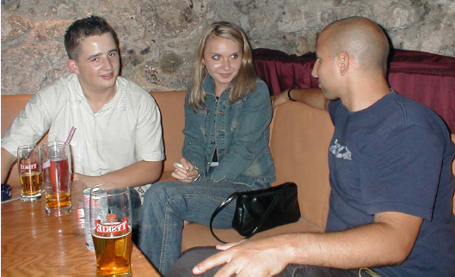
PHY Security: Simple Example
Wireless transmission of a user
  Eavesdropped by an eavesdropper
Notion of secrecy capacity
  Maximum rate sent from a wireless node to its destination in the presence of eavesdroppers
Secrecy capacity of user 1 :
  C₁ = (C^{d}₁ - Ce₁)⁺
I can hear User 1!
C^{d}₁
Ce₁

Slide 5
Outline
Overview of Physical Layer Security
Cooperation Improves Physical Layer security
  Collaborative beamforming
Game Theoretical Study
  Coalition formation
  Stackleberg game
  Auction theory
Resource Allocation Perspectives
  Variety of problem formulation
Overview of our Research Lab
Conclusion

Slide 6






Cooperative System Model
Cooperative protocol
  Stage one: source broadcasts its message signal locally to its trusted relays within the cluster.
  Stage two: relays that successfully decode the message, together with the source, cooperatively transmit signal to the destination.
Capacity at the destination
Capacity at the eavesdropper
Secrecy capacity
R
R
R
R

Slide 7






Secrecy Capacity Maximization or Power Minimization
Secrecy Capacity: due to nulling, always have non-zero value
Secrecy capacity maximization or power minimization
  The solution of this Rayleigh quotient problem is the scaled eigenvector corresponding to the largest eigenvalue of the symmetric matrix
  Properties: Distributed solution, convergence, optimality, etc.
Lun Dong, Zhu Han, Athina P. Petropulu and H. Vincent Poor, ``Improving Wireless Physical Layer Security via Cooperating Relays", IEEE Transactions on Signal Processing, Volume: 58, Issue:3, p.p. 1875 - 1888, March 2010

Slide 8
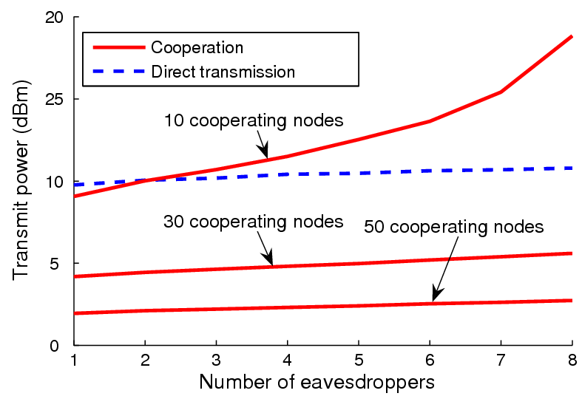
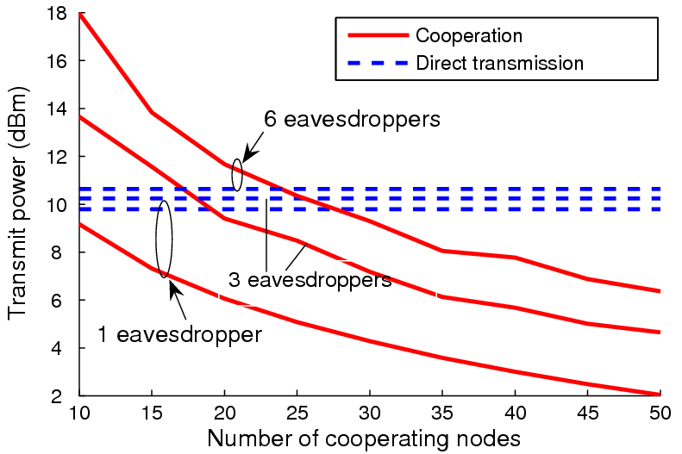
Simulation (Power Minimization)
The more eavesdroppers, the more power
The more collaborative nodes, the less power
Direct transmission without considering the security

Slide 9
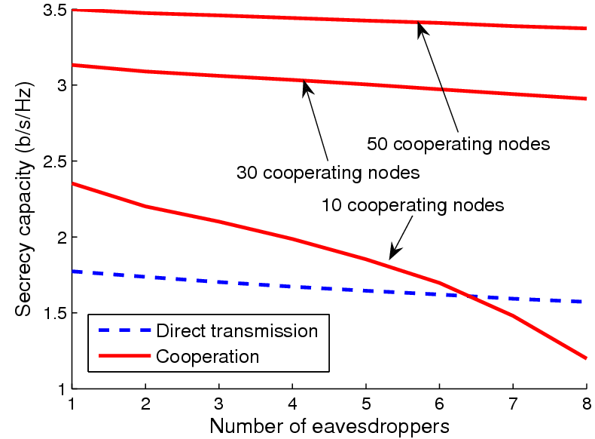
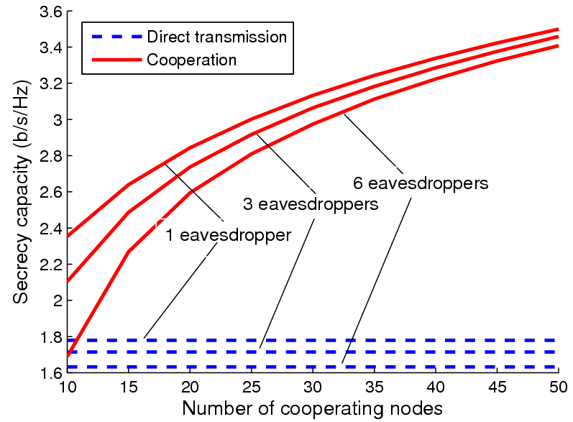
Simulation (Secrecy Capacity Maximization)
Number of cooperating node increases, secrecy capacity increases
Number of eavesdroppers increase, secrecy capacity drops.

Slide 10
Outline
Overview of Physical Layer Security
Cooperation Improves Physical Layer security
  Collaborative beamforming
Game Theoretical Study
  Coalition formation
  Stackleberg game
  Auction theory
Resource Allocation Perspectives
  Variety of problem formulation
Overview of our Research Lab
Conclusion

Slide 11
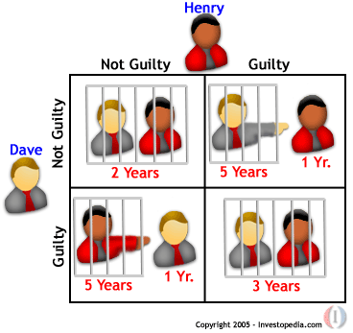
Rich Game Theoretical Approaches
Non-cooperative static
game: play once
  Mandayam and Goodman (2001)
  Virginia tech
Repeated game: play multiple times
  Threat of punishment by repeated game. MAD: Nobel prize 2005.
  Tit-for-Tat (infocom 2003):
Dynamic game: (Basar’s book)
  ODE for state
  Optimization utility over time
  HJB and dynamic programming
  Evolutional game (Hossain and Dusit’s work)
Stochastic game (Altman’s work)
Prisoner Dilemma
Payoff: (user1, user2)
Notes:
John Edwards

Slide 12

Auction Theory
  Book of Myerson (Nobel Prize 2007), J. Huang, H. Zheng, X. Li

Slide 13
Coalitional Game System Model
Coalition 3
Coalition 1
Coalition 2

Slide 14

Coalitional Games Preliminaries
Coalitional game (N,v)
  A set of players N, a coalition S is a group of cooperating players
  Value (utility) of a coalition v
  User payoff x_{i} : the portion received by a player i in a coalition S
Transferable utility (TU)
  The worth v(S) of a coalition S can be distributed arbitrarily among the players in a coalition hence,
  v(S) is a function over the real line
Non-transferable utility (NTU)
  The payoff that a user receives in a coalition is pre-determined, and hence the value of a coalition cannot be described by a function
  v(S) is a set of payoff vectors that the players in S can achieve

Slide 15
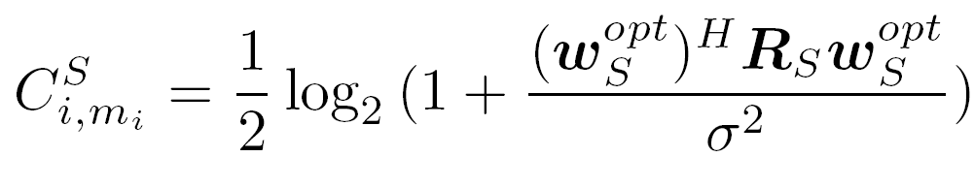
PHY Security Coalitional Game (1)
Coalitional game: the players are the users (transmitters)
Utility function must account for
  Cooperation gains, in terms of secrecy capacity
  Cooperation costs, in terms of power for information exchange
Secrecy capacity achieved by a user i part of coalition S transmitting data to its destination m_{i} in a single slot
Function of:
Users-destinations and users-eaves. channels
Power available for transmission in the slot
Function of the users-destination channels
R_{S} = h_{S}h_{S}^{H}
Optimal weights that null the signal at the eavesdroppers

Slide 16
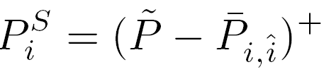

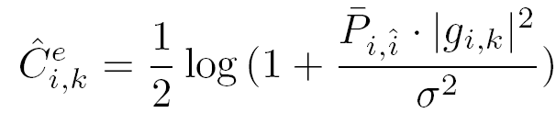
PHY Security Coalitional Game (2)
Power considerations
  Power constraint per coalition S (time slot)
  The power available in a slot for a coalition S to transmit the data of a user i is given by
Security cost during information exchange
  where
Power cost: the power needed for information exchange between user i and the farthest user in the coalition
Power constraint per slot

Slide 17
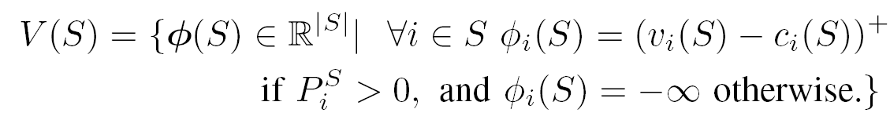
PHY Security Coalitional Game (3)
The proposed PHY security game is modeled as a (N,V) NTU coalitional game, with a value given by a singleton set
  ϕ_{i} is the payoff of a user i when transmitting as part of coalition S
  v_{i}(S)= C^{S}_{i,mi} = secrecy capacity using transmit beamforming given in previous slides
  For a user that spends all of its power for information exchange, the utility is negative (no benefit from cooperating)

Slide 18
Properties of PHY Security Game
The proposed NTU game is generally non-super-additive (cooperation is not always beneficial)
  Traditional concepts such as the core or the Shapley value are not suitable as solutions
  The grand coalition is seldom the optimal solution
    Due to the cooperation cost, as reflected by the false alarm
In the proposed game, the minimum coalition size is equal to K+1 where K is the number of eavesdroppers
  To null K eavesdroppers, K+1 users are needed
The proposed game is classified as a coalition formation game
  The objective is to answer the question “Who should cooperate with who in the network?”

Slide 19
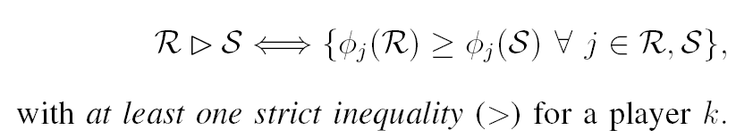


Coalition Formation: Merge and Split
Define the Pareto order preference relation between two collections of coalitions R and S
Merge rule: merge any group of coalitions where
Split rule: split any group of coalitions where
A decision to merge (split) is an agreement between all players to form (break) a new coalition

Slide 20
Coalition formation algorithm
Initial Network State:
Non-cooperative transmission
Neighbor discovery:
Each user discovers neighbors within specified
feasible areas (intersection of circles)
Merge-and-split iterations until convergence
Periodic Merge-and-Split
Allow the network to
Self organize after mobility
Each users (or coalition) surveys
the neighbors for possible Merge
Each coalition investigates
Split possibility
Final partition:
Secure cooperative transmission

Slide 21
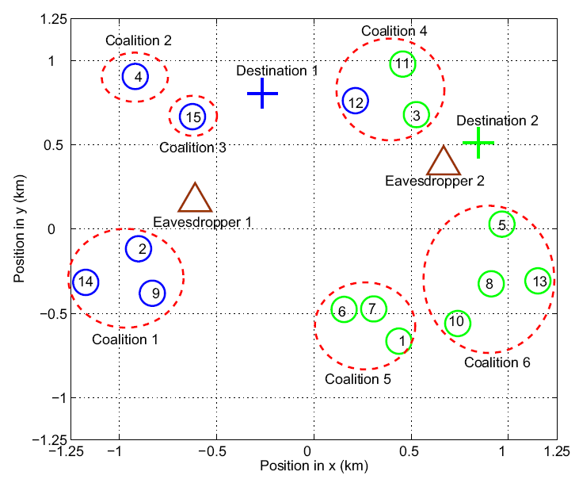
Simulation Results (1)
  Coalition example

Slide 22
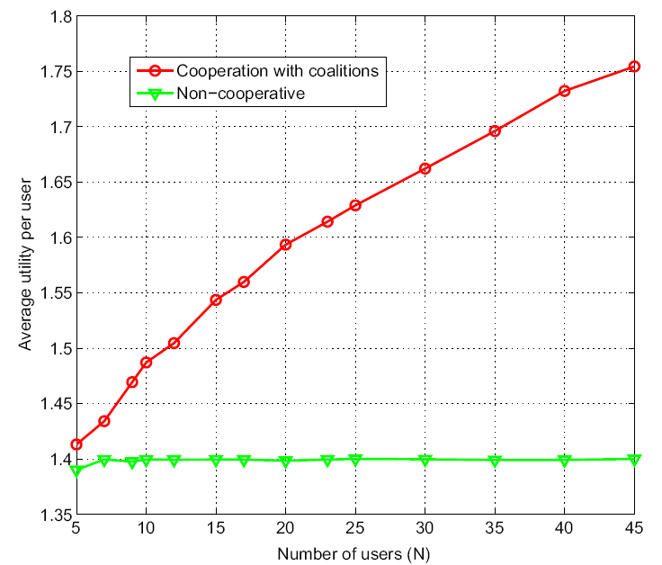
Simulation Results (2)
  Utility vs. Number of users
Walid Saad, Zhu Han, Merouane Debbah, Are Hjorungnes, and Tamer Basar, “Distributed Coalition Formation Games for Secure Wireless Transmission," invited, Journal of Mobile Networks and Applications, Special Issues on Mobility of Systems, Users, Data and Computing, ACM/Springer, April 2011.

Slide 23
Outline
Overview of Physical Layer Security
Cooperation Improves Physical Layer security
  Collaborative beamforming
Game Theoretical Study
  Coalition formation
  Stackleberg game
  Auction theory
Resource Allocation Perspectives
  Variety of problem formulation
Overview of our Research Lab
Conclusion

Slide 24



Power Allocation using Stackleberg Games
  Solution to my Friend: Distract the poor boyfriend
    Both s-d capacity and s-e capacity reduced
    But the secrecy capacity can be increased
  Increase secrecy rate by buying jamming power
  Jammer sets the optimal price to maximize profits

Slide 25
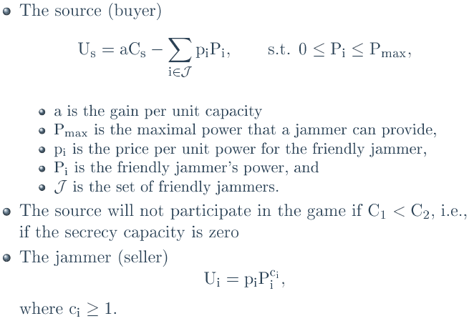
Game Definition
Notes:
24
Thank you very much and any questions?

Slide 26
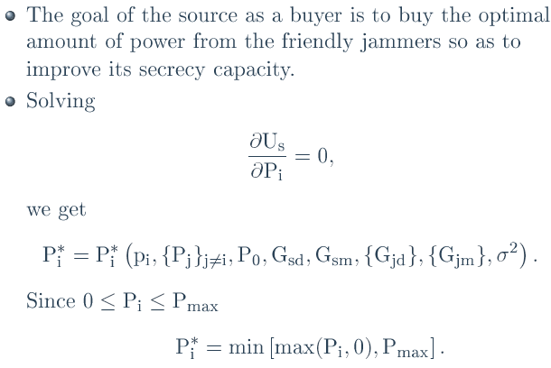
Source Analysis
Notes:
25
Thank you very much and any questions?

Slide 27
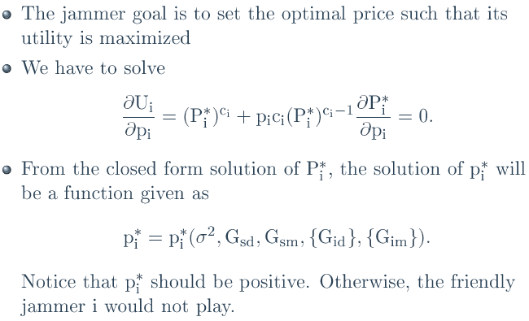
Jammer Analysis
Notes:
26
Thank you very much and any questions?

Slide 28
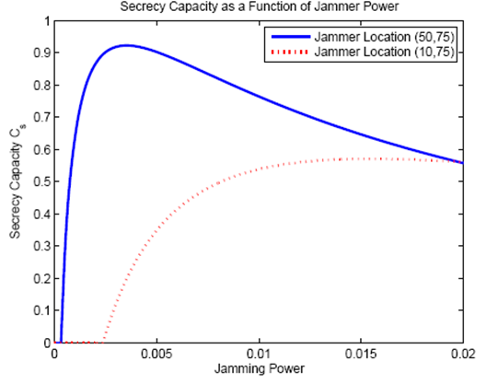
Results
Zhu Han, Ninoslav Marina, Merouane Debbah, and Are Hjorungnes, “Physical Layer Security Game: Interaction between Source, Eavesdropper and Friendly Jammer," EURASIP Journal on Wireless Communications and Networking, special issue on Wireless Physical Layer Security, Volume 2009, Article ID 452907, 10 pages, June 2009.
Notes:
27
Thank you very much and any questions?

Slide 29
Outline
Overview of Physical Layer Security
Cooperation Improves Physical Layer security
  Collaborative beamforming
Game Theoretical Study
  Coalition formation
  Stackleberg game
  Auction theory
Resource Allocation Perspectives
  Variety of problem formulation
Overview of our Research Lab
Conclusion

Slide 30
Auction Setup
Players
  Source S_{i} as one of the bidders,
  Friendly jammer J as the auctioneer.
  Sources submit bids to compete for the jamming power from the friendly jammer, in order to increase the secrecy
Utility
  Source S_{i} can have a performance gain by successfully getting the jamming power, meanwhile it needs to pay for the power offered by the friendly jammer.
  Friendly jammer charges the sources for the jamming service at a price for every unit of jamming power.

Slide 31
Auction Games
Different types of auctions
  Power Allocation using Traditional Ascending Clock Auction (ACA-T)
  Power Allocation using Alternative Ascending Clock Auction (ACA-A)
  Share Auction
Properties
  Optimality
  Cheat Proof
Rongqing Zhang, Lingyang Song, Zhu Han, and Bingli Jiao, \Distributed Auction-Based Power Allocation for Improving Physical Layer Security in Cooperative Networks," submitted to IEEE Journal on Selected Areas in Communications
Jianwei Huang, Zhu Han, Mung Chiang, and H. Vincent Poor, \Auction-based Resource Allocation for Cooperative Communications," IEEE Journal on Selected Areas on Communications, Special Issue on Game Theory, vol.26, no.7, pp.1226-1238, September 2008.

Slide 32
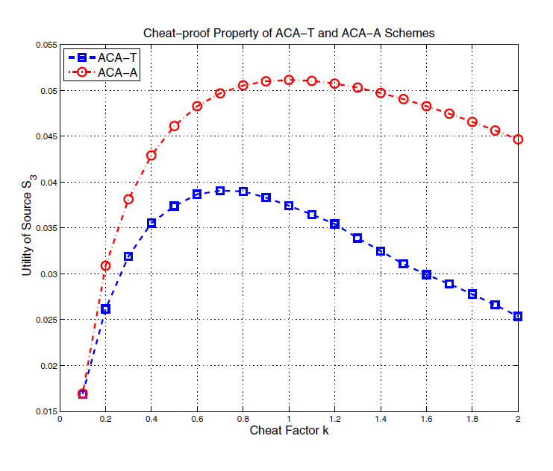
Simulation (cheat proof)
Cheat-proof performance of the ACA-T and ACA-A schemes.

Slide 33
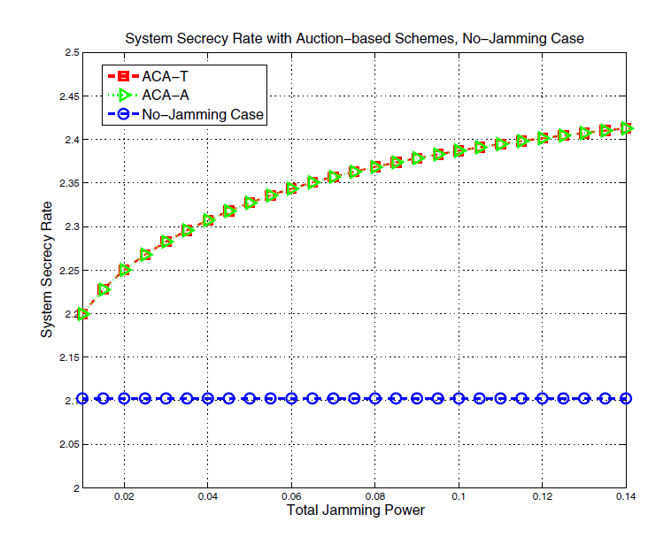
Simulation (optimality)
System secrecy rate with ACA-T and ACA-A plus no-jamming case.

Slide 34
Outline
Overview of Physical Layer Security
Cooperation Improves Physical Layer security
  Collaborative beamforming
Game Theoretical Study
  Coalition formation
  Stackleberg game
  Auction theory
Resource Allocation Perspectives
  Variety of problem formulation
Overview of our Research Lab
Conclusion

Slide 35
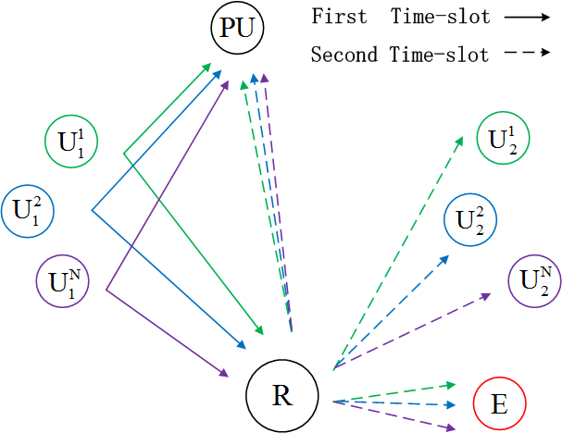
Cognitive Relay Network
Cognitive radio considering interference to primary users
Tianyu Wang, Lingyang Song, Zhu Han, Xiang Cheng, and Bingli Jiao, “Power Allocation using Vickrey Auction and Sequential First-Price Auction Games for Physical Layer Security in Cognitive Relay Networks," IEEE International Conference on Communications, Ottawa, Canada, June 2012.

Slide 36
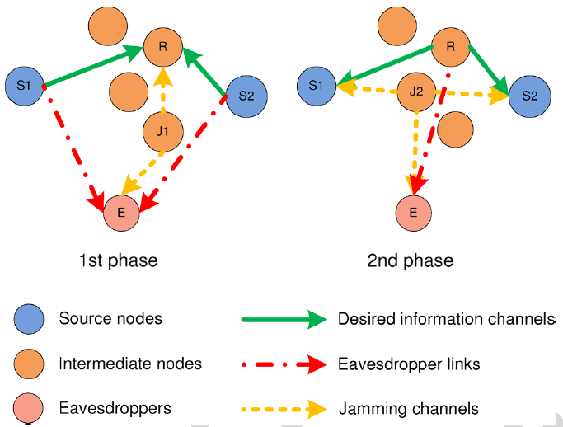
Two Way Relay
Intermediate node can change roles between relay and jammer
Rongqing Zhang, Lingyang Song, Zhu Han, and Bingli Jiao, ``Physical Layer Security for Two Way Relay Communications with Untrusted Relay and Friendly Jammers," to appear, IEEE Transactions on Vehicular Communication.

Slide 37
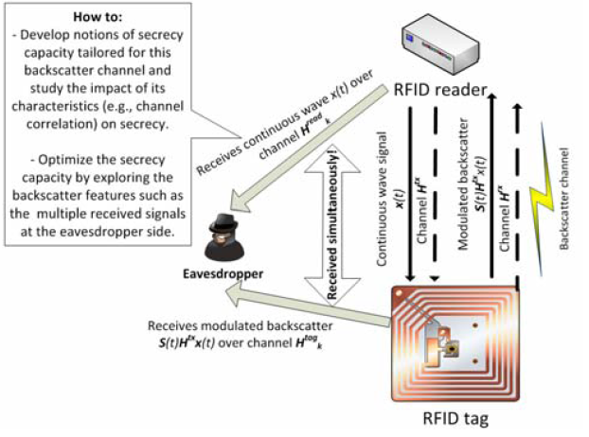
RFID
Walid Saad, Zhu Han, and H. Vincent Poor, “On the Physical Layer Security of Backscatter RFID Systems," invited, The Ninth International Symposium on Wireless Communication Systems, Paris, France, August 2012.

Slide 38
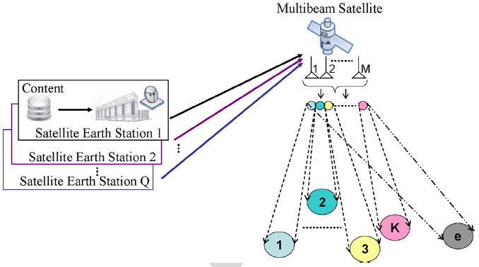
Satellite
Jiang Lei, Zhu Han, M. A. Vazquez-Castro, and Are Hjorungnes,``Multibeam Satellite Power Control and Beamforming with Individual Secrecy Rate Constraints," IEEE Transactions on Information Forensics and Security, Special Issue on Using the Physical Layer for Securing the Next Generation of Communication Systems, vol.6, no.4, p.p.661-671, September 2011.

Slide 39
Overview of Wireless Amigo Lab
Lab Overview
  7 Ph.D. students, 2 joint postdocs (with Rice and Princeton)
  supported by 5 NSF,1 DoD, 1 Qatar, and 1 Texas grants
Current Concentration
  Game theoretical approach for wireless networking
  Compressive sensing and its application
  Smartgrid communication
  Bayesian nonparametric learning
  Security: trust management, belief network, gossip based Kalman
  Physical layer security
  Quickest detection
  Cognitive radio routing/security
  Sniffing: femto cell, cloud computing and big data
USRP2 Implementation Testbed

Slide 40
Conclusion
Wireless physical layer security is an alternative
Cooperation can improve secrecy capacity
  Collaborative beamforming/relay
Game theoretical approach
  Distributed approach
  Jamming solution
Resource allocation perspective
  Variety of scenarios
Source-eavesdropper channel: Achilles heel
  The closer source-eavesdropper, the more needed resource

Slide 41

Questions?
Thank you very much
Notes:
Thank you very much and any questions?

