Slide 1


Resource Allocation for Wireless Physical Layer Security
Lingyang Song⁺ and Zhu Han*
⁺School of Electronics Engineering and Computer Science,
Peking University, Beijing, China
* Department of Electrical and Computer Engineering
University of Houston, Houston, TX, USA
Tutorial Presentation at WCNC 2013, Shanghai, China

Slide 2
Outline
Overview of Physical Layer Security
Information Theoretic Fundamentals
Signal Processing Technique
Resource Allocation and Game Theoretical Study
Variety of Applications
Conclusion
Slides will be on
http://wireless.egr.uh.edu/research.htm

Slide 3
Wireless Networks: Layers
Application (APP)
Web Browsing, Voice, etc.
Network (NET)
Routing, Flow Control, etc
Medium Access Control (MAC)
Physical (PHY)
Scheduling, Access Control, etc.
Data Transmission
Notes:
Security is traditionally viewed as an independent feature working above the physical layer, like RSA or AES protocols. However, the principle of information theoretic security supports the idea of a physical layer security, where the physical layer itself is designed to achieve perfect secrecy and the reliability of the transmission.

Slide 4
Physical Layer Security
Security of Wireless Networks
  Traditionally through higher layer techniques such as cryptography
    Unsuited and complex to implement in large scale decentralized networks
    Encryption can be complex and difficult without infrastructure (e.g, in ad-hoc networks)
Alternative: Physical Layer Security
  Main idea: exploit the wireless channel characteristics to secure wireless transmission in the presence of eavesdroppers
    Started with the seminal work of Wyner, 1975
  Recently received attention in multi-user wireless networks, such as Dr. Vincent Poor’s group

Slide 5
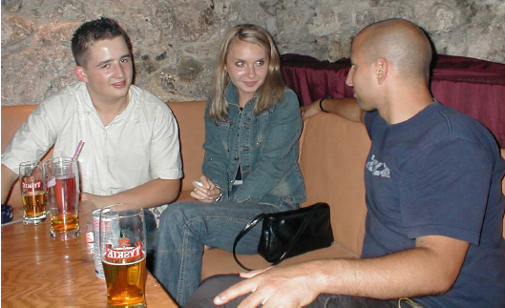
PHY Security: Simple Example
Wireless Transmission of a User
  Eavesdropped by an eavesdropper
Notion of Secrecy Capacity
  Maximum rate sent from a wireless node to its destination in the presence of eavesdroppers
Secrecy Capacity of User 1 :
  C₁ = (C^{d}₁ - Ce₁)⁺
I can hear User 1!
C^{d}₁
Ce₁

Slide 6
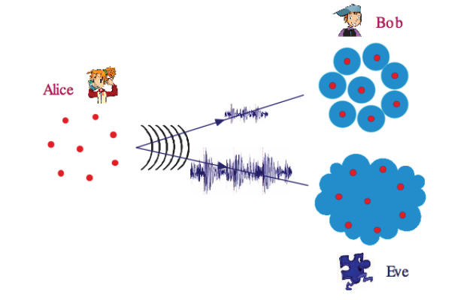
Physical Layer Security Intuition

Slide 7
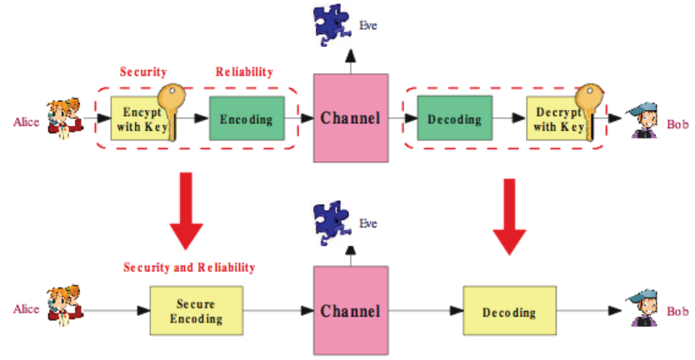
Physical Layer Security: An Alternative

Slide 8
Outline
Overview of Physical Layer Security
Information Theoretic Fundamentals
  Broadcast Channel
  Multiple Access Channel
  Other Channels
  Other results and Open Issue
Signal Processing Technique
Resource Allocation and Game Theoretical Study
Variety of Applications
Conclusion

Slide 9
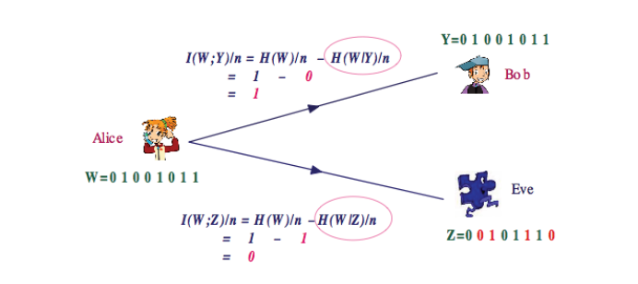
Quantifying Security: Equivocation
Capacity-equivocation regions
Secret capacity regions (rate = equivocation)

Slide 10
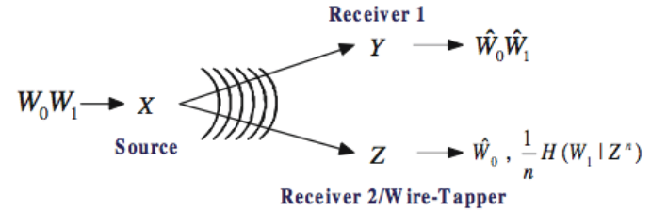
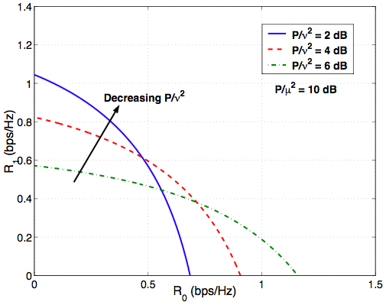
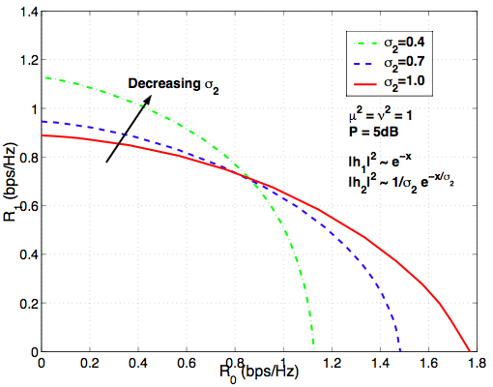
Broadcast Channel
Liang, Poor & Shamai

Slide 11
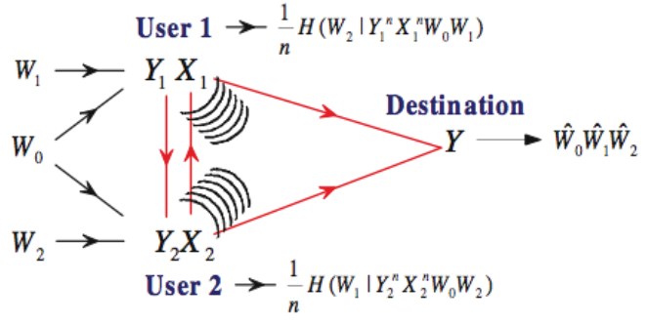
Multiple-Access Channel
Liang & Poor [IT08]

Slide 12
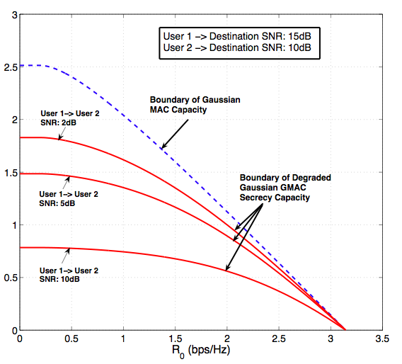

Slide 13
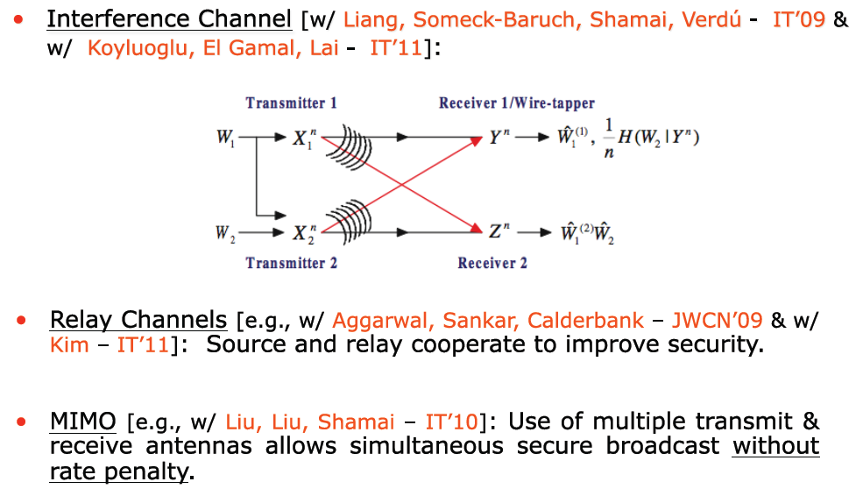
Other Channels

Slide 14
Other Recent Progress
Authentication [w/ Lai, El-Gamal – IT’09]: “Cheating” probability is characterized for authentication in noisy channels.
Feedback [e.g., w/ Lai, El-Gamal – IT’08, w/ Liu, Tang, Spasojevic – IT’09 & w/ Kim – IT’10]: Judicious use of feedback enhances security.
Code Design [e.g., w/ Liu, Liang & Spasojevic – IT (under review)]: Nested structure for secure error-control codes for the wire-tap channel.
Scheduling of Secure Broadcast [Liang, Poor & Ying [IFS11]
  Reliability (low error probability)
  Security (Perfect secrecy)
  Stability (Queues remain finite)

Slide 15
Outline
Overview of Physical layer security
Information Theoretic Fundamentals
Signal Processing Technique
  Collaborative Beamforming
  Jamming
Resource Allocation and Game Theoretical Study
Variety of Applications
Conclusion

Slide 16






Cooperative System Model
Cooperative protocol
  Stage one: source broadcasts its message signal locally to its trusted relays within the cluster.
  Stage two: relays that successfully decode the message, together with the source, cooperatively transmit signal to the destination.
Capacity at the destination
Capacity at the eavesdropper
Secrecy capacity
R
R
R
R

Slide 17






Secrecy Capacity Maximization or Power Minimization
Secrecy Capacity: due to nulling, always have non-zero value
Secrecy capacity maximization or power minimization
  The solution of this Rayleigh quotient problem is the scaled eigenvector corresponding to the largest eigenvalue of the symmetric matrix
Lun Dong, Zhu Han, Athina P. Petropulu and H. Vincent Poor, “Improving Wireless Physical Layer Security via Cooperating Relays", IEEE Transactions on Signal Processing, Volume: 58, Issue:3, p.p. 1875 - 1888, March 2010.

Slide 18
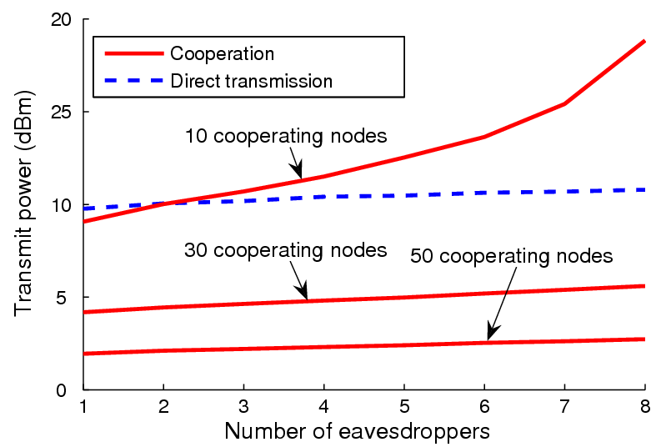
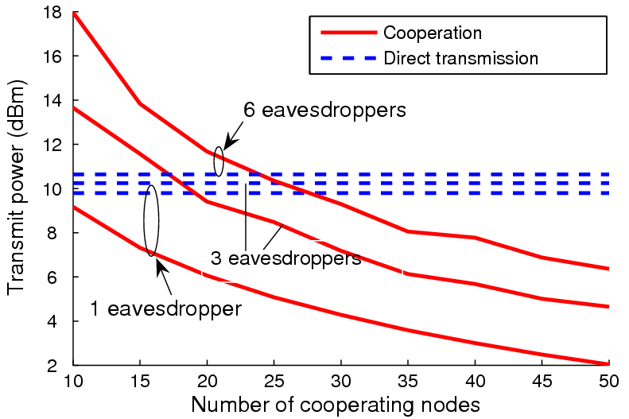
Simulation (Power Minimization)
The more eavesdroppers, the more power
The more collaborative nodes, the less power
Direct transmission without considering the security

Slide 19
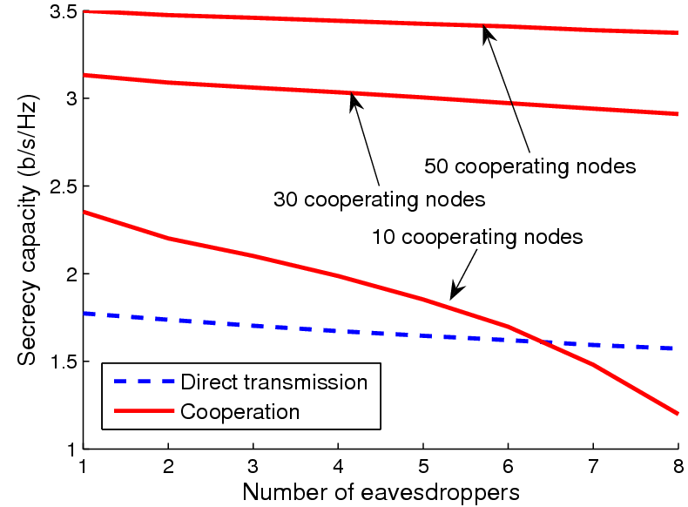
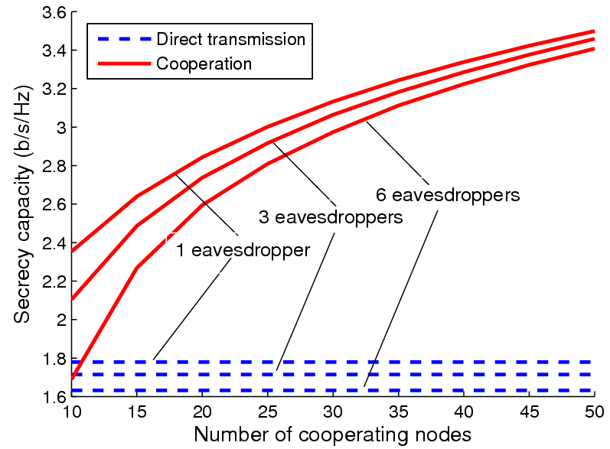
Simulation (Secrecy Capacity Maximization)
Number of cooperating node increases, secrecy capacity increases
Number of eavesdroppers increase, secrecy capacity drops

Slide 20
Jamming Techniques
Cooperative (or Friendly) Jamming
  The jamming signal can be as interference to both destination and eavesdropper, which makes both the wire-tap channel and the main channel getting worse.
  But if the interference effect on Bob is less than that on Eve, the secrecy rate will be improved.
Jamming Signal
  Noise
  Independent Codewords
Jamming Power Control
  Within a proper power region, jamming may
  improve the secrecy capacity.
  But if the jamming power further increases,
  the secrecy capacity will approach zero.
Friendly Jammer

Slide 21
Outline
Overview of Physical Layer security
Information Theoretic Fundamentals
Signal Processing Technique
Resource Allocation and Game Theoretical Study
  Basics
  Coalition Formation
  Stackelberg Game
  Auction Theory
Variety of Applications
Conclusion
Notes:
Collaborative Beamforming: Coalition Games
Jamming: Stackleberg Game and Auction Theory
Power Allocation (control) is our main focus to improve the secrecy performance

Slide 22
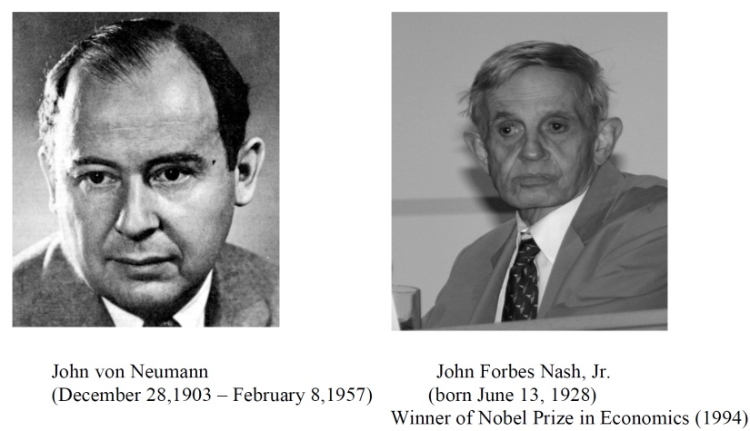

History of Game Theory
John von Neuman (1903-1957) co-authored, Theory of Games and Economic Behavior, with Oskar Morgenstern in 1940s, establishing game theory as a field.
John Nash (1928 - ) developed a key concept of game theory (Nash equilibrium) which initiated many subsequent results and studies.
Since 1970s, game-theoretic methods have come to dominate microeconomic theory and other fields.
Nobel Prizes
  Nobel prize in Economic Sciences 1994 awarded to Nash, Harsanyi (Bayesian games) and Selten (subgame perfect equilibrium).
  2005, Auman and Schelling got the Nobel prize for having enhanced our understanding of cooperation and conflict through game theory.
  2007 Leonid Hurwicz, Eric Maskin and Roger Myerson won Nobel Prize for having laid the foundations of mechanism design theory.

Slide 23
Introduction
Game theory - mathematical models and techniques developed in economics to analyze interactive decision processes, predict the outcomes of interactions, identify optimal strategies
Game theory techniques were adopted to solve many protocol design issues (e.g., resource allocation, power control, cooperation enforcement) in wireless networks.
Fundamental component of game theory is the notion of a game.
  A game is described by a set of rational players, the strategies associated with the players, and the payoffs for the players. A rational player has his own interest, and therefore, will act by choosing an available strategy to achieve his interest.
  A player is assumed to be able to evaluate exactly or probabilistically the outcome or payoff (usually measured by the utility) of the game which depends not only on his action but also on other players’ actions.

Slide 24
Games in Strategic (Normal) Form
A game in strategic (normal) form is represented by three elements:
  A set of players N
  Set of strategies of player Si
  Set of payoffs (or payoff functions) Ui
Notation s_{i} strategy of a player i while s_{-i} is the strategy profile of all other players.
Notice that one user’s utility is a function of both this user’s and others’ strategies.
A game is said to be one with complete information if all elements of the game are common knowledge. Otherwise, the game is said to be one with incomplete information, or an incomplete information game.

Slide 25
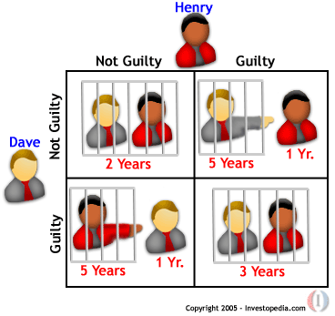
Rich Game Theoretical Approaches
Non-cooperative Static Game: play once
  Mandayam and Goodman (2001)
  Virginia tech
Repeated Game: play multiple times
  Threat of punishment by repeated game.
    MAD: Nobel prize 2005.
  Tit-for-Tat (infocom 2003):
Dynamic game: (Basar’s book)
  ODE for state
  Optimization utility over time
  HJB and dynamic programming
  Evolutional game (Hossain and Dusit’s work)
Stochastic game (Altman’s work)
Prisoner Dilemma
Payoff: (user1, user2)
[25]
Notes:
John Edwards

Slide 26

Auction Theory
  Book of Myerson (Nobel Prize 2007), Matching/Contract (2012)

Slide 27
Outline
Overview of Physical Layer Security
Information Theoretic Fundamentals
Signal Processing Technique
Resource Allocation and Game Theoretical Study
  Basics
  Coalition Formation
  Stackelberg Game
  Auction Theory
Variety of Applications
Conclusion

Slide 28

Coalitional Games Preliminaries
Coalitional game (N,v)
  A set of players N, a coalition S is a group of cooperating players
  Value (utility) of a coalition v
  User payoff x_{i} : the portion received by a player i in a coalition S
Transferable utility (TU)
  The worth v(S) of a coalition S can be distributed arbitrarily among the players in a coalition hence,
  v(S) is a function over the real line
Non-transferable utility (NTU)
  The payoff that a user receives in a coalition is pre-determined, and hence the value of a coalition cannot be described by a function
  v(S) is a set of payoff vectors that the players in S can achieve

Slide 29
Coalitional Game System Model
Coalition 3
Coalition 1
Coalition 2

Slide 30
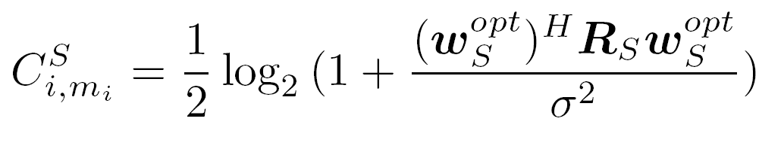
PHY Security Coalitional Game (1)
Coalitional game: the players are the users (transmitters)
Utility function must account for
  Cooperation gains, in terms of secrecy capacity
  Cooperation costs, in terms of power for information exchange
Secrecy capacity achieved by a user i part of coalition S transmitting data to its destination m_{i} in a single slot
Function of:
Users-destinations and users-eaves. channels
Power available for transmission in the slot
Function of the users-destination channels
R_{S} = h_{S}h_{S}^{H}
Optimal weights that null the signal at the eavesdroppers (see paper or Dong et al. for expression)

Slide 31
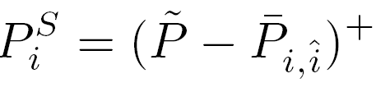

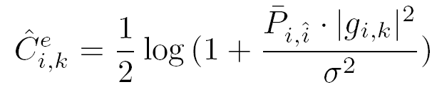
PHY Security Coalitional Game (2)
Power considerations
  Power constraint per coalition S (time slot)
  The power available in a slot for a coalition S to transmit the data of a user i is given by
Security cost during information exchange
  where
Power cost: the power needed for information exchange between user i and the farthest user in the coalition
Power constraint per slot

Slide 32
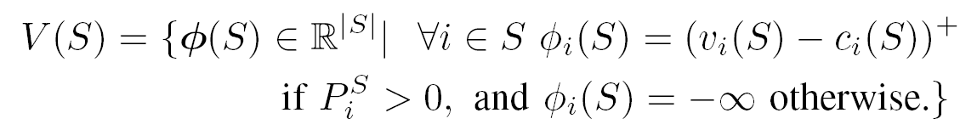
PHY Security Coalitional Game (3)
The proposed PHY security game is modeled as a (N,V) NTU coalitional game, with a value given by a singleton set
  ϕ_{i} is the payoff of a user i when transmitting as part of coalition S
  v_{i}(S)= C^{S}_{i,mi} = secrecy capacity using transmit beamforming given in previous slides
  For a user that spends all of its power for information exchange, the utility is negative (no benefit from cooperating)

Slide 33
Properties of PHY Security Game
The proposed NTU game is generally non-super-additive (cooperation is not always beneficial)
  Traditional concepts such as the core or the Shapley value are not suitable as solutions
  The grand coalition is seldom the optimal solution
    Due to the cooperation cost, as reflected by the false alarm
In the proposed game, the minimum coalition size is equal to K+1 where K is the number of eavesdroppers
  To null K eavesdroppers, K+1 users are needed
The proposed game is classified as a coalition formation game
  The objective is to answer the question “Who should cooperate with who in the network?”

Slide 34
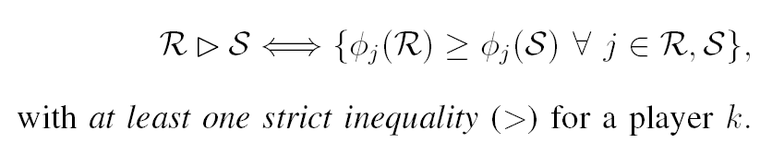


Coalition Formation: Merge and Split
Define the Pareto order preference relation between two collections of coalitions R and S
Merge rule: merge any group of coalitions where
Split rule: split any group of coalitions where
A decision to merge (split) is an agreement between all players to form (break) a new coalition

Slide 35
Coalition Formation Algorithm
Initial Network State:
Non-cooperative transmission
Neighbor discovery:
Each user discovers neighbors within specified
feasible areas (intersection of circles)
Merge-and-split iterations until convergence
Periodic Merge-and-Split
Allow the network to
Self organize after mobility
Each users (or coalition) surveys
the neighbors for possible Merge
Each coalition investigates
Split possibility
Final partition:
Secure cooperative transmission

Slide 36
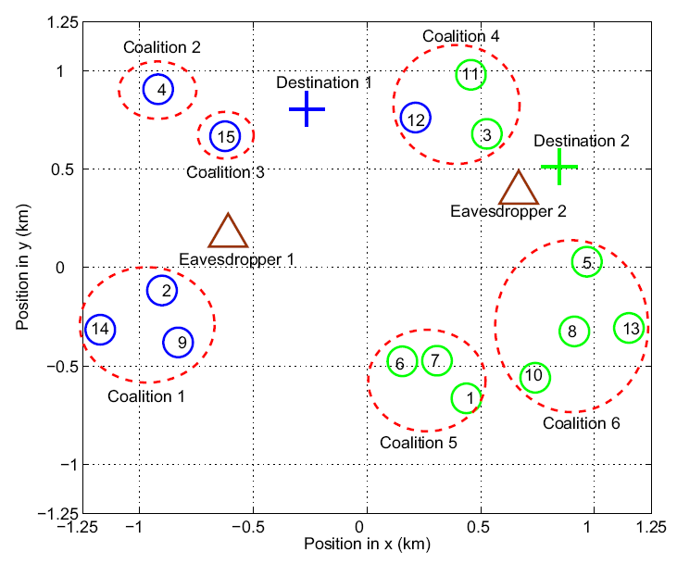
Simulation Results (1)
  Coalition example

Slide 37
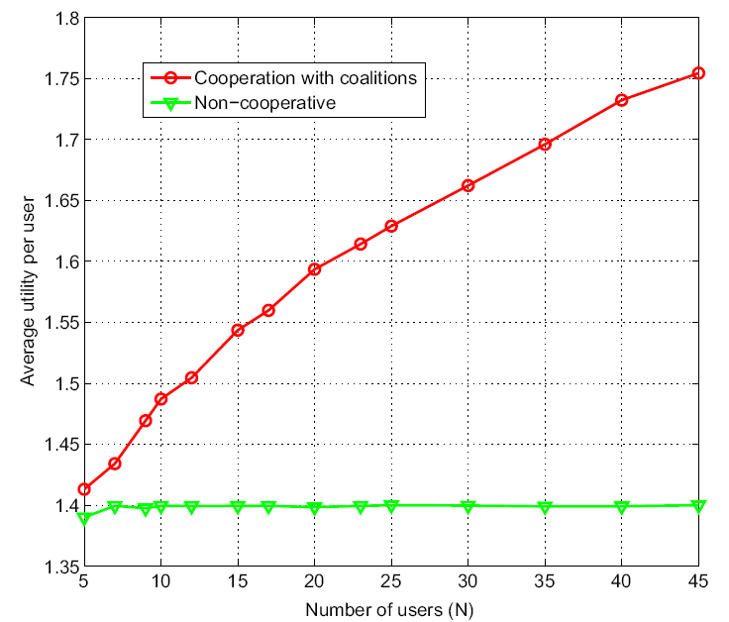
Simulation Results (2)
  Utility vs. Number of users
Walid Saad, Zhu Han, M¶erouane Debbah, Are Hj¿rungnes, and Tamer Basar, “Distributed Coalition Formation Games for Secure Wireless Transmission," invited, Journal of Mobile Networks and Applications, Special Issues on Mobility of Systems, Users, Data and Computing, ACM/Springer, April 2011.

Slide 38
Outline
Overview of Physical Layer Security
Information Theoretic Fundamentals
Signal Processing Technique
Resource Allocation and Game Theoretical Study
  Basics
  Coalition Formation
  Stackelberg Game
  Auction Theory
Variety of Applications
Conclusion

Slide 39
  Stackelberg Game Preliminaries (1)
Leader-Follower Strategy
  Given a two-person game, where Player 1 wants to minimize a cost function and Player 2 wants to minimize a cost function by choosing and from the strategies set.
  The strategy set is called a Stackelberg strategy with Player 2 as leader and Player 1 as follower if for any and
  where

Slide 40
  Stackelberg Game Preliminaries (2)
Applications in Physical Layer Security
  Appropriate for classes of system problems consisting of multiple criteria, multiple decision makers, decentralized information, and natural hierarchy of decision making levels.
  To study the interactions between source-destination pairs and cooperative relays/jammers.
Source-Destination Pair as Buyer:
  The buyer-level game
  Aim to achieve the best security performance with the relays/jammers’ help with the least reimbursements to them.
Cooperative Relays/Jammers as Sellers:
  The seller-level game
  Aim to gains as many profits as possible.

Slide 41



Date a Girl with her BF on the Same Table
  Solution with my Friend: Distract the poor BF
  Both s-d capacity and s-e capacity reduced.
  But the secrecy capacity can be increased.
  Increase secrecy rate by buying jamming power.
  Jammer sets the optimal price to maximize profits.

Slide 42
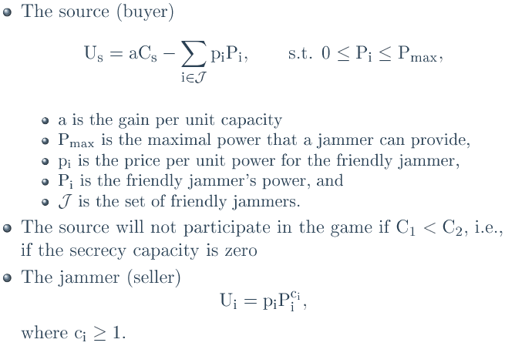
Game Definition
Notes:
42
Thank you very much and any questions?

Slide 43
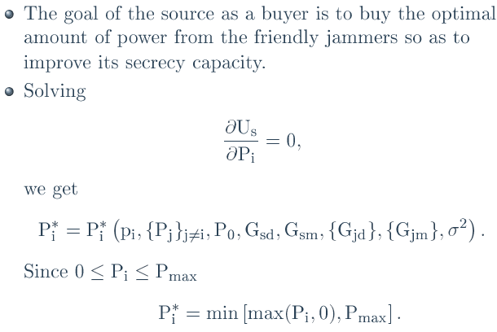
Source Analysis
Notes:
43
Thank you very much and any questions?

Slide 44
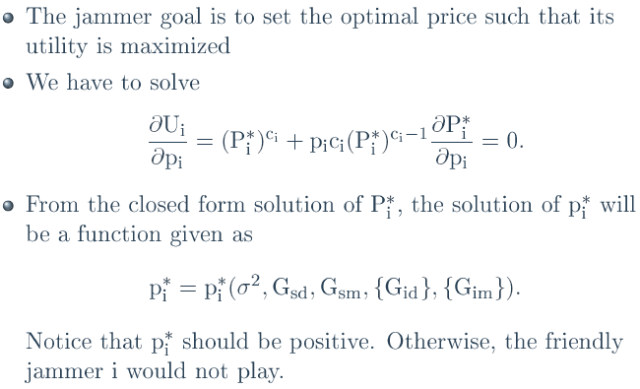
Jammer Analysis
Notes:
44
Thank you very much and any questions?

Slide 45
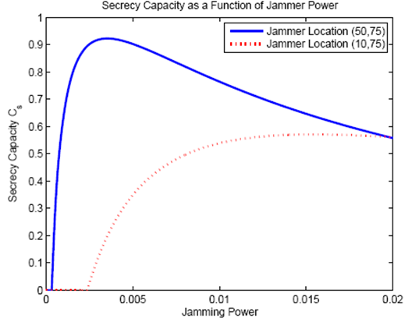
Results
Zhu Han, Ninoslav Marina, Merouane Debbah, and Are Hjorungnes, “Physical Layer Security Game: Interaction between Source, Eavesdropper and Friendly Jammer," EURASIP Journal on Wireless Communications and Networking, special issue on Wireless Physical Layer Security, Volume 2009, Article ID 452907, 10 pages, June 2009.
Notes:
45
Thank you very much and any questions?

Slide 46
Outline
Overview of Physical Layer Security
Information Theoretic Fundamentals
Signal Processing Technique
Resource Allocation and Game Theoretical Study
  Basics
  Coalition Formation
  Stackelberg Game
  Auction Theory
Variety of Applications
Conclusion

Slide 47
  Auction Theory Preliminaries (1)
Recently, auction theory (pioneered by Vickrey, etc) has been widely employed in wireless networks to solve the resource allocation issues.
In an auction, each bidder bids for an item, or items, according to a specific mechanism, and the allocation(s) and price(s) for the item, or items, are determined by specific rules.
Auctioneers: The players own resources (spectrum, power, etc) and expect to earn rewards by offering the resources.
Bidders: The players hope to obtain the resources from the auctioneers to improve their performance but in return need to provide some rewards.

Slide 48
  Auction Theory Preliminaries (2)
Various Types:
  Vickrey Auction [Vickrey’1961]
  Ascending Auction [Ausubel’1997, Cramton’1998]
  First Price Auction, Second Price Auction
  Single Object Auction, Multiple Object Auction
  Double Auction (multiple auctioneers and multiple bidders)
  Hot Application Scenarios:
  Cognitive Radio Networks (PU as auctioneer and SUs as bidders)
  WLAN (users compete for the transmission resources)
  Cellular Networks (D2D, Femtocell)

Slide 49
  Ascending Auction
Procedure of Ascending Auction
  The auctioneer announces an initial price to the bidders;
  The bidders report back the quantities demanded at that price ;
  The auctioneer raises the price;
  This process repeats until the sum of the reported bids meet the total quantity of the on-sale resources.
  Properties:
  With private values, this ascending auction yields the same outcome as the (sealed-bid) Vickrey auction, but has advantages of simplicity and privacy preservation.
  With interdependent values, this ascending auction may retain efficiency, whereas the Vickrey auction suffers from a generalized Winner's Curse.

Slide 50
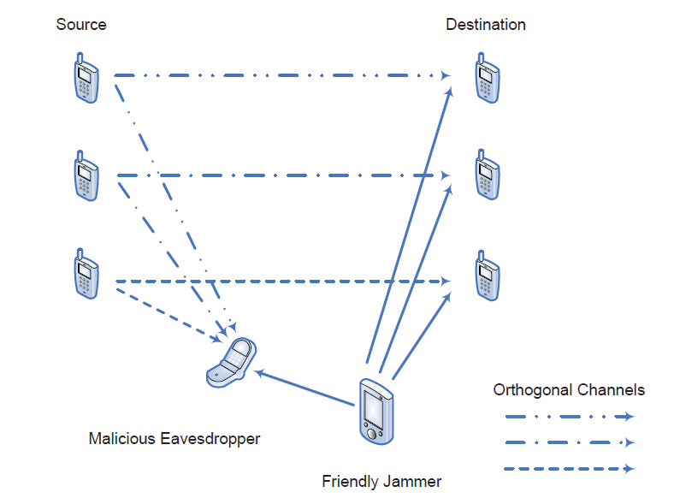
  Jammer-Assisted System Scenario
[1] Rongqing Zhang, Lingyang Song, Zhu Han, and Bingli Jiao, “Improve Physical Layer Security in Cooperative Wireless Network using Distributed Auction Games,” INFOCOM Workshop on Cognitive & Cooperative Communications, Shanghai, Apr. 10-15, 2011.
[2] Rongqing Zhang, Lingyang Song, Zhu Han, and Bingli Jiao, “Distributed Auction-Based Power Allocation for Improving Physical Layer Security in Cooperative Networks,” IEEE Journal on Selected Areas in Communications, in revision.

Slide 51
  Jammer-Assisted System Scenario
  Secrecy rate for the source-destination pairs:
  With a proper amount of jamming power, the secrecy rate can be improved effectively.
  How to allocate the jamming power among multiple source-destination pairs efficiently and effectively?
  Auction!!

Slide 52
Auction Definition
Players:
  Source S_{i} as one of the bidders;
  Friendly jammer J as the auctioneer;
  Sources submit bids to compete for the jamming power from the friendly jammer, in order to increase the secrecy rate.
Utilities:
  Source S_{i} can have a performance gain by successfully getting the jamming power, meanwhile it needs to pay for the jamming power offered by the friendly jammer.
  Friendly jammer charges the sources for the jamming service at a price for every unit of jamming power.

Slide 53
Auction Definition
Source’s Utility Function
  We consider source S_{i} as one of the bidders, while friendly jammer J as the auctioneer. The sources submit bids to compete for the jamming power from the friendly jammer, in order to increase the secrecy rate of their own data transmission.
  Source S_{i} can have a performance gain by successfully getting the jamming power, meanwhile it needs to pay for the power offered by the friendly jammer.
  Therefore, the utility function of source Si can be defined as
  where is the performance gain with the jamming power ,
  is the cost paid for the friendly jammer, and represents
  the unit price of jamming power.

Slide 54
Auction Definition
Source’s Utility Function
  Using linear pricing scheme as cost function, then we have
  Jammer’s Utility Function
    The friendly jammer charges the sources for the jamming service at a price for every unit of jamming power. Then the utility of friendly jammer J can be defined as

Slide 55
Distributed Auction Games
Power Allocation using Traditional Ascending Clock Auction (P-ACA-T)
  The P-ACA-T scheme is proposed based on traditional ascending clock auction, where each source is allowed to bid any power demand between 0 and at every iteration.
  In P-ACA-T, the friendly jammer sets an asking price which is increased at every iteration, then each source submits its optimal demand based on the current asking price to maximize its utility.
  The friendly jammer will conclude the auction until the total jamming power bids satisfy the condition that .

Slide 56
P-ACA-T
Auction Initialization
Friendly Jammer
Announce the current
asking price to the sources
Sources
Each source calculates its
optimal bid based on the
asking price and submits it
to the friendly jammer
Update asking price
Repeat
Yes
The sum of bids >
the total jamming power?
Auction Concludes
No

Slide 57
Distributed Auction Games
Power Allocation using Alternative Ascending Clock Auction (P-ACA-A)
  The P-ACA-A scheme is proposed based on alternative ascending clock auction which can guarantee the cheat-proof property.
    Cheat-proof: Reporting true optimal demand at every iteration is a mutually best response for each source and there is no incentive for the sources to cheat since any cheating may lead to a loss in utility.
  The procedures of P-ACA-A are the same as P-ACA-T except that at every iteration in P-ACA-A, the friendly jammer computes the cumulative clinch, which is the amount of jamming power that each source is guaranteed to win at every iteration.

Slide 58
Distributed Auction Games
Key difference between P-ACA-T and P-ACA-A:
  In P-ACA-T, the final payment of source S_{i}, based on only the final allocated jamming power and the final asking price:
  In P-ACA-A, the final payment of source S_{i}, based on the cumulative clinch and the asking price at every iteration during the auction:
  The different payment rules lead to different cheat-proof properties of these two auction-based schemes

Slide 59
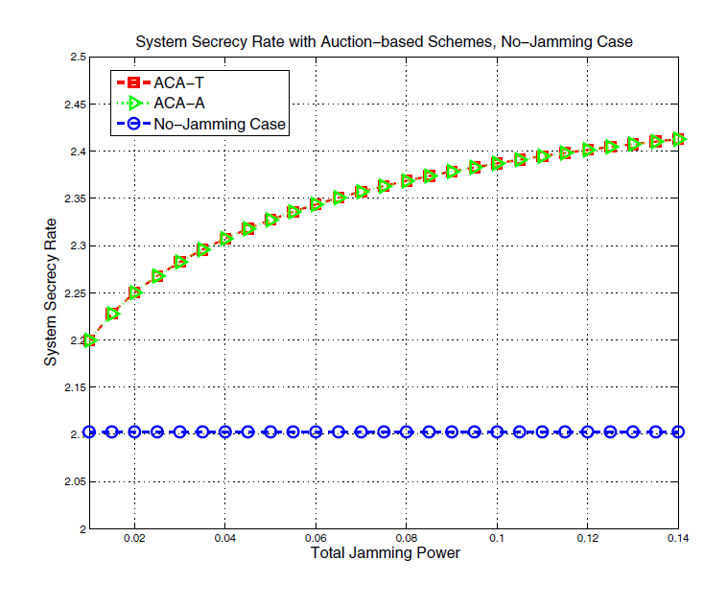
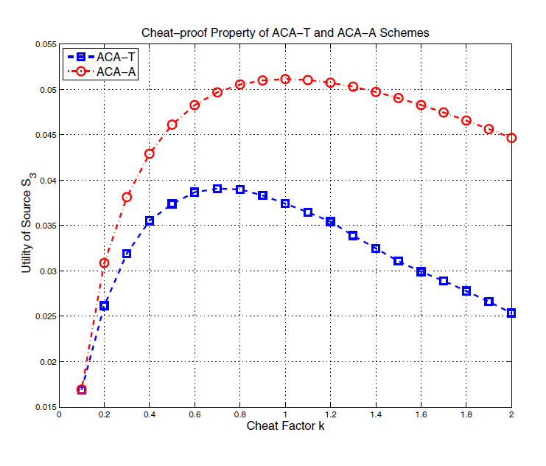
Simulations (Cheat-proof and Secrecy Rate)
P-ACA-T and P-ACA-A can improve the system secrecy rate effectively.
P-ACA-A is cheat-proof, while P-ACA-T is not.
  Cheat-proof: Reporting true optimal demand at every iteration is a mutually best response for each source and there is no incentive for the sources to cheat since any cheating may lead to a loss in utility.
Notes:
Simulation Conditions
Considering a network with three pairs of sources and destinations, in which the sources are located at (-100 m, 0 m), (-100 m, 100 m), and (-100 m, 200 m), while the corresponding destinations are located at (100 m, 0 m), (100 m, 100 m), and (100 m, 200 m), respectively. The friendly jammer is located at (0 m, -100 m).
The whole jamming power p_{max} is 0.1 W.
The noise variance is σ² = -70 dBm.
The reserve price is 0.001 and the price step is 0.01.

Slide 60
Outline
Overview of Physical Layer Security
Information Theoretic Fundamentals
Signal Processing Technique
Resource Allocation Game Theoretical Study
Variety of Applications
  Cognitive Relay Network
  Two-Way Relay Network
  Femtocell Network
  RFID
  Satellite Network
Conclusion

Slide 61
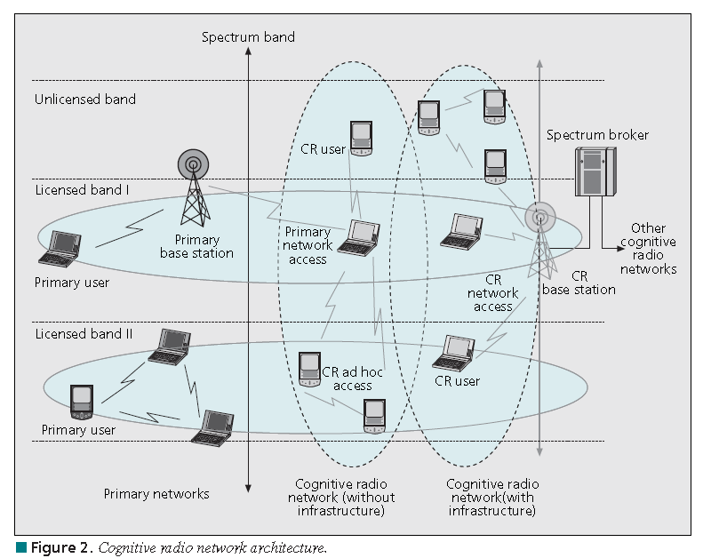
PHY Security in CR Networks
Power Allocation for Physical Layer Security in Cognitive Relay Networks
[1] Tianyu Wang, Lingyang Song, Zhu Han, Xiang Cheng, and Bingli Jiao, “Power Allocation using Vickrey Auction and Sequential First-Price Auction Games for Physical Layer Security in Cognitive Relay Networks,” IEEE International Conference on Communications, Ottawa, Canada, Jun. 2012.
[2] Tianyu Wang, Rongqing Zhang, Lingyang Song, Zhu Han, and Bingli Jiao, “Power Allocation for Two-Way Relay System Based on Sequential Second Price Auction,” Wireless Personal Communications, Aug. 2012.

Slide 62
Introduction
The components can be classified as:
  The primary network (or licensed network) : the primary users have a license to operate in a certain spectrum band.
  The CR network (secondary network, or unlicensed network) does not have a license to operate in a desired band.
Four main functions:
  Spectrum sensing: Monitor the available spectrum bands, capture their information, and then detect spectrum holes.
  Spectrum decision: Based on the spectrum availability, CR users can allocate a channel.
  Spectrum sharing/access: Prevent multiple CR users colliding in overlapping portions of the spectrum-Underlay and overlay;
  Spectrum mobility: If the specific portion of the spectrum in use is required by a primary user, the communication must be continued in another vacant portion of the spectrum.
Notes:
The components of the CR network architecture can be classified as two groups: the primary network and the CR network.
The primary network (or licensed network) is referred to as an existing network, where the primary users have a license to operate in a certain
Spectrum band.
The CR network (also called the dynamic spectrum access network, secondary network, or unlicensed network) does not have a license to
operate in a desired band. Hence, additional functionality is required for CR users to share the licensed spectrum band.
Four main functions:
• Spectrum sensing: A CR user can allocate only an unused portion of the spectrum. Therefore, a CR user should monitor the available spectrum bands, capture their information, and then detect spectrum holes.
(Matched filter detection, Energy detection, Feature detection, Cooperative/collaborative detection)
• Spectrum decision: Based on the spectrum availability, CR users can allocate a channel. This allocation not only depends on spectrum availability, but is also determined based on internal (and possibly external) policies.
(first, each spectrum band is characterized, based on not only local observations of CR users but also statistical information of primary
networks. Then, based on this characterization, the most appropriate spectrum band can be chosen.)
• Spectrum sharing/access: Because there may be multiple CR users trying to access the spectrum, CR network access should be coordinated
to prevent multiple users colliding in overlapping portions of the spectrum.
(based on architecture: centralized and distributed)
(based on allocation behavior: cooperative/collaborative and non-cooperative)
(based on access technology: underlay, overlay and interweave)
(based on types of solutions: Intranetwork spectrum sharing and Internetwork spectrum sharing:)
• Spectrum mobility: CR users are regarded as visitors to the spectrum. Hence, if the specific portion of the spectrum in use is
required by a primary user, the communication must be continued in another vacant portion of the spectrum.
(spectrum handoff)

Slide 63
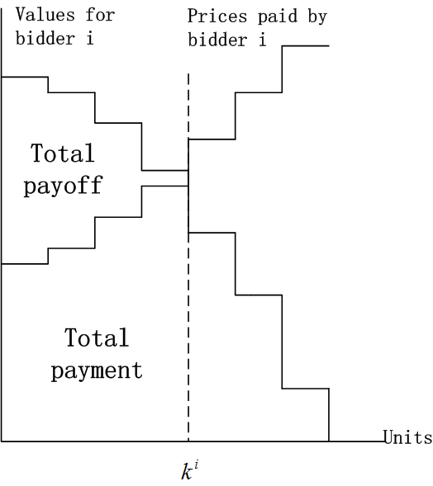
Introduction
Vickrey Auction
Each of N bidders is asked to submit K bids, satisfying , to indicate how much he is willing to pay for each additional unit.
Thus, a total of bids are collected and the K units are awarded to the K highest of these bids, i.e., if bidder i has
of the K highest bids, then bidder i is awarded k units.
Any bidder i who wins units pays the highest losing bids of the other bidders, i.e., the highest losing bids not including his own.

Slide 64
Introduction
Sequential First-Price Auction
  The sequential first-price auction is an auction where the K identical units are sold to N > K bidders using a series of first-price sealed-bid auctions.
  Specifically, one of the units is auctioned off at one round, where the unit is sold at the price of the highest bid to the corresponding bidder and the knocking down price is announced immediately.
  After K first-price sealed-bid auctions, the sequential first-price auction ends.

Slide 65
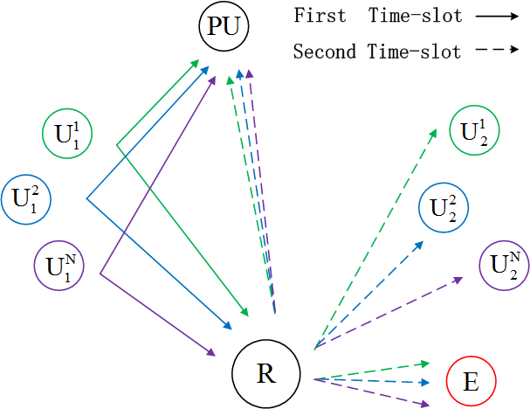
System Model
A cognitive relay network consisting of a PU, a relay working at AF mode, an eavesdropper, and N SU pairs over the orthogonal and no direct line-of-sight links exist between the source and destination.
Notes:
Power Allocation using Vickrey Auction and Sequential First-Price Auction Games for Physical Layer Security in Cognitive Relay Networks
As shown in the figure, we consider a cognitive relay network consisting of a PU, a relay working at AF mode, an eavesdropper, and K SU pairs, which are denoted by PU, R, E, U^i_j, j=1,2, i=1,2,…,N, respectively. The SU transmitters U^i_1 send signal to the SU receivers U^i_2 via the relay over the orthogonal channels with the interference power at the PU below Pinter of each channel and no direct line-of-sight links exist between the source and destination.

Slide 66
System Model
The capacity from to with power units is given
The capacity of the wire-tap channel from to E is
The secrecy rate of souce i is then given by
The marginal secrecy rate (the secrecy rate increase due to the current unit) of the k-th unit for SU pair i is
Notes:
The channel is flat fading with single antenna given by y = ha + w, where w ∼ CN(0,N0), and h = c*r−2 with c ∼ CN(0,1) and r the propagation distance. We assume the users have perfect channel state information (CSI) of all channels which remain constant during the relaying. The transmit power of U^i_1 is P^i_t. The total transmit power of the relay is Pr, which are divided into K equal units for auction with each unit P_unit = Pr/K.
For SU pair i with k^i power units obtained, the relay transmit power for it is k^i*P_unit. The channel gains from U^i_1 to PU, from from U^i_1 to R, from R to PU, from R to U^i_2 and from R to E are denoted by h^i_1p; h^i_1; h^i_2p; h^i_2; h^i_2e, respectively.

Slide 67
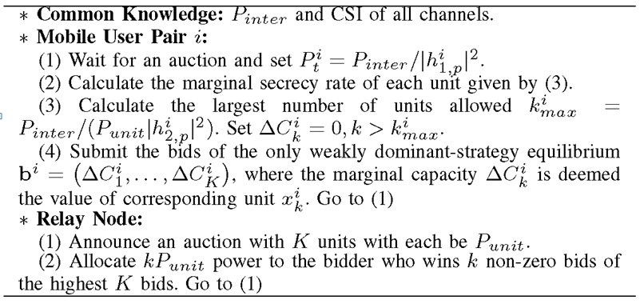
  Vickrey Auction Algorithms
The Vickrey auction has the truth telling property, which implies that each bidder will submit bids equal to its corresponding values to maximize its own payoff.

Slide 68
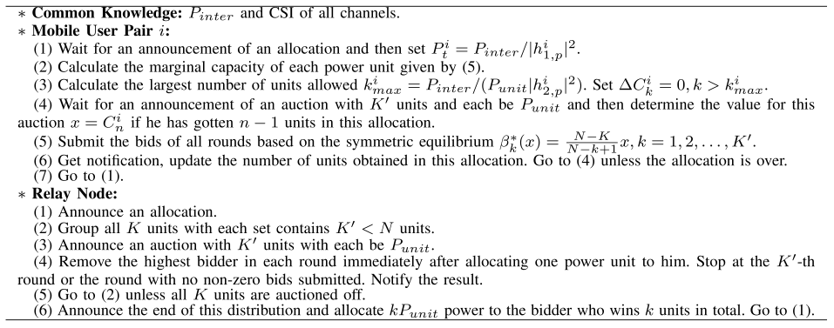
Sequential First-Price Algorithms

Slide 69
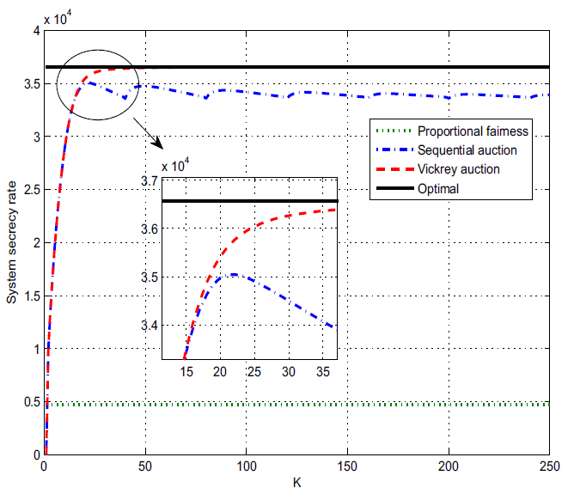
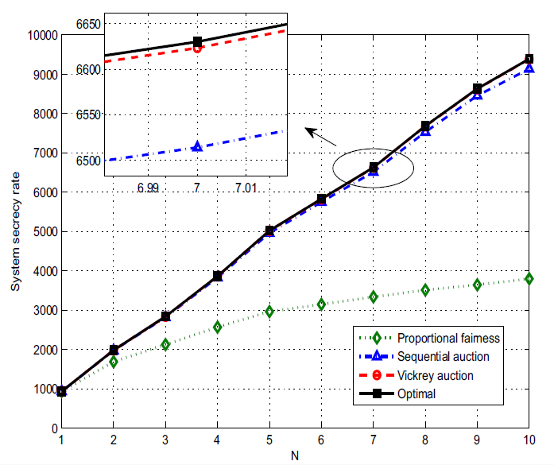
Simulations
Both the algorithms achieve high performances in system secrecy rate.
The Vickrey auction obtains better performance in efficiency while the sequential first-price auction achieves more fairness among SU pairs.
Notes:
As we noted the Vickery auction has the truth telling property, since our auction allocates the units to the highest bidders, the direct result of this truth telling property is that the units are allocated to the bidders with the highest values, which makes the Vickrey auction an efficient
auction. With increasing power units K, the power unit is smaller and the auction result is refined to be closer to the optimal allocation, which explains the increasing trend and the asymptotically optimal trend in Fig. 2.
For the sequential first-price auction, the loss of system secrecy rate is due to both the auction itself and the grouping method we introduced. Due to the single-unit demand assumption, it is possible that the bidder with multiple high-value demands wins one unit only, which drops
down the total efficiency. This phenomenon is more likely to appear in situation where the number of units in each group K′is close to the number of bidders N, so our grouping method affects the system performance as well.

Slide 70
Outline
Overview of Physical Layer Security
Information Theoretic Fundamentals
Signal Processing Technique
Resource Allocation Game Theoretical Study
Variety of Applications
  Cognitive Relay Network
  Two-Way Relay Network
  Femtocell Network
  RFID
  Satellite Network
Conclusion

Slide 71
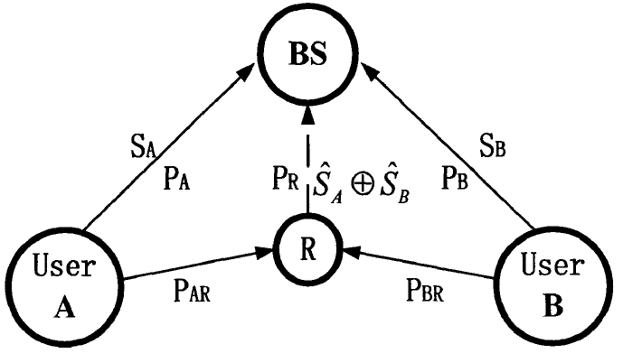
Secure Two-Way Relay Networks
Network coding based relaying
[1] Jingchao Chen, Rongqing Zhang, Lingyang Song, Zhu Han, and Bingli Jiao, “Joint Relay and Jammer Selection for Secure Two-way Relay Networks,” IEEE Transactions on Information Forensics and Security, vol. 7, no. 1, pp. 388-396, 2012.
[2] Jingchao Chen, Lingyang Song, Zhu Han, and Bingli Jiao, “Joint Relay and Jammer Selection for Secure Decode-and-Forward Two-Way Relay Communications," IEEE Globe Communication Conference (Globecom), Houston, USA, Dec. 2011.
[3] Jingchao Chen, Rongqing Zhang, Lingyang Song, Zhu Han, and Bingli Jiao, “Joint Relay and Jammer Selection for Secure Two-way Relay Networks,” IEEE International Conference on Communications (ICC), Kyoto, Japan, Jun. 5-9, 2011.

Slide 72
Literature Overview
Conventional Bi-Directional Relay Protocol

Slide 73
Literature Overview
Amplify-and-Forward Bi-Directional Relay Protocol
Analog Network Coding

Slide 74
System Model
Two sources, K intermediate nodes, which can serve as both relay and jammer, one eavesdropper
Amplify-and-forward mode
Slow, flat, and block Rayleigh fading, i.e., the channel remains static for one coherence interval and changes independently in different coherence intervals

Slide 75
System Model
Two Phases (AF Relay):
1st phase
2nd phase
Key assumption in this two-way relay scenario: The eavesdropper can eavesdrop on the main communication channels in both phases.

Slide 76
System Model
Overall SINR of channel S_{i} → S_{j}:

Slide 77
System Model
Overall SINR of channel S_{i} → E (Optimal Case):
(Instantaneous knowledge of the eavesdropping channels)

Slide 78
System Model
Overall SINR of channel S_{i} → E (Suboptimal Case):
(Average knowledge of the eavesdropping channels)

Slide 79
Problem Formulation
Instantaneous secrecy rate of channel S_{i} → S_{j}:
Overall secrecy rate of the system:
Select one conventional relay and one or two friendly jammers.

Slide 80
Selections without Jamming
Conventional Selection (CS)
Optimal Selection (OS)

Slide 81
Selections with Jamming
Optimal Selection with Jamming
Optimal Switching

Slide 82
Selections with Jamming
Suboptimal Selection with Jamming

Slide 83
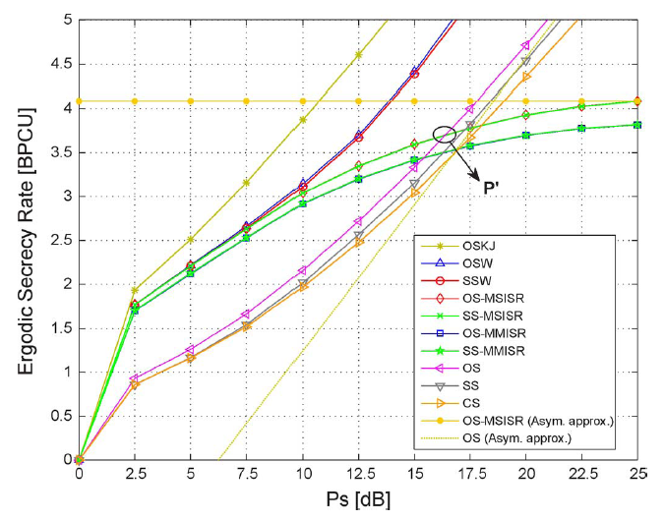
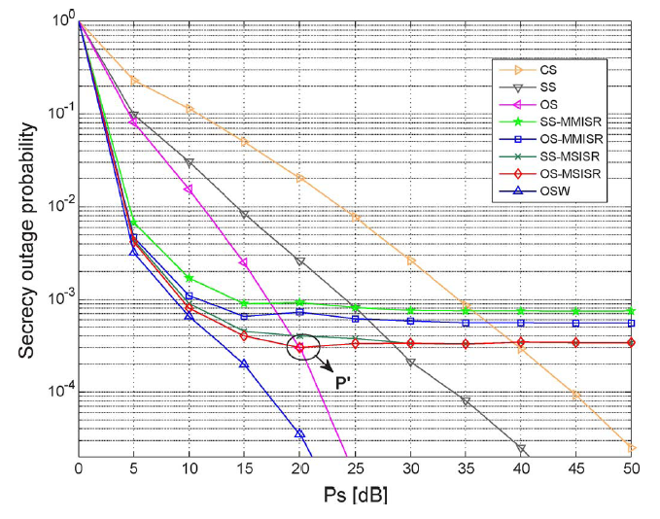
Numerical Results
The hybrid scheme (which switches intelligently between jamming and non-jamming modes) is efficient in providing the highest secrecy rate in almost the whole transmitted power regime.

Slide 84
PHY Security in Two-Way Relay Scenario
[1] Rongqing Zhang, Lingyang Song, Zhu Han, and Bingli Jiao, “Physical Layer Security for Two Way Relay Communications with Friendly Jammers,” IEEE Global Communications Conference (Globecom), Miami, Florida, USA, Dec. 6-10, 2010.
[2] Rongqing Zhang, Lingyang Song, Zhu Han, and Bingli Jiao, “Physical Layer Security for Two Way Relay Communications with Untrusted Relay and Friendly Jammers,” IEEE Transactions on Vehicular Technology, vol. 61, no. 8, pp. 3693 - 3704, Oct. 2012.

Slide 85
System Model
  Two-Way Relay Communication through an Untrusted Relay Node
Untrusted Relay
Source S₂
Source S₁
Friendly Jammers
Phase 1
Phase 2
Notes:
Key Assumptions:
All the nodes are equipped with only a single omni-directional antenna and operating in a half-duplex way.
No direct communication link between the two source nodes.
The untrusted relay node, working in Amplify-and-Forward protocol, acts both as an essential relay and a malicious eavesdropper who also wants to eavesdrop the transmitted data coming from the sources.
The source nodes have perfect knowledge of the jamming signals transmitted by the friendly jammers, for they have paid for the service.

Slide 86
System Model
  Key Assumptions:
  All the nodes are equipped with only a single omni-directional antenna and operating in a half-duplex way.
  No direct communication link between the two source nodes.
  The untrusted relay node, working in Amplify-and-Forward protocol, acts both as an essential relay and a malicious eavesdropper who also wants to eavesdrop the transmitted data coming from the sources.
  The source nodes have perfect knowledge of the jamming signals transmitted by the friendly jammers, for they have paid for the service.

Slide 87
System Model
  Secrecy Rate for S₁ and S₂:
  denote the transmitting power of the sources S₁, S₂, and the friendly jammer J_{i}, respectively.

Slide 88
Game between Sources and Friendly Jammers
  Stackelberg Game between Sources and Jammers
  Here we consider the two sources as two buyers who want to optimize their secrecy rates, while the cost paid for the “service”, i.e., jamming power , should also be taken into consideration.
  We employ the pricing scheme to the payment of the two sources. For simplicity, here we mainly consider linear pricing scheme.

Slide 89
Game between Sources and Friendly Jammers
  Source Side Game
  For the source side, we define the utility function as
  where is a positive constant representing the gain per unit rate,
  and is the cost to pay for the friendly jammers.
  Here we have , where is the price per unit power paid for the friendly jammer i by the sources.
  The source side game can be expressed as

Slide 90
Game between Sources and Friendly Jammers
  Friendly Jammer Side Game
  For the friendly jammer side, we define the utility function of each friendly jammer as
  where is a constant to balance the payment from the sources and the transmission of the jammer itself. With different values of , the jammers have different strategies for asking the price .
  Here the jamming power is also a function of the vector of prices , as the amount of jamming power that the sources will buy also depends on the prices that the friendly jammers ask.

Slide 91
Game between Sources and Friendly Jammers
  Friendly Jammer Side Game
  The friendly jammer side game can be expressed as
  The optimal asking price for jammer i can be given as

Slide 92
Game between Sources and Friendly Jammers
  Distributed Algorithm
    From above, we have
    where , is a function of m, and is the price update function for friendly jammer i.
    The distributed algorithm can be expressed in a vector form as
    where , and the iteration is from time t to time t+1.

Slide 93
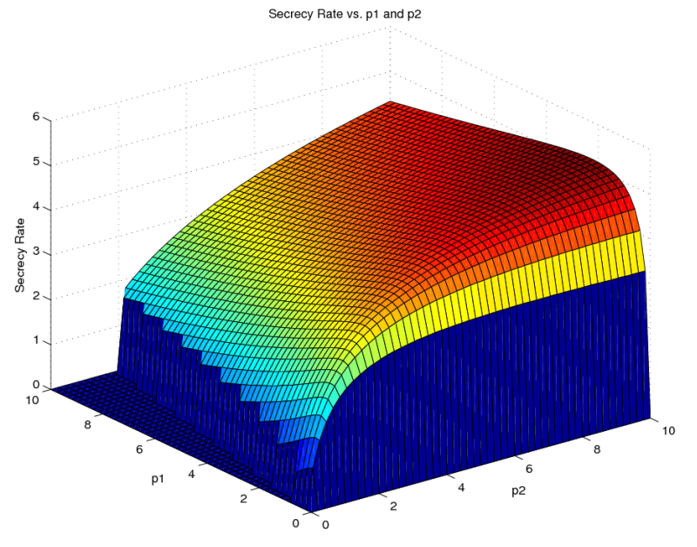
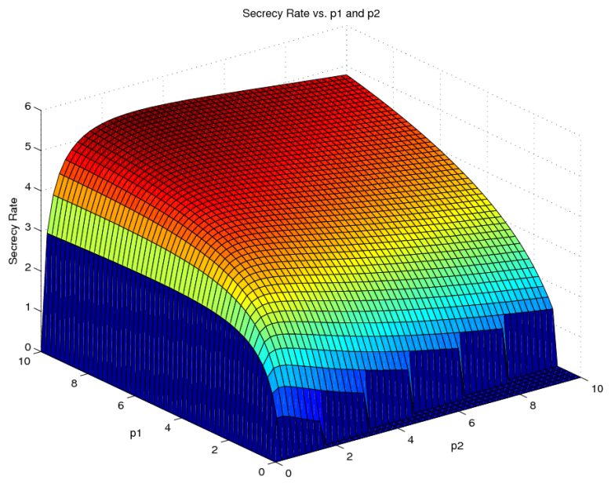
Simulation Results
The Special Case without Jammers
Notes:
Simulation Conditions
The sources S₁, S₂, and the malicious relay R are located at the coordinate (-1,0), (1,0), and (0,0), respectively.
The maximum power constraint p_{max} is 10.
The noise variance is σ² = 0.01.
Rayleigh fading channel is assumed, where the channel gain consists of the path loss and the Rayleigh fading coefficient.

Slide 94
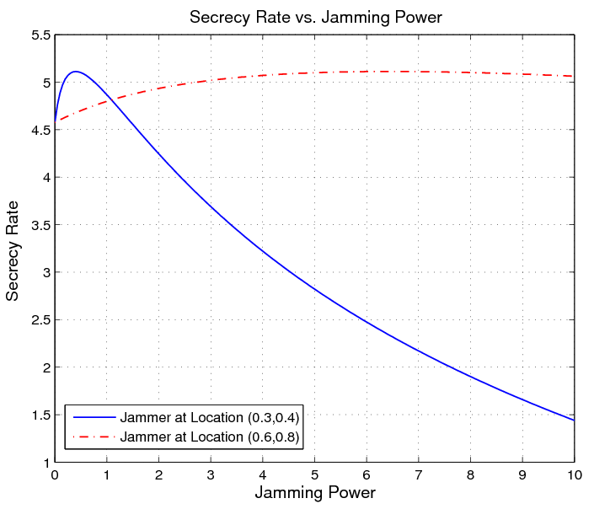
Simulation Results
Secrecy rate vs. jamming power at different jammer locations

Slide 95
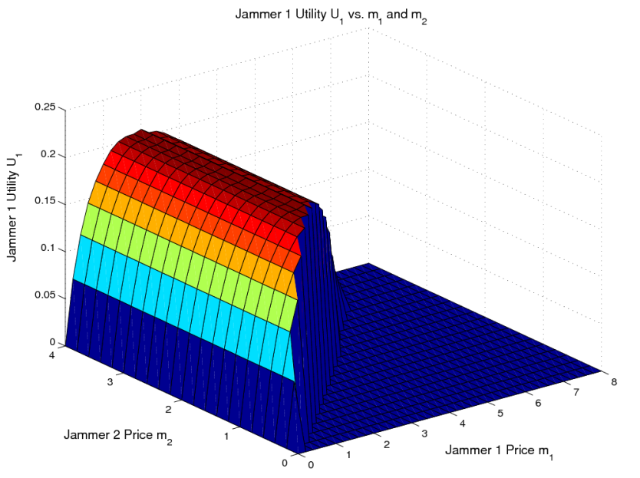
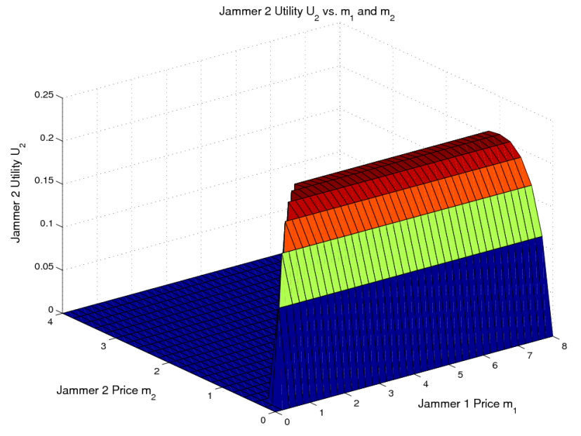
Simulation Results
Multiple-Jammer Case

Slide 96
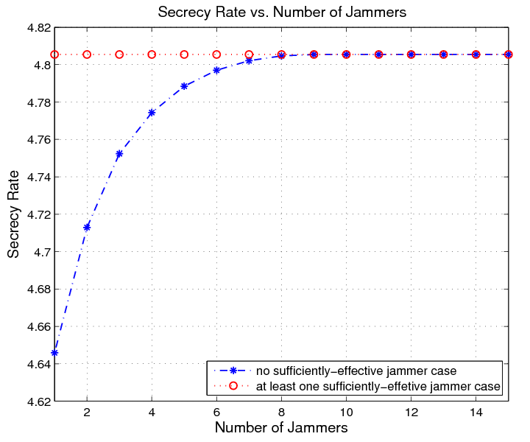
Simulation Results
Multiple-Jammer Case
Notes:
Here we treat jammer i as a sufficiently-effective one if it can offer a power, making the secrecy rate improved up to the maximal value.
In another word, no sufficiently-effective jammer means that the sources could not achieve the maximal secrecy rate with only one jammer's
help.

Slide 97
Outline
Overview of Physical Layer Security
Information Theoretic Fundamentals
Signal Processing Technique
Resource Allocation Game Theoretical Study
Variety of Applications
  Cognitive Relay Network
  Two-Way Relay Network
  Femtocell Network
  RFID
  Satellite Network
Conclusion

Slide 98
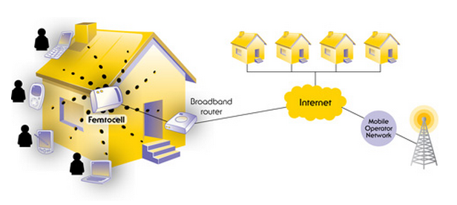
Truthful Mechanisms for Access Control
Femtocells are low-power wireless access points that operate in licensed spectrum to connect standard mobile devices to a mobile operator’s network using residential DSL or cable broadband connections.
Zhiqiang Feng, Jun Deng, Lingyang Song, and Zhu Han, “Joint Access Control and Subchannel Allocation Scheme for OFDMA Femtocell Network Using a Truthful Mechanism,” The first ACM international workshop on Practical issues and applications in next generation wireless networks (PINGEN'12), Istanbul, Turkey, Aug. 2012.

Slide 99
Introduction and Background
Interference in Femtocells
  The avoidance of interference is still an issue that needs to be addressed to successfully deploy a femtocell tier over existing macrocell networks.
Cross-tier interference
Caused by an element of the femtocell tier to the macrocell tier and vice versa
Co-tier interference
Occurs between elements of the same tier, for example, between neighboring femtocells

Slide 100
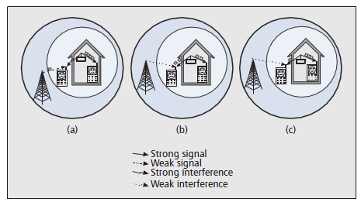
Introduction and Background
Access Control
Closed Access
Only a subset of users defined by the femtocell owner can connect to the femtocell
Open Access
All customers of the operator have the right to make use of any femtocell
Hybrid Access
A limited amount of the femtocell resources are available to all users
Interference is strongly dependent on the type of
access control.
Fig. Three access control methods.

Slide 101
Introduction and Background
Interference in different access controls
Closed Access
Hybrid Access
Open Access
Strong cross-tier interference exists between both tiers
Co-tier interference also comes up between neighboring femtocells in dense deployments.
Avoid cross-tier interference but co-tier interference still exists.
Both cross-tier and co-tier interference exist but not as strong as in the Closed Access scenario.

Slide 102
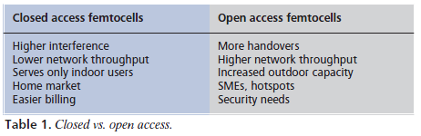
Introduction and Background
Comparison between Closed Access Femtocells and Open Access Femtocells
Hybrid access methods reach a compromise between the impact on the performance of subscribers and the level of access granted to nonsubscribers.

Slide 103
Introduction and Background
Access control mechanisms have a direct effect on interference.
In Hybrid Access, the sharing of femtocell resources between subscribers and nonsubscribers needs to be finely tuned.
Femtocells are mostly deployed by users and hybrid access may be one of the best access methods for users and service providers. However, femtocell owners do not have incentive to authorize others to use their own femtocells.
Service providers shall pay femtocell owners for the access permission and in order to get more money, and femtocells may not tell its true channel information.
The AGV mechanism is a useful mechanism to guarantee truth-telling. So we try to use this mechanism to solve the truth-telling problems.

Slide 104
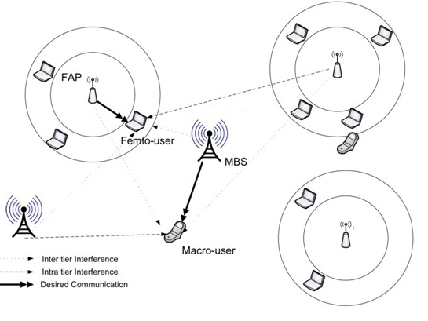
System Model
We consider the system which contains N FAPs (femtocell access point) and M FUEs (femtocell user equipments). Each FAP contains K subchannels.
Fig. Two-tier femtocell system model.

Slide 105
System Model
For FUE m, the Capacity of the kth subchannel of the nth FAP can be written as
Transmit Power
Channel Gain
Co-tier interference
Cross-tier interference
Notes:
Problems
FAPs are willing to give as many access permissions as possible to FUEs to earn money. Their access permission is determined by their channel capacity.
FUEs want to get best service so they prefer larger channel capacities.
Service providers want to give proper money to FAPs which can really help them offload the data in the macrocell base stations.
We try to use AGV mechanism to guarantee FAPs tell their true information so that FUEs can choose the best femtocells and maximize throughput of the whole system in the meantime.

Slide 106
System Model
Problems
  FAPs are willing to give as many access permissions as possible to FUEs to earn money. Their access permission is determined by their channel capacity.
  FUEs want to get best service so they prefer larger channel capacities.
  Service providers want to give proper money to FAPs which can really help them offload the data in the macrocell base stations.
  We try to use AGV mechanism to guarantee FAPs tell their true information so that FUEs can choose the best femtocells and maximize throughput of the whole system in the meantime.

Slide 107
Problem Formulation
Problem Analysis
  In reality, FAPs have more than one subchannels. However, when FUEs choose FAPs, they choose them only according to the total capacity of the FAPs and they don’t know other FUEs’ choices.
  FUE m only cares of FAP n, namely the total capacity. It doesn’t care specific subchannel capacity of FAP n.
  FAP i doesn’t know other FAPs capacity information but know they obey a certain probability density function defined as

Slide 108
AGV Game Preliminaries
AGV Mechanism
  An extension of the Groves mechanism (a kind of effective mechanism in auction theory).
  Can solve the truth-telling problem.
  Can achieve Bayesian Nash Equilibrium when all the FAPs reveal the truth.
  Can be budget balanced (i.e., the total transfer payment of all the FAPs equals to zero).

Slide 109
Game Setup
Algorithm based on AGV mechanism
  The payoff of FAP n to FUE m can be expressed as
  where means the possibility that FAP n is chosen by FUE m,
  is the price per unit of capacity.
  There is no balance because every FAP will report their capacity as large as possible.
  By using a transfer function (according to the AGV mechanism) to balance the payoff allocation, FAP n can gain its largest expected total payoff only when it reports its true channel information
Notes:
Assume that the FUE only choose the FAP with the highest total capacity and
is the realization of channel capacity.
report channel capacity which may not be true due to the incentive to cheat in order to get more utility from the operators.

Slide 110
Game Setup
Utility Function：
    The payoff of FAP n to FUE m can be expressed as
    Transfer payoff of FAP i to FUE m:
    Total payoff of FAP i to FUE m:

Slide 111
Algorithm Analysis
Truth-telling
  Consider the expected total payoff of FAP 1 chosen by FUE m:
  Any cheating leads to a decrease in the total payoff .
  can reach the maximum when FAP 1 reports the truth.
Budget Balance in AGV Mechanism
  The total transfer payoff:
  No extra costs require to be paid by the system.

Slide 112
Simulation Results
The transfer function are monotone decreasing because the larger the reported capacity is, the more transfer payoff they should be paid.
Given that the other FAPs are honest, FAP i could get its maximum total payoff when reporting the truth.
Notes:
Summary:
AGV mechanism can be used in access control problems and guarantee that each FAP report their true channel information, which is an important problem in hybrid or open access scenarios.
Simulation results verify that the FAPs have no incentive to report false information after adding the transfer payoff. Any cheat can cause a loss in its own expected total payoff.
We can solve access permission allocation problems to help FUEs find the best FAP to access and in the meantime we maximize throughput of the whole system.

Slide 113
Outline
Overview of Physical Layer Security
Information Theoretic Fundamentals
Signal Processing Technique
Resource Allocation Game Theoretical Study
Variety of Applications
  Cognitive Relay Network
  Two-Way Relay Network
  Femtocell Network
  RFID
  Satellite Network
Conclusion

Slide 114

RFID
Walid Saad, Zhu Han, and H. Vincent Poor, “On the Physical Layer Security of Backscatter RFID Systems,” invited, The Ninth International Symposium on Wireless Communication Systems, Paris, France, August 2012.

Slide 115





RFID Systems
A Radio Frequency Identification (RFID) system is composed of two key components
  RFID tag: electronic device that can store and transmit data to a reader in a contactless manner
  RFID reader: Transceiver that can read and communicate with RFID tags

Slide 116
RFID Systems
Three types of RFID tags
  Passive: cheapest – does not include any power source, harvests energy from the reader
  Semi-Passive: can include some basic sotrage elements as well as a possible small battery to power the circuitry (but not for TX)
  Active: has transmission capabilities – basically a small sensor
Two main technologies
  Near-field communication (NFC): operate at very short distances, e.g., few centimeters, over HF frequencies (i.e., 13.56 MHz).
  Ultra high frequency (UHF) RFIDs: operate at UHF frequencies (typically 433 MHz), can be used at longer ranges (10 meters is common but recent research is looking at larger distances)

Slide 117

RFID Applications

Slide 118


Basic RFID Communication
Interrogate and Power Tag
Responds with data, by modulating the CW
Reader transmits a continuous wave (CW) carrier signal
  Induces an RF voltage across the tag antenna that is converted to DC by a power harvesting circuit to power the tag’s circuitry and demodulate the received command
Tag transmits back its stored information by controlling the amount of backscatter of the impinging downlink signal by varying the impedance (mis)-match of the antenna front-end
  Role of the reader in energizing the tag

Slide 119
RFID Backscatter: Challenges
Tags must remain cheap and passive tags must harvest energy
  Limitations on circuit design.
  Design of innovative RFIDs is a key challenge.
The uplink tag-to-reader communication has a strictly limited bandwidth due to limited backscatter power and tag collisions
  How to improve the uplink communication?
  Crucial to allow higher distances, better rate, and new applications!
Security is probably the most critical issue
  Fact: Classical cryptography cannot be implemented on RFID tags
  Current solutions (lightweight cryptography) are non-scalable and still present many vulnerabilities
  Big motivation for security solutions that can be implemented with little complexity => Physical layer security!

Slide 120

Presence of Eavesdroppers
A nearby eavesdropper can tap into the communication
Classical cryptography cannot be implemented on RFID tags
  PHY security in RFID: research frontier, no works done yet!
Backscatter features
  Eavesdropping is useful at close distances
  Eavesdroppers are mainly interested in the uplink signal/tag data
  The downlink reader-tag signal is also received by the eavesdropper during backscatter
Tag
Responds
with data/ID
Interrogate
and power
Tag
Passive tag
requires
the reader’s
continuous
wave to power up!

Slide 121
Outline
Overview of Physical Layer Security
Information Theoretic Fundamentals
Signal Processing Technique
Resource Allocation Game Theoretical Study
Variety of Applications
  Cognitive Relay Network
  Two-Way Relay Network
  Femtocell Network
  RFID
  Satellite Network
Conclusion

Slide 122

Satellite Network
Jiang Lei, Zhu Han, M. A. Vazquez-Castro, and Are Hjorungnes, “Multibeam Satellite Power Control and Beamforming with Individual Secrecy Rate Constraints,” IEEE Transactions on Information Forensics and Security, Special Issue on Using the Physical Layer for Securing the Next Generation of Communication Systems, vol. 6, no. 4, pp.661-671, Sept. 2011.

Slide 123
Matrix Model of Satellite Broadcast Channel
The signals received by the kth user can be expressed as desired signal and interference as
The signal received by the eavesdropper is given as
  1. How to realize security communication between satellite and legal users by beams cooperation?
  2. A novel power control problem is studied taking into account both the co-channel interference and the eavesdropping interference.
  3. Minimize the total power consumption subject to the individual target secrecy rate.

Slide 124
Selected Results
Number of antenna elements Vs. Power consumption

Slide 125

Selected Results
Power allocation with or without the available the eavesdropper CSI
  Under the given total power limitation (e.g., 100 Watts), the achieved secrecy SINR per user with known eavesdropper’s CSI performs about 2 dB better than the case of no CSI available. In addition, this gap increases as the available total power increases.

Slide 126

Selected Results
Total transmitted power comparison for the DVB-S2 air-interface and Gaussian inputs
  For the case of the joint beamforming scheme, the sum of power consumption increases as the spectral efficiency requirement increases for both Gaussian inputs and DVB-S2 cases. The power consumption of the DVB-S2 case is always larger than the Gaussian inputs case, and the gap between them tends to decrease as the spectral efficiency increases.

Slide 127
Conclusions
Wireless physical layer security is an alternative.
Collaborative beamforming and jamming can improve secrecy performance.
Game theory is a useful tool to allocate the system resources, e.g., transmit power, for security enhancement.
  Coalition game: Collaborative beamforming;
  Stakelberg game and Auction: Cooperative (Friendly) jamming;
  Cross-layer optimization can further improve performance: subcarrier, space, and power
Resource allocation perspective
  Variety of applications such as cognitive radio, femtocell, relaying networks, the security problem can be leveraged by properly allocating the system resources.
  http://wireless.egr.uh.edu/research.htm

Slide 128

Questions?
Thank you very much
Notes:
Thank you very much and any questions?

