Slide 1

Ph.D. Dissertation Defense
Detecting Cyber-attacks to Smart Grids and Increasing Resiliency Using Data Driven Algorithms
PhD student: Saeed Ahmadian
Advisors: Dr. Zhu Han and Dr. Heidar Malki
Department of Electrical Engineering
University of Houston
Summer. 2020
Notes:
1. Thank you dear committee members
2. Special Thanks to Dr Zhu Han and Dr Malki for supporting me
3. Today I am going to present my proposal about 1. detection 2. mitigation

Slide 2
Presentation Outline
Introduction to smart grids and cyber-security
  Smart grids
  Electricity market
  Cyber security
Contribution 1: Detection of the cyber-attacks to smart grids using optimization
Contribution 2: Detection of the cyber-attacks to smart grids machine learning
Contribution 3: Cyber-attack mitigation
Future work
Conclusion
Notes:
Presentation introduction : Markets and How the cyber attacks are related.

Slide 3
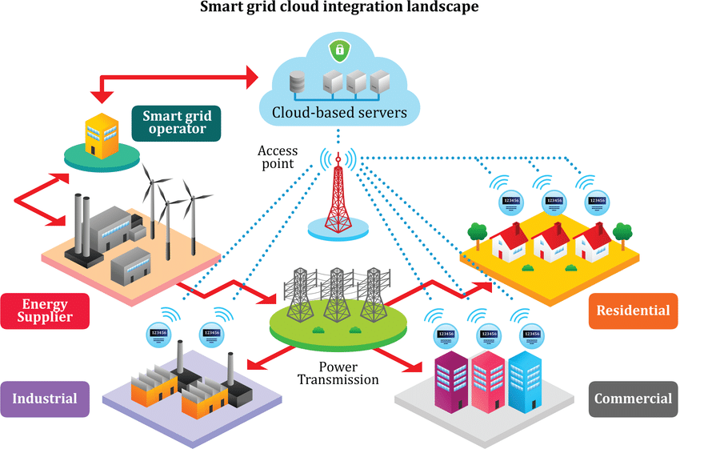
Introduction to smart grids
1. Smart Grids
Cloud Computing
Data Collection
Measurements
Demand
Distributed Generators
System Operator

Slide 4
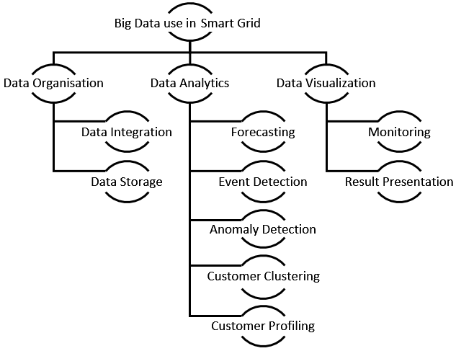
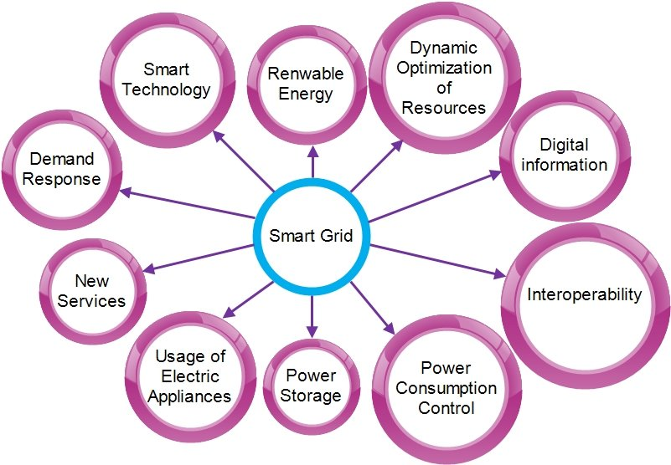
Introduction to smart grids
1. Smart Grids
It is all about data!
Technologies

Slide 5
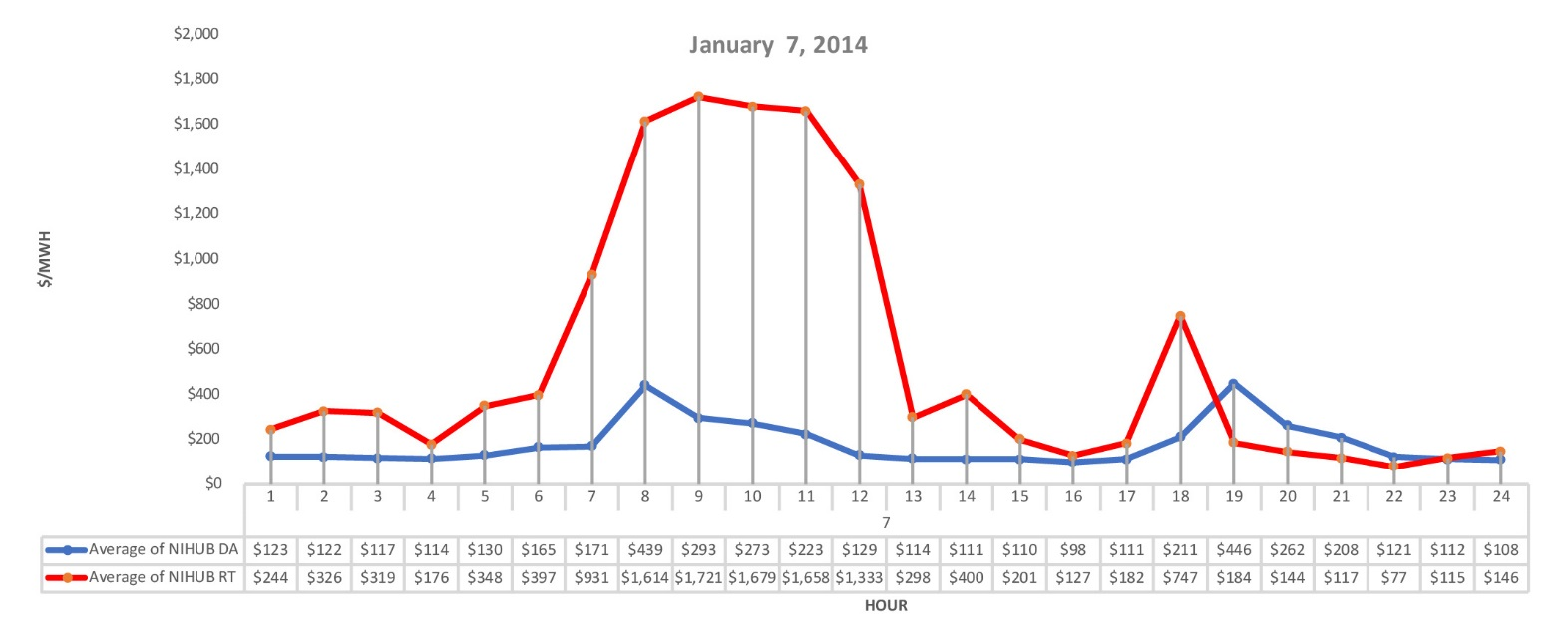

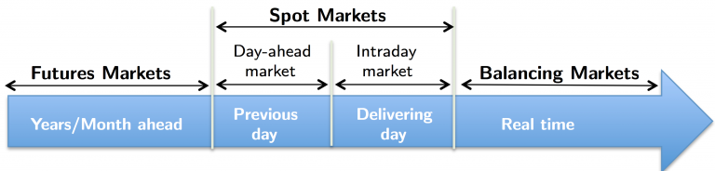
Introduction to smart grids
2. Electricity markets
Day-Ahead (DA) electricity markets
  Predictions
  Errors
Real-Time (RT) electricity markets
  Balancing market
Day-Ahead vs Real-Time electricity prices
Different players
System operator
Generation
Transmission system
Market management
Distribution system
  Smart grid operator
  Customer
  Distributed energy resources
  Retailers
Today
Tomorrow

Slide 6

Introduction
2. Electricity markets
Bidding Problem In Electricity Markets
1. offers
Different players offer their bids (buy/sell)
  Estimating demand, other players’ bids.
2. Clear Market
System operator (SO) runs Market Optimization problem (Clear market)
  Specify price, demand and generation.
Everything is OK?
Cyber attacker
Manipulate the outcome of the market by injecting false data
Notes:
Different players in the market offer their bids
SO clears the market
What if one of the player has the knowledge about the output prices in the market in advance
The idea is that if I know what are the best outcomes of the market for me, then can I manipulate the measurements so that the disred outcome happens?

Slide 7

Introduction to smart grids
3. Cyber-attacks
Intrusion Points
-DOS
-TSA
-MITM
-FDI
…
Notes:
Different kinds of electricity markets in terms of times.
Main focus of our research is about DA and RT

Slide 8
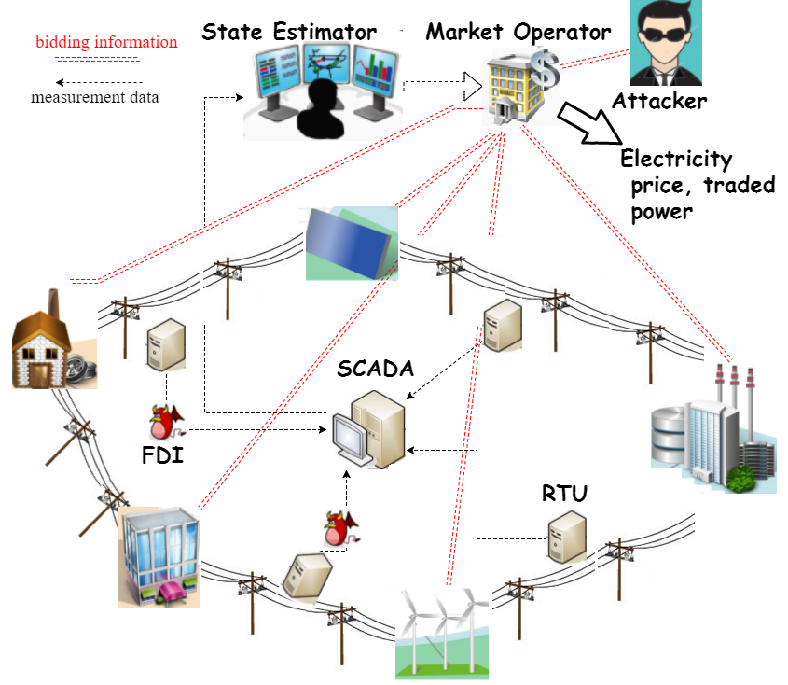
Introduction to smart grids Resiliency
3. Cyber-attacks
Attacker actions (False Data Injection):
  Manipulating the Remote Terminal Units (RTUs)/Phasor Measurement Units (PMUs) signals
Attacker goals:
  Monetary: Maximize its revenue from participation in electricity markets
  Non-monetary: Disrupt the operation of grid (Loss of energy)
Notes:
Different kinds of electricity markets in terms of times.
Main focus of our research is about DA and RT

Slide 9
Introduction
3. Cyber-security of smart grids (False Data Injection)
Different types of FDIs
Hardware attacks:
  Physical access to Intelligent Electronic Devices (IEDs) inside the smart substations
  Electromagnetic interference (EI)
  Stealing the encryption key of IED
Firmware attacks:
  Corruption of firmware update
  Boot-loading attacks
Software attacks:
  Cyber attacks toward payload memories
  Cyber-attacks via Human Machine Interface (HMI) software
Communication attacks:
  Scanning attacks toward TCP/IP open ports
  Black hole attacks to drop data packages
Notes:
Physical access to IEDs, EI inference, scanning open ports, payload memories (Stuxnet)

Slide 10
Presentation Outline
Introduction to smart grids and cyber-security
  Smart grids
  Electricity market
  Cyber security
Contribution 1: Detection of cyber-attacks to smart grids using optimization
Contribution 2: Detection of cyber-attacks to smart grids machine learning
Contribution 3: Cyber-attack mitigation
Future work
Conclusion
Notes:
Presentation introduction : Markets and How the cyber attacks are related.

Slide 11

Detection of Cyber-attacks using Optimization
1. Problem statement
1. Intrusion points
2. FDI values
Notes:
Assume the attacker participate in DA and RT markets.
To solve the optimal bid every players can consider a bi-level optimization
For the attacker→ the question is to how to obtain the relation between the optimal bidding and False data injected into the system

Slide 12
Detection of Cyber-attacks using Optimization
1. Problem statement
Proposed Methods
Bi-level attack model
  The upper level consists of the attacker’s objective function and the being undetected related constraints.
  The lower level contains power flow equations in the DA and RT market.
Intera-correlation between the DA and RT market
  Relation between the DA and RT electricity prices
  How the attacker can alter them by manipulating measurement devices?
  MPEC implementation of model
Notes:
Assume the attacker participate in DA and RT markets.
To solve the optimal bid every players can consider a bi-level optimization
For the attacker→ the question is to how to obtain the relation between the optimal bidding and False data injected into the system

Slide 13
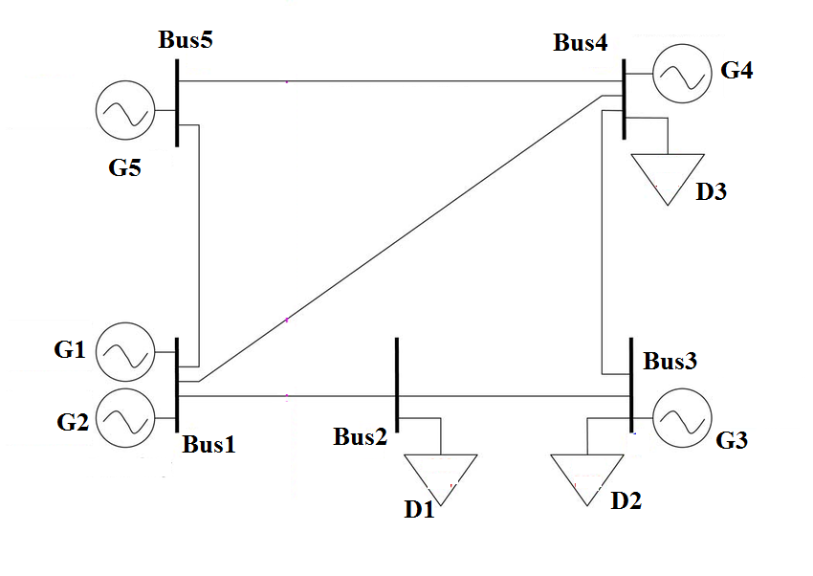














Detection of Cyber-attacks using Optimization
2. Day-ahead and real-time markets formulation
Day-Ahead electricity markets
DA price
Phase angle
System cost
$$θ_{5}$$
$$θ_{4}$$
$$X_{54}$$
$$λ_{4t}^{}$$
Load and generation balance
$$λ_{5t}^{}$$
Line limits
$$X_{34}$$
$$θ_{1}$$
$$θ_{2}$$
$$θ_{3}$$
Generation limits
$$X_{12}$$
$$X_{23}$$
load limits
$$λ_{1t}^{}$$
$$λ_{2t}^{}$$
$$λ_{3t}^{}$$
Phase angle limits

Slide 14







Detection of Cyber-attacks using Optimization
2. Day-ahead and real-time markets formulation
RT prices
Real-Time electricity markets
Demand change
Generator change
RT balance cost
$$∆p_{5}$$
$$λ_{4t}^{′}$$
$$λ_{5t}^{′}$$
Load and generation balance
$$∆d_{3}$$
Generation incremental limits
$$λ_{1t}^{′}$$
$$∆p_{3}$$
Load incremental limits
Line limit
$$∆d_{1}$$

Slide 15
Detection of Cyber-attacks using Optimization
3. Attacker optimization problems
  Attacker as participant in DA and RT markets (Lower level)
DA Market formulation
RT Market formulation
SO constraints in DA market
SO constraints in DA market
SO goal in DA market
SO goal in RT market
Notes:
This is the lower level of the problem that is actually solved by SO.
but if any participant want to simulate the market transactions, then it needs to consider these two optimization problem.

Slide 16


Detection of Cyber-attacks using Optimization
3. Attacker optimization problems
Proposed attack method (upper level)
Attacker decision variable to attack over transmission lines RTUs
Case 1: The $m^{th}$ RTU is not compromised
Case 2: The $m^{th}$ RTU is compromised
Notes:
In the upper level problem it is assumed that decision variables are whether manipulate the mth RTU or not
If not the line flow would be case1 and if yes the line flow would be case2

Slide 17
Detection of Cyber-attacks using Optimization
3. Attacker optimization problems
Electricity market participants in general vs. attacker:
Attack signal
Participant profit
Estate estimation constraint
Number of compromised meters
power transactions in DA and RT market
DA and RT constraints
Notes:
The raw bi-level optimization problem, is bi-level optimization the upper-level is the profit and the lower level is the SO market

Slide 18
Detection of Cyber-attacks using Optimization
3. Attacker optimization problems
Modelling
  Lagrangian multipliers for the DA optimization problem
  Lagrangian multipliers for the RT optimization problem
  Lagrangian function of the lower level problem
Notes:
To turn the problem into single level problem we used the Lagrangian function of the lower level problem. KKT conditions and dual problem of the lower level.

Slide 19
Detection of Cyber-attacks using Optimization
3. Attacker optimization problems
Problem formulation:
Intera-correlation between DA and RT prices
The attacker decision variables
Notes:
The final Optimization problem is as follows including two parts,
First part is the DA and RT market constraints and also KKT conditions of DA and RT.
Second is the choice between attacking toward m the line measurements or not.

Slide 20
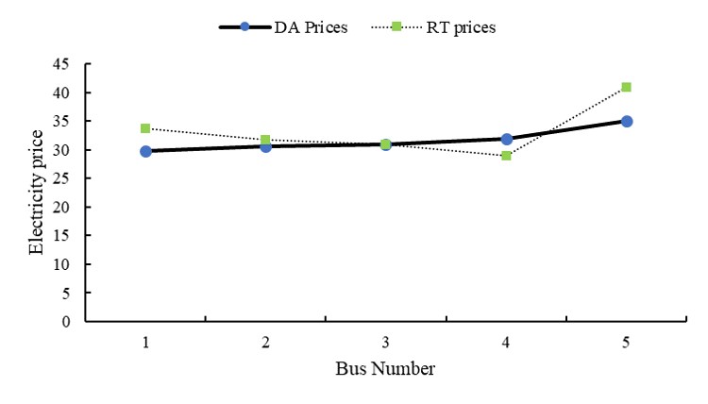
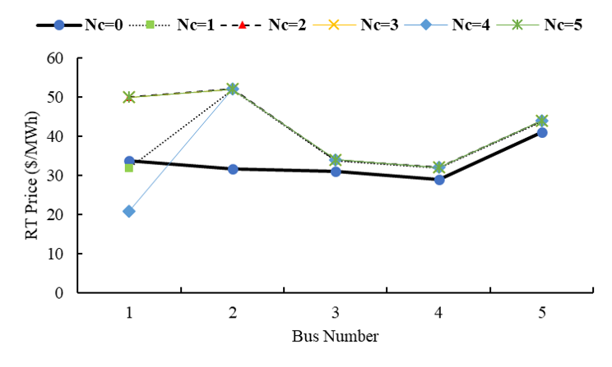
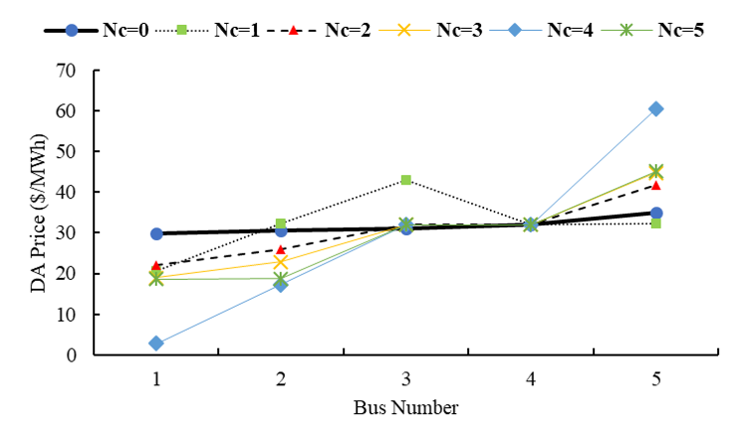
Detection of Cyber-attacks using Optimization
4. Simulation and results
Results
Base Case (No attack):
Results
Attacking to RTUs (DA and RT prices for different scenarios)
5 Bus PJM
Traded Power in market
Electricity prices
RT Electricity prices
DA Electricity prices
Notes:
5 bus PJM network is considered as sample case but loading and generation were modified accordingly.
Decrease the price on one bus on the DA and increase the price on the RT market (Bus 1 and 2)
Increase the price on the DA on bus 5 and decrease real-time price.

Slide 21
Detection of Cyber-attacks using Optimization
4. Simulation and results
Results
Attacking to RTUs (the attacker priority to attack RTUs)
Notes:
Generally it can be said that for buses

Slide 22
Detection of Cyber-attacks using Optimization
5. Summary for contribution 1
The attacker optimization problem (cons and pros)
Directly solves the cyber-attack problem
Needs to estimate many parameters (network parameters, other participants proposed offers).
Residual constraint makes the optimization problem hard to solve.
Any solution?
→ Using data-based approaches (indirect approaches)
→ Deep learning methods

Slide 23
Presentation Outline
Introduction to smart grids and cyber-security
  Smart grids
  Electricity market
  Cyber security
Contribution 1: Detection of cyber-attacks to smart grids using optimization
Contribution 2: Detection of cyber-attacks to smart grids machine learning
Contribution 3: Cyber-attack mitigation
Future work
Conclusion
Notes:
Presentation introduction : Markets and How the cyber attacks are related.

Slide 24

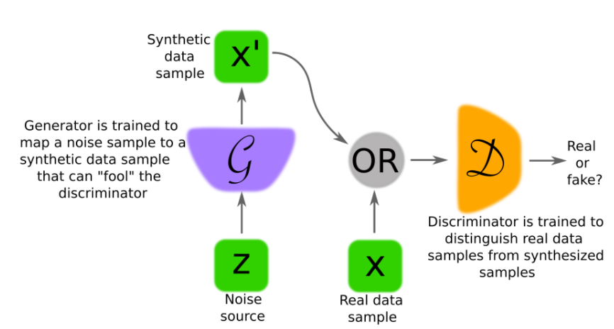
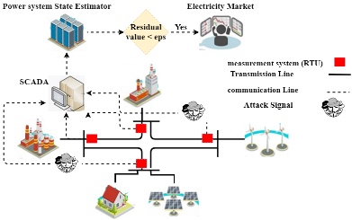
Detection of Cyber-attacks using Machine Learning
1. Zero-sum game
Two parties in competition:
System operator (system defender)
  Detect attacks
Attacker
  Being anonymous
Discriminator (system defender)
Generator (attacker)
→Zero-sum game
→ Generative Adversarial Network (GAN)
Notes:
Game theory perspective. Generally speaking each part tries to maximize its profit

Slide 25
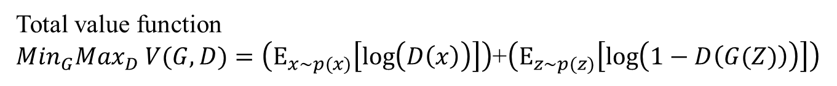


Detection of Cyber-attacks using Machine Learning
2. GAN formulation
Assumptions
  X is input data
Min-max optimization problem (zero-sum game)
Pg(X) : Generation distribution over data X
Pz(Z) : Input noise distribution
PD(X) : Discriminative distribution over data X
Pdata(X) : Real data distribution over data X
G: Generative function ➔ $Z\underset{→}{ }G(Z;θ_{G})$
D: Discriminative function ➔ $X\underset{→}{ }D(X;θ_{D})$
D objective ➔ $Max \log{(D(X))}$
G objective➔ $Min \log{(1−D(G(z))) }$
Total value function
${Min}_{G}{Max}_{D} V(G,D)=\left(Ε_{x\sim p(x)}\left[\log\left(D\left(x\right)\right)\right]\right)$+$\left(Ε_{z\sim p(z)}\left[\log\left(1−D\left(G(Z)\right)\right)\right]\right)$

Slide 26
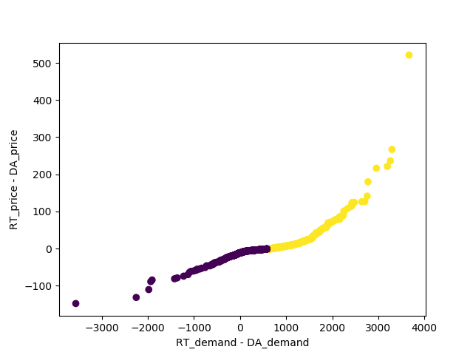
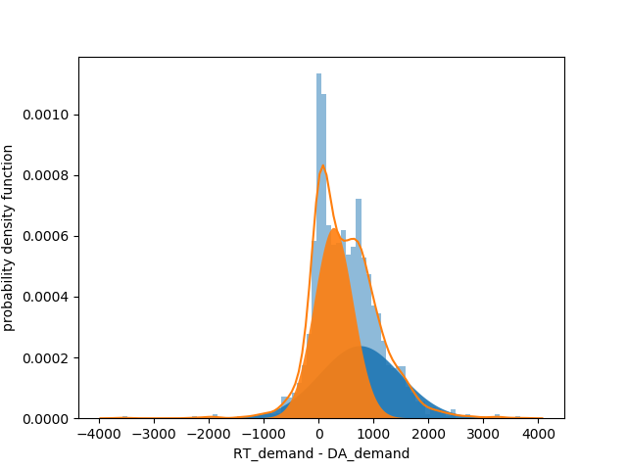
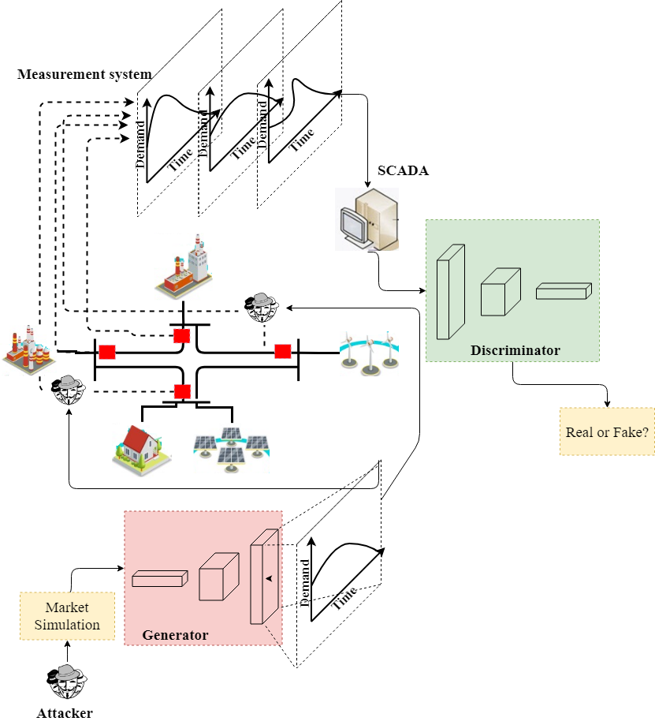

Detection of Cyber-attacks using Machine Learning
3. Proposed Method (first step)
  Proposed cyber-security model
Manipulating the RTUs data to change the RT prices.
  Attacker optimization problem
  $$max {Ε\left\|λ_{n}^{RT}\right\|}_{2}^{2}$$
  $$s.t.$$
  $${\left\|r\right\|}_{2}^{}≤ε$$
Zero-sum cyber-security
Data Analysis
Combined data
Desired demand
Min-Max game between GN and DN
Regular demand
Regular demand
Desired demand
Attacker goal
Notes:
1. Simply speaking if we consider the DA price constant, then the aim of the attacker is to inject false data (here we consider fake demand signal) to maximize the real-time price fluctuations subject to residual value.
2. The advantage of the machine learning is that the attacker doesn’t need to actually solve the lower level optimization it only needs to use the online information and sort the real-time prices based on real time demands.

Slide 27
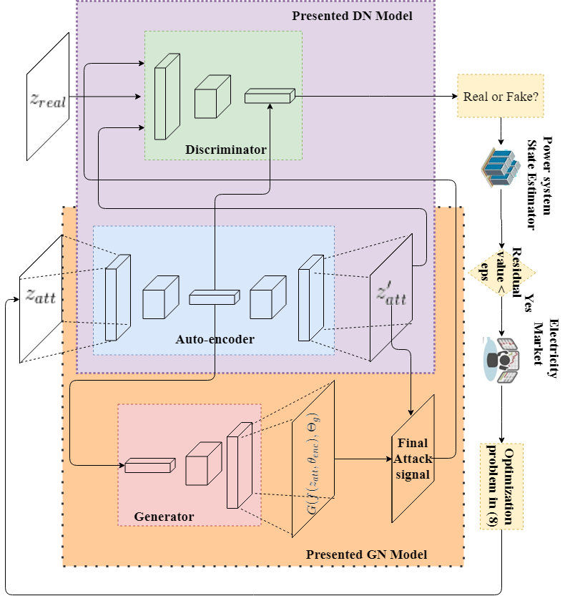
Detection of Cyber-attacks using Machine Learning
3. Proposed Method (second step)
Proposed cyber-attack model
  Auto-encoder objective function
  Discriminator objective function
  Generator objective function
Notes:
So generator mimics the real or regular data,
Auto-encoder mimics the desired date,
Discriminator plays with more powerful rival,

Slide 28
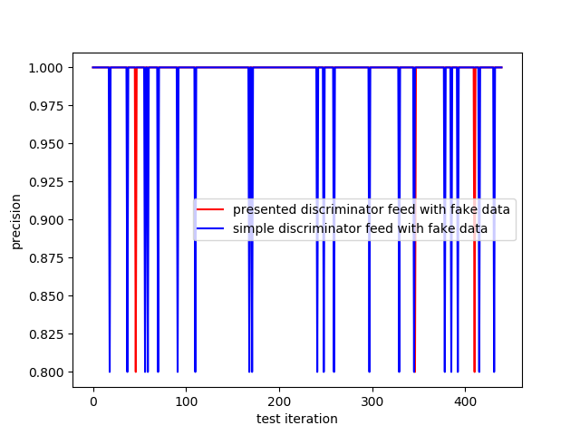
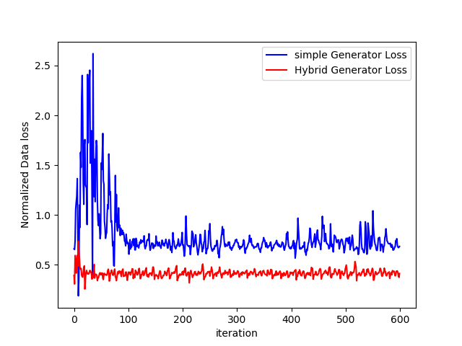
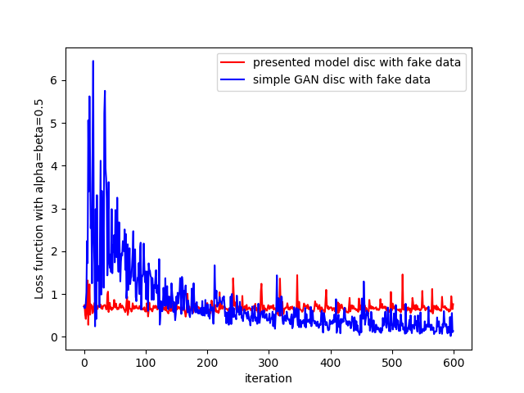
Detection of Cyber-attacks using Machine Learning
4. Simulation and results
Discriminators' loss function comparison
Discriminators' precisions comparison
Generators' loss function comparison
Step by Step procedure
For k=1: Max epoch
Mini batches for real data and desired data
For j=1: N
Update Auto encoder parameters
Update discriminator parameters
End inner loop
Update generator parameters
End outer loop

Slide 29
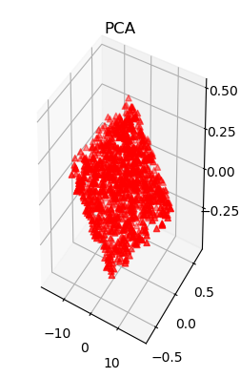
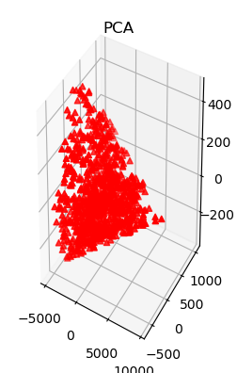
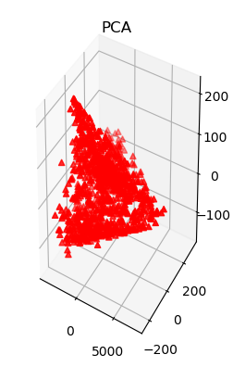
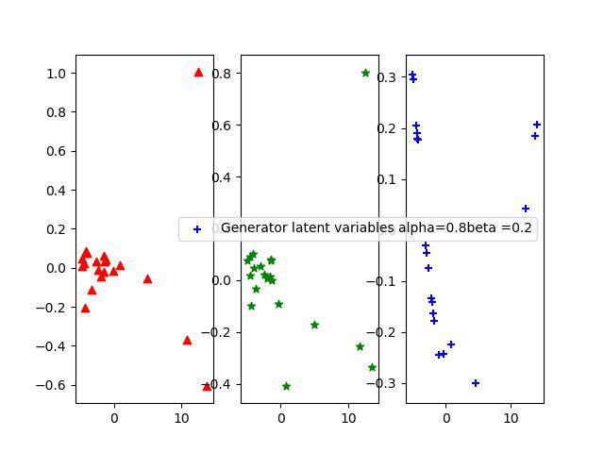
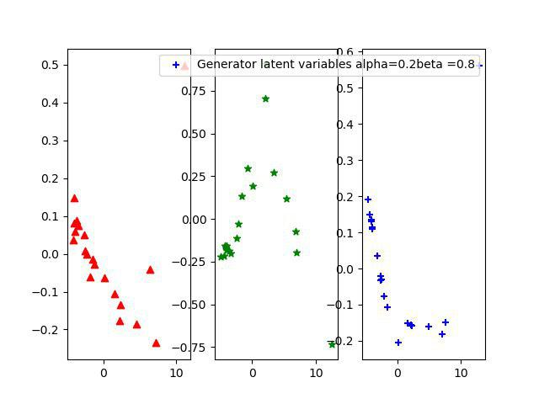
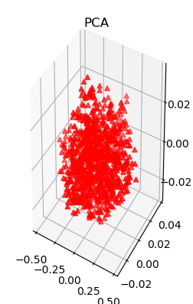
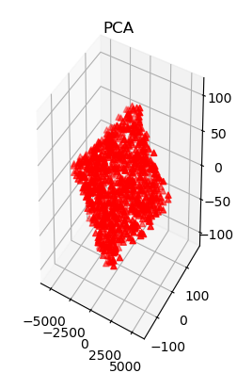
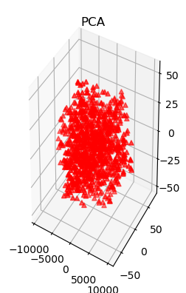



Detection of Cyber-attacks using Machine Learning
4. Simulation and results
PCA analysis for presented GAN and simple GAN outputs
PCA for different $α$ and $β$
Beginning of training
Middle of training
End of training
$α$= 0.8, $β$= .2
$α$= 0.2, $β$= .8
Presented GAN
Simple GAN
Generator
Desired
Regular
Generator
Desired
Regular

Slide 30
Presentation Outline
Introduction to smart grids and cyber-security
  Smart grids
  Electricity market
  Cyber security
Contribution 1: Detection of cyber-attacks to smart grids using optimization
Contribution 2: Detection of cyber-attacks to smart grids machine learning
Contribution 3: Cyber-attack mitigation
Future work
Conclusion
Notes:
Presentation introduction : Markets and How the cyber attacks are related.

Slide 31
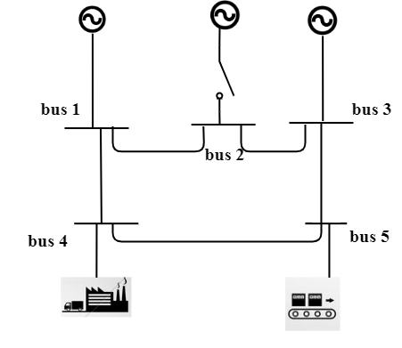

Cyber-attack Mitigation
1. Problem Statement
System reliability
  Keep frequency
  Keep voltage
Actions:
Redispatch generators
Load shedding
System reconfiguration
Notes:
Different kinds of electricity markets in terms of times.
Main focus of our research is about DA and RT

Slide 32
Cyber-attack Mitigation
2. Single-stage mitigation
Post Attack network
Objective of system Defender
  Maximize the free capacity
  Consider Constraints
Free cap : 3*
Load shedding
Free cap : 6*

Slide 33
Cyber-attack Mitigation
2. Multi-stage mitigation
First Stage
Post Attack network
Second Stage
Free cap : 0*
Free cap : 3*
Possible attack scenarios
Possible attack scenarios
Reconfiguration
Load shedding
Free cap : 2*
Free cap : 6*

Slide 34
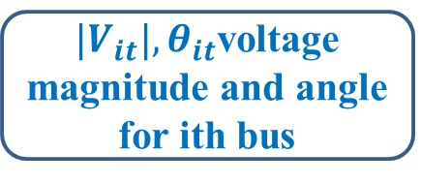
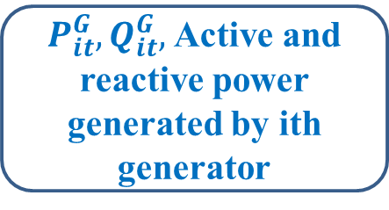
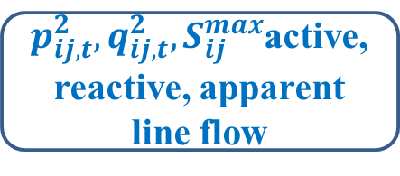
Cyber-attack Mitigation
3. Mathematical formulation
Objective function
System Capacity
$p_{ij,t}^{2},q_{ij,t}^{2},S_{ij}^{max}$active, reactive, apparent line flow
Capacity limit
Line flow balance
${|V}_{it}|,θ_{it}$voltage magnitude and angle for ith bus
$P_{it}^{G},Q_{it}^{G},$Active and reactive power generated by ith generator
Nodal power balance

Slide 35
Cyber-attack Mitigation
3. Mathematical formulation
Generator Limits
Active and reactive power limits
Ramp-up and ramp-down limits
Ramp limit
Voltage limit
Phase and magnitude
Line limit
Thermal limit
Over-current limits

Slide 36
Cyber-attack Mitigation
4. Single-stage RL
What are the current solutions?
Non-convex optimization methods.
Benders decompositions.
Alternating direction method of multipliers (ADMMs).
Solutions?
Challenges:
Needs to run all aforementioned-equations for each scenario
Computation burden with network growth (smart grids are expanding fast).
No memory in learning.
Weakness in distributed learning (poor performance on GPUs).
More computation in terms of uncertainties.

Slide 37
Cyber-attack Mitigation
4. Single-stage RL
Immediate Reward
Actions-Set
States-Set
Environment Model

Slide 38
Cyber-attack Mitigation
4. Multi-stage RL
Model free environment
Uncertainty in next state

Slide 39
Cyber-attack Mitigation
4. Multi-stage RL
Attacker Perspective (Hamiltonian Markov Chain )
Bayesian Equation
How to obtain posterior?
Hamiltonian Markov chain
Likelihood
Attack prior distribution
Posterior distribution of the attack’s location
Smart grids states and system defender

Slide 40


Cyber-attack Mitigation
4. Multi-stage game with RL
Hamiltonian Dynamics
To find the x and m we need gradient of U and K as below;
To find the object properties at t=T, starting from $t_{0}$, we use leap frog as below ($γ=\frac{T−t_{0}}{n}$);
Hamiltonian Dynamics
Hamiltonian Dynamics
Considering x as $S_{t}^{att}$, it can be written;
$$H\left(S_{t}^{att},m\right)=−\log{P\left(S_{t}^{att},m\right)}$$
Considering$P\left(S_{t}^{att},m\right)=p(m|S_{t}^{att})×P(S_{t}^{att})$;
$$H\left(S_{t}^{att},m\right)=−\log{P\left(m|S_{t}^{att}\right)−\log{P(S_{t}^{att})}}$$
Therefore;
$U\left(x\right)=−\log{P(S_{t}^{att})}$ and $K\left(m\right)=−\log{P(m|S_{t}^{att})}$

Slide 41
Cyber-attack Mitigation
4. Multi-stage game with RL
Attacker’s move
Specify set of possible elements
Run H-MCMC
Find attack’s posteriors
Run sampling
Apply SoftMax

Slide 42
Cyber-attack Mitigation
4. Multi-stage game with RL (two-stage example)
Defender’s move
Run RL algorithm
Obtain A and Q
Apply action
Update environment
Feed the results for next attack
Defender’s move
Apply attack
Run environment to obtain states
Run H-MCMC
Specify possible scenarios
Calculate transition probabilities

Slide 43
Cyber-attack Mitigation
5. DDPG Structure (critic)
Two deep network
Original critic Network
Target critic network
Optimal Q
Q value
Total Loss function
Actor outputs ➔ action

Slide 44
Cyber-attack Mitigation
5. DDPG (actor)
Two deep network
Original Actor Network
Target Actor network
Maximize Q value
Target network

Slide 45
Cyber-attack Mitigation
6. Simulation and results
Best reward function
Immediate reward
Critic Loss
Actor Objective

Slide 46
Cyber-attack Mitigation
6. Simulation and results
Attack Scenario
Attack to line between buses 17 and 16 at t=1
Overloads on line between bus 15-16, 14-16 and 21-15
Redispatch generators 1,2 and 3.
Other Scenarios

Slide 47
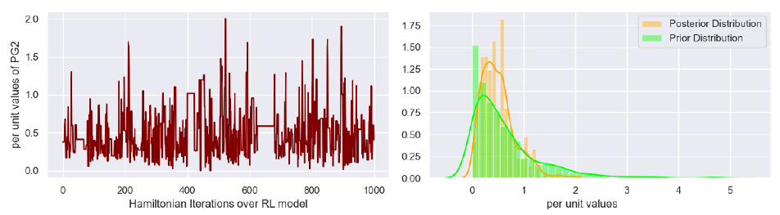
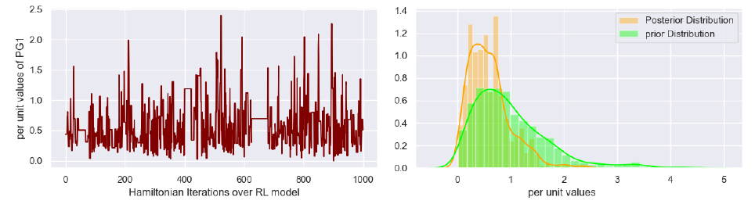
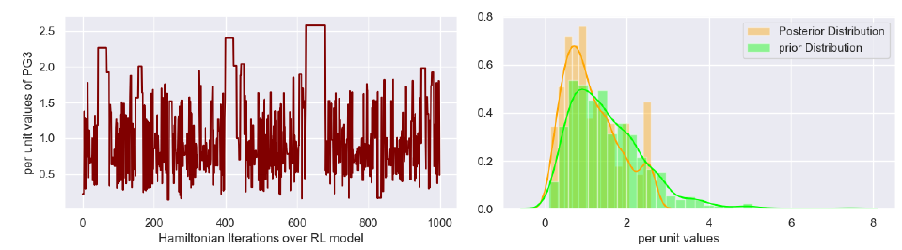
Cyber-attack Mitigation
6. Simulation and results
Actions’ prior and posterior distributions using DDPG
Active power for generator 2
Active power for generator 3
Active power for generator 1

Slide 48
Presentation Outline
Introduction to smart grids and cyber-security
  Smart grids
  Electricity market
  Cyber security
Contribution 1: Detection of cyber-attacks to smart grids using optimization
Contribution 2: Detection of cyber-attacks to smart grids machine learning
Contribution 3: Cyber-attack mitigation
Future work
Conclusion
Notes:
Presentation introduction : Markets and How the cyber attacks are related.

Slide 49
Future Work
Cyber-attack detection
  Improve detection methods by increasing the detection networks’ sensitivity to fake signal generated by the attacker.
  Combination of style transfer learning, Variational Auto-encoders and GANs can make powerful cyber-attacker.
  Bayesian Inference networks and Hidden Markov chains are the other way to mimic both the attacker and system defender in FDI context.
Cyber-attack mitigation
  Formulate self-healing problem in cyber-attack mitigation.
  Using Sequential networks and combination of them with RL methods.

Slide 50
Conclusion and Contribution
Optimization methods to detect cyber-attacks
  Find the weak points
  Find the possible FDI value
Machine learning methods to detect cyber-attacks
  Using GAN to model the zero-sum game between the attacker and system defender.
  Using Auto-encoder to increase power of detection.
Reinforcement learning approach to mitigate the cyber-attacks
  Single stage modeling of attack-mitigation
  Multi-stage modeling of attack-mitigation

Slide 51
List of publications
Saeed Ahmadian, Heidar Malki, Amin R Sadat, “Modeling time of use pricing for load aggregators using new mathematical programming with equality constraints”, IEEE, 2018 5th International Conference on Control, Decision and Information Technologies (CoDIT), pp 38-44. Apr. 2018.
Saeed Ahmadian, Heidar Malki, Zhu Han “Cyber Attacks on Smart Energy Grids Using Generative Adverserial Networks”, 2018 IEEE Global Conference on Signal and Information Processing (GlobalSIP), pp. 942-946, Nov 2018.
S Ahmadian, H Tang, Xiao, Malki, Z Han, “Modeling time of use pricing for load aggregators using new mathematical programming with equality constraints”, IEEE Access, Vol. 7, Feb 2019.
Saeed Ahmadian, Saba Ebrahimi, Ehsan Ghotbi, “Wind Farm Layout Optimization Problem Using Joint Probability Distribution of CVaR Analysis”, 2019 IEEE 9th Annual Computing and Communication Workshop and Conference, pp. 7-12, Jan 2019.
Saeed Ahmadian, Heidar Malki, and Zhu Han, “Detection of False Data Injection Attacks on Smart Grid Using Hybrid Generative Adversarial Networks with Auto-Encoders”, IEEE Transactions on Systems, Man, and Cybernetics: Systems, ready to publish.
Saeed Ahmadian, Heidar Malki, and Zhu Han, “Multi-Stage Dynamic Cyber-Attack Mitigation to Increase Smart Grid Resiliency Using Stochastic Deep Policy Gradient Reinforcement Learning”, IEEE Transactions on Reliability, submitted.

Slide 52

Thanks

Slide 53
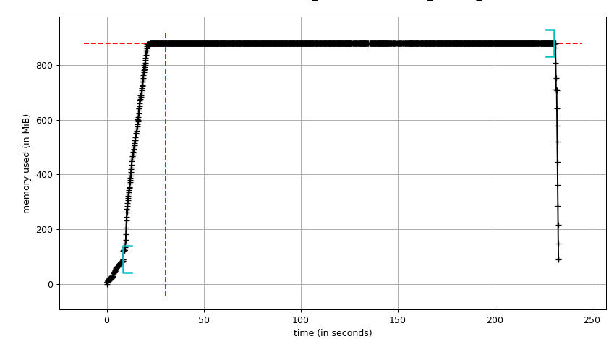
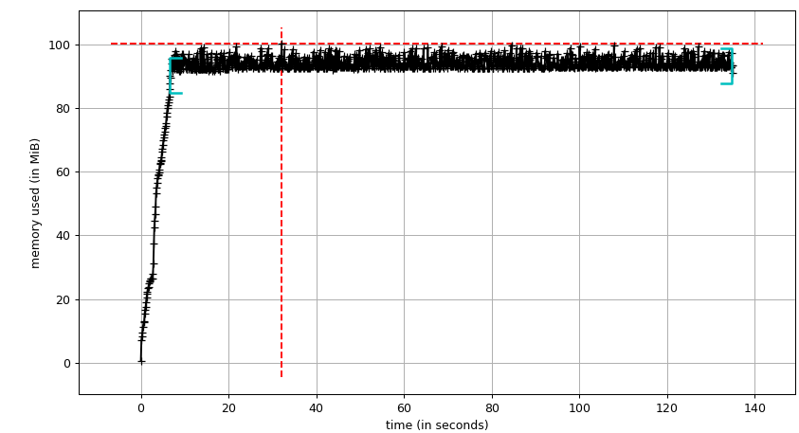
Cyber-attack Mitigation
6. Simulation and results
Memory Performance of the DDPG and non-linear optimization methods
Non-linear Optimization
DDPG

Slide 54
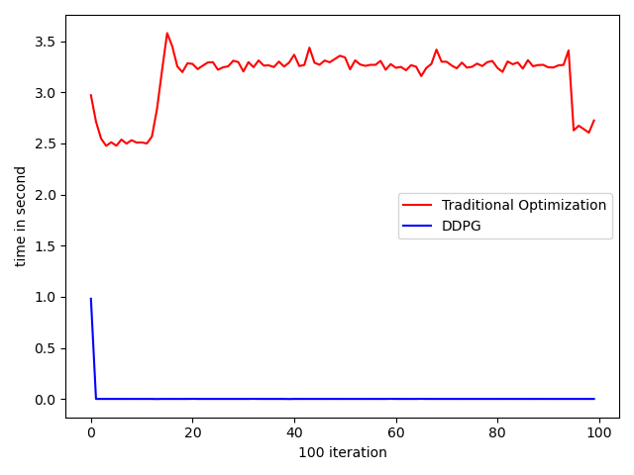
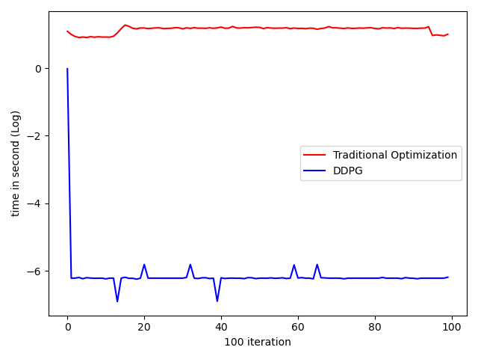
Cyber-attack Mitigation
6. Simulation and results
Time Performance of the DDPG and non-linear optimization methods

