Slide 1
Secure Computing with Privacy Preservation for Cyber-Physical Systems
Zhu Han
John and Rebecca Moores Professor
IEEE Fellow and AAAS Fellow
University of Houston
Ph.D. work of Prof. Sai Mounika Errapotu, Prof. Jingyi Wang, and Mr. Jiahao Ding
Thanks to Prof. Miao Pan and NSF

Slide 2
Outline
Introduction of Cyber Physical Systems
Security Computing and Privacy Preservation for CPS
  Clock Auction for Emergency Demand Response in Colocation Data Centers
  Cost Aware Appliance Scheduling Using Fog Computing in Smart Home
  Differentially Private Optimization for Machine Learning for Physiological Sensors
Conclusion
Our Lab Overview

Slide 3
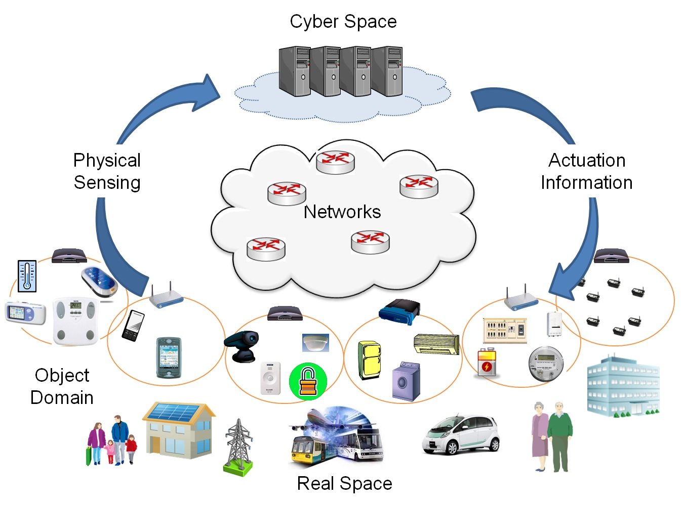
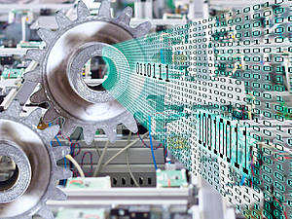
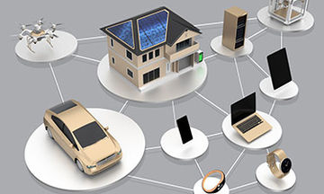

Cyber Physical Systems
“Cyber-physical systems (CPS) are engineered systems that are built from, and depend upon, the seamless integration of computational algorithms and physical components” - NSF
Notes:
Software and physical components are increasingly integrated into network systems—so-called "Cyber-Physical Systems" (CPS)—for solving problems

Slide 4
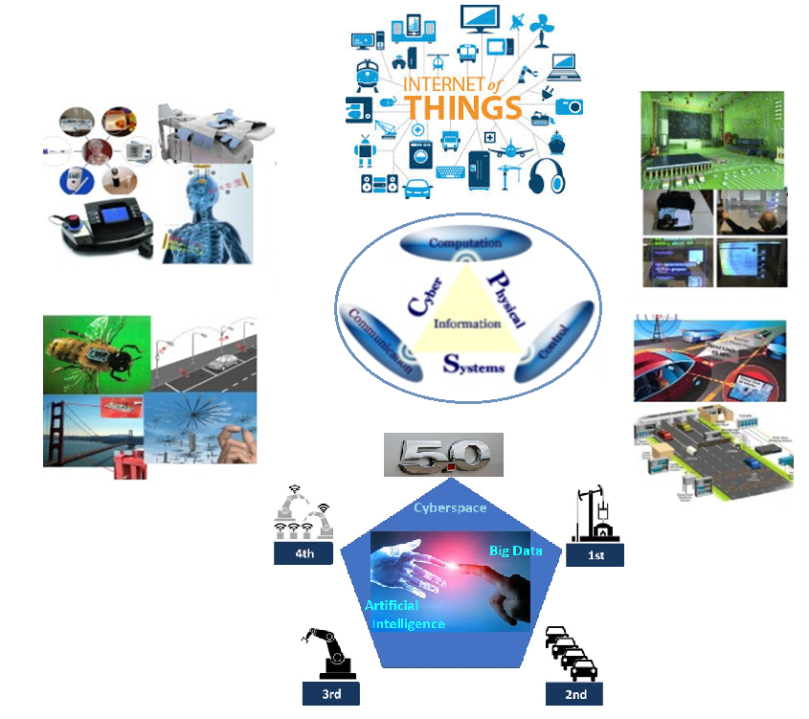

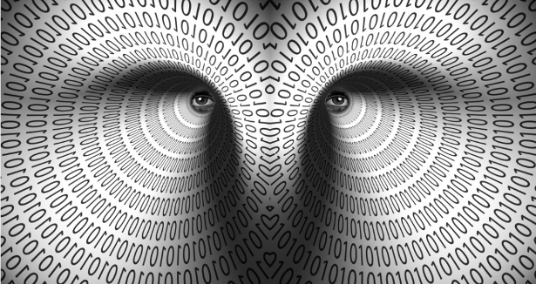
Security and Privacy in CPS
IoT
Medical
Smart spaces
Sensors
Transportation
Industry 5.0
Notes:
Today computer software controls airbags in cars, the temperature of buildings and the timing of cardiac pacemakers.

Slide 5
Contributions of my PhD work
Cyber Physical Systems
Modeling
Applied Cryptography
And Privacy
Secure and Privacy Preserving Computing for CPS
Scenario1: Emergency Demand Response in Colocation Data Centers
(Clock Auction + Privacy Preserving Aggregation)
Scenario II: Cost Aware Appliance Scheduling for Smart Home
(Alternating Direction Method of Multipliers + Paillier Cryptosystem)
Scenario III: Differentially Private Optimization for Efficient Energy Consumption
(Alternating Direction Method of Multipliers + Privacy Preserving)

Slide 6
Outline
Introduction of Cyber Physical Systems
Security Computing and Privacy Preservation for CPS
  Clock Auction for Emergency Demand Response in Colocation Data Centers
  Cost Aware Appliance Scheduling Using Fog Computing in Smart Home
  Differentially Private Optimization for Machine Learning for Physiological Sensors
Conclusion
Our Lab Overview
Sai Mounika Errapotu, Hongning Li, Rong Yu, Shaolei Ren, Qingqi Pei, Miao Pan,
and Zhu Han, “Clock Auction Inspired Privacy Preserving Emergency Demand
Response in Colocation Data Centers," IEEE Transactions on Dependable and
Secure Computing, vol. 16, no. 4, pp. 691 - 702, April 2020.

Slide 7
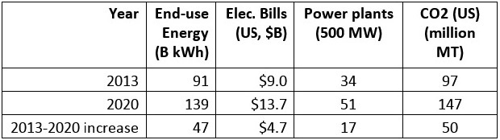
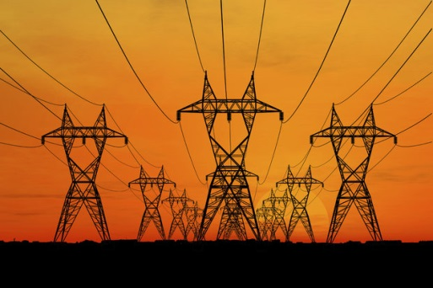
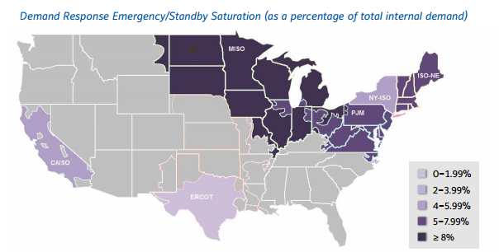
Motivation
Escalating power demand => Need for energy efficiency
Emergency Demand Response (EDR): Shedding load in emergencies or contingencies including system power losses for incentives

Slide 8
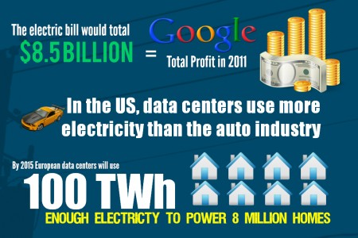
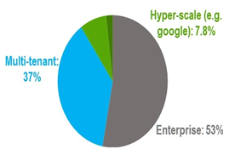
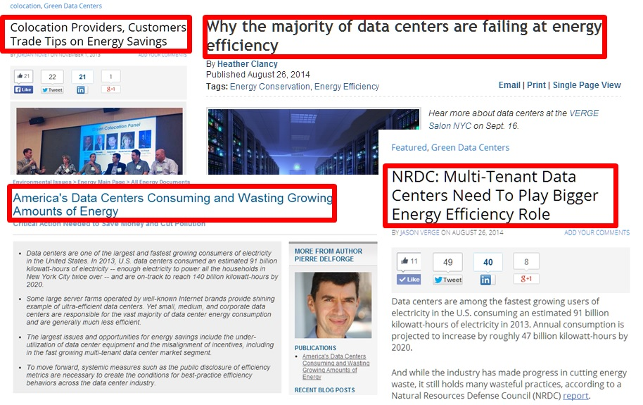
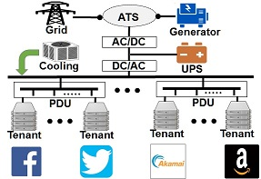
Motivation
(NRDC data)
Owner operated data centers consume 8% of total data center energy usage
Multi-tenant colocation data centers consume 37% of total data center energy usage

Slide 9
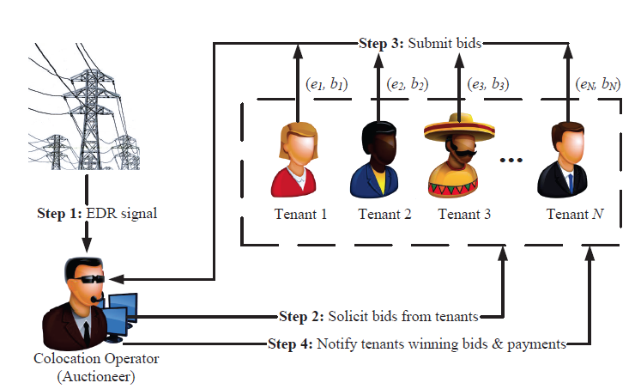

Privacy Issues in Colocation Data Centers
Smart Grid:
Demand – Supply balance during EDR
Grid reliability
Colocation Tenants:
Receive incentives
Privacy preservation during aggregation
Encryption protects tenants’ private information from outside attackers, but how to protect it from semi-honest colocation operators.
Methodology : Clock Auction with Privacy Preserving Aggregation

Slide 10
Clock Auction with PP-Aggregation
Goal: Meet the EDR target under budget while preserving the tenants’ bids from the auctioneer
1. Advantages Clock Auction:
Fast and simple in meeting EDR compared to reverse auction
Bidders receive incentives close to their power consumption.
2. Privacy Preserving Aggregation for EDR:
Effective in finding aggregated energy/price without revealing the individual energy/price quoted by the bidding tenants.
Collusion with the auctioneer or Collusion among group of participating tenants
Does not leak the bids of other tenants
Notes:
Only needs information relevant to price and quantity to know the excess demand in every round and little scope for collusion

Slide 11







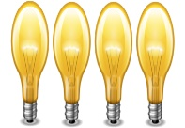













Descending Clock Auction
EDR target:
Time
Reward
Tenant 1
Tenant 2
Tenant 3
Tenant 4
t₀
t₁
t_{n}
t_{n+1}
Notes:
In traditional English auction the winner is the one who quotes higher price, but in reverse auction the lowest price is the winner. For EDR we allocate reward/incentives to the tenants for their energy reduction. Descending clock auction starts with a high reward. At time t0 the auctioneer announces the reward and invites bids from the tenants. If the energy aggregated is higher than the EDR target, the auctioneer reduces the reward in the next round t1 and invites the bids. This continues as long as the aggregated energy in each round is higher than the EDR target. The goal is to aggregate energy needed to meet EDR with lowest budget.
In every round bids are invited from the tenants, the energy being aggregated in that round is calculated. The auction proceeds to the next round if the energy aggregated in the previous round is surplus than the EDR target reduction.

Slide 12
Privacy in Descending Clock Auction
Protect tenants’ privacy from the auctioneer/colocation operator
The auctioneer should calculate the total energy being aggregated in that round without knowing each individual tenant’s contribution to EDR.
Encrypted bids are sent to the auctioneer
Auctioneer determines the aggregated energy using encrypted bids of tenants.
Modified Homomorphic Encryption :
Cyclic group G of prime order p
Generator g ∈ G
Hash function H : Z G
Keys sk₁,sk₂ … sk_{n} ∈ Z_{p}
To preserve tenant privacy:
Operator secret key: sk₀
Tenants secret keys: sk₁, sk₂ … sk_{n}
N
∑ sk_{i} = 0
i=0
Notes:
In order to protect the tenants’ privacy from the auctioneer/colocation operator, the auctioneer should calculate the total energy being aggregated in that round without knowing each individual tenant’s contribution to EDR. To protect the tenant’s privacy we propose modified homomorphic encryption that protects the differential privacy of the tenants, so the auctioneer can calculate the aggregated amount without knowing how much each tenant contributed to it.
Encrypted bids are sent to the auctioneer and the auctioneer determines the aggregated energy using the encrypted bids of the tenants.
First four bullet items are the parameters of the proposed encryption that are based on cyclic groups and hash functions.
The keys needed for the encryption are sk0, sk1,….skn.
And the keys are generated in a way they sum to zero.

Slide 13


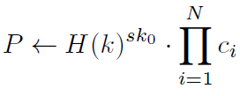


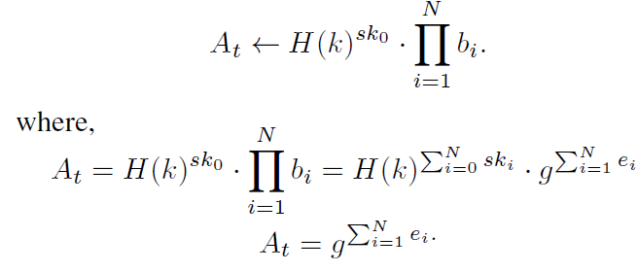
Privacy Preserving Energy Aggregation
Private value
Tenant’s secret key
Encryption:
- Cipher text
- Plain text
Decryption:
Operator’s secret key
Tenants’ bid encryption in price descending clock auction:
Energy willing to reduce
Auctioneer Energy Aggregation
Tenant’s bid
N
∑ sk_{i} = 0
i=0
Can get the aggregated energy without individual contribution
Notes:
The tenants send the encrypted bids to the auctioneer, and the auctioneer determines the aggregated energy in that round.
To tenant encrypts the energy he is willing to reduce v_{i} using the secret key sk_{i}
So tenant 1, encrypts the energy v₁ using his secret key sk₁
g and H(k) are public parameters
The auctioneer gets the bids from all the tenants and computes the aggregated energy using its secret key sk₀ and computes the product of all the bids
Since the keys are generated so that they sum to zero we get the aggregated energy in that round without disclosing the tenants’ contributions. The auctioneer can only get the aggregated energy and cannot get the individual contribution from tenant’s bid due to the security of DLP (Discrete logarithmic problem)
We have hash function H(k) as part of the encryption. Hash function/cryptosystem is one-way transformation. We can do encryption or authentication but cannot do decryption. If we generate the secret keys in a way that they sum to zero, the decrypted value will have H(k)⁰ = 1 nullifying the impact of hash function on the aggregated energy.

Slide 14
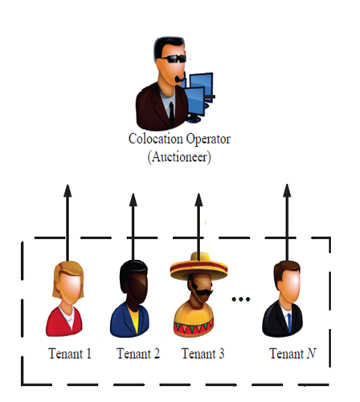
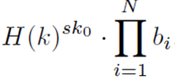
DP-Computation with Untrusted Aggregator
N
∑ e_{i}
Dec(sk₀,b₁, b₂,b₃,…,b_{N}) =
i=1
N
∑ sk_{i} = 0
i=0
modified homomorphic
encryption to achieve privacy
b₁= Enc(sk₁,e₁)
b₂
b₃
b_{N}= Enc(sk_{N},e_{N})
Notes:
In this slide we talk about the differential privacy notion of the proposed EDR clock auction. This works satisfies the notion of differential privacy because it allows us to compute the aggregated energy without knowing each individual’s contribution. The auctioneer can only compute the aggregated energy and in no way can trace back to the contribution of each tenant from the aggregated energy.
In all other methods Paillier cryptosystem (PCS) was used for energy aggregation. Paillier cryptosystem is public key cryptosystem where anyone with public key can encrypt and only the one with private key can decrypt. PCS protects privacy from external attackers but not from the operators because the auctioneer can learn the bids of the tenants while computing the aggregate. “Differential Privacy cannot be achieved with PCS”, so we proposed modified homomorphic encryption to achieve differential privacy. PCS is also additive homomorphic encryption but cannot achieve these goals.

Slide 15
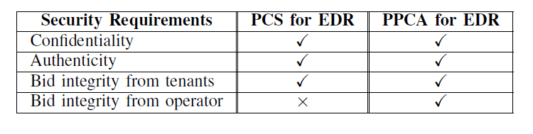
Security Analysis
Differential Privacy Preservation:
Auctioneer can learn aggregated energy value
Cannot learn individual values
Confidentiality:
Tenants’ bids are encrypted using the proposed homomorphic encryption scheme that guarantees bid privacy and confidentiality.
PPCA for EDR - Privacy preserving clock auction (PPCA) for EDR
PCS for EDR - Paillier cryptosystem (PCS) for EDR
(Compared our scheme with Paillier cryptosystem (PCS) used for aggregation in EDR)

Slide 16
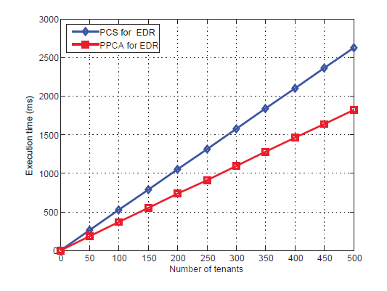
Simulation Results
Price descending clock auction
1024 – bit keys
The communication overhead increases with the number of rounds in the auction as well as with increase in participating tenants for EDR
Trade off between the communication overhead and tenants’ privacy protection from the operator
Notes:
DCA is Descending clock auction
In this slide we compare the performance of PCS and PPCA(our method: privacy preserving clock auction) in both price descending clock auction and energy descending clock auction cases. PPCA protects tenants privacy from the auctioneer but PCS does not. PPCA Communication overhead is lower than PCS for price descending clock auction. Overhead is slightly for energy descending clock auction, but we have to tradeoff the overhead if we are willing to protect tenants’ privacy.

Slide 17
Outline
Introduction of Cyber Physical Systems
Security Computing and Privacy Preservation for CPS
  Clock Auction for Emergency Demand Response in Colocation Data Centers
  Cost Aware Appliance Scheduling Using Fog Computing in Smart Home
  Differentially Private Optimization for Machine Learning for Physiological Sensors
Conclusion
Our Lab Overview
Sai Mounika Errapotu, Jingyi Wang, Yanmin Gong, Jin-Hee Cho, Miao Pan, and
Zhu Han, “SAFE : Secure Appliance Scheduling for Flexible and Ecient Energy
Consumption for Smart Home IoT," IEEE Internet of Things Journal, special issue
on AI Powered Network Management: Data Driven Approaches under Resource
Constraints, vol. 5, no. 6, pp. 4380-4391, December 2018.

Slide 18
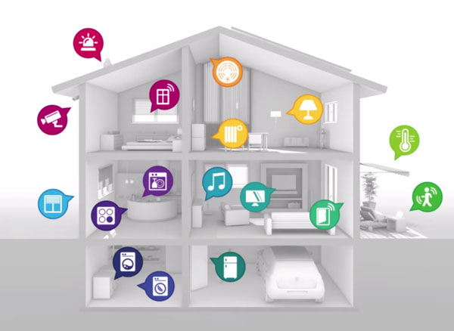


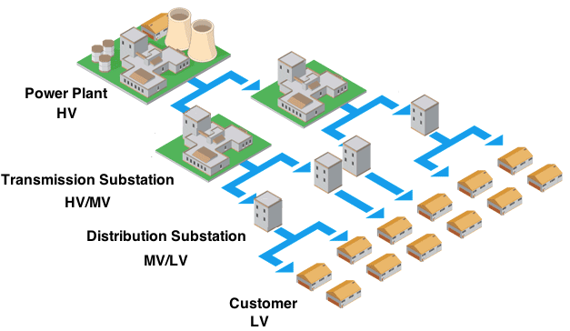


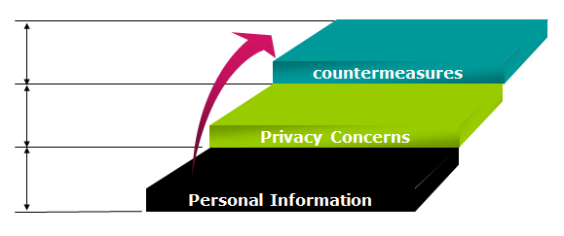
Smart Home
Effective household energy monitoring and control
Handling uncertainties,
Demand side management
Personally identifiable information

Slide 19


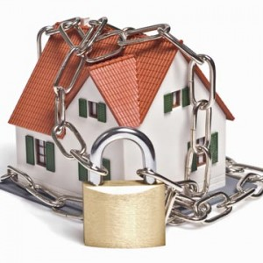
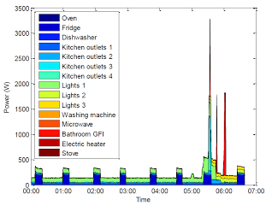
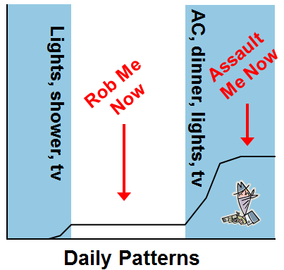
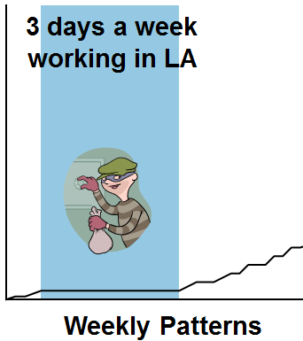
Privacy Concerns in Smart Home
Smart home knows?
What time you go to bed, get up
What time you leave for, come from work
Your vehicle charging information
That you have a brand new $5,000 4K TV

Slide 20
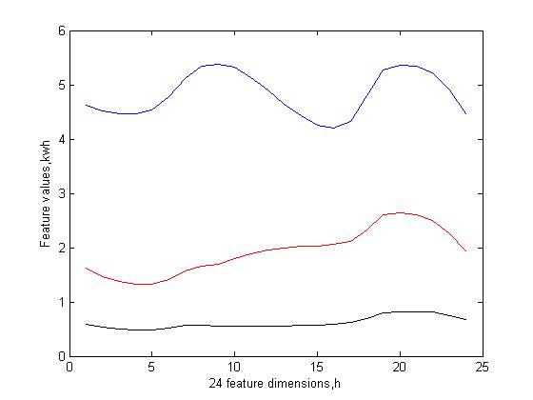
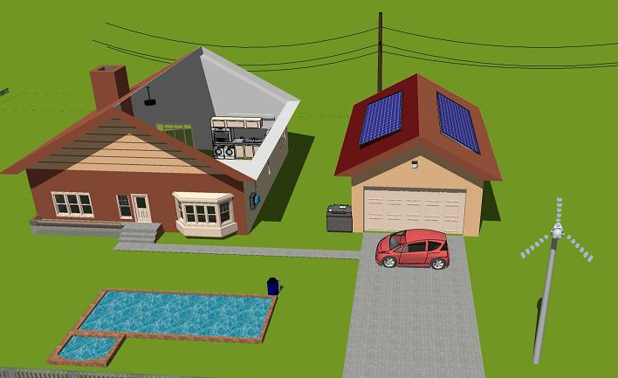
Load Profiling
From smart meter data, try to tell users’ usage behaviors
  CEO, 1%, audience here
  Worker, middle class, myself
  Homeless, slave, Ph.D. students
  Goal: How to prevent others from knowing that you are a Ph.D. student
[20]

Slide 21



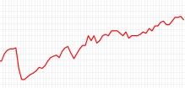
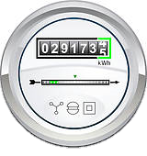













Cost Minimization + User Privacy Preservation?
Utility Provider:
- Cost minimization
- Computational capacity (Fog/Edge)
Smart Home User:
- Privacy concerns (Paillier)
- Appliance scheduling
Utility provider
Large Scale Optimization Problem
. . .

Slide 22


Fog or Edge Computing
Advantages
In close proximity to the users
Low latency => beneficial for time-critical applications
Location awareness and improved QoS
Suitable for distributed real time applications
Fog 1
Fog 2
Fog j
Fog N
Expensive to Affordable Computing

Slide 23




Alternating Direction Method of Multipliers
Solves global problem by decomposing into local sub-problems
Scalable enough to process high dimensional big data sets in parallel or distributed fashion
Convergence properties and decomposability of dual ascent
Objective and constraints can be decoupled
Augmented lagrangian multiplier
California government
x,z update
Texas
government
Dual variable update
US
Congress/Senate
Notes:
ADMM problem form with f,g convex: two sets of variables with separable objective
. It takes the form of a decomposition-coordination procedure, in which the solutions to small local subproblems are coordinated to find a solution to a large global problem.

Slide 24
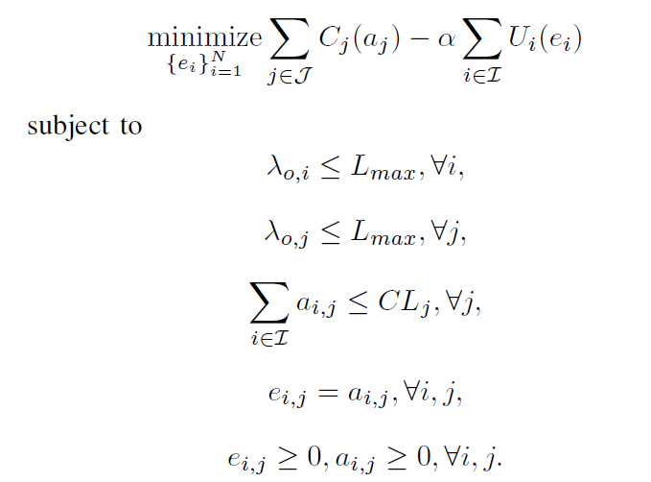
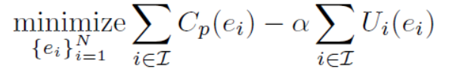
Solving Optimization Problem with ADMM
Optimization problem to minimize the expenditure at utility provider’s end considering latency and computational capacity
Max latency
Fog 2
…
Fog 1
Fog N
Computational limit
Auxiliary variable
Notes:
ADMM: two sets of variables with separable objective
Augmented lagrangian update, x z update, dual variable update

Slide 25







Paillier Encryption
Additive Homomorphism:
$$E\left(m_{1},r_{1}\right)= {r_{1}}^{n}g^{m_{1}} E\left(m_{2},r_{2}\right)={r_{2}}^{n}g^{m_{2}}$$
$E\left(m_{1},r_{1}\right)×E\left(m_{2},r_{2}\right)$
$={r_{1}}^{n}g^{m_{1}}×{r_{2}}^{n}g^{m_{2}}$
$={(r_{1}r_{2})}^{n}g^{m_{1}+m_{2}}$
$=E(m_{1}+m_{2},r_{1}r_{2})$
C₁ . C₂ = E(m₁$+$m₂)
Product of cipher texts will decrypt to the
sum of corresponding
plain texts.
publish
D_{s}(Ep(A+B+C+D)) = A+B+C+D
Aggregator => E_{p}(A) E_{p}(B) E_{p}(C) E_{p}(D)
E_{p}(A)
E_{p}(D)
E_{p}(B)
E_{p}(C)

Slide 26
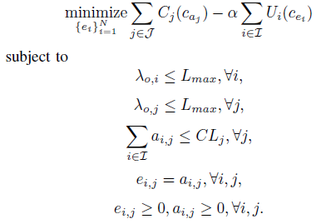

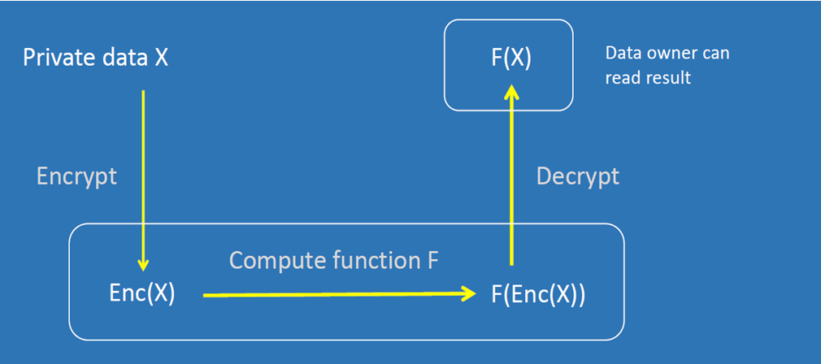

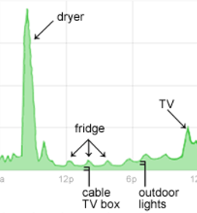


Secure ADMM
Solving ADMM in Fog on Paillier Encrypted User Energy Profiles
Paillier Decrypt

Slide 27
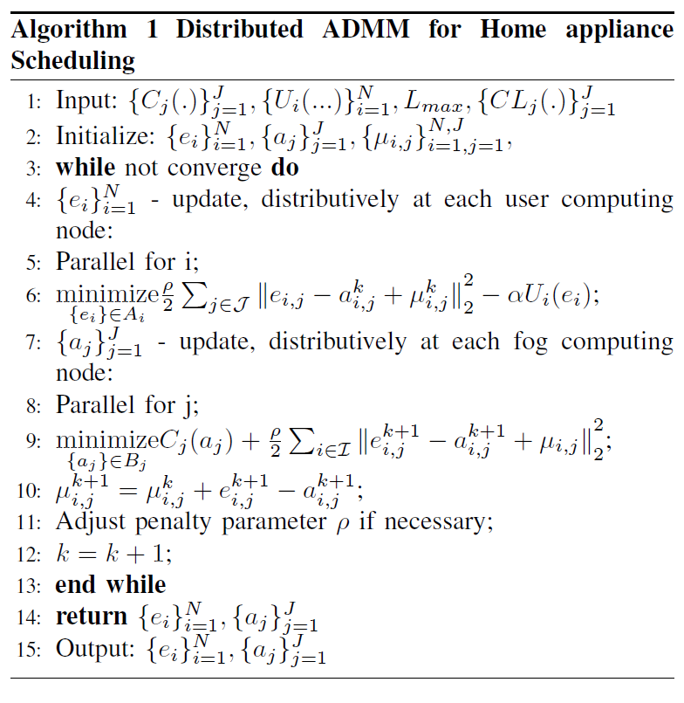
ADMM for Home Scheduling
Paillier Encryption
User Update
Fog Update
Dual Variable Update

Slide 28
Simulation Settings
5 min Location Marginal Prices at Palo Alto, CA
Time horizon of 1 week: 2016 5-min periods
Hourly average solar radiance from Measurement and Instrumentation Data Center at National Energy Renewable Energy Laboratory
Time horizon of 1 week: 168 1-hour slots
8 appliances: both elastic and non-elastic loads

Slide 29
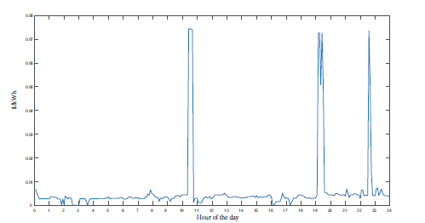
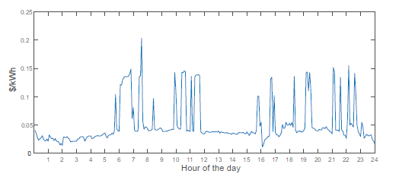
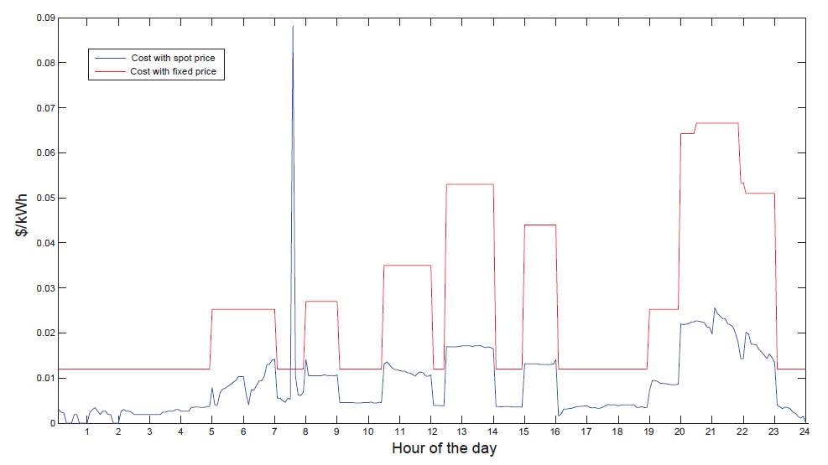
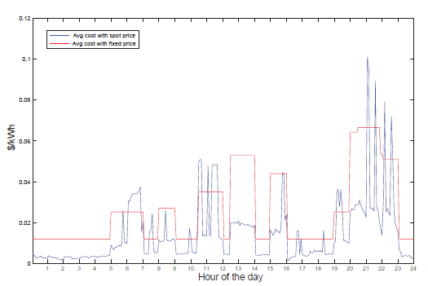
Performance Analysis
One day
One week
Gain: 3.05
Gain: 1.85
Spot price plans with optimal energy usage reduces the consumption cost of the users
Notes:
Gain is basically indicating the reduction in consumption cost with spot price plan.
The consumption cost with spot price plan is 3 times lower than a fixed price plan when we consider a day, and the consumption cost with spot price plan is 1.85 times lower than a fixed price plan when we consider average over a week.

Slide 30
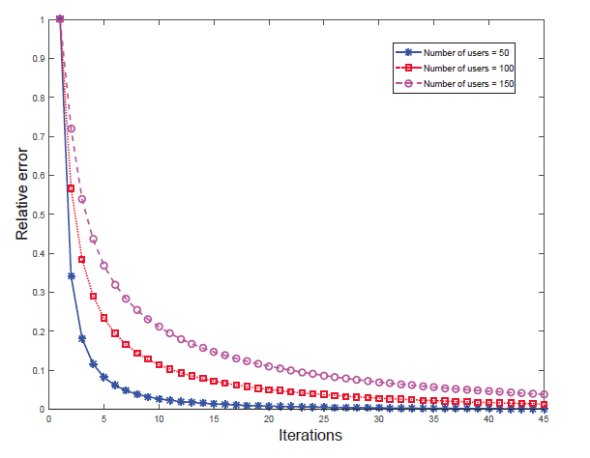
Security and Performance Analysis
As the no. of users increases, the proposed scheme converges with only small increment of iterations
Confidentiality:
Privacy and confidentiality of energy profiles and updates are effectively protected from outside attackers by Paillier cryptosystem.
Privacy preservation in fog during optimization:
Fog cannot learn users’ energy profile while solving the optimization problem.
Notes:
As the no. of users increases, the proposed scheme converges with only small increment of iterations

Slide 31
Outline
Introduction of Cyber Physical Systems
Security Computing and Privacy Preservation for CPS
  Clock Auction for Emergency Demand Response in Colocation Data Centers
  Cost Aware Appliance Scheduling Using Fog Computing in Smart Home
  Differentially Private Optimization for Machine Learning for Physiological Sensors
Conclusion
Our Lab Overview
Jiahao Ding, Sai Mounika Errapotu, Haijun Zhang, Yanmin Gong, Miao Pan, and
Zhu Han, “Stochastic ADMM Based Distributed Machine Learning with Differential
Privacy," SecureComm, Orlando, FL, October 2019.

Slide 32
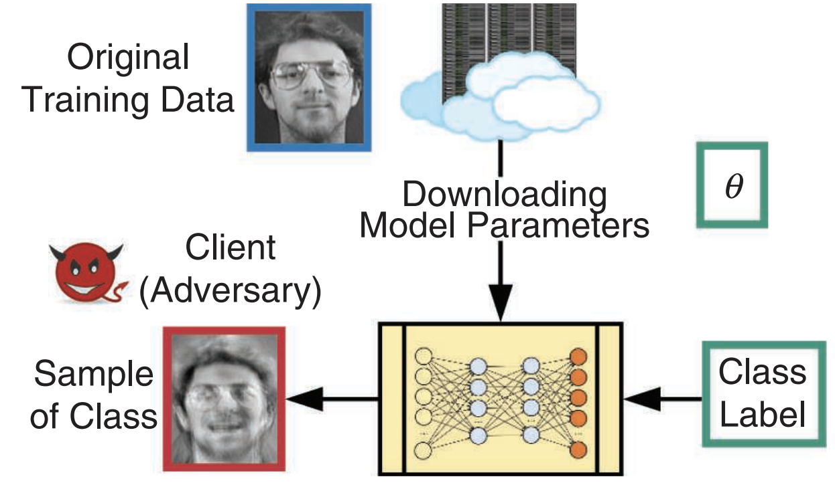
Privacy Concern
Many papers state that machine learning model can leak sensitive information of training data samples, e.g., model inversion attack
Notes:
The model inversion attack extracts information about the training data used for learning the model with either black-box or white-box access to the model.
For example, in the case of a facial recognition system, an attacker can produce an approximate image of one of the people whose image was used in the training phase by only having his name.
Jiahao Ding
3/09/2019

Slide 33
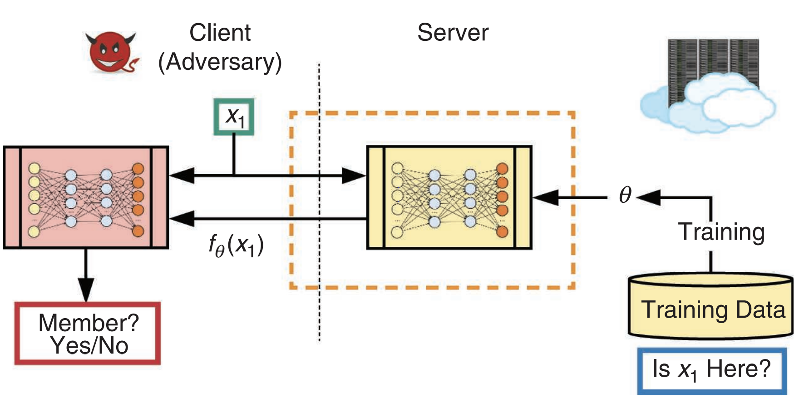
Privacy Concern
Membership inference attack
prediction
score
Therefore, it is vital to use privacy protection method to protect the privacy of training data.
Differential privacy provides a potential solution.
Notes:
In the membership inference attack, the goal is to identify whether a specific record has been used in the training phase or not.
For example, consider a classifier that can recommend different medications for a given disease. A membership inference attack on this classifier can reveal that a person whose data was used in the training phase actually has that disease.
Jiahao Ding
3/09/2019

Slide 34
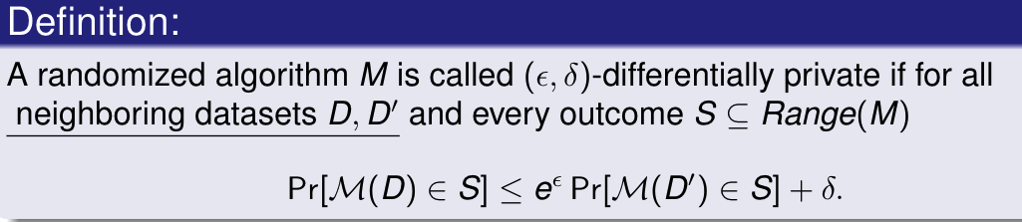
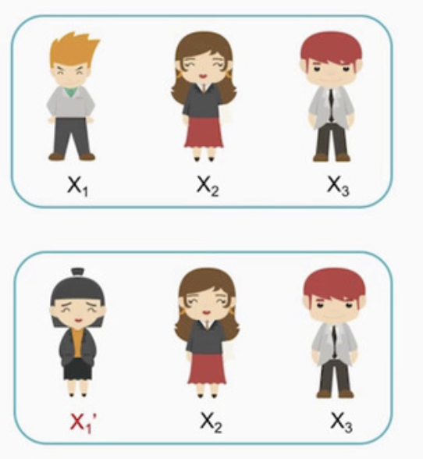
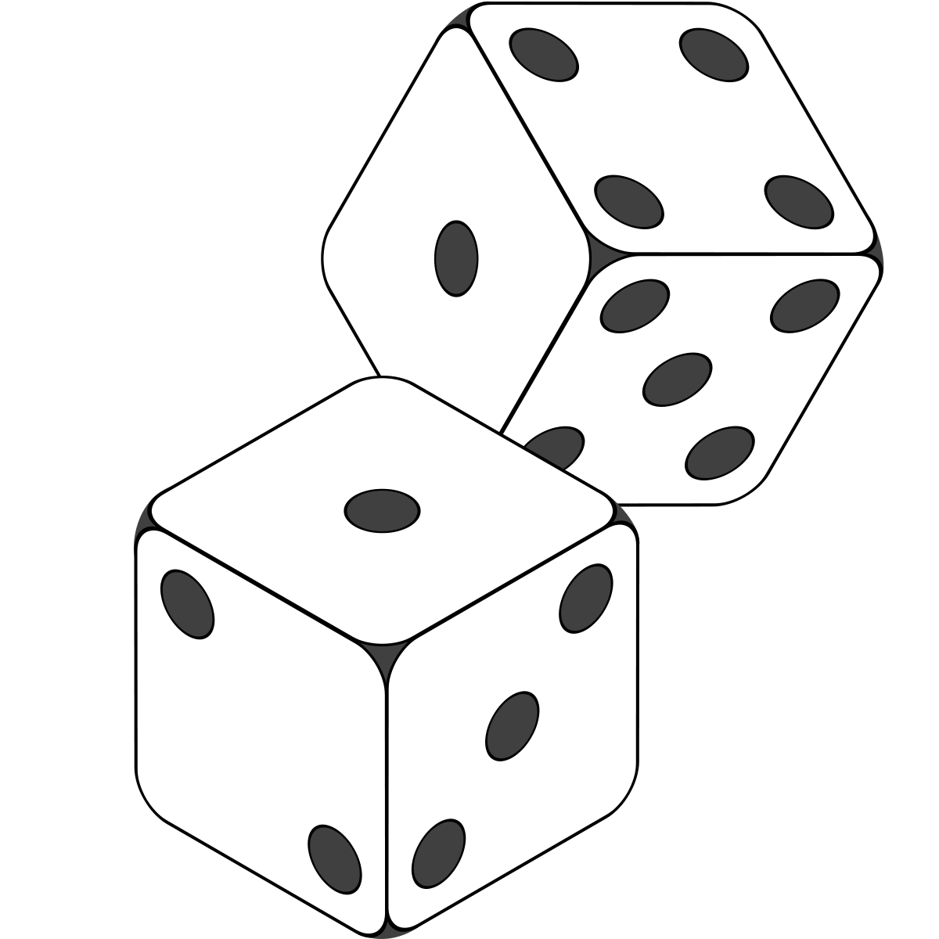
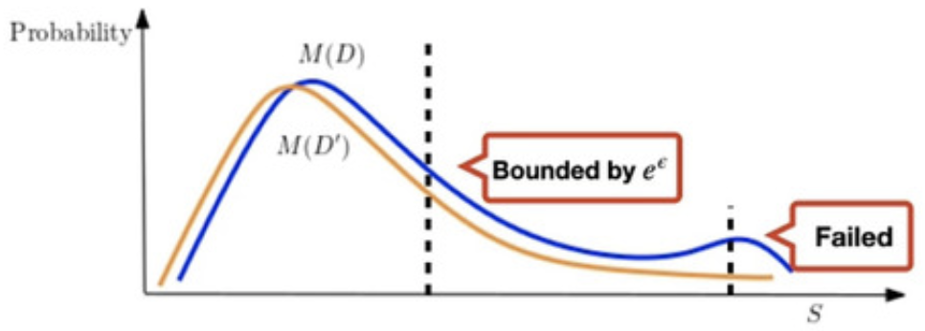






Differential Privacy Preliminary
Main Point: There is no much difference between the output of the
algorithm over two datasets that differ in one data element
Privacy budget
Probability of failure
$$D$$
$$M$$
$$M(D)$$
$$D′$$
$$M(D′)$$
$$M$$
Notes:
Differential privacy provides a privacy standard for data privacy, which guarantees there is no much difference between the output of the algorithm over two datasets that differ in a single data.
Mathematically,
A randomized algorithm M is called epsilon delta differential privacy, if for all neighboring datasets D and D prime, the following inequality holds.
It shows that the distance of these two output distributions is bounded by e^epsilon, and delta here is the probability of failure.

Slide 35
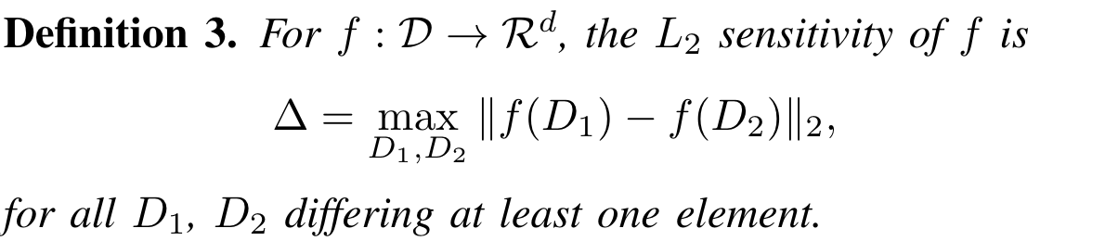

Differential Privacy Preliminary
Sensitivity of a function: L2 sensitivity
To achieve (𝜖,𝛿)-differential privacy, use Gaussian noise $𝒩(0,σ^{2})$
with $σ^{2}=2\ln\left(\frac{1.25}{δ}\right)∆^{2}/ε^{2}$.
Smaller sensitivity means less distortion
Smaller 𝜖 means better privacy
Smaller 𝛿 means less probability of failure
Notes:
Sensitivity is defined with the maximum difference between the function results with the two databases.
To achieve epsilon and delta differential privacy, we can use gaussian noise with sigma = this one.
Where smaller

Slide 36


Differentially Private Robust ADMM (PR-ADMM)
In $\left(k+1\right)$-th iteration, PR-ADMM updates consist of the following
primal updates:
dual updates:
Notes:
To provide differential privacy of each training data point, we let individual agent adds Gaussian noise to the local classifiers before sharing to neighboring agents.
Jiahao Ding
3/09/2019

Slide 37


Differentially Private Robust ADMM (PR-ADMM)
Design noise variance decay schemes
Periodic Linear Decay Scheme
A period
Initial noise variance determined by each agent
Decay rate ($0<R_{P}<1$)
Iteration-Based Decay Scheme
Decay rate ($R_{T}>0$)
Notes:
The perturbed primal variables during the iterative process inevitably destroy the algorithm convergence.
This means that we carefully adjusting noise addition at every training iteration to mitigate the effects of noise addition.
we propose two noise decay schemes for guaranteeing convergence property. Periodic Linear Decay Scheme and Iteration-Based Decay Scheme, to carefully adjust the scale of noise in the iterative process.
Jiahao Ding
3/09/2019

Slide 38
Privacy Analysis
If Periodic Linear Decay Scheme is chosen, PR-ADMM satisfies
(𝜖,𝛿)-differential privacy with
where
If Iteration-Based Decay Scheme is chosen, PR-ADMM satisfies
(𝜖,𝛿)-differential privacy with
where
Notes:
Now, I will show the privacy analysis, we can derive a much tighter bound of epsilon and delta by adopting dynamic zCDP.
Jiahao Ding
3/09/2019

Slide 39



Convergence Analysis
$$General convex problem$$
If the variance of Gaussian noise decays according to Periodic
Linear Decay Scheme and Iteration-Based Decay Scheme, then the
averaged function value approaches the minimum function value
with a convergence rate of $O(\frac{1}{K})$.
Note that the non-private decentralized ADMM in [1] also
achieves a $O(\frac{1}{K})$ rate for a general convex problem.
[1] Makhdoumi and A. Ozdaglar, “Convergence rate of distributed ADMM over networks,” IEEE Transactions on Automatic Control,
vol. 62, no. 10, pp. 5082–5095, October 2017
Notes:
The convergence analysis is based on the convex property of the aggregated function f(x).
We provide convergence analysis of PR-ADMM under above two variance decay schemes for general convex objectives.
Jiahao Ding
3/09/2019

Slide 40






Experiments
Training dataset from Physiological Data Modeling Contest (PDMC)
Timestamp Button
2-axis Accelerometer (inside)
Heart Beat Receiver Board (inside)
Heat Flux Sensor
Near-Body Ambient Temperature Sensor
Determine two activities
(Watching TV or Sleep)?
GSR Sensors
Skin Temperature
Notes:
The data provided at PDMC consists of physiological sessions. Each session is provided with a user identity number, and two characteristics of the users. Each minute of the session consists of nine types of sensor readings. The semantics behind the characteristics and the sensors, as shown in Table I, were provided only after the contest
Jiahao Ding
3/09/2019

Slide 41


Experiment
Convergence comparison under the same privacy guarantee
𝑇𝑜𝑡𝑎𝑙 𝑝𝑟𝑖𝑣𝑎𝑐𝑦 𝑙𝑜𝑠𝑠$(10,{10}^{−4})$
PR-ADMM under two kind of noise decay schemes significantly outperform baselines and get close to the best achievable average loss (Non-private) during the entire iterative process.

Slide 42
Conclusion
Security and Privacy preservation important to build high-confidence and secure CPS, with techniques such as
  Homomorphic Encryption
  Differential Privacy
This talk targets on two major tasks
  Cyber Physical System
  Cloud/Fog/Edge Computation
Our interdisciplinary research work integrates security/privacy preservation with modeling for various CPS :
  Descending Clock Auction based Emergency Demand Response in Colocation Data Centers
  ADMM for Cost Aware Appliance Scheduling in Smart Home
  Differentially Private Optimization for Machine Learning for Physiological Sensors
Future works: Federated Learning, Location Privacy, ….

Slide 43







Amigo Lab, University of Houston
Thanks for students, visitors and collaborators
Collaboration? Tuition and Pension provided. Visitors welcome

Slide 44


