Slide 1
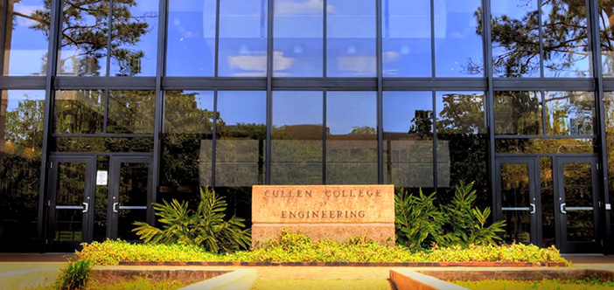
Zhu Han, John and Rebecca Moores Professor IEEE Fellow, AAAS Fellow Electrical and Computer Engineering Department University of Houston, TX USA Thanks to Prof. Lei Fan, Wenlu Xuan, Zhongqi Zhao, Mingze Li, and NSF
Hybrid Quantum and Classic Computing to Solve Optimization and Machine Learning Problems for Future Networking

Slide 2
Outline
Motivation and Quantum Computing Basics
Quantum Annealing
Quadratic unconstrained binary optimization (QUBO)
Hybrid Quantum Benders' Decomposition
Benders Decomposition Basics
Quantum and Class Computing Bender Decomposition
Applications
Optimization Problems in Wireless Networks
Feature Selection for Machine Learning
Cable-Routing Problem in Solar Power Plants
Conclusions

Slide 3
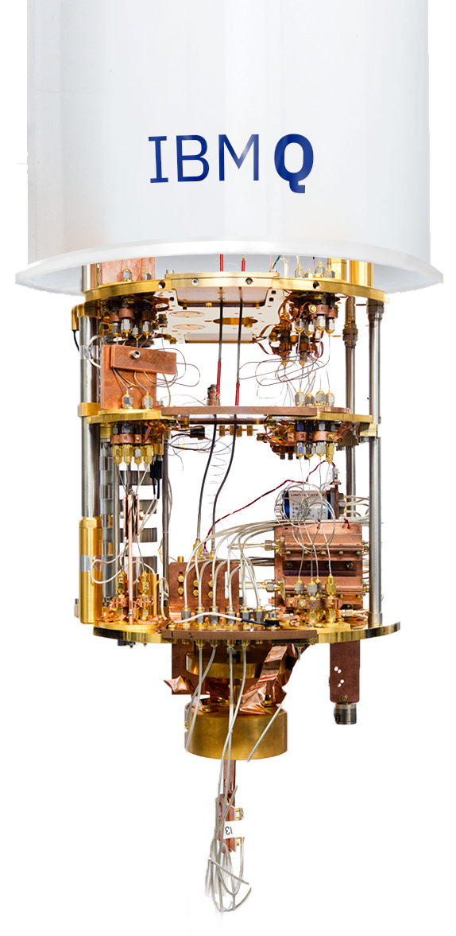
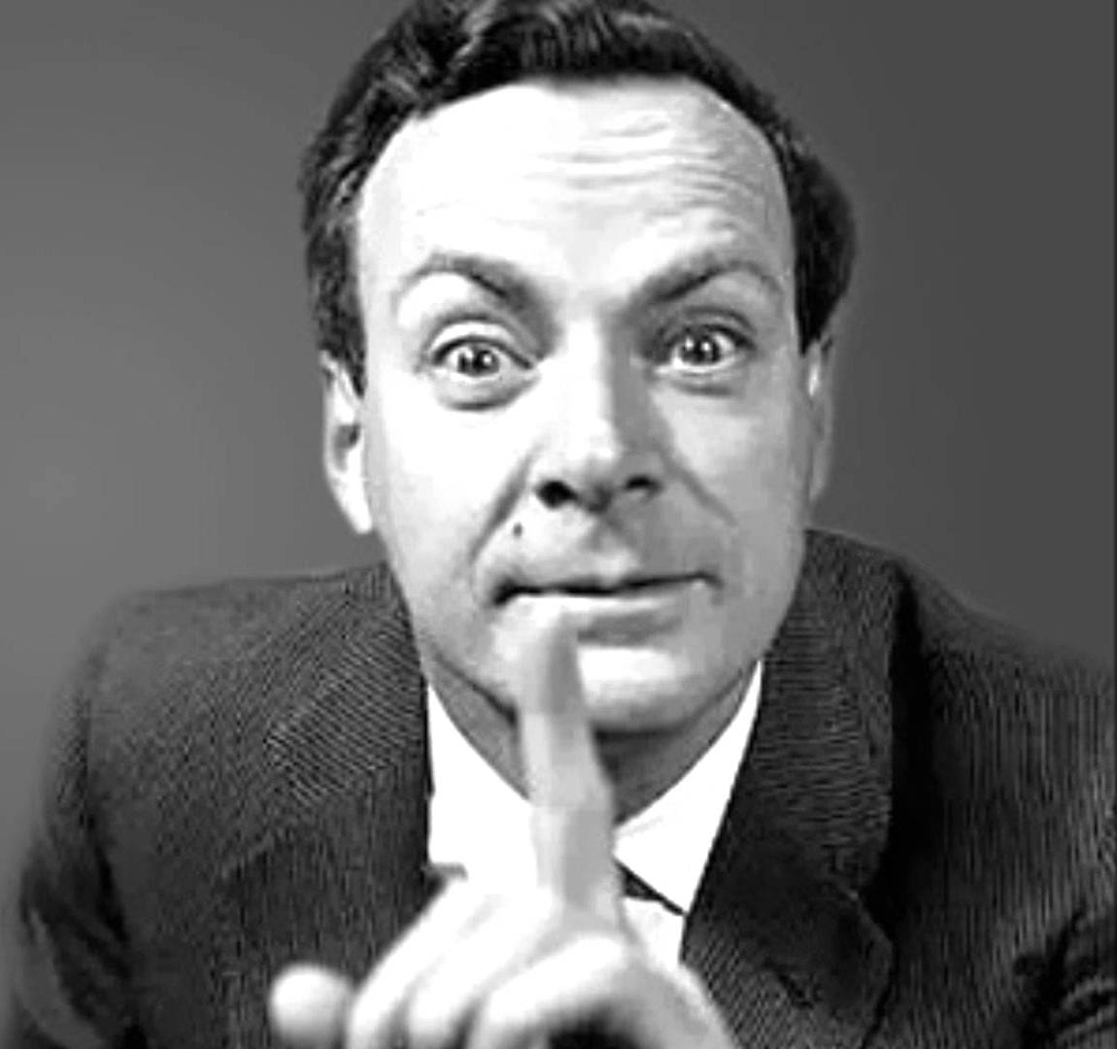
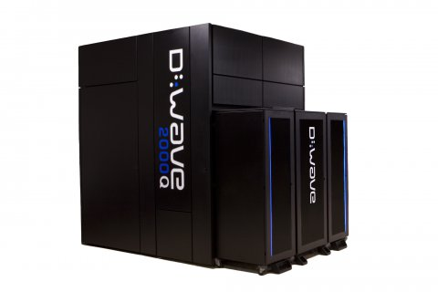
Quantum Computing
Started in the 1980s
Quantum Computer
Maybe we need to use quantum mechanics in our computers.
Many years later …
…
Feynman

Slide 4
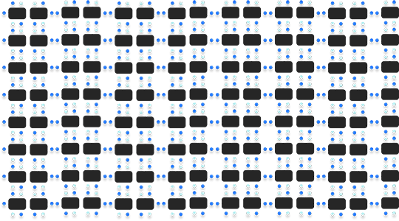
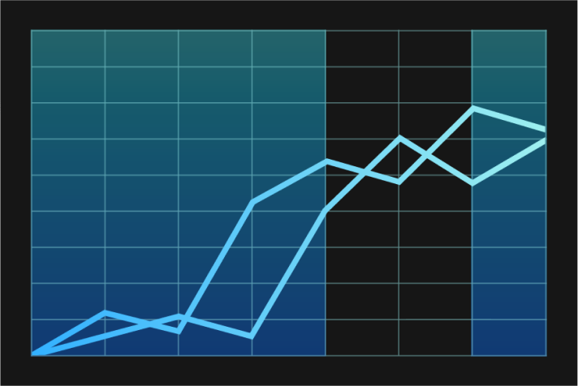
1
Quantum Computing
Electrical & Computer Engineering
What is wrong in classic computing?
Dinner Party
But with only one optimal seating plan
Life science
Total number of combinations exponentially grows
Manufacturing & Logistics
Financial Services
Notes:
The answer is over 3 million and that's just 10 people around a table.
Financial Services:Risk balancing
Manufacturing & Logistics: Delivering

Slide 5
1
Quantum Computing
Electrical & Computer Engineering
Quantum computers
Can
create vast multidimensional spaces to deal with large problems,
and translate them back into
what we can use,
while
classical computers may have difficulties to do the same.
Notes:
The answer is over 3 million and that's just 10 people around a table.
Financial Services:Risk balancing
Manufacturing & Logistics: Delivering

Slide 6
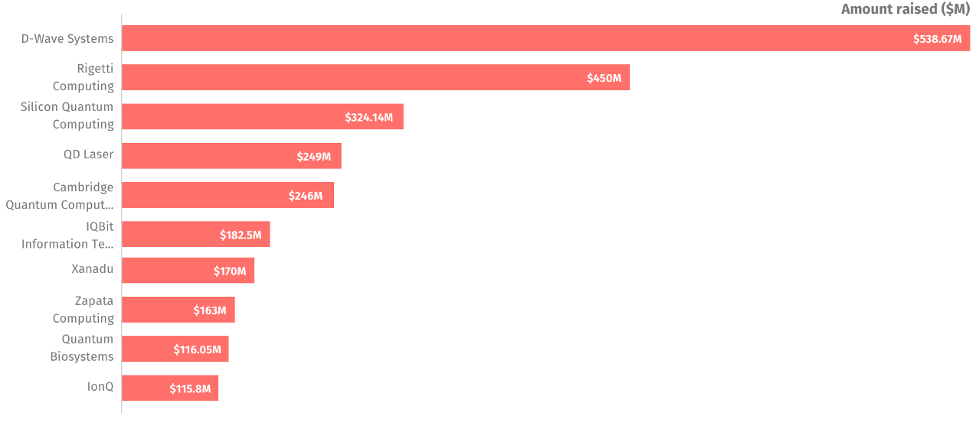
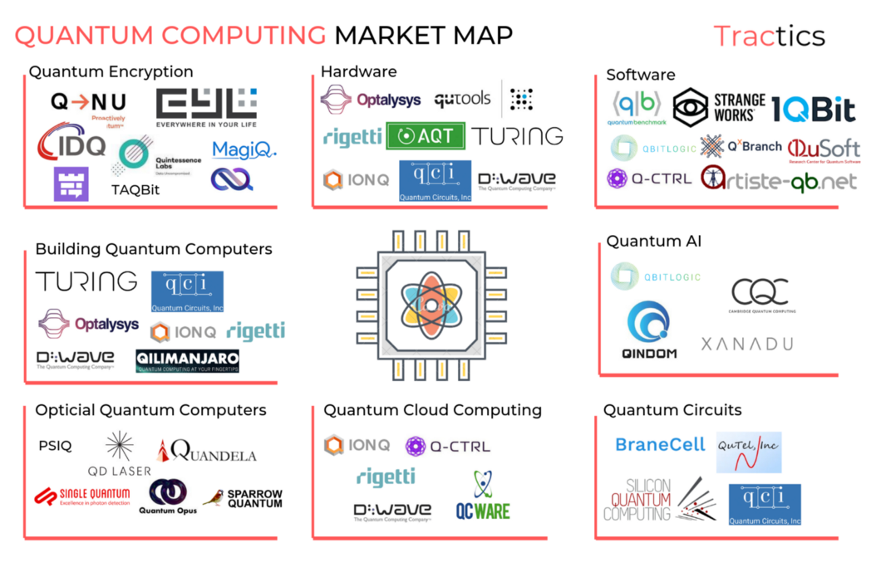
1
Quantum Computing
Electrical & Computer Engineering
Quantum Computing is Booming
Top Funded Companies
Notes:
The answer is over 3 million and that's just 10 people around a table.
Financial Services:Risk balancing
Manufacturing & Logistics: Delivering

Slide 7
1
Quantum Computing
Electrical & Computer Engineering
Known Types of Quantum Computing and Their Applications and Generality.
Quantum Annealer
Analog Quantum
Universal Quantum
Application: | Optimization
Generality : | Restrictive
Application: | Chemistry Sampling Quantum Dynamics
Generality : | Partial
Application: | Cryptography Searching Secure Computing
Generality : | High
Notes:
The answer is over 3 million and that's just 10 people around a table.
Financial Services:Risk balancing
Manufacturing & Logistics: Delivering

Slide 8
1
Quantum Processors
Electrical & Computer Engineering
Rank of quantum processors
Superconducting
Number of Qubit(s)
127
Manufacturer
Photonics
50
Name/Codename/Designation
Eagle
Trapped ion
16
27
49
Q50 P
20
TL
53
72
Circuit-based quantum processors
8
16Q Aspen-1
Normal
QV series
49
Q53
8Q
Agave
17
24
53
Bristlecone
8
Sycamore
17Q Test
X24
X8
12
20
32
65
127
X12
19Q Acorn
Manhattan
Eagle
10
20
50
100
200
500
1000
2000
5000
128
512
1152
2048
5760
D-WAVE quantum annealer computer fits our problem setting the most.
2000Q
Advanced
One
Two
2X
Annealing quantum processors
Notes:
The answer is over 3 million and that's just 10 people around a table.
Financial Services:Risk balancing
Manufacturing & Logistics: Delivering

Slide 9
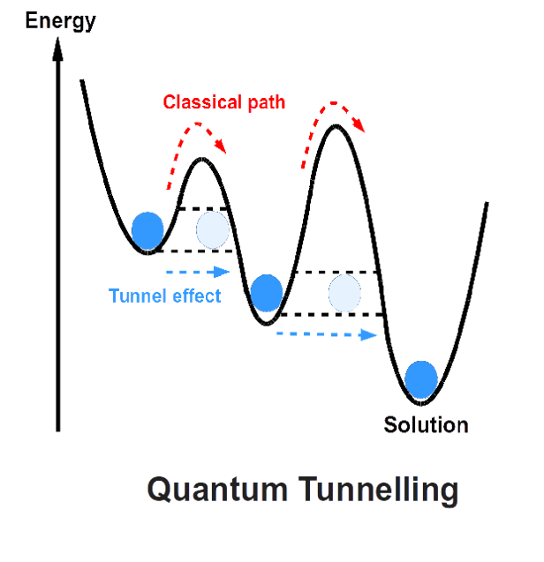
Quantum Computing
Quantum Computer
Why Quantum Annealing?
Gate Model
Analog Quantum Model
Quantum Annealing

Slide 10
Outline
Motivation and Quantum Computing Basics
Quantum Annealing
Quadratic unconstrained binary optimization (QUBO)
Hybrid Quantum Benders' Decomposition
Benders Decomposition Basics
Quantum and Class Computing Bender Decomposition
Applications
Optimization Problems in Wireless Networks
Feature Selection for Machine Learning
Cable-Routing Problem in Solar Power Plants
Conclusions

Slide 11
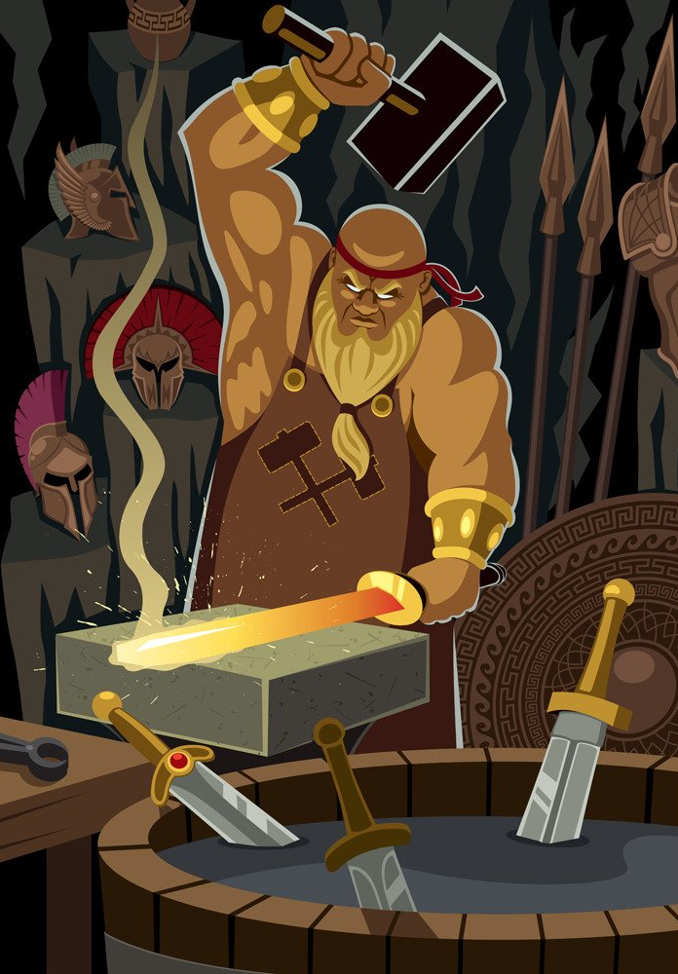
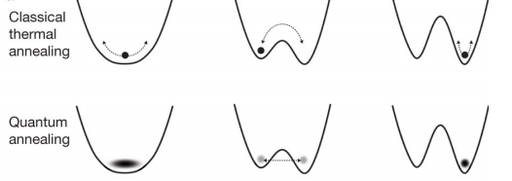
Quantum Annealing
Annealing a Metal
Heat the metal to a temperature;
Lower the temperature;
Simulated Annealing
Heuristic algorithm;
Random search method;
The temperature variable;
Quantum Annealing
Quantum tunneling

Slide 12
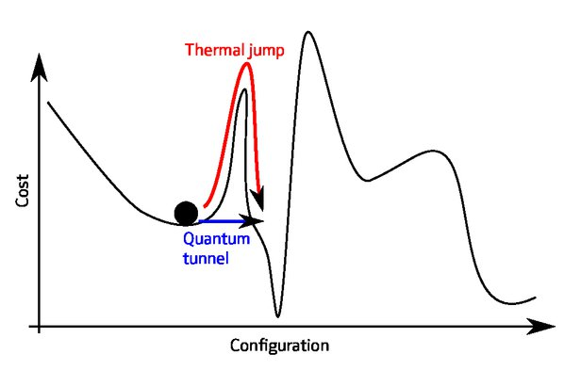
Quantum Annealing
Simulated Annealing VS Quantum Annealing
Quantum Tunneling
Enables jumping from one classical state to another
– Decreases likelihood of getting stuck in a local minimum
Width of energy barrier is important, but height is not

Slide 13
Quantum Annealing
Energy diagram in Quantum Annealing
A matter of microseconds.
Initial Qubits
Superposition at |$\left.0\right\rangle$s and |$\left.1\right\rangle$s.
Not yet coupled.
Qubits are entangled.
At state of many possible answers.
Couplers & biases applied
Inputs’ energy are set.
Lowest energy is at or closes to the optima.
Energy → possibility
Notes:
The signal processing’s final goal is to inverse the data acquisition process:
Figure out the physical properties of the undersurface model based on the signal acquired.
Unfortunately, many problems block our way from observed signals to our interested velocity model.
这张图是定性地在说dwave如何进行退火的，
第一个状态是先初始化qubit(s)并使其处于叠加态，量子之间并未被circuit或者gate耦合.(如何具体耦合见于这个link https://en.m.wikipedia.org/wiki/Superconducting_quantum_computing的coupling qubit第一段)
第二个是通过增添耦合couple和偏置bias模拟问题(类似于构造山峰地形图，但是还没有让小球滚落)，此时qubits已经开始纠缠了，所以此时读取是state of many possible answers。
最后一步是冷却(让所有在不同位置的小球滚落)并读数，state的能量越低越容易被读到(energy变possibility)

Slide 14
Quantum Annealing
Ising Model
$$H\left(s\right)= \sum_{i}{h_{i}s_{i}}+\sum_{i}{\sum_{i<j}{J_{i,j}s_{i}}s_{j}}$$
Neighboring spins interact with each other
Spins interact with applied field
QUBO (Quadratic Unconstrained Binary Optimization)
$$f\left(x\right)= \sum_{i}{Q_{i,i}x_{i}} + \sum_{i}{\sum_{i<j}{Q_{i,j}x_{i}}x_{j}}$$
$Q$ : upper-diagonal matrix
These important optimization problems can be transformed into QUBO model:
Knapsack Problems
Assignment Problems
Task Allocation Problems
Capital Budgeting Problems
… (NP-hard problem)
Quantum Computing:
provide an alternative method to solve some NP-hard problems

Slide 15
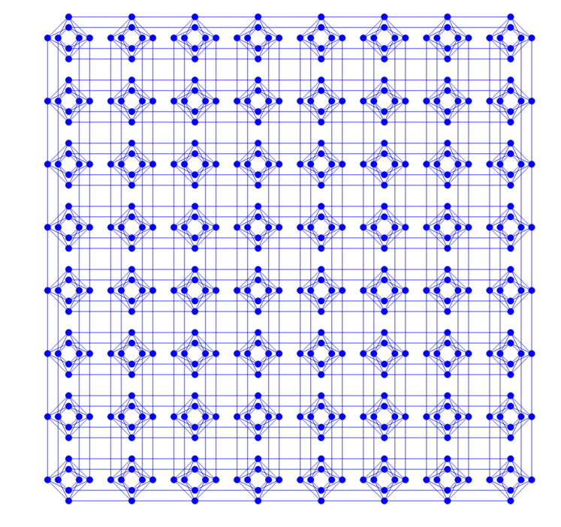
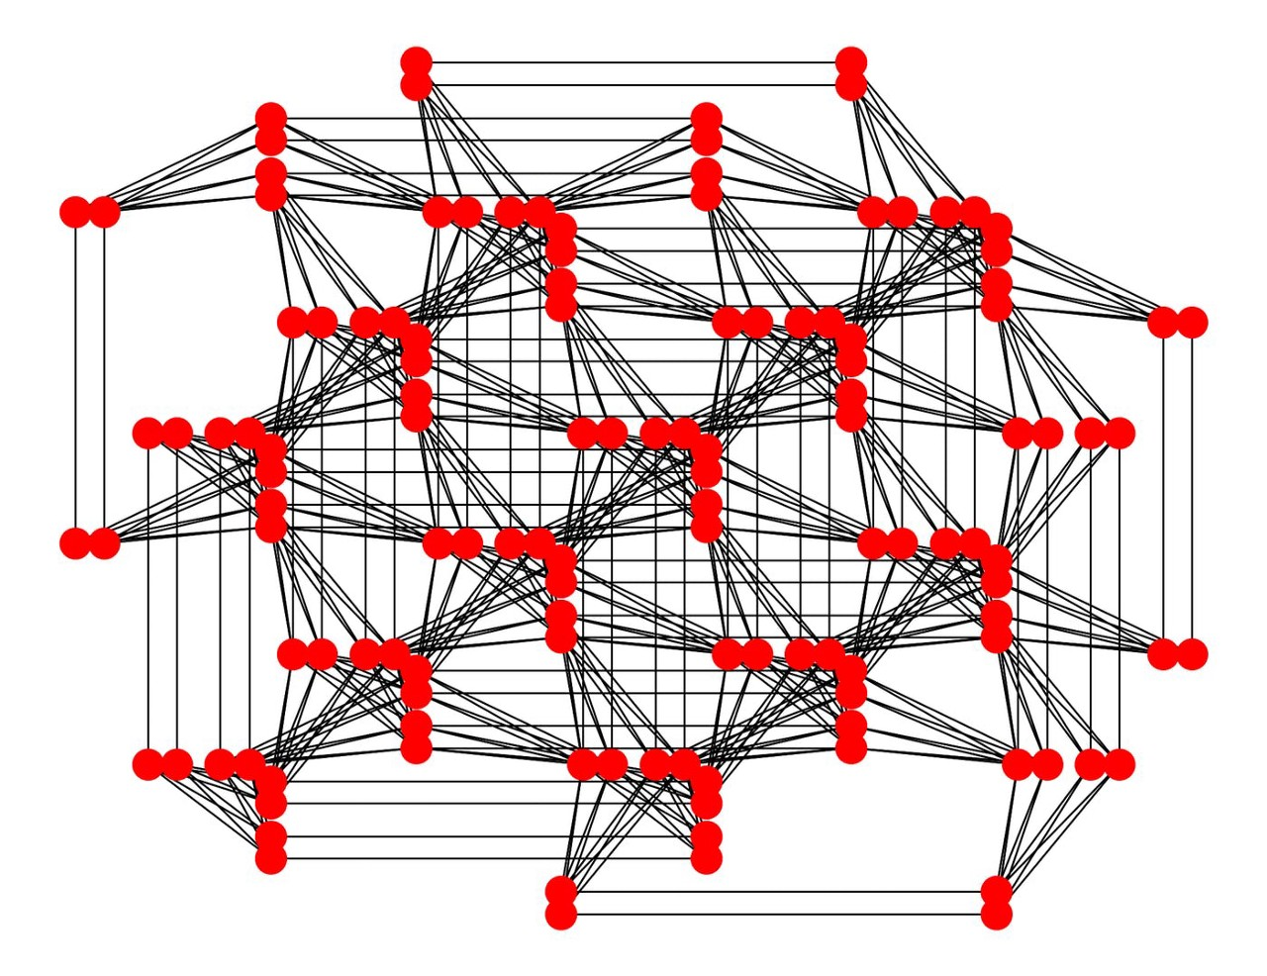
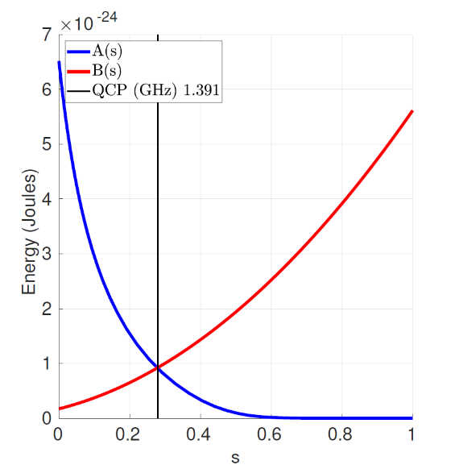
Dwave Hamiltonian
Problem of Hamiltonian:
Goal (what the hardware does)
Minimize σ_{i} ∈ {-1, +1} subject to provided J_{i,j} ∈ R and h_{i} ∈ R coefficients
In other words, a quantum optimization program is merely a list of J_{i,j} and h_{i}
Classical
Much easier to reason than a quantum Hamiltonian
Quantum effects are used internally to work towards the goal
Sparsely connected
Possible to map fully connected problems onto the D-Wave’s Chimera graph
Chimera
Pegasus
Notes:
dwave 所实现的coupling 中的configuration是右上角奇美拉或者天马座circuit(Notably, D-Wave Systems' nearest-neighbor coupling achieves a highly connected unit cell of 8 qubits in the Chimera graph configuration. Generally, quantum algorithms require coupling between arbitrary qubits, therefore the connectivity limitation is likely to require multiple swap operations, limiting the length of the possible quantum computation before the processor decoherence.)

Slide 16
Dwave Hamiltonian
Considering only the external field:
We arbitrarily call σ^{z} = +1 “TRUE” and σ^{z} = —1 “FALSE”
Here are the optimal values of σ^{z} for different values of h
Observations
– A negative h_{i} means, “I want σ^{z} to be TRUE”
– A zero h_{i} means, “I don’t care if σ^{z} is TRUE or FALSE”
– A positive h_{i} means, “I want σ^{z} to be FALSE”

Slide 17
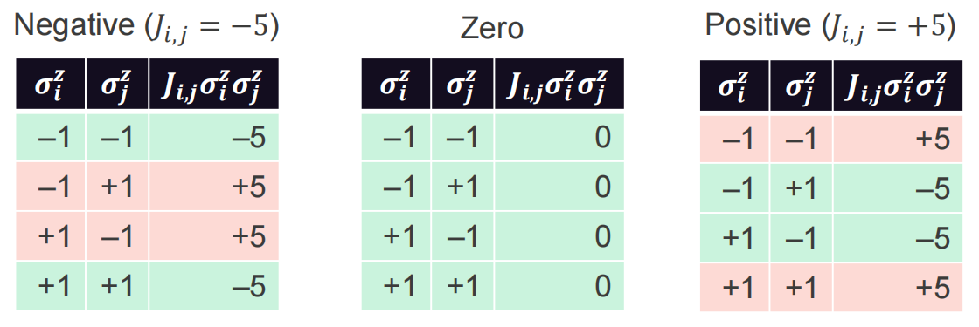
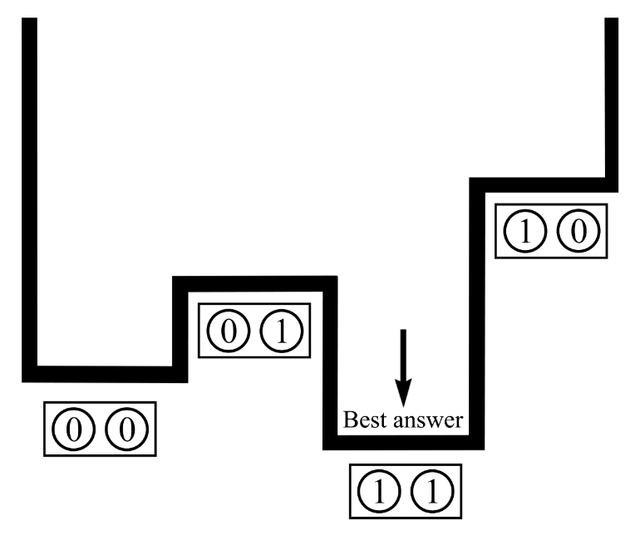
Dwave Hamiltonian
Consider only the coupler strengths:
Here are the optimal values of σ^{z} and σ^{z} for different values of J_{i,j}:
Observations
A negative J_{i,j} means, “I want σ^{z} and σ^{z} to be equal”
i j
A zero J_{i,j} means, “I don’t care how σ^{z} and σ^{z} are related”
i j
A positive J_{i,j} means, “I want σ^{z} and σ^{z} to be different”
i j
Notes:
animation
margin word

Slide 18
Outline
Motivation and Quantum Computing Basics
Quantum Annealing
Quadratic unconstrained binary optimization (QUBO)
Hybrid Quantum Benders' Decomposition
Bender Decomposition Basics
Quantum and class computing Bender Decomposition
Applications
Optimization Problems in Wireless Networks
Feature Selection for Machine Learning
Cable-Routing Problem in Solar Power Plants
Conclusions

Slide 19
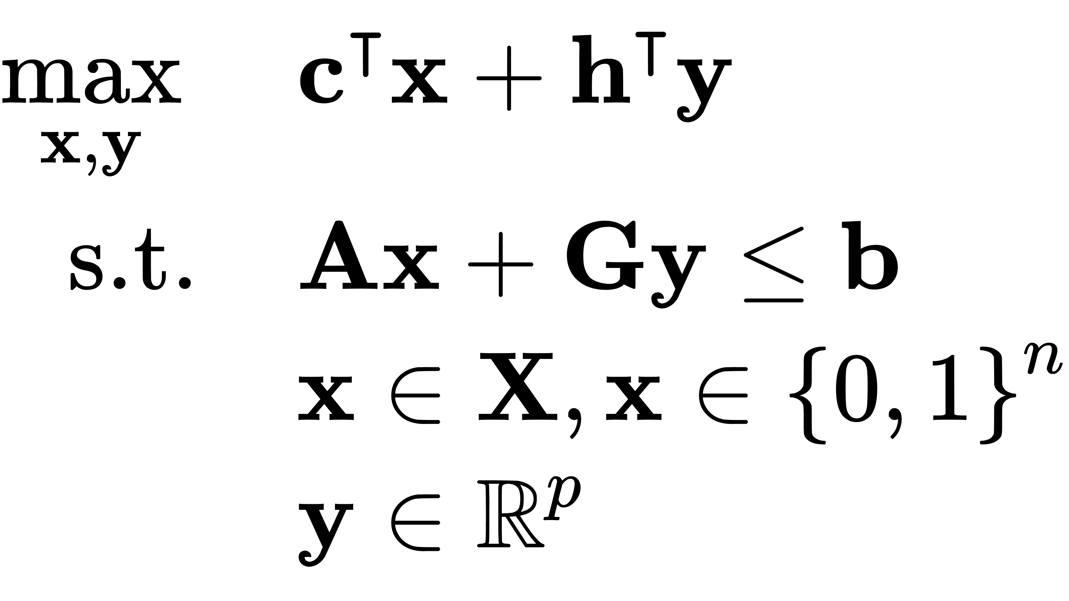
1
Structure of MILP
Electrical & Computer Engineering
Mixed-integer Linear Programming is of:
Problem type | Example Problem
NP-Hard | Matrix Permanent Turing Halting Problem MILP
NP-Complete | Steiner Tree Graph 3-coloring Maximum Clique
NP | Factoring Graph Isomorphism
P | Linear Programming Graph Connectivity
Mixed-Integer linear Programming (MILP) is NP-Hard.
It can't be solved in polynomial time unless P=NP.
NP-Hard
NP-Complete
NP
P
Notes:
The Silicon Valley-based Toyota AI Ventures fund, with $200 million under management,
When decision variables increase, it is very difficult to solve.

Slide 20
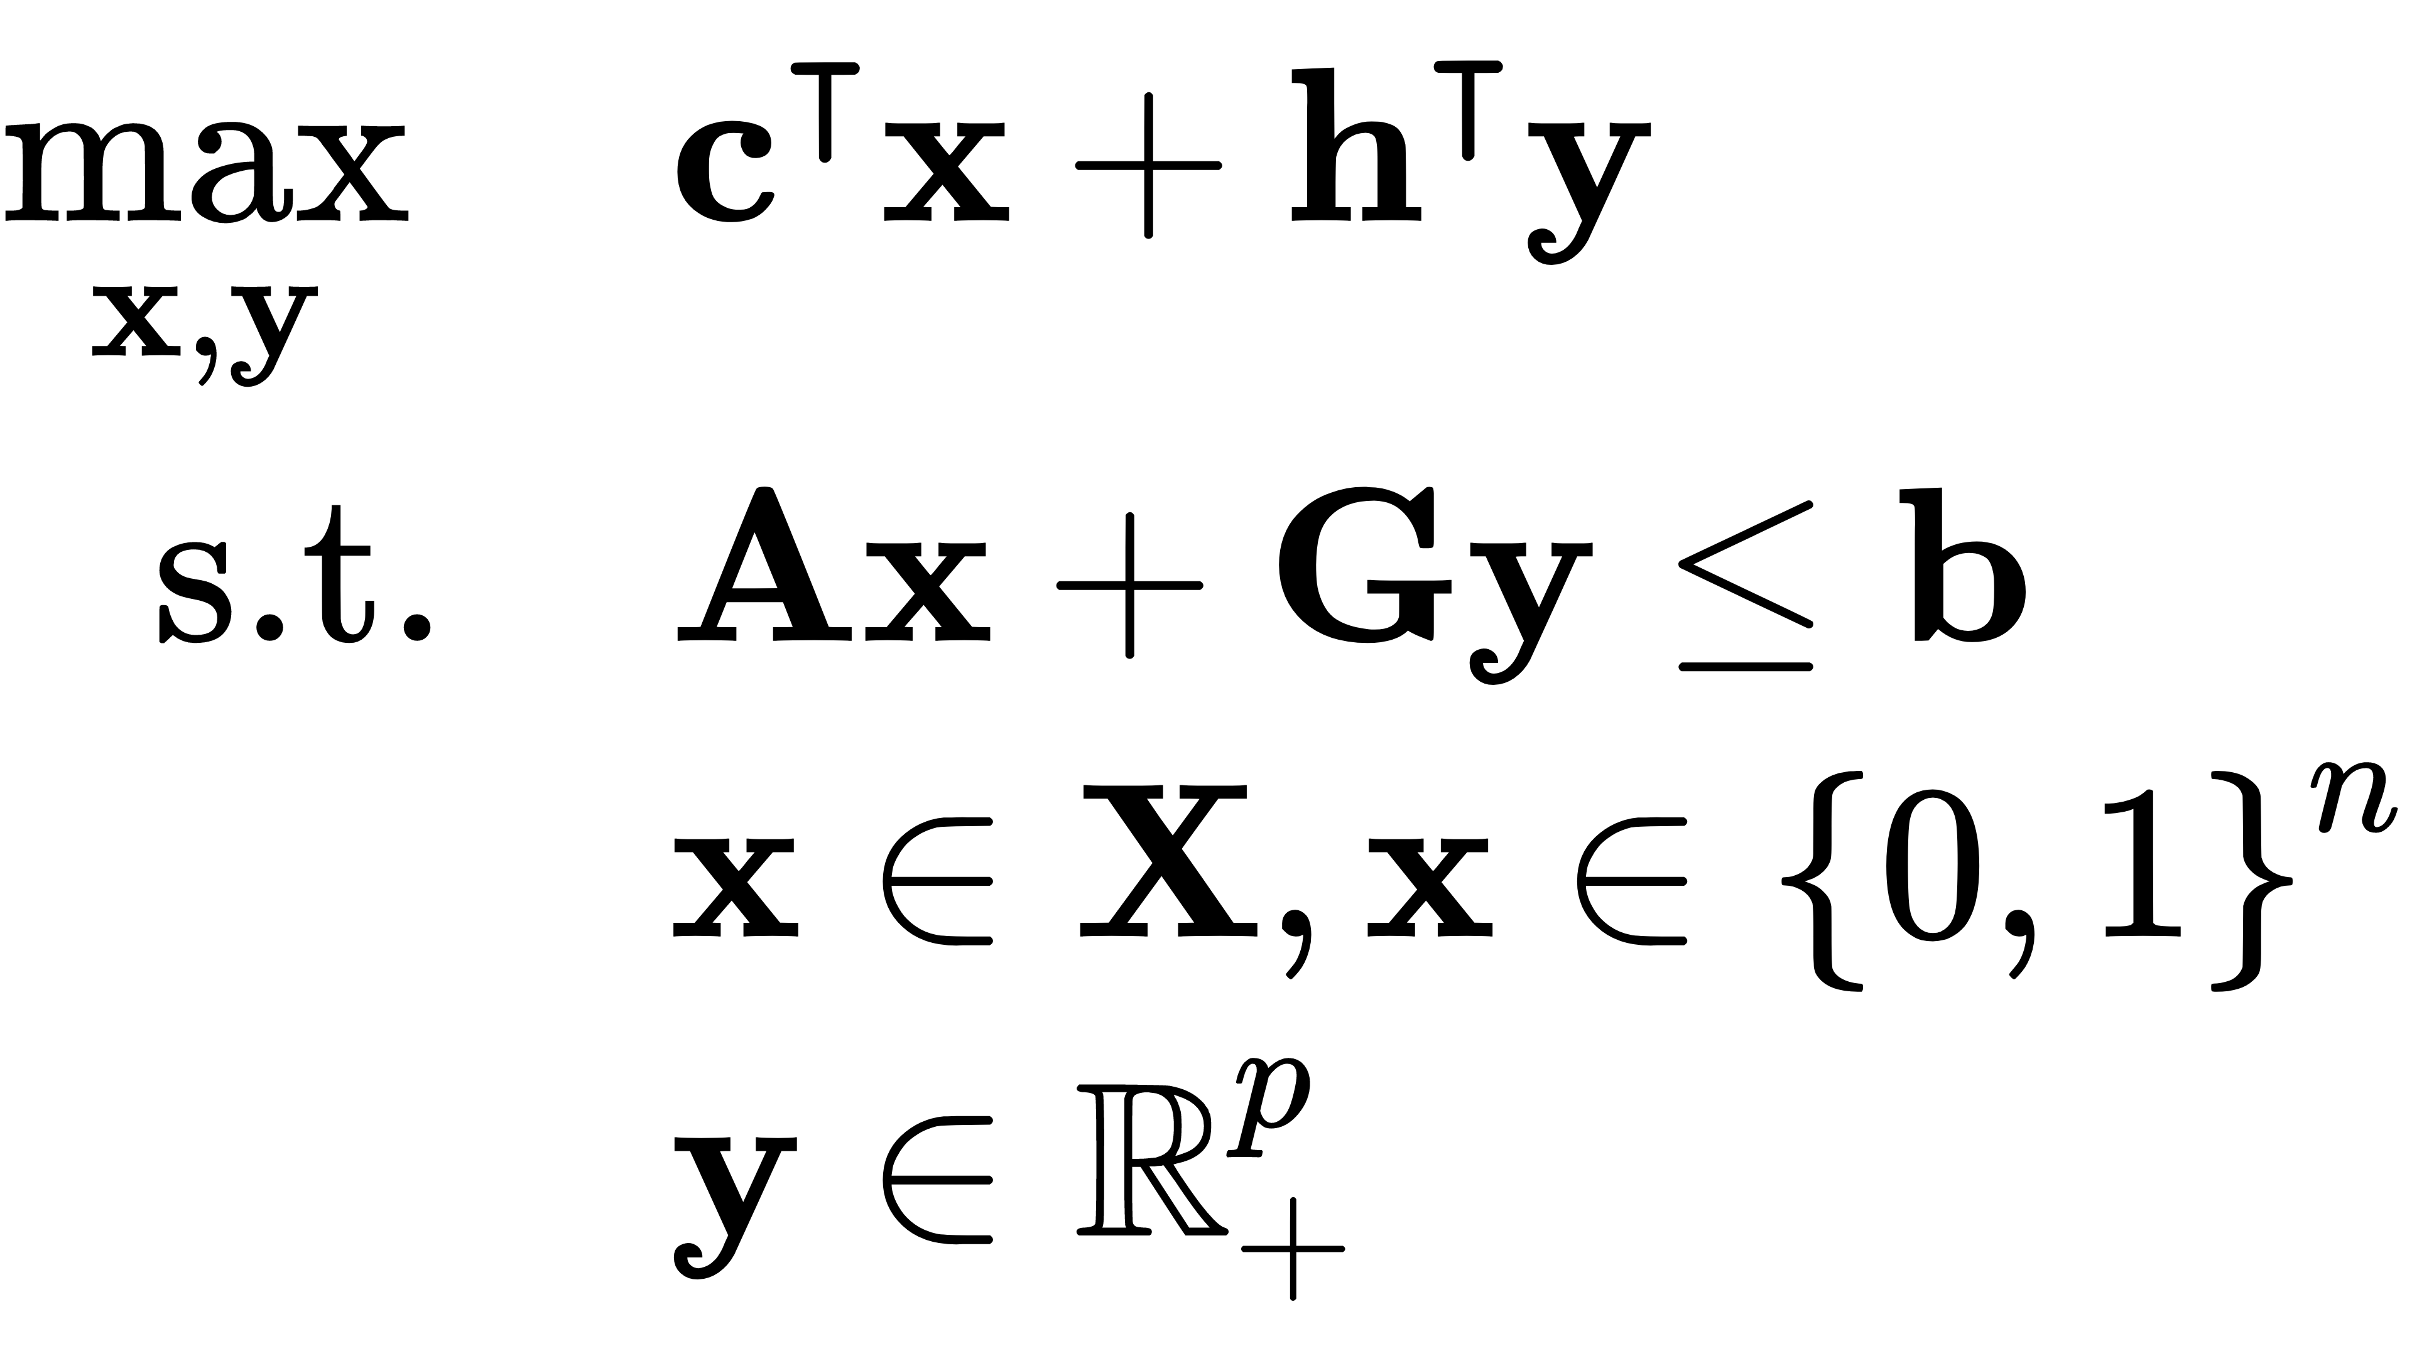
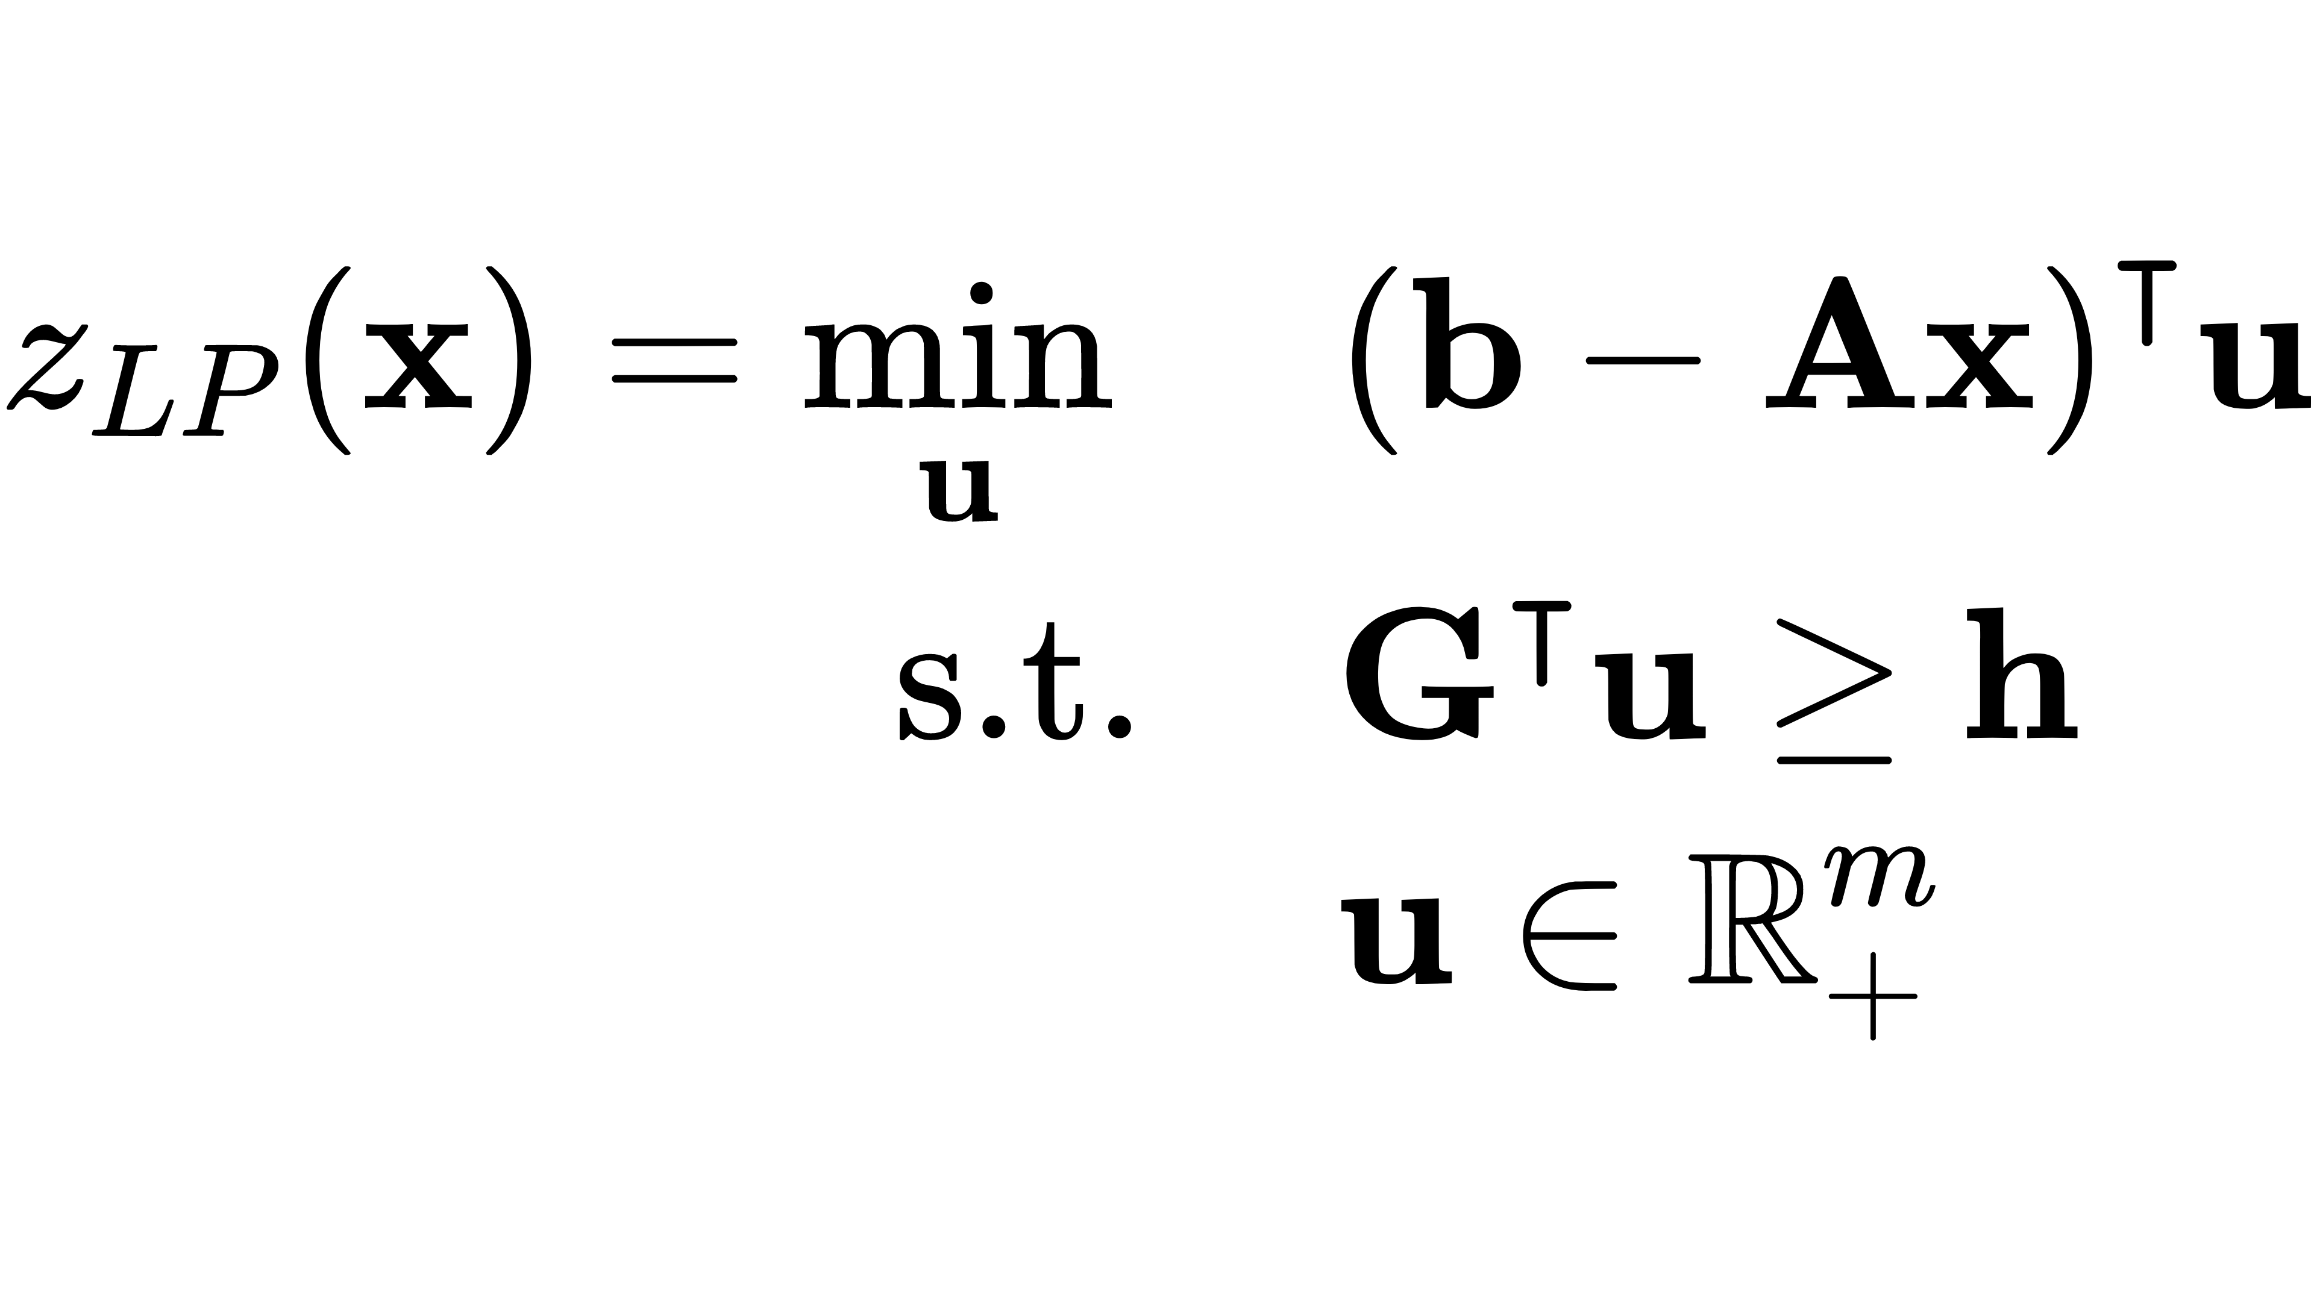
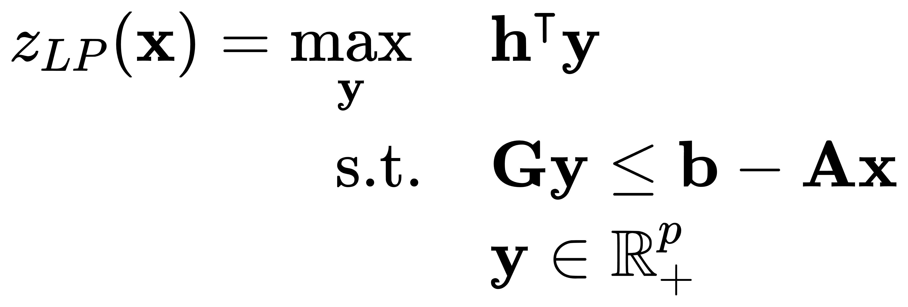
1
Benders’ Decomposition
Electrical & Computer Engineering
Consider a Mixed-integer Linear Programming
$z_{LP}$ Replacement
We denote the value of the best choice for $y$ by $z_{LP}(x)$
LP Duality
Feasible Region $Q$
Notes:
Where {\displaystyle A,B} represent the constraints shared by both stages of variables and {\displaystyle Y} represents the feasible set for {\displaystyle \mathbf {y} }. Notice that for any fixed {\displaystyle \mathbf {\bar {y}} \in Y}, the residual problem is
The original mixed integer program can then be written as a nonconvex problem in the integer variables:
Q for the dual problem does not depend on x

Slide 21
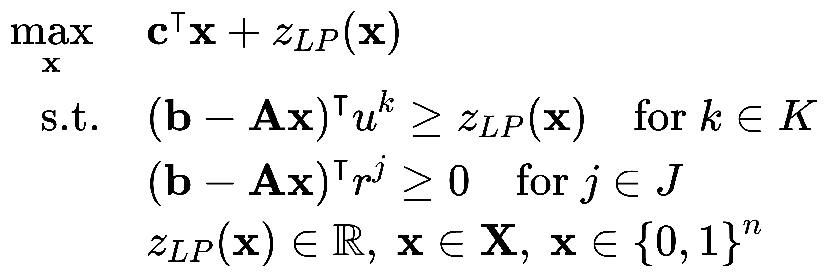
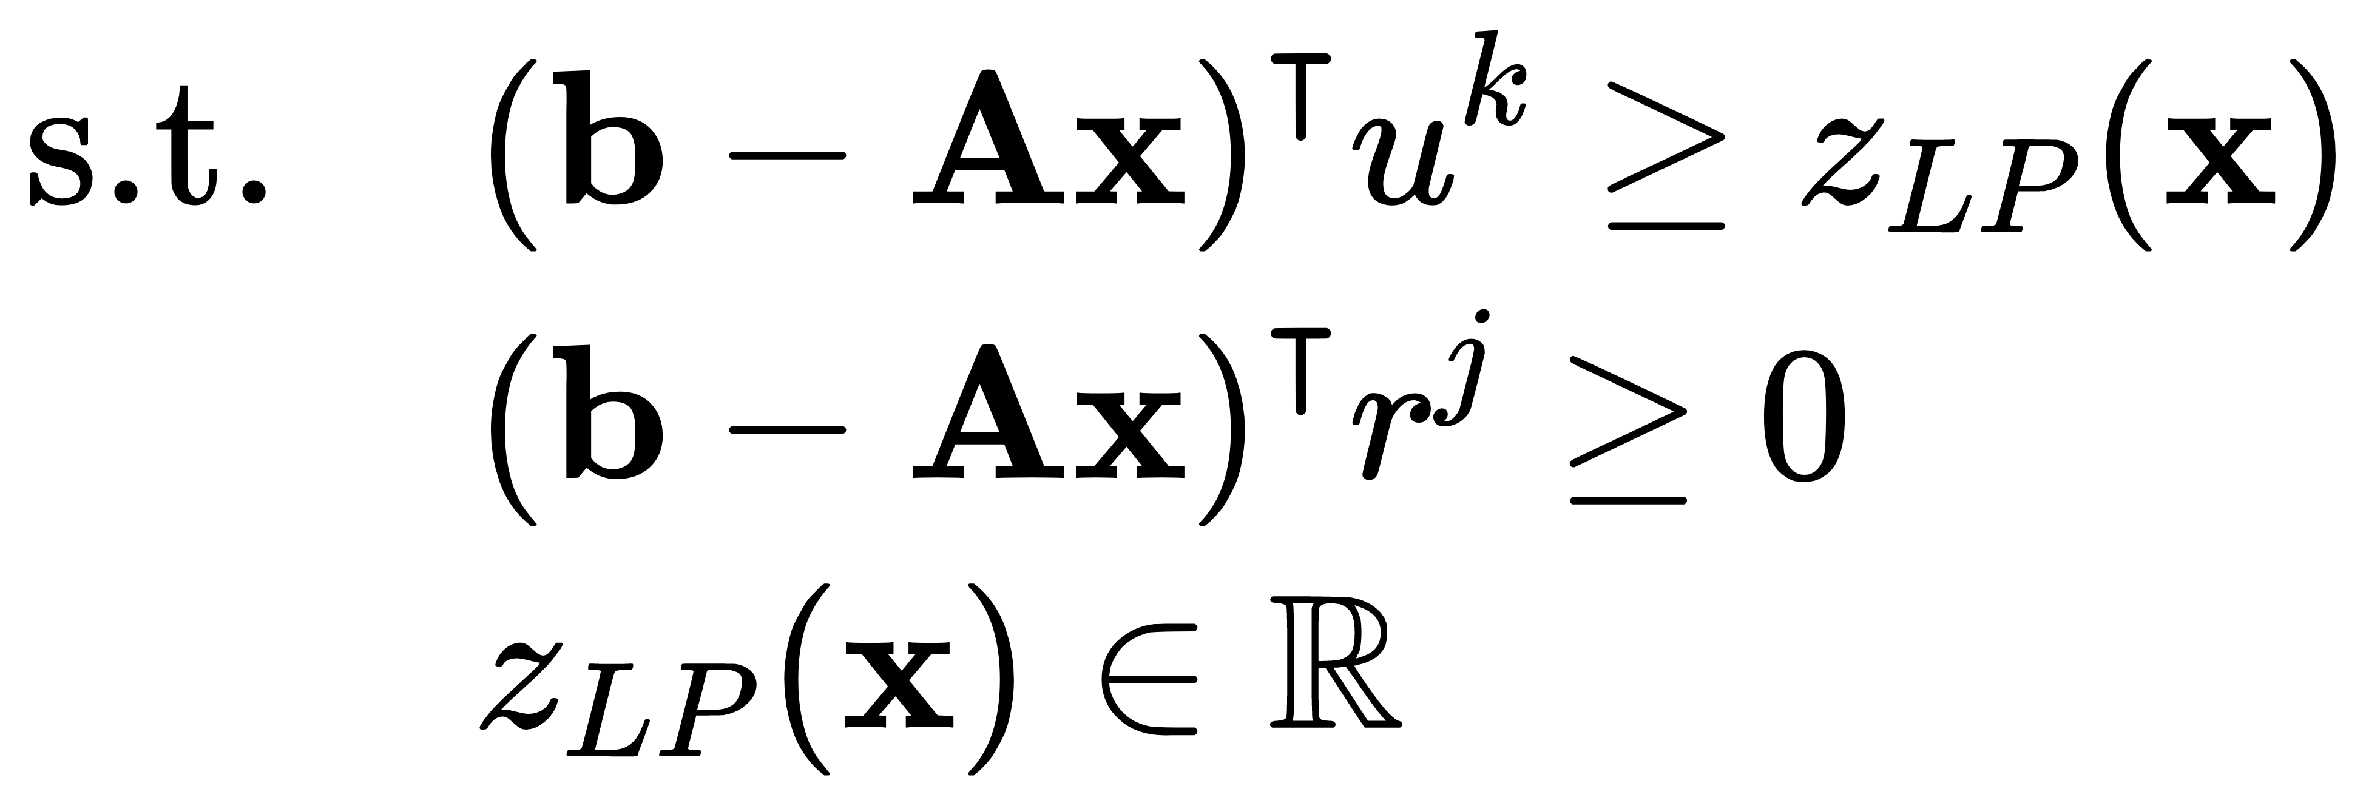
1
Benders’ Decomposition
Electrical & Computer Engineering
Continue:
Feasible Region $Q$
The feasible region Q does not depend on x.
The feasible region Q does not exist
The original problem is not feasible
$$z_{LP} bounded$$
$$z_{LP}=−∞$$
Notes:
Note that the feasible region Q for the Subproblem does not depend on x.
We will yield the extreme points and extreme rays of Q respectively:
if it is Extreme point the Z _ LP will be bounded. therefore the objective function of sub problem will be greater or equal to the Z_LP. We call it an optimality cut.
if it is exrtreme ray. Z _ LP will drop to negative infinity. Equivalently, in this situation, the master problem is infeasible, so x does not allow a feasible solution to the original problem (1). Thus, we have the valid constraints by let the objective bigger then Zero. We call it a feasibility cut.
Then we merge the cuts to the master problem and yield a new master problem of Bender’s decomposition.

Slide 22
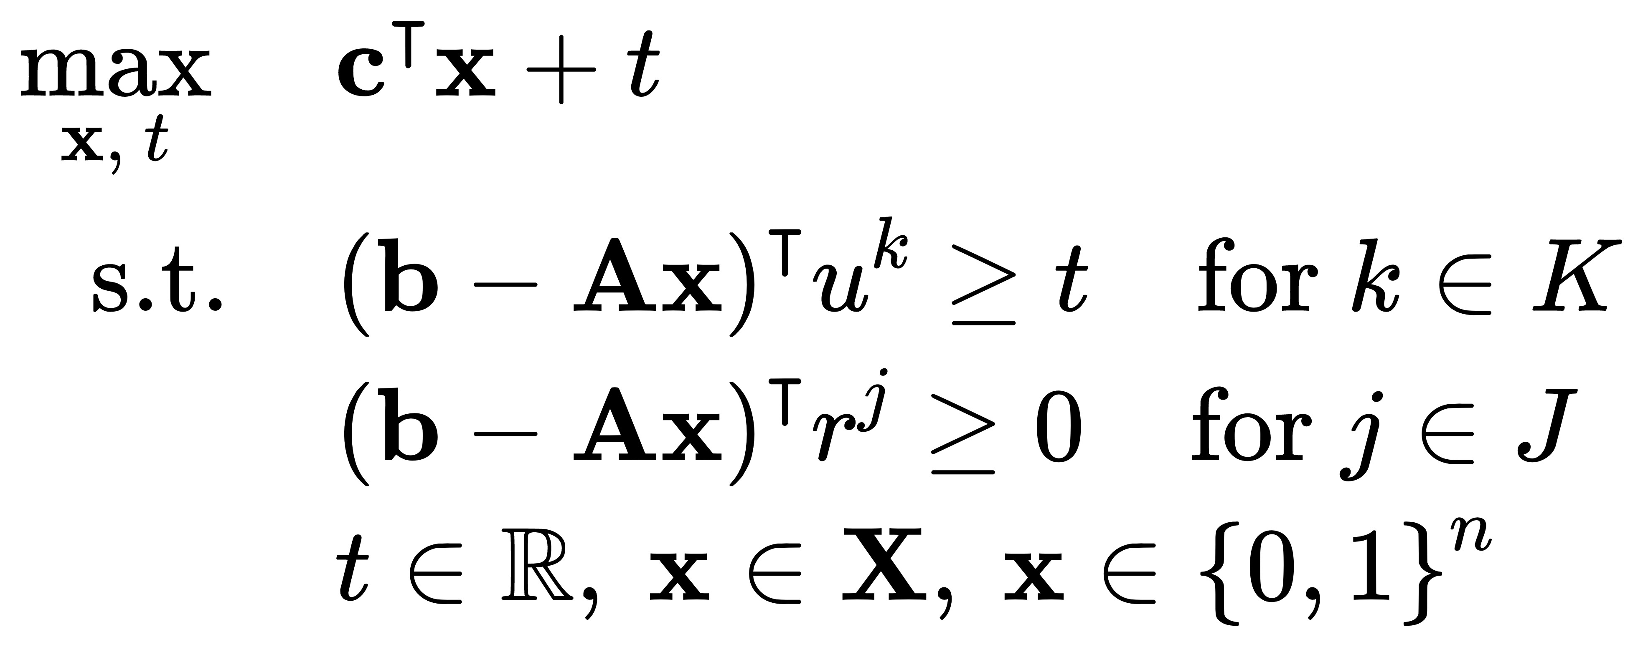
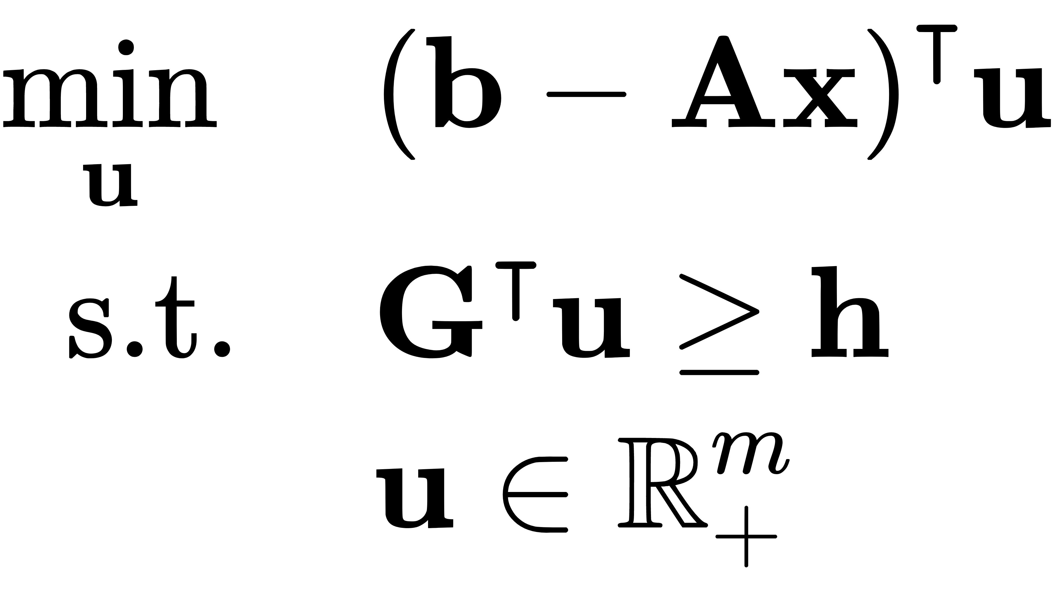
1
Benders’ Decomposition
Electrical & Computer Engineering
Continue:
Feasible Region $Q$
Replace $z_{LP}\left(x\right)$ with symbol $t$
solution $x$
Feasible region Q
Either extreme ray or point
Master Problem
Subproblem
Notes:
Note that the feasible region Q = {u ∈ R m + : GT u ≥ h} for the dual problem does not depend on x. We denote the extreme points and extreme rays of Q as K and J respectively:
If the inner product between (b − Ax) and any ray r j is negative then zLP (x) = −∞. Equivalently, in this situation, problem (2) is infeasible, so x does not allow a feasible solution to the original problem (1). Thus, we have the valid constraints

Slide 23
1
Benders’ Decomposition
Electrical & Computer Engineering
Algorithm:
Master Problem
Determine (possibly empty) initial sets $\hat{K}$ of extreme points and $\hat{\text{J}}$of extreme rays of Q.
Solve problem (6), the relaxation of the Benders reformulation. Obtain solution $\overline{x}$ and corresponding $\overline{t}$.
Determine $z_{LP}(\overline{x})$by solving the dual (3) of the subproblem.
If ${\overline{z}}_{LP}=−∞$, an extreme ray of Q has been found. Add the extreme ray to $\hat{\text{J}}$ and return to Step 2. (Feasibility Cuts).
If $z_{LP}\left(\overline{x}\right)<\overline{t}$ and finite, Add the extreme point of Q to $\hat{K}$ and return to Step 2. (Optimality Cuts)
If $z_{LP}\left(\overline{x}\right)=\overline{t}$ then $\overline{x}$ solves the original mixed integer program (1), with optimal y equal to the solution to the primal subproblem (2) with $x=\overline{x}$ .
Feasible region Q
Either extreme ray or point
solution $x$
Subproblem
Notes:
Note that the feasible region Q = {u ∈ R m + : GT u ≥ h} for the dual problem does not depend on x. We denote the extreme points and extreme rays of Q as K and J respectively:
If the inner product between (b − Ax) and any ray r j is negative then zLP (x) = −∞. Equivalently, in this situation, problem (2) is infeasible, so x does not allow a feasible solution to the original problem (1). Thus, we have the valid constraints

Slide 24
2
Hybrid Quantum Benders' Decomposition for Mixed-integer Linear Programming
Electrical & Computer Engineering
Classical Benders’ Decomposition (CBD)
solution $x$
Feasible region Q
Either an extreme ray or a point
Master Problem
Subproblem
QUBO (Quadratic Unconstrained Binary Optimization)
Master problem of the CBD is
one step away from
pure ILP (Integer-linear programming).
The last barrier is the scalar $t$.
${\text{Q}}_{\text{obj}}$: Upper triangular matrix $x_{\text{i} }$ : Binary variable
Notes:
After looking at the exploration signal data acquired from the surface and interior of the earth,
I’d like to move on to the second part of the presentation and talk about subsurface signal denoising.

Slide 25
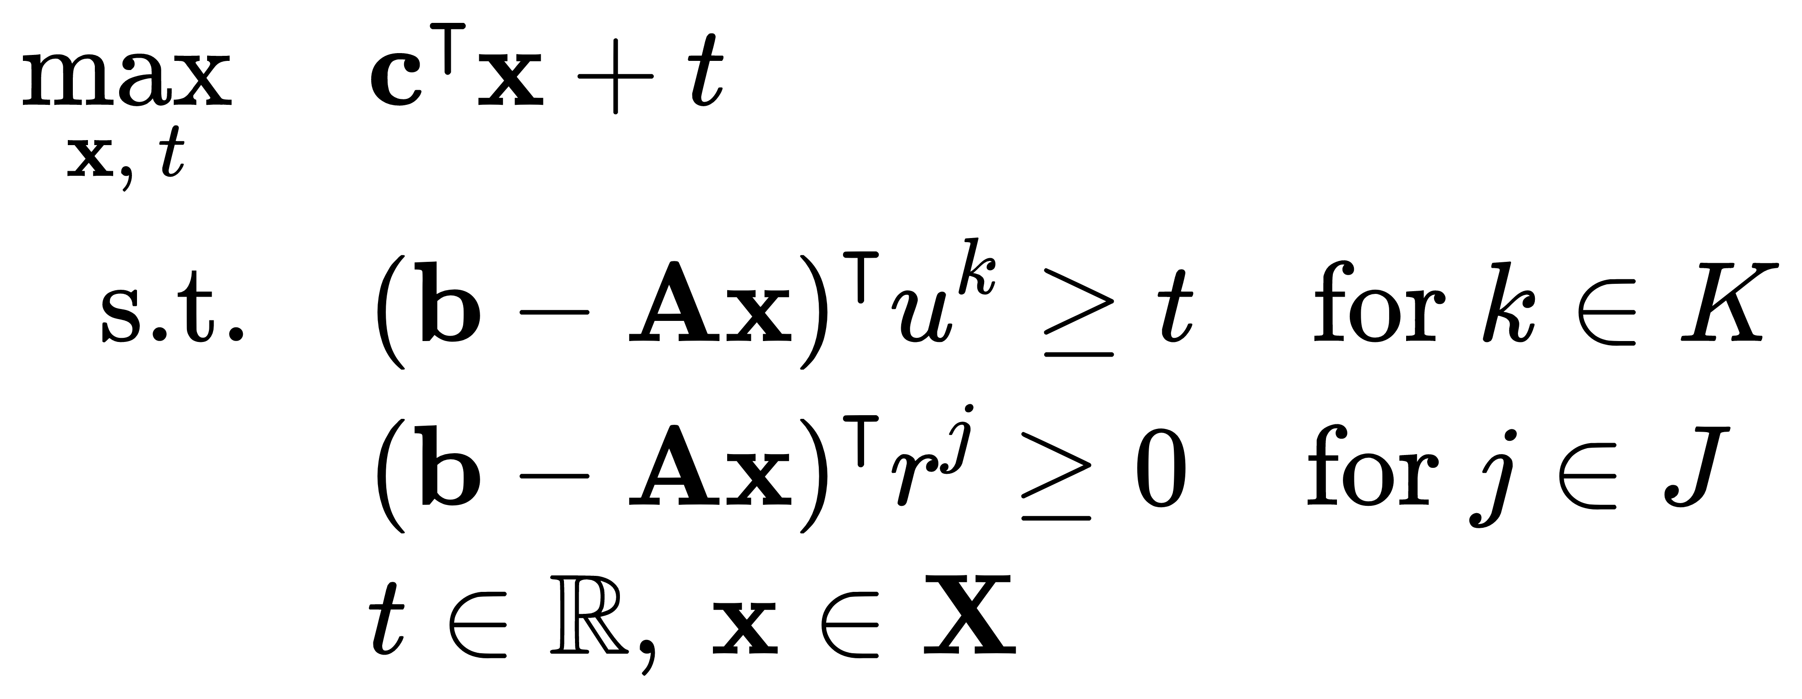
2
Hybrid Quantum Benders' Decomposition for Mixed-integer Linear Programming
Electrical & Computer Engineering
Classical Benders’ Decomposition Master Problem
In order to reformulate the master problem into the QUBO formulation,
We use a binary vector $w$with length of $M={\overline{m}}_{+}+\underline{m}+{\overline{m}}_{−}+1$ bits to replace the continuous variable 𝑡.
$${\overline{m}}_{+}$$ | : # of bits of $\text{ℕ}$ part.
$$\underline{m}$$ | : # of bits of the decimal part.
$${\overline{m}}_{−}+1$$ | $:$ # of bits of ${\text{ℤ}}_{−}$ part.
Notes:
After looking at the exploration signal data acquired from the surface and interior of the earth,
I’d like to move on to the second part of the presentation and talk about subsurface signal denoising.

Slide 26
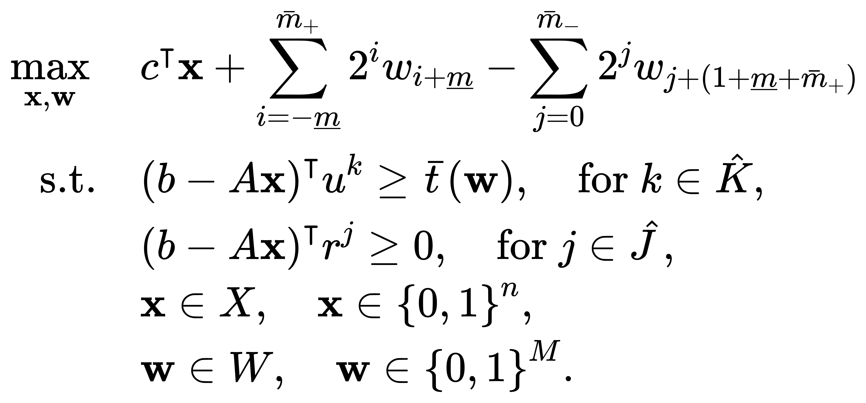
2
Hybrid Quantum Benders' Decomposition for Mixed-integer Linear Programming
Electrical & Computer Engineering
Classical Benders’ Decomposition Master Problem
Alternative Benders’ Decomposition Subproblem
$t$ reformulation
MILP
Pure ILP
QUBO can be applied now.
Notes:
After looking at the exploration signal data acquired from the surface and interior of the earth,
I’d like to move on to the second part of the presentation and talk about subsurface signal denoising.

Slide 27
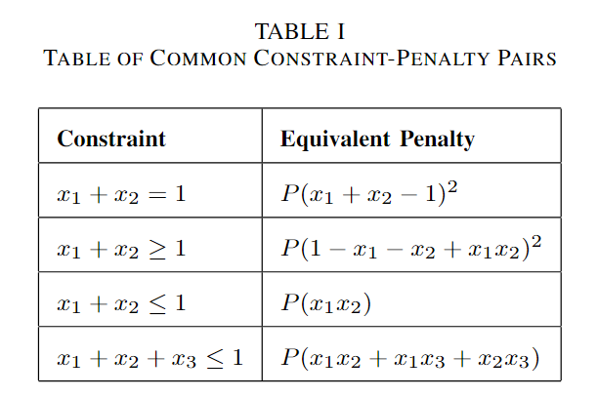
2
Hybrid Quantum Benders' Decomposition for Mixed-integer Linear Programming
Electrical & Computer Engineering
Hybrid Quantum Benders’ Decomposition Master Problem
Alternative Benders’ Decomposition Master Problem
1) Objective Function:

Slide 28
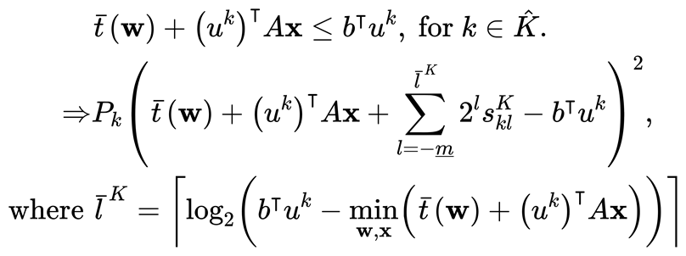
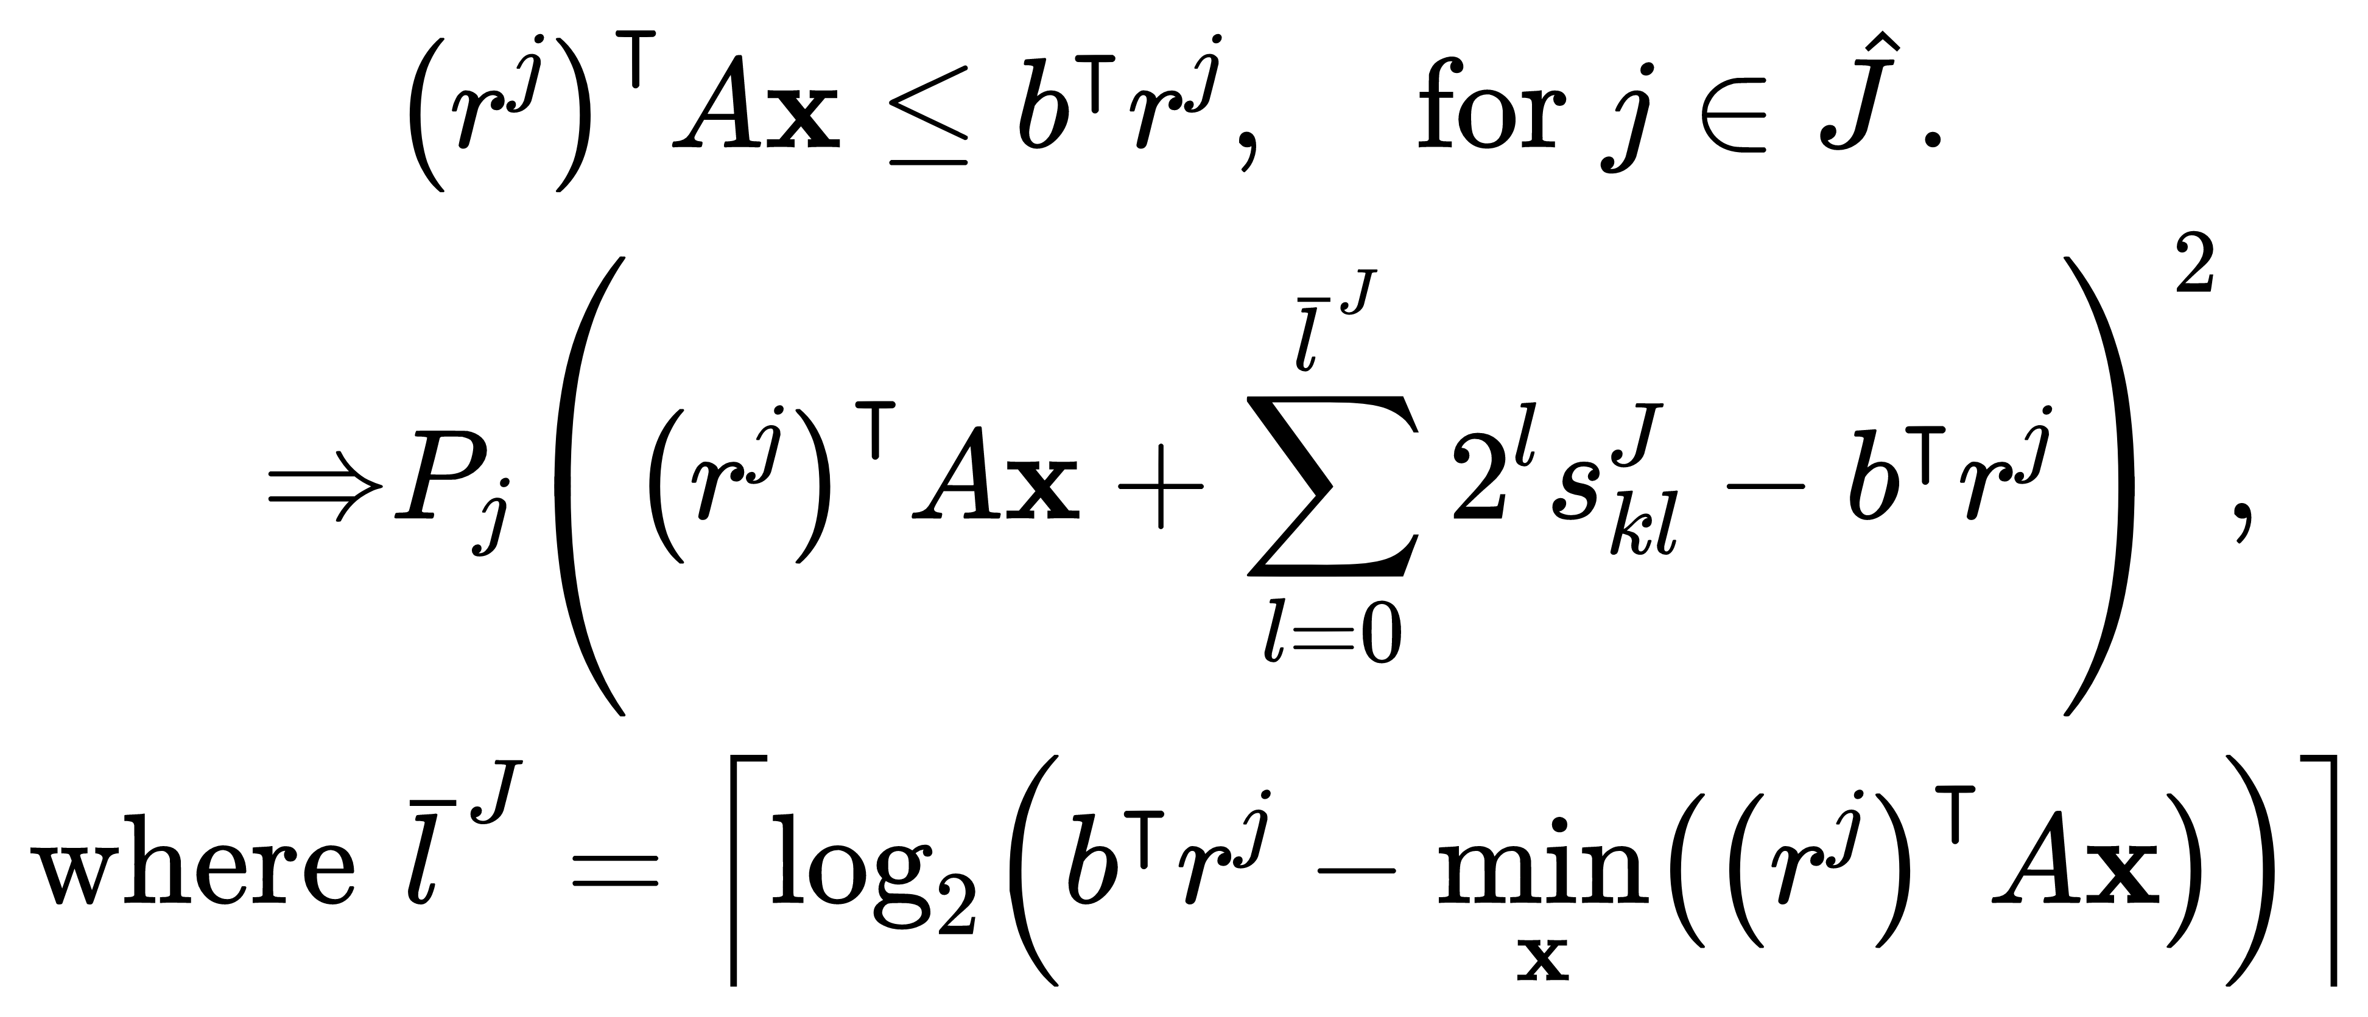
2
Hybrid Quantum Benders' Decomposition for Mixed-integer Linear Programming
Electrical & Computer Engineering
2) Optimality Cuts：
Hybrid Quantum Benders’ Decomposition
Master Problem
3) Feasibility Cuts：

Slide 29
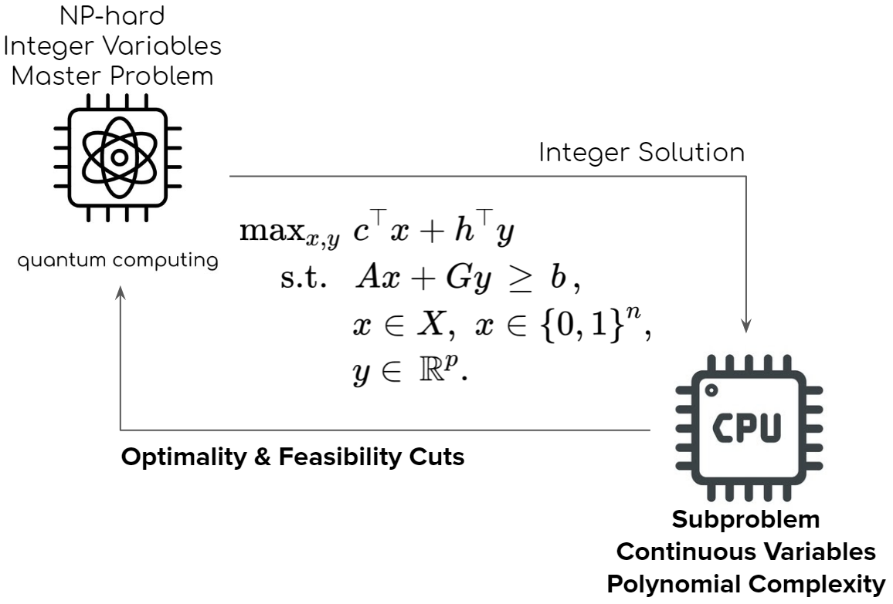
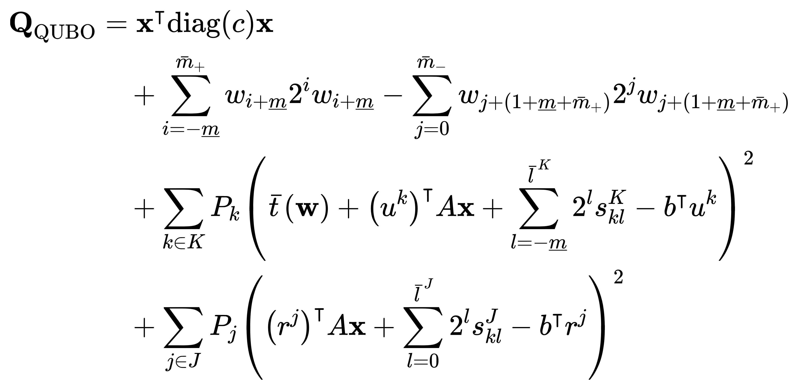
2
Hybrid Quantum Benders' Decomposition for Mixed-integer Linear Programming
Electrical & Computer Engineering
Hybrid Quantum Benders' Decomposition for Mixed-integer Linear Programming
Notes:
After looking at the exploration signal data acquired from the surface and interior of the earth,
I’d like to move on to the second part of the presentation and talk about subsurface signal denoising.

Slide 30
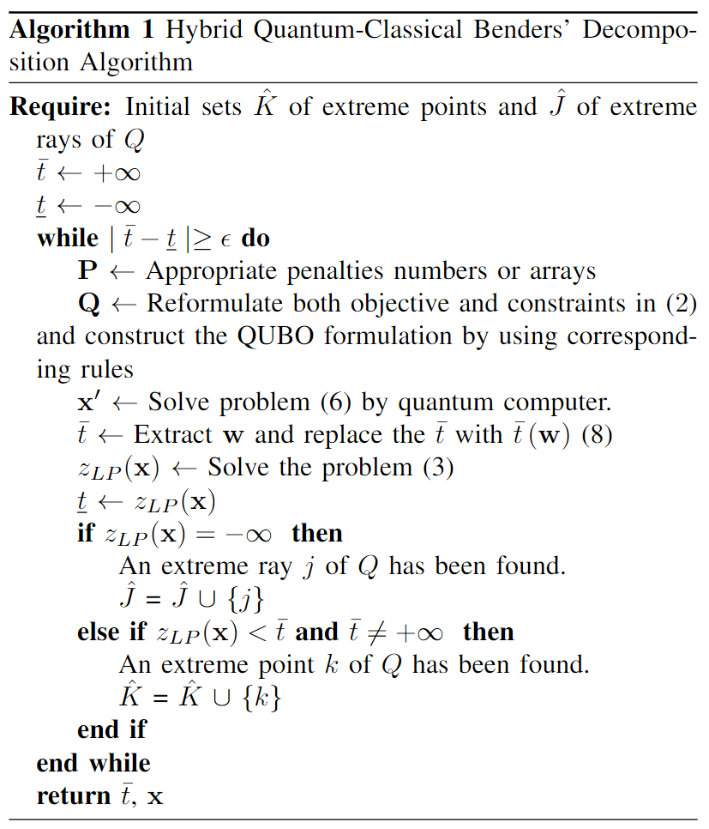
2
Hybrid Quantum Benders' Decomposition for Mixed-integer Linear Programming
Electrical & Computer Engineering
Hybrid Quantum Benders' Decomposition Algorithm
$$x$$
$\underline{t}=\overline{t}$ ?
$$\underline{t}={(b−Ax)}^{\text{T}}u$$ $u^{k}$ or $r^{k}$
30
Notes:
After looking at the exploration signal data acquired from the surface and interior of the earth,
I’d like to move on to the second part of the presentation and talk about subsurface signal denoising.

Slide 31
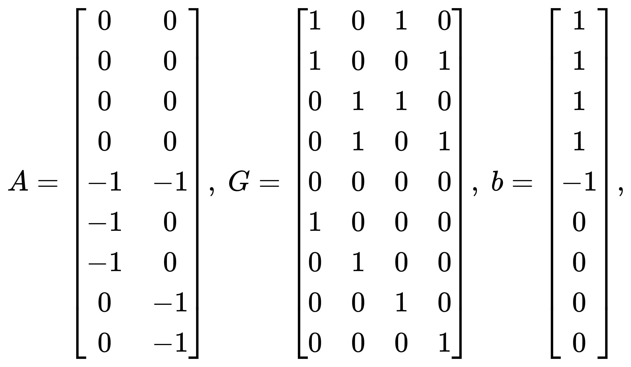
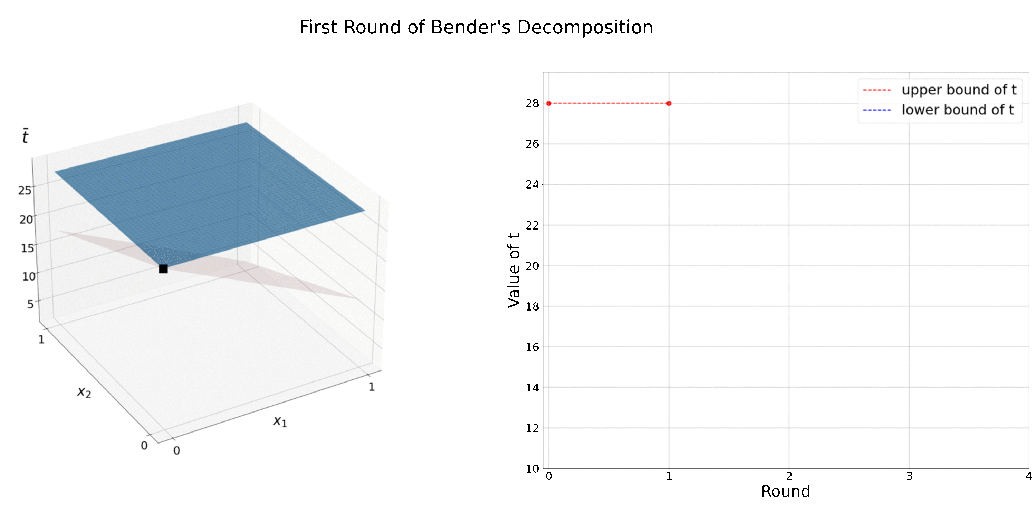
2
Hybrid Quantum Benders' Decomposition for Mixed-integer Linear Programming
Electrical & Computer Engineering
Hybrid Quantum Benders’ Decomposition Algorithm
D-Wave hybrid solver: use classical computation to assist quantum annealing.
Zhongqi Zhao, Lei Fan, and Zhu Han, ``Hybrid Quantum Benders' Decomposition For Mixed-integer Linear Programming," IEEE Wireless Communications and Networking Conference (WCNC), Austin, TX, April 2022.
Lei Fan and Zhu Han, ``Hybrid Quantum-Classical Computing for Future Network Optimization," IEEE Network, special issue on Quantum Communications and Networking.
Notes:
After looking at the exploration signal data acquired from the surface and interior of the earth,
I’d like to move on to the second part of the presentation and talk about subsurface signal denoising.

Slide 32
Outline
Motivation and Quantum Computing Basics
Quantum Annealing
Quadratic unconstrained binary optimization (QUBO)
Hybrid Quantum Benders' Decomposition
Benders Decomposition Basics
Quantum and Class Computing Bender Decomposition
Applications
Optimization Problems in Wireless Networks
Feature Selection for Machine Learning
Cable-Routing Problem in Solar Power Plants
Conclusions

Slide 33
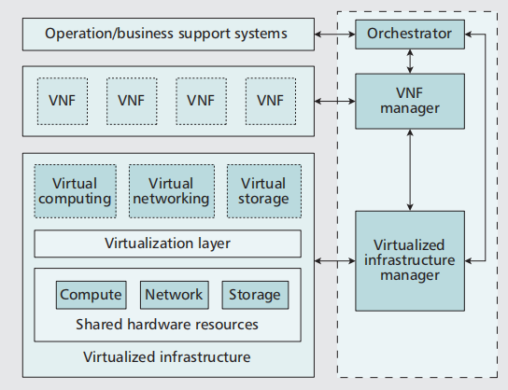
Network Function Virtualization
NFV reduces the difficulty of hardware configuration, improve the flexibility of a network.
Vast service chains;
VNF scheduling problem:
--- how to deploy VMs to process VNFs;
Delay minimization;

Slide 34
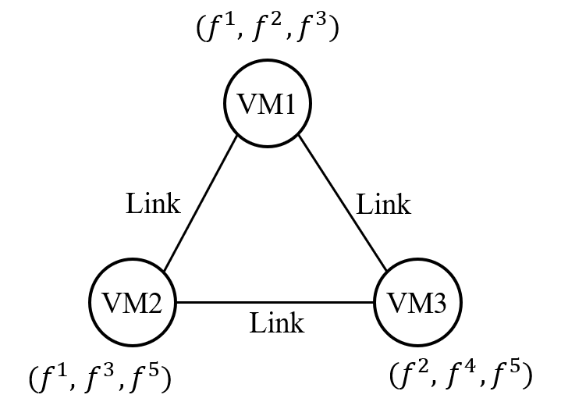
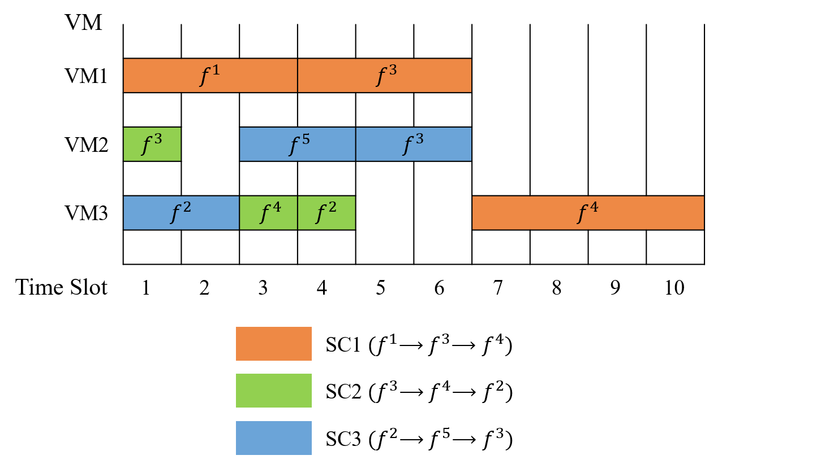
System Model
All hardware is located in a data center ---- Neglect the transmission delay
${ T}_{ijm}$: the minimum integer that is equal to or larger than ${(t}_{ijm}/∆T).$
Example
A NFV network
A possible arrangement of service chains

Slide 35
Problem Formulation
ILP Model
Decision Variable
$x_{ijm}$ | equals to 1, if VM $m$ is used to process $f_{ij}^{k}$; otherwise, equals to 0
$$y_{ijmt}$$ | equals to 1, if VM $m$ is used to process $f_{ij}^{k}$in the time slot $t$ ; otherwise, equals to 0
$$z_{ijmt}$$ | equals to 1, if VM $m$ starts to process $f_{ij}^{k}$at the beginning of the time slot $t$ ; otherwise, equals to 0
$$p_{ijmt}$$ | equals to 1, if VM $m$ finishes processing $f_{ij}^{k}$at the beginning of the time slot $t$ ; otherwise, equals to 0
Other
$$f_{ij}^{k}$$ | the $j^{th}$ function in service $i$ belongs to the $k^{th}$ type of functions
$$V_{ij}^{k}$$ | the set of VMs which can serve $f_{ij}^{k}$
$T_{ijm}$ | the number of time slots occupied by processing $f_{ij}^{k}$on VM $m$

Slide 36
Problem Formulation
ILP Model
The objective function: minimize the total delay of all service chains in the network.
Calculate the finish time of any service chain.
Any function $f_{ij}^{k}$can be processed on only one VM.
If and only if $f_{ij}^{k}$ is allocated to VM $m$, this VM can start processing $f_{ij}^{k}$ at some point.

Slide 37
Problem Formulation
Once the VM starts processing the function $f_{ij}^{k}$, the VM must process it for required time.
Each VM can process at most one function in one time slot.
The relationship between $x_{ijm}$ and $y_{ijmt}$.
The next function of the service chain must be processed after the processing of the one before it.
Required total time $T_{ijm}$ for processing function $f_{ij}^{k}$ must be satisfied
$x_{ijm}, y_{ijmt}, z_{ijmt}$and${ p}_{ijmt}$must be equal to 0 if the VM cannot process the function $f_{ij}^{k}$ .
$z_{ijmt}$and $p_{ijmt}$cannot be equal to 1 at the same time.
For any function $f_{ij}^{k}$ , only one $z_{ijmt}$, and one ${ p}_{ijmt}$can be equal to 1 because the function $f_{ij}^{k}$can be only processed for one time.
The logical relationship between $y_{ijmt}, z_{ijmt}$and${ p}_{ijmt}.$

Slide 38
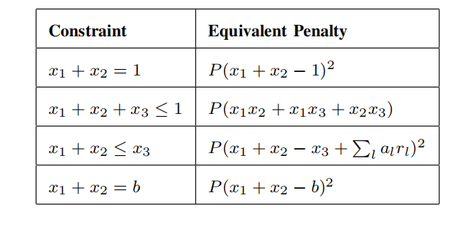
Problem Formulation
QUBO Model
$$f\left(x\right)= \sum_{i}{Q_{i,i}x_{i}}+\sum_{i}{\sum_{i<j}{Q_{i,j}x_{i}}x_{j}}$$
Q : upper-diagonal matrix
symmetric matrix
QUBO: Quadratic Unconstrained Binary Optimization ------ No constraint
How to transfer the ILP model to QUBO model?
Reformulate all constraints into quadratic penalties;
Add them to the original objective function;
Penalty coefficient:
large positive constant
Binary variable:
$$x_{1}=x_{1}^{2}$$
Slack variable
Ref.[8]

Slide 39
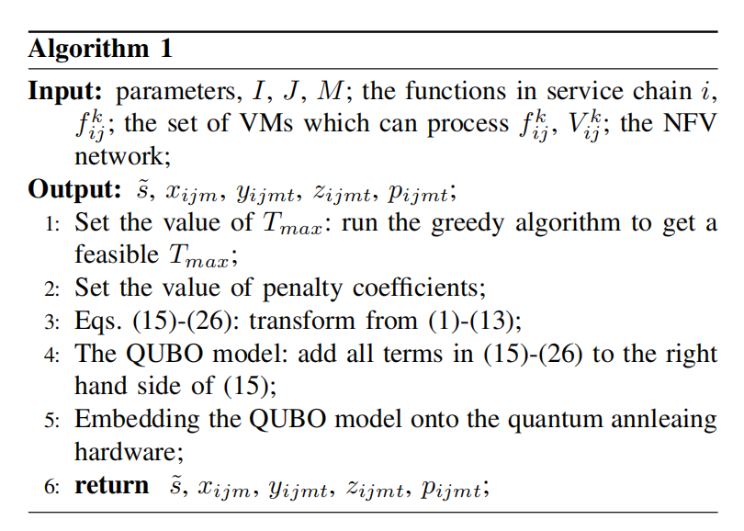
Algorithm
----- Find a reasonable $T_{max}$
----- Reduce the number of variables
The greedy algorithm: rearrange all VNFs in service chains to a service chain
----- Solve the problem with more variables
D-Wave hybrid solver: use classical computation to assist quantum annealing
Wenlu Xuan, Zhongqi Zhao, Lei Fan, and Zhu Han, ``Minimizing Delay in Network Function
Visualization with Quantum Computing," invited, The 18th IEEE International Conference on Mobile Ad-Hoc and Smart Systems (MASS), Denver, CO, October 2021.

Slide 40
Study Case Results
Case | Parameter | Matrix Q Size | Average QPU Access Time (s) | Average Solver Run Time (s) | Success Rate
a | I=2, J=2, M=2 | (272, 272) | 0.065 | 2.993 | 100%
b | I=3, J=2, M=2 | (675, 675) | 0.065 | 2.997 | 64%
c | I=2, J=3, M=2 | (600, 600) | 0.063 | 2.998 | 36%
d | I=2, J=2, M=3 | (462, 462) | 0.061 | 2.994 | 100%
e | I=3, J=3, M=2 | (1191, 1191) | 0.064 | 2.997 | 58%
f | I=3, J=3, M=3 | (1303,1303) | 0.063 | 3.630 | 4%
Spending a much longer time on finding a feasible solution for case f ;
For case f, the success rate is very low (because of too many variables);
Matrix Q size ↑, the difficulty of finding the optimal solution ↑ .

Slide 41
Outline
Motivation and Quantum Computing Basics
Quantum Annealing
Quadratic unconstrained binary optimization (QUBO)
Hybrid Quantum Benders' Decomposition
Benders Decomposition Basics
Quantum and Class Computing Bender Decomposition
Applications
Optimization Problems in Wireless Networks
Feature Selection for Machine Learning
Cable-Routing Problem in Solar Power Plants
Conclusions

Slide 42
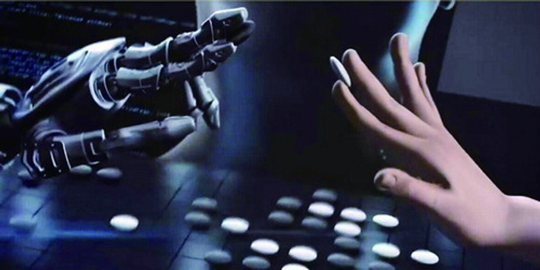
Quantum Machine learning
Machine Learning
Classical learning technicues facing complex tasks
Quantum Computing
Quadradic speed-up
QML
Quantum Machine Learning Machine learning and fast Not only fast

Slide 43
Feature Selection
Need for feature selection
With feature selection, we can optimize our model in some way
Huge data to train
Relevant feature
Irrelevant feature
Redundant feature
set of features
select best features
Prevent overfitting
Improve accuracy
Reduce training time
learning algorithm
evaluate

Slide 44
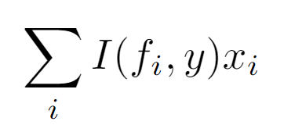
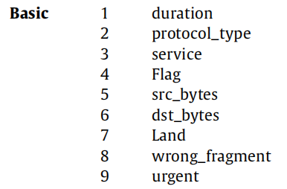
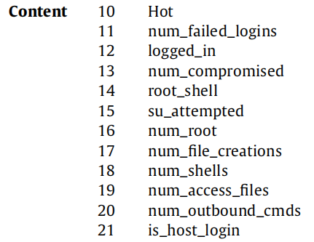
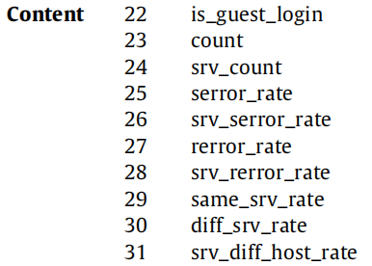
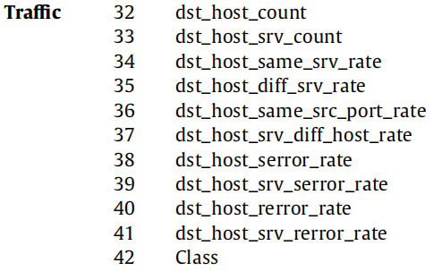
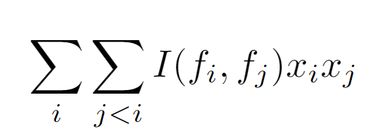
BILP Model
Objective function: maximize relevant feature
while minimizing redundant feature
Many Constraints
“influence”
“influence”
α：bias
α：bias
x：decision variable
k：number of feature
x：decision variable
k：number of feature
Set K is decided by a wrapper method
“independence”
“independence”

Slide 45
Constraints
Some rely on others
Some are conflict
Feature in C_{g} may have the same information,
and are selected at most once
Some are essential and have priority

Slide 46
Algorithm & Experiments
Number of features
Accuracy of feature selection methods, including Qubo, GR^{[1]}
QUBO get best performance when k = 12
QUBO’s performance is better than other feature selection methods
Mingze Li, Hongliang Zhang, Lei Fan, and Zhu Han, ``A Quantum Feature Selection Method for Network Intrusion Detection," IEEE 19th International Conference on Mobile Ad Hoc and Smart Systems (MASS), 2022.

Slide 47
Outline
Motivation and Quantum Computing Basics
Quantum Annealing
Quadratic unconstrained binary optimization (QUBO)
Hybrid Quantum Benders' Decomposition
Benders Decomposition Basics
Quantum and Class Computing Bender Decomposition
Applications
Optimization Problems in Wireless Networks
Feature Selection for Machine Learning
Cable-Routing Problem in Solar Power Plants
Conclusions

Slide 48
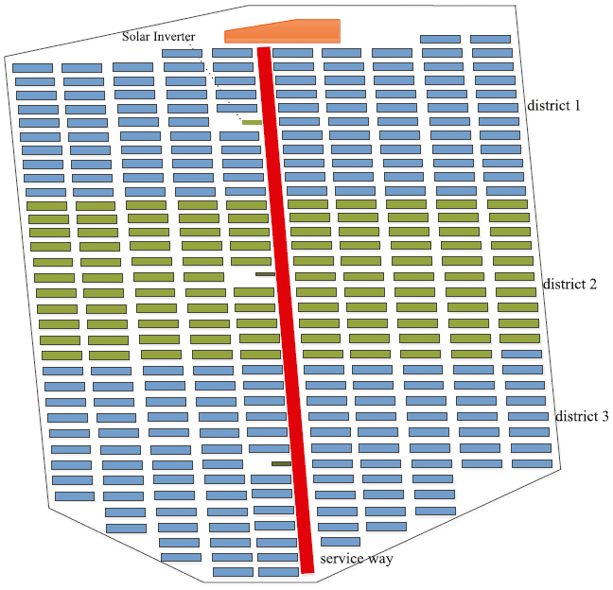
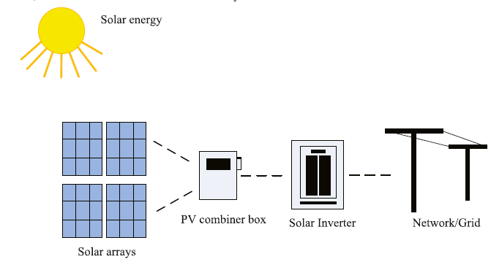
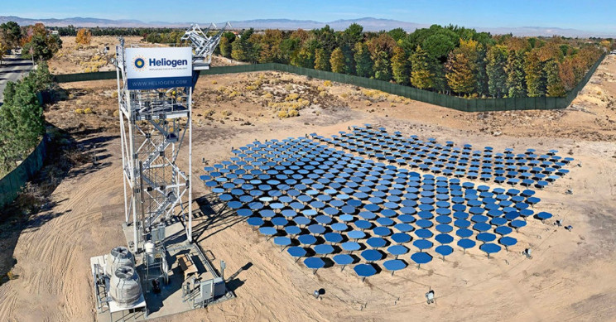
Cable-Routing Problem (CRP) in Solar Power Plants
Quantum Computing for Cable-Routing Problem in Solar Power Plants
Exploring the edge of quantum annealing in the networking problem
Fast arrangement with minimum building cost is one objective of the solar power plant design.

Slide 49
The CRP Model
Quantum Computing for Cable-Routing Problem in Solar Power Plants
Pure integer Programming problem
Bus level
Electricity unity leaving
Electricity I/O unity difference
Bus level requirements
Special requirements
Notes:
The answer must follow four rules, according to graph theory and physical theory.
4 rules that list to the right
p: the coefficient controlling the flow cost;
C_e: the cost of the edge e ∈ E;
V’ all vertices except vertex 0;

Slide 50
Experiments
Histogram and Density Graph of Gurobi & D-Wave’s Quantum computer in 2 Cases with 30 Attempts
The quantum computing approach outperforms the classical computing approach in terms of solution quality, average running time, and robustness.
Notes:
We test our model on Dwave and we run the same on Gurobi on PC. The testbench has 2 cases and each cases has 30 random scenarios (samples). Each test bench will be run 3 times to mitigate the randomness.
Histogram and Density Graph of Gurobi & D-Wave’s Quantum computer in Case A with 30 Attempts
We evaluate two approaches respectively based on three criteria: success rate, average execution time, and robustness.
c) Robustness: As seen in Table II and Figure, the execution time of the classical computing approach has a 30 times larger standard deviation than the quantum computing approach in both cases. The quantum computing approach outperformed the classical computing approach. Therefore, our data support that the quantum approach is more robust than the counterpart which means it is not sensitive to the disturbs of the parameters in the optimization model.

Slide 51
Conclusion
Quantum Computing
Universal Quantum
Analog Quantum
Quantum Annealing
QUBO model
Benders’
decomposition
Collaboration
VNFs scheduling problem
Feature selection
MILP problem
A heuristic algorithm
A wrapper algorithm
A classical-quantum hybrid algorithm
The optimal solution
The best combination of features
More Applications …
The optimal solution
Wireless Networks
Machine Learning
Smart Grid Networks

Slide 52
Reference
[1] M. Kim, D. Venturelli, and K. Jamieson, “Leveraging quantum annealing for large MIMO processing in centralized radio access networks,” in Proceedings of the ACM Special Interest Group on Data Communication (SIGCOMM), Beijing, China, Aug. 2019.
[2] W. Cruz-Santos, S. E. Venegas-Andraca, and M. Lanzagorta, “A QUBO formulation of minimum multicut problem instances in trees for D-wave quantum annealers,” Sci. Rep., vol. 9, no. 17216, pp. 1–12, Nov. 2019.
[3] R. P. Feynman, “Simulating physics with computers,” Int. J. Theor. Phys., vol. 21, pp. 467–488, Jun. 1982.
[4] M. Johnson, M. Amin, S. Gildert, et al. “Quantum annealing with manufactured spins,” Nature, vol. 473, pp. 194–198, May 2011.
[5] B. Han, V. Gopalakrishnan, L. Ji, and S. Lee, “Network function virtualization: challenges and opportunities for innovations,” IEEE Communications Magazine, vol. 53, no. 2, pp. 90–97, Feb. 2015.
[6] J. Ordonez-Lucena, P. Ameigeiras, D. Lopez, J. J. Ramos-Munoz, J. Lorca, and J. Folgueira, “Network slicing for 5G with SDN/NFV: Concepts, architectures, and challenges,” IEEE Communications Magazine, vol. 55, no. 5, pp. 80-87, May 2017.
[7] W. Xuan, Z. Zhao, L. Fan and Z. Han, "Minimizing Delay in Network Function Visualization with Quantum Computing," 2021 IEEE 18th International Conference on Mobile Ad Hoc and Smart Systems (MASS), Denver, USA, Oct. 2021. (my publication)
[8] F. Glover, G. Kochenberger, and Y. Du, “Quantum bridge analytics I: a tutorial on formulating and using qubo models,” 4OR, vol. 17, no. 4, pp. 335–371, Dec. 2019.
[9] “Operational Behavior of a High Definition Map Application (White Paper),” May 2020. https://aecc.org/wp-content/uploads/2020/05/Operational-Behavior-of-a-High-Definition-Map-Application.pdf
[10] Shrivas, A. K., & Dewangan, A. K. (2014). An ensemble model for classification of at_x0002_tacks with feature selection based on kdd99 and nsl-kdd data set. International Journal of Computer Applications, 99(15), 8–13.
[11] Aljawarneh, S., Aldwairi, M., & Yassein, M. B. (2018). Anomaly-based intrusion de_x0002_tection system through feature selection analysis and building hybrid efficient model. Journal of Computational Science, 25, 152–160.

Slide 53
Visit Our Lab
http://wireless.egr.uh.edu/
53
http://www2.egr.uh.edu/~zhan2

Slide 54
THANK YOU

