Slide 1

MetaSensing: Reconfigurable Intelligent Surface Assisted RF Sensing and Localization
Zhu Han
Department of Electrical and Computer Engineering
University of Houston, Houston, TX, USA
http://wireless.egr.uh.edu/research.htm
ACK: Boyao Di, Hongliang Zhang, Lingyang Song, Jingzhi Hu, Haobo Zhang

Slide 2
Table of Contents
Background
  6G Communications and Requirements
  RIS Basics and Potential Applications
RIS-aided RF Sensing and Localization
  Case 1: Posture Recognition
  Case 2: RF 3D Shape Sensing
  Case 3: Ubiquitous Localization
Potential Future Directions
Conclusions

Slide 3

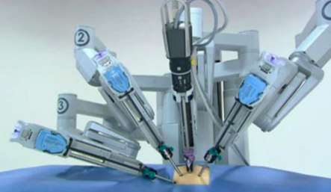




Moving Towards 6G: Emerging Use Cases
VR/AR
Internet-of-Things
Intelligence
AR for surgery
Auto-manufacturing
Smart home
VR for education
E-health
Environment sensing

Slide 4








General 6G KPI Targets
Energy efficiency
Peak data rate
6G
Connectivity
5G
Security
eMBB
URLLC
Greater sensing capability
mMTC
Sensing accuracy
Latency
Higher positioning accuracy
Notes:
难以满足6G的需求

Slide 5
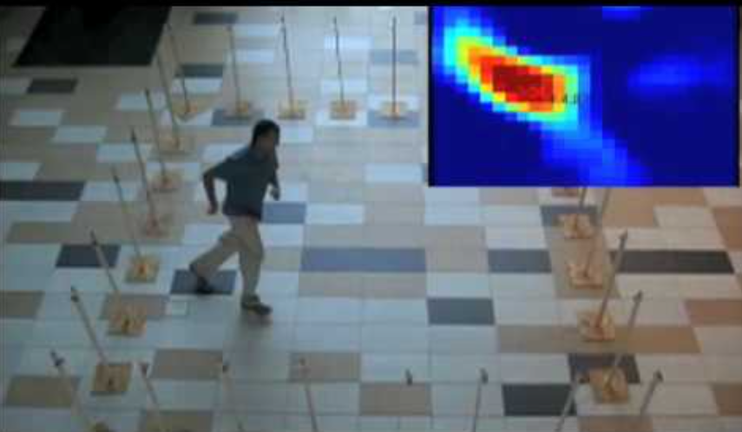
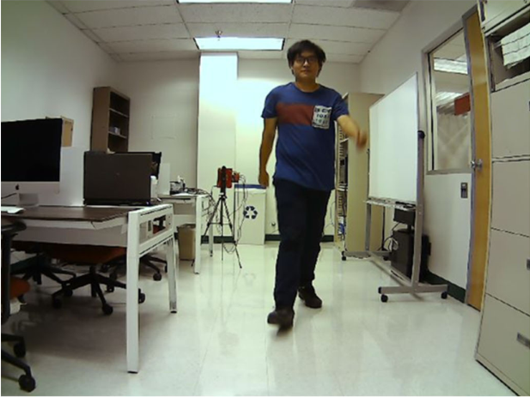
6G Challenges: Sensing Efficiency
Conflict between simplicity (comfort) and high sensing accuracy
WiFi based RF Sensing
  Requires the cooperation of multiple WiFi access points to achieve high sensing accuracy
mmWave Radar
  High hardware cost makes it hard for mass deployment
Radar
WiFi based RF Sensing
mmWave Radar

Slide 6
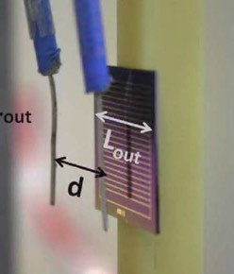
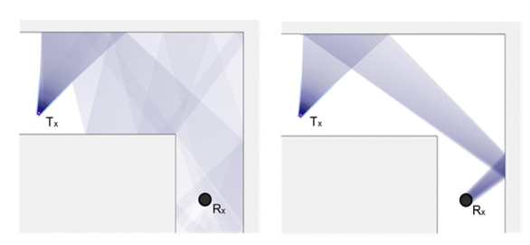
Solutions: Meta-Material aided Sensing
Expectation on a new technology
Low cost in manufacture
Easy and flexible deployment
Compatible with 6G demands on sensing and localization
Reconfigurable Meta-surfaces
Implemented by metamaterial
Cost efficient in manufacture and deployment
Control and customize favorable radio environments
Provide high accuracy contact/contactless sensing with wireless data gathering
So-called Reconfigurable Intelligent Surface,
(RIS) or Intelligent Reflecting Surface (IRS)
RIS
RF antennas

Slide 7
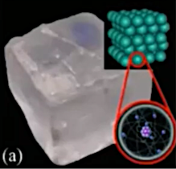




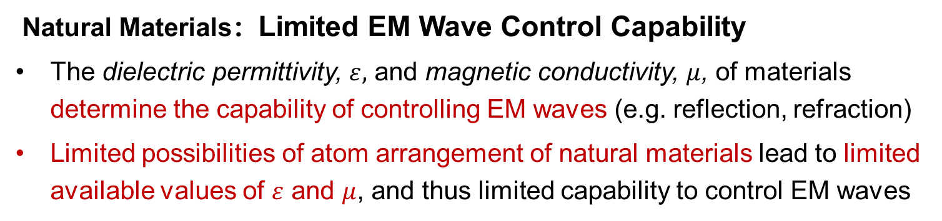
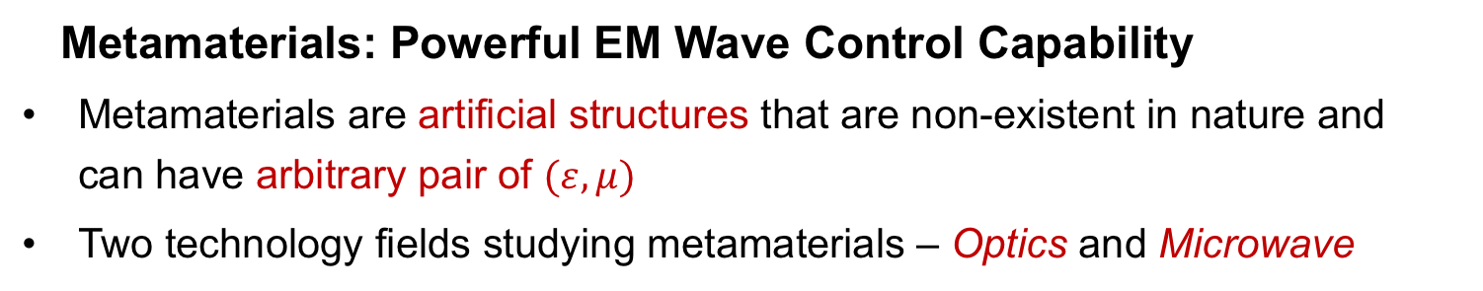
Introduction of Metamaterial
Natural Materials：Limited EM Wave Control Capability
The dielectric permittivity, $ε,$ and magnetic conductivity, $μ$, of materials determine the capability of controlling EM waves (e.g. reflection, refraction)
Limited possibilities of atom arrangement of natural materials lead to limited available values of $ε$ and $μ$, and thus limited capability to control EM waves
$$μ$$
Metal materials
at light frequency
Common materials
(e.g., water and glass)
$$ε$$
Rare in nature
Magnetic materials
at low frequency
Atom arrangement has limited possibilities
Metamaterials: Powerful EM Wave Control Capability
Metamaterials are artificial structures that are non-existent in nature and can have arbitrary pair of $(ε, μ)$
Two technology fields studying metamaterials – Optics and Microwave
Notes:
根据麦克斯韦方程组，一块材料在受电磁波（包括光）照射时，所表现出的电磁特性（即出射的电磁波长什么样）由两个参数来决定：介电常数ε和磁导率μ。不同材料的区别就在于这两个参数的不同。如下图，对于自然界中的物质，这两个参数组合大部分存在于1,2象限，极少数在第4象限。

Slide 8
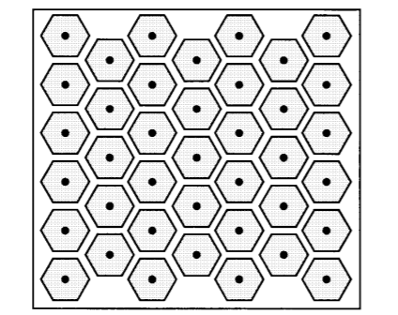


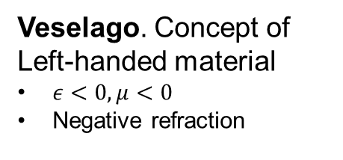
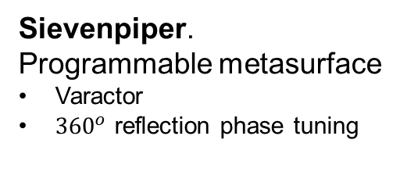
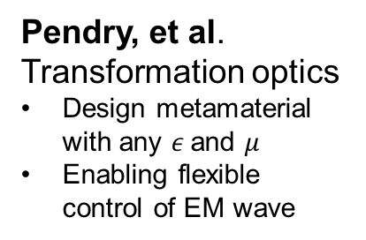
History of Metamaterial Development
Veselago. Concept of Left-handed material
$ε<0, μ<0$
Negative refraction
Sievenpiper. Proposal of meta-surface
Two-dimensional
Simplify design and manufacturing
D. R. Smith. Experimental verification
Left-handed material
1968
1999
2001
1996 & 1999
2001
2006
Pendry. Realize -ε and -μ
-ε: periodic array of metallic rods
-μ: periodic array of split ring
Sievenpiper. Programmable metasurface
Varactor
${360}^{o}$ reflection phase tuning
Pendry, et al. Transformation optics
Design metamaterial with any $ε$and $μ$
Enabling flexible control of EM wave
Notes:
最早奠定超材料理论基础的是前苏联前苏联物理学家Veselago，他于1968年在理论上提出了left-handed material，即介电常数和磁导率都小于0的材料。该材料能够实现负折射率等。然而这一材料当时仅仅是理论上提出来的，并未实现，所以未引起科学界的广泛关注
1996年和1999年，Pendry爵士分别利用周期性的金属棒阵列和周期性的开口谐振环阵列实现了负介电常数和负磁导率
之前考虑的超材料都是三维的，在高频时设计和加工起来比较困难。为了克服这个困难，在1999年，D. Sievenpiper提出了超表面。超表面是一种二维的超材料，可以借助成熟的纳米印刷或者光刻技术来制作，所以大大的降低了加工难度，简化了设计。
对传统超表面而言，一旦被加工成型后，其特性就固定下来。为了更好地满足社会需求，人们构造了多种可调的超表面。构造可调超表面的一种方法是向单元中加入可调物质，包括液晶、半导体等。其中的半导体可调超表面最早可以追溯到2001年。在2001年，Daniel. Sievenpiper利用变容二极管实现了可编程超表面，通过控制变容二极管的偏置电压，单元反射相位可以达到接近360度的变化。
在2001年，超材料领域还有一个重大的进展，就是D. R. Smith首次在实验上验证了左手材料以及负折射率
之后在2006年，Pendry和D. R. Smith共同提出了变换光学理论，提出可以构造出一种介电常数和磁导率可独立任意变化的超材料，这相对之前又是一个很大的进步，使得我们可以任意设计所需的电磁响应，从而实现灵活控制电磁波的能力

Slide 9
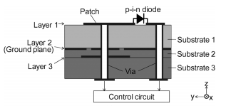
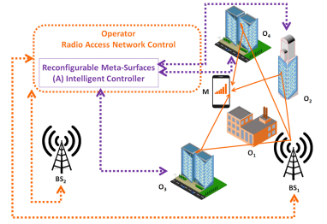
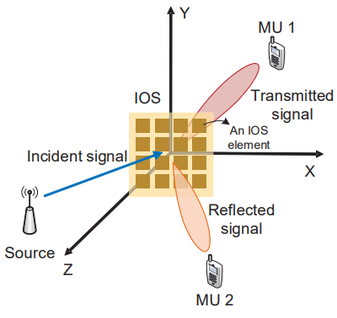
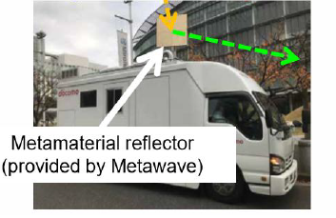


History of Metamaterial Development
H. Kamoda, et al. Reconfigurable large reflectarray with PIN diodes
Easy to control
Millimeter wave
M. D. Renzo, et al.
Proposal of reconfigurable intelligent surfaces
Focus on reflection
Extensive applications in wireless networks
S. Zhang, et al.
Proposal of intelligent omni-surface
Enabling dual function of reflection and transmission
2011
2019
2020
2014
2019
T. Cui, et al. Programmable metasurface with PIN diodes
Simplify the design
Digital coding
NTT Docomo.
Protype of metamaterial reflector
10x increase in data rate
Notes:
最早奠定超材料理论基础的是前苏联前苏联物理学家Veselago，他于1968年在理论上提出了left-handed material，即介电常数和磁导率都小于0的材料。该材料能够实现负折射率等。然而这一材料当时仅仅是理论上提出来的，并未实现，所以未引起科学界的广泛关注
1996年和1999年，Pendry爵士分别利用周期性的金属棒阵列和周期性的开口谐振环阵列实现了负介电常数和负磁导率
之前考虑的超材料都是三维的，在高频时设计和加工起来比较困难。为了克服这个困难，在1999年，D. Sievenpiper提出了超表面。超表面是一种二维的超材料，可以借助成熟的纳米印刷或者光刻技术来制作，所以大大的降低了加工难度，简化了设计。
对传统超表面而言，一旦被加工成型后，其特性就固定下来。为了更好地满足社会需求，人们构造了多种可调的超表面。构造可调超表面的一种方法是向单元中加入可调物质，包括液晶、半导体等。其中的半导体可调超表面最早可以追溯到2001年。在2001年，Daniel. Sievenpiper利用变容二极管实现了可编程超表面，通过控制变容二极管的偏置电压，单元反射相位可以达到接近360度的变化。

Slide 10
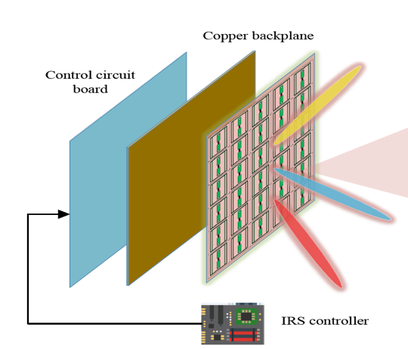
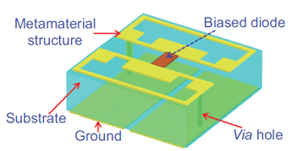
Reconfigurable Intelligent Surfaces (RIS)
An ultra-thin metasurface composed of multiple layers
Outer layer: A 2D-array of RIS elements; directly interact with incident signals.
Middle layer: A copper plate; prevent the signal energy leakage.
Inner layer: A printed circuit; connect the RIS elements to the RIS controller.
Copper backplane
Control circuit board
RIS element
Low-cost sub-wavelength programmable metamaterial particle.
Reflect incident RF signals and impose a controablle phase shift
Working frequency: from sub-6 GHz to THz
RIS controller
PIN diode
Example of a programmable metamaterial particle

Slide 11
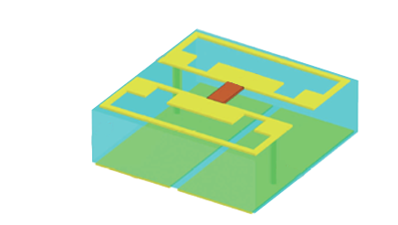
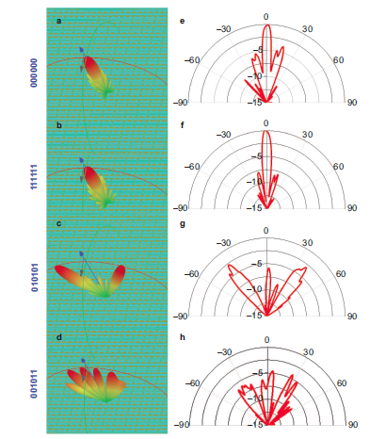
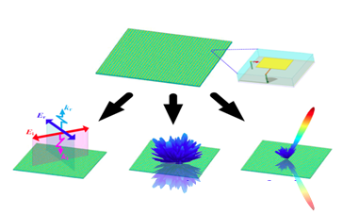



Working Principle for Wireless Communications
RIS works as a beamformer
Signals can be reflected or transmitted
Phase shift of the radiation is controlled by PIN diodes’ bias voltages (ON/OFF of the diode)
Reflect: $e^{j2πft+θ}$
Incident: $e^{j2πft}$
Programming the ON/OFF of all diodes
collectively realize different beamforming modes
Advantage
Cost efficiency: Analog beamforming, no extra RF chains needed for demodulation & modulation
Energy Efficiency: No extra RF signals generation, energy saving
Transmit: $e^{j2πft+θ}$
RIS element
000 000
111 111
ON/OFF coding of diodes
010101
001011
Polarization
Scattering
Focusing
Reflected beam

Slide 12
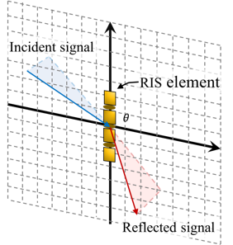




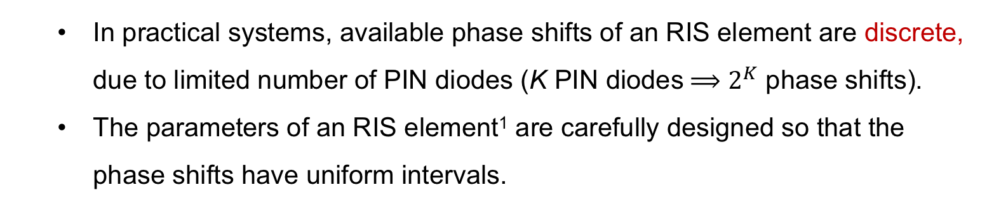
Signal Reflection Model
Model of reflected signal on an RIS element
Model of reflected signal on RIS
  $$y= Γe^{jθ}x$$
$Γ∈[0,1]$: reflection amplitude
  $Γ=0$: absorbed
  $Γ=1$: fully reflected
$θ ∈[0,2π]$: phase shift between incident and reflected signals.
Mechanism
Incident EM wave
$$x$$
$$Γ,θ$$
$$y$$
Emitted EM radiation
from induced
current
induced current distribution
  In practical systems, available phase shifts of an RIS element are discrete, due to limited number of PIN diodes (K PIN diodes$⟹$ $2^{K}$ phase shifts).
  The parameters of an RIS element¹ are carefully designed so that the phase shifts have uniform intervals.
¹: e.g., shape of the metal patch and type of the PIN diodes

Slide 13

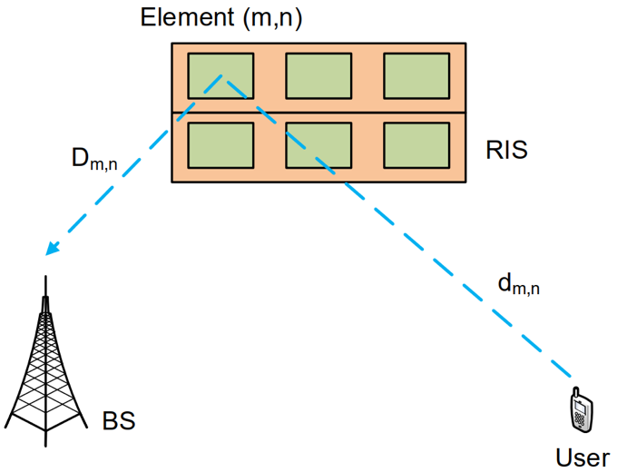


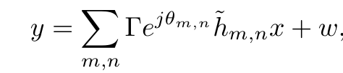


Channel Model
Rician Model
User-RIS-BS links act as the dominant LoS component
All other paths contributes the NLoS
Product of distance path loss
Received signal
Ratio of LoS to NLoS
LoS
NLoS
noise
Reflection coefficient
Channel gain
$h_{m,n}$, LoS component
${\hat{h}}_{m,n}$, NLoS component

Slide 14
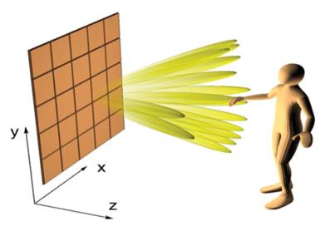
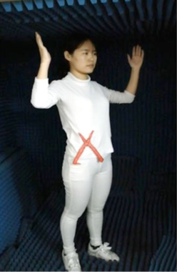
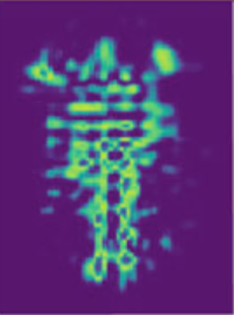

Applications: Radio Frequency Sensing
Indoor Localization and Recognition
Enhance remote RF sensing by customize radio environments.
Enable high accuracy indoor human and object localization and recognition
Customize signal beams for scanning human location
Customized radio environement for sensing human posture

Slide 15
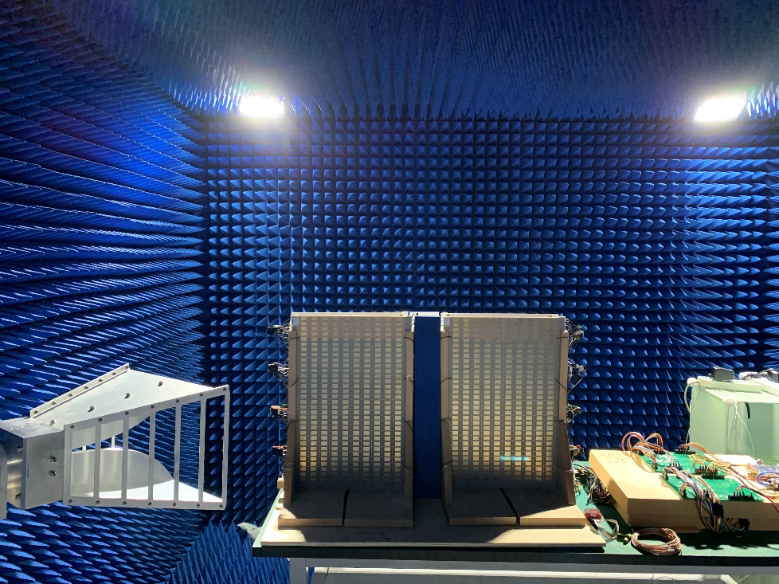

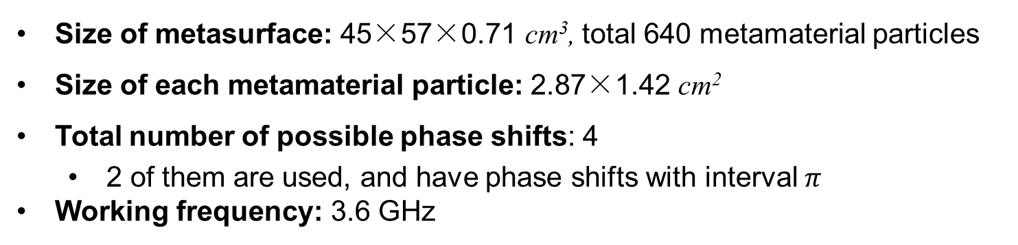
Prototype of Metasurface
Metamaterial Particle
Photo
Choke inductance
PIN #1,2,3
Structure
Via hole
Substrate
Copper Patch
Metal layer
Size of metasurface: 45×57×0.71 cm³, total 640 metamaterial particles
Size of each metamaterial particle: 2.87×1.42 cm²
Total number of possible phase shifts: 4
  2 of them are used, and have phase shifts with interval $π$
Working frequency: 3.6 GHz
* Photo shows the actual metasurface prototype used as the testbed in PKU lab.

Slide 16
Table of Contents
Background
  6G Communications and Requirements
  RIS Basics and Potential Applications
RIS-aided RF Sensing and Localization
  Case 1: Posture Recognition
  Case 2: RF 3D Sensing
  Case 3: Ubiquitous Localization
Potential Future Directions
Conclusions

Slide 17


Background
RF sensing
Living environment is covered seamlessly by wireless signals
Ubiquitous signals provide the foundation for RF sensing
Principles:
  Sensing targets between a pair of RF Tx and Rx impact the RF channel .
  The Rx can recognize different sensing targets by getting different received signals.
Visualization of cellular signals
Received signals change due to change of target

Slide 18






Applications
Security
Smart Space
Safety
Theft Detection
Interaction
Fall Detection
Theft detection
Emergency Alarm
Elderly Care
Advantages:
  No needs for the contact or line-of-sight view of the sensing targets

Slide 19
Techniques Review
Active Methods
  WiFi Sensing:
    Utilize the impact of the targets on WiFi signals
    Various metrics: signal strength, phase, doppler and so on
  mmWave Radar:
    Utilize the directional beams in mmWave communications
    Receivers can detect reflected signals from targets
Limitations: sensing accuracy is limited by channel conditions
Solution
Passive Method: RIS-aided RF sensing

Slide 20
Goals and Challenges
Goals
  Implement practical RIS-aided RF sensing system for human and object localization and recognition
  Achieve high sensing accuracy
Challenges
  Design practical sensing protocols to coordinate the RIS and the RF transceiver.
  Search the optimal phase shift selection for the RIS elements in a large feasible region.
  Propose efficient algorithms to obtain semantic meaning and location information of human and objects from received signals.

Slide 21
Case Study I: RIS aided Posture Recognition
RIS-based RF Sensing:
Design, Optimization, and Implementation
J. Hu, et al, “Reconfigurable Intelligent Surfaces based RF Sensing: Design, Optimization, and Implementation,” IEEE Journal of Selected Areas in Communications, vol. 38, no. 11, pp. 2700-2716, Nov. 2020.

Slide 22
Motivation
RIS-based RF sensing system
RIS can control the wireless environment, which can provide favorable wireless environment for RF sensing.
Application in human posture recognition:
  Recognize different human postures automatically
Challenges
RIS configuration design: How does RIS control the wireless environment
  The discrete phase shifts of a massive number of RIS elements need to be determined.
Decision function design: How does Rx judge human posture
  RF channels involve an RIS and a practical are hard to analyze, which makes the relationship between Rx signals and human posture inexplicit.
Moreover, RIS configuration and decision function are coupled.

Slide 23
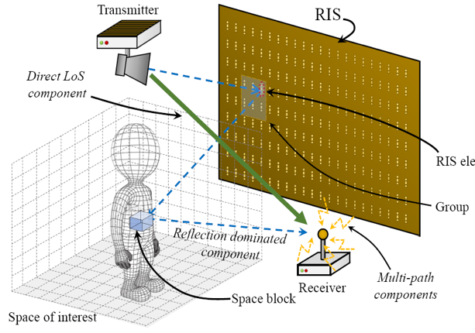
Model Description
System Structure
Transmitter: A directional antenna which is pointed towards the RIS
Receiver: An omni-directional vertical antenna below the RIS
Human：Space reflection vector carries the information of postures.
RIS: RIS elements in the same group are in the same state.
Channel Model
Multi-path component:
  Environment scattering
LoS component:
  Transmitter → Receiver
RIS
element
Reflection dominated components
  Transmitter → RIS → Human → Receiver

Slide 24
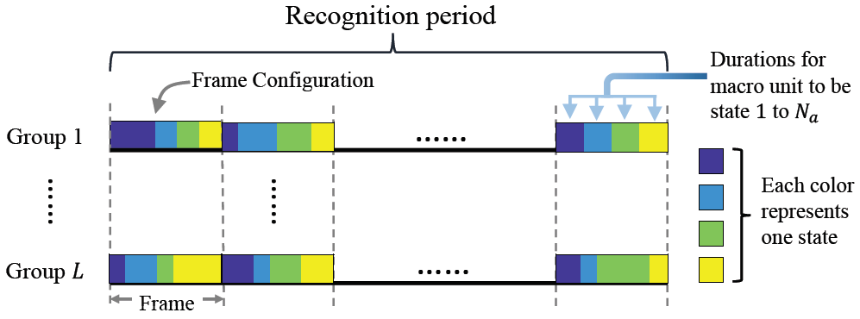
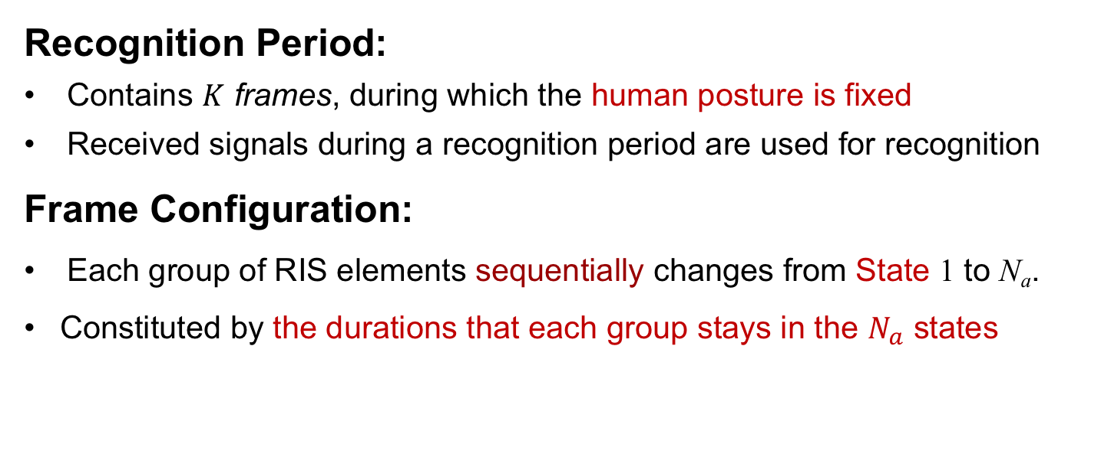
Periodic Configuring Protocol
Recognition Period:
Contains $K$ frames, during which the human posture is fixed
Received signals during a recognition period are used for recognition
Frame Configuration:
Each group of RIS elements sequentially changes from State 1 to N_{a}.
Constituted by the durations that each group stays in the $N_{a}$ states
Different states correspond to different phase shifts

Slide 25

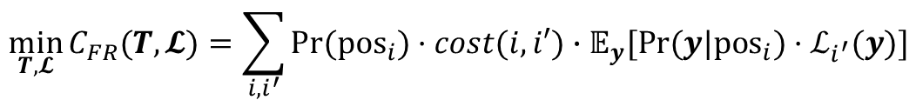

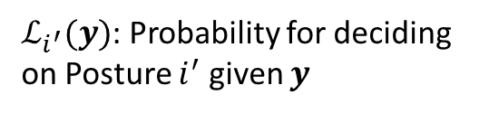






Problem Formulation
Decision Function: The receiver use the decision function to generate the probabilities for deciding on different human postures.
Optimization Problem: Minimize the false recognition cost
(P1)
$$\min_{T,𝓛}{C_{FR}(T,𝓛)=\sum_{i,i^{′}}{{Pr(pos}_{i})·cost(i,i′)}}∙𝔼_{y}[Pr⁡(y|pos_{i})·ℒ_{i^{′}}(y)]$$
Optimization Variables
$y$: Measured signals in a period
Probability of Posture $i$ to appear
$T$: Frame configurations in a recognition period
$ℒ_{i^{′}}(y)$: Probability for deciding on Posture $i^{′}$ given $y$
$𝓛$: Decision function
Cost for recognizing Posture $i$ as $i′$
Problem Decomposition:
Decomposing (P1) into the frame configuration optimization and the decision function optimization.
$$C_{FR}(T)$$
RIS frame configuration optimization objective
$$C_{FR}(T,𝓛)$$
$$C_{FR}(𝓛)$$
Decision function
optimization objective
Coupled optimization objective in (P1)

Slide 26
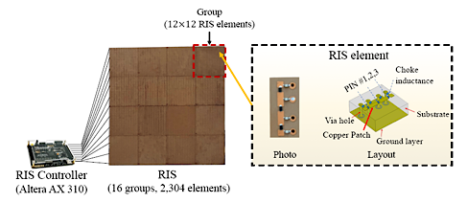
Implementation
RIS & RIS Control Circuit
Size of RIS: 69 × 69 × 0.52 cm³
Dielectric substrate: Rogers 3010 (dielectric constant:$ε=$10.2)
PIN diodes: BAR 65-02L $×$ 3
Total number of possible phase shifts: 8
  Four of them are used with phase shifts ($\frac{π}{8}, \frac{3π}{8},\frac{5π}{8}, \frac{7π}{8}$)
RIS controller: FPGA ALTERA-AX301

Slide 27
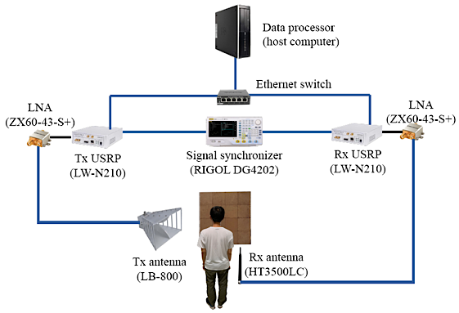
Implementation
RF Circuit
Baseband Processor: USRPs LW-N210
RF Board: SBX-120W (0-6GHz, Max Power = 100mW)
Amplifier: ZX60-43-S+ (Gain around 17dB)
Synchronizer: RIGOL DG4202 provides the
pps and clock signals.
Date Processor
Host computer connects the
Tx/Rx USRPs with Ethernet
to send/receive baseband data

Slide 28
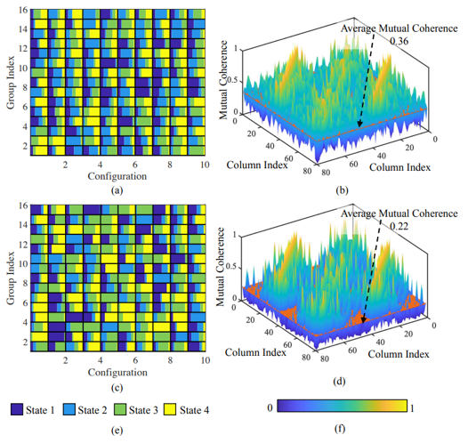
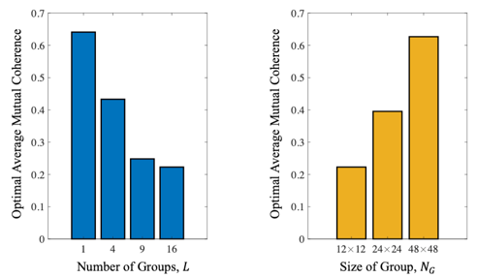
Experimental Results
Effectiveness:
The average mutual coherence of the measurement matrix is reduced, which can improve sensing accuracy.
Insights:
The optimized average mutual coherence decreases with the number of groups that the RIS contains, i.e., the size of the RIS.
The optimal average mutual coherence increases with the size of groups.

Slide 29
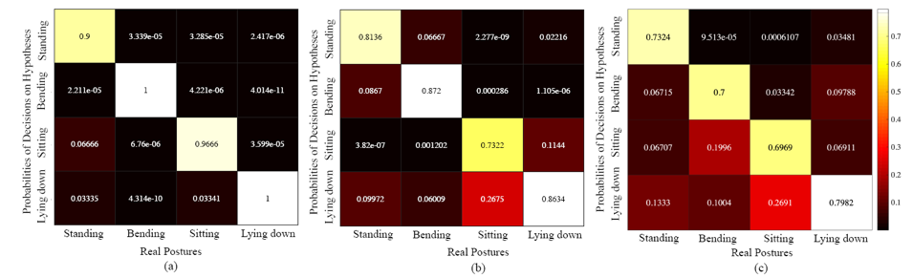
Experimental Results
Proposed method
Random method
Without RIS method
Compared with traditional RF sensing systems, RIS increases the posture recognition accuracy with 23.5%.
Compared with the system with random frame configurations, the system with optimized frame configurations achieves 14.6% higher recognition accuracy.

Slide 30
Case Study II: RIS aided RF 3D Shape Sensing
MetaSensing:
Intelligent Metasurface Assisted RF 3D Shape Sensing by Deep Reinforcement Learning
J. Hu, et al, “MetaSensing: Intelligent Metasurface Assisted RF 3D Sensing by Deep Reinforcement Learning,” IEEE Journal of Selected Areas in Communications, to be published.

Slide 31
Motivation
RF 3D shape sensing:
From optical images, the complete information about 3D objects is hard to acquire due to the blocking of themselves.
RF signals can detect these space of objects by reflection and scattering, which makes 3D sensing possible from RF signals
RIS-based 3D shape sensing
RIS controls RF signal beams by manipulating configuration
Using controlled RF signal beams, RIS can obtain more information about 3D objects in space and construct their shapes.
Challenges
How to optimize the RIS's configuration to create favorable propagation channels for sensing
How to obtain the mapping from RF signals to 3D shapes.

Slide 32
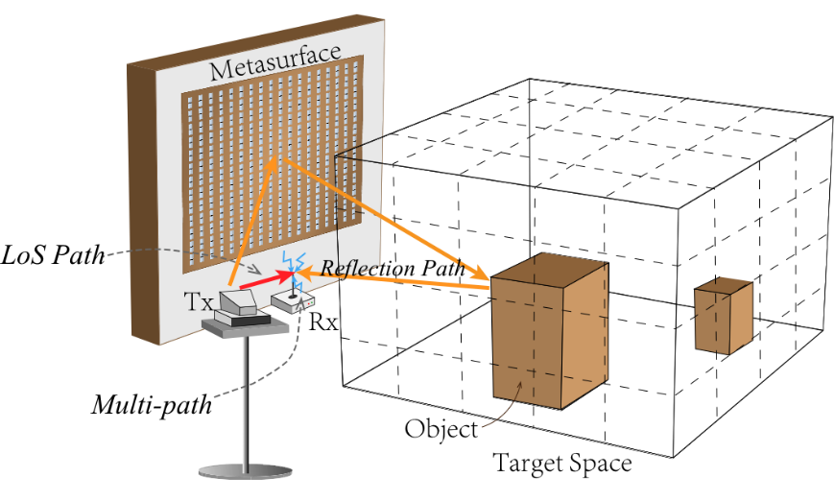
Model Description
System Description
Transmitter: A directional antenna which is pointed towards
the RIS
Receiver: An omni-directional vertical antenna below the RIS
RIS: Contains $N$ meta-elements, each with $N_{S}$ phase shifts
Sensing Target: Existence of objects at $M$ space grids
Channel Model
The target space is discretized into
$M$ space grids.
The total $N×M$ reflection paths
(Tx$→N$ RIS elements$→M$ grids$→$Rx)
are summed at the Rx

Slide 33
Sensing Protocol
RF Sensing Protocol
Synchronization Phase: synchronizes the Tx transmission, the RIS's configuration changes, and Rx reception
Calibration Phase: the RIS is in $c_{0}$ (no phase shifts incurred), and the received signal is used to subtract the environmental scattering.
Data Collection Phase: RIS changes its configuration with equal time interval, and the Rx averages the received signals in each config.
Data Processing Phase: The Rx use a decision function to determine the objects' existence at different space grids.

Slide 34
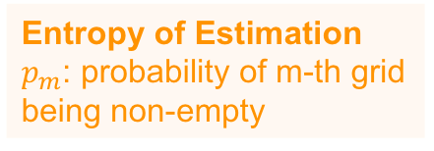
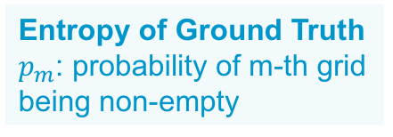
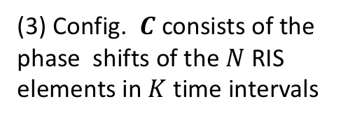
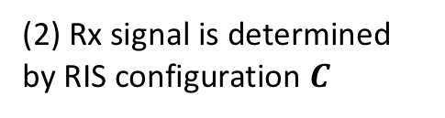
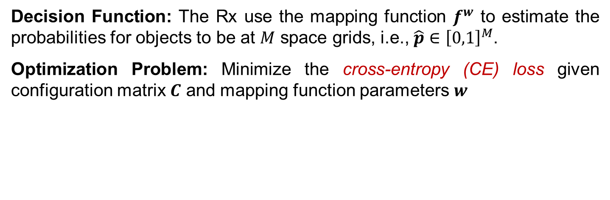

Problem Formulation
Decision Function: The Rx use the mapping function $f^{w}$ to estimate the probabilities for objects to be at $M$ space grids, i.e., $\hat{p}∈{\left[0,1\right]}^{M}$.
Optimization Problem: Minimize the cross-entropy (CE) loss given configuration matrix $C$ and mapping function parameters $w$
Entropy of Ground Truth
$p_{m}$: probability of m-th grid being non-empty
Entropy of Estimation
$p_{m}$: probability of m-th grid being non-empty
Constraints
(1) Estimation is obtained by mapping of received signals
(2) Rx signal is determined by RIS configuration $C$
(3) Config. $C$ consists of the phase shifts of the $N$ RIS elements in $K$ time intervals
Challenge :
  Optimization of config. $C$ and mapping $f^{w}$ are highly coupled.

Slide 35
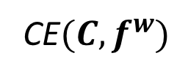




Algorithm Design
Decompose (P1) into configuration optimization and mapping function optimization problems
Coupled optimization objective in (P1)
RIS configuration optimization (sP1)
CE$(C,f^{w})$
Mapping function
optimization (sP2)
CE$\left(C\right)|f^{w}$
CE$\left(f^{w}\right)|C$
Challenge: Configuration matrix $C$ is an integer matrix and has a large number of elements.
Solution: Propose a deep reinforcement learning algorithm which can find the optimal policy for selecting $C$.
Challenge: Mapping function
$f^{w}$ has unknown form and parameter $w$.
Solution: Model $f^{w}$ by a neural network depicting an arbitrary function and propose a supervised learning algorithm to train $w$.

Slide 36

Simulation Results
Sensing results of a 3D object gets close quickly to the ground truth as the training proceeds
The proposed algorithm converges with a high speed
The proposed algorithm results in the lowest CE loss among all benchmark algorithms.

Slide 37
Case Study III: RIS aided Ubiquitous Localization
Towards Ubiquitous Positioning
by Leveraging RIS
H. Zhang, et al, “Towards Ubiquitous Positioning by Leveraging Reconfigurable Intelligent Surface,” IEEE Commun. vol. 25, no. 1, pp. 284-288, Jan. 2021.
H. Zhang, et al, “MetaRadar: Indoor Localization by Reconfigurable Metamaterials,” IEEE Trans. Mobile Comput., to appear. Arxiv: https://arxiv.org/abs/2008.02459.

Slide 38
Background
Radio Frequency (RF) based Positioning:
Applications: Navigation, healthcare monitoring, indoor positioning
Categories:
  Received signal strength (RSS)
  Channel state information (CSI)
  Angle-of-arrival (AoA)
  Time-of-arrival (ToA)
RSS based Positioning:
Advantages: simplicity of measuring RSS and minimum hardware requirements
Principle: users’ locations are obtained by comparing the measured RSS and the stored RSS distribution in the indoor environment.

Slide 39
Motivation
Limitations of Traditional Methods
The RSS distribution is passively measured and cannot be customized
The localization performance degrades if RSS values are similar to each other in the RSS distribution
RIS aided Positioning:
Users receive the signals from the AP and the RIS.
RIS adjusts the RSS distribution by changing its configuration.
Challenges
Localization protocol design: coordination among the RIS, AP and users.
RIS configuration design
  Large number of RIS configurations.
  Complicated relation between the RIS configuration and the RSS distribution.

Slide 40


System Model
Positioning Scenario
AP: sends signals to the RIS and mobile users.
RIS: reflects the signals from the AP to the users.
Users: measure the RSS for positioning.
Space of Interest (SOI): is discretized into N blocks to represent users’ positions.
RIS Model
M elements.
  Each element has C states with different reflection coefficients.
  $$r_{m}\left(c_{m}\right)=r\left(c_{m}\right)e^{−jc_{m}Δθ}$$
  Configuration $c$：the vector of all the elements’ states
Amplitude
Phase shift

Slide 41





System Model
RSS Model
  Direct LOS channel $h_{lo}$: AP $→$ User at the $n$-th block
  Reflection channel $h_{m, n}(c_{m})$: AP $→$ element $m$ $→$ User at the $n$-th block
  RSS at the $n$-th block under configuration $c$
Wavelength of the RF signal
Power gains of AP and user antennas
Distance between AP and the $m$-th element
Distance between the $m$-th element and the user
Transmission power of AP
Log-normal shadowing
component

Slide 42






Positioning Protocol
The positioning process has K cycles, and each cycle contains four steps:
Optimization: AP selects the optimal configuration $c_{k}$ for this cycle.
Broadcast: AP broadcasts $c_{k}$ to users and the RIS.
Measurement: AP sends single-tone signal with frequency $f_{c}$, and users record the RSS under configuration $c_{k}$.
Response: Users send the RSS information to the AP.
Optimization
Broadcast
Measurement
Response

Slide 43

Problem Formulation
Objective: Minimize the average positioning loss (weighted probabilities of false positioning) in every cycle.
$$l\left(c^{k}\right)=\sum_{i∈I}{\sum_{\begin{aligned}n, n^{′}∈𝒩 \\ n≠n′\end{aligned}}{p_{i, n}^{k}γ_{n, n^{′}}^{k}\int_{ℛ_{i, n^{′}}^{k}}{ℙ\left(s_{i}^{k} | c^{k}, n\right)⋅ds_{i}^{k}}}}$$
$p_{i, n}^{k}$: prior probability that user $i$ is at the $n$-th block in the $k$-th cycle.
$γ_{n, n^{′}}^{k}$: loss parameter when the positioning result is the $n′$-th block while the user is at the $n$-th block.
$ℙ\left(s_{i}^{k} | c^{k}, n\right)$: probability that user $i$ receives $s_{i}^{k}$ under $c^{k}$ at the $n$-th block.
$ℛ_{i, n^{′}}^{k}$: decision region for block $n^{′}$.
  Obtained using the maximum likelihood estimation method [1].
  If $s_{i}^{k}∈ℛ_{i, n^{′}}^{k}$, we estimate that user $i$’s position is $n′$ in the k-th cycle.
[1] M. A. Youssef, et al, “WLAN location determination via clustering and probability distributions,” in Proc. IEEE PerCom, Fort Worth, TX, Mar. 2003.

Slide 44



Implementation
Metasurface module:
Metasurface layer
  Size: 69 × 69 × 0.52 cm³
  4 phase shifts (interval $\frac{π}{2}$)
Control layer
Power Supply Layer
AP and user modules:
USRPs (LW-N210)
Horn antenna (for AP) or small polymer antenna (for users)
Space of interest (SOI)
Size: 0.5 × 0.5 × 0.5 m³
Notes:
字号要调节到20.

Slide 45


Simulation Results
The positioning error obtained by the proposed scheme is much lower and has a faster convergence speed than that of the random configuration scheme.
The positioning error increases when the standard deviation increases and number of cycles K decreases.

Slide 46


Experimental Results
Multi-user localization:
The localization error increases with the number of users and the SOI distance.
Accuracy in different axes:
The localization error in the x axis is clearly larger than those in the y and z axes.
This is because the signal correlation in the x axis (perpendicular to the metamaterials) is higher, rendering it more difficult to distinguish different blocks in the x axis.

Slide 47

Potential Future Directions
Spectrum efficiency
Broadband Communications: OFDMA
Full Spectrum Band Operation: mmWave, Terahertz
Full Dimension Coverage: Transmissive-reflective meta-surface
Implementation: Real-time environment configuration
High-resolution sensing
Mobility and Doppler resolution
Angular resolution and
non-uniform illumination
Other issues
Context-awareness
Security and privacy

Slide 48


Conclusions
RIS is a promising paradigm for future communications
  Control and customize favorable radio environments
  Provide high accuracy contact/contactless sensing with wireless data gathering
  If mirrors can be controlled, Bruce Lee can do a better localization job.
We explore different aspects related to RIS-aided sensing and localization
  Posture recognition
  RF 3D shape sensing
  Ubiquitous positioning

Slide 49
Publications
J. Hu, H. Zhang, B. Di, L. Li, L. Song, Y. Li, Z. Han, and H. V. Poor, “Reconfigurable Intelligent Surfaces based RF Sensing: Design, Optimization, and Implementation,” IEEE J. Sel. Areas Commun., vol. 38, no. 11, pp. 2700-2716, Nov. 2020.
J. Hu, H. Zhang, K. Bian, M. D. Renzo, Z. Han, and L. Song, “MetaSensing: Intelligent Metasurface Assisted RF 3D Sensing by Deep Reinforcement Learning,” ,” IEEE J. Sel. Areas Commun., to be published.
H. Zhang, H. Zhang, B. Di, K. Bian, Z. Han, and L. Song, “Towards Ubiquitous Positioning by Leveraging Reconfigurable Intelligent Surface,” IEEE Commun. vol. 25, no. 1, pp. 284-288, Jan. 2021.
H. Zhang, J. Hu, H. Zhang, B. Di, K. Bian, Z. Han, and L. Song, “MetaRadar: Indoor Localization by Reconfigurable Metamaterials,” IEEE Trans. Mobile Comput., to appear. Arxiv: https://arxiv.org/abs/2008.02459.
J. Hu, H. Zhang, K. Bian, Z. Han, H. V. Poor, and L. Song, “HoloSketch: Semantic Segmentation by Radio Environment Reconfiguration,” IEEE Trans. Mobile Comput., submitted.
H. Zhang, H. Zhang, B. Di, K. Bian, Z. Han, and L. Song, “MetaLocalization: Reconfigurable Intelligent Surface Aided Multi-user Wireless Indoor Localization,” IEEE Trans. Wireless Commun., under revision.

Slide 50








Join or Visit Our Lab
http://wireless.egr.uh.edu/
http://www2.egr.uh.edu/~zhan2

Slide 51

THANK YOU

