Slide 1
Utilizing Full Duplex Multiple Antenna
in Heterogeneous Networks
Ph.D. Dissertation Defense
Radwa Sultan
Advisor: Dr. Zhu Han
November 9th, 2017

Slide 2
Outline
1
Introduction
2
Motivation and Contribution.
3
Resource Allocation Challenges in Full-Duplex MIMO HetNets.
4
Asymptotic Rate Analysis in Full-Duplex Massive MIMO Networks.
5
Conclusion and Future Work.

Slide 3
1. Introduction
Full Duplex.
Heterogeneous Networks.
Massive MIMO.

Slide 4
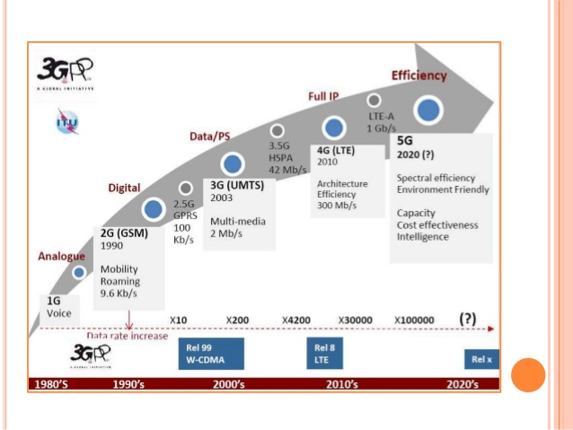
Introduction
By 2020, the 5G of mobile networks is expected to be released.
No standard for 5G deployments.

Slide 5
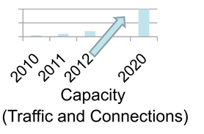
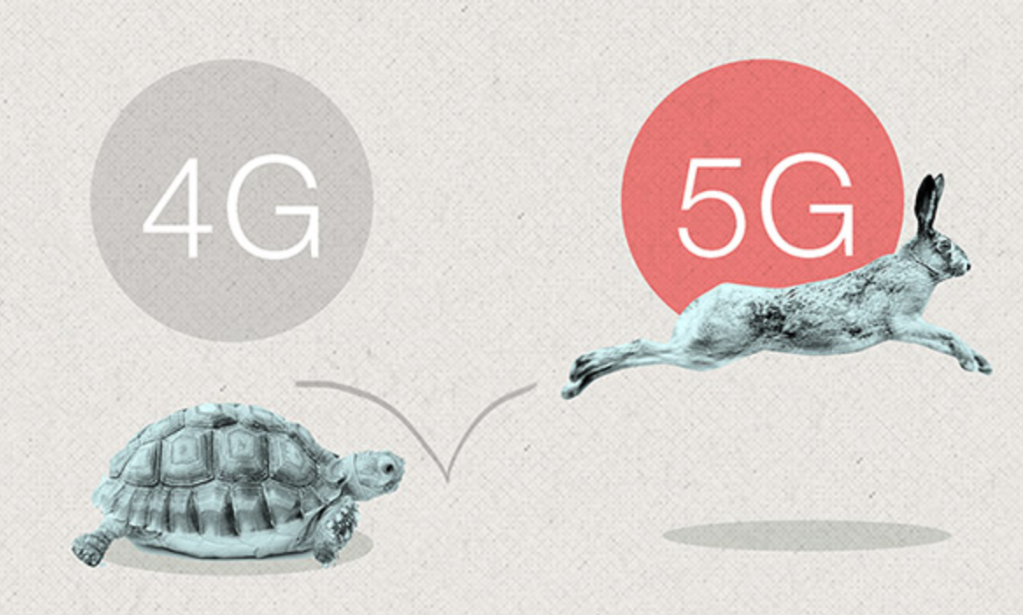
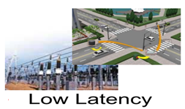
Introduction
Future Wireless Challenges
The question is how to meet these challenges?
Full-duplex: potentially doubles the speed of wireless communication.
Heterogeneous Networks: offer more spectrum and increase diversity
Massive MIMO offers significant gains in data rates and link reliability.

Slide 6
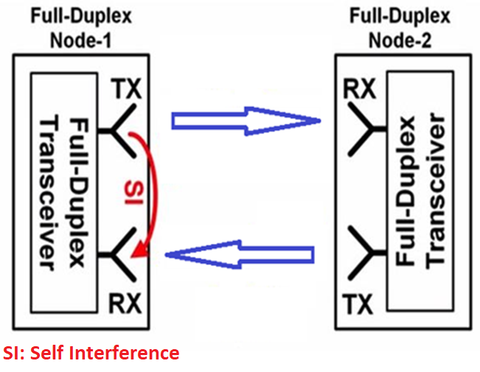
Introduction
Full Duplex:
Advantages:
High spectral efficiency.
Low cost.
Challenges:
Very large self interference.
ADC is the bottleneck.

Slide 7
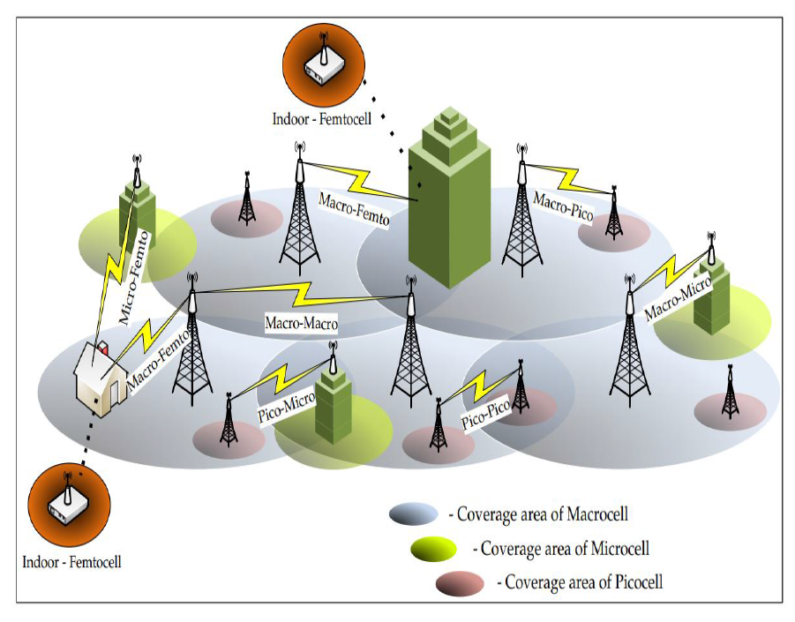
Introduction
Heterogeneous Networks (HetNets):
Advantages:
Increasing the capacity in hot spots
Offloading from the large macro cells
Challenges:
Complicates Network Planning
Increases the interference on DL reception.

Slide 8
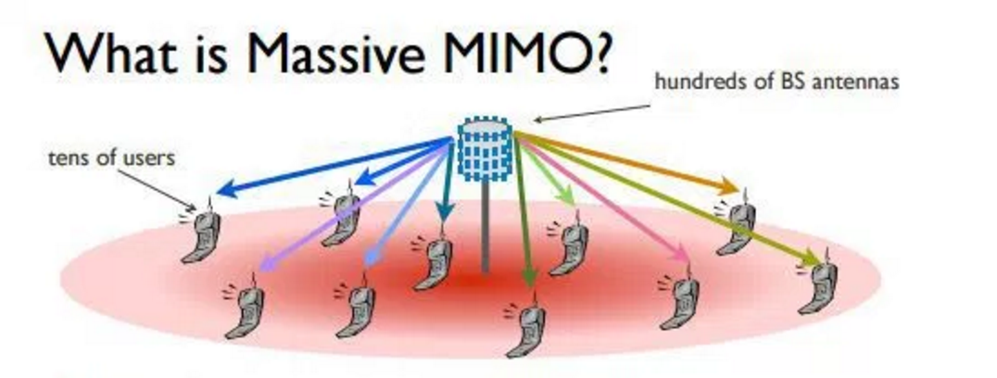
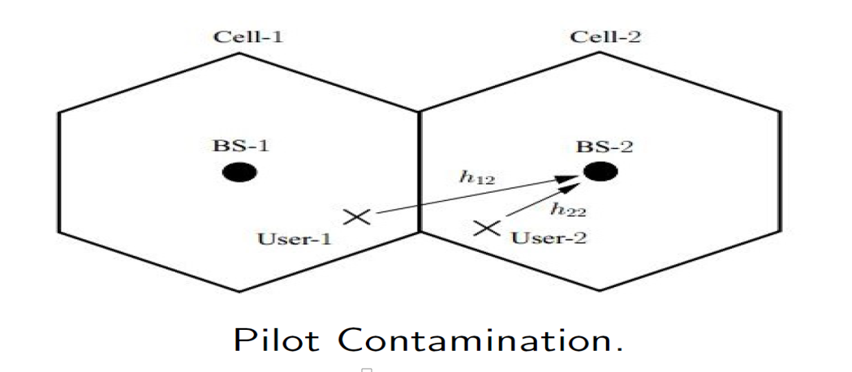
Introduction
Massive MIMO:
Challenges:
Antenna Correlation.
Acquiring Channel State Information.
Pilot Contamination.
Advantages:
Lower Transmission Power
Channel Hardening.
Accurate Spatial Multiplexing

Slide 9
2. Motivation and Contribution
Motivation
Contribution

Slide 10
Motivation and Contributions Motivation:
To answer the following questions:
What are the benefits and challenges of combining FD and massive MIMO?
When to utilize FD communication?
What is the asymptotic FD rate behavior?

Slide 11
Motivation and Contributions Contributions:
Investigate the performance keys in FD MIMO HetNets.
Propose mode selection criterions between FD and HD.
Jointly optimize the user-pairing and subcarrier allocation in FD-OFDMA network
Propose the crystallized rate region to derive the FD rate region with lower complexity.
Derive the FD-DL and FD-UL asymptotic rate bounds.
Optimize the SI cancellation in FD massive MIMO setting.

Slide 12
3. Resource Allocation Challenges in FD MIMO HetNets
Performance keys in FD MIMO HetNets.
Resource Allocation Problems.
Solution Algorithms.

Slide 13
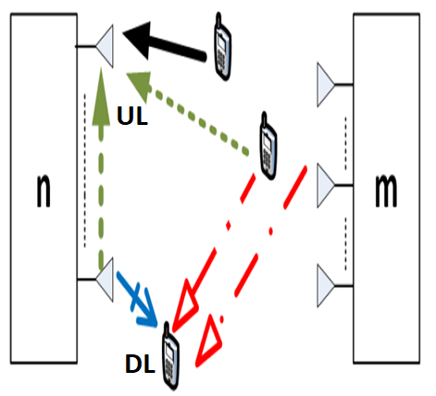
Resource Allocation Challenges in Full-Duplex MIMO Small Cell Networks.
Performance keys in FD HetNets.
Self-Interference.
Co-channel Interference.
Multiuser Interference.
DL power Control
UL power Control
User Pairing
Subcarrier Allocation

Slide 14
Resource Allocation Challenges in Full-Duplex MIMO Small Cell Networks.
Performance keys in FD MIMO.
Number of TX and RX antennas
Self-Interference
Antenna Selection
SI Cancellation with Beamforming

Slide 15
Resource Allocation Challenges in Full-Duplex MIMO Small Cell Networks.
Resource Allocation Challenges:
FD Transmission
Mode Selection.
Power Allocation.
Subcarrier Allocation.
User Pairing.
FD MIMO Transmission
Antenna Selection
SI Cancellation via Beamforming
The joint optimization problems are MINLPs.

Slide 16
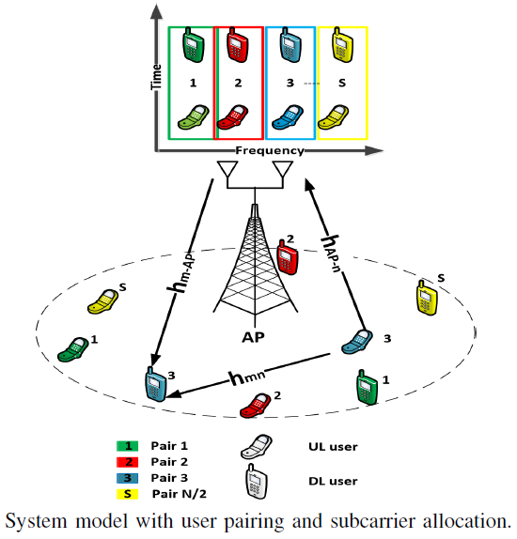
Resource Allocation Challenges in Full-Duplex MIMO Small Cell Networks.
DL SINR
DL Transmission Power
Large Scale Fading
Small Scale Fading
Noise Variance
Co-Channel Interference
UL-DL Mutual Distance
UL Transmission Power
Channel gain between UL and DL

Slide 17
Resource Allocation Challenges in Full-Duplex MIMO Small Cell Networks.
UL SINR
UL Transmission Power
Large Scale Fading
Small Scale Fading
Noise Variance
SI Cancellation Parameter
Self Interference

Slide 18
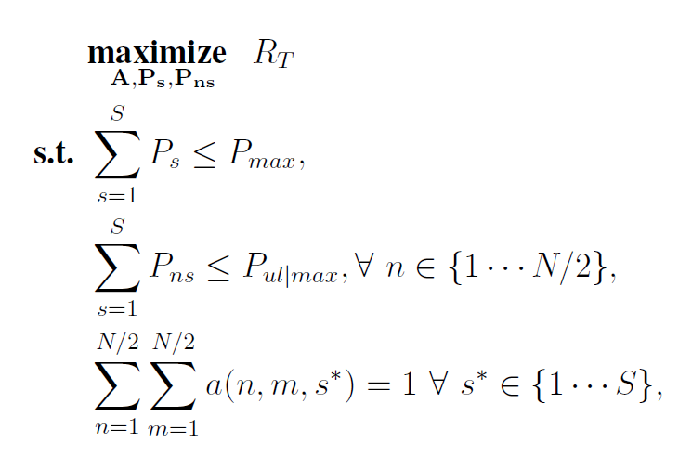
Resource Allocation Challenges in Full-Duplex MIMO Small Cell Networks.
Joint Allocation Problem:
Sum Rate
DL Power Constraints
UL Power Constraints
Subcarrier Assignment Constraint
Binary Assignment Variables

Slide 19
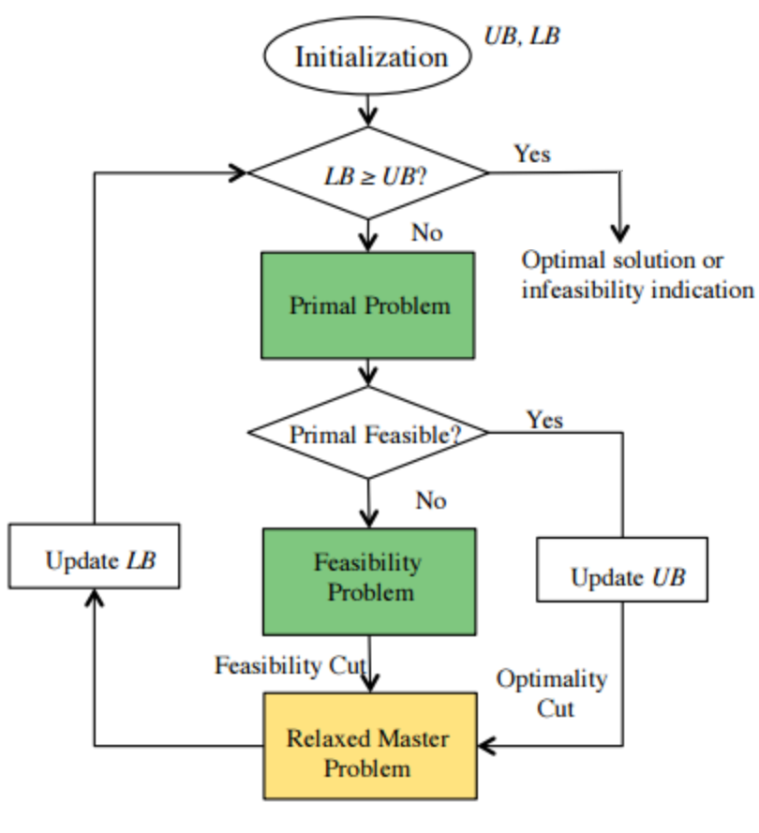
Resource Allocation Challenges in Full-Duplex MIMO Small Cell Networks.
Generalized Benders Decomposition
Target problem
$$\min_{x}f\left(x,\overline{y}\right)$$
s.t. $g\left(x,\overline{y}\right)≤0$
$$x∈X$$
$$\min_{x,y}f\left(x,y\right)$$
s.t. $g\left(x,y\right)≤0$
$$x∈X, y∈Y$$
Solve for
continuous variables
Constant value
$\overline{y}∈Y$
Continuous Variables
Integer Variables

Slide 20
Resource Allocation Challenges in Full-Duplex MIMO Small Cell Networks.
Generalized Benders Decomposition
Number of
Feasible Iterations
$$\min_{y_{0}} y_{0}$$
s.t. $L^{∗}\left(y,u^{k_{1}}\right)≤y_{0}, k_{1}=1, ……K^{f}$
$L_{∗}(y,λ^{k_{2}})≤0$, $k_{2}=1, ……K^{i}$
Number of
infeasible Iterations
$$L^{∗}\left(y,u^{k_{1}}\right)= \min_{x∈X} f(x,y),$$
$L_{∗}(y,λ^{k_{2}})$ $= \min_{x∈X} λ^{T}g\left(x,y\right).$
$$\min_{x∈X}{ λ}^{∗T}g(x,y)$$

Slide 21
Resource Allocation Challenges in Full-Duplex MIMO Small Cell Networks.
Heuristic Algorithm:
→ A two step iterative algorithm to solve the joint optimization MINLP
Joint User Pairing and Subcarrier Allocation Solution Algorithm.
Power Allocation.

Slide 22
Resource Allocation Challenges in Full-Duplex MIMO Small Cell Networks.
Joint User Pairing and Subcarrier Allocation
Construct initial candidate triplets.
For each subcarrier, highest sum rate UL-DL pair is chosen
The complexity order .
Full search’s complexity order
DL users
set
UL users
set
Pairing
Condition
Subcarrierss
set

Slide 23
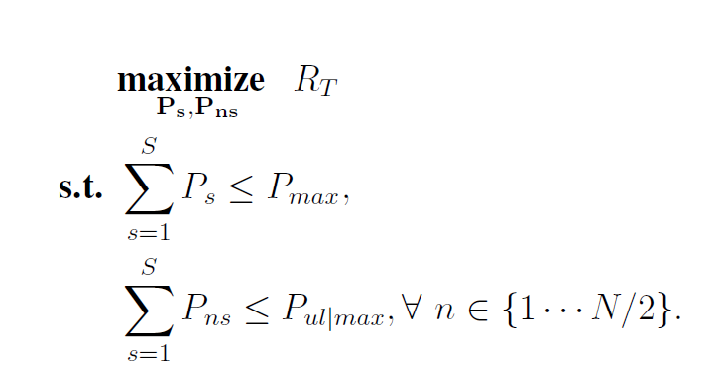
Resource Allocation Challenges in Full-Duplex MIMO Small Cell Networks.
2. Power Allocation
For High SINR case, the power allocation is a convex problem.
Total Rate
DL
power constraints
UL
power constraints
ADMM is adopted for solving the power allocation problem

Slide 24
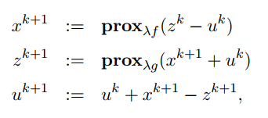
Resource Allocation Challenges in Full-Duplex MIMO Small Cell Networks.
The Alternating Direction Method of Multipliers (ADMM)
Consider the Problem
Then the ADMM is
Proximal Operator
x update
z update
Check difference between x and z

Slide 25
Resource Allocation Challenges in Full-Duplex MIMO Small Cell Networks.
The ADMM can solve separable problem in a distributed way
Ex:
This can be reformulated to
Separable
Objective
Indicator Function
Then the ADMM is
Projection on Allocation Set
Allocation Set

Slide 26
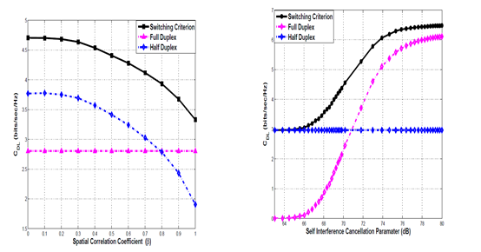
Resource Allocation Challenges in Full-Duplex MIMO Small Cell Networks.
Mode Selection:
System will switch between FD and HD for best performance
High gain at low Spatial correlation Coefficient and large SI cancellation

Slide 27
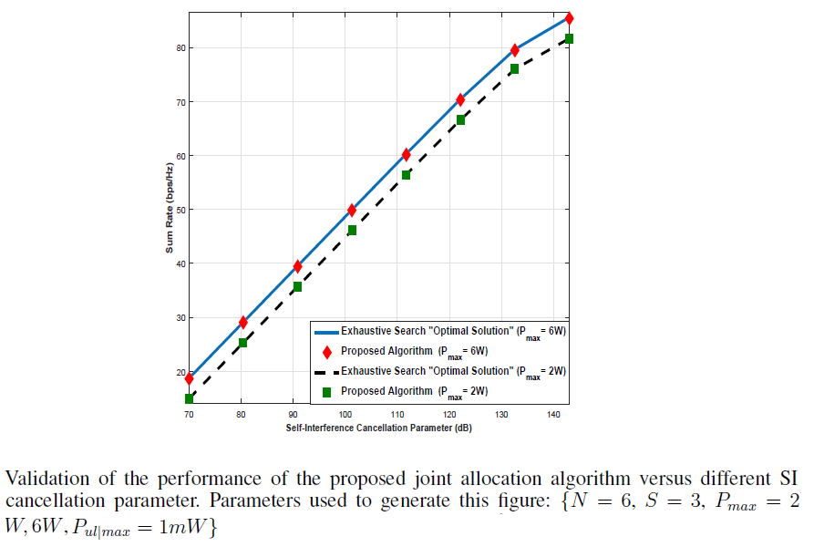
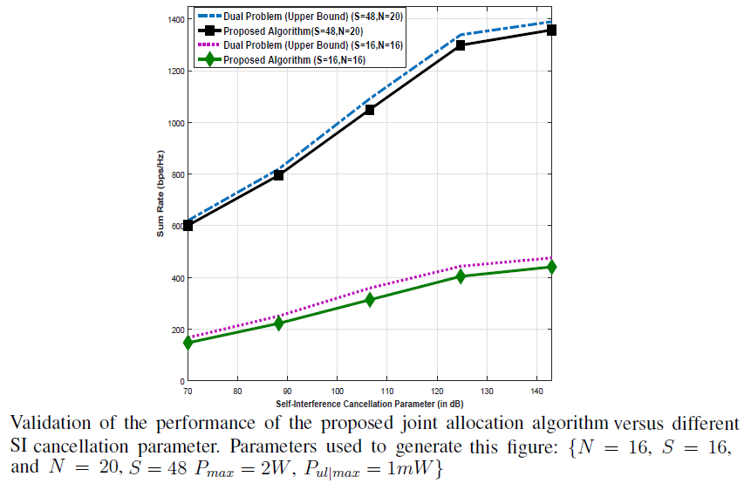
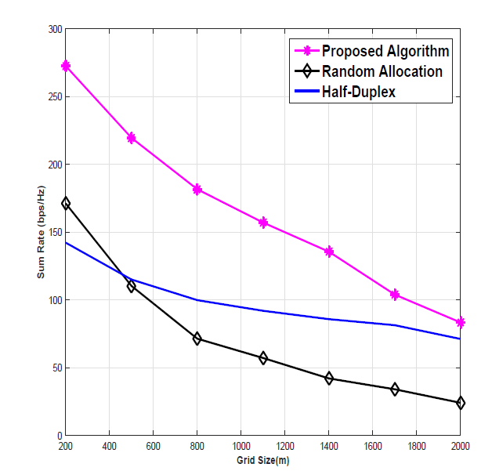
Resource Allocation Challenges in Full-Duplex MIMO Small Cell Networks.
The difference between the upper bound and the Proposed algorithm’s capacity is very small
The difference between the exact solution and the proposed algorithm’s capacity is very small
Better Performance than Random allocation and HD

Slide 28
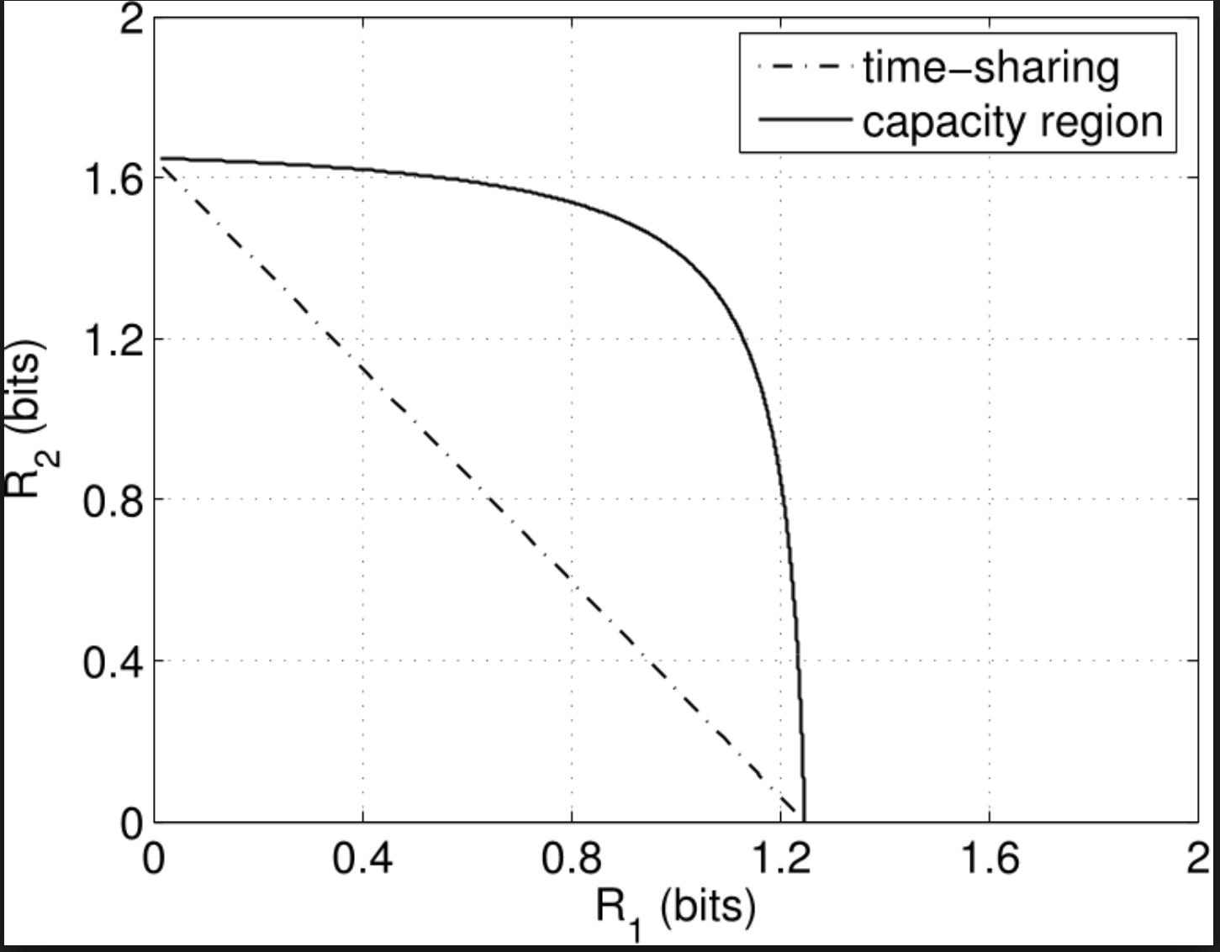
Resource Allocation Challenges in Full-Duplex MIMO Small Cell Networks.
Another way to compare between FD and HD is to derive the rate region
Full search rate regions: consider all cases of users and power allocation.
Crystallized rate region: Consider a subset of combinations which most likely will lie on the boundary of the feasible rate region.
Construct the convex hull of the rate region based on those combinations

Slide 29
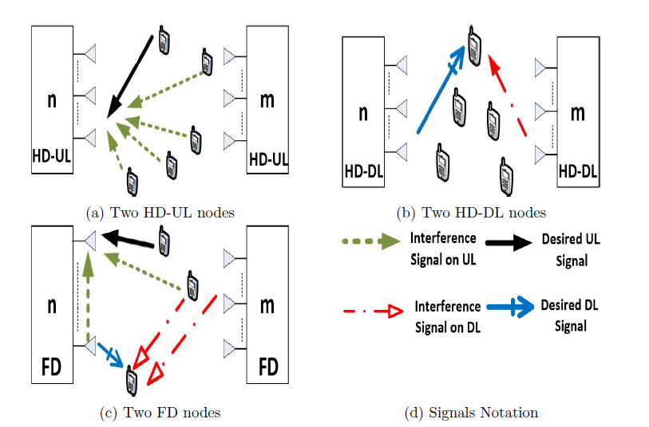
Resource Allocation Challenges in Full-Duplex MIMO Small Cell Networks.

Slide 30
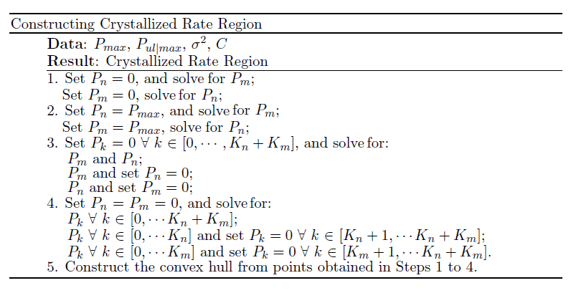
Resource Allocation Challenges in Full-Duplex MIMO Small Cell Networks.
Either node 𝑛 or 𝑚 is silent:
Either node 𝑛 or 𝑚 transmits at maximum Power
Only DL is active
Only UL is active
Construct the convex hull

Slide 31
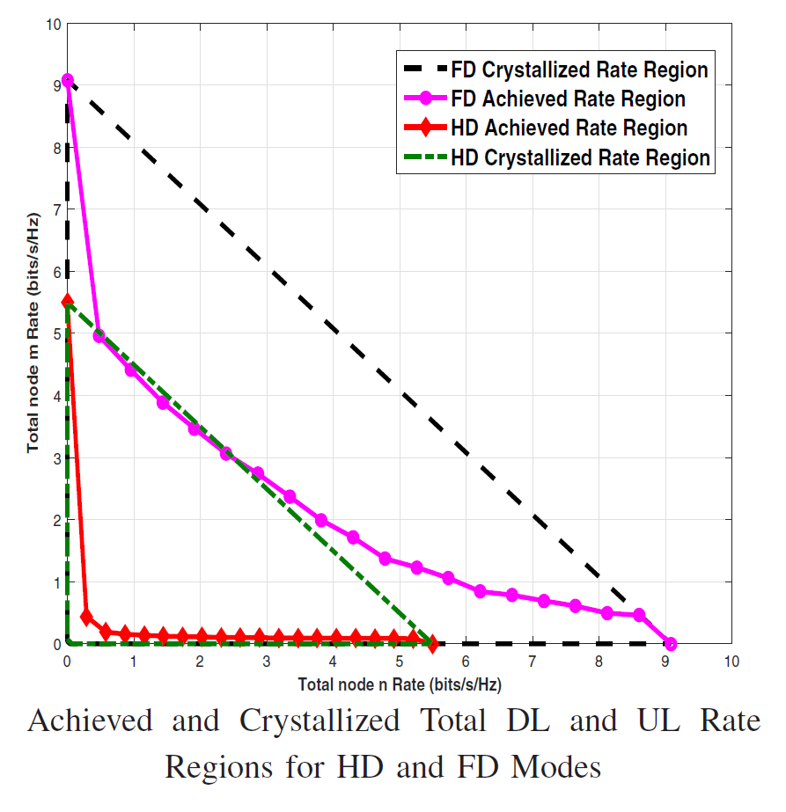
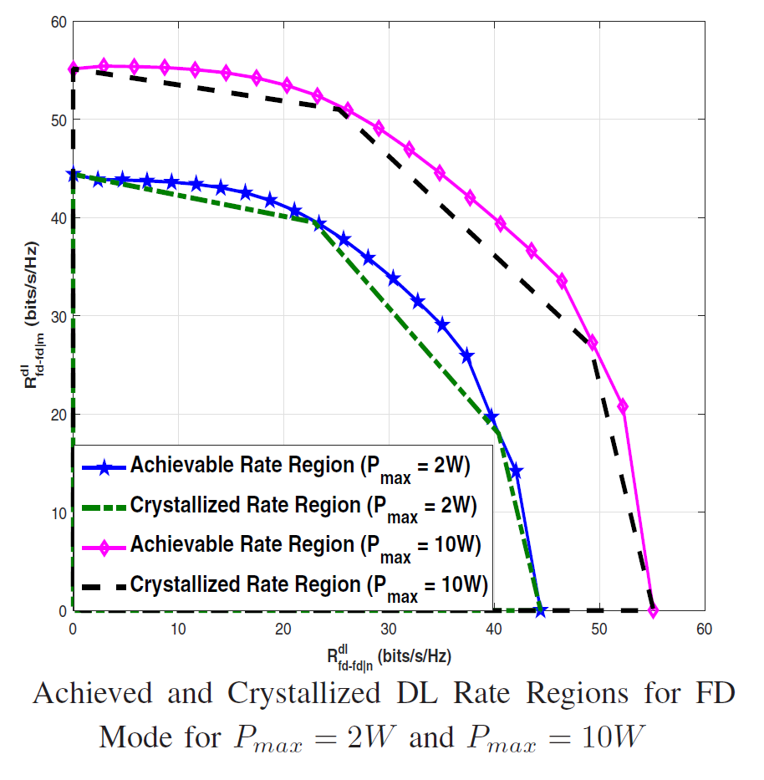
Resource Allocation Challenges in Full-Duplex MIMO Small Cell Networks.
Low Interference: Crystallized region offers a very accurate approximation for the full search region.
High Interference: Crystallized region fully includes the full search region.

Slide 32
4. Asymptotic Rate Behavior in FD MIMO
Random Matrix Theory
Asymptotic Rate Analysis
Performance Optimization

Slide 33
Asymptotic Rate Behavior in FD MIMO
Random Matrix Theory
$$∞$$
Let ${P≜\left[p_{1}… p_{n}\right]}^{T}$ and ${q≜\left[q_{1}… q_{n}\right]}^{T}$ be mutually independent $n×1$ random vectors.
The entries of $P$ and $q$ are:
i.i.d. zero-mean random variables
$𝔼\left\{{\left|p_{i}\right|}^{2}\right\}=σ_{p}^{2}$ and $𝔼\left\{{\left|q_{i}\right|}^{2}\right\}=σ_{q}^{2}, i=1,…,n$.

Slide 34
Asymptotic Rate Behavior in FD MIMO
Random Matrix Theory
$$∞$$
If $A$is a $m×n$ random matrix whose columns are zero-mean independent complex Gaussian vectors.
Then for $n≥m, B=AA^{H}, B$is a central complex Wishart matrix
If $B$is a $m×n$ random matrix whose columns are zero mean independent complex Gaussian vectors with identity covariance matrix

Slide 35
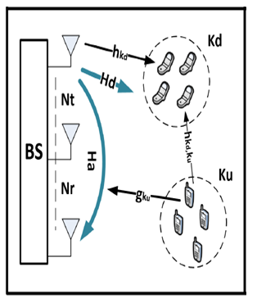
Asymptotic Rate Behavior in FD MIMO
DL users
TX antennas
The upper bound of the DL-FD Transmission is given by
DL SNR
Similarly, we can derive the following bounds
UL-FD lower bound
DL-HD upper bound
UL-HD lower bound
RX antennas

Slide 36
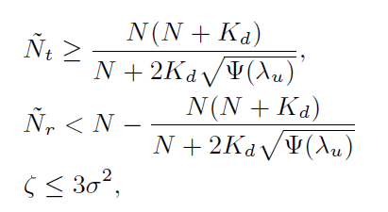
Asymptotic Rate Behavior in FD MIMO
For ${\hat{C}}_{UL|FD}≥{\hat{C}}_{UL|HD}$, the self-interference cancellation is given by,
For ${\hat{C}}_{DL|FD}≥{\hat{C}}_{DL|HD}$, the following conditions must be satisfied
TX Antennas Threshold
SI Cancellation Threshold
RX Antennas Threshold
CCI Expectation

Slide 37
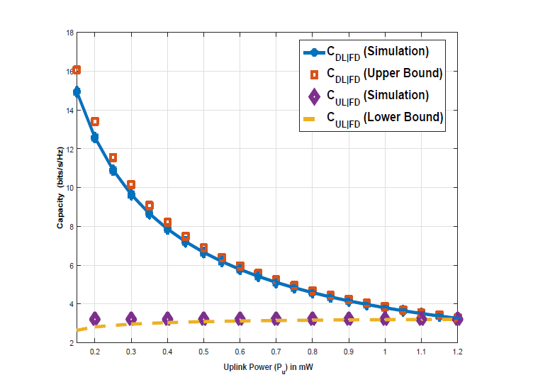
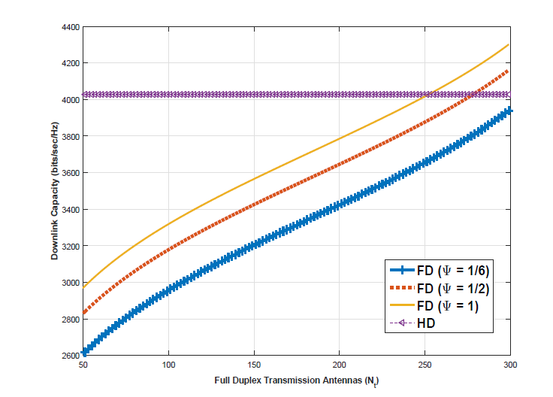
Asymptotic Rate Behavior in FD MIMO
For large CCI, FD-DL rate is always less than HD-DL rate
The derived asymptotic bounds are tight bounds.

Slide 38
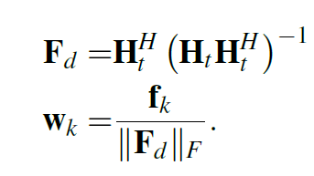
Asymptotic Rate Behavior in FD MIMO
Performance Optimization in FD massive MIMO
The DL transmit pre-coder is designed to cancel SI on $αN_{r}$ receive antennas
$$(0≤α≤1)$$
Channel matrix between transmit antennas and $α N_{r}$ receive antennas
DL Channel Matrix

Slide 39
Asymptotic Rate Behavior in FD MIMO
A lower bound for the total FD DL rate $C_{d}\left(β,α\right)$is given by
A lower bound for the total FD UL rate $C_{u}(β,α)$is given by
DL Power
Antenna Ratio
Ratio of RX antennas at which SI is cancelled
DL Users
UL Power
UL users
SI Cancellation

Slide 40
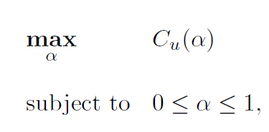
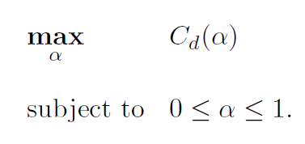
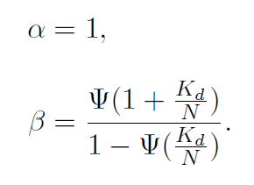
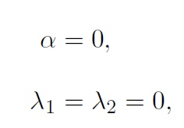
Asymptotic Rate Behavior in FD MIMO
Constant $C_{u}:$Maximizing $C_{d} (β,α)$
Constant $C_{d}:$Maximizing $C_{u} (β,α)$
Dual Problem
Lagrange Multipliers
Nonlinear Relation
Linear Relation

Slide 41
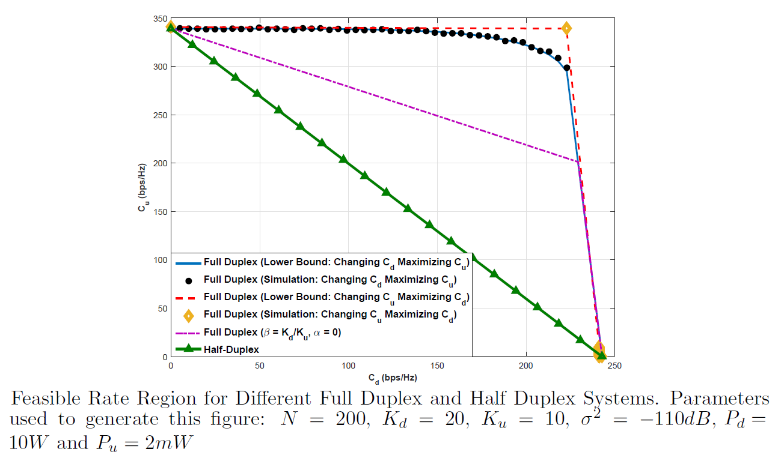
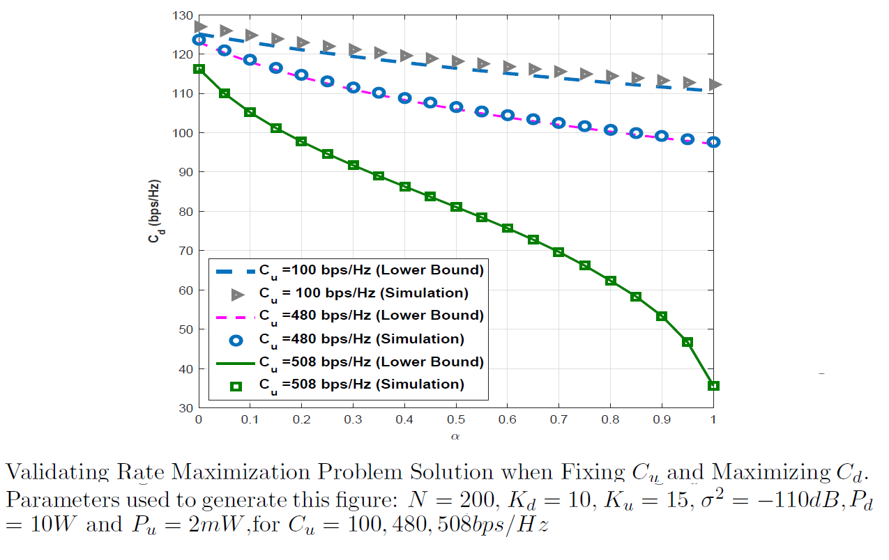
Asymptotic Rate Behavior in FD MIMO
Better rate region is achieved with SI cancellation via beamforming
DL capacity is minimum when $α=1$(SI is completely Cancelled)

Slide 42
5. Conclusion
and
Future work

Slide 43
Conclusion and Future Work. Conclusion
We investigate resource allocation challenges in FD-MIMO HetNets.
We propose a heuristic algorithm for user-pairing based on defining the user equipment SNR wall.
We derive the FD operation regions for different network scenarios.
We optimize the SI cancellation in a FD massive MIMO setting.

Slide 44
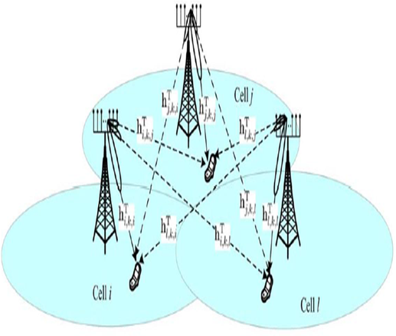
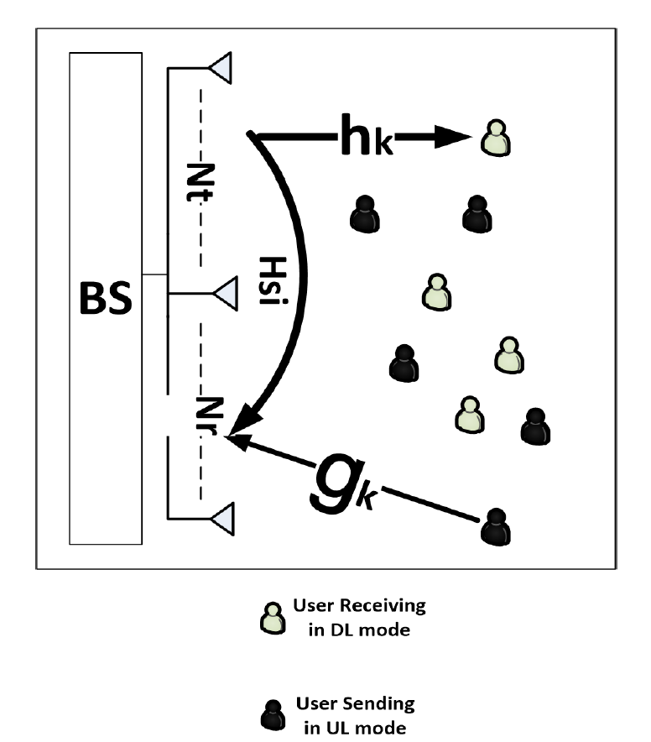
Conclusion and Future Work. Future Work
Study antenna selection problem in FD MIMO networks.
Study beamforming optimization in FD MIMO networks
Study the effects of pilot contamination on SI cancellation via beamforming.

Slide 45
References
Journal Publications
[1] Radwa Sultan, Karim G. Seddik, Zhu Han, “Full Duplex Enabled Massive MIMO Networks: Research Challenges and Applications ” to be submitted.
[2] Radwa Sultan, Karim G. Seddik, Zhu Han, and Behnaam Aazhang, “Joint Transmitter-Receiver Optimization and Self-interference Suppression in Full Duplex
MIMO Systems” to be submitted.
[3] Radwa Sultan, Lingyang Song, Karim G. Seddik and Zhu Han, “Joint User Pairing, Subcarrier, and Power Allocation in Full-Duplex OFDMA Networks”
submitted
[4] Radwa Sultan, Lingyang Song, Karim G. Seddik and Zhu Han, “Full-Duplex Meets Multiuser MIMO: Comparisons and Analysis” in IEEE Transactions on
Vehicular Technology, vol. 66, no. 1, pp. 455 – 467, Mar. 2016.
Conference Publications:
[1] Radwa Sultan, Karim G. Seddik, Zhu Han and Behnaam Aazhang, “Asymptotic Behavior Analysis and Performance Optimization in Full Duplex Massive
MIMO” accepted in IEEE Global Communications Conference (Globecom 2017), Singapore, December 2017.
[2] Radwa Sultan, L. Song, K. Seddik and Z. Han, “Crystallized Rate Regions for Full Duplex Enabled Small Cell Networks” accepted in IEEE Global
Communications Conference (Globecom 2017), Singapore, December 2017.
[3] Radwa Sultan, Lingyang Song, Karim G. Seddik and Zhu Han, “Full Duplex in Massive MIMO Systems: Analysis and Feasibility” accepted in The First
International Workshop on Full Duplex Wireless Communications (GLOBECOM 2016), Washington, DC, December. 2016.
[4] Radwa Sultan, Lingyang Song, karim G. Seddik, and Zhu Han, “Users Association in Small Cell Networks with Massive MIMO,” in International Conference
on Computing, Networking and Communications (ICNC), Kauai, Hawaii, February. 2016.
[5] Radwa Sultan, Lingyang Song, Karim G. Seddik, and Zhu Han, “Mode Selection, User Pairing, Subcarrier Allocation and Power Control in Full Duplex OFDMA
HetNets,” in IEEE International Conference on Communications Workshops (ICCW), London, UK, June. 2015
[6] Radwa Sultan, Lingyang Song, and Zhu Han, “Impact of full duplex on resource allocation for small cell networks,” in IEEE Global Conference on Signal and
Information Processing (GlobalSIP), Atlanta, GA, Dec. 2014.

Slide 46
Questions?

Slide 47
THANK YOU

