Slide 1
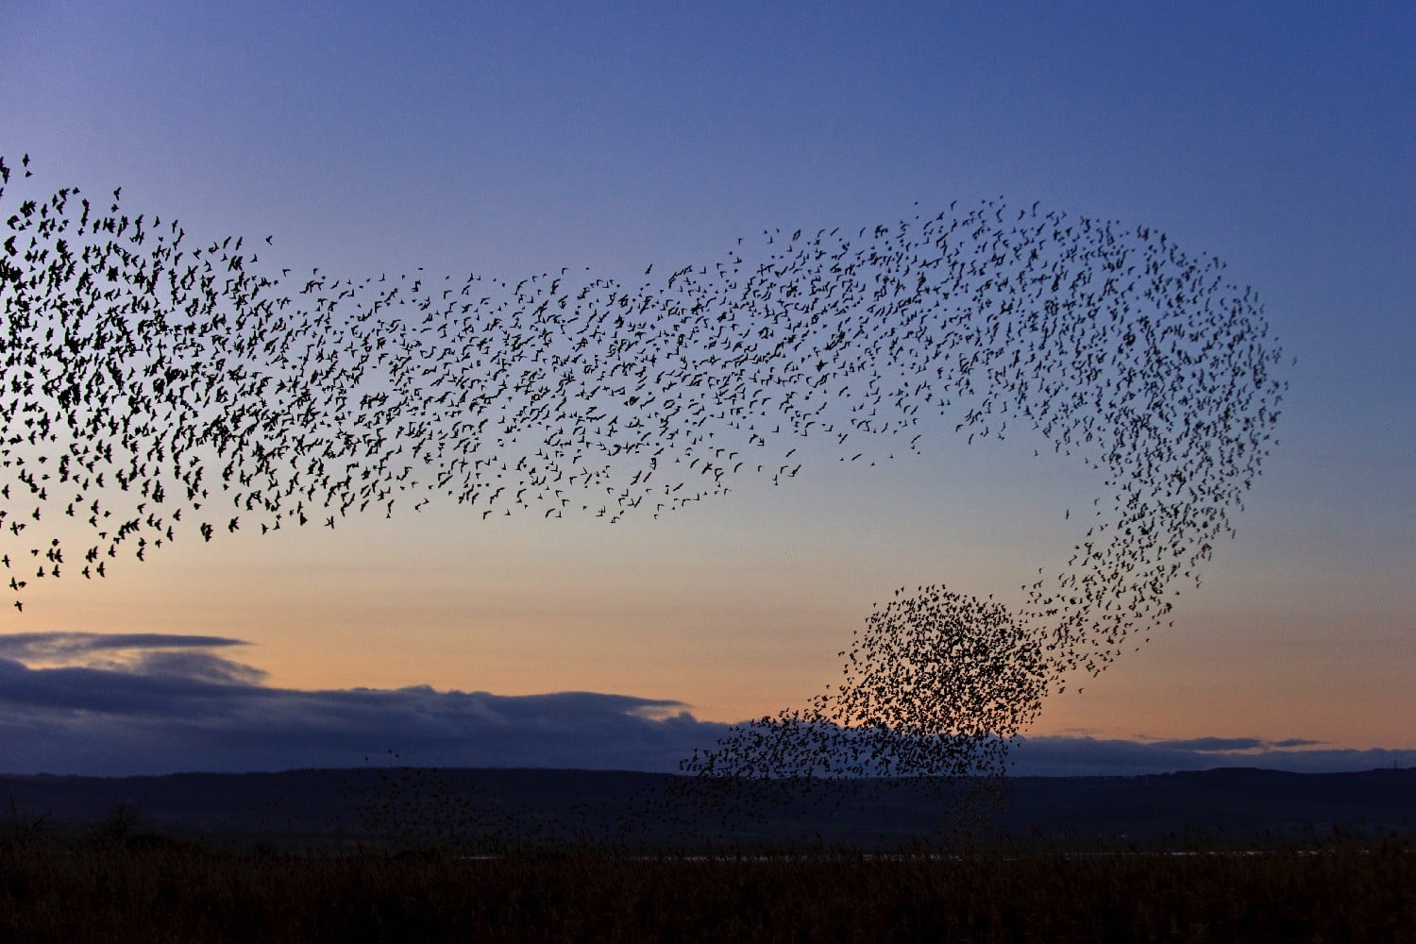
Mean Field Game Theory for Future Heterogeneous and Hierarchical Communication Networks
Reginald A. Banez
Advisor: Prof. Zhu Han
April 15, 2020

Slide 2
Outline
Introduction
Mean Field Game Theory
  Background
Mean Field Game with Several Populations
  Belief and Opinion Evolution in Social Networks
Mean-Field-Type Game
  Computation Offloading in Mobile Edge Computing Networks
Future Works
Publications
Conclusion

Slide 3
Outline
Introduction
Mean Field Game Theory
  Background
Mean Field Game with Several Populations
  Belief and Opinion Evolution in Social Networks
Mean-Field-Type Game
  Computation Offloading in Mobile Edge Computing Networks
Future Works
Publications
Conclusion

Slide 4
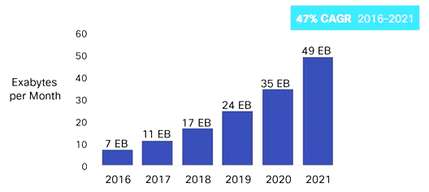
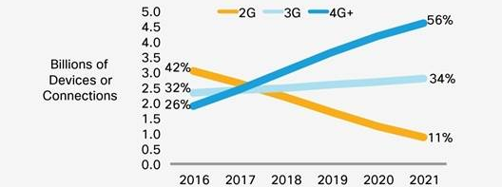
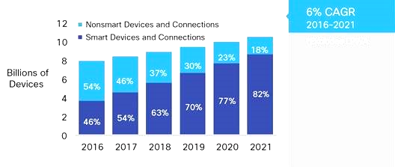
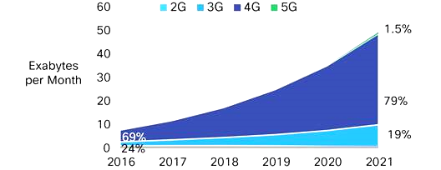
Motivation for Future Networks
Maturity – reaching the limit
More frequent usage
Increase data traffic
Growing number of devices
Need for new design and architecture of networks

Slide 5
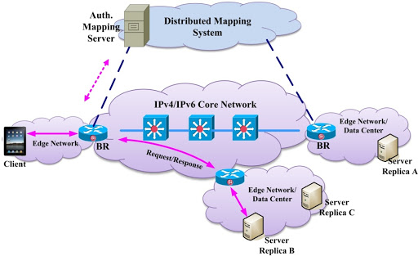
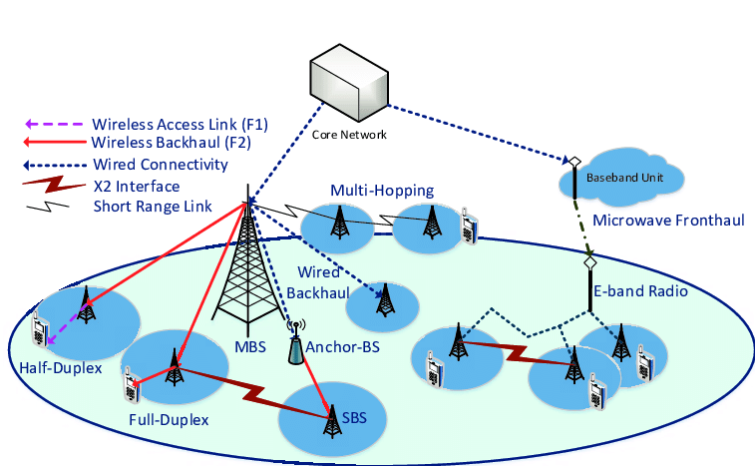
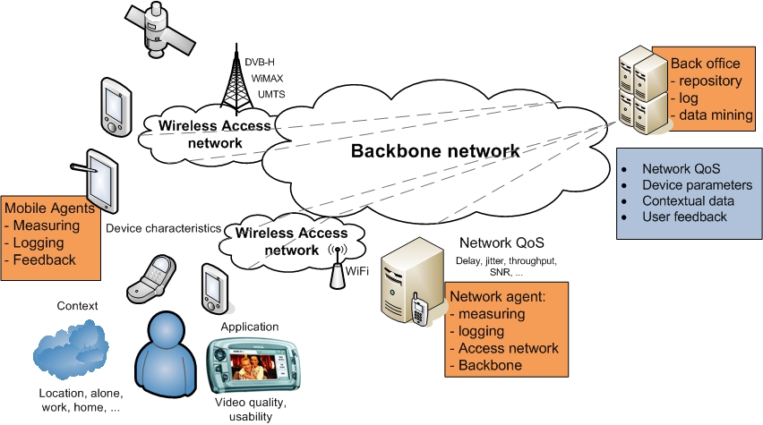
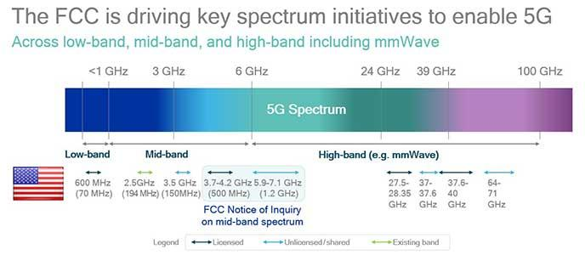
Network Challenges and Solution
Challenges
  high capacity
  high data rate
  massive connections
  low latency
  low cost
  quality of experience
Enablers
  ultra-dense networks
  high carrier frequencies
  massive bandwidths
  edge networks
  energy management
  traffic management
Problem: large quantities of
  cells/base stations
  users
  connections
Solution: an appropriate mathematical framework that can handle large number of interacting players –
MEAN FIELD GAMES

Slide 6
Outline
Introduction
Mean Field Game Theory
  Background
Mean Field Game with Several Populations
  Belief and Opinion Evolution in Social Networks
Mean-Field-Type Game
  Computation Offloading in Mobile Edge Computing Networks
Future Works
Publications
Conclusion

Slide 7
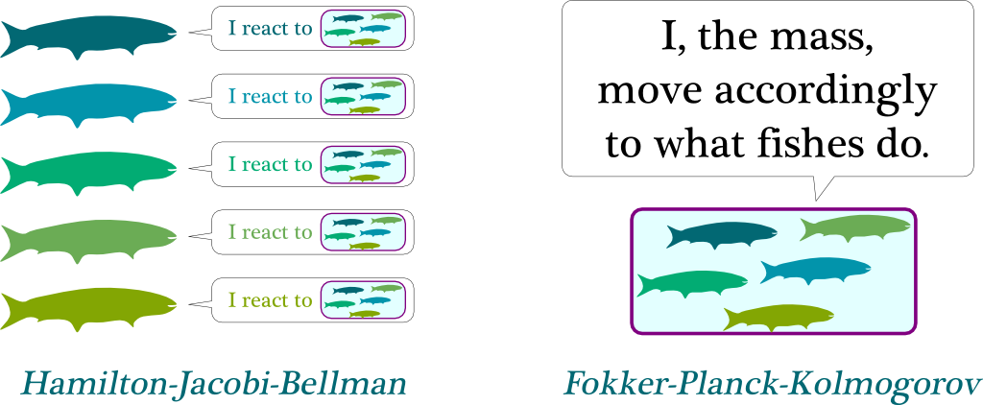

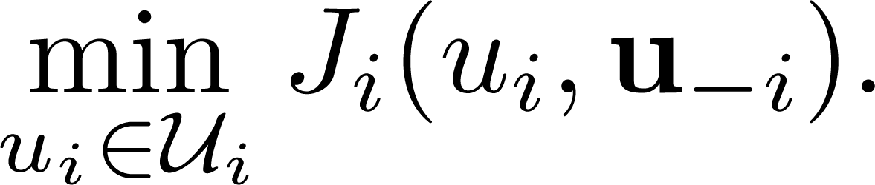
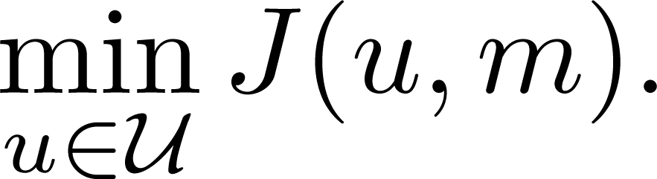
Classical Game Theory vs Mean Field Game
Classical game theory
  It models the interaction of a player with each of the other players
  For each player ,
Mean field game
  It models the interaction of a reference player with the collective effect of the other players
  For any player,

Slide 8
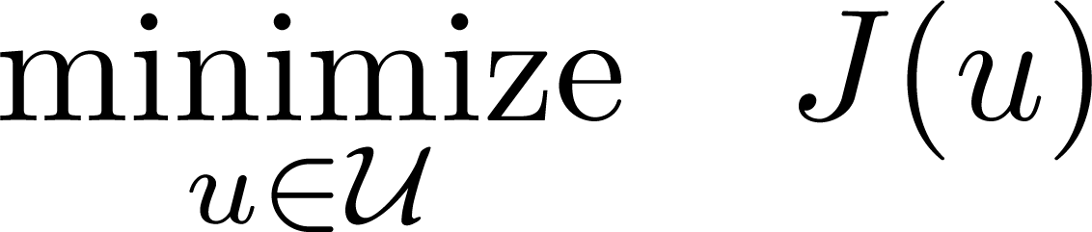
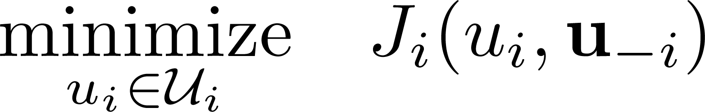
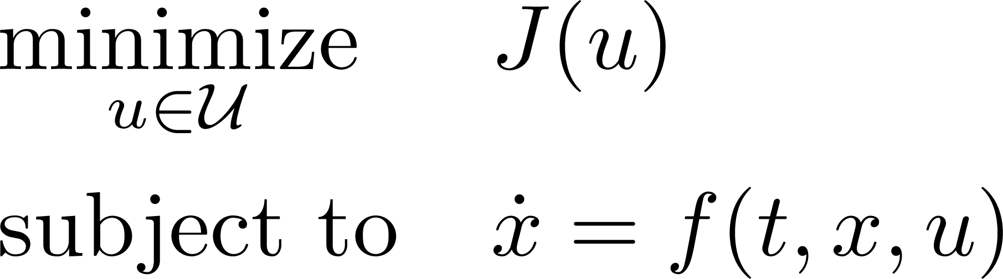
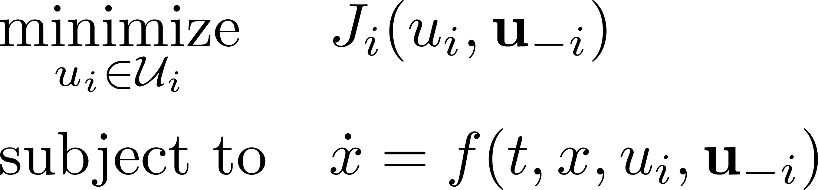
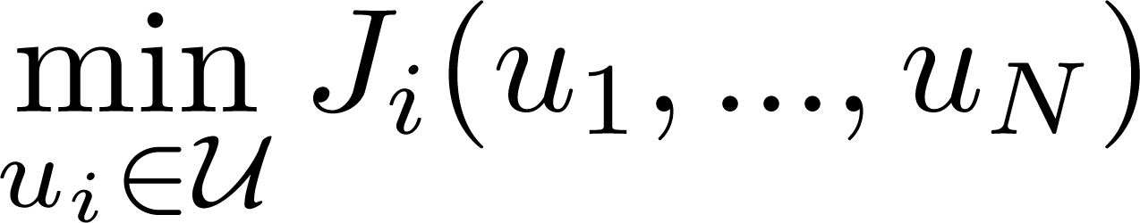
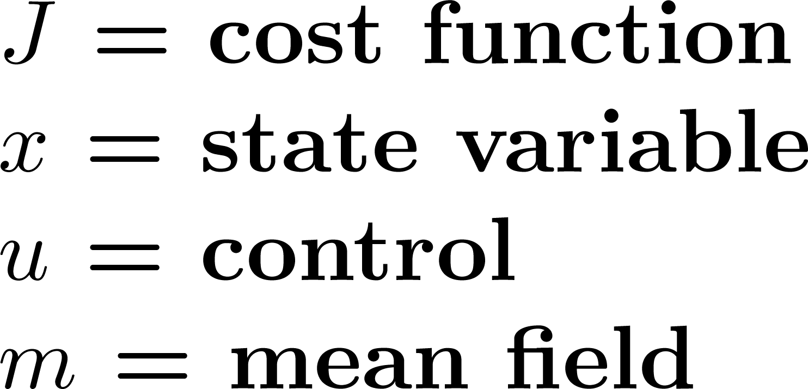
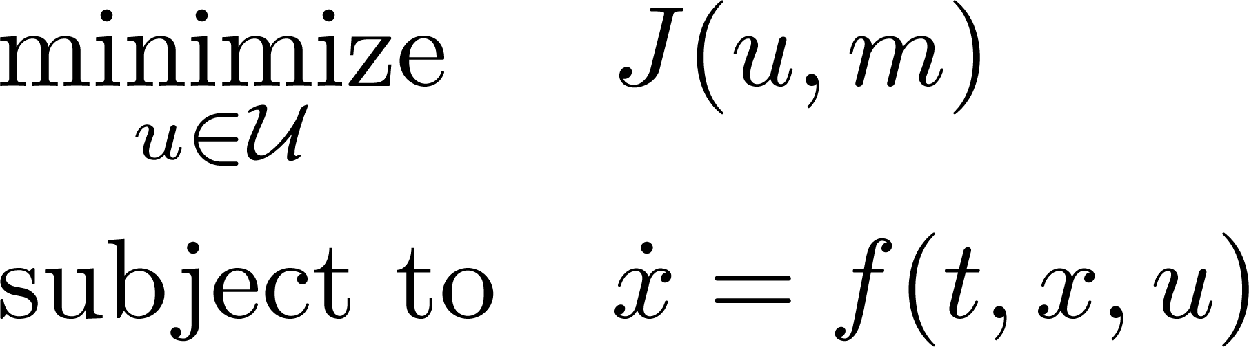
Mean Field Games (MFG)
Involves a large number of players that are indistinguishable, rational, heterogeneous
A player chooses its optimal strategy given the available global information that results from the actions of all players.
A standard control problem between:
  a reference player
  the aggregate of all the other players
Optimization Problem
Game Theory
Optimal Control Problem
Differential Game
Mean Field Game

Slide 9
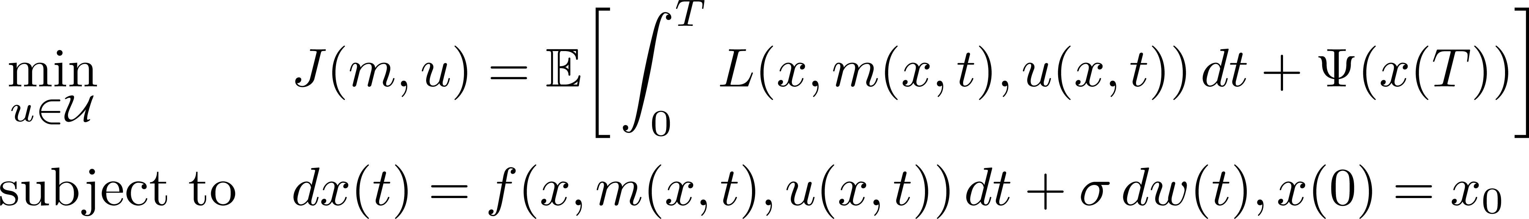
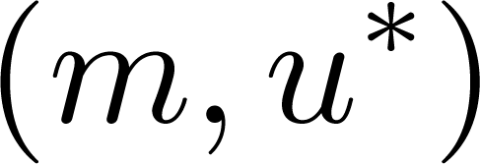
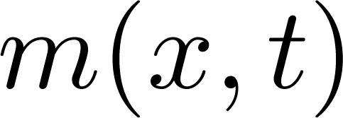
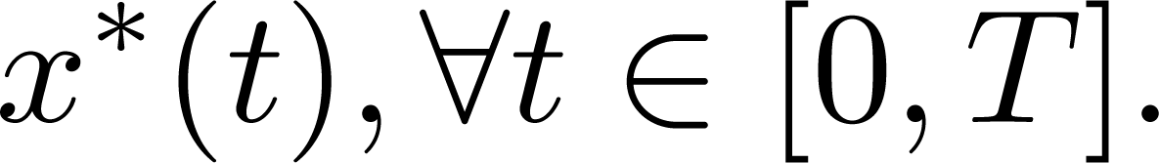
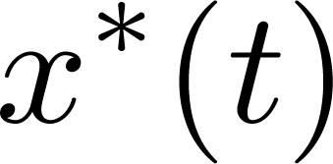
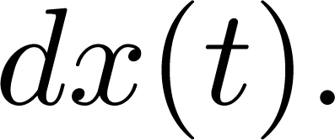
Mean Field Games
Problem: optimal control problem of a reference player:
Solution: find such that
and is the probability distribution of
This condition describes a Nash equilibrium where is a solution to
→ Cost function
→ State dynamics
mean field

Slide 10
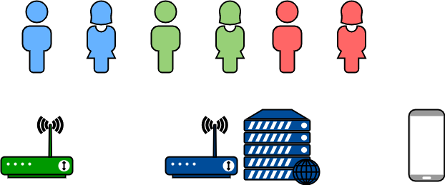
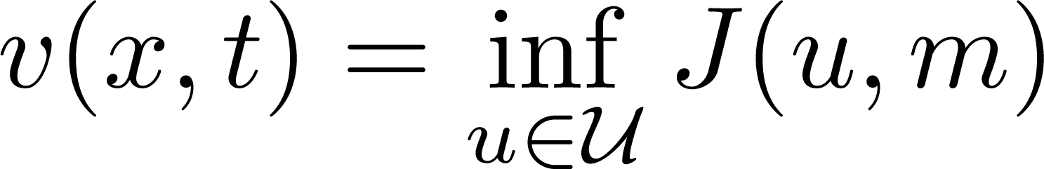
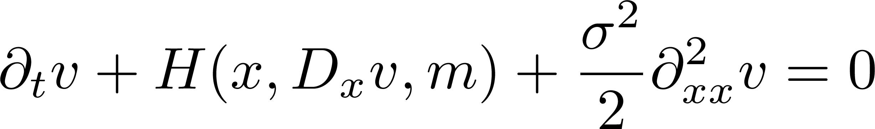
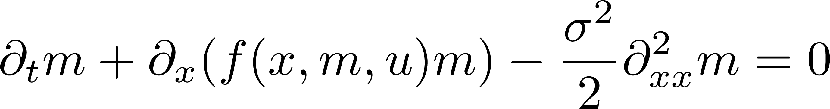
HJB/FPK (Reduced) Form
Hamilton-Jacobi-Bellman (HJB) equation – reaction of a player with the mean field
Fokker-Planck-Kolmogorov (FPK) equation – evolution of the mean field function of players
state dynamics
value function
Bellman Optimality Principle

Slide 11
Outline
Introduction
Mean Field Game Theory
  Background
Mean Field Game with Several Populations
  Belief and Opinion Evolution in Social Networks
Mean-Field-Type Game
  Computation Offloading in Mobile Edge Computing Networks
Future Works
Publications
Conclusion

Slide 12
Mean Field Games with Several Populations
Interaction among several populations with large number of indistinguishable players
The behavior of each group is approximated using a mean field approach.
A standard control problem at each population between:
  a reference player
  the aggregate of all the other players in each population
Population
  Non-cooperative – mean field game
  Cooperative – mean-field-type game
Players
  Non-cooperative – Nash equilibrium
  Cooperative – common equilibrium

Slide 13
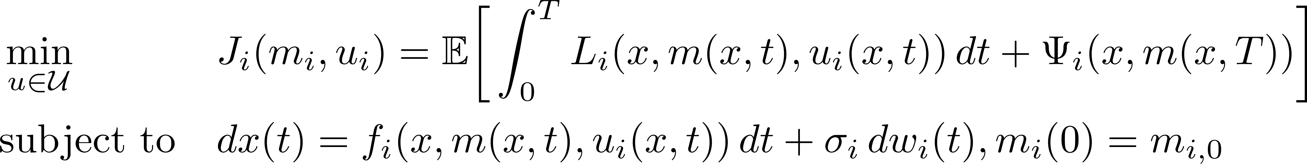
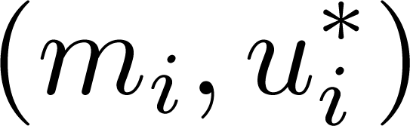
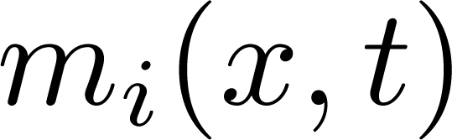
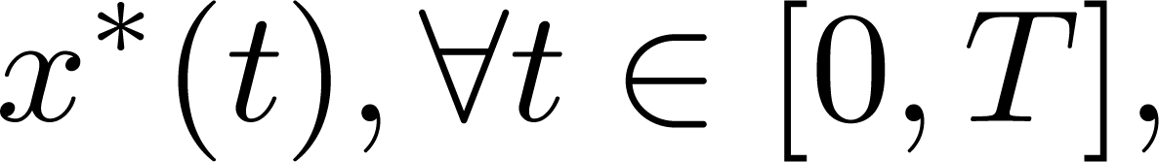
Problem Statement
Problem: optimal control problem of a reference player in population i:
Solution: find such that
and is the probability distribution of at population .
This condition describes a Nash equilibrium where is a solution to
→ Cost function
→ State dynamics
mean field

Slide 14
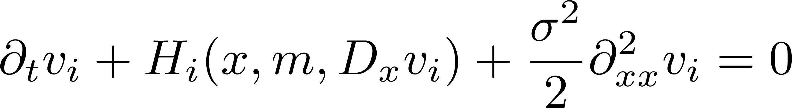
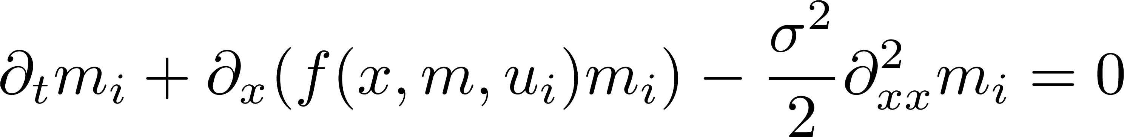
HJB/FPK (Reduced) Form
HJB equation – derived from Bellman optimality principle
FPK equation – evolution of the mean field function of players
HJB
FPK
HJB
FPK

Slide 15

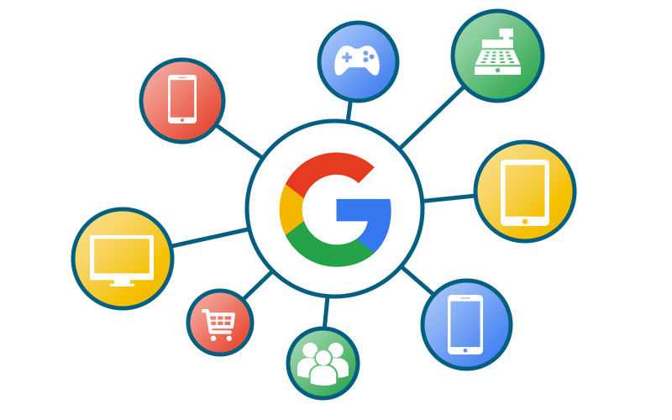
Belief and Opinion Evolution in Social Networks
Social networks – based on social relationships
  mobile social networks (MSN) – mobile environments
  online social networks (OSN) – applications
Challenge: modeling social network user behavior
  belief and/or opinion evolution
Motivations:
  learn evolution of traffic
  knowledge of user behavior
  enhance user experience
Solution: mean field game with several populations

Slide 16
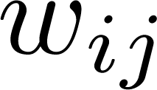

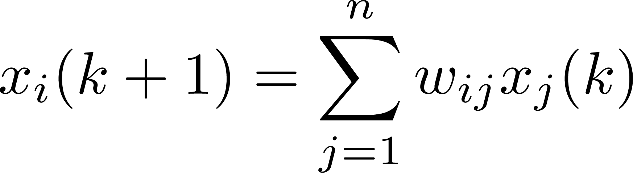
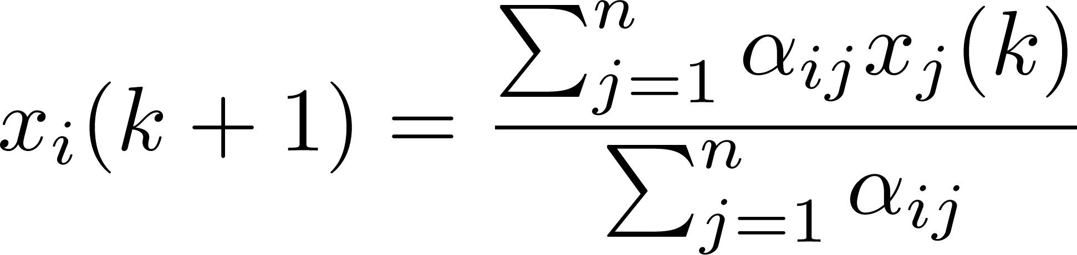
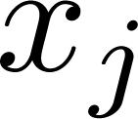
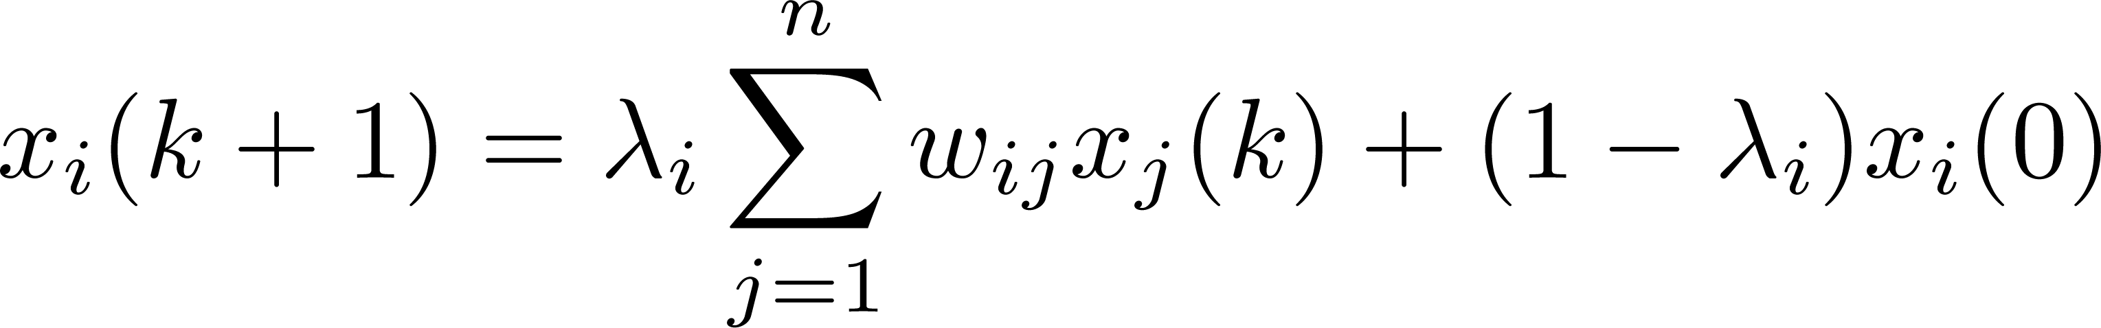
Belief and Opinion Evolution in Social Networks
Opinion dynamics – opinion update
  DeGroot model – weighted sum of neighbor opinions
  Hegselmann-Krause model – average of neighbor opinions
Opinion dynamics with stubborn agents
  Friedkin-Johnsen model – compromise between neighbor opinion and initial opinion
↓
average neighbor opinion
↓
initial opinion

Slide 17

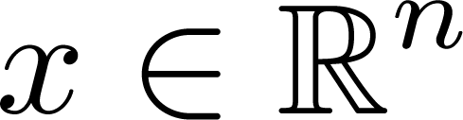


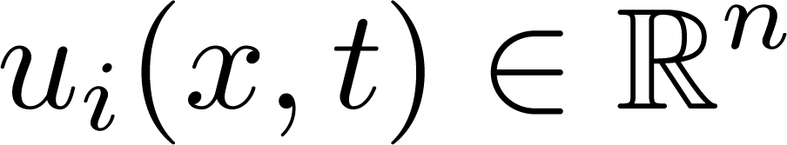
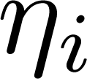
System Model
Players: social network users, divided in to populations
State: opinion of a user
Mean field: distribution of
Control: interaction of a user in population
Goal: determine information about opinion evolution of users in a multiple-population setting
Method: mean field game with several population

Slide 18
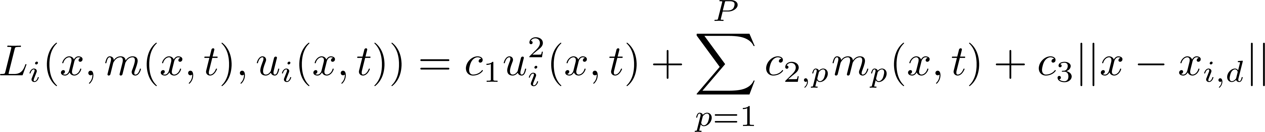
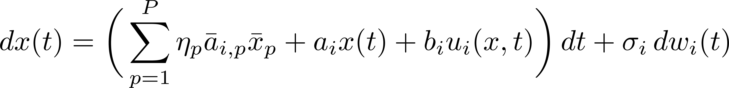
Problem Formulation
Cost function
  influence effort – more effort = more cost
  popularity – more popular opinion = high reward
  opinion distance – farther from desired opinion = more cost
State dynamic equation
  Hegselmann-Krause (HK) model – averaging of neighborhood opinions:
↓
influence effort
↓
popularity
↓
opinion distance
↓
average neighbor opinion
↓
influence
↓
randomness

Slide 19
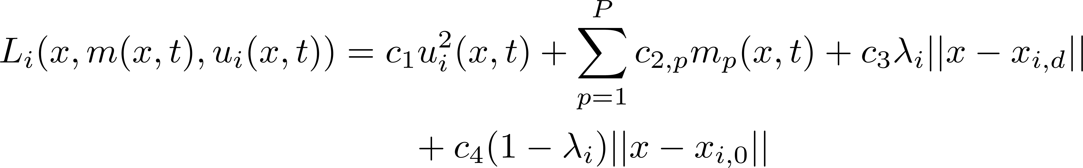
Problem Formulation
With stubborn agents – players reluctant to change from initial opinion
Cost functional
State dynamic equation
→ distance to initial opinion
↓
average neighbor opinion
↓
initial opinion
↓
influence
↓
randomness

Slide 20
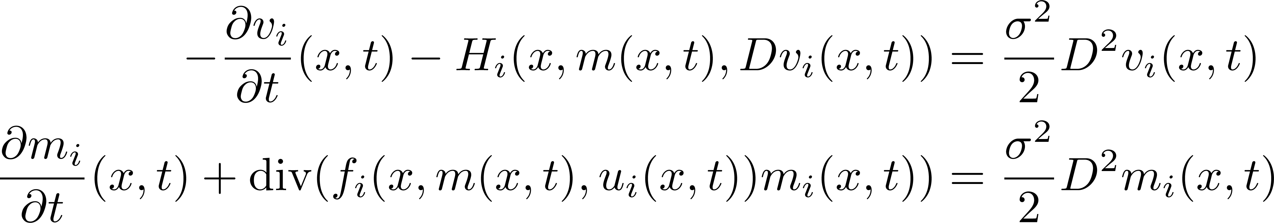
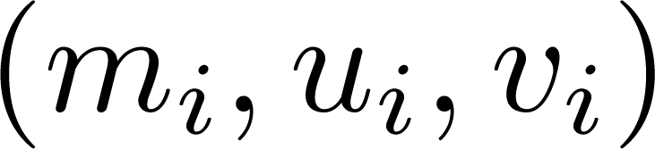
Problem Formulation
MFG SP problem: HJB/FPK (reduced) form
  Each population solves the following pair of HJB/FPK equations
where the Hamiltonian is defined as
Find a stable solution to the MFG problem.

Slide 21
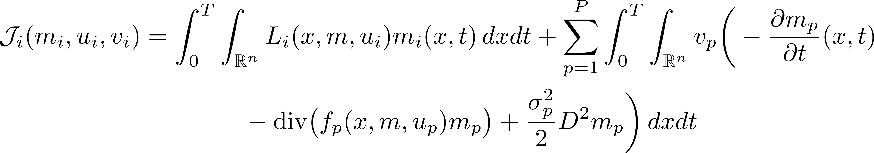

Solution by Analytic or Adjoint Method
Extended cost functional
  Rewrite the original cost function as
Optimality conditions
  To find a stable solution set

Slide 22





Solution by Numerical Method
Finite difference method – discretized the optimality conditions
  first-order derivative → first-order difference
  second-order derivative → second-order difference
Lax-Friedrichs scheme – preserve the sign of the mean fields

Slide 23





Theoretical Simulations
Setup
Independent vs dependent populations
Existence of another population affects the distribution of opinions.

Slide 24


Theoretical Simulations
Effect of stubborn agents
Level of stubbornness affects the evolution of distribution of opinions.

Slide 25
Experimental Simulations
Social Evolution Dataset
  80 students in a housing facility at MIT
  attributes include political party (i.e. Democratic or Republican) and opinion about approval of President Obama
  relationship with other students (close friends, social activities, social network posts such as Facebook and Twitter)
  survey during March, April, and June 2009
Procedure
  convert the dataset to numerical values
  compute distribution of opinions based on the dataset
  estimate the distribution of opinions using the proposed algorithms
  predict the distribution of opinions using the proposed algorithms

Slide 26


Experimental Simulations
Estimation and prediction of opinion distribution
The proposed MFG-based algorithm can estimate the distribution of opinions in the dataset with good accuracy (97.25% and 96.93%).

Slide 27


Experimental Simulations
Estimation and prediction of opinion distribution
The proposed MFG-based algorithm can predict the distribution of opinions not in the dataset.

Slide 28
Outline
Introduction
Mean Field Game Theory
  Background
Mean Field Game with Several Populations
  Belief and Opinion Evolution in Social Networks
Mean-Field-Type Game
  Computation Offloading in Mobile Edge Computing Networks
Future Works
Publications
Conclusion

Slide 29
Mean-Field-Type Games (MFTG)
A relaxed MFG formulation
The number of interacting agents is not necessarily large.
MFTG extends MFG to include
  non-symmetry and
  non-negligible
effect of individual decision on the mean field term
Other quantities of interest, aside from the mean field term:
  variance
  skewness
  kurtosis
  value at risk
  success probability
  mean-variance payoff

Slide 30






Linear-Quadratic MFTG
Problem: find the optimal control that satisfies
Solution: a Nash equilibrium that satisfies
for every , for all

Slide 31
Computation Offloading in
Mobile Edge Computing Networks
Mobile Cloud Computing (MCC)
  offers cloud services such as computing and storage
Mobile Edge Computing (MEC)
  lower latency than MCC
  Computation offloading – a service offered in MEC in which a device can assign other devices to perform a computation-intensive task

Slide 32
Computation Offloading in
Mobile Edge Computing Networks
Challenges:
  Mobile users require computation-intensive tasks. Devices are constrained in execution time and energy consumption.
  As an edge computing network becomes more dense, optimization becomes more challenging.
Solution:
  Computation offloading helps mobile devices and edge computing nodes perform computation-intensive tasks.
  Mean field game is a framework that avoids solving N-coupled optimization problems.

Slide 33










System Model
Players: ECN
State: = the amount of aggregate computation task
Control: = the portion of the aggregate computation task to be offloaded by ECN
State dynamics: = the evolution of state with time
Goal: find optimal portion of computation task
Method: mean-field-type game
Edge Computing Node (ECN)
Task Aggregator (TA)

Slide 34









System Model
Running and terminal cost functions
  energy cost
  execution time
  number of computation task
    energy cost coefficient:
    computation time cost coefficient:
    computation task cost coefficient:
    ECN computing capability: = number of CPU cycles per seconds
    cost weights:
Network state dynamics
  incoming computation task rate:
  outgoing computation task rate:

Slide 35




Problem Formulation
MFTG formulation – based on mean field terms and
  Running and terminal cost functions
  Network state dynamics equation
→ sum of costs due to energy, time, number of tasks
→ expressed in terms of mean field and difference to mean field
→ difference between incoming tasks and outgoing tasks

Slide 36


Problem Formulation
MFTG problem
  Each ECN tries to solve the following linear-quadratic MFTG problem:
  A solution refers to the optimal portion of the aggregate computation task that ECN can offload.
  An optimal control that solves the MFTG problem can be found by using a direct method proposed in the literature.
    It does not require solving coupled partial differential equation.

Slide 37



Non-Cooperative Scenario
The ECNs optimize their own cost.
Problem
  Using a direct method, the LQ-MFTG problem can be rewritten as
Solution
  A function of the mean field and the difference

Slide 38


Cooperative Scenario
The ECNs optimize a global cost.
Problem
  Using a direct method, the LQ-MFTG problem can be rewritten as
Solution
  A function of the mean field and the difference

Slide 39



Simulations
Setup
  randomly placed in a 150 m by 150 m cell
Non-cooperative vs cooperative
  Non-cooperative algorithm has more balanced distribution of tasks than cooperative algorithm.

Slide 40


Simulations
Effects of computing capability and cost weights
An ECN with lower computing capability offloads more from the TA if minimizing the energy consumption is more critical. If the priority is to minimize computation time, then an ECN with higher computing capability offloads more from the TA,

Slide 41


Simulations
Comparison with baseline
The proposed MFTG-based algorithms is more efficient than local and dynamic greedy algorithms.

Slide 42
Outline
Introduction
Mean Field Game Theory
  Background
Mean Field Game with Several Populations
  Belief and Opinion Evolution in Social Networks
Mean-Field-Type Game
  Computation Offloading in Mobile Edge Computing Networks
Future Works
Publications
Conclusion

Slide 43





Future Works
Mean Field Stackelberg Game (MFSG)
  MFG with Stackelberg mode between one leader and N uniform followers.
    leader announces its strategy
    the follower determine their strategy
    the leader takes into account the follower optimal response.
Application: pursuit and evasion in multiple unmanned aerial vehicle (UAV) networks

Slide 44

Future Works
Mean Field Game with Major and Minor Agents
  MFG when players are non-identical
    major agent/s – non-negligible
    minor agents – negligible effect
Application: resource allocation in network virtualization
  multiple virtual networks can reside in a physical network
  hierarchy in represents levels of differing effect
  determine portion to be allocated
PN
VN₁
VN₂
EUs

Slide 45
Publications
Book
  R. A. Banez, L. Li, C. Yang, and Z. Han, Mean Field Game and its Applications in Wireless Networks, in preparation, Springer Science + Business Media, LLC.
Journal
  R. A. Banez, H. Gao, L. Li, C. Yang, Z. Han, and H. V. Poor, “Multiple-Population Mean Field Belief and Opinion Evolution in Social Networks,” ready to submit to IEEE journal.
  R. A. Banez, H. Tembine, L. Li, C. Yang, L. Song, Z. Han, and H. V. Poor, “Mean-Field-Type Game Based Computation Offloading in Mobile Edge Computing Networks,” minor revision, submitted to IEEE Transactions on Wireless Communications.
  R. A. Banez, H. Xu, N. H. Tran, J. B. Song, C. S. Hong, and Z. Han, “Network Virtualization Resource Allocation and Economics Based on Prey–Predator Food Chain Model,” IEEE Transactions on Communications, vol. 66, no. 10, pp. 4738-4752, Oct. 2018.
Conference
  R. A. Banez, H. Gao, L. Li, C. Yang, Z. Han, and H. V. Poor, “Belief and Opinion Evolution in Social Networks Based on a Multi-Population Mean Field Game Approach,” IEEE International Conference on Communications, Dublin, Ireland, Jun. 2020.
  R. A. Banez, L. Li, C. Yang, L. Song, and Z. Han, “A Mean-Field-Type Game Approach to Computation Offloading in Mobile Edge Computing Networks,” IEEE International Conference on Communications, Shanghai, China, May 2019.

Slide 46



Contributions and Conclusions
MEAN FIELD GAME THEORY
Mean Field Game
Several Populations
Mean Field Stackelberg Game
Mean Field Game with Major and Minor Agents
Mean-Field-Type Game
Computation Offloading in Mobile Edge Computing Networks
Belief and Opinion Evolution in Social Network Behavior
Pursuit and Evasion with Unmanned Aerial Vehicles
Resource Allocation in Network Virtualization

Slide 47


