Slide 1




IEEE SmartGridComm Tutorial
(25-28 October 2022, Singapore)
AI-Driven Decarbonization for Energy Systems
Dr. Dawei Qiu#, Prof. Shengrong Bu*, and Prof. Zhu Han&
#Department of Electrical and Electronic Engineering, Imperial College London, UK
*Department of Engineering, Brock University, Canada
&Department of Electrical and Computer Engineering, University of Houston, US

Slide 2
Objective
To introduce fundamentals of energy system and its deregulation transition
  Smart grid
  Decarbonization framework
  Energy market
To learn AI-driven tools to solve complex smart grid problems
  Reinforcement learning
  Multi-agent system
To introduce popular smart grid applications
  Ancillary service provision by electric vehicles
  Peer-to-peer energy trading in local energy community

Slide 3
Table of Contents
Background
  Smart grid
  Decarbonization framework
  Energy market design
AI-driven tools
Smart grid applications
Conclusion and future work

Slide 4
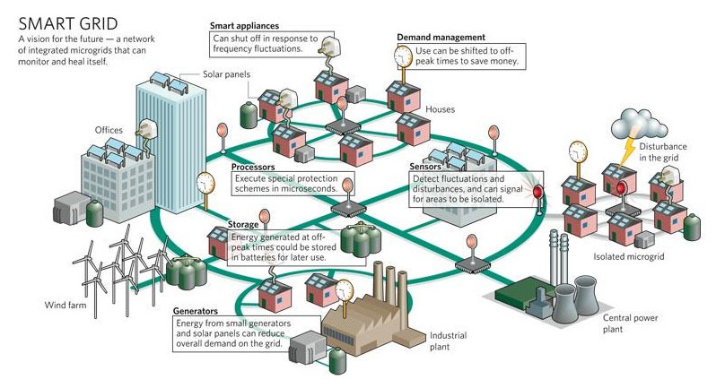
Smart Grid
In 2009, “American Recovery and Reinvestment Act”
  $3.4 billion for SG investment grant program
  $615 million for SG demonstration program
  It leads to a combined investment of $8 billion in SG capabilities.

Slide 5
Existing vs. Smart Grid
Existing Grid | Smart Grid
One-way communication | Two-way communication
Centralized generation | Distributed generation
Few sensors | Sensors throughout
Manual monitoring | Self-monitoring
Manual restoration | Self-healing
Limited control | Pervasive control
Few customer choices | Many customer choices
Table 1 Comparison on properties of the grids

Slide 6
Benefit and Requirement of SG (NIST)
  Improving power reliability and quality;
  Optimizing facility utilization and averting construction of back-up (peak load) power plants;
  Enhancing capacity and efficiency of existing electric power networks;
  Improving resilience to disruption;
  Enabling predictive maintenance and self-healing responses to system disturbances;
  Facilitating expanded deployment of renewable energy sources;
  Accommodating distributed power sources;
  Automating maintenance and operation;
  Reducing greenhouse gas emissions by enabling electric vehicles and new power sources;
  Reducing oil consumption by reducing the need for inefficient generation during peak usage periods;
  Presenting opportunities to improve grid security;
  Enabling transition to plug-in electric vehicles and new energy storage options;
  Increasing consumer choice;
  Enabling new products, services, and markets.

Slide 7
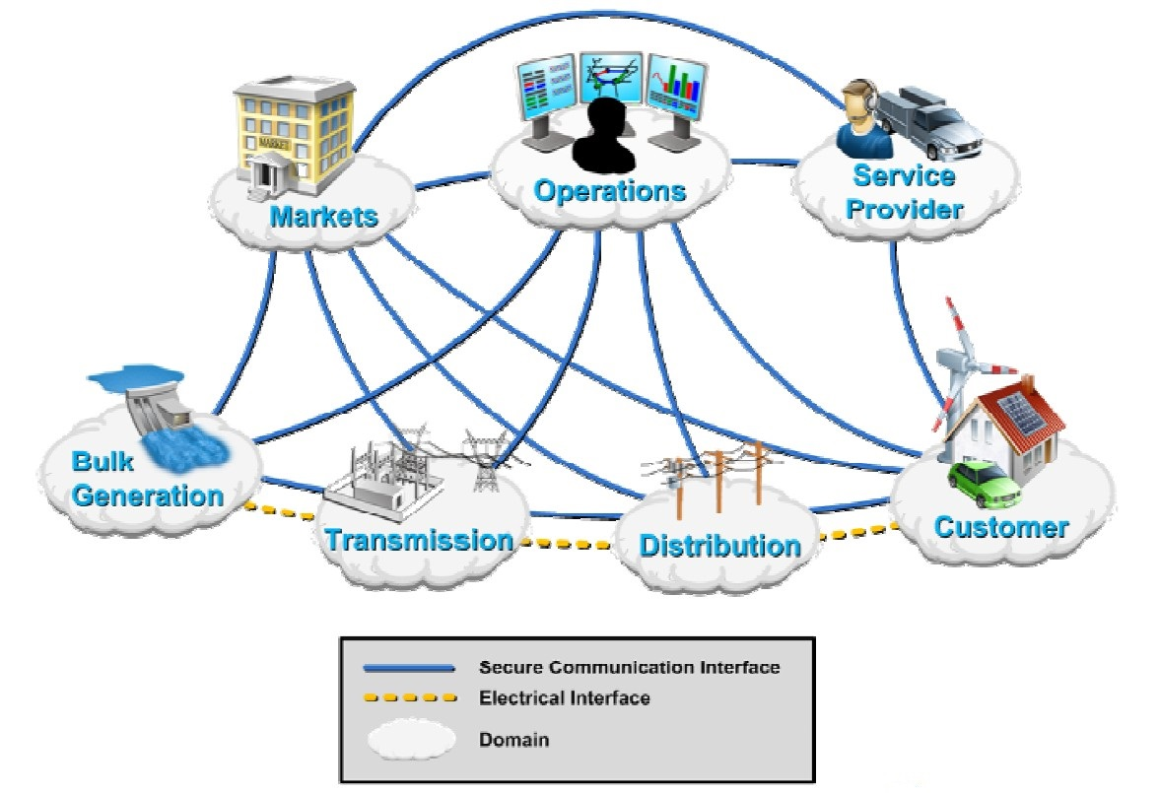
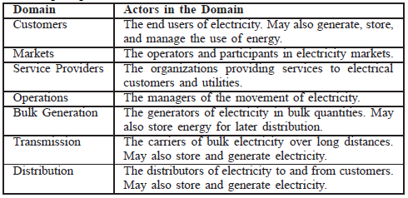
Smart Grid Domains
Fig. 1 Smart Grid domains by the U.S. DOE
Table 2 Smart Grid domains by the U.S. DOE

Slide 8
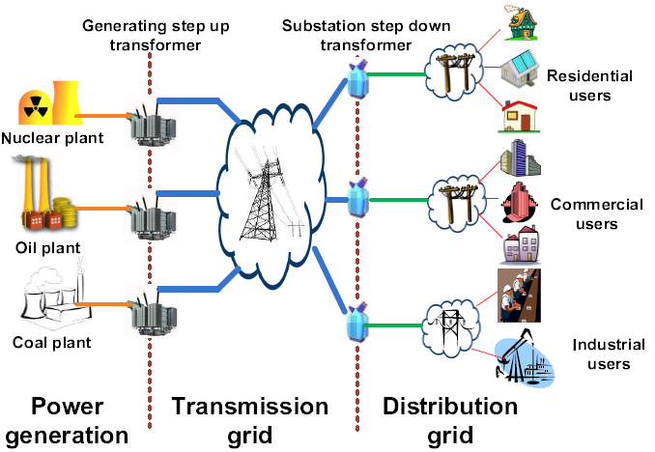
Energy Subsystem in Power Grid
Renewable energy can be either in power generation or distribution grid

Slide 9
Table of Contents
Background
  Smart grid
  Decarbonization framework
  Energy market design
AI-driven tools
Smart grid applications
Conclusion and future work

Slide 10
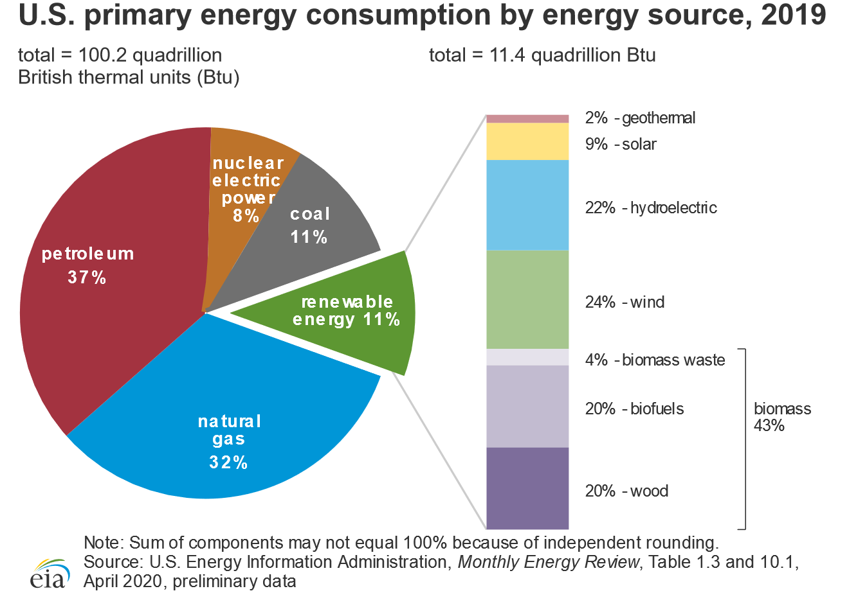
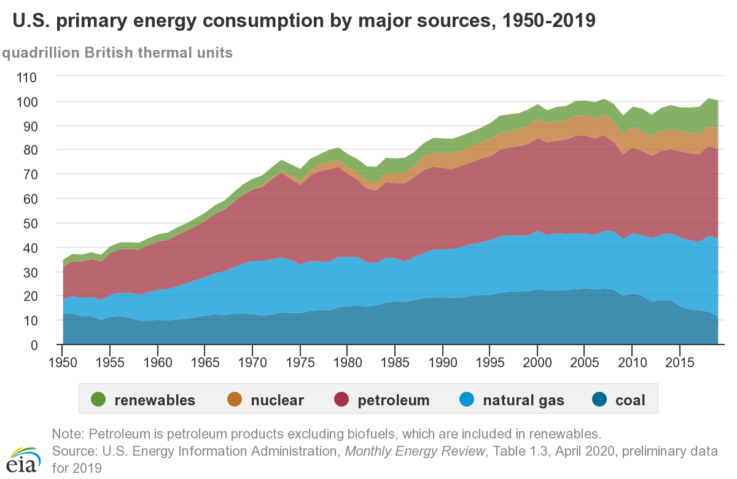
US Primary Energy Sources

Slide 11
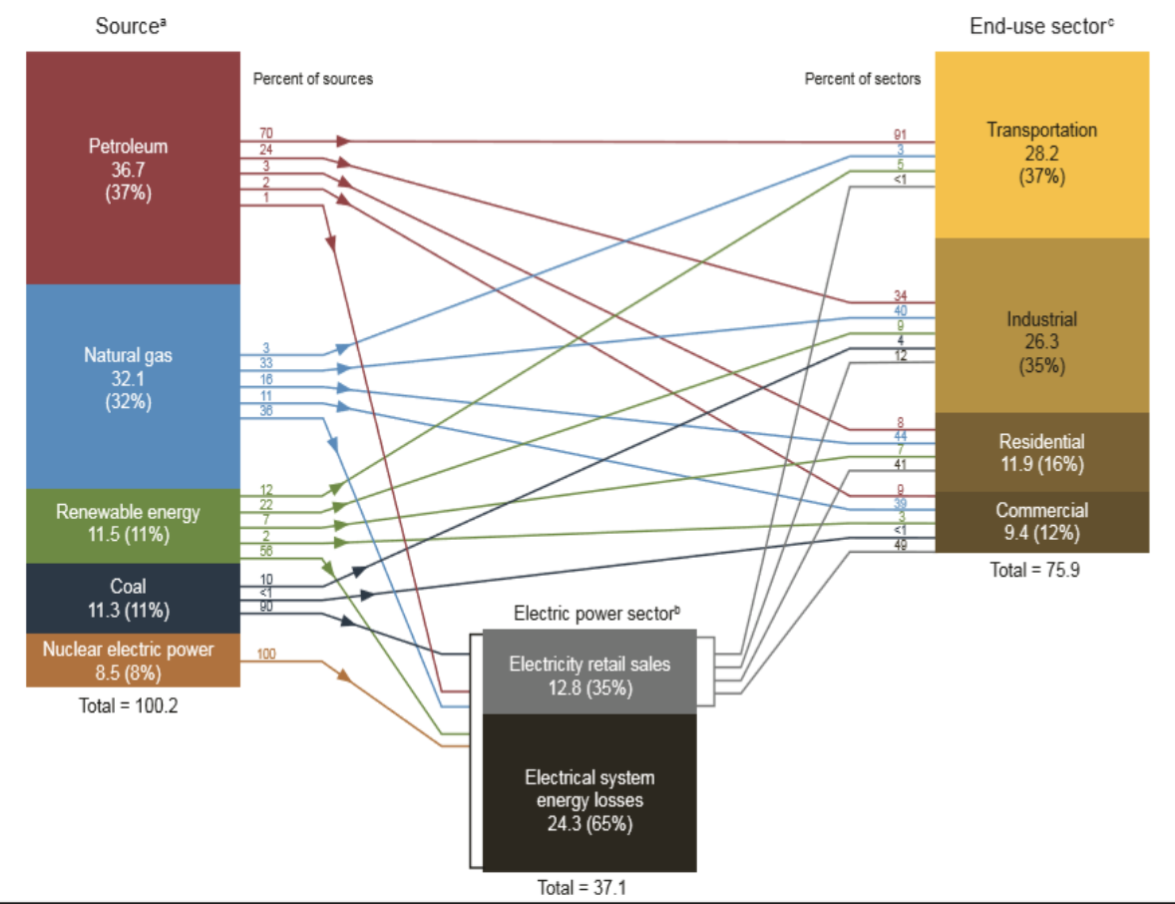
US Energy by Source and Sector

Slide 12
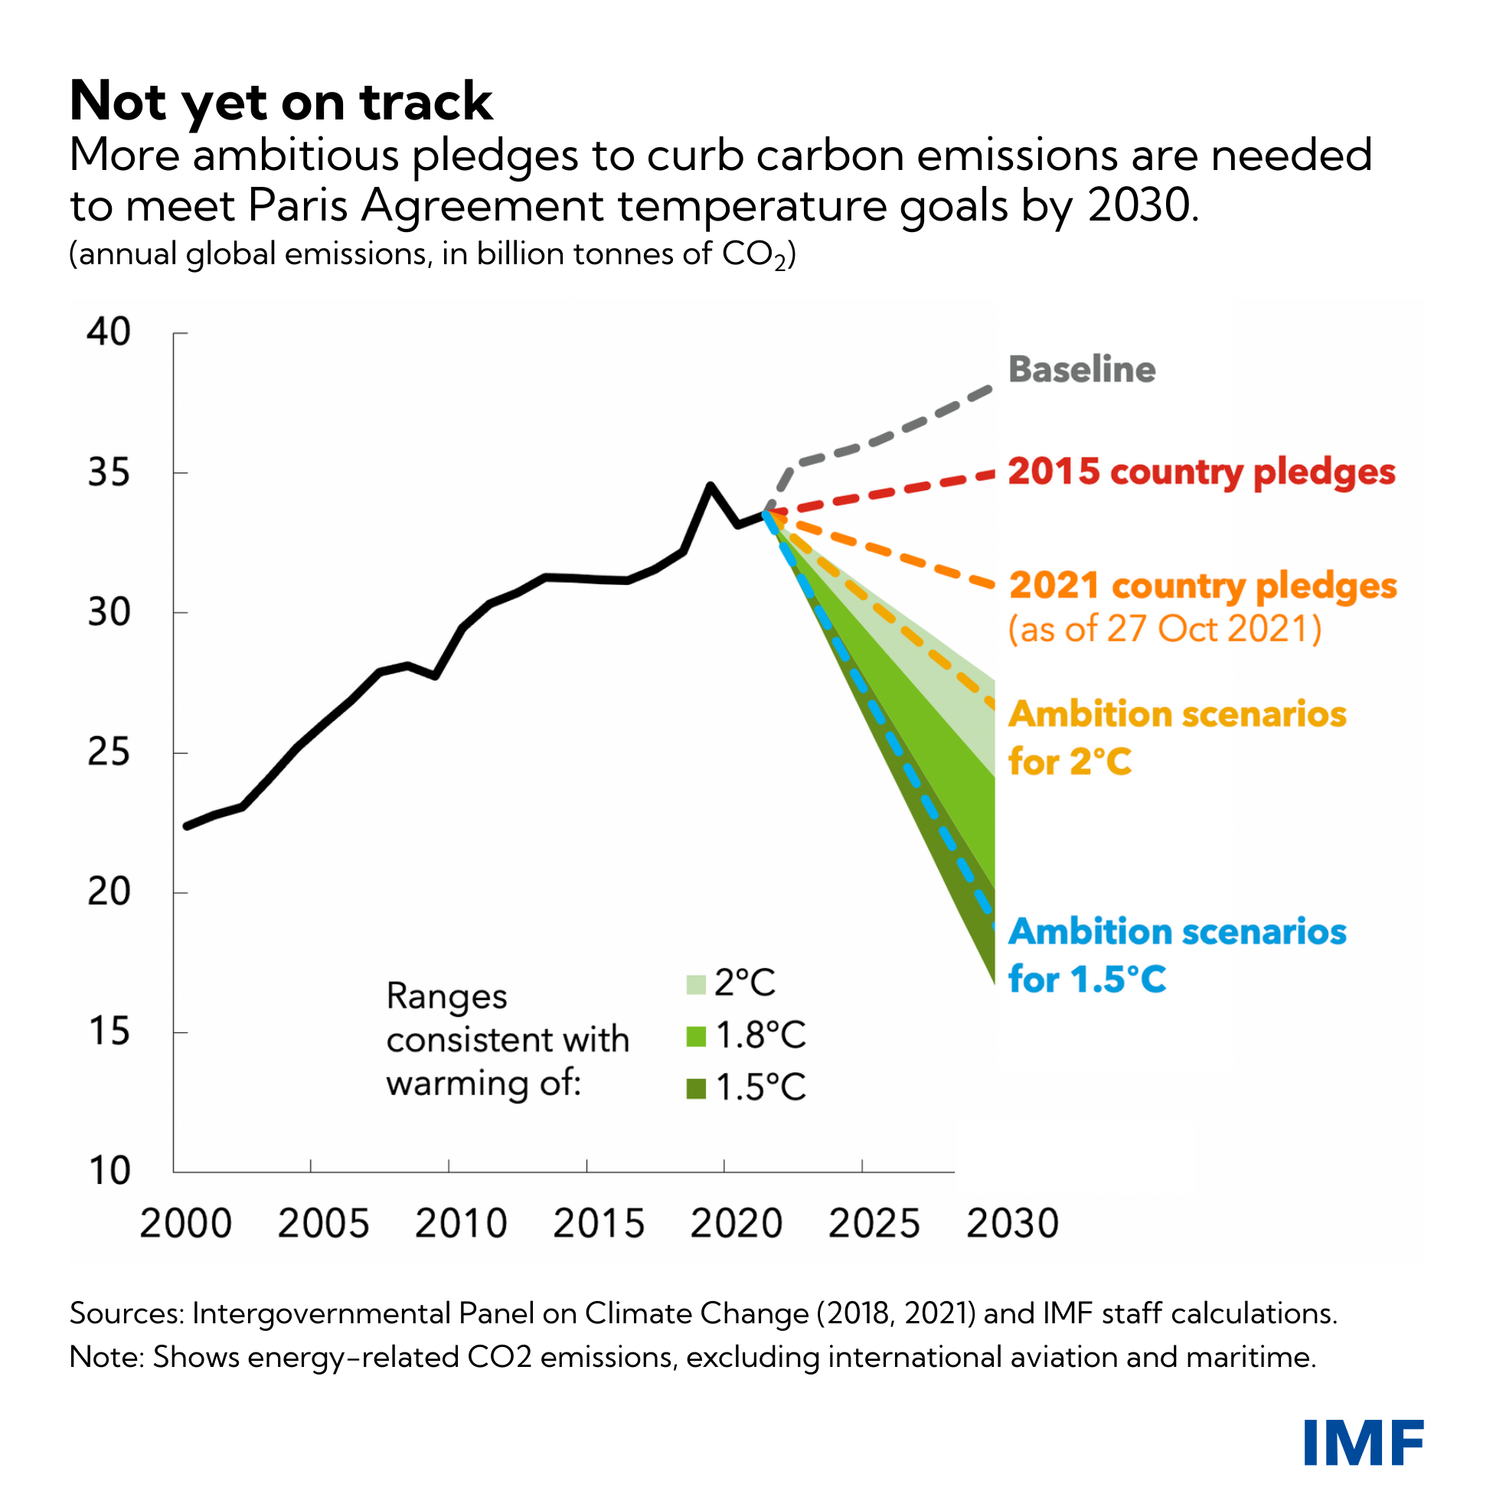
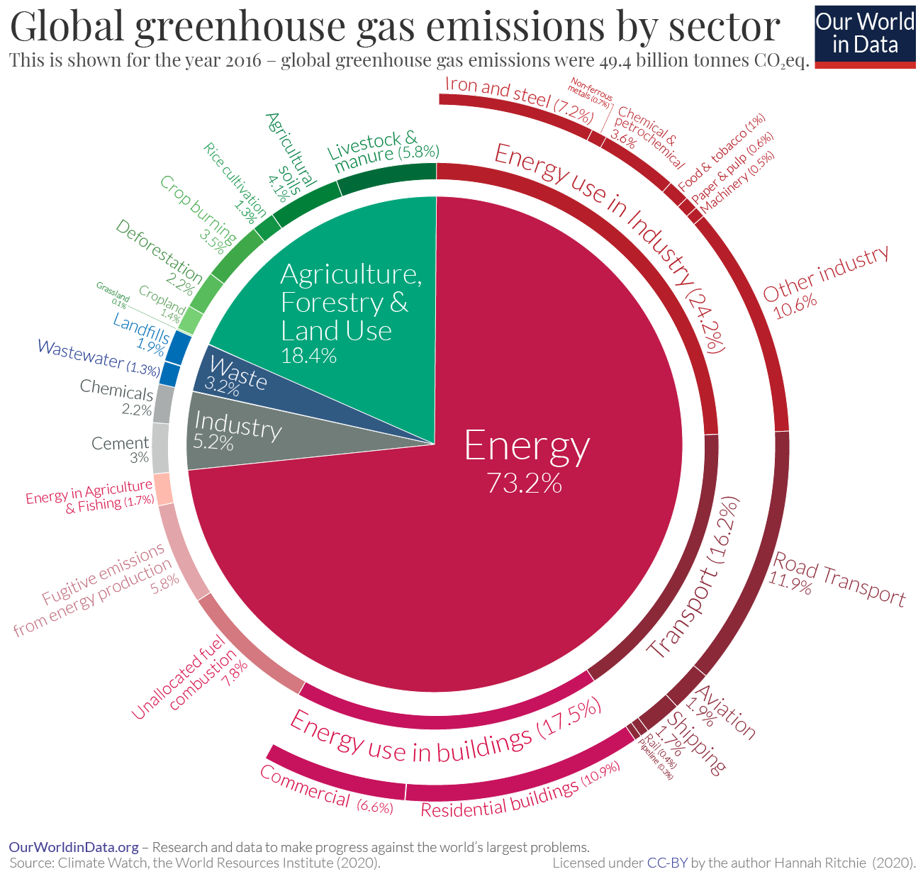
Emission Trends
Despite the progress, the current emission trends are NOT on track to meet the urgent climate goal set by the climate leaders.

Slide 13

Share of Renewables in Power Sector
Electricity generation (TWh/yr)
A 2-degree Celsius scenario for electricity generation, REmap Case, 2015-2050.
Source: IRENA, 2018a

Slide 14
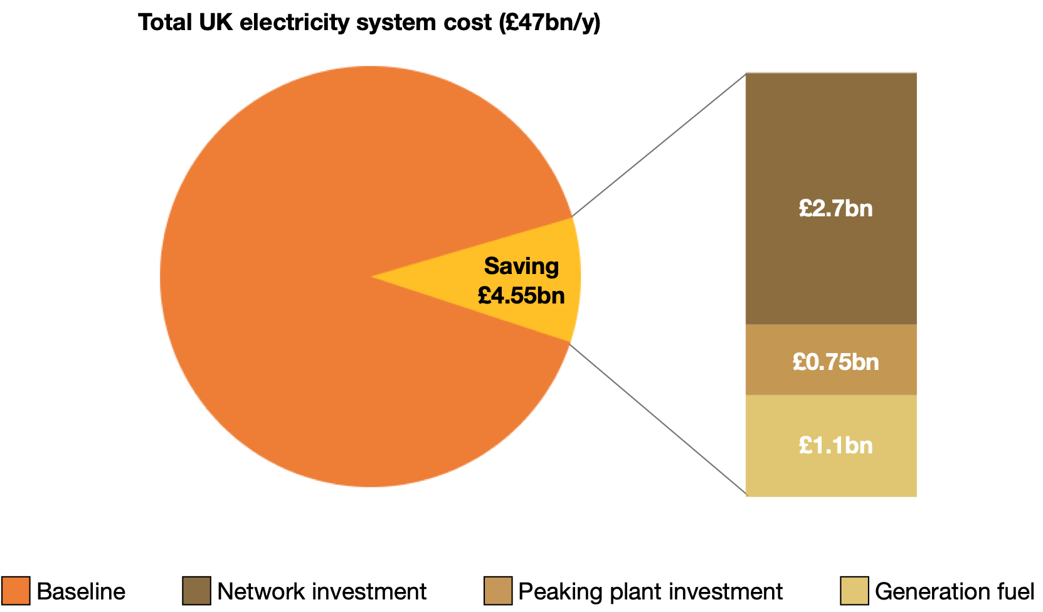
The Value of Flexibility
Flexibility: Better ways of matching supply and demand over multiple time and spatio-scales.
Source: Piclo, 2020

Slide 15


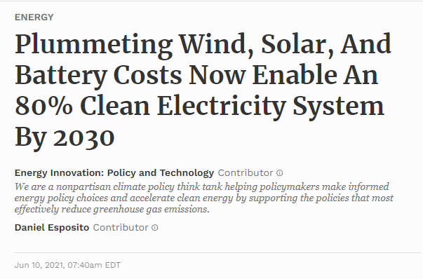
US Actions

Slide 16
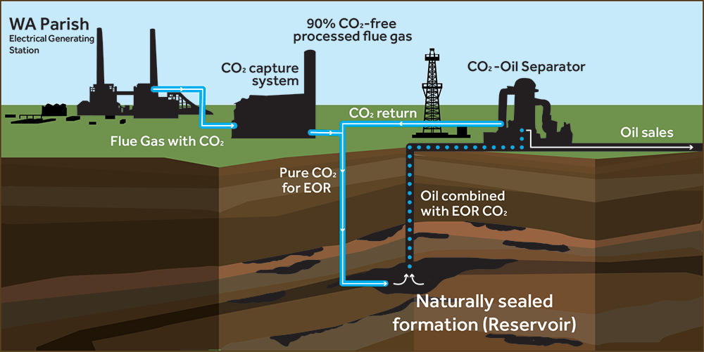
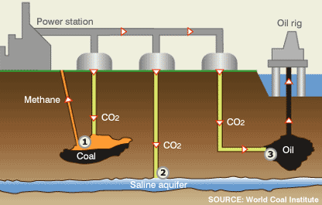
Power Systems in Transition​
A multi-faceted approach is necessary:
  Technical measures: the continued substitution of zero-/low-emission power sources, improvements in end-use efficiency, large-scale deployment of storage as a grid flexibility resource, and use of carbon capture, utilization, and storage (CCUS).
  Innovations in policy and regulation: equally important to stimulate near-term actions from stakeholders, address system-wide impacts of decarbonization, and facilitate the net-zero energy transition.
Geological Storage
Clean Coal Technology

Slide 17
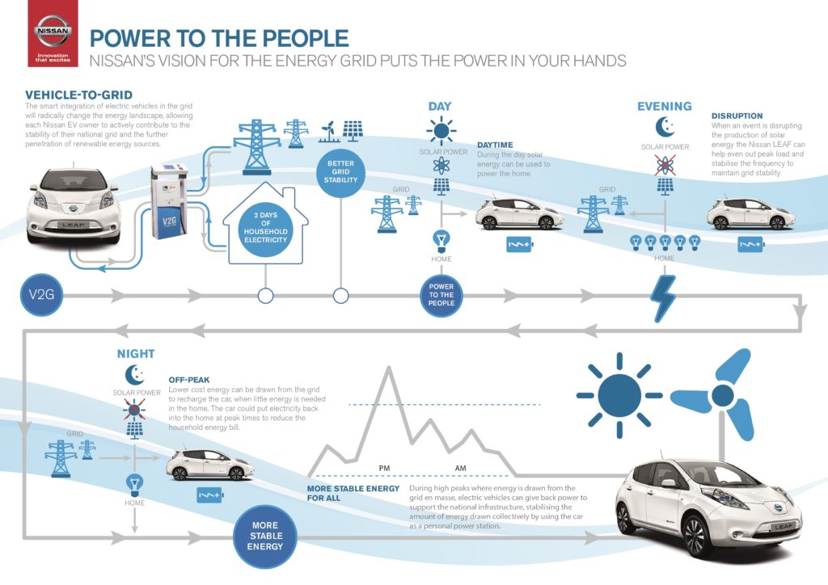
Electrical Vehicle to Grid

Slide 18
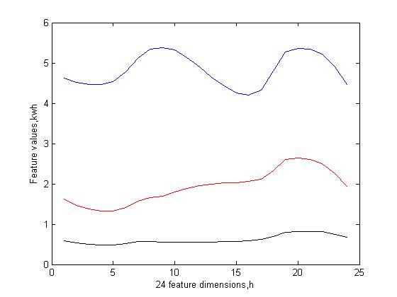
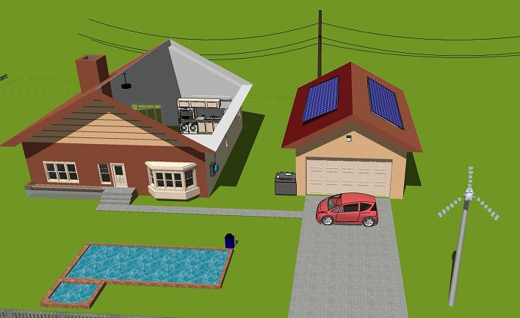
Load Profiling
From smart meter data, try to tell users’ usage behaviors
  CEO, 1%, audiences here in the future
  Worker, middle class, professor
  Ph.D. students

Slide 19
Emission Policy Instruments​
Two main emission policy instruments existed to mitigate carbon emissions and facilitate the green energy transition:
Carbon emission taxes/credits:
  Takes the form of a predetermined fixed tax rate, which is determined by the policy maker and then applied to power-generating companies that produce carbon emissions.
  When facing a carbon tax, power producers will seek to minimize the cost by deploying emission reduction strategies and substituting away from carbon-intensive technologies and operations.
Cap-and-trade emission trading system (ETS):
  In an ETS, an allowable amount of emissions (i.e., emission cap) is imposed by the policy-maker on the energy system to explicitly limit the overall emissions.
  This allowance, typically measured by tonnes of CO2, is then assigned to energy producers who make their energy generation decisions accordingly and ensure that their emissions do not exceed the emission allowance they hold.
  ETS participants can also trade their unused carbon allowances in a market environment.

Slide 20
Emission Policy Instruments​
Compared with carbon taxes, ETS focuses on:
  Policy certainty: explicitly limiting the overall emissions cap.
  Price incentives: for reducing fossil-fuel-based energy consumption and investing in clean low-carbon technologies.
Current Situations
  Due to its attractiveness, as of 2021, CETs have been implemented or are under development in 38 countries across four continents, with European Union (EU) ETS being the world's largest carbon market.
  EU ETS covers roughly 41% of the total EU GHG emissions and accounted for 84% of the value of the total global carbon market.
  During the past decade, ETSs have been proven effective. For instance, since its establishment in 2005, EU ETS has resulted in a 42.8% emission reduction to date.

Slide 21
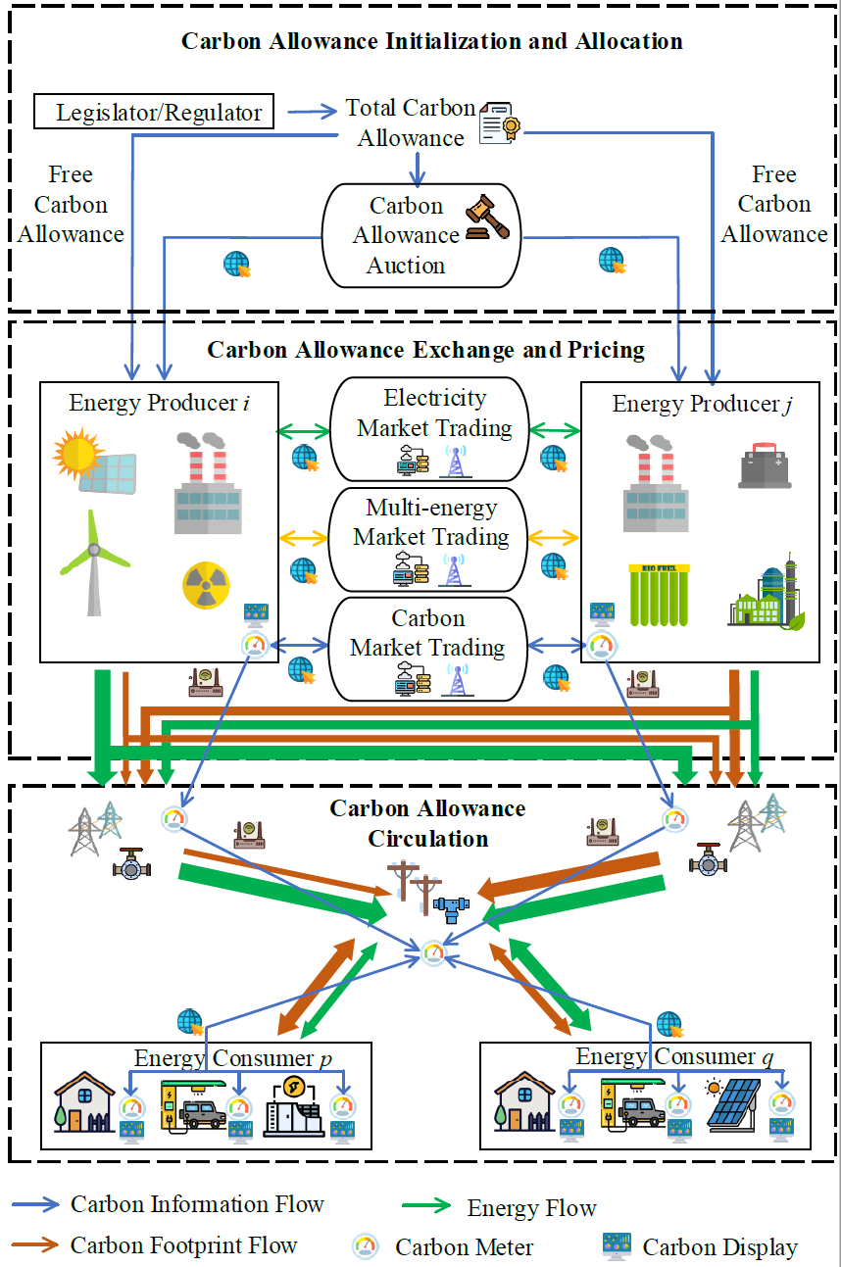
Carbon-oriented Framework
We divide the carbon flows through the multi-energy system into three stages:
  Carbon allowance initiation and allocation
  Carbon allowance exchange and pricing
  Carbon allowance circulation
Research mission
​
Building a carbon-centered systematic framework to pave the pathway of the low/zero-carbon transition of the power system.
Develop fundamentally new methods, as well as modifications and supplements to existing conventions, to meet the 2030 climate goal.
Establish a carbon perspective to analyze and exploit the synergy between the “life cycle” of carbon emissions in the electric power value chain.

Slide 22
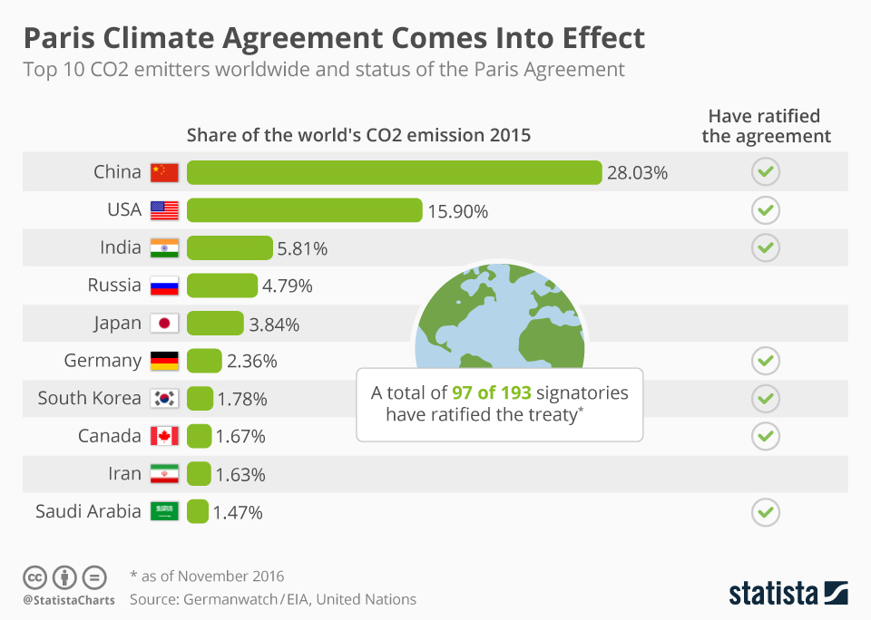
Stage 1: Carbon Allowance Initiation and Allocation
The first step for a regulator is to initialize the emission cap based on its emission reduction target as well as other policy-level assessment, such as technology readiness, mitigation potential, and costs.
The capped amount of carbon allowances, as an asset, is then assigned to the market participants.
The choice of this allocation directly affects how the energy producers participating in the ETS react to the carbon price signal and then determine their optimal operational and investment strategies.
Selection of the correct allocation strategy is the key to establish a well-functioned and competitive market, preserve the appropriate incentives for emission mitigation, and ensure economic efficiency.

Slide 23
Stage 1: Carbon Allowance Initiation and Allocation
Two strategies to allocate carbon allowance: Free allocation through grandparenting and auctioning
Free allocation through grandparenting:
  Carbon allowances are allocated to energy producers completely free based on historical benchmarks, such as emission intensity levels and power/energy generation.
  Easy to implement but draws constant criticism since grandfathering all carbon allowances creates a large windfall profits for energy producers: giving away the allowances for free is not a good idea!
  Free allocation through grandparenting is considered a transitional approach. For instance, it has only been used in the EU ETS in Phase 1 (2005-2007) where almost all the allowances were given out for free and Phase 2 (2008-2012) where free allocation fell to around 90% of the total allowances. In Phase 3 (2013-2020) of the EU ETS, auctioning became the default method for allocating allowances.
Research questions:
  How to find a sensible mix of the two allocation strategies to facilitate efficient near-term and foster long-term technological innovations towards the goal of deep decarbonization?
  How to design an enhanced allowance auctioning model?

Slide 24
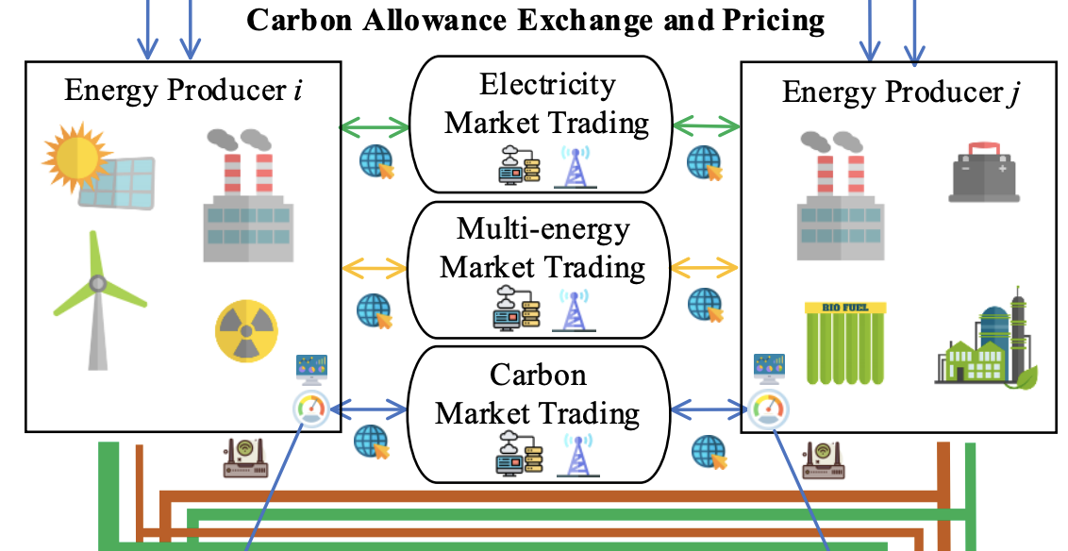
Stage 2: Carbon Allowance Exchange and Pricing
A power producer can benefit both financially and functionally by participating in multiple energy markets as well as the ETS.
Strategic power producers that own electric and other energy supplies and demands can participate jointly in multiple markets (e.g., electricity market and natural gas market) to maximize their profits.
Power producers can also exercise market power and trade their carbon allowances obtained through free allocation or auctioning in the ETS. In this way, energy markets and the ETS become coupled.
Research questions:
  How to identify the operational equilibrium of the integrated carbon and energy markets?
  How do power producer determine their offering/bidding strategies in multiple markets to maximize their profits?

Slide 25
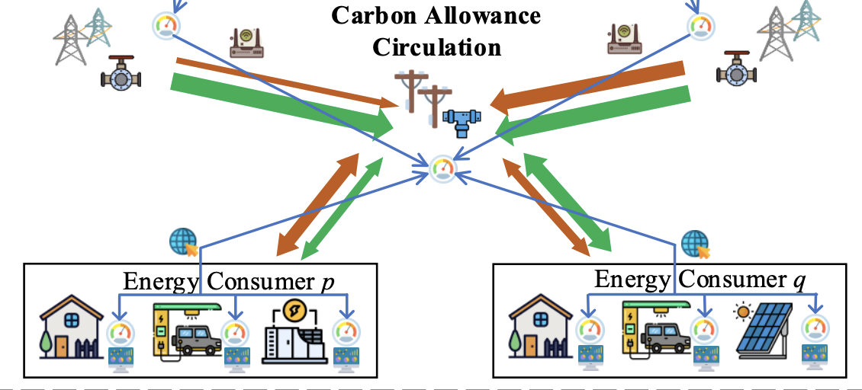
Stage 3: Carbon Allowance Circulation
The carbon flow in a power grid can be modeled in two layers:
  Carbon footprint flow (CFF) that describes how the carbon footprints circulate with the physical energy flow in the network, potentially across multiple energy sectors.
  Carbon information flow (CIF) that focuses on capturing the information exchange based on the carbon monitoring, recording, and visualization devices and mechanisms within the power system.
Research questions:
  How to develop the sensing infrastructure on accurate carbon metering?
  Protocols for information to be easily exchanged by different energy information systems with data privacy.
  The computing framework for distributed and collaborative decision making.

Slide 26
Table of Contents
Background
  Smart grid
  Decarbonization framework
  Energy market design
AI-driven tools
Smart grid applications
Conclusion and future work

Slide 27
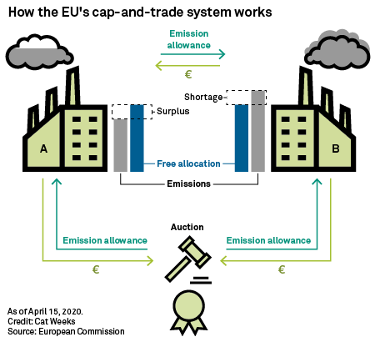
Basics of the EU ETS​
The EU ETS is an environmental law, and its regulation and policy were by the European Parliament, Commission, and Council. It is mandated by the EU Commission.
The EU ETS is a ‘cap-and-trade’ system: the cap level is determined by the legislative branches, and is designed to decrease annually from 2013 (in a linear fashion).
Each year, a proportion of the allowances are given to certain participants for free. The rest are sold through auctions.
At the end of a year, all the participants must return an allowance for every tonne of CO2 they emit during that year. If a participant has insufficient allowances then it must either take measures to reduce its emissions or buy more allowances on the market.
Participants can acquire allowances at auction, or from each other.
Participants can also decide to bank allowances for use in later years.
Compliance is ensured through the penalty (€100/CO2 tonne) and enforcement structure (the allowance owned will be surrendered).
The secondary market
The primary market

Slide 28
Basics of the EU ETS​
Phase 1
2005-07
Key features of Phase 1:
Covered only CO₂ emissions from power generators and energy-intensive industries.
Almost all allowances were given to participants for free based on their historical emission levels.
The penalty for non-compliance was €40 per tonne.
Outcome of Phase 1
A price for carbon.
Free trade in emission allowances across the EU.
The infrastructure needed to monitor, report and verify emissions from the businesses covered.
Phase 1 caps were set based on estimates, so the total amount of allowances issued exceeded emissions and, with supply significantly exceeding demand, in 2007 the price of allowances fell to zero.
Trading volumes was 2.1 billion in 2007.

Slide 29
Basics of the EU ETS​
Phase 1
2005-07
Phase 2
2008-12
Key features of Phase 2:
The aviation sector was brought into the EU ETS in 2012.
Better emissions reduction target with a lower cap on allowances based on the actual emission data obtained from Phase 1 (6.5% lower compared to 2005).
Free allocation fell to around 90%, some countries started auction.
The penalty for non-compliance was increased to €100 per tonne.
Outcome of Phase 2:
The 2008 economic crisis led to emissions reductions greater than expected. This led to a large surplus of allowances and credits, and also impacted the carbon price.
In 2012, 7.9 billion allowances were traded, worth €56 billion. EU allowances accounted for 84% of the value of the total global carbon market.

Slide 30
Basics of the EU ETS​
Phase 1
2005-07
Phase 2
2008-12
Phase 3
2013-20
Key features of Phase 3:
A single, EU-wide cap on emissions to replace the system of national caps.
Auctioning as the default method for allocating allowances (instead of free allocation).
Roughly 43% of the total phase 3 cap were given to the industry sector deemed exposed to carbon leakage for free. However, the power generation sector was subject to 100% auctioning.
More sectors and gases were included.
5% of the allowances set aside in the New Entrants Reserve to fund the deployment of innovative, renewable energy technologies and carbon capture and storage.
Outcome of Phase 3
As a long-term solution, a market stability reserve (MSR) began operating in 2019 to address the surplus of allowances.
MSR is designed to improve the system's resilience to major disruptions by adjusting the supply of allowances to be auctioned. Unallocated allowances will also be transferred to the reserve.
Each year, the Commission publishes in May the total number of allowances in circulation.
The market imbalance is also supported by a faster reduction of the annual emission cap in line with the 2030 target of at least 40% cuts in EU greenhouse gas emissions below the 1990 level.

Slide 31
Auctioning in the EU ETS​
Governed by the Auctioning Regulation. Hosted by common auction platform such as European Energy Exchange AG (EEX).
88% of the total amount of allowances that can be auctioned is distributed to Member States based on their share of GHG emissions in Phase 1 of the EU ETS. A 10% of the auctioning rights are divided between Member States with low GDPs. The remaining 2% of auction rights are distributed to Member States that take early actions and already meet their emission reduction goal.
The auction format is a single-round, sealed bid and uniform-price auction.
  During a single bidding window, bidders can submit, modify and withdraw any number of bids with a lot size of 500 or 1000 allowances (depending on the auction platform). Each bid must specify the number of allowances the bidder wants to buy at a given price.
  The bidding window must be open for at least two hours, and then a clearing price will be determined and published based on the sum of the volumes bid and the volume of allowances auctioned.
  All bids higher than the clearing price are successful. These bids are sorted in descending order of price and bid volumes are allocated starting with the highest bid. Tied bids are sorted through a random selection algorithm.

Slide 32
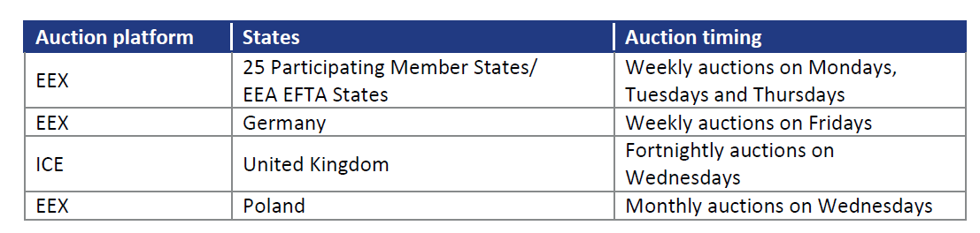
Auctioning in the EU ETS​
For each auction, if the volume is not auctioned entirely, the auction is cancelled.
If the clearing price is below the auction reserve price (i.e., a secret minimum clearing price set prior to the auction).
Allowances is delivered one day after the auction.
Auctioning calendars are published annually by the auction platforms.
The revenues from the auctions go to Member States based on their auction distribution. This revenue will be used to reduce greenhouse gas emissions, mitigate and adapt to climate change.

Slide 33
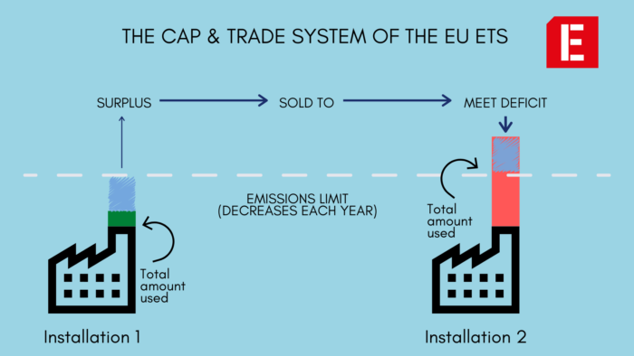
Market Trading in the EU ETS​
Trading can be done directly between buyers and sellers, commonly referred to as “Over-the-Counter” (OTC), through organized exchanges.
Different types of trades can take place as part of the EU ETS:
  Spot: transactions for immediate delivery of allowances, usually small amount.
  Futures/Forward market: trade with a priced agreed presently but shall be delivered and paid at a specific future date.
  Options: Options are about giving market participants the right, but not the obligation to buy or sell allowances at a fixed price upfront.

Slide 34
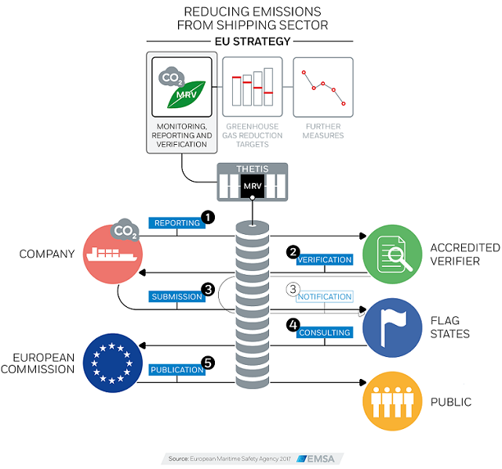
Monitoring, Reporting and Verification (MRV)
Every year, operators of installations and aircraft operators need to hand in an annual emission report (AER) to the competent authority.
The AER needs to be verified by an independent accredited verifier.
AER should include a complete and site-specific monitoring methodology and a monitoring plan. All data collection, compilation and calculation need to be accessible to the auditor.
Different “tiers” are specified to define accuracy levels in which installations of different sizes need to report their emissions.

Slide 35
Table of Contents
Background
AI-driven tools
  Data-driven reinforcement learning approach
  Markov decision process
  Single-agent reinforcement learning
  Markov Games
  Multi-agent reinforcement learning
Smart grid applications
Conclusion and future work

Slide 36

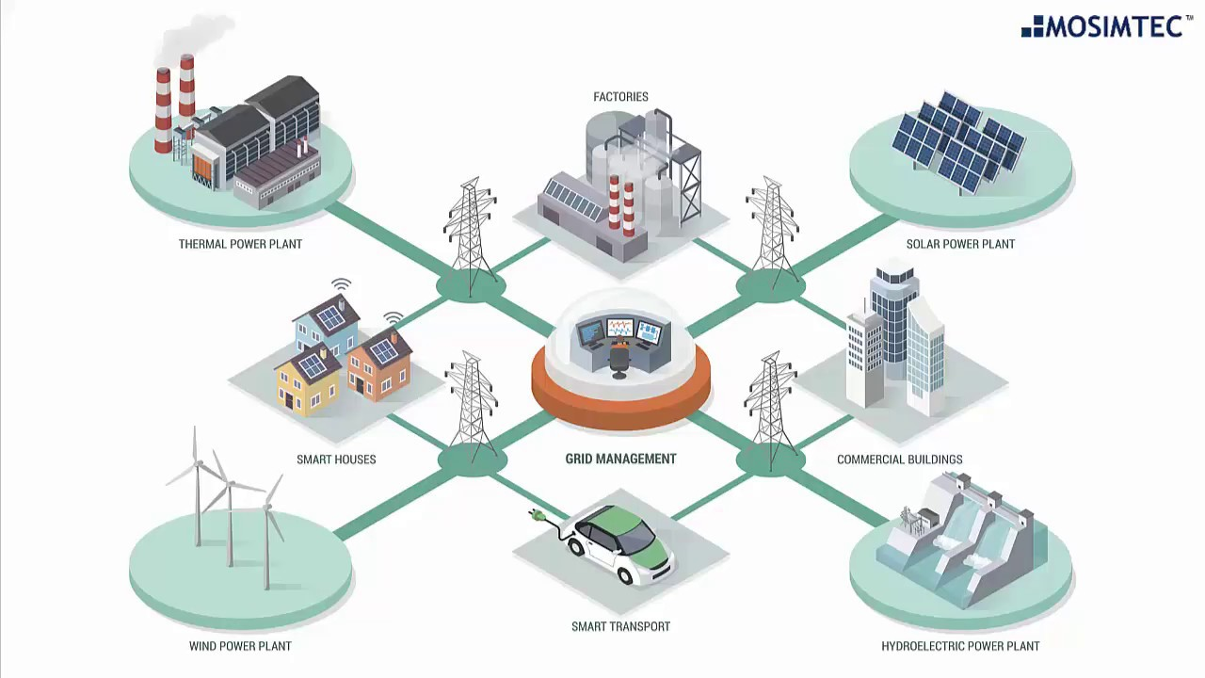





Why Data-Driven Reinforcement Learning?
Optimization
Agent
Models, Specifications
(everything)
Optimal solutions are guaranteed
state
action
$$o_{t}$$
$$a_{t}$$
reward
$$r_{t}$$
Environment
Model-base $→$ Model-free
Know exact mathematical models and accurate technical parameters
Forecast/Assume system uncertainties
Time-consuming in large-scale stochastic MILP
Destroy privacy perseverance (model-base)
AI agent does not rely on knowledge of smart grid environment, but only on its observed grid signals
Dynamic programming captures system uncertainties
Well-trained RL policy can be deployed in milliseconds
With privacy perseverance (model-free)

Slide 37
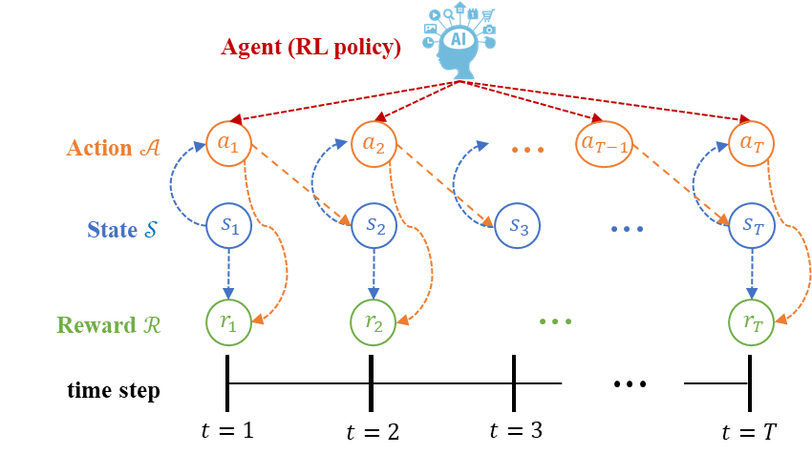
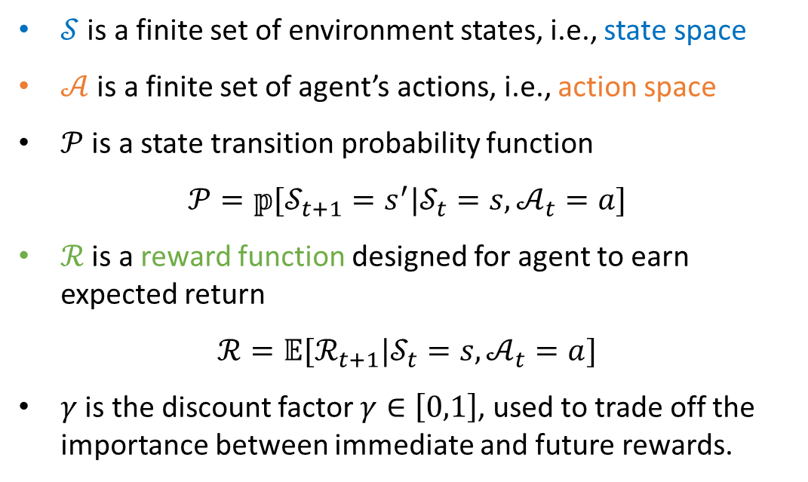
Markov Decision Process
A Markov decision process (MDP) is a Markov reward process with decisions, which can be defined as a tuple: $\left\langle 𝒮,𝒜,𝒫,ℛ,γ\right\rangle$
$𝒮$ is a finite set of environment states, i.e., state space
$𝒜$ is a finite set of agent’s actions, i.e., action space
$𝒫$ is a state transition probability function
$$𝒫=𝕡[𝒮_{t+1}=s^{′}|𝒮_{t}=s,𝒜_{t}=a]$$
  $ℛ$ is a reward function designed for agent to earn expected return
  $$ℛ=𝔼[ℛ_{t+1}|𝒮_{t}=s,𝒜_{t}=a]$$
  $γ$ is the discount factor $γ∈\left[0,1\right]$, used to trade off the importance between immediate and future rewards.

Slide 38
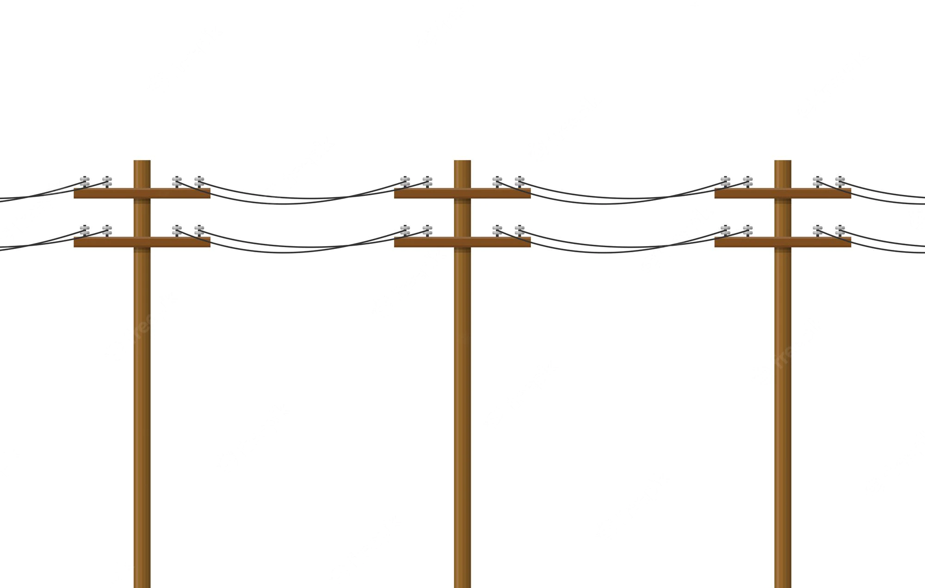




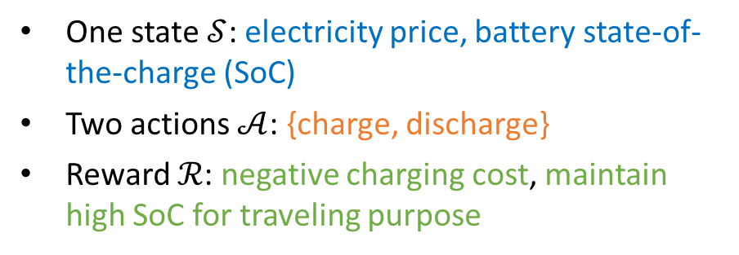


Example: EV Charging MDP
Taking EV charging problem as an example, an MDP can be described as below:
One state $𝒮$: electricity price, battery state-of-the-charge (SoC)
Two actions $𝒜$: {charge, discharge}
  Reward $ℛ$: negative charging cost, maintain high SoC for traveling purpose
Charging Station
EV agent
Power Grid
discharge
charge
price is low
SoC is medium
charge
price is high
SoC is high
charge
$s_{1}$ (medium reward)
price is low
SoC is low
$s_{3}$ (high reward)
$$s_{0}$$
price is high
SoC is low
discharge
discharge
$s_{2}$ (medium reward)

Slide 39
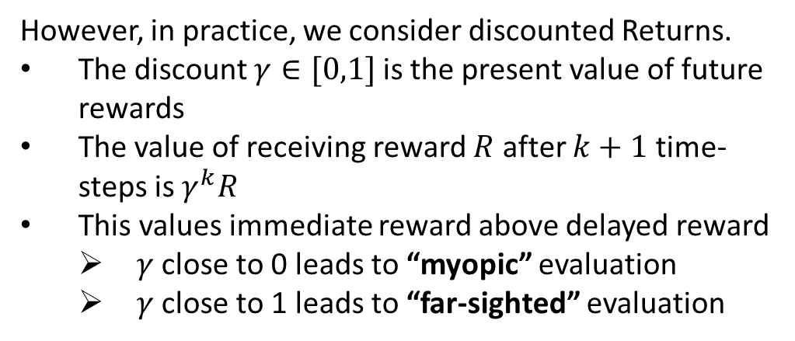
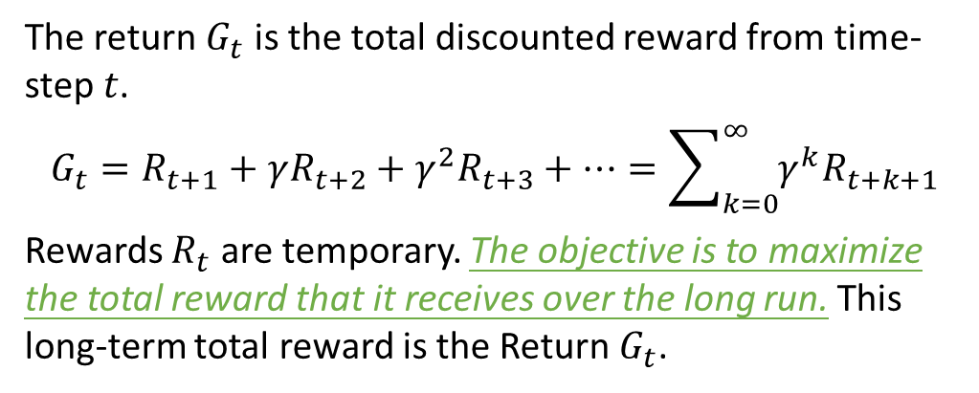
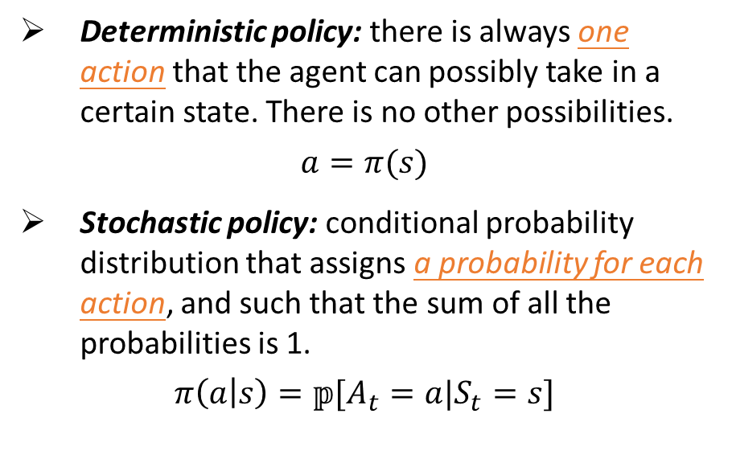
Discounted Return and Policy
The return $G_{t}$ is the total discounted reward from time-step $t$.
$$G_{t}=R_{t+1}+γR_{t+2}+γ^{2}R_{t+3}+⋯=\sum_{k=0}^{∞}{γ^{k}R_{t+k+1}}$$
Rewards $R_{t}$ are temporary. The objective is to maximize the total reward that it receives over the long run. This long-term total reward is the Return $G_{t}$.
A policy is a mapping from the perceived states of the environment to actions to be taken when in those states. An agent uses a policy to select actions given the current environment state – the agent’s behavior.
Deterministic policy: there is always one action that the agent can possibly take in a certain state. There is no other possibilities.
$$a=π(s)$$
Stochastic policy: conditional probability distribution that assigns a probability for each action, and such that the sum of all the probabilities is 1.
$$π\left(a | s\right)=𝕡[A_{t}=a|S_{t}=s]$$
However, in practice, we consider discounted Returns.
The discount $γ∈[0,1]$ is the present value of future rewards
The value of receiving reward $R$ after $k+1$ time-steps is $γ^{k}R$
This values immediate reward above delayed reward
  $γ$ close to 0 leads to “myopic” evaluation
  $γ$ close to 1 leads to “far-sighted” evaluation

Slide 40
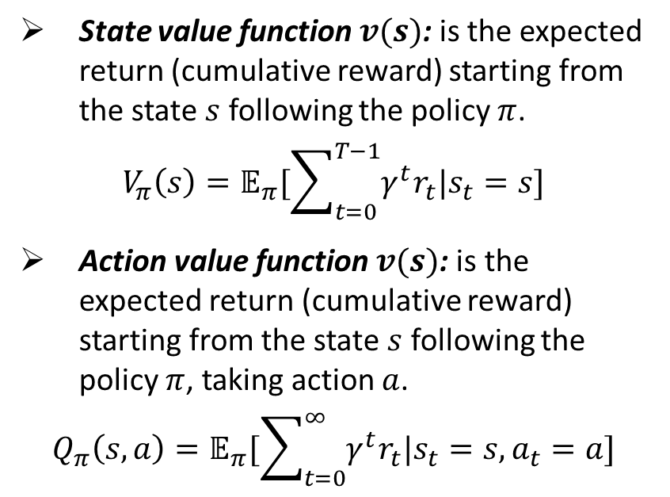
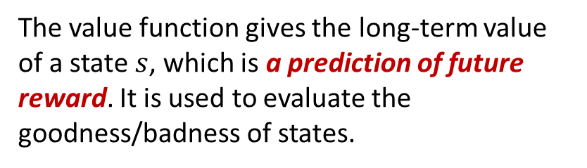
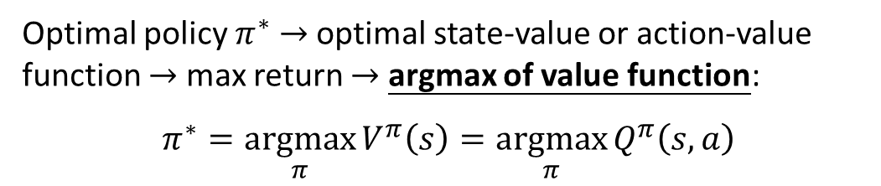
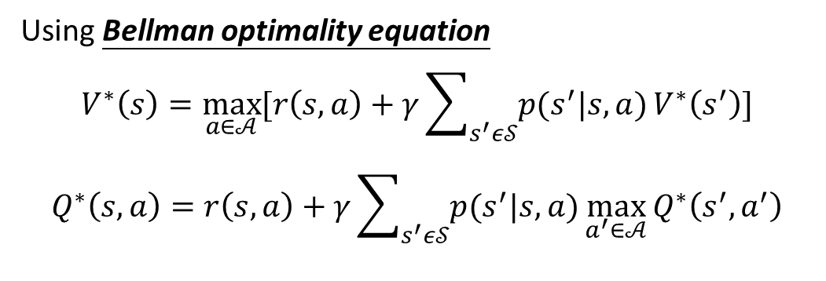
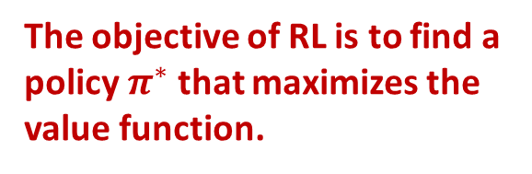
Value Function and Policy Optimization
The value function gives the long-term value of a state $s$, which is a prediction of future reward. It is used to evaluate the goodness/badness of states.
s
The objective of RL is to find a policy $π^{∗}$ that maximizes the value function.
a
r
s’
State value function $v(s)$: is the expected return (cumulative reward) starting from the state $s$ following the policy $π$.
$$V_{π}\left(s\right)=𝔼_{π}[\sum_{t=0}^{T−1}{γ^{t}r_{t}|s_{t}=s}]$$
Action value function $v(s)$: is the expected return (cumulative reward) starting from the state $s$ following the policy $π$, taking action $a$.
$$Q_{π}\left(s,a\right)=𝔼_{π}[\sum_{t=0}^{∞}{γ^{t}r_{t}|s_{t}=s,a_{t}=a}]$$
Using Bellman optimality equation
$$V^{∗}\left(s\right)=\max_{a∈𝒜}{[r\left(s,a\right)+γ\sum_{s^{′}ε𝒮}{p(s^{′}|s,a)}V^{∗}\left(s^{′}\right)]}$$
$$Q^{∗}\left(s,a\right)=r\left(s,a\right)+γ\sum_{s^{′}ε𝒮}{p(s^{′}|s,a)}\max_{a^{′}∈𝒜}{Q^{∗}\left(s^{′},a^{′}\right)}$$
Optimal policy $π^{∗}$ $→$ optimal state-value or action-value function $→$ max return $→$ argmax of value function:
$π^{∗}=\underset{π}{argmax}{V^{π}\left(s\right)}=\underset{π}{argmax}{Q^{π}\left(s,a\right)}$

Slide 41
Table of Contents
Background
AI-driven tools
  Data-driven reinforcement learning approach
  Markov decision process
  Single-agent reinforcement learning
  Markov Games
  Multi-agent reinforcement learning
Smart grid applications
Conclusion and future work

Slide 42
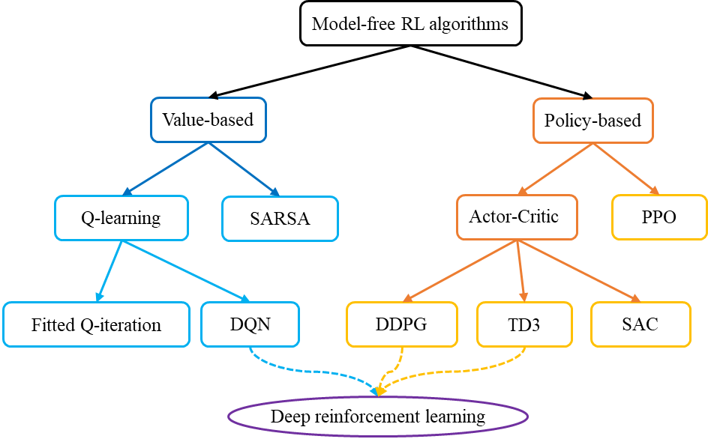
Solving Bellman Optimality Equation
Bellman Optimality Equation is non-linear. There is generally no closed form solution in getting optimal action-value and state-value functions. Hence, we need other iterative approaches like:
Monte-Carlo methods
Temporal difference (TD) learning
  Q-learning
  Deep Q-network (DQN)
Policy gradient
  Stochastic Policy Gradient (SPG)
  Stochastic Policy Gradient (DPG)
  Actor-Critic
  Proximal Policy Optimization (PPO)
  Deep Deterministic Policy Gradient (DDPG)
  Twin Delayed Deep Deterministic policy gradient (TD3)
(with deep neural network)

Slide 43
Comparison of RL/DRL Methods
Methods | On-/Off-policy | Value-/Policy-based | Action type | Discrete/Continuous spaces
Q-learning | Off | Value | Deterministic | Discrete state and action
DQN | Off | Value | Deterministic | Continuous state, Discrete action
SPG | On | Policy | Stochastic | Continuous state, Mixed action
DPG | On | Policy | Deterministic | Continuous state and action
Actor-Critic | On | Policy + Value | Mixed | Continuous state, Mixed action
PPO | On | Policy | Mixed | Continuous state, Mixed action
DDPG | Off | Policy + Value | Deterministic | Continuous state and action
TD3 | Off | Policy + Value | Deterministic | Continuous state and action
Table 1: Comparisons of various RL and DRL methods.
Key Summary:
Policy-based = On-policy (deterministic or Stochastic), Value-based = Off-policy, Actor-Critic = Value-based (Actor) + Policy-based (Critic).
Policy-based methods can generate both discrete (softmax) and continuous (sigmoid/tanh, tanh + softplus) policies.
Policy-based methods can generate both deterministic (sigmoid/ tanh) and stochastic (softmax, tanh + softplus) policies.

Slide 44
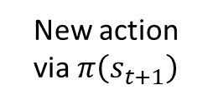

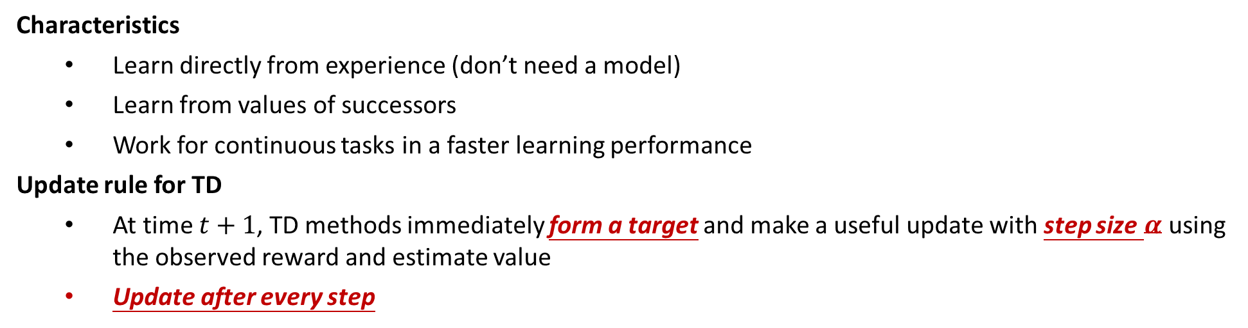
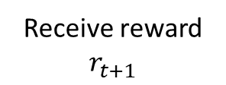

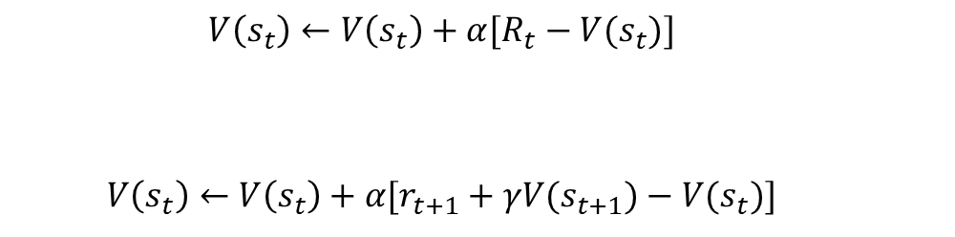
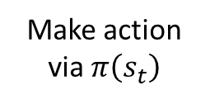







Temporal-Difference (TD) Learning
Characteristics
  Learn directly from experience (don’t need a model)
  Learn from values of successors
  Work for continuous tasks in a faster learning performance
Update rule for TD
  At time $t+1$, TD methods immediately form a target and make a useful update with step size $α$ using the observed reward and estimate value
  Update after every step
$$a_{t,1}$$
$$a_{t+1,1}$$
  $$V\left(s_{t}\right)←V\left(s_{t}\right)+α[R_{t}−V(s_{t})]$$
  $$V\left(s_{t}\right)←V\left(s_{t}\right)+α[r_{t+1}+γV(s_{t+1})−V(s_{t})]$$
Make action via $π\left(s_{t}\right)$
Receive reward $r_{t+1}$
New action via $π\left(s_{t+1}\right)$
target
$$s_{t}$$
$$a_{t,2}$$
$$s_{t+1}$$
$$a_{t+1,2}$$
TD update $V\left(s_{t}\right)$
$$a_{t,3}$$
$$a_{t+1,3}$$

Slide 45



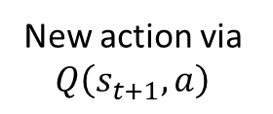

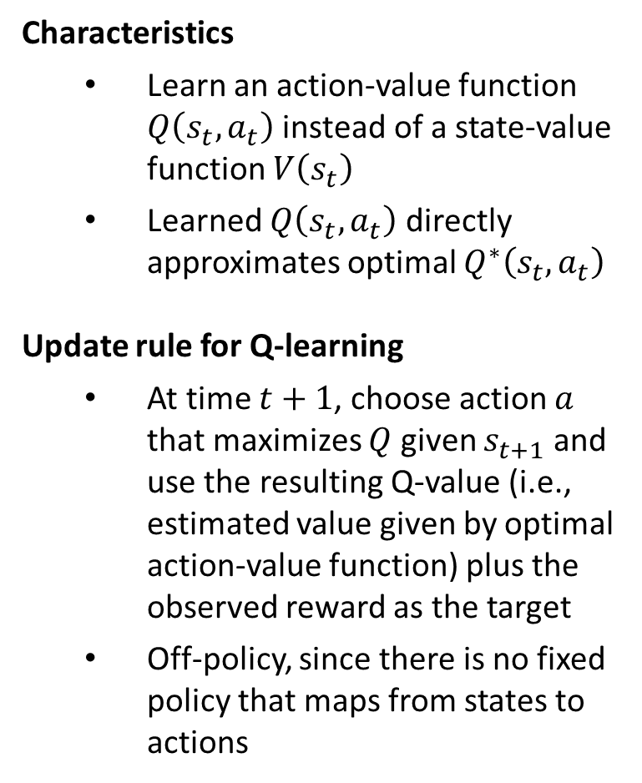
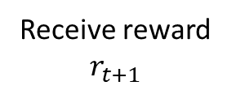

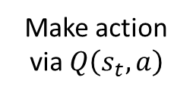
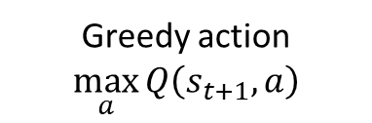



Q-learning
Characteristics
  Learn an action-value function $Q\left(s_{t},a_{t}\right)$ instead of a state-value function $V\left(s_{t}\right)$
  Learned $Q\left(s_{t},a_{t}\right)$ directly approximates optimal $Q^{∗}\left(s_{t},a_{t}\right)$
Update rule for Q-learning
  At time $t+1$, choose action $a$ that maximizes $Q$ given $s_{t+1}$ and use the resulting Q-value (i.e., estimated value given by optimal action-value function) plus the observed reward as the target
  Off-policy, since there is no fixed policy that maps from states to actions
$$a_{t,1}$$
$$a_{t+1,1}$$
Make action via $Q\left(s_{t},a\right)$
Receive reward $r_{t+1}$
New action via $Q\left(s_{t+1},a\right)$
$$s_{t}$$
$$a_{t,2}$$
$$s_{t+1}$$
$$a_{t+2,2}$$
Greedy action $\max_{a}{Q\left(s_{t+1},a\right)}$
$$a_{t,3}$$
$$a_{t+3,3}$$
Learning rate
TD error
  $$Q\left(s_{t},a_{t}\right)←Q\left(s_{t},a_{t}\right)+α∙[r_{t+1}+γ∙\max_{a}{Q\left(s_{t+1},a\right)}−Q\left(s_{t},a_{t}\right)]$$
Current value
Target value
Current value

Slide 46



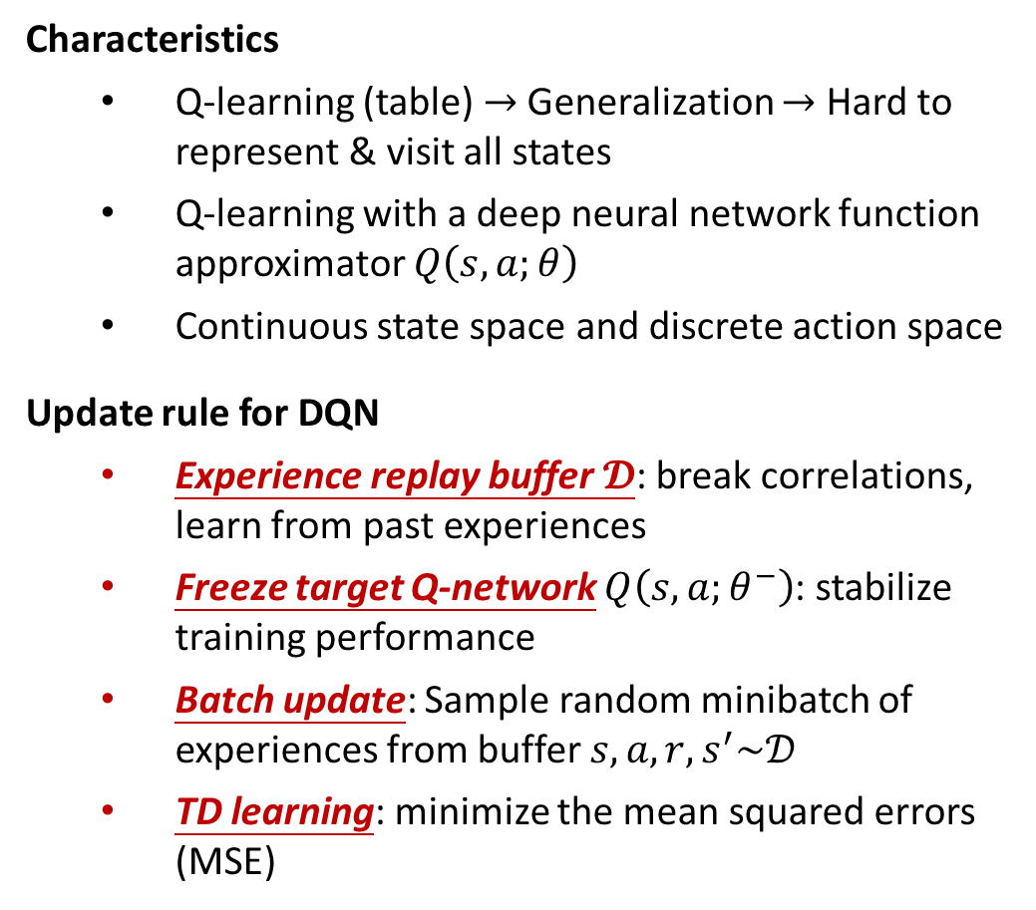






Deep Q-Network (DQN)
Characteristics
  Q-learning (table) $→$Generalization $→$ Hard to represent & visit all states
  Q-learning with a deep neural network function approximator $Q\left(s,a;θ\right)$
  Continuous state space and discrete action space
Update rule for DQN
  Experience replay buffer $𝓓$: break correlations, learn from past experiences
  Freeze target Q-network $Q\left(s,a;θ^{−}\right)$: stabilize training performance
  Batch update: Sample random minibatch of experiences from buffer $s,a,r,s^{′}\sim 𝒟$
  TD learning: minimize the mean squared errors (MSE)
Q-learning
$$s$$
$$Q\left(s,a\right)$$
$$a$$
table
DQN (deep learning + Q-learning)
$$Q\left(s,a_{1};θ\right)$$
$$s$$
$$Q\left(s,a_{2};θ\right)$$
$$θ$$
$$Q\left(s,a_{3};θ\right)$$
input
hidden
output
TD updates neural network parameters $θ$
  $$𝓛\left(θ\right)=𝔼_{s,a,r,s^{′}\sim 𝓓}[r+γ\max_{a^{′}}{Q\left(s^{′},a^{′};θ^{−}\right)}−Q\left(s,a;θ\right)]$$

Slide 47
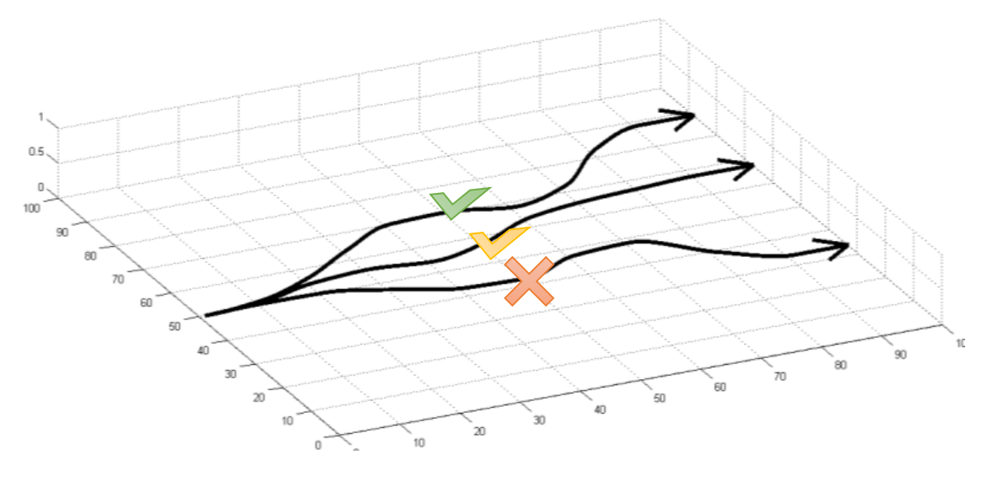


Policy Gradient Theorem (PG)
Characteristics
  Search directly for the optimal policy $π^{∗}\left(a|s;φ\right)$, which represents the probability that action $a$ is taken in state $s$ with policy weight vector $φ$
  Continuous state space and discrete/continuous action space
Update rule for PG
  Learning the policy weights using the gradient of some performance measure (e.g., state-action value function $Q\left(s,a\right)$) with respect to the policy weights $φ$
  Move $φ$ toward the direction suggested by the gradient $∇_{φ}J\left(φ\right)$ to find the best $φ$ for $π$ that produces the highest return.
  $$∇_{φ}J\left(φ\right)=𝔼_{π }[∇_{φ}\log{π(a|s;φ)}Q\left(s,a\right)]$$
  Gradient tries to:
    Increase probability of paths with positive 𝑄(𝑠,𝑎)
    Decrease probability of paths with negative 𝑄(𝑠,𝑎)

Slide 48









Deep Deterministic Policy Gradient (DDPG)
Characteristics
  An actor-critic algorithm, combining DPG with DQN
  Deterministic policy $a=μ\left(s;φ\right)$
  Actor $μ\left(s;φ\right)$: (online and target) Q-networks
  Critic $Q\left(s,a;θ\right)$: (online and target) policy networks
  Soft update of target networks
  Continuous state space and continuous action space
Update rule for DDPG
  Actor network update (policy gradient)
  $$∇_{φ}J\left(φ\right)=𝔼_{s\sim 𝒟 }[∇_{φ}μ\left(s;φ\right)∇_{a}Q\left(s,a;θ\right)]$$
  Critic network update (TD learning)
  $$ℒ\left(θ\right)=𝔼_{s,a,r,s^{′}\sim 𝒟}[r+γQ\left(s^{′},μ\left(s^{′};φ^{−}\right);θ^{−}\right)−Q\left(s,a;θ\right)]$$
Actor Network
$$s$$
$$a$$
$$φ$$
input
hidden
output
Critic Network
$$a$$
$$s$$
$$θ$$
$$Q\left(s,a;θ\right)$$
input
hidden
output
TD updates neural network parameters $φ,θ$

Slide 49
Table of Contents
Background
AI-driven tools
  Data-driven reinforcement learning approach
  Markov decision process
  Single-agent reinforcement learning
  Markov Games
  Multi-agent reinforcement learning
Smart grid applications
Conclusion and future work

Slide 50




Markov Games
Agents
Multiple agents operating in an environment.
A Markov game is a tuple $\left\langle 𝒮,𝒪_{i},𝒜_{i},ℛ_{i},𝒫,γ\right\rangle$:
  $𝒮$ is a finite set of environment states, i.e., state space
  $𝒪_{i}$ is a finite set of agent’s individual observation space
  $𝒜_{i}$ is a finite set of agent’s individual action space
  $ℛ_{i}$ is a reward function designed for individual agent
    $$ℛ_{i}=𝔼[ℛ_{i,t+1}|𝒪_{i,t}=s,𝒜_{i,t}=a]$$
  $𝒫$ is a state transition probability function
  $$𝒫=𝕡[𝒮_{t+1}=s^{′}|𝒮_{t}=s,𝒜_{1:I,t}=a]$$
  $γ$ is the discount factor $γ∈\left[0,1\right]$, used to trade off the importance between immediate and future rewards.
Objective: Each agent learns a control policy to maximize the expected individual discounted reward
$$𝔼\{\sum_{t=1}^{T}{γ^{t}∙r_{i,t}}\}$$
state
actions
$$s_{t}$$
$$a_{1..I,t}$$
rewards
$$r_{1…I,t}$$
Environment

Slide 51


Centralized Training with Centralized Execution
Train all agents’ actor-critic networks in a centralized manner
CTCE aims at training a joint model which takes the observations and actions of all the agents as its input and produces a centralized policy mapping the joint observation of all the agents to a joint action.
Advantages:
  Knowing all information to reach the optimal policy.
Disadvantages:
  Exponential growth in the observation and actions spaces with the number of agents.
  Curse of dimensionality.
  Raise privacy issue.
Update rule for CTCE (actor and critic)
  $$∇_{φ}J\left(φ\right)=𝔼_{o_{1:I}\sim 𝒟 }[∇_{φ}μ\left(o_{1:I};φ\right)∇_{a_{1:I}}Q\left(o_{1:I},a_{1:I};θ\right)]$$
  $$ℒ\left(θ\right)=𝔼_{o_{1:I},a_{1:I},r_{1:I},o_{1:I}^{′}\sim 𝒟}[r_{1:I}+γQ\left(o_{1:I}^{′},μ\left(o_{1:I}^{′};φ^{−}\right);θ^{−}\right)−Q\left(o_{1:I},a_{1:I};θ\right)]$$
Figure: Centralized Training with Centralized Execution (CTCE)

Slide 52


Decentralized Training with Decentralized Execution
Train individual actor-critic networks in a decentralized manner
DTDE policy maps an agent’s local observation to an action for the individual agent, and therefore each agent’s policy is independent.
Advantages:
  Allow learning of heterogeneous policies.
Disadvantages:
  The variation in these heterogeneous policies leads to the environmental non-stationarity.
  Does not scale to large-scale problem.
Update rule for DTDE (actor and critic)
  $$∇_{φ_{i}}J\left(φ_{i}\right)=𝔼_{o_{i}\sim 𝓓_{i}}[∇_{φ_{i}}μ\left(o_{i};φ_{i}\right)∇_{a_{i}}Q\left(o_{i},a_{i};θ_{i}\right)]$$
  $$ℒ\left(θ_{i}\right)=𝔼_{o_{i},a_{i},r_{i},o_{i}^{′}\sim 𝓓_{i}}[r_{i}+γQ\left(o_{i}^{′},μ\left(o_{i}^{′};φ_{i}^{−} \right);θ_{i}^{−}\right)−Q\left(o_{i},a_{i};θ_{i}\right)]$$
Figure: Decentralized Training with Decentralized Execution (DTDE)

Slide 53


Centralized Training with Decentralized Execution
Train centralized critic networks and execute decentralized actor network
CTDE paradigm providing an effective remedy to eliminate the environmental non-stationarity by integrating all agents’ local observations and actions into the critic network for training.
Advantages:
  Avoid environmental non-stationarity.
  Other agents’ information is no longer needed in test process.
Disadvantages:
  Does not scale to large-scale problem.
  Raise privacy issue.
critics
actors
Update rule for DTDE (actor and critic)
  $$∇_{φ_{i}}J\left(φ_{i}\right)=𝔼_{o_{i}\sim 𝓓_{i}}[∇_{φ_{i}}μ\left(o_{i};φ_{i}\right)∇_{a_{i}}Q\left(o_{1:I},a_{1:I};θ_{i}\right)]$$
  $$ℒ\left(θ_{i}\right)=𝔼_{o_{1:I},a_{1:I},r_{1:I},o_{1:I}^{′}\sim 𝓓_{i}}[r_{i}+γQ\left(o_{1:I}^{′},μ\left(o_{1:I}^{′};φ_{i}^{−} \right);θ_{i}^{−}\right)−Q\left(o_{1:I},a_{1:I};θ_{i}\right)]$$
Figure: Centralized Training with Decentralized Execution (CTDE)

Slide 54

Summary of MARL Frameworks
 | CTCE | DTDE | CTDE
Training | Centralized | Decentralized | Centralized
Execution | Centralized | Decentralized | Decentralized
Stationarity | Yes | No | Yes
Privacy preserving | No | Yes | No
Scalability | No | Yes | No
Key Summary:
DTDE suffers from non-stationarity issue, which may not reach the optimal solutions, thus is not suitable for most of smart grid applications.
CTCE and CTDE can both address the non-stationarity issue of DTDE, but may lose privacy and scalability, since the critic network needs to take all agent’s local observations and actions as input.
Compared to CTCE, CTDE benefits from its decentralized execution that only requires local observations when on-line test.
Table 1: Characteristics of three MARL frameworks.
 | CTCE | DTDE | CTDE
Actor critic – input | $$o_{1:I}$$ | $$o_{i}$$ | $$o_{i}$$
Actor critic – output | $$a_{1:I}$$ | $$a_{i}$$ | $$a_{i}$$
Critic network – input | $$[o_{1:I},a_{1:I}]$$ | $$[o_{i},a_{i}]$$ | $$[o_{1:I},a_{1:I}]$$
Critic network – output | $$Q\left(o_{1:I},a_{1:I};θ\right)$$ | $$Q\left(o_{i},a_{i};θ_{i}\right)$$ | $$Q\left(o_{1:I},a_{1:I};θ_{i}\right)$$
Table 2: Actor-critic network structures of three MARL frameworks.

Slide 55
Table of Contents
Background
AI-driven tools
Smart grid applications
  Household P2P energy trading
  Multi-energy Microgrid P2P energy trading
  EV ancillary services in power-transportation network
Conclusion and future work

Slide 56
Smart Grid Applications
Application 2: Energy coordination of multiple multi-energy microgrids (MEMGs):
Residential, Industrial, and Commercial areas can coordinate with each other
System flexibility can be fully explored from
  Local trading among MEMGs
  Complementary among multi-energy sectors
Application 1: P2P energy trading for households/smart homes:
Households can balance their demand and PV generation locally
Reduce dependence on main grid
Save energy bills
Application 3: EVs ancillary service provision for smart grid:
Charging service
Demand management service
Carbon intensity service
Up and down balancing services

Slide 57
Table of Contents
Background
AI-driven tools
Smart grid applications
  Household P2P energy trading
  Multi-energy Microgrid P2P energy trading
  EV ancillary services in power-transportation network
Conclusion and future work

Slide 58
Case Study I: Households P2P Energy Trading
Scalable Coordinated Management of Peer-to-Peer Energy Trading: A Multi-Cluster Deep Reinforcement Learning Approach
[1] Dawei Qiu, Yujian Ye, Dimitrios Papadaskalopoulos, and Goran Strbac, “Scalable coordinated management of peer-to-peer energy trading: A multi-cluster deep reinforcement learning approach”, Applied Energy, Volume 292, page 116940, June 2021.

Slide 59

Cluster of Households with DER Portfolios
An appropriate market mechanism is required for efficiently coordinating these large number of small-scale DERs in the distribution level.
Apart from inflexible demand, these 4 clusters also have
Basic cluster: WA and HVAC
EV cluster: WA, HVAC, EV
PV+ES cluster: WA, HVAC, PV, ES
EV+ES+PV cluster: all resources
Figure: Four types of household clusters, with different DER portfolios.
Integrating and coordinating small-scale DERs:
Distributed generators (DG), energy storage systems (ES) and flexible demand technologies (FD).
Price differentials of retail pricing >> high import price & low export price.
Balancing demand-supply locally >> reduce cost and demand peaks.

Slide 60
Market Structures of Local Energy Market
HV
HV
Substation
Substation
LV
LV
Buy / Sell prices
Net response
Buy / Sell prices
Net response
Market Operator
P2P energy trading
Prosumer 2
Prosumer 1
Prosumer 2
Prosumer 3
Prosumer 1
Prosumer 3
Centralised manner
Maximize local market total surplus
subject to:
Energy balance between local prosumers and retailer
Demand, generation, storage operating constraints
Decentralised manner
Minimize individual cost for each prosumer
subject to:
Energy balance between self net demand and trading with neighbours & retailer
Self demand, generation, storage operating constraints

Slide 61
P2P Energy Trading Platform
Households with energy deficiency:
Take advantage of other households with energy surplus by buying their excess at a relatively cheaper local price with respect to higher grid buy price.
Households with excess energy:
Make more revenue compared to the unattractive (low) grid sell price by participating in P2P energy trading.
Households can:
share their energy consumption and generation internally within the community
settle the remaining energy deficit or surplus with the electricity supplier.
Power flow
Electricity supplier
Household cluster 1
Grid prices
Household cluster 2
Local prices
Grid prices
Community energy deficit / surplus
Household cluster 3
Information flow
Household cluster 4
Community market
P2P trading platform
Energy portfolios:
Fixed load
PV generator (prosumer only)
Electric vehicles (G2V, V2H, V2G)
Wet appliances (washing machines)
Heating, Ventilation, and Air Conditioning (HVAC)

Slide 62


















Mid-Market Rate Pricing Scheme
Price
Price
Price
$$λ^{+}$$
$$λ^{+}$$
$$λ^{+}$$
$$λ^{lem,+}$$
$$λ^{lem,−}$$
$$(λ^{mid})$$
$$λ^{lem,+}$$
$$λ^{lem,−}(λ^{mid})$$
$$λ^{lem,+}(λ^{mid})$$
$$λ^{lem,−}$$
$$λ^{−}$$
$$λ^{−}$$
$$λ^{−}$$
$$P^{lem,d}$$
$$P^{lem,n}=0$$
$$P^{lem,g}$$
Power
$$P^{lem,d}$$
$$P^{lem,n}>0$$
$$P^{lem,g}$$
Power
$$P^{lem,d}$$
$$P^{lem,n}<0$$
$$P^{lem,g}$$
Power
Case 1: Local demand ($P^{lem,d}$) = local generation ($P^{lem,g}$)
Local buy price = local sell price = mid-market price
$$λ^{lem,+}=λ^{lem,−}=λ^{mid}=(λ^{+}+λ^{−})/2$$
Case 2: Local demand ($P^{lem,d}$) > local generation ($P^{lem,g}$):
Local sell price = mid-market price
  $$λ^{lem,−}=λ^{mid}=(λ^{+}+λ^{−})/2$$
Local buy price > mid-market price
  $$λ^{lem,+}=(λ^{mid}×\left[P^{lem,g}\right]+λ^{+}×P^{lem,n})/P^{lem,d}$$
Case 3: Local demand ($P^{lem,d}$) < local generation ($P^{lem,g}$):
Local buy price = mid-market price
  $$λ^{lem,+}=λ^{mid}=(λ^{+}+λ^{−})/2$$
Local sell price < mid-market price
  $$λ^{lem,−}=(λ^{mid}×P^{lem,d}+λ^{−}×[P^{lem,n}])/[P^{lem,g}]$$

Slide 63
















Parameter-Sharing MADDPG
$$r_{1}$$
$$r_{2}$$
$$r_{I}$$
Characteristics:
Actor-critic network >> handle high-dimensional continuous state and action spaces.
Allow all agents to share the parameters (e.g., the weights of the actor and critic networks) of a single policy.
Being trained using experiences gathered from all agents.
Benefits:
Accelerate learning speed.
Sampled experiences are better diversified.
Improve convergence speed and stability.
$$(ψ_{1},ξ_{1})$$
$$(ψ_{2},ξ_{2})$$
$$(ψ_{I},ξ_{I})$$
Shared critic
(cluster $k$)
Agent 1
Agent 2
Agent $I$
$$o_{1}$$
$$o_{2}$$
$$o_{I}$$
Shared actor
(cluster $k$)
Agent 1
Agent 2
Agent $I$
$$a_{1}$$
$$a_{2}$$
$$a_{I}$$
P2P trading platform
LEM Environment
MMR pricing
Reward shaping
Collective market behavior
Figure: Multi-agent reinforcement learning in parameter-sharing framework based on an actor-critic architecture.

Slide 64

P2P Household Physical and Economic Values
Aggregate demand/generation profiles in the community
Common trends:
Energy is shifted from peak demand of high price hours to off-peak demand of low price hours.
PV generation is absorbed to supply the energy consumptions.
Figure: Net loads of aggregate 300 households without and with P2P market.
Absorption of PV generation: more PV generation is absorbed during mid-peak hours, since P2P trading allows households to fully exploit their DER flexibility to absorb their neighbours’ PV generation.
Peak demand reduction: demand peaks are significantly reduced given the reward shaping mechanism restricting the households' contribution to peak concentrations.
Markets | Peak demand (kWh) | Cost ($)
w/o P2P | 1,064 | 1,882
with P2P | 783 | 1,478
Table: Peak demand and energy cost of 300 households without and with P2P market.

Slide 65
Table of Contents
Background
AI-driven tools
Smart grid applications
  Household P2P energy trading
  Multi-energy Microgrid P2P energy trading
  EV ancillary services in power-transportation network
Conclusion and future work

Slide 66
Case Study II: MEMG P2P Energy Trading
Work 1: Peer-to-Peer Energy Trading and Energy Conversion in Interconnected Multi-Energy Microgrids using Multiagent Deep Reinforcement Learning
Work 2: Coordination for Multi-Energy Microgrids using Multi-Agent Reinforcement Learning
[2] Tianyi Chen, Shengrong Bu, Xue Liu, Jikun Kang, F. Richard Yu, and Zhu Han, “Peer-to-peer energy trading and energy conversion in interconnected multi-energy microgrids using multiagent deep reinforcement learning”, IEEE Transactions on Smart Grid, Volume 13, Issue 1, pages 715 – 727, January 2022.
[3] Dawei Qiu, Tianyi Chen, Goran Strbac, and Shengrong Bu, “Coordination for multi-energy microgrids using multi-agent reinforcement learning”, IEEE Transactions on Industrial Informatics, Early Access, April 2022.

Slide 67

Multi-Energy Microgrids Coordination
Background:
Microgrids (MGs) are solutions for coordinating a high share of DERs within a local region.
Multi-energy MGs are an extension from Microgrids with multi-energy sectors coupling with each other.
Problem:
How does each multi-energy MG to meet its electricity and heat demand while minimizing its operational cost?
Any advanced control algorithm for these multi-energy MGs operating in a decentralized manner without central control?

Slide 68



Residential, Commercial, Industrial Microgrids
Energy converters:
Residential: fuel cell, electrolyser, boiler.
Commercial: heat pump, boiler.
Industrial: CHP, boiler.
Storage units:
Residential: electrical storage.
Commercial & Industrial: electrical storage, thermal storage.
Energy balances:
Residential & Commercial & Industrial : electricity and heat.

Slide 69



Partially Observable Markov Decision Process
System Problem for MG i
Objective of MG i
Finding a control policy $π$ that maximizes the expected discounted reward over the daily trading horizon.

Slide 70



Flowchart of Proposed MATD3
  Solve the overestimation and high variance problems
  Critic consists of two Q networks
  Delay policy updates
  Centralized training with decentralized execution
  The centralized critic takes observations and actions of all MGs
  Only local information is used when executing policies
  The gradient of the neural network of actor can be written as:
  The centralized Q-value function is updated as

Slide 71

Simulation Setup
Real-World Datasets
    Renewable generation and energy demand data at 1-hour resolution
    Residential households located in Mueller, Austin, Texas
    Commercial data warehouse located in Mueller, Austin, Texas
    Power plant at trial site Aachen/Cologne, Germany
Neural Network architecture
Training techniques:
    State/Observation Normalization
    Reward Scaling

Slide 72
Performance Evaluation
Methods | Specifications | CPU time (h)
MATD3 | Proposed energy trading and energy conversion scheme Proposed MATD3 approach | 1.62
SATD3 | Use our system model for P2P energy trading and energy conversion The agents are three independent TD3 agents | 2.13
SATD3-SEP | Use the same configuration as the rule-based method Use three independent TD3 agents to find the trading actions | 0.74
Rule-based | Do not use any energy converters Only trade energy with external networks Sell the surplus electricity or buy the needed energy | -

Slide 73


Meeting Electricity & Heat Demand
ED | Electricity demand
HD | Heat demand
PV | Solar generation
ET | Energy trading
ES | Electrical storage
HS | Thermal storage
FC | Fuel cell
WE | Water electrolyser
GB | Gas boiler
HP | Heat pump
CHP | Combined heat and power generator
ET | Energy trading
Electricity and heat demand can be fully supplied via various multi-energy resources (generators, storages, converters) and energy trading activities.

Slide 74


Electricity & Heat Trading among three MGs
ET | Energy trading
PG | Electricity trading with the main grid
RES | P2P electricity trading with residential MG
COM | P2P electricity trading with commercial MG
IND | P2P electricity trading with industrial MG
GB | Gas boiler
P2P energy trading accounts for a considerable proportion of the heat traded.
The majority of electricity trading is with the main power grid, since all three MGs have insufficient renewable generation to meet their own demand and energy conversion.

Slide 75

Effect of Carbon Tax Price
When the carbon tax price increases, the average hourly costs of each MG increase due to the increase of the environmental cost.
The carbon tax price impact is less on the residential MG, because the amount of energy trading with the external network is smaller compared to the commercial and industrial MGs.
The CO2 emissions from the commercial MG are stable when the carbon tax price is lower than 0.02 $/kg, decrease significantly when the carbon tax increases from 0.02 to 0.04 $/kg, and stay unchanged when the price increases beyond 0.04 $/kg.
When the carbon tax price is above 0.02 $/kg, the amount of the heat traded with other MGs is reduced, and the CO2 emissions are reduced until no more heat trading takes place.
Figure: The impact of the carbon tax price on the average hourly costs and CO2 emissions for each MEMG

Slide 76

Market Approach for P2P Energy Trading
Centralized / Decentralized / Distributed control
Centralized framework employs a central operator to manage everything in the trading activities, does not generalized to the large-scale problem.
Decentralized framework allows MEMGs to manage their own resources with limited information exchanges, system benefit may not be maximized.
Control theory
Control $→$ Market
Double-auction market, takes advantages of both centralized and decentralized frameworks.
Allow price-quantity bids.
Can evaluate the energy trading via the local prices.
Protect private information.
Market social welfare maximized.
Market mechanism
Market operator /
Market pricing scheme /
Auction market

Slide 77

Market-Driven for Multi-Energy Microgrids
Three types of multi-energy microgrids (MEMGs):
Residential MEMG
Commercial MEMG
Industrial MEMG
Electric load (EL)
Heat load (HL)
Solar photovoltaic (PV)
Wind generator (WG)
Electric energy storage (EES)
Thermal energy storage (TES)
Combined heat and power (CHP)
Fuel cell (FC)
Electric heat pump (EHP)
Gas boiler (GB)
Each MEMG has a variety of options for supplying their demand:
Manage the energy schedules of their equipped multi-energy system (MES) components to meet both electric and heat energy consumptions.
Trade electricity locally in the local energy market.
Still buy and sell their unbalanced energy in the main grid at grid buy and sell prices.

Slide 78

Privacy-Preserving DA-MATD3 Methods
DA-MATD3 derives three concrete implementation details that are insightful and particularly critical to our proposed MEMG energy management coordination problem:
Learning an abstracted Q-value function for each agent through the DA market public order books to protect the private information of each MEMG.
Forming an actor-critic architecture to handle the high-dimensional continuous state and action spaces of the MEMGs.
Taking advantage of double critic networks in Twin delayed DDPG (TD3) algorithm to address the Q-value overestimation problem, thereby stabilizing the training performance.
Oder books contain all agents’ price and quantity bidding/offering information:
MEMGs’ energy portfolios are unknown.
MEMGs’ energy schedules are unknown.
Capture market dynamics.

Slide 79
Double-Auction Market
Market Clearing Process
ToU
A double-auction market comprises:
A set of buyers (blue), define their bidding price and quantity.
A set of sellers (green), define their offering price and quantity.
An order book, allocates and lists all accepted bids and offers.
0.1129
i1: 2kWh @ 0.11$
j3: 1kWh @ 0.11$
0.11
j2: 2kWh @ 0.10$
0.10
i2: 3kWh @ 0.09$
0.09
Price ($/kWh)
0.08
i3: 2kWh @ 0.07$
0.07
0.06
j1: 4kWh @ 0.05$
0.05
FiT
0.04
Step 1: the clearing process iterates down the order books and attempts to match each buy order with sell order until the bidding price is less than the offering price or no unmatched order exists anymore.
Step 2: when two orders get matched:
Local trading price = mid-pricing of two orders.
Local trading quantity = lower value of two orders.
Step 3: the remaining order quantity and the unmatched orders are balanced with the utility company at the unattractive grid electricity prices, Time-of-Use and Feed-in-Tariff.
0
1
2
3
4
5
6
7
Quantity (kWh)
Oder Book before Clearing
 | ID | price | quantity
 | i1 | 0.11 | 2
 | i2 | 0.09 | 3
 | i3 | 0.07 | 2
 | j1 | 0.05 | - 4
 | j2 | 0.10 | - 2
 | j3 | 0.11 | - 1
Oder Book after Clearing
 | ID | price | quantity
 | i2 | 0.09 | 1
 | i3 | 0.07 | 2
 | j2 | 0.10 | - 2
 | j3 | 0.12 | - 1
buy
buy
sell
sell

Slide 80


Local Trading for Multi-Energy Microgrids
Markets | Internal trading (kWh) | External trading (kWh) | Cost ($)
P2G | - | 7,382 | 1,151
P2P | 7,263 | 1,933 | 881
Figure 1: Net loads for 3 MEMGs under P2G (power-to-grid) and P2P markets.
Compared to the conventional P2G (power-to-grid) case, MEMGs under P2P case can absorb more renewable energies and reduce more demand peaks.
MEMGs trade more frequently (23 hours) and a large amount of quantities among each other within the day.
MEMGs select the suitable trading prices, so that the buyers and sellers of MEMGs can achieve more trading deals and reduce net costs.
Figure 2: Local trading quantities and prices under P2P market.

Slide 81
Table of Contents
Background
AI-driven tools
Smart grid applications
  Household P2P energy trading
  Multi-energy Microgrid P2P energy trading
  EV ancillary services in power-transportation network
Conclusion and future work

Slide 82
Case Study III: EVs Ancillary Service
Multi-Service Provision for Electric Vehicles in Power-Transportation Networks Towards a Low-carbon Transition: A Hierarchical and Hybrid Multi-Agent Reinforcement Learning Approach
[4] Dawei Qiu, Yi Wang, Mingyang Sun, and Goran Strbac, “Multi-service provision for electric vehicles in power-transportation networks towards a low-carbon transition: a hierarchical and hybrid multi-agent reinforcement learning approach”, Applied Energy, Volume 313, page 118790, May 2022.

Slide 83




Scheme of EV Multi-Service Provision
Transport System:
EVs can move between different transportation nodes and choose to connect with certain electric buses through charging stations (CSs).
Two journeys, i.e., travel from homes to offices in the morning and back homes from offices at night.
Power System:
EVs connected to the power network through CSs can charge/discharge in the distribution network to provide multiple services, including:
  charging service in distribution network
  Demand management service provided to distribution network operator (DNO)
  carbon intensity service provided to national grid,
  up and down balancing services (up-BS and down-BS) provided to system operator
Communication network
Aggregator
Control policy
MARL algorithm
Information signals
EV1
EV2
EVI
Transportation network
Routing decisions
Transportation information
Power network
Load
Scheduling decisions
Load
Power information
CS
DG
Load
CS
PV
Figure: The scheme of EVs routing and scheduling process for multi-service provision in a power-transportation network.

Slide 84


Coupled Power-Transport System
Figure 2: Transportation network of 9-node and 12-edge map
Figure 1: Power network of 15-bus system
The power network is a 15-bus radial distribution network, including 2 distributed generators (DGs), 2 photovoltaics (PVs), 1 wind turbines (WT), 3 charging stations (CSs).
The transportation network is a 9-node 12-edge road map, where 1 CS is located at road node 6 for EV drivers parking at home, and 2 CSs are located at road nodes 1 and 2 for EV drivers parking at workplaces.
Each road is characterized by its individual distance and travel time to simulate the dynamic congestion impact during the EV routing process.

Slide 85


EV Routing Behaviors
Two travelling patterns: home to work in the morning, work to home in the evening.
4 EVs follow different routes in these two patterns and receive different arrival time due to their different departure time and the dynamically updated road congestion status.
Figure 1: Routing process of 4 EVs in the morning (home to work)
Figure 2: Routing process of 4 EVs in the evening (work to home)
EVs will choose the routes with less travelling time rather than the shortest distance to avoid the traffic congestion.
The travelling pattern work to home normally leads to longer traveling time than the travelling pattern home to work because of more serious congestion issues in the early evening.

Slide 86



EV Scheduling Behaviors
Service | Revenue (￡)
Charging | -3.91
Demand | 8.18
Carbon | 13.70
Balancing | 20.13
Net | 38.10
Figure 1: Locational marginal prices of 3 CSs.
Table: Business cases of EVs for service provisions.
Figure 3: EV charging and discharging power.
EVs charge power in the morning and midday, while discharging power at night to supply demand.
EVs can make arbitrage between the low prices in the morning (complete zero in the midday due to the fully supply by renewable) and the high prices at night.
EVs achieve 38.10 £ total revenue for multi-service provisions.
Figure 2: Energy supply of distribution system.

Slide 87
Table of Contents
Background
AI-driven tools
Smart grid applications
Conclusion and future work

Slide 88
Conclusion
Deregulation and decarbonization of future energy system
  Energy system has been widely deregulated worldwide, shifting from the conventional centralized manner to the smart grid concept with decentralized manner.
  Environment concern has taken significant initiatives towards the decarbonization of energy systems, moving into a low-carbon transition.
  Need fundamental changes in employed market design, coupling energy and carbon sectors.
AI-driven tools
  Discuss the weakness of model-based optimization approach, highlight the benefits of AI approach.
  Introduce the Markov decision process and Markov game.
  Study the single-/multi-agent reinforcement learning methods.
Smart grid applications
  P2P energy trading for multi-cluster households.
  P2P energy trading and double-auction market for multi-energy microgrids.
  Multi-service provisions of EVs in the coupled transport-power network.

Slide 89
Future Work
Actions towards future low-carbon smart grids
  More effectively capture the coordination between energy market and carbon market.
  Carbon-oriented planning and operation of smart grid.
Advanced AI technique
  Deal with large-scale multi-agent problem, e.g., EVs, smart homes, etc.
  Handle highly stochastic and dynamic environments in smart grid, e.g., renewable, load patterns, etc.
  Privacy preserving is also critical in smart grid concept, i.e., stakeholders in decentralized manner are not willing to share their private information, e.g., energy portfolios, energy usage behaviors, etc.
New smart grid applications
  New market design for joint energy and carbon trading in the local community.
  Novel pricing schemes for local flexibility to provide green energy service.
  Efficient energy transition by integrating multi-energy sectors (electricity, heat, cooling, gas, hydrogen, etc.) into one fashion.

Slide 90
Publications (1)
P2P Energy Trading
Dawei Qiu, Yujian Ye, Dimitrios Papadaskalopoulos, and Goran Strbac, “Scalable coordinated management of peer-to-peer energy trading: A multi-cluster deep reinforcement learning approach”, Applied Energy, Volume 292, page 116940, June 2021.
Tianyi Chen, Shengrong Bu, Xue Liu, Jikun Kang, F. Richard Yu, and Zhu Han, “Peer-to-peer energy trading and energy conversion in interconnected multi-energy microgrids using multiagent deep reinforcement learning”, IEEE Transactions on Smart Grid, Volume 13, Issue 1, Pages 715-727, January 2022.
Dawei Qiu, Tianyi Chen, Goran Strbac, and Shengrong Bu, “Coordination for multi-energy microgrids using multi-agent reinforcement learning”, IEEE Transactions on Industrial Informatics, Early Access, April 2022.
Dawei Qiu, Jianhong Wang, Junkai Wang, and G. Strbac, “Multi-agent reinforcement learning for automated peer-to-peer energy trading in double-side auction market”, in Proceedings of the Thirtieth International Joint Conference on Artificial Intelligence, pp. 2913-2920, August 2021.
Yongsheng Cao, Demin Li, Yihong Zhang, Qinghua Tang, Amin Khodaei, Hongliang Zhang, and Zhu Han, “Optimal energy management for multi-microgrid under a transactive energy framework with distributionally robust optimization”, IEEE Transactions on Smart Grid, Volume 13, Issue 1, pp. 599-612, January 2022.

Slide 91
Publications (2)
EVs Ancillary Service Provision
Dawei Qiu, Yi Wang, Mingyang Sun, and Goran Strbac, “Multi-service provision for electric vehicles in power-transportation networks towards a low-carbon transition: a hierarchical and hybrid multi-agent reinforcement learning approach”, Applied Energy, Volume 313, page 118790, May 2022.
Dawei Qiu, Yi Wang, Tingqi Zhang, Mingyang Sun, and Goran Strbac, "Hybrid multi-agent reinforcement learning for electric vehicle resilience control towards a low-carbon transition", IEEE Transactions on Industrial Informatics, volume 18, issue 1, pages 8258-8269, November 2022.
Yi Wang, Dawei Qiu, Goran Strbac, Zhiwei Gao, “Coordinated Electric Vehicle Active and Reactive Power Control for Active Distribution Networks”, IEEE Transactions on Industrial Informatics, Early Access, April 2022.
Yi Wang, Dawei Qiu, and Goran Strbac, “Multi-agent deep reinforcement learning for resilience-driven routing and scheduling of mobile energy storage systems”, Applied Energy, Volume 310, page 118575, March 2022.
Haitao Xu, Hung Khanh Nguyen, Xianwei Zhou, Zhu Han, “Charging control of electric vehicles in smart grid: a Stackelberg differential game based approach”, Mobile Networks and Applications, volume 26, pp. 562-570, April 2021.

Slide 92


Imperial College London (ICL) Team
Dr. Dawei Qiu
Email: d.qiu15@imperial.ac.uk
Research Associate
Control and Power Research Group, EEE
Imperial College London, UK
Prof. Goran Strbac
Professor of Energy Systems
Chair in Electrical Energy Systems
Control and Power Research Group, EEE
Imperial College London, UK
Research Interests:
Electricity Market
Peer-to-Peer Energy Trading
Microgrid Resilience
Multi-Energy System
Power System Low-Carbon Transition
Vehicle-to-Grid Flexibility
Electricity-Transportation Nexus
5G Telecommunication and Energy System
PhD Co-Supervision (with Prof. Goran Strbac):
Junkai Wang
    Market-driven generation investment
    Multi-energy system planning
Alicia J, Blatiak
    V2G flexibility in smart grid
Yaa A, Kwateng
    P2P energy trading
Yi Wang
    Microgrid resilience planning and operation

Slide 93



Brock University Bu’s Team
Department of Engineering,
Brock University, Canada
sbu@brocku.ca
https://www.shengrongbu.com/
*) Co-supervising 8 students at UESTC, China

Slide 94







University of Houston Amigo Lab
Join our adventure? Tuition and Pension provided. Visitor welcome http://wireless.egr.uh.edu/

Slide 95
Thanks for your attending
(Q & A)

