Slide 1



Renewable Energy & Carbon Neutralization
Zhu Han, John and Rebecca Moores Professor
IEEE Fellow and AAAS Fellow
Dept. of Electrical and Computer Engineering, University of Houston
http://www2.egr.uh.edu/~zhan2/
Thanks to National Science Foundation, Toyota, Chevron, Shell, Direct Energy, CenterPoint
and many of my former students.

Slide 2
Outline
Energy Sources for Human Society
  Classic Energy Sources
  Petroleum Industry Basics
Renewable Energy
  Power System Basics
  Green Energy Sources
  Why Renewable Energy can be Dirty and Expensive
Carbon Neutralization
  Carbon Capture and Storage
  Smart Grid and Electrical Cars
  Policy and Marketing
Conclusion

Slide 3
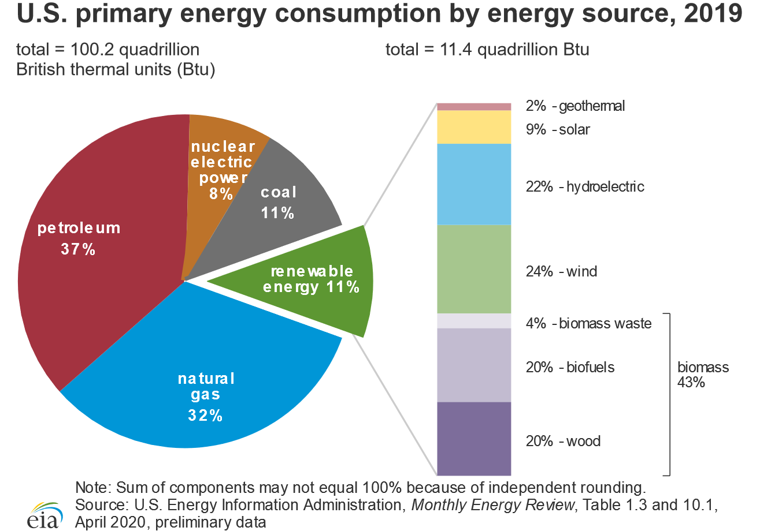
US Primary Energy Sources

Slide 4
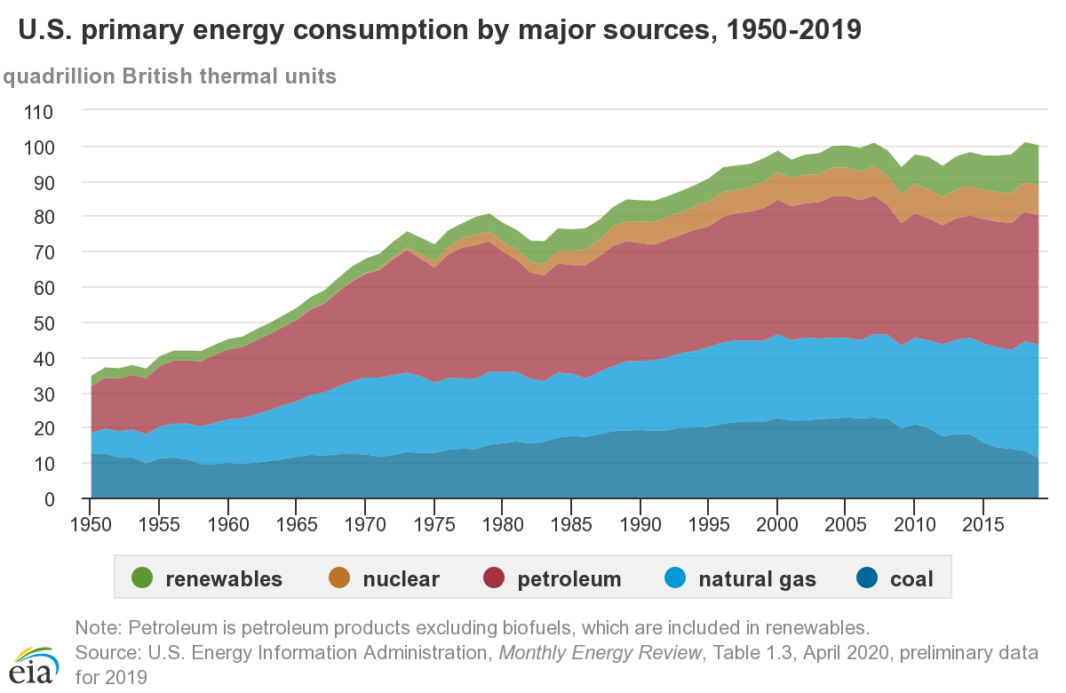
Energy Source over Time

Slide 5
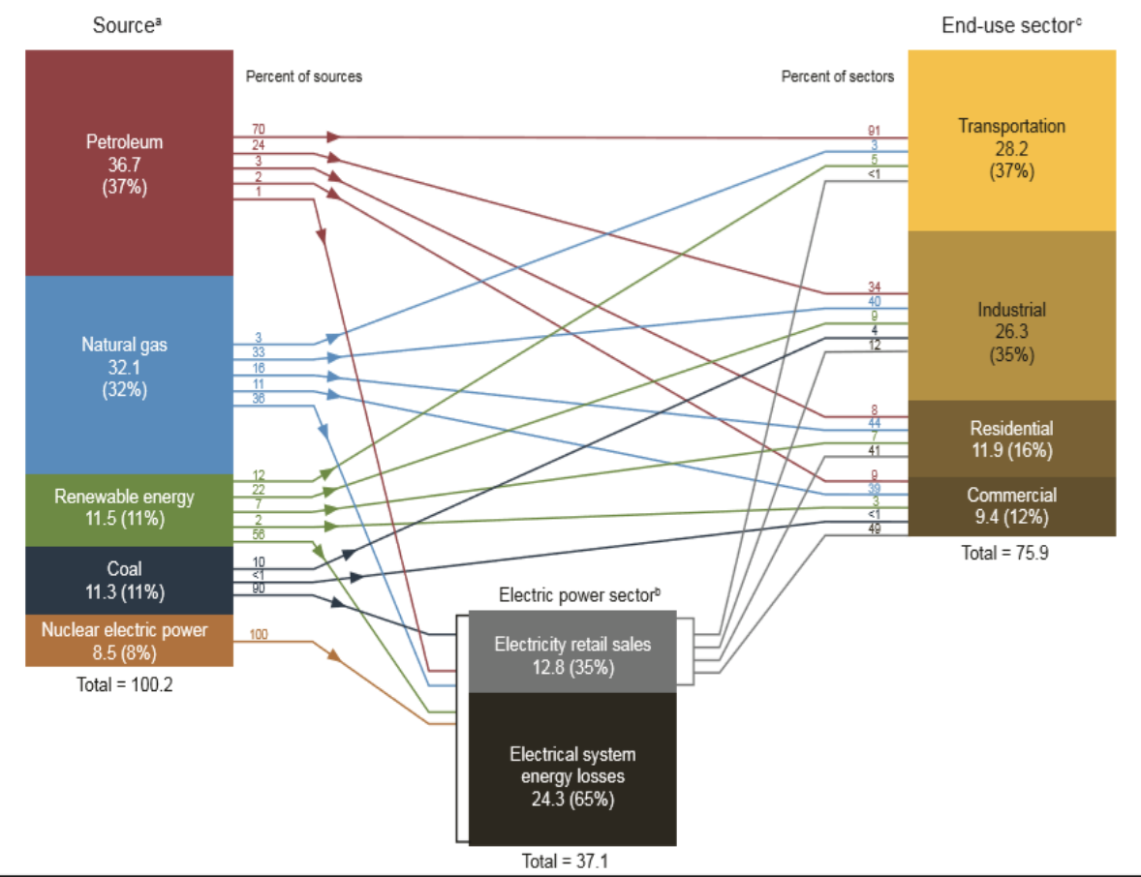
US Energy by Source and Sector

Slide 6
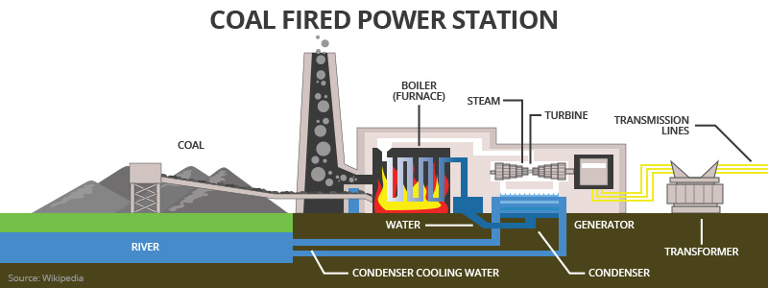
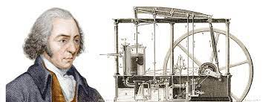
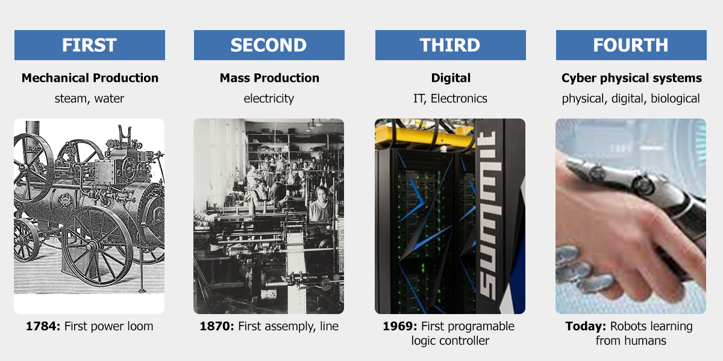
Coal Mine

Slide 7

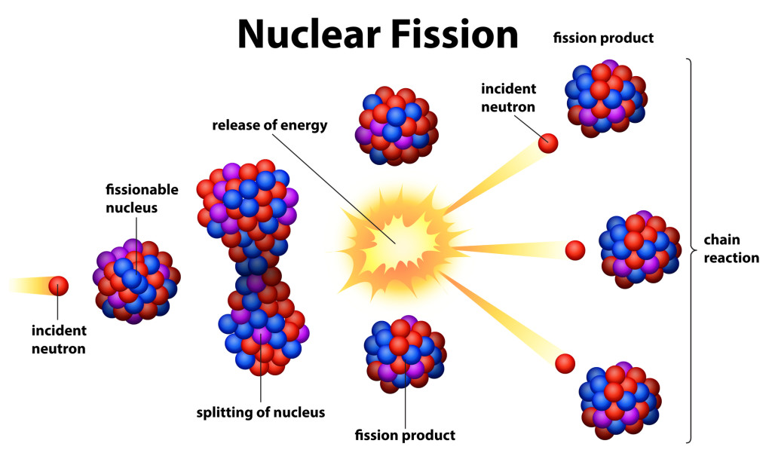
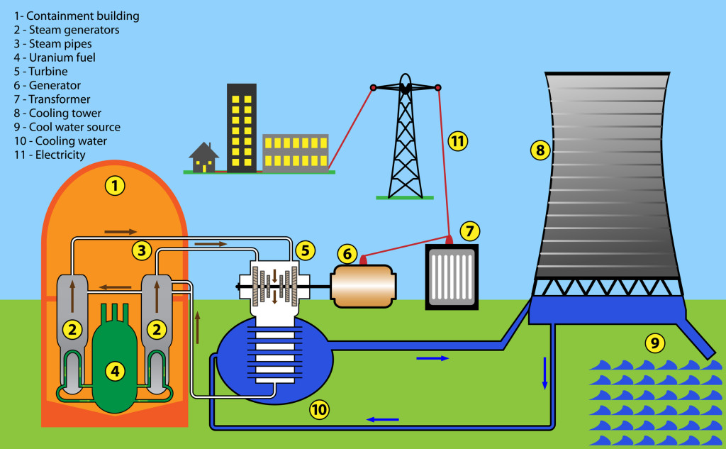
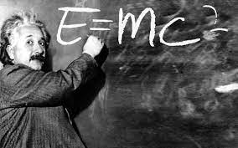
Nuclear Power

Slide 8
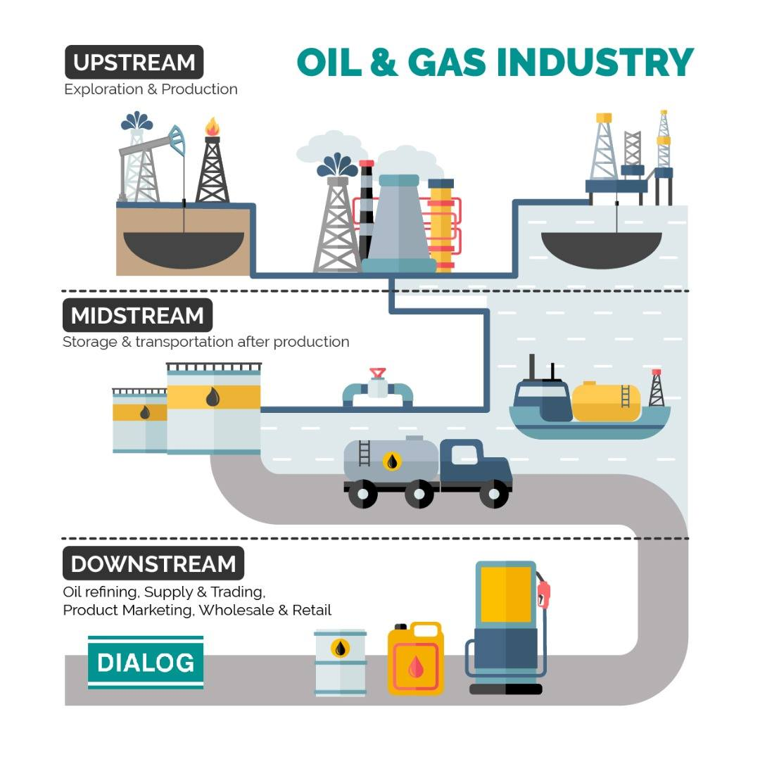
Oil & Gas Industry

Slide 9

Big Data for Seismic Imaging
Jia Meng
Ph.D. 2010

Slide 10

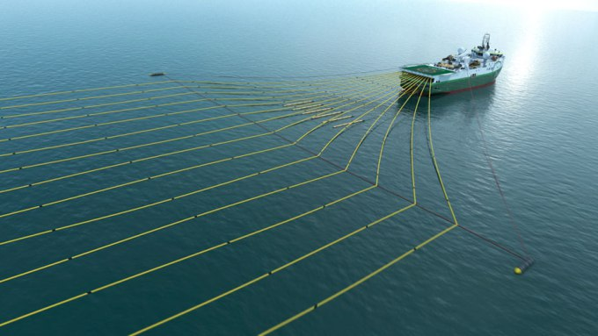
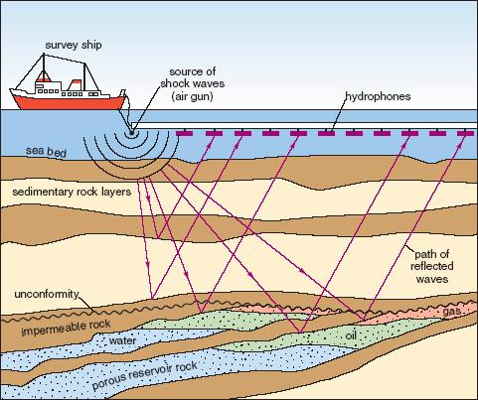

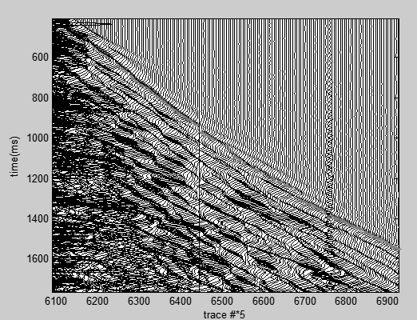
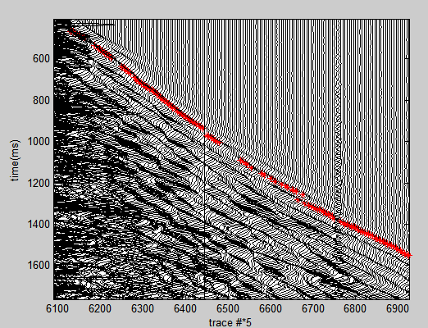
First Arrival Problem using Machine Learning
Kevin Tsai
Ph.D. 2020

Slide 11


Well Logging using
Reinforcement Learning
Qiuyang Shen
Ph.D. 2020
Real-time Drilling
Feed drilling data
Data Interpretation
Navigate drilling direction

Slide 12
Outline
Energy Sources for Human Society
  Classic Energy Sources
  Petroleum Industry Basics
Renewable Energy
  Power System Basics
  Green Energy Sources
  Why Renewable Energy can be Dirty and Expensive
Carbon Neutralization
  Carbon Capture and Storage
  Smart Grid and Electrical Cars
  Policy and Marketing
Conclusion

Slide 13
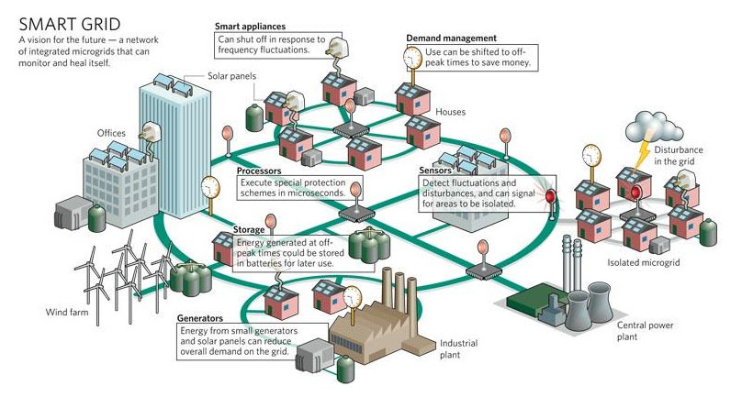
Smart Grid
In 2009, “American Recovery and Reinvestment Act”
  $3.4 billion for SG investment grant program
  $615 million for SG demonstration program
  It leads to a combined investment of $8 billion in SG capabilities.

Slide 14
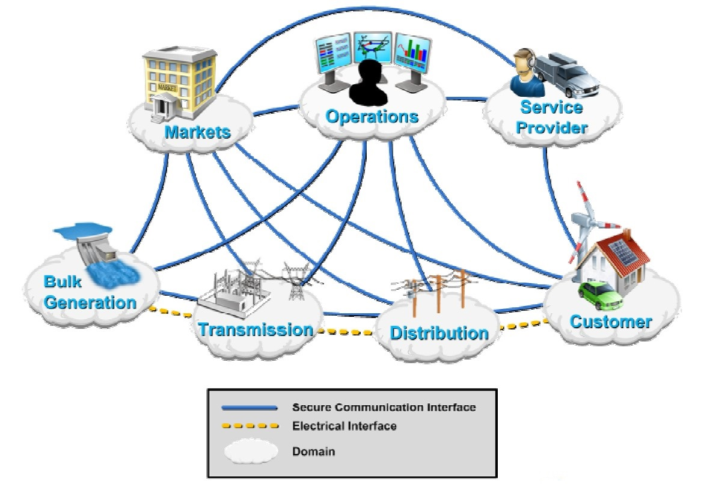
Smart Grid Domains

Slide 15
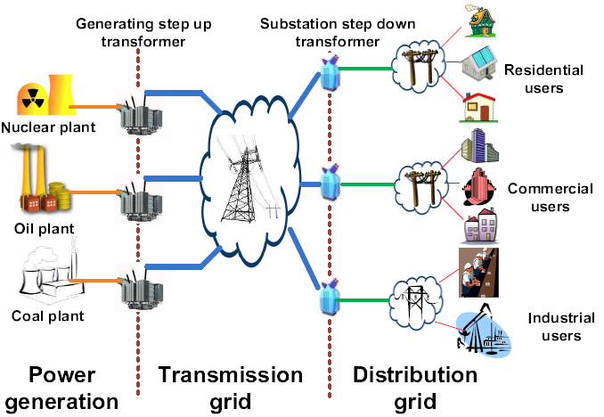
Energy subsystem in power grid

Slide 16
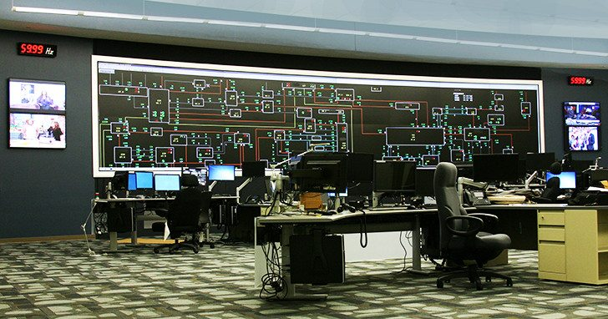
Operations and Service Provider: Supervisory Control and Data Acquisition (SCADA) Center

Slide 17
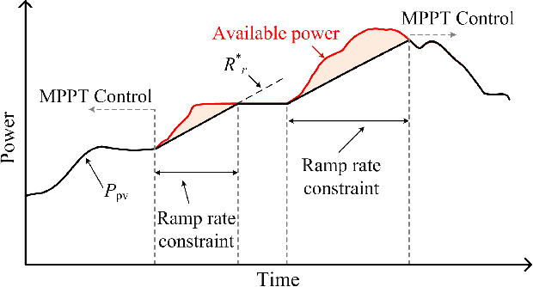
Day-ahead vs. real-time markets
Electricity Market
(OPF)
Bid’s from Gen and loads, Structure of network, etc.
Electricity Prices, Schedule for gen, etc
Day-Ahead
Market:
Predicted values for power network
DCOPF for EX-Ante Electricity Market
Ramping
Constraint
Real-time Market:
Direct Measurements
in power network
State
Estimation
DCOPF for EX-Post Electricity Market

Slide 18
Energy Retailer
The profit = sum of utility bill – cost to buy power
  Different shape of loads cost different
  Incentive using pricing to change the loads
  The cost reduction is greater than loss of bills

Slide 19
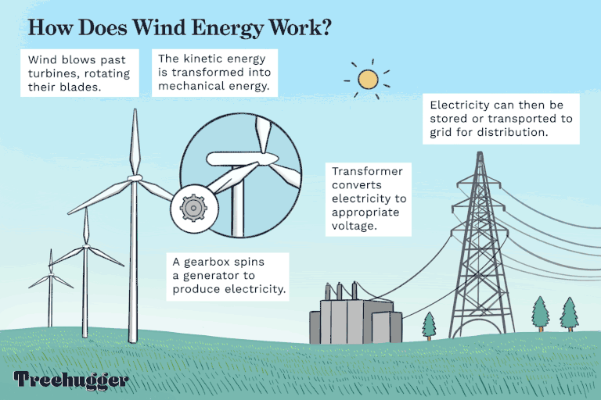
Renewable Wind Power

Slide 20
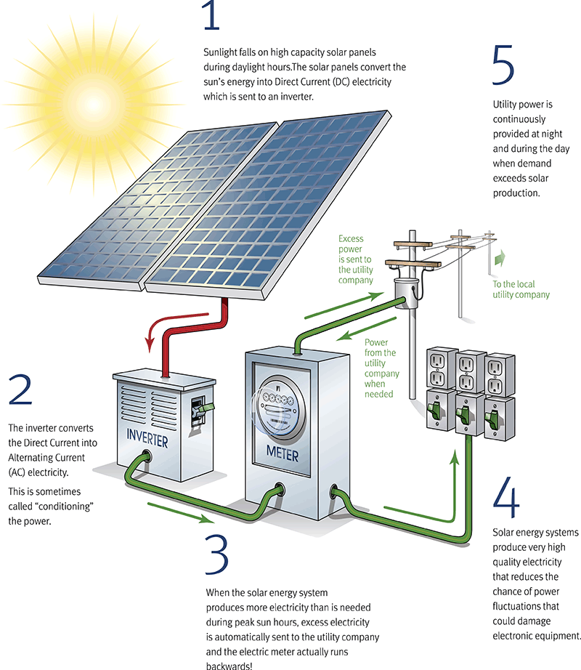
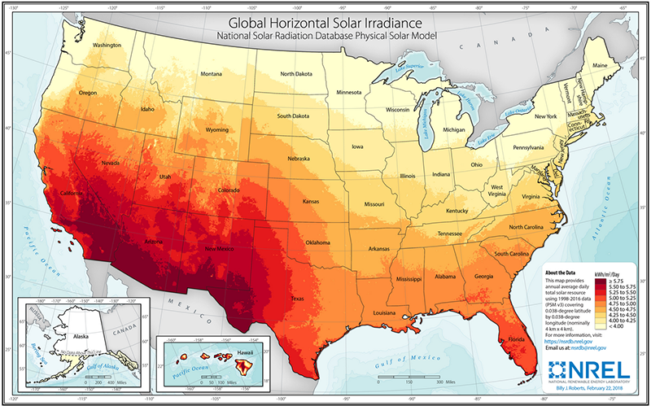
Renewable Solar Power

Slide 21
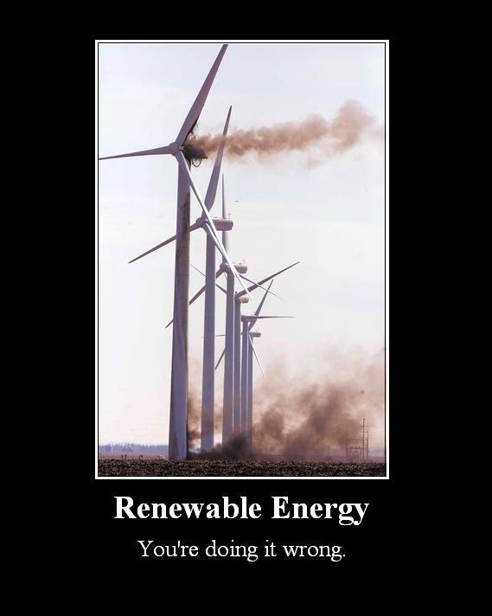
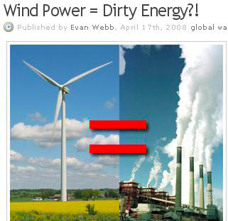
Reason Why Renewable
Energy can be Dirty and Expensive
Ramping constraint for the existing power plants
Gap due to the unpredicatable renewable energy is filled by diesel generator

Slide 22

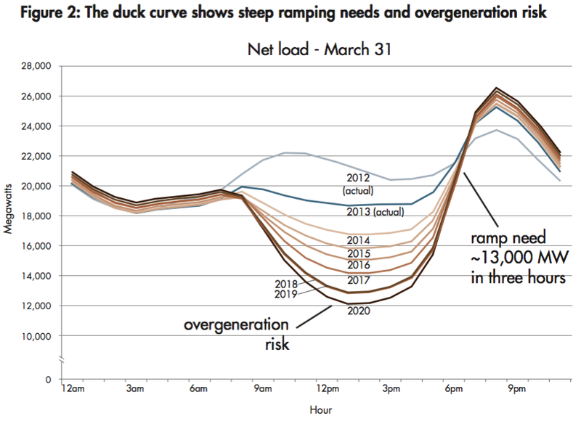
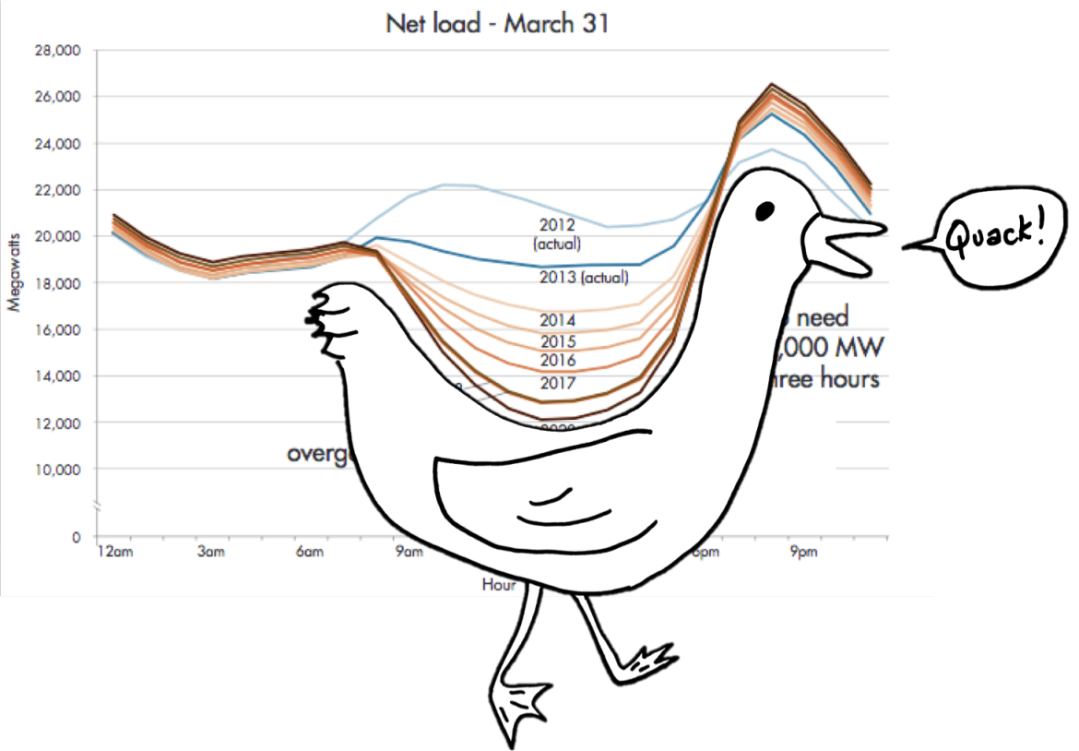
Solar Energy Threat
Hung Nguyen
Ph.D. 2013
Duck curve

Slide 23
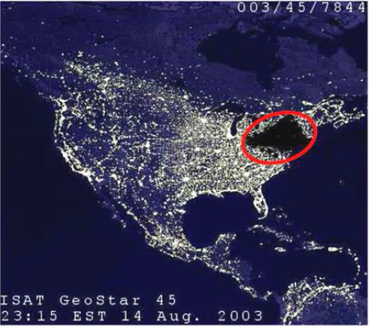

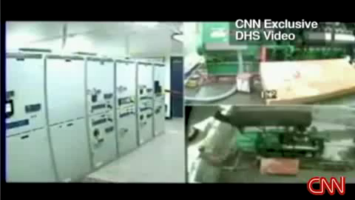

Reason why Renewable Energy can Make Power Systems Unstable
Renewable energy phase ~= power system phase
Yi Huang
Ph.D. 2013
Mohammad Esmalifalak
Ph.D. 2013

Slide 24

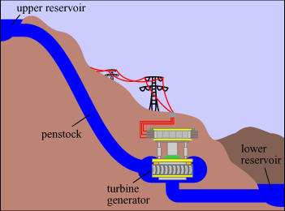
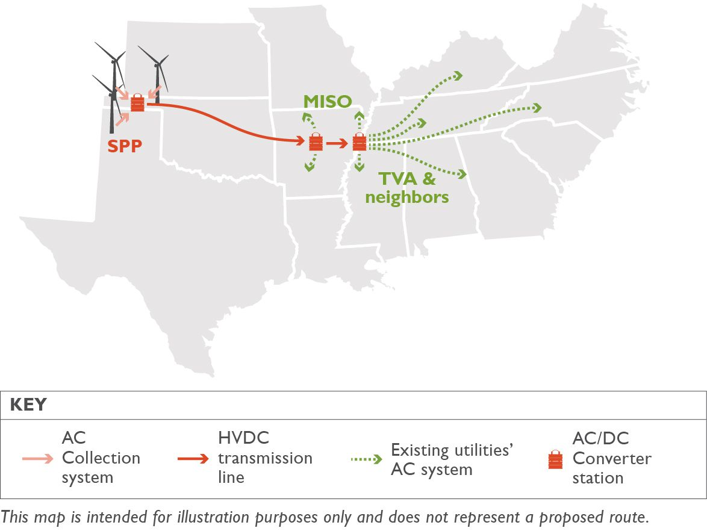
Techniques to improve
Najmeh Forouzandehmehr
Ph.D. 2013
Pumped-storage plant
High voltage transmission

Slide 25
Outline
Energy Sources for Human Society
  Classic Energy Sources
  Petroleum Industry Basics
Renewable Energy
  Power System Basics
  Green Energy Sources
  Why Renewable Energy can be Dirty and Expensive
Carbon Neutralization
  Carbon Capture and Storage
  Smart Grid and Electrical Cars
  Policy and Marketing
Conclusion

Slide 26
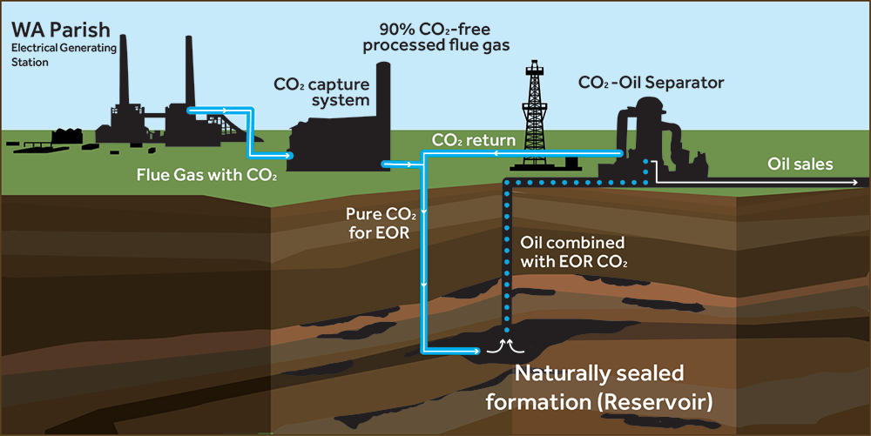
Geological Storage

Slide 27
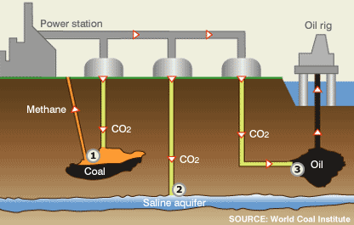
Clean Coal Technology

Slide 28
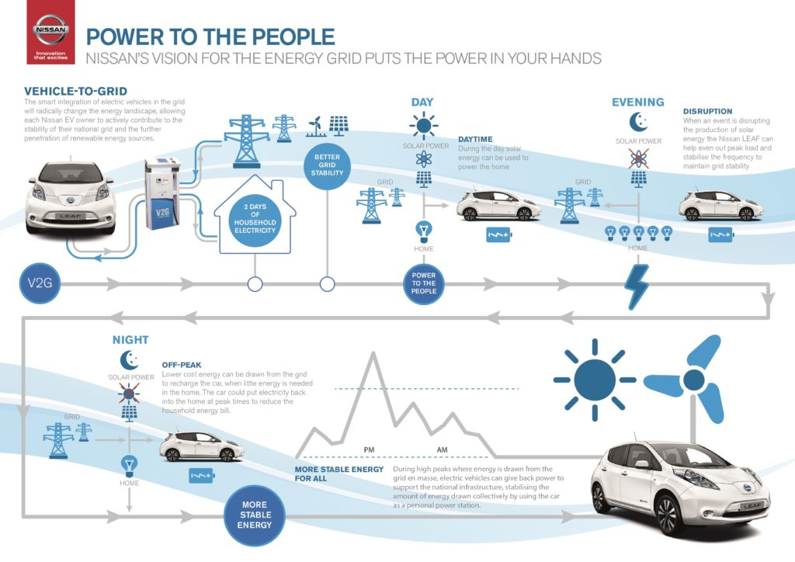
Electrical Vehicle to Grid

Slide 29

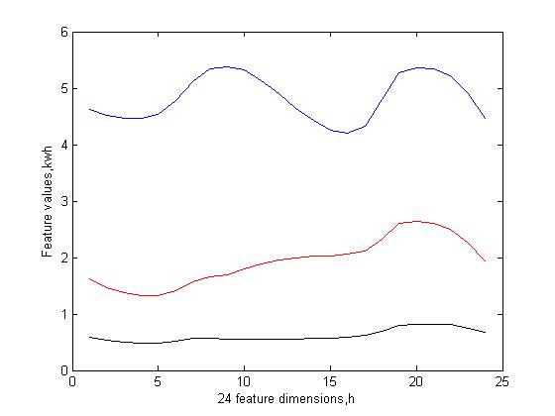
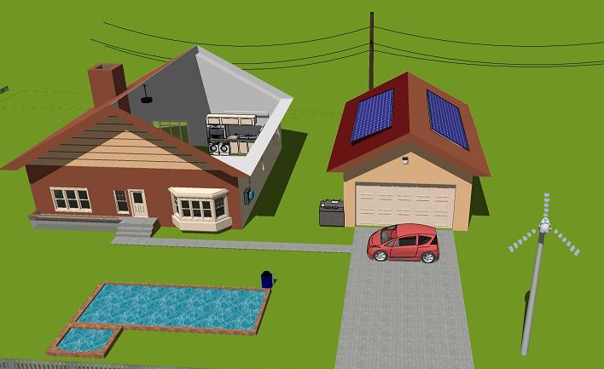
Load Profiling
Erte Pan
Ph.D. 2013
From smart meter data, try to tell users’ usage behaviors
  CEO, 1%, audiences here in the future
  Worker, middle class, professor
  Ph.D. students

Slide 30
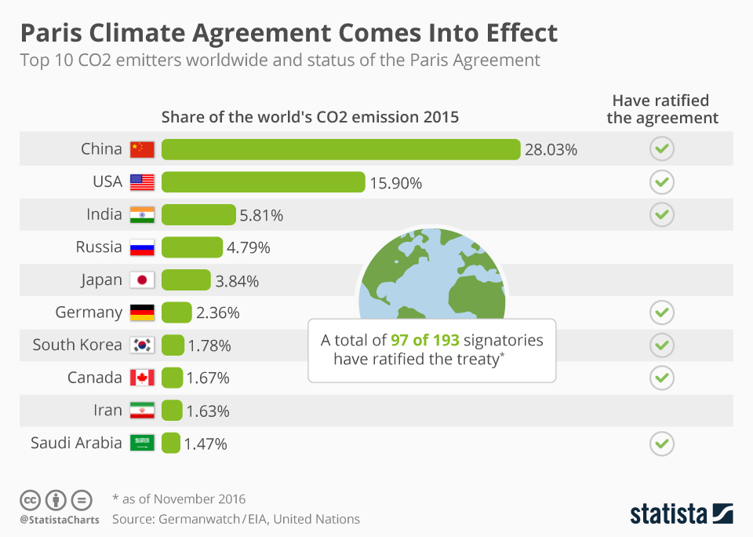
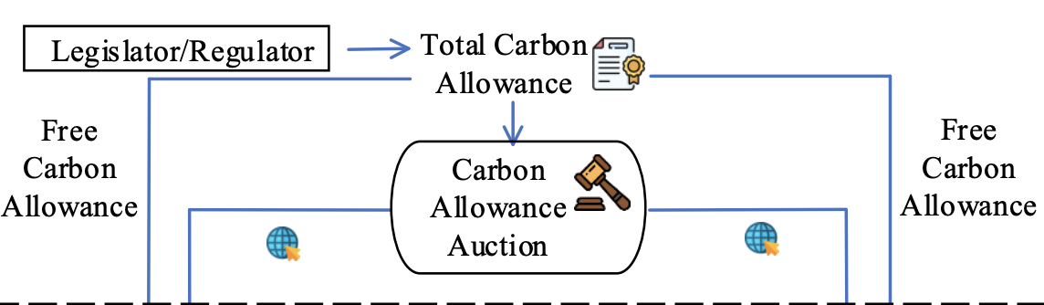
Carbon Allowance Initialization and Allocation

Slide 31
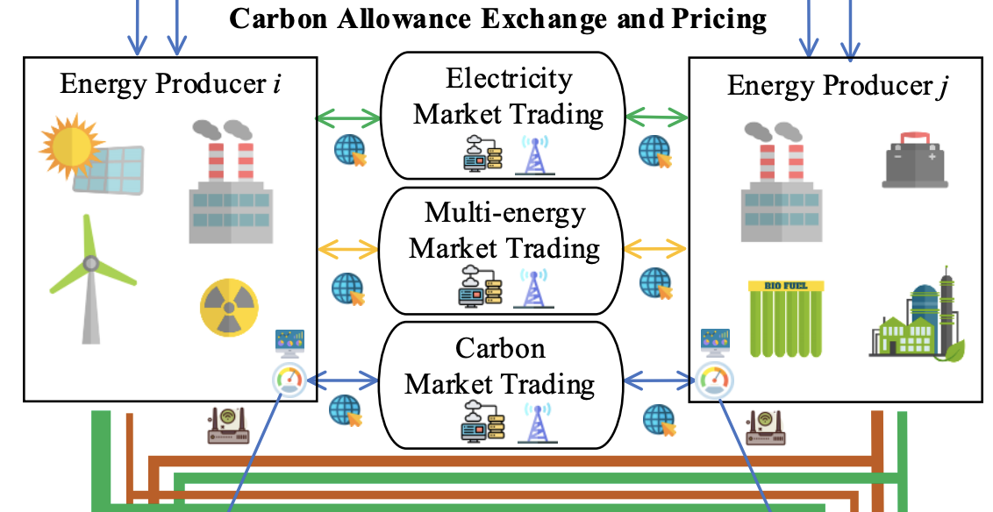
Carbon Allowance Exchange and Pricing

Slide 32
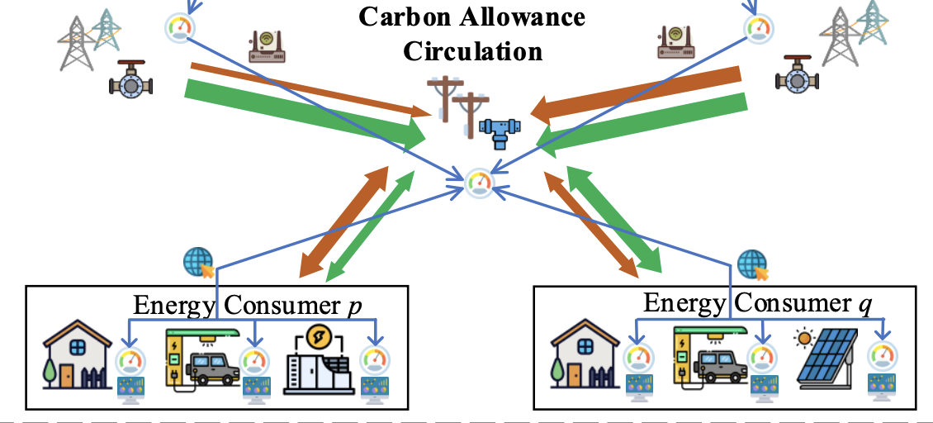
Carbon Allowance Circulation

Slide 33
Conclusion
Basics of energy source and smart grid
Renewable Energy
  Characteristics and limitation
  Too much renewable energy can be dirty and expensive.
  Techniques for improve renewable energy
Carbon neutralization
  Carbon Capture and Storage, Clean Coal
  Smart Grid and Electrical Cars
  Policy and Marketing
    Paris Climate Agreement
    Carbon Allowance Exchange, Pricing and Circulation
Scientifically Deploy Technologies can Save Our Earth

Slide 34







THANK YOU
http://wireless.egr.uh.edu/
34

