Slide 1
An Introduction of Stochastic Network Calculus
Xuefang Liu
School of Telecommunications Engineering , Xidian University
Xi’an , China
Feb. 2017

Slide 2
Outline
What’s Network Calculus
Qos in Network
Math theory
Service curves & Arrival curve
What’s Stochastic Network Calculus
Examples and Focus

Slide 3
Queue System
How long will
it take?
Processing time is
too long.
Wait or not?
The answers often serve as basis for the decisions we make

Slide 4
Queueing Theory
General queueing system
Output
Arrivals
Buffer
Service
Queueing theory helps in planning and analyzing a system's performance.
performance guaranteens for worst-case view?
Notes:
Queueing theory: maximize the performance and minimize the risk.

Slide 5
Network Calculus
R.Cruz. lay the foundation of Network Calculus.
[1]R. L. Cruz. A calculus for network delay, Part I: Network elements in isolation. IEEE Transactions on Information Theory, 37(1):114-131, January 1991. [2] R. L. Cruz. A calculus for network delay, Part II: Network analysis. IEEE Transactions on Information Theory, 37(1):132-141, January 1991.
Goal:
A theoretical framework to analyze performance guarantees (maximum delays, maximum buffer space requirements…) in network.;
Transform complex non-linear network systems into analytically tractable linear systems.

Slide 6
Network Calculus
Deterministic Network Calculus (DNC)
provide deterministic service guarantee that all packets of a flow arrive at the destination within its required performance (as throughput, delay, and loss bounds).
Provides the highest QoS level.
Drawback---must reserve network resources based on the worst-case scenario and hence leaves a significant portion of network resources unused.

Slide 7
Network Calculus
Stochastic Network Calculus (SNC)
Provide stochastic service guarantee that allows the QoS to be guaranteed with a probability .
Allowing some packets to violate the required QoS measures.
Advantage—better exploit the statistical multiplexing gain at network links and hence improve network utilization.

Slide 8
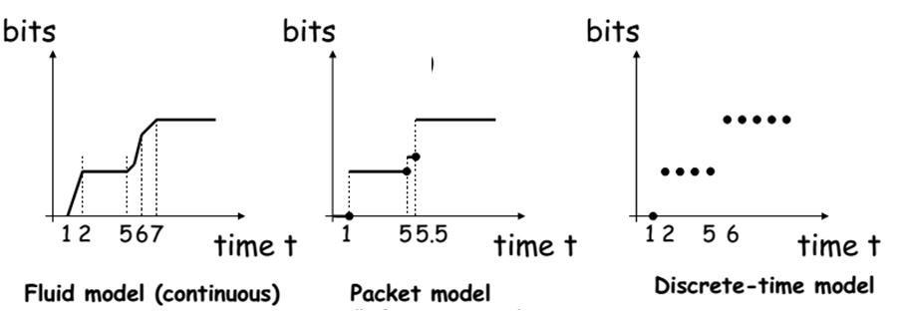
QoS
Cumulative function
describe the data flow as the number of bits in time interval.
A1(t)
A2(t)
A3(t)
Notes:
It is convenient to describe data flows by means of the cumulative function
A1:continuous function of continuous time
A2:continuous time with discontinuities at packet arrival times,packet arrivals are ovserved when the packet has been fully received
A3:

Slide 9
QoS---Backlog
Definition: For a lossless system
The amount of bits that are held inside the system.
vertical deviation between input and output functions

Slide 10
QoS ---Delay
Definition: For a lossless system, the virtual delay is
$d\left(t\right)=inf⁡\{τ≥0:A(t)≤B(t+τ)\}$
the delay that would be experienced by a bit arriving at time t if all bits received before it are served.
Horizontal deviation

Slide 11
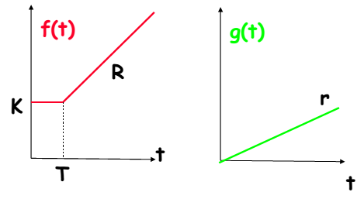
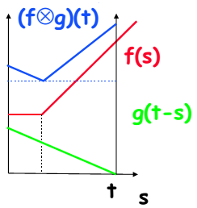
Mathematical basis for NC
Four network operations----reduce the complexity
Wide-sense increasing function
Min-plus
algebra
Notes:
The second and last operator represent the point wise addition and subtraction of th einvolved functions

Slide 12
Ex: Why use convolution
Scenario
Service element has constant service rate u
Assumption
No data is lost or produced inside the service element
Backlog
New arrivals
Processed data
Backlog at time t
Service curve
Notes:
b(t-1): backlog of the previous slot
A(t): new arrivals
U:processed data

Slide 13
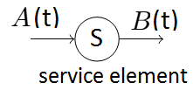
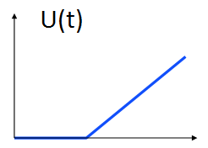
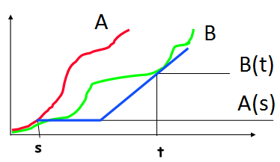
Service curve
A service element has the input-output pair A and B.
The service element provides a service curve
$B\left(t\right)−A(s)≥U(t−s)$
The service curve connects the convolution operator with a minimum guarantee on the service.
Notes:
a service curve defines a lower bound on the service provided by a server.

Slide 14
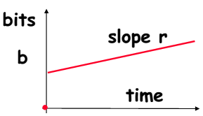
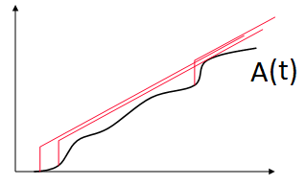
Arrival curve
For any times 0 ≤ s ≤ t, the cumulative flow A(.) satisfies
$$A\left(t\right)−A(s)≤α(t−s)$$
Flow A has arrival curve $α$
the deconvolution operator is connected with a maximal bound on the arrivals. If arrivals were unbounded, one could immediately (and innitely) overload the system.
restricts the amount of arrivals on each interval of length t.
Notes:
In order to deterministically guarantee a certain level of QoS for a flow, the traffic sent by the flow must be limited

Slide 15
use the network operation
Concatenation-Theorem
the whole system has the service curve
Notes:
The initial arrival is denoted by A0 , n service elements and each departure Ai of service element i is fed directly into the next service element i +1. If each service element has a service curve Ui, then the whole system has the service curve

Slide 16
Output bound
Assume that a service element offers a service curve U for an input flow .
The output flow is bounded as
Notes:
The output of a system is bounded with the help of

Slide 17
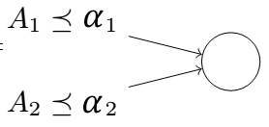
Multiplexing
Two flows with arrival curves are multiplexed into a single one.

Slide 18
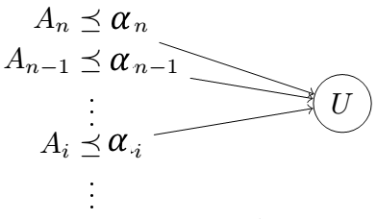
Leftover service curve
a strict priority scheduling scenario
For the incoming flows ,their priorities are sorted by their index i.
the service element provides a strict service curve U for the aggregate
Notes:
the lower priority ow only receives service, if the higher priority ow is not backlogged.

Slide 19
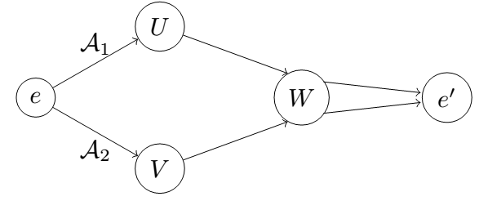
Networks as Labeled Graphs

Slide 20
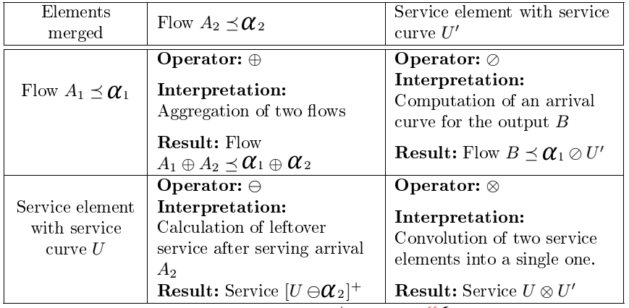
use network operations
Transform the graph to a single labeled node with a single labeled edge.

Slide 21
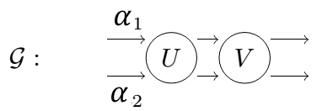
Example:Reduce the network
Orginal graph
end-to-end behavior of the system
the behavior at the service element V.
Notes:
(1)merging both arrivals and then either convolute the two service elements----Convolution after multiplexing (2) calculate an output bound for the departures of the first node----Deconvolution after multiplexing (3) describes an end-to-end behavior, subtract one of the flows
(4) is more suitable for the local analysis at the second node.

Slide 22
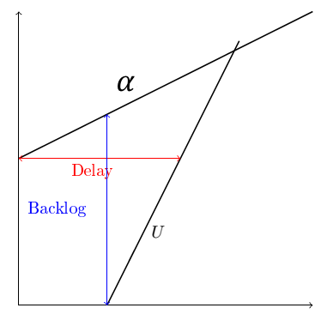
Performance Bounds
$D\left(t\right)=inf⁡\{τ≥0:A(t)≤B(t+τ)\}$
Considering an input flow A with arrival curve α entering a service element with service curve U.
performance bounds :
the maximal vertical and horizontal distance
Notes:
After a labeled graph is successfully reduced, the goal of network calculus is to derive performance bounds of the system.

Slide 23
SNC-- Stochastic Network Calculus
Motivation of SNC:
when the worst case is defined by an event that is possible, yet not very likely, DNC has the problem.
Solution: bounds can be broken, but only with (very) small probabilities.
Difficult to get the bound
Category: two SNC description which differ in how stochastic processes are described:
Tail-bounds cut off unwanted (and unlikely) outcomes ,
Moment Generating Functions (MGF) are a compact way to describe a distribution as a whole.

Slide 24
Tailbounded Network Calculus
main idea : define an arrival curve that can be broken by a given probability.
Two new functions: envelope function, error function.
Envelope function: $α(t,ε)$
t-----describes the typical behavior of input flow,
ɛ-----describes a deviation from the behavior.
might occur depending on the considered intervals length t.
Decreasing in $ε$
Error function:$η(t,ε$)
Large deviations should happen with a smaller probability.

Slide 25
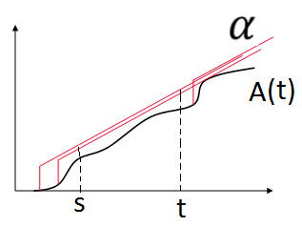
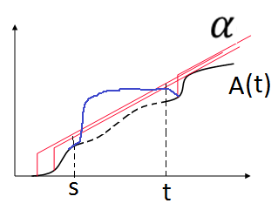
Tailbounded Arrival curve
Defininition: A flow A is tail-bounded with envelope function α and error function η, if for all (s, t) ∈ Λ and ε > 0 it holds
$$P(A\left(s,t\right)>α\left(t−s,ε\right))≤η(t−s,ε)$$
burst
$$A\left(t\right)−A(s)≤α(t−s)$$

Slide 26
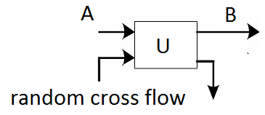
Tailbounded Service curve
Defininition: Consider An input-output pair A and B and a service element. The service element provide tail-bounded service curve U with error function ζ, if for all t, it holds
Notes:
Service element often shows stochastic behavior, due to some random cross flow interfering with an otherwise deterministic service guarantee

Slide 27
Tailbounded Network Calculus
Multiplexing
Subtraction
Deconvolution

Slide 28
Performance Bounds
Consider the arrivals: A with arrive curve α(t,ɛ)
Consider the service element: service curve (U, ζ).
for all t ≥ 0 and ε > 0 ,
the performance bounds

Slide 29
Application in power communication
Flows are classified into different sets according to their QoS demands
Yang Zhou,Li Yu, Juhong Tian, Chao Luo, “Stochastic Delay Analysis of Multi-services in Power Communication Networks”, International Journal of Computer and Communication Engineering, Volume 5, Number 6, November 2016
Notes:
Delay bounds of different services under respective scheduling mechanisms

Slide 30
Application in power communication
Check the pre-negotiated policies of flow, if not, packets of the flow will be discarded
Notes:
Delay bounds of different services under respective scheduling mechanisms

Slide 31
Application in power communication
If overload, some packets will be droped
Notes:
Delay bounds of different services under respective scheduling mechanisms

Slide 32
Application in power communication
Core mechanisms to provide QoS guarantees, enable different flow to get service with different level
Notes:
Delay bounds of different services under respective scheduling mechanisms

Slide 33
Application in power communication
Optimize or guarantee performance, improve latency, increase usable bandwidth for some kinds of packets
Notes:
Delay bounds of different services under respective scheduling mechanisms

Slide 34
Application in power communication
Focus on the impacts of different scheduling on the performance
Three typical traffics with different QoS guarantees:
voice service (denoted by A),
real-time data service (B) , monitoring service (C)
Three scheduling policy:
FIFO, Priority queueing , Custom queueing
Notes:
Delay bounds of different services under respective scheduling mechanisms
From high to low

Slide 35
Application in power communication
Virtual-backlog-centric stochastic arrival curve
Considering an input flow X with the arrival curve α(t) with bounding function f, for all $t≥0 \& x≥0$,
$P\left\{\sup\left(X\left(s,t\right)−α\left(t−s\right)\right)>x\right\}≤f\left(x\right)$
Virtual-backlog- stochastic strict service curve
Considering an service element with service curve β(t) with bounding function g, for any period (s,t] , the service S(s,t) satisfies
$P\left\{\sup\left(β\left(t−s\right)−S(s,t)\right)>x\right\}≤g\left(x\right)$

Slide 36
Application in power communication
FIFO
According to the aggregation property, combined service satisfies
Notes:
As the packets in the queue tail may come from service A, B and C and the scheduler operates on “first come, first serve” basis, A, B and C have a similar delay.

Slide 37
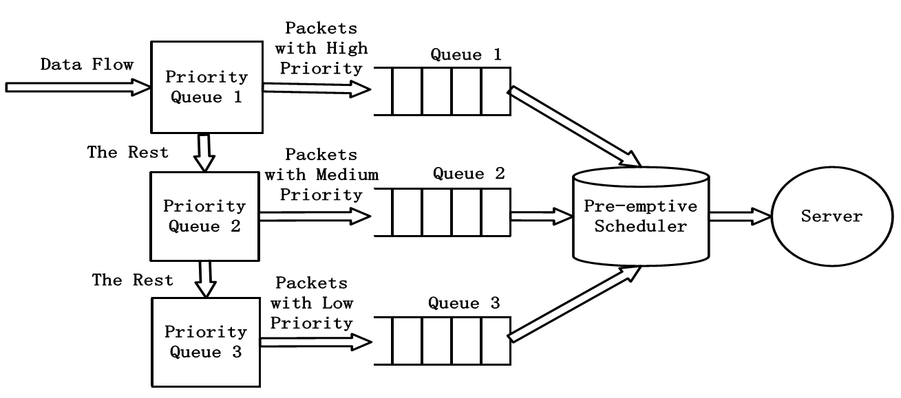
Priority Queueing scheduling
Notes:
Only when all the packets in the queues with higher priorities have been processed, the packets in the queues with lower priorities could get service
service A, it suffers no competition from service B and C, which means service B and service C can be seen as not existed.

Slide 38
Priority Queueing scheduling
Notes:
Only when all the packets in the queues with higher priorities have been processed, the packets in the queues with lower priorities could get service
service A, it suffers no competition from service B and C, which means service B and service C can be seen as not existed.

Slide 40
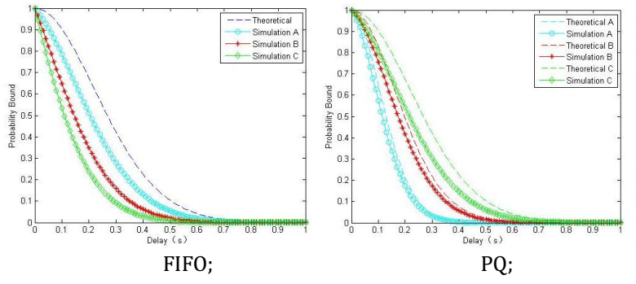
Assumption: the arrival processes of A, B, C follow Poisson distributions, and service curve is a constant rate.

Slide 41
What’s the focus
Network , traffic (arrival model), service (service model)
Performnce
Resource Allocation
Schedule policy
………

Slide 42
Reference
J-Y Le Boudec and P. Thiran, Network calculus, Springer ,2001
Yuming Jiang, Yong Liu,Stochastic Network Calculus, Springer, 2008
Michael Beck, Advances in Theory and Applicability of Stochastic Network Calculus, [D], the University of
Kaiserslautern,2016

Slide 43
Q&A
Thank You!
Xuefang Liu
xfliu325@gmail.com
xfliu1@mail.xidian.edu.cn
Wireless Networking, Signal Processing and Security Lab
Department of Electrical and Computer Engineering
University of Houston, TX, USA

