Slide 1


Distributed Resource Allocation for 5G Communication Systems
Lingyang Song* and Zhu Han⁺
* School of Electronics Engineering and Computer Science,
Peking University, Beijing, China
⁺ Department of Electrical and Computer Engineering
University of Houston, Houston, TX, USA
Acknowledgement
Tianyu Wang, Hongyu Cui, Boya Di, Yun Liao, Radwa Sultan, Yunan Gu,
Huaqing Zhang, Yanru Zhang, Zhiwen Hu, Siavash Bayat, and Yonghui Li
Tutorial presentation, IEEE ICC 2016, Kuala Lumpur, Malaysia

Slide 2
Table of Content
5G Basics
Game Theory Introduction
Distributed Resource Allocation
  Device-to-device communication
  Full-duplex communication
  Wireless caching
Other Applications
  Wireless network virtualization
  LTE-unlicensed
  Massive MIMO
  mmWave
Conclusions

Slide 3
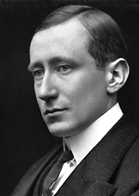
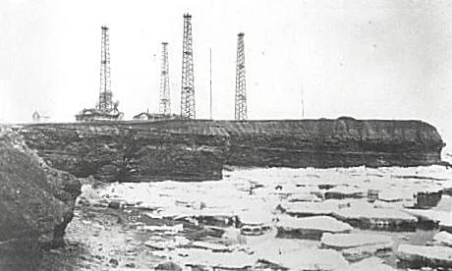
1900: Famous patent No. 7777, "tuned or syntonic telegraphy"
1900: Marconi's Wireless Telegraph Company Limited founded
History of Mobile Communications
1901: Transmitting the first wireless signals across the Atlantic between Poldhu, Cornwall, and St. John's, Newfoundland, a distance of 2100 miles.
1909: The Nobel Prize in Physics

Slide 4

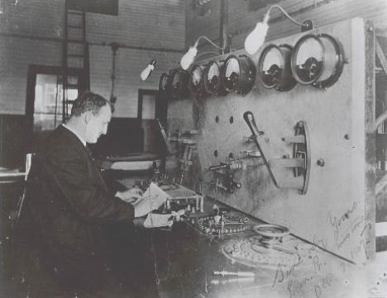
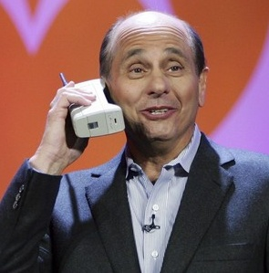
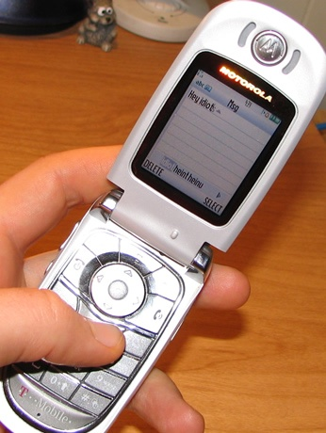

A Market Needs both Technology and Application
From data …
to voice …
to everything

Slide 5
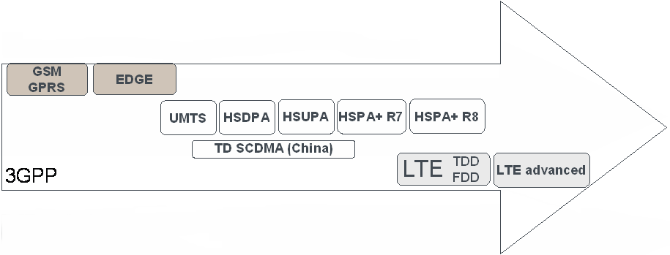
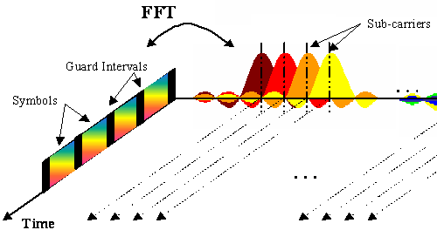
Standardization Facilitates Technology Evolution
Each new evolution builds on the established market of the previous
Backwards-compatible evolution
But larger technology steps require revolutions:
1995
2000
2005
2010
2015
From TDMA:
to CDMA:
to OFDMA:

Slide 6
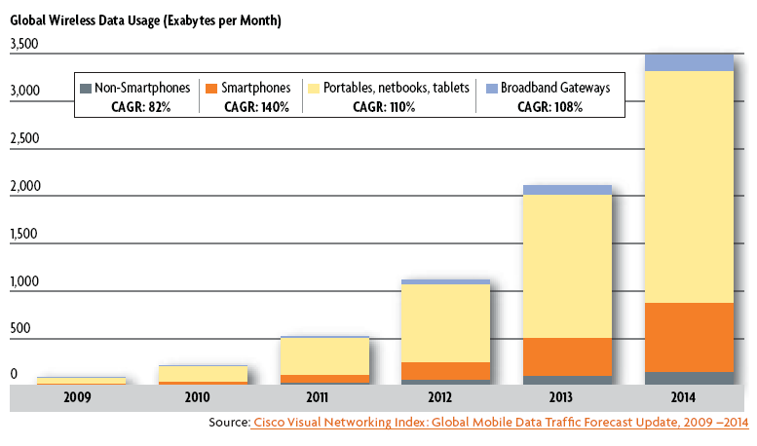
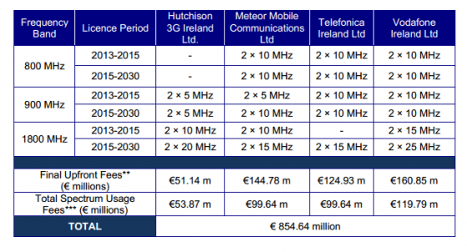
Future Wireless Challenges
Explosion of data traffic
VS
Limited spectrum
Source: Irish Regulator ComReg Announces Results of its 4G Spectrum Auction
Fig. 2 Results of Irish 4G Spectrum Auction
Fig.1 Cisco Visual Networking Index Global Mobile Data Traffic Growth

Slide 7

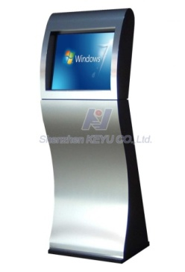



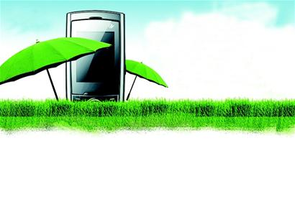
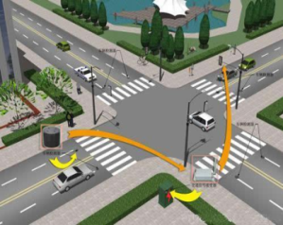

KPIs
Key Performance Indicators (KPIs)
10Gbps
1000X Capacity
(Traffic and Connections)
10X User Rate Anywhere
(100M-1Gbps)
10X Peak Data Rate
(10+Gbps)
6 Key Requirements
1000X Energy&Cost Reduce
10X Low Latency,
High reliability
5-10X Spectrum Efficiency
Notes:
上面是传统指标

Slide 8
Future Wireless Challenges: Analysis
Signal to Noise plus Interference Radio
Scaled Transmission Time
Capacity：C = N * W * T * log(1 + SINR)
No. of APs
Bandwidth
Notes:
N: Ultra-dense W: mmWave, higher f, cognitive, T:D2D, 对应后一张

Slide 9

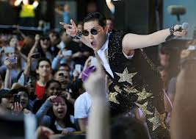
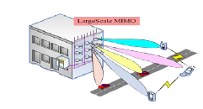





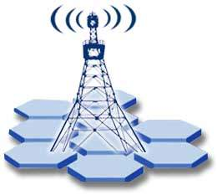


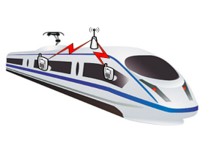
Evolution （1）
Evolutions
Ultra Dense Deployment:
LTE-Hi and Further Evolution
Cell Edge User Experience:
Coordination and Comp, Advanced IC
Link Efficiency:
Massive MIMO, 3D-BF,
Full-duplex
    More Scenarios and Use Case：
    M2M, D2D, V2X
    Flexible Network and High
    Reliability: Mobile Relay, UE Relay,
    MAC direct,
    Smart Network:
    Service & Environment Awareness
    SON; Multi-Radio/Multi-RAT SON
Notes:
D2D FD caching- 我讲
韩：MMWave。。。
Based on game

Slide 10
Table of Content
5G Basics
Game Theory Introduction
Distributed Resource allocation
  Device-to-device communication
  Full-duplex communication
  Wireless caching
Other Applications
  Wireless network virtualization
  LTE-unlicensed
  Massive MIMO
  mmWave
Conclusions

Slide 11
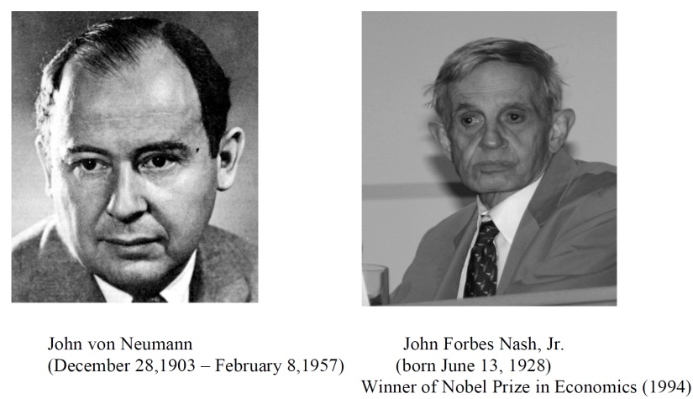

History of Game Theory
John von Neuman (1903-1957) co-authored, Theory of Games and Economic Behavior, with Oskar Morgenstern in 1940s, establishing game theory as a field.
John Nash (1928 - ) developed a key concept of game theory (Nash equilibrium) which initiated many subsequent results and studies.
Since 1970s, game-theoretic methods have come to dominate microeconomic theory and other fields.
Nobel Prizes
  Nobel prize in Economic Sciences 1994 awarded to Nash, Harsanyi (Bayesian games) and Selten (subgame perfect equilibrium).
  2005, Auman and Schelling got the Nobel prize for having enhanced our understanding of cooperation and conflict through game theory.
  2007 Leonid Hurwicz, Eric Maskin and Roger Myerson won Nobel Prize for having laid the foundations of mechanism design theory.

Slide 12
Introduction
Game theory - mathematical models and techniques developed in economics to analyze interactive decision processes, predict the outcomes of interactions, identify optimal strategies
Game theory techniques were adopted to solve many protocol design issues (e.g., resource allocation, power control, cooperation enforcement) in wireless networks.
Fundamental component of game theory is the notion of a game.
  A game is described by a set of rational players, the strategies associated with the players, and the payoffs for the players. A rational player has his own interest, and therefore, will act by choosing an available strategy to achieve his interest.
  A player is assumed to be able to evaluate exactly or probabilistically the outcome or payoff (usually measured by the utility) of the game which depends not only on his action but also on other players’ actions.

Slide 13
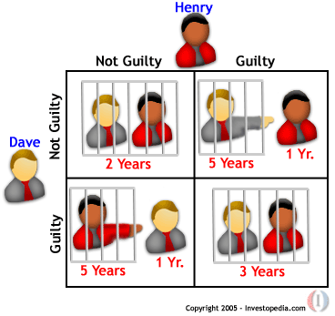
Examples: Rich Game Theoretical Approaches
Non-cooperative Static Game: play once
  Mandayam and Goodman (2001)
  Virginia tech
Repeated Game: play multiple times
  Threat of punishment by repeated game. MAD: Nobel prize 2005.
  Tit-for-Tat (infocom 2003):
Dynamic game: (Basar’s book)
  ODE for state
  Optimization utility over time
  HJB and dynamic programming
  Evolutional game (Hossain and Dusit’s work)
Stochastic game (Altman’s work)
Cooperative Games
  Nash Bargaining Solution
  Coalitional Game
Prisoner Dilemma
Payoff: (user1, user2)
Notes:
John Edwards

Slide 14
Games in Strategic (Normal) Form
A game in strategic (normal) form is represented by three elements:
  A set of players N
  Set of strategies of player Si
  Set of payoffs (or payoff functions) Ui
Notation s_{i} strategy of a player i while s_{-i} is the strategy profile of all other players.
Notice that one user’s utility is a function of both this user’s and others’ strategies.
A game is said to be one with complete information if all elements of the game are common knowledge. Otherwise, the game is said to be one with incomplete information, or an incomplete information game.

Slide 15
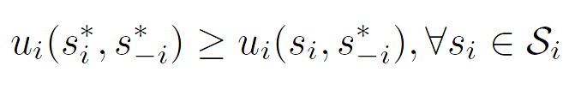
Nash Equilibrium
Dominant strategy is a player's best strategy, i.e., a strategy that yields the highest utility for the player regardless of what strategies the other players choose.
A Nash equilibrium is a strategy profile s* with the property that no player i can do better by choosing a strategy different from s*, given that every other player j ≠ i .
In other words, for each player i with payoff function u_{i} ,
No user can change its payoff by Unilaterally changing its strategy, i.e., changing its strategy while s_{-i} is fixed

Slide 16
The price of Anarchy
Centralized system: In a centralized system, one seeks to find the social optimum (i.e., the best operating point of the system), given a global knowledge of the parameters. This point is in many respect efficient but often unfair.
Decentralized: When the players act noncooperatively and are in competition, one operating point of interest is the Nash equilibrium. This point is often inefficient but stable from the players’ perspective.
The Price of Anarchy (PoA), defined as the ratio of the cost (or utility) function at equilibrium with respect to the social optimum case, measures the price of not having a central coordination in the system
PoA is, loosely, a measure of the loss incurred by having a distributed system!

Slide 17
Example: Prisoner’s Dilemma
Two suspects in a major crime held for interrogation in separate cells
  If they both stay quiet, each will be convicted with a minor offence and will spend 1 year in prison
  If one and only one of them finks, he will be freed and used as a witness against the other who will spend 4 years in prison
  If both of them fink, each will spend 3 years in prison
Components of the Prisoner’s dilemma
  Rational Players: the prisoners
  Strategies: Stay quiet (Q) or Fink (F)
  Solution: What is the Nash equilibrium of the game?
Representation in Strategic Form

Slide 18
Example: Prisoner’s Dilemma
Price of Anarchy 3
 | P2 Quiet | P2 Fink
P1 Quiet | 1,1 | 4,0
P1 Fink | 0,4 | 3,3
Pareto optimal
(recall we’re minimizing)
Nash Equilibrium

Slide 19
Algorithms for Finding the NE
For a general N-player game, finding the set of NEs is not possible in polynomial time!
    Unless the game has a certain structure
Some existing algorithms
  Fictitious play (based on empirical probabilities)
  Iterative algorithms (can converge for certain classes of games)
  Best response algorithms
    Popular in some games (continuous kernel games for example)
  Useful Reference
  D. Fundenberg and D. Levine, The theory of learning in games, the MIT press, 1998.

Slide 20
Table of Content
5G Basics
Game Theory Introduction
Distributed Resource Allocation
  Device-to-device communication
  Full-duplex communication
  Wireless caching
Other Applications
  Wireless network virtualization
  LTE-unlicensed
  Massive MIMO
  mmWave
Conclusions

Slide 21
Game-theoretic Methods for Device-to-Device Communications
Lingyang Song* and Zhu Han⁺
* School of Electronics Engineering and Computer Science,
Peking University, Beijing, China
⁺ Department of Electrical and Computer Engineering
University of Houston, Houston, TX, USA
D2D communication website:
http://wireless.pku.edu.cn/home/songly/d2d.html

Slide 22






Definition and Benefits
Definition of Device-to-Device (D2D) Communications
  D2D communications commonly refer to the technologies that enable devices to communicate directly without an infrastructure of access points or base stations.
Increase network capacity
Extend coverage
Offload data
Improve energy efficiency
Create new applications
eNB
eNB

Slide 23


D2D Direct Deployment Roadmap
Cellular unaware D2D
Cellular network is not aware of D2D
2 RATs, e.g. 3G + Wifi
No cooperation between cellular and D2D
Cellular aware D2D
Cellular network is aware of D2D
2 RATs, e.g. LTE + Wifi
Kind of cooperation between cellular and D2D
Cellular controlled D2D
Cellular network fully controls D2D
A single RAT, e.g. LTE-A
D2D is a part of cellular communication
RAT1
RAT1
RATs converging
RAT1
flow1
flow1
flow1
flow2
RAT2
UE2
RAT2
flow2
UE2
flow2
UE2
UE1
UE1
UE1
Scenario A
Scenario B
Scenario C
D2D Benefits Scenario A Scenario B Scenario C
Traffic offload
Unified & Simplified comm.
User experience improvement
Cellular capacity enhancement

Slide 24
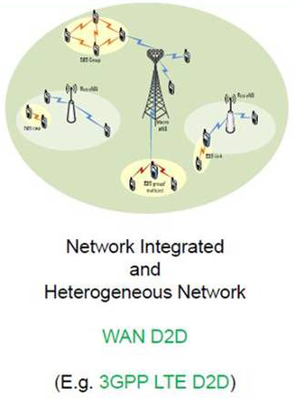
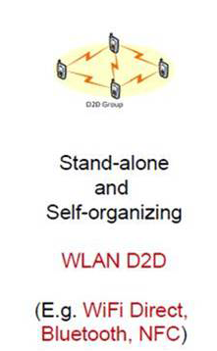
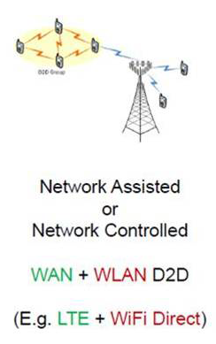
D2D LAN Roadmap
Cellular unaware D2D-LAN
Cellular network is not aware of D2D LAN
2 RATs, e.g. 3G + Wifi
No cooperation between cellular and D2D
Cellular aware D2D-LAN
Cellular network is aware of D2D LAN
2 RATs, e.g. LTE + Wifi
Kind of cooperation between cellular and D2D
Cellular controlled D2D-LAN
Cellular network fully controls D2D LAN
A single RAT, e.g. LTE-A
D2D is a part of cellular communication
Source：Intel

Slide 25
Application Scenarios (1)
There are two important services of ProSe.
  The first one is proximity discovery with which users can discovery each other in proximity.
  The second is direct communication with which users can communicate with each other in proximity.
There is no causality between proximity discovery and direct communication.
  Proximity discovery can be stand alone services to users and doesn’t always trigger direct communication.
  Users may initiate direct communication directly without proximity discovery.
  However, users can use direct communication easily when they know the proximity information.

Slide 26
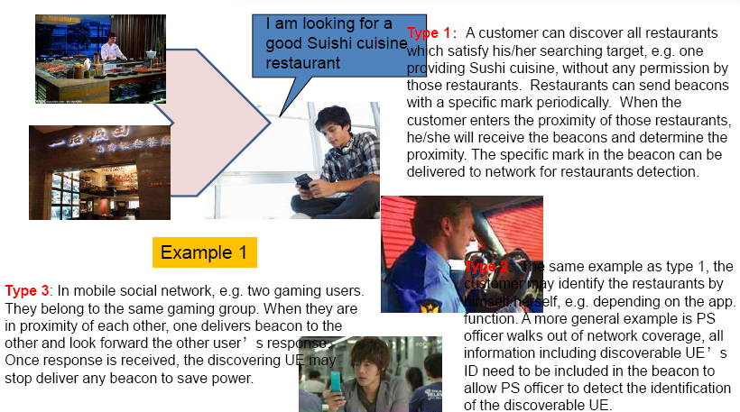
Application Scenarios (2): Social Networking

Slide 27
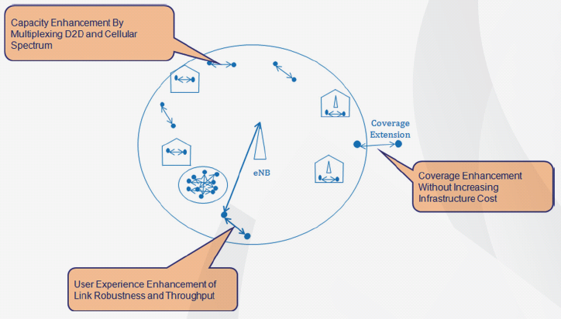
Application Scenarios (3)
Enhance Network Capability (Offloading)
  D2D applications can provide coverage enhancement without increasing infrastructure cost, capacity enhancement by multiplexing D2D and cellular spectrum and user experience enhancement of link robustness and throughput.
e.g.
Concert Networks
Stadium Networks

Slide 28
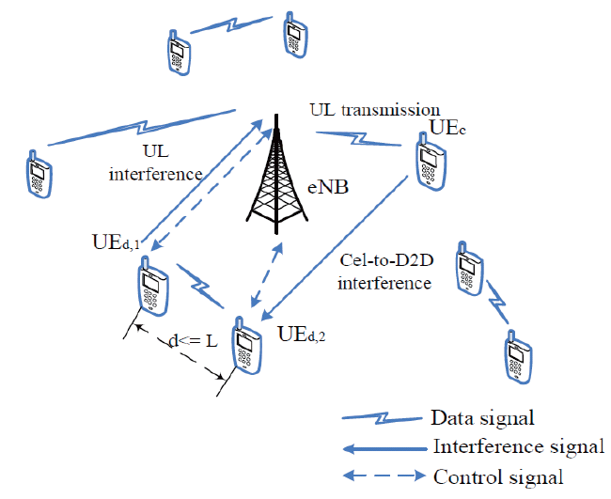
System Models
Two Basic System Models
MME
S-GW
CN
Cellular
D2D LAN

Slide 29
Useful info for Research on D2D Comms
PPT slides available at :
  http://wireless.egr.uh.edu/research.htm
    Device-to-Device (D2D) Communication
    Smart Grid
    Big Data
    Wireless Physical Layer Security
    Game Theory…
D2D communication website:
  http://wireless.pku.edu.cn/home/songly/d2d.html
    Tutorial and Survey
    Books
    Technical papers
    Standardization…
Book
  Chen Xu, Lingyang Song, and Zhu Han, “Resource Management for Device-to-Device Underlay Communication”, Springer Briefs in Computer Science, 2014.
  Lingyang Song, Dusit Niyato, Zhu Han, and Ekram Hossain, “Wireless Device-to- Device Communications and Networks,” Cambridge University Press, UK, 2015

Slide 30
Mode Selection
Mode selection criteria
  Cellular Mode: The mobile works in a traditional cellular way relaying data by a BS.
  D2D Mode: The mobiles exchanges information directly.
  Mode Adaptation: The mobiles can select the right mode for communication according to the predefined criterions.
Typically, all the UEs are implemented with two modes, i.e. cellular mode, and D2D mode, and can adaptively utilize the proper way for transmission.

Slide 31
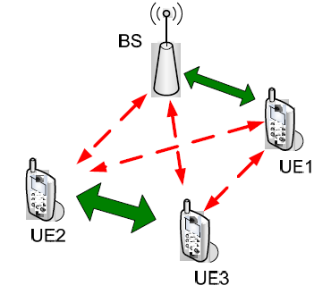
Signal and Interference Model
Resource allocation | Interference
Uplink (UL) | CEL— From: D2D user. To: BS D2D— From: cellular user. To: D2D user
Downlink (DL) | CEL— From: D2D user. To: cellular user D2D— From: BS. To: D2D user
D2D comm. reusing cellular resources. Solid arrows indicate the wanted signals and dashed arrows the interference.

Slide 32
Interference Analysis
D2D networks provides coverage at the customer premises, but radiates toward neighboring mobile users, introducing interference.
Considering that these networks define two separate layers, interference can be classified as follows:
  Cross-layer: This refers to situations in which the aggressor (e.g., a D2D user) and the victim (e.g., a cellular user) of interference belong to different network layers.
  Co-layer: In this case the aggressor (e.g., a D2D user) and the victim (e.g., a neighboring D2D user) belong to the same network layer.
Combating the interference
  Transmitter: Frequency, time, space, power etc, allocation
  Receiver: Signal processing for interference cancelation

Slide 33
Spectrum Sharing
Spectrum sharing as an overlay:
  The D2D users occupies the vacant cellular spectrum for communication.
  This approach that completely eliminates cross-layer interference is to divide the licensed spectrum into two parts (orthogonal channel assignment).
  This way, a fraction of the subchannels would be used by the cellular users while another fraction would be used by the D2D networks.
  Although optimal from a cross-layer interference standpoint, this approach is inefficient in terms of spectrum reuse.
Spectrum sharing as an underlay:
  This scheme allows multiple D2D users to work as an underlay with cellular users, and thus to improve the spectrum efficiency.
  Therefore, co-channel assignment of the cellular and D2D users seems more efficient and profitable for operators, although far more intricate from the technical point of view.

Slide 34

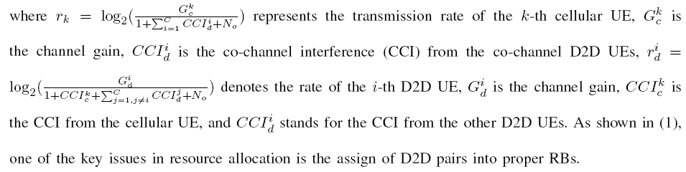
Signal and Interference Model
During the uplink period of the cellular system, both cellular and D2D UEs receive interference as they share the same sub-channels.
During the UL period, the sum rate of the cellular UEs and D2D UEs can be written as

Slide 35
Radio Resource Management (1)
With regards to the underlay approach, to mitigate cross- and co-layer interference, there would be a central entity in charge of intelligently telling each cell which subchannels to use.
This entity would need to collect information from the D2D users, and use it to find an optimal or a good solution within a short period of time.
The presence of large number of D2D users, and the allowance of multiple D2D users coexistence with cellular user makes the optimization problem too complex.
Latency issues arise when trying to facilitate the D2D communication with the central subchannels broker throughout the backhaul.
A distributed approach to mitigate cross- and co-layer interference, where the D2D users can manage their own subchannels, is thus more suitable in this case (i.e., self-organization).

Slide 36
Radio Resource Management (2)
In a non-cooperative solution, i.e. self-organized approach
  each D2D user would plan its subchannels so as to maximize the throughput and QoS for its users.
  this would be done independent of the effects its allocation that might cause to co-channel D2D and cellular users.
In a cooperative approach, i.e. network assisted approach
  the D2D users can gather partial information about subcarrier usage situation.
  may perform its allocation taking into account the effect it would cause to its co-channel neighbors.
  the average cellular and D2D users' throughput and QoS, as well as their global performance can be locally optimized.

Slide 37
Game-theoretic Methods for RRM in D2D-Direct
Given resource allocation methods, corresponding games can be applied.
Global Optimization: Optimize both cellular and D2D users
  Auction game: combinatorial auction
Local Optimization: Given the current cellular networks, optimize D2D users only
  Non-cooperative game
  Stackelberg-type game

Slide 38
Stackelberg-type Game Preliminaries
Leader-follower game
  A hierarchical game with one leader and one/multiple followers.
  The leader acts first.
  The follower observes the leader’s behavior, and decides its own strategy
Solving Stackelberg game
  The leader knows ex ante that the follower observes his action.
  The follower has no means of committing to a future non-Stackelberg follower action and the leader knows this.
  The game can be solved by backward induction.

Slide 39
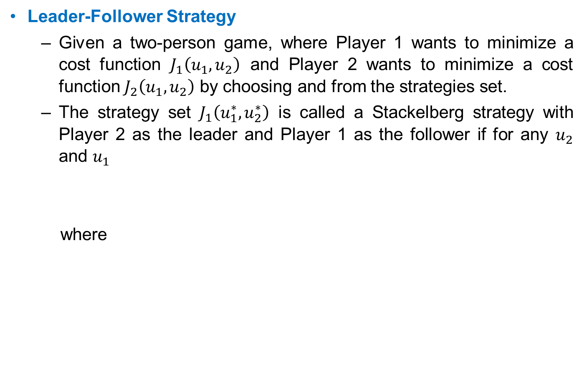
  Stackelberg-type Game Preliminaries
Leader-Follower Strategy
  Given a two-person game, where Player 1 wants to minimize a cost function $J_{1}\left(u_{1},u_{2}\right)$ and Player 2 wants to minimize a cost function $J_{2}\left(u_{1},u_{2}\right)$ by choosing and from the strategies set.
  The strategy set $J_{1}\left(u_{1}^{∗},u_{2}^{∗}\right)$ is called a Stackelberg strategy with Player 2 as the leader and Player 1 as the follower if for any $u_{2}$ and $u_{1}$
  where

Slide 40
Stackelberg-type Game Preliminaries
Applications in D2D Resource Allocation
  Appropriate for classes of system problems consisting of multiple criteria, multiple decision makers, decentralized information, and natural hierarchy of decision making levels.
  To study the interactions between source-destination pairs and cooperative relays.
D2D User as Buyer:
  The buyer-level game
  Aim to achieve the best security performance with the relays/jammers’ help with the least reimbursements to them.
Cellular User as Sellers:
  The seller-level game
  Aim to gains as many profits as possible.

Slide 41
Stackelberg-type Game - Introduction
We employ the Stackelberg game to coordinate the system.
A hierarchical game with a leader and a follower
The leader acts first
The follower observes the leader’s behavior, and determines its own strategy
The leader knows ex ante that the follower will react to the leader’s strategy
Cellular UEs – leaders
D2D UEs – followers
The leader can charge the D2D UE some fees for using the channels, and has the right to decide the price.
The leader has an incentive to share the channel with the D2D UE if it is profitable.
The follower can choose the optimal power to maximize its payoff.

Slide 42
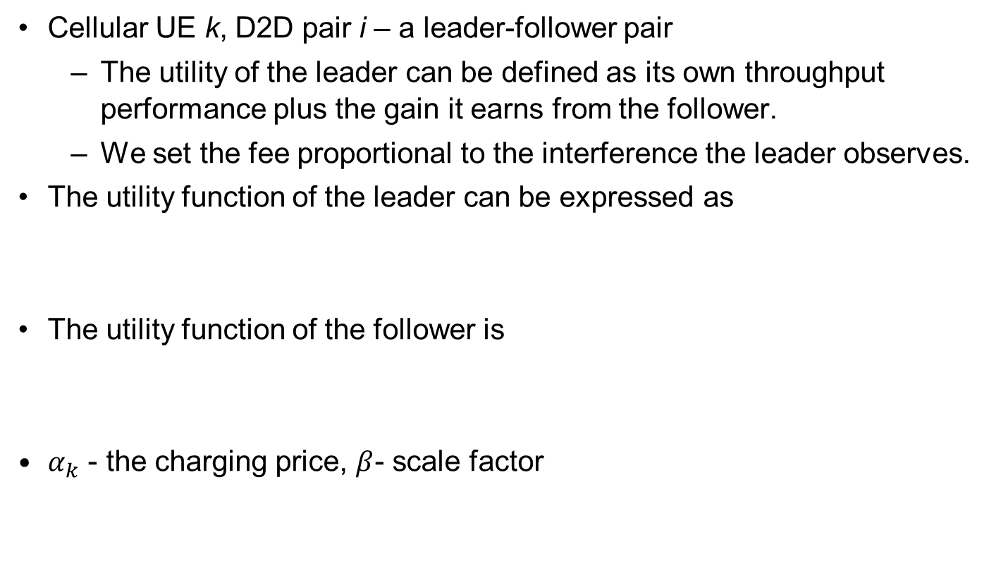
Stackelberg Game – Utility Function
Cellular UE k, D2D pair i – a leader-follower pair
  The utility of the leader can be defined as its own throughput performance plus the gain it earns from the follower.
  We set the fee proportional to the interference the leader observes.
The utility function of the leader can be expressed as
The utility function of the follower is
$α_{k}$ - the charging price, $β$- scale factor

Slide 43
Stackelberg Game – Utility Function
The optimization problem for the leader is to set a charging price that maximizes its utility, i.e.,
The optimization problem for the follower is to set proper transmit power to maximize its utility, i.e.,

Slide 44
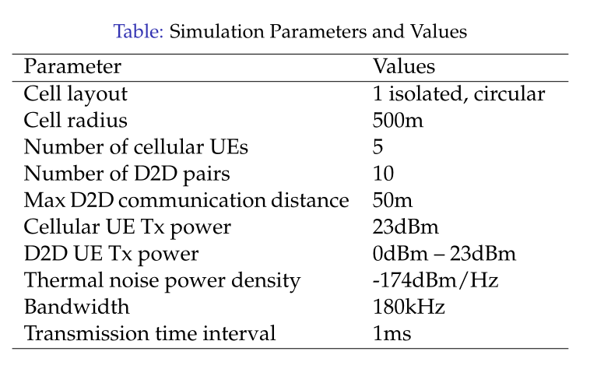
Simulation Results

Slide 45
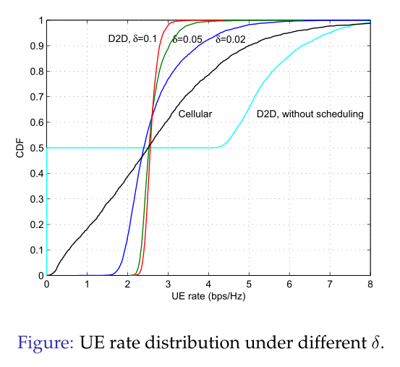
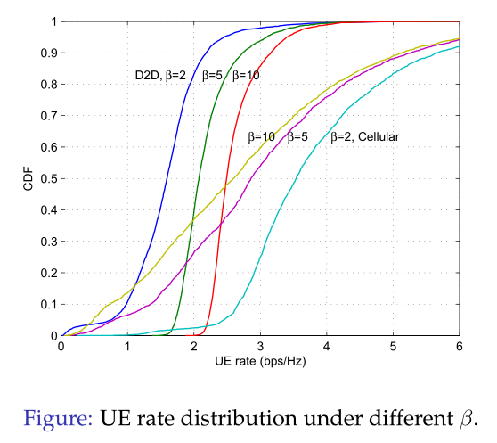
Simulation Results

Slide 46
Game-theoretic Methods for RRM in D2D-Direct
Given resource allocation methods, corresponding games can be applied.
Global Optimization: Optimize both cellular and D2D users
  Auction game: combinatorial auction
Local Optimization: Given the current cellular networks, optimize D2D users only
  Non-cooperative game
  Stackelberg-type game

Slide 47
  Auction Theory Preliminaries (1)
Recently, auction theory (pioneered by Vickrey, etc) has been widely employed in wireless networks to solve the resource allocation issues.
In an auction, each bidder bids for an item, or items, according to a specific mechanism, and the allocation(s) and price(s) for the item, or items, are determined by specific rules.
Auctioneers: The players own resources (spectrum, power, etc) and expect to earn rewards by offering the resources.
Bidders: The players hope to obtain the resources from the auctioneers to improve their performance but in return need to provide some rewards.

Slide 48
  Auction Theory Preliminaries (2)
Various Types:
  Vickrey Auction [Vickrey’1961]
  Ascending Auction [Ausubel’1997, Cramton’1998]
  First Price Auction, Second Price Auction
  Single Object Auction, Multiple Object Auction
  Double Auction (multiple auctioneers and multiple bidders)
  Combinatorial Auction
  Hot Application Scenarios:
  Cognitive Radio Networks (PU as auctioneer and SUs as bidders)
  WLAN (users compete for the transmission resources)
  Cellular Networks (D2D, Femtocell)

Slide 49
Properties of Auctions
Allocative efficiency means that in all these auctions the highest bidder always wins (i.e., there are no reserve prices).
It is desirable for an auction to be computationally efficient.
Revenue Equivalence Theorem: Any two auctions such that:
  The bidder with the highest value wins
  The bidder with the lowest value expects zero profit
  Bidders are risk-neutral 1
  Value distributions are strictly increasing and atomless
have the same revenue and also the same expected profit for each bidder. The theorem can help find some equilibrium strategy.

Slide 50

Design goal and properties
The objective of a mechanism M = (S, g) is to achieve the desired game outcome
Desired properties
  Efficiency: select the outcome that maximizes total utility.
  Fairness: select the outcome that achieves a certain fairness criterion in utility.
  Revenue maximization: select the outcome that maximizes revenue to a seller (or more generally, utility to one of the players).
  Budget-balanced: implement outcomes that have balanced transfers across players.
  Pareto optimality

Slide 51
Combinatorial Auction Preliminaries
In a combinatorial auction, bidders are allowed to place bids on combinations of resources, called “packages”, rather than just individual resource.
Combinatorial auctions motivate bidders to fully express their preferences, which is an advantage in improving system efficiency and auction revenues.
The main problems in combinatorial auctions are winner determination problem (WDP).
Combinatorial auctions (CAs) have been employed in a variety of areas, e.g., truckload transportation, airport arrival and departure slots, as well as wireless communication services.

Slide 52
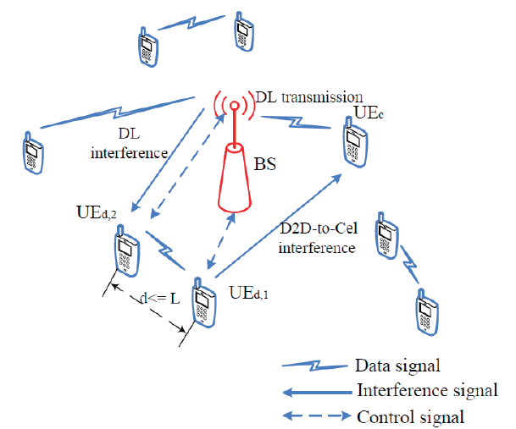
Radio Resource Allocation for Device-to-Device Communication Underlaying Cellular Networks
A single cell environment
Downlink period
Two types of UEs
  Cellular UEs
  D2D UEs
D2D UEs are in pairs
Interference
  BS -> D2D UEs
  D2D -> Cellular UEs
Chen Xu, Lingyang Song, Zhu Han, Qun Zhao, Xiaoli Wang, and Bingli Jiao, “Efficient Resource Allocation for Device-to-Device Underlaying Networks using Combinatorial Auction”, IEEE Journal on Selected Areas in Communications, special issue on “Peer-to-Peer Networks”, Jun. 2012
Chen Xu, Lingyang Song, Zhu Han, Dou Li, and Bingli Jiao, “Resource Allocation Using A Reverse Iterative Combinatorial Auction for Device-to-Device Underlay Cellular Networks,” IEEE Global Communication Conference (Globecom), Anaheim, CA, Dec. 2012.

Slide 53
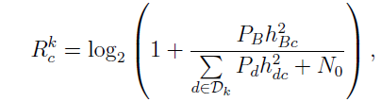
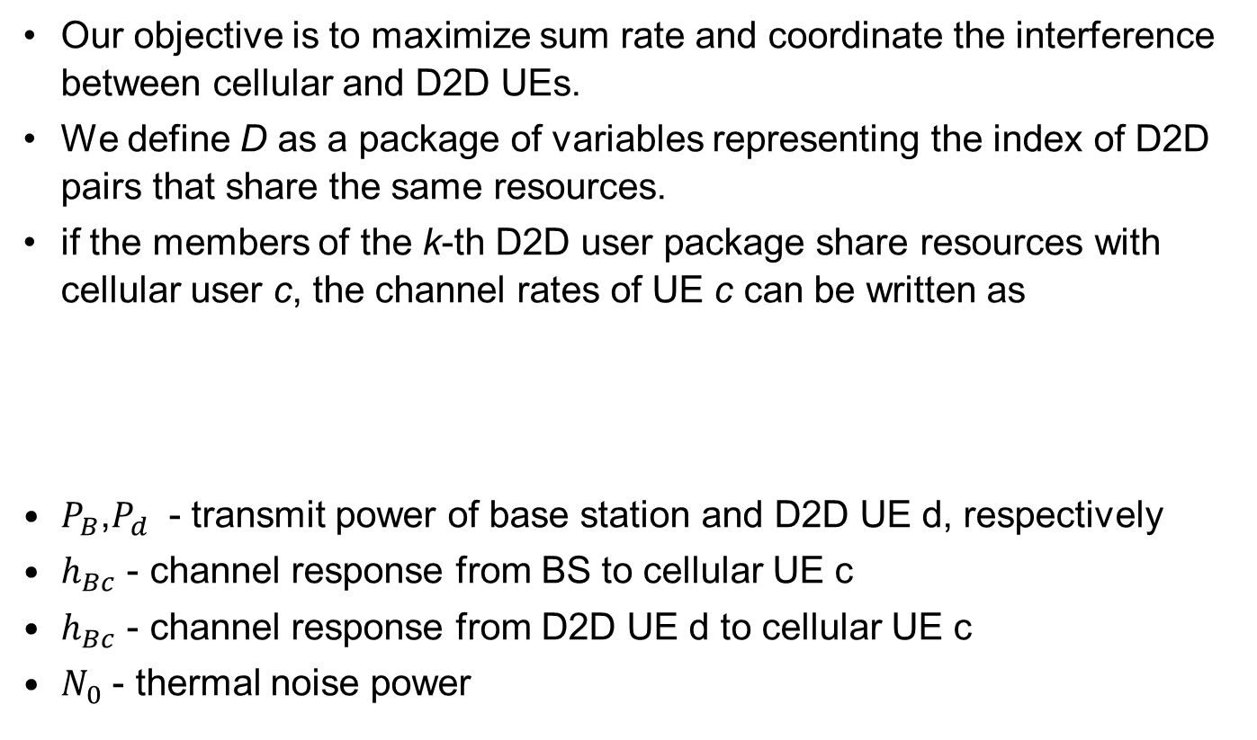
Problem Formulation
Our objective is to maximize sum rate and coordinate the interference between cellular and D2D UEs.
We define D as a package of variables representing the index of D2D pairs that share the same resources.
if the members of the k-thD2D user package share resources with cellular user c, the channel rates of UE c can be written as
$P_{B}$,$P_{d}$ - transmit power of base station and D2D UE d, respectively
$h_{Bc}$ - channel response from BS to cellular UE c
$h_{Bc}$ - channel response from D2D UE d to cellular UE c
$N_{0}$ - thermal noise power

Slide 54
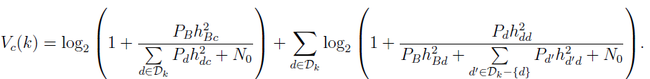


Problem Formulation
When assigning resources of UE c to the k-th package of D2D pairs, the channel rate is given by
The pay price for the k-th package is
p(d) is unit price
The utility function of bidder c for package k is

Slide 55
Resource Allocation Algorithm
Basic ideas
The auction is based on ask prices. We use linear price for its simplicity and efficiency.
Because of the interference from D2D links, cellular channels should guarantee the performance of cellular system. Hence, we consider a descending price criterion in the algorithm.
Prices update by a greedy mode that once a bidder submits a bid for items or packages the corresponding prices are fixed, otherwise the prices are decreased.

Slide 56
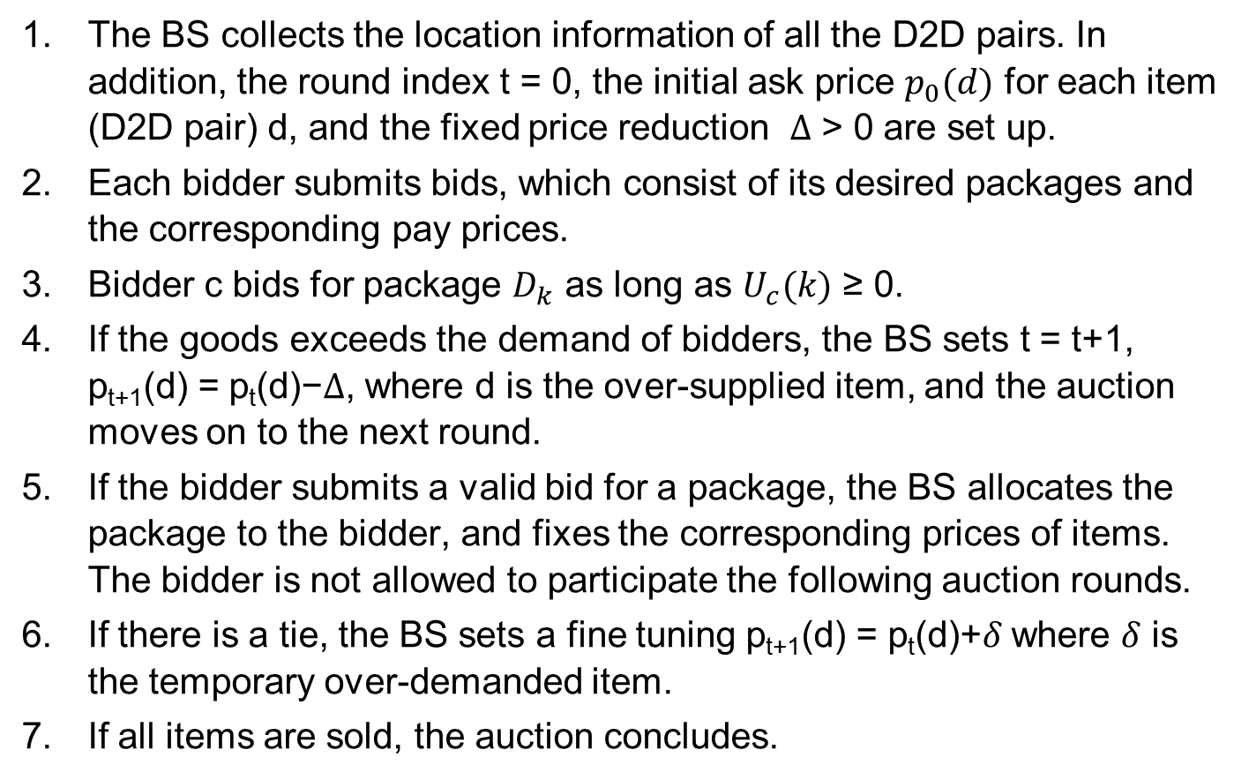
Resource Allocation Algorithm
The BS collects the location information of all the D2D pairs. In addition, the round index t = 0, the initial ask price $p_{0}(d)$for each item (D2D pair) d, and the fixed price reduction $Δ$>0 are set up.
Each bidder submits bids, which consist of its desired packages and the corresponding pay prices.
Bidder c bids for package $D_{k}$as long as $U_{c}(k)$≥ 0.
If the goods exceeds the demand of bidders, the BS sets t = t+1, p_{t+1}(d) = p_{t}(d)−$Δ$, where d is the over-supplied item, and the auction moves on to the next round.
If the bidder submits a valid bid for a package, the BS allocates the package to the bidder, and fixes the corresponding prices of items. The bidder is not allowed to participate the following auction rounds.
If there is a tie, the BS sets a fine tuning p_{t+1}(d) = p_{t}(d)+$δ$where $δ$is the temporary over-demanded item.
If all items are sold, the auction concludes.

Slide 57
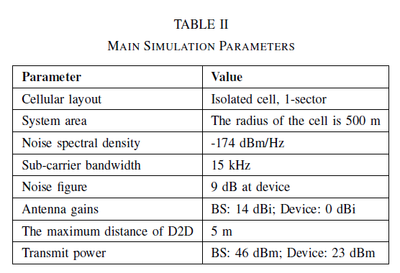
Simulation Parameters

Slide 58
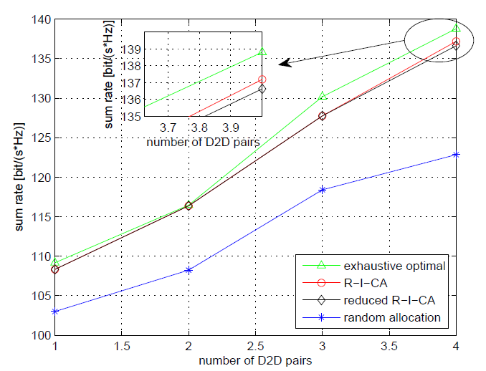
Simulation Results
Figure: System sum rate for different allocation algorithms

Slide 59
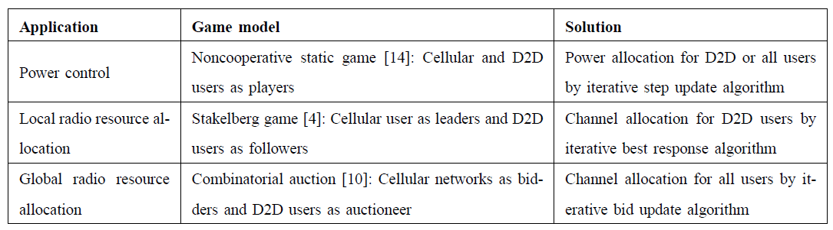
Summary for Game-theoretic RRM in D2D-Direct
Lingyang Song, Dusit Niyato, Zhu Han, and Ekram Hossain, "Game-theoretic Resource Allocation Methods for Device-to-Device (D2D) Communication," appear in IEEE Wireless Communications Magazine, available in arxiv

Slide 60
Game-theoretic Methods for RRM in D2D-LAN
In the non-cooperative approach for D2D direct, each mobile makes individual decisions, which may lead to severe interference.
For resource allocation of group communication and multi-hop relay communication in D2D LANs, cooperative game models will be more suitable.
With a cooperative approach, the mobiles cooperate with each other to maximize its utility function for a better network
MME
S-GW
CN
Cellular
D2D LAN

Slide 61

Coalitional Games Preliminaries
Coalitional game (N,v)
  A set of players N, a coalition S is a group of cooperating players
  Value (utility) of a coalition v
  User payoff x_{i} : the portion received by a player i in a coalition S
Transferable utility (TU)
  The worth v(S) of a coalition S can be distributed arbitrarily among the players in a coalition hence,
  v(S) is a function over the real line
Non-transferable utility (NTU)
  The payoff that a user receives in a coalition is pre-determined, and hence the value of a coalition cannot be described by a function
  v(S) is a set of payoff vectors that the players in S can achieve

Slide 62
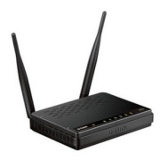



Joint Spectrum Sensing and Channel Access for Collaborative Data Dissemination
Emerging technology which provides applications ranging from traffic safety, traffic efficiency to infotainment.
V2R : Vehicle-to-Roadside communication
V2V : Vehicle-to-Vehicle communication
OBU : On-Board Units equipped by vehicles
RSU : Road-side Units equipped by infrastructure
V2R
V2R
V2V
V2V
Tianyu Wang, Lingyang Song, and Zhu Han, “Popular Content Distribution in CR-VANETs with Joint Spectrum Sensing and Channel Access” IEEE Journal on Selected Areas in Communications, special issue “on Emergying Technologies” , Jun. 2012
Tianyu Wang, Lingyang Song, and Zhu Han, “Joint Spectrum Sensing and Channel Access for Collaborative Data Dissemination in Cognitive VANETs”, 7th International Conference on Communications and Networking in China (ChinaCom2012), Kunming, People‘s Republic of China, Aug. 8-10, 2012 Best Student Paper Award
Notes:
Vehicular communication is one of the emerging wireless technology whose sole aim is to provide safety and efficiency in the intelligence transportation systems. Now-a-days, VANETs can also provide content downloading services, which covers videos, audios and software.
Vehicular Communication system consists of two major units known as Road Side Unit which is usually fixed and On-board Unit which is usually mobile and is located in the vehicles. The communication between Road-side Unit and On-board Unit is known as Vehicle-to-Roadside communication (V2R) and the communication between On-Board Units is known as Vehicle-to-Vehicle communication (V2V) communication.

Slide 63
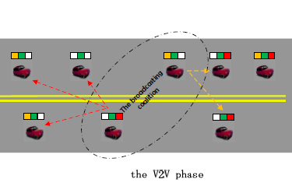
System Model
CR-VANET: N OBUs engaged in sensing one PU channel, M packets for dissemination.
Notes:
We consider the V2V phase of the hybrid solution for PCD in CR-VANETs. There are N OBUs in the network and M packets for dissemination. Each OBU initially possesses only part of the entire content, and need to exchange packets with others. As secondary users, OBUs sense the only PU channel, cooperatively or non-cooperatively, and then access the spectrum when it is unoccupied. The PU data is modeled as a Poisson process with arriving rate lambda. The initial possessed packets of each OBU is randomly distributed among the M packets.

Slide 64

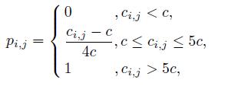
System Model
V2V channel capacity
Each OBU broadcasts at most one packet in each slot, with the probability of success
Notes:
We divide the V2V phase into slots, and in each slot the V2V channel is assumed to be static. We assume the broadcasted packets can only be received only when a line of sight exists between the transmitter and receiver. Here, we only consider the path-loss without any small-scale fading, and the V2V channel capacity is given by. In each slot, we assume each OBU broadcasts at most one packet, with the probability of success given by. The probability of success is assumed to be proportional to the channel capacity.

Slide 65


Cooperative scheme
Cooperative spectrum sensing (OR-rule)
  Probability of missing detection :
  Probability of false detection:
Coordinated spectrum access
  Which OBUs to access? coalition formation game
Greedy packet selection
  Broadcast the most wanted packets.
Notes:
For improving the total performance from the three aspects, we propose the cooperative scheme, in which cooperation among OBUs are introduced. In the cooperative, the broadcasting OBUs, the set of which is denoted by S, cooperatively sense the PU channel, and access the spectrum by broadcasting the most wanted packets of its neighbors. Note that it is easy to know which is most wanted by neighbors if communication between OBUs are allowed. The question is how to decide S?

Slide 66




Coalition Formation Game
Throughput with no collision to the PU
Throughput with collisions to the PU
Cost function
Value function
Notes:
The utility of each OBU is not only decided by its own decision, but also the decisions of other vehicles. For example, if node A successfully broadcast packet x to 2 neighbors lacking x, the corresponding utility is 2. However, if one of A’s neighbor B also received signal from C in the same slot, the hidden terminal problem, then B can not achieve any useful data, which decrease A’s utility to 1. Thus, the utility should not be individually defined, but should be a function of the set of all broadcasting OBUs, or we say, the broadcasting coalition. Also, the cooperation among OBUs needs overhead information, which should be formulated as a cost function. We assume the cost is a linear with the coalition size.
Explain the meaning of each equation and variables.

Slide 67

Coalition Formation Game
Preferences for merging and splitting
Algorithm for coalition formation:
Initial partition in which each OBU forms a coalition
Iterations of merging and splitting based on preferences
final partition
Notes:
We say i prefers S1 rather than S2, if Vi(S1)>Vi(S2) and S1 belongs to A(i), which is the set of those coalitions that welcomes i’s joining, or equally every other member’s value is increased or at least maintained by I’s joining.
This definition implies that OBU i prefers being a member of S1 over S2 only when OBU i gains an increase in individual
profit and meanwhile no other OBUs in S1 suffers a decrease because of OBU i’s joining.
Except for the overhead information, the coalition formation algorithm is accomplished in distributed manner. The result is a final partition where no OBU has the willing to switch to another coalition, which is therefore Nash-stable.
Among all the coalition in the final partition, the one with the highest sum value, which implies the highest throughput, will access the sepctrum by broadcasting their most wanted segments.

Slide 68
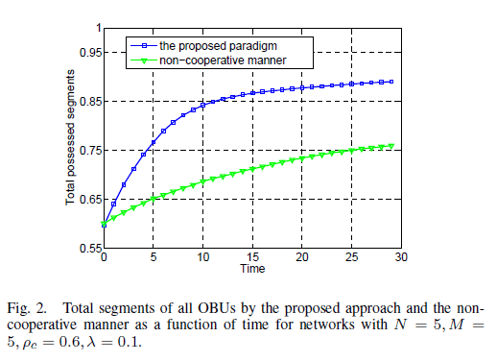
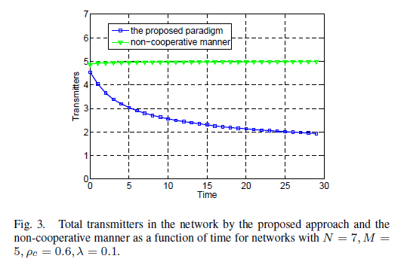
Simulation Results

Slide 69
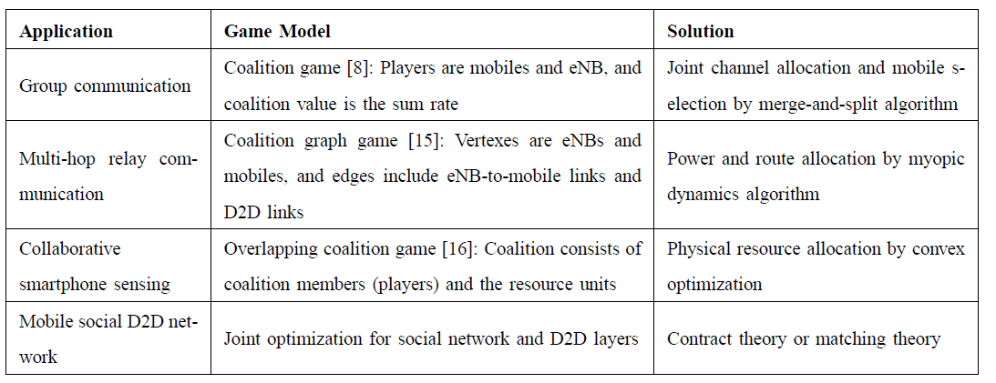
Summary for Game-theoretic RRM in D2D-LAN

Slide 70
Conclusions
D2D and D2D-LAN Communications:
  Can perform BS-controlled short-range direct data transmission for local area services;
  Can share the resources with traditional cellular communications;
  Improved network spectral efficiency;
  Enhanced local user throughput;
Game theory can be readily used:
  Non-cooperative game
  Dynamic game
  Cooperative game
  Auction theory
Many applications in the frame work of D2D-LAN such as VANET and MSN can be easily integrated.

Slide 71
References
Books
Chen Xu, Lingyang Song, and Zhu Han, “Resource Management for Device-to-Device Underlay Communication”, Springer Briefs in Computer Science, 2014.
Tutorial and Survey
Lingyang Song and Zhu Han, “Resource Allocation for Device-to-Device Communications,” IEEE International Conference on Communications in China (ICCC 2013), Xi’ An, Aug. 2013
Lingyang Song and Zhu Han, “Device-to-Device Communications and Networks,” IEEE Globe Communication Conference (Globecom), Atlanta, USA, Dec. 2013.
Lingyang Song, Dusit Niyato, Zhu Han, and Ekram Hossain, "Game-theoretic Resource Allocation Methods for Device-to-Device (D2D) Communication," appear in IEEE Wireless Communications Magazine.
Papers
Tianyu Wang, Lingyang Song, and Zhu Han, “Coalitional Graph Games for Popular Content Distribution in Cognitive Radio VANETs,” to appear, IEEE Transactions on Vehicular Technologies, special issue “on Graph Theory and Its Application in Vehicular Networking”
Chen Xu, Lingyang Song, Zhu Han, Qun Zhao, Xiaoli Wang, and Bingli Jiao, “Efficient Resource Allocation for Device-to-Device Underlaying Networks using Combinatorial Auction”, to appear, IEEE Journal on Selected Areas in Communications, special issue “on Peer-to-Peer Networks”
Tianyu Wang, Lingyang Song, Zhu Han, and Bingli Jiao “Popular Content Distribution in CR-VANETs with Joint Spectrum Sensing and Channel Access” to appear, IEEE Journal on Selected Areas in Communications, special issue “on Emerging Technologies”

Slide 72
References
Feiran Wang, Chen Xu, Lingyang Song, Qun Zhao, Xiaoli Wang, and Zhu Han, “Energy-Aware Resource Allocation for Device-to-Device Underlay Communication," IEEE International Conference on Communications, Budapest, Hungary, June 2013.
Rongqing Zhang, Lingyang Song, Zhu Han, Xiang Cheng, and Bingli Jiao, “Distributed Resource Allocation for Device-to-Device Communications Underlaying Cellular Networks," IEEE International Conference on Communications, Budapest, Hungary, June 2013.
Feiran Wang, Lingyang Song, Zhu Han, Qun Zhao, Xiaoli Wang, “Joint Scheduling and Resource Allocation for Device-to-Device Underlay Communication,” 2013 IEEE Wireless Communications and Networking Conference (WCNC), Shanghai China, Apr. 2013.
Feiran Wang, Chen Xu, Lingyang Song, Zhu Han, and Baoxian Zhang, “Energy-Efficient Radio Resource and Power Allocation for Device-to-Device Communication Underlaying Cellular Networks,” The IEEE International Conference on Wireless Communications and Signal Processing (WCSP), Anwei,China, Otc. 25 - 27, 2012.
Chen Xu, Lingyang Song, Zhu Han, Dou Li, and Bingli Jiao, “Resource Allocation Using A Reverse Iterative Combinatorial Auction for Device-to-Device Underlay Cellular Networks,” IEEE Globe Communication Conference (Globecom), Los Angels, USA, Dec. 2012.
Chen Xu, Lingyang Song, Zhu Han, Qun Zhao, Xiaoli Wang, and Bingli Jiao, “Interference-Aware Resource Allocation for Device-to-Device Communications as an Underlay Using Sequential Second Price Auction," IEEE International Conference on Communications (ICC), Ottawa, Canada, Jun. 2012.
Yanru Zhang, Lingyang Song, Walid Saad, Zaher Dawy, and Zhu Han, “Exploring Social Ties for Enhanced Device-to-Device Communications in Wireless Networks,” IEEE Globe Communication Conference (Globecom), Atlanta, USA, Dec. 2013.

Slide 73
Game-theoretic Methods for Full-duplex Communications
Lingyang Song* and Zhu Han⁺
* School of Electronics Engineering and Computer Science,
Peking University, Beijing, China
⁺ Department of Electrical and Computer Engineering
University of Houston, Houston, TX, USA
Full-duplex communication website:
http://wireless.pku.edu.cn/home/songly/fd.html

Slide 74
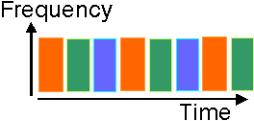
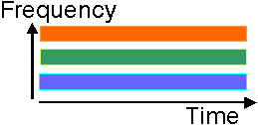
Background of Full-Duplex Techniques
Traditional half duplex: using orthogonal resources
  Time-division duplex
  Frequency-division duplex
Problems
  The orthogonal resources are allocated for reception and transmission.
Solutions
  The same resources are allocated for reception and
  transmission
Fig. 3 Time-division duplex
Fig. 4 Frequency-division duplex
Spectral loss
Full-duplex
Comms

Slide 75
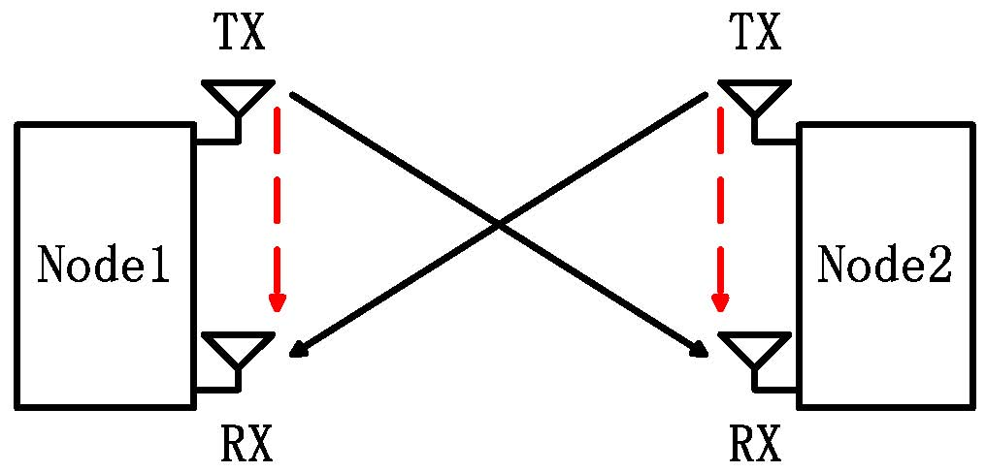
Full Duplex Introduction
A full duplex system allows communication at the same time and frequency resources.
Advantages
  High spectral efficiency
    Same time & same frequency band
  Low cost
    Readily use the existing MIMO radios
    Hardware advancement, etc
: Signal of interest
: Self interference
Fig. 5 Full duplex communication

Slide 76
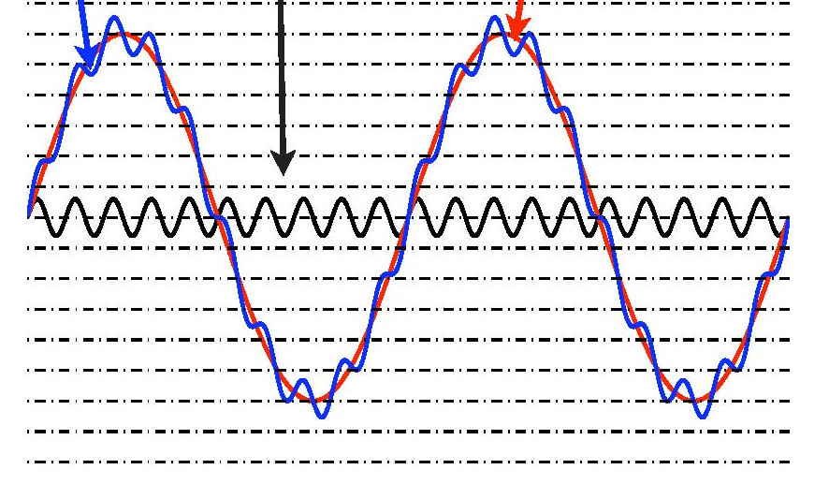

Main Challenges
Traditional Challenges
  Very large self interference
    50-110dB larger than signal of interest
    Depending on inter-node distance
  ADC is the bottleneck
    Limited dynamic range: saturation distortion.
    Limited precision: signal of interest is less than noise.
      For 12 bit ADC, INR(dB) > SNR(dB) + 35 dB implies self interference is too strong
Need to reduce interference before ADC
Received signal
Signal of interest
Self interference
Fig. 6 Very large Self interference
Fig. 7 Signal after quantization

Slide 77



Main Application Scenarios
Full-Duplex Distributed Communication Systems
  Two-node bi-directional MIMO system
  FD random access network
Centralized Full-Duplex Communication Systems
  Full-duplex relay network
    DF relay
    AF relay
    Two-way relay
  Full-duplex wireless network
    FD cellular network
    FD HetNet

Slide 78
Useful info for Research on FD Comms
Full-duplex communication website
  http://wireless.pku.edu.cn/home/songly/fd.html
    Tutorial and survey, books, technical papers, standardization…
Books
  Yun Liao, Tianyu Wang, Lingyang Song, and Zhu Han, “Listen-and-Talk: Full-Duplex Cognitive Radio,” in contract with SpringerBieft.
  Lingyang Song, Risto Wichman, Yonghui Li, and Zhu Han, “Full-Duplex Communications and Networks,” in contract with Cambridge University Press, UK.
  Tutorials
  Lingyang Song and Zhu Han, “Resource Allocation for Full-Duplex Wireless Communication and Networks,” IEEE International Conference on Communications (ICC), London, UK, Jun. 2015
  Lingyang Song and Zhu Han, “Full-Duplex Wireless Communication and Networks: Key Technologies and Applications,” IEEE International Conference on Communications in China (ICCC 2014), Shanghai, China, Oct. 2014

Slide 79

Full-Duplex Communication: Signal Model
It presents a two-node full-duplex system, where each node
  transmits signal xi, i = 1, 2 to the other
  has one antenna for transmission with another for reception
  concurrently transmit sand receive s the signals at the same frequency carrier and time interval

Slide 80


Full-Duplex Communication: Signal Model
Each source receives a combination of the signal transmitted by the other source, the RSI, and noise
The instantaneous SINR at source i’s receiver for full-duplex is
The RSI depends largely on the transmit power, and also varies due to the practical constraint.
The values of |h_{ji}|², |h_{ii}|², and P_{s} have strong impact on SINR, which will affect the system performance significantly.
Thus, proper resource allocation that can further reduce the effects of residual self-interference is crucial for full-duplex communication.

Slide 81


Matching Theory: Introduction
The Nobel Prize in Economic Sciences 2012
Lloyd S. Shapley
  Developed the theory in the 1960s
Alvin E. Roth
Generated further analytical
development
practical design of market institutions

Slide 82
Matching Theory: Introduction
Definition on Wikipedia
  A mathematical framework attempting to describe the formation of mutually beneficial relationships over time.
Where is it used
  The U.S. National Resident Matching Program (NRMP) for medical school graduates
  Public schools in Boston and NYC
  Many medical and other labor markets across

Slide 83
Classification
Bipartite matching problem with two-sided preferences
  One-to-one (stable marriage)
  One-to-many (College admission)
Bipartite matching problem with one-sided preferences
  Campus housing allocation
  Assign reviewers to papers
Non-bipartite matching problem with preferences
  Many-to-many (Create partnership in P2P network)

Slide 84
Stable Marriage Problem (SM)
women and men be matched
respecting their individual preferences
Fran
Adam
Geeta
Bob
Carl
Heiki
David
Irina

Slide 85


Stable Marriage Problem (SM)
Definitions
  Preference list:
    Strictly orders all members of the opposite sex
    If a man m prefers w₁ to w₂, we write
  A matching μ
Blocking pair

Slide 86
Blocking Pair
X
Adam
Geeta
David
Heiki
Geeta prefers Carl to Adam!
Blocking Pair
X
Bob
Irina
Carl
Fran
Carl likes Geeta better than Fran!

Slide 87
Stable Matching
Adam
Heiki
David
Irina
Unfortunately,
Irina loves David better!
Stable Matching: a matching without blocking pairs
Bob and Irina are not a blocking pair
Bob
Fran
Carl
Geeta
Bob likes Irina better than Fran!

Slide 88
Algorithms
How can we find a stable matching?
  many approaches (minimizing sum/ max of ranks, minimizing difference of total ranks, Gale and Shapley algorithm, linear programming)
  Most popular: Deferred acceptance or GS algorithm
GS algorithm
    National Resident matching program (NRMP) in US since 1997
    Higher education admission in China, Germany, Hungary, Spain and Turkey
    Online dating in US

Slide 89
Gale-Shapley (GS) Algorithm
The Gale-Shapley algorithm can be set up in two alternative ways:
  men propose to women
  women propose to men
Each man proposing to the woman he likes the best
  Each woman looks at the different proposals she has received (if any)
  retains what she regards as the most attractive proposal (but defers from accepting it) and rejects the others
The men who were rejected in the first round
  Propose to their second-best choices
  The women again keep their best offer and reject the rest
Continues until no men want to make any further proposals
Each of the women then accepts the proposal she holds
The process comes to an end

Slide 90
GS Algorithm
Geeta, Heiki, Irina, Fran
Adam, Bob, Carl, David
Adam
Fran
Irina, Fran, Heiki, Geeta
Carl, David, Bob, Adam
Bob
Geeta
Geeta, Fran, Heiki, Irina
Carl, Bob, David, Adam
Carl
Heiki
Irina, Heiki, Geeta, Fran
Adam, Carl, David, Bob
David
Irina

Slide 91
GS Algorithm
Geeta, Heiki, Irina, Fran
Adam
Fran
Carl > Adam
Irina, Fran, Heiki, Geeta
This is a stable matching
Geeta
Bob
Geeta, Fran, Heiki, Irina
Carl
Heiki
Irina, Heiki, Geeta, Fran
David > Bob
David
Irina

Slide 92
Resource Allocation in FD Cellular Networks

Slide 93

System Model
One BS, M transmitters (TXs), M receivers (RXs), and K subcarriers
A transceiver unit
  A base station, a
  transmitter and a receiver
Self interference between
antennas
Transceiver-subcarrier pairing
  One TX can only be paired with one RX
  One subcarrier can only be paired with one TX-RX pair
The transmit power of the BS is fixed
Fig. 1: System Model
Boya Di, Siavash Bayat, Lingyang Song, and Yonghui Li, “Radio Resource Allocation for Full-Duplex OFDMA Networks Using Matching Theory,” IEEE INFOCOM - Student Activities (Posters), Toronto, Canada, May, 2014.
Lingyang Song, Yonghui Li, and Zhu Han, “Resource Allocation in Full-Duplex Communications for Future Wireless Networks,” to appear, IEEE Wireless Communications Magazine [arxiv: http://arxiv.org/abs/1505.02911]

Slide 94


System Model
Optimization problem
the transmitter power allocated to the pair
Constraints
Each TX can only be paired with one RX and vice versa
Each subcarrier can only be assigned to one transceiver unit and vice versa
The total transmit power of the BS is subject to its peak power constraint P_{s}

Slide 95
Matching Formulation
Objective: matching the TXs, RXs, and subcarriers to each other and adjust the BS power level in each subcarrier such that the total network’s sum-rate is maximized.
Defining a subcarrier-RX (SR) unit that consists of one subcarrier and one RX.
Matching: M TXs on one side and M×K SR units on the other side.
Stability: there is no pair consisting of any TX_{i} and any SR unit such that they prefer other combinations over their current ones.

Slide 96

Proposed Algorithm
First the BS allocates equal power levels to all the transceiver units.
Define a price for each SR unit and set the price to 0.
Unmatched TX_{i} proposes to its most preferred SR_{k,j}
Matching: when RX_{j} and subcarrier k both receive only one offer, which comes from TX_{i}, they will be matched together.
The conflict part raises its price each iteration.
Ending: the bid and matching continues until there is no one willing to make new offers.
Fig 2: One-to-one matching algorithm

Slide 97

Simulation Results
Random matching algorithm:
the TXs, the RXs, and
subcarriers are randomly
matched with each other
Complexity level: the
iteration number is much
smaller than that of the
centralized algorithm
The performance is close to
the centralized algorithm
Performs much better than the random algorithm
Fig. 3: Total sum-rate vs. transmitted power of each user p_{u}

Slide 98
Resource Allocation in FD Cognitive Networks

Slide 99


CR Preliminaries (1): Background
However…
Densely allocated
Low utilization efficiency
Broadcast TV band
We are now consuming much more data and demanding much higher data rate.
Increasing demand on spectrum resources.
US Spectrum Allocation Policy
Notes:
近年来，随着无线通信的发展，人们对移动数据业务的需求量越来越大，对其传输速率的要求也越来越高

Slide 100

CR Preliminaries (2): Solution
Cognitive Radio (CR) was proposed for promoting the utilization efficiency of spectrum by exploiting the existence of spectrum holes.

Slide 101
CR Preliminaries (3): Main Problems
How to find the spectrum holes?
  Spectrum sensing
      Detection of spectrum holes in some interested band;
      Collection of the changing information of the external wireless environment periodically;
      transmitter detection / receiver detection / cooperative sensing
  How to allocate and share the spectrum resource?
  Spectrum allocation and sharing
      Promotion of the utilization efficiency of spectrum;
      Most research is base on spectrum pooling policy;

Slide 102
CR Preliminaries (4): Spectrum Allocation
The basic idea of spectrum allocation between primary users (PUs) and secondary users (SUs) in CR is to open licensed spectrum to secondary users while limiting the interference perceived by primary users.
Severe constraints on the transmission power of secondary users so that they operate below the noise floor of primary users.
Underlay Approach
Spectrum
Allocation
Overlay Approach
Spectrum sensing is necessary in overlay to detect the spatial, temporal and spectral holes.

Slide 103
Conventional CR: Listen-before-Talk Protocol
LBT protocol:
  SUs sense the spectrum before transmission
  Sensing and transmission separate in time domain
Main problems:
  Discontinuous transmission
    Can never fully utilize spectrum holes for transmission
  Discontinuous sensing
    Inevitable collision and spectrum waste

Slide 104
FD CR: Listen-and-Talk Protocol
Listen-and-talk (LAT) protocol
  FD CR transmitters simultaneously sense and transmit on the vacant spectrum.
  Ant₁ of SU₁ senses the spectrum, while Ant₂ transmits if a spectrum hole is detected simultaneously.
  Sensing result of one slot determines SU’s activity in the next slot.
Y. Liao, L. Song, Z. Han, and Y. Li, “Full-Duplex Cognitive Radio: A New Design Paradigm for Enhancing Spectrum Usage,” IEEE Communications Magazine, vol. 53, no. 5, pp. 138-145, May 2015.
Y. Liao, T. Wang, L. Song, and Z. Han, “Full-duplex Cognitive Radio Networks: Protocol Design and Performance Analysis,” IEEE Transactions on Vehicular Technology (TVT).
Y. Liao, T. Wang, L. Song, and Z. Han, “Listen-and-Talk: Full-duplex Cognitive Radio Networks,” in Proc. IEEE Globecom’14, Austin, TX, Dec. 2014. best paper award

Slide 105


FD Cognitive Cellular Network: System Model
One primary user with K orthogonal channels, each of which is occupied with probabilities $P_{on}$.
One SBS with total power constraint of P, N secondary users, and we assume each SU can occupy at most one channel.
T. Wang, Y. Liao, B. Zhang, and L. Song, “Joint Spectrum Access and Power Allocation in Full-Duplex Cognitive Cellular Networks,” in IEEE International Communications Conference 2015 (ICC’15), London, UK, Jun. 2015.

Slide 106


Problem Formulation (1)
Joint Spectrum Access and Power Allocation
The SBS senses the k-th channel and decides its state $\{β_{k}\}$, where $β_{k}=0$ represents the channel is occupied and $β_{k}=1$ represents the channel is ideal.
Spectrum Sensing in Full-duplex Cognitive Radio
The SBS decides the spectrum access strategy of SUs, which is denoted by $\{α_{k,n}\}$, where $α_{k,n}=1$ represents SU n uses channel k, and $α_{k,n}=0$ the opposite.
The SBS decides the power allocation, where $P_{k}$ represents the transmit power of the k-th channel.
Resource allocation problem

Slide 107





Problem Formulation (2)
Joint Spectrum Access and Power Allocation
$$\max_{α_{k,n},p_{k} }{\sum_{k=1}^{K}{\sum_{n−1}^{N}{β_{k}}α_{k,n}\left(1−P_{k}^{f}\right)\log{(1+\frac{P_{k}{\left|h_{k,n}\right|}^{2}}{σ^{2}})}}}$$
s.t. $P_{k}^{m}≤P_{0}^{m}, k=1,2,…,K$
$$\sum_{k=1}^{K}{P_{k}}≤P$$
(1)
$$\sum_{k=1}^{K}{α_{k,n}}≤1, n=1,2,…,N$$
$$\sum_{n=1}^{N}{α_{k,n}}≤1, k=1,2,…,K$$
Notes:
Here is the subjective function and the constraints.
What we want is to maximize the total throughput of the secondary network.
Condition 1: the miss detection probability can not exceed a certain threshold to ensure PU’s outage probability constraint.
Condition 2: the sum of transmit power on each channel must satisfy the total power constraint
Condition 3: ensures that each SU can occupy at most one channel
Condition 4: ensures that each channel is exclusively occupied by at most one SU

Slide 108
Matching Formation and Algorithm (1)
Problem (1) as 3-Dimensional Matching – NP hard
M. R. Garey and D. S. Johnson, Computers and Intractability: A Guide to the Theory of NP-Completeness, San Francisco, CA: W. H. Freeman and Company, 1979.
108
Notes:
X channels, Y secondary users, Z transmit powers, w(x,y,z) is the secondary throughput of SU y on channel x with transmit power z. The optimal solution of (1) is to find the optimal 3d matching in this graph theory problem, which is NP-hard as shown in [2].

Slide 109

Matching Formation and Algorithm (2)
Opt
M power units
Opt
$$w_{k,n}\left(P_{k}\right)=β_{k}\left[1−P_{k}^{f}\left(P_{k},λ^{∗}\right)\right]\log{(1+\frac{P_{k}{\left|h_{k,n}\right|}^{2}}{σ^{2}})}$$
3D matching → 2D matching problem
109
Notes:
The idea is to divide the total power into M discrete units with each unit Δ = P/M, and iteratively allocate the discrete units to the channels.
In each iteration, one power unit is added to the channel that generates the largest marginal throughput of the current SU, and then, the 2-dimensional matching method is performed to optimize the spectrum access strategy with the new power allocation.
The algorithm stops when all power units are allocated or there is no channel-user pair that can increase its secondary throughput by increasing the transmit power.
The weight of each pair can be given by the following function, where lambda^* is the optimal sensing threshold.

Slide 110

Simulations (1)
We consider the proposed algorithm, compared with the random algorithm and greedy algorithm.
In the random algorithm, the SBS randomly chooses an SU for each idle channel.
In the greedy algorithm, the SBS sequentially chooses the optimal SU for each idle channel.

Slide 111


Simulations (2)
Throughput vs. SU number N
Throughput vs. transmit power P

Slide 112


Simulations (3)
Throughput as a function of power unit size $Δ$

Slide 113
Resource Allocation Problem Summary (1)
Mode Switch
  Half-duplex radio
    Due the limited size of transmitter and receiver, many wireless communication systems suffer from the spatial correlation which degrades the performance gain of HD mode.
  Full-duplex radio
    It allows a node to send and receive signals at the same time in the same frequency band.
    However, it is practically impossible to have perfect self interference cancelation, and thus, the amount of RSI greatly affects the performance of FD system.
    As a result, in some scenarios, the HD mode may outperform the FD mode for certain RSI values.
This motivates the adaptive mode switching between the FD and HD modes based on the RSI and channel conditions to maximize the ergodic capacity.

Slide 114
Resource Allocation Problem Summary (2)
Power Control
  due to RSI, power control algorithm needs to be properly redesigned in order to maximize system performance of all users.
    FD-MIMO:
      The antennas at the FD node are divided into transmit and receive antenna sets
      Water-filling power allocation can be applied at the transmit antenna set to maximize the sum rate based on individual power constraint.
    FD-Relay:
      In FD-Relay networks with individual power constraint at each relay, the relayed signals are corrupted by the RSI,
      Power allocation can be considered to reduce RSI subject to total and individual power constraints

Slide 115
References
Lingyang Song, Yonghui Li, and Zhu Han, “Resource Allocation in Full-Duplex Communications for Future Wireless Networks,” to appear, IEEE Wireless Communications Magazine [arxiv: http://arxiv.org/abs/1505.02911]
Mingxin Zhou, Lingyang Song, Yonghui Li, and Xuelong Li, “Simultaneous Bidirectional Link Selection in Full Duplex MIMO Systems,” to appear, IEEE Transactions on Wireless Communications.
Kun Yang, Hongyu Cui, Lingyang Song, and Yonghui Li, “Efficient Full-Duplex Relaying with Joint Antenna-Relay Selection and Self-Interference Suppression,” to appear, IEEE Transactions on Wireless Communications.
Yun Liao, Lingyang Song, Yonghui Li, and Zhu Han, “Full-Duplex Cognitive Radio: A New Design Paradigm for Enhancing Spectrum Usage,” to appear, IEEE Communications Magazine, vol. 53, no. 5, pp. 138-145, May 2015. [arxiv: http://arxiv.org/abs/1503.03954]
Hongyu Cui, Lingyang Song, and Bingli Jiao, “Relay Selection for Two-Way Full Duplex Relay Networks with Amplify-and-Forward Protocol,” IEEE Transactions on Wireless Communications, vol. 13, no. 7, pp. 3768-3876, Jul. 2014.
Mingxin Zhou, Hongyu Cui, Lingyang Song, and Bingli Jiao, “Transmit-Receive Antenna Pair Selection in Full Duplex Systems,” IEEE Wireless Communications Letters, vol. 3, no. 1, pp. 34-37, Feb. 2014
Kun Yang, Hongyu Cui, Lingyang Song, and Yonghui Li, “Joint Relay and Antenna Selection for Full-Duplex AF Relay Networks,” IEEE International Conference on Communications, Sydney, Australia, Jun. 2013. Extended version will appear in TWC.
Boya Di, Siavash Bayat, Lingyang Song, and Yonghui Li, “Radio Resource Allocation for Full-Duplex OFDMA Networks Using Matching Theory,” 2014 IEEE INFOCOM - Student Activities (Posters), Toronto, Canada, May, 2014.
Radwa Sultan, Lingyang Song, and Zhu Han, “Impact of Full Duplex on Resource Allocation for Small Cell Networks,” The IEEE Global Conference on Signal and Information Processing (GlobalSIP), December 3-5, 2014. Atlanta, Georgia, USA.
Yun Liao, Tianyu Wang, Lingyang Song,ang Zhu Han, “Listen-and-Talk: Full-duplex Cognitive Networks”, IEEE Globecom Conference, Austin, Tx, Dec. 2014. [Best paper award]
Yun Liao, Tianyu Wang, Lingyang Song, and Zhu Han, “Cooperative Spectrum Sensing for Full-Duplex Cognitive Radio Networks,” 14th IEEE International Conference on Communication Systems (ICCS), Macau, Nov. 2014.
Liao Yun, Tianyu Wang, Kaigui Bian, Lingyang Song and Zhu Han, “Decentralized Dynamic Spectrum Access in Full-Duplex Cognitive Radio Networks,” IEEE International Conference on Communications (ICC), London, UK, June 2015. [Best paper award]
Tianyu Wang, Yun Liao, Baoxian Zhang, and Lingyang Song, “Joint Spectrum Access and Power Allocation in Full-Duplex Cognitive Cellular Networks,” IEEE International Conference on Communications (ICC), London, UK, June 2015.
Yun Liao, Kaigui Bian, Lingyang Song and Zhu Han, “Full-duplex WiFi: Achieving Simultaneous Sensing and Transmission for Future Wireless Networks,” ACM Mobihoc (poster), Hangzhou, China, 2015.
Yun Liao, Kaigui Bian, Lingyang Song and Zhu Han, “Robust Cooperative Spectrum Sensing in Full-duplex Cognitive Radio Networks,”International Conference on Ubiquitous and Future Networks (ICUFN 2015 ), July, Japan.
Radwa Aly Sultan, Lingyang Song, Karim G Seddik, Yonghui Li, and Zhu Han, “Mode Selection, User Pairing, Subcarrier Allocation and Power Control in Full-Duplex OFDMA HetNets,” IEEE ICC 2015 - 4th International Workshop on Small Cell and 5G Networks (SmallNets) , London, UK, June 2015.
Chao Yao, Kun Yang, Lingyang Song, and Yonghui Li, “X-Duplex: Adapting of Full-Duplex and Half-Duplex,” The 33nd IEEE International Conference on Computer Communications (INFOCOM) (Poster), HK, Apr. 2015.

Slide 116
Useful info for Research on FD Comms
Full-duplex communication website
  http://wireless.pku.edu.cn/home/songly/fd.html
    Tutorial and survey, books, technical papers, standardization…
Books
  Yun Liao, Tianyu Wang, Lingyang Song, and Zhu Han, “Listen-and-Talk: Full-Duplex Cognitive Radio,” in contract with SpringerBieft.
  Lingyang Song, Risto Wichman, Yonghui Li, and Zhu Han, “Full-Duplex Communications and Networks,” in contract with Cambridge University Press, UK.
  Tutorials
  Lingyang Song and Zhu Han, “Resource Allocation for Full-Duplex Wireless Communication and Networks,” IEEE International Conference on Communications (ICC), London, UK, Jun. 2015
  Lingyang Song and Zhu Han, “Full-Duplex Wireless Communication and Networks: Key Technologies and Applications,” IEEE International Conference on Communications in China (ICCC 2014), Shanghai, China, Oct. 2014

Slide 117
Caching as a Service: Wireless Caching Mechanism Design for Service Providers
Lingyang Song
ACK: Zhiwen Hu, Tao Wang, and Xiaoming Li
School of Electronics Engineering and Computer Science
Peking University, Beijing, China

Slide 118
Table of Contents
Introduction
  Wireless network virtualization
  Caching storage as resource allocation
System model
Auction mechanism design
Simulation results
Conclusion & Achievements

Slide 119
Introduction (2/6)
Wireless network virtualization as a solution:
  The role of Internet service provider (ISP) is separated.
  Mobile network operators (MNOs) manage physical resources and create virtual resources.
  Service providers (SPs) utilize virtual resources to create online services for mobile users.
Online services
SP
Virtual resources
ISP
MNO
Physical resources

Slide 120

Introduction (3/6)
Wireless network virtualization as a solution:
  Multiple SPs lease resources from multiple MNOs to create individual virtual networks to serve their users.
  Multiple virtual networks can coexist together in isolation from each other.
  Resource utility, flexibility, and compatibility can improve.
SP
SP
SP
MNO
MNO

Slide 121




Introduction (4/6)
Resource allocation in wireless network virtualization:
  Available resources from MNOs are limited.
  Demands of SPs are excessive.
  Allocation becomes an important issue.
Most studies focus on:
  Spectrum
  Infrastructure (antennas, CPUs, switches)
Undiscussed resources:
  Storages of APs (e.g. base stations) [2]
[2] N. Golrezaei, K. Shanmugam, A. G. Dimakis, A. F. Molisch, and G. Caire, “Femtocaching: Wireless video content delivery through distributed caching helpers”, INFOCOM, Orlando, FL, Mar. 2012.

Slide 122



Introduction (5/6)
Storages of APs can be regarded as resources.
  SPs can lease them for proactive content caching.
    Reduce the latency of content delivery.
    Alleviate the load of wireless networks.
(Content)

Slide 123
Introduction (6/6)
Main challenges:
  How to deal with the competition among SPs, since each SP only care about its own quality of service?
  How to guarantee the overall caching performance?
  How to cope with the time-dependent characteristics?
Proposed solution:
  A multi-step multi-object auction mechanism.
Main research scenario:
  A small-cell network, where small-cell base stations (SBSs) are the storage-enabled APs to cache contents.

Slide 124

System Model (1/3)
N contents with equal sizes, from L providers.
M SBSs, where each SBS can cache B contents.
Users are distributed in the coverage area of SBSs.

Slide 125
System Model (2/3)
Traffic latency:
  If the requested content is not cached in nearby SBSs, then the delay is time-dependent ( time slot = one hour ).
  If the requested content is cached in nearby SBSs, then the delay is assumed to be a constant.
Content popularity: the probability of each content being requested by each user in one hour.
User density: described by a function of position and time.
Other assumptions:
  Inter-cell interference (ICI) is not considered.
  System parameters are known by MNOs and SPs.

Slide 126


System Model (3/3)
Objective function:
  Minimize average delay in each hour.
  Can be proved to be NP-complete by reducing the 3-SAT problem to this optimization problem.
Theoretical analysis:
  The influence of the number of total contents N.
  The influence of the storage capacity of SBSs B.
  The influence of overlapping percentage of SBSs O.
  (By using the Euler Formula in planar graph)

Slide 127
Auction mechanism design (1/11)
Auction mechanism:
  Update the caching storages hourly.
  Each hour’s allocation is determined by a serial of multi-object auctions, where in the n^{th} auction, the n^{th} memory block of all SBSs are the object to be sold.
  When contents are being replaced between hours:
    Phenomenon: Additional load of SBSs are caused.
    Solution: Additional prices are charged for content replacement. The SP of the newly occupied content will pay the money. Therefore the frequency of replacement can be reduced.
1st：
2nd：
3rd：

Slide 128
Auction mechanism design (2/11)
Algorithm for each multi-object auction [3] :
  Satisfies VCG principle.
  Guarantees maximum social welfare.
Contents play the role of bidders.
Memory blocks play the role of objects.
Each Bidder has a valuation to each object.
  Estimated by SP, depends on marginal utility of caching.
Input: valuations of bidders to objects.
Output: allocation results and transaction prices.
[3] G. Demange, D. Gale, and M. Sotomayor, “Multi-Item Auctions”, Journal of Political Economy, vol. 94, no. 4, pp. 863-872, Aug. 1986.

Slide 129
Auction mechanism design (3/11)
Step 1: Add virtual objects.
To equalize the number of bidders and the number of objects.
Bidders
Bidders
A
B
C
D
A
B
C
D
Objects
Objects
Virtual object
1
2
3
1
2
3
4

Slide 130
Auction mechanism design (4/11)
Step 2: Initialize the prices of all objects as zero.
Objects
1
2
3
4
P₁
P₂
P₃
P₄
Price vector
A
V_{A1}
V_{A2}
V_{A3}
V_{A4}
Valuation matrix
B
V_{B1}
V_{B2}
V_{B3}
V_{B4}
Bidders
C
V_{C1}
V_{C2}
V_{C3}
V_{C4}
Virtual object has zero valuations
D
V_{D1}
V_{D2}
V_{D3}
V_{D4}

Slide 131
Auction mechanism design (5/11)
Step 3: Build a preferred-object graph.
Each bidder node only connects to the object nodes that bring the most profit (profit = valuation - price).
Objects
1
2
3
4
Bidders
Objects
A
1
2
1
0
0
B
2
A
4
6
3
4
2
2
0
0
3
5
2
3
2
2
0
B
0
C
3
Bidders
1
3
1
2
0
0
0
C
0
D
4
0
2
1
2
1
1
0
D
0
Preferred-object graph

Slide 132
Auction mechanism design (6/11)
Step 4: Find a maximum matching.
Use augmenting paths to expand the current matching until no augmenting paths can be found.
Bidders
Objects
Augmenting paths can be found by repeatedly using Breadth-First-Search (BFS).
A
1
B
2
C
3
Current matching is maximum.
D
4
Preferred-object graph

Slide 133
Auction mechanism design (7/11)
Step 5: Check whether the maximum matching is perfect.
If it is perfect, then go to step 7; else, find a constricted set.
Bidders
Objects
The equivalent condition of a graph not containing a perfect matching is the existence of constricted sets [4].
A
1
B
2
What: A constricted set is a subset of nodes where bidders are only connected to less objects.
C
3
How: When we failed to find an augmenting path in BFS, the visited nodes form a constricted set.
D
4
A constricted set
Preferred-object graph
[4] L. Lszl and M. Plummer, Matching theory, American Mathematical Soc, 2009.

Slide 134
Auction mechanism design (8/11)
Step 6: Raise the prices of objects in the constricted set.
Until the topology of the preferred-object graph changes.
Repeat Step 3 to Step 6, until there’s a perfect matching.
Objects
1
2
3
4
Bidders
Objects
A
1
3
2
2
1
0
0
0
0
B
2
A
6
4
2
0
3
2
2
0
B
5
3
2
0
2
1
2
0
C
3
Bidders
C
3
2
0
0
0
0
0
0
D
4
D
2
2
1
0
-1
0
1
0
Preferred-object graph

Slide 135
Auction mechanism design (9/11)
Step 6: Raise the prices of objects in the constricted set.
Until the topology of the preferred-object graph changes.
Repeat Step 3 to Step 6, until there’s a perfect matching.
Objects
1
2
3
4
Bidders
Objects
A
1
4
2
1
0
3
2
2
1
0
0
0
0
B
2
A
2
6
2
4
1
2
0
3
2
2
0
0
1
C
3
5
1
3
1
2
0
B
2
1
2
0
0
Bidders
-1
3
0
2
-1
0
0
C
0
0
0
0
0
D
4
-2
2
0
2
0
1
0
D
-1
0
1
0
0
Preferred-object graph

Slide 136
Auction mechanism design (10/11)
Step 7: The matching result is the allocation result.
The bidder who obtains virtual object actually gets nothing.
Bidders
Objects
A
1
A
Cache
1
Price=4
B
2
B
Cache
2
Price=2
C
3
C
Uncache
4
Virtual object
D
4
D
Cache
3
Price=1
Preferred-object graph

Slide 137


Simulation results (1/4)
The coordinates of SBSs are set as the left figure.
The delay profile is shown in the right figure.
Uncached delay is approximately set as the data given in [5].
Delay: uncached > greedy > proposed mechanism.
[5] J. Lorincz, T. Garma, and G. Petrovic, “Measurements and modelling of base station power consumption under real traffic loads,” Sensors, vol. 12, no. 4, pp. 4281-4310, Mar. 2012.

Slide 138


Simulation results (2/4)
The impacts of (1) total number of contents N, (2) storage capacity B, and (3) overlapping percentage O are given.
The densely-distributed nature of SBSs [6] can improve the performance of the caching system.
[6] T. Nakamura, S. Nagata, A. Benjebbour, Y. Kishiyama, H. Tang, X. Shen, N. Yang, and N. Li, “Trends in small cell enhancements in LTE advanced,” IEEE Communications Magazine, vol. 51, no. 2, pp. 98-105, Feb. 2013.

Slide 139
Table of Content
5G Basics
Game Theory Introduction
Distributed Resource Allocation
  Device-to-device communication
  Full-duplex communication
  Wireless caching
Other Applications
  Wireless network virtualization
  LTE-unlicensed
  Massive MIMO
  mmWave
Conclusions

Slide 140



Traditional Wireless Network
Players
Relationships
Service Providers (SPs)
Service Provider
Build and maintain underlying physical networks
Service Layer: Authentication, Billing,
Mobility Management, Routing, …
Purchase and manage wireless resources
Network Layer: Wireline Network,
Base Stations, …
Deploy customized end-to-end services
Radio Network: Spectrum, Radios, …
End Users
Buy and use services from different service providers
End Users

Slide 141
Traditional Wireless Network
Wireless Operators
Wi-Fis
Small Cells
VLCs
Service Layer
Service Layer
Service Layer
Service Layer
Network Layer
Network Layer
Network Layer
Network Layer
…
Radio Network
Radio Network
Radio Network
End Users
End Users
End Users
End Users

Slide 142
Wireless Network Virtualization
Wireless Operators
Wi-Fis
Small Cells
VLCs
Service Layer
Service Layer
Service Layer
Service Layer
Service Providers
Network Layer
Network Layer
Network Layer
Network Layer
Infrastructure Providers
Radio Network
Radio Network
Radio Network
Resource Owners
End Users
End Users
End Users
End Users
End Users

Slide 143


Wireless Network Virtualization

Slide 144
User-Centric Design
Wireless Operators
Wi-Fis
Small Cells
VLCs
Service Layer
Service Layer
Service Layer
Service Layer
Service Providers
Black Box / Cloud
Network Layer
Network Layer
Network Layer
Network Layer
Infrastructure Providers
Radio Network
Radio Network
Radio Network
Resource Sharing
Weaken the limitation of locations;
Combining with mobile social networks.
…
End Users
End Users
End Users
End Users

Slide 145



Extending LTE into Unlicensed Spectrum
LTE in unlicensed spectrum:
  Link aggregation / dual connectivity
  Carrier aggregation
Primary Carrier: licensed spectrum
  FDD or TDD
  Control signaling, mobility, user data
Secondary Carrier: unlicensed spectrum
  Best-effort user data in DL, and potentially UL
Available unlicensed bands
Modem-level aggregation

Slide 146

Benefits of LTE-Unlicensed in Small Cell Deployment
Unified LTE Network for operators
  One radio network with common authentication, security and management
Enhanced user experience
  Robust mobility with a LTE anchor in licensed
Better performance for operator controlled / licensed-assisted deployments
  Better coverage and increased capacity

Slide 147


Fair Coexistence of LTE and Wi-Fi
LTE-U: without LBT regulation
  Clear channel selection: interference sensing
  Carrier Sensing Adaptive Transmission (CAST)
  Opportunistic use: release unlicensed channel at low traffic loa
LAA: with LBT regulation
  Clear channel selection
  LBT-based transmission
  Opportunistic use
USA, Korea, China etc. using 3GPP Rel. 10/11/12
Europe, Japan and beyond using 3GPP Rel. 13 LAA

Slide 148
Milimeter Wave
Millimeter wave (also millimeter band) is the band of spectrum between 30 gigahertz (Ghz) and 300 Ghz.
The sheer capacity requirement of the next-generation wireless network would inevitably demand us to exploit the frequency bands above 6GHz that can offer huge spectrum, which is still under-utilized.

Slide 149
Why Milimeter Wave
 | Sub 6 Ghz | mmWave
Bandwidth | 1-160MHz | 100MHz-2GHz100MHz-2GHz
Role of antennas | Multiplexing & Diversity | Array gain & Multiplexing
Antennas @ BS | 1 to 8 | 32 to 256
Antennas @ UE | 1 or 2 | 1 to 32
Penetration loss | High | High
Large-scale fading | Distant dependent + shadowing | Distant dependent + blockage
Beamforming | Digital | Analog
The mmWaves have extremely short wavelength, it becomes possible to pack a large number of antenna elements in a small area, which consequently help realize massive MIMO at both the base stations and user equipments.
The mmWave frequencies can be used for outdoor point-to-point backhaul links or for supporting indoor highspeed wireless applications (e.g., high-resolution multimedia streaming).
Notes:
The rain attenuation and atmospheric and molecular absorption characteristics of mmWave propagation limit the range of mmWave communications
However, with smaller cell sizes applied to improve spectral efficiency today, the rain attenuation and atmospheric absorption do not create significant additional path loss for cell sizes on the order of 200 m [19]. Therefore, mmWave communications are mainly used for indoor environments, and small cell access and backhaul with cell sizes on the order of 200 m.
MmWave links are inherently directional. With a small wavelength, electronically steerable antenna arrays can be realized as patterns of metal on circuit board. Then by controlling the phase of the signal transmitted by each antenna element, the antenna array steers its beam towards any direction electronically and to achieve a high gain at this direction, while offering a very low gain in all other directions. To make the transmitter and receiver direct their beams towards each other, the procedure of beam training is needed, and several beam training algorithms have been proposed to reduce the required beam training time
Electromagnetic waves have weak ability to diffract around obstacles with a size significantly larger than the wavelength. With a small wavelength, links in the 60 GHz band are sensitive to blockage by obstacles (e.g., humans and furniture). For example, blockage by a human penalizes the link budget by 20-30 dB . Taking human mobility into consideration, mmWave links are intermittent. Therefore, maintaining a reliable connection for delay-sensitive applications such as HDTV is a big challenge for mmWave communications.
Analog beamforming in mmwave is motivated by power consumption of ADCs and hardware complexity.

Slide 150


MIMO Milimeter Wave
Hybrid Beamforming
Analog Beamforming
Notes:
Analog Beamforming
Motivated by power consumption of ADCs and hardware complexity
Suitable for single-stream transmission, multi-stream and multi-user complicated
Joint search for optimal beamforming and combining vectors w/ codebooks
Hybrid Beamforming
Makes compromise on power consumption and hardware complexity
Hybrid analog/digital precoding enables spatial multiplexing and multi-user MIMO
Digital can correct for analog limitations

Slide 151

mmWave in Consumer Applications

Slide 152
What is Massive MIMO
Massive MIMO (also known as Large-Scale Antenna Systems, Very Large MIMO, Hyper MIMO, Full-Dimension MIMO ) makes a clean break with current practice through the use of a very large number of service antennas (e.g., hundreds or thousands) that are operated fully coherently and adaptively.
Extra antennas help by focusing the transmission and reception of signal energy into ever-smaller regions of space.
This brings huge improvements in throughput and energy efficiency.

Slide 153

The Potential of Massive MIMO
Limiting Factors of Massive MIMO
Antenna Correlation
Acquiring CSI for large number of Antennas
Pilot Contamination
Increase IN the capacity 10 times or more and simultaneously, improve the radiated energy-efficiency in the order of 100 times.
Massive MIMO can be built with inexpensive, low-power components.
Reduction of latency on the air interface.
Massive MIMO simplifies the multiple-access layer.
Notes:
The capacity increase results from the aggressive spatial multiplexing used in massive MIMO. The fundamental principle that makes the dramatic increase in energy efficiency possible is that with large number of antennas, energy can be focused with extreme sharpness into small regions in space.
With massive MIMO, expensive, ultra-linear 50 Watt amplifiers used in conventional systems are replaced by hundreds of low-cost amplifiers with output power in the milli-Watt range. The contrast to classical array designs, which use few antennas fed from high-power amplifiers, is significant. Several expensive and bulky items, such as large coaxial cables, can be eliminated altogether. (The typical coaxial cables used for tower-mounted base stations today are more than four centimeters in diameter!)
The performance of wireless communications systems is normally limited by fading. The fading can render the received signal strength very small at some times. This happens when the signal sent from a base station travels through multiple paths before it reaches the terminal, and the waves resulting from these multiple paths interfere destructively. It is this fading that makes it hard to build low-latency wireless links. If the terminal is trapped in a fading dip, it has to wait until the propagation channel has sufficiently changed until any data can be received. Massive MIMO relies on the law of large numbers and beamforming in order to avoid fading dips, so that fading no longer limits latency.
Owing to the law of large numbers, the channel hardens so that frequency-domain scheduling no longer pays off. With OFDM, each subcarrier in a massive MIMO system will have substantially the same channel gain. Each terminal can be given the whole bandwidth, which renders most of the physical-layer control signaling redundant.

Slide 154

mmWave and Massive MIMO in 5G Networks
There are many possibilities to enable the 5G wireless HetNet incorporating massive MIMO and mmWave technologies.
To determine the operating frequency bands of different communications in the architecture shown, several factors may need to be considered such as the regulatory issues, application, channel, and path loss characteristics of various frequency bands.
In general, path loss increases as the carrier frequency increases. This observation leads to the utilization of microwave frequencies for long-range outdoor communications
Challenges:
Network Planning and Traffic Management.
Radio Resource Management
Cell Association and Mobility Management
Backhaul Design
Notes:
In fact, mobile operators would only optimize the placement and planning of certain network nodes (BSs), namely the numbers and locations of macro, micro, and pico BSs. This optimization must be performed considering that a large number of low-power femtocells are unplanned and installed quite arbitrarily by the end users. Moreover, the fact that large amount of mobile data traffic can be offloaded from one RAT to another tier of the same RAT or a different RAT must be taken into account in the network planning. This design task can be even more complicated since the network capacity offered by the indoor infrastructure may not be easy to estimate and can indeed vary over time.
At mmWave frequency bands, the channel vector of each UE would have the specular characteristic which is the result of very few scatterers. Consequently, the beam pattern of a given UE is concentrated mainly around the direction of LOS path. Thus, UEs having different LOS paths would minimally interfere with each other. However, since the signal power of mmWave communication systems experiences high attenuation and the transmission bandwidth of mmWave systems is fairly large, noise will be a limiting factor for mmWave frequency communications. On the other hand, microwave channels are formed from several scatterers arising from different directions. Consequently, the beamforming pattern designed for one UE would create strong interference to all other UEs. For this reason, interference is a major limiting factor for microwave communication systems. Thus, interference management is very crucial for microwave frequency bands. In particular, inter-user and intercell interference becomes more challenging to manage in the dense environment. This is because the cross-tier interference between macrocells and small-cells can only be mitigated efficiently if heavy coordination between the network tiers is performed by using high-speed and reliable backhauls, which are difficult to realize in practice.
MmWave and massive MIMO technologies provide great opportunities to resolve limited backhaul challenges. Specifically, one can form a large number of beams to establish point-to-multipoint backhaul links by using massive MIMO. In addition, mmWave offers virtually unlimited bandwidth for short-range backhaul links, which would be sufficient for the future dense Hetnet. . The massive MIMO beamforming, if designed appropriately, can realize mmWave narrow beams which provide a unique opportunity to have scalable backhaul network with minimal (negligible) interference.

Slide 155
Thanks for your attending!
  Call for Participation
  Lingyang Song and Zhu Han,,” IEEE Global Communication Conference (Globecom), Washington DC, USA, Dec. 2015.
Slides are available at :
http://wireless.egr.uh.edu/research.htm

Slide 156
Overlapping Coalition Game for Future Communications and Networks
Lingyang Song* and Zhu Han⁺
* School of Electronics Engineering and Computer Science,
Peking University, Beijing, China
⁺ Department of Electrical and Computer Engineering
University of Houston, Houston, TX, USA

Slide 157
Motivations: Massive MIMO/UDN
Principle and Privilege
  System capacity, frequency efficiency and power efficiency promoted.
Research Field
  Large scale antenna array channel model
  CSI achieving method
  Transmission and detection
  Antenna array design and correction

Slide 158
Table of Content
Overlapping Coalition Formulation Game
  Game Theory Basics
  Why Overlapping Coalition?
    Conventional Coalition Formulation Game
  Overlapping Coalition Formulation Game
    Definitions
    Properties
    Examples

Slide 159
Overlapping Coalition Formation Games
Similarities with traditional coalition formation games
  The players form coalitions.
  The players in a coalition generate a certain gain, given by the utility function.
  The coalition utility is distributed to the coalition members as their payoffs for joining the coalition.
Differences with the traditional coalition formation games
  A player may join multiple coalitions: the coalitions overlap each other, and the coalition structure become more complicated.
  A player can partially join a coalition by contributing a part of its limited resources: the set of coalition members cannot fully represent a coalition.
  A player can partially leave a coalition by removing a part of the contributed resources: the partial deviation may have different impact on the payoff allocation rule.

Slide 160
Overlapping Coalition Formation Games
A toy example:
  There are 3 coders A, B, C in a software company, and each one of them works 8 hours per day.
  Small projects require 8 coding hours per day and provide a 1000 dollar bonus, while big projects require 12 hours per day and provide a 2400 dollar bonus.
  Comparisons: the traditional CF-game VS the OCF-game

Slide 161
Overlapping Coalition Formation Games
The traditional CF-game only allows disjoint coalitions, and the maximal payoffs are given by (1200, 1200, 1000).
The OCF-game allows a coder to split working hours into two overlapping coalitions, and the maximal payoffs are given by (1600, 1600, 1600).
Thus, OCF-game can improve the system performance and individual payoffs.

Slide 162
Overlapping Coalition Formation Games
The coalition structures are the same in both cases,
  The payoffs are (1600, 1600, 1600) in the left case
  The payoffs are (1200, 1450, 750) in the right case
Thus, the concept of coalition should be extended to reflect the resources contributed by each coalition member.

Slide 163
Overlapping Coalition Formation Games
For CF-games, a coder is whether in or not in a coalition
  the payoff allocation is straightforward when a coder leaves or joins the coalition.
For OCF, a coder can partially leave or join a coalition.
A question is how to allocate the utility in this case.
  Should the coder C punish coder B for its deviation?

Slide 164




Overlapping Coalition Formation Games
Consider N players, denoted by $𝒩=\left\{1,2,…N\right\}$, where the resources of player i is given by a scalar $R_{i}$. In OCF-games, a coalition is no longer a set of players, but defined by a vector
where $r_{i}$ represents the resources contributed by player i.
The set of coalition members is referred to as the coalition support, which is formally defined by
Thecoalition utility is now defined by a function as follows
$$r=(r_{1},r_{2},…,r_{N})$$
$$supp\left(r\right)=\{j∈𝒩|r_{j}>0\}$$
$$v:ℝ^{N}→ℝ$$
G.~Chalkiadakis, E.~Elkind, E.~Markakis, and N.~R.~Jennings, ``Cooperative Games with Overlapping Coalitions," Journal of Artificial Intelligence Research, vol.~39, no.~1, pp.~179-216, Sep.~2010.
Notes:
We have seen the advantage of OCF-games in resource allocation, compared with the traditional CF-games. Also, we show OCF-games have extra problems need to be addressed.

Slide 165




Overlapping Coalition Formation Games
The coalition structure is still defined by a set of coalitions, but it is now written as
which satisfies $\sum_{i=1}^{k}{r_{j}^{i}}≤R_{j}$ for all j=1,2,…,N
The payoff allocation is still defined as the payoffs of all players, but it is now given by a set of vectors
where $X^{i}$is a $1×N$vector representing the payoff allocation of coalition
$r^{i}$, and each element $x_{j}^{i}$ represents player j’s payoff from this coalition,
satisfying $\sum_{i=1}^{N}{x_{j}^{i}}≤v(r^{i})$. The total payoff of player i is then given by
$$CS=\{r^{1},r^{2},…, r^{k}\}$$
$$X=(X^{1},X^{2},…,X^{k})$$
$$φ_{i}\left(CS,X\right)=\sum_{j=1}^{|CS|}{x_{i}^{j}}$$
Notes:
The coalition structure and the payoff allocation constitutes the outcome of an OCF-game.

Slide 166
Overlapping Coalition Formation Games
The limitation of stability concepts in traditional CF-games
  Coalition Structure
    In CF-games, if some players try to leave the current outcome, they simply leave their current coalitions and form a new coalition.
    However, in OCF-games, the players can form an overlapping coalition structure with an arbitrary amount of their resources.
  Players’ Payoffs
    In CF-games, if some players leave the current outcome, their payoffs are straightforwardly given by the newly formed coalition.
    However, in OCF-games, the players may receive payoffs from both the new and old coalitions, and the payoff allocation depends on the punishing rule of the considered scenario.
The stability concept in OCF-games
  Describe the deviation of players, i.e., a list of resources that the players try to withdraw from each coalition in CS.
  Describe the punishing rule, which is referred to as the arbitration function.
Notes:
Many stability concepts have been used in CF-games, core, shapley value, nuclear. In OCF-games, currently, there is only extension of the core.

Slide 167

Overlapping Coalition Formation Games
The arbitration function $𝒜$is a mapping that receives as its input
  (1) a feasible outcome (CS; X),
  (2) a set of deviating players $T⊆N$, and
  (3) the proposed deviation of T.
Given this data, $𝒜$returns how much payoff the deviators can get after
they deviate, from each original coalition $r∈CS$ with $supp\left(r\right)∩ \left(𝒩\backslash 𝒯\right)≠∅$ and $supp\left(r\right)∩\left(𝒯\right)≠∅$.
An outcome (CS; X) is said to be in the $𝒜$-core, or $𝒜$-stable, if no set of players $T⊆N$ can deviate from the current coalition structure CS, which is referred to as $𝒜$-profitable deviations, so that each deviator $i∈CS$gets more than $φ_{i}\left(CS,X\right)$ after the deviation. The payoffs from the original coalitions in CS are given by the arbitration function $𝒜$, and the payoffs from the new coalitions are given by the value function v.

Slide 168

Overlapping Coalition Formation Games
The arbitration function $𝒜$can be various.
  If the players are extremely conservative, the deviators may receive no payoff from the original coalitions, even if they still contribute to these coalitions. ->c-core
  In a less conservative setting, the deviators can still get payoffs from an original coalition as long as its coalition value is not decreased by the deviation. ->r-core
  In a generous setting, as long as the payoffs of the non-deviators are guaranteed to be unchanged, the deviators are allowed to get the “leftover” payoff. ->o-core
Y. Zick and E. Elkind, ``Arbitrators in Overlapping Coalition Formation Games," in Proceedings of 10th International Conference on Autonomous Agents and Multiagent Systems, Taipei, Taiwan, May~2011.

Slide 169

Overlapping Coalition Formation Games
Some assumptions for practical OCF-games
  The resources are discrete, i.e., $R_{i}∈ℤ^{+},i∈𝒩$.
  The resources are limited, i.e., $R=\max{R_{i}}<∞$.
  The size of a coalition support is preliminarily bounded, i.e., $supp\left(r\right)≤K$. This assumption is reasonable due to the cost to maintain a coalition.
  The size of a deviation is preliminarily bounded, i.e., $\left|T\right|≤K$. This assumption is reasonable due to the cost to initiate a deviation.
Notes:
The analysis of a general OCF-game is very hard. Thus, we focus on some subclasses.

Slide 170


Overlapping Coalition Formation Games
A new type of $𝒜$-core – x-core
Due to the arbitrariness of $𝒜$-core, it is generally very hard to find an $𝒜$-stable outcome, even if we have the above assumptions. Here, we define a new type of $𝒜$-core, x-core, where the non-deviators simply require the deviators to compensate the losses caused by the deviation, i.e., for the coalitions $r∈CS$ with $supp\left(r\right)∩\left(𝒩\backslash 𝒯\right)≠∅$ and $supp\left(r\right)∩\left(𝒯\right)≠∅$, the total payoff of deviators is given by
where ($CS′,X′$) is the outcome when the deviators deviate from the current outcome $(CS,X)$. Using the concept of x-core, each profitable deviation for the deviators is also profitable for the non-deviators as a whole. Thus, the any OCF-game will converge to a x-stable outcome after finite iterations of x-profitable deviations.
$$\sum_{i∈(𝒩\backslash 𝒯)}{φ_{i}\left(CS′,X′\right)−φ_{i}(CS,X)}$$
Notes:
The analysis of a general OCF-game is very hard. Thus, we focus on some subclasses.

Slide 171

Overlapping Coalition Formation Games
Class-I games – the utility function v is superadditive
In a general OCF-game, even if we can prove that x-profitable deviations lead to an x-stable outcome.
  It is still not easy to find those x-profitable deviations, since the deviators may form a large amount of overlapping coalition structures.
For Class-I games, the superadditive utility function guarantees to form a single coalition is the optimal structure of the deviators.
  Thus, we can easily exam whether a deviation is x-profitable and decide whether the current outcome is x-stable.
$$v\left(r\right)+v\left(r^{′}\right)≤v(r+r′)$$
Notes:
Even we prove that an OCF-game can converge to a x-stable outcome. It is still not easy to find the x-profitable

Slide 172
Overlapping Coalition Formation Games
Class-II games – the number of coalitions is predetermined
  In some applications, the number of coalitions is predetermined.
    No set of deviators can actually deviate the current outcome, but only reallocate their resources among the current coalitions.
  The transfer operation can be seen as specific form of deviation, where no new coalitions are formed.
    The corresponding payoff can be easily calculated by the arbitration function, and decide whether the current outcome is x-stable.
Note that Class-II games do not require the utility function to be supperadditive.
Notes:
Even we prove that an OCF-game can converge to a x-stable outcome. It is still not easy to find the x-profitable

Slide 173
Cooperative Spectrum Sensing in CRNs
A novel overlapping coalition structure for secondary users (SUs) to form cooperative sensing groups, where an SU may join multiple, overlapping groups, or coalitions.
Limited resources for data reporting
How to cooperate?
Optimizing system sensing performance
[1] Tianyu Wang, Lingyang Song, Zhu Han, and Walid Saad, “Overlapping Coalitional Games for Collaborative Sensing in Cognitive Radio Networks,” 2013 IEEE Wireless Communications and Networking Conference (WCNC), Shanghai China, Apr. 2013.
TCOM Journal version: http://arxiv.org/abs/1408.3182

Slide 174












System Model and Problem Formulation
$Λ$is a vector representing the local sensing thresholds of SUs;
$Ω$is a matrix representing the report structure between SUs;
K is a factor representing the local K-out-of-N fusion rule.
$Q_{m}+Q_{f}$ Criterion
  s.t.
$Q_{m}/Q_{f}$ Criterion
s.t.
$$\min_{Λ,Ω,K }{\sum_{i∈𝒩}{(Q_{m,i}+Q_{f,i})}}$$
$$\sum_{ω_{i,j}=1}{\frac{1}{\log{(1+SNR_{i→j})}}}≤T$$
$$i=1,2,…,N$$
$$\min_{Λ,Ω,K}{\sum_{i∈𝒩}{Q_{m,i}}}$$
$T$is the reporting time for all SUs
$$\sum_{ω_{i,j}=1}{\frac{1}{\log{(1+SNR_{i→j})}}}≤T$$
$$i=1,2,…,N$$
$$Q_{f,i}≤α$$
$$i=1,2,…,N$$
$α$is the false alarm constraint
Notes:
In this paper, we assume K=N, i.e., the local fusion rule is AND rule.

Slide 175

OCF-game Approach
Using the proposed OCF-game model, we define N coalitions in the network, where each coalition is given by
representing the set of SUs that report to SU i.
$$ℛ_{i}=\{j∈𝒩|ω_{j,i}=1\}$$

Slide 176







OCF-game Approach
The utility of coalition $ℛ_{i}$ is the sensing performance of SU i, given by
The utility is distributed among the SUs in $ℛ_{i}$, where the payoff of each SU $j≠i$ is given by its marginal increase, and the payoff of SU i is given by the remaining payoff, i.e.,
Switch Operation: SU itransfers its report time from $ℛ_{x}$ to $ℛ_{y}$ if
$$U(ℛ_{i})=\left\{\begin{aligned}2−\min_{Λ(ℛ_{i})}{(Q_{m,i}+Q_{f,i})} \\ 1−\min_{Λ\left(ℛ_{i}\right),Q_{f,i}<α}{Q_{m,i}}\end{aligned}\right.$$
$$φ_{j}\left(ℛ_{i}\right)=U\left(ℛ_{i}\right)−U(ℛ_{i}\backslash \{j\})$$
$$j∈𝒩,j≠i$$
$$φ_{j}\left(ℛ_{i}\right)=U\left(ℛ_{i}\right)−\sum_{j≠i}{φ_{j}\left(ℛ_{i}\right)}$$
$φ_{i}\left(ℛ_{y}∪\{i\}\right)>φ_{i}$($ℛ_{x}$)
$$\frac{1}{\log{(1+SNR_{i→x})}}+T_{remain}≥\frac{1}{\log{(1+SNR_{i→y})}}$$

Slide 177

Some Results
Fig. Snapshots of the reporting structures resulting from both the non-overlapping and overlapping algorithms in a 5-SU network.

Slide 178

Some Results
Fig. System sensing performance as a function of the number of SUs N.

Slide 179
Radio Resource Allocation in UDN
An overlapping approach for SAPs to mitigate the inter-cell interference, in which the SAPs can automatically form multiple, overlapping groups, and coordinate their radio resources allocation within each group.
Limited radio resources
How to coordinate?
Multiple interfering SAPs
[2] Zengfeng Zhang, Lingyang Song, Zhu Han, and Walid Saad, “Coalitional Games with Overlapping Coalitions for Interference Management in Small Cell Networks,” IEEE Transactions on Wireless Communications, vol. 13, no. 5, pp. 2659 - 2669, May 2014.

Slide 180




System Model
Consider M RBs in the cellular spectrum, in which each SAP has different available RBs due to the distribution of the macro users. For SAP n, its available RBs are given by a random 0-1 vector
The traffic load of SAP n is given by $L_{n}$. In the non-cooperative case, we assume the available RBs $B_{n}$ are randomly allocated to the users, and thus, the probability that an RB is utilized by SAP n is given by
Also, we assume that each SAP is aware of its neighboring SAPs that may interfere its transmissions, and the set of the interfering neighbors of SAP n is denoted by $𝒩_{n}$. For the transmission of SAP n on RB m, the potential interfering SAPs are then given by
$$B_{n}=(B_{n,1},B_{n,2}…B_{n,M})$$
$$p_{n}=\min{\{L_{n}/\sum_{m=1}^{M}{B_{n,m}},1\}}$$
$$ℐ_{n,m}=\{k∈𝒩_{n}|B_{k,m}=1\}$$
Notes:
In this paper, we assume K=N, i.e., the local fusion rule is AND rule.

Slide 181




OCF-game Approach
The interfering SAPs can form a coalition by contributing a part of their available RBs, which is given by
where $b_{n}≼B_{n}$ represents the RBs contributed by SAP n.
For any coalition r, we denote by
representing the set of SAPs that contribute RB m to coalition $r$ .
Within any coalition, if there are multiple SAPs trying to utilize the same RB, we assume the RB will be randomly allocated to one of the SAPs. Thus, the probability that SAP n utilizes RB m is given by,
where r is the coalition that contains the RB mcontributed by SAP n.
$$r=(b_{1},b_{2}…b_{N})$$
$$𝒮_{m}\left(r\right)=\{n∈supp(r)|b_{n,m}=1\}$$
$$P_{n,m}^{use}=\frac{1}{|𝒮_{m}\left(r\right)|}[1−\prod_{k∈𝒮_{m}\left(r\right)}{(1−p_{k})}]$$
Notes:
In this paper, we assume K=N, i.e., the local fusion rule is AND rule.

Slide 182




OCF-game Approach
Due to the coordination within coalitions, the inner-coalition interference can be avoided. For the transmission of SAP n on RB m, the potential interfering SAPs is narrowed down to
where $r$is the coalition that contains the RB mcontributed by SAP n.
Thus, the probability that the transmission on RB m of SAP n is not interfered, is given by
Therefore, the utility of coalition r is defined by the total throughput of the SAPs using their contributed RBs, which is given by
$$ℐ_{n,m}−𝒮_{m}\left(r\right)$$
$$P_{n,m}^{non−inter}=\prod_{k∈ℐ_{n,m}−𝒮_{m}\left(r\right)}{\left(1−p_{k}\right)}$$
$$v\left(r\right)=\sum_{m=1}^{M}{\sum_{k∈𝒮_{m}\left(r\right)}{P_{n,m}^{use}}}P_{n,m}^{non−inter}$$
Notes:
In this paper, we assume K=N, i.e., the local fusion rule is AND rule.

Slide 183


Some Results
Fig. The total throughput as a function of the number of SAPs within networks with different traffic load $L_{n}/𝔼\{\sum_{m=1}^{M}{B_{n,m}}\}$.

Slide 184
Extensions
Application | Player | Resources | Coalition & Value | OCF Type
Cooperative Sensing | SUs | Reporting time | Cooperative sensing performance of an SU | Class-II
Resource Sharing | SAPs | Available RBs | Total throughput of a coordination group | Class-I
Multi-radio traffic offloading | Mobile Users | Data traffic | Total throughput of the MUs via an SAP | Class-II
CoMP | SAPs | Radio Resources | Total throughput of cell-edge users of an SAP | Class-II
Virtual MIMO | Mobile Users | Antennas | Throughput of MIMO transmissions | Class-I
Smartphone sensing | Mobile Users | Battery energy | The utility of a task | Class-II

Slide 185
Conclusions
OCF games provide a distributed, self-organizing approach to study future wireless networks:
  in which a large number of wireless devices require automatic configuration and overlapping cooperation between each other.
This talk presents the general concepts of OCF-games, with an comparison with the CF game, and provide two subclasses,
  Class-I and Class-II games, in which the polynomial time algorithms are given.
Two applications are given to show how OCF-games can solve the problem and improve the performance.
We also present some other extensions that can be studied by OCF-games.

Slide 186
References
Zengfeng Zhang, Lingyang Song, Zhu Han, and Walid Saad, “Coalitional Games with Overlapping Coalitions for Interference Management in Small Cell Networks,” IEEE Transactions on Wireless Communications, vol. 13, no. 5, pp. 2659 - 2669, May 2014.
Zengfeng Zhang, Lingyang Song, Zhu Han, Walid Saad, and Zhaohua Lu, “Overlapping Coalition Formation Games for Cooperative Interference Management in Small Cell Networks,” 2013 IEEE Wireless Communications and Networking Conference (WCNC), Shanghai China, Apr. 2013.
Boya Di, Tianyu Wang, Lingyang Song, and Zhu Han, “Incentive Mechanism for Collaborative Smartphone Sensing using Overlapping Coalition Formation Games,” IEEE Globe Communication Conference (Globecom), Atlanta, USA, Dec. 2013.
Tianyu Wang, Lingyang Song, Zhu Han, and Walid Saad, “Overlapping Coalitional Games for Collaborative Sensing in Cognitive Radio Networks,” 2013 IEEE Wireless Communications and Networking Conference (WCNC), Shanghai China, Apr. 2013.
Tianyu Wang, Lingyang Song, Zhu Han, and Walid Saad, “Distributed Cooperative Sensing in Cognitive Radio Networks: An Overlapping Coalition Formation Approach,” IEEE Transactions on Communications, vol. 62, no. 9, pp. 3144 -3160, Sep. 2014.
Tianyu Wang, Lingyang Song, Zhu Han, and Walid Saad, “Overlapping Coalition Formation Games for 5G Networks,” to appear, IEEE Network Magazine.

Slide 187
Thanks for your attending!
  Call for Participation
  Lingyang Song and Zhu Han,,” IEEE Global Communication Conference (Globecom), Washington DC, USA, Dec. 2015.
Slides are available at :
http://wireless.egr.uh.edu/research.htm

