Slide 1
USRP2 Implementation of OFDM Channel Estimation using Compressive Sensing
Presented by: Tina Jayce Mathews
Advisor: Dr. Zhu Han
Wireless Networking, Signal Processing & Security Lab
University of Houston, USA
October, 2012
Notes:
1
1

Slide 2
Overview
Objective
OFDM Basics
Introduction to USRP2 & GNU Radio
CS OFDM channel estimation system model
Random convolution
Uniformly down-sample
CS-OFDM Design and Implementation
System Overview
OFDM Receiver Design
OFDM Transmitter Design
USRP2 Demonstration
System Simulations
Experimental Results
Challenges
Conclusion

Slide 3
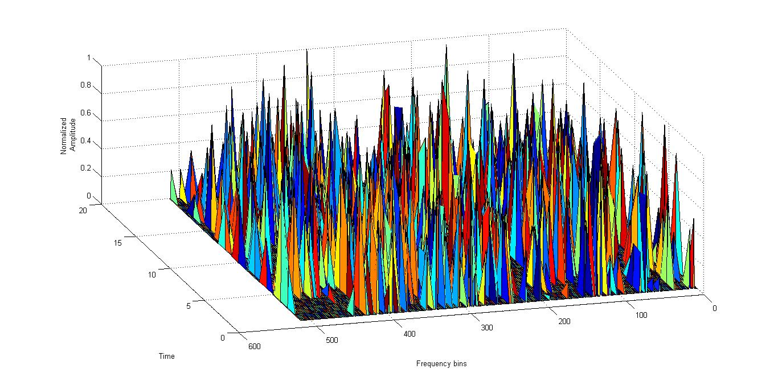
Objective
Radio channel impairment has become a major concern in wireless system

Slide 4
Contributions
Implement a CS based channel estimator for a OFDM system on a soft radio platform
Build GNU Radio signal processing blocks for $l_{1}$ optimization and $l_{2}$ solution

Slide 5
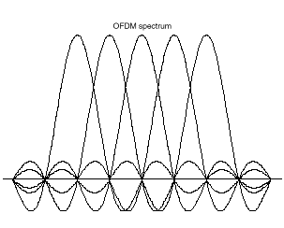
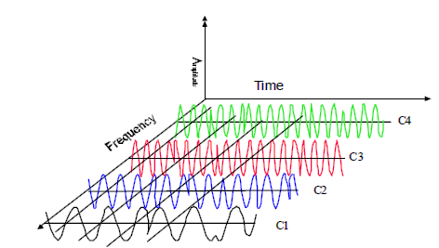
OFDM Basics
Combination of multiplexing and modulation
Subcarriers are orthogonal to each other
Implementation with a IFFT/FFT pair & with a DAC/ADC pair
Used in WiFi – 802.11a/g/n, MIMO, ADSL, UWB, etc.
Notes:
So at the centre frequency of all the subcarriers, there will not be crosstalk between the carriers.
OFDM signals in time and frequency domain – parallellised. They are serialised to form the final signal. The Parallel to Serial Converter is the IFFT block. They are added together to give a time domain signal.

Slide 6
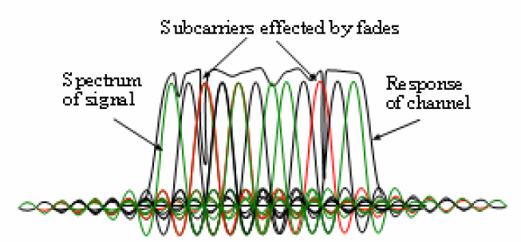
OFDM Basics
Advantages
Bandwidth efficiency
Narrowband interference avoidance
Effects from fading and delay spread
Only some subcarriers undergo fading
Including the Cyclic Prefix
Notes:
How is the bandwidth effienciency attained ?
OFDM has frequency selective response. We can choose the subcarriers over which can send data. Similarly we can use effective coding techniques to overcome these fading effects.
Fading & Delay spread – Fading delat in the above manner
Delay spread – fixed with Cyclic Prefix- the copying is done over the entire composite signal. At Rx, the CP is removed and the rest of the data is taken to make it periodic before taking the FFT for it

Slide 7
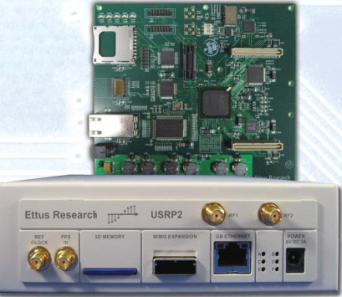
Introduction to USRP2 & GNU Radio
Hardware platform to implement software radio
SDR used is the GNU Radio
100 MS/s, 14-bit, ADC for RX
400 MS/s, 16-bit, DAC for TX
Daughter boards used:
XCVR2450, Dual-band Transceiver, 2.4–2.5 GHz & 4.9–5.85 GHz.
RFX2400, 2.3–2.9 GHz Transceiver, 20+mW output

Slide 8
Introduction to USRP2 & GNU Radio
Software defined radio used is GNU Radio - free & open-source software development toolkit
Signal processing blocks area available to implement software radios
RX
Antenna -> Receive RF Front End -> ADC -> Software Code
TX
Software Code ->DAC -> Transmit RF Front End -> Antenna
GNU Radio is written in the format
Python
C++
C++
Sink
Source
C++
Notes:
C++ - Performance-critical modules
Python - Glue to connect modules, Non performance-critical modules
The patching is done using SWIG

Slide 9
Overview
OFDM Basics
Introduction to USRP2 & GNU Radio
CS OFDM channel estimation system model
CS Concepts
Random convolution
Uniformly down-sample
CS-OFDM Design and Implementation
System Overview
OFDM Receiver Design
OFDM Transmitter Design
USRP2 Demonstration
System Simulations
Experimental Results
Challenges
Conclusion

Slide 10
CS OFDM channel estimation system model
Channel estimates ‘h’ is sparse in time domain
$$h_{n}= \sum_{l=1}^{L}{a_{l}}δ\left(n−τ_{l}T\right), 1≤n≤N$$
where $a_{l}$ is the complex multipath component, $δ$ is the Dirac delta function and $τ_{l}$ is the multipath delay.
CS can use the sparsity of $h_{n}$ effectively.
This system model is based on the paper : Compressive Sensing Based High Resolution Channel Estimation for OFDM System - Jia (Jasmine) Meng, Wotao Yin, Yingying Li, Nam Tuan Nguyen, and Zhu Han
Notes:
– trying getting existing ‘h’ calculated to prove this

Slide 11
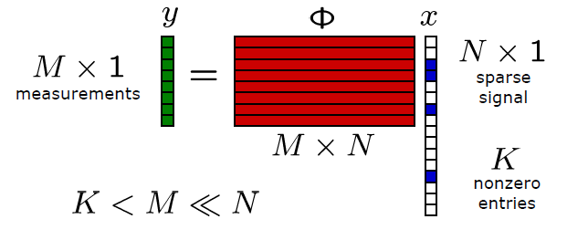
CS Concepts
Integrates compression and sensing
Sub Nyquist sampling
y = φx
compress x into a sketch φ, where φ is a carefully designed matrix
m X n, where n >> m
By taking the L1 norm of x, we can obtain x
Notes:
want to recover x from Ax
• Impossible: undetermined system of equations
If x is sparse, then we can use L1 optimization to approximate x. And also based on a sparsity parameter k.

Slide 12
Random Convolution
The received signal y in a wireless system can be written as,
$y=x∗h+w,$
Notice that this is convolution and not multiplication.
Existing model breaks it into a circulant matrix
$$y=Ch+w,$$
$x∗h= F^{−1}diag\left(X\right)Fh$
X is designed as the pilot signal or preambles as a complex vector whose entries have uniform magnitude and random phases
$$x∗h= F^{−1}(F\left(x\right). F(h))$$

Slide 13
Uniformly down-sampling
To obtain higher resolution channel estimation, which is limited by the ADC speed
Increase DAC speed
DAC speed can be increased at low cost.
Keep ADC at low speed
ADC price goes up steeply with the speed increase
Actually performed uniform down-sample on convolution results

Slide 14
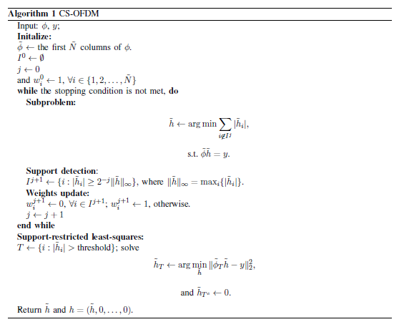
CS Algorithm used

Slide 15
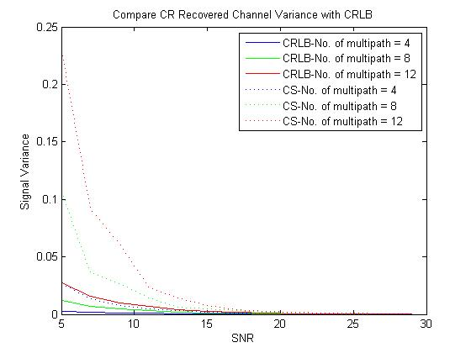
Simulations on existing model
MSE vs SNR chart for an unbiased estimator for maximum down sampling, 8 possible in the existing USRP2 setup (Max TX = 512 IDFT/Min RX = 64 DFT).
Notes:
CRLB for unbiased estimator

Slide 16
Overview
OFDM Basics
Introduction to USRP2 & GNU Radio
CS OFDM channel estimation system model
CS Concepts
Random convolution
Uniformly down-sample
CS-OFDM Design and Implementation
System Overview
OFDM Receiver Design
OFDM Transmitter Design
USRP2 Demonstration
System Simulations
Experimental Results
Challenges
Conclusion

Slide 17
CS-OFDM Design & Implementation
Pilots were chosen on the principle of random convolution in frequency domain
Random Pilots x
$t=$[CP(x) x]
$$tconv=t conv h$$
$$yconv=tconv+AWGN$$
$$yrec=yconv followed CP removal$$
This is equivalent to ifft(RanPilots.*fft(h)) + AWGN
The channel estimation is shifted from the frequency domain to the time domain
CS-OFDM can be implemented in symmetric and asymmetric system mode
IFFT
Notes:
CRLB for unbiased estimator

Slide 18
OFDM Receiver Design What happens at the OFDM RX?

Slide 19
Functions defined in GNU Radio ofdm_receiver.py
chan_filt
ofdm_sync
sigmix
ofdm_sampler
Fine Frequency Correction
ofdm_sampler
fft_demod
ofdm_frame_acq
FC
CE
Frame and symbol timing equalization
Notes:
The blue path shows the received signals, whereas the black path are the signals useful in decoding and synchronization

Slide 20
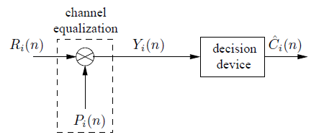
Channel Estimation in USRP2 setup
Done in ofdm_frame_acq block
$$R_{i}\left(n\right)=H_{i}\left(n\right)C_{i}\left(n\right)+ W_{i}\left(n\right), 0≤n≤N−1$$
$$P_{i}\left(n\right)=1/H_{i}\left(n\right)$$
$$Y_{i}\left(n\right)=\frac{R_{i}\left(n\right)}{H_{i}\left(n\right)}= C_{i}\left(n\right)+ W_{i}\left(n\right)/H_{i}\left(n\right), 0≤n≤N−1$$
$$\overbrace{H}\left(n\right)=\frac{R_{p}\left(n\right)}{C_{p}\left(n\right)}= H_{p}\left(n\right)+ W_{p}\left(n\right)/C_{p}\left(n\right), 0≤n≤N−1$$

Slide 21
Channel Estimation in USRP2 setup
Fine Tuning done before taking the channel estimates in the frequency domain.
The phase shift across a shifted FFT length or bins(default=10) is used to obtain the symbol with max correlation. Then that symbol is used for calculating the taps or the channel estimates.
1-tap equalization done on all subcarriers.
Taps for odd subcarriers are calculated directly
Taps for even subcarriers are interpolated

Slide 22
CS-OFDM Receiver Design ofdm_receiver_cs.py
chan_filt
ofdm_sync
sigmix
ofdm_sampler
↓
Fine Frequency Correction
ofdm_sampler
fft_demod
ofdm_frame_acq
ofdm_mixer
FC
CE
Frame and symbol timing equalization

Slide 23
CS-OFDM Receiver Design
CS Estimator
We used the down sampled data at the receiver and use the CS Algorithm for estimation
Limitations of down sampling
Mixer
Sampler
FFT

Slide 24
CS-OFDM Algorithm Flowchart
Initialize MM
$$l_{1}$$
Is Stopping condition met?
$$l_{2}$$
Update MM
Update weights

Slide 25
CS-OFDM Algorithm
Measurement Matrices(MM) are constructed based on the known pilots.
An iterative support detection (ISD) scheme is used here which gives us a good performance in noisy environments
After every iteration we update the weights
Final de-noising step is also done after ISD as a least squares problem
YALL1 solver (open source Rice University) for solving the $l_{1}$ ISD based reconstruction
Stopping Condition has to be used to check the over optimization

Slide 26
CS-OFDM Receiver Design System Block Diagram
YALL1
POST
YALL1
BUILT NEW MM
L2
SC
MISC
BUILTMM

Slide 27
CS-OFDM Receiver Design Software Stack
Easiest way to implement in GNU Radio is use a hierarchical model using class gr.hier_block
However most of the algorithms are iterative, and these modules cannot be used iteratively
Built class cs_est as a interpolator block (Input = 64, Output = 256/512)

Slide 28
CS-OFDM Receiver Design Software Stack
chan_est.py
Module
cs_cpp
chan_est.i
qa_yall.py
qa_ds.py
qa_pinv.py
qa_misc.py
yall.i
ds.i
pinv.i
misc.i
chan_est.cc
yall.cc
ds.cc
pinv.cc
misc.cc

Slide 29
CS-OFDM Receiver Design YALL1 & Post Processing
class cs_cpp_yall_fftw
Different models to solve using $l_{1}$optimization
Derived from classical approach of ADMM
Accelerated computation compared to other solvers
Easily available
class cs_cpp_misc
Compare with a threshold
Update the weights
Use the weights in next iteration

Slide 30
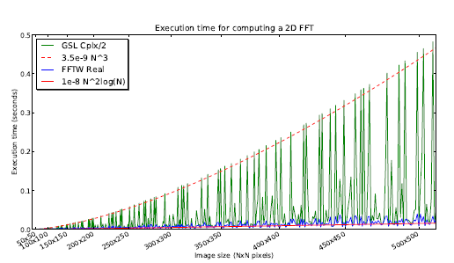
CS-OFDM Receiver Design Building the MM
class gri_fft_MatrixA_ccc
There are different FFT libraries in GNU Radio
Develop 2 components to build the final MM
ifft(fft(a)*.pilots)
ifft(fft(b)*.conj(pilots))
Use fft from FFTW3 or GSL libraries

Slide 31
CS-OFDM Receiver Design $l_{2}$ Solution
class cs_cpp_pinv
Solving $l_{2}$ optimization
A/y = h
y = Ah
We use
$h = y ∗pinv(A)$
Implement Moore Penrose inverse using SVD in C++
Find $A^{−1}$ from A
$A=U∗S∗V^{t}$
$A^{−1} =V∗Si∗U^{t}$
$Si=1/S$

Slide 32
CS-OFDM Receiver Design $l_{2}$ Solution
GSL Library was used to solve
However func linalg_SV_decomp is used for SVD decomposition was only good for real numbers, so had to extend for complex numbers
So a NxN complex matrix was broken down as 2Nx2N real matrix
Our complex matrix
$$A=A_{r}+i A_{i}$$
We construct a new matrix
$\begin{matrix}A_{r} & −A_{i} \\ A_{i} & A_{r}\end{matrix}$

Slide 33
CS-OFDM Receiver Design $l_{2}$ Solution
N
N
R
I
R
-I
64
64
I
R
N
64

Slide 34
OFDM Transmitter Design What happens at OFDM TX ?

Slide 35
Functions defined in GNU Radio ofdm_tx.py
Get occupied tones
Pad preambles
ofdm_mapper_bcv
ofdm_insert_preambles
gr_fft_vcc
gr_ofdm_cyclic_prefix
scale

Slide 36
OFDM Transmitter Design Preambles in S & C Model
Preambles are known symbols used for synchronization & initial channel estimation in the current setup. Complex models have pilots for tracking channel and fine tuning the estimates
Modulated payload –Depending on the type of constellation carriers
Preambles are send first followed by the modulated raw payload.
Notes:
How are symbols made???

Slide 37
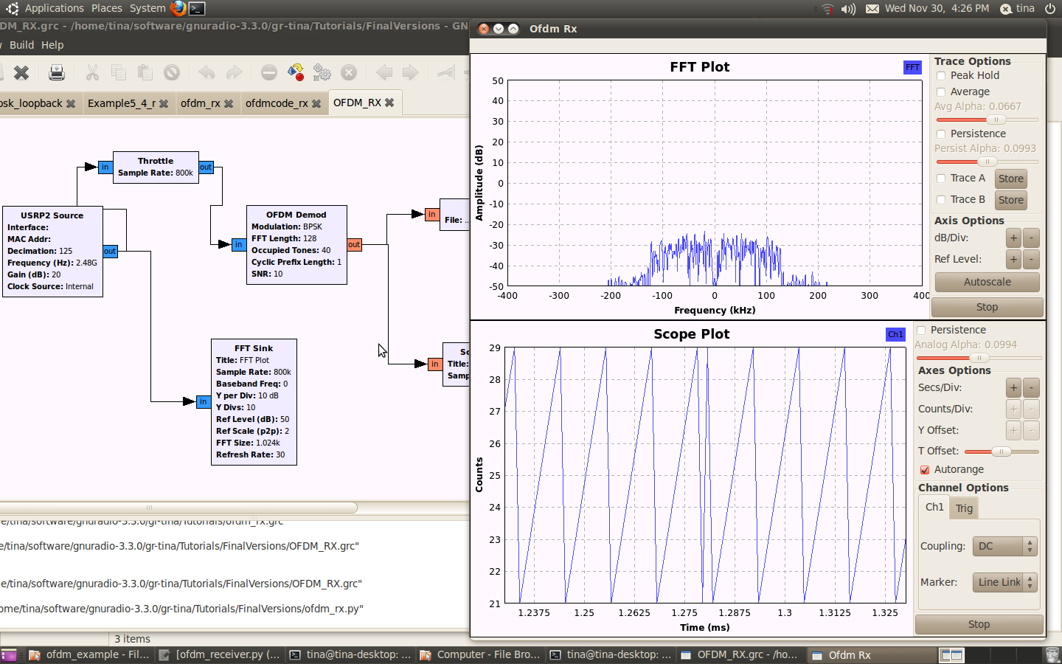
Demo for USRP2 setup for CS OFDM
Video Demo for CS based channel estimation in OFDM

Slide 38
Overview
OFDM Basics
Introduction to USRP2 & GNU Radio
CS OFDM channel estimation system model
CS Concepts
Random convolution
Uniformly down-sample
CS-OFDM Design and Implementation
System Overview
OFDM Receiver Design
OFDM Transmitter Design
USRP2 Demonstration
System Simulations
Experimental Results
Challenges
Conclusion

Slide 39
Experimental Setup System Simulations
Power in Pilots or Preamble must be same as power in data
The number of taps in channel impulse response h was assumed to the lesser than cyclic prefix length
Moving to time domain helps in decreasing the estimation error , although it increases the complexity

Slide 40
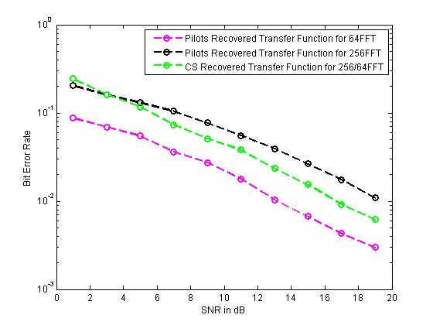
Experimental Setup System Simulations – Setup 1
Lfft = 256 , Locc = 64, Lcp = 256 for 256 point FFT
Lfft = 64, Locc = 16 for 64 point FFT Note: Bandwidth occupied by both scenerios in 64 FFT and 256 FFT are the same
This is compared against frequency based estimation used in USRP

Slide 41
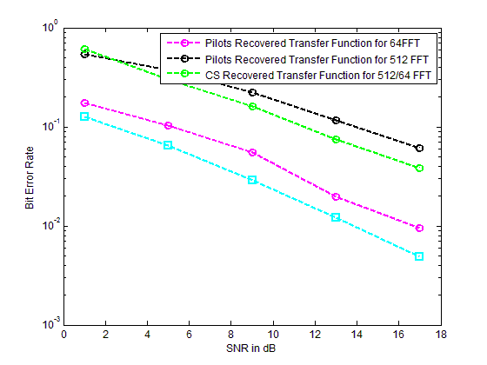
Experimental Setup System Simulations – Setup 2
Custom CS code with theoretical bound

Slide 42
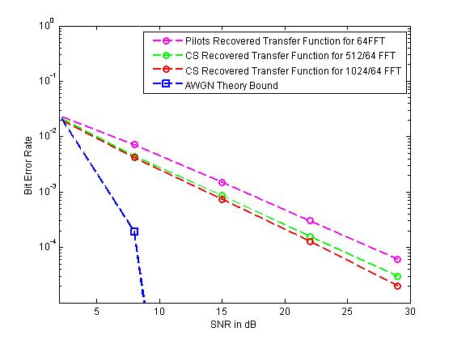
Experimental Setup System Simulations – Setup 3
Asymmetrical Setup

Slide 43
Experimental Setup System Characterization
Original Image
Retrieved Image 10dB
Retrieved Image 20dB

Slide 44
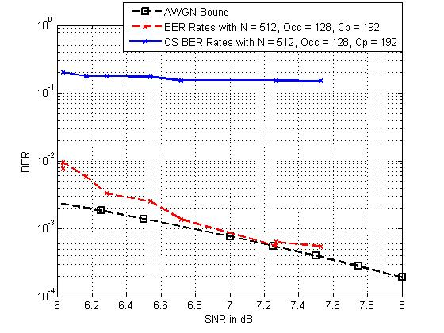
Experimental Setup CS-OFDM Comparision
Notes:
Change this to new one

Slide 45
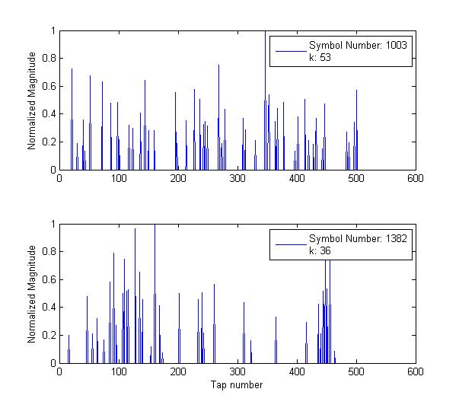
Experimental Setup Sparse Channel Estimates

Slide 46
Challenges
Building the C++ modules in the GNU Radio framework with Python-SWIG-C++ interfaces and memory leaks
Real time issues while running the USRP2 setup
Currently the channel estimation is done in the frequency domain; however the channel estimates on all the used subcarriers should be moved to the time domain. Time domain estimation is more complex
Frequency Compensation was not extended to the TEQ
Throughput issues as an SDR constraint
The SNR was measured using the bpsk probe, however the need for a good quality OFDM estimator is required

Slide 47
Conclusions
Simulations were done with all scenarios
CS based channel estimation can use the sparse nature of the channel impulse response effectively and this was proved in the setup
Functional CS based estimation was implemented however comparing the performance was an issue
Building the $l_{1}$ optimization and $l_{2}$ solution blocks in GNU Radio which can be used as a plug in other applications

Slide 48
Thank you
48
Notes:
48

