Slide 1


UAV Communications in 5G and Beyond: Integration of Sensing, Control, and Learning
Lingyang Song*, Zhu Han⁺, and Hongliang Zhang⁺
* School of Electronics Engineering and Computer Science,
Peking University, Beijing, China
⁺ Department of Electrical and Computer Engineering
University of Houston, Houston, TX, USA
Tutorial Presentation at WCNC’2020, Seoul, South Korea
http://wireless.egr.uh.edu/research.htm
ACK: Shuhang Zhang, Zhiwen Hu, Jingzhi Hu, Boya Di, and Yuzhe Yang

Slide 2
Objectives
To introduce UAV basics and applications into cellular networks
    Access point/aerial user
To learn related mathematical tools to integrate UAV into cellular networks
    Machine learning and game theory
To understand how to optimize UAV enabled communication networks
  Communication: UAV-to-X Communications
  Control: Trajectory design
  Learning: Internet of UAVs applications

Slide 3
Table of Contents
Background
  5G Communications and Beyond
  UAV Communication Basics
Mathematical Tools
  Machine Learning
  Game Theory
UAV assisted Cellular Communications
  UAV serving as Base Station
  UAV serving as Relay
Cellular assisted UAV Sensing
  Internet of UAVs
  Cooperative Internet of UAVs
  UAV-to-X Communications
Applications
  Aerial-Ground IoTs for Air Quality Monitoring in Smart City

Slide 4
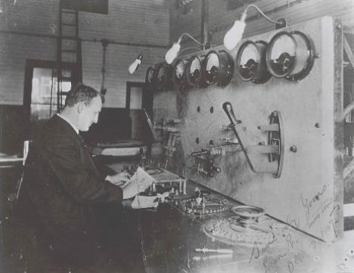
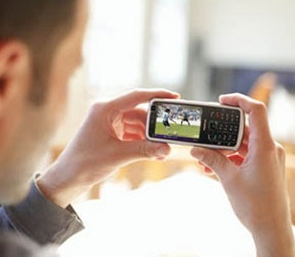
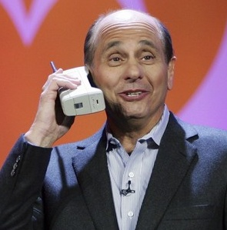

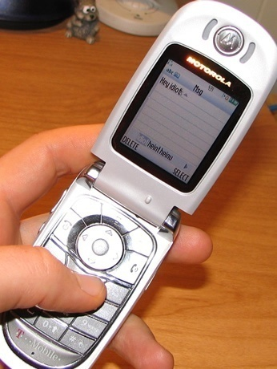
Mobile Communication Development
A market needs both technology and application
From texts …
to voice …
to data and everything

Slide 5
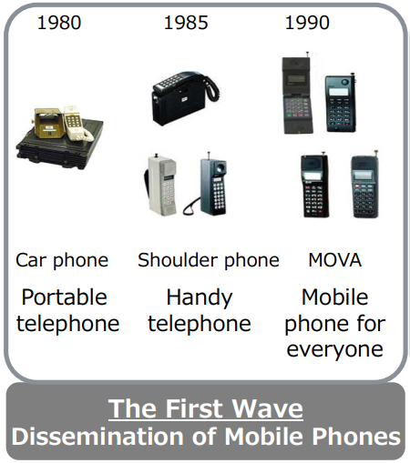
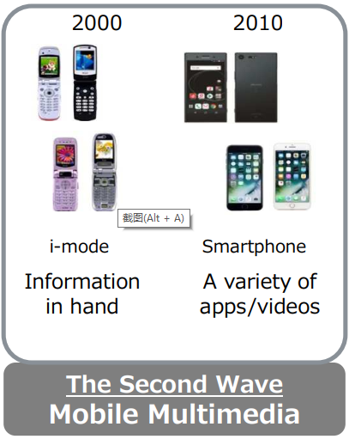

Standardization Facilitates Technology Evolution
Each new evolution builds on the established market of the previous
1G
2G
3G
4G
5G
6G

Slide 6
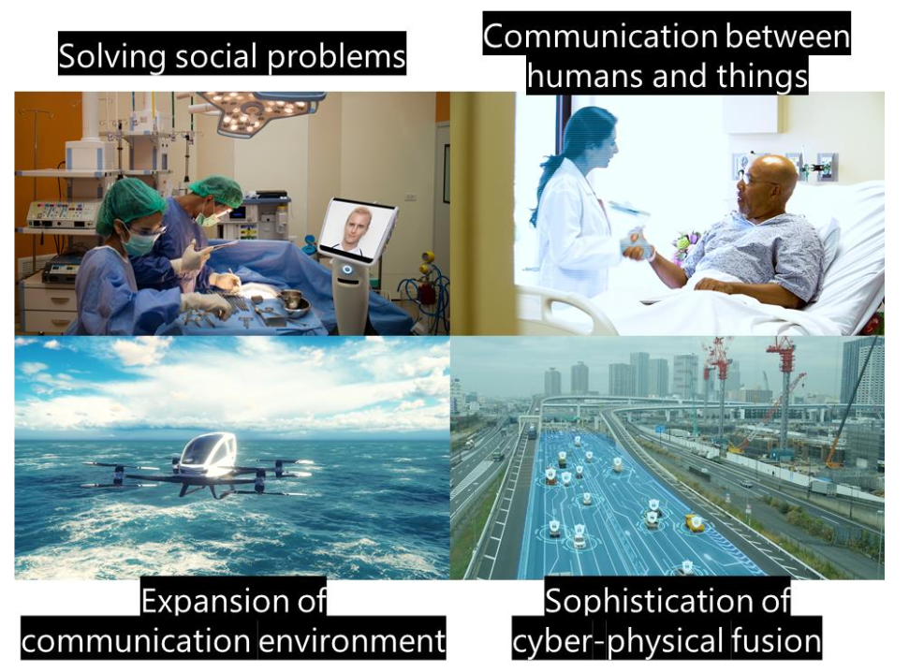
Future Network/Communication Society

Slide 7
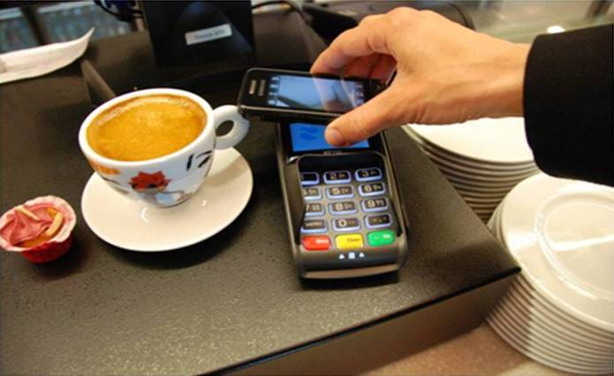
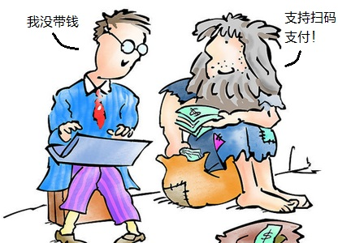

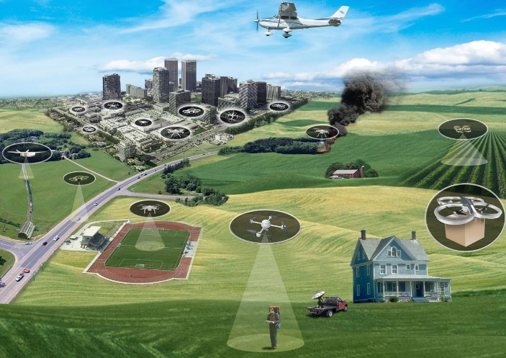
Internet of Things
Mobile web payments
  QR Codes：WeChat/Ali Pay
Internet of Things
  Connect physical world by sensors
Internet of UAVs
Smart Planet
Notes:
除了线上模式，在物理世界，主要通过物联网的方式
物联网：通过传感器的感知，将物理世界信息上网，形成物联网
跨学科的研究！！！

Slide 8

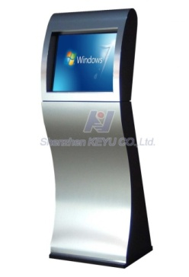
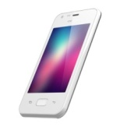


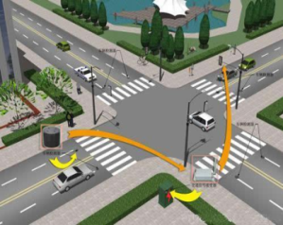
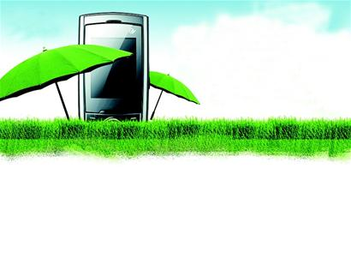
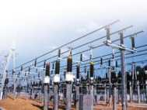
Key Performance Indicators
10Gbps
1000X Capacity
10X User Rate Anywhere
100M → 1Gbps
10X Peak Data Rate
10+Gbps
6 Key Requirements
1000X Energy&Cost
Reduce
10X Low Latency, High reliability
5~10X Spectrum Efficiency

Slide 9
Future Wireless Challenges: Analysis
Signal to Noise plus Interference Ratio
Scaled Transmission Time
Capacity：C = N * W * T * log(1 + SINR)
No. of APs
Bandwidth

Slide 10

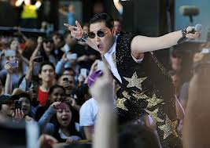
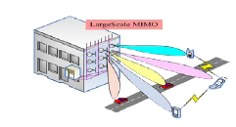


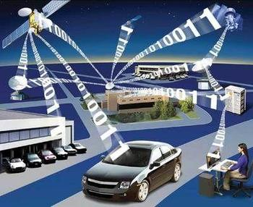


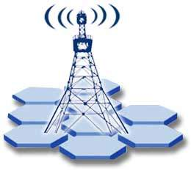


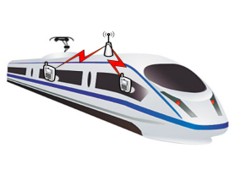
Evolutions
Ultra Dense Deployment:
LTE-Hi and UAV
Cell Edge User Experience:
Coordination and Comp, Advanced IC, UAV
Link Efficiency:
Massive MIMO, 3D-BF,
Full-duplex
    More Scenarios and Use Case：
    M2M, D2D, V2X, U2X
    Flexible Network and High
    Reliability: Mobile Relay, UE Relay,
    UAV Relay, MAC direct
    Smart Network:
    Service & Environment Awareness
    SON; Multi-Radio/Multi-RAT SON

Slide 11
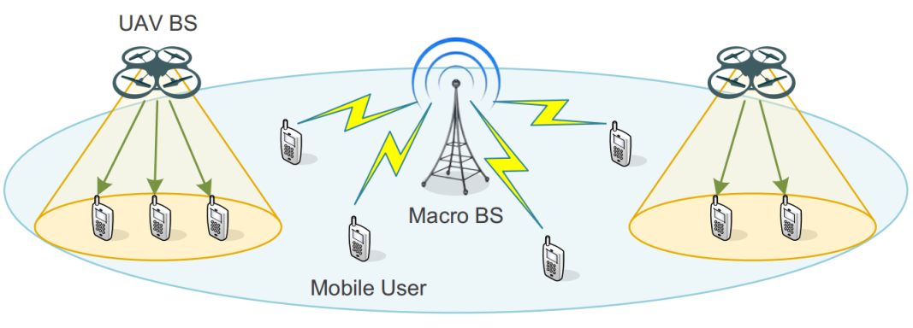
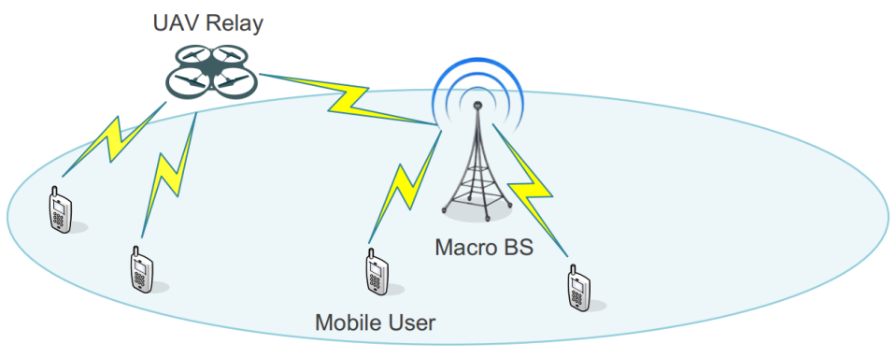
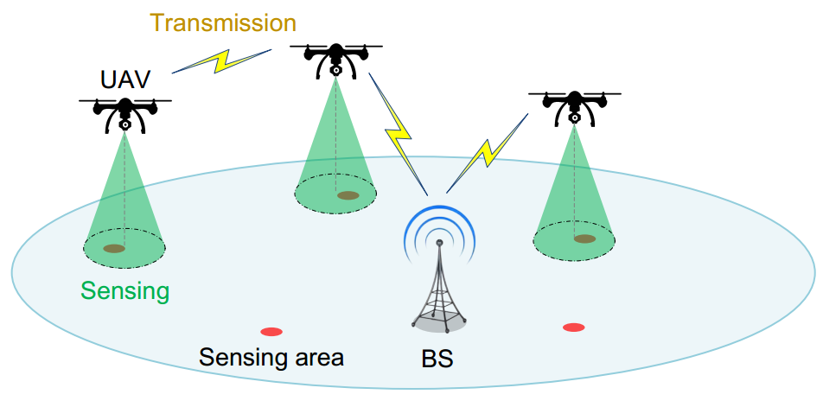
Cellular UAV Applications
UAV working as Flying Infrastructure
UAV base station: data offloading;
emergency communications
UAV relay: coverage extension; QoS improvement
UAV working as Aerial User
Cellular Internet of UAVs: ULLHR

Slide 12
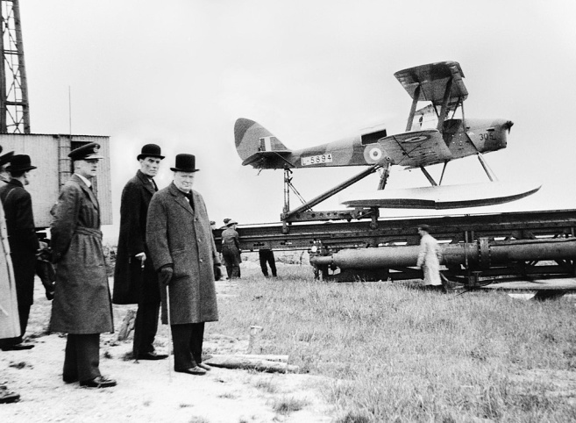
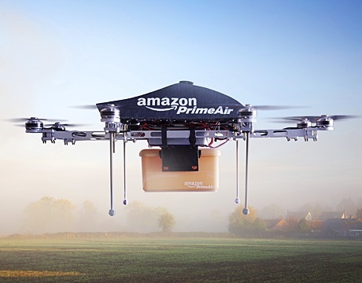
Wireless UAV History
During the 1930s, the US Navy began to experiment with radio-controlled UAV.
From the 1990s, micro UAVs started to be widely used in public and civilian applications.
Recently, UAV communications have been investigated in various applications.
  UAV assisted cellular communications
  Cellular assisted UAV sensing

Slide 13
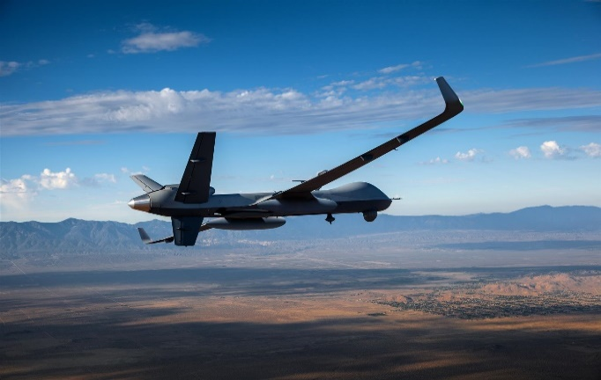
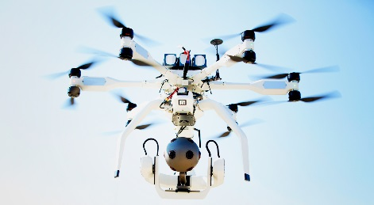
UAV Classification
 | Fixed-wings | Rotary-wings
Speed | Up to 500 km/h | Typically <60 km/h
Altitude | Up to 20 km | Typically <1km
Flight time | Up to several hours | Typically <30 min
Applications | Airborne surveillance Carry cellular infrastructure | Recreation Sensing

Slide 14
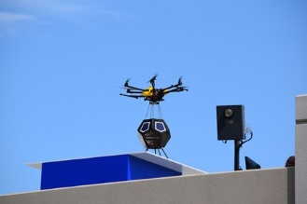

UAV Assisted Cellular Communication
Existing Projects
  Nokia’s flying-cell (F-Cell) and Facebook’s Aquila
Facebook’s Aquila
  UAVs with solar panels sent 18-27km into the stratosphere
  To provide widespread Internet coverage (40-80 square kilometers)
Nokia’s F-Cell
Facebook’s Aquila

Slide 15
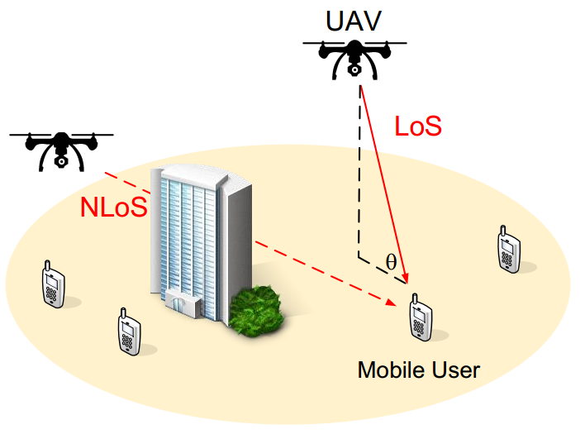
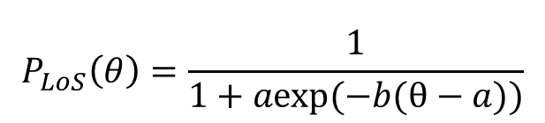
Channel Models
Air-to-ground (A2G) channel
  Different from ground communication
    Altitudes and elevation angles
  Probability path loss model [1]
    LoS and NLoS with different probabilities of occurrence
      Propagation environment and elevation angels
  Small-scale fading: Rican
Probability of LoS
$$P_{LoS}\left(θ\right)=\frac{1}{1+aexp(−b(θ−a))}$$
elevation angle
[1] A. Al-Hourani, S. Kandeepan, and S. Lardner, “Optimal LAP altitude for maximum coverage,” IEEE Wireless Commun. Lett., vol. 3, no. 6, pp. 569-572, Dec. 2014.

Slide 16
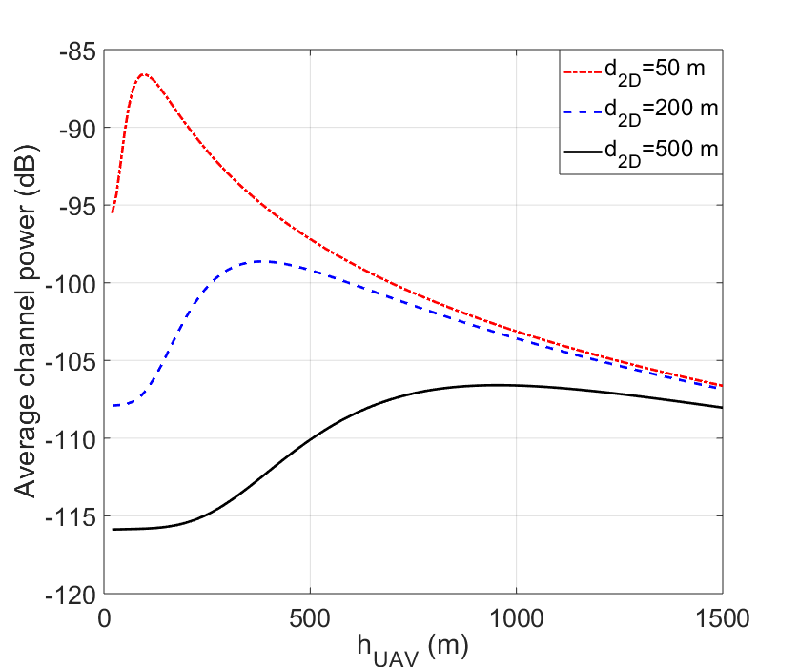
Performance Analysis: Channel Models
Notations
  d_{2D}: horizontal distance between the UAV and the user
  h_{UAV}: the altitude of the UAV
As the UAV altitude grows
  Expected channel power increases first because the probability of LoS increases
  Expected channel power then decreases because the transmission distance increases

Slide 17
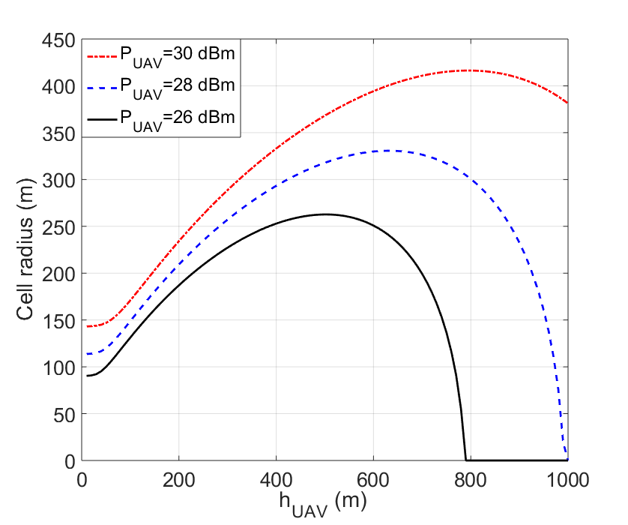
Performance Analysis: UAV BS
UAV BS
  The received SNR should be larger than a threshold (0 dB)
  Only consider the pathloss
Remarks
  The UAV cell radius increases with the transmit power
  The radius increases first and then decreases as the altitude of UAV increases
The radius will be 0 when the altitude of the UAV is larger than a threshold due to the large pathloss

Slide 18
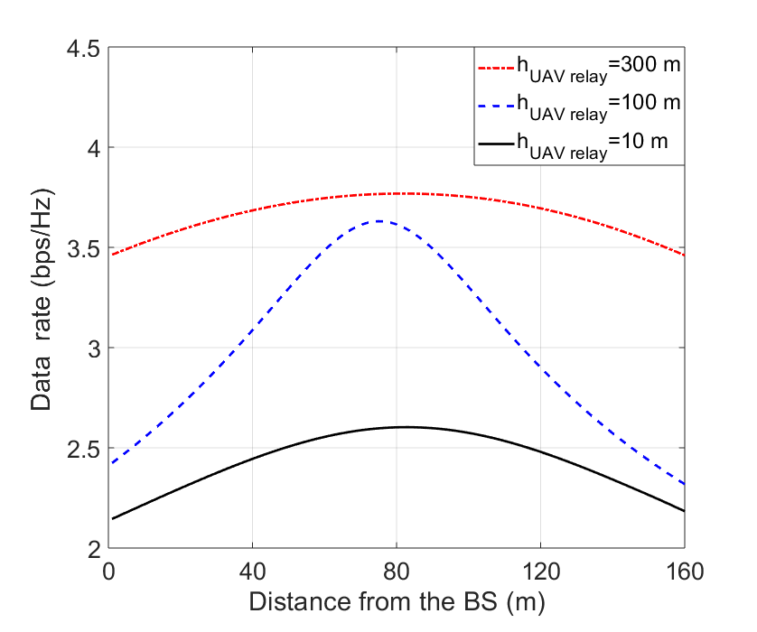
Performance Analysis: UAV Relay
UAV Relay
  AF relay
  Distance from user to BS: 165 m
  Data rate is defined as the minimum one
Remarks
  The data rate increases with the altitude of the UAV
  The data rate increases first and then decreases as the distance from the BS increases
The influence is more significant when the UAV altitude is moderate

Slide 19
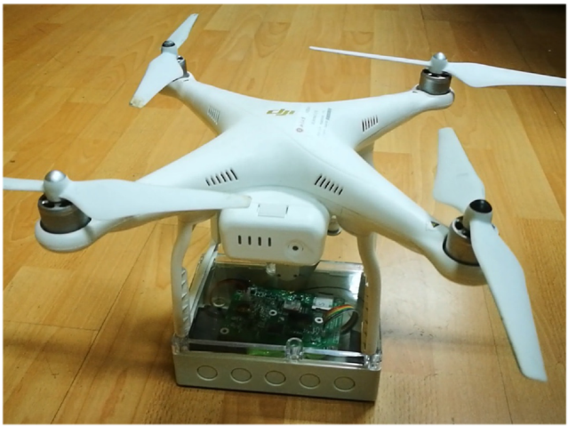
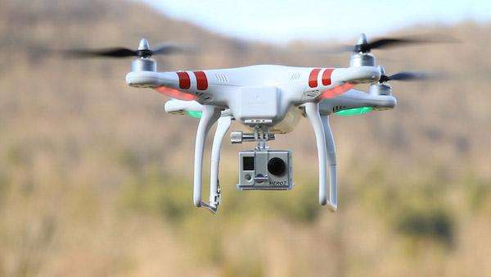
Unmanned Aircraft System (UAS)
Key Components in UAS
  UAVs: typically rotary-wings UAVs
  Payload: camera, thermometer, AQI sensor, etc…
  Applications: real-time sensing
Wireless Communications for UAS
  Payload Communication (PC): Sensory data transmission
  Control and Non-payload Communication (CNPC) : Command/Control signals transmission
UAV
Payload

Slide 20
CNPC v.s. PC
 | CNPC | PC
Objective | ensure safe, reliable, and effective flight operation | transmit mission-related information
Requirement | low data rate, ultra-reliability, high security, low latency. | high data rate
Example | telemetry (UAV status reporting); command and control; navigation aids; sense and avoid (S&A); air traffic control (ATC) relay. | real-time video; image; temperature; relaying data.

Slide 21
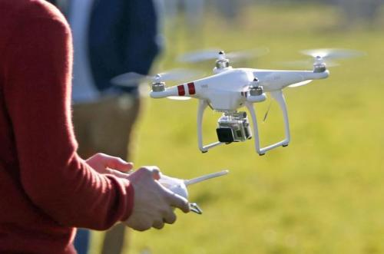
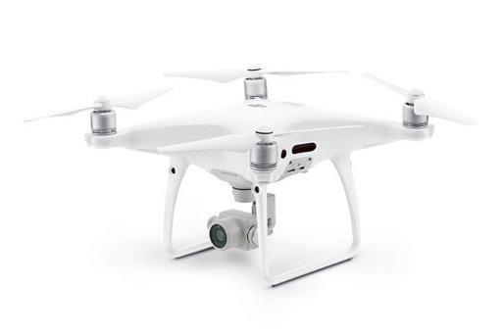
Existing Systems
Direct point-to-point communication links with their ground pilots or ground control stations
Use the unlicensed spectrum (e.g., ISM Band) for CNPC & PC
E.g., DJI Phantom 4 Pro
  Working Bands:
    2.400 ~ 2.483 GHz
    5.725 ~ 5.825 GHz
Limitations
  QoS is not guaranteed in the ISM band
  Limited communication range
}
ISM Band
DJI Phantom 4 Pro

Slide 22
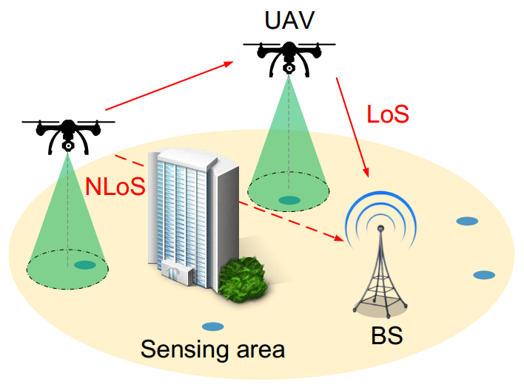
Cellular assisted UAV Sensing
Future cellular network is able to support UAV sensing applications (cellular Internet of UAVs)
  Larger coverage
  More reliable and flexible
In cellular Internet of UAVs, the UAVs transmit the sensory data to the BS by
  Air-to-ground (A2G) channels
    Probability path loss model
  Air-to-air (A2A) channels
    LoS dominated

Slide 23
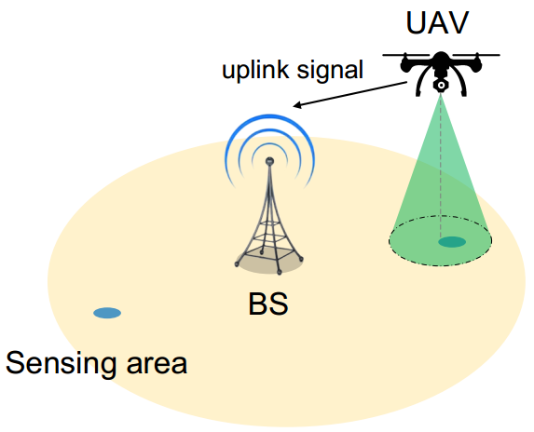
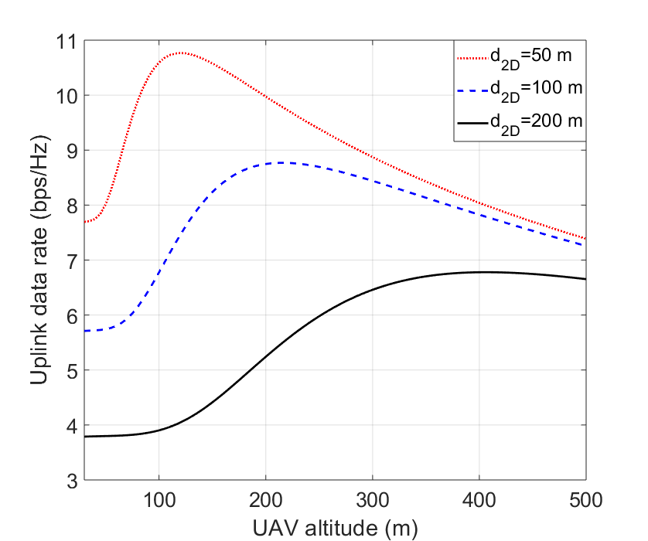
Performance Analysis
The uplink data rate increases first when the UAV altitude grows because the probability of LoS increases
The uplink data rate decreases when the UAV altitude grows because the transmission distance increases

Slide 24
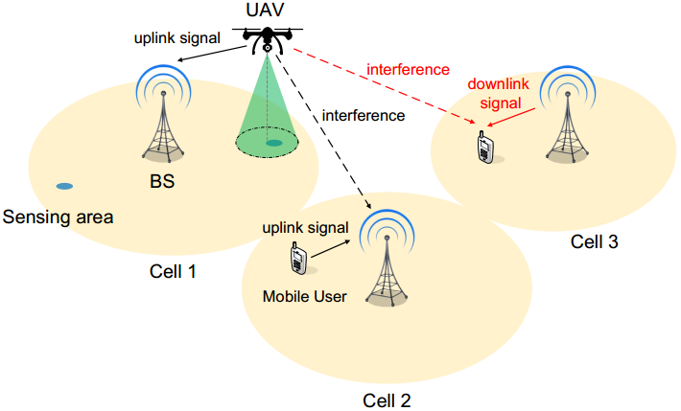
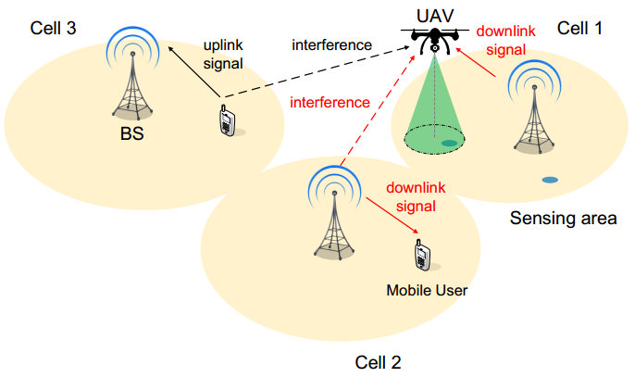
Interference Analysis
Severe interference between UAVs and terrestrial networks
  Uplink Transmission
    Interference from the UAV to the neighboring BS
  Downlink Transmission
    Interference from the neighboring BS to the UAV
Uplink
Downlink

Slide 25
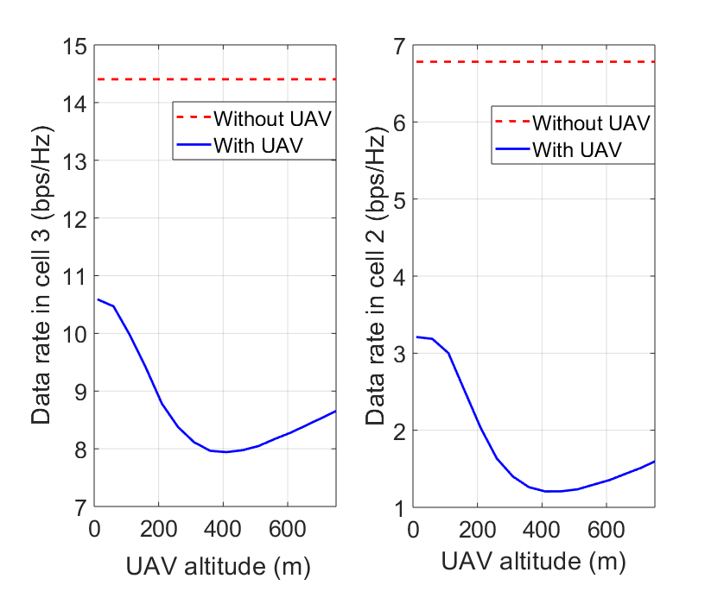
Interference Analysis: Uplink UAV
The data rate of terrestrial users in neighboring cells decreases when the UAV altitude grows
The interference from the UAV increases first and then decreases as the UAV altitude grows

Slide 26
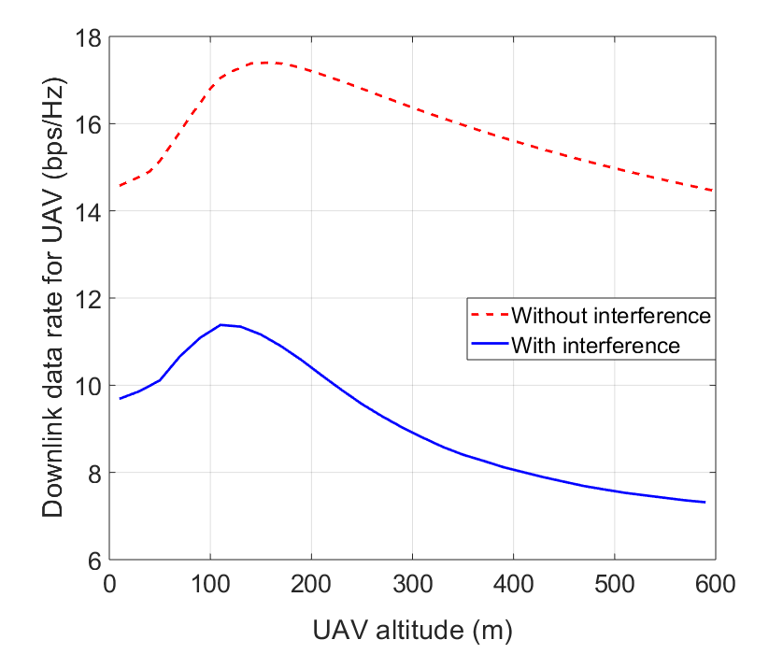
Interference Analysis: Downlink UAV
The data rate of the UAV increases first and then decreases when the UAV altitude grows
The interference from the neighboring BS/users is more significant when the UAV altitude is higher

Slide 27








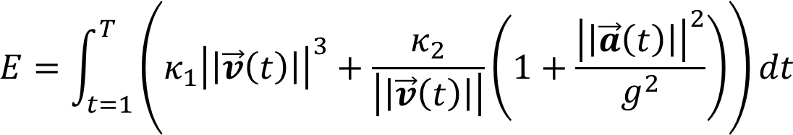
Mobility and Propulsion Energy Models
The trajectory of a UAV is a line segment in two successive time slots
Define as the 3D location of the UAV, where the
  velocity
  accelerated velocity
  propulsion energy (velocity is larger than a threshold) [2]
[2] G. J. Leishman, Principles of Helicopter Aerodynamics. Cambridge, U.K.: Cambridge Univ. Press, 2006, pp. 159–193.

Slide 28
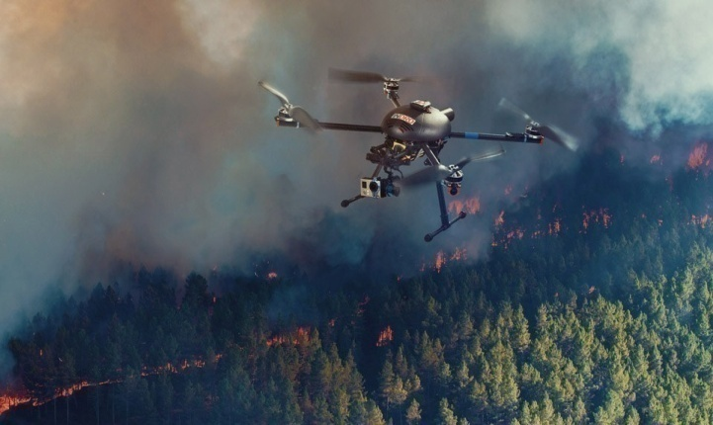
Research Challenges
UAV BS/Relay as a Flying Cell (Fixed-wing)
  Co-channel Interference cancelation
  Radio Resource Management (RRM)
  Self-organizing Networks (SON)
  Backhauling
  Spectrum-leasing issues
UAV as Flying Users (Rotary-wing)
  Co-channel Interference
  Trajectory Design
  Communication Protocol Design
  Distributed Learning Algorithms
  Network optimization with terrestrial users

Slide 29
Table of Contents
Background
  5G Communications and Beyond
  UAV Communication Basics
Mathematical Tools
  Machine Learning
  Game Theory
UAV assisted Cellular Communications
  UAV serving as Base Station
  UAV serving as Relay
Cellular assisted UAV Sensing
  Internet of UAVs
  Cooperative Internet of UAVs
  UAV-to-X Communications
Applications
  Aerial-Ground IoTs for Air Quality Monitoring in Smart City

Slide 30
Learning Methods
Classical Machine Learning
Deep Learning
Reinforcement Learning

Slide 31
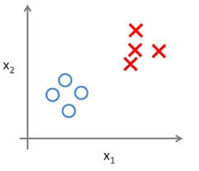
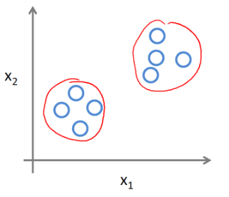
Classical Machine Learning
“Computers: learn without being explicitly programmed”
Types:
  Supervised Learning:
    Example inputs (features) and their desired outputs (labels)
    Goal: learn a general rule that maps inputs to outputs
    SVM, neural networks, etc.
  Unsupervised Learning:
    No labels
    Find structure in its input
    Goal: discover hidden patterns in data
    Clustering, K-means, etc.

Slide 32
Supervised Learning: SVM
Distance from sample x_{i} to the separator: r
Support vectors: samples closest to the hyperplane
Margin ρ: the distance between support vectors
Objective: maximize the margin ρ
ρ
r

Slide 33
Supervised Learning: Applications
The best performers for a number of classification tasks ranging from text to genomic data.
Complex data types beyond feature vectors (e.g. graphs, sequences, relational data) by designing kernel functions for such data.
Extend to a number of tasks such as regression [Vapnik et al. ’97], principal component analysis [Schölkopf et al. ’99], etc.

Slide 34
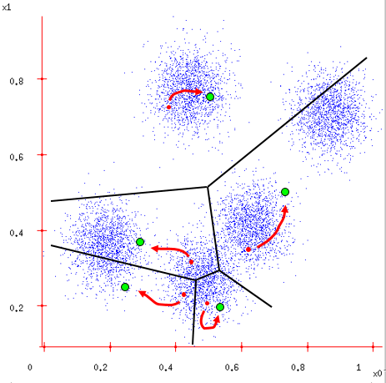
Unsupervised Learning: K-Means
Ask user how many clusters they’d like. (e.g. k=5)
Randomly guess k cluster center locations
Each data point: find out which center it’s closest to
Each center: find the centroid of the points it owns
Change center
Repeat until terminated

Slide 35
Unsupervised Learning: Applications
Data mining
Acoustic data in speech understanding to convert waveforms into one of k categories (known as Vector Quantization or Image Segmentation)
Also used for choosing color palettes on old fashioned graphical display devices and Image Quantization

Slide 36
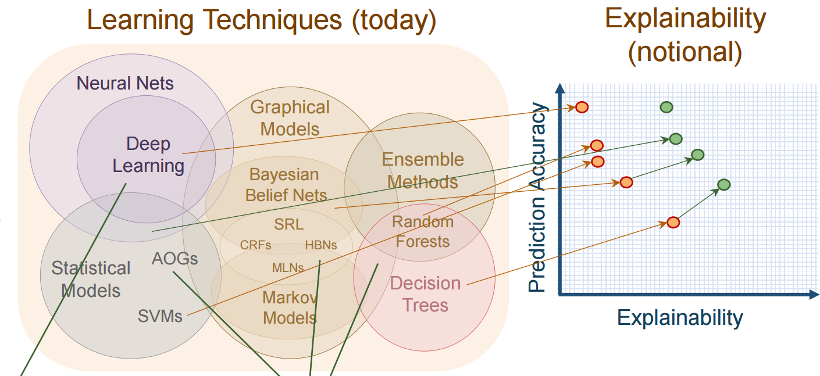
Deep Learning: Motivations
Classic Methods
  Do not have a lot of data, or
  Training data have categorical features
  A more explainable model
  A high run-time speed
Deep Learning
  A lot of training data of the same or related domain
  Improve Domain Adaptation
  Appropriate scaling and normalization have to be done
  Much slower

Slide 37




Deep Learning: Basic Idea
Add Hidden Layers in Neural Networks
Linear transformation followed by non-linear rectification
More parameters
More non-linear parts

Slide 38
Typical Deep Neural Networks
Convolutional Neural Networks (CNNs)
Recurrent Neural Networks (RNNs)
Deep Belief Networks

Slide 39

Convolutional Neural Networks (CNNs)
INPUT IMAGE
CONVOLUTION (LEARNED)
NON-LINEAR RECTIFIER
POOLING
FEATURE MAPS
Work well in image processing!
[3] LeCun, Yann. "LeNet-5, convolutional neural networks". Retrieved Nov. 2013.

Slide 40

Recurrent Neural Networks (RNNs)
Produce an output at each time step and have recurrent connections between hidden units
  Long Short-Term Memory
Unconstrained handwriting recognition (Graves et al., 2009),
Speech recognition (Graves et al., 2013; Graves and Jaitly, 2014)
Handwriting generation (Graves, 2013),
Machine translation (Sutskever et al., 2014)
Image captioning (Kiros et al., 2014;Vinyals et al., 2014; Xu et al., 2015)
Parsing (Vinyals et al., 2014a).

Slide 41



Deep Belief Networks
Each link associates with a probability
Parametric
Applied in clustering
[4] G. E. Hinton, S. Osindero, and Y. W. Teh, “A Fast Learning Algorithm for Deep Belief Nets”, Neural Computation. Vol. 18, No. 7, pp.1527–1554, 2006.

Slide 42

Comparison

Slide 43


Reinforcement Learning
Agent —— An intelligent individual
Environment —— Changes with the agent’s action, then provides reward
The agent observes the environment, takes action, and gets reward iteratively
Target of the agent —— To maximize the total reward in the long run
In case of full observation:
  System states can be modelled as Markov Decision Process (MDP)
Agent
Action
Observation
Reward
Environment

Slide 44





Markov Decision Process
A Markov decision process further includes action in the Markov reward process, written as a tuple
is a finite set of the states that have Markov property:
  Any finite set of discrete states Markov states
can be
transformed
is a finite set of the actions, from which the agent can choose to perform at each current state
is the state transition probability matrix, defined as the probability of state transition based on a given action:

Slide 45






Markov Decision Process
A Markov decision process further includes action in the Markov reward process, written as a tuple
is a reward function, showing the average reward of the next step when the current state is , given as
is a discount factor, which is used to weaken the reward of future, given by , avoiding infinite returns in cyclic state transitions
Denote accumulative future reward as:

Slide 46
Markov Decision Process: Example
Cultivating the flower by deciding whether to water it (a=1 for watering and a=0 for non-watering)
1
Dead
0.9
R=0
0.9
0.1
Droughty
0.1
a=0
Waterlogged
a=1
R=1
R=2
0.2
a=1
a=0
0.2
0.8
Normal
R=5
0.8
a=0
a=1
0.3
0.7
0.7
0.3

Slide 47




Policy and Value Function
Policy is the agent's behavior
It is a map from state to action
Deterministic: Stochastic:
Value function is a prediction of future reward
Used to evaluate the goodness/badness of states
Defined as the average accumulative future reward from the current state based on the given policy :
  State value function:
  Action value function:

Slide 48




Optimal Policy
What is the optimal policy?
  A policy that leads to the highest value for any state:
Theorem: For any Markov decision process, there exists an optimal policy that is better than / equal to any other policy:
There is always a deterministic optimal policy for any MDP, given as
Non-linear, no closed solution, many iterative methods

Slide 49


Q-Learning
Off-policy learning
  Experience from behavior
  E.g., learning from existing chess movement records
A slightly different update function
Use the best successor action instead of the action form the behavior to update the current Q(S,A)
a'₁
R
S,A
S'
a'₂
Recorded Behavior

Slide 50
Game Theory
Overview of Game Theory
Contract Theory
Mean Field Game

Slide 51
Introduction
Game theory - mathematical models and techniques developed in economics to analyze interactive decision processes, predict the outcomes of interactions, identify optimal strategies
Game theory techniques were adopted to solve many protocol design issues (e.g., resource allocation, power control, cooperation enforcement) in wireless networks.
Fundamental component of game theory is the notion of a game.
  A game is described by a set of rational players, the strategies associated with the players, and the payoffs for the players. A rational player has his own interest, and therefore, will act by choosing an available strategy to achieve his interest.
  A player is assumed to be able to evaluate exactly or probabilistically the outcome or payoff (usually measured by the utility) of the game which depends not only on his action but also on other players’ actions.

Slide 52

Examples: Rich Game Theoretical Approaches
Non-cooperative Static Game: play once
  Prisoner Dilemma
  Mandayam and Goodman (2001)
Repeated Game: play multiple times
  Threat of punishment by repeated game. MAD: Nobel prize 2005
  Tit-for-Tat (infocom 2003)
Dynamic game: (Basar’s book)
  ODE for state
  Optimization utility over time
  HJB and dynamic programming
  Evolutional game (Hossain and Dusit’s work)
Stochastic game (Altman’s work)
Cooperative Games
  Nash Bargaining Solution
  Coalitional Game
Prisoner Dilemma
Payoff: (user1, user2)

Slide 53
Games in Strategic (Normal) Form
A game in strategic (normal) form is represented by three elements:
  A set of players N
  Set of strategies of player S_{i}
  Set of payoffs (or payoff functions) U_{i}
Notation S_{i}: strategy of a player i while S_{-i} is the strategy profile of all other players.
Notice that one user’s utility is a function of both this user’s and others’ strategies.
A game is said to be one with complete information if all elements of the game are common knowledge. Otherwise, the game is said to be one with incomplete information, or an incomplete information game.

Slide 54

Nash Equilibrium
Dominant strategy is a player's best strategy, i.e., a strategy that yields the highest utility for the player regardless of what strategies the other players choose.
A Nash equilibrium is a strategy profile s* with the property that no player i can do better by choosing a strategy different from s*, given that every other player j ≠ i .
In other words, for each player i with payoff function u_{i}
No user can change its payoff by unilaterally changing its strategy, i.e., changing its strategy while s_{-i} is fixed

Slide 55
The price of Anarchy
Centralized system: In a centralized system, one seeks to find the social optimum (i.e., the best operating point of the system), given a global knowledge of the parameters. This point is in many respect efficient but often unfair
Decentralized: When the players act noncooperatively and are in competition, one operating point of interest is the Nash equilibrium. This point is often inefficient but stable from the players’ perspective.
The Price of Anarchy (PoA), defined as the ratio of the cost (or utility) function at equilibrium with respect to the social optimum case, measures the price of not having a central coordination in the system
PoA is, loosely, a measure of the loss incurred by having a distributed system!

Slide 56
Example: Prisoner’s Dilemma
Two suspects in a major crime held for interrogation in separate cells
  If they both stay quiet, each will be convicted with a minor offence and will spend 1 year in prison
  If one and only one of them finks, he will be freed and used as a witness against the other who will spend 4 years in prison
  If both of them fink, each will spend 3 years in prison
Components of the Prisoner’s dilemma
  Rational Players: the prisoners
  Strategies: Stay quiet (Q) or Fink (F)
  Solution: What is the Nash equilibrium?
Representation in Strategic Form

Slide 57



Example: Prisoner’s Dilemma
Price of Anarchy 3

Slide 58
Algorithms for Finding the NE
For a general N-player game, finding the set of NEs is not possible in polynomial time!
  Unless the game has a certain structure
Some existing algorithms
  Fictitious play (based on empirical probabilities)
  Iterative algorithms (converge for certain classes of games)
  Best response algorithms
    Popular in some games (continuous kernel games for example)
Useful Reference
  D. Fundenberg and D. Levine, The theory of learning in games, the MIT press, 1998.

Slide 59

Contract Theory
Contract Theory
  How to regulate monopoly with asymmetric information by introducing cooperation among competitors
    Regulators don’t know everything about how firms are operating
  Employer and employee(s)/Buyer and seller(s)
Jean Tirole: Nobel Prize winner in economic science of 2014
  Most economic theory before consisted of price caps for monopolists and preventing cooperation among competitors
  “A Nobel Prize for Real World Economics”
Great potential to ensure cooperation in wireless networks
Two general types of asymmetric information problems
  Hidden-information problem -- Adverse Selection
  Hidden-action problem -- Moral Hazard

Slide 60



Adverse Selection of PhD Student
The plan you try to find the advisor with financial aid
The real plan
The secret plan
“I am going to be a professor at a major research university after I graduate.”
Look for career alternatives
Become a baker/rock star/writer

Slide 61
Adverse Selection
Asymmetric information:
  Relevant characteristics of the employee are hidden from the employer
    Distaste for certain tasks, the level of competence
  Preference/productivity are private information of employee, but unavailable to employer
    All employee types would respond by "pretending to be skilled" to get the higher wage
Employers respond to adverse selection by revelation principle
  Employer offers multiple employment contracts
    Different contracts destined to different skill level employees
    Employee selects contract to maximize its benefit but will reveal his skill level

Slide 62

Bilateral Contracting
Revelation principle offers a key simplification
  Type θ_{H}must prefer contract (q_{H},T_{H}) over (q_{L},T_{L})
  Type θ_{L}must prefer contract(q_{L},T_{L}) over (q_{H},T_{H})
The optimal menu of employment contracts under hidden information
$$\max_{q,T}{β\left(q_{H}−cT_{H}\right)+\left(1−β\right)\left(q_{L}−cT_{L}\right)}$$
  (IRH) $θ_{H}v\left(T_{H}\right)−q_{H}≥0$
  (IRL) $θ_{L}v\left(T_{L}\right)−q_{L}≥0$
  (ICH) $θ_{H}v\left(T_{H}\right)−q_{H}≥θ_{H}v\left(T_{L}\right)−q_{L}$
  (ICL) $θ_{L}v\left(T_{L}\right)−q_{L}≥θ_{L}v\left(T_{H}\right)−q_{H}$
Individual Rationality (IR): The contract that selected should guarantee a nonnegative utility
Incentive Compatible (IC): Each one should prefer the contract designed specifically for its own type

Slide 63




Moral Hazard of PhD Student
What my parents thinks I do
What my advisor thinks I do
What I actually do
  When advisor presents
  When advisor on travel

Slide 64
Moral Hazard
Asymmetric information:
  Employee's actions that are hidden from the employer
    Whether it works or not, how hard it works, how careful it is
In contrast to Adverse Selection
  Informational asymmetries arising after the signing of a contract
  Employee is not asked to choose from a menu of contracts
    But from a menu of action-reward pairs
Employers typically respond to moral hazard by
  Rewarding good performance
    Through bonus payments, piece rates, efficiency wages, stock options
  And/or punishing bad performance
    Through layoffs

Slide 65




Bilateral Contracting
Hires
Employee
  Exerts an effort
    $a$
  Incentivized by receiving the performance related reward
Employer
  Observe the performance
    $q∝a$
  Offer a reward package
    $w\left(t,s\right)=t+sq$
    $t$: fixed reward
    $s$: performance related reward
Objective function
  $\max_{(a,t,s)}{U(a,t,s)}$
  Subject to
    (IC) $a^{∗}∈\underset{a}{argmax}{U(a,t,s)}$
    (IR) $U(a,t,s)≥U(\overline{w})$
Employer designs optimal contract to maximizes utility
Employee chooses optimal effort to maximize utility
Employee prefers to work than not

Slide 66
Mean Field Games
MFGs study the existence of Nash equilibria in games involving a large number of asymptotically negligible agents modeled by controlled stochastic dynamical systems.
MFGs refer to methods and techniques that study differential games with large population of indistinguishable, rational, and heterogeneous agents
  Indistinguishable - agents share common structure of the model
  Rationality - agents act optimally (maximize utility / minimize cost)
  Heterogeneity – agents can have heterogeneous states
MFGs reduce to a standard control problem and an equilibrium.
Methodologies to solve a MFG
  Dynamic programming -> leads to HJB/FPK pair
  Stochastic maximum principle -> for mean field games

Slide 67

Classical Game vs Mean Field Game
In classical game theory, a fish reacts to what other fishes nearby do.
In mean-field game theory, each fish does not care about each of the other fishes. Rather, it cares about how the fishes nearby, as a mass, globally move. In other words, each fish reacts only to the mass.

Slide 68

Mean Field Game vs Optimal Control

Slide 69





Example: Highway Driving
Consider the state of the highway (location of vehicles) and its evolution with time.
The driver’s goal is to minimize its driving cost by controlling driving speed .
Optimize based on other drivers’ control
Optimize based on distribution

Slide 70


MFG HJB-FPK Solutions: Summary
HJB equation governs the computation of the optimal path of control of the player.
FPK equation governs the evolution of the mean field function of players.

Slide 71

EX1: Dense Drone Small Cell Networks
Integrating drones to overloaded terrestrial networks may offer benefits by offloading traffic, reducing handovers for highly mobile users.
However, such performance enhancement is largely limited by mutual interference and energy availability in dense drone networks.
The interference control problem can be mapped to an altitude control problem. Using Mean-Field Game to obtain the optimal altitude control strategy.

Slide 72

EX2: Wireless Powered Internet of Things
In wireless powered IoT (WP-IoT) networks, there exists severe interference greatly reducing the energy transmission efficiency.
The interference mitigation problem in a WP-IoT can be modeled as a MFG, taking the sensor nodes’ energy and the mutual interference among the sensors into consideration.

Slide 73

EX3: NOMA-Based UAV Networks
Non-orthogonal Multiple Access (NOMA)-based interference mitigation problem
In MFG with dominator, there exists at least one interference dominator, which should not be aggregated in the interference mean field.

Slide 74
EX4: Multi-UAV Emergency Communication Systems
In emergency communication system, a large number of UAVs replace damaged base stations for air-to-ground service, with dense users and wide areas.
A flight strategy of multi-UAVs is solved by a discrete time MFG, which consider the number of users covered by each UAV.
Meanwhile the MFG model also concludes the energy consumption and User's mobility.

Slide 75

EX5: Multi-UAV Wireless Communication Systems
The D2D communication system with Ultra-dense UAVs and ground users.
The power control is modeled as a Discrete-Time Mean Field Game system.
Meanwhile, the system concludes the interference from other D2D pairs and the energy constraint.

Slide 76
Table of Contents
Background
  5G Communications and Beyond
  UAV Communication Basics
Mathematical Tools
  Machine Learning
  Game Theory
UAV assisted Cellular Communications
  UAV serving as Base Station
  UAV serving as Relay
Cellular assisted UAV Sensing
  Internet of UAVs
  Cooperative Internet of UAVs
  UAV-to-X Communications
Applications
  Aerial-Ground IoTs for Air Quality Monitoring in Smart City

Slide 77

Infrastructure: Base Station
UAVs as base stations -- Low operational cost
  Capacity enhancement
  Data offloading
  Emergency communications

Slide 78

Infrastructure: Relay Station
UAVs as relays -- Flexible deployment
  Coverage extension
  Data aggregation
  Backhauling

Slide 79
Research Challenges
Objective
  Guarantee communication quality
Communication
  Frequency allocation
    Interference avoidance, user scheduling
  Power control
    Transmission
Control
  3-dimensional trajectory design/UAV placement
    Trade-off between coverage and data rate

Slide 80
Case Study I: UAV Base Station
UAV Offloading: Spectrum Trading Contract Design for UAV-Assisted Cellular Networks
[5] Z. Hu, et al., “UAV Offloading: Spectrum Trading Contract Design for UAV-Assisted Cellular Networks”, IEEE Trans. Wireless Commun., vol. 17, no. 9, pp. 6093-6107, Sep. 2018.

Slide 81
Motivations
No existing studies consider the UAV operators as selfish individuals.
The MBS plays the role of the primary user (PU).
The UAVs play the roles of the secondary users (SUs).
The MBS manager authorizes the UAVs to occupy different subsets of the channels in an exclusive usage mode.
The payment depends on the number of channels.
The MBS manager has to design the optimal contract to maximize its revenue.
Each UAV operator only chooses one of the options in the contract, so as to maximize its profit based on its demand.
Contract of the MBS
(An example)
1 channel —— $11
2 channels —— $21
3 channels —— $30
Notes:
<1> In this paper, we consider the MBS as the primary user, who owns a certain number of channel for its downlink transmission.
<2> And we consider the UAVs as the secondary users, who need to buy some channels for their own downlink transmissions.
<3> The MBS manager authorizes the UAVs to occupy different subsets of the channels in an exclusive usage mode, which means that the channel used by one UAV will not be reused by another UAV or the MBS.
<4> Since there are payments to be made, the MBS manager has to design a contract to maximize its revenue.
<5> Each UAV operator only chooses one of the options in the contract, so as to maximize its profit based on its demand.
[Click]

Slide 82

System Model
One MBS and multiple UAVs
UAV horizontal locations: controlled by their own operators
UAV vertical locations: a unified height assigned by MBS
Cell partition: Each user only connects to the UAV/MBS with the best average received SNR.
Notes:
<1> In this figure, the MBS and the UAVs have different owners.
<2> All of them have to use wireless channels to serve their own downlink users.
<3> We assume that, the horizontal locations of the UAVs is controlled by their own operators, but the vertical location of them has to be of the same height that announced by the MBS manager.
<4> This can be seen as a simple regulation to control the offloading system.
<5> The reason of using this assumption is to focus on the impact of the height of the UAVs.
[Click]

Slide 83
Spectrum Trading Model
User access: For a region with n potential users, the number of active users is approximated as Poisson-Distribution.
UAV type: For a UAV, if the average number of the active users in its offloading region equals to λ, we call this UAV as λ-type.
Other assumptions: 1. All channels have the same bandwidth; 2. Each user can only occupy one single channel.
The Utility of a λ-type UAV with w channels is defined as the average number of users it can serve with w channels
The cost of the MBS selling m channels is defined as the utility loss of selling m channels from all its M channels
Notes:
<1> The mobile users are not always seeking for wireless connections.
<2> At a given moment, each potential user has an independent probability p, to become an active user.
<3> We approximate this random variable as Poisson-Distribution, with mean value of n times p.
[Click]
<5> We refer to a UAV as a lambda-type UAV if the average number of active users in its offloading region equals to lambda.
<6> The probability of happening to be k active users in its offloading region is given by the Poisson Density Distribution Function.
[Click]
<7> In addition, we also assume that all the channels of the MBS have the same bandwidth, and they are equivalent with each other.
<8> Each active user can only occupy one single channel of the serving UAV (or the MBS), and the occupied channel cannot be used to serve other users.

Slide 84



Spectrum Trading Model
The MBS manager has to design a contract which has many “bandwidth-price” options, given as
where and are the bandwidth and the price designed for λ-type UAVs.
Contract: An example
1 channel —— $11
2 channels —— $21
3 channels —— $30
Different
Bandwidths
Different Prices
Incentive Compatible (IC) constraint : Each UAV chooses the option that brings the highest profit (＝utility－price).
Individual Rational (IR) constraint: The best option for λ-type UAVs should leads to a non-negative profit.
Notes:
<1> Since different types of UAVs have different demands, the MBS manager has to design a contract for them.
<2> In this example, we can see that if you buy 1 channel, you have to pay 11 dollars; if you buy 2 channels, you have to pay 21 dollars, and so on.
<3> To consider the selfishness of the UAV operator, we have two major constraints on the contract design.
<4> The first one is the incentive compatible condition: It means that each UAV operator only chooses the option that can bring it the highest profit.
<5> To make sure that the lambda-type UAV will choose the corresponding option, we have this inequality.
<6> The second constraint is the individual rational condition: It means that the best option for the lambda-type UAV in the contract should leads to a non-negative profit.
<7> Otherwise, they will not choose any of the options in the contract.

Slide 85



Optimal Contract Design
Objective: maximizing MBS’s total revenue by properly designing the contract by considering the aforementioned two constraints.
Our solution:
  First derive the optimal pricing strategy based on any fixed bandwidth allocation analytically;
  Then find the optimal bandwidth allocation by running dynamic programming algorithm.
Notes:
<1> The objective of the MBS manager is to design a contract that maximizes its total revenue.
[Click]
<2> In the following, we first analytically derive the optimal pricing strategy based on the fixed bandwidth allocation.
<3> Then we can focus on how to find the optimal bandwidth allocation, and use the proposed dynamic programming algorithm to solve it.
<4> First, this Lemma tells us that the bandwidth allocation should be feasible, that is to say, it is not acceptable for a higher type of UAV taking fewer channels.
<5> Based on this, we have this theorem, showing the optimal pricing strategy based on a fixed and feasible bandwidth allocation.

Slide 86

Socially Optimal Contract
MBS optimal contract: to maximize the MBS’s revenue;
Socially optimal contract: to maximize social welfare;
Physical meaning of social welfare: the average increased number of users that can be served by UAV offloading.
As a benchmark to compare with the MBS optimal contract
The solution is similar to the MBS optimal contact
Notes:
<1> Well, what is social welfare and what is a socially optimal contract?
<2> Social welfare includes all the benefits of UAV offloading, which can be calculated as, the total utilities of all the UAVs minus the cost of the MBS.
<3> This problem can also be solved by the same dynamic programming algorithm, just by replacing some of the variables.
<4> It’s worth noticing that the physical meaning of social welfare is actually the average increased number of users that can be served by the offloading system.
<5> This is because the utility of the UAV and the cost of the MBS is based on the average number of users can be served.

Slide 87

Simulation Results
A larger UAV type means more channels but also a higher price.
A heavily loaded MBS sells fewer channels to the UAVs.
A socially optimal contract allocates more channels to the UAVs.
86
Notes:
First, we study the UAV offloading system based on given UAV types (i.e., fixed active user number for each UAV), from which we can acquire basic comprehension of the MSB optimal contract and the socially optimal contract.
Then we further study a more practical scenario where the density of users and the height of the UAVs determine the types of them, in which way the results of the contract are indirectly affected.
<1> In the first simulation, we have ten UAVs with hypothetical types, from one to ten.
[Click]
<2> It can be observed that: A higher type of UAV is allocated with more channels but also a higher price.
[Click]
<3> A heavily loaded MBS sells fewer channels than a lightly loaded MBS.
[Click]
<4> And a socially optimal contract allocates more channels to the UAVs than a MBS optimal contract.
[Click]

Slide 88

Simulations and Discussions
very close
As the H increases, offloading regions first expand then shrink.
Optimal height in MBS optimal contract ≈ optimal height in Socially optimal contract → Selfishnes does not affect UAV’s height
87
Notes:
<1> In the second simulation, we have ten UAVs symmetrically deployed around the MBS, with different user density settings.
[Click]
<2> It can be observed that: As the height increases, the offloading regions first expand then shrink.
[Click]
<3> There is an optimal height that can further maximize the revenue of the MBS manager in the MBS optimal contract.
[Click]
<4> This height is very close to the height that can maximize the social welfare in the socially optimal contract.
<5> This means that the height designated by the selfish MBS manager will generally keep a high social welfare.
[Click]

Slide 89
Brief Summary
We studied the spectrum trading problem in UAV assisted offloading cellular networks with selfish MBS manager and UAV operators.
We modeled the utilities and costs of serving users and formulated the problem of designing the optimal contract.
We first derived the optimal pricing strategy based on a fixed bandwidth allocation, and then use our dynamic programming algorithm to obtain the optimal bandwidth allocation.
By simulations, we found that the MBS optimal contract would allocate fewer channels to the UAVs, and the UAVs’ height designated by the selfish MBS manager would not impair the overall system.
Notes:
<1> We studied the spectrum trading problem in UAV assisted offloading cellular networks with selfish MBS manager and UAV operators.
<2> We modeled the utilities and costs of serving users and formulated the problem of designing the optimal contract.
<3> We first derived the optimal pricing strategy based on a fixed bandwidth allocation, and then use our dynamic programming algorithm to obtain the optimal bandwidth allocation.
<4> By simulations, we found that the MBS optimal contract would allocate fewer channels to the UAVs, and the UAVs’ height designated by the selfish MBS manager would not impair the overall system.
[Click]

Slide 90
Case Study II: UAV Relay Station
Power and Trajectory Optimization for UAV Relay Networks
[6] S. Zhang, et al., “Power and Trajectory Optimization for UAV Relay Networks,” IEEE Commun. Lett., vol. 22, no. 1, pp. 161-164, Jan. 2018.

Slide 91
Motivation
Conventional relay nodes are fixed in location, and a wide coverage requires high operational cost
UAV relaying is promising due to the high mobility, flexible deployment, and low operational cost
Various topics on UAV relay have been discussed recently. However, most of them consider the location of UAV as a fixed point or on a fixed trajectory
We consider the UAV as a mobile node that is capable to move freely in the 3-dimensional space
The UAV relay adjusts its location and transmission power to minimize the uplink outage probability of a remote mobile device

Slide 92


System Model
System model
  One MD, one UAV, one BS
  Uplink network
  UAV works as a AF relay
    Time slot 1: MD → UAV
    Time slot 2: UAV → BS
      UAV 3D trajectory
Outage probability
  The probability that the SNR falls below a predetermined threshold
Notes:
In two consecutive time slots, the MD transmits signals to UAV in the first time slot, and the UAV amplifies and forwards the received signals from the MD to BS in the second time slot.

Slide 93



Problem Formulation
Minimize outage probability
Total power constraint
UAV speed constraint
Non-convex problem
Problem decomposition
  Trajectory optimization
Power optimization
Notes:
P_M^t: transmit power of MD in time slot t
P_U^t+1: transmit power of UAV relay in time slot t+1
d_M^t: distance between UAV and MD in time slot t
d_B^t+1: distance between UAV and BS in time slot t+1
d_t,t+1: UAV moving distance in time slot t

Slide 94






Trajectory and Power Optimization
Trajectory optimization
  is approximately convex with respect to and
  Gradient descent algorithm
  Set step size as
  Stop moving when the gradient of converges to 0
Power optimization
  The optimal solution satisfies
  The solution is mostly determined by
  An optimal solution can be derived
The method can also be applied to the DF relay [7]
[7] S. Zeng, et al, “UAV Relaying: Power Allocation and Trajectory Optimization using Decode-and-Forward Protocol”, in Proc. IEEE ICC WKHPS, Kansas City, USA, May 2018.

Slide 95
Simulation Results
The performance converges after about 1000 time slots
The proposed power and trajectory optimization algorithm reduces outage probability for about 23%
The performance between the proposed algorithm and exhaustive search is less than 5%
Large transmit power and short transmission distance reduce the outage probability

Slide 96

OFDMA UAV Relay Network
System Model
  OFDMA cellular network
  One BS, multiple users
  A UAV as the AF relay: improve the QoS of cell-edge users
  Different users use orthogonal subcarriers
Transmission Mode
  Cellular mode: Users transmit to the BS directly
  Relay mode: two phases
    User → UAV relay; UAV relay → BS
[8] S. Zeng, et al., “Trajectory Optimization and Resource Allocation for Multi-user OFDMA UAV Relay Networks,” in Proc. IEEE GLOBECOM, Waikoloa, HI, USA, Dec. 2019.

Slide 97

Problem Formulation
Objective
  Improve the sum rate and achieve the fairness among users
  Sum rate maximization based on proportional fairness scheduler
Problem Formulation
Total power constraint
Subcarrier allocation constraint
UAV speed constraint
QoS constraint

Slide 98
Problem Decomposition
Subchannel Allocation
  Given trajectory and power
  Transformed into a many-to-one matching with externalities
  Solved by swap matching algorithm
Trajectory Design
  Given power and subchannel allocation
  Transformed to a series of convex problems
  Solved by existing convex techniques
Power Allocation
  Given trajectory and subchannel allocation
  Transformed to a series of convex problems

Slide 99


Simulation Results
Proposed algorithm outperforms the cellular scheme and the random algorithm in terms of the sum rate
The users in the cell-edge cannot transmit in the cellular mode
The proposed algorithm can achieve a higher fairness than the cellular scheme
The fairness will increase with the maximum transmit power of users

Slide 100
Brief Summary
UAV trajectory
  Moves along the minus gradient of outage probability
  The stable location is collinear with BS and MD
UAV transmission power
  Larger power when UAV is closer to MD
  Lower power when UAV is closer to the BS
Extension: OFDMA UAV Relay
  Subchannel allocation
  Trajectory design
  Power allocation

Slide 101
Table of Contents
Background
  5G Communications and Beyond
  UAV Communication Basics
Mathematical Tools
  Machine Learning
  Game Theory
UAV assisted Cellular Communications
  UAV serving as Base Station
  UAV serving as Relay
Cellular assisted UAV Sensing
  Internet of UAVs
  Cooperative Internet of UAVs
  UAV-to-X Communications
Applications
  Aerial-Ground IoTs for Air Quality Monitoring in Smart City

Slide 102


User Equipment: Aerial User
UAVs as aerial users -- High mobility
  Various applications
  Cellular Internet of UAVs
    UAV sensing and transmission
Precision Agriculture
Wildfire Surveillance

Slide 103


UAV Sensing Requirements
Rich sensing applications
  Camera
  Air-quality sensor
  Thermometer
Sensing point
  The location of the UAV performing sensing
Probability of successful sensing
  Related to the distance between the UAV and the sensing area
Feasible sensing area
  Probability of successful sensing is higher than a threshold

Slide 104


UAV Communication Requirements
Communication requirements
  URLL: e.g. disastrous/traffic monitoring
    Strict latency constraint
  eMBB: Photographing or filming
    A large amount of sensory data

Slide 105
Research Challenges
Objective
  Guarantee sensing and communication quality
Sensing:
  3-dimentional trajectory optimization
    High successful sensing probability
Communication
  Frequency allocation
    Interference avoidance, UAV transmission scheduling
  Power control
    Propulsion energy, transmission power

Slide 106
Case Study III: Internet of UAVs
Joint Trajectory and Power Optimization for UAV Sensing over Cellular Networks
[9] S. Zhang, et al., “Joint Trajectory and Power Optimization for UAV Sensing over Cellular Networks,” IEEE Commun. Lett., vol. 22, no. 11, pp. 2382-2385, Nov. 2018.

Slide 107


Introduction
In cellular Internet of UAVs, the sensory data such as live video streaming and high-resolution images needs to be transmitted to the BS with limited onboard battery
Therefore, it poses the high uplink rate and low energy consumption requirements
It is necessary to optimize the system energy efficiency

Slide 108
Motivation
Many studies the UAVs as access points to collect the sensory data from sensors
We consider UAV as aerial user that perform sensing and transmission, and maximize its energy efficiency
Define: Energy efficiency=Sensory data/Energy cost
BS optimizes the trajectory and transmission power of the UAV according to the locations of the sensing tasks in a centralized way
UAV performs sensing and transmission according to the command of the BS
Transmitted data
Sensing energy + Transmission energy + Flight energy

Slide 109

Centralized Cellular Internet of UAVs
System model
  One UAV collects data and transmits to the BS
  The UAV executes multiple sensing tasks in sequence
  Sensory data needs to be sent before
  the next sensing tasks
Sense-and-Send Protocol
  UAV sensing
    Located in the feasible sensing area
  UAV transmission
    Transmission rate should be larger than the sensed data
Tasks completion time
  Transmission time, hovering time and flying time

Slide 110


Energy Efficient Optimization
Energy Consumption
  Transmission energy
    Power times the time length
  Hovering energy
    A constant
  Propulsion energy
    Related to velocity and accelerated velocity
Objective
  Maximize the Energy Efficiency (EE)
accelerated velocity
time length
velocity
received sensory data
propulsion
transmission
hovering

Slide 111

Formulation and Decomposition
Problem formulation
Constraints for altitude, velocity and accelerated velocity
Feasible sensing area
Data rate constraint
UAV’s speed is zero when performing tasks
Decomposition
  Non-convex
  UAV sensing optimization and UAV transmission optimization

Slide 112

Problem Decomposition I
UAV sensing optimization
  Given transmission power in UAV transmission
  Trajectory optimization
    Minimizing the energy is equivalent to minimize the length of trajectory
    The trajectory between two successive tasks is a line segment
    The end point of the line segment should be in the feasible sensing area
    The problem is a convex problem
  Speed optimization
    The initial and final speed along the trajectory is 0 (Symmetric)
    We only need to optimize the speed in the first half of the trajectory
      The UAV will accelerate with to approach the optimal speed
      Then the UAV keeps the optimal speed

Slide 113


Problem Decomposition II
UAV transmission optimization
  Given trajectory and speed in UAV sensing
  Define data rate as R₀ when the maximum EE is achieved
  The transmission data rate can be obtained by
  Derive the optimal transmit power from the data rate
noise
path loss
Overall algorithm
  The above two subproblems are solved iteratively
  Terminates when the EE increment is less than a threshold

Slide 114


Simulations and Discussions
The EE increases when R_{s} < 12 Mbps owing to the decreasing propulsion energy consumption
The EE decreases when R_{s} > 12 Mbps which is affected by the increasing transmission energy
The EE increases first and then converges to a stable constant
The EE of the UAMM scheme decreases after v_{max} > 50m/s as a large UAV speed will increase the propulsion energy consumption.

Slide 115
Brief Summary
Sense-and-send protocol
  Joint optimization of sensing & transmission to maximize EE
Low sensing rate
  Propulsion energy consumption dominates the EE
High sensing rate
  Transmission energy consumption dominates the EE

Slide 116
Case Study III: Internet of UAVs
Reinforcement Learning for Decentralized Trajectory Design in Cellular UAV Networks with Sense-and-Send Protocol
[10] J. Hu, et al, “Reinforcement Learning for Decentralized Trajectory Design in Cellular UAV Networks with Sense-and-Send Protocol”, IEEE Internet Things J., Apr. 2019.

Slide 117
Introduction
Centralized UAV trajectory design can be computational expensive when the number of UAVs is large.
Besides, UAVs can be from different institutions, which means they are non-cooperative and aim to maximize their own goals instead of following a centralized controller.
Therefore, there is a significant need to consider distributed trajectory design approaches for cellular Internet of UAVs.
116
Notes:
<1> The rapid development of small-scale unmanned aerial vehicles has created many civil applications, such as: cargo delivery, fire monitoring, remote sensing, and date relaying.
<2> The advantages like low-cost, high flexibility and ease of scheduling make them a good choice in many scenarios.
<3> And from the viewpoint of wireless communications: A UAV usually has a high probability of Line-of-Sight with other communication nodes.
[Click]

Slide 118

System Model
Cellular Internet of UAVs
  UAVs perform real-time sensing and transmit the sensory data
  UAVs determine their trajectory in distributed manner
  Each UAV associates with one sensing task
  UAV Sensing: probabilistic sensing model
  UAV Transmission: received should be larger than a threshold
Limited subchannels: competition
  Priority: UAVs with the highest successful transmission probability
117
Notes:
The cycle is divided into several frames.
In the beaconing phase, each UAV sends its control information, e.g., location, to the
BS in its beacon. Collecting the beacons sent by the UAVs, the BS then broadcasts
to inform the UAVs of the general network settings as well as the locations of all the UAVs. By this means, UAVs can obtain the locations of other UAVs in the beginning of each cycle.
In the sensing phase, each UAV senses the task for several frames continuously.
In each frame of the transmission phase, the UAVs attempt to transmit the collected sensory data to the BS if SCs are allocated to them by the BS. There are 4 possible cases:
No subchannel allocated: No subchannel is allocated to the UAV by the BS. Therefore, the UAV cannot transmit its collected sensory data to the BS. It will wait for the BS to assign a subchannel to transmit the sensory data.
Transmission failed: The transmission is unsuccessful due to the low SNR at the BS, and thus, the UAV attempts to send the sensory data again to the BS in the next frame.
Transmission succeeded: The UAV succeeds in sending its collected sensory data to the BS.
Idle: The UAV has successfully sent its sensory data in the former frames, and will keep idle in the rest of the cycle.

Slide 119

Sense-and-Send Protocol
Sense-and-Send Cycle
  Beaconing phase
    Control information exchange
  Sensing Phase
    Continuous sensing
    Collecting Sensory Data
  Transmission Phase
    No subchannel allocated
    Transmission failed
    Transmission succeeded
    Idle
Four possible cases depending on subchannel allocation
Notes:
The cycle is divided into several frames.
In the beaconing phase, each UAV sends its control information, e.g., location, to the
BS in its beacon. Collecting the beacons sent by the UAVs, the BS then broadcasts
to inform the UAVs of the general network settings as well as the locations of all the UAVs. By this means, UAVs can obtain the locations of other UAVs in the beginning of each cycle.
In the sensing phase, each UAV senses the task for several frames continuously.
In each frame of the transmission phase, the UAVs attempt to transmit the collected sensory data to the BS if SCs are allocated to them by the BS. There are 4 possible cases:
No subchannel allocated: No subchannel is allocated to the UAV by the BS. Therefore, the UAV cannot transmit its collected sensory data to the BS. It will wait for the BS to assign a subchannel to transmit the sensory data.
Transmission failed: The transmission is unsuccessful due to the low SNR at the BS, and thus, the UAV attempts to send the sensory data again to the BS in the next frame.
Transmission succeeded: The UAV succeeds in sending its collected sensory data to the BS.
Idle: The UAV has successfully sent its sensory data in the former frames, and will keep idle in the rest of the cycle.

Slide 120

Problem Formulation
Markov Decision Process (MDP)
  State($S$)
    Joint location of all the UAVs
  Action ($A$)
    UAV’s flying trajectory in the cycle
    Simplified to a set of 27 linear trajectories
  State Transition $\left(𝒯:(S,A)↦S′\right)$
    Joint location transition between adjacent cycles
  Reward ($R$)
    The UAV gets 1 reward for successful sensing and data transmission
    The UAV gets 0 reward otherwise
  Each UAV aims to maximize the discounted total rewards in the future

Slide 121


Algorithm Design
Enhanced Multi-UAV Q-learning Algorithm
  Q-learning
    UAV $i$records Q-value $Q_{i}(s,a_{i})$ indicating the expected future reward for after taking action $a_{i}$ at state $s$
    UAV $i$ selects the action with the maximum Q-value
  Multi-UAV Q-learning
    Each UAV records the action selection profile of other UAVs at each state.
    The update of the Q-value and the action selection takes other UAVs’ action selection profile into account.
  Enhancement to speed up convergence
    The action set of each UAV is reduced to ensure the UAV close to the plane passing the task and the BS.
Reduced action set

Slide 122
Simulations and Discussions
1
1.3
    Compared with traditional single-agent Q-learning algorithm and multi-agent
    Q-learning algorithm without action set reduction, the proposed algorithm
      converges with higher speed and to higher rewards for the UAVs.
      results in less performance degradation due to the increment of task distance.

Slide 123
Brief Summary
Distributed sense-and-send protocol
  Multiple UAVs perform real-time sensing and transmit the sensory data with limited subchannels
Trajectory design problem: a MDP
  Enhanced multi-UAV Q-learning algorithm is proposed to solve the problem
Compared with the traditional Q-learning algorithm, the proposed algorithm converges with higher speed and to higher rewards for UAVs.

Slide 124
Case Study IV: Cooperative Internet of UAVs
Cellular Cooperative Unmanned Aerial Vehicle Networks with Sense-and-Send Protocol
[11] S. Zhang, et al, “Cellular Cooperative Unmanned Aerial Vehicle Networks with Sense-and-Send Protocol”, IEEE Internet Things J., vol. 6, no. 2, pp. 1754-1767, Apr. 2019.

Slide 125







Introduction
Sensing failure may occur in practical systems
Cooperative sensing
  Multiple UAVs perform one sensing task
  Improves the performance of both sensing and transmission
UAV
UAV1
UAV sensing
UAV trajectory
UAV transmission
Sensing target
UAV2

Slide 126
Contributions
In most of the existing works, UAV cooperation is considered in either UAV sensing or UAV transmission
We study the sensing and transmission process for multiple cooperative UAVs jointly
  The sensing and transmission for a UAV are coupled together
  The trajectory of a UAV is affected by other cooperative UAVs
The BS designs the UAV trajectory, sensing location, and transmission scheduling, to minimize the maximum task completion time for all the UAVs

Slide 127



Model Description
Cooperative UAV sensing and transmission network
  Each task is sensed by multiple UAVs
  Successful sensing probability with one UAV:
  Successful sensing probability with multi-UAVs:
Transmission Model
  Probabilistic channel model
  Limited subchannels
Objectives
  Minimize the maximum task completion time among UAVs

Slide 128

Cooperative Sense-and-Send Protocol
Sensing time slot: UAVs stop moving and perform cooperative sensing
Transmission time slot: UAVs cooperatively transmit data to the BS
Empty time slot: UAVs completed the current task and moves to the next sensing task
Notes:
127

Slide 129

Problem Formulation
Minimize the maximum task completion time
Altitude constraint
Speed constraints
Successful sensing requirement
QoS constraint
Transmission resource constraint
NP-hard problem
Decompose into 3 sub-problems and solve iteratively
Notes:
τ_i^j: the time slot when UAV I perform sensing for task j
PR: successful sensing probability
R_s^j: sensing rate for task j
128

Slide 130
Cooperative Sensing Optimization
UAV trajectory optimization
  UAV speed: the maximum speed is the optimal solution
    Reduce the flying time
  UAV moving direction
    Move towards the next task if the transmission can be completed
    Otherwise, detour to the BS for a larger transmission rate
Sensing location optimization
  Given an initial feasible solution for the cooperative UAVs
  For each task, adjust the sensing locations of the cooperative UAVs to reduce the maximum completion time among these UAVs
UAV scheduling
  UAVs with a larger completion time will be scheduled first
Notes:
129

Slide 131
Simulations and Discussions
Cooperative sensing can cut down the completion time for all the tasks because the sensing quality required for each UAV is reduced.
UAV transmission determines the completion time when the spectrum resource is scarce
UAV sensing determines the completion time when the data size is large

Slide 132
Brief Summary
Cooperative Sense-and-Send Protocol
  Joint optimization of sensing location, trajectory, and scheduling to minimize the maximum completion time
When the spectrum resource is limited
  UAV transmission dominates the completion time
When the task’s size is large
  UAV sensing dominates the completion time

Slide 133
Case Study V: U2X Communications
Cellular UAV-to-X Communications: Design and Optimization for Multi-UAV Networks
[12] S. Zhang, et al, “Cellular UAV-to-X Communications: Design and Optimization for Multi-UAV Networks”, IEEE Trans. Wireless Commun., vol. 18, no. 2, pp. 1346-1359, Feb. 2019.

Slide 134


Motivation
UAVs are capable to provide sensing service for a large area due to its high mobility
When a UAV is remote from the BS, the SNR of the UAV to BS (U2N) link is low, which may not satisfy the data rate requirement
UAV-to-UAV (U2U) transmission can be utilized to improve the transmission quality of the remote UAVs
U2N
U2U

Slide 135
Contributions
In most of the existing works, U2U transmission is discussed in the network where UAVs work as BSs or relays
We consider the UAVs as aerial users that are capable to relay the data from other UAVs to the BS
  A UAV transmits the sensory data to either the BS or another UAV
  The transmission link, spectrum resource, and UAV speed are optimized by the BS jointly
The objective is to maximize the sensory data rate received at the BS side

Slide 136

UAV-to-X Communications
UAVs collect data and transmit to the BS
  UAVs have two communication modes
    U2N transmission: UAVs with high SNR → BS
    U2U transmission: UAVs with low SNR → UAV relay

Slide 137
U2X Communications Objectives
Objective
  Maximize uplink sum-rate by optimizing the subchannel allocation and the UAV speed
  Constraints
    The QoS requirements should be satisfied
    A UAV may stop to satisfy the QoS of U2U communications
      Task completion time for each UAV is constrained
Assumptions
  Each UAV moves along a given trajectory
  U2N transmissions overlay the spectrum of cellular users
  U2U links share the spectrum with U2N or cellular links

Slide 138

U2X Communication Optimization
Problem formulation
Sum-rate
QoS requirement
UAV speed constraint
Task completion time constraint
Transmission resource constraints

Slide 139
Problem Decomposition
NP-Hard
Decompose into three sub-problems
  U2N resource allocation
    Relax to a convex continuous variable problem
  U2U resource allocation
    Use branch-and-bound method to search the solution efficiently
  UAV speed optimization
    Solve successively over different time slots: convex
Solve the three sub-problems iteratively
Notes:
The speed optimization problems over different time slots are solved successively. The problem is convex when the speeds of the UAV over the previous time slots are given.

Slide 140


Simulations and Discussions
The uplink sum-rate increases and then becomes saturated when the number of U2N links increases
Proposed subcarrier allocation improves uplink sum-rate for about 10%
Uplink sum-rate increases with task completion time
The UAV with a higher altitude can provide a higher data rate due to a higher probability of LoS U2N transmission
Notes:
The UAV can stay longer at the position with a higher QoS when the task completion time requirement is looser. Thus, the uplink sum-rate increases with task completion time.

Slide 141
Brief Summary
U2U transmission
  Improve spectrum efficiency
  Provide high transmission rate for remote UAVs
Time consumption and uplink rate trade-off
  Tight completion time constraint corresponds to low uplink sum-rate
  Higher data rate requires longer transmission time, leading to higher task completion latency

Slide 142
Table of Contents
Background
  5G Communications and Beyond
  UAV Communication Basics
Mathematical Tools
  Machine Learning
  Game Theory
UAV assisted Cellular Communications
  UAV serving as Base Station
  UAV serving as Relay
Cellular assisted UAV Sensing
  Internet of UAVs
  Cooperative Internet of UAVs
  UAV-to-X Communications
Applications
  Aerial-Ground IoTs for Air Quality Monitoring in Smart City

Slide 143


Case Study VI
  UAV aided Aerial-Ground IoTs for Air Quality Monitoring
  in Smart City
[13] Z. Hu, et al. “UAV Aided Aerial-Ground IoT for Air Quality Sensing in Smart City: Architecture, Technologies, and Implementation”, IEEE Network, vol. 33, no. 2, pp. 14-22, Mar. 2019.

Slide 144






Air Pollution Problem
Air pollution
  Respiratory diseases
  1/8 global deaths each year
  Caused by industries and daily activities
Notes:
143

Slide 145


Air Quality Index
AQI | Description
0-50 | Good
51-100 | Moderate
101-195 | Unhealthy for Sensitive Groups
151-200 | Unhealthy
201-300 | Very Unhealthy
301-500 | Hazardous
Air quality index (AQI)
  Showing how polluted the air is
  Calculated based on air
  Pollutants (e.g., PM_{2.5})
Notes:
144

Slide 146



Motivations and Contributions
Motivations
  Official monitoring stations
    2D map without height profiling
    Coarse-grained
    Static stations
Our contributions
  3D AQI map
  Fine-grained monitoring
  Real-time profiling
Notes:
145

Slide 147

System Design
An aerial-ground air quality sensing system
Four-layer architecture
    Sensing layer
    Transmission layer
    Processing layer
    Presentation layer
Notes:
146

Slide 148


Sensing Layer
Ground sensing
  Internet-of-Things (IoT) sensors
    Air quality sensor (A3-IG)
    Micro-controller unit (ATmega128A)
    Wireless transmission module (SIM7000C)
    Battery (13600mAh)
  Monitoring period: 90 days without charging
  Instrumental error: Below 5% after calibration
Sensor
Battery
Wireless transmission module
Micro-controller unit
Notes:
147

Slide 149


Sensing Layer
Aerial Sensing
  Attaching the device to a UAV
Ground sensing vs Aerial sensing
  AQI on/off the ground
  In/continuously sensing
Deployment
  Peking University and Xidian University
Notes:
148

Slide 150




Presentation Layer
Graphical User Interfaces (GUIs)
  Website
  Wechat official account
  System management
Notes:
149

Slide 151

UAV Sensing Location Selection
Complete monitoring
  Measure all cubes (not realizable due to UAV battery constraint)
Selective monitoring
  Measure a few locations and estimate the unmeasured locations
  Location selection and path planning are necessary
[14] Yuzhe Yang, et al. “Realtime Profiling of Fine-Grained Air Quality Index Distribution using UAV Sensing,” IEEE Internet Things J., vol. 5, no. 1, pp. 186-198, Feb. 2018.
Notes:
150

Slide 152




UAV Sensing Location Selection
Estimation: Hybrid Gaussian Plume-Nerual Network model
  Input: features (wind, 3D location, weather condition)
  Output: estimated AQI value at unmeasured locations
Applications
  Generating real-time AQI maps (2D & 3D)
  Instructions on mask wearing and Ventilation system design for large buildings
Notes:
151

Slide 153

Ground Sensing Network Optimization
Constraints: limited battery capacity & number of sensors
Inference for unmeasured time or space could lead to:
  Inference error depends on node relation & weather condition
  Power control problem: When to turn on the sensors?
  Location selection problem: Where to deploy the sensors?
Objective: Minimize the average inference error in a given period of time (with random future weather)
[15] Zhiwen Hu, et al. “Real-Time Fine-Grained Air Quality Sensing Networks in Smart City: Design, Implementation and Optimization,” IEEE Internet of Things J., vol. 6, no. 5, pp. 7526 – 7542, Oct. 2019.
Notes:
152

Slide 154



Ground Sensing Network Optimization
The power control problem→ Markov Decision Process
  The $i$-thsystem state:
Dynamic programming
  Optimal but high complexity
Solved by offline Deep Q-learning instead
  Online “state-action” strategy can be applied
For the location selection problem
  Apply k-means algorithm
  to choose k initial locations
  Improve the performance
  iteratively by genetic algorithm
time
power
delay
last-time AQIs
who’s turn to take the action
current average AQI
Notes:
153

Slide 155



Image & Sensor Combination
Two categories of AQI monitoring approaches:
  Sensor-based:
    Monitoring stations: Coarse-grained, 2D, high cost.
    IoT sensors: High energy consumption.
  Vision-based:
    Image-based AQI monitoring stations: Static stations.
    Crowd-sourced photos by mobile phones: Low quality photos.
Notes:
154

Slide 156


Image & Sensor Combination
Six haze-relevant features extraction (vision-based)
(a) (b) (c) (d) (e) (f) (g)
3D CNN-based Learning for AQI Scale Inference
(a) Original image (b) Refined Dark Channel (c) Max Local Contrast (d) Max Local Saturation (e) Min Local Color Attenuation (f) Hue Disparity (g) Chroma
[16] Y. Yang, et al, “ImgSensingNet: UAV Vision Guided Aerial-Ground Air Quality Sensing System”, in Proc. IEEE INFOCOM, Paris, France, May 2019.

Slide 157



Image & Sensor Combination
Ground sensors wake up only when the images are not accurate for estimation/inference, evaluated by the degree of bias and the degree of variance
Wake-up mechanism: Finding the minimum point domination set from the sensors in the target regions

Slide 158

Deliverables
Dataset
  Both 2D and 3D fine-grained AQI data
  https://github.com/pku-bzx/pku-air
User Interface
  Webpage: http://aqimaps.com/
  Wechat official account: 未名蓝天
Demo Video
  https://youtu.be/POX-kazz_Ec (3D UAV)
  https://youtu.be/VUn4e-oP0xk (ImgSensingNet)
  System project won First Prize (1st out of 23 finalist),
  in IEEE ComSoc Student Competition 2017
Wechat official QR

Slide 159
Open Problems for an Internet of UAVs
Trajectory Control
  Low-latency high reliability for CNPC
  Inter-UAV collision problems
Learning
  Distributed on-line algorithms
  Various application datasets
UAV-to-X Communications
  Co-channel interference among UAVs, BSs, and UEs
  Enabling transmission technology for both UAVs and BSs
Energy Efficiency
  Energy efficient algorithm design
  Tradeoffs among propulsion, communications and learning
Integration of UAV with Terrestrial Networks
  Interference management, dual connection, etc
  Cross-operator spectrum leasing issues

Slide 160
Conclusions
Basic Theoretical Background
  UAV Communications
  Learning Methods
  Game Theory
UAV Assisted Cellular Communications
  UAV working as BS: data offloading
  UAV working as relay: QoS improvement
Cellular Assisted UAV Sensing
  Centralized/decentralized cellular Internet of UAVs
  Cooperative cellular Internet of UAVs for successful sensing
  U2X communications to provide a high data rate
Application: An aerial-ground air quality sensing system

Slide 161
Publications (1)
UAV assisted Cellular Communications
  UAV Base Station
  Z. Hu, Z. Zheng, L. Song. T. Wang, X. Li, “UAV Offloading: Spectrum Trading Contract Design for UAV-Assisted Cellular Networks”, IEEE Trans. Wireless Commun., vol. 17, no. 9, pp. 6093-6107, Sep. 2018.
  Z. Hu, Z. Zheng, T. Wang, L. Song, “Spectrum Trading Contract Design for UAV Assisted Offloading in Cellular Networks”, IEEE ICC, Kansas City, USA, May 2018.
  J. Wang, C. Jiang, Z. Han, Y. Ren, and H. Lajos, “Taking Drones to the Next Level: Cooperative Distributed Unmanned-Aerial-Vehicular Networks for Small and Mini Drones," IEEE Veh. Technol. Mag., vol. 12, no. 3, pp. 73-82, Sep. 2017.
  UAV Relay
  S. Zhang, H. Zhang, Q. He, K. Bian, and L. Song, “Power and Trajectory Optimization for UAV Relay Networks,” IEEE Commun. Lett., vol. 22, no. 1, pp. 161-164, Jan. 2018.
  S. Zeng, H. Zhang, K. Bian, and L. Song, “UAV Relaying: Power Allocation and Trajectory Optimization using Decode-and-Forward Protocol”, in Proc. IEEE ICC WKHPS, Kansas City, USA, May 2018.
  S. Zeng, H. Zhang, L. Song, “Trajectory Optimization and Resource Allocation for Multi-user OFDMA UAV Relay Networks,” in Proc. IEEE GLOBECOM, Waikoloa, HI, USA, Dec. 2019.
  H. Wang, J. Wang, J. Chen, G. Ding, Y. Li, and Z. Han, “Spectrum Sharing Planning for Full Duplex UAV Relaying Systems with Underlaid D2D Communications," IEEE J. Sel. Area Commun., vol. 36, no. 9, pp. 1986-1999, Sep. 2018.

Slide 162
Publications (2)
Cellular assisted UAV Sensing
  Internet of UAVs
  S. Zhang, H. Zhang, B. Di, and L. Song, “Joint Trajectory and Power Optimization for UAV Sensing over Cellular Networks,” IEEE Commun. Lett., vol. 22, no. 11, pp. 2382 – 2385, Nov. 2018.
  S. Zhang, H. Zhang, B. Di, and L. Song, “Cooperative Sensing and Transmission for Cellular Network Controlled Unmanned Aerial Vehicles”, in Proc. IEEE GLOBECOM, Abu Dhabi, UAE, Dec. 2018.
  S. Zhang, H. Zhang, B. Di, and L. Song, “Cellular Controlled Cooperative Unmanned Aerial Vehicle Networks with Sense-and-Send Protocol”, IEEE IoT Journal, vol. 6, no. 2, pp. 1754-1767, Apr. 2019.
  S. Zhang, J. Yang, H. Zhang, and L. Song, “Dual Trajectory Optimization for a Cooperative Internet of UAVs”, IEEE Commun. Lett., vol. 23, no. 6, pp. 1093-1096, Apr. 2019.
  J. Hu, H. Zhang, and L. Song, “Reinforcement Learning for Decentralized Trajectory Design in Cellular UAV Networks with Sense-and-Send Protocol”, IEEE IoT Journal, vol. 6, no. 4, pp. 6177-6189, Aug. 2019.
  J. Hu, H. Zhang, K. Bian, L. Song, and Z. Han, “Distributed Trajectory Design for Cooperative Internet of UAVs Using Deep Reinforcement Learning”, in Proc. IEEE GLOBECOM, Waikoloa, HI, USA, Dec. 2019.
  J. Hu, H. Zhang, L. Song, Z. Han, and H. V. Poor, “Reinforcement Learning for a Cellular Internet of Unmanned Aerial Vehicles”, IEEE Wireless Commun., vol. 27, no. 1, pp. 116-123, Feb. 2020.
  S. Zhang, H. Zhang, L. Song, Z. Han, and H. V. Poor, “Sensing and Communication Tradeoff Design for AoI Minimization in a Cellular Internet of UAVs,” in Proc. IEEE ICC, Dublin, Ireland, Jun. 2020.

Slide 163
Publications (3)
Cellular assisted UAV Sensing
  Cellular UAV-to-X Communications
  S. Zhang, H. Zhang, B. Di, and L. Song, “Cellular UAV-to-X Communications: Design and Optimization for Multi-UAV Networks”, IEEE Trans. Wireless Commun., vol. 18, no. 2, pp. 1346-1359, Feb. 2019.
  S. Zhang, H. Zhang, B. Di, and L. Song, “Resource Allocation and Trajectory Design for Cellular UAV-to-X Communication Networks in 5G”, in Proc. IEEE GLOBECOM, Abu Dhabi, UAE, Dec. 2018.
  F. Wu, H. Zhang, J. Wu, and L. Song, “Trajectory Design for Overlay UAV-to-Device Communications by Deep Reinforcement Learning,” in Proc. IEEE GLOBECOM, Waikoloa, HI, USA, Dec. 2019.
  H. Zhang, L. Song, Z. Han, and H. V. Poor, “Cooperation Techniques for a Cellular Internet of Unmanned Aerial Vehicles”, IEEE Wireless Commun., vol. 26, no. 5, pp. 167-173, Oct. 2019.
  F. Wu, H. Zhang, J. Wu, and L. Song, “UAV-to-Device Communications Overlaying Cellular Networks by Multi-agent Deep Reinforcement Learning,” IEEE Trans. Commun., to be published.
  S. Zhang, H. Zhang, and L. Song, “Beyond D2D: Full Dimension UAV-to-Everything Communications in 6G,” IEEE Trans. Veh. Technol., to be published.

Slide 164
Publications (4)
Internet of UAV Applications
Y. Yang, Z. Hu and Z. Zheng, “3D Air Pollution Monitoring System in Urban Areas using UAV”, IEEE Commun. Society Student Competition, Best Student Project Award, 2017.
. Z. Hu, Z. Bai, Y. Yang, Z. Zheng, K. Bian, and L. Song, “Aerial-Ground Air Quality Sensing: Architecture, Technologies and Implementation”, IEEE Network Magazine, vol. 33, no. 2, pp. 14-22, Apr. 2019.
Z. Hu, Z. Bai, K. Bian, T. Wang, and L. Song, “Real-time Fine-grained Air Quality Sensing Networks in Smart City: Design, Implementation and Optimization”, IEEE IoT Journal, vol. 6, no. 5, pp. 7526-7542, Oct. 2019.
Y. Yang, Z. Hu, K. Bian, and L. Song, “ImgSensingNet: UAV Vision Guided Aerial-Ground Air Quality Sensing System”, in Proc. IEEE INFOCOM, Paris, France, Apr. 2019.
Y. Yang, Z. Zheng, K. Bian, L. Song, and Z. Han, “Realtime Profiling of Fine-Grained Air Quality Index Distribution using UAV Sensing,” IEEE IoT Journal, vol. 5, no. 1, pp. 186-198, Feb. 2018.

Slide 165

Publications (5)
Game-theoretical Methods
W. Saad, Z. Han, T. Basar, Me. Debbah, and A. Hjorungnes, “Hedonic Coalition Formation for Distributed Task Allocation among Wireless Agents," IEEE Trans. Mobile Comput., vol. 10, no.9, pp.1327-1344, Sep. 2011.
Z. Han, A. L. Swindlehurst, and K. J. Ray Liu, “Optimization of MANET Connectivity Via Smart Deployment/Movement of Unmanned Air Vehicles," IEEE Trans. Veh. Technol., vol.58, no.7, pp.3533-3546, Sep. 2009.
Z. Hu, Z. Zheng, L. Song. T. Wang, X. Li, “UAV Offloading: Spectrum Trading Contract Design for UAV-Assisted Cellular Networks”, IEEE Trans. Wireless Commun., vol. 17, no. 9, pp. 6093-6107, Sep. 2018.
Z. Zhang, L. Li, X. Liu, W. Liang, Z. Han, “Matching-Based Resource Allocation and Distributed Power Control Using Mean Field Game in the NOMA-Based UAV Networks," in Proc. APSIPA ASC, Honolulu, Hawaii, Nov. 2018.
Y. Xu, L. Li, Z. Zhang, K. Xue, and Z. Han, “A Discrete-Time Mean Field Game in Multi-UAV Wireless Communication System," in Proc. IEEE/CIC ICCC, Beijing, China, August 2018.
Book
H. Zhang, L. Song, and Z. Han, “Unmanned Aerial Vehicle Applications over Cellular Networks for 5G and Beyond,” Springer, 2020.

Slide 166

Thanks for your attending

