Slide 1

UAV Applications over Cellular Networks: Sensing, Communication, and Control
Zhu Han
John and Rebecca Moores Professor
Electrical and Computer Engineering Department
University of Houston, Houston
ACK: Profs. Lingyang Song, Guoru Ding and Lixin Li

Slide 2
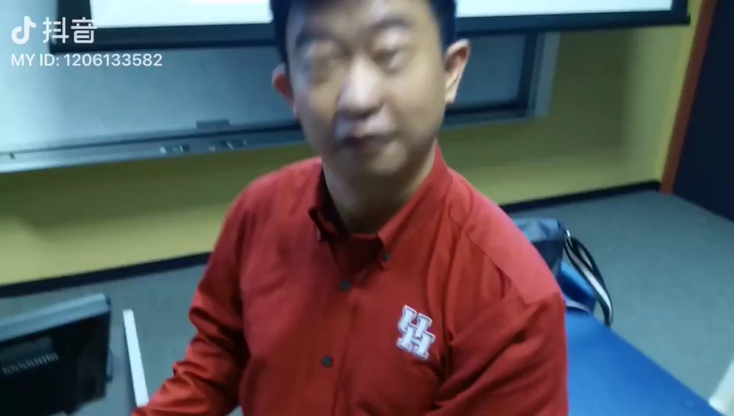
Outline
01/50
Overview of LTE-based U2X Services
  Introduction
  UAV Sensing and Transmission
  Key Challenges
Three Scenarios
  UAV Sensing and Machine Learning
  Flight Trajectory Planning and Communication Optimization
  Mean Field Game for Control
Conclusions

Slide 3
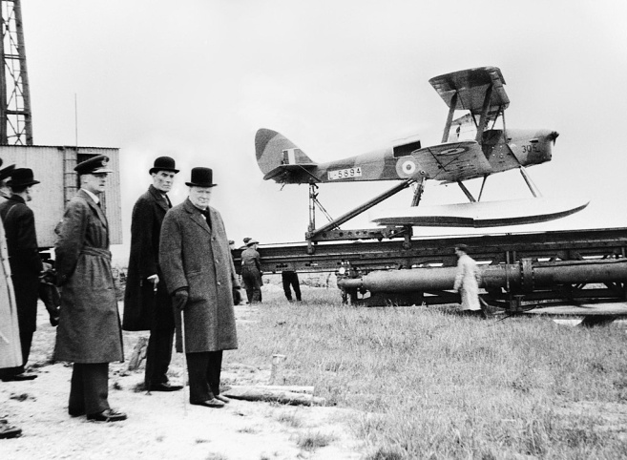
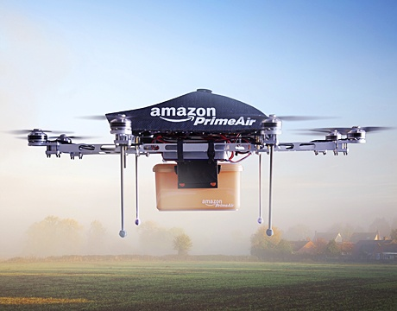
Introduction - History
02/50
In the early 1900s, UAV innovations started for training military personnel.
During the 1930s, the US Navy began to experiment with radio-controlled UAV.
From the 1990s, micro UAVs started to be widely used in public and civilian applications.
Recently, the communication of UAVs have been investigated in various applications.

Slide 4
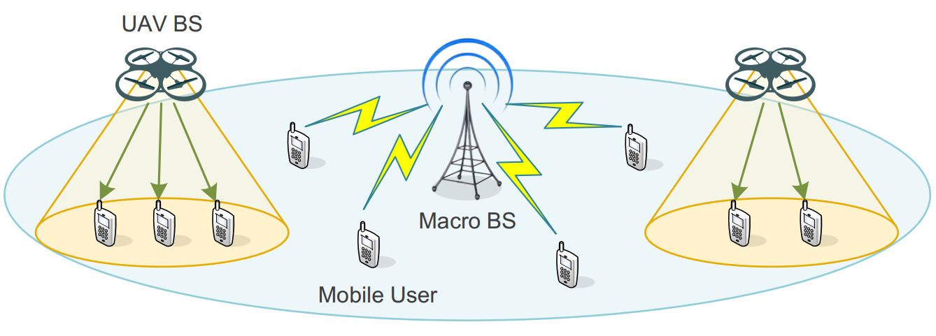
UAV as Cellular Infrastructure
03/50
UAVs as base stations [1] -- Low operational cost
  Capacity enhancement
  Data offloading
  Emergency communications
[1] Qingqing Wu, et al. “Joint Trajectory and Communication Design for Multi-UAV Enabled Wireless Networks," IEEE Trans. Wireless Commun., vol. 17, no. 3, pp. 2109-2121, Mar. 2018.

Slide 5
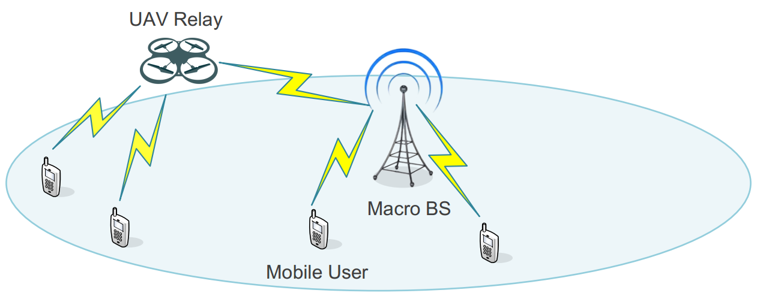
UAV as Cellular Infrastructure
04/50
UAVs as relays [2] -- Flexible deployment
  Coverage extension
  Data aggregation
  Backhauling
[2] Shuhang Zhang, et al. “Power and Trajectory Optimization for UAV Relay Networks,” IEEE Commun. Lett., vol. 22, no. 1, pp. 161-164, Jan. 2018.

Slide 6
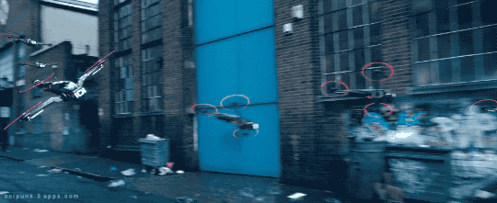
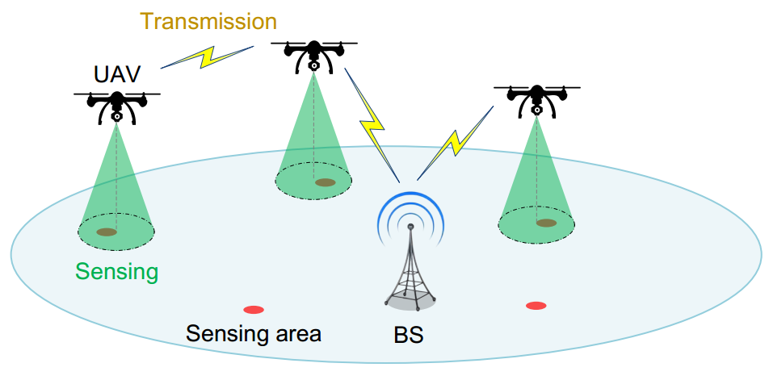
UAV as User Equipment
05/50
UAVs as aerial users [3] -- High mobility
  Sense and send protocol
    UAV sensing
    UAV transmission
Movie: Ready player one
[3] Hongliang Zhang, et al. “Cellular Network Controlled UAV-to-X Communications for 5G,” IEEE Wireless Commun., submitted.

Slide 7
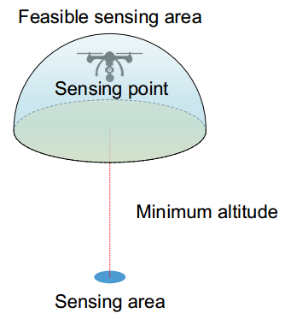
UAV Sensing
06/50
Rich sensing applications
  Camera
  Air-quality sensor
  Thermometer
Probability of successful sensing
  Related to the distance between the UAV and the sensing area
Feasible sensing area
  Probability of successful sensing is higher than a threshold
Sensing point
  The location of the UAV performing sensing

Slide 8
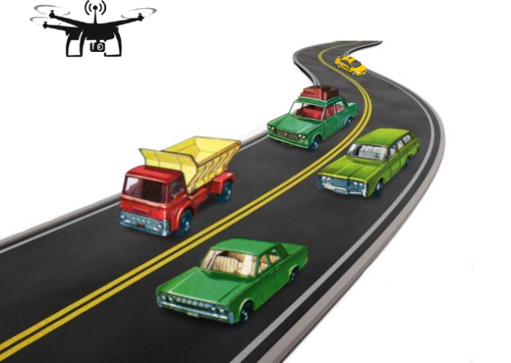
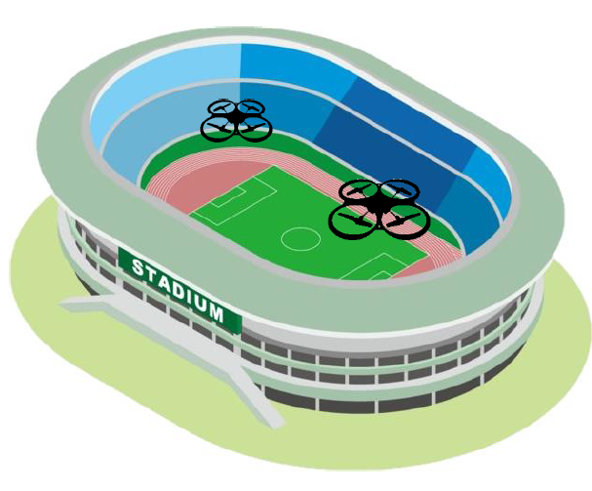
UAV Transmission
07/50
Communication requirements
  URLL: e.g. disastrous/traffic monitoring
    Strict latency constraint
  eMBB: Photographing or filming
    A large amount of sensory data

Slide 9
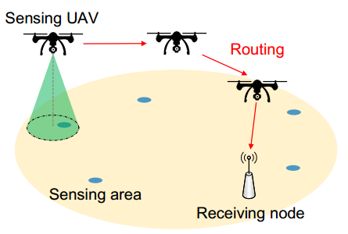
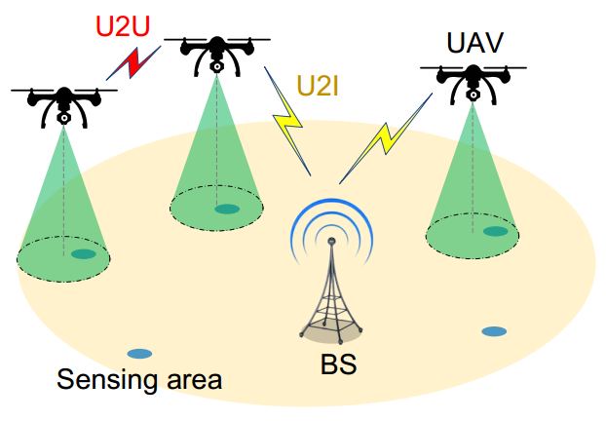
UAV Transmission
08/50
Existing Solutions
  UAV ad hoc network
    Inefficient routing
    Unlicensed band: unguaranteed QoS
Cellular controlled UAV Network
UAV-to-X Communications
  Transmit data to the BS when performing sensing
    U2I communications
    U2U communications

Slide 10
UAV Sensing and Transmission
09/50
 | Cellular controlled UAV network | UAV Ad hoc Network
Networking | U2X | Ad-hoc
Sensing | All UAVs | Some UAVs
Transmission | Licensed | ISM
Latency | Controllable | Unexpected
Rate | Guaranteed | Unguaranteed
Cost | Low | High

Slide 11
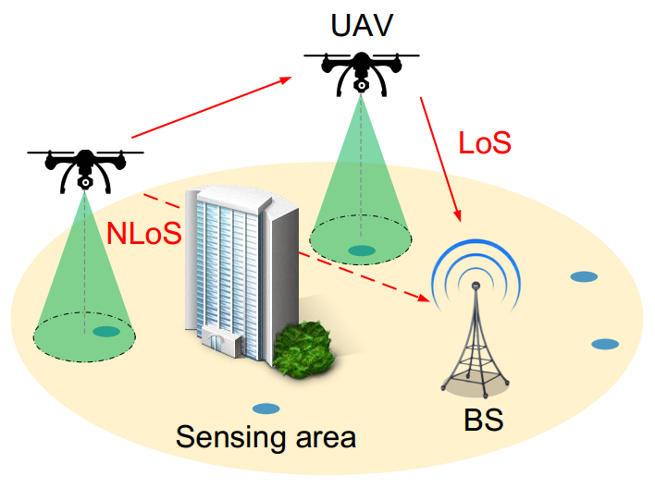
UAV-to-X Communication Channels
10/50
Air-to-ground channel
  Different from ground communication
    Altitudes and elevation angles
  Probability path loss model
    LoS and NLoS with different probabilities of occurrence
    Probability: environment and elevation angels
  Small-scale fading: Rican
Air-to-air channel
  Dominated by the LoS component
  Suffer more Doppler shifts

Slide 12
Key Challenges
11/50
3-dimentional trajectory optimization
  High QoS for UAV communication
  High successful sensing probability
Frequency allocation
  Interference avoidance
  UAV transmission scheduling
Power control
  Propulsion energy
  Transmission power

Slide 13
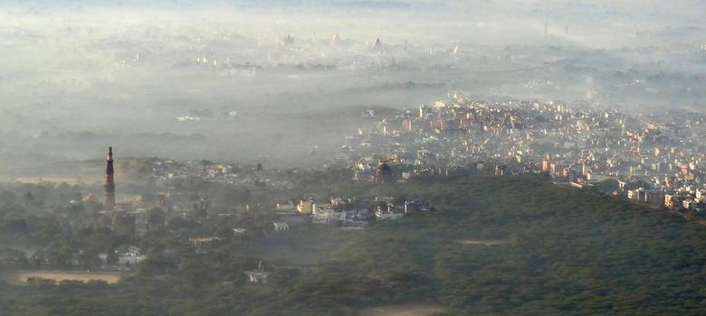
Outline
12/50
Overview of LTE-based U2X Services
UAV Sensing and Machine Learning
  3D Air Quality Index Real-time Monitoring by UAV
Flight Trajectory Planning & Communication Optimization
Mean Field Game for Control
Conclusions

Slide 14
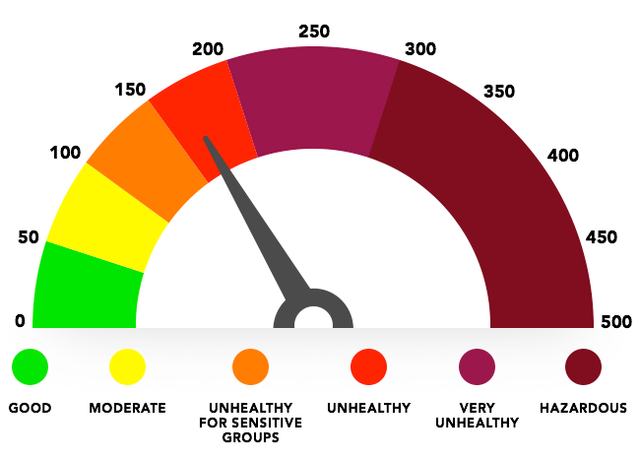
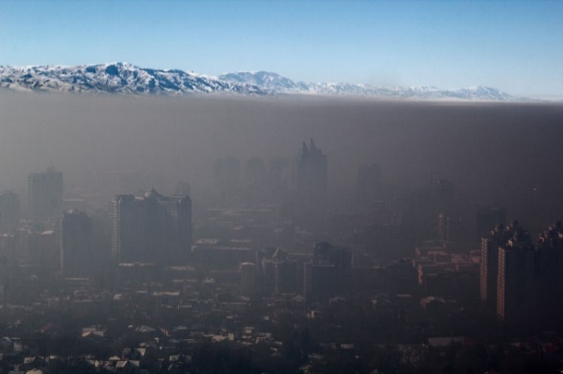
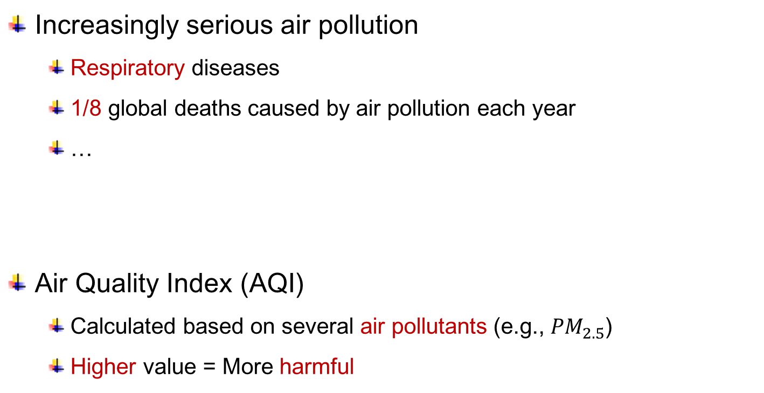
Real-time AQI Monitoring
13/50
Increasingly serious air pollution
  Respiratory diseases
  1/8 global deaths caused by air pollution each year
  …
Air Quality Index (AQI)
  Calculated based on several air pollutants (e.g., ${PM}_{2.5}$)
  Higher value = More harmful
  Yuzhe Yang, et al. “Realtime Profiling of Fine-Grained Air Quality Index Distribution using UAV Sensing,” IEEE Internet Things J., vol. 5, no. 1, pp. 186-198, Feb. 2018.

Slide 15
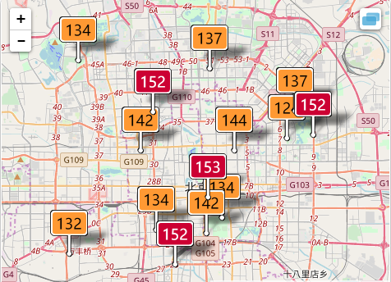
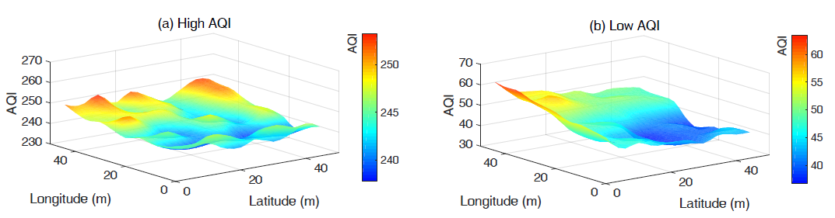
Motivation and Contribution
14/50
Motivations
  Static stations on dedicated locations
  2D map without height profiling
  Coarse-grained
Our contributions
  Fine-grained monitoring
  3D AQI map
  Real-time profiling

Slide 16
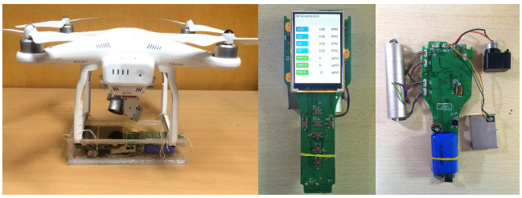
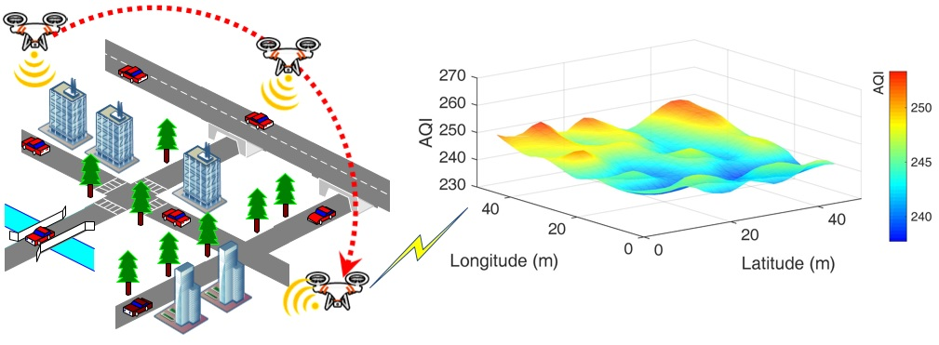
System Model
15/50
System Design [6]
  Mobile sensing system based on UAV
  Sensor：laser-based AQI detector
System Operation
  Data sensing (UAV monitoring algorithm)
  Real-time data analysis (map construction)
  AQI map visualization (dataset + webpage)
[6] Yuzhe Yang, et al. “Realtime Profiling of Fine-Grained Air Quality Index Distribution using UAV Sensing,” IEEE Internet Things J., vol. 5, no. 1, pp. 186-198, Feb. 2018.

Slide 17
AQI Features
16/50
Key feature selection
  In coarse-grained scenario [7]
    Wind, temperature, humidity, 3D location
  Feature selection in fine-grained scenario
    Hypothesis test: test the coefficient for each feature
    Wind
    3D Location coordinates (x, y, z)
    Weather condition
    Features will be considered as model’s input later
[7] Michela Cameletti, et al. ”Comparing spatio-temporal models for particulate matter in Piemonte,” Environmetrics, vol. 22, no. 8, pp. 985-996. Dec. 2011.

Slide 18
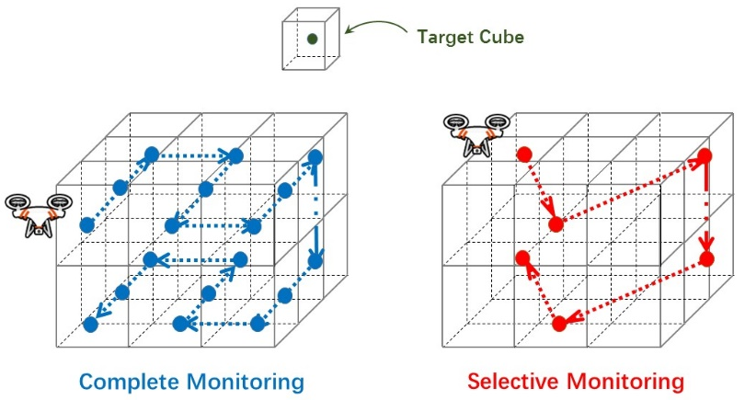
AQI Monitoring Solutions (1)
17/50
Complete monitoring
  Measure all cubes
  However: UAV battery constraint
Solution
  Measure only a few locations
  Use a model to estimate AQI at unmeasured locations

Slide 19
AQI Monitoring Solutions (2)
18/50
Selective monitoring
  Choose only a few cubes based on the latest AQI map
  Update AQI map use Gaussian Plume Model- Neural Network (GPM-NN) model
  If the area experiences severe environmental changes (e.g., gale)?
    Trigger complete monitoring again!

Slide 20
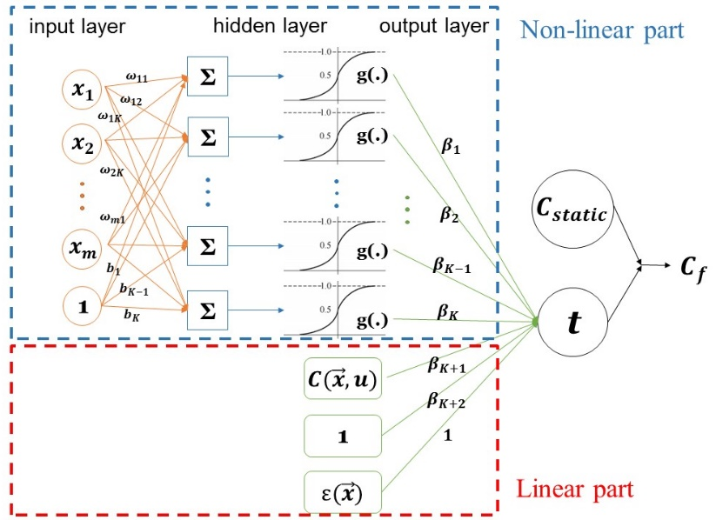
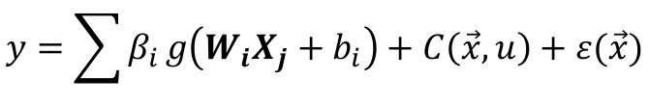
AQI Monitoring Solutions (3)
19/50
GPM-NN model
  Input: features (wind, 3D location, weather condition)
  Output: estimated AQI value at unmeasured locations
Contributions
  Combine physical model & Neural networks (nonlinearity to rectify the output for better regression)
  High accuracy, better than single NN/single physical model
  NN guide system selecting specific
  locations for monitoring
$$y=\sum{β_{i}}g\left(W_{i}X_{j}+b_{i}\right)+C\left(\vec{x},u\right)+ε(\vec{x})$$
NN part
Physical part

Slide 21
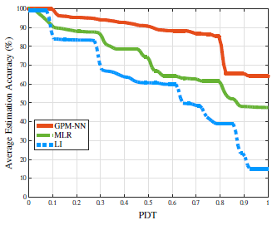
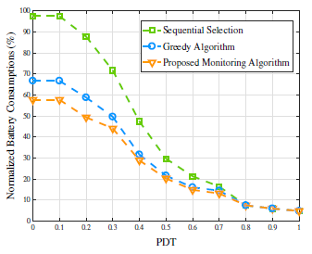
Simulations and Discussions
20/50
Experimental Result
Partial derivative threshold (PDT), larger the value, the more locations we will select to monitor
GPM-NN has the highest estimation accuracy compared to other common methods
Adaptive monitoring algorithms can best save the UAV’s battery consumption

Slide 22
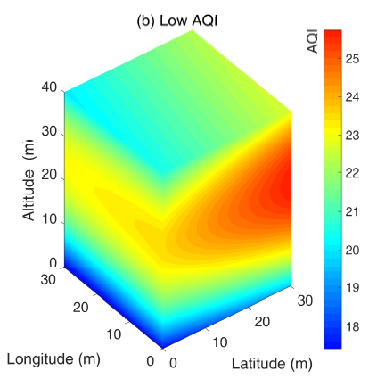
Simulations and Applications
21/50
Applications
  Generate real-time AQI maps
  2D area:
  3D area:
A deeper color corresponds to a higher AQI value
A deeper color corresponds to a higher AQI value

Slide 23
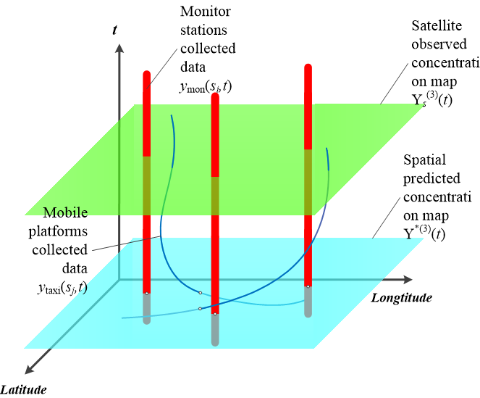
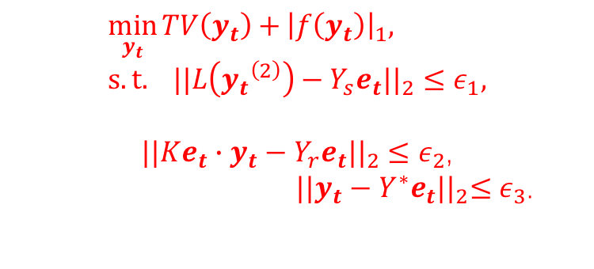
Improving using Sparse Optimization
22/50
Monitor stations
Fully-resolved
Low accuracy
3D map
Covariates
Spatial prediction
Mobile platforms
Satellite data
High resolution
High accuracy
3D map
Restoration
TV constraints
$$\min_{y_{t}}{TV\left(y_{t}\right)+}{\left|f\left(y_{t}\right)\right|}_{1}, s.t. {||L\left({y_{t}}^{\left(2\right)}\right)−Y_{s}e_{t}||}_{2}≤ε_{1},$$
${||Ke_{t}∙y_{t}−Y_{r}e_{t}||}_{2}≤ε_{2}$,
${ ||y_{t}−Y^{∗}e_{t}||}_{2}≤ε_{3}$.

Slide 24
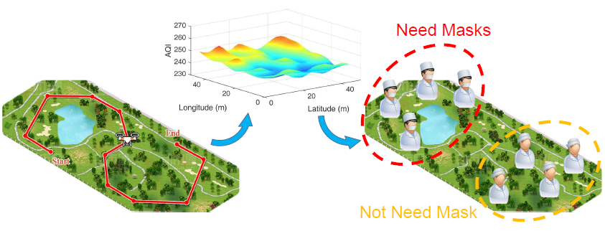
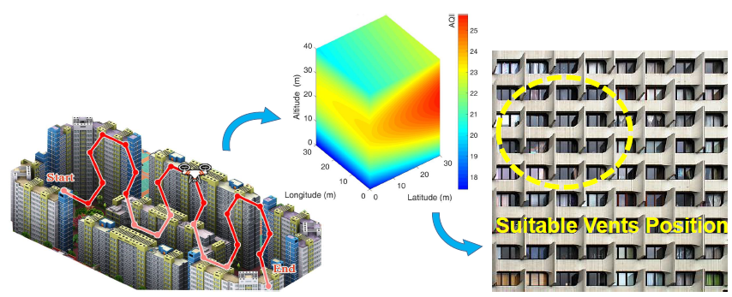
Applications
23/50
Applications
  Instructions on mask wearing
  Ventilation System Design for Buildings

Slide 25

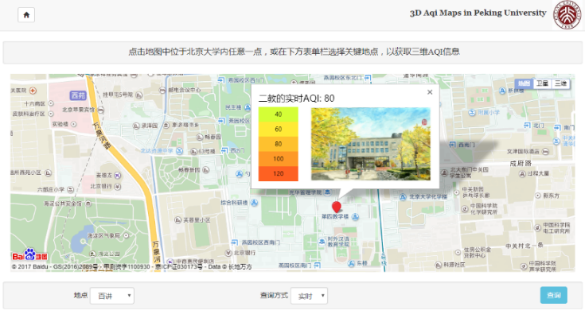
Deliverables
24/50
Dataset
  Include both 2D and 3D fine-grained AQI data
  https://github.com/YyzHarry/AQI_Dataset
Map Visualization: Webpage Design
  Realtime 3D AQI map: http://aqimaps.com/
  Data can also be uploaded by sensors and
  crowd-sourcing
Demo Video
  https://www.youtube.com/embed/POX-kazz_Ec (YouTube)
  System project won First Prize (1st out of 23 finalist), in
  IEEE ComSoc Student Competition 2017
Fine-grained AQI
Dataset link

Slide 26
Outline
25/50
Overview of LTE-based U2X Services
UAV Sensing and Machine Learning
Flight Trajectory Planning & Communication Optimization
  Spectrum Sharing Planning for Full-Duplex UAV Relaying Systems With Underlaid D2D Communications
  IEEE Journal on Selected Areas in Communications
Mean Field Game
Conclusions

Slide 27
System Model
26/50
Flight Trajectory
Power Control

Slide 28
Problem Formulation
27/50
Objective:
maximize the destination node’s throughput
Constraints:
information causality constraints
minimum SINR requirements of D2D pairs
transmit power budget
UAV’s trajectory constraints
Optimization variables:
UAV’s flight trajectory
transmit power of the source node
transmit power of the UAV
transmit power of the i-th D2D transmitter (D2D-Tx)

Slide 29
Algorithm Design
28/50
The formulated problem is difficult to be solved
  The objective function is non-convex/non-concave since the achievable throughput not only depends on its own transmit power, but also influenced by the transmit power of any D2D pairs;
  The information causality constraint C 1 is coupled in consecutive time slots and no convex property is guaranteed;
  The feasible region of the investigated optimization problem is varied and even non-convex because the SINR requirement of the D2D pair results in a protection region.
To this end, we first study two subproblems:
  Transmit power planning with given trajectory
  Trajectory planning with given transmit power
This is basically block coordinate descent method

Slide 30
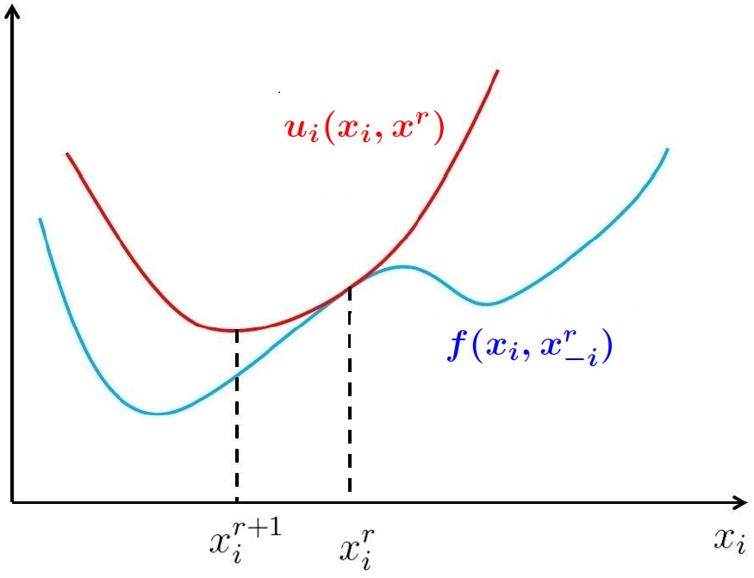
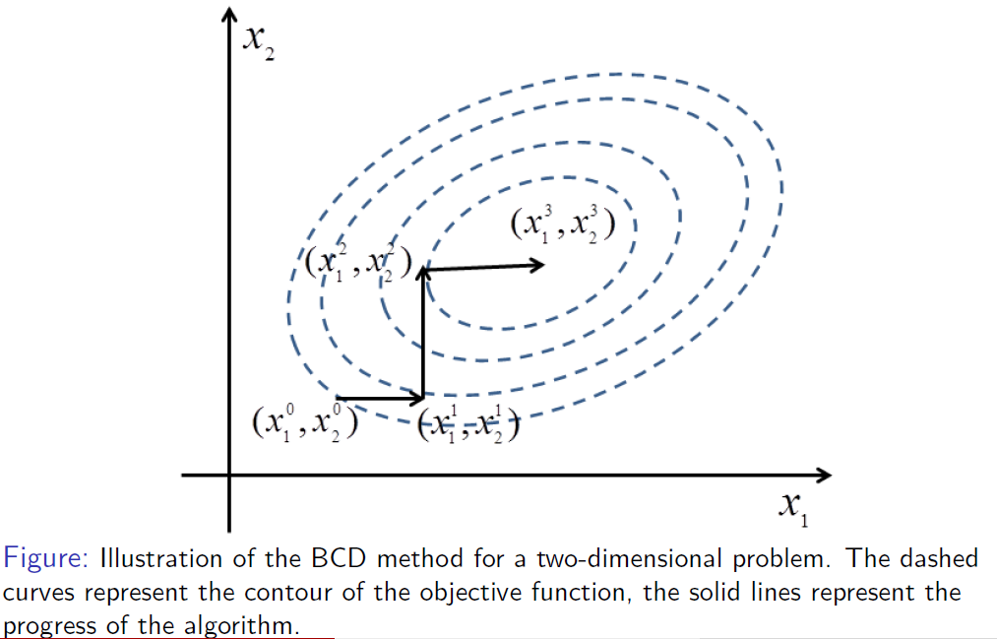
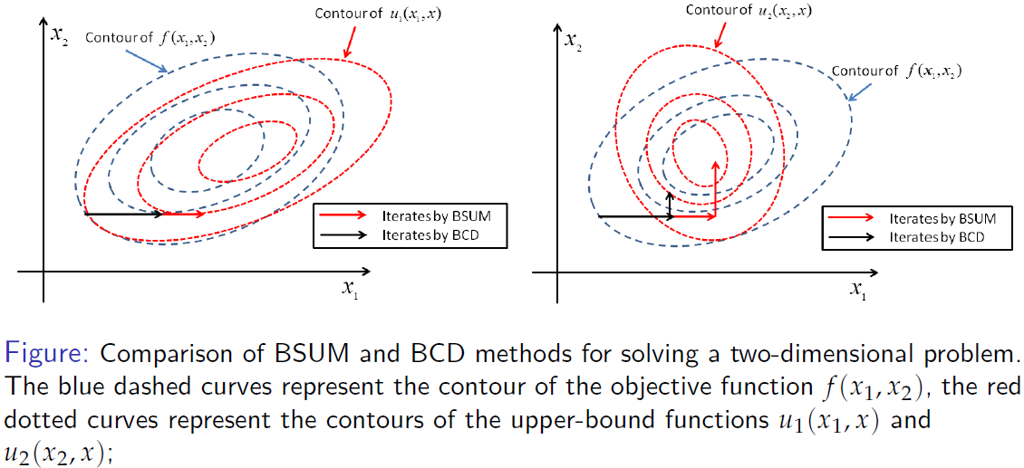
Block successive upper bound minimization (BSUM)
29/50

Slide 31
Simulation Setup
30/50
Square mark: the source node
Triangle mark: the destination node
Star mark: D2D pairs
x-mark: start (end) location
UAV’s trajectories for 3 different cases
Case I, where the start and end locations of the UAV are (0; 500; 100) and (1000; 500; 100), and the destination node is located at (800; 250; 0);
Case II, in which the destination node is located at (500; 400; 0) with the same start and end locations of the UAV as in case I;
Case III, for which the start and end locations of the UAV are (0; 500; 100) and (0; 500; 100) with the same destination node location as in case I.

Slide 32
Simulation Results
31/50
trajectory planning transmit power planning
The UAV’s speeds obtained by the proposed algorithm for different cases over the time slot, where the maximum UAV’s speed is V = 60 m/s.
The transmit powers of the source node, UAV and D2D pairs for different cases.

Slide 33
Some other related works
32/50
UAV to Improve Network Connectivity
  global message connectivity, worst-case connectivity, network bisection connectivity, and k-connectivity
  Optimal deployment and movement
Zhu Han, A. Lee Swindlehurst, and K. J. Ray Liu, “Optimization of MANET Connectivity Via Smart Deployment/Movement of Unmanned Air Vehicles," IEEE Transactions on Vehicular Technology, vol.58, no.7, pp.3533-3546, September 2009.
Coalition Formation Game Approaches
  A number of UAVs to collect data from several arbitrarily located tasks
  UAVs take the roles of sensor, delivery, or relay
  The cost in terms of polling system delay
  Proposed distributed hedonic coalition formation algorithm
Walid Saad, Zhu Han, Tamer Basar, Merouane Debbah, and Are Hjorungnes, “Hedonic Coalition Formation for Distributed Task Allocation among Wireless Agents," IEEE Transactions on Mobile Computing, vol. 10, no.9, pp.1327-1344, September 2011.

Slide 34
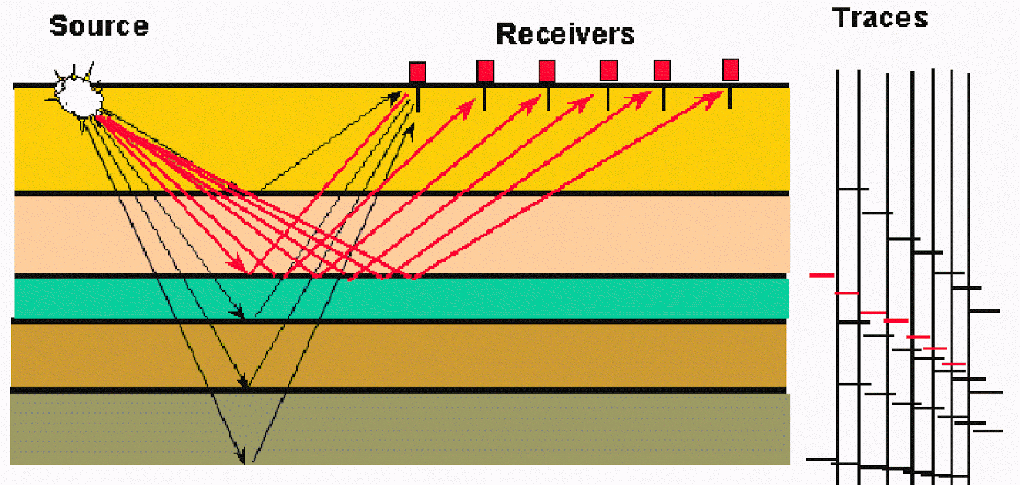
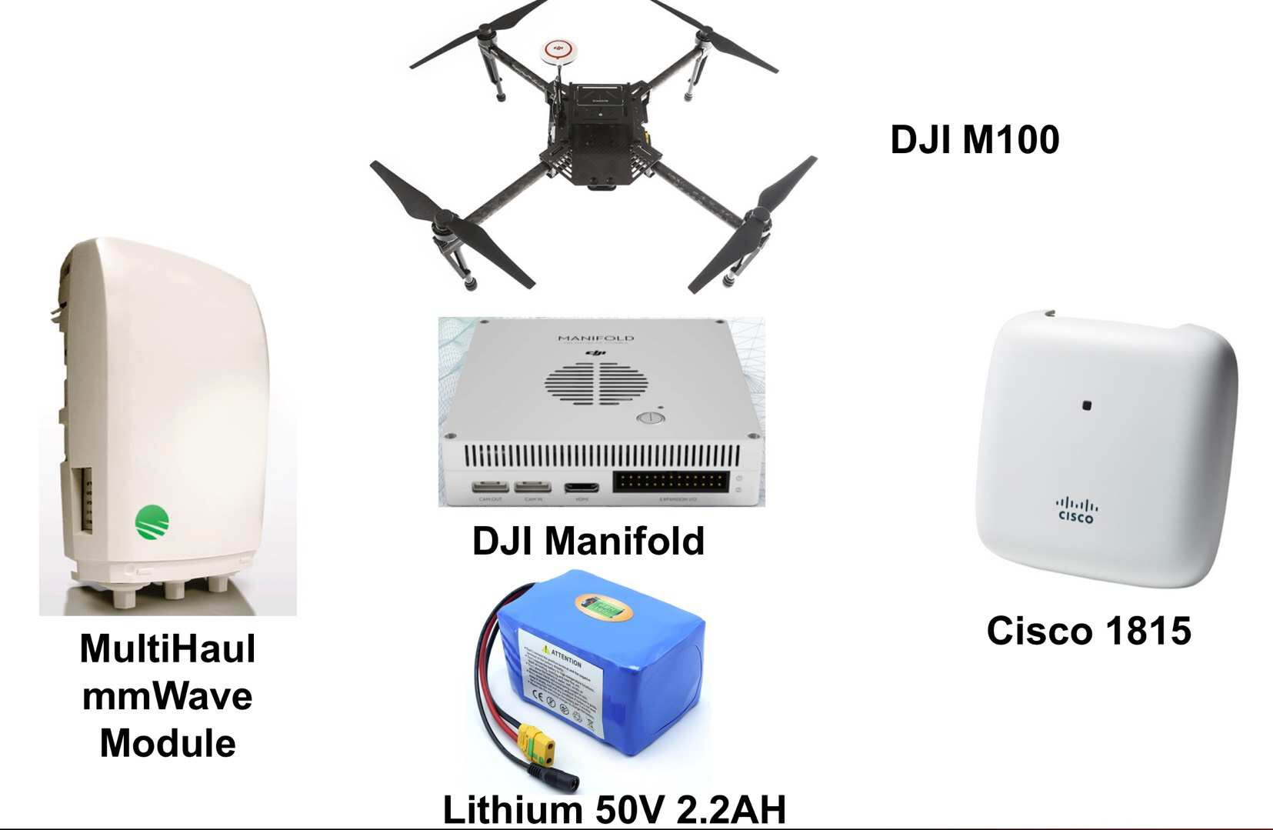
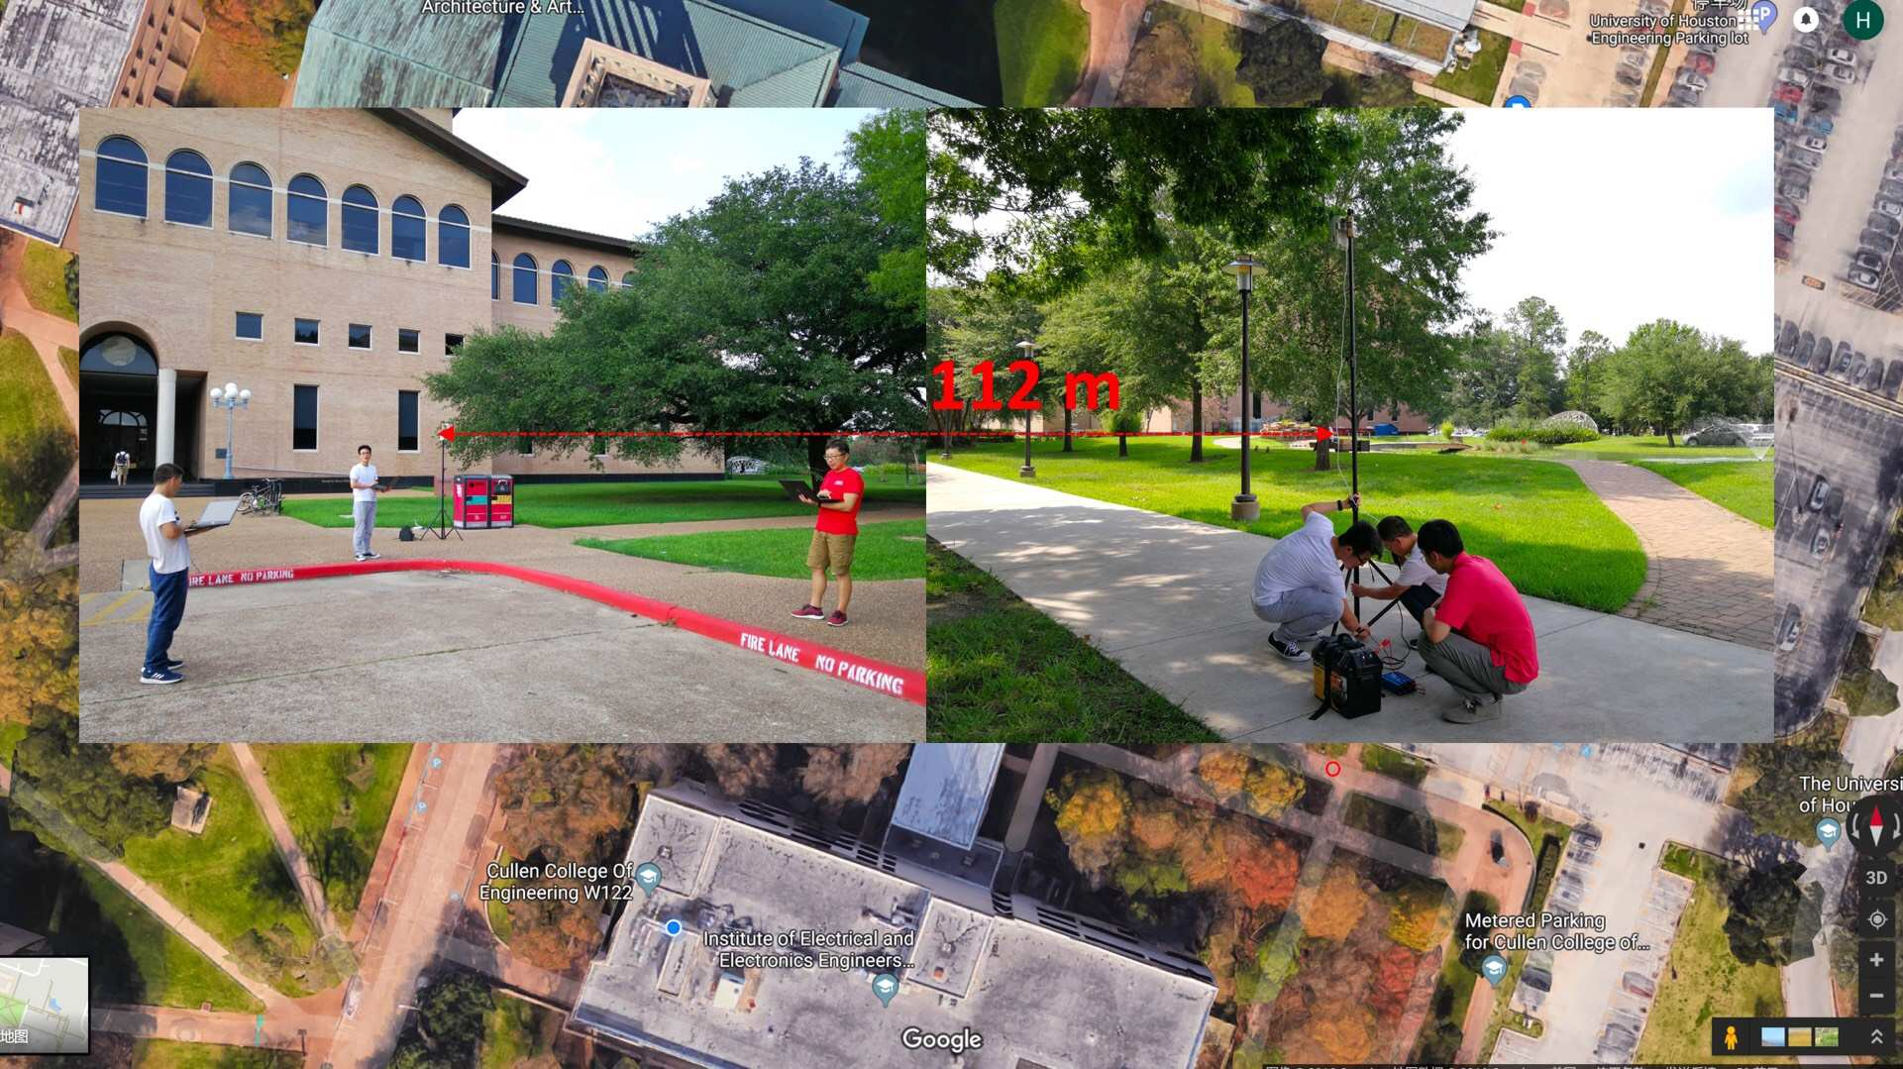
mmWave on Sky for Oil Company
33/50

Slide 35

Outline
34/50
Overview of LTE-based U2X Services
UAV Sensing and Machine Learning
Flight Trajectory Planning and Resource allocation
Mean Field Game for Control
  Basic Concepts
  Examples
Conclusions

Slide 36
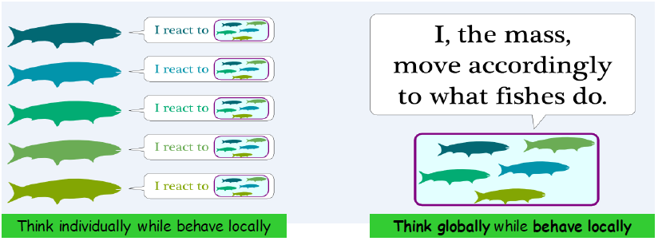
Classical Game Theory vs Mean Field Game
35/50
In classical game theory, a fish reacts to what other fishes nearby do.
In mean-field game theory, each fish does not care about each of the other fishes. Rather, it cares about how the fishes nearby, as a mass, globally move. In other words, each fish reacts only to the mass.

Slide 37
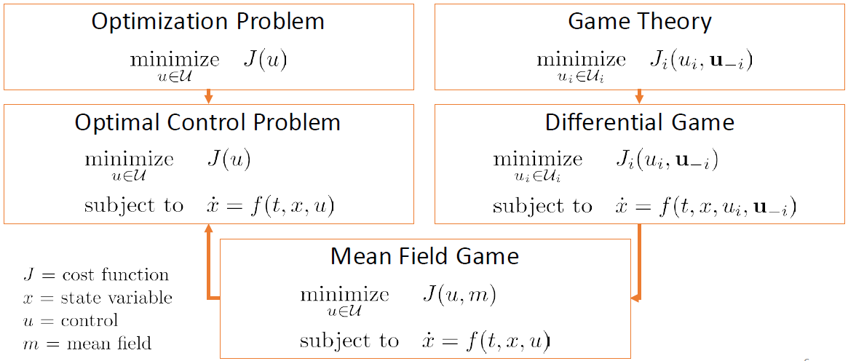
Mean Field Game as an Optimal Control Problem
36/50

Slide 38
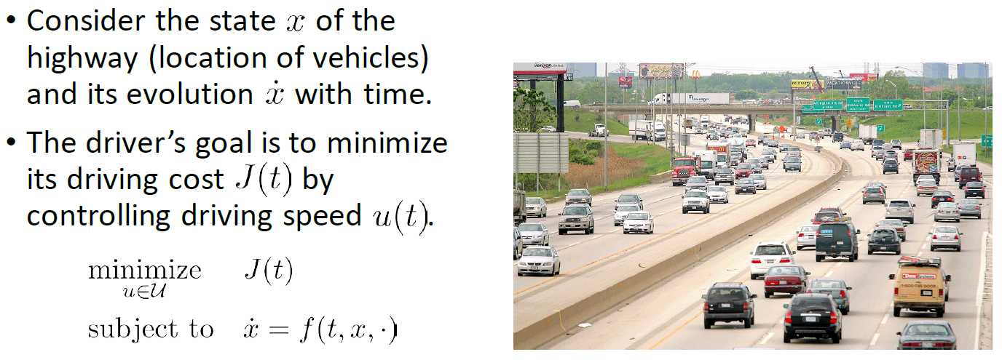
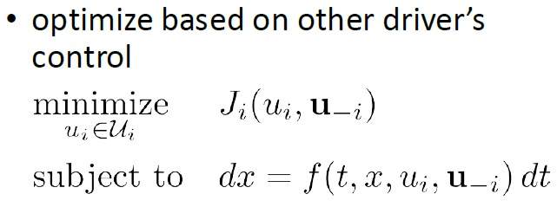
Example: Highway Driving
37/50

Slide 39
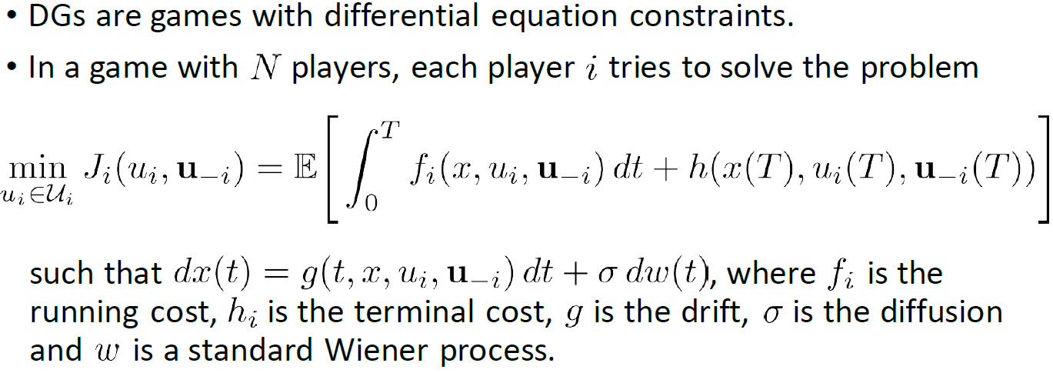
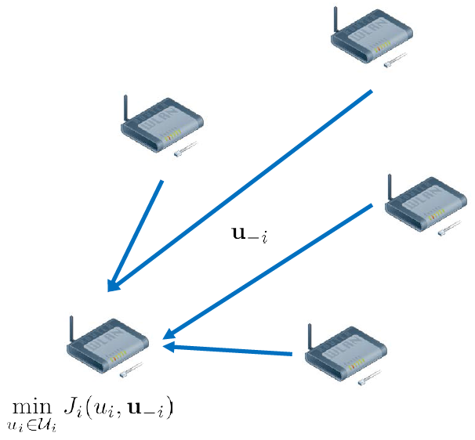
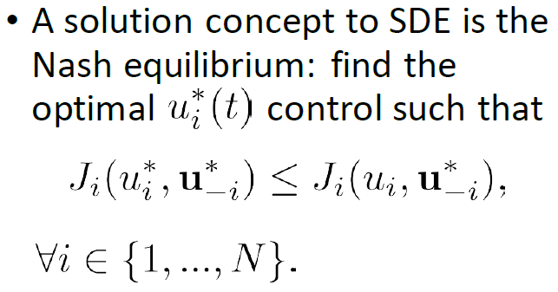
Stochastic Differential Games
38/50

Slide 40
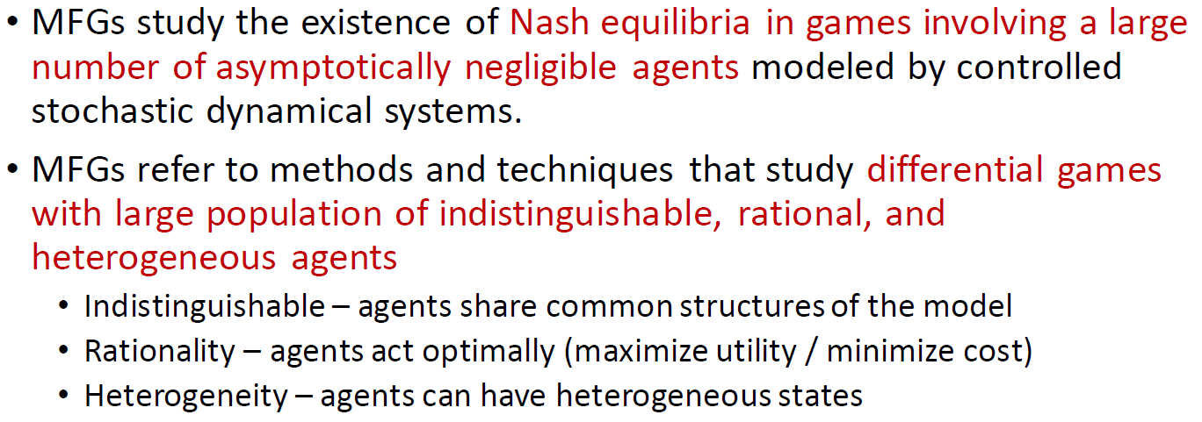
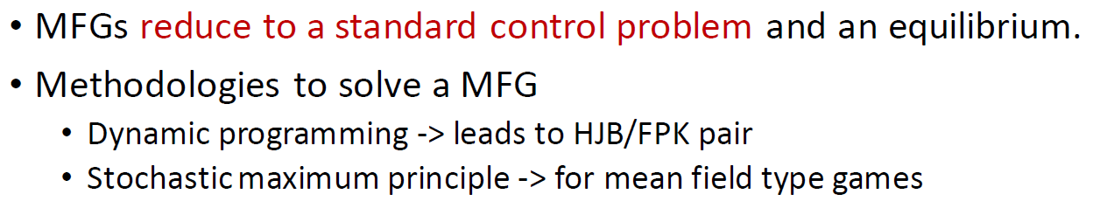
Mean Field Games
39/50

Slide 41
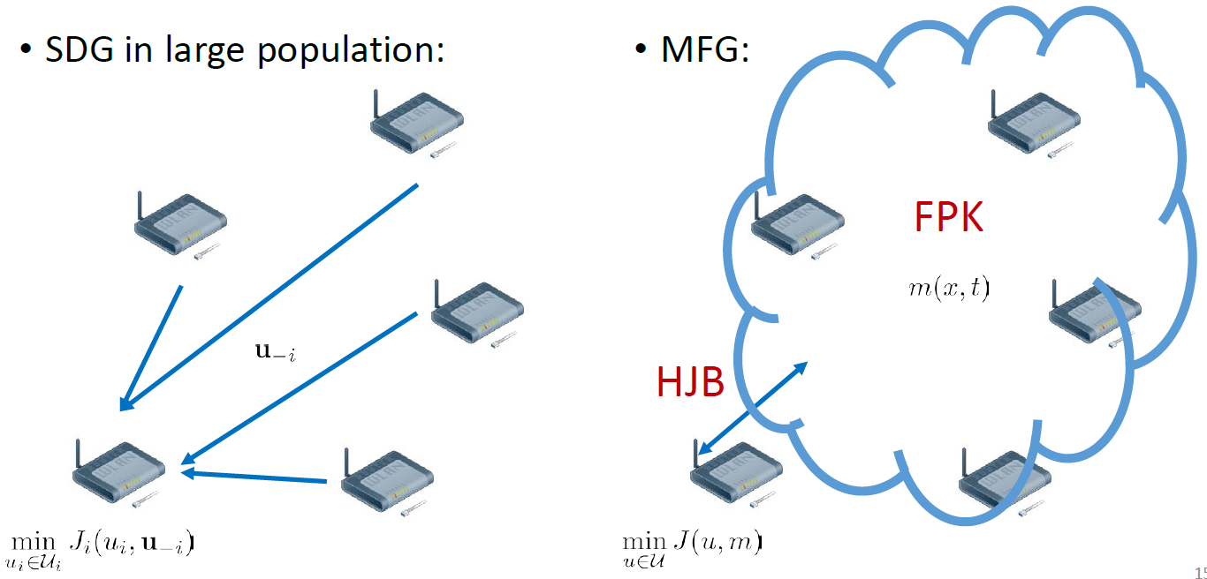
Mean Field Games
40/50

Slide 42
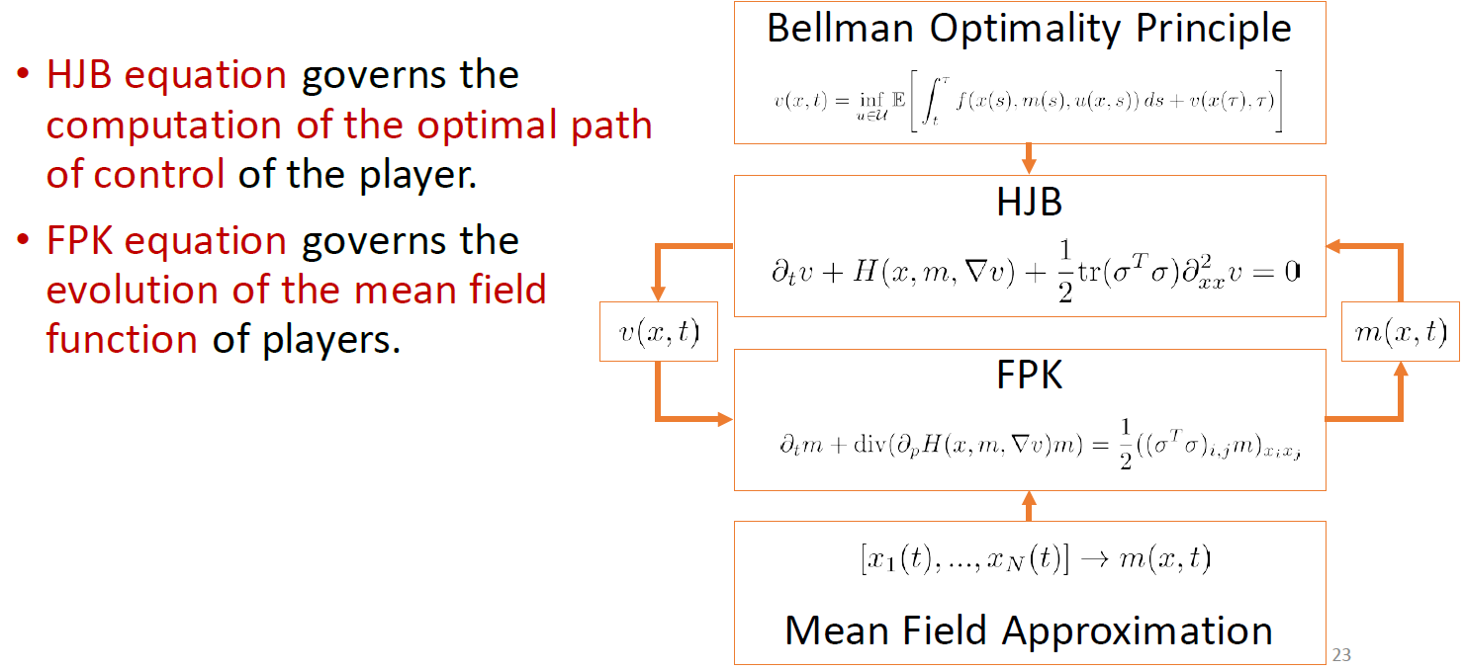
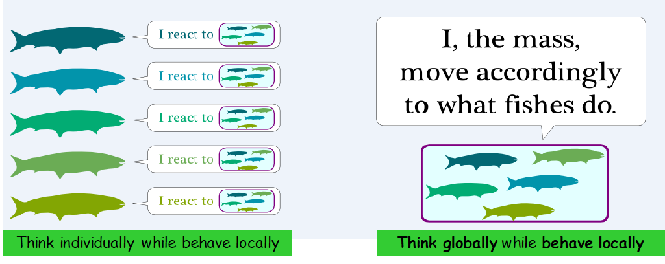
Summary of HJB-FPK Solution to MFG
41/50

Slide 43




Example 3: Existing UAV Works Using MFG
42/50
Interference Management in Dense Drone Small Cells Networks Using MFG
Charging Policy and Interference Mitigation in Wireless Powered IoTs
Distributed Resource Allocation in NOMA-Based UAV Networks Using MFG
Adaptive Coverage Solution In Multi-UAVs Emergency Communication System

Slide 44
Conclusion
43/50
U2X communications for UAV sensing tasks
  UAV sensing and transmission
  U2I and U2U schemes
  Applicable 5G technologies
Applications:
  3D AQI Real-time Monitoring
  Trajectory planning and resource optimization
  Mean field game theoretical approach

Slide 45
Reference
44/50
Y. Yang, Z. Zheng, K. Bian, L. Song and Z. Han, “Realtime Profiling of Fine-Grained Air Quality Index Distribution using UAV Sensing,” IEEE Internet Things J., vol. 5, no. 1, pp. 186-198, Feb. 2018.
Haichao Wang, Jinlong Wang, Jin Chen, Guoru Ding, Yuzhou Li, and Zhu Han, “Spectrum Sharing Planning for Full Duplex UAV Relaying Systems with Underlaid D2D Communications," to appear IEEE Journal on Selected Areas in Communications, Special Issue on Airborne Communication Networks.
Jingjing Wang, Chunxiao Jiang, Zhu Han, Yong Ren, and Hanzo Lajos, “Taking Drones to the Next Level: Cooperative Distributed Unmanned-Aerial-Vehicular Networks for Small and Mini Drones," IEEE Vehicular Technology Magazine, vol. 12, no. 3, pp. 73-82, September 2017.
Walid Saad, Zhu Han, Tamer Basar, Merouane Debbah, and Are Hjorungnes, “Hedonic Coalition Formation for Distributed Task Allocation among Wireless Agents," IEEE Transactions on Mobile Computing, vol. 10, no.9, pp.1327-1344, September 2011.
Zhu Han, A. Lee Swindlehurst, and K. J. Ray Liu, “Optimization of MANET Connectivity Via Smart Deployment/Movement of Unmanned Air Vehicles," IEEE Transactions on Vehicular Technology, vol.58, no.7, pp.3533-3546, September 2009.
Zihe Zhang, Lixin Li, Xiaomin Liu, Wei Liang, Zhu Han, “Matching-Based Resource Allocation and Distributed Power Control Using Mean Field Game in the NOMA-Based UAV Networks," Asia-Pacific Signal and Information Processing Association Annual Summit and Conference, Honolulu, Hawaii, November 2018.
Yang Xu, Lixin Li, Zihe Zhang, Kaiyuan Xue, and Zhu Han, “A Discrete-Time Mean Field Game in Multi-UAV Wireless Communication System," IEEE/CIC International Conference on Communications in China, Beijing, China, August 2018.

Slide 46
Overview of Wireless Amigo Lab
45/50
Lab Overview
  Currently: 14 Ph.D. students and many visitors
  Alumni: 17 Ph.D. and 4 postdocs.
  Since 2008, 15 NSF funding, DOD, DOI, Gulf of Mexico Research Initiative, Power consortium, Qatar grants and many companies supports
  1% highly cited researcher Web of Science, google citation >31,000, h factor 88.
Current Concentration
  Game Theoretical Approach 40%
  Compressive Sensing and Big Data
  Machine Learning
      Bayesian nonparamentric learning: IGMM, Gibbs sampling
      Deep learning
      Multiarm Bandit: Exploration and exploitation
  RF Energy Harvesting and Transfer
  Full Duplex/D2D/mmWave/femtocell/Backscatter/IoT
  Mobile Edge Computing/Network Virtualization/Software defined network
  Airial Access Networks: UAV and Satellite

Slide 47









Research Lab Summary
46/50
  Security
    Device identification by Baysian nonparametric method
    Trust management and belief network/propagation
    Quickest detection
    Physical layer security
    Primary user emulation attack
  Smart Grid
    False data injection attack
    PHEV optimization
    Distributed microgrid control
    Renewable energy
    Smart meter
    Demand side management
Summary from my student’s facebook
  Theory is something we know why, but it does not work.
  Practice is something works, but we do not know why.
  In our research lab, we have both: nothing works and we really do not know why.

Slide 48






Amigo Lab in University of Houston
Our Group
47/50

Slide 49
Thanks for your attending

Slide 50








Current Other Research
Application
  Wireless Networking
  Smart Grid
  Data Analysis
Theory (two courses)
  Game Theory
  Big Data
Academic Index
  won 3 best journal paper awards (including IEEE JSAC),
  16 IEEE conference best paper awards.
  >300 published/accepted transactions/magazines/letters, >300 conference papers, 17 book chapters, and 2 patents.
  google citation > 29,000 with H factor 85
  1% highly cited researcher since 2017 according to Web of Science.
  IEEE fellow class of 2014, IEEE distinguished lecturer since 2015
  8 Cambridge University Press Books and 8 Springer Books

Slide 51
Ex1: Downlink Interference Management in Dense Drone Small Cells Networks Using Mean-Field Game Theory
42/50
Integrating drones to overloaded terrestrial networks may offer benefits by offloading traffic, reducing handovers for highly mobile users.
However, such performance enhancement is largely limited by mutual interference and energy availability in dense drone networks.
The interference control problem can be mapped to an altitude control problem. Using Mean-Field Game to obtain the optimal altitude control strategy.

Slide 52
Ex2: A Prediction-Based Charging Policy and Interference Mitigation Approach in the Wireless Powered Internet of Things
43/50
In wireless powered IoT (WP-IoT) networks, there exists severe interference greatly reducing the energy transmission efficiency.
The interference mitigation problem in a WP-IoT can be modeled as a MFG, taking the sensor nodes’ energy and the mutual interference among the sensors into consideration.

Slide 53
Ex3: Matching-Based Resource Allocation and Distributed Power Control Using Mean Field Game in the NOMA-Based UAV Networks
44/50
Non-orthogonal Multiple Access (NOMA)-based interference mitigation problem
In MFG with dominator, there exists at least one interference dominator, which should not be aggregated in the interference mean field.

Slide 54
Ex4: Adaptive Coverage Solution In Multi-UAVs Emergency Communication System: A Discrete-Time Mean-Field Game
In emergency communication system, a large number of UAVs replace damaged base stations for air-to-ground service, with dense users and wide areas.
A flight strategy of multi-UAVs is solved by a discrete time MFG, which consider the number of users covered by each UAV.
Meanwhile the MFG model
also concludes the energy
consumption and User's
mobility.
45/50

Slide 55
Ex5: A Discrete-Time Mean Field Game in Multi-UAV Wireless Communication Systems
46/50
The D2D communication system with Ultra-dense UAVs and ground users.
The power control is modeled as a Discrete-Time Mean Field Game system.
Meanwhile, the system
concludes the interference
from other D2D pairs and
the energy constrain.

