Slide 1
GNU RADIO INTRODUCTION
By
Sumit Abhichandani
Veera bapineedu nune
Tushar ambre
Kiran kumbhar
Sathya sridharan
ukash

Slide 2
OUTLINE
Introduction
USRP
USRP 2
USRP vs USRP2
References

Slide 3
INTRODUCTION
Software radio
What is GNU Radio

Slide 4
SOFTWARE RADIO
An implementation technology
A technique for moving digital signal processing as close as
possible to the antenna
Replacing rigid Hardware with flexible software based solutions
A software (defined) radio is a radio that includes a transmitter in which the operating parameters of the transmitter, including the frequency range, modulation type or maximum radiated or conducted output power can be altered by making a change in software without making
any hardware changes.

Slide 5
Defining software radio using tiers...
The SDR Forum has defined the following tiers, describing evolving capabilities in terms of flexibility
Tier 0
The Hardware Radio:
Hardware components only
cannot be modified ( Need physical intervention)

Slide 6
Defining software radio using tiers...
The SDR Forum has defined the following tiers, describing evolving capabilities in terms of flexibility
Tier 0:The Hardware Radio
Tier 1
Software Controlled Radio (SCR):
Only control functions software
Extends to inter-connects, power levels etc. but not to frequency bands and/or modulation types

Slide 7
Defining software radio using tiers...
The SDR Forum has defined the following tiers, describing evolving capabilities in terms of flexibility
Tier 0: The Hardware Radio
Tier 1: Software Controlled Radio (SCR)
Tier 2
Software Defined Radio (SDR):
provide software control of provide control of a variety of modulation techniques, such as
Wide-band or narrow-band operation,
Communications security functions (such as hopping),
Waveform requirements of current and evolving standards over a broad frequency range.
The frequency bands covered may still be constrained at the
front-end requiring a switch in the antenna system

Slide 8
Defining software radio using tiers...
The SDR Forum has defined the following tiers, describing evolving capabilities in terms of flexibility
Tier 0: The Hardware Radio
Tier 1: Software Controlled Radio (SCR)
Tier 2: Software Defined Radio (SDR)
Tier 3
Ideal Software Radio (ISR):
Even the analog amplification or heterodyne mixing prior to digital-analog conversion is eliminated.
Programmability extends to the entire system with analog conversion only at the antenna, speaker and microphones.

Slide 9
Defining software radio using tiers...
The SDR Forum has defined the following tiers, describing evolving capabilities in terms of flexibility
Tier 0: The Hardware Radio
Tier 1: Software Controlled Radio (SCR)
Tier 2: Software Defined Radio (SDR)
Tier 3:Ideal Software Radio (ISR)
Tier 4 (for comparison purpose only)
Ultimate Software Radio (USR):
Accepts fully programmable traffic
supports a broad range of frequencies, air-interfaces & applications software.
can switch from one air interface format to another in milliseconds, use GPS to track the users location, store money using smartcard technology, or provide video so that the user can watch a local broadcast station or receive a satellite transmission.

Slide 10
Defining software radio using tiers...
The SDR Forum has defined the following tiers, describing evolving capabilities in terms of flexibility
Tier 0: The Hardware Radio
Tier 1: Software Controlled Radio (SCR)
Tier 2: Software Defined Radio (SDR)
Tier 3: Ideal Software Radio (ISR)
Tier 4 : Ultimate Software Radio (USR)
Cognitive radio (CR) : wireless communication in which a
transceiver can intelligently detect which communication channels are in
use and which are not, and instantly move into vacant channels while
avoiding occupied ones.

Slide 11
GNU RADIO

Slide 12
BLOCK DIAGRAM
TRANSMIT PATH
RECEIVE RF FRONT END
ADC
YOUR CODE HERE!
XMIT RF FRONT END
DAC
YOUR CODE HERE!

Slide 13
PLATFORMS
WINDOWS
Cygwin
MinGW
LINUX
Ubuntu

Slide 14
SOFTWARE
GNU Radio provides a library of signal processing blocks and the glue to tie it all together.
LANGUAGES
C++
PYTHON
SWIG

Slide 15
APPLICATION
A TiVo equivalent for radio, capable of recording multiple stations simultaneously.
Time Division Multiple Access (TDMA) waveforms.
A passive radar system that takes advantage of broadcast TV for its signal source. For those of you with old TVs hooked to antennas, think about the flutter you see when airplanes fly over.
Radio astronomy.
TETRA transceiver.
Digital Radio Mundial (DRM).
Software GPS.
Distributed sensor networks.
Distributed measurement of spectrum utilization.
Amateur radio transceivers.
Ad hoc mesh networks.
RFID detector/reader.
Multiple input multiple output (MIMO) processing.

Slide 16
Overall Architecture
Hardware

Slide 17
Universal Software Radio Peripheral
Basic USRP facts
4*ADC, 12 bit @ 64MSPS
4*DAC, 14 bit @ 128MSPS
Altera EP1C12 FPGA for preprocessing tasks
USB 2.0 interface to host PC (32 MB/s)

Slide 18
Mother Board
Four digital downconverters with programmable decimation rates
Two digital upconverters with programmable interpolation rates
Capable of processing signals up to 16 MHz wide
Modular architecture supports wide variety of RF daughterboards
Auxiliary analog and digital I/O support complex radio controls such as RSSI and AGC
Fully coherent multi-channel systems (MIMO capable)

Slide 19
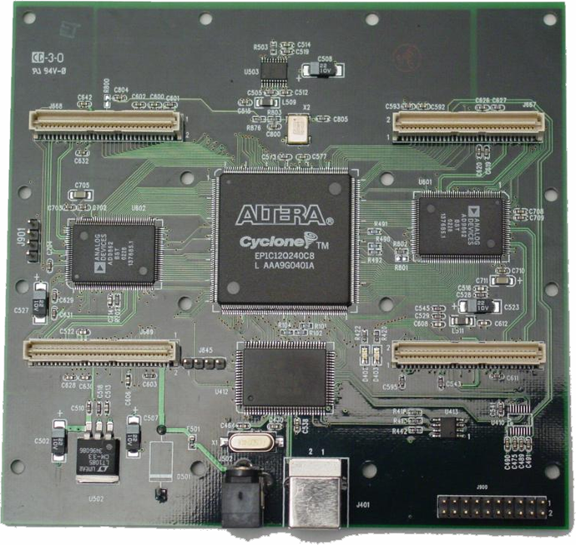
Transceiver port
ADC
Altera FPGA
Power
USB 2.0

Slide 20
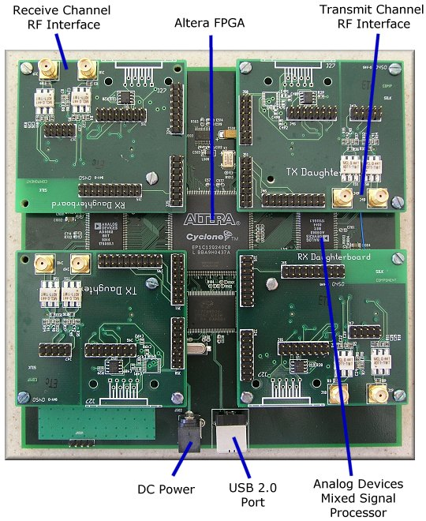

Slide 21
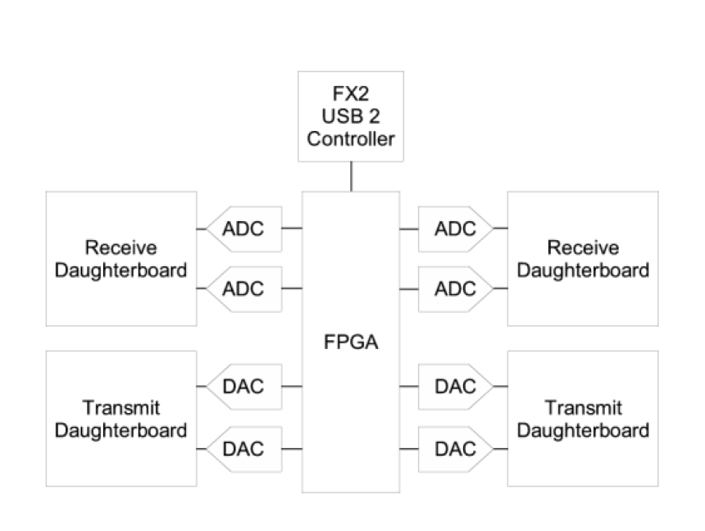
ARCHITECTURE

Slide 22
ARCHITECTURE
Sender
USRP (mother board)
User-defined
Code
USB
FPGA
DAC
RF
Front end
PC
One mother board support up to four daughter boards.
Several kinds of daughter boards available
modules that has been provided in GNU radio project to communicate between two end systems

Slide 23
Transmitter/Reciever
Sender
User-defined
Code
USB
FPGA
DAC
RF
Front end
PC
USRP (mother board)
Receiver
User-defined
Code
USB
FPGA
ADC
RF
Front end

Slide 24
ARCHITECTURE
Sender
USRP (mother board)
User-defined
Code
USB
FPGA
DAC
RF
Front end
PC
Support USB2.0/At this stage, USB 1.x is not supported at all
Support 32MB/sec across the USB.
Samples are in 16-bit signed integers in IQ format,
16-bit I and 16-bit Q data (complex), resulting in 8M complex samples/sec
across the USB.

Slide 25
ARCHITECTURE
Sender
USRP (mother board)
User-defined
Code
USB
FPGA
DAC
RF
Front end
PC
Includes digital down converters (DDC) implemented with cascaded integrator-comb (CIC) filters (for receivers).
Digital up converters (DUCs) on the transmit side are actually contained in the AD9862 CODEC chips, not in the FPGA.
The only transmit signal processing blocks in the FPGA are the interpolators.

Slide 26
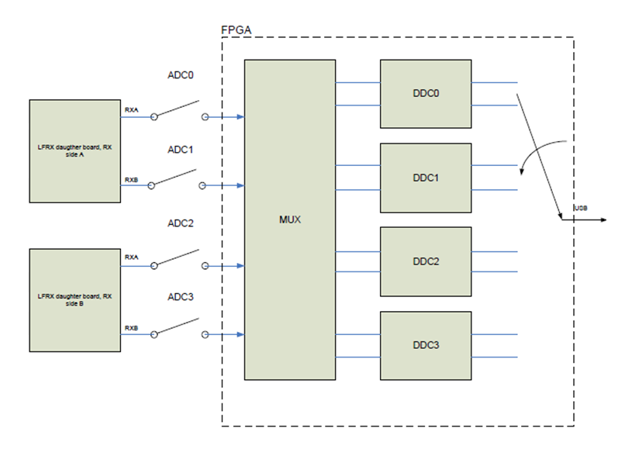
FPGA
Multiplexer
MUX is like router
Decides which ADC to each DDC

Slide 27
DDC
Down converts the IF band into base band
Decimates the signal to data rate so it can be transferred to usb.

Slide 28
ARCHITECTURE
Sender
USRP (mother board)
User-defined
Code
USB
FPGA
DAC
RF
Front end
PC
4 high-speed 14-bit DA converters, DAC clock frequency is 128 MS/s (stay below about 50MHz or so to make filtering easier.)
4 high-speed 12-bit AD converters, sampling rate is 64M samples per second.

Slide 29
Further developments in Gnu radio
The current GNU Radio architecture primarily aimed at Streaming Radio
The current scheduler relies on a steady stream of input data to processing blocks
Packet Radio (TDD/TDMA) is therefore difficult to implement with precise timing
Architectural change is implemented (USRP 2)
Processing of arbitrarily sized blocks of data
Treats input as messages, Data, Metadata
Include modification to FPGA
Python replaced by C++ as programming language

Slide 30
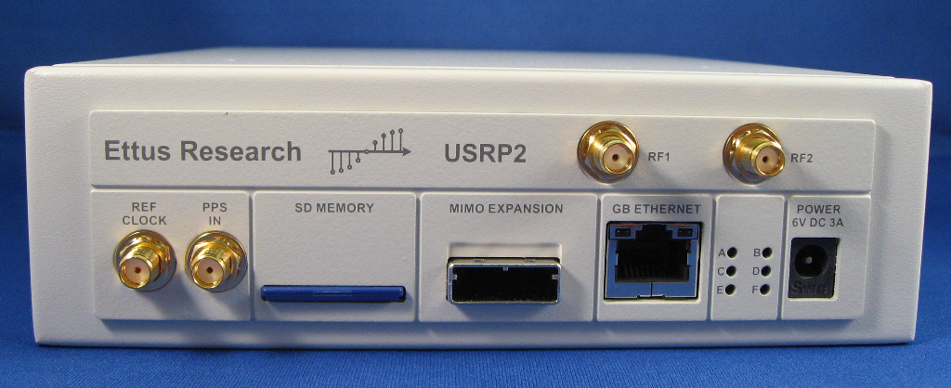
USRP2

Slide 32
FEATURES
100 MS/s 14-bit dual (IQ) ADCs
400 MS/s 16-bit dual (IQ) DACs
Gigabit Ethernet interface
Allows for 25 MHz of RF BW each way @16bits
Wide enough for WiFi!
Bigger FPGA w/Multipliers (Spartan 3)
1 MB high-speed on-board SRAM
High speed serial expansion interface

Slide 33
Features continued:
Can operate without host computer
External Frequency Reference Input
Flexible choice of reference, not just 10 MHz
Pulse per second (PPS) input for precise Timing
Uses the same daughterboards as USRP1
- Only holds 1 TX and 1 RX
- MIMO via expansion interface

Slide 34
USRP2 FPGA
Spartan 3
- ~40K logic cells, Lots of RAM and multipliers
32-bit RISC Processor soft core
- 50 MHz
- GCC tool chain
FIFOs and full crossbar between interfaces
Precise timing control (10ns) for TDMA, etc.

Slide 35
FPGA can handle High sample rate processing, like digital up- and down conversion.
Lower sample rate operations can be done in the FPGA, which contains a 32-bit RISC microprocessor.
The larger FPGA allows the USRP2 to be used as a standalone system without a host computer in many cases

Slide 36
DAUGHTER BOARDS
Provide transformation of mother board into a complete RF transreceiver system .
Daughter boards provide various features which helps their integration into complex systems.

Slide 37
FEATURES:
30 MHz transmit and receive bandwidth
Fully synchronous design, MIMO capable
All functions controllable from software or FPGA
Independent local oscillators (LOs) for TX and RX enable
split-frequency operation &built-in T/R switching
TX and RX on same connector or use auxiliary RX port
16 digital I/O lines to control external devices

Slide 38
VARIOUS DAUGHTER BOARDS USED
WBX0510
• Frequency Range: 50 MHz to 1 GHz
• Transmit Power: 100mW (20dBm)
RFX900
• Frequency Range: 750 to 1050 MHz
• Transmit Power: 200mW (23dBm)
RFX1200
• Frequency Range: 1150 to 1450 MHz
• Transmit Power: 200mW (23dBm)
RFX1800
• Frequency Range: 1.5 to 2.1 GHz
• Transmit Power: 100mW (20dBm)
RFX2400
• Frequency Range: 2.3 to 2.9 GHz
• Transmit Power: 50mW (17dBm)
XCVR2450
• Frequency Range: 2.4 to 2.5 GHz, and 4.9 to 5.9 GHz
• Transmit Power: 100mW (20dBm)

Slide 39
RFX900
• Frequency Range: 750 to 1050 MHz
• Transmit Power: 200mW (23dBm)
The RFX900 comes with a 902-928 MHz ISM-band filter
installed for filtering strong out-of-band signals (like pagers).
The filter can easily be bypassed to allow usage
over the full frequency range, enabling use with cellular,
Paging and two-way radio, in addition to the ISM
band.

Slide 40
New Transceiver Daughterboards (coming in '09)
50 MHz to 1 GHz Transceiver
800 MHz to 2.2 GHz Transceiver
Both are MIMO Capable, 100+ mW output

Slide 41
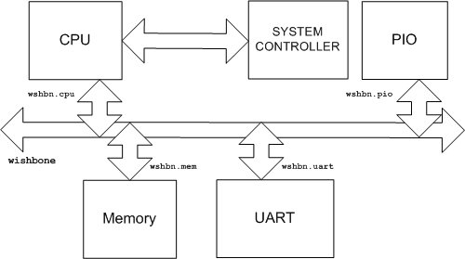
Extensive use of Opencores.org
Processor
Wishbone
Crossbar switch
Wishbone Bus

Slide 42
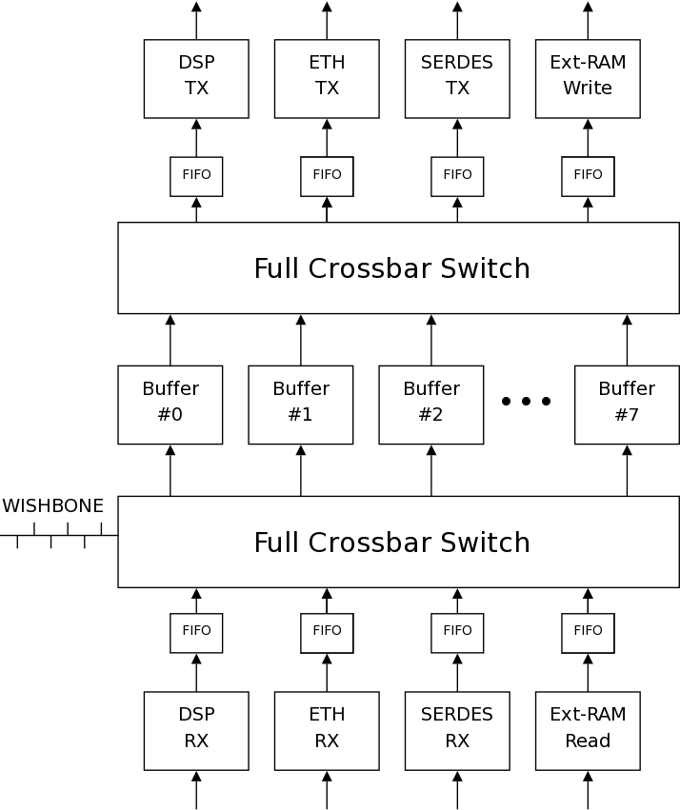
USRP2 uses cross bar switches to perform MIMO via expansion interface

Slide 43
PROPERTIES/COMPONENTS
REFERENCE CLOCK:
External Input of 10 MHz (sine or square) can be provided. (DC blocked terminated at 50 ohms). Stability of the clock is 20ppm.
Internal Input of 100 MHz (time stamped) is used by USRP2.
PPS: Signals (0-5V) go directly to FPGA hence faster sync pulse is possible. PPS is for precise timing. (not DC blocked but AC terminated at 50 ohms and DC terminated at 1Kohms.

Slide 44
Properties/components Contd.
RF Bandwidth: 25 MHz at 16 bits.
Chipset: National Semiconductor PHY chip, DP83856.
SD Card: Supposedly supports stand-alone mode as delay can be reduced in it.
MIMO: USRP2 has MIMO cable port to exchange clock and data among USRP2 boards.

Slide 45
Properties/components Contd.
AeMB processor: Heart of USRP2.
It performs :
Configuration of FPGA.
Reports FPGA about all the peripherals.
Controls Channel for daughterboard operation.
It is clocked at 50 MHz.

Slide 46
Properties/components Contd.
1 MB SRAM:
Used as:
Large buffer to hold premodulated packets.
Large FIFO to hold bursts of samples at higher rates than Ethernet.
Auxiliary RAM for either Data or Instructions or both.

Slide 47
Properties/components Contd.
High Speed Serial Link:
Four differential signals in each direction:
Carries data at 2 Gbps each way.
Reference clock for phase locking oscillators.
Time sync signal.
One high speed differential link available for user.
Network of USRP2 “Line Cards”:
Two USRP2s linked directly.
Four or more USRP2s linked by hub using MIMO.

Slide 48
APPLICATION
FM RADIO
RF ID READER
CELLULAR GSM BASE STATION
GPS RECIVER
DIGITAL TV DECODER
AMATUER RADIO

Slide 49
USRP v/S USRP 2
 | USRP | USRP2
INTERFACE | USB2.0 | GIGABIT ETHERNET
FPGA | ALTERA EP1C12 | Xilinx Spartan 3 2000
ADC SAMPLES | 12- bit 64 MS/S | 14- bit, 100 MS/S
DAC SAMPLES | 14 bit, 128 MS/s | 16- bit, 400 MS/S
DAUGHTER BOARD | 2 TX, 2 RX | 1 TX, 1 RX
SRAM | NONE | 1 MEGABYTE

Slide 50
USB 2.0 and Ethernet
 | USB 2.0 | Ethernet
Speed | Mbps | Gbps
Driver | Required | Not Required
Switch | Not required | Required (Gigabit Switch)

Slide 51
ADC and DAC
Increase in bits Increased Resolution
SNR= 6.02 N + 10.8 - 20log(X p/σx)
(6 db increase per bit)
Sampling rate Increased Bandwidth
USRP can digitize a band as wide as 32 MHz
USRP2 can digitize bandwidth as wide as 64 MHz

Slide 52
DAUGHTERBOARD
Can USRP2 support 2 TX or 2 RX Simultaneously?
NO
USRP2 supports 1 RX and 1 TX daughterboard
OR 1 Transceiver Daughter Board
2 RX or two TX can be connected at a time using MIMO cable.

Slide 53
References
GNU Radio-An introduction, Jesper M. Kristensen
Department of Electronic Systems Technology Platforms Section jmk@es.aau.dk ,Mobile Developer Days 2007.
GNU Radio & USRP, presentationWireless Center,
Copenhagen University College of Engineering
Center for Software Defined Radio, Aalborg University.
http://gnuradio.org/trac/wiki
http://www.snowymtn.ca/gnuradio
Ettus Research LLC
- http://ettus.com
- matt@ettus.com
GNU Radio Home Page
- Wiki, Source Code, Schematics, Mailing Lists
- http://gnuradio.org/trac

Slide 54
THE END

