Slide 1
Distributionally Robust Optimization and Its Applications in Communication and Networking
Lei Fan and Zhu Han
University of Houston
Thanks to Drs. Zhuang Ling, Kai-Chu Tsai, Hongliang Zhang, Yali Chen, Yang Yang, and Yuan Zi
Notes:
Hello everyone today I will give my presentation about Distributionally Robust Optimization and Its Application in Wireless Communications

Slide 2
Outline
Introduction
Introduction to DRO
Sample History of DRO
What is DRO and Key Question
Case 1: Discrepancy-based DRO Optimization
Case 2: DRO, Risk Aversion and CVaR
Case 3: DRO based Reinforcement Learning
Conclusion
Notes:
This presentation includes four parts. The first part is Distributionally Robust Optimization

Slide 3
Introduction
Optimization under Uncertainty
In traditional deterministic programming, parameters are all determined.
Processing time
Shipping time
Many decision problems in real-world arising in engineering and management have uncertain parameters.
result from
Limited observability of data
Noisy measurements
Prediction errors
Notes:
在传统确定规划中,参数都是确定的，比如处理时间确定，运送时间确定。但在实际生活中，这些值往往是有波动的，于是就有了不确定优化。这些不确定性可能来自对数据观察缺失，噪声干扰，错误估计等。

Slide 4
Introduction
Optimization Classification
Optimization
Deterministic Optimization
Optimization under Uncertainty
Stochastic
Programming
(SP)
Distributionally
Robust
Optimization
(DRO)
Robust
Optimization
(RO)
Notes:
优化问题分为两大类：传统的确定优化问题以及不确定优化问题。
不确定优化问题又可以分为随机规划、鲁棒优化、分布式鲁棒优化。这三个问题的保守性是逐渐递增的。

Slide 5
Introduction
Optimization Classification
Stochastic Programming (SP)
assumes that the probability distribution of random parameters is known (inferred from the historical data). Objective is to find a decision $x$that minimizes a functional of the expected cost.
Robust Optimization (RO)
assumes that the probability distribution of random parameter is unknown, but its fluctuation range is known. Objective is to find a decision $x$that minimizes the worst-case cost over an uncertainty set.
Distributionally Robust Optimization (DRO)
The distribution is known, but the random parameters of probability distribution is uncertain. In most cases, random parameters can only be estimated by the samples. Objective is to find a decision $x$that minimizes the worst-case expected cost over an uncertainty set.
Notes:
随机规划，假设随机参数的概率分布已知，这个分布可能是从历史数据中推断出来的，目标是找到一个决策x来优化一个期望值形式的目标函数。也就是说它的不确定集是一个概率分布。
鲁棒优化假设随机参数概率分布未知，但知道其波动范围，也就是知道它所有的取值，这个波动范围就是它的不确定集，目标函数是对不确定集中最差的情况进行优化，即worst-case scenario。找到的这个决策x，对于不确定集中的所有情况都要成立。可以看出鲁棒优化是相对保守的一种优化方法。
分布鲁棒优化结合了随机规划和鲁棒优化，假定不仅随机参数是不确定的，随机参数服从的概率分布也具有不确定性。它参数的不确定集不需要包含类似于鲁棒优化中的所有的取值，只需要包含一部分。这里就出现了两种特殊情况，第一，如果它的不确定集小到只包含了随机参数的真实分布，那个它就会变成随机规划；如果不确定集大到包含了所有可能的取值情况，如果取值都是被鲁棒优化的不确定集所支持的，那么分布式鲁棒优化又会变成鲁棒优化。分布式鲁棒优化没有鲁棒优化那么保守。

Slide 6
Introduction: Stochastic Programming
Stochastic Programming (SP)
The probability distribution of random parameters is known (inferred from the historical data). Objective is to find a decision $x$that minimizes a functional of the expected cost.
$$\min_{x∈χ }{E_{P}[h\left(x,ξ\right)]}$$
$x$ -- Decision variables
$χ$ -- Convex set of feasible solutions
𝜉 -- Uncertain parameter follows a certain distribution $P$
$h\left(x,ξ\right)$ -- Objective function in 𝑥 that depends on parameters 𝜉
Classical assumptions in stochastic programming:
The probability distribution of the random parameter vector is independent of decisions
The "true" probability distribution of the random parameter vector is known relaxing it requires addressing distributional uncertainty.
Notes:
We first consider Stochastic Programming which represents uncertain parameters by a random vector - a classical stochastic optimization: the probability distribution of random parameters is known (inferred from the historical data). Objective is to find a decision $x$that minimizes a functional of the expected cost.
The probability distribution of the random parameter vector is independent of decisions - exogenously given relaxing it requires addressing endogenous uncertainty. The "true" probability distribution of the random parameter vector is known relaxing it requires addressing distributional uncertainty.

Slide 7
Introduction: Robust Optimization
Robust Optimization (RO)
The probability distribution of random parameter is unknown, but its fluctuation range is known. Objective is to find a decision $x$that minimizes the worst-case expected cost over an uncertainty set.
$\min_{x∈χ }{\max_{ξ∈U} h}\left(x,ξ\right)$ (2)
$x$ -- Decision variables
$ξ$ -- Uncertain Parameter
$χ$ -- Convex set of feasible solutions
$U$ -- Uncertain set
$h\left(x,ξ\right)$ -- Objective function in $x$ that depends on parameters $ξ$
First find a decision $x$ that minimizes the cost.
Then a parameter $ξ$ which leads to the maximum cost (worst case for given decision)
Notes:
As for Robust Optimization , the probability distribution of random parameter is unknown, but its fluctuation range is known. Objective is to find a decision $x$that minimizes the worst-case expected cost over an uncertainty set. If the uncertain parameter $ξ$ follows a certain distribution $P$: we need to make a reasonable decision (find an $x$) to ensure that the expectation is optimal when the parameters have certain distribution characteristics.

Slide 8
Introduction: DRO
Distributionally Robust Optimization (DRO)
In practice, the random parameters are uncertain.
Although the exact distribution of the random variables may not be known, people usually know partial statistic information via certain observed samples.
Choose an intermediate approach to obtain a robust form of distributed optimization problem (DRO):
$\min_{x∈χ }{E_{P}[h\left(x,ξ\right)]}$ $\min_{x∈χ}{\max_{P∈𝒫}{E_{P}[h\left(x,ξ\right)]}}$
$𝒫$is an uncertain set of probability distributions constructed from the samples.
Objective is to find a decision $x$that minimizes the worst-case expected cost over an ambiguity set.
Notes:
In practice, not only the random parameters are uncertain, but also the probability distribution of the random parameters is uncertain.
Although the exact distribution of the random variables may not be known, people usually know certain observed samples or training data and other statistical information.
Choose an intermediate approach to obtain a robust form of distributed optimization problem (DRO):
Objective is find a decision $x$that minimizes the worst-case expected cost over an ambiguity set.

Slide 9
Introduction: Uncertainty Sets
Key question: How to build ambiguity sets (uncertain sets)?
The probability distribution quantifying the model parameter uncertainty is known ambiguously. When choosing ambiguity sets, we need to consider the following:
Rich enough to contain the true data-generating distribution with high confidence.
Small enough to exclude pathological distributions.
Tractability
Practical (Statistical) Meanings
Performance (the potential loss comparing to the benchmark cases)
The form of ambiguity sets can be used to classify the distributionally robust optimization problems.
Moment-based ambiguity sets : $𝒫=\{ξ:E[ξ]≤μ,E[ξ^{T}ξ]≤Σ,…\}$
Discrepancy-based ambiguity sets:$𝒫=\{P:d(\hat{P_{N}},P)≤ρ\}$
Notes:
Now we have to face a Key question: How to build ambiguity sets (uncertain sets)?
Specially, the probability distribution quantifying the model parameter uncertainty is known ambiguously. When choosing ambiguity sets, we need to consider the following:
Rich enough to contain the true data-generating distribution with high confidence. Chance constraint
Small enough to exclude pathological distributions.
Tractability
Practical (Statistical) Meanings in wireless communication
Performance (the potential loss comparing to the benchmark cases)
The form of ambiguity sets can be used to classify the distributionally robust optimization problems.
Moment-based ambiguity sets and Discrepancy-based ambiguity sets

Slide 10
Introduction
Robustness is important
Model (self-driving car perception, automatic detection of tumors) failures gradually lead to life-threatening situations; in these systems, deploying models that cannot prove their robustness is irresponsible.
Financial industry：
Portfolio theory: In the case of uncertain returns and risks, a
reasonable choice of investment portfolio will maximize the expected
returns.
Inventory management: In the case of uncertainty in the order
time and order quantity, the inventory amount should be reasonably
arranged so that the reserve is maintained at an economically reasonable
level.
Machine learning:
Regression problem: In the classification problem, consider how to obtain robust results when the samples are disturbed.
Notes:
在很多系统中，例如，自驾车的感知，肿瘤的自动检测，模型故障导致危及生命的情况发生, 在这些系统中, 需要部署能够证明其鲁棒性的模型。
分布式鲁棒优化在金融、调度以及机器学习等领域中都有着广泛的应用。
投资组合理论：在收益和风险具有不确定性的情况下，合理选择投资组合，使得期望收益最大化。
库存管理在订单时间以及订单数量具有不确定性的情况下，合理安排库存量，使得储备保持在经济合理的水平上。
回归问题：分类问题中，考虑样本受到扰动情况下，如何训练得到鲁棒结果。

Slide 11
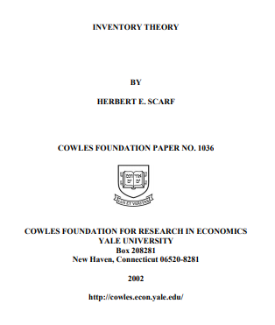
Distributionally Robust Optimization
Sample History of DRO
First introduced by Scarf [1958] in the context of inventory control problem with a single random demand variable.
Distribution set based on moments: Dupacova [1987], Prekopa [1995], Bertsimas and Popescu [2005], Delage and Y[2009,2010].
Distribution set based on Likelihood/Divergences: Nilim and El Ghaoui [2005], Iyanger [2005], Wang, Glynn and Y [2012].
Ambiguity set based on Wasserstein distance: Mohajerin Esfahani and Kuhn [2015], Blanchet et al. [2016], Duchi et al. [2016,17], Gao et al. [2017].
Notes:
DRO was First introduced by Scarf [1958] in the context of inventory control problem with a single random demand variable. Which includes Three directions:
Distribution set based on moments
Distribution set based on Likelihood/Divergences
Ambiguity set based on Wasserstein distance

Slide 12
Outline
Introduction
Case 1: Discrepancy-based DRO Optimization
Wasserstein distance
Tractability of Wasserstein DRO
Application 1: Energy Management
Application II: Computation Offloading
Case 2: DRO, Risk Aversion, and CVaR
Case 3: DRO Based Reinforcement Learning
Conclusion

Slide 13
Discrepancy-based DRO
Motivation
In many situations, we have an empirical estimate of the underlying probability distributions.
A natural way to hedge against the distributional ambiguity is to consider a neighborhood of the empirical probability distribution
Discrepancy
Ambiguity sets based on probability distance:
$𝒫=\{P:d(\hat{P_{N}},P)≤ε\}$
$\hat{P_{N}}$ -- Empirical probability
$ε$ -- Radius
$d(\hat{P_{N}},P)$ -- Metric of the similarity of two distributions
By selecting a suitable metric, certain infinite-dimensional convex DRO problems can be transformed into finite-dimensional convex optimization problems
Is there a metric that is simple to calculate and suitable for discrete / continuous distributions?
Wasserstein
distance
Notes:
Considering the Discrepancy-based ambiguity sets: we introduce ambiguity sets based on probability distance:
$\hat{P_{N}}$ is Empirical probability$. ε$is Radius. $d(\hat{P_{N}},P)$is the Metric of the similarity of two distributions
By selecting a suitable metric, certain infinite-dimensional convex DRO problems can be transformed into finite-dimensional convex optimization problems
Is there a metric that is simple to calculate and suitable for discrete / continuous distributions? Wasserstein distance

Slide 14
Discrepancy-based DRO
Wasserstein distance
used to measure the distance between two distributions.
Definition:
$${d_{W}\left(P_{1},P_{2}\right)=\inf_{γ\sim ∏(P_{1},P_{2})}{𝔼}}_{(x,y)\sim γ}[\left\|x−y\right\|]$$
$∏(P_{1},P_{2})$: the set of all possible joint distributions of $P_{1}$and $P_{2}$.
$(x, y)\sim γ:$samples under joint distribution $γ$
$\left\|x−y\right\|$: sample distance
$𝔼_{(x,y)\sim γ}[\left\|x−y\right\|]$: expectation of distance for sample $x$ and $y$ under joint distribution $γ$
Wasserstein distance of $P_{1}$and $P_{2}$: the lower bound of this expectation.
Notes:
Wasserstein distance is used to measure the distance between two distributions,w$here ∏(P_{1},P_{2})$is the set of all possible joint distribution of $P_{1}$and $P_{2}$. $\left(x, y\right)\sim γ denotes$samples under joint distribution $γ$ $\left\|x−y\right\|$ is sample distance $𝔼_{(x,y)\sim γ}[\left\|x−y\right\|]$shows expectation of distance for sample $x$ and $y$ under joint distribution $γ$

Slide 15
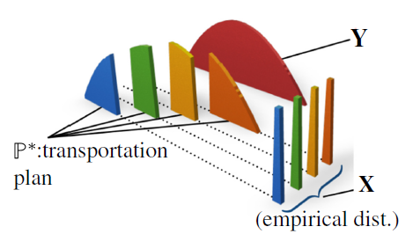
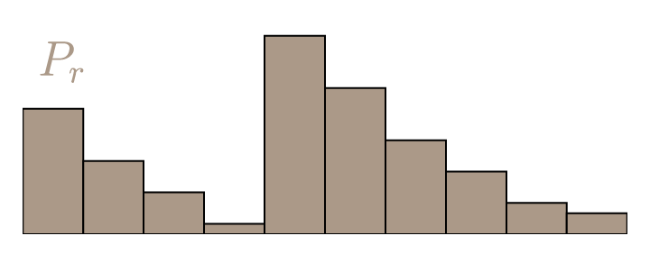
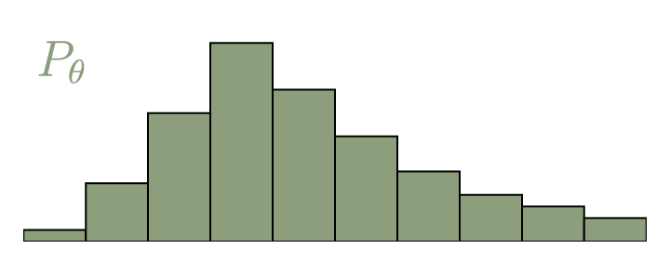
Discrepancy-based DRO
Wasserstein distance
$$P_{1}$$
$$P_{2}$$
$∏(P_{1},P_{2})$: transportation plan
$\left\|x−y\right\|$: distance the soil moves
$Y(x,y)$: amount of moving soil from $x$ to $y$
$𝔼_{(x,y)\sim γ}[\left\|x−y\right\|]$: bulldozing cost
Move mass $P_{1}$ into the shape and position of $P_{2}$.
Bulldozing cost : amount of moving soil multiplied by the distance the soil moves.
Wasserstein distance: the smallest bulldozing cost from $P_{1}$to $P_{2}$.
Notes:
Probability metrics represent distance functions on the space of probability distributions. A general class of Bulldozing Distances just like Move mass $P_{1}$ into the shape and position of $P_{2}$. Bulldozing cost : amount of moving soil multiplied by the distance the soil moves. The decision variable can be viewed as a transportation plan for moving a mass distribution described by P1 to another one described by P2. Thus, the Wasserstein distance between P1 and P2 represents the cost of an optimal mass transportation plan,
$∏(P_{1},P_{2})$: transportation plan $\left\|x−y\right\|$: distance the soil moves $Y(x,y)$: amount of moving soil from $x$ to $y$ $𝔼_{(x,y)\sim γ}[\left\|x−y\right\|]$: bulldozing cost

Slide 16
Discrepancy-based DRO
Wasserstein distance
Wasserstein distance-based ambiguity set:
$𝔹_{ε}\left(\hat{P_{N}}\right)=\{Q:d_{W} (\hat{P_{N},}Q)≤ε\}$
The ambiguity set $Q$can be viewed as a Wasserstein ball which contains all probability distributions whose Wasserstein distance to the empirical distribution $\hat{P_{N}}$ is less than $ε$.
$Q$ will cover the true distribution with a higher probability with a larger value of $ε$.
There exists a trade-off between the accuracy and the complexity
It is important to well design the value of $ε$
Notes:
In the remainder we will examine the ambiguity set
The ambiguity set $Q$can be viewed as the Wasserstein ball of radius$ε$ centered at the empirical distribution $\hat{P_{N}}$. Wasserstein ball contains all possible probability distributions. $Q$ will include the true distribution with a higher probability.
Under a common light tail assumption on the unknown data-generating distribution, this ambiguity set offers attractive performance.

Slide 17
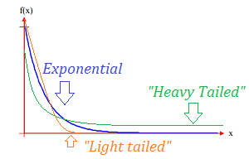
Discrepancy-based DRO
Wasserstein distance
How to calculate $ε \text{of} \text{ambiguity} \text{set}$
Light-tailed distribution assumption: Distribution is call light-tailed if there exists an exponent $a>1$ such that
This assumption requires the tail of the distribution to decay at an exponential rate. The assumption guarantees that the ambiguity set can cover most of the possible distributions.
Radius selection: With this assumption, suppose that $\hat{P_{N}}$ is the empirical distribution, m is related to the dimension and cost parameter, for $m≠2$ and $c_{1},c_{2}>0$, under a confidence level of $1−β$, we have
Number of samples
Notes:
How to calculate $ε \text{of} \text{ambiguity} \text{sets}$
We will introduce Theorem. Suppose that $\hat{P_{N}}$ is the empirical distribution,, and the unknown true distribution $P$ is light-tailed in the sense Then, there are constants $c1, c2>0$ that depend on $P$ only through $α, A$, and $m$ such that for any $η ∈ (0, 1]$the concentration inequality i.e., the Measure concentration can be given as
Theorem provides an a priori estimate of the probability that the unknown data-generating distribution resides outside of the Wasserstein ball. Thus, we can use Theorem to estimate the radius of the smallest Wasserstein ball that contains P with certain confidence. Theorem can be used directly during reformulation.

Slide 18
Discrepancy-based DRO
Tractability of Wasserstein DRO
With Wasserstein ball, the DRO problem can be rewritten as
$$\min_{x∈χ}{\max_{P∈𝔹_{ε}\left(\hat{P_{N}}\right)}{E_{P}[h(x,ξ)]}}$$
Assumption:
The uncertainty set is convex and closed
$h(x,ξ)$ is convex with respect to $ξ$
Challenges to Compute Wasserstein Distances:
Computing the Wasserstein distance between two distributions $\hat{P_{N}}$ and $P_{N}$is NP-hard if one of them is continuous since the dimension will be infinite.
Solution:
Rewrite the problem into a finite-dimensional convex program by leveraging tools from robust optimizations
Notes:
Computing the Wasserstein distance between two discrete distributions amounts to solving a tractable linear program
However, if one of the distributions is continuous, it becomes intractable to compute Wasserstein distance
Computing the Wasserstein distance between two distributions $\hat{P_{N}}$ and $P_{N}$is NP-hard if not both the distributions are discrete.
Even though we cannot compute the Wasserstein distance, we can derive tractable bounds on the worst-case risk in the Wasserstein ball, and exact computation for the worst-case risk in some situations.

Slide 19
Discrepancy-based DRO
Tractability of Wasserstein DRO
How to transform an infinite-dimensional optimization problem into a finite-dimensional convex program:
$\max_{P∈𝔹_{ρ}\left(\hat{P_{N}}\right)}{E_{P}[h(x,ξ)]}=\left\{\begin{aligned}\sup_{Π,P}{\int_{Ξ}{h\left(x,ξ\right)P(dξ)}} \\ s.t. \int_{Ξ^{2}}{\left\|ξ−ξ^{′}\right\|Π(dξ,dξ′)≤ε}\end{aligned}\right.$ $=\left\{\begin{aligned}\sup_{P_{i}∈𝓜(Ξ)}{\frac{1}{N}\sum_{i=1}^{N}{\int_{Ξ}{h\left(x,ξ\right)P_{i} (dξ)}}} \\ s.t. \frac{1}{N}\sum_{i=1}^{N}{\int_{Ξ}{\left\|ξ−\hat{ξ_{i}}\right\|P_{i}(dξ)≤ε}}\end{aligned}\right.$
$Π$ is a joint distribution of $ξ^{′}$ and $ξ$ with marginals distribution $P$ and $\hat{P_{N}}$ of $ξ^{′}$ given $ξ^{′}$= $\hat{ξ_{i}}$,and conditional $P_{i}$of $ξ$. N is number of samples. Due to the law of total probability, we have
$$Π=\frac{1}{N}\sum_{i=1}^{N}{δ_{\hat{ξ_{i}}}⨂P_{i}}$$
$$\hat{P_{N}}=\frac{1}{N}\sum_{i=1}^{N}{δ_{\hat{ξ_{i}}}}$$
Convex reduction
Notes:
How to transform an infinite-dimensional optimization problem into a finite-dimensional convex program:
we can re-express the worst-case expectation as,
Where the $\text{J}\text{oint} \text{distribution} Π$ of $ξ$ and $ξ^{′}$can be constructed from the marginal distribution $\hat{P_{N}}$ of $ξ^{′}$when given $ξ^{′}$= $\hat{ξ_{i}}$,and conditional $P_{i}$of $ξ$. Due to the law of total probability, we may write

Slide 20
Discrepancy-based DRO
Tractability of Wasserstein DRO
Using a standard duality argument, we obtain
$$\max_{P∈𝔹_{ε}\left(\hat{P_{N}}\right)}{E_{P}[h(x,ξ)]}$$
$$=\sup_{P_{i}∈𝓜(Ξ)}\inf_{λ≥0}{\frac{1}{N}\sum_{i=1}^{N}{\int_{Ξ}{h\left(x,ξ\right)P_{i} (dξ)}}}{+λ(ε−\frac{1}{N}\sum_{i=1}^{N}{\int_{Ξ}{\left\|ξ−\hat{ξ_{i}}\right\|P_{i}(dξ)}})}$$
$≤$ $\inf_{λ≥0}\sup_{P_{i}∈𝓜(Ξ)}{λε+\frac{1}{N}\sum_{i=1}^{N}{\int_{Ξ}{(h\left(x,ξ\right){−λ\left\|ξ−\hat{ξ_{i}}\right\|)P}_{i}(dξ}}}{)}$
$=\inf_{λ≥0}λε{+\frac{1}{N}\sum_{i=1}^{N}{\sup_{ξ∈Ξ}(h\left(x,ξ\right)−λ\left\|ξ−\hat{ξ_{i}}\right\|)}}$
Maximum minima is always less than minimum maxima
The uncertainty set contains all distributions
Notes:
Using a standard duality argument, we obtain:

Slide 21
Discrepancy-based DRO
Tractability of Wasserstein DRO
Introducing epigraphical auxiliary variables $s_{i}$, $i≤N$:
$$\max_{P∈𝔹_{ε}\left(\hat{P_{N}}\right)}{E_{P}[h(x,ξ)]}=\left\{\begin{aligned}\inf_{λ,s_{i}}{λε}+\frac{1}{N}\sum_{i=1}^{N}{s_{i}} \\ s.t. \sup_{ξ∈Ξ}\left(h\left(x,ξ\right)−λ\left\|ξ−\hat{ξ_{i}}\right\|\right)≤s_{i}, ∀i≤N \\ λ≥0\end{aligned}\right.$$
As such, the problem is transformed into a finite convex program and can be solved by existing convex optimization techniques.
Notes:
Introducing auxiliary variables $s_{i}$, $i≤N$: we can get the dual norm and the decomposability form

Slide 22
Discrepancy-based DRO
Special Case
For the case of quadratic loss (possibly non-convex and non-concave), we still can derive its exact form.
Assume that $x\left(ξ\right)=ξ^{T}Qξ+{2q}^{T}ξ$ is a (possibly indefinite) quadratic loss function. Then the worst-case risk coincides with the optimal value of a tractable semidefinite program (SDP), that is,
$\max_{P∈𝔹_{ε}\left(\hat{P_{N}}\right)}{E_{P}[h(x,ξ)]}=\left\{\begin{matrix}\inf_{γ,s_{i}}{ γε^{2}}+\frac{1}{N}\sum_{i=1}^{N}{s_{i}} \\ s.t. \left(\begin{matrix}γ−Q & q+γ\hat{ξ_{i}} \\ q^{T}+γ{\hat{ξ_{i}}}^{T} & {s_{i}+\left\|\hat{ξ_{i}}\right\|}_{2}^{2}\end{matrix}\right)≥0\end{matrix}\right.$
Notes:
For the case of quadratic loss (possibly non-convex and non-concave), we still can derive its exact form.
Assume that $x\left(ξ\right)=ξ^{T}Qξ+{2q}^{T}ξ$ is a (possibly indefinite) quadratic loss function. Then the worst-case risk coincides with the optimal value of a tractable semidefinite program (SDP), that is,

Slide 23
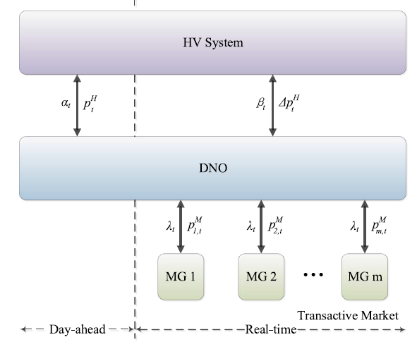
Application 1: Energy Management
Transactive Energy Management Framework
Upstream Network
A transactive market is organized by the Distribution System Operator (DSO) to coordinate the energy management of Microgrids (MGs) in the operation
DSO manages the power exchange between MGs and the upstream network with two parts:
day-ahead (planned power)
real-time (deviant power for the renewable energy and some electricity demands)
DSO will also determine the clearing prices for the power exchange with MGs
DSO
Uncertain
Yongsheng Cao, Demin Li, Amin Khodaei, Hongliang Zhang, and Zhu Han, “Optimal Energy Management for Multi-Microgrid under A Transactive Energy Framework with Distributionally Robust Optimization,” to appear, IEEE Transaction on Smart Grid.
Notes:
Now I will introduce Wasserstein DRO Application 1: A Transactive Energy Framework for Coordinated Energy Management of Networked Microgrids With Distributionally Robust Optimization
Transactive Energy Management Framework
A transactive market is organized by the Distribution Network Operator to coordinate the energy management of the DS and MGs in the operation
DS is connected with the HV system and the DNO needs to manage the power exchange between the DS and the HV system.

Slide 24
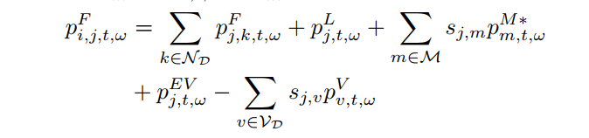
Application 1: Energy Management
Optimization of DSO
Objective: minimize the operation cost
Cost of power exchange between MGs and the upstream network
Settlement between the upstream network and MGs
Power flow constraints according to the DistFlow model
Notes:
Optimization Model of Distribution Network Operator
cost for the scheduled power exchange between the DS and HV system
generation cost of the MTs in the DS.
the cost for the deviant power exchange between the DS and HV system
settlement between the DS and MGs
the power exchange between the DS and MG m by the solutions of the MGs' energy scheduling optimization

Slide 25
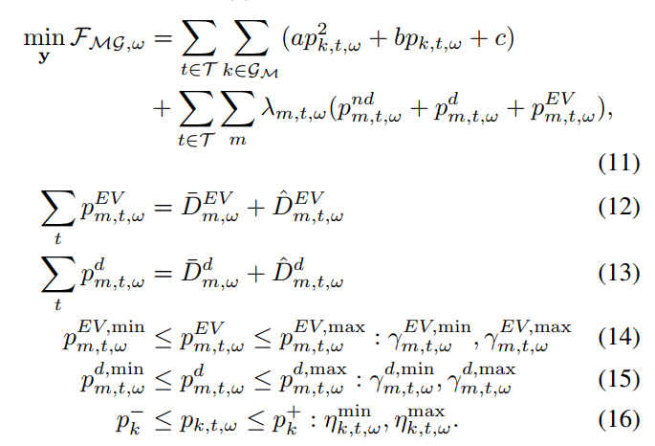
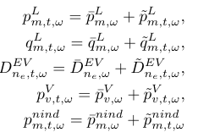
Application 1: Energy Management
Optimization of MGs
Objective: minimize the operation cost considering the clearing price
Renewable energy generation cost
Settlement for MGs
The generated renewable power and demand is uncertain
Electricity demands
expected value+random terms
Notes:
Active power exchange between MG m and DS at time t in scenario ω, positive value means injection from DS to MG, negative value means export from MG to DS.
Active power output of MT g at time t in scenario ω.
Clearing price in transactive market at time t in scenario ω.
Uncertainties related to the MT and electric vehicles in scenario \omega are expressed as follows, expected value+random terms

Slide 26
Application 1: Energy Management
DRO Reformulation
Uncertainty set characterization
We have an empirical distribution for the random variable through historical data
We measure the distance between two distributions for the random variable by Wasserstein distance
The Wasserstein ambiguity set can be written by
Constrain the distance between a distribution to the empirical distribution
The objective function can be written by the expected value of the total operation cost with the DRO formulation
Distribution of the generated renewable energy and demand
Notes:
The scenario based SP model is transformed to DRO
Original problem is To minimize the expected value of the operation cost
Which can be transformed a mixed integer quadratic minimax optimization model

Slide 27
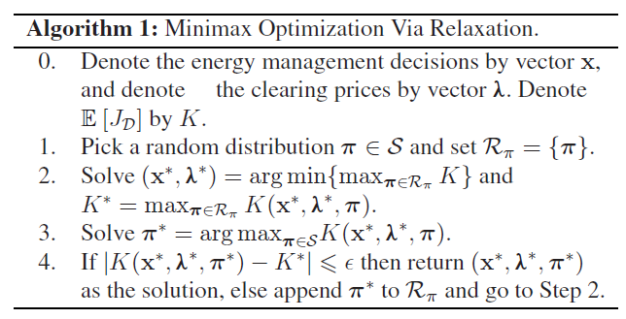
Application 1: Energy Management
Iterative Algorithm based on Relaxation
With the max min relaxation introduced in previous slides, we repeat the following iterations until the convergence criteria is satisfied
Calculate the power exchange between DSO and MGs
Calculate the dynamic price
The outputs of Algorithm 1 give the energy scheduling decision of the DSO by x∗ and the optimal clearing prices in the transactive market by λ∗ at the same time.
Notes:
The Wasserstein distance can be defined in the following expression
An iterative algorithm based on the relaxation approach for the minimax optimization

Slide 28
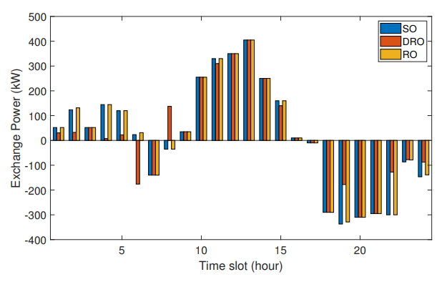
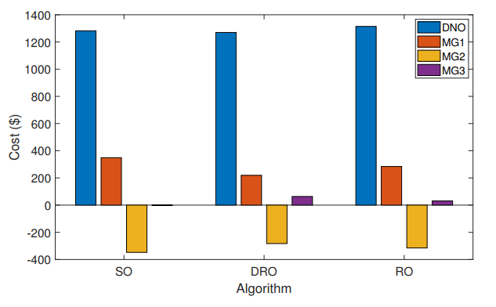
Application 1: Energy Management
The solution with RO schedules the power exchange in the worst case to meet the electricity demand and maintain the stability of the power system
The solution with SO schedules the least power exchange to meet the electricity demand and achieve a lower electricity bill
The solution with DRO aims to give an intermediate solution
Notes:
The Wasserstein distance can be defined in the following expression
An iterative algorithm based on the relaxation approach for the minimax optimization

Slide 29
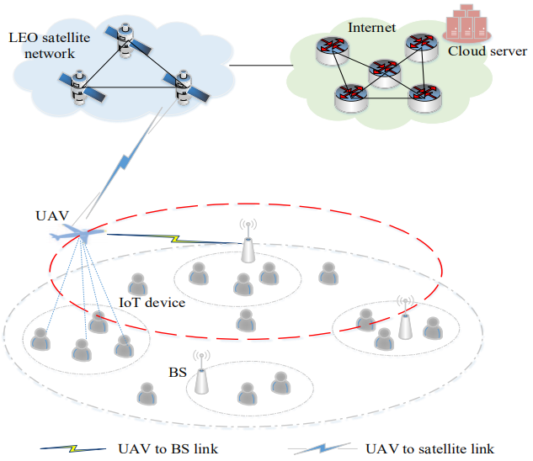
Application 2: Computation Offloading
Space-Air-Ground Integrated Networks:
IoT devices: request services
UAV: collect data from IoT devices
Determine to offload to a nearby BS or offload to a certain satellite and utilize the cloud server
Determine the proportion of tasks to offload, and the others will be done by the UAV
The task request received by the UAV is uncertain
Yali Chen, Bo Ai, Yong Niu, Hongliang Zhang, and Zhu Han, “Energy-Constrained Computation Offloading in Space-Air-Ground Integrated Networks using Distributionally Robust Optimization,” IEEE Transactions on Vehicular Technology (Volume: 70, Issue: 11, Nov. 2021)

Slide 30
Application 2: Computation Offloading
The channel between the UAV u and the BS b works in the C-band at the time slot t :
shadow fading
large-scale pathloss
The channel between the UAV u and the satellite s works in the Ka-band:
LoS
NLoS
wavelength of Ka-band
Rician factor
antenna gain

Slide 31
Application 2: Computation Offloading
: arriving workload at the UAV is a random variable
: whether the BS b is selected
: whether the LEO satellite s is selected
The task can only be offloaded to one destination
UAV
Latency
Energy consumption
computation workload to data ratio
the amount of tasks the UAV needs to process in the time slot t
Computing
Propulsion
UAV computing capability
Computing
UAV-BS
amount of assigned tasks
Transmission
Transmission
Computing
UAV-Satellite
Transmission
Transmission

Slide 32
Application 2: Computation Offloading
Ambiguity Set Construction
Suppose that there exists a sample space which contains K possible values of the task volume
We can obtain the reference distribution $P_{0}$ from historical data
We consider three metrics for the uncertainty set construction
$L_{1}$ norm metric: the distance between an arbitrary distribution and the reference distribution is modeled by $L_{1}$ norm
$L_{∞}$ norm metric: the distance between an arbitrary distribution and the reference distribution is modeled by $L_{∞}$ norm
Wasserstein distance metric: the distance between an arbitrary distribution and the reference distribution is modeled by Wasserstein distance

Slide 33
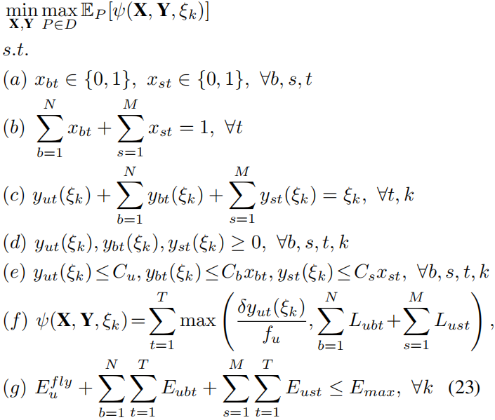
Application 2: Computation Offloading
Objective: minimize the expected total latency of T time slots under the worst-case distribution realization in uncertainty set D
the sum of tasks processed by UAV, all BSs, and all LEO satellites equals to the amount of tasks arrived
ensure the tasks assigned cannot exceed its capacity
total system latency
energy constraint

Slide 34
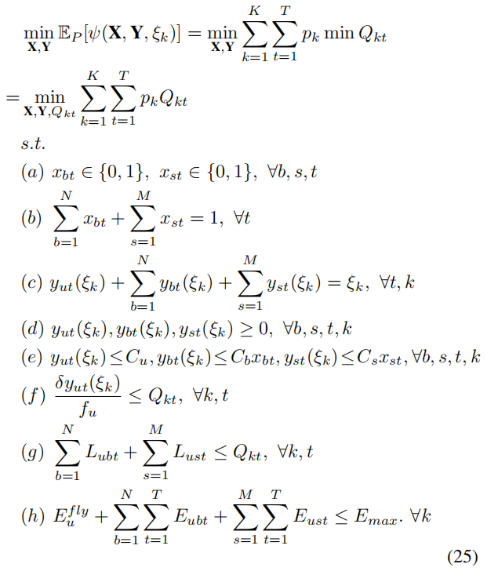
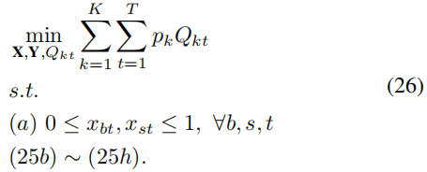
Application 2: Computation Offloading
Distributionally Robust Latency Optimization Algorithm Design
Introducing auxiliary variable
Continuous relaxation
Max min relaxation

Slide 35
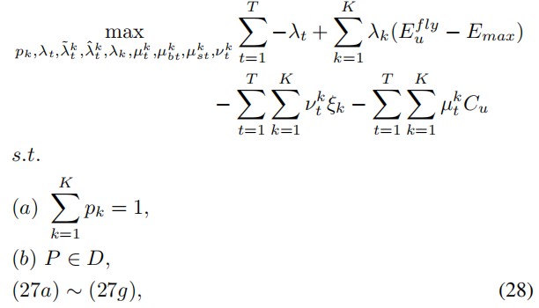
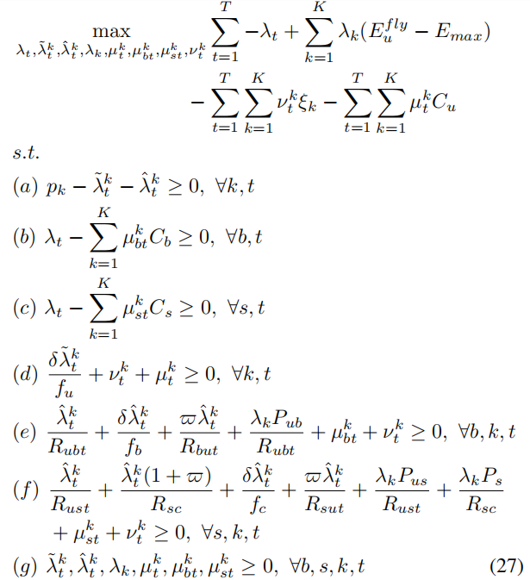
Application 2: Computation Offloading
dual problem
using the Gurobi Optimizer
the worst case distribution P are otained
using the Gurobi Optimizer
continuous X and Y are otained
branch and bound
X and Y

Slide 36
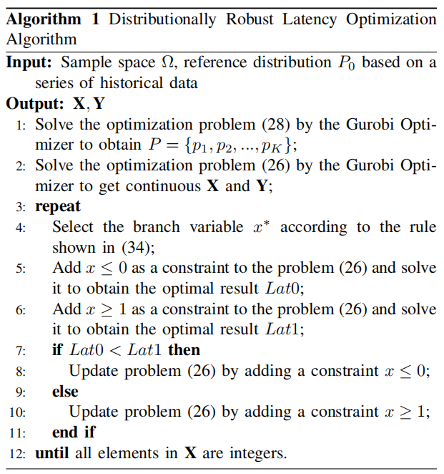
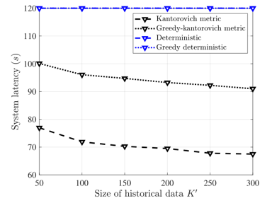
Application 2: Computation Offloading
The same as Wasserstein metric
For deterministic scheme, many tasks cannot be processed and retransmission is required, leading to a higher latency

Slide 37
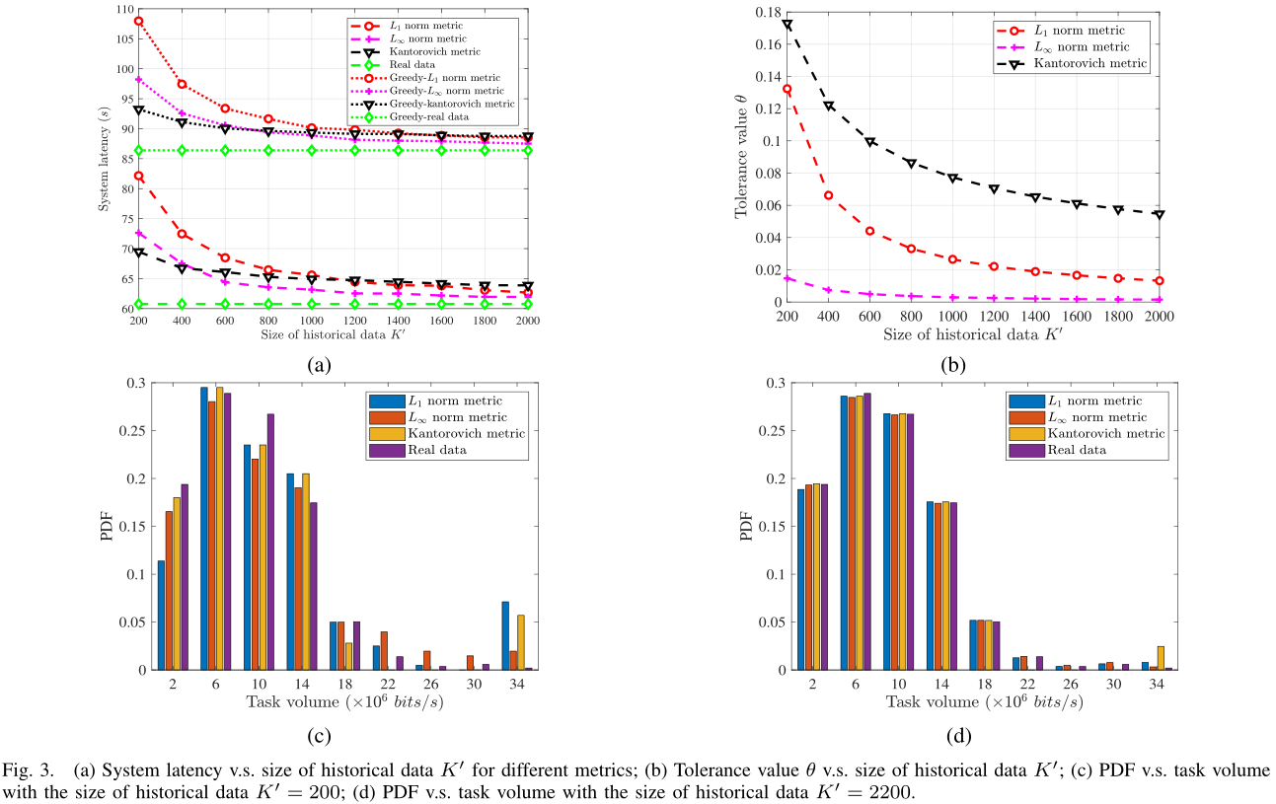
Application 2: Computation Offloading
The performance under L₁ norm and L∞ norm metrics is more affected by the size of historical data
Wasserstein metric has the highest conservativeness
L∞ norm metrics has the lowest conservativeness

Slide 38
Outline
Introduction
Case 1: Discrepancy-based DRO Optimization
Case 2: DRO, Risk Aversion and CVaR
Value-at-Risk (VaR) and Conditional Value-at-Risk (CVaR)
VaR and CVaR in Optimization
Application 1: URLLC
Application II: Age of Information
Case 3: DRO based Reinforcement Learning
Conclusion
Notes:
Next I will introduce DRO and Risk Aversion

Slide 39
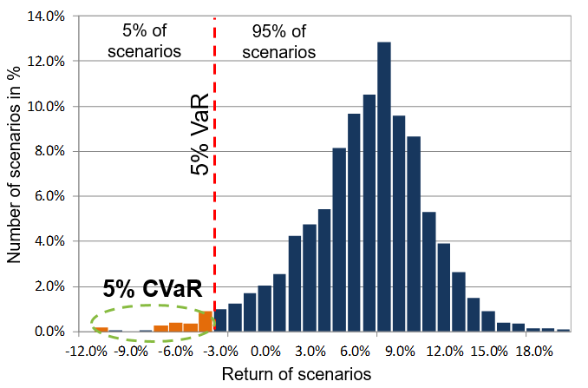
DRO and Risk Aversion
VaR& CVaR Representation
Risk Management is a procedure for evaluating loss distribution in Risk Aversion.
Value-at-Risk (VaR) and Conditional Value-at-Risk (CVaR) are popular function for measuring risk.
Risk functions: graphical representation of VaR, VaR Deviation, CVaR, CVaR Deviation, Max Loss, and Max Loss Deviation.
Notes:
Risk management is a broad concept. From the mathematical perspective considered in this presentation, risk management is a procedure for shaping a loss distribution (for instance, an investor’s risk profile)
From the VaR& CVaR Representation
1. CVaR has nice mathematical properties versus VaR for instance, the CVaR of a portfolio is a continuous and convex function with respect to positions in instruments, whereas the VaR may be even a discontinuous function.
2. Risk management with CVaR functions can be done very efficiently
CVaR can be optimized and constrained with convex and linear programming methods, whereas VaR is relatively difficult to optimize
3. VaR does not control scenarios exceeding VaR
The indifference of VaR risk measure to extreme tails may be a good property if poor models are used for building distributions.
The indifference of VaR to extreme tails may be quite an undesirable property, allowing to take high uncontrollable risks
4. CVaR accounts for losses exceeding VaR
CVaR provides an adequate picture of risks reflected in extreme tails.
This is a very important property if the extreme tail losses are correctly estimated.

Slide 40
DRO and Risk Aversion
VaR & CVaR
Let X be a random variable, with the X may have meaning of loss or gain.
VaR Definition
A lower α-percentile of the random variable X.
is nonconvex and discontinuous function of the confidence level α for discrete distributions.
Difficult to control/optimize for non-normal distributions: VaR has many extremums for discrete distributions.
Notes:
Based on the above example, Let X be a random variable with the X may have meaning of loss or gain.
We first give VaR Definition， which is a lower α-percentile of the random variable X.
VaR is non convex and discontinuous function of the confidence level α for discrete distributions
Difficult to control/optimize for non-normal distributions: VaR has many extremums for discrete distributions

Slide 41
DRO and Risk Aversion
VaR& CVaR
CVaR Definition
The CVaR of $X$with confidence level $α ∈\left[0, 1\right]$is the mean of the generalized $α$-tail distribution:
where the distribution in question is the one with distribution function defined by
For random variables with continuous distribution functions, ${\text{CVaR}}_{α}$(X) equals the conditional expectation of X subject to $Z ≥ {VaR}_{α} (X).$
CVaR is continuous with respect to $α.\text{CVaR} \text{is} \text{convex} \text{in} X$
Notes:
As for CVaR Definition The CVaR of $X$with confidence level $α ∈\left[0, 1\right]$is the mean of the generalized $α$-tail distribution:
where the distribution in question is the one with distribution function defined by
For random variables with continuous distribution functions, ${\text{CVaR}}_{α}$(X) equals the conditional expectation of X subject to $Z ≥ {VaR}_{α} (X).$

Slide 42
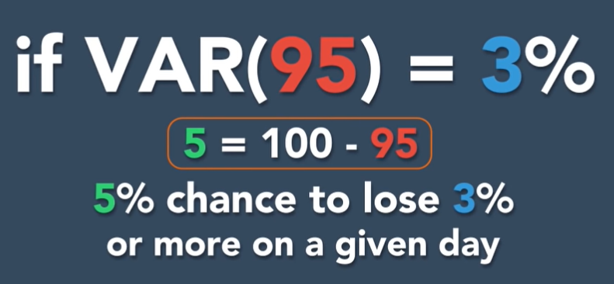
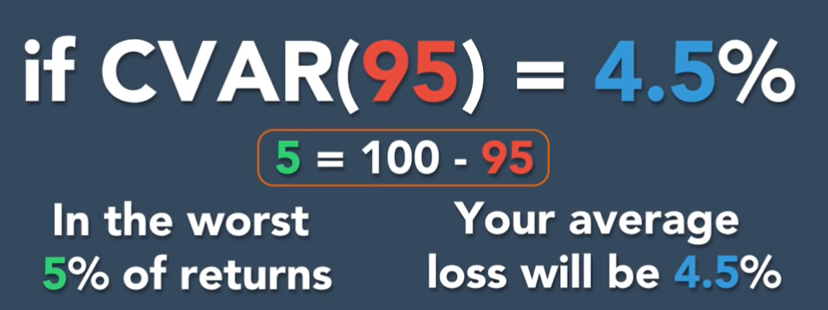
DRO and Risk Aversion
VaR& CVaR Example
Main focus:
Value-at-Risk (VaR) and Conditional Value-at-Risk (CVaR) [Rockafellar and Uryasev, 2000].
CVaR gives us an average expected loss
VaR gives us a range of potential losses
If more than lost 3% happens with 5%, but we still do not know average lost.
CVAR describes the average lost conditioned on VaR happens.
Notes:
VaR is a percentile of a loss distribution
CVaR approximately (or exactly, under certain conditions) equals the average of some percentage of the worst-case loss scenarios.
For example if VaR 95 equal to 3 percent, you have 5% chance to lose 3%
If CVaR 95 is equal to 4.5%, we will know in the worst case you have 5% chance to lose averge 4.5%

Slide 43
DRO and Risk Aversion
Equivalence of Chance Constraints and VaR Constraints
In portfolio management, often it is required that portfolio loss at a certain future time is, with high reliability, at most equal to a certain value.
Let $f(x, y)$be the loss associated with the decision vector $x$and the random vector $y$.
$Prob\{f_{i}\left(x,y\right)\}≤0\}≥p_{i}$ $, i=1,…,m.$
Let${ VaR}_{α}$ $\left(x\right)$be the${ VaR}_{α}$ of a loss function $f(x,y)$
Then the following holds:
$$Prob\left\{f\left(x,y\right)≤ζ\right\}≥α↔Prob\left\{f\left(x,y\right)>ζ\right\}≤1−α↔{VaR}_{α}(x)≤ζ$$
In general, ${ VaR}_{α}$ $\left(x\right)$ is nonconvex w.r.t. $x$, (e.g., discrete distributions)
Notes:
I will introduce Equivalence of Chance and VaR Constraints
In portfolio management, often it is required that portfolio loss at a certain future time is, with high reliability, at most equal to a certain value.
Let $f(x, y)$be the loss associated with the decision vector $x$and the random vector $y$.
Let${ VaR}_{α}$ $\left(x\right)$be the${ VaR}_{α}$ of a loss function $f(x,y)$
Then the following holds:
In general, ${ VaR}_{α}$ $\left(x\right)$ is nonconvex w.r.t. $x$, (e.g., discrete distributions)
${VaR}_{α}(x)≤ζ$ and $Prob\left\{f\left(x,y\right)≤ζ\right\}≥α$ may be non convex constraints

Slide 44
DRO and Risk Aversion
Minimization and CVaR Constraints
The underlying probability distribution of $y$ will be assumed for convenience to have density $p(y)$. The $α$-CVaR of the loss associated with a decision x is the value
The main idea is to define a function that can be used in connection with VaR and CVaR
1. is convex with respect to α;
2. is a minimum point of function w.r.t. ;
3. As a function of , is finite and convex (hence continuous), :
Notes:
Nowadays, VaR has achieved the high status, however, It is difficult to optimize VaR numerically when losses are not normally distributed.
So, we will consider Minimization and CVaR Constraints
The underlying probability distribution of $y$ will be assumed for convenience to have density $p(y)$. The $α$-CVaR of the loss associated with a decision x is the value
The main idea is to define a function that can be used in connection with VaR and CVaR

Slide 45
DRO and Risk Aversion
Conditional value-at-risk in optimization
In problems of optimization under uncertainty, CVaR can be used in the objective or the constraints, or both.
Optimization shortcut
CVaR accounts for losses exceeding VaR. So when CVaR is considering, VaR can be ignored
Notes:
As for CVaR in optimization
In problems of optimization under uncertainty, CVaR can enter into the objective or the constraints, or both. We can derive minimiza CVaR equal to minimize x kexi F alpha x kexi and finally, get the optimal solution
CVaR accounts for losses exceeding VaR.
So when CVaR is considering, VaR can be ignored
As for risk shaping we can get the CVaR constraints

Slide 46
DRO and Risk Aversion
Chance constrained programs
It is known that distributionally robust chance constraints can be conservatively approximated by Worst-Case Conditional Value-at-Risk (CVaR) constraints.
$x$ is the decision vector and c is a cost vector
$Pr$ can be unknown arbitrary distribution
The chance constraint requires a set of $m$ uncertainty-affected inequalities to be jointly satisfied with a probability of at least $1−ε.$
Notes:
It is known that Distributionally robust chance constraints can be conservatively approximated by Worst-Case Conditional Value-at-Risk (CVaR) constraints.
where x ∈ Rn is the decision vector, X ⊆ Rn is a convex closed set that can be represented by semidefinite constraints, and c ∈ Rn is a cost vector.
The chance constraint in (1) requires a set of m uncertainty-affected inequalities to be jointly satisfied with a probability of at least 1−$ε$, where $ε$∈ (0, 1) is a desired safety factor specified by the modeler

Slide 47
DRO and Risk Aversion
Distributionally robust approach
A natural way to immunize the chance constraint against uncertainty in the probability distribution is to adopt the following ambiguous or distributionally robust chance constraint.
denotes the distribution belongs to an uncertainty set with certain known structural properties.
the worst case
Distributionally robust chance constraint means satisfies the probability at least $1−ε$in the presence of channel uncertainties.
For m = 1, the feasible set is denoted by
Notes:
A natural way to immunize the chance constraint against uncertainty in the probability distribution is to adopt the following ambiguous or distributionally robust chance constraint.
Robust chance constraint means the worst case satisfies the probability at least $1−ε$in the presence of channel uncertainties.
For m = 1 we can get the feasible set

Slide 48
DRO and Risk Aversion
CVaR chance constraints
The CVaR at $ε$level with respect to is defined as
CVaR essentially evaluates the conditional expectation of loss above the (1 −$ε$)-quantile of the loss distribution. It can be shown that CVaR represents a convex functional of the random variable
Notes:
In CVaR chance constraints The CVaR at $ε$level with respect to P is defined as
CVaR essentially evaluates the conditional expectation of loss above the (1 −$ε$)-quantile of the loss distribution. It can be shown that CVaR represents a convex functional of the random variable L kexi
The chance Constraint problems can be transformed this form

Slide 49
Application 1: Ultra Reliable Communication
Application 1: A Robust Design for Ultra Reliable Ambient Backscatter Communication Systems[1]
In consideration of CSI mismatch, there are two main research aspects.
One is assuming the distribution of errors are known, such as the Gaussian distribution.
The other is that the errors are uncertain and can be chosen from some (bounded) set, which can lead to a worst-case based optimization problem.
1939-1945: World War II
A chance-constrained optimization problem to maximize the minimum user rate for BCSs with consideration of the imperfect CSI.
[1] Y. Zhang, B. Li, F. Gao and Z. Han, "A Robust Design for Ultra Reliable Ambient Backscatter Communication Systems," IEEE Internet of Things Journal, vol. 6, no. 5, pp. 8989-8999, Oct. 2019.
Notes:
Now I will introduce the application 1 : A Robust Design for Ultra Reliable Ambient Backscatter Communication Systems
In this system model, Ambient backscatter system consisting of a power station, a single antenna reader and K single-antenna tags. The signal received at the reader from the $k$-th tag is y_Rk The total energy harvested by the $k$-th tag during the whole frame is E_Hk The achievable throughput of the $k$-th tag R_k

Slide 50
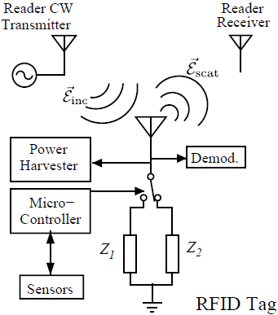
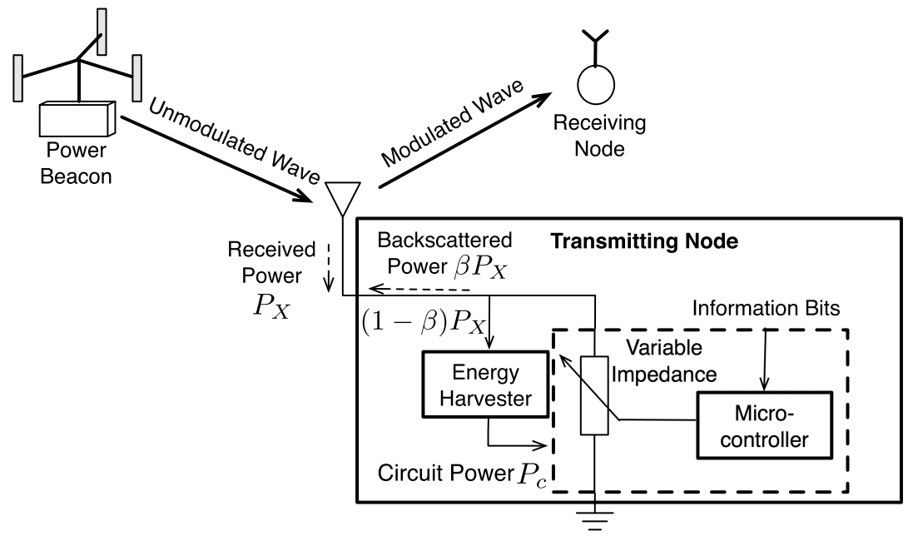
Application 1: Ultra Reliable Communication
Backscatter Communications
Definition：Transmits data via reflecting and modulating an incident RF signal by adapting the level of antenna impedance mismatch to vary the reflection coefficient, while harvests energy from the signal for operating the circuit.
Components: Reader and tag. The tag backscatters a portion of the reader’s downlink signal and modulates information onto the backscattered signal.

Slide 51
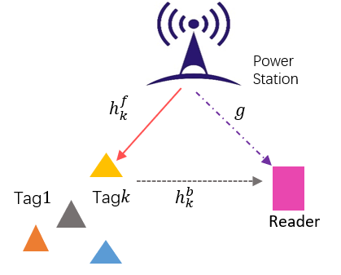
Application 1: Ultra Reliable Communication
System Model
The signal received at the reader from the $k$-th tag
The total energy harvested by the $k$-th tag during the whole frame
The achievable throughput of the $k$-th tag
Ambient backscatter system consisting of a power station, a single antenna reader and K single-antenna tags.
$$T$$
$$t_{1}$$ | $$t_{2}$$ | … | $$t_{k}$$ | … | $$t_{K}$$
Backscatter time allocation for different tags.
Notes:
Now I will introduce the application 1 : A Robust Design for Ultra Reliable Ambient Backscatter Communication Systems
In this system model, Ambient backscatter system consisting of a power station, a single antenna reader and K single-antenna tags. The signal received at the reader from the $k$-th tag is y_Rk The total energy harvested by the $k$-th tag during the whole frame is E_Hk The achievable throughput of the $k$-th tag R_k

Slide 52
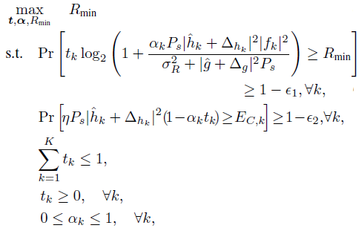
Application 1: Ultra Reliable Communication
A Chance-constrained Problem Formulation
(1)
Throughput chance constraint
(2)
EH chance constraint
(3)
Time constraint
(4)
(5)
reflection coefficient constraint
CVaR Based Method
PPT模板下载：www.1ppt.com/moban/ 行业PPT模板：www.1ppt.com/hangye/
节日PPT模板：www.1ppt.com/jieri/ PPT素材下载：www.1ppt.com/sucai/
PPT背景图片：www.1ppt.com/beijing/ PPT图表下载：www.1ppt.com/tubiao/
优秀PPT下载：www.1ppt.com/xiazai/ PPT教程： www.1ppt.com/powerpoint/
Word教程： www.1ppt.com/word/ Excel教程：www.1ppt.com/excel/
资料下载：www.1ppt.com/ziliao/ PPT课件下载：www.1ppt.com/kejian/
范文下载：www.1ppt.com/fanwen/ 试卷下载：www.1ppt.com/shiti/
教案下载：www.1ppt.com/jiaoan/
字体下载：www.1ppt.com/ziti/
Notes:
Our objective is to maximize the minimum user rate among all the tags by jointly optimizing the backscatter time allocation vector where Rmin is the minimum individual throughput. Inequation(1) is the throughput chance constraint, which means the throughput of each tag should meet the minimum throughput requirement with the probability at least 1-\epsilon 1 in the presence of channel uncertainties. Inequation (2) is the EH chance constraint, which reveals the probability that the harvested energy under CSI errors is above the consumed energy EC;k is at least 1-\epsilon 2 for each tag. The chance constraints are motivated by the facts that the system can accept the outage with a tolerable probability. The backscatter time constraints are given in (3) and (4), respectively. (5) gives the constraint for each tag’s power
reflection coefficient.

Slide 53
Application 1: Ultra Reliable Communication
Proposed Safe Approximation Methods
Lemma 1：For a continuous loss function : that is concave or quadratic in . The distributionally robust chance constraint is equivalent to the worst-case constraint, given by
In lemma 1, if the constraint function is concave or quadratic in the random variable, the distributionally robust version of the chance constraints are equivalently to the worst-case CVaR constraint.
Lemma 2：Let a quadratic function of the worst-case CVaR is computed as
In lemma 2, The worst-case CVaR can be converted into a group of semi-definite programs (SDPs).
Notes:
Now we will introduce two lemmas to transform DRO
In lemma 1, if the constraint function is concave or quadratic in the random variable, the distributionally robust version of the chance constraints are equivalently to the worst-case CVaR constraint
In lemma 2, The worst-case CVaR can be converted into a group of semi-definite programs (SDPs), which will be shown in the
following lemma.

Slide 54
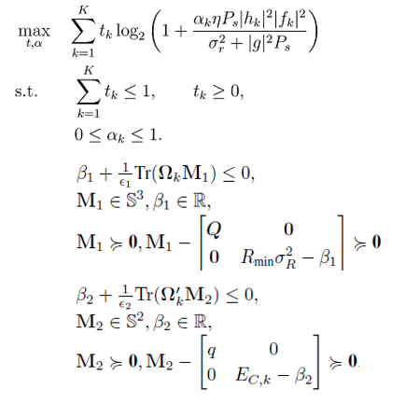
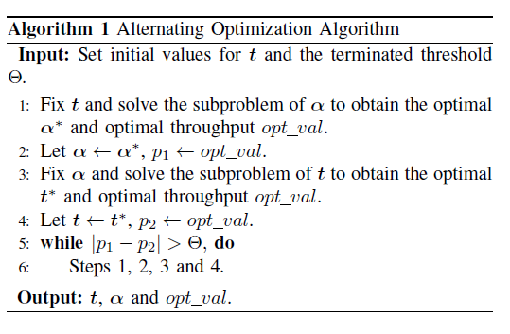
Application 1: Ultra Reliable Communication
Problem Formulation and Algorithm
The original distributionally chance-constrained problem can be reformulated as
An alternating optimization method to address the joint optimization problem
Notes:
Therefore, the original distributionally chance-constrained problem can be reformulated as
we give an alternating optimization method to address the joint optimization problem of \alpha and t, as shown in Algorithm 1. The nonconvexity in problem P1 and P2 are caused by the multiplication of \alpha k and tk in the constraints.

Slide 55
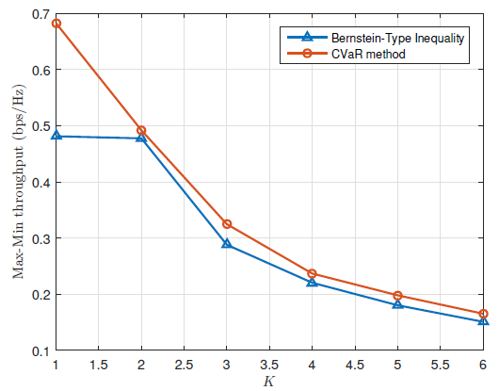
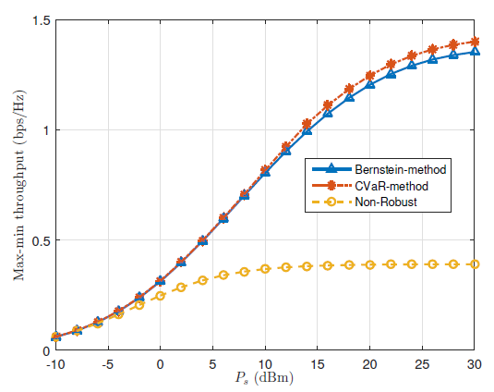
Application 1: Ultra Reliable Communication
Numerical Results
The CVaR based method for non-Gaussian CSI errors scenario performs better than the Bernstein-type inequality based method.
The robustness of the Bernstein-type-inequality method is not good as the CVaR method. The non-robust scheme takes no account of the uncertainty of channels
Notes:
In Numerical Results
The left figure shows the max-min throughput versus the number of tags. As the number of tags increases, the max-min throughput among all the tags becomes smaller. the CVaR method considering the worst-case scenario among all the distributions, It can be also seen from the figure that the CVaR based method for non-Gaussian CSI errors scenario performs better than the Bernstein-type inequality based method.
The right figure shows the max-min throughput versus the transmit power Ps for the three different optimization scenarios
The robustness of the Bernstein-type-inequality method is not good as the CVaR method. The non-robust scheme takes no account of the uncertainty of channels

Slide 56
Application 2: Age of Information
Application 2: Age of Information Minimization in Healthcare IoT Using Distributionally Robust Optimization [2]
How can I deal with channel state information (CSI) errors in Healthcare IoT system ?
The retransmission scheme is investigated against CSI errors to reduce the AoI.
The retransmission will lead to the energy consumption of the IoT device increase dramatically, especially when the IoT device is used to retransmit the same updates for infinite times
The perturbations in CSI are modeled to be statistically unbounded according to Gaussian distribution and Rayleigh distribution.
These statistical channel assumptions may not match the healthcare IoT applications perfectly.
A key open problem is to consider the case of imperfect CSI and investigate how CSI error effects may be mitigated through quantitative designs.
[2] Z. Ling, F. Hu, H. Zhang and Z. Han, "Age of Information Minimization in Healthcare IoT Using Distributionally Robust Optimization," IEEE Internet of Things Journal, to be appeared.
Notes:
Now I will introduce Application 2: Age of Information Minimization in Healthcare IoT Using Distributionally Robust Optimization

Slide 57
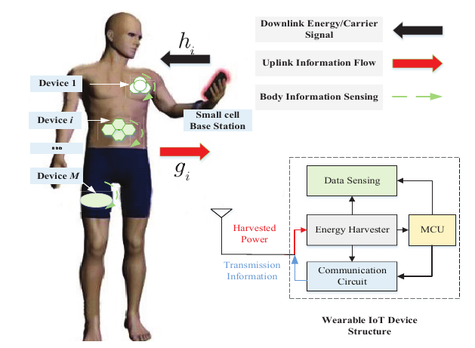
Application 2: Age of Information
System model
As shown in this picture, we consider a single-hop cellular IoT to support healthcare IoT applications:
the wearable IoT devices harvest wireless RF energy from a dedicated power cell BS
the wearable IoT devices send their sensing physiological information signals to a separate information receiving cell BS.
Notes:
Now I will introduce Application 2: Age of Information Minimization in Healthcare IoT Using Distributionally Robust Optimization
To keep the freshness of the data received at the cell BS, the wearable IoT device needs to update the data of the sensing physiological information tasks frequently in a period to minimize the average AoI.
There is an inherent tradeoff about the average AoI, where the wearable device energy consumption grows as the transmit power increases, while the average AoI of the healthcare IoT decreases as them increases.

Slide 58
Application 2: Age of Information
Channel Model
In our proposed model, we consider the imperfection of the instantaneous CSI, and get some rough knowledge of channel gain.
The actual channels can be represented by
the presumed channels
We define an ambiguity set of all distributions of and with the same means and (co)variances,
denotes arbitrary distribution as long as its distribution meets the means and (co)variances requirements.
Notes:
In our proposed model, we consider the imperfection of the instantaneous CSI, and get some rough knowledge of channel gain. The actual channel of ${h_i}$ and ${g_i}$ can be represented by
where $\hat{h}_i$ and $\hat{g}_i$ are the presumed channels of ${h_i}$ and ${g_i}$, respectively.
we has no prior knowledge of the exact distribution of the CSI errors, while only the first and second order moments of the CSI errors are known. We define an ambiguity set ${\cal P}$ of all distributions of ${\Delta _{{h_i}}}$ and ${\Delta _{{g_i}}}$ with the same means and (co)variances, as follows
P denotes arbitrary distribution as long as its distribution meets the means and (co)variances requirements.

Slide 59
Application 2: Age of Information
Energy harvesting Model
The small cell BS first transmits energy signal to the wearable IoT device.
The signal received by the wearable IoT device:
The total non-linear EH model:
where and .
To guarantee the wearable IoT device operation, the harvested energy should be larger than the consumed energy
The harvested energy under CSI errors is equal or greater than the consumed energy with the probability at least
Notes:
The small cell BS first transmits energy signal to the wearable IoT device. The signal received by the wearable IoT device can be expressed as
where ${s_i}\left( t \right)$ is the signal transmitted by the small cell BS with power ${p_i\left( t \right)}$ at wearable IoT device $i$ in time slot and ${n_S}$ is the noise, which follows the CSCG distribution.
The nonlinear energy harvesting model is more satisfied with the healthcare IoT requirements. The total non-linear EH model at the wearable IoT device is given by
$a$ and $b$ are parameters related to the state of the EH circuit, $\varphi _i$ is a logical function related to ${p_i\left(t\right)}$, $P_{max}$ is the maximum transmission power. $T$ denotes the wireless energy transmission time. $ {0 < {\alpha _i} < 1} $ is a power splitting proportion
To guarantee the wearable IoT device operation, the harvested energy should be larger than the consumed energy. the consumed energy by the wearable IoT device is related to data rates
The harvested energy under CSI errors is equal or greater than the consumed energy with the probability at least 1-gamma

Slide 60
Application 2: Age of Information
Communication Model
During the uplink phase, only the wearable IoT device operates transferring data.
The signal received at the small cell BS :
The uplink transmission data rate for transferring sensing information：
The end-to-end transmission data rate chance constraint
The minimum individual transmission data rate
where is the outage probability for each round of transmission, which should meet the minimum QoS requirement with the probability at least in the presence of channel uncertainty.
Notes:
During the uplink phase, in the $t$-th slot, only the $i$-th wearable IoT device operates transfering data. The signal received at the small cell BS is given by
where ${z_i}\left( t \right)$ is the sensed information and ${n_A}$ denotes the noise at the small cell BS
The uplink transmission data rate for transferring sensing information of wearable IoT device $i$ in a block can be given by
where $B$ is the channel bandwidth. Then, we consider the minimum individual transmission data rate $r_{U,\min }^{}$ in time slot $t$ during the uplink transmission phase.
The end-to-end transmission data rate chance constraint can be given as
where \tau_i is the outage probability for each round of transmission, which should meet the minimum QoS requirement with the probability at least $1-{\tau_i\left(t\right)}$ in the presence of channel uncertainty.

Slide 61
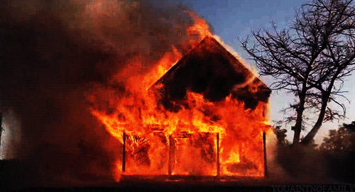
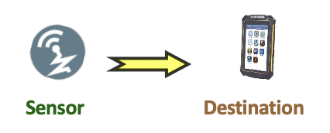
Application 2: Age of Information
Age of Information= Time – Timestamp
Measure the “age of information” that destination know about a source node.
Potential application: UAV, Uplink, Down link system in wireless communication IoT network, etc.
Evolutions of AoI function.

Slide 62
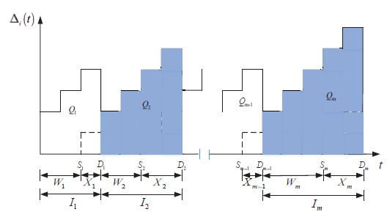
Application 2: Age of Information
Age of Information: Definition
At time $t$, the AoI $∆(t)$ is the time interval between the current time 𝑡 and the time of the latest data update
If sample $i$ generates at $S_{i}$ and delivered at $D_{i}$
$$∆(t)=t−max⁡\{S_{i}: D_{i}≤t\}$$
Evolutions of AoI function.

Slide 63
Application 2: Age of Information
Performance Evaluation of Average AoI
We first assume that the status updates generated at the wearable IoT device follows a Possion process,
The waiting time follows a geometric distribution with probability
To further study status update packet management, we subsequently investigate two different cases.
Case I : The first generated update from wearable IoT device is decoded successfully at the small cell BS until being discarded.
Case II: A new status update is generated at the wearable IoT device, while the small cell BS is currently serving a status update, which discards the status update and waits for a new status update.
Case I
Case II
Notes:
As for the Performance Evaluation of Average AoI
We first assume that the status updates generated at the wearable IoT device $i$ follows a Possion process, $W_m$ follows a geometric distribution with probability $\gamma_i\left(t\right)$
To further study status update packet management, we subsequently investigate two different cases.
Case I: The first generated update from wearable IoT device is decoded successfully at the small cell BS until being discarded.
Case II: A new status update is generated at the wearable IoT device, while the small cell BS is currently serving a status update, which discards the status update and waits for a new status update.
Based on the above analysis，we evaluate the expectation of $X_m$ and the square of $X_m$ by using a recursive method
The first term refers to the first case that the generated status update is successfully received by the small cell BS. The second term corresponds to the second case that the first generated status update cannot be decoded correctly at the small cell BS.
$L$ is information service time for each round of status update transmission, which reveals the number of blocks required to complete the transmission of a packet. Let ${{\hat X}_m}$ be the remaining process of ${{X}_m}$ after the generation of a new status update, which is defined as the interval from the preemption until the small cell BS receives an update accurately.

Slide 64
Application 2: Age of Information
Performance Evaluation of Average AoI
With the derived expectations, the expectation of interval can be evaluated as
Finally, the average AoI of the considered system can be expressed as
Notes:
With the derived expectations, the expectation of ${I_m}$ and ${I_m^2}$ can be evaluated as
Finally the average AoI of the considered system can be expressed as

Slide 65
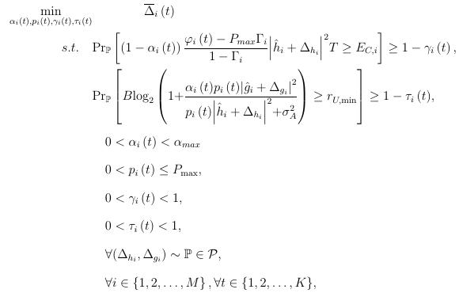
Application 2: Age of Information
Problem Formulation
Distributionally robust chance constraints.
Power splitting constraint
Power constraint
Outage probability constraint for energy harvesting.
Outage probability constraint for transmission
The distribution belongs to an uncertainty set with certain known structural properties, i.e. their first and second moments but without knowing the explicit distribution.

Slide 66
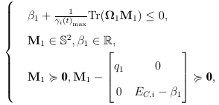
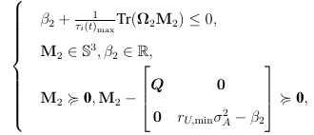
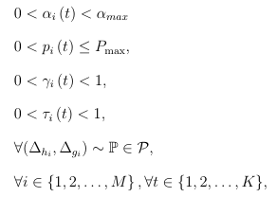
Application 2: Age of Information
CVaR constraint.
CVaR constraint.
Power constraint
Outage probability constraint for energy harvesting.
Outage probability constraint for transmission
Notes:
Through the CVaR based method, we can reformulate each of the individual distributionally robust chance constraints in terms of tractable Linear Matrix Inequalities (LMIs) to get the optimal average AoI under the uncertain errors chance constraint region. The final formulation can be shown as

Slide 67
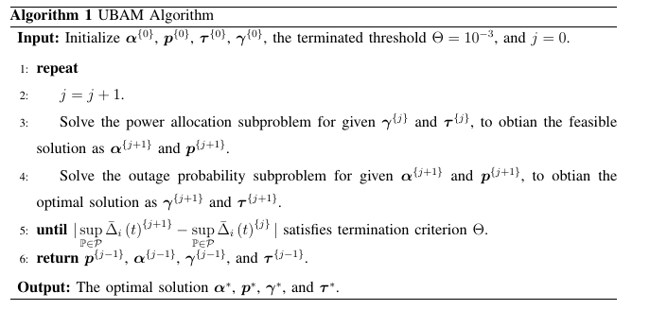
Application 2: Age of Information
To get the optimal average AoI, we propose a low-complexity upper bound of AoI minimization (UBAM) algorithm in an iterative manner to address the distributionally robust optimization problem.
Notes:
Our objective is to minimum the upper bound of AoI, by jointly optimizing transmission power ,energy harvesting outage probability, and information transmission outage probability with respect to the CVaR constraints. However, simultaneous optimization over these variables would result in a non-convex optimization problem, and such problem is known to be NP-hard in general. Thus, we introduce an efficient iterative algorithm to solve it suboptimally by applying the BCD techniques. In each iteration, we optimize different blocks of variables alternatively.

Slide 68
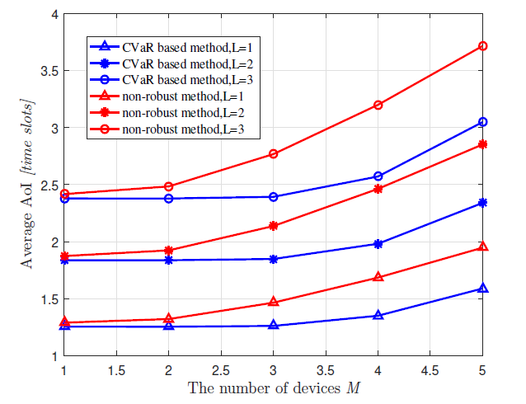
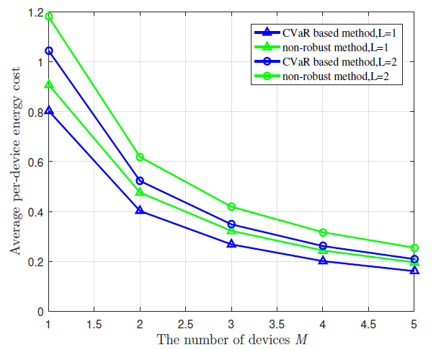
Application 2: Age of Information
The energy harvesting and information transmission successful opportunities for each link become lower with more wearable IoT devices. In this sense, we find an AoI-energy tradeoff in the healthcare IoT system.

Slide 69
Outline
Introduction
Case 1: Discrepancy-based DRO Optimization
Case 2: DRO, Risk Aversion, and CVaR
Case 3: DRO Based Reinforcement Learning
Introduction to Reinforcement Learning
Disadvantages of RL and how to learn safely
Distributionally robust policy iteration
Extended to continuous control
Applications
Conclusion
Notes:
Typical procedure of reinforcement learning
Reinforcement learning: An agent keeps observing the environment, obtain external feedback (game reward points, etc.) after taking actions

Slide 70
Reinforcement Learning
The mathematic tool used to formulate the reinforcement learning is the Markov Decision Process (MDP)
Characteristics of the MDP
State $S=\left\{s_{n}\right\}$: a set of N states
Action $A=\left\{a_{m}\right\}$: a set of M actions
Reward $R: S×A→R$: reward function
$R=R(s_{n},a_{m})$
Transition probability P: 𝑆×𝐴→𝜋(𝑆)
Element in set P: $Pr\{s_{k}|s_{n},a_{m}\}$
Discount factor $γ∈\left[0,1\right)$
$γ$ → 1 : future reward
$γ$ → 0 : immediate reward
Agent
Environment
From state $s$, take action $a$
Get Reward $R$, new state $s′$

Slide 71
Reinforcement Learning
Goal of Reinforcement Learning
Highest accumulated rewards
unsplash.com
Optimal policy
Policy $π$: a function from S to A that specifies which action to take in each state
Optimal policy $π^{∗}$: a policy that maximizes the cumulated rewards $\sum_{t≥0}{γ^{t}{r_{t}}^{}}$
$π^{∗}={argmax}_{π}E[\sum_{t≥0}{γ^{t}r_{t}|}$ $π]$
Notes:
then based on the feedback improves the action to get the highest accumulated rewards.
The strategy of the action sequence can bring best-accumulated rewards is called the best policy.
Policy (π): The strategy that the agency employs to determine the next action based on the current state.

Slide 72
Reinforcement Learning
Standard Bellman operator for value function
expected cumulated reward under certain state and following policy $π$
${[T}^{π}V]\left(s\right):=E_{a\sim π(∙|s)}\left[\sum_{t≥0}{γ^{t}r_{t}|}s_{0}=s, π\right]$
${= E}_{a\sim π(∙|s)}[r\left(s,a\right)+γ{ E}_{s^{′}\sim p\left(s^{′} | s,a\right)}[V(s^{′})]]$…Bellman equation
MDP meets the properties of dynamic programming
Recursive structure in dynamic programming : Bellman equation
Store the value for future used
Bellman optimality operator
Maximum value function
${[T}^{⬆}V]\left(s\right)≔\max_{π(∙|s)∈ΔA}{{[T}^{π}V]\left(s\right)}_{}^{}$ $∀s∈S$
Bellman operator
Set of greedy policies
Policies that maximum value function
Action-value function
expected cumulated reward under certain state and action and following policy $π$
$Q_{V}\left(s,a\right)=E_{π}\left[\sum_{t≥0}{γ^{t}r_{t}|}s_{0}=s,a_{0}=a,π\right]$= $r\left(s,a\right)+γ{ E}_{s^{′}\sim p\left(s^{′} | s,a\right)}[V(s^{′})]$
Notes:
Optimal policy: Ultimate goal of reinforcement learning
This is why we need the bellman equation
Value (V): The expected long-term return with discount, as opposed to the short-term reward R. Vπ(s), is defined as the expected long-term return of the current state sunder policy π.
Q-value or action-value (Q): Q-value is similar to Value, except that it takes an extra parameter, the current action a. Qπ(s, a) refers to the long-term return of the current state s, taking action a under policy π.T

Slide 73
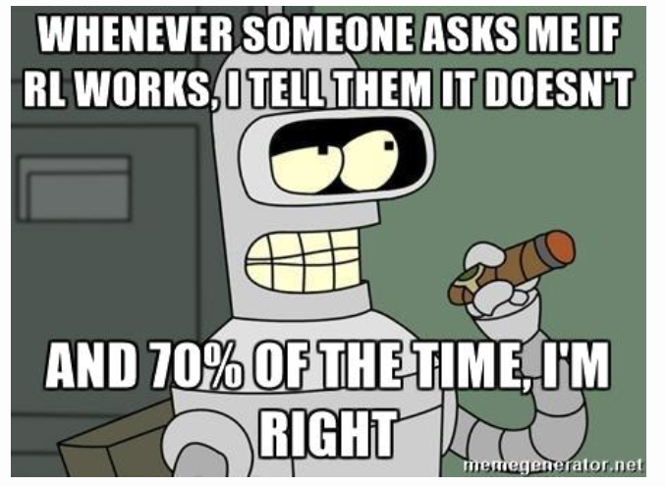
Challenges of Reinforcement Learning
Two possible ways to perform policy learning for real-world physical tasks:
Real-world Policy Learning
Expensive, dangerous, and time-consuming
Scarce data and limited set of strategies leads to overfitting
Cannot be generalized in various test scenarios
Learning in simulation
Gap between real system and
simulation system

Slide 74
Robust Reinforcement Learning
Robustness
Model used requires high accuracy and effectiveness
Small deviations(ex: noises) would only cause a small impact on the performance of the algorithm
Huge deviations in the data must not cause a catastrophic impact on the performance of the algorithm
Robust Reinforcement Learning
Search for strategies to achieve the best performance in the worst case of the simulation environment

Slide 75
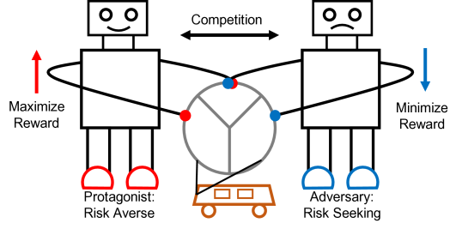
Robust Adversarial Reinforcement Learning
Two competing agents
Protagonist (main agent)
Risk averse
(achieve goals safely)
Adversary
Risk Seeking
(providing random and
systematic attacks)
75
Pan, Xinlei, et al. "Risk averse robust adversarial reinforcement learning." 2019 International Conference on Robotics and Automation (ICRA). IEEE, 2019.
Notes:
Two competing agents acting against each other:
protagonist: trying to drive a car quickly and safely
Adversary: trying to slow or crash the car
As the adversary gets stronger, the protagonist experiences harder challenges.
75

Slide 76
Motivation
Previous works considering robustness in Reinforcement Learning
Mainly focus on the uncertainty in environment
DRO RL
Not only consider uncertain environment
Limited collected samples when training
→ Affect how to transit to new state based on current state and action
Concentrate on learning process for agent itself
Conservative policy in unknown environment
Optimistic policy in familiar environment

Slide 77
Policy Iteration
an iterative algorithm
Process
First Step - Policy evaluation
Given current policy $π_{t}$ , calculate state value and iterate until converge
$V_{i+1}^{π_{t}}(s)←\sum_{s^{′}}{P\left(s^{′} | s,π\left(s\right)\right)\left(r\left(s,π\left(s\right),s^{′}\right)\right)+γV_{i}^{π_{t}}(s^{′})}$
Second Step - Policy improvement
find the best action according to the converged state value from first step
Repeat steps until the policy convergences
Iteration $i$
$$π_{t+1}(s)←{argmax}_{a}\sum_{s^{′}}{P\left(s^{′} | s,a\right)[r\left(s,a,s^{′}\right)+γV_{}^{π_{t}}\left(s^{′}\right)]}$$

Slide 78
Modified Policy Iteration (MPI)
Disadvantages of policy iteration:
For some cases, do not need to converge to actual $v^{π}$
Introduce stopping criterion when only little fluctuation occurs for value function
Stop after $m$ iterations of iterative policy evaluation
Process
Policy improvement: (greedy step)
Policy evaluation: (evaluation step)
$$m=∞$$
policy iteration
$$m=1$$
value iteration
Puterman, M. L. (1990). Markov decision processes. Handbooks in Operations Research and Management Science, 2(C), 331–434. https://doi.org/10.1016/S0927-0507(05)80172-0

Slide 79
Approximate Modified Policy Iteration (MPI)
Reasons for the evaluation step subject to an estimation error $δ_{t}$
finite sample of transitions
disturbance of the environment used to perform evaluation.
Process
Policy improvement: (greedy step)
Policy evaluation: (evaluation step)
Estimation error in Algorithm
On-policy algorithm: due to the finite number of trajectories
Off-policy algorithm: because of mini-batch of samples from a reply buffer
Since the amount of collected experience is limited, the value function is uncertain.
consider training the agent safely under the finite sample estimates.
Estimation error
Notes:
The first uncertainty need to be considered is the estimation error
In practice, the state are huge. It's impossible to sample all states for updating value. When using the reinforcement learning to tackle different MDP problems such as robotic control(infinity possible positions and velocities of the robotic), recommendation system(billions products and costumers) and Resource Allocations(infinity possible energy consumption situations). All model free Reinforcement learning using experience sample strategy to build a finite experience buffer to approximate the real all possible experience. Due to the finite amount of collected experience, the value Vt is uncertain. The uncertainty of empirical estimate is captured by its variance and is known under parametric uncertainty

Slide 80
Distributionally Robust Policy Evaluation
Uncertainty set:
Adversarial Bellman operator:
Considered
possible
policies
Best policy
$$D_{KL}≤ε$$
$$π^{ }$$
$${\tilde{π}}^{ }$$
Evaluate with an adversarial policy
worse case
$$π^{ε }$$
Notes:
The idea for the distributionally robust policy evaluation: policy is a distribution(possibility of taking each actions), the goal is to find a optimal policy in a space. But during the iteration, Instead of choosing the looks best policy , sometimes choosing the most cowardly policy located near this policy coule result a better final end.
As mentioned before, DR RL using Discrepancy-based DRO way to build the uncertainty set: KL divergency.

Slide 81
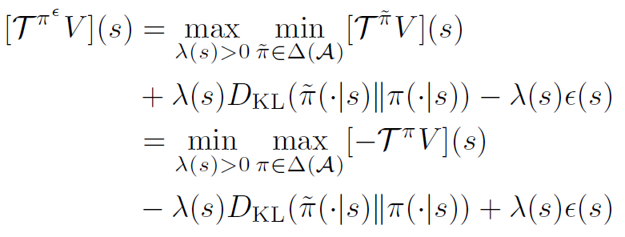
Distributionally Robust Policy Evaluation
Rewrite the maximum problem by
Distributionally robust modified policy iteration
Policy improvement:
Policy evaluation:
$$π^{ }$$
$$π^{ε }$$
$$a_{1}$$
$$a_{2}$$
$$a_{3}$$
$$a_{1}$$
$$a_{2}$$
$$a_{3}$$
Re-weight policy action probabilities opposite to Q-values
adversarial policy
adversarial temperature
Notes:
For example, current policy is around (0.1, 0.8, 0.1) since the q value said the action 2 is very valuable with ignorant confidence. But the uncertainty in the real world always teach people to be humble, so based on the level of uncertainty the agent will have a seems cowardly but wisely action maybe (0.3, 0.5, 0.3). Thoughtful coward is better than ignorant pioneer.
All this classical reinforcement learning algorithm face a problem of high dimensional of real word: the value space is huge and the action space is huge. After introduced the deep neural network to estimate the value and predict the action, the reinforcement learning is enter the modern period.
Then Let's introduce the current SOTA algorithms in Reinforcement learning filed and it's DRO version.

Slide 82
Regularized Bellman Optimality Operator
Rewritten of Bellman operator for value function
${[T}^{π}V]\left(s\right)≔E_{a\sim π(∙|s)}\left[\sum_{t≥0}{γ^{t}r_{t}|}s_{0}=s, π\right]$
${= E}_{a\sim π(∙|s)}\left[r\left(s,a\right)+γ{ E}_{s^{′}\sim p\left(s^{′} | s,a\right)}\left[V\left(s^{′}\right)\right]\right]$
= $<π\left(∙ | s\right),Q_{V}\left(s,a\right)>$ … inner product of the policy and Q-function
$$Q_{V}\left(s,a\right)$$
Regularized Bellman optimality operator
${[T}^{π,Ω}V]\left(s\right)≔T^{π}V−Ω(π)$ is a Fenchel dual function and can be seen as the normal value function minus the baseline.
Set of optimal policies
Lengendre-Fenchel duality (Conjugate function)
Fenchel dual : ${[Ω}^{⬆}V]\left(Q_{V}\right)=\max_{π∈ΔA}{(<π,Q_{V}>−Ω(π))}_{}^{}$
Gradient form: ${[∇Ω}^{⬆}V]\left(Q_{V}\right)=\underset{π∈ΔA}{argmax}{(<π,Q_{V}>−Ω(π))}_{}^{}$
Soft distributionally robust modified policy
Distributionally robust soft actor-critic
Strongly convex function
$$=λ× ( )$$
Notes:
First formulate Bellman Funtion by writing Bellman Operator

Slide 83
Extension to Entropy-Regularized Policy Maximum Entropy
Soft distributionally robust modified policy
Policy improvement:
Policy evaluation:
Soft adversarial Bellman operator
Here, we take entropy form into consideration to obtain robustness guarantees on exploration process.
Adversarial entropy-regularized policy
Recall the adversarial policy
entropy form
$$E_{a\sim π\left(∙ | s\right)}log⁡[π(a|s)]$$
regularized policy

Slide 84
Extended to Continuous Control
Apply this distributional robust MPI to the continuous control problem.
The formulation is intractable and we get the approximate formula as follows:
Regularized Bellman operator can be written in terms of Fenchel conjugate
Fenchel conjugate
Regularization parameter
Prior policy
$$=λ× ( )$$
Logarithm of moment-generating function
Taylor expansion
reward shaping
Potential-based reward shaping
When it come to the implementation, it‘s quite simple. Just change the reward
encourage the agent to visit states with smaller variance
Notes:
To extend the Distributional Policy iteration to the SAC which invented to solve the Continuous Control problem is not easy. The Formulation is intractable, but with several Taylor first order Approximation derivations, we can get this formular to guide design of the distributional SAC and other Distributional algorithms: Shape the reward to encourage the agent visit the state with smaller Q variance under prior policy. The uncertain level is depend on the ½Lamda which depend on the visited count of states. If the agent has visited this state many times, it is familiar with this state, then the Lamda is big, the reward is certainy, doesn't need the variance to correct the reward. If the state is not familiar to the state, the lamda is small, the variance regularizer is essential.
Real-world applications usually operate in continuous state/action space.
So in this part, the authors formulate the distributionally robust soft actor-critic by extending the previous distributionally robust approach to continuous case.
Again, the regularized Bellman operator can be written as the conjugate function.
And the regularization parameter is the KL-divergence based regularization with the prior policy mu.
The Fenchel conjugate of omega_lambda can be expressed by the logarithm of moment-generating function.
By doing the Taylor expansion and potential-based reward shaping, we can get the last formula.
The goal of the reward shaping is to make the learning faster.
Corollary 2 (by other papers)

Slide 85
Soft Actor-Critic (SAC)
Taxonomy of RL Algorithms
Soft Actor-Critic
Based on actor-critic (AC) algorithm
Difference from AC
Importance: entropy V.S. reward
Notes:
There are lots of reinforcement learning algorithms
One of the most important branching points in an RL algorithm is the question of whether the agent has access to (or learns) a model of the environment. By a model of the environment, we mean a function which predicts state transitions and rewards.
Policy Optimization. Methods in this family represent a policy explicitly. They optimize the parameters either directly by gradient ascent on the performance objective , or indirectly, by maximizing local approximations. This optimization is almost always performed on-policy, which means that each update only uses data collected while acting according to the most recent version of the policy. Policy optimization also usually involves learning an approximator for the on-policy value function , which gets used in figuring out how to update the policy.
Q-Learning. Methods in this family learn an approximator for the optimal action-value function. Typically they use an objective function based on the Bellman equation. This optimization is almost always performed off-policy, which means that each update can use data collected at any point during training, regardless of how the agent was choosing to explore the environment when the data was obtained.
SAC is belong to the Actor Critic based. This kind algorithms conbined the Q-learning and Policy Optimization two types' algorithms.
SAC idea:
1. collect pairs (state, action, state after take this action, the reward corresponding to this state and action)
2. Using these pairs we can train the Critic(input is the state and action, output label is the Q value calculated by reward) Q(t) = reward + discount ratio*Q(t+1). Q() is the Critic neural network.
3. Then using the improved Q() to help Actor's training. Actor input is the state, and output label is the higher Q calculated by using the Q()
During the training, the Q() can approximate more precisely and the actor can act better alternately. And better Actor can bring more good sampled pairs (state, action, state after take this action, the reward corresponding to this state and action)
SAC is based on the Actor Critic algorithm, which using two neural networks to approximate the Agent(map state to action) and Critic(map state and action pair to Q value). This is only change compare the SAC to AC. The entropy regularizer which is aim for encouraging the agent's exploration.

Slide 86
Distributionally Robust Soft Actor-Critic (DRSAC)
In this continuous control case: the distribution of the policy is Normal distribution.
parametrized Gaussian policies
Approximation the variance of Q-values by using the 1st order Taylor approximation
of Q-values around the mean action
Combined with the soft-actor critic algorithm
1st order Taylor approximation of
Q-values around the mean action
Independent actions
Haarnoja, T., Zhou, A., Abbeel, P., and Levine, S. Soft actor-critic: Off-policy maximum entropy deep reinforcement learning with a stochastic actor. arXiv preprint arXiv:1801.01290, 2018a.

Slide 87
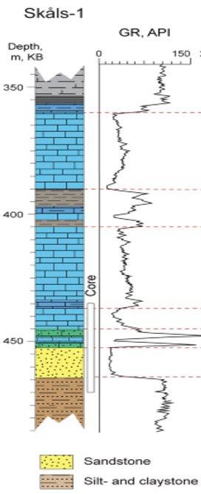
Application 1: Signal Localization
Well 1
Well 2
Gamma-Ray Signal Localization Task
Many 1D signals containing the same signal pattern are collected by the well-logging process and sent to human-expert to do hand-picking for oil&gas localization.
Traditional methods
The human experts pick the patterns associated with interested rock based on one reference signal:
Recognize the pattern with domain prior knowledges.
Roughly matching with correlation matching methods.
Yuan Zi, Lei Fan, Jiefu Chen, and Zhu Han, “Active Gamma-ray Log Pattern Localization with Distributional Robust Reinforcement Learning,” submitted to IEEE Transactions on Neural Networks and Learning Systems.
Notes:
Now I will introduce Wasserstein DRO Application 1: A Transactive Energy Framework for Coordinated Energy Management of Networked Microgrids With Distributionally Robust Optimization
Transactive Energy Management Framework
A transactive market is organized by the Distribution Network Operator to coordinate the energy management of the DS and MGs in the operation
DS is connected with the HV system and the DNO needs to manage the power exchange between the DS and the HV system.

Slide 88
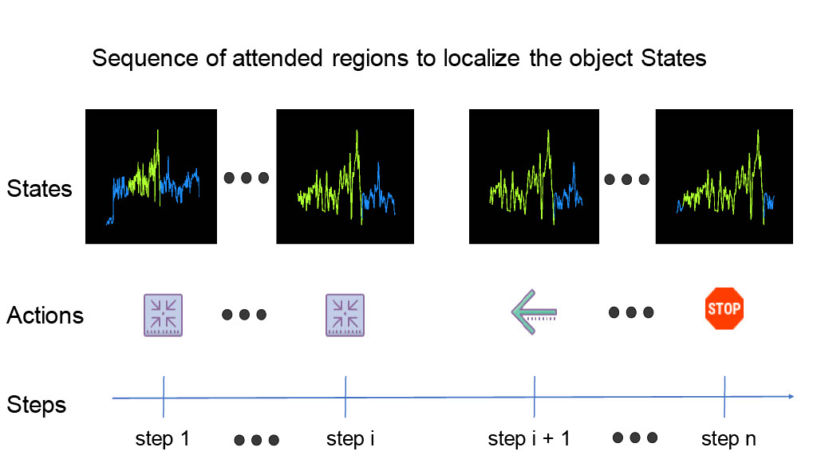
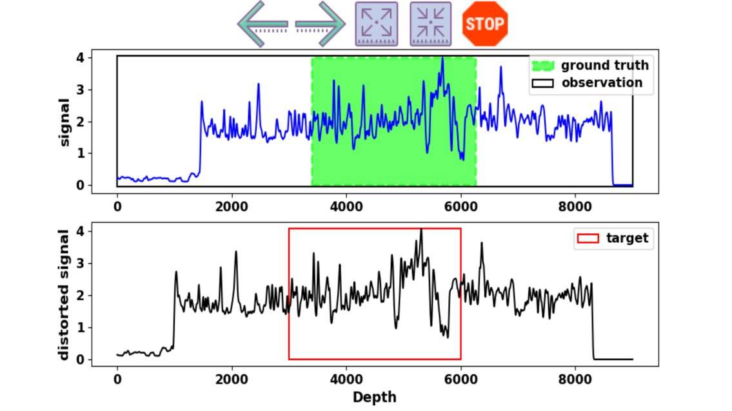
Application 1: Signal Localization
Reinforcement Learning Signal Localization Scheme
Thoroughly studied log with interested signal fragment as reference/target.
In the new log, there is a signal fragment that has the same pattern as the reference
Initial the whole new log trace as the agent's observation.
Let the agent move (left, right, expand, shrink) to search the reference pattern.
Notes:
Optimization Model of Distribution Network Operator
cost for the scheduled power exchange between the DS and HV system
generation cost of the MTs in the DS.
the cost for the deviant power exchange between the DS and HV system
settlement between the DS and MGs
the power exchange between the DS and MG m by the solutions of the MGs' energy scheduling optimization

Slide 89
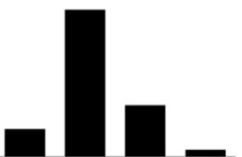
Application 1: Signal Localization
Neural Network Architecture
The neural network took both target fragment and current observation as input to make search move decisions.
Then, it output the probability distribution of discrete movement as action.
Notes:
Active power exchange between MG m and DS at time t in scenario ω, positive value means injection from DS to MG, negative value means export from MG to DS.
Active power output of MT g at time t in scenario ω.
Clearing price in transactive market at time t in scenario ω.
Uncertainties related to the MT and electric vehicles in scenario \omega are expressed as follows, expected value+random terms

Slide 90
Application 1: Signal Localization
Extended DR-RL to Discrete Control Reformulation
Policy: distribution of actions’ probabilities
Advantages brought by discrete reformulation:
Q function moves from Q(S, A) to Q(S).
Distributions like loss function of temperature, Q, V, A become calculatable directly rather than approximate with a gaussian distribution.
The variance of Q becomes calculatable rather than approximate with gradient.
DRO regularizer is easier to obtain with higher accuracy.
Value of the state
Temperature: one hyperparameter
Loss of temperature
Target entropy
Parameters of policy network
Number of actions
Loss of policy network
Entropy of current policy
Notes:
The scenario based SP model is transformed to DRO
Original problem is To minimize the expected value of the operation cost
Which can be transformed a mixed integer quadratic minimax optimization model

Slide 91
Application 1: Signal Localization
Algorithm based on Discrete DRRL Reformulation
Compare to the vanilla SAC algorithm
This algorithm stores visited states to a data pool as its comfortable and confident zone.
Then calculate the size of uncertainty based on the "strange level" of new visited state (difference between familiar states and new visited state).
Add DRO regularizer to reward to penalize the blindly confident action on not familiar states.
Notes:
The Wasserstein distance can be defined in the following expression
An iterative algorithm based on the relaxation approach for the minimax optimization

Slide 92
Application 1: Signal Localization
Experiment 1: full training dataset can represent the true distribution of signals.
Experiment 2: 15 training dataset removed, which no more true distribution of signals
Although the DRSAC sacrifice some accuracy when training dataset is good, it can resistent the unexpected damage and stay robust.
The DRSAC usually took more actions per search because of its conservative strategy.
The distributionally robust reinforcement learning searching model guarantees robustness even in training data shortage situations with some sacrifice of accuracy.​
Notes:
The Wasserstein distance can be defined in the following expression
An iterative algorithm based on the relaxation approach for the minimax optimization

Slide 93
Application 1: Signal Localization
The Top-down attention reinforcement learning searching model can successfully and efficiently localize the target.
Notes:
The Wasserstein distance can be defined in the following expression
An iterative algorithm based on the relaxation approach for the minimax optimization

Slide 94
Conclusion
Motivation
DRO accounts for the fact that one is never able to exactly specify a probability distribution in practice.
Due to the finite experience sample, the distribution of the real experience is hard to get.
DRO Optimization
The Wasserstein distributionally robust problems can often be reformulated as (or tightly approximated by) finite convex programs within a certain Wasserstein distance from the empirical distribution constructed from training samples.
CVAR
Distributionally robust chance constraints can be conservatively approximated by worst-case CVaR constraints.
DRO RL
The risk-averse exploration in approximate RL setting is required and we can use the distributionally robust modified policy iteration scheme that implements safety in policy evaluation step w.r.t. estimation errors to avoid.
Implement DRO to the Reinforcement Learning is just add one safe regularizer to encourage agent visit the state with smaller variance.
Notes:
And finally I will give some conclusions.
DRO accounts for the fact that one is never able to exactly specify a probability distribution in practice.
Distributionally robust chance constraints can be conservatively approximated by worst-case CVaR constraints.
The Wasserstein distributionally robust problems can often be reformulated as (or tightly approximated by) finite convex programs within a certain Wasserstein distance from the empirical distribution constructed from training samples.

Slide 95
Main References
Rahimian H, and Mehrotra S.
Distributionally robust optimization: A review. 2019
Zymler S, Kuhn D, and Rustem B.
Distributionally robust joint chance constraints with second-order moment information. 2013
Esfahani P M, and Kuhn D.
Data-driven distributionally robust optimization using the Wasserstein metric: Performance guarantees and tractable reformulations. 2018
T. Haarnoja, A. Zhou, P. Abbeel, and S. Levine.
Soft actor-critic: Off-policy maximum entropy deep reinforcement learning with a stochastic actor. 2018
B. Scherrer, M. Ghavamzadeh, V. Gabillon, B. Lesner, and M. Geist.
Approximate modified policy iteration and its application to the game of tetris. Journal of Machine Learning Research, 16:1629–1676, 2015
E. Smirnova, E. Dohmatob, J. Mary.
Distributionally robust reinforcement learning. 2019
Notes:
They are main references

Slide 96
Thank You Very Much
for
Your Attention !

