Slide 1


Multi-Armed Bandits and Its Application in Wireless Communications
Zhu Han,
John and Rebecca Moores Professor
Electrical and Computer Engineering Department
University of Houston
IEEE Fellow and AAAS Fellow
Thanks for Jingwen Tong, Liqun Fu, Amir Leshem, Fahira Sangare, Thanh Le, and Rong Zheng

Slide 2
Outline
Background
About MAB: History and Story
Why Do You Need to Know MAB
Part I: Multi-Armed Bandits (MAB)
Part II: Applications
Conclusion and Limitation
Notes:
This presentation includes four parts.

Slide 3

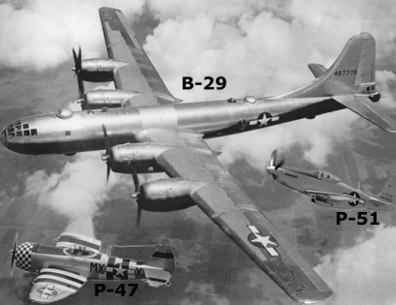
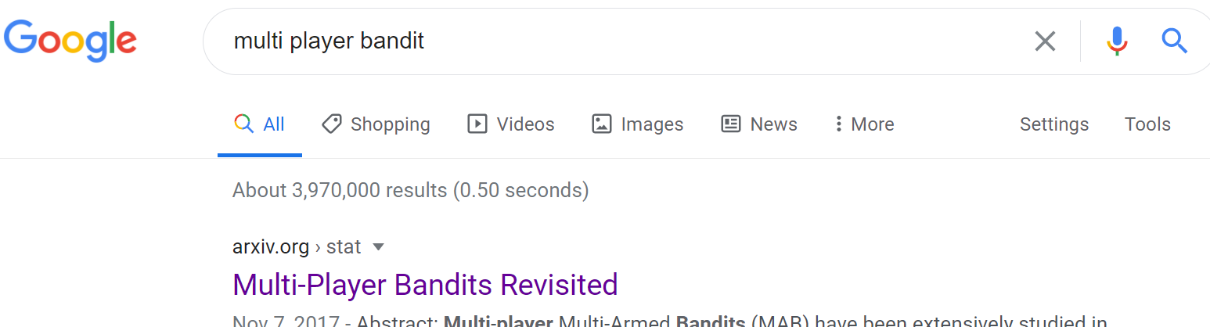
Background
History of MAB
Introduced by Wiliam R. Thompson in 1933
Study the clinical trials
Famous in the Second World War
Modeled as a sequential decision making problem by Lai and Robbins in 1950s
Solve this problem mathematically and provide a famous low regret bound
Gain attention until 1980s
E.g. apply in engineering, economic, etc.
Explosion over the last two decades
Due to the online recommend system, reinforcement learning, etc.;

Slide 4
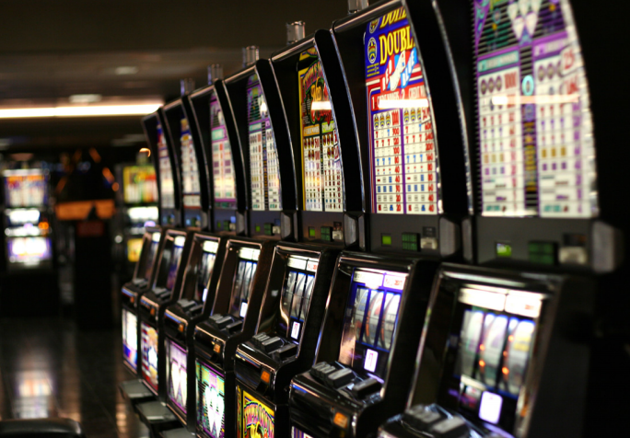
Background
Why is it call MAB (a story)?
A gambler plays slot machine in a casino
There is a row of slots, i.e., multi-arms
This gambler needs to decide which arm should to play
Usually, he will lost all of his money. So the slot like a robber or bandit will rob people’s money;
Notes:
The name of MAB comes from a colorful story
Playing a slot machine is typically a sequential decision making problem
casino

Slide 5



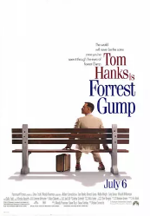
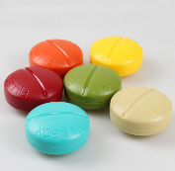




Background
Why do you need to know MAB
Think about MAB for your next decision making problems !
An alternative to understand the reinforcement learning
A powerful tool to tread-off the exploration vs exploitation dilemma
Rigorous theoretical results, i.e., regret bounds
Most machine learning problems no theoretical guarantees
Used to solve many practical problems
For example
K possible treatments (Clinical trial)
K different movies (Recommend system)
Which treatment should be allocated to patient
based on the effect of previous patients
Which movie should be recommended to new user
based on the ratings of previous (similar) users
Notes:
A bandit algorithm plays a role in Monte Carlo tree search, and the success of AlphaGo

Slide 6
Outline
Background
Part I: Multi-Armed Bandits (MAB)
Language of MAB
Classifications and Algorithms
Multi-Player MAB
Part II: Applications
Conclusion and Limitation
Notes:
This presentation includes four parts.

Slide 7
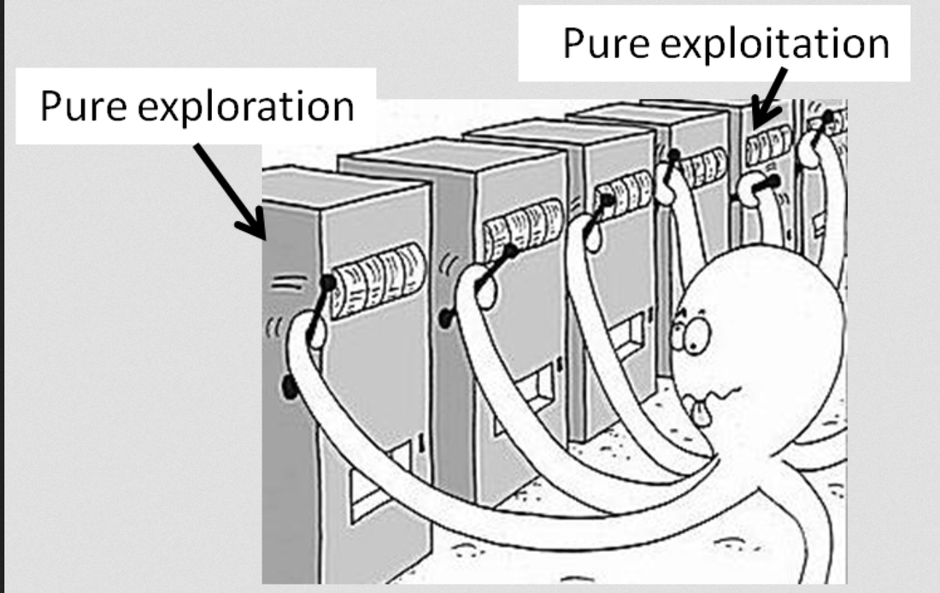
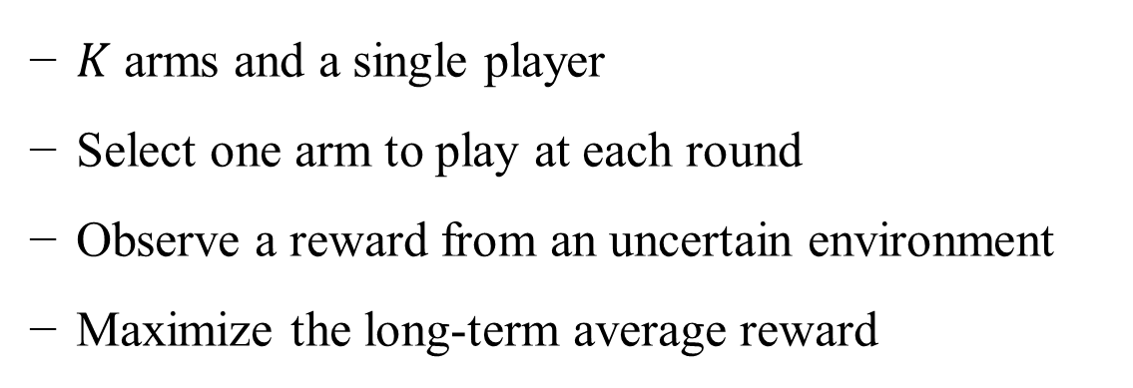
Language of MAB
Definition
$K$ arms and a single player
Select one arm to play at each round
Observe a reward from an uncertain environment
Maximize the long-term average reward
Exploration v.s. Exploitation (EE)
Exploration: need to play a new arm to explore its reward statistics
Exploitation: need to play the current best arm to maximize the agent’s long-term average reward
Notes:
So, the core of MAB problem is how to balance the EE dilemma

Slide 8

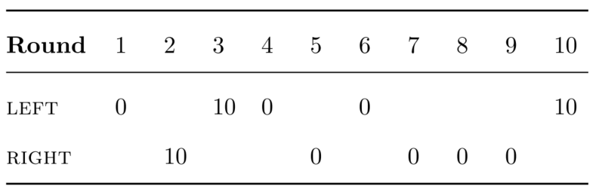
Language of MAB
Example (two-armed bandit)
Table 1 Reward list
Fig. 1 Two-armed bandit
The average reward of left arm is 4 dollars.
The average reward of right arm is 2 dollars.
Notes:
How many samples are required to identify the best arm?
How to quantify the player’s selection strategy?

Slide 9


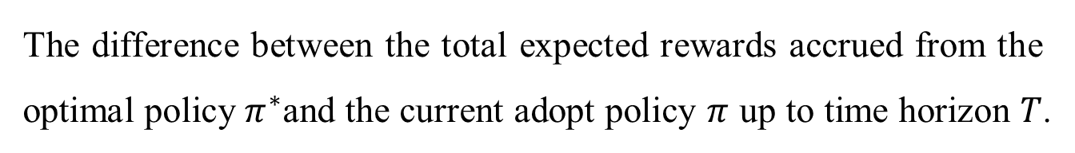
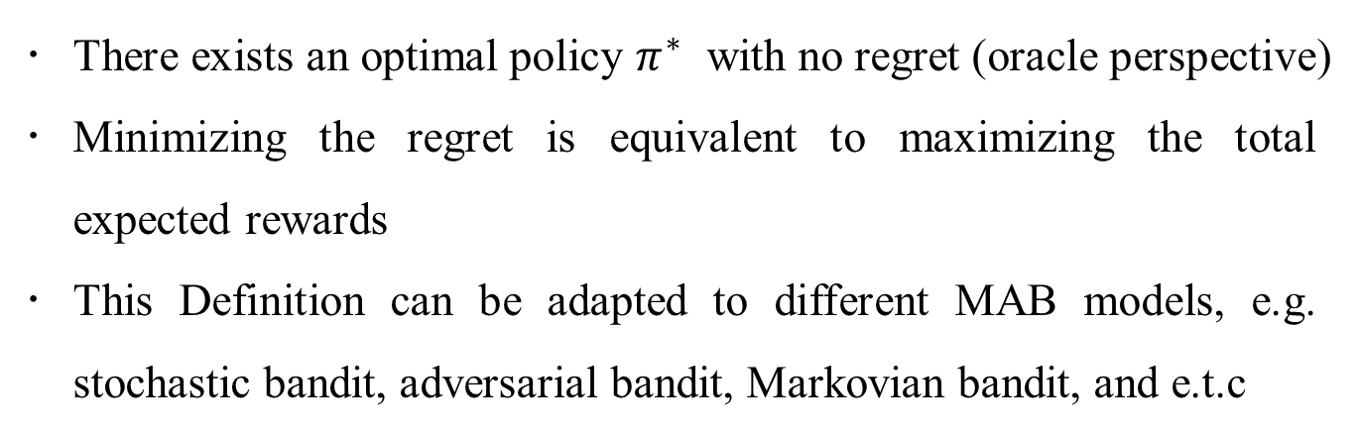
Language of MAB
Regret
Definition
The difference between the total expected rewards accrued from the optimal policy${ π}^{∗}$and the current adopt policy $π$ up to time horizon $T$.
Notes
There exists an optimal policy $π^{∗}$ with no regret (oracle perspective)
Minimizing the regret is equivalent to maximizing the total expected rewards
This Definition can be adapted to different MAB models, e.g. stochastic bandit, adversarial bandit, Markovian bandit, and e.t.c
Notes:
There is a optimal policy with no regret. Also call oracle

Slide 10
Outline
Classifications and Algorithms
Stochastic Bandits (ETC, Epsilon-greedy, UCB, KL-UCB, GBA, TS Algorithms)
Adversarial Bandits (Exp3 Algorithm)
Contextual bandits (Exp4 and LinUCB Algorithms)
Markovian Bandits (Gittins Index Algorithm)
Lipschitz Bandits (Zooming Algorithm)

Slide 11
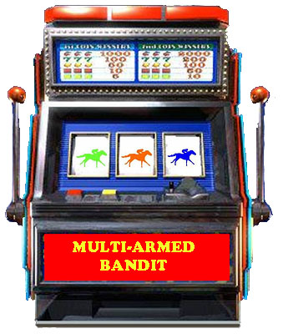


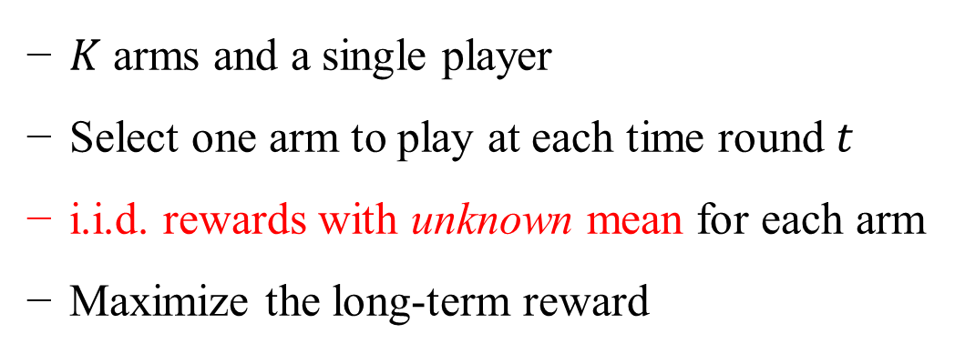
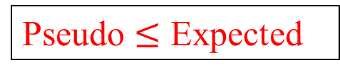

Stochastic Bandits
Definition
$K$ arms and a single player
Select one arm to play at each time round $t$
i.i.d. rewards with unknown mean for each arm
Maximize the long-term reward
$$⋯$$
Arm 1
Arm 2
Arm K
Regret
Expected Regret:
Pseudo $≤$ Expected
Pseudo Regret:
where $X_{i,t}$ is the reward of arm i at time slot t, and $I_{t}$ denotes the current selected arm
Notes:
The difference is the expectation operate on different place.
The expected regret is to find the difference between the maximum reward
While the pseudo regret is to find the difference between the man reward

Slide 12
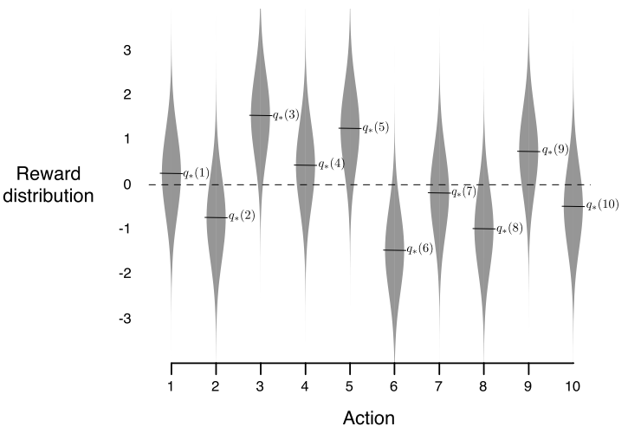


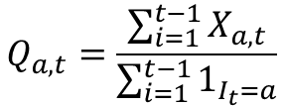









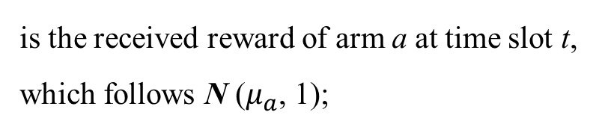


Stochastic Bandits
Example (10-armed bandit)
is the value or mean reward for a = 1, 2, 3…10, follows standard Gaussian distribution N (0, 1);
$$μ_{a}$$
$$X_{a,t}$$
is the received reward of arm a at time slot t, which follows N ($μ_{a}$, 1);
$$μ_{3}$$
$$μ_{5}$$
$$μ_{4}$$
$$μ_{9}$$
$$μ_{1}$$
$$μ_{7}$$
$$μ_{10}$$
$$μ_{2}$$
denotes the estimated average reward of arm a at round t, i.e.
$$μ_{8}$$
$$Q_{a,t}$$
$$μ_{6}$$
$$Q_{a,t}=\frac{\sum_{i=1}^{t−1}{X_{a,t}}}{\sum_{i=1}^{t−1}{1_{I_{t}=a}}}$$
Objective: find the optimal arm (i.e., arm 3) as soon as possible to maximize the total rewards.
Fig. 2 10-armed stochastic bandit problem
Sutton, Richard S., and Andrew G. Barto. Reinforcement learning: An introduction. MIT press, 2018. (Chapter 2)
Notes:
There are many algorithms to solve this stochastic bandit problem.
Today I will introduce seven algorithms to you

Slide 13
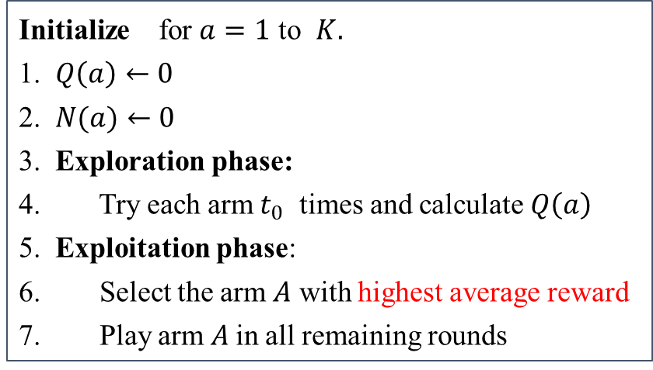
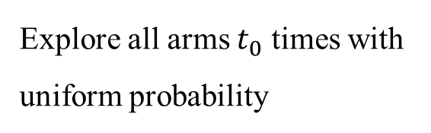
Stochastic Bandits--ETC
Explore-Then-Commit (ETC) Algorithm
Algorithm
ETC Algorithm
Initialize for $a=1$ to $K.$
1. $Q\left(a\right)←0$
2. $N(a)←0$
3. Exploration phase:
4. Try each arm $t_{0}$ times and calculate $Q\left(a\right)$
5. Exploitation phase:
6. Select the arm $A$ with highest average reward
7. Play arm $A$in all remaining rounds
Explore all arms $t_{0}$ times with uniform probability
Notes:
The idea of the ETC algorithm is that it explore all arms with uniform probability in a fixed time rounds.
Then select the arm with highest average reward and play this arm in all remaining rounds.
The feature of ETC algorithm is that is has two phases.
The exploration phase used to estimate all arms’ mean reward

Slide 14
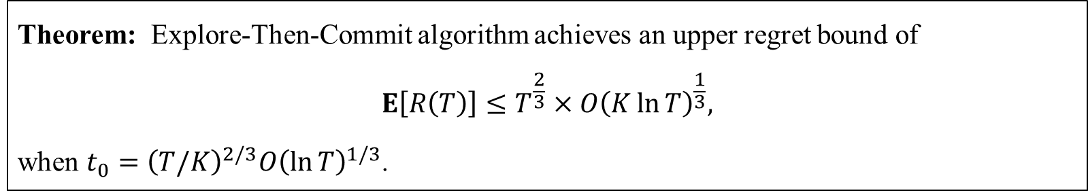
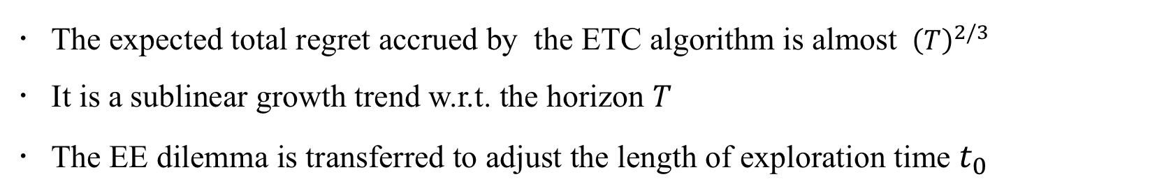
Stochastic Bandits--ETC
Explore-Then-Commit (ETC) Algorithm
Regret bound (problem-independent)
Theorem: Explore-Then-Commit algorithm achieves an upper regret bound of
$$E\left[R\left(T\right)\right]≤T^{\frac{2}{3}}×O{\left(K\ln{T}\right)}^{\frac{1}{3}},$$
when $t_{0}={\left(T/K\right)}^{2/3}O{\left(\ln{T}\right)}^{1/3}$.
Remarks
The expected total regret accrued by the ETC algorithm is almost ${ \left(T\right)}^{2/3}$
It is a sublinear growth trend w.r.t. the horizon $T$
The EE dilemma is transferred to adjust the length of exploration time $t_{0}$
Slivkins, Aleksandrs. "Introduction to Multi-Armed Bandits." Foundations and Trends® in Machine Learning 12.1-2 (2019): 1-286. (Chapter 1)
Notes:
The ETC algorithm can achieve this regret bound when to takes this value
So we need to know the T first. And not too small
So it is better to spread exploration more uniformly over each time round

Slide 15
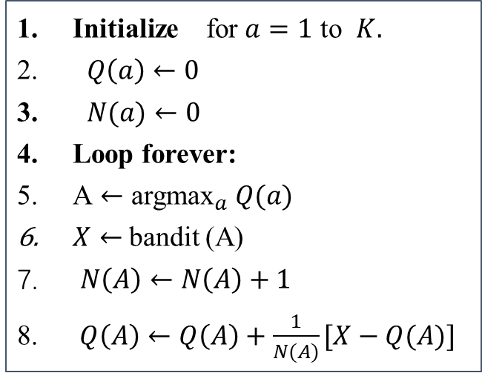
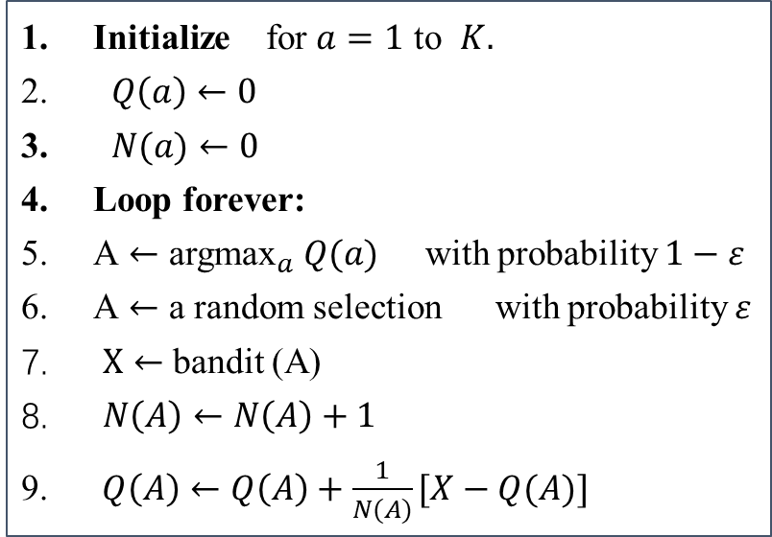
Stochastic Bandits--𝜀-Greedy
Greedy and 𝜀-Greedy Algorithms
exploitation
exploration
Algorithm
exploitation
Greedy Algorithm
Epsilon Greedy Algorithm
Initialize for $a=1$ to $K.$
$Q\left(a\right)←0$
$N(a)←0$
Loop forever:
A $←$ argma${\text{x}}_{a}$ $Q(a)$
$X←$ bandit (A)
$N\left(A\right)←N\left(A\right)+1$
$Q\left(A\right)←Q\left(A\right)+\frac{1}{N(A)}[X−Q(A)]$
Initialize for $a=1$ to $K.$
$Q\left(a\right)←0$
$N(a)←0$
Loop forever:
A $←$ argma${\text{x}}_{a}$ $Q(a)$ with probability $1−ε$
A $←$ a random selection with probability $ε$
$X←$ bandit (A)
$N\left(A\right)←N\left(A\right)+1$
$Q\left(A\right)←Q\left(A\right)+\frac{1}{N(A)}[X−Q(A)]$
Notes:
Epsilon Greedy Algorithm can explore in each time rounds
The difference between greed algorithm and the epsilon greedy algorithm is that
epsilon greedy algorithm maintains a small probability to exploration;
While greed algorithm just exploit
So it will suffer from big regret

Slide 16
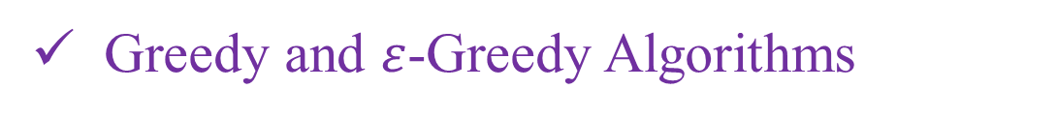
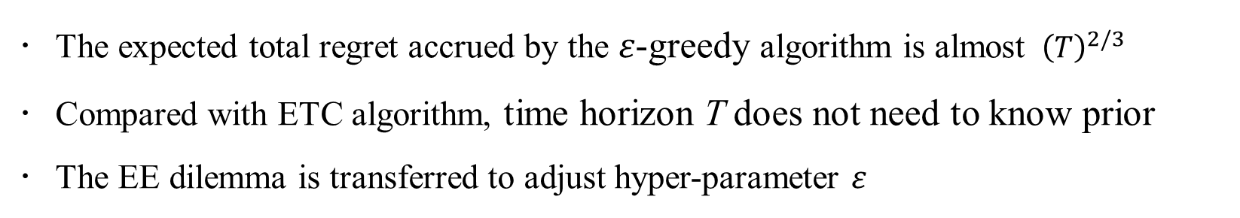
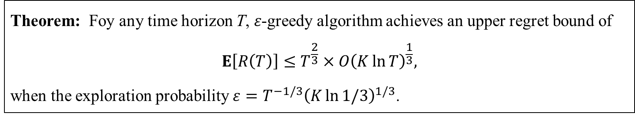
Stochastic Bandits--𝜀-Greedy
Greedy and $ε$-Greedy Algorithms
Regret bound (problem-independent)
Theorem: Foy any time horizon T, 𝜀-greedy algorithm achieves an upper regret bound of
$$E\left[R\left(T\right)\right]≤T^{\frac{2}{3}}×O{\left(K\ln{T}\right)}^{\frac{1}{3}},$$
when the exploration probability $ε=T^{−1/3}{\left(K\ln{1/3}\right)}^{1/3}$.
Remarks
The expected total regret accrued by the 𝜀-greedy algorithm is almost ${ \left(T\right)}^{2/3}$
Compared with ETC algorithm, time horizon T does not need to know prior
The EE dilemma is transferred to adjust hyper-parameter 𝜀
Slivkins, Aleksandrs. "Introduction to Multi-Armed Bandits." Foundations and Trends® in Machine Learning 12.1-2 (2019): 1-286. (Chapter 1)
Notes:
Since exploration is now spread uniformly over time, one can hope to derive meaningful regret bounds even for small t.
Because we have much information about arms, not too much time to explore

Slide 17
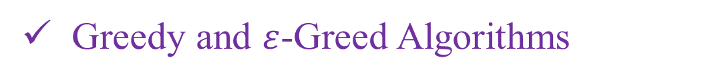

Stochastic Bandits--𝜀-Greedy
Greedy and $ε$-Greed Algorithms
Simulations
$ε$-Greedy Algorithm
Greedy Algorithms
Fig. 3 Average performance of greedy and $ε$-greedy algorithm on the 10-armed testbed over 2,000 runs with different bandit problems. Optimal action is a percentage on round t by the selected times of each arm.
Notes:
X-axis is the time rounds, y-axis is the average reward.
We can see the greedy algorithm has a bad performance.
The smaller epsilon has high long-term reward.
So how to choose a epsilon to balance the long-term reward and the short-term reward

Slide 18
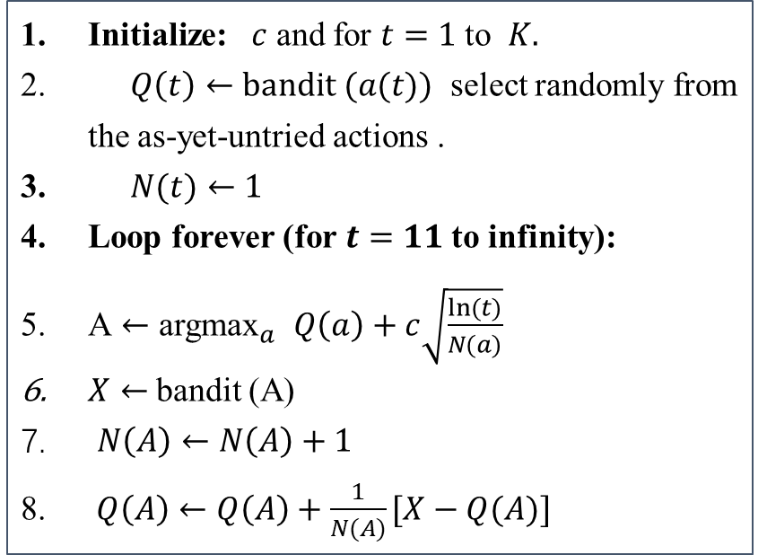
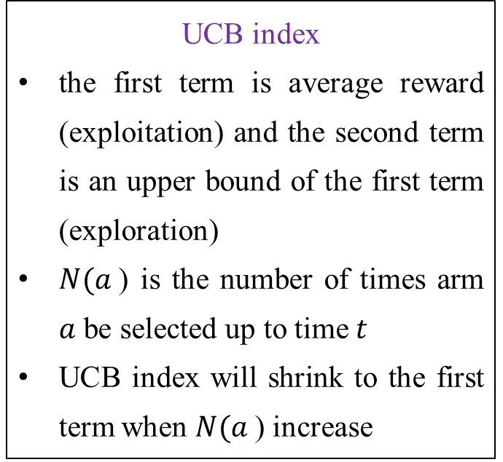
Stochastic Bandits--UCB
Upper Confidence Bound (UCB) Algorithm
Algorithm
UCB Algorithm
Initialize: $c$ and for $t$ $=1$ to $K.$
$Q\left(t\right)←bandit (a(t))$ select randomly from the as-yet-untried actions .
$N(t)←1$
Loop forever (for $t=11$ to infinity):
A $←$ argma${\text{x}}_{a}$ $Q\left(a\right)+c\sqrt{\frac{ln⁡(t)}{N(a)}}$
$X←$ bandit (A)
$N\left(A\right)←N\left(A\right)+1$
$Q\left(A\right)←Q\left(A\right)+\frac{1}{N(A)}[X−Q(A)]$
UCB index
the first term is average reward (exploitation) and the second term is an upper bound of the first term (exploration)
$N(a$) is the number of times arm $a$ be selected up to time $t$
UCB index will shrink to the first term when $N(a$) increase
Notes:
Next, we introduce the UCB algorithm for the stochastic bandits.
Unlike ETC, epsilon greedy algorithm, at each round player choose an arm with the highest UCB index.
Not the estimate mean value Q. The benefit is that it can balance the EE dilemma at the same time.

Slide 19


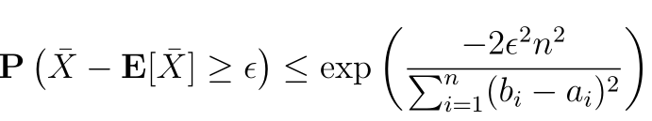
Stochastic Bandits--UCB
Upper Confidence Bound (UCB) Algorithm
Intuition (Chernoff Hoeffding bound)
Chernoff Bound
Hoeffding Lemma
Hoeffding Inequality
Recall the 10-armed bandit problem:
$Q_{a,t}=\frac{1}{N_{a,t}}\sum_{i=1}^{N_{a,t}}{X_{a,i}}$ is the estimated average reward of arm $a$ up to time $t$ and $μ_{a}$ is the true value at arm $a.$
Notes:
How to construct the UCB algorithm?
There many approach to construct the UCB index.
Here, we introduce the Chernoff Hoeffding method.
Chernoff bound used to bound the tail probability of a distribution
Hoeffding Lemma is to bound the moment generating function, subject to

Slide 20
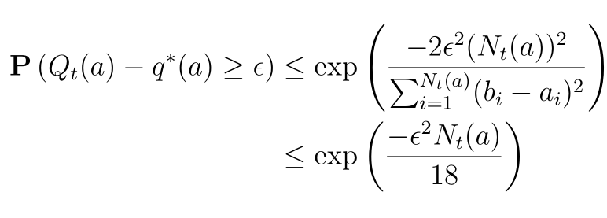
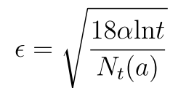

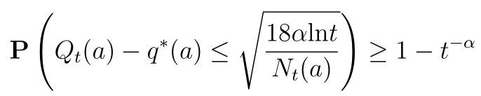

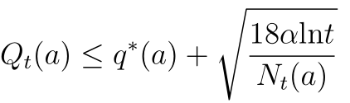
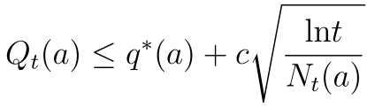
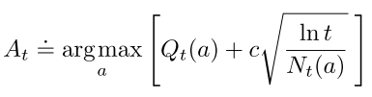




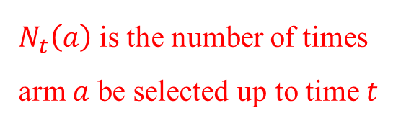





Stochastic Bandits--UCB
Then, applying Hoeffding inequality yields
$$Q_{a,t}$$
$$μ_{a}$$
a small probability
. We have
$$Q_{a,t}$$
$$μ_{a}$$
with high probability, i.e.,
$$Q_{a,t}$$
$$μ_{a}$$
$$Q_{a,t}$$
$$μ_{a}$$
Therefore, the UCB index is:
$N_{t}\left(a\right)$ is the number of times arm $a$ be selected up to time $t$
$$Q_{a,t}$$
Notes:
With some simple transform and calculation, we can obtain the upper bound of the estimate average reward Q

Slide 21
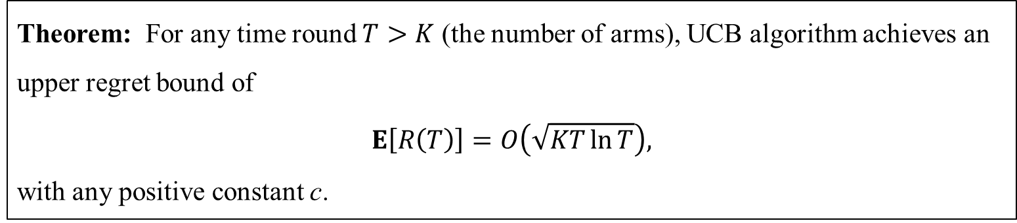
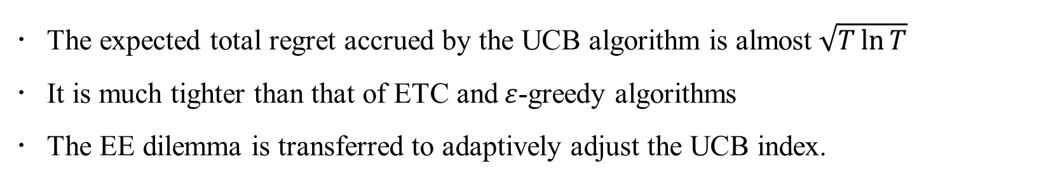
Stochastic Bandits--UCB
Upper Confidence Bound (UCB) Algorithm
Regret bound (problem-independent)
Theorem: For any time round $T>K$ (the number of arms), UCB algorithm achieves an upper regret bound of
$$E\left[R\left(T\right)\right]=O\left(\sqrt{KT\ln{T}}\right),$$
with any positive constant c.
Remarks
The expected total regret accrued by the UCB algorithm is almost$\sqrt{T\ln{T}}$
It is much tighter than that of ETC and$ε$-greedy algorithms
The EE dilemma is transferred to adaptively adjust the UCB index.
Slivkins, Aleksandrs. "Introduction to Multi-Armed Bandits." Foundations and Trends® in Machine Learning 12.1-2 (2019): 1-286. (Chapter 1)
Notes:
Since exploration is now spread uniformly over time, one can hope to derive meaningful regret bounds even for small t.

Slide 22
Stochastic Bandits--UCB
Upper Confidence Bound (UCB) Algorithm
Simulations
Fig. 4 Average performance of UCB and $ε$-greedy algorithms on the 10-armed testbed over 2,000 runs with different bandit problems. Optimal action is a percentage on round t by the selected times of each arm.

Slide 23
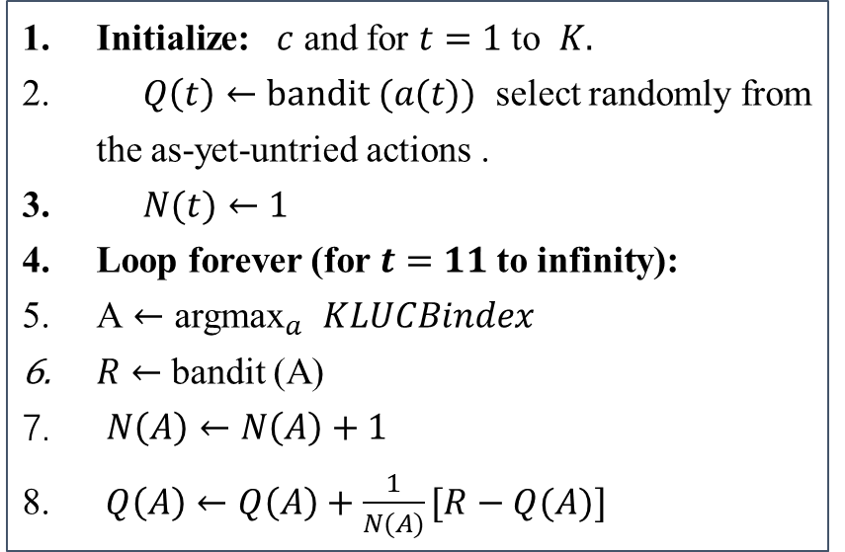
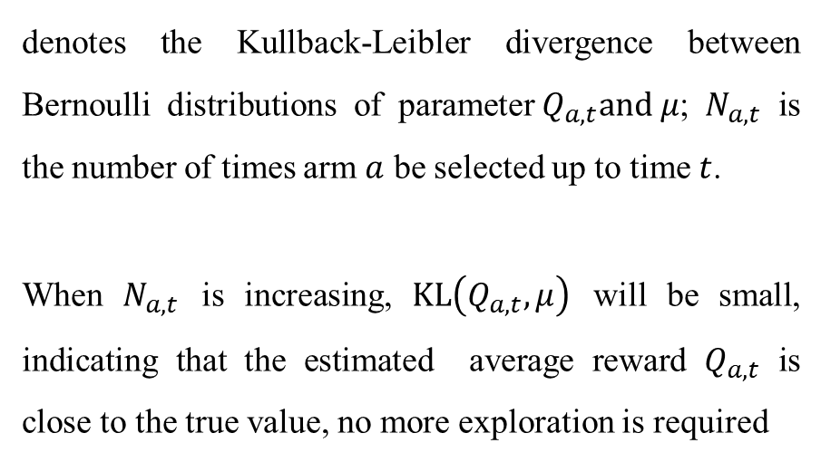

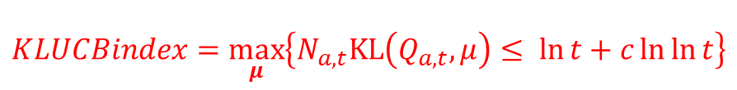
Stochastic Bandits--KL-UCB
UCB Variant (Kullback–Leibler KL-UCB Algorithm)
Algorithm (for Bernoulli distribution rewards )
Using Newton method
$KLUCBindex=\max_{μ}\left\{N_{a,t}KL\left(Q_{a,t}, μ\right)≤\ln{t}+c\ln{\ln{t}}\right\}$
KL-UCB Algorithm
Initialize: $c$ and for $t$ $=1$ to $K.$
$Q\left(t\right)←bandit (a(t))$ select randomly from the as-yet-untried actions .
$N(t)←1$
Loop forever (for $t=11$ to infinity):
A $←$ argma${\text{x}}_{a}$ $KLUCBindex$
$R←$ bandit (A)
$N\left(A\right)←N\left(A\right)+1$
$Q\left(A\right)←Q\left(A\right)+\frac{1}{N(A)}[R−Q(A)]$
$$where KL\left(Q_{a,t},μ\right)=Q_{a,t}\ln{\frac{Q_{a,t}}{μ}+\left(1−Q_{a,t}\right)\ln{\frac{1−Q_{a,t}}{1−μ}}}$$
denotes the Kullback-Leibler divergence between Bernoulli distributions of parameter${ Q}_{a,t}and μ$; $N_{a,t}$ is the number of times arm $a$ be selected up to time $t$.
When $N_{a,t}$ is increasing, $KL\left(Q_{a,t},μ\right)$ will be small, indicating that the estimated average reward $Q_{a,t}$ is close to the true value, no more exploration is required
23
Notes:
KL-UCB is a variant of the UCB algorithm.
The difference is the selection strategy.
At each round, KL-UCB select an arm with the highest KLUCB index, which calculate by using this equation.

Slide 24
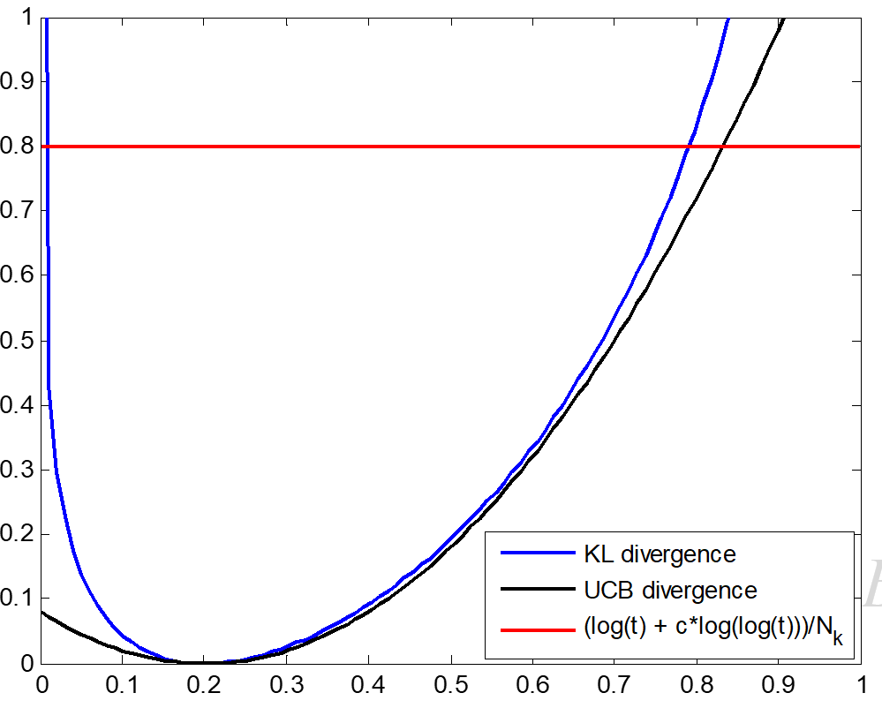


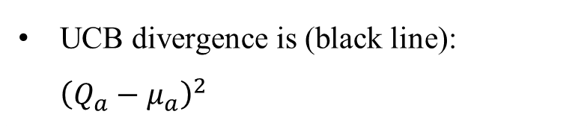
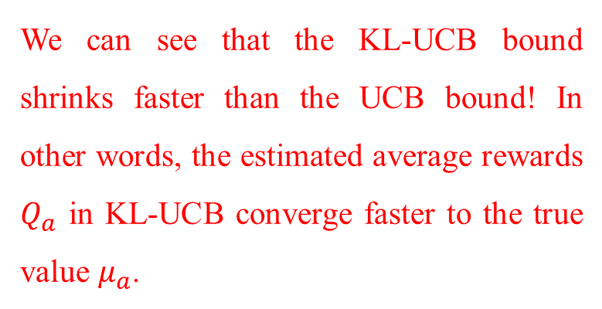
Stochastic Bandits--KL-UCB
Kullback–Leibler UCB (KL-UCB) Algorithm for Bernoulli distribution rewards
Intuition (why KL-UCB is better than UCB?)
UCB divergence is (black line): ${\left(Q_{a}−μ_{a}\right)}^{2}$
KL-UCB bound
KL divergence is (blue line):
UCB bound
$$KL\left(Q_{a,t},μ\right)=Q_{a,t}\ln{\frac{Q_{a,t}}{μ}+\left(1−Q_{a,t}\right)\ln{\frac{1−Q_{a,t}}{1−μ}}}$$
Value
We can see that the KL-UCB bound shrinks faster than the UCB bound! In other words, the estimated average rewards $Q_{a}$ in KL-UCB converge faster to the true value $μ_{a}$.
True value $μ_{a}$
The mean reward
Notes:
This means that KL-UCB needs less time to explore than that of UCB.
So it can find the best arm more quickly results in a small regret bound

Slide 25
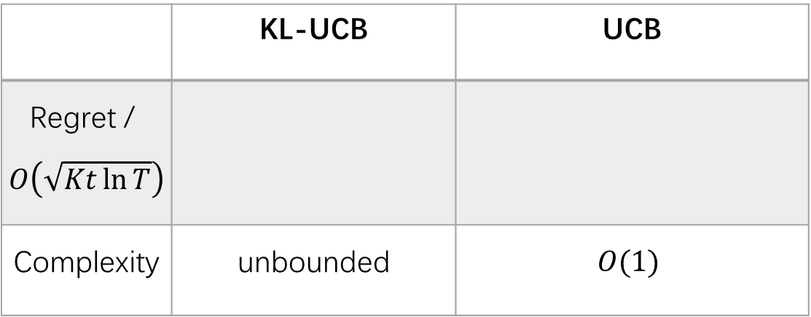


Stochastic Bandits--KL-UCB
Kullback–Leibler UCB (KL-UCB) Algorithm
Regret bound (problem-dependent)
Table 2 Regret compare
 | KL-UCB | UCB
Regret / $O\left(\sqrt{Kt\ln{T}}\right)$
Complexity | unbounded | $$O(1)$$
$$O\left(\sum_{a=1}^{K}{\frac{μ^{∗}−μ_{a}}{KL\left(μ_{a} , μ^{∗}\right)}}\right)$$
$$O\left(\sum_{a=1}^{K}{\frac{μ^{∗}−μ_{a}}{2{\left(μ_{a}− μ^{∗}\right)}^{2}}}\right)$$
Note: The Pinsker’s inequality: $2{\left(μ_{a}−μ_{b}\right)}^{2}≤KL\left(μ_{a} , μ_{b}\right)$
25
Notes:
So the KL-UCB regret bound is tighter than the UCB bound
Denominator

Slide 26
Stochastic Bandits--KL-UCB
Kullback–Leibler UCB (KL-UCB) Algorithm
Simulations
Fig. 5 Average performance of UCB and KL-UCB algorithms on the 2-armed (0.7 0.9) testbed over 2,000 runs with different bandit problems and c=3. Optimal action is a percentage on round t by the selected times of each arm.

Slide 27


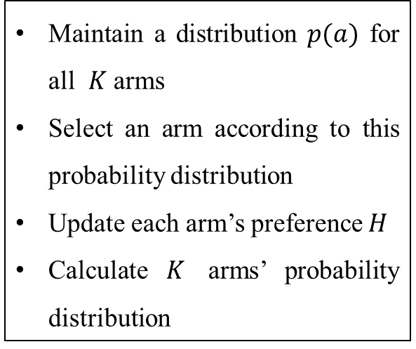
Stochastic Bandits--GBA
Gradient Bandit Algorithm (GBA)
Maintain a distribution $p(a)$ for all $K$ arms
Select an arm according to this probability distribution
Update each arm’s preference $H$
Calculate $K$ arms’ probability distribution
Algorithm
Gradient Bandit Algorithm
Initialize $Q=0$, $α$ and for $a=1$ to $K.$
$H\left(a\right)←0$
$p(a)←0$
Loop forever (for $t=1$ to $+∞$ )
A $←$ according to $p(a)$
$X←$ bandit (A)
$Q=Q+\frac{1}{t}(X−Q)$
$H \left(A\right)←H\left(A\right)+α(X−Q)(1−p(A))$ and
$H \left(A\right)←H\left(A\right)−α\left(X−Q\right)p(a)$ for all $a≠A$
$p\left(a\right)=\frac{e^{H(a)}}{\sum_{b=1}^{K}{e^{H(b)}}}$
𝑄 is the average reward over all history rewards, serves as a baseline
𝛼 is a step size, control the convergence rate
Stochastic gradient method update the arm’s preference
Soft-max approach
Notes:
Next is the gradient bandit algorithm to solve the stochastic bandits.
GBA is related to the stochastic optimization, where the average reward is the sub-gradient.
We can see that GBA select an arm according to the probability p that arm to be best.
If the reward X of arm A is bigger than the baseline, then arm A will be assign a high weight.
So this arm has a high probability to be the best arm.
Soft-max method

Slide 28
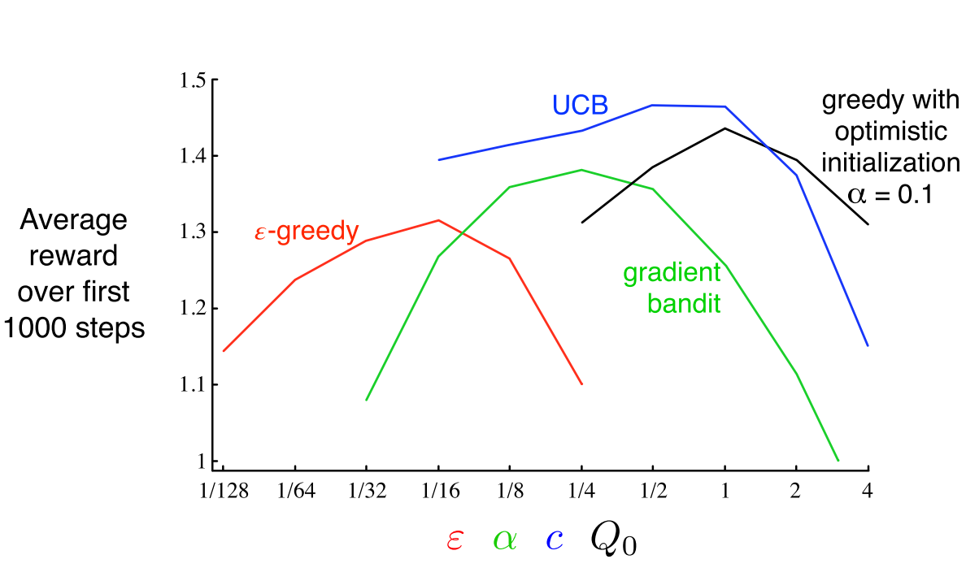

Stochastic Bandits--GBA
Gradient Bandit Algorithm (GBA)
Remarks
stems from the stochastic gradient descent algorithms
robust convergence properties
currently no regret bound analysis
Algorithms Comparison
Fig. 6: A parameter study of the various bandit algorithms on the 10-armed testbed. Each point is the average reward obtained over 1000 steps with a particular algorithm at a particular setting of its parameter. $Q_{0}$ is the optimistic initialization of average reward.
The value of difference algorithms via parameters
Notes:
$Q_{0}$ is the optimistic initialization of average reward;
Epsilon is the greedy algorithm parameter
Alpha is the step size in the GBA algorithm
C is a constant in the UCB algorithm
The UCB method has the best performance when the constant not over 1
The epsilon greed algorithm has the worst performance, but with some optimistic initialization Q its performance increase significantly

Slide 29


Stochastic Bandits--TS
Thompson Sampling (TS) Algorithm
Algorithm
Intuition
TS Algorithm
Initialize prior $p_{μ_{a}}(1)$ and for $a=1$ to $K.$
Loop forever (for $t=1$ to $+∞$ )
Draw $μ_{a}\left(t\right)\sim p_{μ_{a}}\left(t\right)$
A $←$ argma${\text{x}}_{a}{ μ}_{a}\left(t\right)$
$X←$ bandit (A)
Update the posterior:
$p_{μ_{a}}\left(t+1\right)∝P\left(X|μ_{a}\right)$ $p_{μ_{a}}\left(t\right)$
likelihood
prior
Fig. 7 The posterior distributions are concentrate on the underlying parameters as the time round increase
Notes:
Need prior information For Thomson sampling
The last algorithm for the stochastic bandit is the Thompson sampling algorithm.
It is a Bayesian inference method.
TS choose an arm with the highest posterior probability
As the number of rounds increase, the posterior distributions are concentrate on the underlying parameters. After 499 rounds, the optimal arm selected more than 400 times!
The posterior distribution with converge to the true value of this arm

Slide 30



Stochastic Bandits--TS
Thompson Sampling (TS) Algorithm
An example (Beta-Binomial distribution)
A Beta distribution is chosen to be prior:
  Example: a=2, b=2 (head and tail prob. are equal)
A Binomial distribution is the conjugate likelihood:
  One trial (N=1) and the result is one head (m=1)
Lead to the Posterior:
  Update of parameters given the observations
  The probability of head happening is higher
Notes:
The prior distribution is beta distribution parameter a=2 and b=2
Likelihood function is the Binomial distribution with

Slide 31


Stochastic Bandits--TS
Thompson Sampling (TS) Algorithm
Regret bound (problem-independent)
Theorem: Given time horizon $T>K$, TS algorithm achieves an upper regret bound of
$$E\left[R\left(T\right)\right]=O\left(\sqrt{KT\ln{T}}\right),$$
where K is the number of arms.
Remarks
The expected total regret accrued by the TS algorithm is almost$\sqrt{T\ln{T}}$
Its problem-dependent regret bound matches the Lai and Robbins’s lower regret bound
The TS algorithm requires the prior information of each arm’s reward distribution
Agrawal, Shipra, and Navin Goyal. "Analysis of thompson sampling for the multi-armed bandit problem." Conference on learning theory. JMLR Workshop and Conference Proceedings, 2012.

Slide 32
Outline
Classifications and Algorithms
Stochastic Bandits (ETC, Epsilon-greedy, UCB, KL-UCB, GBA, TS Algorithms)
Adversarial Bandits (Exp3 Algorithm)
Contextual bandits (Exp4 and LinUCB Algorithms)
Markovian Bandits (Gittins Index Algorithm)
Lipschitz Bandits (Zooming Algorithm)
Notes:
Next we look the second type of MAB, Adversarial bandit and its solution exp3 algorithm

Slide 33




Adversarial Bandits
Definition
$K$ arms and a single player
Select one arm to play at each round
Non-oblivious: Rewards are adjusted realtime by an adversary
Oblivious: Rewards are chosen in advance by an adversary
Maximize the long-term reward
Player
Adversary
Regret
Weak regret:
$$R\left(T\right)=\max_{a=1,⋯,K}{\sum_{t=1}^{T}{X_{a,t}}−\sum_{t=1}^{T}{X_{I_{t},t}}}$$
where $I_{t}$ is selected arm at time round t.
Notes:
The reward of stochastic bandit is i.i.d. distribution, is super-optimistic
The reward of adversarial bandit no i.i.d. assumption, is super-pessimistic
The main difference between the stochastic bandit and the adversarial bandit is that, adversarial bandit drops all assumptions on the rewards
Oblivious: If this mechanism is independent of the forecaster’s actions, that is, the costs for all arms and all rounds are chosen in advance
In general, however, the adversary may adapt to the forecaster’s past behavior, in which case we speak of a nonoblivious adversary.
Adversarial bandits usually links to the game theory

Slide 34


Adversarial Bandits--Exp3
Exponential-weight algorithm for Exploration and Exploitation (Exp3) Algorithm
Maintain a distribution for all $K$ arms
Select an arm according to this probability distribution
Update each arm’s weight using unbiases estimated rewards
Calculate $K$ arms’ probability distribution
Weighted majority algorithm
Uniform explore account for exploration
Unbiases estimated reward
Notes:
Q:Explain Exp3 algorithm
A:Exp3 algorithm is a variation of Hedge Algorithm. It assigns a higher probability or weight to the arm that produce more rewards.
The probability or weight of an arm is calculated by using its total history unbiases estimated rewards.
The variance of the estimated rewards will influence the regret bound.
Meanwhile, Exp3 algorithm adds a uniform explore term (gamma/K) accounts for exploration requirement.
Q:Why have to Exp3, why not UCB cannot work in adversary bandit?
A: I am not very clear about the work mechanism of Exp3 work mechanism. But I know that the UCB, TS, GBA algorithms are based on the fact that the rewards are i.i.d. at each arm. In the adversarial bandit. i.i.d. reward assumption is dropped. So the stochastic algorithms perform bad in here.

Slide 35


Adversarial Bandits--Exp3
Exp3 Algorithm
Regret bound
Theorem: For any $K>0$ and for any $γ∈\left(0,\right.\left.1\right]$ , Exp3 algorithm achieves an upper regret bound of
$$E\left[R\left(t\right)\right]≤O\left(c\sqrt{gK\ln{K}}\right),$$
where c is a constant and $g≥\max_{a=1,⋯,K}{\sum_{t=1}^{T}{X_{a,t}}}$.
Remarks
The expected total regret accrued by the Exp3 algorithm is almost$\sqrt{KT}$
Has a sublinear growth trend whose pre-round regret goes to 0 when T is sufficiently large
This is the worst cast regret
Auer, Peter, et al. "The non-stochastic multi-armed bandit problem." SIAM journal on computing 32.1 (2002): 48-77.

Slide 36
Outline
Classifications and Algorithms
Stochastic Bandits (ETC, Epsilon-greedy, UCB, KL-UCB, GBA, TS Algorithms)
Adversarial Bandits (Exp3 Algorithm)
Contextual bandits (Exp4 and LinUCB Algorithms)
Markovian Bandits (Gittins Index Algorithm)
Lipschitz Bandits (Zooming Algorithm)
Notes:
The third type of MAB is the contextual bandits, and its solution Exp4 and LinUCB algorithms

Slide 37



Contextual Bandits
Definition
Context is a side information about the arms and environment
$K$ arms and a single player
At each round, the player will observe a context
Choose an arm according to a context-arm mapping policy
Receive a loss from the environment (e.g. stochastic, adversarial, etc)
Determine the best mapping policy (mapping from contexts to arms)
Mapping policy is a probability distribution over $K$ arms
Different mapping policies can be regarded as different experts
Regret
Pseudo-regret:
where g is the mapping policy, $I_{t}$ is current selected arm and $s_{t}$ is the context at time round t
Notes:
Q: what is the meaning of context?
A: The context is a side information in current round. For example, in movie recommendation, the arms are movies, the context are the movies info. and the current user’s info. like age, male, movie history, etc.
So it is no longer interested in learning one good arm, since any one arm may be great for some contexts, and terrible for some others.
Instead, it strives to learn the best policy which maps contexts to arms (while not spending too much time exploring).

Slide 38
Contextual Bandits
Differences between MAB, contextual bandits and RL
Bandit model; Explore stochastic reward; Reward only related to the action
Action
Reward
Multi-armed bandit
Bandit model; Explore the context-arm mapping policy; reward related to the action and context;
Context
Action
Reward
Contextual bandit
MDP and POMDP model; Explore user interests change, such as transition probability; reward related to the action and context; Action will influence the state in future
State
Action
Reward
Full RL problem
Contextual bandit is more close to RL than other MAB models
Has a wide range of applications, e.g., Google search, Advertisement
Notes:
Q: Not clear why context bandits for the middle figure?
I put this figure in here just want to show the relationship between the bandit problem and reinforcement learning problem, where the contextual bandit is a type that close to the RL.
For more details about this difference, I would like referring you to this online article: https://boliu68.github.io/2017/Reinforcement-Learning-versus-Bandit/. I think it addresses almost of your concern.

Slide 39

Contextual Bandits
Exp4 Algorithm (for adversarial loss)
notes: exponential gradient; compared with Exp3, adding the expert
mapping policy is formulated as expert’s advice
The expected loss is simply multiply expert’s advice and the estimated reward
0000000000
Compared with Exp3 algorithm, Exp4 tries to find the best expert or context-arm mapping policy, rather than to find the arm with highest reward!
Notes:
Q:Exp4 algorithm is not clear
A: Compared to Exp3 algorithm, Exp4 algorithm strives to address the following problem: There is a great amount of useful contextual information in the query and user’s profile, which is ignored in EXP3. How to take those contexts into account?
The basic idea is to introduce the experts advices as context-arm mapping policy. So the Exp4 algorithm is to calculate the expected loss by adopting a specific expert.
Source from: https://courses.cs.washington.edu/courses/cse599s/14sp/scribes/lecture10/lecture10_draft.pdf
Q:LinUCB algorithm is not clear
A: LinUCB algorithm is designed for a kind of contextual bandit where the reward is a linear function of the context’s feature.
The LinUCB algorithm performs like the UCB algorithm. The challenge in LinUCB algorithm is how to extract the context’s feature and how to
formulate the reward as a linear function of this feature.

Slide 40

Contextual Bandits
LinUCB Algorithm (for linear contextual bandit)
notes: reward is a linear function of the features of the context, a variant of UCB
Features about all arms and all users
Estimated coefficient of features
LinUCB index where the first term for exploitation and the second term for exploration
Compared with the UCB algorithm: LinUCB index is about the feature vector of the context, rather on the average reward!
Notes:
Q:Exp4 algorithm is not clear
A: Compared to Exp3 algorithm, Exp4 algorithm strives to address the following problem: There is a great amount of useful contextual information in the query and user’s profile, which is ignored in EXP3. How to take those contexts into account?
The basic idea is to introduce the experts advices as context-arm mapping policy. So the Exp4 algorithm is to calculate the expected loss by adopting a specific expert.
Source from: https://courses.cs.washington.edu/courses/cse599s/14sp/scribes/lecture10/lecture10_draft.pdf
Q:LinUCB algorithm is not clear
A: LinUCB algorithm is designed for a kind of contextual bandit where the reward is a linear function of the context’s feature.
The LinUCB algorithm performs like the UCB algorithm. The challenge in LinUCB algorithm is how to extract the context’s feature and how to
formulate the reward as a linear function of this feature.

Slide 41


Contextual Bandits
Regret bound
Theorem: Exp4 without mixing and with $η_{t}=η=\sqrt{\frac{2\ln{N}}{NK}}$ satisfies
$${\overline{R}}_{T}^{ctx}≤O\left(\sqrt{2TN\ln{K}}\right),$$
On the other hand, with $η_{t}≥\sqrt{\frac{\ln{N}}{tK}}$ it satisfies ${\overline{R}}_{T}^{ctx}≤O\left(2\sqrt{TN\ln{K}}\right)$, where $N$ is the number of experts $and K$ is the number of arms
Remarks
The expected total regret accrued by the Exp4 algorithm is almost$\sqrt{2KT}$
Has a sublinear growth trend whose pre-round regret goes to 0 when T is sufficiently large
Auer, Peter, et al. "The non-stochastic multi-armed bandit problem." SIAM journal on computing 32.1 (2002): 48-77.

Slide 42
Outline
Classifications and Algorithms
Stochastic Bandits (ETC, Epsilon-greedy, UCB, KL-UCB, GBA, TS Algorithms)
Adversarial Bandits (Exp3 Algorithm)
Contextual bandits (Exp4 and LinUCB Algorithms)
Markovian Bandits (Gittins Index Algorithm)
Lipschitz Bandits (Zooming Algorithm)

Slide 43




Markovian Bandits
Definition
$N$ independen arms and a single player
With known states $s\left(t\right)=\{s_{1}\left(t\right),s_{2}\left(t\right),⋯s_{N}\left(t\right)\}$
Each time slot $t$ select $K$ arms to play where $(1≤K<N)$
Observe a state-dependent reward $r_{n}(s_{n}(t))$ and state transition $P(s_{n}^{′}|s_{n})$
Maximize its long-term total rewards over time horizon $T$
Regret
$$R^{π}\left(T\right)=Tμ^{∗}−E^{π}\left[\sum_{t=1}^{T}{r_{I^{t}}(s_{I^{t}}(t))}\right]$$
where $I^{t}$ is the arm that selected by using policy $π$ at round $t$, $s_{I^{t}}(t)$ is the state of arm$I^{t}$.
Tekin, Cem, and Mingyan Liu. "Online algorithms for the multi-armed bandit problem with markovian rewards [C]" IEEE Allerton. 2010.

Slide 44


Markovian Bandits
$u\left(t\right)=0$ freezes the process and gives no reward;
$u\left(t\right)=1$ continues the process and gives reward $r_{n}(s_{n}(t))$
Notes:
The Gittins index is a measure of the reward that can be achieved through a given stochastic process ;
The Gittins index can be calculated by using this formulation.
The bandit strategy
with certain properties, namely: the process has an ultimate termination state and evolves with an option, at each intermediate state, of terminating.
Optimal stopping of markov chain
T. Ferguson: “Most problems of optimal stopping without some form of Markovian structure are essentially untractable....”

Slide 45

Markovian Bandits
We need to decompose objective problem as N-bandit processes;
Then solve each single-bandit process’s DP.
Notes:
The Gittins index is a measure of the reward that can be achieved through a given stochastic process ;
The Gittins index can be calculated by using this formulation.
The bandit strategy
with certain properties, namely: the process has an ultimate termination state and evolves with an option, at each intermediate state, of terminating.
Optimal stopping of markov chain
T. Ferguson: “Most problems of optimal stopping without some form of Markovian structure are essentially untractable....”

Slide 46

Markovian Bandits--Gittins index
Algorithm (Gittins index for Rested Bandits)
Notes:
The Gittins index is a measure of the reward that can be achieved through a given stochastic process ;
The Gittins index can be calculated by using this formulation.
The bandit strategy
with certain properties, namely: the process has an ultimate termination state and evolves with an option, at each intermediate state, of terminating.
Optimal stopping of markov chain
T. Ferguson: “Most problems of optimal stopping without some form of Markovian structure are essentially untractable....”

Slide 47

Markovian Bandits--Whittle index
Algorithm (Whittle index’s definition and policy for Restless Bandits)
Notes:
Indexable is a very important condition to establish the whittle index

Slide 48


Markovian Bandits--Whittle index
Algorithm (Whittle index’s definition and policy for Restless Bandits)

Slide 49
Outline
Classifications and Algorithms
Stochastic Bandits (ETC, Epsilon-greedy, UCB, KL-UCB, GBA, TS Algorithms)
Adversarial Bandits (Exp3 Algorithm)
Contextual bandits (Exp4 and LinUCB Algorithms)
Markovian Bandits (Gittins Index Algorithm)
Lipschitz Bandits (Zooming Algorithm)
Notes:
The last

Slide 50


Lipschitz Bandits
Definition
Continuum arm and a single player
Select one arm to play at each round
Has information on similarity between arms
Expected reward f(t,y) obey a Lipschitz condition
Maximize its long-term total rewards
Lipschitz condition:
P1: How to handle the continuum-armed bandit ?
Fixed discretization
Mapping to different metric space, e.g., distance, norm-p etc.
Sample a fixed, finite arm set $Χ$ from whole arm space $S$
Run an off-the-shelf MAB algorithm on this small arm set $Χ$
Notes:
D is the metric space

Slide 51


Lipschitz Bandits
Regret
Quantization error
Regret by running algorithm
P2: How to adaptively define the fixed, finite arm set $Χ$ ?
where $W$(algorithm) is the total reward of the algorithm
Zooming algorithm (adaptive discretization)
The basic idea
Place more probes in regions that could produce better reward
Less probes in regions which are known to yield low rewards with high probability .
Notes:
Despite the existence of a matching lower bound, the fixed discretization approach is wasteful.

Slide 52






Lipschitz Bandits
The zooming algorithm
$n_{t}\left(x\right)$is the selected times of arm$x$up to round $t$. So the confidence ball shrinks when $n_{t}\left(x\right)$ increase
inde$x_{t}\left(x\right)={\overline{μ}}_{t}\left(x\right)+2r_{t}\left(x\right)$ is the radius of the ball (like the UCB index)
Main features
In each round, all arms are covered by confidence balls of the active arms
If some arm become uncovered by confidence balls of the active arms, active this uncovered arm.
Play an active arm with the largest index (break ties arbitrarily).
$$S$$
Fig. The basic idea of zooming algorithm. The more balls in a region the more high reward arms exist
Notes:
r_t(x) confidence radius of arm x at time t

Slide 53


Lipschitz Bandits
Regret bound
Theorem: Consider Lipschitz MAB problem with time horizon $T$, Assume that realized rewards take values on a finite set. For any given problem instance and any $c>0$, the zooming algorithm achieves an upper regret bound of
$$E\left[R\left(T\right)\right]≤O\left(T^{\frac{d+1}{d+2}}{\left(c\ln{T}\right)}^{\frac{1}{d+2}}\right),$$
where $d$ is the zooming dimension with multiplier c.
Remarks
The expected total regret accrued by the zooming algorithm is almost $T^{\frac{d+1}{d+2}}$
Has a sublinear growth trend whose pre-round regret goes to 0 when T is sufficiently large
Slivkins, Aleksandrs. "Introduction to Multi-Armed Bandits." Foundations and Trends® in Machine Learning 12.1-2 (2019): 1-286. (Chapter 4)

Slide 54

Outline
Part II: Applications
Rate Adaption in Underwater Acoustic Communications (Stochastic Bandit)
Throughput Enhancement in Full Duplex CSMA Networks (Multi-Player Bandit, Adversary)
Notes:
Now, we are go to the application part. To see how could we apply MAB to solve practical problem

Slide 55
Outline
Part II: Applications
Rate Adaption in Underwater Acoustic Communications (Stochastic Bandit)
Throughput Enhancement in Full Duplex CSMA Networks (Multi-Player Bandit, Adversary)
Notes:
Now, we are go to the application part. To see how could we apply MAB to solve practical problem

Slide 56





Application 1: Rate Adaption in Underwater Acoustic Communications
Scenario
Frequencies:
Data rates:
How to choose the optimal frequency and data rate so as to maximize the UAC link’s throughput ?
Problem formulation
Joint successful transmission probability of frequency $f_{i}$ and data rate $r_{j}$
Tong, Jingwen, ,Shuyue Lai, Liqun Fu, and Zhu Han. "Optimal Frequency and Rate Selection Using Unimodal Objective Based Thompson Sampling Algorithm." IEEE International Conference on Communications (ICC). IEEE, 2020.
Notes:
The scenario is that a underwater sensor need to report its data to node.
The sensor has a available set of channels/frequencies and data rates to select
The problem is how to….

Slide 57


Application 1: Rate Adaption in Underwater Acoustic Communications
Challenges
No determined UAC channel model;
Frequency-dependent attenuation, constraint bandwidth;
Not only need to learn the channel characteristics online, but also to automatically find the best frequency and data rate to maximize the average throughput!
Stochastic MAB problem
……
Arms:
……
Rewards:
(0:Failure;1: Success)
Notes:
So we model this rate adaption problem as a MAB problem
The reward is the fail and success transmission feedback
Since the arms are the combination of frequency and data rate, so the number of arms maybe very large

Slide 58



Application 1: Rate Adaption in Underwater Acoustic Communications
How to reduce the arm space? (unimodality structure)
The objective function can be rewritten as
Unimodality structure
Unimodal Objective based Thompson Sampling (UOTS) Algorithm
P. Qarabaqi and M. Stojanovic, “Statistical characterization and computationally efficient modeling of a class of underwater acoustic communication channels,” IEEE Journal of Oceanic Engineering, vol. 38, no. 4, pp. 701–717, Apr. 2013.
Notes:
The remain problem is how to reduce the arm space?
The answer is to make use of the structure of the objective function.
We have found that the objective function has this unimodality structure feature (qusi-convex)
monotonicity

Slide 59






Application 1: Rate Adaption in Underwater Acoustic Communications
Algorithm (Unimodal Objective Based TS (UOTS) Algorithm)
$$a_{i,j+1}$$
$$a_{i−1,j}$$
Data rate
$$a_{i,j}$$
$$a_{i+1,j}$$
$$a_{i,j−1}$$
Frequency
The neighbors set:
Only need to search on the partial arm space, not the whole arm space !
Notes:
Compared to the original TS algorithm, the proposed UOTS only need to …..
For example, if the current best arm is a_i,j, then at next round the algorithm only need to explore this five arms

Slide 60




Application 1: Rate Adaption in Underwater Acoustic Communications
Simulations
Fig.8-9 The average throughput of UCB, KLUCB, MTS, GORS, and UOTS algorithms versus time slot for different successful transmission probabilities (0.90, 0.80, 0.70, 0.55, 0.45 , 0.35, 0.20, 0.10) and different data rates (0.2, 0.4, 0.6, 0.9, 1.2, 1.4, 1.6, 2) kbps
Small size: $f=\{4,6,8,10,14\}$ khz
Large size: $f=\{1,2,4,6,8,10,14\}$ khz
Notes:
Graphical based optimal rate sampling (GORS) algorithm
Small size frequency, there are 5 f and large size frequency, there are 7 f
The performance gap between the proposed algorithm and other bandit algorithm is enlarge when the number of frequency increase from 5 to 7. The reason is that UCB KLUCB MTS algorithms don’t use the unimodal feature

Slide 61
Outline
Part II: Applications
Rate Adaption in Underwater Acoustic Communications (Stochastic Bandit)
Throughput Enhancement in Full Duplex CSMA Networks (Multi-Player Bandit, Adversary)
Notes:
Now, we are go to the application part. To see how could we apply MAB to solve practical problem

Slide 62





Application 2: Throughput Enhancement of Full Duplex CSMA Networks
Scenario
Transmit power (TP):
Carrier sensing threshold (CST):
Logarithm access intensity (LAI):
it is the log function of the ratio of mean transmission time
to mean back-off time
FD-link: it can transmit and receive signal in the same frequency band and at the same time
How to choose the best TP, CST, and LAI for each FD-link so as to maximize the network throughput?
Problem Formulation
Mean back-off time
Average throughput by using Markov chain
1, 0, 0
0, 0, 0
0, 1, 0
1, 0, 1
Mean transmission time
0, 0, 1
0, 1, 1
(b)
Tong, Jingwen, Liqun Fu, and Zhu Han. "Throughput Enhancement of Full-Duplex CSMA Networks Using Multi-Player Bandits." IEEE Internet of Things Journal (2021).
Notes:
The scenario is the FD-enabled link pairs need to transmit data to each other
So it can be formulated as this optimization form.
We refer it as the master problem.
It is difficult to solve this problem

Slide 63



Application 2: Throughput Enhancement in Full Duplex CSMA Networks
Challenges
Non-convex since the finite number of TP and CST
Discontinuous since the piecewise constant rate model
Determine all feasible states is a NP-hard problem
No coordination among links in such a distributed network
Piecewise constant rate model
Two subproblems
multi-player MAB framework
convex optimization tool
Subproblem 1: Joint scheduling and congestion control
Subproblem 2: Parameter selection problem
Notes:
So we have decomposed the master problem as two subproblem
Subproblem 1: used to find the optimal LAI
Subproblem 2: used to find the best TP and CST pair

Slide 64

Application 2: Throughput Enhancement in Full Duplex CSMA Networks
Optimal FD-CSMA Algorithm for subproblem 1
  Features
Standard sub-gradient algorithm
Optimality guarantee
Fully distributed (just record its own transmission outcomes)
Simulated by using the FD-CSMA protocol

Slide 65

Application 2: Throughput Enhancement in Full Duplex CSMA Networks
Multi-Player Multi-Armed Bandit Framework for subproblem 2
……
Players:
FD-Link 1
FD-Link 2
……
FD-Link K
Arms:
No collision will happen among players since all player choose an arm from its local set! The reward is between stochastic and adversarial
……
Rewards:
Regret (defined on each player, not the whole system)
Difference between the best arm’s rewards and the current received rewards (weak regret):
Notes:
We can find that the reward in here is neither stochastic nor adversarial;

Slide 66

Application 2: Throughput Enhancement in Full Duplex CSMA Networks
Stochastic and Adversarial Optimal (SAO) Algorithm for Subproblem 2
  Features
Based on Exp3 algorithm
Starting with some prior information
Proceeding in epoch
Decreasing learning rate
A tight regret bound
Notes:
We have proposed a

Slide 67


Application 2: Throughput Enhancement in Full Duplex CSMA Networks
SAO-FD-CSMA Algorithm for Master Problem
Notes:
Algorithm 1 was a subgradient method used to solve subproblem 1 to find the optimal LAI
Algorithm 2 was a bandit algorithm used to solve subproblem 2 to find the best TP and CST
Algorithm 3 is a fully distributed algorithm
Upper Regret Bound
Theorem: For any $M_{k}>0, ∀k∈K$, the number of arms at link k , SAO-FD-CSMA algorithm achieves regret bound
$$Reg≤O\left(\sum_{∀k∈K}{c\sqrt{R_{k,max}M_{k}\ln{M_{k}}}}\right),$$
where c is a constant and $R_{k,max}=\max_{a=1,⋯,M_{k}}{\sum_{t=1}^{T}{r_{a,t}}}$.
Notes:
We give a whole solution for the master problem.
The algorithm first choose a TP and CST for each link according to this probability
Square root growth trend; the per-round regret will trend to 0 when the time horizon is sufficiently large

Slide 68



Application 2: Throughput Enhancement in Full Duplex CSMA Networks
Simulations
Using exhaustive search method
Fig. 11 The total network throughput of several algorithms in the fixed network scenario, where the total time slots is 12,000.
Fig. 10 A simple network scenario with three links distributive in a $100×100$ area.
Notes:
1, the proposed algorithm with prior information has the best method close to the optimal value.
The optimal value was obtained by using the exhaustive search method
Compared to the random selection method, the network throughput of the proposed method has improved by 48%

Slide 69


Application 2: Throughput Enhancement in Full Duplex CSMA Networks
Simulations
Fig. 12 Average network throughput of serval algorithms versus the number of links for 1,000 random network scenarios, where T = 12,000.
Fig. 13 Average network throughput versus the maximum link length dmax of each Tx-Rx pair by using the proposed algorithm without prior knowledge for 1,000 random network scenarios, where T = 12,000.
Notes:
Fig. 12 show the average network throughput change with the number of links.
It can be seen that when the number of link over 5, the proposed algorithm has the best performance.
Fig.13 compare the performance of HD- and FD-CSMA networks by changing he link’s transmit and receiver distance
The performance of HD and FD-csma network decrease when the dmax increase.
More interesting, the performance of the FD-CSMAN

Slide 70
Outline
Background
Part I: Multi-Armed Bandits (MAB)
Language of MAB
Classifications and Algorithms
Multi-Player MAB
Part II: Applications
Conclusion and Limitation
Notes:
This presentation includes four parts.

Slide 71
Conclusion
MAB is a nature answer for the sequential decision making problem;
MAB belongs to the stochastic scheduling and can be regard as a stochastic optimization, also related to the game theory and RL;
A powerful tool to handle the Exploration and Exploitation dilemma;
Rigorous theoretical guarantees, i.e., regret bounds;
Connect to many practical problems and easy to apply;

Slide 72
Limitation of MAB
High sample complexity
Rewards are observed in every round, require many samples to converge
Model dependence
MAB requires different assumptions on the model
Fail to model complicate scenarios
e.g., MAB fails to handle the problems with many states and each state contains many actions (arms)

Slide 73



Main References
Richard S. Sutton, and Andrew G. Barto
Reinforcement Learning: An Introduction, 2018
https://inst.eecs.berkeley.edu/~cs188/sp20/assets/files/SuttonBartoIPRLBook2ndEd.pdf
Think about MAB for your next decision making problems !
Aleksandrs Slivkins
Introduction to Multi-Armed Bandits, 2019
https://arxiv.org/pdf/1904.07272.pdf
Tor Lattimore and Csaba Szepesv´ari
Bandit Algorithms, 2020
https://tor-lattimore.com/downloads/book/book.pdf
S´ebastien Bubeck and Nicol`o Cesa-Bianchi
Regret Analysis of Stochastic and Non-stochastic Multi-armed Bandit Problems, 2012
https://arxiv.org/pdf/1904.07272.pdf

Slide 74
Thank You Very Much
for
Your Attentions !

