Slide 1

Contract Theory Framework for
Wireless Networking
Ph.D. Research Defense
Yanru Zhang
Advisor: Dr. Zhu Han
April 2016

Slide 2
Outline
Introduction
  Motivation
  Contract theory
    Adverse Selection
    Moral Hazard
  Contribution
Finished Work
  Adverse Selection in Device-to-Device Communication
  Moral Hazard in Mobile Crowdsourcing
Current Work
  Multi-User Moral Hazard in Mobile Crowdsourcing
  Mixed Adverse Selection and Moral Hazard in Cognitive Radio Network
Future Works
Conclusion

Slide 3
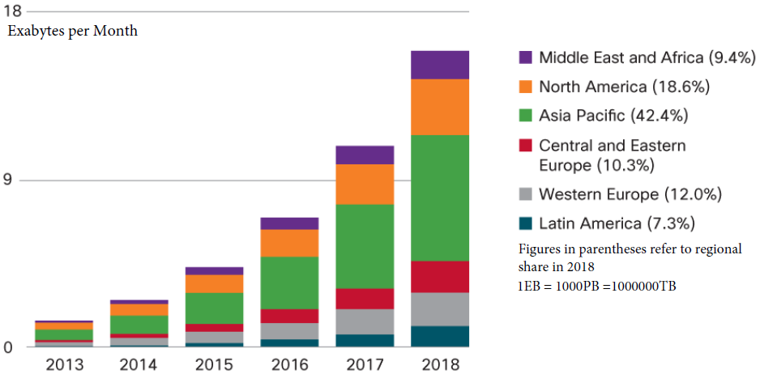
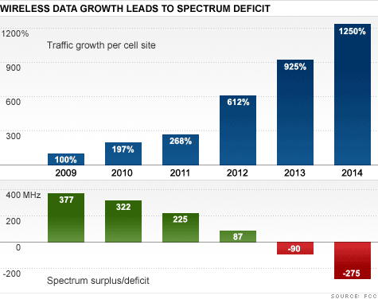
Motivation
Imminent wireless traffic boost
  Facebook and YouTube
  Smartphones and tablets
  Users (will) have anywhere, anytime wireless communications
Wireless network capacity crunch
  Additional spectrum is a tool that can help relieve congestion on wireless networks
  Spectrum crisis

Slide 4
Possible Solutions for
Capacity Crunch
Current cellular capacity constraint
  Upper bounded by Shannon theory
Possible solutions
  Introduce more access points (APs) by making the wireless networks heterogeneous
    Device-to-device (D2D) communication
    Cognitive radio network (CRN)
    Software defined network (SDN)
    Small cell
    Wireless network virtualization
Need of cooperation
Combine Cellular and Heterogeneous
Cell Capacity
Optimal rate
Shannon Theory
network capacity relies on bandwidth and APs
Sum rates
Number of UE

Slide 5
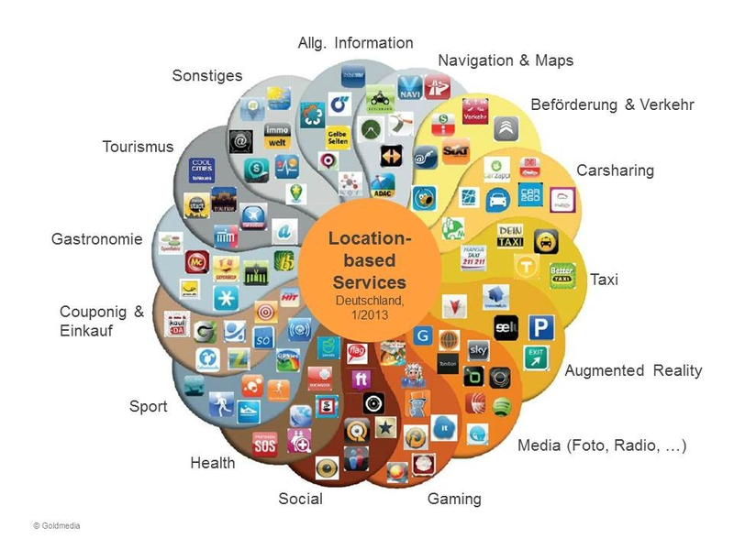
Observation
Dramatic growing market of location based service
  Navigation, local search, mobile advertisements, emergency notification
Role changing of users
  Various embedded sensors in smartphone
  Users are not only data receivers, but also active data providers

Slide 6
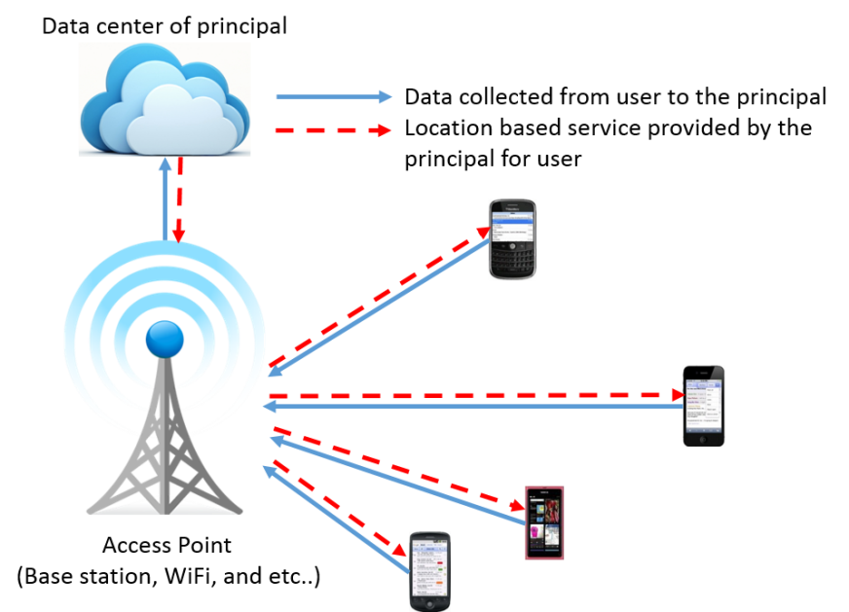
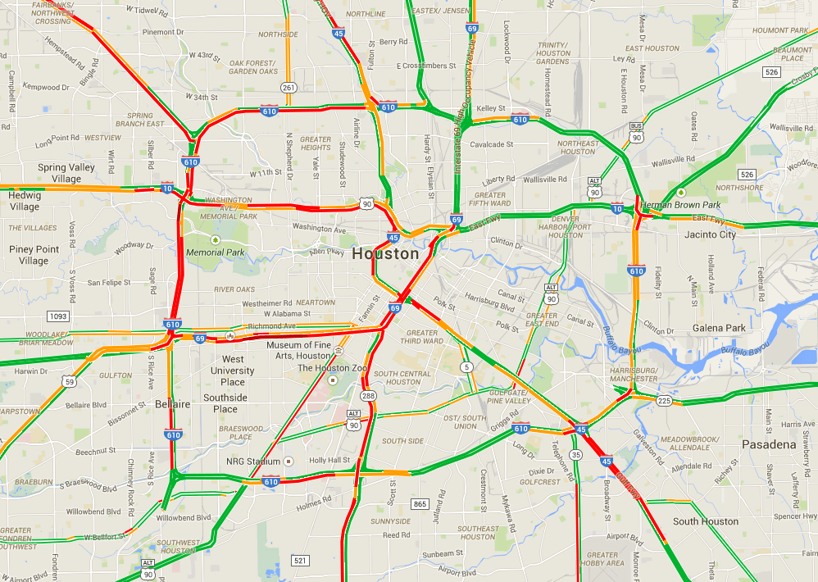
Possible Solution for
Location Based Data Crunch
Sophisticated location based service constrained by
  Adequate and comprehensive location based data
Possible solution
  Crowdsourcing
    Large group of users regularly transmit data obtained by the embedded sensors to the principal
  Popular apps
    Navigation: Google Map
    Social network: Yelp
    Sport: Sports Tracker
Need of cooperation
Large group of users

Slide 7
Possible Solution to Ensure Cooperation
In both traffic offloading and data uploading processes
  Third parties/users are consuming resources (battery power and computing capacity), and threaten to privacy
Motivations are needed to ensure cooperation
  To successfully increase wireless network capacity
  To collect adequate location based data
Design incentive mechanisms
  Considering third parties/users' consumptions during the offloading/uploading processes
  Provide necessary rewards/compensations according to their contributions

Slide 8

Methodology Adopted
Contract Theory
  How to regulate monopoly with asymmetric information by introducing cooperation among competitors
    Regulators don’t know everything about how firms are operating
  Employer and employee(s)/Buyer and seller(s)
    A manager hiring a worker
    A farmer hiring a sharecropper
  Jean Tirole - Nobel Prize winner in economic science of 2014
  Most economic theory before consisted of price caps for monopolists and preventing cooperation among competitors
    Ideal analysis and unpractical in real world economics
  “A Nobel Prize for Real World Economics”
    Says the Enlightened Economist blog, written by Diane Coyle
Great potential to ensure cooperation in wireless networks
Two general types of asymmetric information problems
  Hidden-information problem---- Adverse Selection
  Hidden-action problem---- Moral Hazard

Slide 9



Adverse Selection of PhD Student
The plan you tell your advisor
The real plan
The secret plan
“I am going to be a professor at a major research university after I graduate.”
Look for career alternatives
Become a baker/rock star/writer

Slide 10
Adverse Selection
Asymmetric information:
  Relevant characteristics of the employee are hidden from the employer
    Distaste for certain tasks, the level of competence
  Preference/productivity are private information of employee, but unavailable to employer
    All employee types would respond by "pretending to be skilled" to get the higher wage
Employers typically respond to adverse selection by revelation principle
  Employer offers multiple employment contracts
    Different contracts destined to different skill level employees

Slide 11
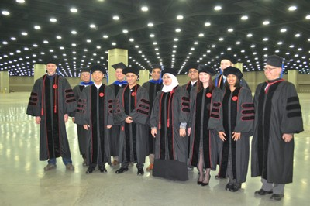


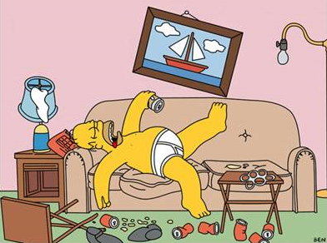
Moral Hazard of PhD student
What my parents thinks I do
What my advisor thinks I do
What I actually do
  When advisor presents
  When advisor on travel

Slide 12
Moral Hazard
Asymmetric information:
  Employee's actions that are hidden from the employer
    Whether it works or not, how hard it works, how careful it is
In contrast to Adverse Selection
  Informational asymmetries arising after the signing of a contract
  Employee is not asked to choose from a menu of contracts
    But from a menu of action-reward pairs
Employers typically respond to moral hazard by
  Rewarding good performance
    Through bonus payments, piece rates, efficiency wages, stock options
  And/or punishing bad performance
    Through layoffs

Slide 13
Classification
Adverse Selection
Moral Hazard
Applications
  Device-to-device communication
  Mobile crowdsourcing
  Cognitive radio network
Static contracting
Repeated contracting
Single Employer/Seller-to-Single-Employee/Buyer
Bilateral (One-to-one)
  One-dimension
  Multi-dimension
Multilateral (One-to-many)
Single-Aspect/Task/Item
Multi-Aspect/Task/Item
Single Employer/Seller-to-Multi-Employee/Buyer

Slide 14
Dissertation Contributions
Provide a theoretical research between wireless communications, networking, and economics
Place a fundamental research on network economics, especially with the framework of contract theory
Have the potential to contribute to the future of wireless network economics area
  Incentive mechanism, pricing schemes design, resource sharing and trading

Slide 15
Outline
Introduction
  Motivation
  Contract theory
    Adverse Selection
    Moral Hazard
  Contribution
Finished Work
  Adverse Selection in Device-to-Device Communication
  Moral Hazard in Mobile Crowdsourcing
Bilateral (One-to-one)
  One-dimension
  Multi-dimension
Multilateral (One-to-many)
Static contracting
Repeated contracting

Slide 16
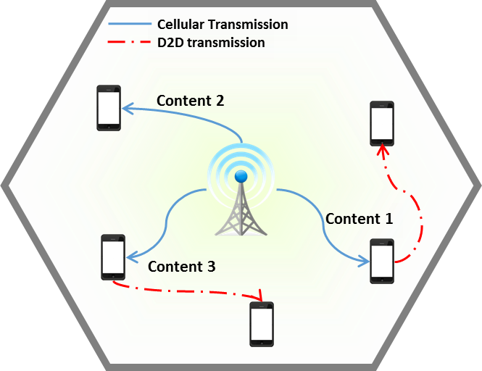
D2D Communication
D2D communication offloading cellular traffic
Why traffic can be offloaded?
  Popular contents are requested more
  BSs serving different users
    With the same contents
    Using multiple duplicate transmissions
  Transmiting locally availbale content by D2D communication
Main design challenge
  Incentivize content owners to participate and cooperate via D2D communication

Slide 17
Apply of Adverse Selection
Information asymmetry
  BS prefers users with high preference/capability
  User will attempt to harness more reward by claiming that it is a high preference/capability user
  The actual preference/capability
    Naturally known by the users
    The BSs may not be aware of
Adverse selection model can overcome this information asymmetry
  Offering different contracts designed for different type users
  Specify multiple contracts: (performance, reward)

Slide 18
Outline
Introduction
  Motivation
  Contract theory
    Adverse Selection
    Moral Hazard
  Contribution
Finished Work
  Adverse Selection in Device-to-Device Communication
  Moral Hazard in Mobile Crowdsourcing
Bilateral (One-to-one)
  One-dimension
  Multi-dimension
Multilateral (One-to-many)
Static contracting
Repeated contracting

Slide 19
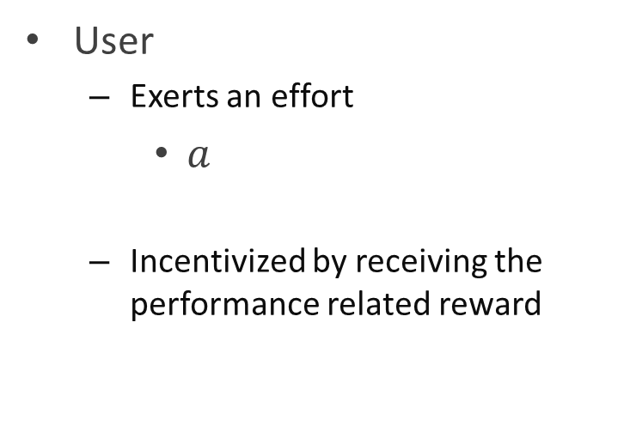
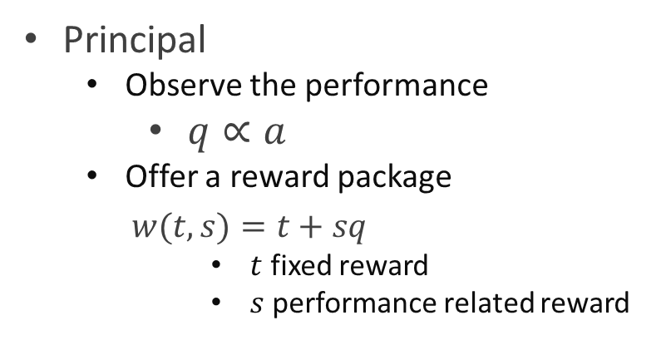
Moral Hazard in
Mobile Crowdsourcing
Incentivize users continuously uploading data instead of shutting down the location services
  Moral hazard model
    Principal “employs” the users to upload data
    Reward users based on performance
  One-dimension case
Initiates crowdsourcing
User
  Exerts an effort
    $a$
  Incentivized by receiving the performance related reward
Principal
  Observe the performance
    $q∝a$
  Offer a reward package
  $w(t,s)=t+sq$
      $t$ fixed reward
      $s$ performance related reward

Slide 20
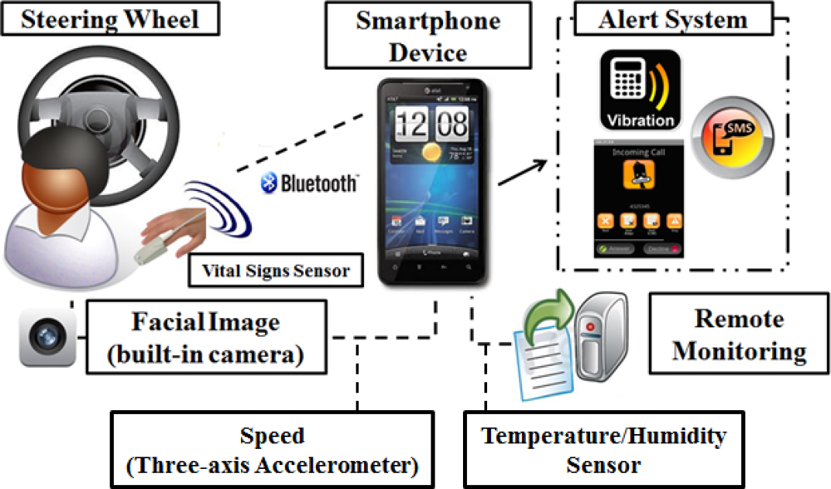
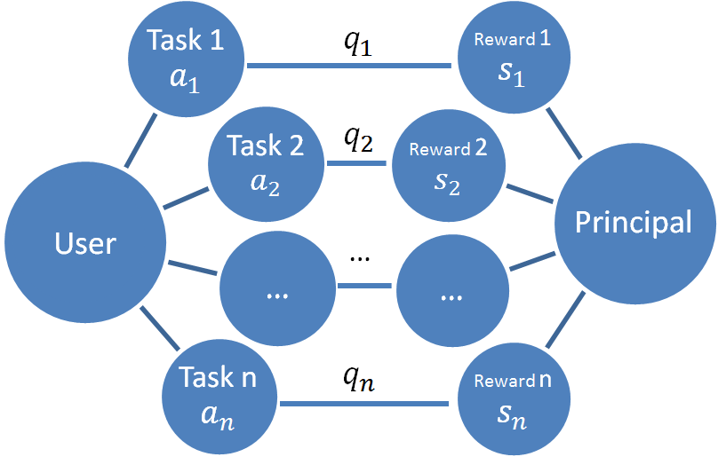
Multi-Dimension
The necessarity to adopt multi-dimension model
  Users are supposed to work on different tasks
  User’s cost include time, power, experience

Slide 21
Outline
Introduction
  Motivation
  Contract theory
    Adverse Selection
    Moral Hazard
  Contribution
Finished Work
  Adverse Selection in Device-to-Device Communication
  Moral Hazard in Mobile Crowdsourcing
Current Work
  Multi-User Moral Hazard in Mobile Crowdsourcing
  Mixed Adverse Selection and Moral Hazard in Cognitive Radio Network
Future Works
Conclusion

Slide 22


Multilateral Contracting
One-to-Many
In corporate finance and firm organization
  Output is produced by a group of employees
  Cooperation or Competition
How to reward a group of employees?
  Group’s aggregated effort
    Problem of free riding on others’ efforts
  Individual effort
    Absolute performance
    Relative performance
Common Shock
Lose of Accuracy and Incentive

Slide 23

Common Shock
Common shock when rewarding users based on absolute performance
  Negative mean measurement error at user's performance
    The principal has a strong incentive to cheat by claiming that users had poor performances that deserve low rewards
    Principal can pay less, an increase in utility/decrease of all users' utilities
  Positive mean measurement error at user's performance
    Users’ performances increase at the principal's observation
    Users are rewarded more, utility increases/principal loses of utility
In general case, common shock is unobservable to either or both sides
  Incentive mechanism based on absolute performance can be easily affected
Relative performance (tournament design) can filter out this common shock problem
  The principal has to offer the fixed amount of rewards no matter who wins
  Ordinal ranking is hard to manipulate
Typically seen in economics:
Booming and depression that are unpredictable, and typically impact supply or demand throughout the markets

Slide 24
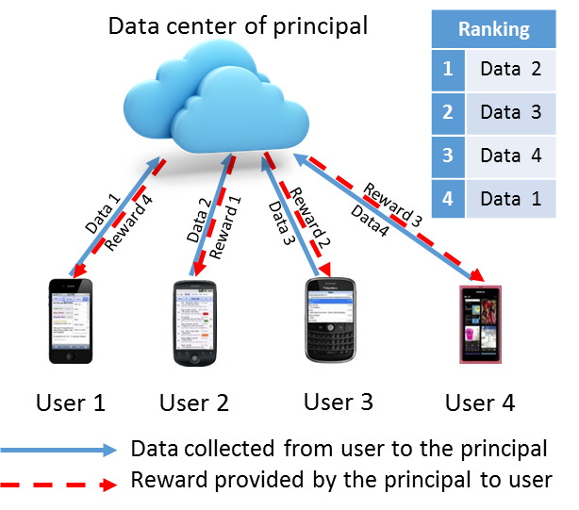
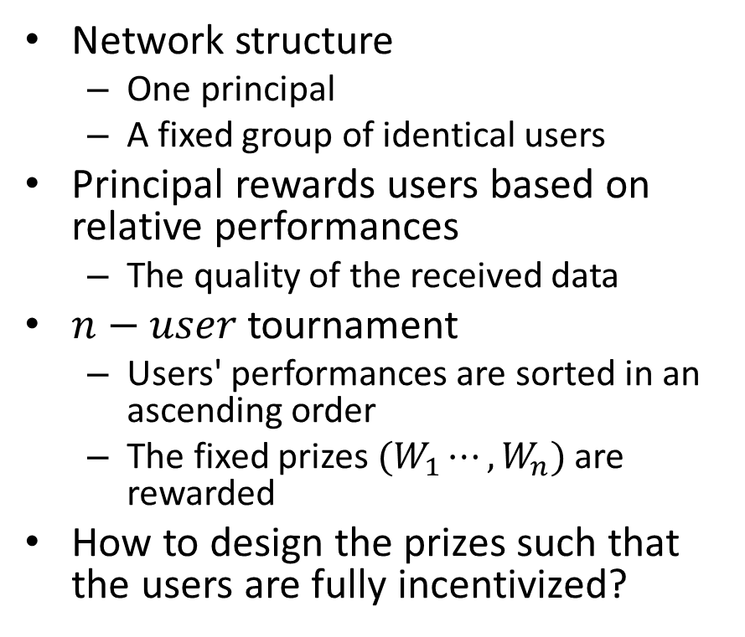
Crowdsourcing by Tournament
Network structure
  One principal
  A fixed group of identical users
Principal rewards users based on relative performances
  The quality of the received data
$n−user$ tournament
  Users' performances are sorted in an ascending order
  The fixed prizes $(W_{1}⋯,W_{n})$ are rewarded
How to design the prizes such that the users are fully incentivized?

Slide 25





System Model
Initialize a tournament
$n$Users
  Each of them exerts an effort
    $$a=\left(a_{1},⋯,a_{i},⋯,a_{n}\right)$$
  Incentivized by receiving the performance related reward
Principal
  Sort the performance in an ascending order
  $$q=\left(q_{1},⋯,q_{j},⋯,q_{n}\right)$$
  Offer the fixed prizes based on the rank
  W=$\left(W_{1},⋯,W_{j},⋯,W_{n}\right)$
Performance observed
Prizes offered
Performance observed by the principal is affect by
$$q_{i}=z_{i}+ε$$
The effort $a_{i}$ exerted by users
$z_{i}$: random variable, distribution depends on $a_{i}$
  $F(z_{i};a_{i})$: cumulative distribution function (CDF)
  $f(z_{i};a_{i})$: probability distribution function (PDF)
    Positive everywhere
    Continuously differentiable in $a_{i}$
Common shock
  $ε$: random variable
$G$: distribution function for the common shock $\left(μ,σ^{2}\right)$
$ε$: zero mean when no common shock presents

Slide 26
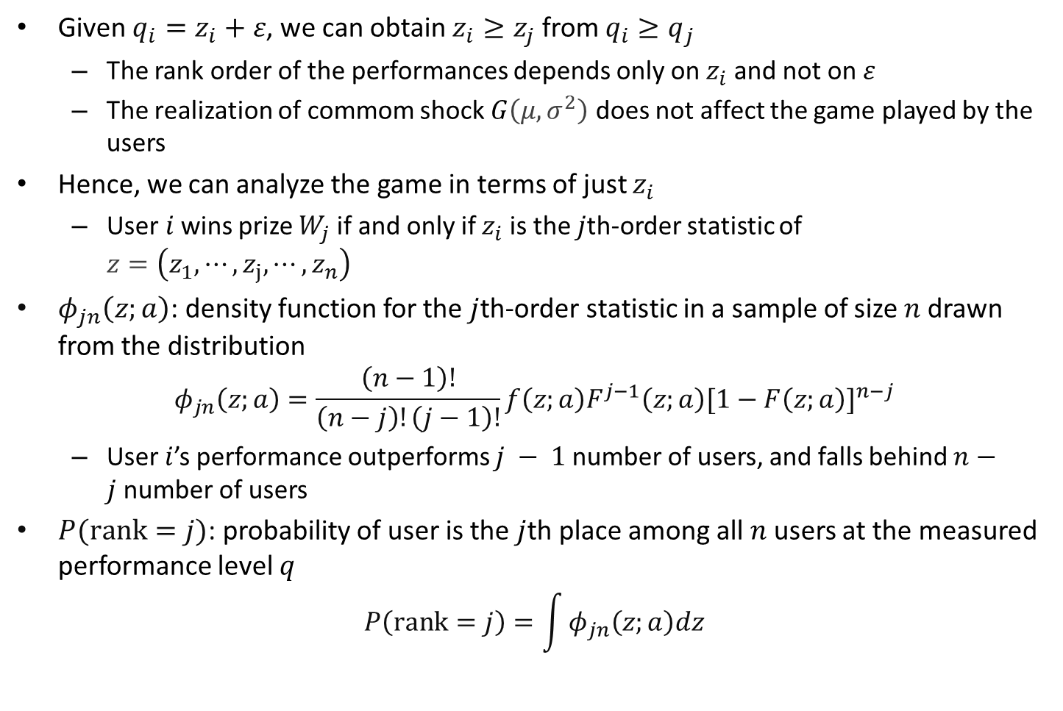
Ranking Probability
Given $q_{i}=z_{i}+ε$, we can obtain $z_{i}≥z_{j}$ from $q_{i}≥q_{j}$
  The rank order of the performances depends only on $z_{i}$ and not on $ε$
  The realization of commom shock $G\left(μ,σ^{2}\right)$ does not affect the game played by the users
Hence, we can analyze the game in terms of just $z_{i}$
  User$i$wins prize $W_{j}$ if and only if $z_{i}$ is the $j$th-order statistic of $z=\left(z_{1},⋯,z_{j},⋯,z_{n}\right)$
$φ_{jn}\left(z;a\right)$: density function for the $j$th-order statistic in a sample of size $n$ drawn from the distribution
$$φ_{jn}\left(z;a\right)=\frac{\left(n−1\right)!}{\left(n−j\right)!\left(j−1\right)!}f\left(z;a\right)F^{j−1}\left(z;a\right){[1−F\left(z;a\right)]}^{n−j}$$
  User $i$’s performance outperforms $j − 1$ number of users, and falls behind $n−j$number of users
$P(rank=j)$: probability of user is the $j$th place among all $n$ users at the measured performance level $q$
$$P\left(rank=j\right)=\int{φ_{jn}\left(z;a\right)dz}$$

Slide 27
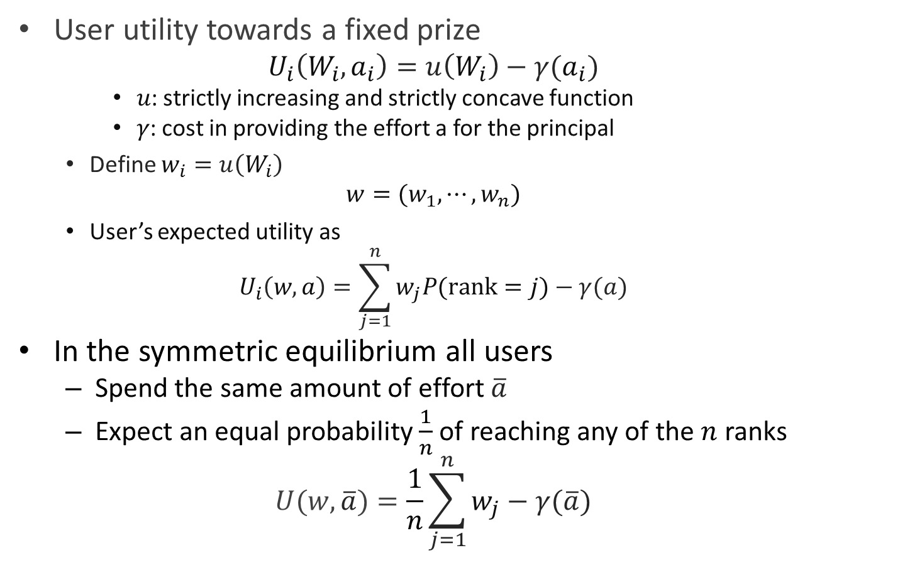
Utility Function of User
User utility towards a fixed prize
  $$U_{i}\left(W_{i},a_{i}\right)=u\left(W_{i}\right)−γ(a_{i})$$
    𝑢: strictly increasing and strictly concave function
    𝛾: cost in providing the effort a for the principal
    Define $w_{i}=u\left(W_{i}\right)$
    $$w=(w_{1},⋯,w_{n})$$
    User’s expected utility as
    $$U_{i}\left(w,a\right)=\sum_{j=1}^{n}{w_{j}P(rank=j)}−γ(a)$$
In the symmetric equilibrium all users
  Spend the same amount of effort $\overline{a}$
  Expect an equal probability $\frac{1}{n}$ of reaching any of the $n$ ranks
  $$U(w,\overline{a})=\frac{1}{n}\sum_{j=1}^{n}{w_{j}}−γ(\overline{a})$$

Slide 28
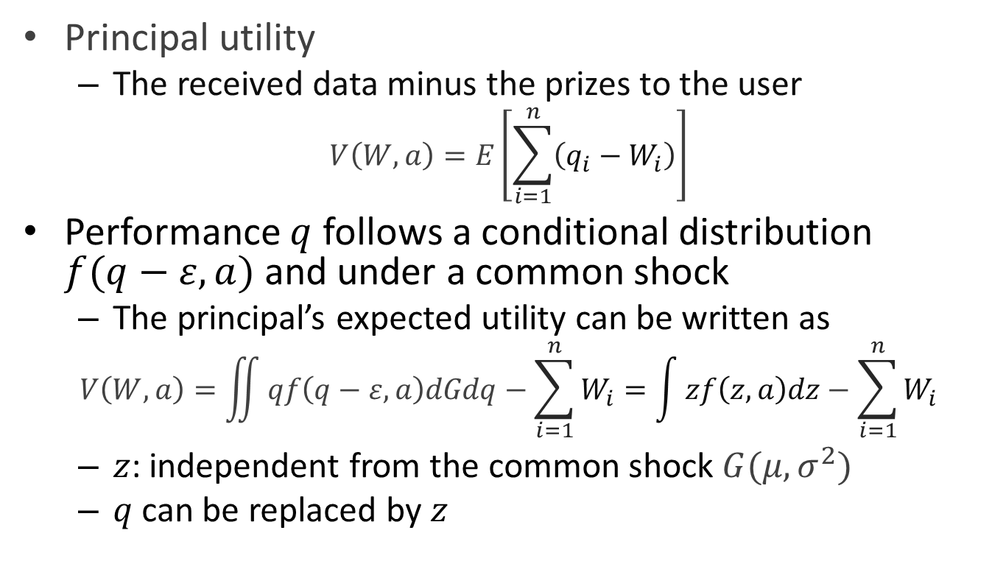
Utility Function of Principal
Principal utility
  The received data minus the prizes to the user
    $$V\left(W,a\right)=E\left[\sum_{i=1}^{n}{\left(q_{i}−W_{i}\right)}\right]$$
Performance $q$ follows a conditional distribution $f(q−ε,a)$ and under a common shock
  The principal’s expected utility can be written as
    $$V\left(W,a\right)=\iint{qf\left(q−ε,a\right)dGdq}−\sum_{i=1}^{n}{W_{i}}=\int{zf\left(z,a\right)dz}−\sum_{i=1}^{n}{W_{i}}$$
  $z$: independent from the common shock $G(μ,σ^{2})$
  $q$can be replaced by $z$

Slide 29

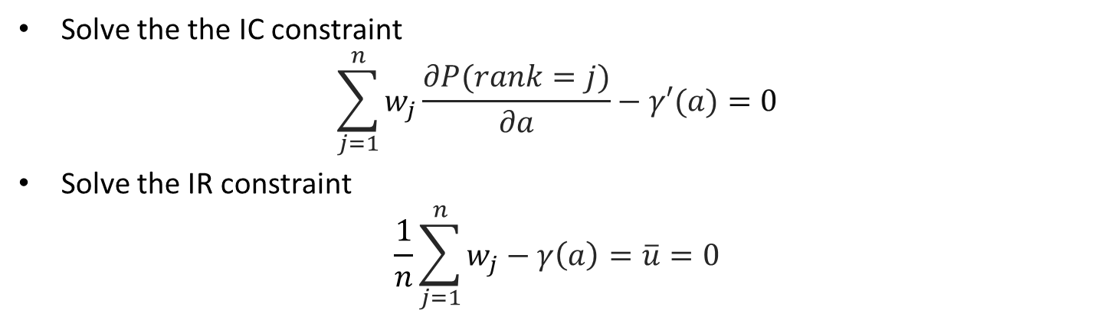
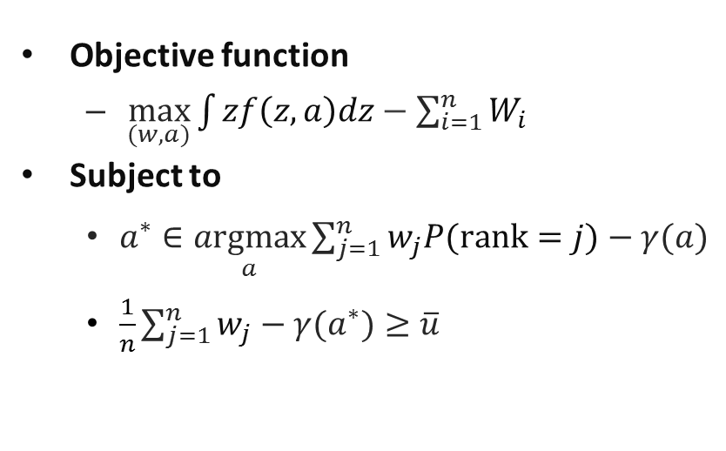
Optimization Problem
Objective function
  $\max_{(w, a)}{V(w,a)}$
Subject to
    $a^{∗}∈\underset{a}{argmax}{ U(w,a)}$
    $u(w,a)≥ \overline{u}$
Objective function
  $\max_{(w,a)}{\int{zf\left(z,a\right)dz}−\sum_{i=1}^{n}{W_{i}}}$
Subject to
    $a^{∗}∈\underset{a}{argmax}{\sum_{j=1}^{n}{w_{j}P(rank=j)}−γ(a) }$
    $\frac{1}{n}\sum_{j=1}^{n}{w_{j}}−γ(a^{∗})≥\overline{u}$
Principal’s utility
User’s incentive constraint (IC)
User’s participation constraint (IR)
Solve the the IC constraint
$$\sum_{j=1}^{n}{w_{j}}\frac{∂P(rank=j)}{∂a}−γ′(a)=0$$
Solve the IR constraint
$$\frac{1}{n}\sum_{j=1}^{n}{w_{j}}−γ\left(a\right)=\overline{u}=0$$

Slide 30
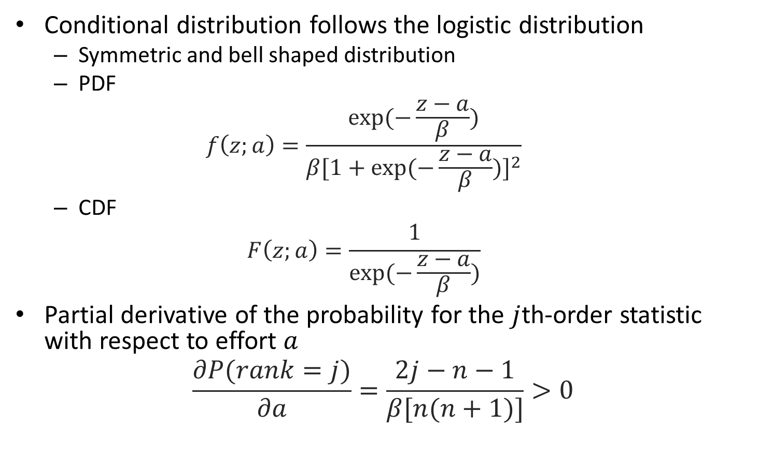
Simulation Setup
Conditional distribution follows the logistic distribution
  Symmetric and bell shaped distribution
  PDF
  $$f\left(z;a\right)=\frac{exp⁡(−\frac{z−a}{β})}{β{[1+exp⁡(−\frac{z−a}{β})]}^{2}}$$
  CDF
  $$F\left(z;a\right)=\frac{1}{exp⁡(−\frac{z−a}{β})}$$
Partial derivative of the probability for the $j$th-order statistic with respect to effort $a$
$$\frac{∂P(rank=j)}{∂a}=\frac{2j−n−1}{β[n(n+1)]}>0$$

Slide 31
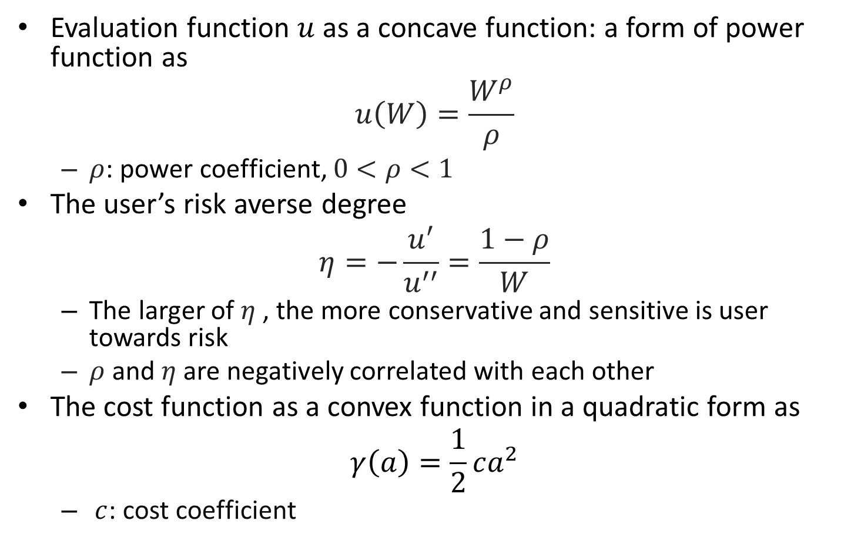
Functions
Evaluation function $u$ as a concave function: a form of power function as
$$u\left(W\right)=\frac{W^{ρ}}{ρ}$$
  $ρ$: power coefficient, $0<ρ<1$
The user’s risk averse degree
$$η=−\frac{u^{′}}{u^{′′}}=\frac{1−ρ}{W}$$
  The larger of $η$ , the more conservative and sensitive is user towards risk
  $ρ$ and $η$ are negatively correlated with each other
The cost function as a convex function in a quadratic form as
$$γ\left(a\right)=\frac{1}{2}ca^{2}$$
      $c$: cost coefficient

Slide 32
Comparisons
Optimal Contract
  Under Full Information, and the principal rewards users based on the absolute performance
Rank-Order Tournament (ROT)
  The amount of reward is based on the relative rank achieved
  Larger amounts rewarded to higher ranks
Multiple-Winners (MW)
  Special cases of ROT in which several top winners share the reward equally

Slide 33
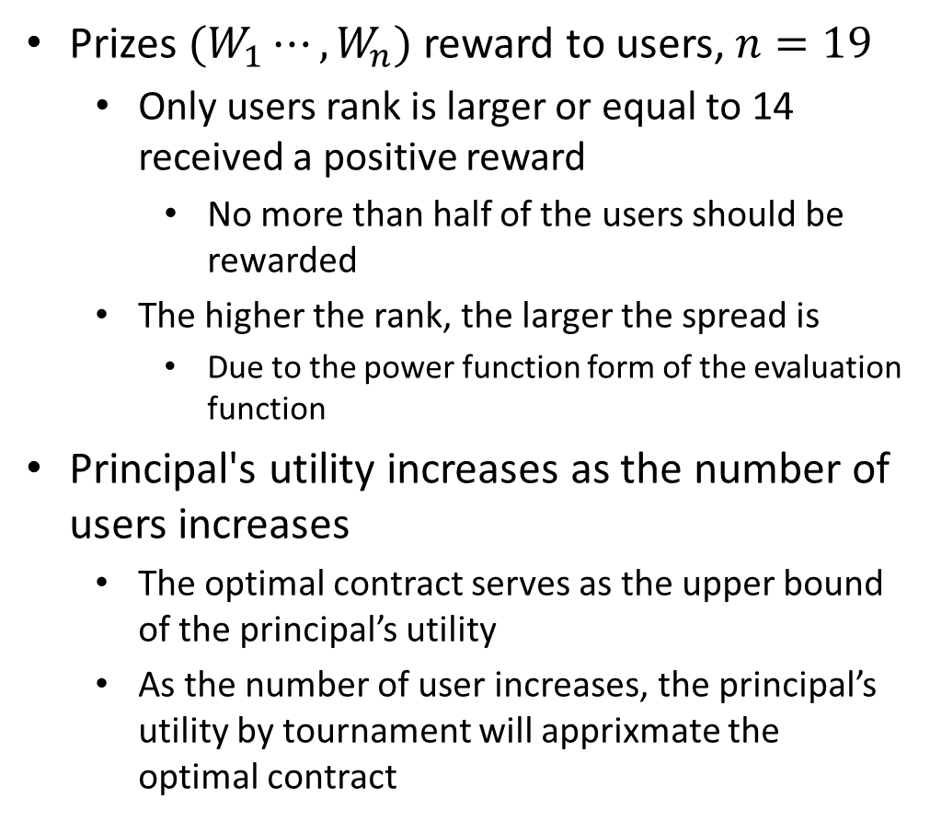
Simulation Results
Prizes $(W_{1}⋯,W_{n})$ reward to users, $n=19$
  Only users rank is larger or equal to 14 received a positive reward
    No more than half of the users should be rewarded
  The higher the rank, the larger the spread is
    Due to the power function form of the evaluation function
Principal's utility increases as the number of users increases
  The optimal contract serves as the upper bound of the principal’s utility
  As the number of user increases, the principal’s utility by tournament will apprixmate the optimal contract
Approximation of optimal contract by tournament

Slide 34
Outline
Introduction
  Motivation
  Contract theory
    Adverse Selection
    Moral Hazard
  Contribution
Finished Work
  Adverse Selection in Device-to-Device Communication
  Moral Hazard in Mobile Crowdsourcing
Current Work
  Multi-User Moral Hazard in Mobile Crowdsourcing
  Mixed Adverse Selection and Moral Hazard in Cognitive Radio Network
Future Works
Conclusion

Slide 35
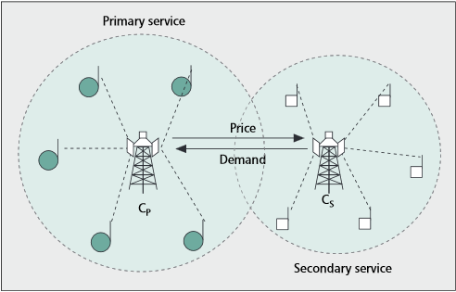
Motivations
Possible solutions for Imminent wireless traffic boost
  Increase the spectrum efficiency
    Cognitive radio network (CRN)
      Primary user (PU)
      Secondary user (SU)
Spectrum trading in CRNs
  SU can purchase/rent the available licensed spectrum
    Need radio resources to support traffic demand
  Achieves SU's dynamic spectrum accessing/sharing
  Creates more economically benefits for the PU

Slide 36
Financing Contract
Existing literature
  Auction theory
  Game theory
When SU purchasing spectrum from PU
  Allows the SU to do a financing
  As we do for a house or a car
1) Down payment :
Pay part of the total amount at the point of signing the contract
SU
PU
2) Release the spectrum to the SU
3) Utilize spectrum
Transmit package
Generate revenue
4) Installment payment:
The SU pays the rest of the loan

Slide 37
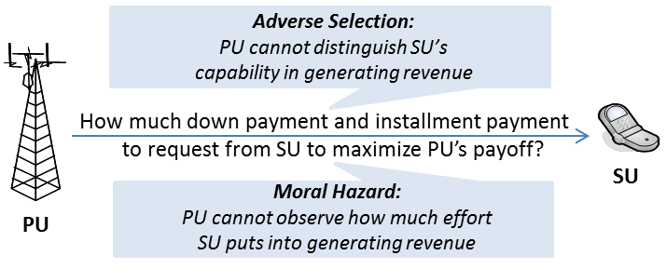
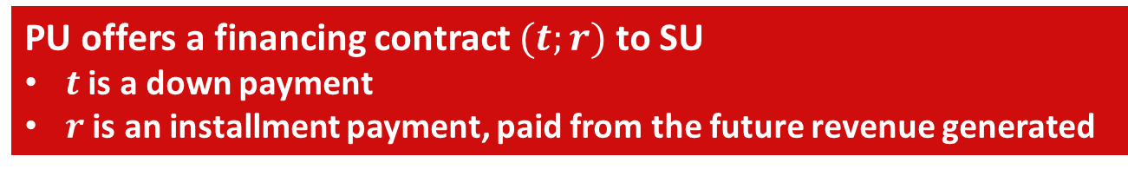
Adverse Selection and
Moral Hazard in CRN
Problem of adverse selection
  PU may not have the full knowledge of SU's capability in utilizing the spectrum
Problem of moral hazard
  PU neither knows how much effort SU puts into
PU offers a financing contract $(t;r)$ to SU
$t$ is a down payment
$r$ is an installment payment, paid from the future revenue generated

Slide 38
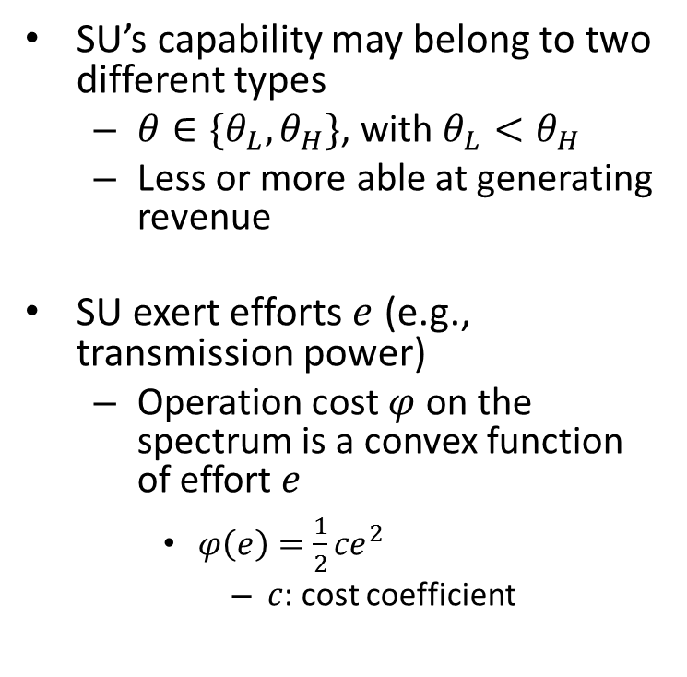
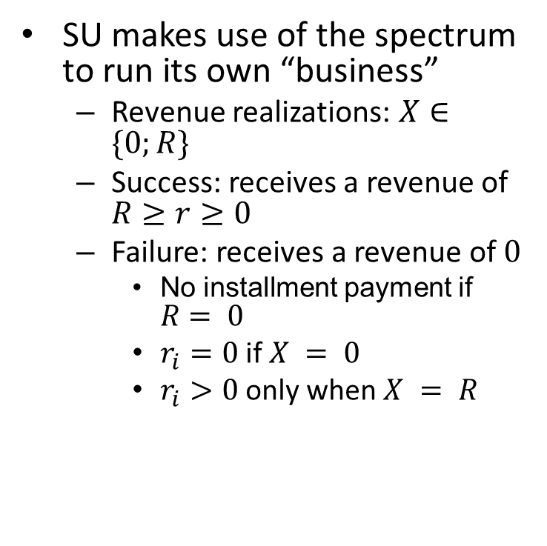
System Model
Revenue Realizations
Type of Capability
  SU makes use of the spectrum to run its own “business”
  Revenue realizations: $X∈\{0;R\}$
  Success: receives a revenue of $R≥r≥0$
  Failure: receives a revenue of $0$
    No installment payment if $R= 0$
    $r_{i}=0$ if $X = 0$
    $r_{i}>0$ only when $X = R$
SU’s capability may belong to two different types
  $θ∈\{θ_{L},θ_{H}\}$, with $θ_{L}<θ_{H}$
  Less or more able at generating revenue
SU exert efforts $e$ (e.g., transmission power)
  Operation cost $φ$ on the spectrum is a convex function of effort $e$
    $φ\left(e\right)=\frac{1}{2}{ce}^{2}$
      $c$: cost coefficient
Operation Cost

Slide 39

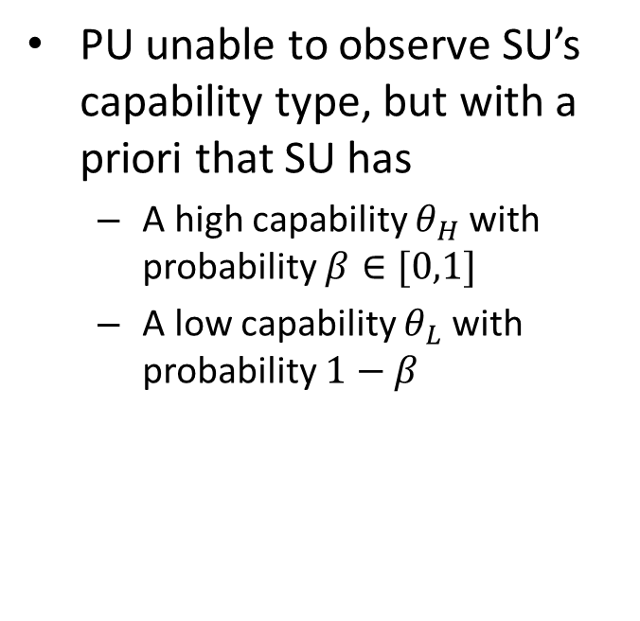
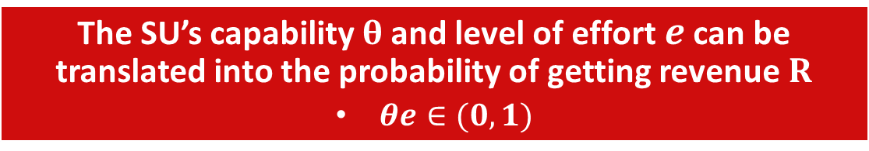
Information Asymmetry
Adverse Selection
Moral Hazard
PU unable to observe SU’s capability type, but with a priori that SU has
  A high capability $θ_{H}$ with probability $β∈[0,1]$
  A low capability $θ_{L}$ with probability $1−β$
PU neither knows how the amount of effort $e$ SU exerts
The SU’s capability $θ$ and level of effort $e$ can be translated into the probability of getting revenue $R$
  $θe∈(0,1)$

Slide 40
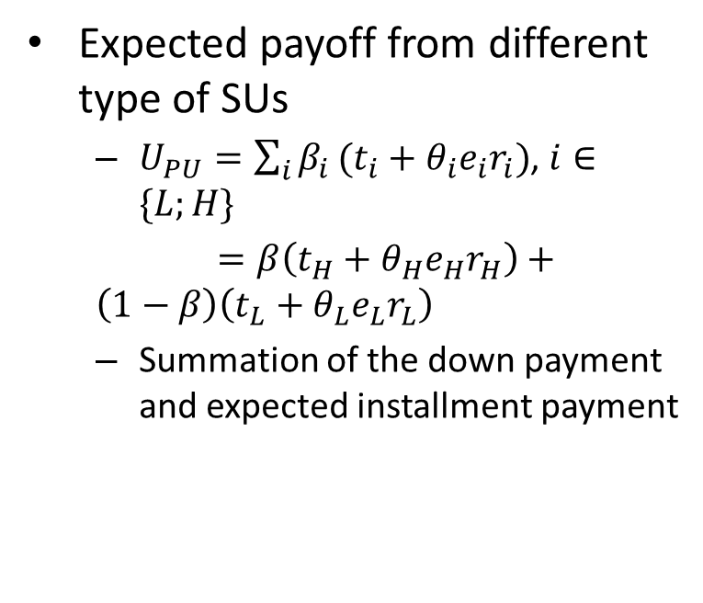
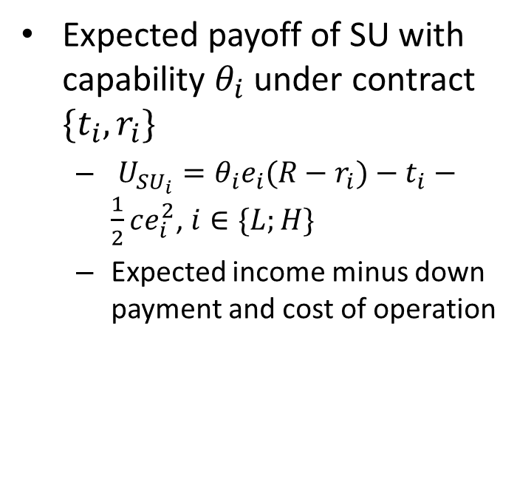
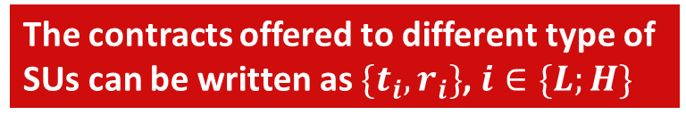
Payoffs
Payoff of SU
Payoff of PU
Expected payoff of SU with capability $θ_{i}$ under contract $\{t_{i},r_{i}\}$
  $U_{{SU}_{i}}=θ_{i}e_{i}{(R−r}_{i})−t_{i}−\frac{1}{2}ce_{i}^{2}$, $i∈\{L;H\}$
  Expected income minus down payment and cost of operation
Expected payoff from different type of SUs
  $U_{PU}=\sum_{i}{β_{i}}(t_{i}+θ_{i}e_{i}r_{i})$, $i∈\{L;H\}$
  $=β\left(t_{H}+θ_{H}e_{H}r_{H}\right)+\left(1−β\right)\left(t_{L}+θ_{L}e_{L}r_{L}\right)$
  Summation of the down payment and expected installment payment
The contracts offered to different type of SUs can be written as $\{t_{i},r_{i}\}$, $i∈\{L;H\}$

Slide 41
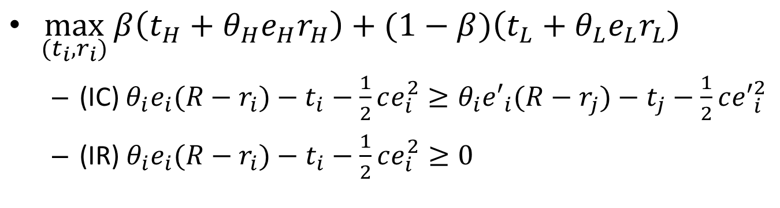
PU’s Optimization Problem
$\max_{(t_{i},r_{i})}{β\left(t_{H}+θ_{H}e_{H}r_{H}\right)+(1−β)\left(t_{L}+θ_{L}e_{L}r_{L}\right)}$
  (IC) $θ_{i}e_{i}{(R−r}_{i})−t_{i}−\frac{1}{2}ce_{i}^{2}≥θ_{i}{e′}_{i}{(R−r}_{j})−t_{j}−\frac{1}{2}c{e′}_{i}^{2}$
  (IR) $θ_{i}e_{i}{(R−r}_{i})−t_{i}−\frac{1}{2}ce_{i}^{2}≥0$
incentive compatibility:
SU can only maximize its expected payoff by selecting the financing contract that fits its own capability
individual rationality:
Provides SU necessary incentives to sign the contract

Slide 42
Comparisons
Optimal Contract with Both Adverse Selection and Moral Hazard
  PU is unable to see SU’s capability and effort
  An adequate representation of the basic problem in practice
Optimal Contract with Moral Hazard Only
  PU is able to observe SU’s capability
  Quality is garenteed
Optimal Contract with Adverse Selection Only
  SU’s effort level is fixed at a certain level
  On quality garenteen but drive Incentive

Slide 43
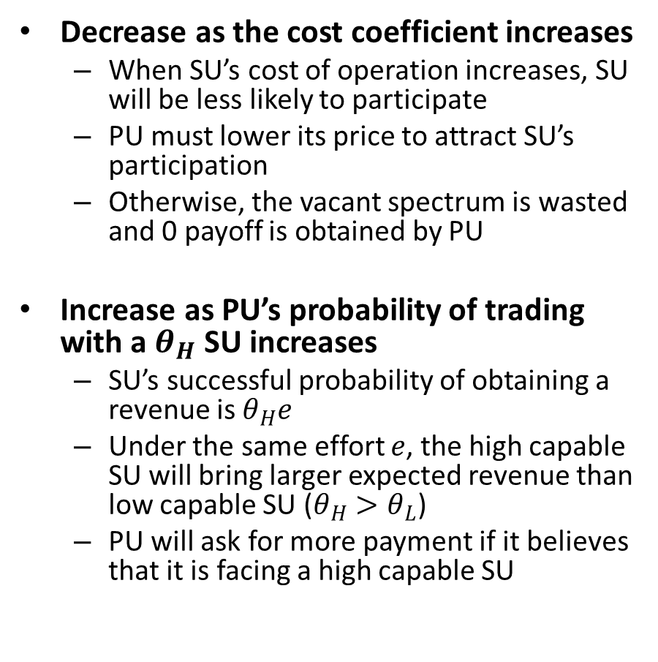

Simulation Results
Decrease as the cost coefficient increases
  When SU’s cost of operation increases, SU will be less likely to participate
  PU must lower its price to attract SU’s participation
  Otherwise, the vacant spectrum is wasted and 0 payoff is obtained by PU
Increase as PU’s probability of trading with a $θ_{H}$ SU increases
  SU’s successful probability of obtaining a revenue is $θ_{H}e$
  Under the same effort $e$, the high capable SU will bring larger expected revenue than low capable SU ($θ_{H}>θ_{L}$)
  PU will ask for more payment if it believes that it is facing a high capable SU
PU’s payoffs as $c$ and $β$ increase

Slide 44
OUTLINE
Introduction
  Motivation
  Contract theory
    Adverse Selection
    Moral Hazard
  Contribution
Finishsed Work
  Adverse Selection in device-to-device communication
  Moral Hazard in mobile crowdsourcing
Current Work
  Multi-User Moral Hazard in mobile crowdsourcing
  Adverse Selection and Moral Hazard in cognitive radio network
Future Work
Conclusion

Slide 45
Future Work
Exploring emerging wireless network applications
  Wireless network virtualization, physical layer security, multimedia distribution in ultra-dense networks, and load management in wireless networks with machine-to-machine communications
Exploring new contract theory models
  Extend the static models into repeated contracting ones to model more sophisticated interplay between different parties
  Address problems other than cooperation incentives
    Insurance design and audition in mobile cloud computing
    System hierarchy efficiency in infrastructure deployment
Exploring the connection between wireless physical meanings and economic factors
  Model and define the economic parameters with appropriate wireless communication network physical meanings

Slide 46
Conclusions
Theory Part
  An overview of basic concepts, classifications, and models
Applications of three contract theory problems
  Adverse selection in device-to-device (D2D) communication
  Moral hazard mobile crowdsourcing
  A mixed of the two in cognitive radio network
Potential and challenges of contract theory as a tool for designing mechanisms in future wireless networks

Slide 47
Publications
Book:
Conference:
Yanru Zhang and Zhu Han, “Contract Theory Framework for Wireless Networking,” will contract with, Springer, Wireless Networks Book Series.
Journal:
Yanru Zhang, Chunxiao Jiang, Nguyen H. Tran, Shengrong Bu, Fei Richard Yu, and Zhu Han, “Insurance Plan for Guaranteed Service Assurance in Cloud Computing Market with Incomplete Information,” submitted to, IEEE Globe Communication Conference (GLOBECOM), Washington, DC, Dec. 2016.
Yanru Zhang, Chunxiao Jiang, Lingyang Song, Walid Saad, Zaher Dawy, and Zhu Han, “'Complementary Investment of Infrastructure Provider and Service Provider in Wireless Network Virtualization,” submitted to, IEEE Globe Communication Conference (GLOBECOM), Washington, DC, Dec. 2016.
Duy H. N. Nguyen, Yanru Zhang, and Zhu Han, “A Contract-Theoretic Approach to Spectrum Resource Allocation in Wireless Virtualization,” submitted to, IEEE Globe Communication Conference (GLOBECOM), Washington, DC, Dec. 2016.
Jingbo Tan, Wenbo Ding, Yanru Zhang, Zhu Han, and Jian Song, “Compressive Sensing Based Inter-community Detection in Mobile Social Networks,” submitted to, IEEE Globe Communication Conference (GLOBECOM), Washington, DC, Dec. 2016.
Meng Li, Yanru Zhang, Li Wang, Mei Song, and Zhu Han, “Incentive Design for Collaborative Jamming Using Contract Theory in Physical Layer Security,” submitted to, IEEE/CIC International Conference on Communications in China(CIC/ICCC), Chengdu, China, Jul. 2016.
Yanru Zhang, Yunan Gu, Lingyang Song, Miao Pan, Zaher Dawy, and Zhu Han, “Tournament Based Incentive Mechanism Designs for Mobile Crowdsourcing,” IEEE Globe Communication Conference (GLOBECOM), San Diego, CA, Dec. 2015.
Yunan Gu, Yanru Zhang, Lin X. Cai, Miao Pan, Lingyang Song, and Zhu Han, “Exploiting Student-Project Allocation Matching for Spectrum Sharing in LTE-Unlicensed,” IEEE Globe Communication Conference (GLOBECOM), San Diego, CA, Dec. 2015.
Yanru Zhang, Yunan Gu, Miao Pan, Zaher Dawy, Lingyang Song, and Zhu Han, “Financing Contract with Adverse Selection and Moral Hazard for Spectrum Trading in Cognitive Radio Networks,” invited, IEEE China Summit and International Conference on Signal and Information Processing (ChinaSIP), Chengdu, China, Jul. 2015.
Yanru Zhang, Yunan Gu, Lanchao Liu, Miao Pan, Zaher Dawy, and Zhu Han, “Incentive Mechanism in Crowdsourcing with Moral Hazard,” IEEE Wireless Communications and Networking Conference (WCNC), New Orleans, LA, Mar. 2015.
Yunan Gu, Yanru Zhang, Miao Pan, and Zhu Han, “Student Admission Matching based Content-Cache Allocation,” IEEE Wireless Communications and Networking Conference (WCNC), New Orleans, LA, Mar. 2015.
Yanru Zhang, Yunan Gu, Miao Pan, and Zhu Han, “Distributed Matching Based Spectrum Allocation in Cognitive Radio Networks,” IEEE Globe Communication Conference (GLOBECOM), Austin, TX, Dec. 2014.
Yunan Gu, Yanru Zhang, Miao Pan, and Zhu Han, “Cheating in Matching of Device to Device Pairs in Cellular Networks,” IEEE Globe Communication Conference (GLOBECOM), Austin, TX, Dec. 2014.
Yawei Pang, Yanru Zhang, Yunan Gu, Miao Pan, and Zhu Han, “Efficient Data Collection for Wireless Rechargeable Sensor Clusters in Harsh Terrains Using UAVs,” IEEE Globe Communication Conference (GLOBECOM), Austin, TX, Dec. 2014.
Yanru Zhang, Lingyang Song, Walid Saad, Zaher Dawy, and Zhu Han, ‘‘Exploring Social Ties for Enhanced Device-to-Device Communications in Wireless Networks,’’ IEEE Globe Communication Conference (GLOBECOM), Atlanta, GA, Dec. 2013.
Yanru Zhang, Erte Pan, Lingyang Song, Walid Saad, Zaher Dawy, and Zhu Han, ‘‘Social Network Enhanced Device-to-Device Communication Underlying Cellular Networks,’’ IEEE International Conference on Communications in China (ICCC), D2D Workshop, Xi'an, China, Aug. 2013.
Yanru Zhang, Miao Pan, Lingyang Song, Zaher Dawy, and Zhu Han, “Incentive Mechanism by Contract Theory in Wireless Networks,” to appear, IEEE Wireless Communications Magazine.
Yanru Zhang, Lanchao Liu, Yunan Gu, Dusit Niyato, Miao Pan, and Zhu Han, “Offloading in Software Defined Network at Edge with Information Asymmetry: A Contract Theoretical Approach,” invited, Journal of Signal Processing Systems, SP for Ultra High Performance and High Efficiency in 5G Mobile Networks, vol. 81, no. 2, pp. 1-13, Nov. 2015.
Yanru Zhang, Lingyang Song, Walid Saad, Zaher Dawy, and Zhu Han, “Contract-Based Incentive Mechanisms for Device-to-Device Communications in Cellular Networks,” IEEE Journal on Selected Areas on Communications (JSAC), Special Issue on Recent Advances in Heterogeneous Cellular Networks, vol. 33, no. 10, pp. 2144-2155, Oct. 2015.
Yunan Gu, Yanru Zhang, Miao Pan, and Zhu Han, “Matching and Cheating in Device to Device Communications Underlying Cellular Networks,” IEEE Journal on Selected Areas on Communications (JSAC), Special Issue on Recent Advances in Heterogeneous Cellular Networks, vol. 33, no. 10, pp. 2156-2166, Oct. 2015.
Yanru Zhang, Erte Pan, Lingyang Song, Walid Saad, Zaher Dawy, and Zhu Han, “Social Network Aware Device-to-Device Communication in Wireless Networks," IEEE Transactions on Wireless Communications (TWC), vol.14, no.1, pp.177-190, Jan. 2015.
Yanru Zhang, Yunan Gu, Lingyang Song, Miao Pan, Zaher Dawy, and Zhu Han, “Optimized Incentive Mechanism for Mobile Crowdsourcing Using a Tournament Model,” under revision, IEEE Transactions on Wireless Communications (TWC).
Yanru Zhang, Yunan Gu, Miao Pan, Nguyen H. Tran, Zaher Dawy, and Zhu Han, “Multi-Dimensional Incentive Mechanism in Mobile Crowdsourcing with Moral Hazard,” submitted to, IEEE Transactions on Mobile Computing (TMC).
Yanru Zhang, Lingyang Song, Chunxiao Jiang, Zaher Dawy, and Zhu Han, “Social-Aware Framework for Efficient Information Dissemination in Wireless Ad Hoc Networks,” submitted to, IEEE Communications Magazine, Series on Adhoc and Sensor Networks.
Yunan Gu, Yanru Zhang, Lin Cai, Miao Pan, Lingyang Song, and Zhu Han, “LTE-Unlicensed Co-existence Mechanism: A Matching Game Framework,” submitted to, IEEE Wireless Communications Magazine.
Jingyi Wang, Yunan Gu, Yanru Zhang, Hongyan Li, Miao Pan, and Zhu Han, “D-FROST: Distributed Frequency Reuse Based Opportunistic Spectrum Trading via Matching with Evolving Preferences,” submitted to, IEEE Transactions on Wireless Communications (TWC).
Hung Khanh Nguyen, Yanru Zhang, Zheng Chang, Tapani Ristaniemi, and Zhu Han, “Parallel and Distributed Resource Allocation with Minimum Traffic Disruption for Wireless Network Virtualization,” submitted to, IEEE Transactions on Communications (TCOM).
Yanru Zhang, Yunan Gu, Miao Pan, Zaher Dawy, Lingyang Song, and Zhu Han, “Financing Contract with Adverse Selection and Moral Hazard for Spectrum Trading in Cognitive Radio Networks,” will submit, IEEE IEEE Journal on Selected Areas on Communications (JSAC), Special Issue on Game Theory for Networks.
Yanru Zhang, Lingyang Song, Walid Saad, Zaher Dawy, and Zhu Han, “Incentive Mechanism in Device-to-Device Communications with Dynamic Moral Hazard,” will submit , IEEE Transactions on Wireless Communications (TWC).

Slide 48



48

